Slide 1
16 Step Analog/Digital Synthesizer
Team #1
Justin Sconza and Kyle Vondrak
TA: Eric Clark
Sponsor: Skot Wiedmann

Slide 3
Introduction
Low cost, easy to play instrument
Combines both a synthesizer and a step sequencer into an easy to use package
Intended for hobbyists, or those just becoming interested in music synthesis

Slide 4
Objectives
User control of tempo via keypad
Easily adjustable voltage control for synthesizer
Ability to be used in any location that standard wall outlets are available

Slide 5
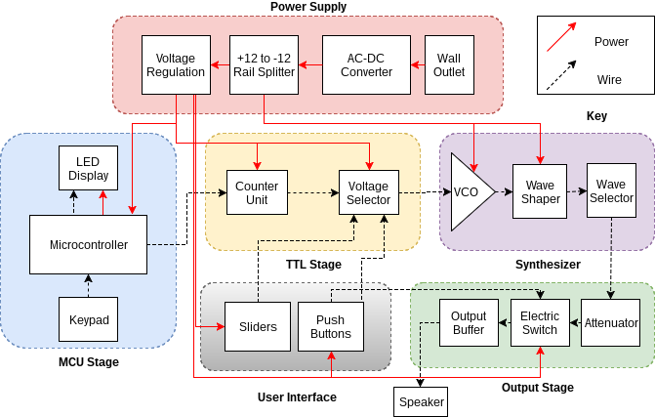
Block Diagram

Slide 6
VCO - Control and Octave/Volt
Aiming for one octave/volt
Coarse and fine tuning adjustable trimpots
Octave/volt adjustable trimpot for fine tuning
1% resistors used for best accuracy

Slide 7
VCO - Exponentiator
Dual Pair must be perfectly matched

Slide 8
VCO - Oscillator
Fast comparator to make reset time as small as possible
Ultra-high impedance integrator
JFET has high pinch-off and low on resistance

Slide 9
Waveshaper - Sawtooth
Amplifies Raw Sawtooth to 20 V_{p-p}

Slide 10
Waveshaper - Square
Slams Raw Sawtooth to +10 V or -10 V

Slide 11
Waveshaper - Triangle
Diodes add together Sawtooth and Inverted Sawtooth
Inverts and amplifies output to 20 V_{p-p}

Slide 12
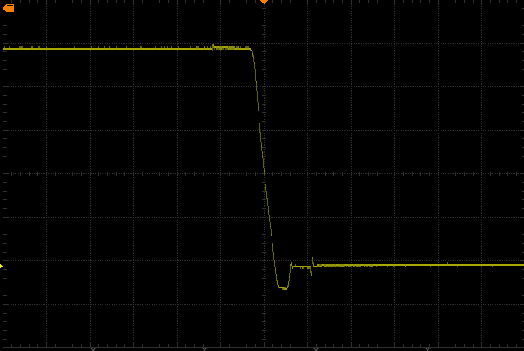
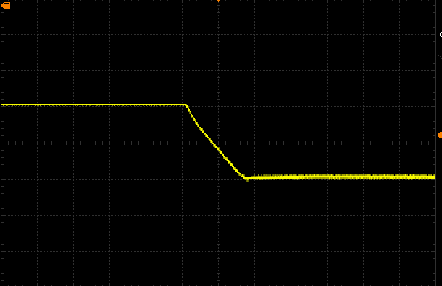
Verification
Reset time of sawtooth less than 1% of total period.
Trapezoidal Component of Square less than 1% of total period
Sawtooth Reset Time
Square Trapezoidal Time

Slide 13
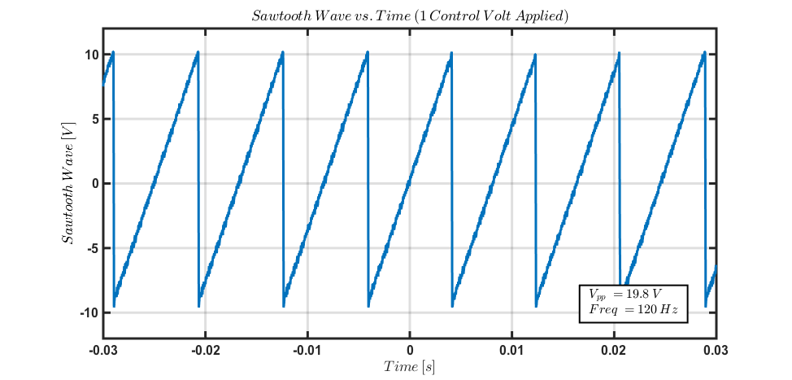
Verification - Waveshaper
Peak to Peak is within 10% of 20 V
Frequency = 60 Hz * 2^{Control Volts}

Slide 14
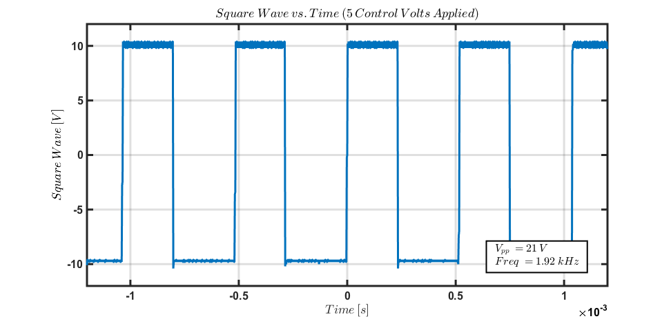
Verification - Waveshaper
Peak to Peak is within 10% of 20 V
Frequency = 60 Hz * 2^{Control Volts}

Slide 15
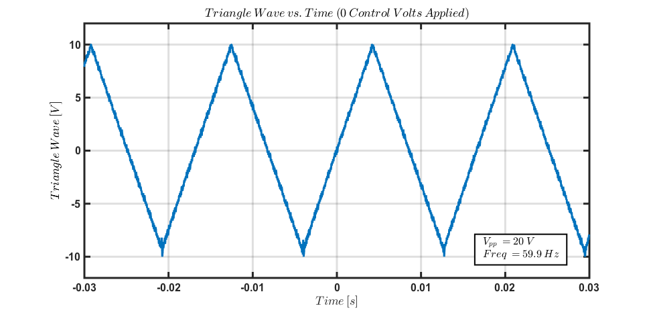
Verification - Waveshaper
Peak to Peak is within 10% of 20 V
Frequency = 60 Hz * 2^{Control Volts}

Slide 16
Block Diagram - TTL Stage

Slide 17
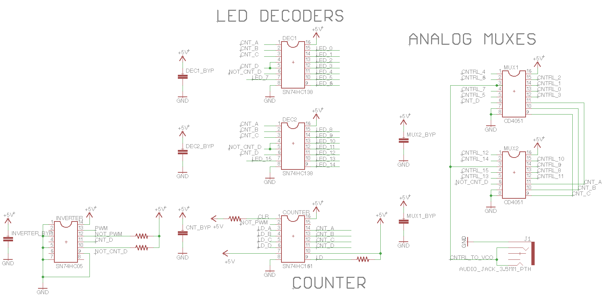
TTL Stage
Counter driven by PWM output from MCU stage
Control Voltage set by potentiometers

Slide 18
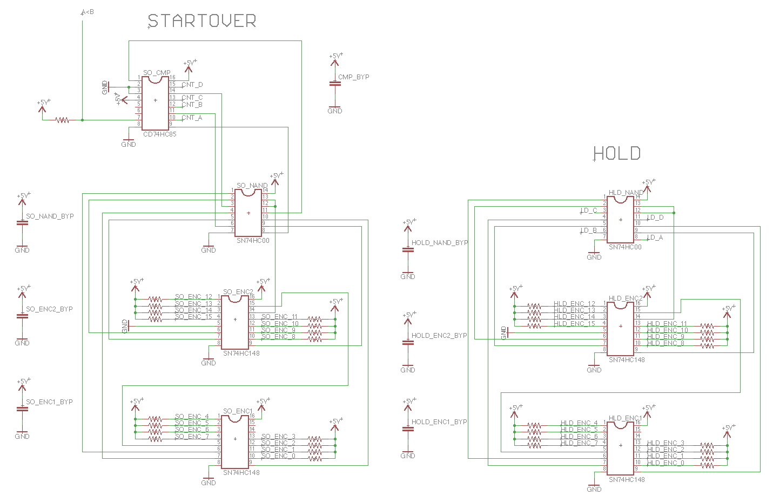
TTL - Priority Encoders

Slide 19
Verifications
Pushbuttons perform task in less than 50 ms
Voltage range of sliders is 0.005 to 5.01 V
0.1% error on the lower limit
0.2% error on the upper limit

Slide 20
Block Diagram - MCU Stage

Slide 21
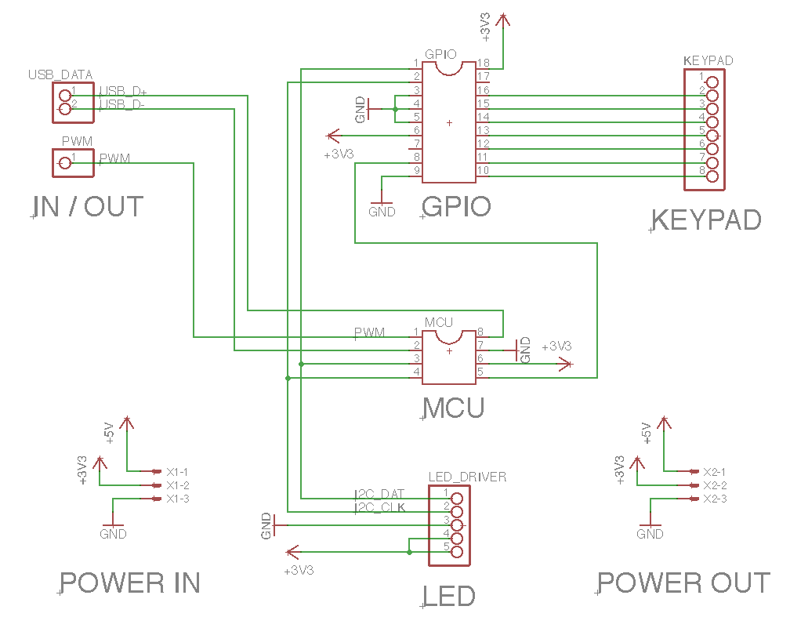
MCU Stage

Slide 22
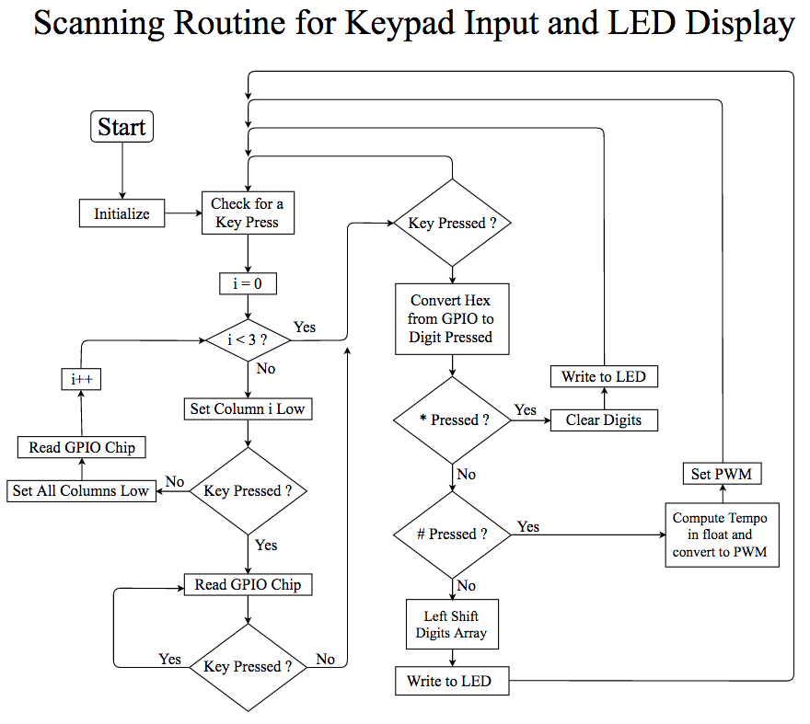
Software

Slide 23
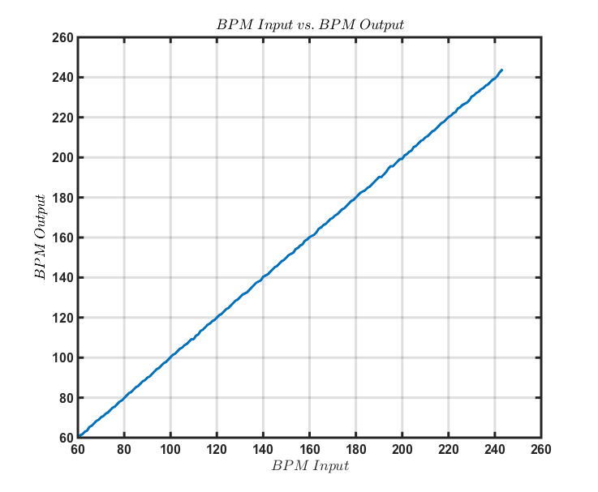
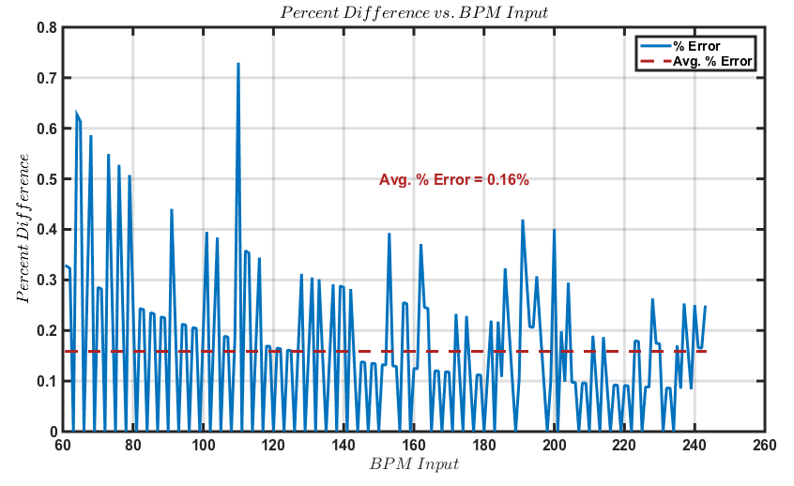
Verifications
Keypad works and correctly displays BPM value
Goal was to keep output BPM within 1% of input value

Slide 24
Block Diagram - Power Supply

Slide 25
Power Supply - Analog Supply
VCO Power Inputs
Bipolar Voltage for Electric Switch

Slide 26
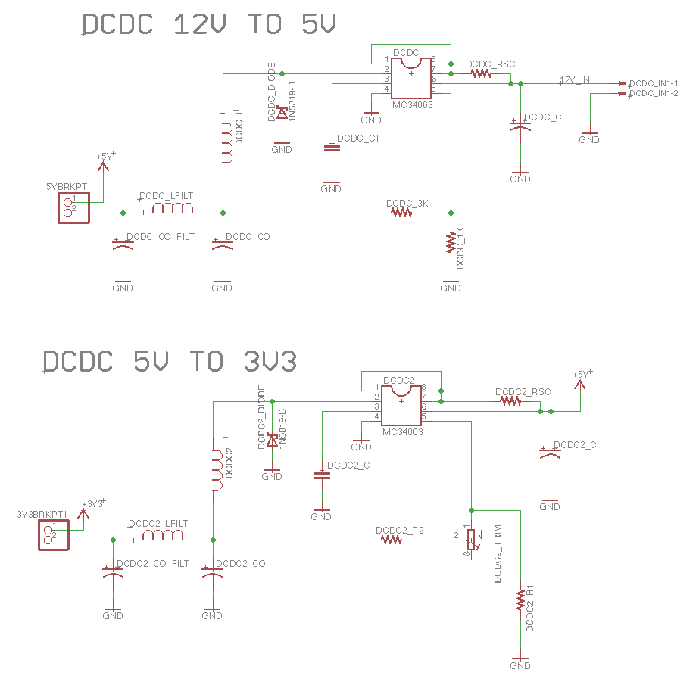
Power Supply - Digital Supply

Slide 27
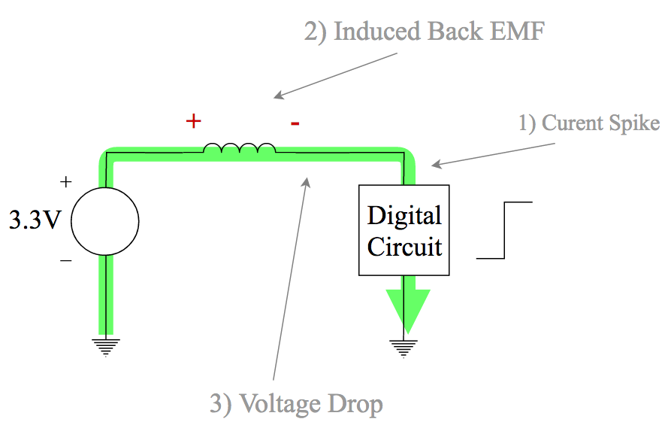
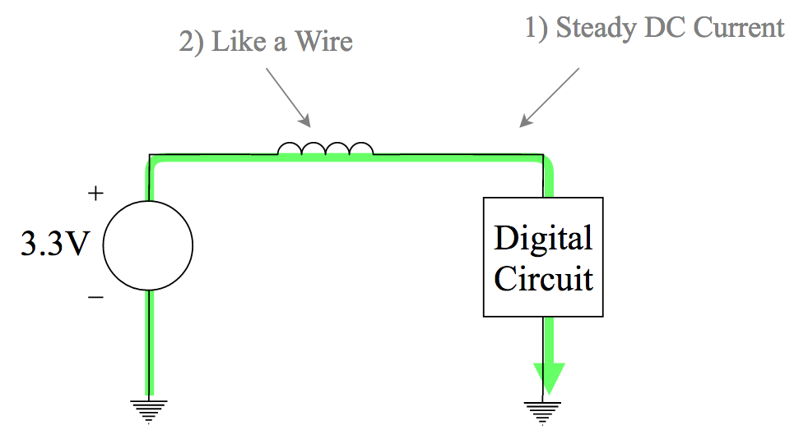
Fixing the Current Problem
Large current when LED display was switching caused sharktooth dips in MCU voltage
Fixed by switching to DC-DC converters for better isolation
Eliminated the voltage sag

Slide 28
Verifications
+10 V Regulator measured at +10.01 V
-10 V Regulator measured at -10.00 V
+5 V DC-DC Step-down converter measured at +5.01 V
+3.3 V DC-DC Step-down converter measured at +3.300 V

Slide 29
Block Diagram - Output and UI

Slide 30
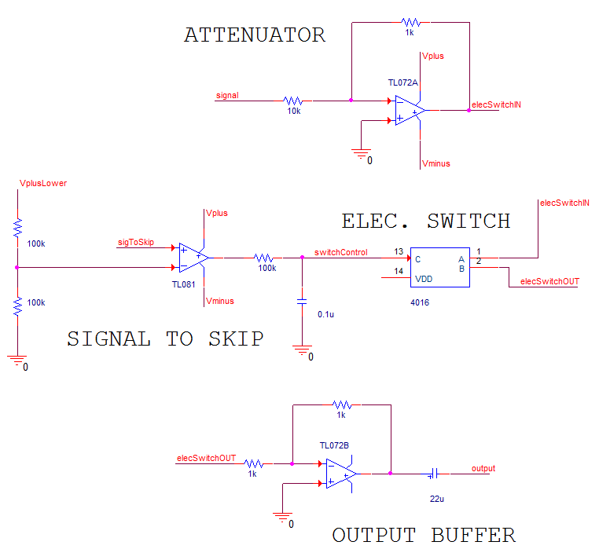
Output Stage

Slide 31
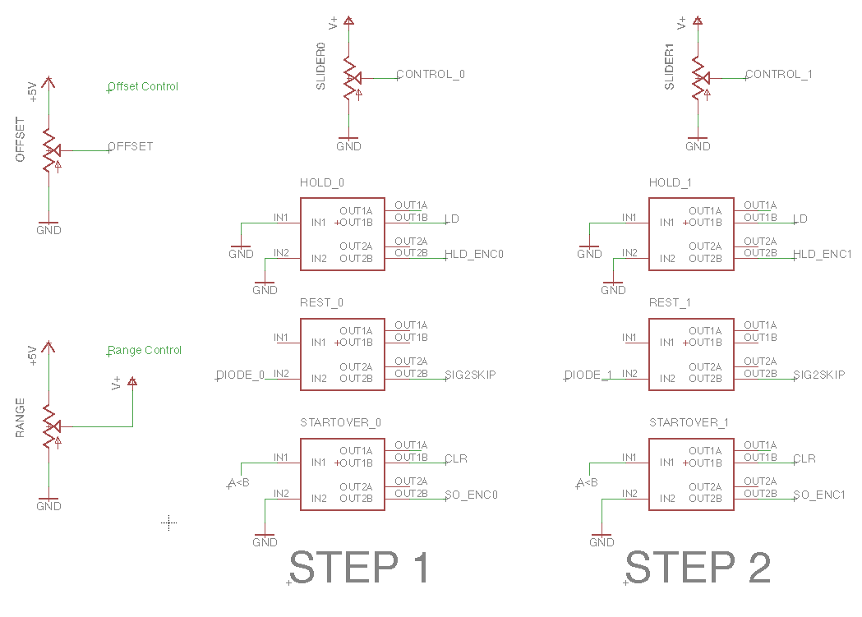
User Interface
First version of UI board was found to contain errors
Two 8 step UI boards were then designed and chained together to form 16 steps

Slide 32
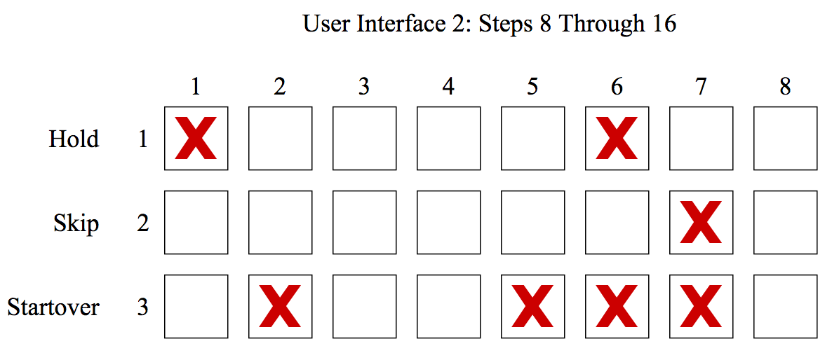
User Interface - Uncertainties
Buttons found to be broken on final board
Caused by desoldering from previous version of UI board

Slide 33
Future Work
Create visually appealing enclosure, and to reduce the number of wires (Ribbon cables)
Adding extra features such as voltage controlled filters (VCF) and additional waveshapes
Using CPLDs to replace the TTL logic ICs

Slide 34
Conclusion
Successful in achieving all design goals
BPM tempo can be easily input and a corresponding PWM wave is generated
Control Voltage levels, offset and range easily adjustable on the UI board
User is able to skip, hold and start over via pushbuttons
Three distinct waveshapes were successfully generated
Power supply is robust and portable

Slide 35
Questions?

Slide 36
Thank You!

