Slide 1
Team 55: Head Impact Telemetry Data Logging System
Matt Hebard, Matt Schafer, & Evan Qi

Slide 2
Introduction
Concussions are a major factor in most high impact sports
No accurate system in market that gives good data for concussion correlation
Millions of dollars have been poured into developing a system…

Slide 3
Objective
Create a system that can provide valuable and accurate data to researchers
A wearable design that any athlete can wear in a high impact sport
Answer the question: Is it feasible for an ECE 445 group to build this design under certain constraints?

Slide 4
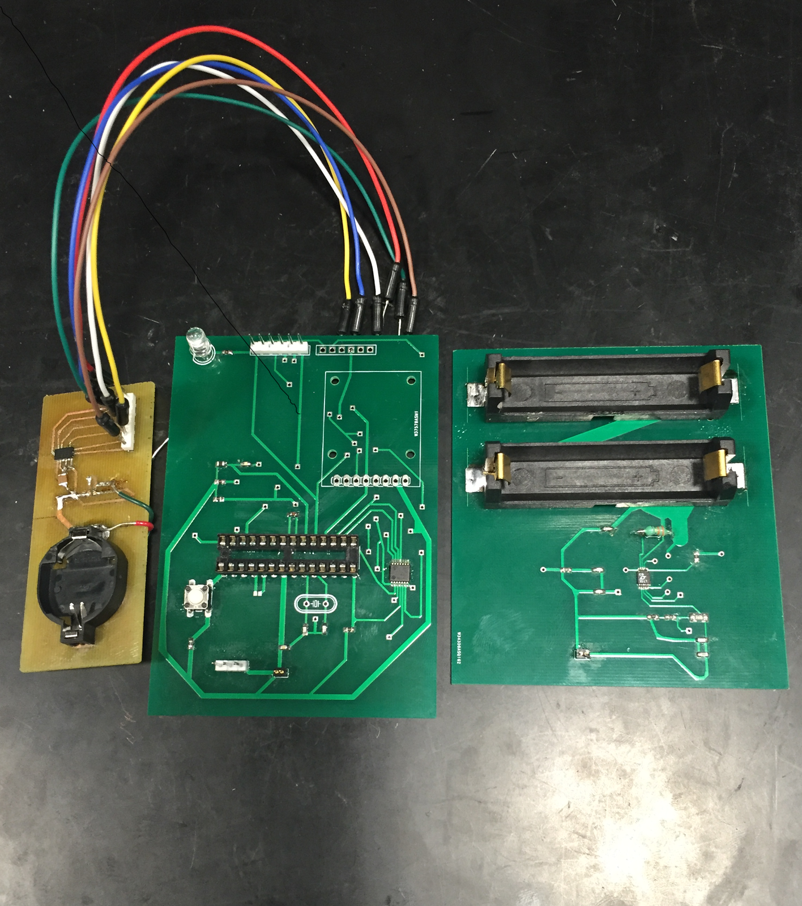
Design
Takes accelerometer and heart rate data
Time stamp this data to microSD to be used for further use
Design system under constraints:
Power: System runs at 3.3v
PCB Size: 10cm x 9cm x 2cm
Wearability: Fit on any athletes body

Slide 5
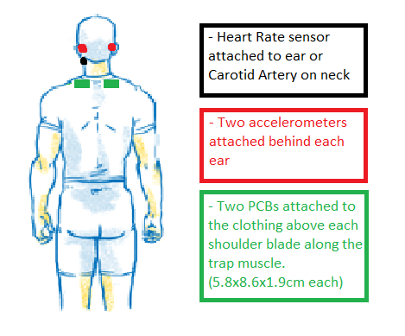
Design (cont.)
Device will be attached to athletes body
Durable and can adjust to athlete
Weight < 400g

Slide 6
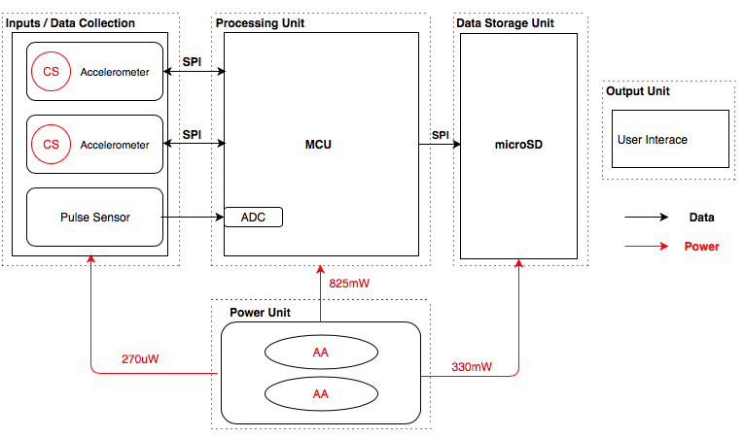
Block Diagram

Slide 7
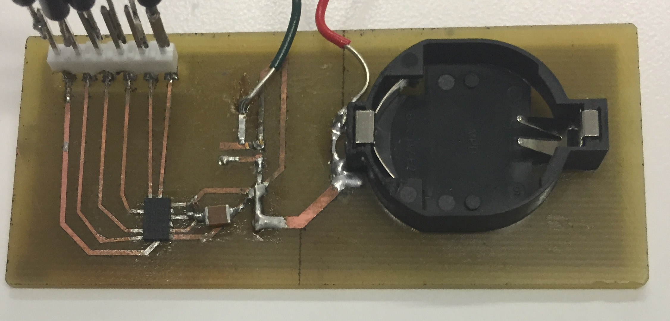
Accelerometer PCB
Small enough to attach to athletes head
Uses the ADXL375 3-axis accelerometer
Own power supply: 3.3v Coin Cell
Communicates via SPI: 4 MHz
Battery Holder
ADXL375
3.2cm
7.5cm
Notes:
How does the speed relate to our overall design?
Research states in order to collect useful data for analyzing concussive blows, need a Bandwidth of at least 600Hz
Our output data rate we set to 1600Hz to achieve bandwidth of 800Hz
Need high speed communication to ensure no missed samples of data

Slide 8
Data from Accelerometer
Sampling rate: 1600 Hz
BW: 800 Hz
X Axis of Accel
Z Axis of Accel
Force (Gs)
Y Axis of Accel
Time (ms)
Notes:
High sampling rate ensures the correct detection and magnitude of hit in high impact sports
Football hits last roughly 10ms

Slide 9
Data From Acceleromter (cont.)
Sampling rate: 100 Hz
BW: 50 Hz
Z Axis of Accel
Force (Gs)
Y Axis of Accel
X Axis of Accel
Time (ms)
Notes:
We can miss the entire magnitude of the impact due to low sampling rates (100Hz)

Slide 10
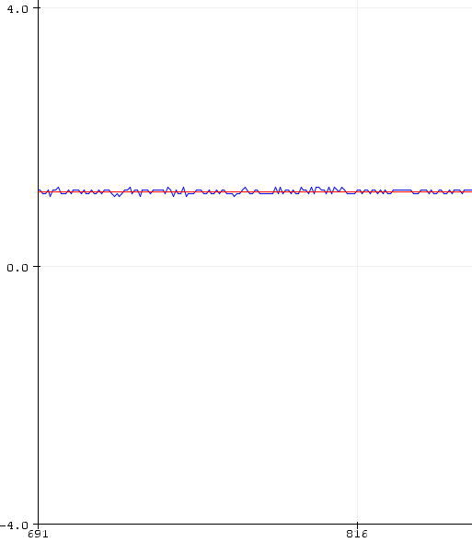
Noise Analysis
Need to understand noise characteristics for research use
Actual Signal
Avg. 1g output
Force (Gs)
Time (ms)

Slide 11
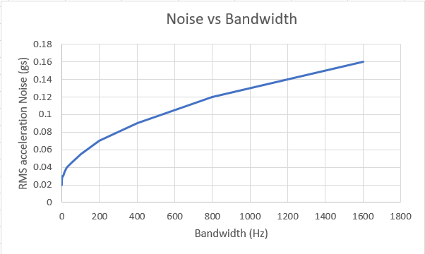
Noise Analysis (Cont.)
As bandwidth changes based on the desired constraints, noise increases by 5mg/$\sqrt{Hz}$
SNR at 800 Hz =
$20\log{\frac{Asignal}{Anoise}}$ = 18dB

Slide 12
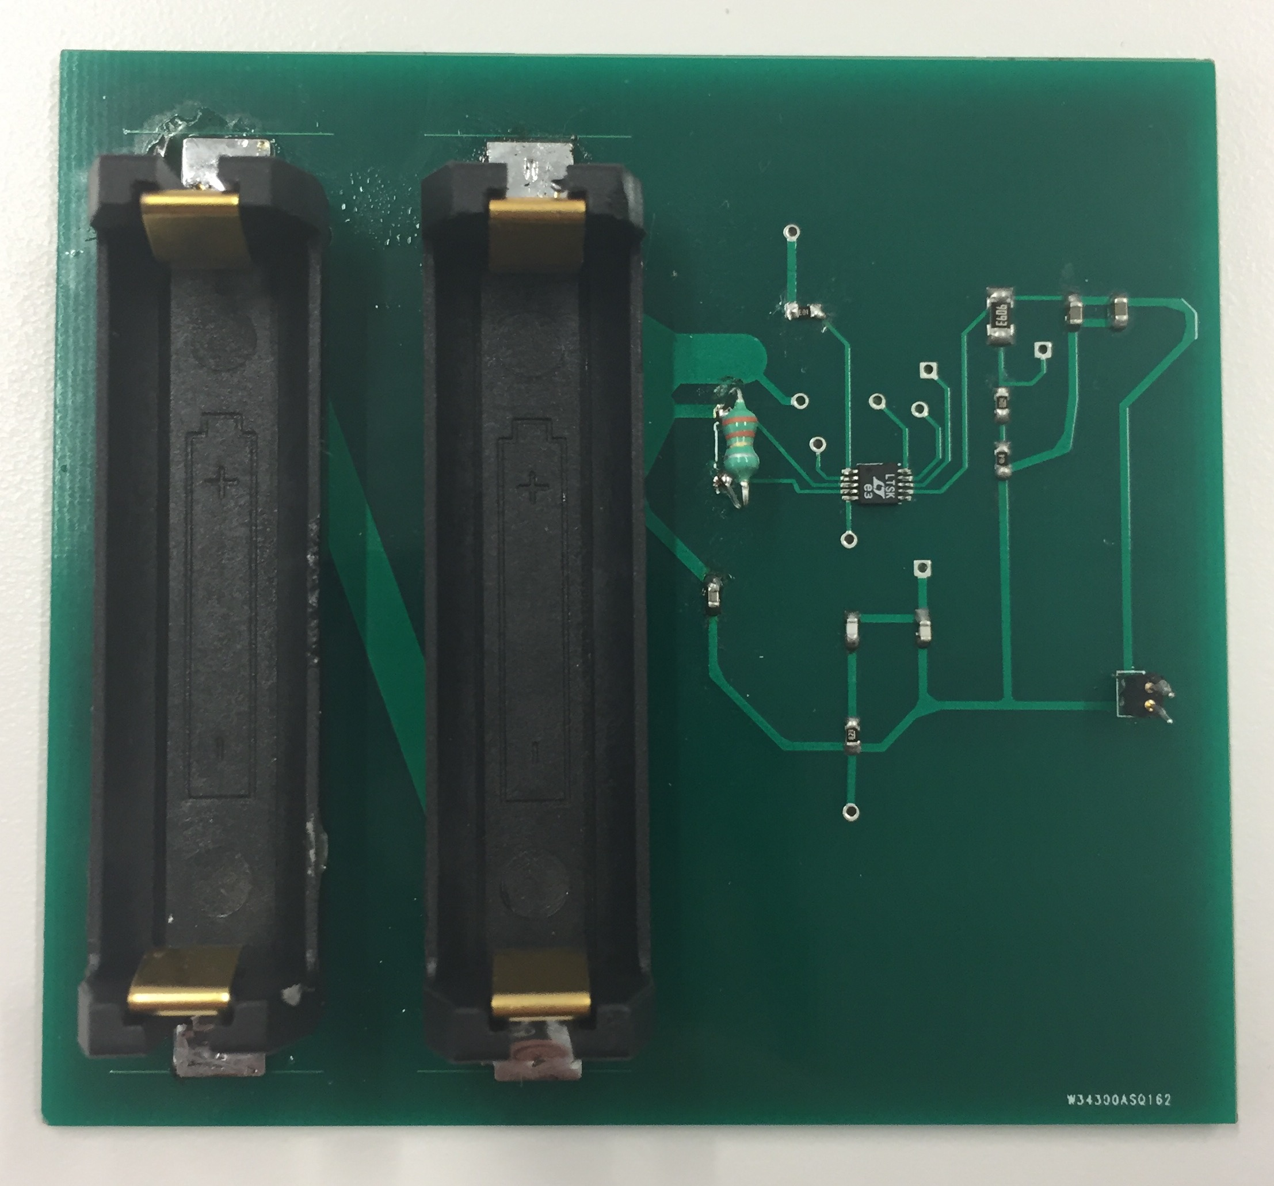
Power
Two AA Energizer Alkaline batteries
LTC3402 Boost Converter
Outputs 3.3v with max 1A draw
Specifically for MCU and microSD
AA Battery Holder
LTC3402
Output
8cm
8.8cm

Slide 13
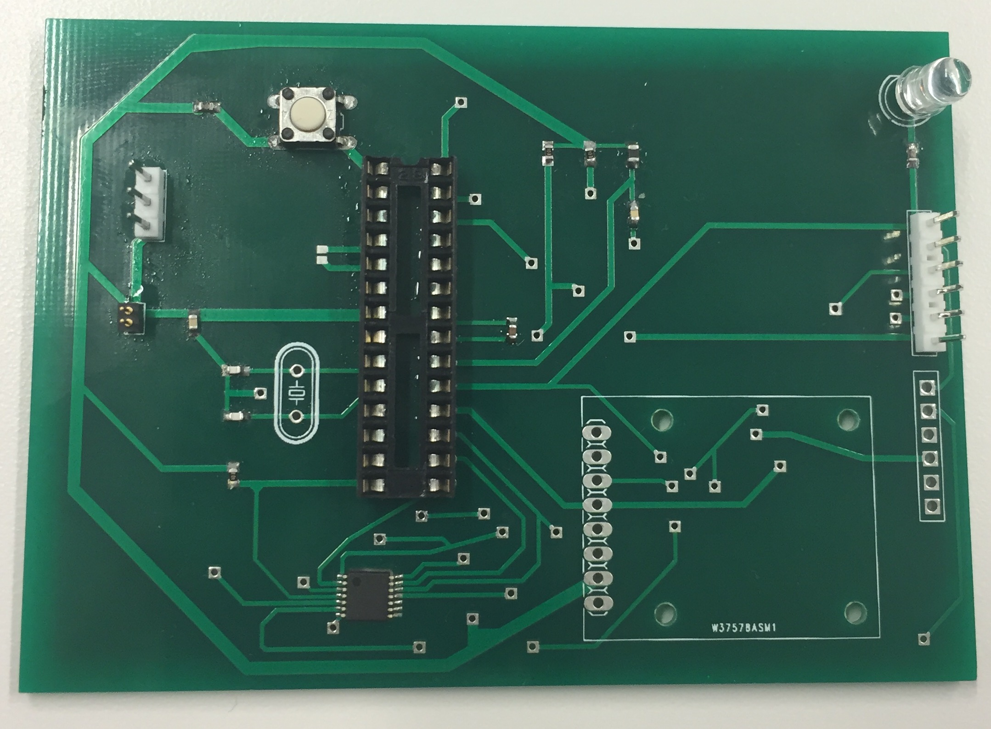
MCU PCB
ATmega328P
ATmega328P
3.3V input | Max current draw of 250 mA
Communicates via SPI
Breakout Board
7.1cm
10cm

Slide 14
Heart Rate Sensor
10-bit Analog/Digital Converter
Adaptive response to variance in inputs
BPM Calc
BPM Graph

Slide 15
Heart Rate Sensor (cont.)
Digital Filter
Real-time digital filtering

Slide 16
MicroSD
5v -> 3.3v conversion
Interface through microSD breakout board
Datalog format at 1600 Hz
“hh:mm:ss.sss - ±xxx.xx ±yyy.yy ±zzz.zz H hhh.h”
Easy access and readability for graphing and analysis

Slide 17
Challenges
Power
Battery System did not output correctly
Communication
Notes:
We need a final statement telling us of our findings
What worked/ What didn’t?
How could we improve on the design?
What did we learn? Key takeaways

Slide 18
Results
HR Sensor Logged Data
Accelerometer Logged Data

Slide 19
Looking Forward
Testing on Human subject for wearability and accuracy during activity
Making number of Accelerometers scalable

Slide 20
Thank You!
Questions?

