Slide 1
PathTracker: A Smartphone Clip-on Sensor of HIV Virus
Team 6: Qingxi Meng, Yunxiao Diao
ECE 445 Fall 2019

Slide 2
Introduction
A smartphone clip-on device that enables efficient HIV sensing at the point of care
It is comprised of a macro lens, LEDs, an optical filter, a PTC heater and two rechargeable batteries

Slide 3
Objectives
Enable the LAMP chemical reaction to occur for 30 minutes
Clear footage of fluorescent foci of the HIV viruses is captured through smartphone’s camera

Slide 4
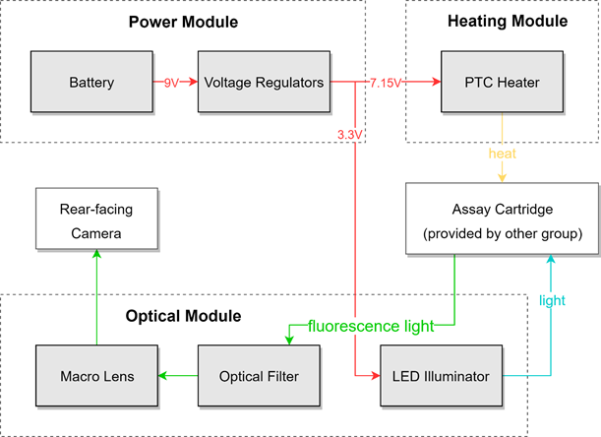

Slide 5
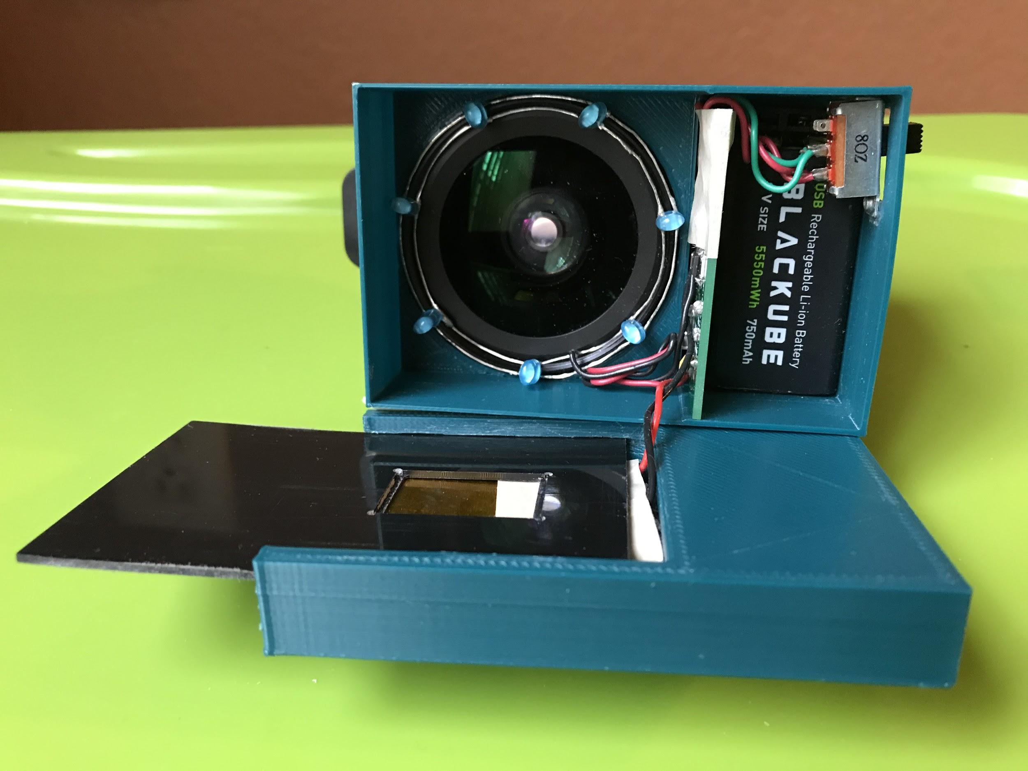

Slide 6
1. Power Module

Slide 7
Requirements
PTC heater is provided with 7.15± 0.03 V
LEDs are provided with around 3.3± 0.3 V

Slide 8
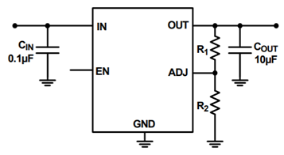
Linear Regulator (ISL80410)
±1% accurate voltage reference

Slide 9
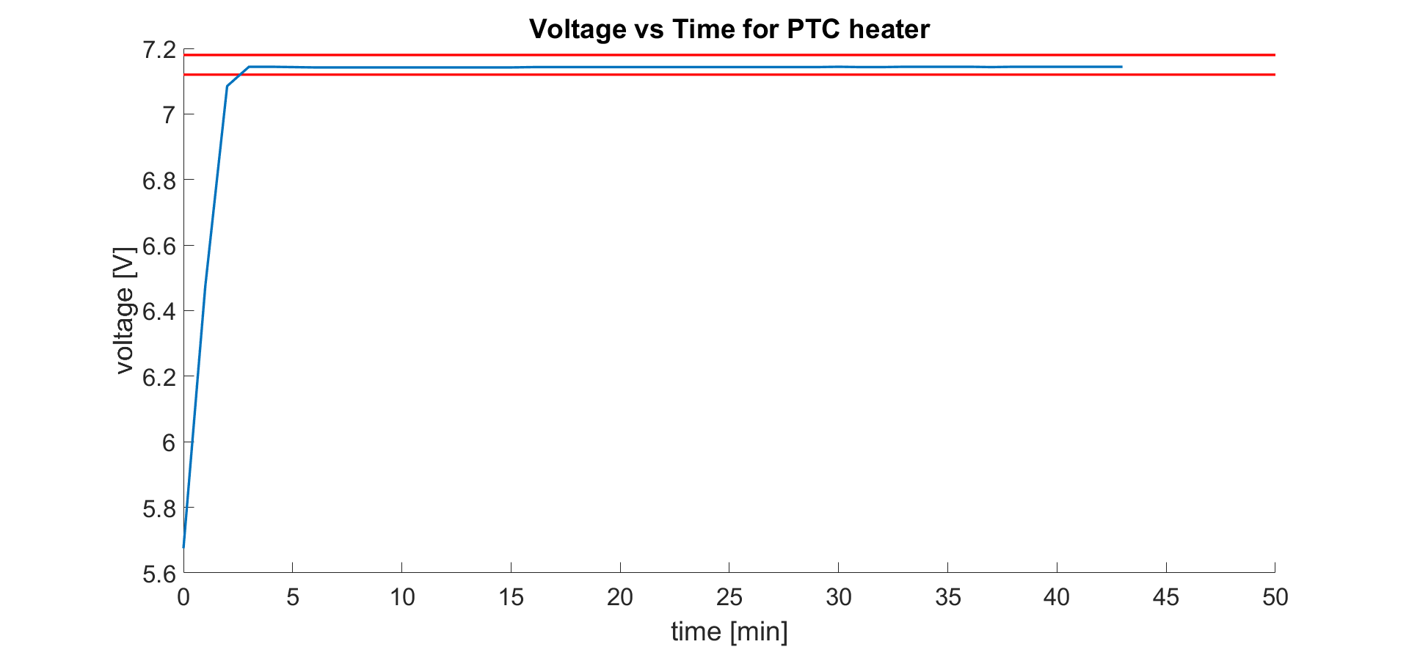
PTC heater voltage:

Slide 10
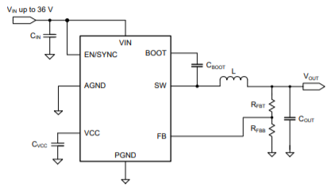
Switching Regulator (LMR23625)

Slide 11
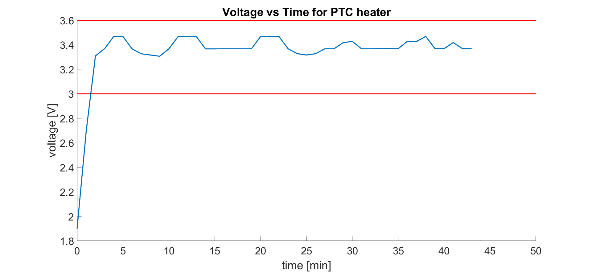
LED voltage:

Slide 12
2. Heating Module

Slide 13
Requirements
PTC heater remains 65°C ± 3°C for at least 30 minutes

Slide 14
PTC heater Temperature VS voltage:
Voltage [V] | Temperature [°C]
6 | 60.5 ± 0.5
7 | 63.5 ± 0.5
7.08 | 64.5 ± 0.4
7.15 | 65.5 ± 0.3
7.22 | 65.7± 0.3
8 | 67.5 ± 0.5

Slide 15
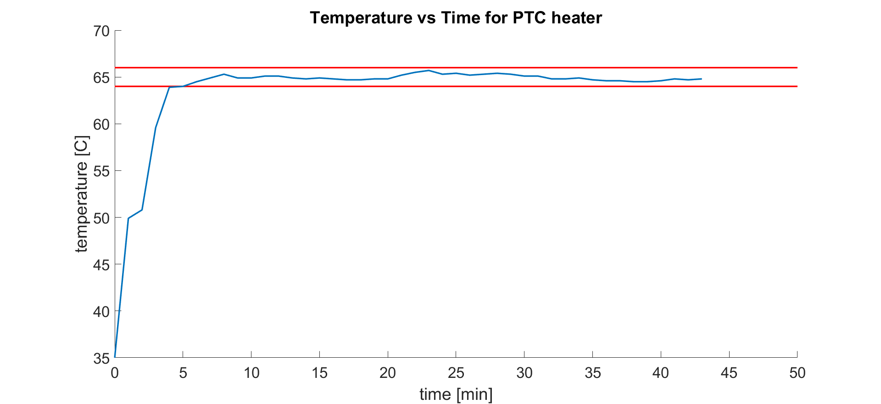
PTC heater temperature:

Slide 16
Future work
Change from linear regulator to switching regulator
Use thermal sensor to control the temperature

Slide 17
3. Optical Module

Slide 18
Three parts:
Requirements:
Activation Wavelength: 500 nm
Fluorescence Wavelength: 530 nm
Macro Lens Set
Bandpass Filter
LED Ring

Slide 19
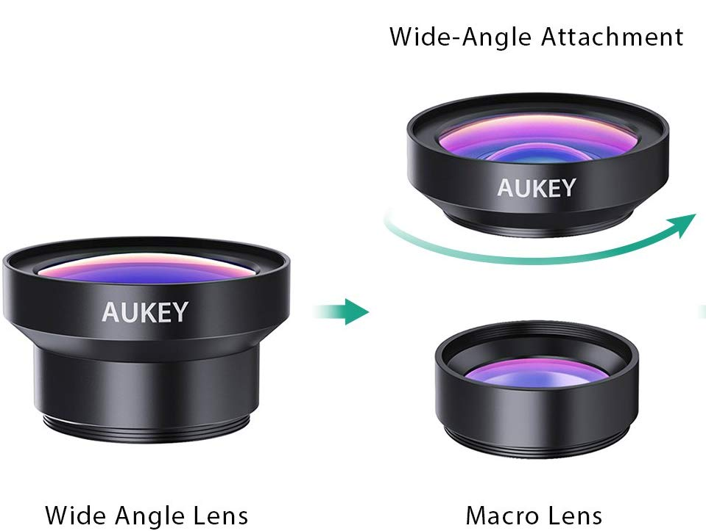
Macro Lens Set
15X Macro Lens
0.45X Wide-Angle Lens
Notes:
Macro lens is for shortening the focus distance, and the wide angle lens is for make the field of view larger so that we can see the whole cartridge

Slide 20
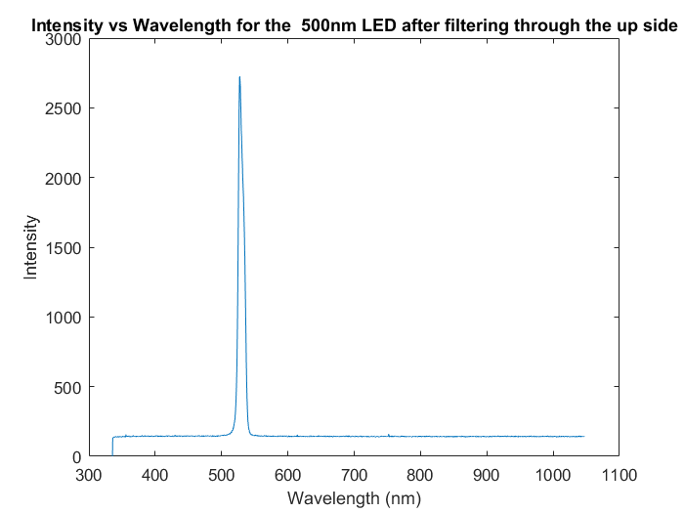
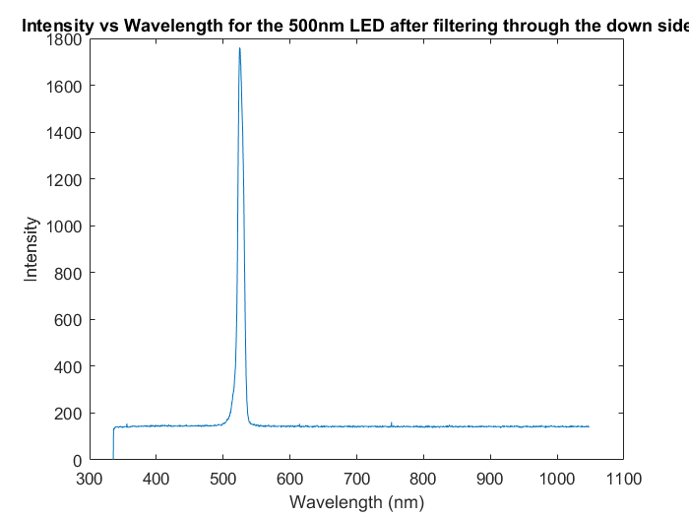
Bandpass Filter
Central Wavelength: 532 ± 2 nm
Full Width at Half Maximum: 10 ± 2 nm
Notes:
As specification on both sides

Slide 21
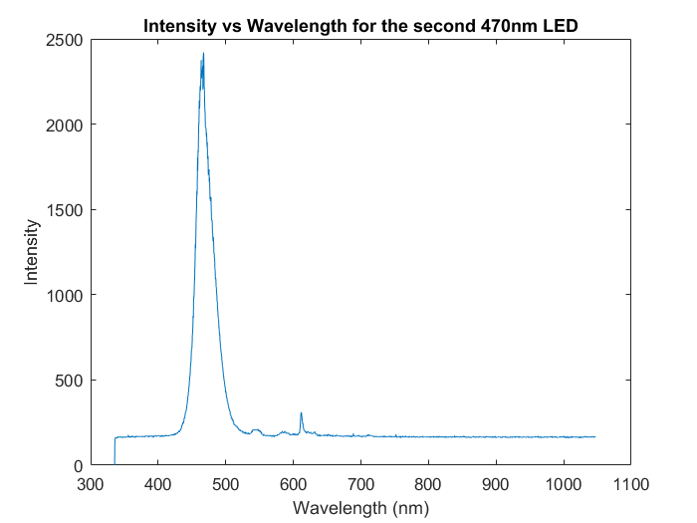
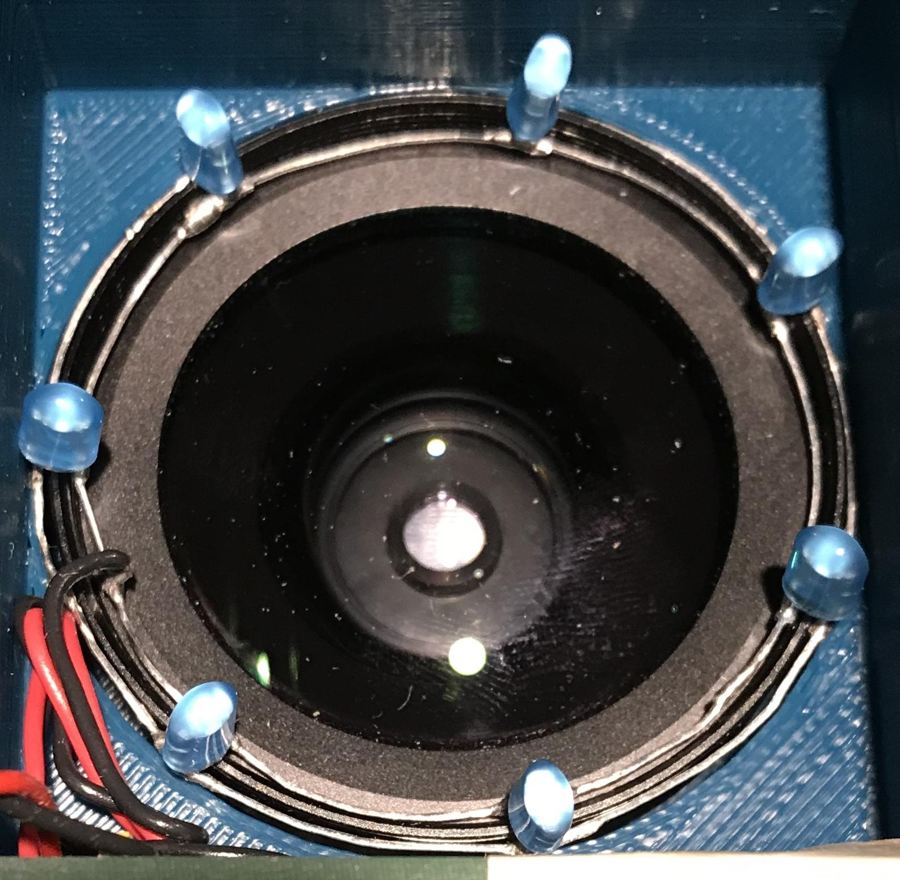
LED Ring
Wavelength: 470 nm, Color: Blue
View Angle: 100° and 40° (2 axis)
Use 7 LEDs to make a ring
Notes:
Some ripples and intensity is not zero at 530 nm

Slide 22
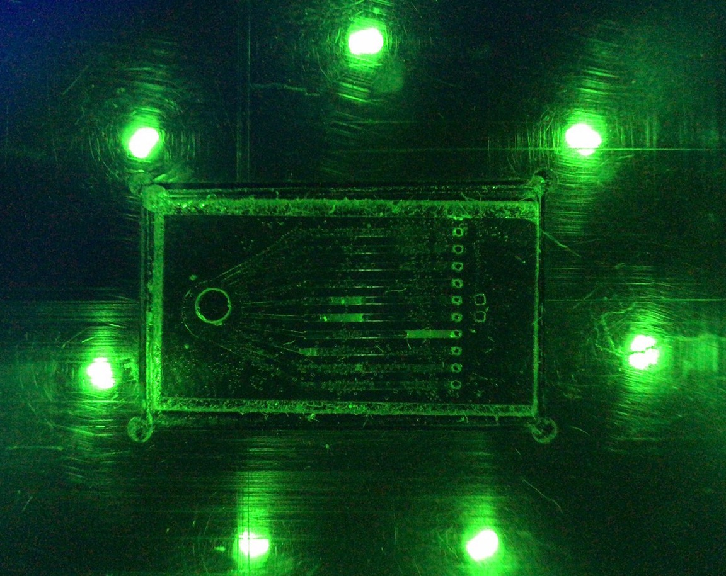
Further Work
Could apply a shortpass filter in front of the LEDs to filter out the light of wavelength higher than 520 nm, to make the contrast ratio higher.
Notes:
The current solution is to chop the photo to only show the cartridge and then send it to doctor for analysis.

Slide 23
4. Cradle

Slide 24
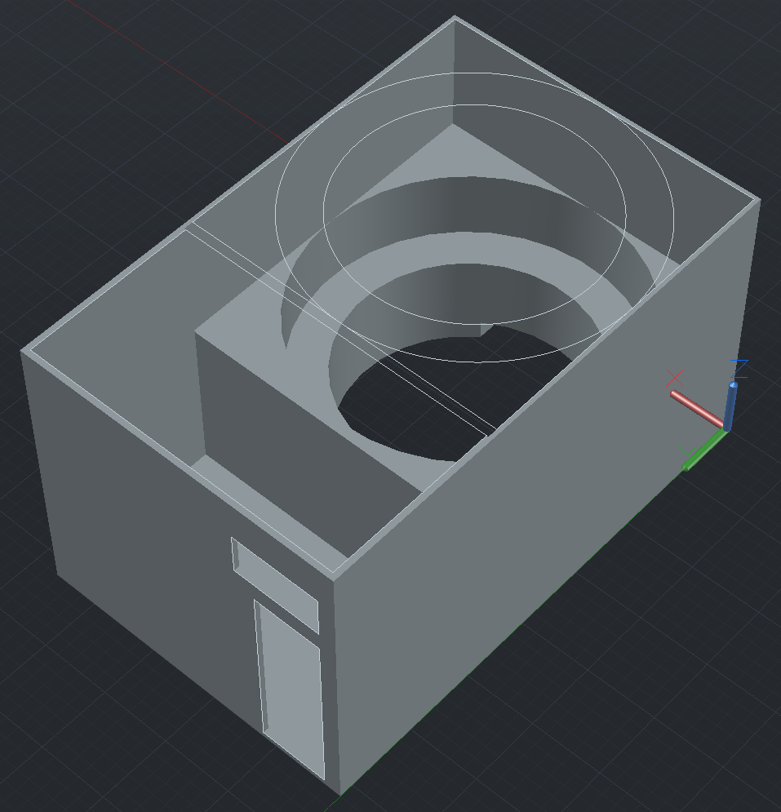
Top piece of the cradle (upside down)
Notes:
Macro lens is here, the opening for clip, the battery and the PCB will be placed here, these are the opening for the switch and the charging ports of the batteries

Slide 25
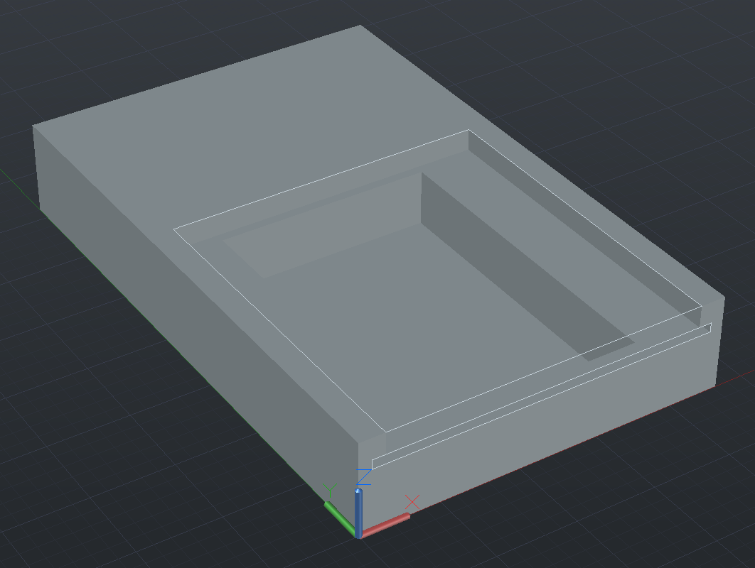
Bottom piece of the cradle
Notes:
Slot for cartridge, place for sponge and ptc heater

Slide 26
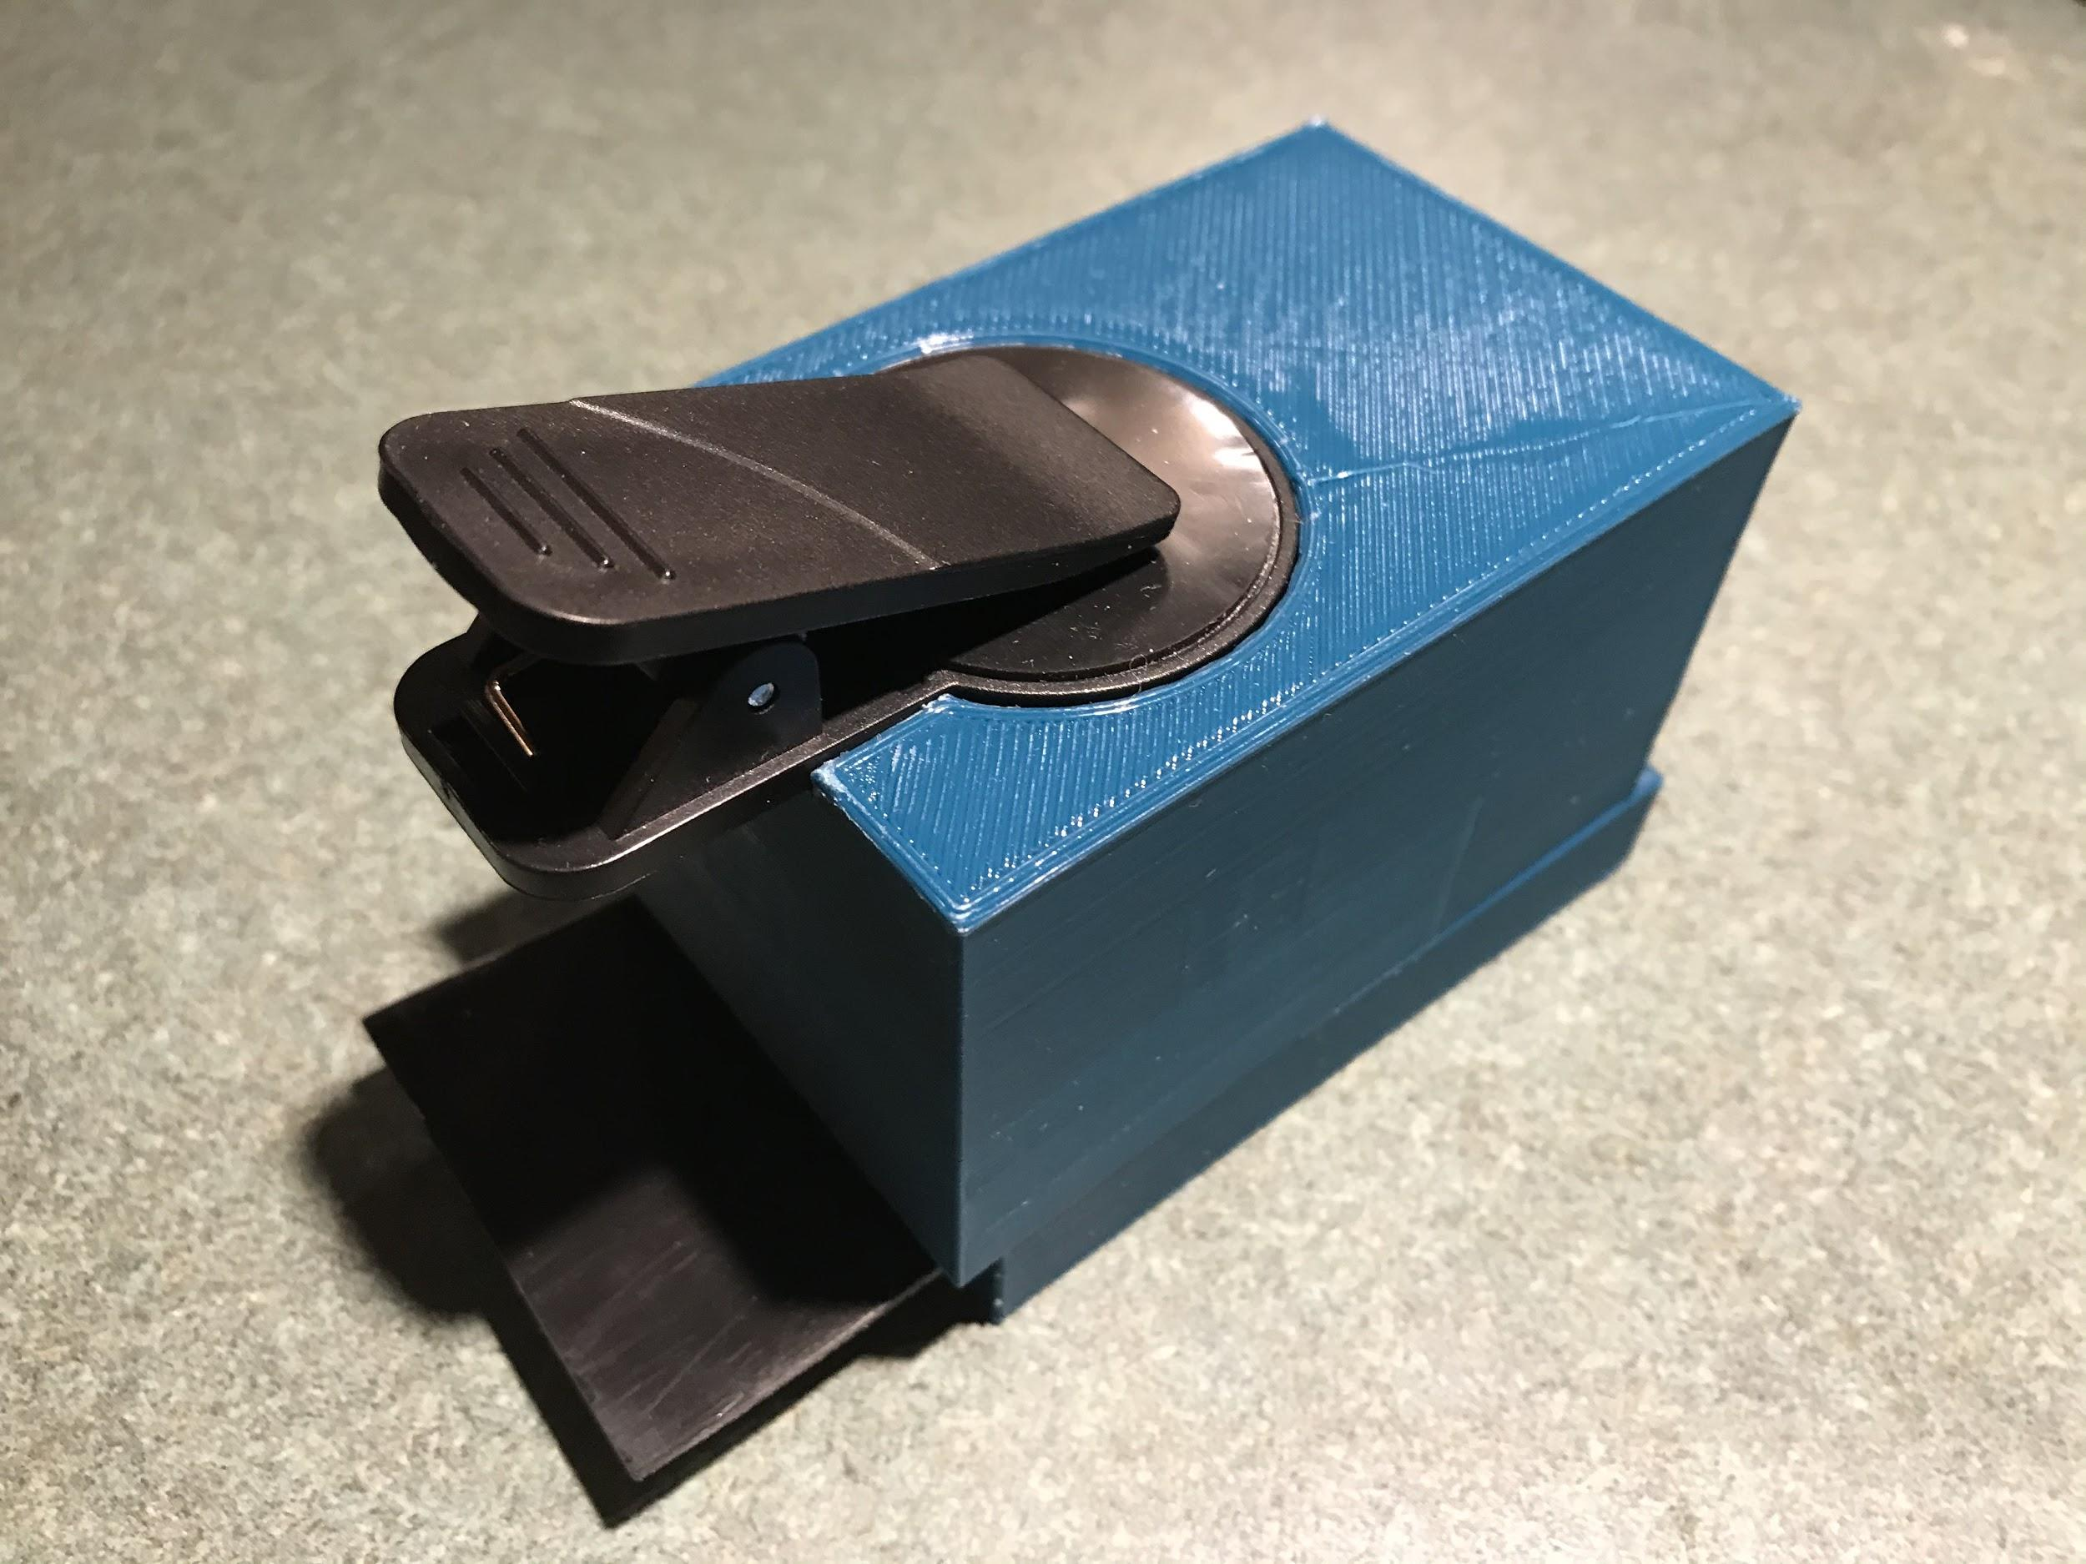
Finished Product

Slide 27
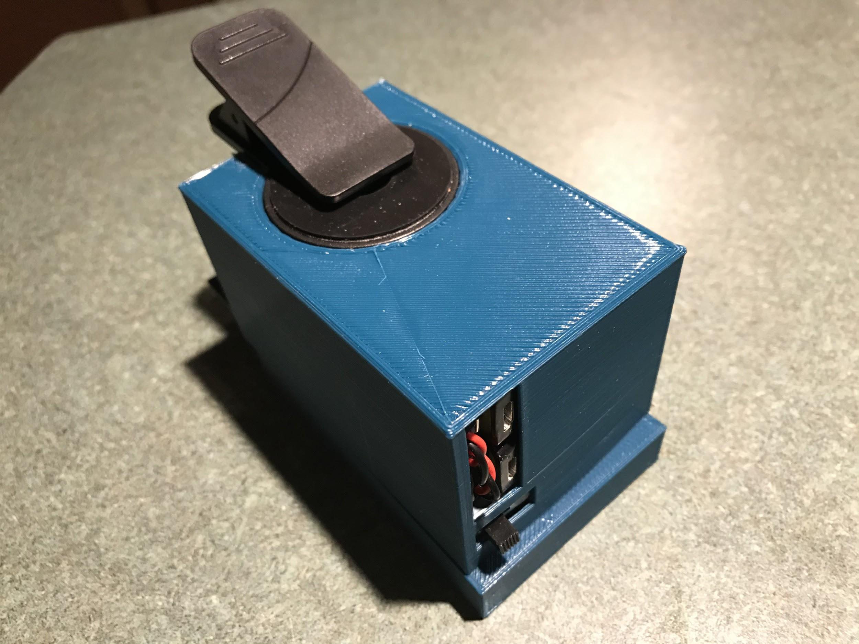

Slide 28
Thanks you!
Any questions?

