Slide 1
Group #30 Remote Controlled LED Project
Jintao Chen
Yuming Jin
Jingfan Zhang

Slide 2
Introduction
While most of the LEDs that we commonly used are being controlled by a single wired
switch, sometimes when we are right about to fall asleep in our cozy bed,
especially in the winter, we find it so tormenting to get up, reach the switches,
and turn off the LEDs.
A friendly designed wireless bedside system that controls all the LEDs around the house
would avoid such cases.

Slide 3
High-level Requirements List
1. The user should be able to turn the LEDs on and off using the bedside controller within
10 meters distance from the wallside controller which is connected with the target LED
strip light. The user can also increase/decrease the brightness level by pressing the
brightness up/down buttons on both controllers.
2. The bedside and wallside controllers should transmit data to each other through
Bluetooth channel established by private key pairs at a minimum data transmission rate of
10 Mbit/s.
3. Date(MM/DD/YYYY), time(Local time accurate to minute), humidity(%) and
temperature(F) should be displayed on the LCD screens of both controllers.

Slide 4
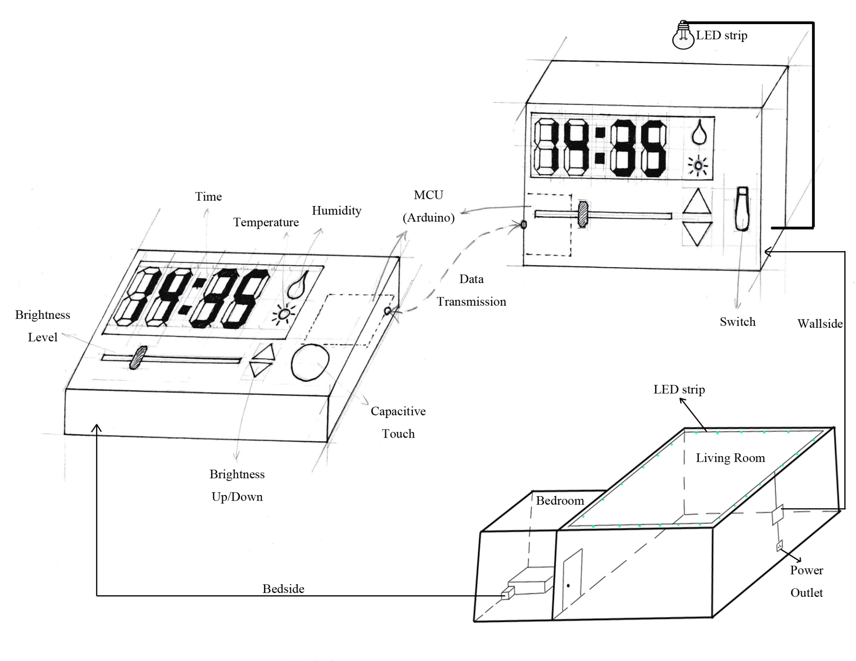
Physical
Design

Slide 5
Block
Diagram

Slide 6
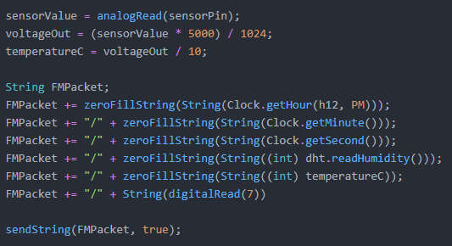
Data
Transmission
Bedside
FMPacket:
HH/MM/SS/HH/TT/O

Slide 7
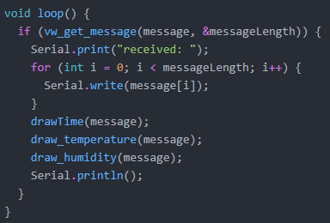
Data
Transmission
Wallside

Slide 8
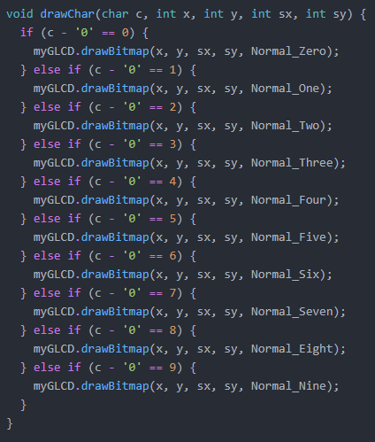
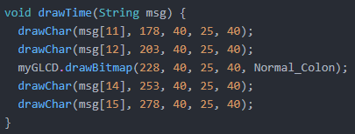
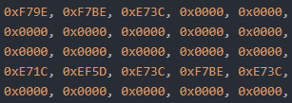
LCD Display

Slide 12
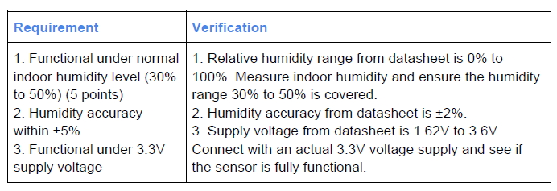
HDC2010 Humidity & Temperature Digital Sensor

Slide 13
LM35 Temperature Sensor

Slide 14
DS3231 Real-time Clock

Slide 15
Brightness control circuit

Slide 16
In The Future
Better, working FM module
More stable capacitive touch circuit to gain better control on the switch sensitivity so that the LED system will be more stable.
Better overall design and so that we can replace our perf boards with PCB
Try to use Atmega328P directly rather than arduino to add difficulty of the design.

Slide 17
Our Own Project Evaluation
For the project, we basically have every part functioning and working independently. However, when we fit them together as a whole, we burned out our FM model so we were not able to demo the information exchange between the FM transmitter and receiver modules. But we did make videos showing their functionality.
The overall design is successful and we made progress step by step throughout the semester.
We do think we did a fine job on the project.

Slide 18
Thank You!

