Slide 1
Scrim Light A controllable LED light
Mario Posso and Gary Liu – ECE 445 Spring 2017
Project 35 – TA: Jose Sanchez ViCarte

Slide 2
Introduction
Rick Kessinger, a local photographer, was attempting to photograph automobiles in a particular fashion and asked ECE445 students to come up with a solution.
He needed to produce flexible lighting gradients to highlight the shapes and contours of the vehicles.

Slide 3
Objectives
We intend to design a lighting device which gives more control to the user to produce lighting patterns.
The user should have full control over their intended lighting setup.
The device should be cordless and battery powered

Slide 4
Objectives
The design should also be modular: if a single LED unit breaks, the user will be able to replace it quickly and simply as opposed to fixing the entire light.
The user will also be able to store a certain profile for later usage or adjustment.

Slide 5
Design

Slide 6
Design - MBus
MBus is a custom protocol similar to I2C which allows us to produce the desired gradients and effects required by the strip.
The bus must be able to communicate at least 3 bytes per LED module to all modules within 8 ms, the best possible visual latency of the human eye. This would require a total number of clock cycles of
120x8 + 120 = 1080 cycles
-> 1080/.008 = 135 kHz
This necessary clock speed is faster than the typical I2C transfer speed of 100 kHz

Slide 7
Design - MBus
The protocol operates very similarly to I2C, with a few changes:
There is no start condition.
The bus is write-only.
The bus supports multiple-slave addressing and variable-size data streams. The application benefits greatly from allowing the brightness of multiple LEDs to be changed simultaneously.
The bus has a third line – Data Enable. This line allows the master to determine when the data stream terminates and closes.
Two SIPO registers are cascaded together, with each outputting to one of two LED drivers. To communicate with both, we can simply send a 16 bit value.

Slide 8
Design – Mbus - Schematic

Slide 9
Design – LED Driver
The LEDs are driven by using an 8-bit shift in parallel out register to store their brightness value.
The 8-bit value is output to an R-2R Ladder DAC.
The DAC then drives the base of a PNP BJT, which acts as an approximate VCCS. Depending on the brightness value stored in the register, a specific current value flows through the LED, which adjusts the brightness.

Slide 10
Design – LED Driver
In order to properly meet the requirements, we need to use resistors at the base of the BJT to limit the current to our desired value. Also, we must ensure that the maximum output voltage of the R-2R ladder is matched to ~.7 below the battery voltage, as this allows the BJT to remain in active mode. We base our calculations off a 3.6 battery voltage
Thus, we can calculate the necessary base resistance with the equations below, where V_{T} is the output of the R-2R ladder, and $I_{C}= βI_{B}$. Solving for the case where $I_{C}=60 mA$ with $V_{T}=0$ yields $R_{ladder}+ R_{B} ≈14 kΩ$.
$$I_{B}=\frac{2.9− V_{T}}{R_{ladder}+R_{B}}$$
After performing the simulations with the specific part, we determined that an actual input resistance of 1kΩ would produce the desired range from the BJT.

Slide 11
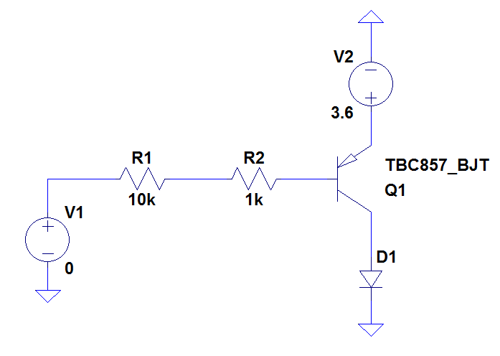
Design – LED Driver
Here, the output voltage of the R-2R ladder is simulated as a voltage source. In order to verify the operation of the driver, we swept the voltage across a range of 0 V to 2.9 V, and plotted the output current:

Slide 12
Requirements and Verification - MBUS
Requirements | Verification
Must allow the microcontroller to establish communication with the LEDs using the MBus protocol. Should minimize latency as detected by a camera for more time sensitive future applications. Should allow multiple LEDs to be loaded simultaneously. Should allow for color temperature adjustment through communication to multiple LEDs simultaneously. Color temperature should range from about 3000 K (warm, red light) to 5700 K (cool, bluish white). Data packet size must be flexible (1 - 16 bits). Must be able to communicate information to all of the LEDs below the average latency of the human eye. Must be able to operate at frequencies above 135KHz. | Change the brightness of multiple LEDs and verify that there is no visible latency. Change the color temperature and verify that there is no visible latency. Reset the brightness of all LEDs simultaneously and verify that there is no visible latency through a camera to

Slide 13
Requirements and Verification – MBUS

Slide 14
Requirements and Verification – LED Driver
Requirements | Verification
Must be able to provide a linear digitally controlled brightness values for the LED. The current values must then be linear, ranging from 0 to 60 mA because the LED brightness depends on the current value that is driving it. The LEDs should remain at a safe temperature as specified in the datasheet. Must not exceed a maximum continuous forward current of 65 mA. | Vary the brightness values of the LED over the entire range. Verify the linearity in the steps of brightness. Operate the device at maximum brightness for the duration of the battery life, and ensure that the LEDs do not feel more than lukewarm.

Slide 16
Requirements and Verification – User Interface
Requirements | Verification
LCD Display The LCD Display should readable in a low light environment. Should convey information regarding current state of the light. Should show current brightness level, current profile, and save status. Buttons Profile Toggle Function Profile toggling will cycle through the profiles as they are displayed on the LCD display and stored in the flash memory. Saving Profiles User must have the ability to save the current profile into flash memory or to discard it. The user will have access to 8 different modes, and these modes should be able to be overwritten. Rotary Encoders Their rotation must be effortless but robust enough to prevent accidental turning. Window adjustment The user should have access to a window of LEDs of flexible size and position that allows for their full customization. Brightness/Color Temperature Adjustment The user should be able to adjust the brightness and color temperatures of the LEDs within the window that they have selected. | In a dark environment, display 40 different characters with the backlight on. Hold at arm’s length and verify readability. Use the buttons to cycle through the various profiles offered by the device. Verify that the information of the current profile is updated on the LCD Display. Select an arbitrary window and adjust its brightness and color temperature with the rotary encoders. Verify that the information of the current mode is updated on the LCD Display. Save the current profile using the buttons. Turn the device off, and attempt to load the saved profile. Verify that the loaded profile is the same as the previously saved profile.

Slide 17
Project Build
Physically, the scrim light exists as an aluminum housing containing the LEDs, and a handle containing the user interface and microcontroller.
The user interface consists of an LCD display, three buttons, and two knobs. These buttons and knobs allow the user to fully customize the lights as desired.
The strip consists of 16 individual MBus modules, wired serially through the on-board female headers.

Slide 18
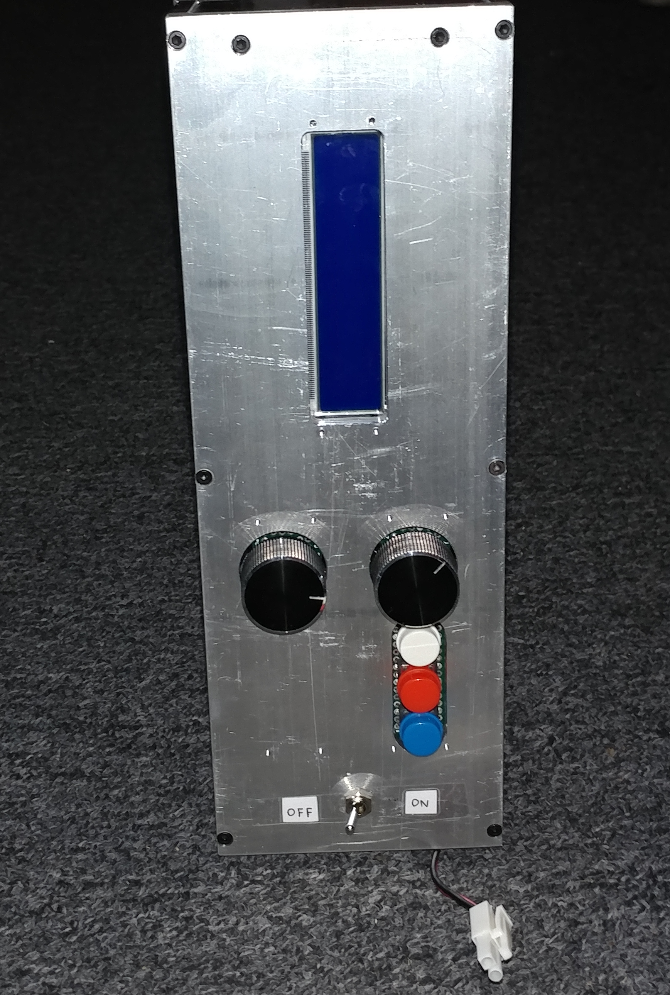
Project Build - Pictures

Slide 19
Functional Testing
In order to test the end product, we begin with an initialization sequence programmed into the MCU to ensure that the onboard devices are properly initializing on power up.
De-bouncing redundancies were experimentally determined to provide what we felt was a fluid experience. This ensured that the interrupts were being correctly received by the MCU.

Slide 20
Successes And Challenges
Overall, we were able to properly communicate with and control the LED modules using our custom protocol.
Additionally, we were able to operate the UI elements successfully except for the LCD display.
Finally, our physical design was successfully implemented as we were able to meet the specifications set out by our sponsor, in terms of length and light diffusion requirements.

Slide 21
Successes And Challenges
One of the most challenging portions of our design was the layout of the MBus LED modules, as they were very space sensitive.
Additionally, it was quite challenging to solder each of the individual modules, as they had to be fixed one by one if any of them broke.
Finally, coming up with a way to communicate mode changes in the user interface was also somewhat difficult, as well as debouncing and properly interfacing the buttons and knobs with the microcontroller.

Slide 22
Failures
Unfortunately, we were unable to fully deliver on the number of LED modules over the entire length of the strip, due to time and budgeting issues.
Due to some issues regarding the connections on the PCB and some problems with the ribbon cable connector to the LCD, we were unable to implement the LCD display.

Slide 23
Further Work
For further work, the primary goal would be to improve the diffusive layer of our device to produce a better gradient and to eliminate shadows. Additionally, we would like to produce a better, lighter, and more aesthetically pleasing LED housing, through some other method like 3D Printing.
Also, we would like to fix the individual LED modules and microcontroller boards by adding passive components like decoupling capacitors to improve the response of the modules as well as eliminate any potential bugs.
Finally, we would like to be able to implement the LCD display to improve the user’s experience with the device.

Slide 24
Conclusions
Overall, we were quite successful in completing the goals that we set out to do, besides the LCD display. Even though we were unable to fully implement the display, we were still able to communicate user interface changes through the light itself.
We would like to thank our TA, Jose, for helping us throughout the entire process of this project, and Rick Kessinger, for providing us with the inspiration behind this project.

