Slide 1
Portable Wind Turbine
Sachin Reddy, Charles Hummel, Kemal Emre Ercikti
Team 41

Slide 2
Introduction
A way to charge your phone or other device when solar is not available
A novel way to use wind power on a small scale

Slide 3
Objectives
Strove to create:
A small power source compatible with most portable electronics using only wind
Ability to capture wide range of wind speed and in any direction
A screen to see wind speed data and voltage generated from the turbine

Slide 4
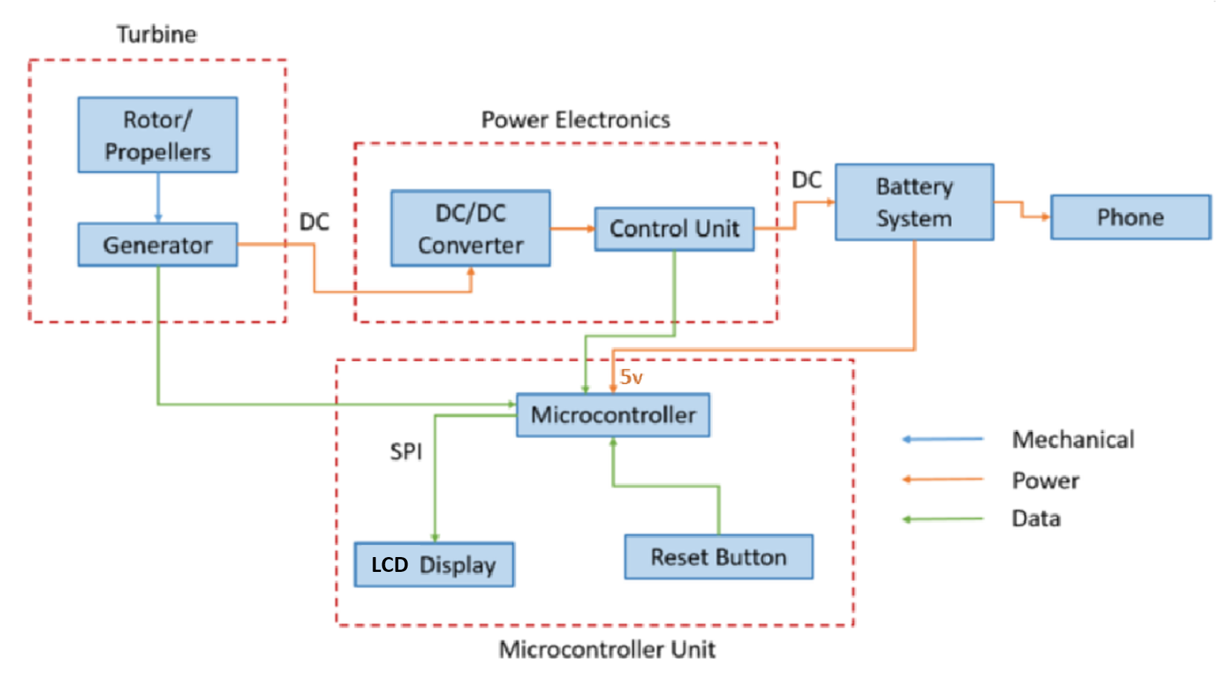
Block Diagram

Slide 5
Original Design
VAWT: Omnidirectional and more stable compared to HAWT
Ćuk originally chosen, fewer parts than SEPIC
Microcontroller with 2x16 LCD Display and voltage divider to reading voltage produced
Notes:
Overall, we followed the same block diagram

Slide 6
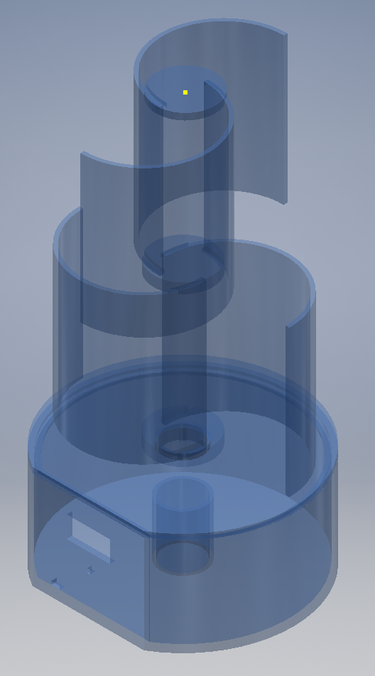
Turbine
Savonius two-level two-bucket design
Must be able to start at 5 m/s and maintain stability at 11 m/s
Must be able to output 3 W

Slide 7
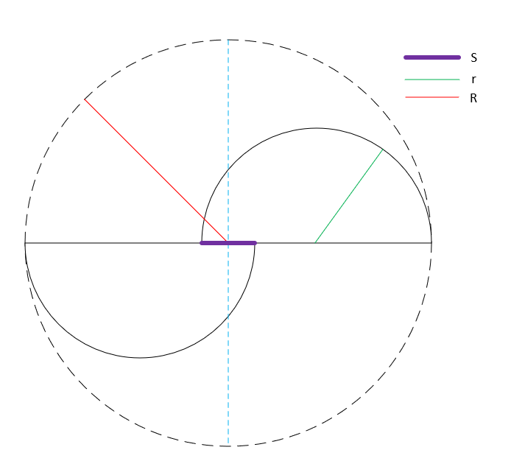
Wind Power Theory

Slide 8
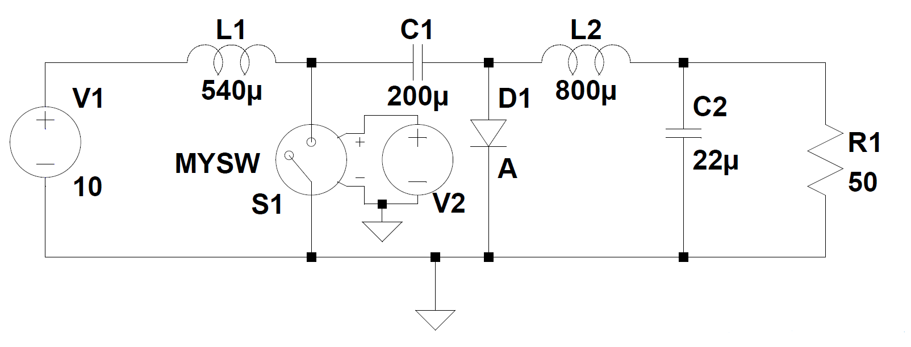
Power Electronics
Planned to use Ćuk topology which offers buck and boost
Control circuit would be a Proportional Integral (PI) controller combined with Pulse Width Modulation (PWM) generator
Primary focus was to output 5V regardless of input
Notes:
Additionally wanted an efficient circuit original idea was 80% but for energy star rating only need 60%
Low ripple ~1% ripple ratio further research revealed only needed about 100 mV peak to peak

Slide 9
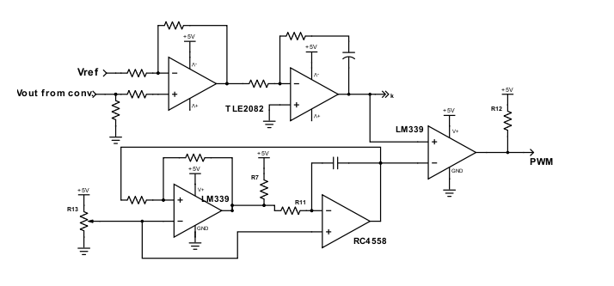
Control
Error generator with 5V reference
PI control outputs 0 to 5V in order to adjust duty ratio
PWM generation involves a Schmitt trigger an integrator and a comparator

Slide 10
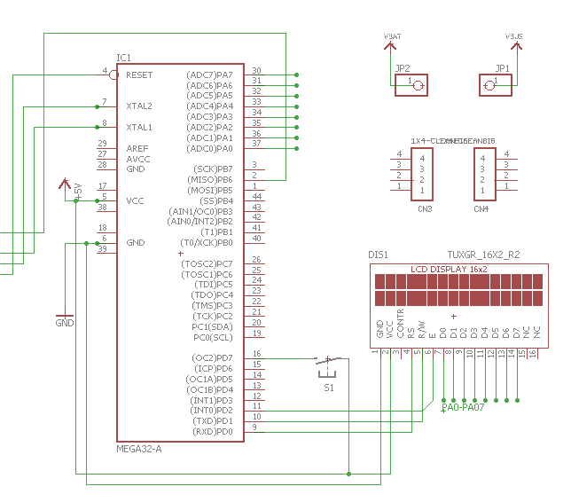
Original Microcontroller
ATMEGA32
LCD 16x2 Display
Voltage Divider across generator
Powered Via USB 2.0

Slide 11
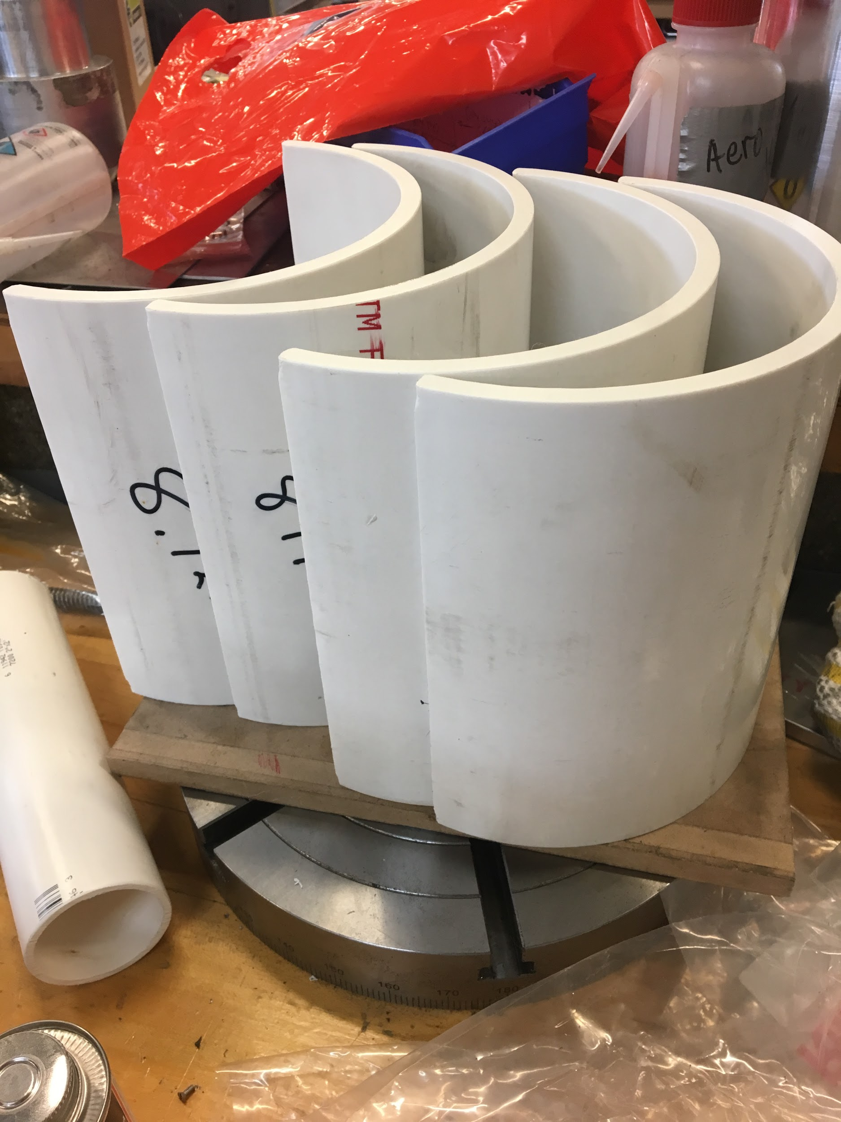
Turbine Block Build
Collaborated with the machine shop to manufacture turbine
8’’ Sch. 40 PVC pipe was used to create rotor blades

Slide 12
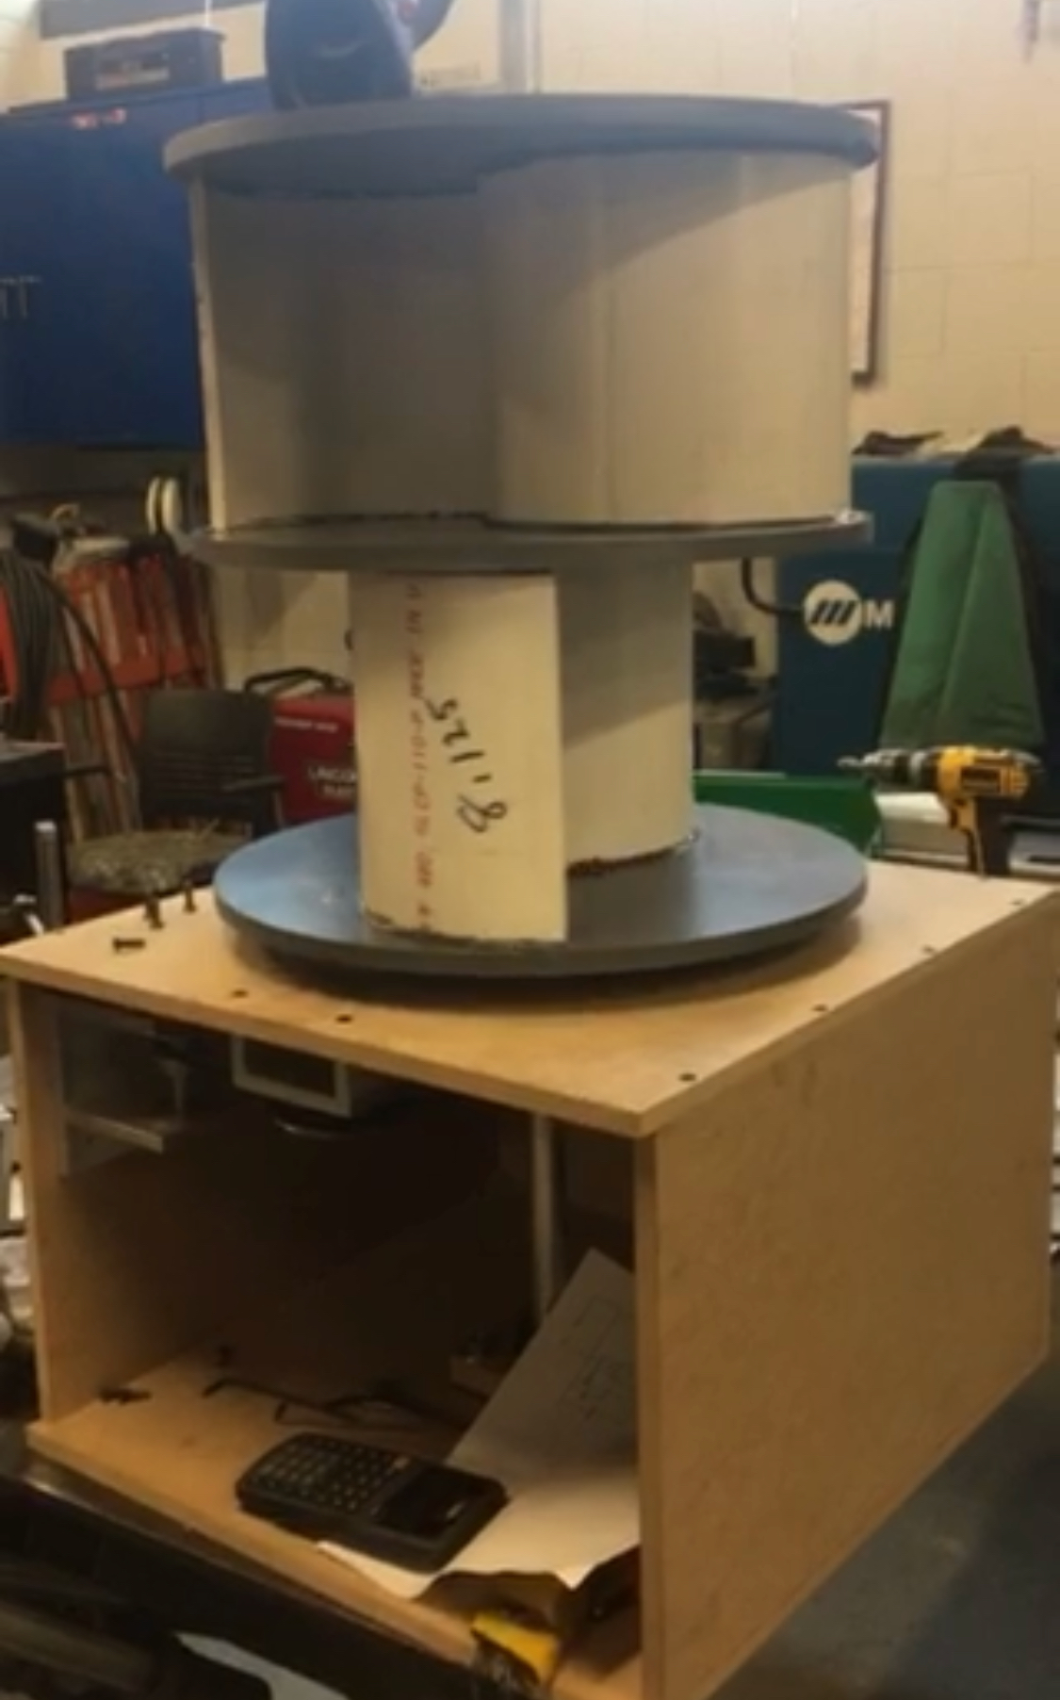
Turbine and Physical Design
Used MBF wood to create the base to house the gearbox, circuitry and generator
Gearbox created using belt system
Notes:
Compare and contrast original design here
Note that the size is larger and base is simple strong stability

Slide 13
Generator Load Testing
Rotational Speed [rpm] | Empty Load Results | 10Ω Load Results
500 | 4V | 2.5V 0.25A 0.63W
1000 | 8V | 5.5V 0.55A 3W
1500 | 12V | 8.5V 0.85A 7.2W
2000 | 16V | 11.5V 1.15A 13.2W
2500 | 20V | 14.5V 1.45A 21W

Slide 14
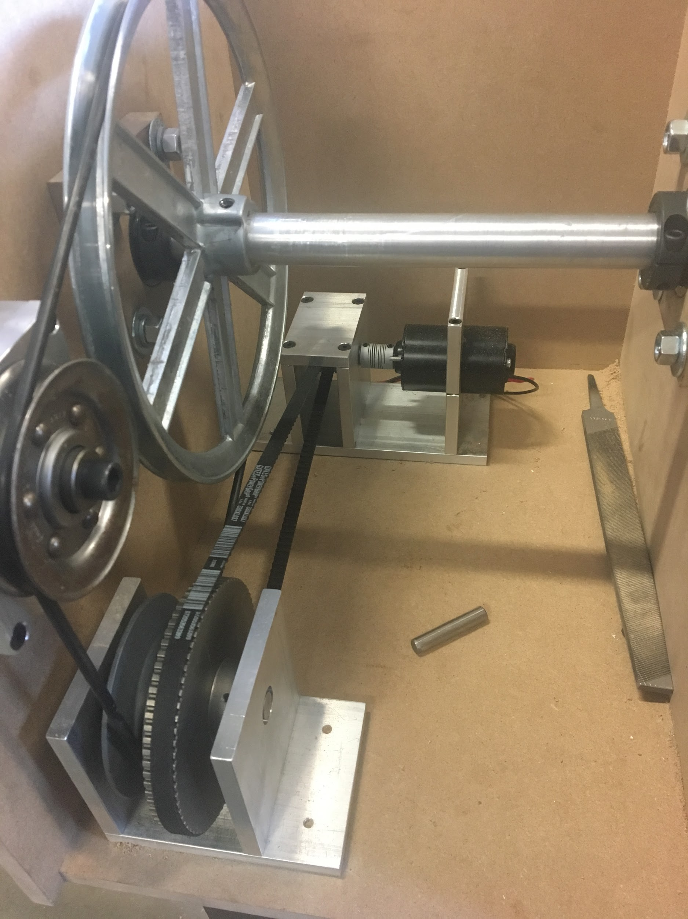
Turbine Gear
Gearing ratio of 13 to accommodate high wind speeds
Too much internal drag

Slide 15
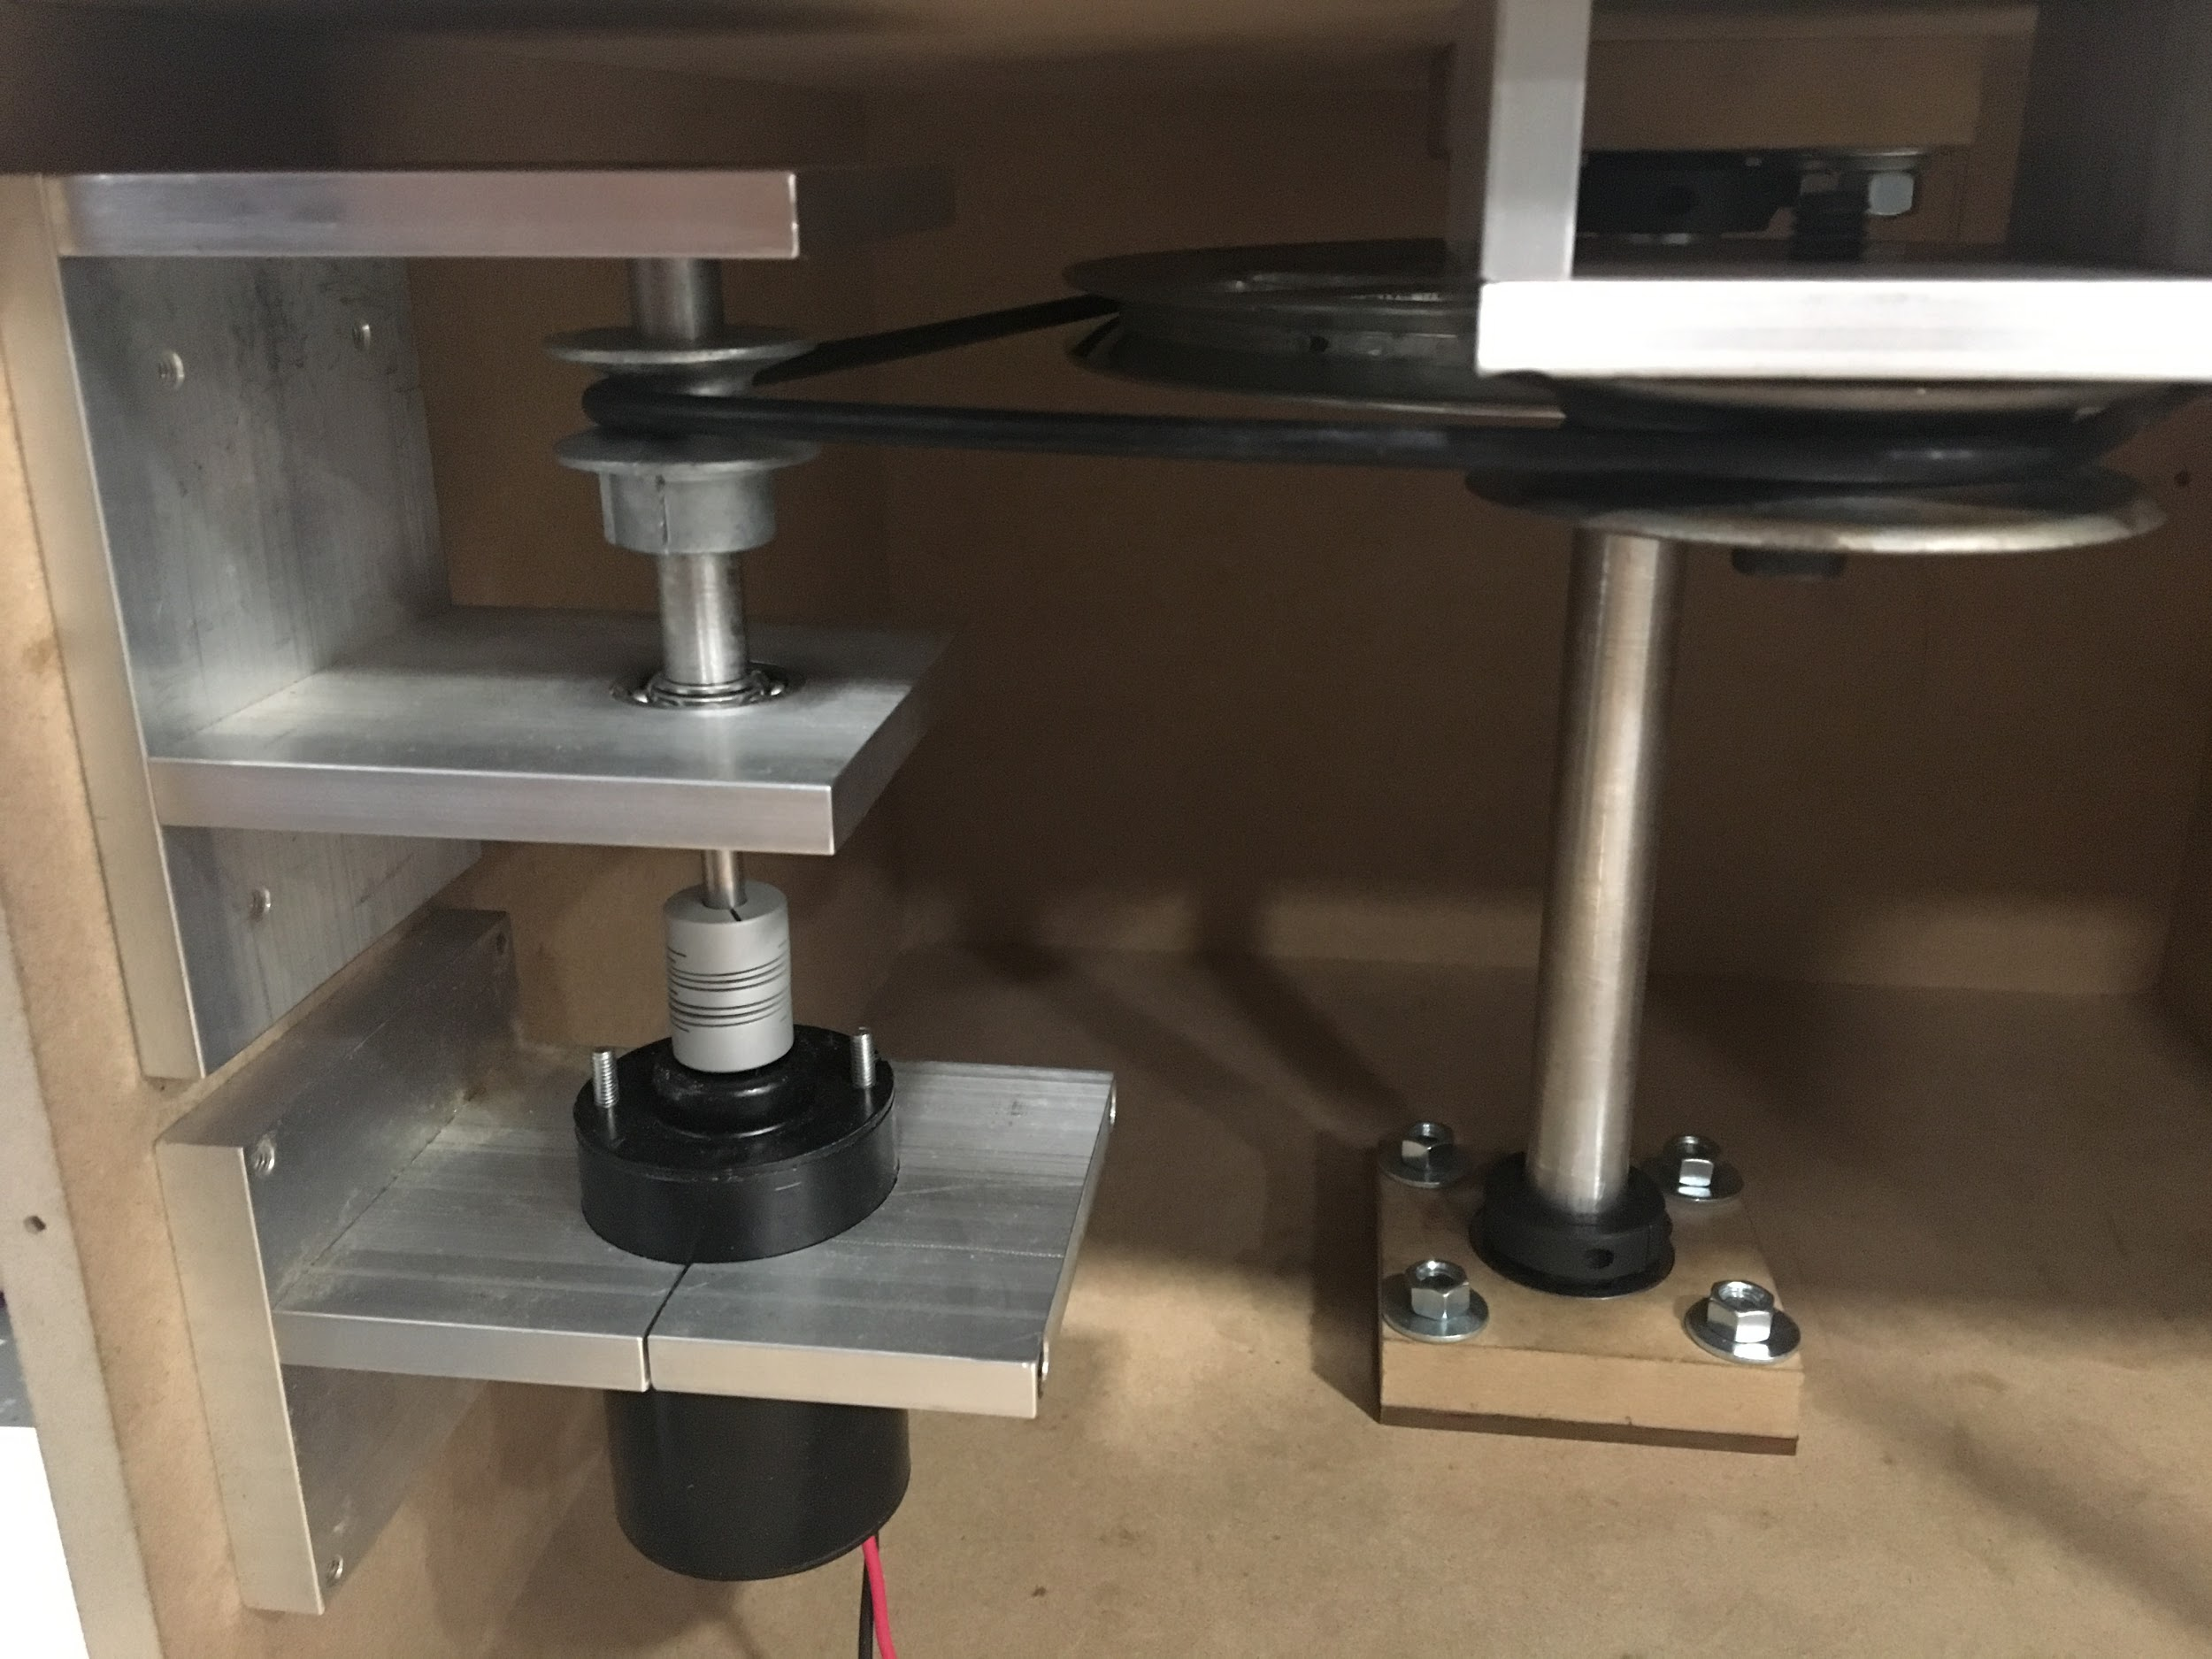
Turbine Gear (Updated)
Gearing ratio of 9
Eliminated much of previous drag
Difference in gear ratio may not directly correlate to higher wind speeds!

Slide 16
Turbine Results
RPM | Load(Ω) | Voltage
594 | 10 | 4V
~1200 | 50 | 12V
~2500 | Open Circuit | 18+ (Stopped for safety)
Notes:
MENTION OVERALL SUCCESS
We need to give some analysis of how the turbine and generator preformed.
Reference original R and V design
Maybe a video or include the pics of final product (one that showcases the internal mechanics) make note that we will discuss ideas of futur iteration

Slide 17
Notes:
TURBINE VIDEO

Slide 18
Power Electronics Overview
Changed from Ćuk to SEPIC topology
Outputs 5V to USB-C interface
Notes:
Original idea was cuk but had to be changed to SEPIC to be compatible with control circuit

Slide 19
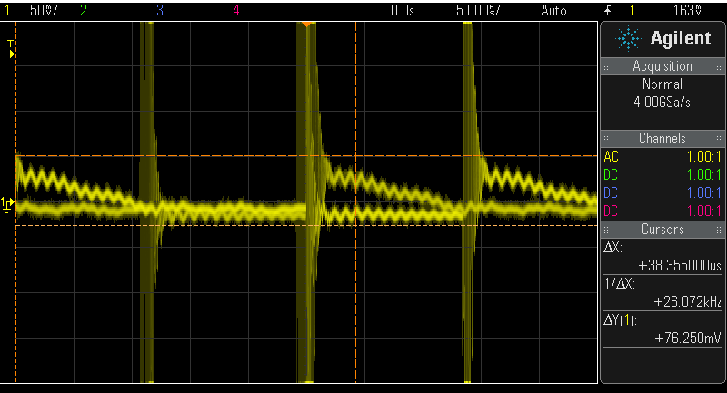
Converter
Notes:
Able to handle 1-18V and within 100mV ripple

Slide 20
Converter Results
50Ω Load, 25 kHz switching frequency
Input Voltage(V) | Output Ripple Voltage(V) | Efficiency(%)
1.5 | .074 | 71
2.5 | .073 | 78
3.5 | .069 | 79
4.5 | .068 | 79
5.5 | .070 | 79
Notes:
Testing at 25kHz

Slide 21
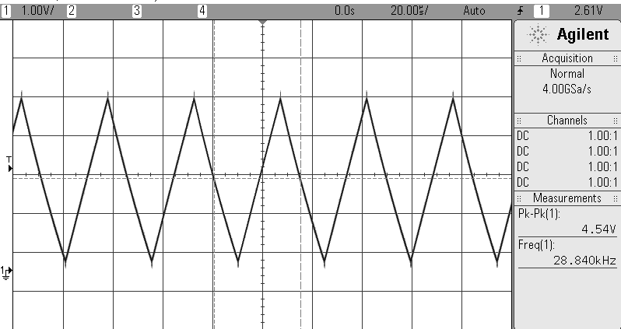
Control Results
Input Voltage(V) | Error Voltage(V)
0 | -3.667
1 | -3.89
2 | -2.926
3 | -1.935
4 | -0.95
5 | .016
6 | 1.011
7 | 2.006
8 | 3.000
Notes:
Also mention how the design of the controller remained unchanged
Hard to assess accuracy of PI due to constant integration however in breadboarding initial converter designs with the control produced no steady state error and quick response which is exactly what is needed from control
Must talk about failure to integrate

Slide 22
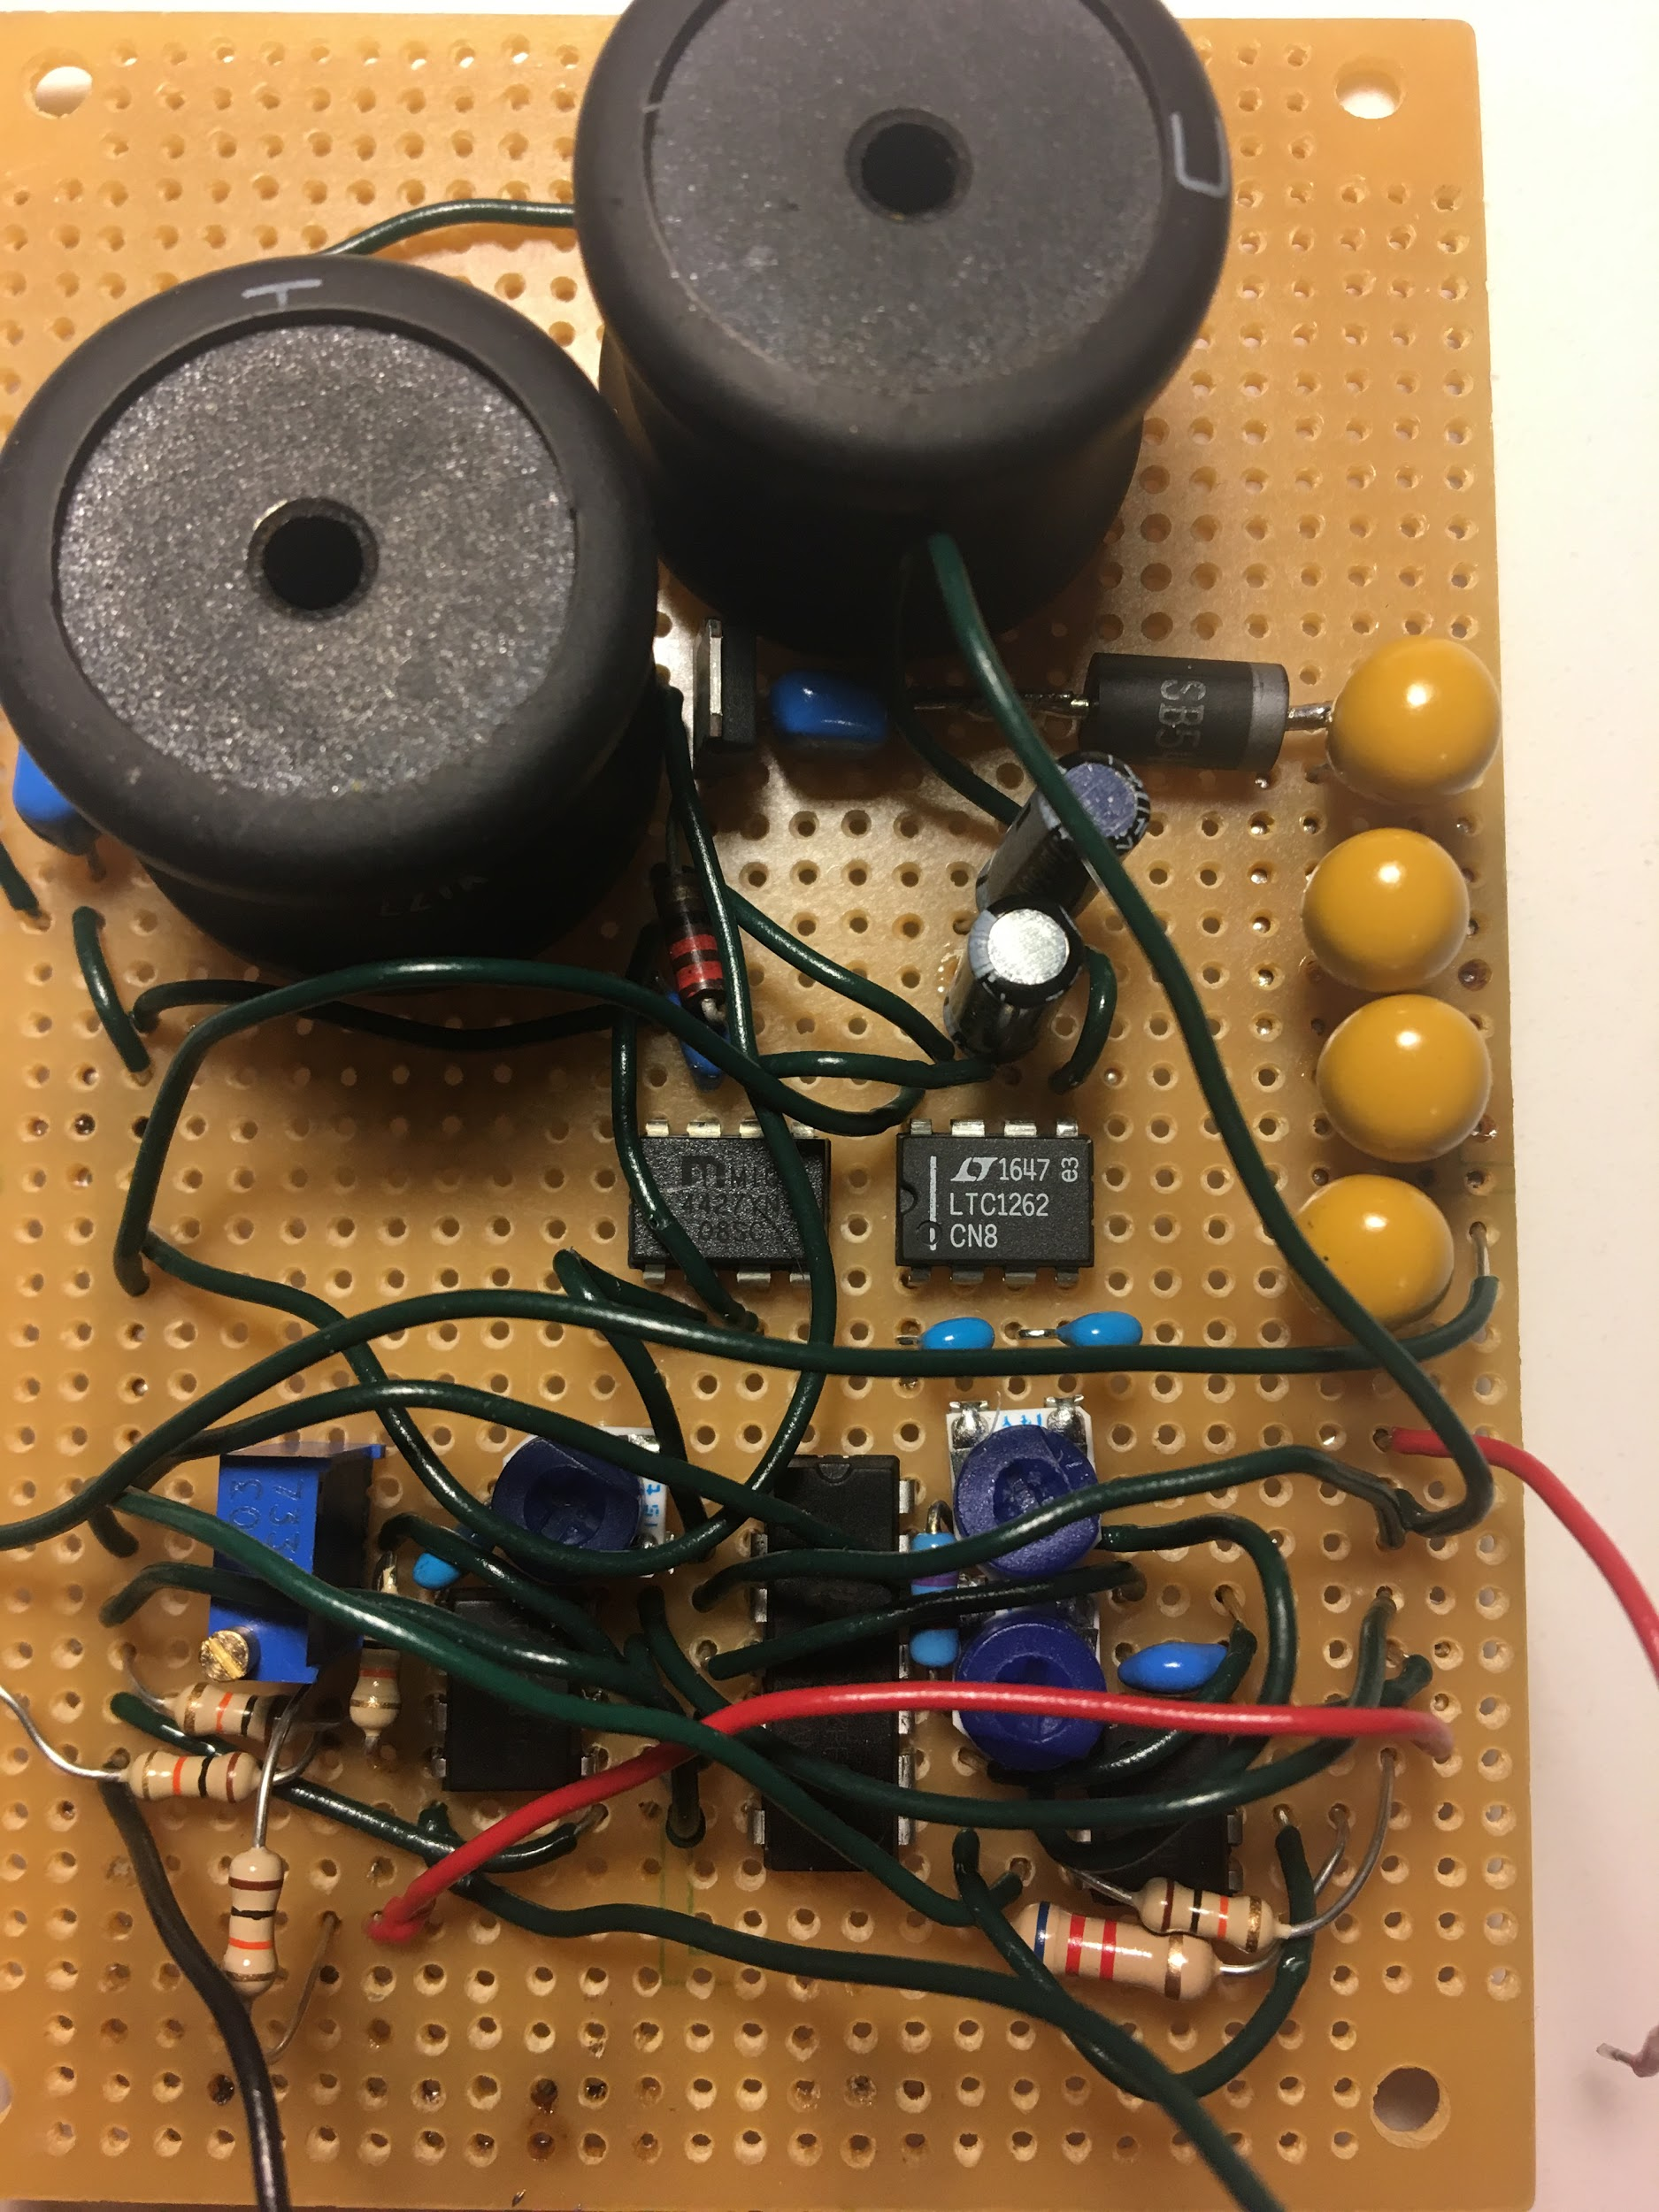
Initial Board
Difficulty debugging
Poor heat dissipation

Slide 23
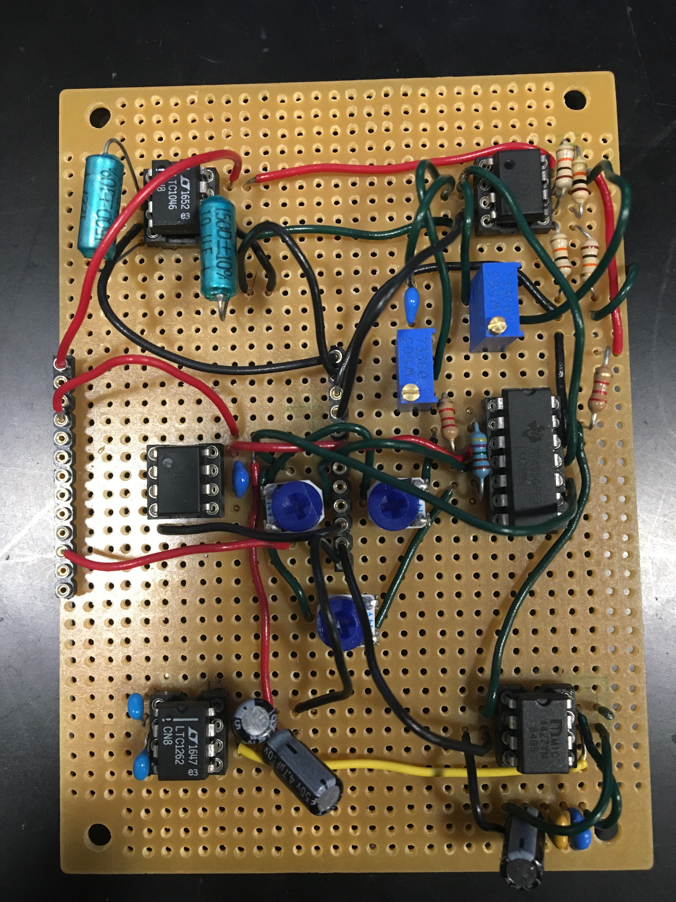
Updated Boards
Easier debugging
Able to unit test to determine problems
Ensures heating elements do not negatively impact all circuits
Notes:
Modular construction!!! Test as we go

Slide 24
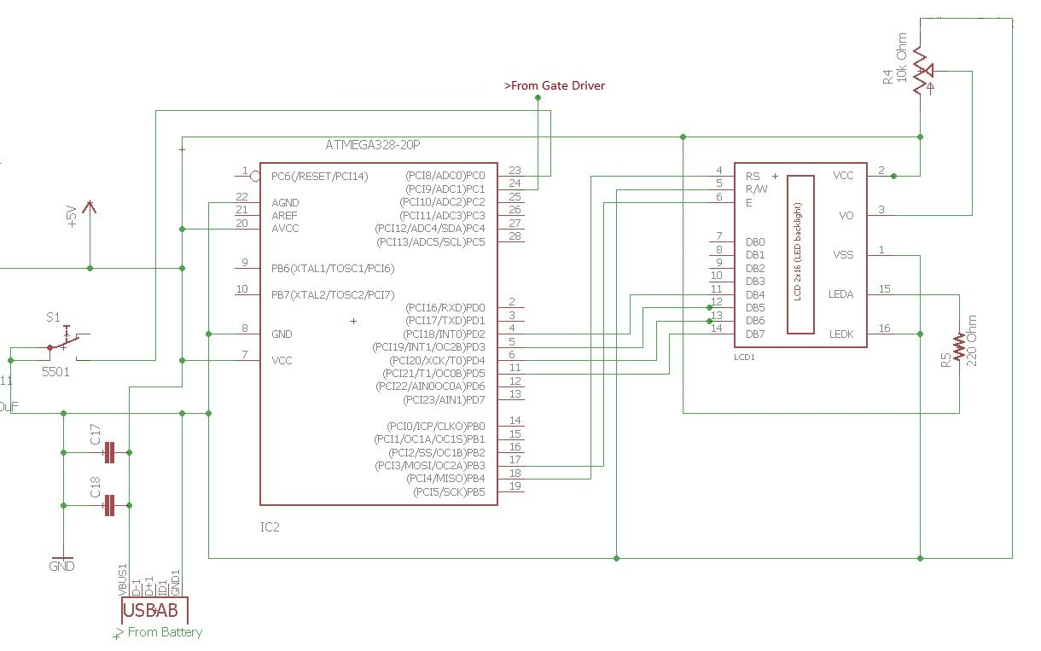
Microcontroller
Changed Microcontroller from
Atmega32 to Atmega32-PU
Used USB 2.0 for 5 V power

Slide 25
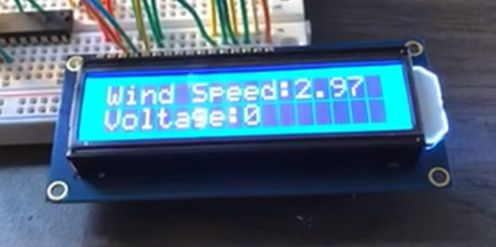
Microcontroller Results
Powered via USB 2.0
Able to read voltage produced from generator
Added a reset button for hardware reset

Slide 26
Ethics and Safety
Potential Risks:
Moving parts
Lithium Polymer Battery
Exposed hazardous circuitry within bottom housing
Heating elements

Slide 27
Conclusions
All parts work individually
Integration of all parts together and fine tuning the wind speed computation
Future work: Mechanical redesign to be smaller and lighter. Also, higher efficiencies with gearbox and electronic adjusted

Slide 28
Questions?

