Slide 1
Health-Care Neckband
Group #65
Jiahao Wen
Jue Gong
TA: John Capozzo

Slide 2
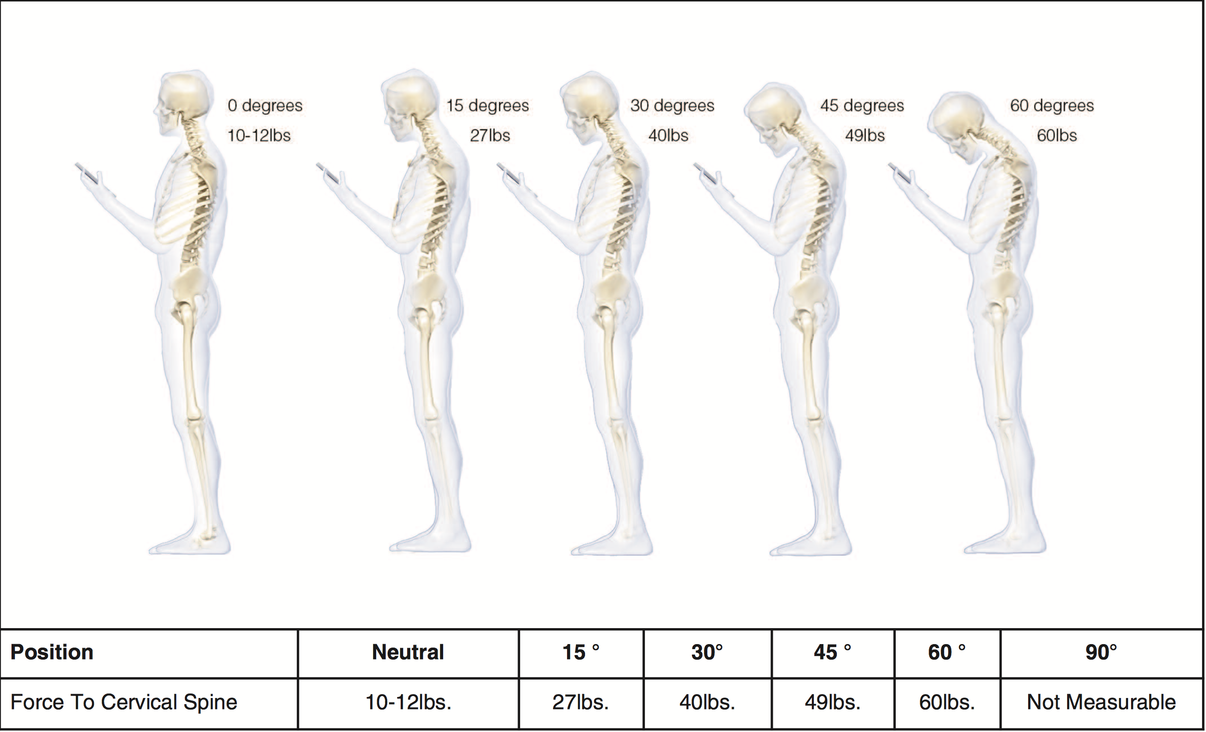
WHAT’S WRONG WITH YOUR NECK?
Cervical spondylosis, also known as neck arthritis, is a common, age-related condition that affects the joints and discs in your neck.
sedentary lifestyle
incorrect posture
overuse of neck muscles

Slide 3
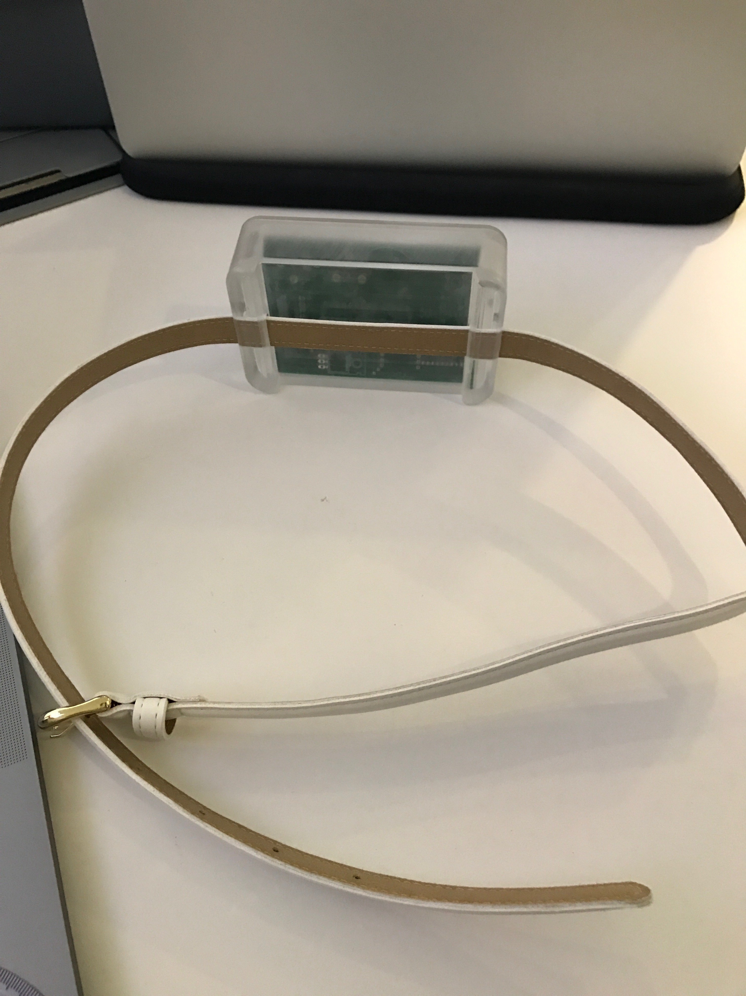
Objective
A wearable device attached to the back of your neck
Keep track of your head posture
Data collected and organized by your smartphone APP (Head tilting angles)
Interactive module to alarm user by vibration when not in healthy posture for a period of time

Slide 4
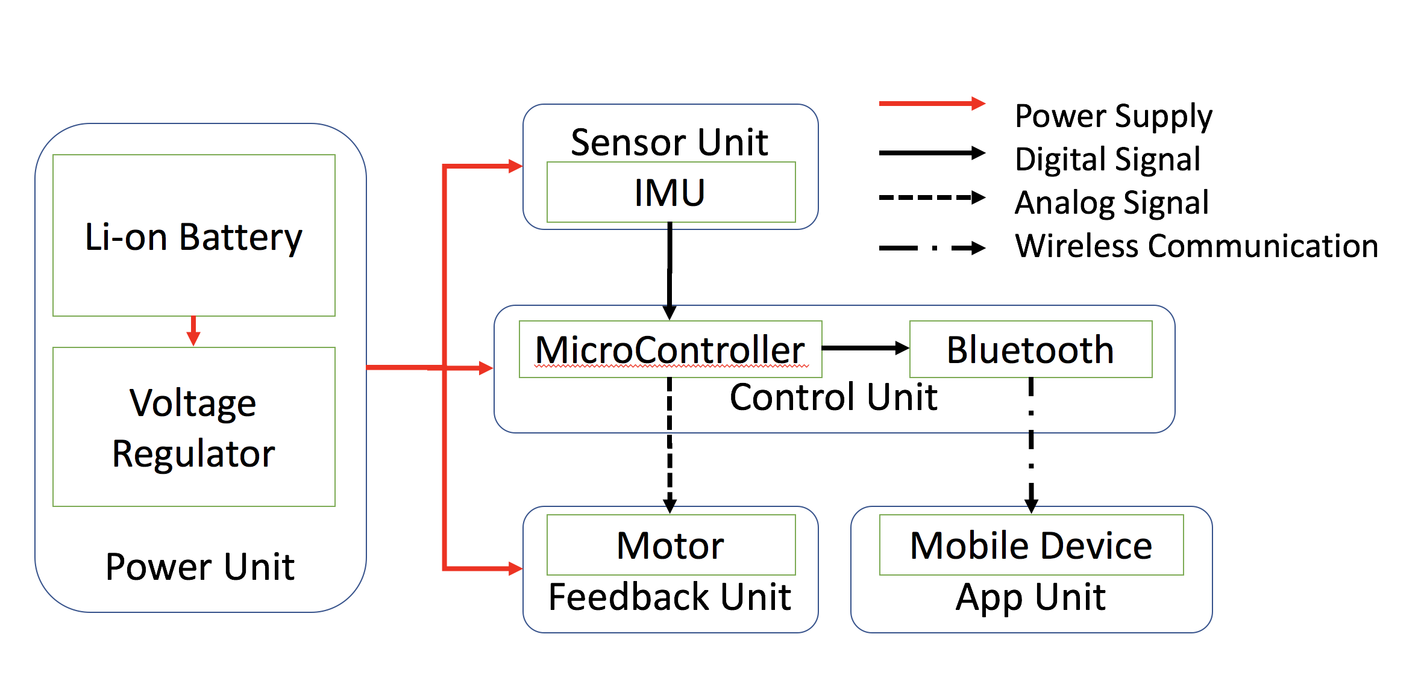
Block diagram

Slide 5
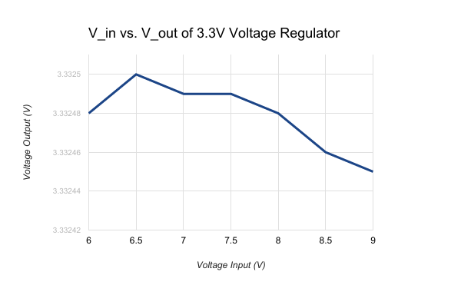
pOwer unit
Two rechargeable 3.7V Lithium-ion battery
Battery sustains the device for over 12 hours
Linear voltage regulator to lower the input voltage to all units to 3.3V
Protection circuit on battery to prevent over-charging and over-discharging

Slide 6
Imu(inertial measurement unit) Breakout
The IMU breakout board integrates the following three sensors
Gyroscope: devices that sense angular velocity
Accelerometer: devices that measure acceleration forces
Magnetometer: instrument that measures magnetism

Slide 7
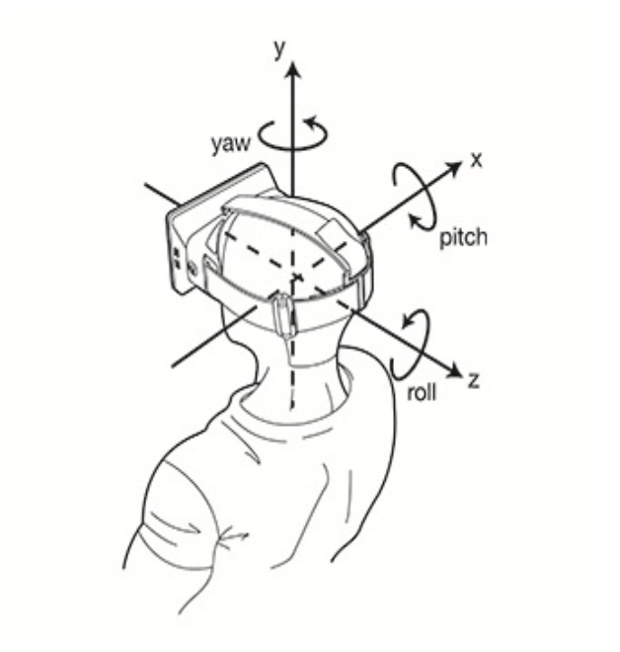
Why imu?
Integrating gyroscope readings creates drift away from the calculated orientation
Sensor fusion corrects for the deficiencies of the gyroscope
Accelerometer corrects drift in the pitch and roll angles
Magnetometer corrects drift in the yaw angle

Slide 8
IMU Requirement and verification
Requirement | Verification
Range of output angle should be 90 degrees in pitch of the IMU; (2) Measure the angle with accuracy of +/- 5 degrees; | Connect an android phone to the neckband. Real angle is measured with a protractor. Place the IMU from 0° to 90° with 10° intervals around the pitch axis. Compare the measured angle from IMU with real angle to see the accuracy.

Slide 9
IMU test result
Real Angle from protractor | 10° | 20° | 30° | 40°
Measured Angle from IMU | 11° | 20° | 31° | 42°
50° | 60° | 70° | 80° | 90°
53° | 64° | 74° | 85° | 85°

Slide 10
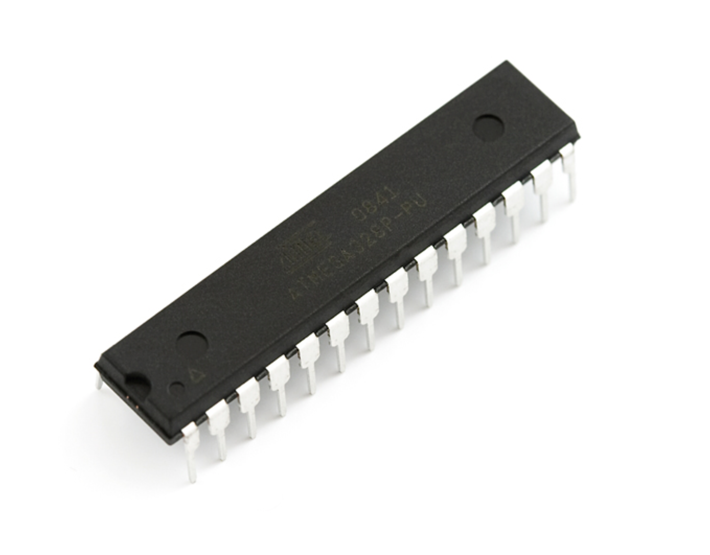
Control unit
Read and process data from IMU
Control feedback unit when necessary
Connect with Bluetooth module to send data to Smartphone APP

Slide 11
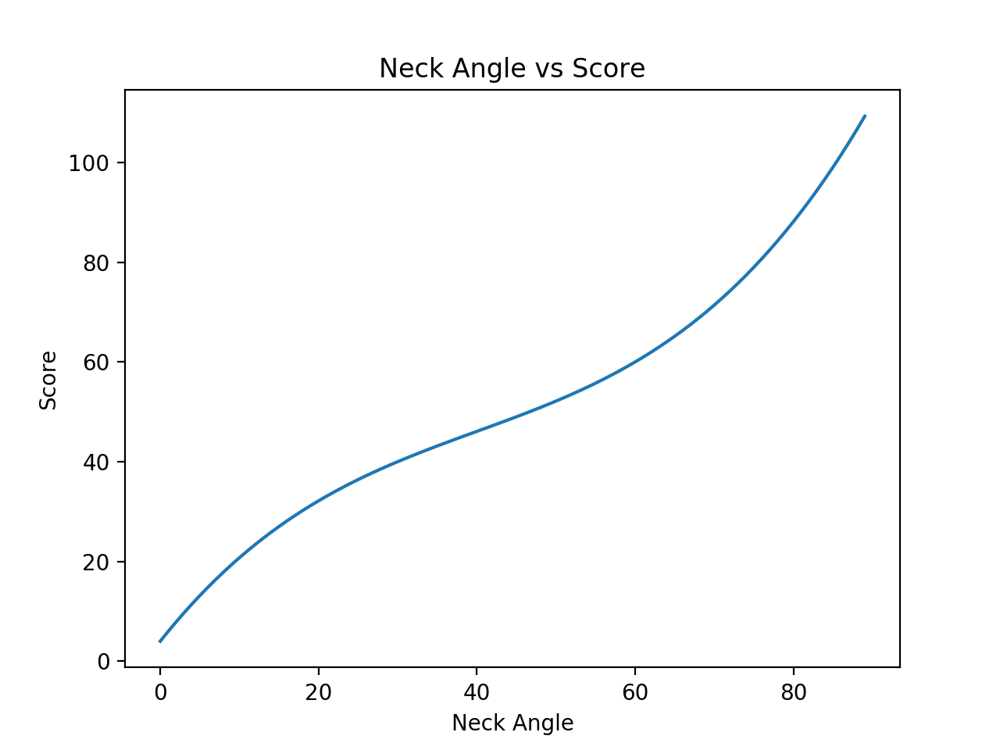
Unhealthy posture
Head posture vs. force to Cervical Spine
Position(degrees) | 15 | 30 | 45 | 60
Force to Cervical Spine(lbs) | 27 | 40 | 49 | 60
Force $=2.962963∗{10}^{−4}∗x^{3}−3.555556∗{10}^{−2}∗x^{2}+2∗x+4$
X as the tilting angle
Score = Force

Slide 12
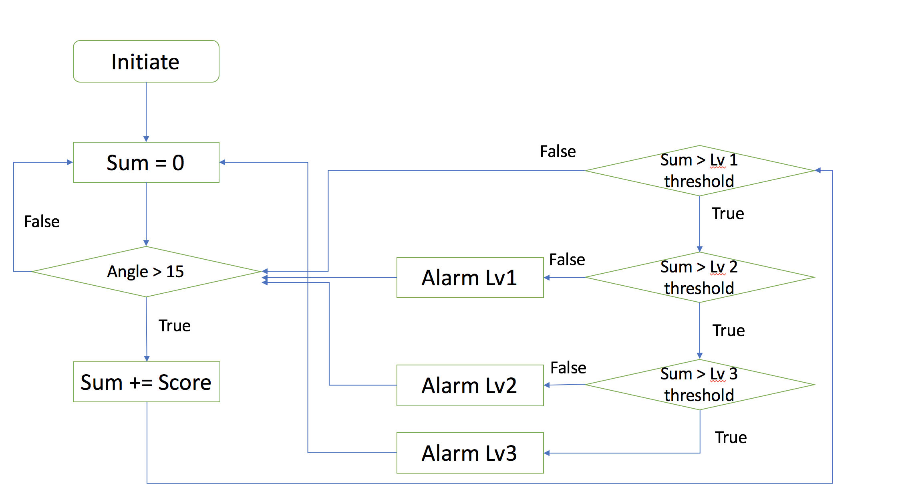
Flow Chart of program on microcontroller

Slide 13
Error analysis
Real Angle from protractor/time to first alarm | 10°/N/A | 20°/1007s | 30°/810s | 40°/703s
Measured Angle from IMU/time to first alarm | 11° /N/A | 20°/1007s | 31°/797s | 42°/686s
50°/621s | 60°/540s | 70°/454s | 80°/368s | 90°/289s
53°/597s | 64°/506s | 74°/419s | 85°/327s | 85°/327s

Slide 14
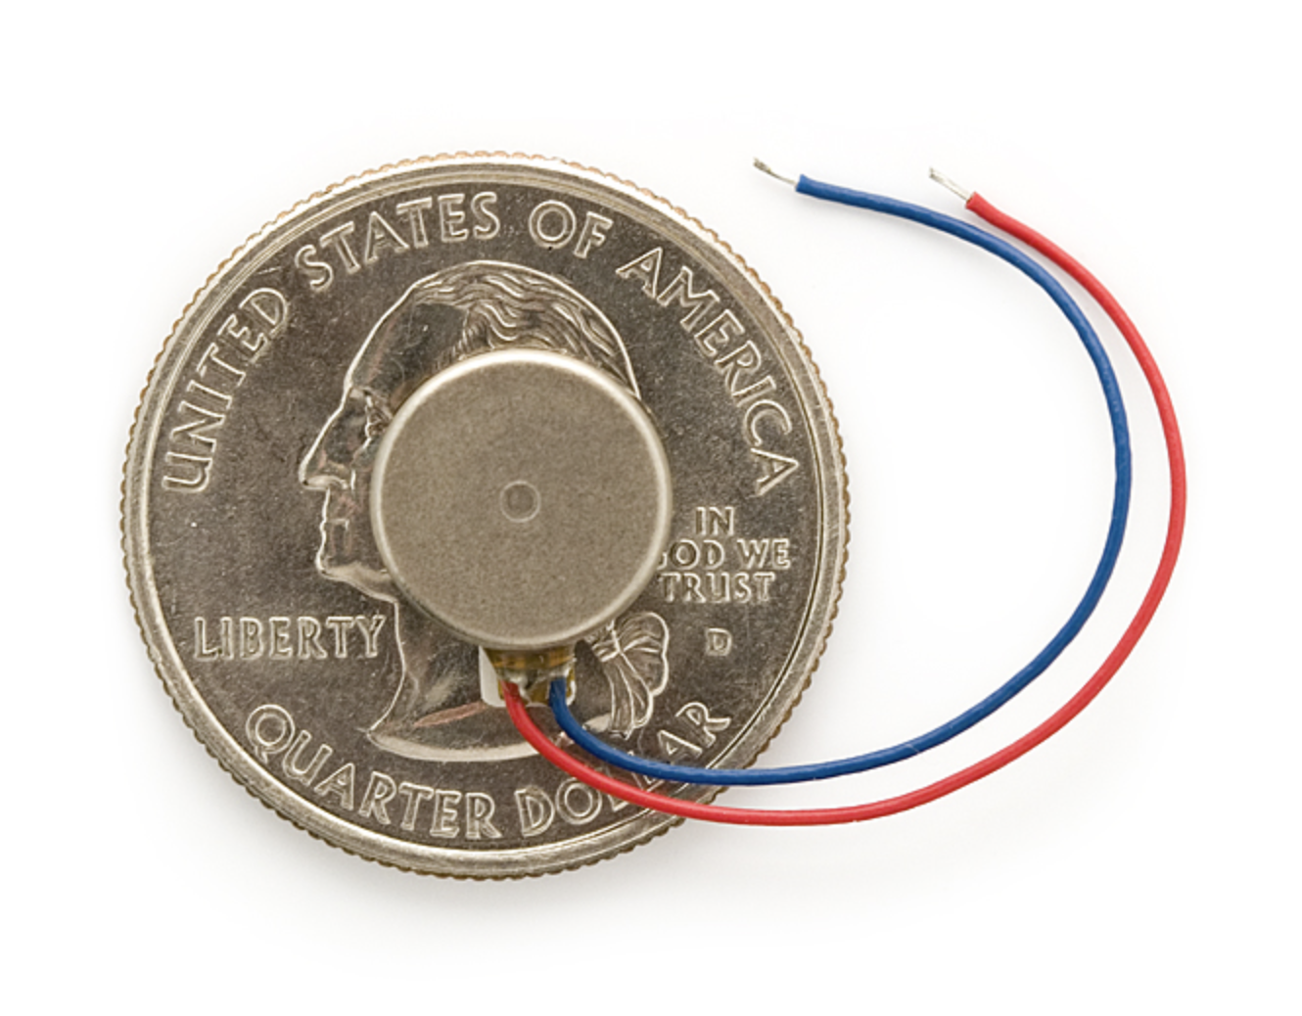
Feedback UNIT
Small vibration motor of 10mm diameter
Shakes crazily at 3.3V
Can output three different vibration intensity depending on user’s posture
Use PWM(pulse width modulation) to control the intensity

Slide 15
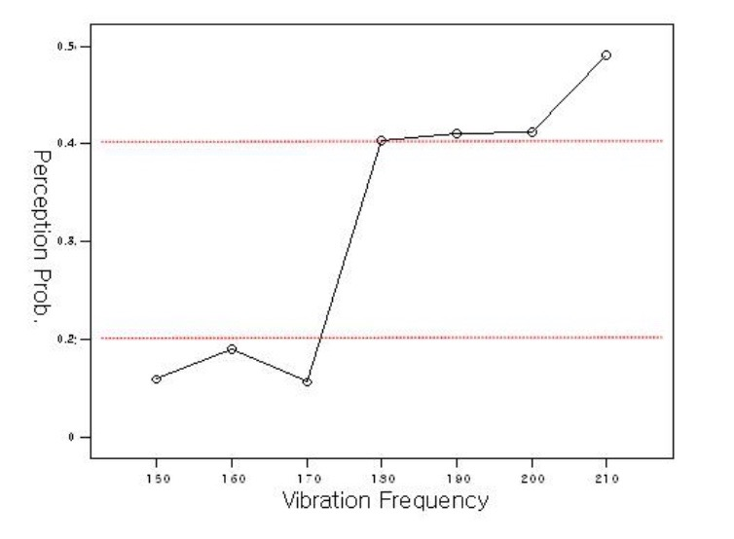
Human perception of vibration

Slide 16
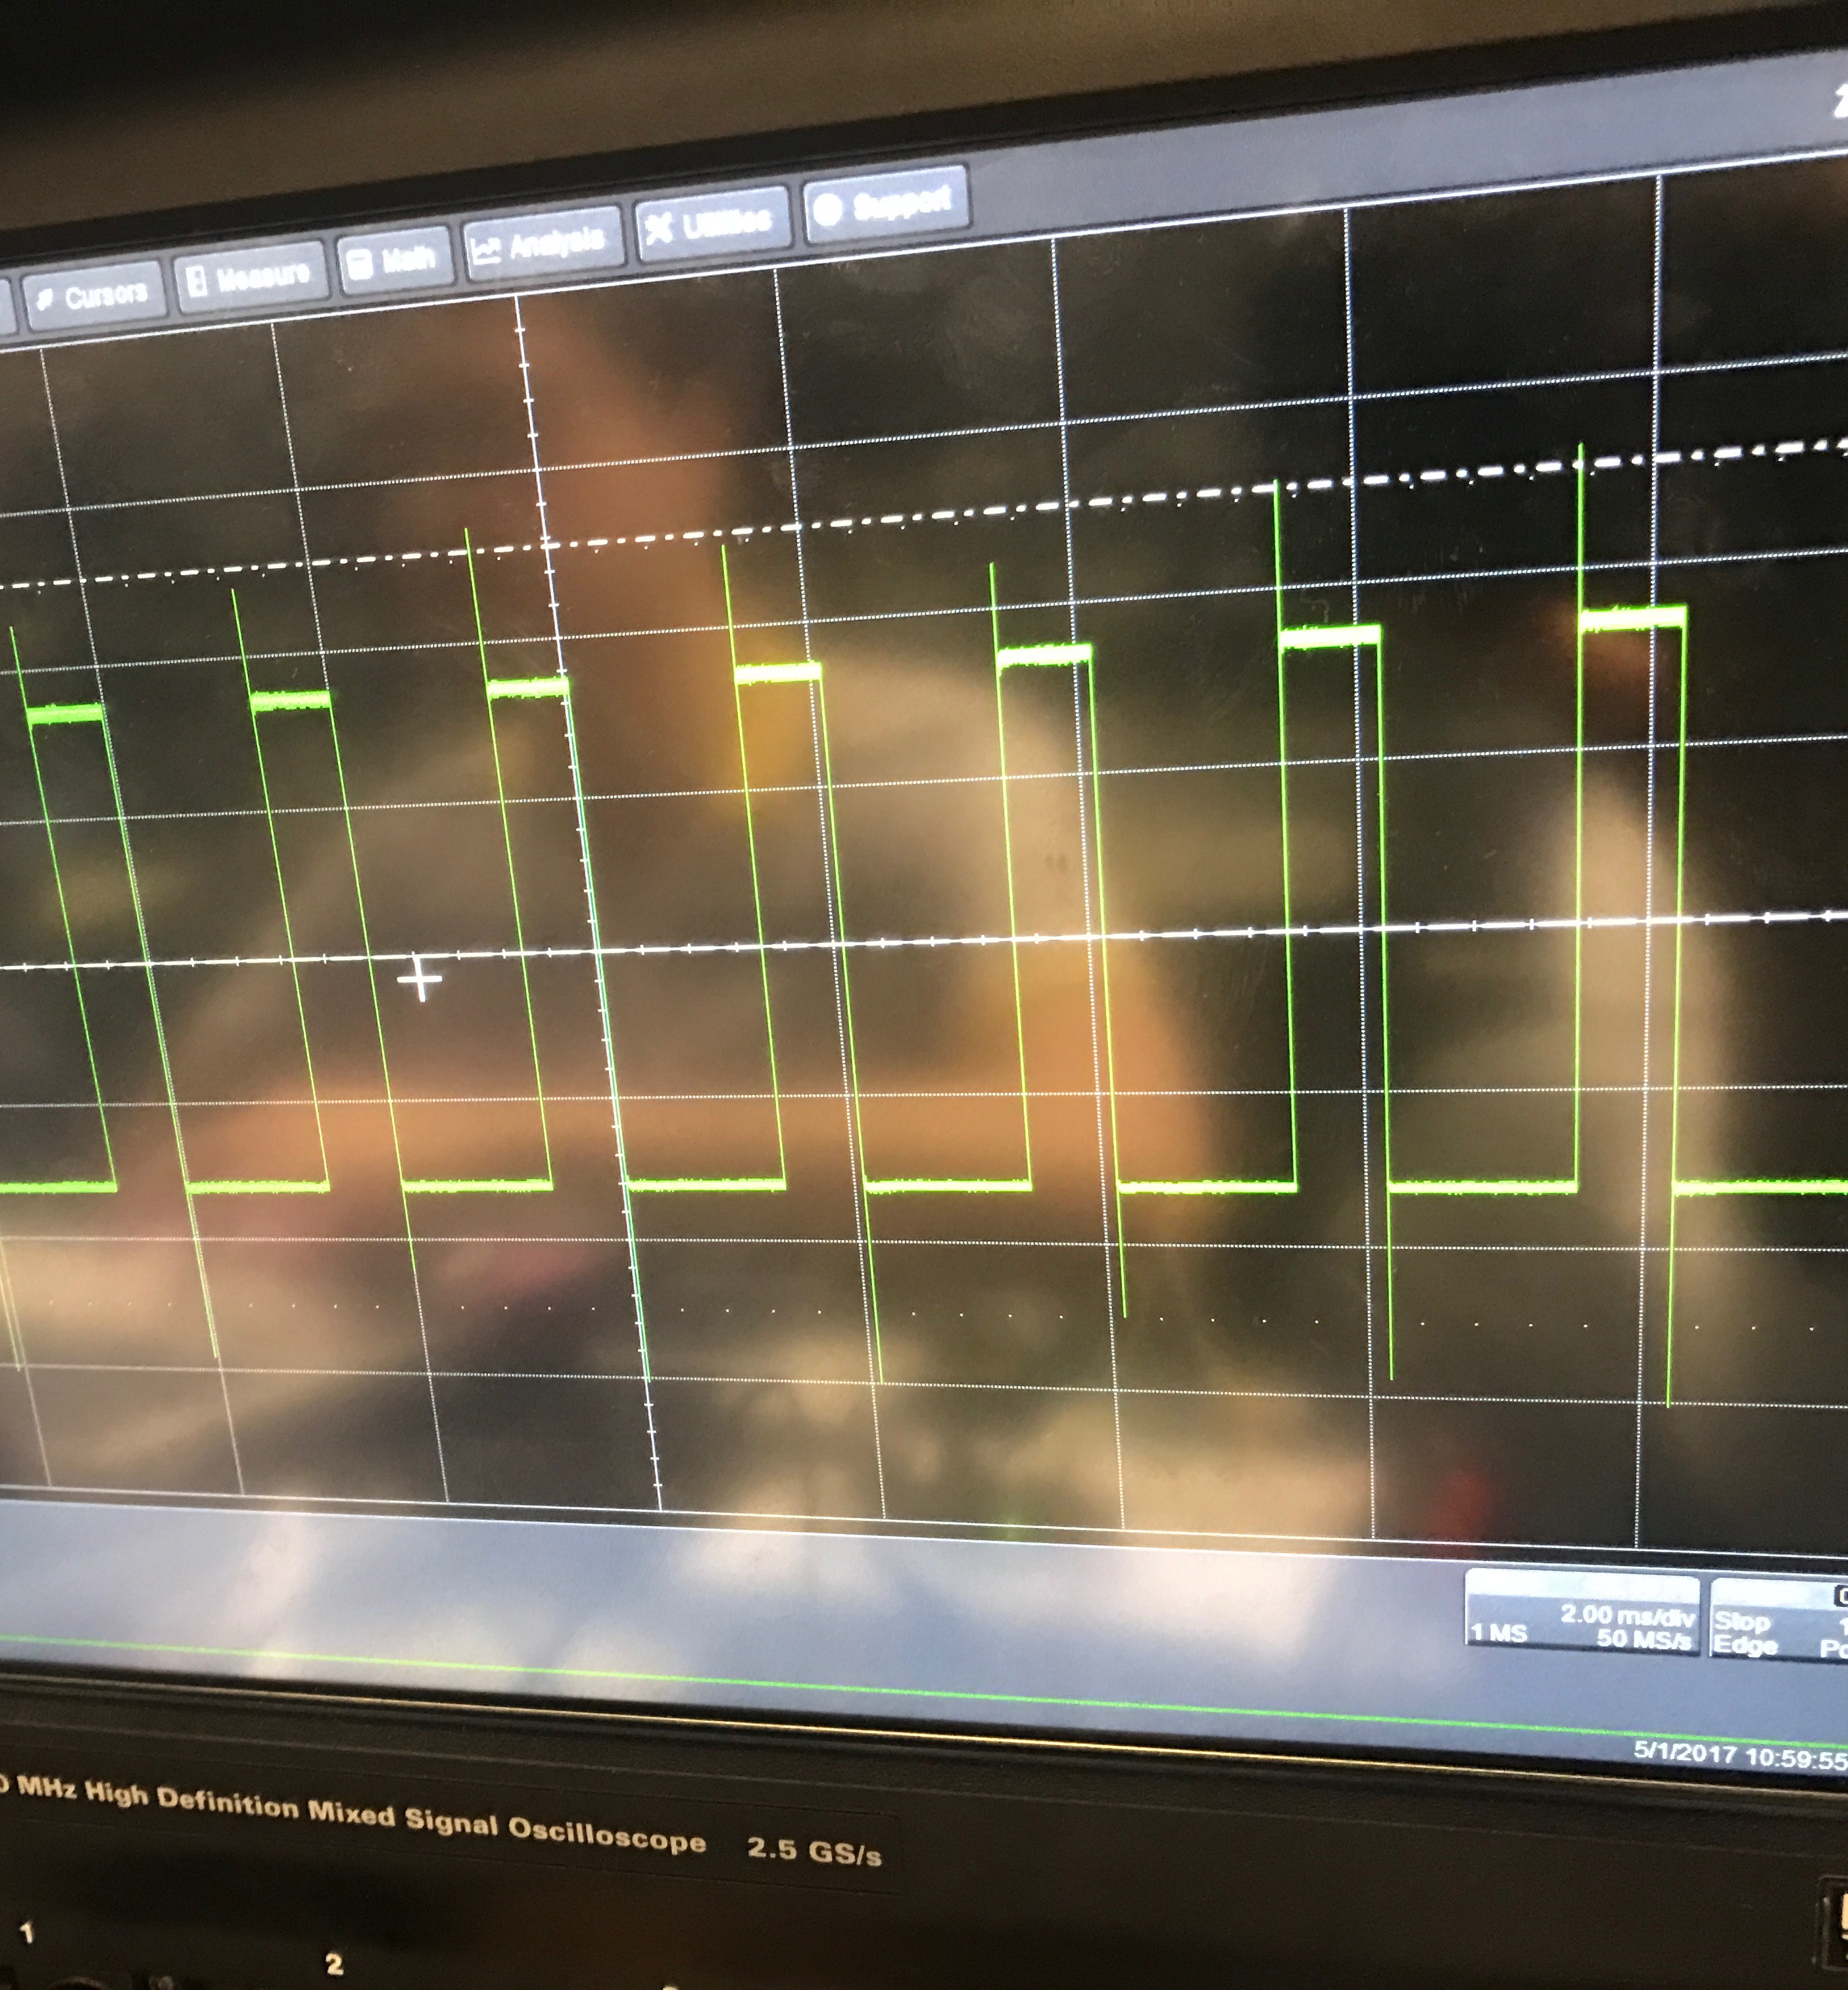
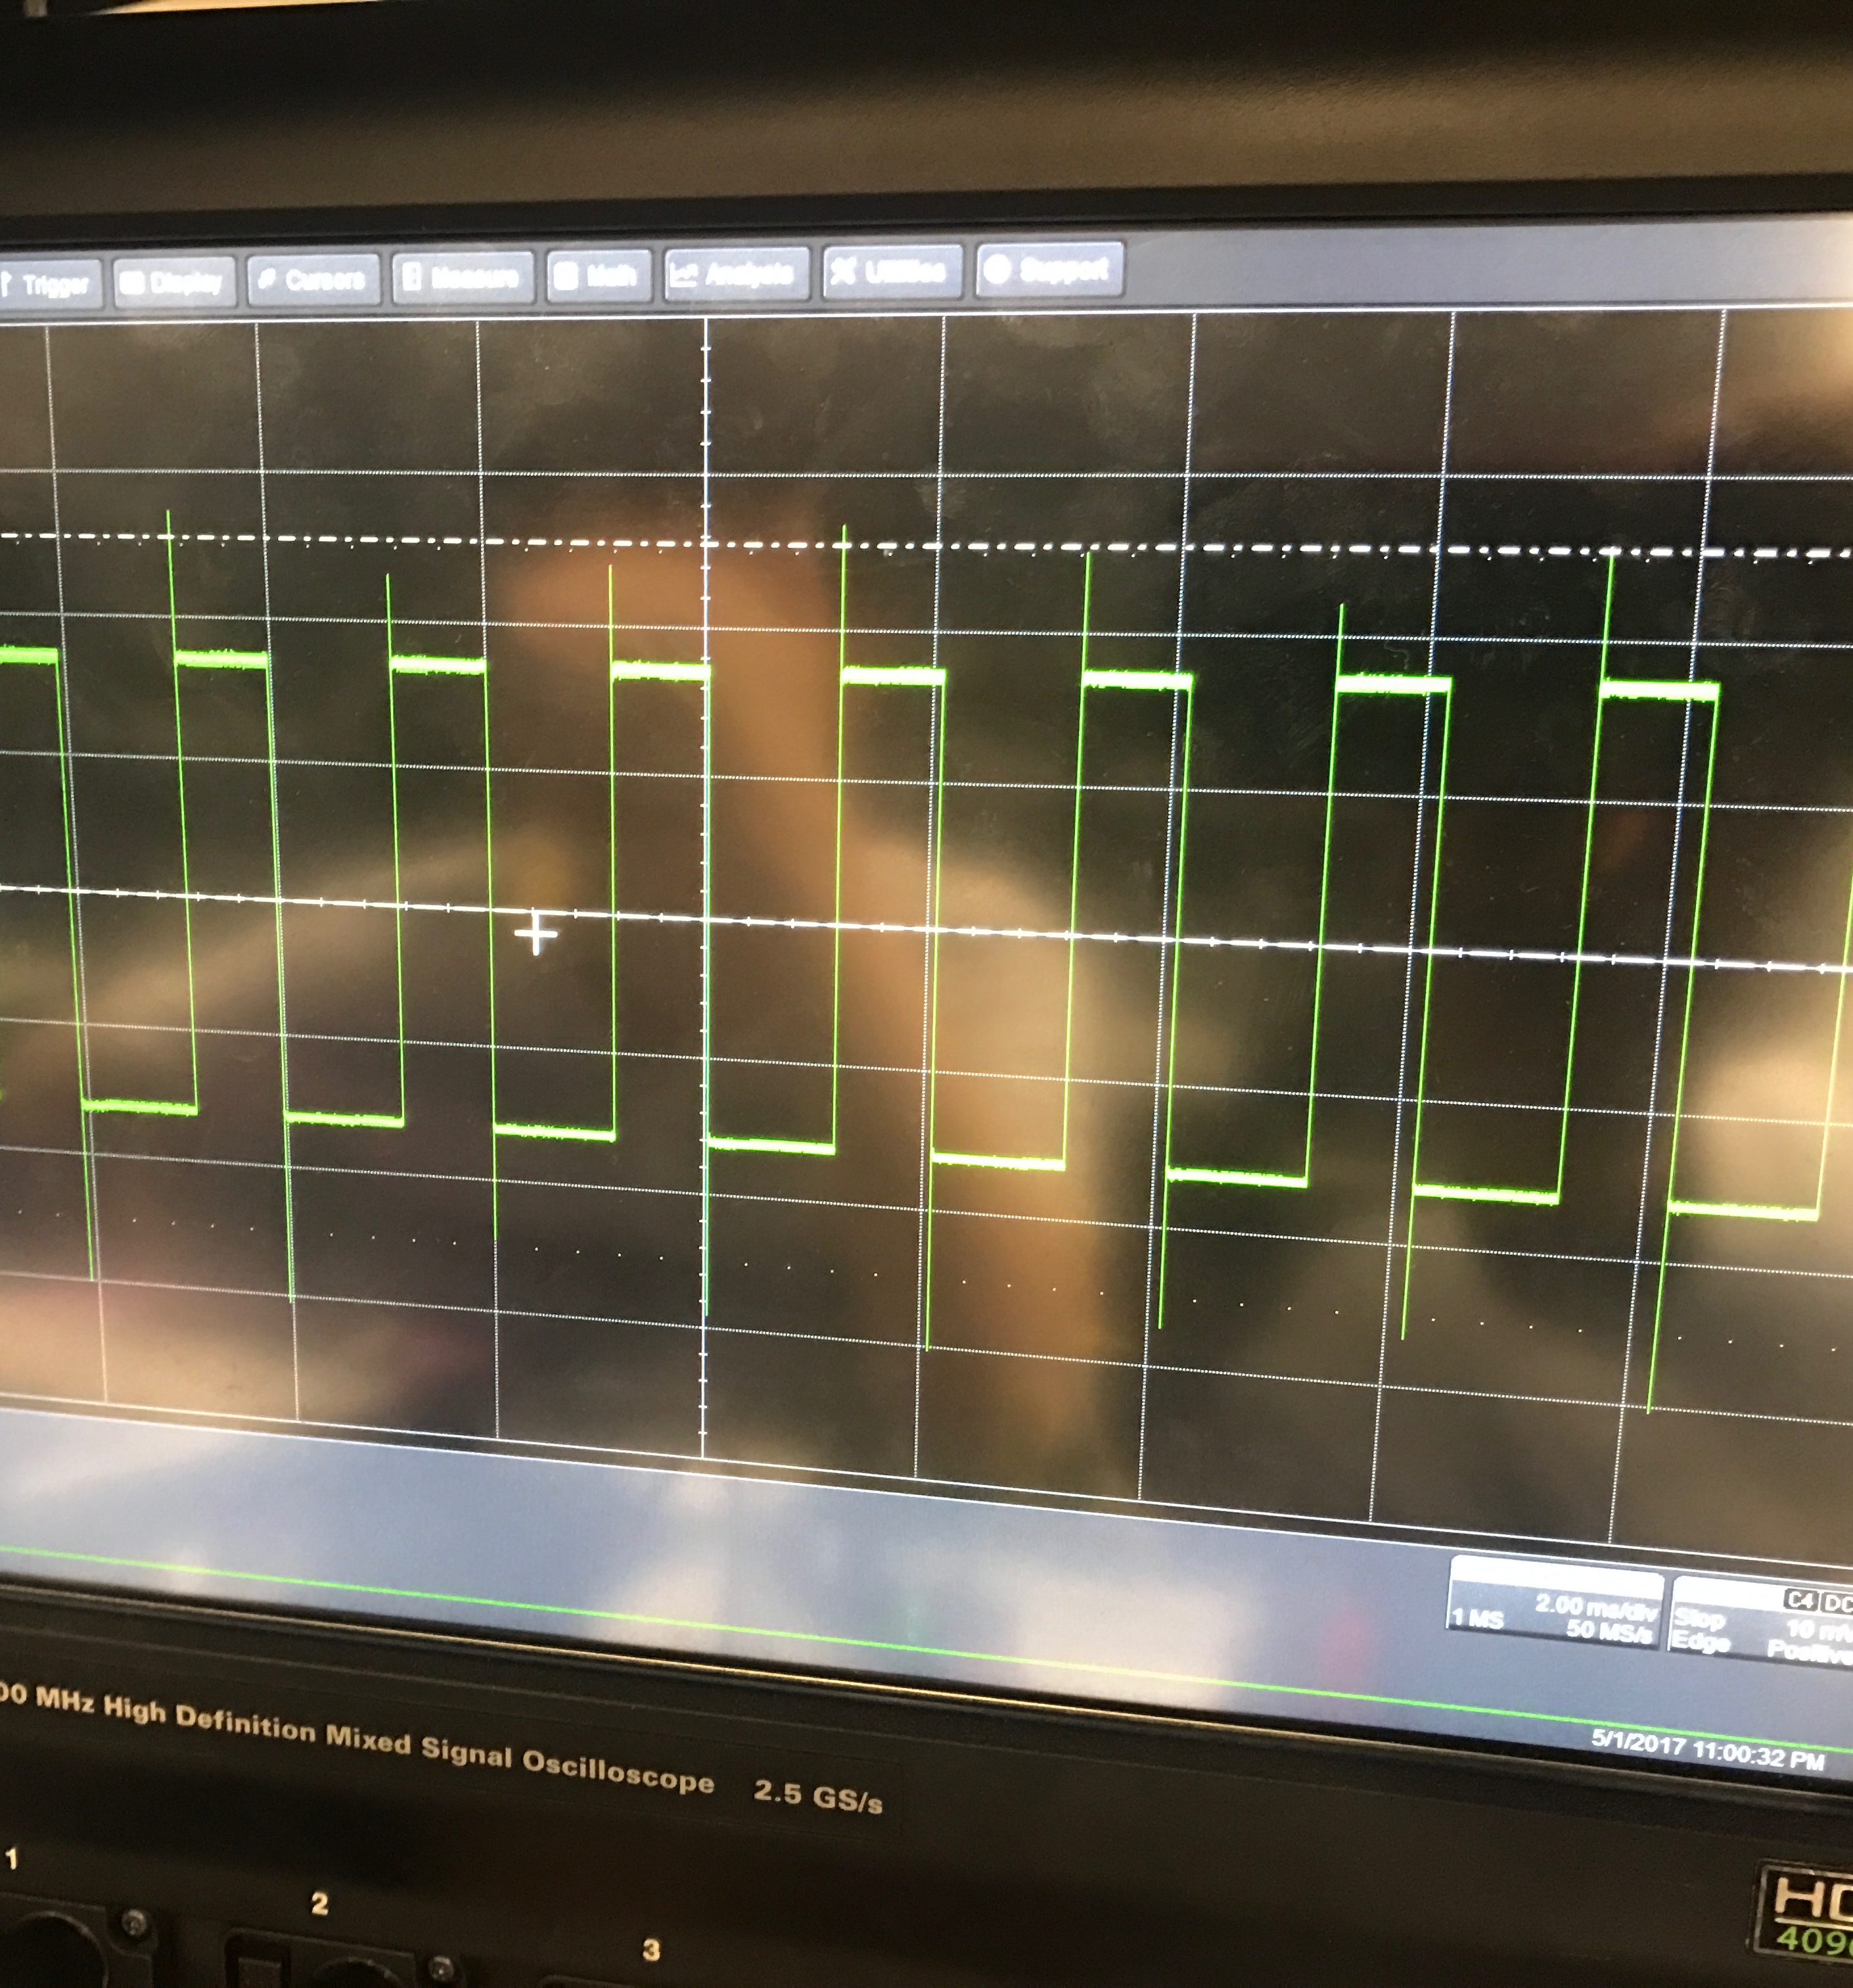
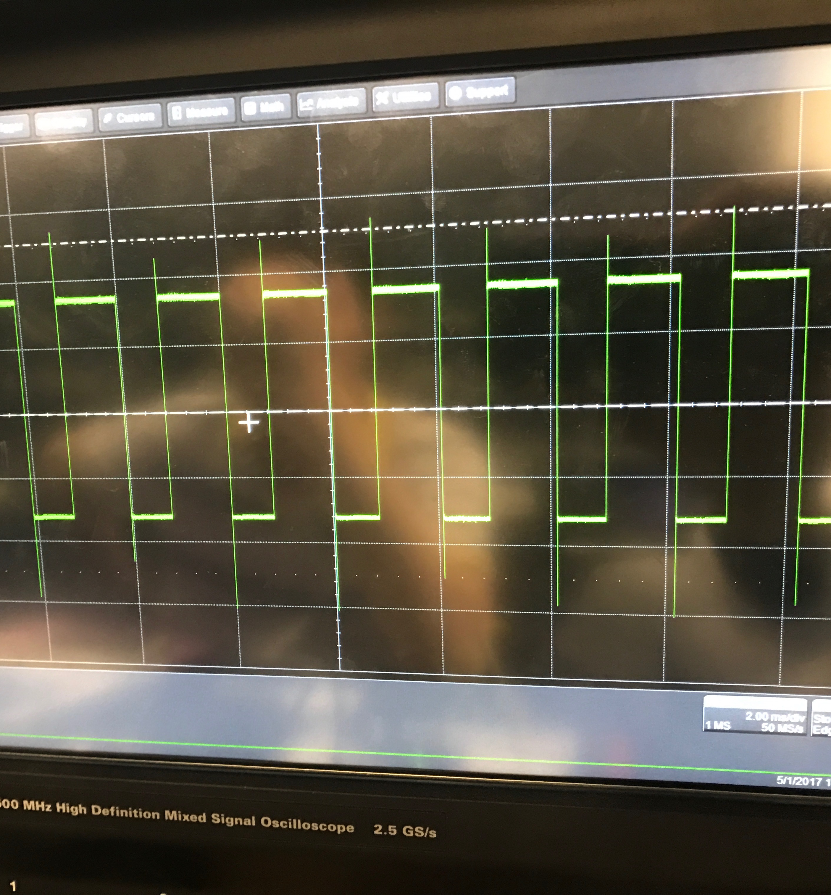
PWM Testing

Slide 17
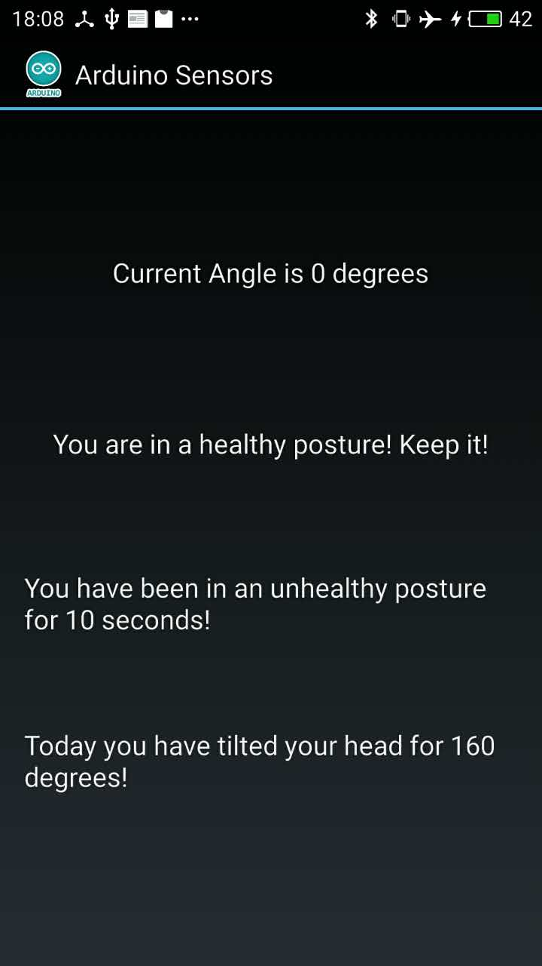
Smartphone APP
Communicate with the Bluetooth module
Show whether user is in healthy posture
Record length of time in unhealthy posture during a day
Record total degree tilted during a day
Future work:
Interactive smartphone game controlled by neck movement
More details and functionality in user interface

Slide 18
Conclusions and further work
IMU tested and verified
Integrate IMU with Microcontroller
Integrate Microcontroller with Bluetooth module and vibration motor
Smartphone APP built and tested
Power unit tested and added
Integrate whole circuit on PCB
Further work:
Reduce the size of physical design and make it more user-friendly
Improve and add more functionality to the smartphone APP

Slide 19
Questions?

