Slide 1
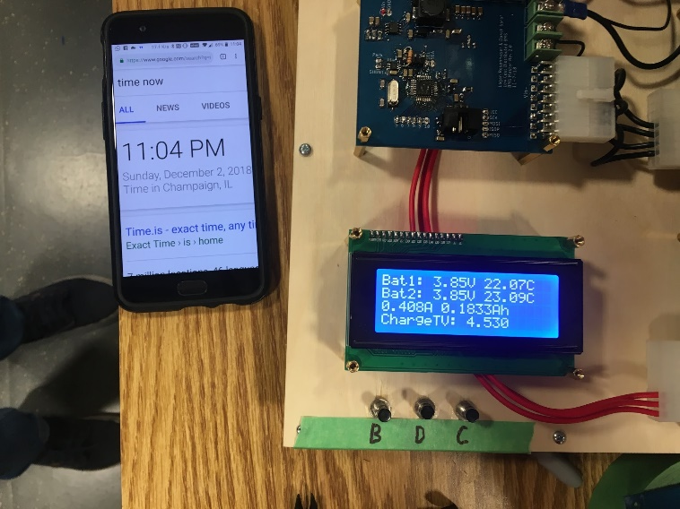
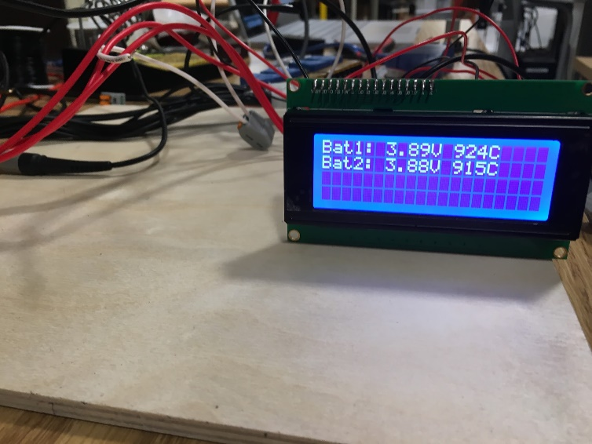
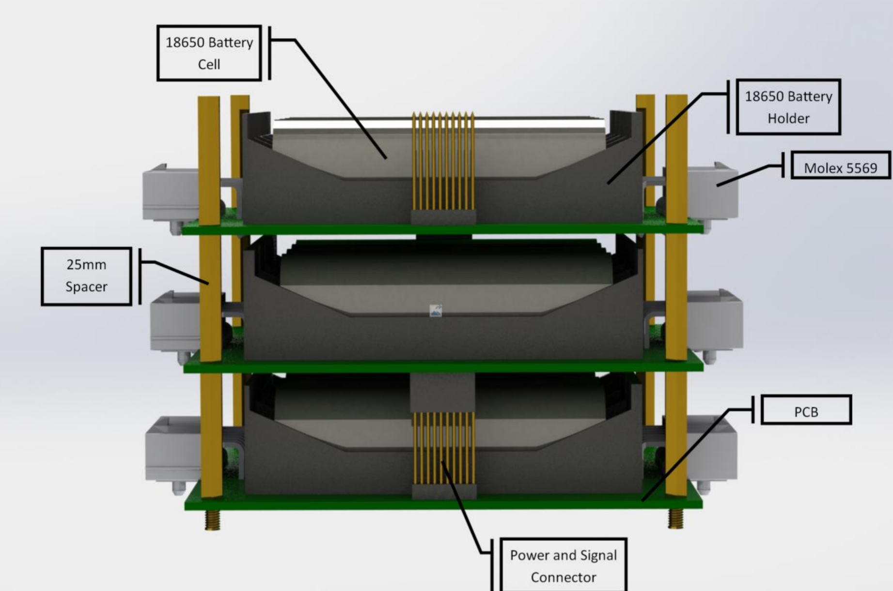
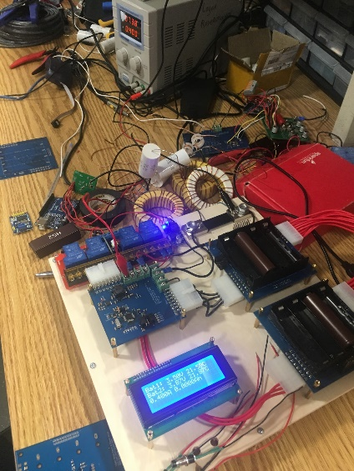
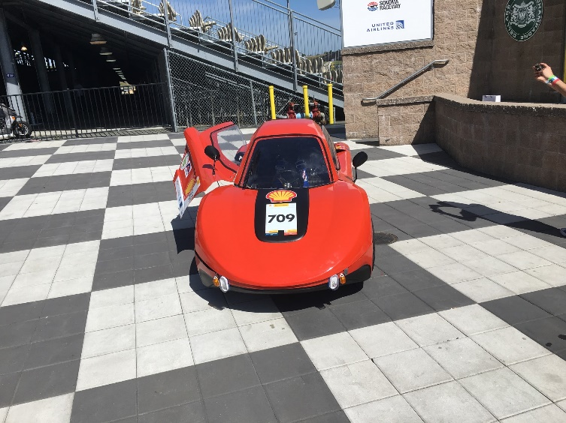
Low Cost Distributed Battery Management System
Logan Rosenmayer and Daksh Saraf
Team 1

Slide 2
Project Overview
Keep lithium ion cells in safe operating range
System must give user feedback on state of batteries
Temperature
Voltage
State of charge (SOC)
Previous Car Team BMS

Slide 3
Car Team
Race High Efficiency Vehicles
Car built and designed by UIUC students
Flexible
Low cost
Small learning curve
Current BMS
100mV error
Monolithic
UIUC Car (Front Middle)

Slide 4
Objectives
Balance cells to within 50mV of target
Total system bidirectional communication
BMS can prevent cells spec violations

Slide 5
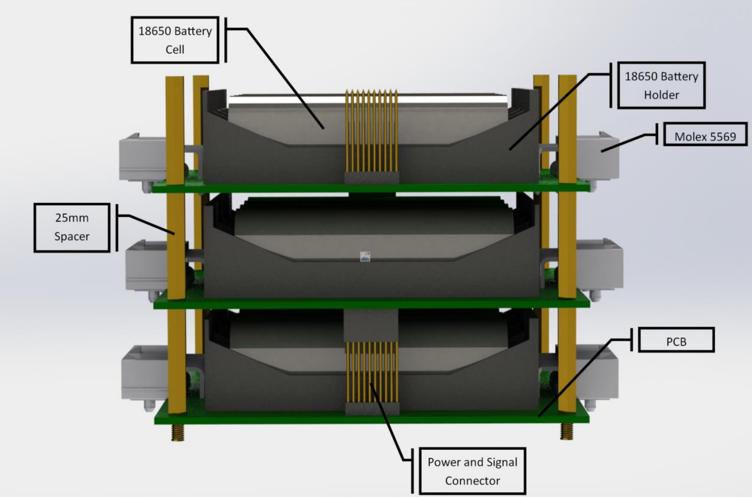
High Level Design
For UIUC Electric Vehicle car teams
Easy to Reconfigure
Keep battery cells in user specified operating regions
Low cost
Slave Stack Render

Slide 6
Distributed BMS vs Monolithic BMS
Distributed BMS | Monolithic BMS
High Cost | Low Cost
High Flexibility | Low Flexibility
Low Wire Count | High Wire Count
Easy to Reconfigure | Hard to Reconfigure
Simple Setup | Complex Setup

Slide 7
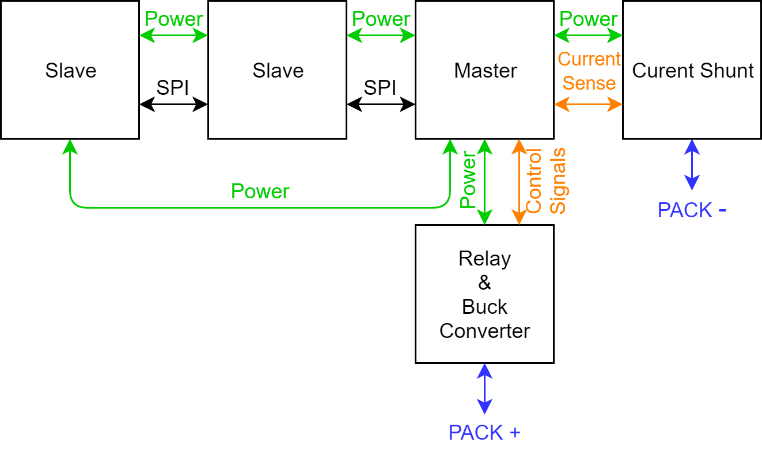
System Block Diagram

Slide 8
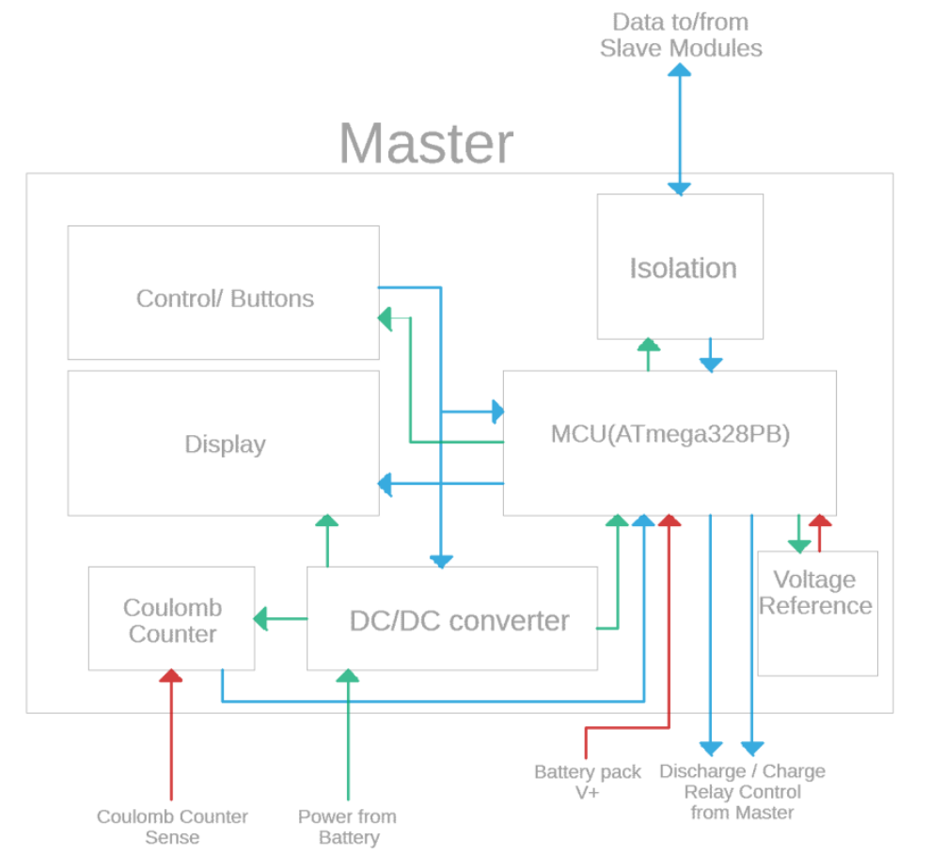
Master Module Design
UI: Buttons and LCD
DC/DC converter for flexible input voltage
Isolation for communication
Coulomb Counter for SOC tracking
Master Block Diagram

Slide 9
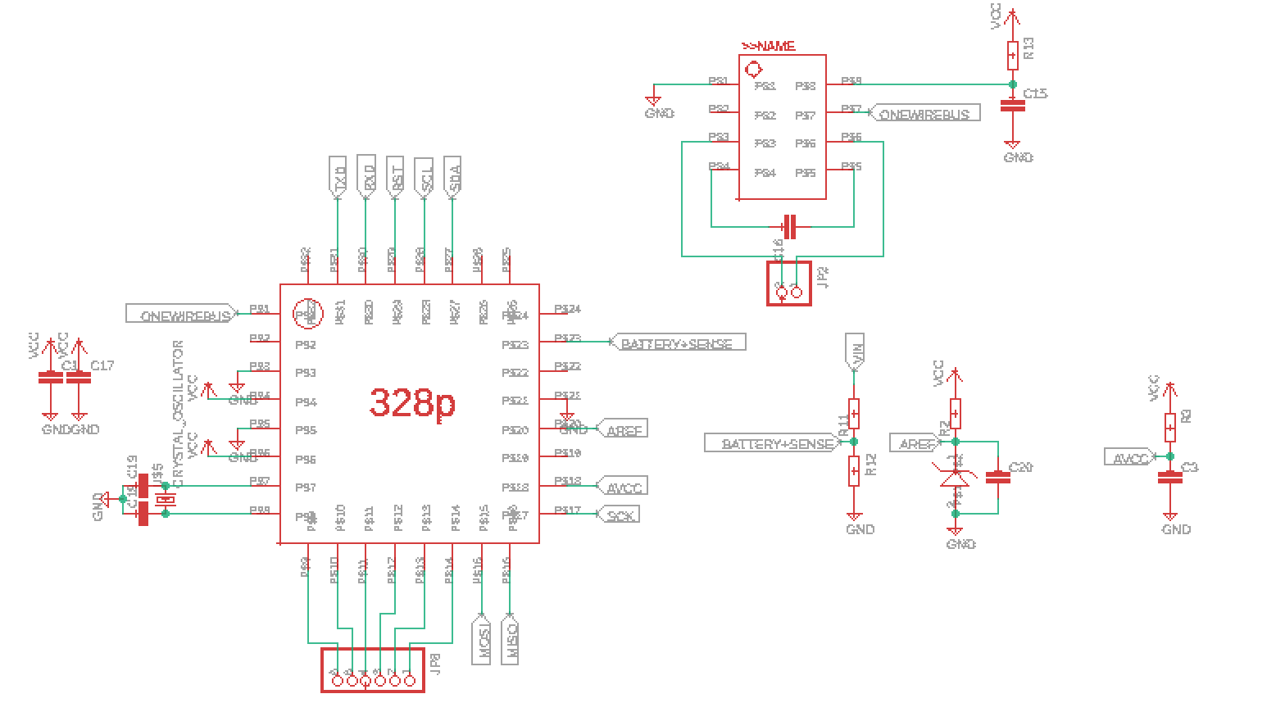
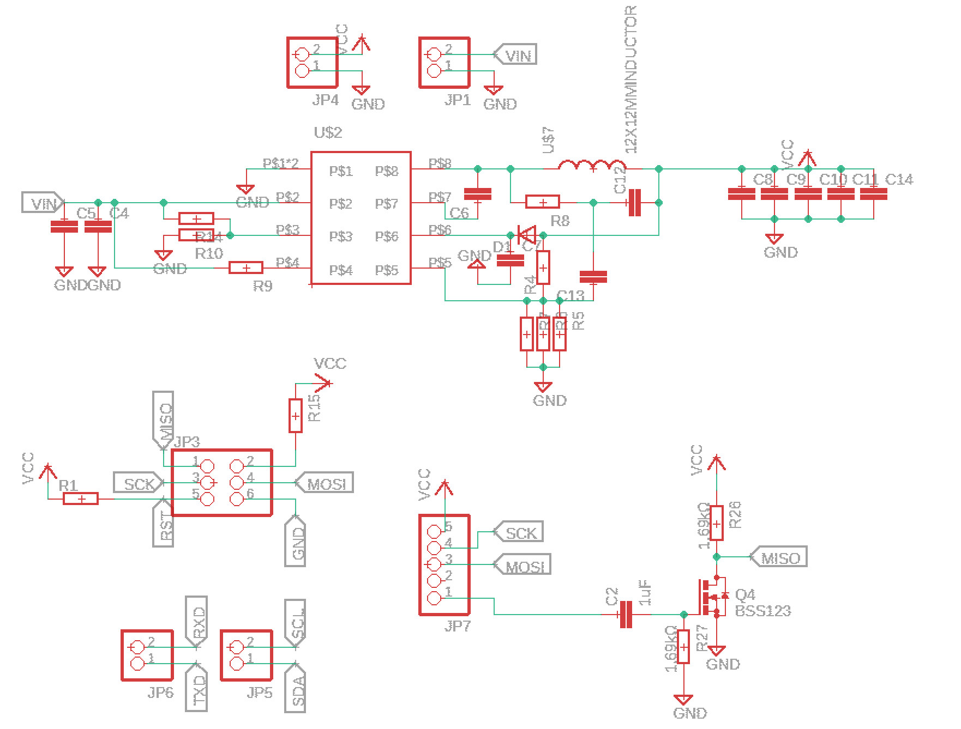
Master Module Schematic

Slide 10
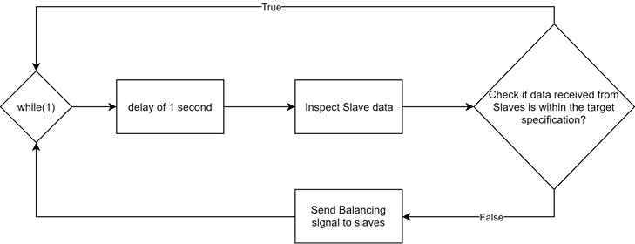
Master Software Flowchart

Slide 11
Master Module Requirements
Easy to interface UI
Relay control
Send balance commands
Track Battery SOC
Bidirectional Communication

Slide 12
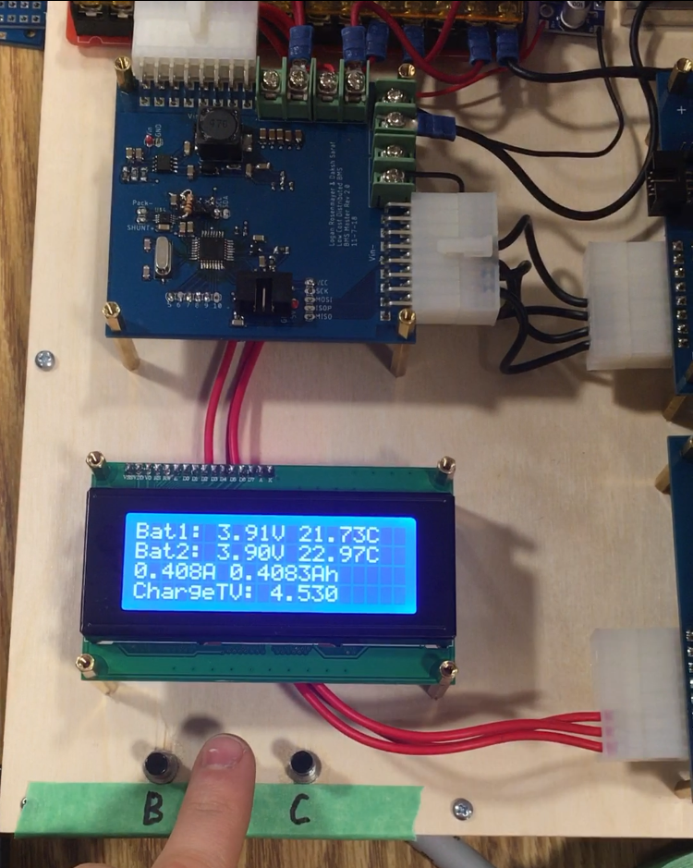
Master Verification
Display data
Control relays with UI
Balance battery pack
Charged battery with current source
Master UI

Slide 13
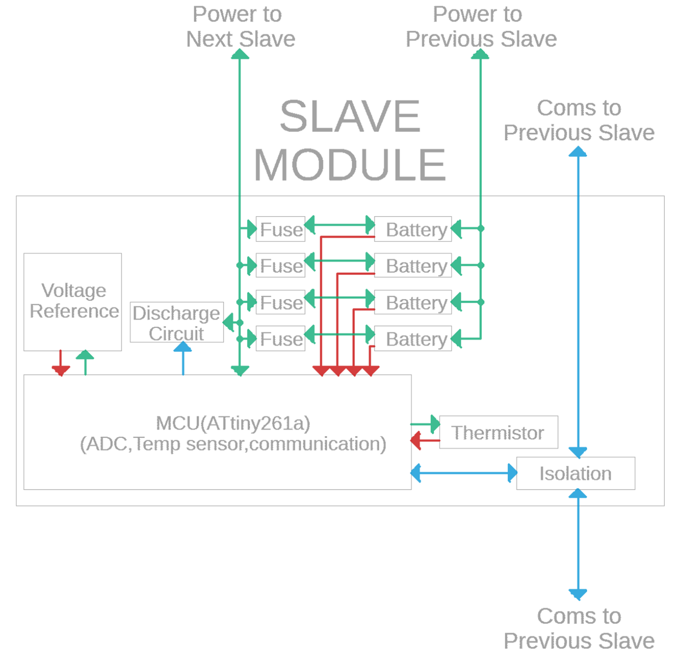
Slave Module Design
High precision voltage reference
Thermistor for temperature
Fusing for short protection
Isolation for communication
Slave Block Diagram

Slide 14
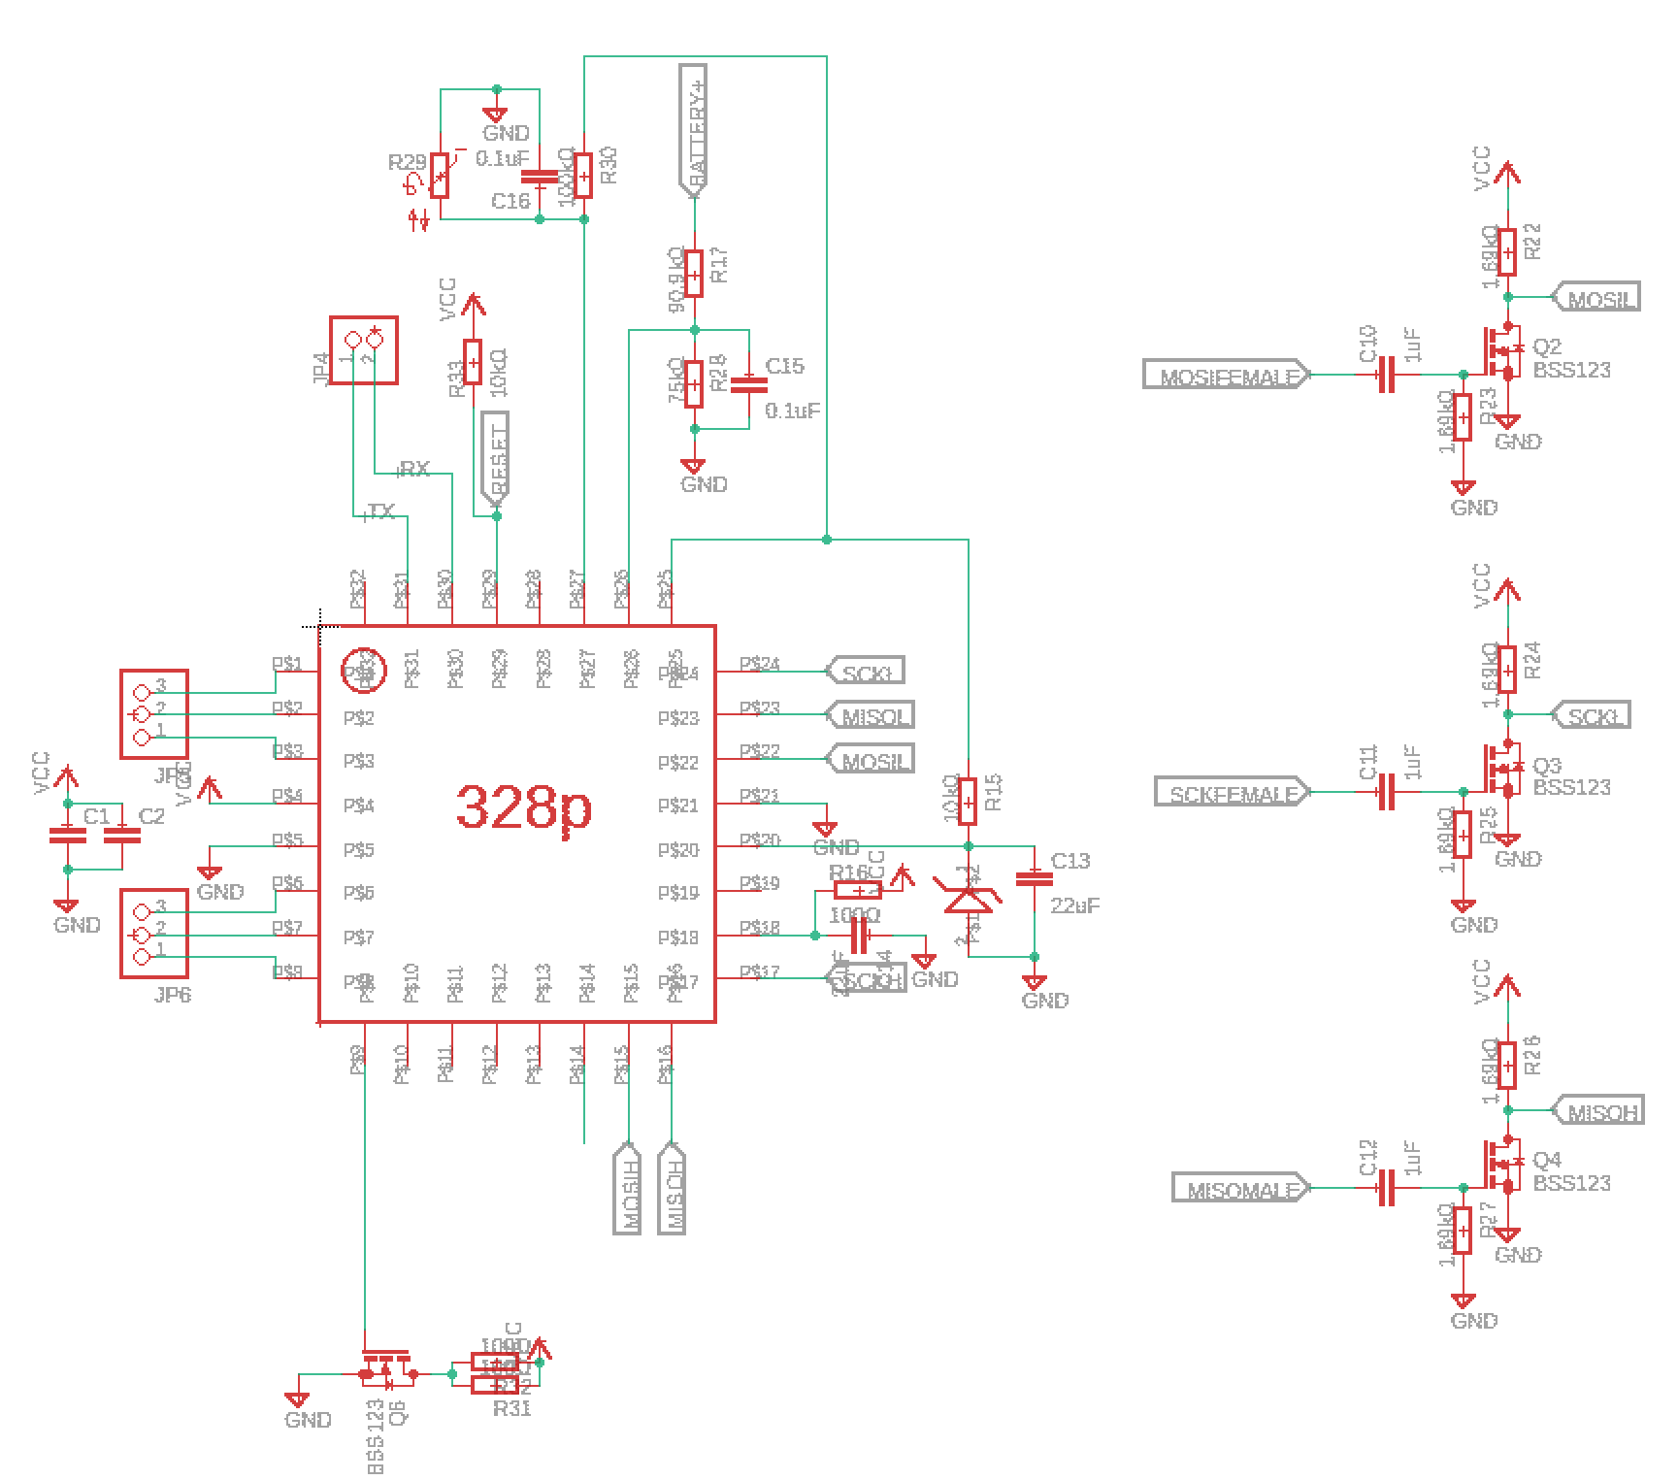
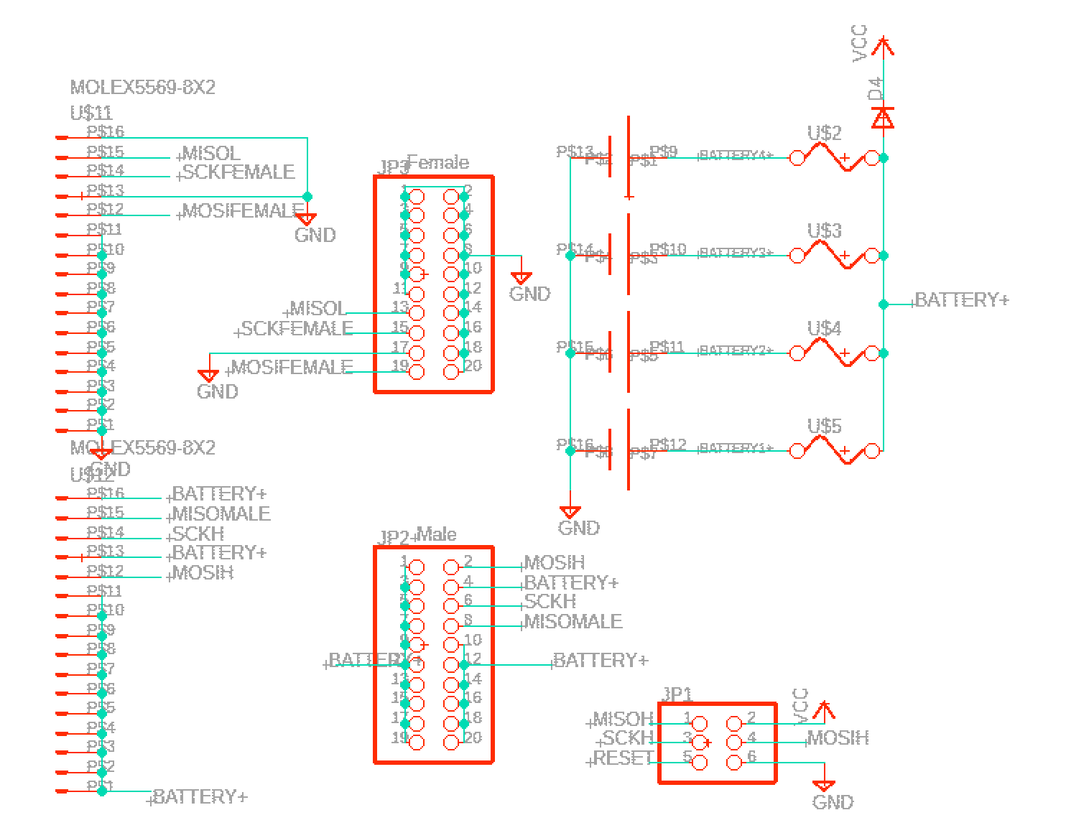
Slave Schematic

Slide 15
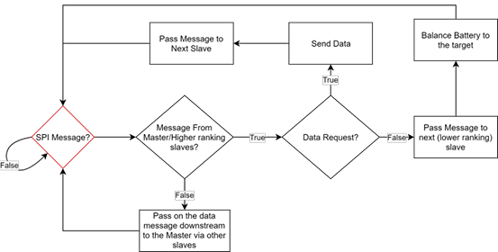
Slave Software Flowchart

Slide 16
Slave Module Requirements
Gather data
Measure pack temperature
Measure pack voltage
Safety
Protect from over current at cell level
Send data
Relay messages

Slide 17
Slave Verification
Voltage Reading [V] | Actual Voltage [V]
4.20 | 4.20
4.10 | 4.10
3.90 | 3.90
3.78 | 3.80
3.70 | 3.70
3.60 | 3.60
3.50 | 3.50
3.40 | 3.40
3.29 | 3.30
3.20 | 3.20
3.10 | 3.10
2.99 | 3.00
Battery readings within 5mV
Temperature reading
Measured: 71.6F
Actual: 72F
Over current protection
Short prevent
Battery Voltage Readings

Slide 18
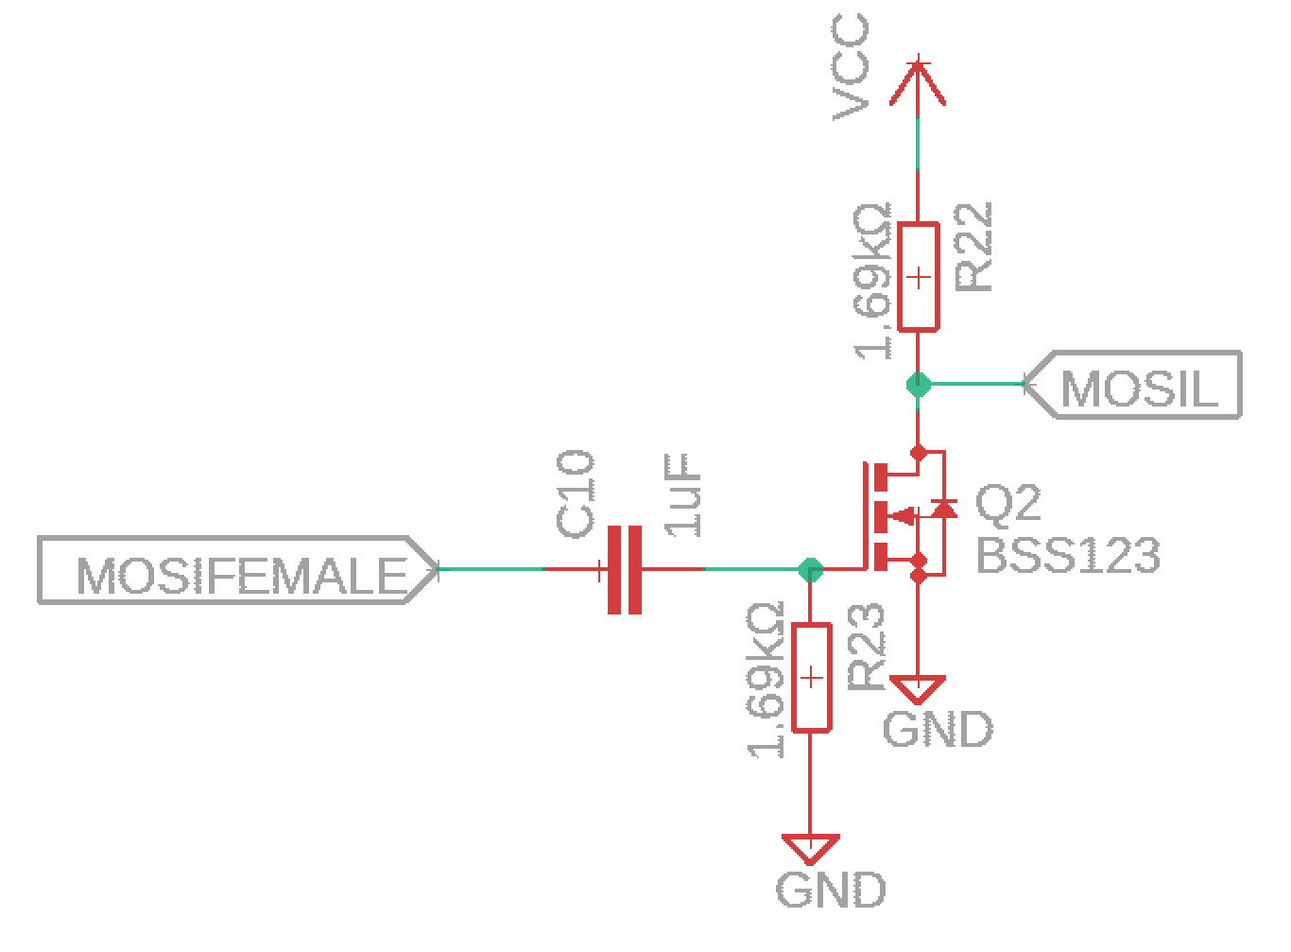
Isolation
Removes DC offset
Acts as level shifter
Low quiescent power
Isolation Circuit

Slide 19
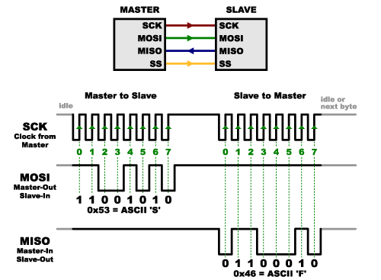
SPI
3 wire communication interface
Master controlled CLK (SCK)
Uni-directional data wires
Master Out Slave In (MOSI)
Master In Slave Out (MISO)
Basic SPI Communication

Slide 20
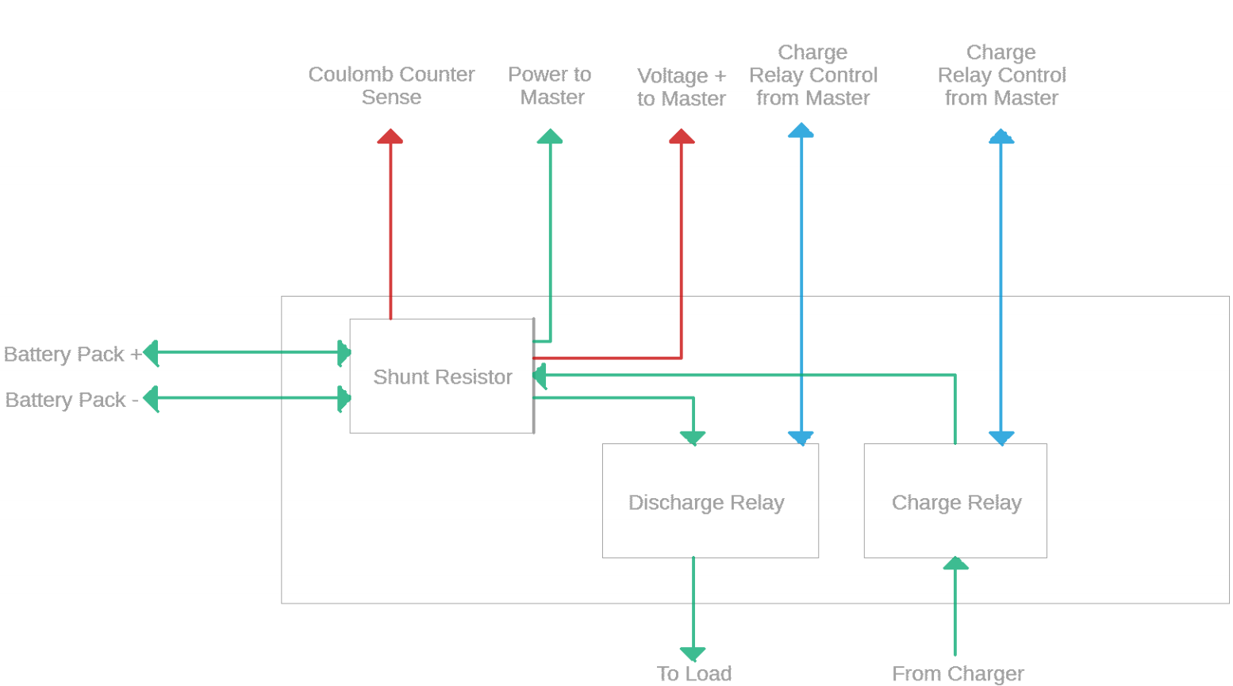
Power Module
Shunt Resistor Rated for current measurement
Relays for charge and discharge control
Power Module Block Diagram

Slide 21
Results
Balance cells to within 50mV of target
Total system bidirectional communication
BMS can prevent cells spec violations
Battery Balancing Time Lapse

Slide 22
Challenges
Hardware error on SPI port
Opto-isolators to slow
Started with uncommon MCU
Weak internal pull-ups
Broken LCD controller

Slide 23
Successes
Software SPI using interrupts
Home-brewed isolation
Precise voltage readings
Clean stackable design
Easy to use UI

Slide 24
Outcome
Project acts as a POC for future BMS designs
Validates daisy chain configuration
Proves MCUs ability to gather accurate data
Uses only low-cost parts
Future work:
Polish UI
Hardware SPI

Slide 25
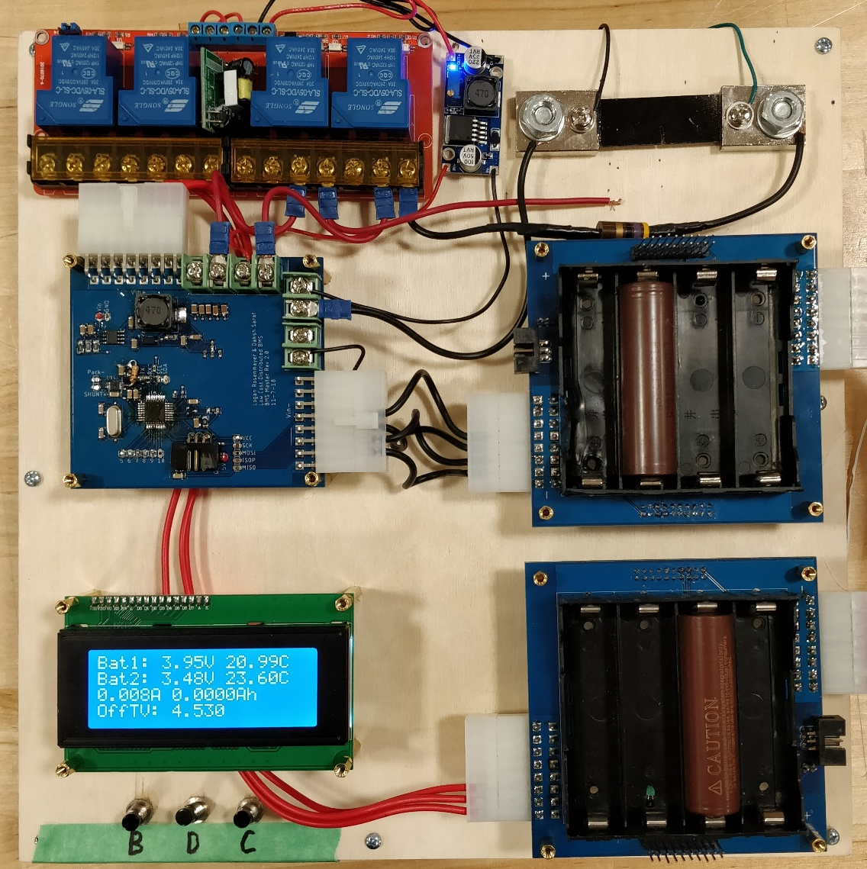
Low Cost Distributed Battery Management System
Thank you

