Slide 1
Auto Aquarium
ECE445 Senior Design Project
Caleb Chow, Sihun Hyun, Irfaan Attarwala
May 2, 2022
Notes:
Irfaan

Slide 2
Team Members
Caleb Chow
Senior
Computer Engineering
Sihun Hyun
Senior
Computer Engineering
Irfaan Attarwala
Senior
Electrical Engineering
ECE 445
GRAINGER ENGINEERING
Notes:
All

Slide 3
OBJECTIVE
Create a cost effective add-on to any aquarium that helps automate mundane maintenance tasks
ECE 445
GRAINGER ENGINEERING
Notes:
Irfaan

Slide 4
Objective
Problem
Aquarium owners have fish that require different water environment
Maintenance cost of water quality test kits
Existing solutions are expensive and large
Solution
Automate water quality testing
Alert consumer in real time of dangerous water conditions
Create profiles for different types of fish
ECE 445
GRAINGER ENGINEERING
Notes:
Irfaan

Slide 5
HIGH LEVEL REQUIREMENTS
Requirements the device must fulfill to be considered functional and complete
ECE 445
GRAINGER ENGINEERING
Notes:
Irfaan

Slide 6
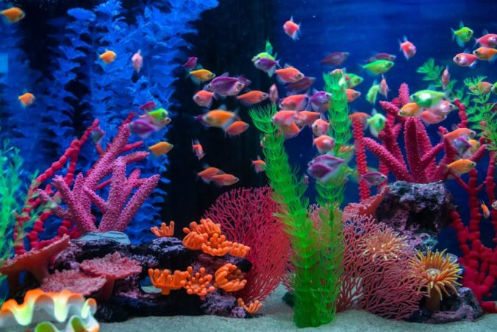
High Level Requirements
Detect data within these tolerances:
Temperature: ± 2 ℃
pH: ± 0.5
Conductivity: ± 20ppm
App sends/receive live data
Query time < 30s
Modular and portable
Side length < 20in
ECE 445
GRAINGER ENGINEERING
Notes:
Irfaan

Slide 7
DESIGN
Block diagram and breakdown of each subsystem
ECE 445
GRAINGER ENGINEERING
Notes:
Sihun

Slide 8
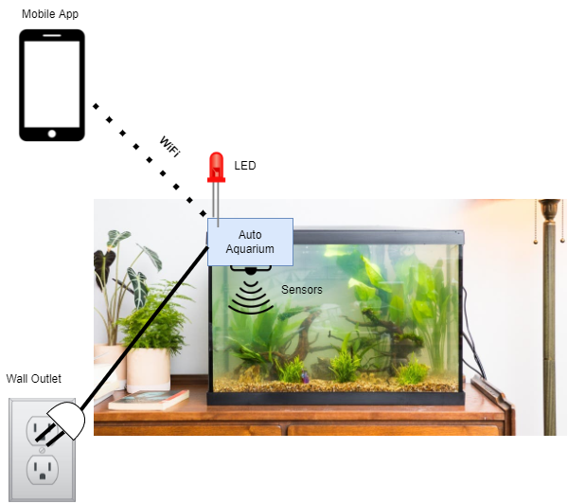
Physical Design
Basic physical design
ECE 445
GRAINGER ENGINEERING
Notes:
Sihun

Slide 9
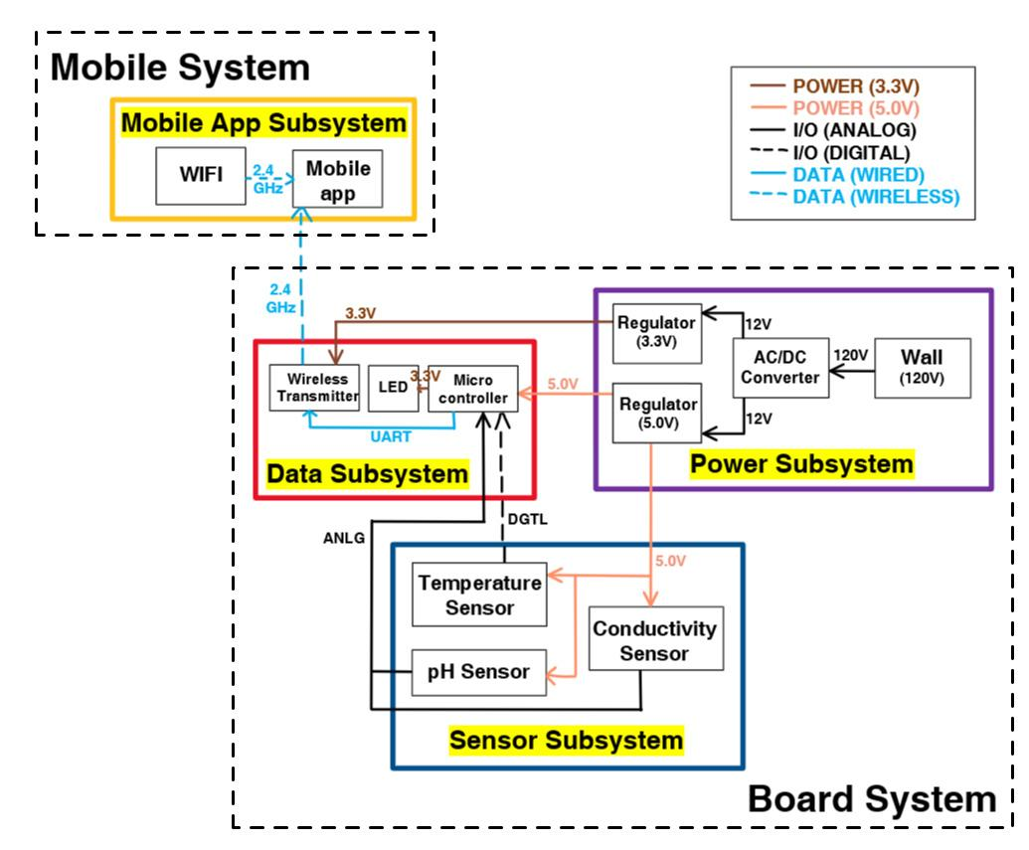
Block Diagram
Block Diagram
ECE 445
GRAINGER ENGINEERING
Notes:
Sihun

Slide 10
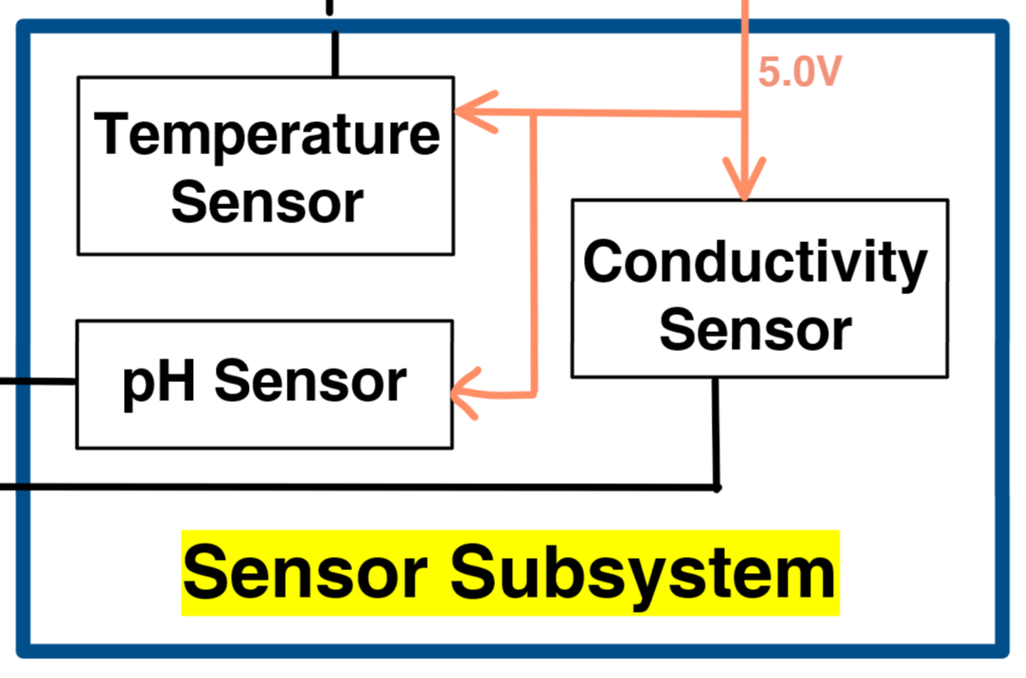
Sensors
Components
Temperature sensor
pH sensor
TDS Conductivity sensor
Temperature, pH, and Conductivity
Temperature: 20-30℃
pH: 6-7
TDS (total dissolved solids): 300-400ppm
ECE 445
GRAINGER ENGINEERING
Notes:
Sihun

Slide 11
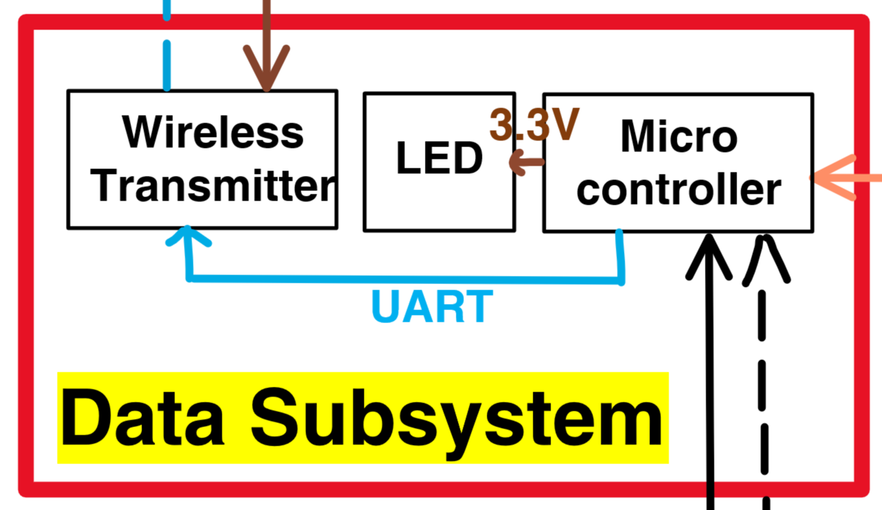
Data
Components
Microcontroller
WiFi transmitter
LEDs
Sending Data
Sensors Subsystem → Microcontroller → Wireless Transmitter
UART Protocol
Programming
ISP Serial Programming
ECE 445
GRAINGER ENGINEERING
Notes:
Sihun

Slide 12
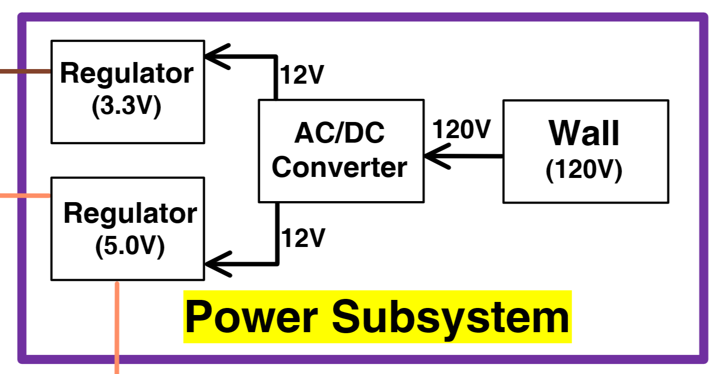
Power
Components
120V Wall plug adapter
AC/DC Converter
5V Regulator
3.3V Regulator
Converting Voltage
Microcontroller, sensors → 5V
Wireless transmitter → 3.3V
ECE 445
GRAINGER ENGINEERING
Notes:
Irfaan

Slide 13
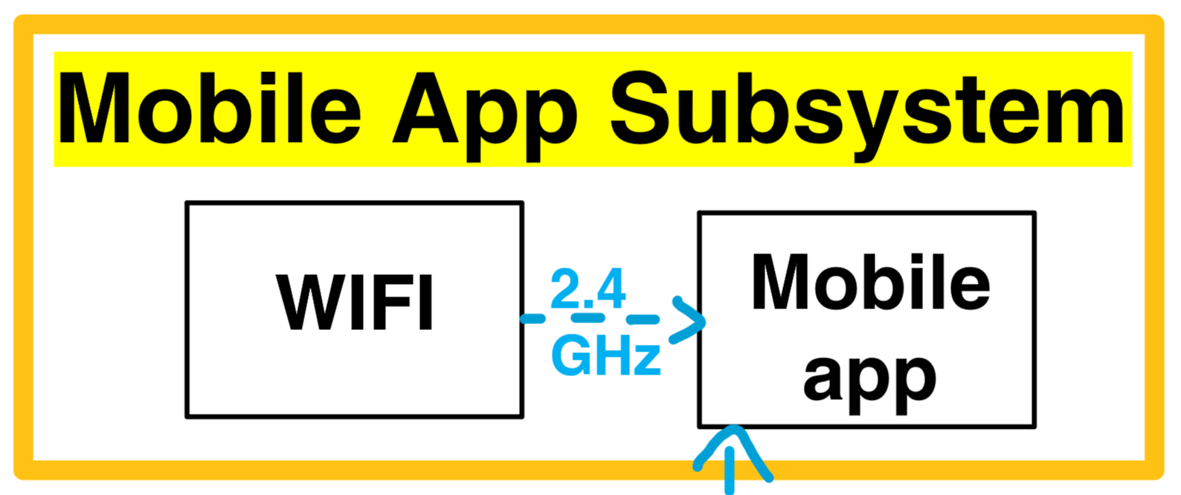
Web/Mobile App
Components
2.4GHz Mobile Hotspot
ReactJS frontend mobile app
MongoDB database
Profiles
Create profiles with ranges for each variable (temperature, pH, conductivity)
Select different profiles and alert user if data is outside of tolerable ranges (dangerous conditions)
ECE 445
GRAINGER ENGINEERING
Notes:
Caleb

Slide 14
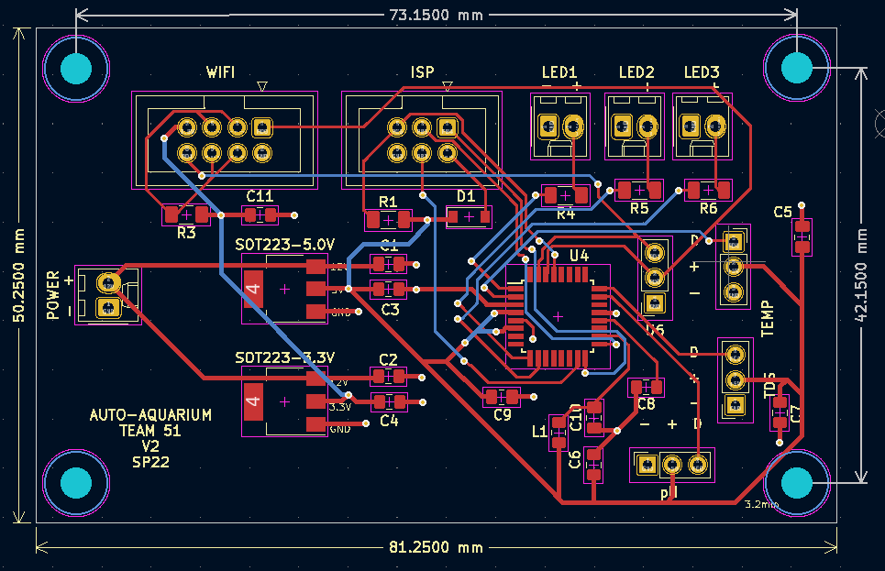
PCB Diagram
ECE 445
GRAINGER ENGINEERING
Notes:
Sihun

Slide 15
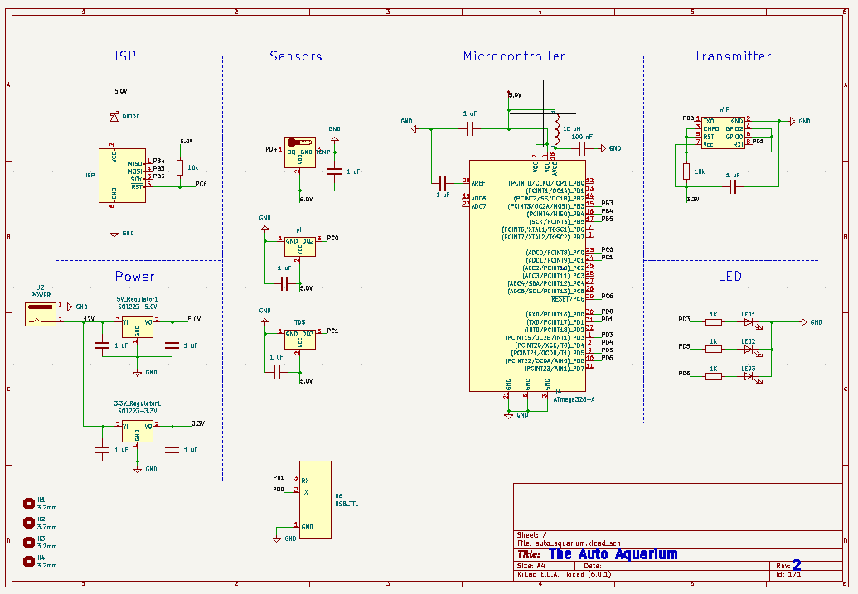
PCB Schematic
ECE 445
GRAINGER ENGINEERING
Notes:
Sihun

Slide 16
BUILD
Our functioning prototype demonstration
ECE 445
GRAINGER ENGINEERING
Notes:
Irfaan

Slide 17
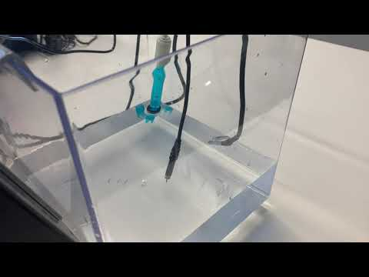
Finalized Design
Finalized design video
ECE 445
GRAINGER ENGINEERING
Notes:
Irfaan

Slide 18
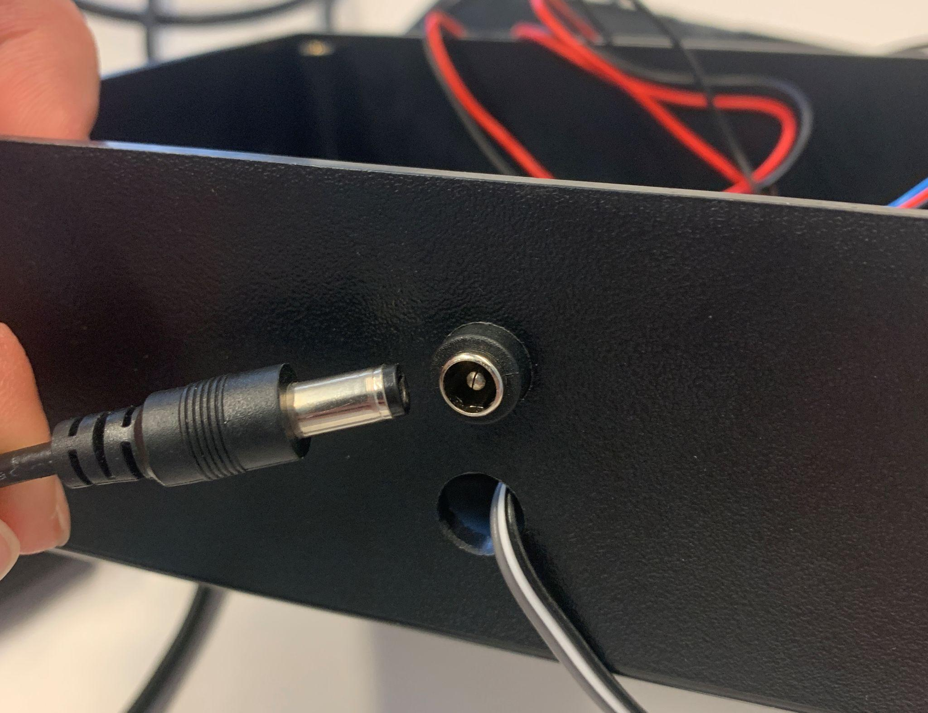
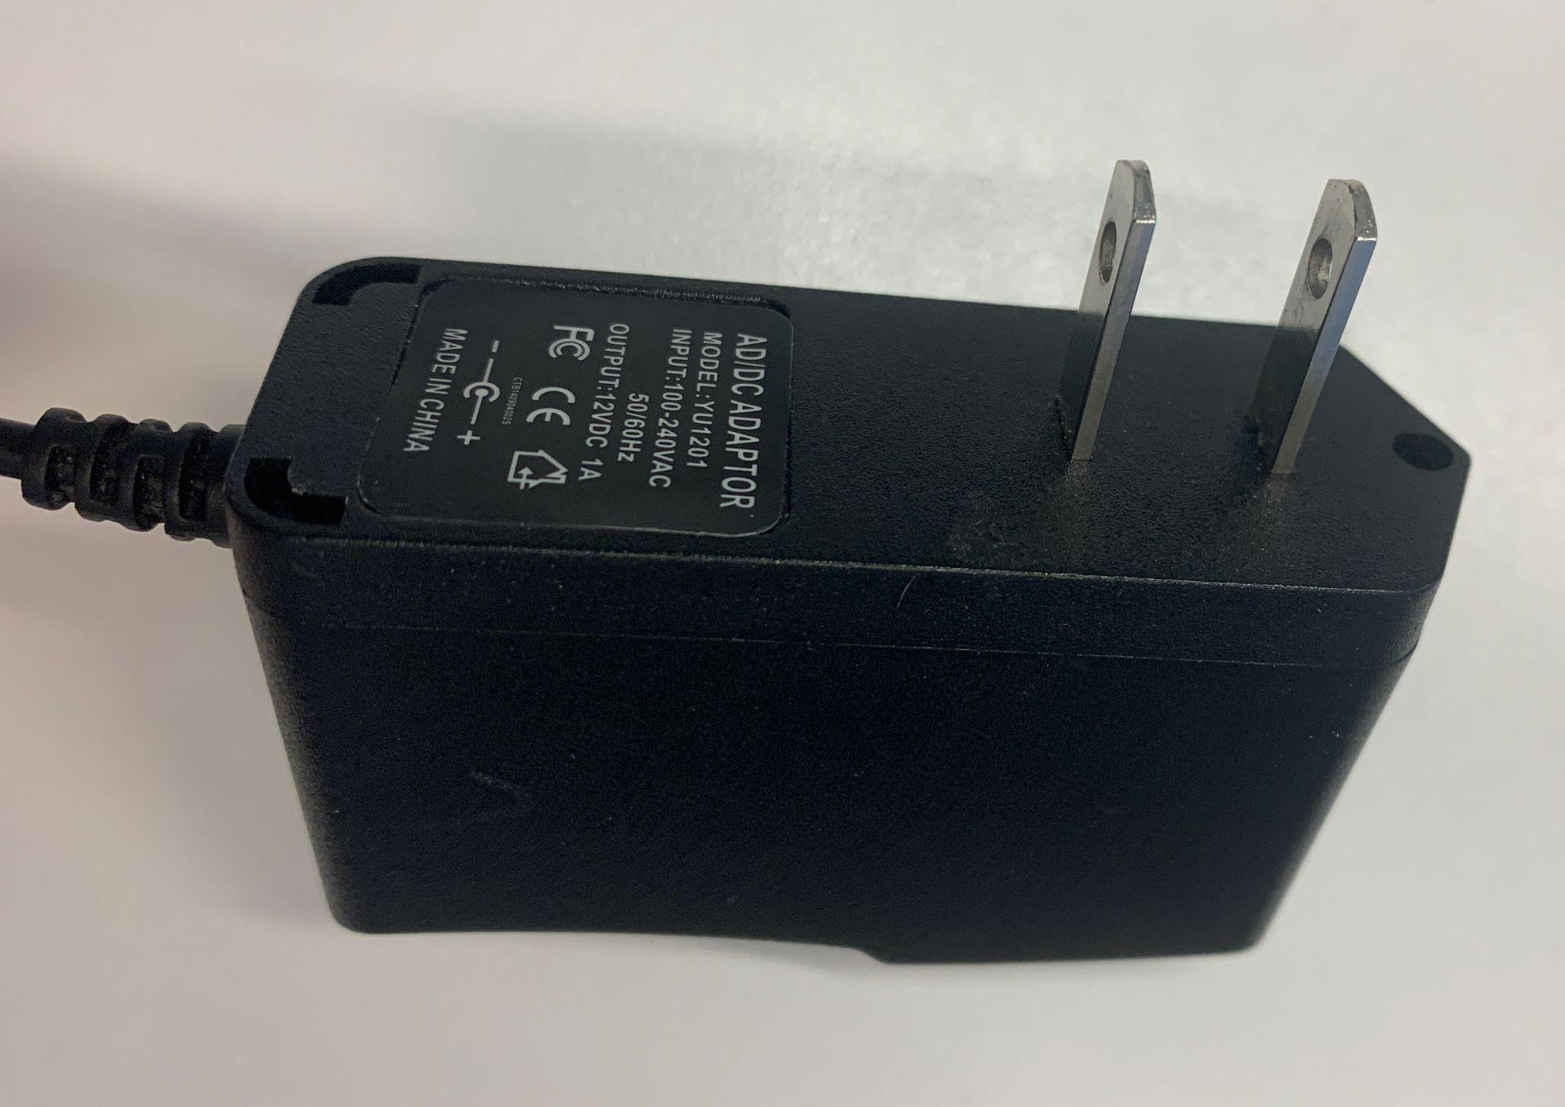
Power
Source
YU1201 AC/DC Adaptor
Input: 100-240 VAC
Output: 12 VDC, 1A
Barrel Jack
ECE 445
GRAINGER ENGINEERING
Notes:
Sihun

Slide 19
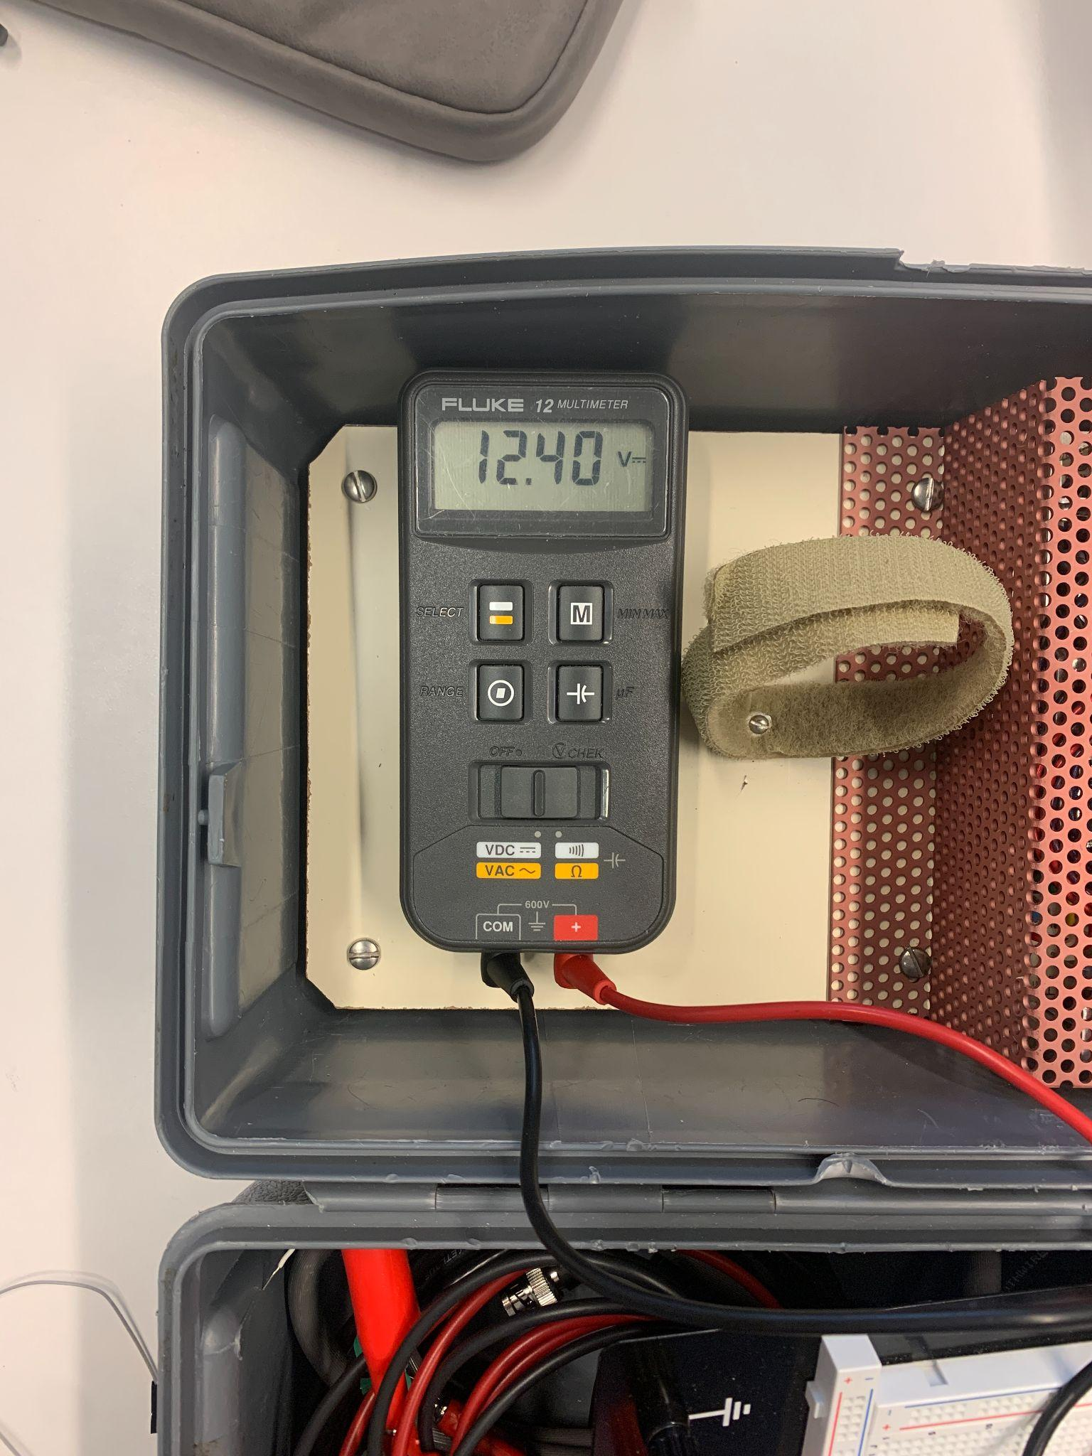
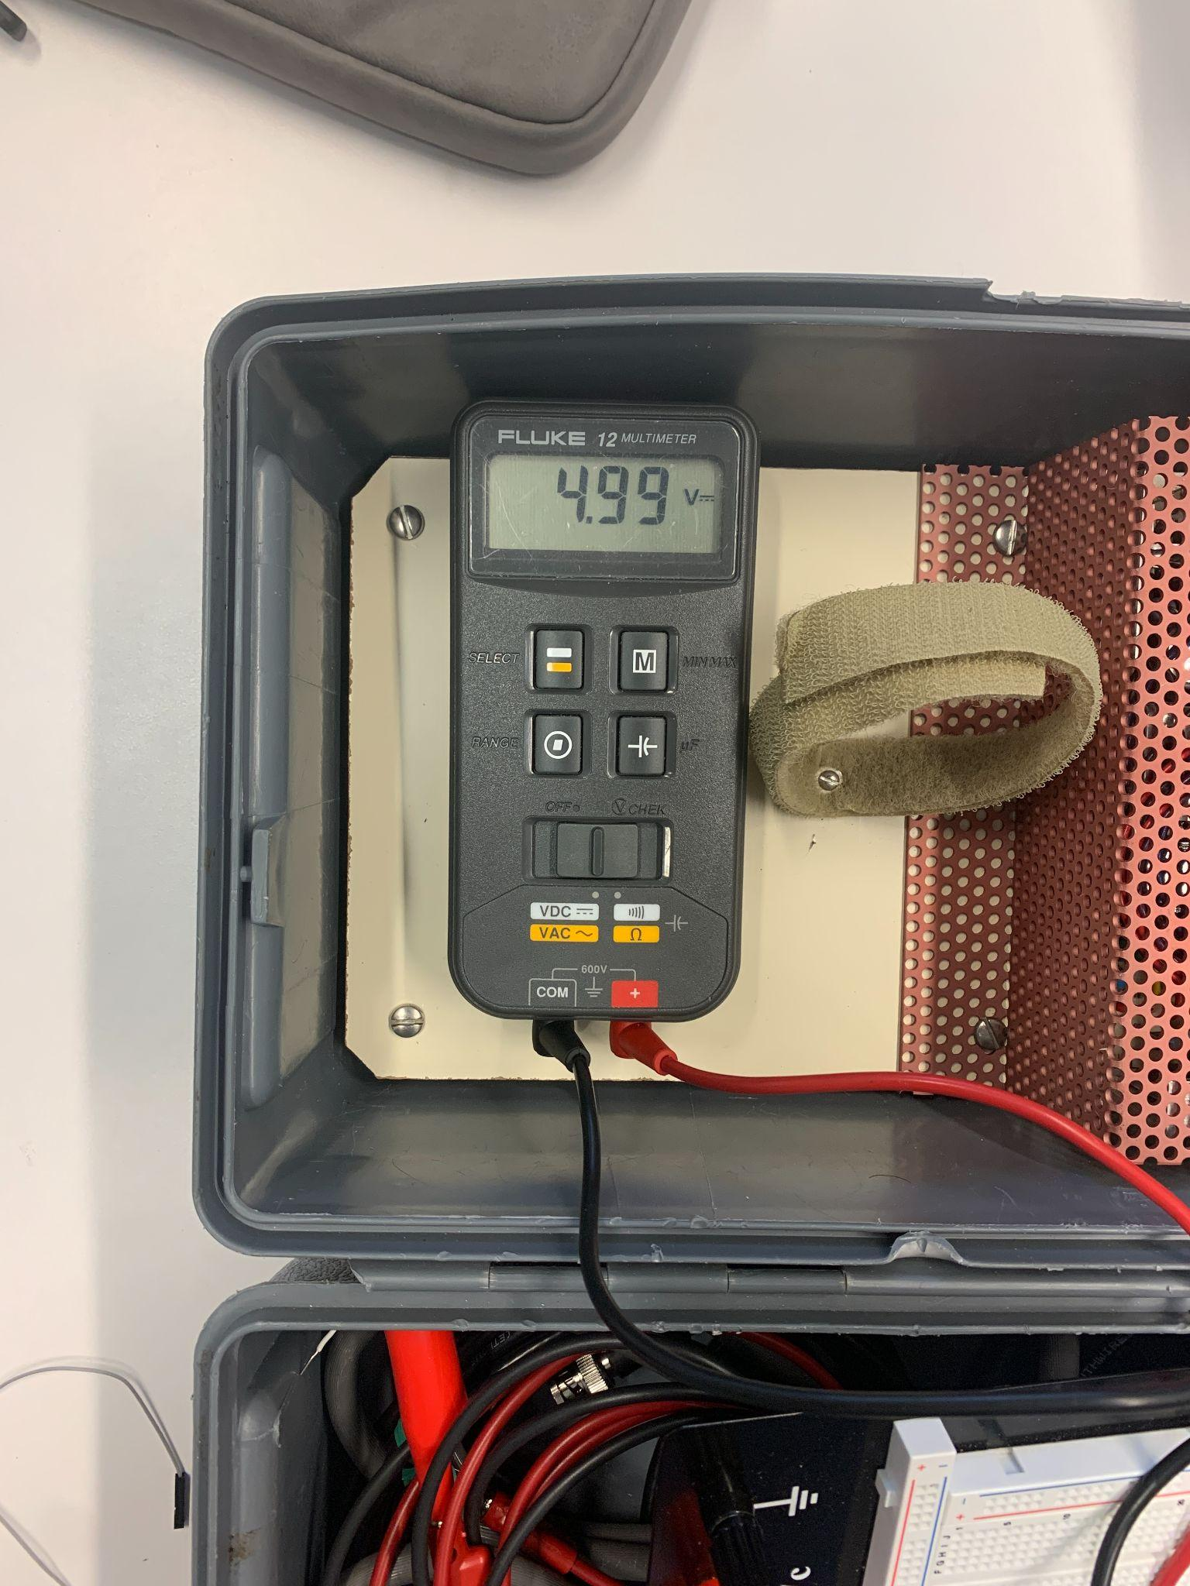
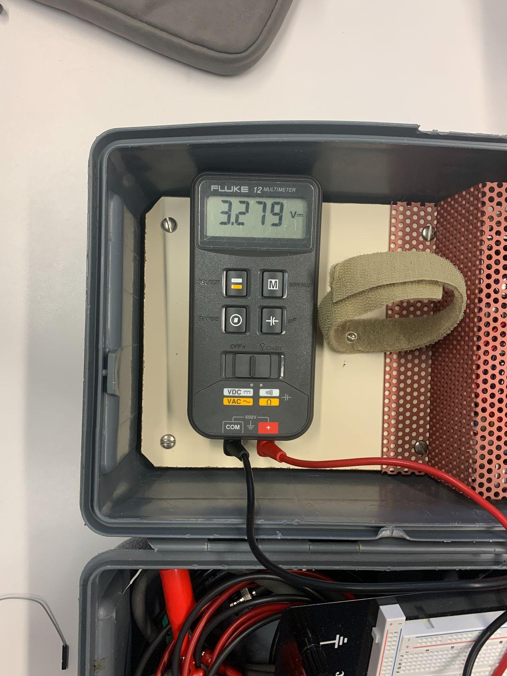
Verification
AC/DC
5.0V Regulator
3.3V Regulator
ECE 445
GRAINGER ENGINEERING
Notes:
Sihun

Slide 20
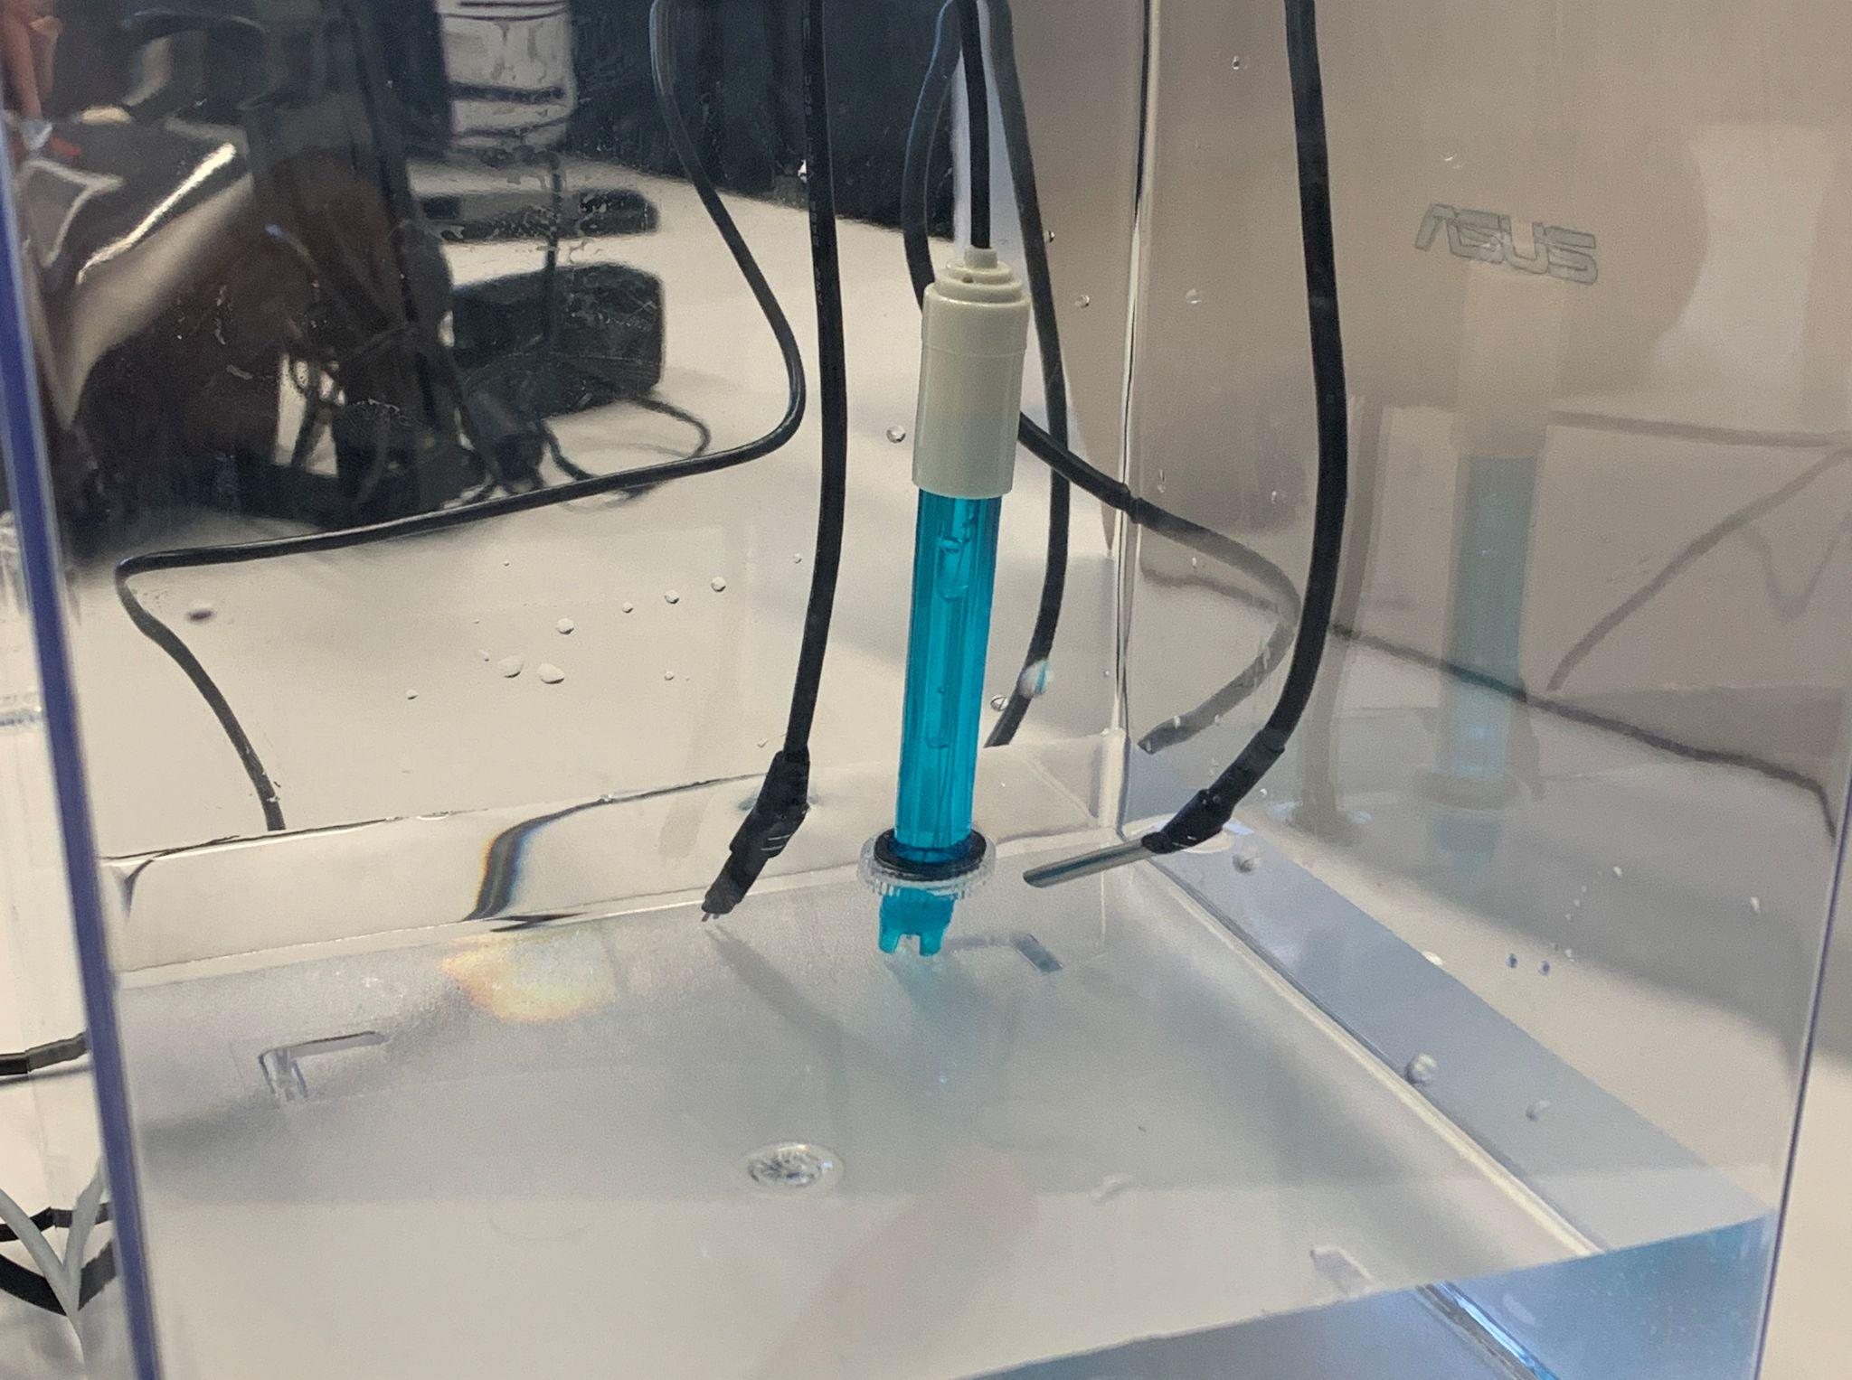
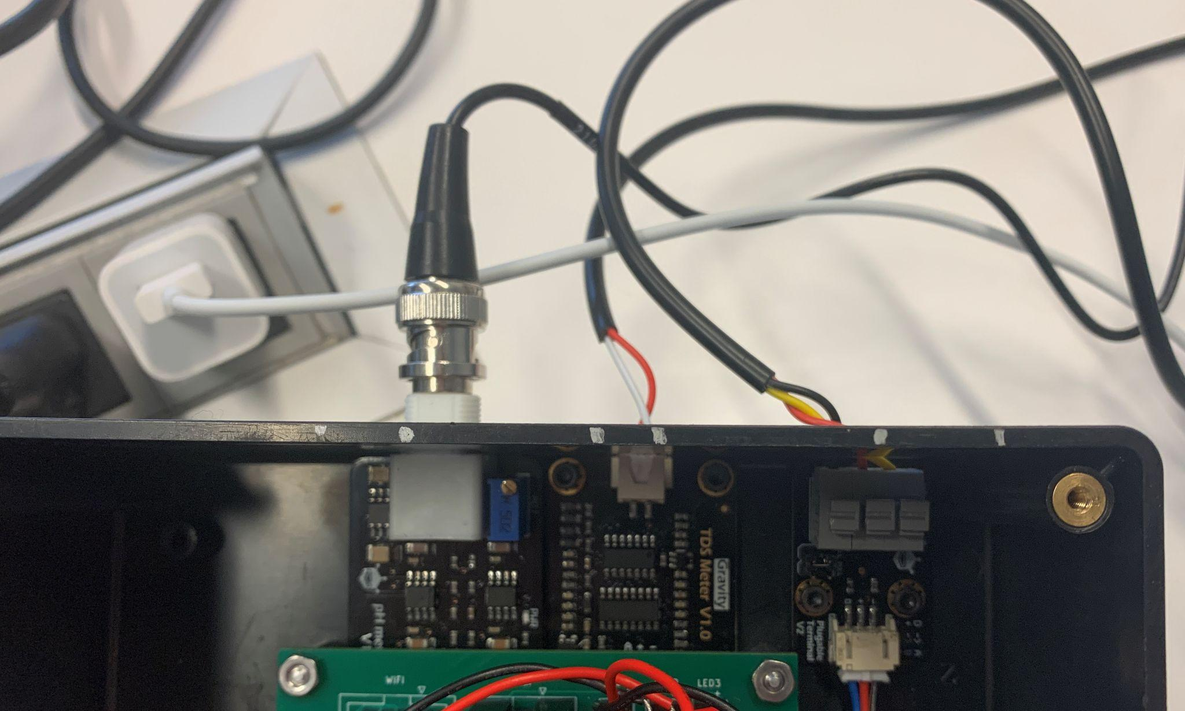
Sensors
Sensors
DS18B20 Temperature sensor
SEN0169 pH sensor
SEN-0244 TDS Conductivity sensor
ECE 445
GRAINGER ENGINEERING
Notes:
Sihun

Slide 21
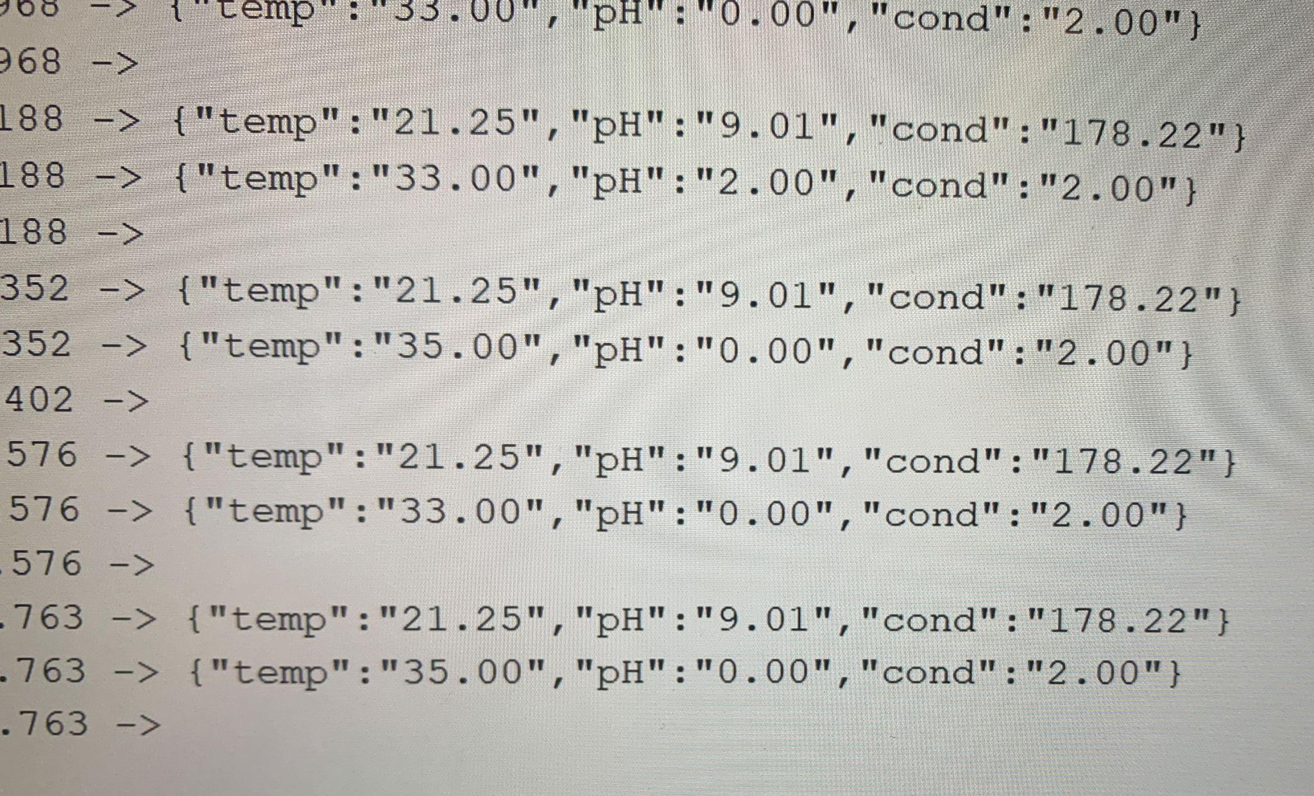
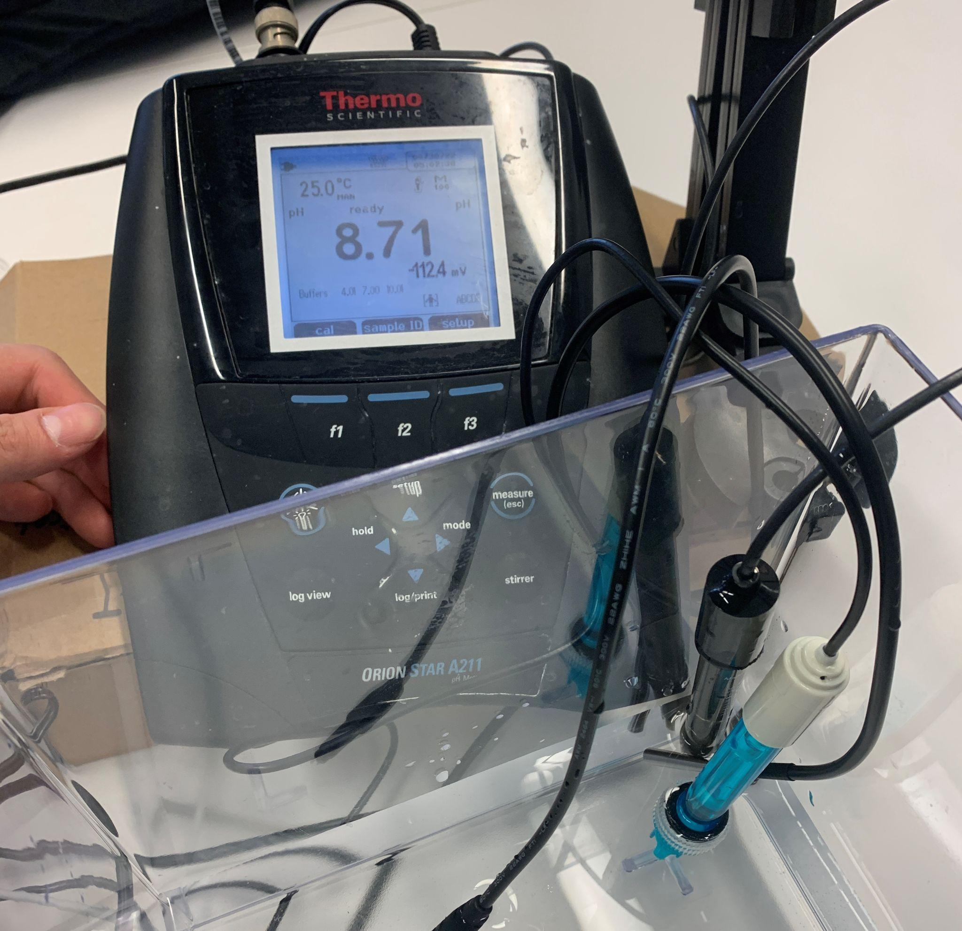
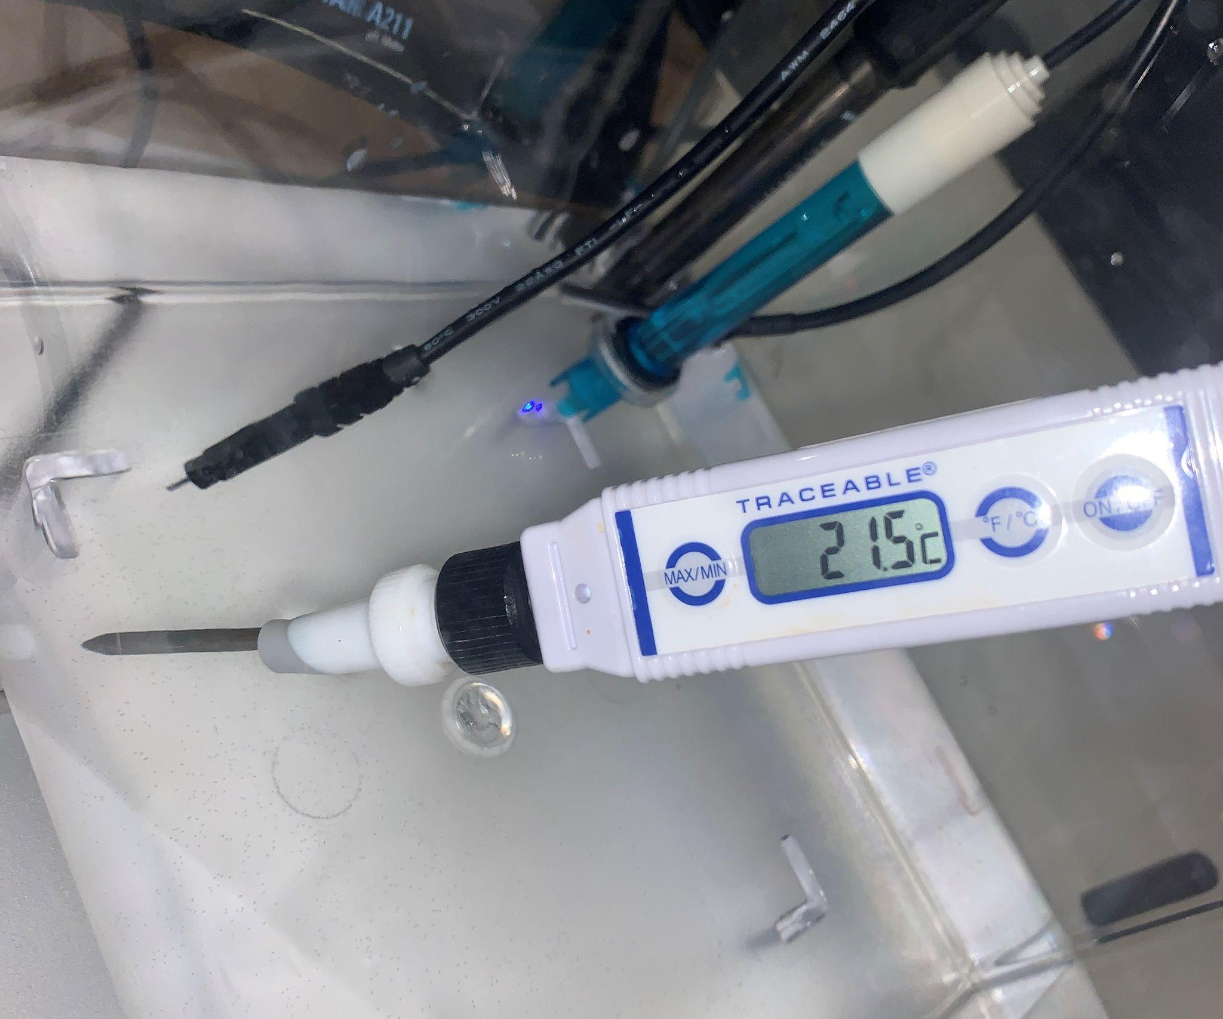
Verification
Temperature (±2°C)
Sensor Data
< 1000ms query time (±250ms)
pH (±0.5)
ECE 445
GRAINGER ENGINEERING
Notes:
Sihun

Slide 22
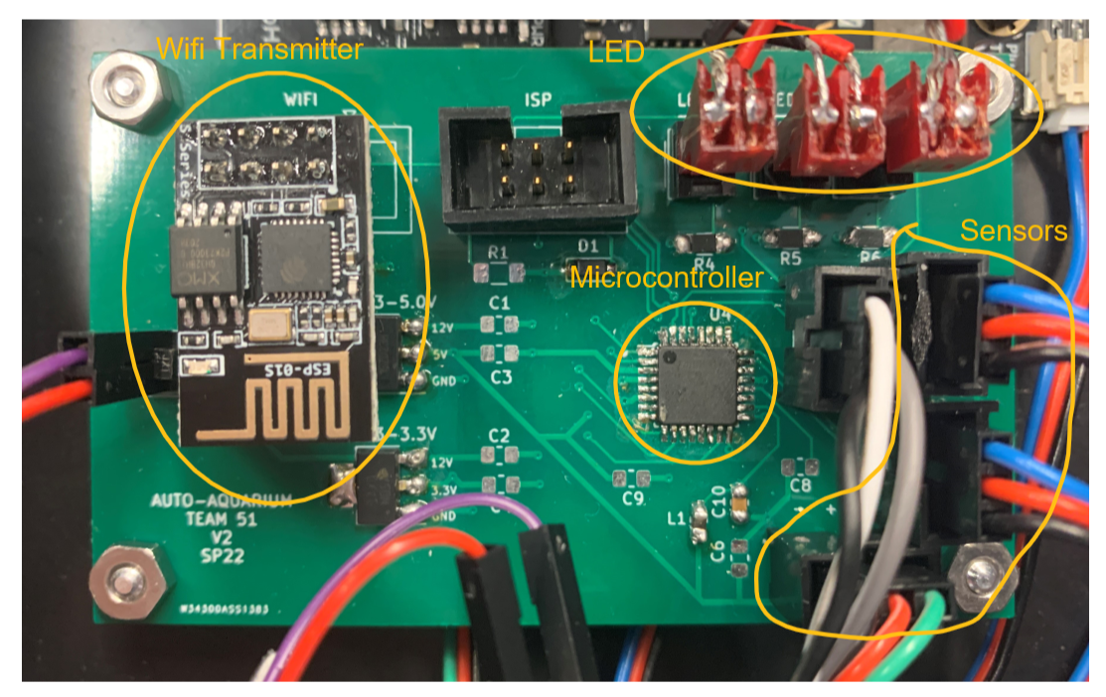
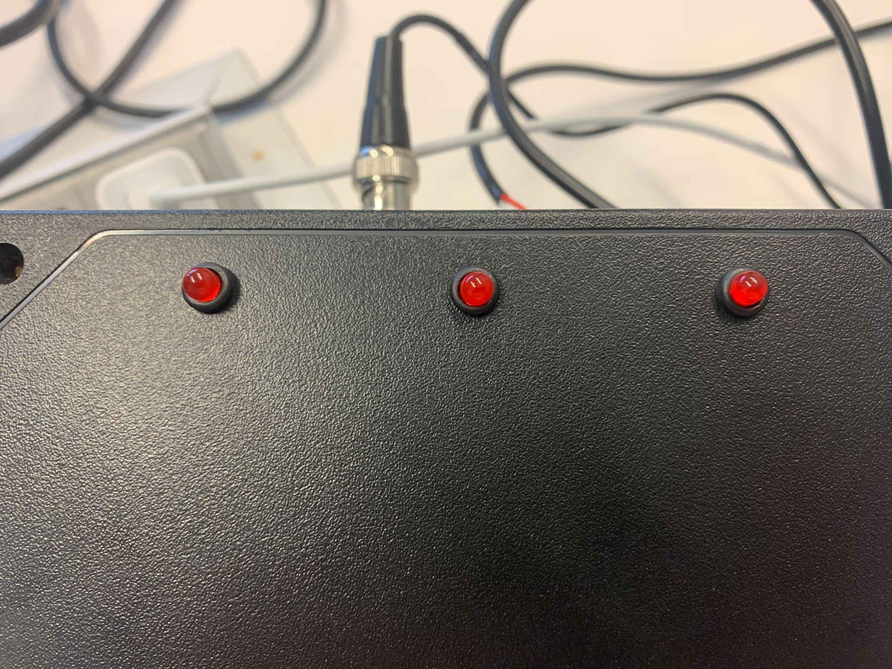
Data
Parts
ATMEGA-328 Microcontroller
ESP8266 WiFi transmitter
LEDs
ECE 445
GRAINGER ENGINEERING
Notes:
Sihun

Slide 23
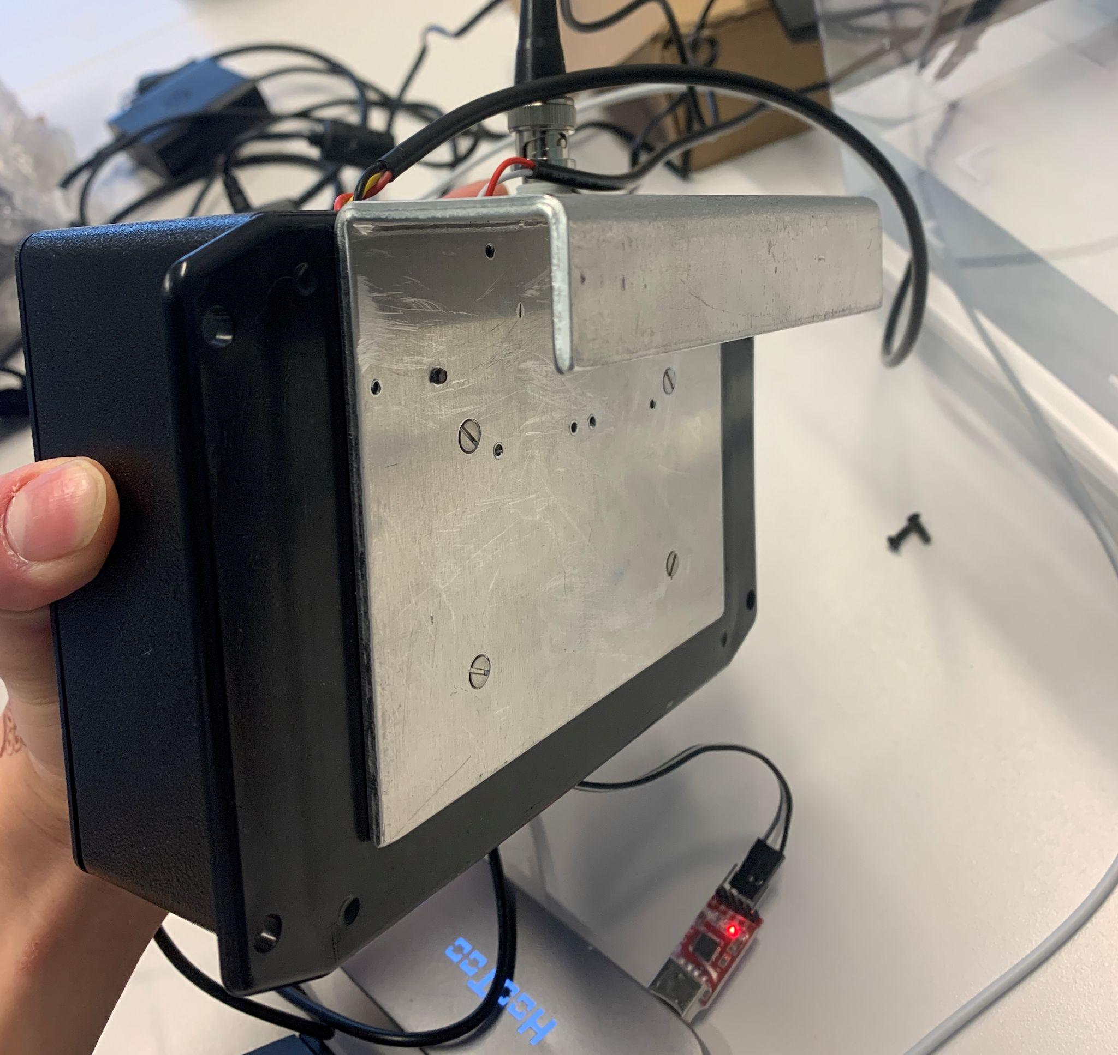
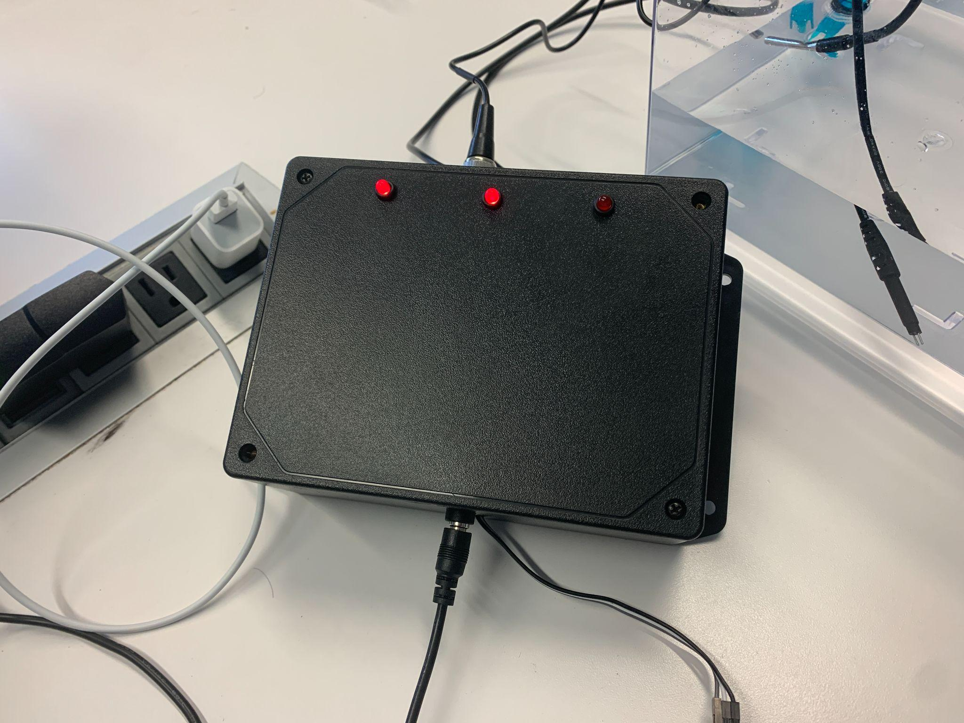
Enclosure
Polycase Enclosure
Waterproof
Attaching Hook
ECE 445
GRAINGER ENGINEERING
Notes:
Irfaan

Slide 24
WEB/MOBILE APP
App for the consumer connected to our product to display and send data
ECE 445
GRAINGER ENGINEERING
Notes:
Caleb

Slide 25
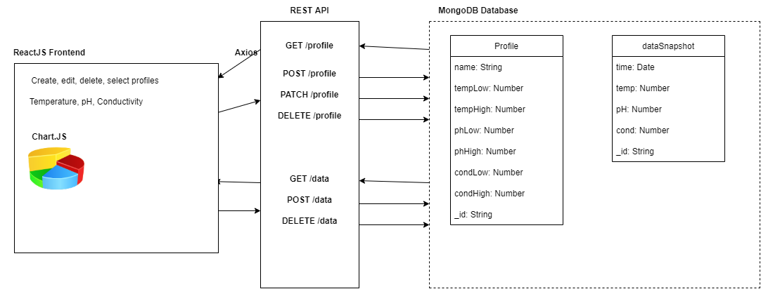
Web/Mobile App Overview
Overall design of the web/mobile app (ReactJS, REST API, MongoDB database)
ECE 445
GRAINGER ENGINEERING
Notes:
Caleb

Slide 26
Web/Mobile App Demo
ECE 445
GRAINGER ENGINEERING
Notes:
Caleb

Slide 27
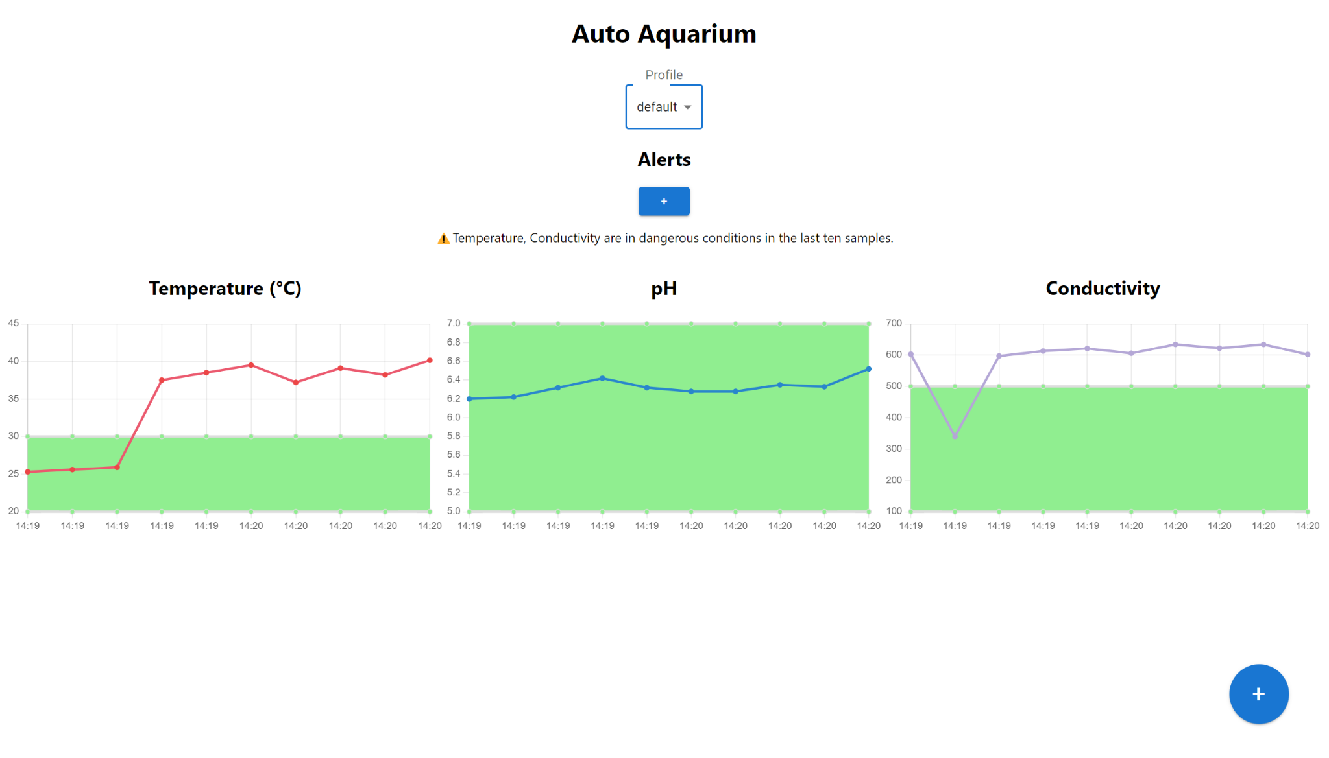
Verification
Dangerous conditions alerts
ECE 445
GRAINGER ENGINEERING
Notes:
Caleb

Slide 28
RESULTS
Project Functionality and Errors
ECE 445
GRAINGER ENGINEERING
Notes:
Caleb

Slide 29
Results
Successes
Satisfied all three of our high level requirements
Successful prototype that accurately measured temperature, pH, and conductivity
App that displays live data sent via WiFi
Profiles for the consumer to create and set tolerance ranges
Small and modular design
Failures
Microcontroller ↔ Wireless transmitter
Wireless transmitter did not properly receive 3.3V → cannot power on
Using a high resistor to lower voltage resulted in current being too low
solution: Regulate voltage and current output from microcontroller to wifi transmitter
Inability to properly calibrate TDS sensor
No separate device to measure conductivity
ECE 445
GRAINGER ENGINEERING
Notes:
Caleb
Sihun

Slide 30
ETHICS AND SAFETY
Understanding of IEEE Code of Ethics
ECE 445
GRAINGER ENGINEERING
Notes:
Irfaan

Slide 31
Ethics and Safety
Ethics
Device was non-toxic and harmless to both humans and animals
No leakage or exposed wire in water
Any malfunction could not change values of the water
Misuse of the product would only cause damage to the sensors or circuitry
Safety
Lab safety was ensured by following proper procedures
No food or drinks were taken or consumed in the lab
Potentially hazardous items were handled with care
Station was clean and equipment used were turned off and returned
ECE 445
GRAINGER ENGINEERING
Notes:
Irfaan

Slide 32
CONCLUSION
Final Remarks
ECE 445
GRAINGER ENGINEERING
Notes:
Irfaan

Slide 33
Final Remarks
Conclusion
Designed a PCB from scratch using KiCAD
Created a working prototype that properly detects temperature, pH, and conductivity
Document design and build process
Created a cost-effective unique product
Our Next Steps
Fix data transfer between microcontroller and wireless transmitter
Further reduce costs by creating a smaller product
ECE 445
GRAINGER ENGINEERING
Notes:
Irfaan

Slide 34
Thank You!
Q&A
ECE 445
GRAINGER ENGINEERING
Notes:
Irfaan

