Slide 1
Posture Guidance Chair
Team 58: Alex Shen, Pablo Corral Vila, Emre Ulusoy

Slide 2
Introduction

Slide 3
Motivation
Back pain → Major health issue
Leading cause of disability worldwide, according to the ACA
Estimated 31 million Americans experience back pain
Bad posture → Potential major culprit of back pain
Causes poor pressure distribution on the spine and nearby muscle groups
People generally know what postures are good or bad
Subconscious tendencies for bad posture can be problematic
Can we do something to notify people about their posture?

Slide 4
The answer is YES
COLLECTING
Collect posture data with pressure sensors and a distance sensor
CLASSIFYING
Supervised learning classifiers will decide if the sensor data represents good or bad posture and how to notify the user
WARNING
Haptic feedback
REPORTING
A GUI will display posture pressure information to the user

Slide 5
Objectives
Detect and guide the sitting posture of users accurately
Non-intrusive
Cost-effective
Power-efficient

Slide 6
Features
Wireless chair with up to 30 feet of range from a computer
Batteries last approximately 20 hours of continuous use
Calibration mechanism to generalize the posture classification of users of various weights
4 vibration motors to guide the user’s posture
GUI to visualize the pressure distribution of 8 posture-distinguishing areas and a back distance reading

Slide 7
Design

Slide 8
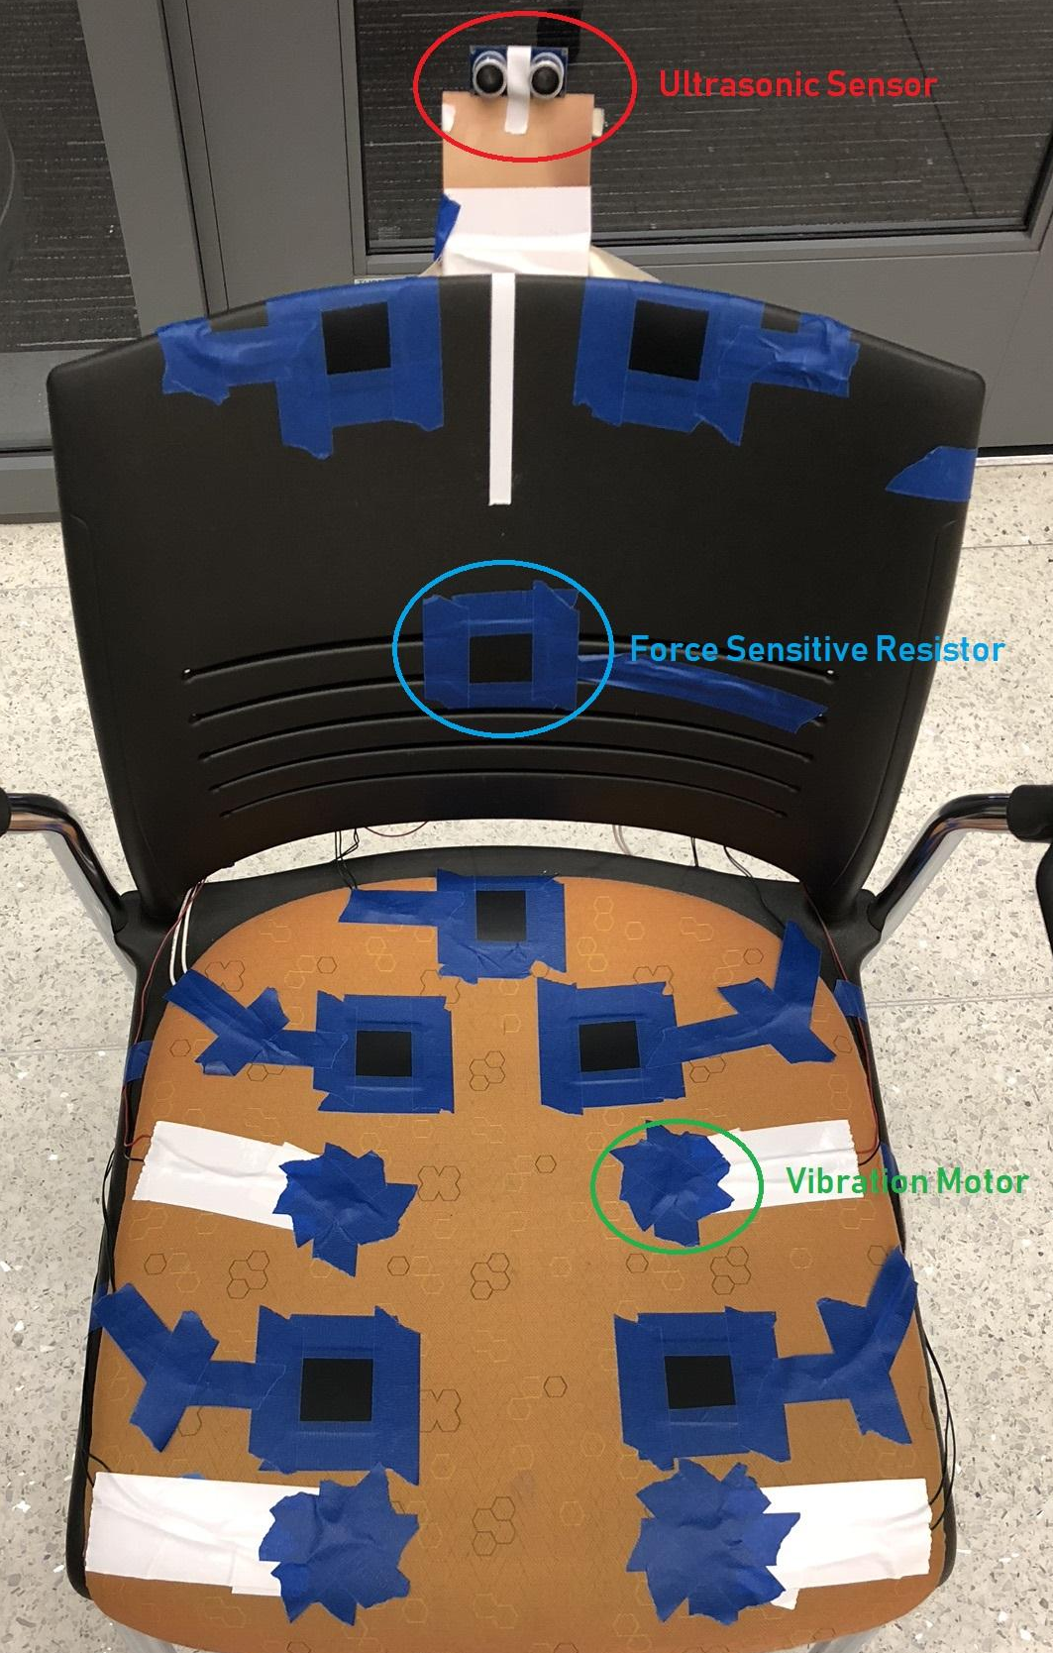
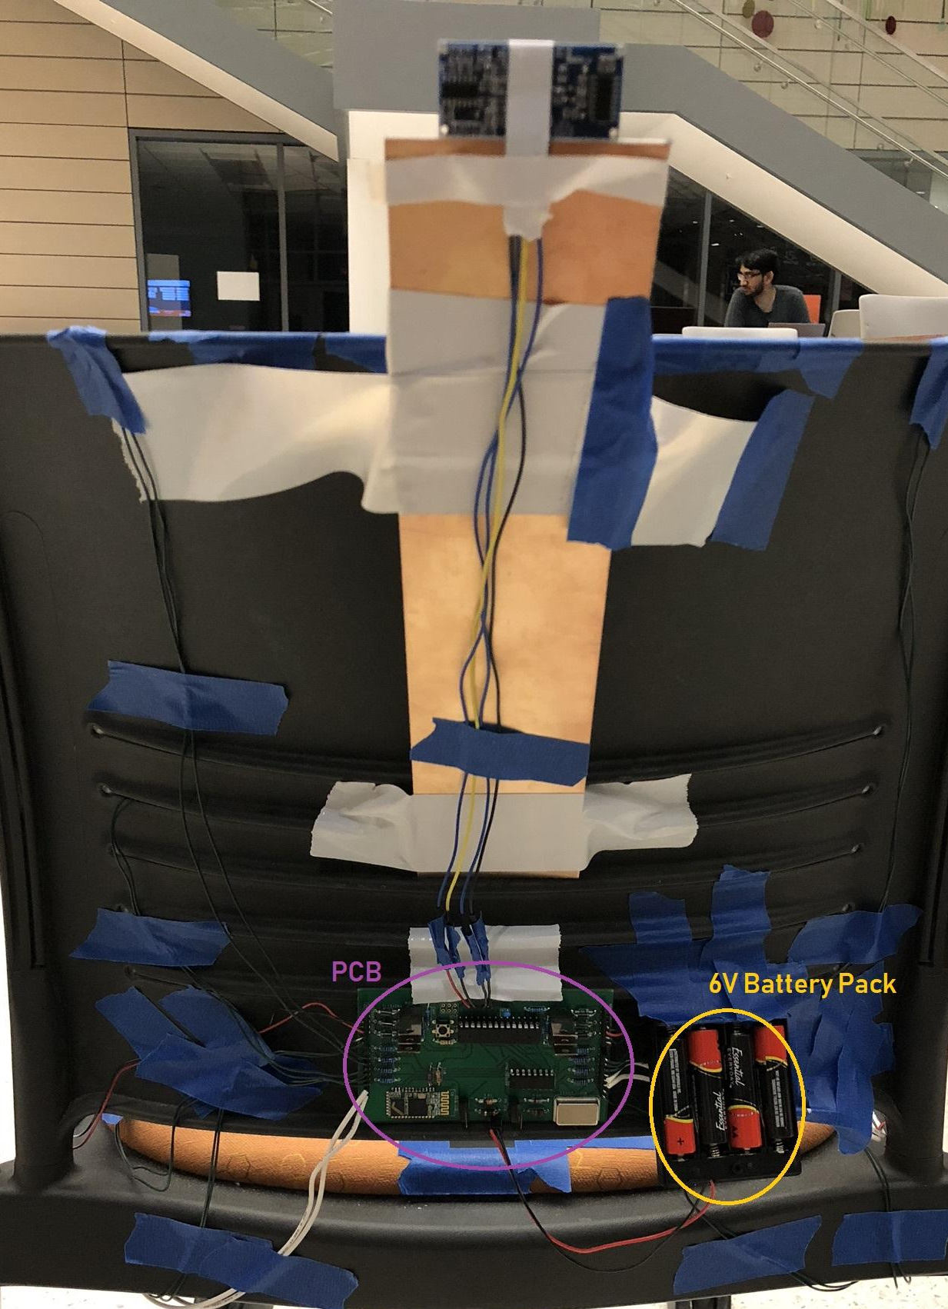
Layout
Shoulders
Sensors placed in the most effective areas for detecting posture
Wires directed to the back for a cleaner look
Lumbar
Ischial Tuberosity
Thigh

Slide 9
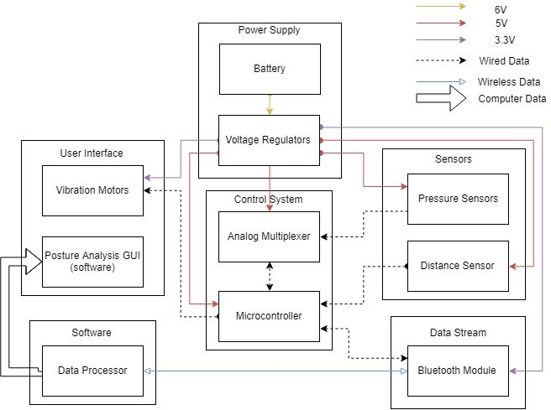

Slide 10
Power supply
Battery: Four AA batteries in series (6V) with ~2500mAh capacity
The average load current is ~125mA
What voltages do our devices need?
5V (sensors, analog multiplexer and microcontroller)
3.3V (Bluetooth module and vibration motors)
Conclusion: We need two voltage regulators

Slide 11
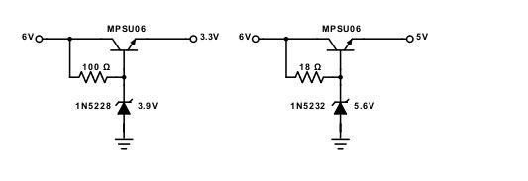
Voltage Regulator Design
Resistance based on expected load and desired zener diode current
Designed to work within a 5.5-6V input range
3.3V Regulator
5V Regulator

Slide 12
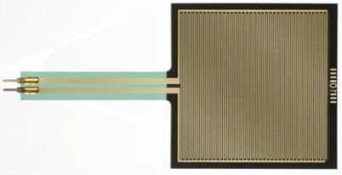
Pressure sensors
Primary source of posture information
Type: Force Sensitive Resistor (FSR)
No force applied → Infinite resistance
As the force increases → Resistance decreases linearly
0.2 - 20N force sensitivity range
Not accurate, but allows high resolution readings
Five sensors on the seat and three at the back of the chair are sufficient to effectively detect most positions
1.75”

Slide 13
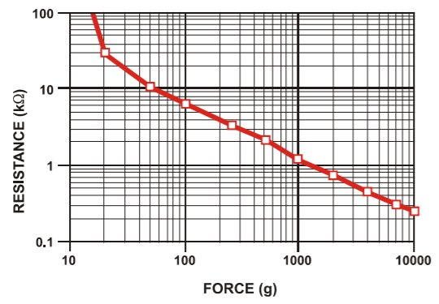

Slide 14
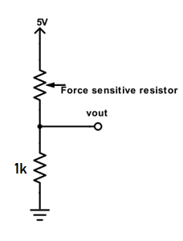
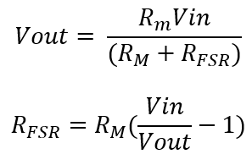
Force Measurement
The circuit used is a voltage divider with a 1k resistor and 5V input
Vout is inversely related to the FSR resistance
Voltage divider can be rearranged to obtain the resistance that varies linearly with force
R_{M}

Slide 15
Balanced Resolution RV

Slide 16
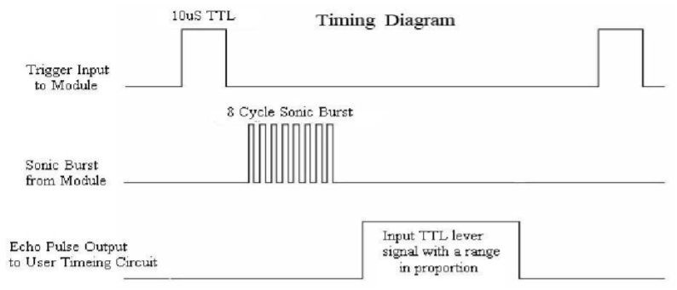
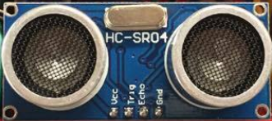
Distance sensor
Detects if somebody is on the chair
Can be used to help determine a slumped posture
Type: HC-SR04 Ultrasonic sensor
It sends an ultrasonic wave and detects its return
Range of 2cm to 4m
Allocated on top of the back of the chair

Slide 17
Problem with distance sensor: Angle
The reflected wave goes to infinity and beyond
When the user bends over 15º
Irregular readings
Not consistent enough to be used to always detect poor posture
Solution:
Pressure sensors
Higher priority information
Distance sensor
Supplement the readings from the pressure sensors (secondary)

Slide 18
Minimum Distance RV

Slide 19
Microcontroller
ATmega328p is commonly used and well-documented
10-bit analog-to-digital converter
Granularity of 4.88 mV for each FSR
Polls each sensor
10 readings per second
Sends the sample to the Bluetooth module as a CSV
Decodes received byte indicating which vibration motor to activate for 1 second
4 most significant bits are one-hot encoded to the motors
4 least significant bits map to the intensity

Slide 21
Analog Multiplexer
CD4051 analog multiplexer by Texas Instruments
Allows exponentially more sensors to be used per input pin from the microcontroller
8-to-1 multiplexer selects the input with an average latency of 15 ns

Slide 22
Vibration motors
C1034B018F vibration motor
Main part of the user interface
Controlled by the microcontroller using a PWM input
The chair has four of them, all of them on the seat

Slide 23
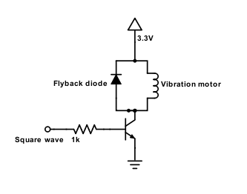
Vibration motor Schematic
The motor is in parallel to a flyback diode to dissipate back EMF
Current draw is ~60mA
Larger than the maximum output of the ATmega328p’s pins
Need a transistor to draw current from the 3.3V regulator

Slide 24
Bluetooth module
HC-05: simple TX/RX pipeline, and uses 3.3V with a 3.3V regulator for compatibility.
Average power consumption is 26.4 mW, and works from up to roughly 30 ft away.
9600 baud rate
Up to 44 bytes transmitted per sample
No more than 10 samples per second

Slide 25
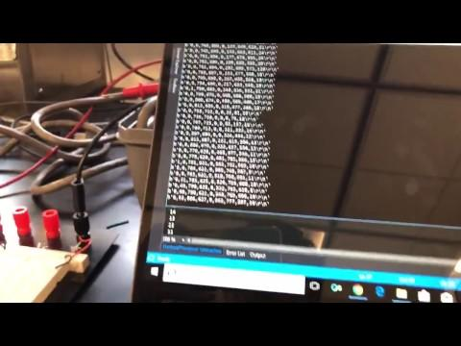
Raw Readings from Bluetooth

Slide 26
Software
Implemented using Python 3.6
Fast prototyping
Powerful data processing tools for machine learning and visualization
scikit learn
pandas
seaborn
Real-time analysis requires multithreading for responsiveness
4 components (each with its own thread):
Bluetooth serial port connection
Classification
Calibration
GUI

Slide 27
Principal Component Analysis
Principal Component 1
Explains 35.6% of the variance
Most relevant features: ischial tuberosities, lumbar
Principal Component 2
Explains 21.1% of the variance
Most relevant Features: shoulders
Principal Component 3
Explains 18.9% of the variance
Most relevant Features: thighs

Slide 28
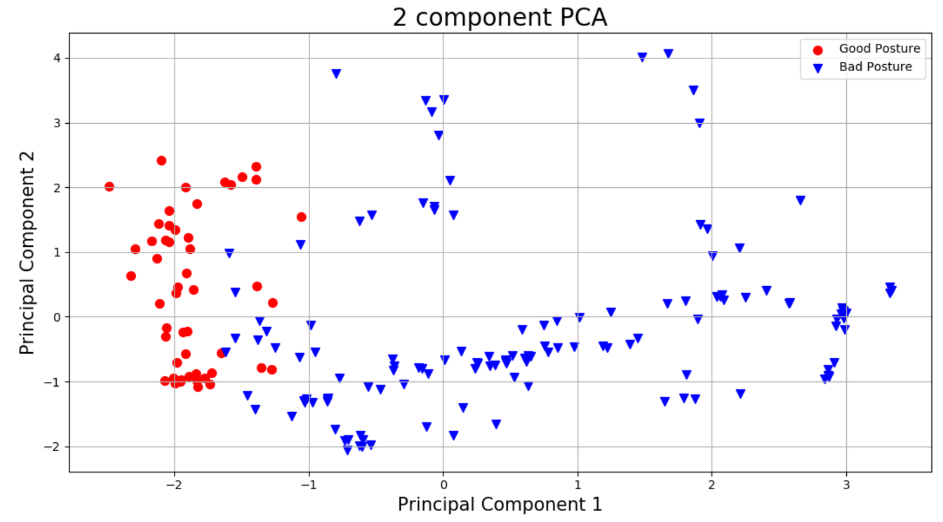

Slide 29
Machine learning
Use a supervised learning classifier to examine 9 inputs as features and provide binary classification of good & bad posture
Since there are no existing data on postures, algorithm must be robust and compatible with small training sets.
SVM is the main algorithm. Reliable for small training sets, works well with binary classification/regression, deduces decision boundaries.

Slide 30
Further classification
In the case of bad posture, we use our second classifier to select the motor to vibrate.
Multi-class SVM is used here with the same rational as the binary classifier
We made the decision to use a second classifier because of the extent of practicality modularization provided for us.
Both algorithms are built with Python Scikit Learn.

Slide 31
Training
Training set: 185 rows
134 bad, 51 good
Trained on multiple weights
Randomized Cross-validated grid search with 5 folds to obtain the best hyperparameters
Same training set used in PCA
Separate from the test set used to score the classifiers

Slide 32
Hyperparameters and Accuracy
Radial Basis Function kernel
Binary posture classifier
C = 0.174, gamma = 0.0281
Accuracy: 98%
Multi-class haptics classifier
C = 356, gamma = 0.0281
Accuracy: 95%

Slide 33
Calibration
Recall the linearity of resistance and force of the FSRs
The voltage reading of the FSRs can be used to compute the resistance
Users of different weights can have their readings shifted to a “baseline” and achieve roughly the same accuracy
Enables generalization and customization
Generalizable to work accurately for users of different weights
Customizable to identify any posture as good (e.g amputee)

Slide 34
Calibration Mechanism
Takes alpha as input from the user
Stores and updates w per FSR feature per user
Adds w to input data before transforming and sending it to the classifiers

Slide 35
Graphical user interface (GUI)
Heatmap-style visualization of sensor data
User can easily see how much force is exerted
Updates every second
Learning rate and calibration button
Asynchronous
Allows the system to learn the current posture of the user

Slide 36
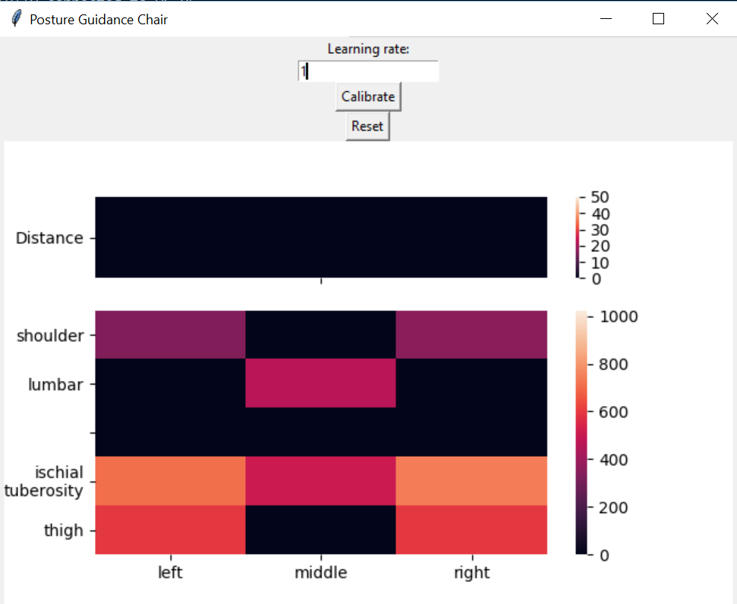

Slide 37
Real-time Visualization Updates

Slide 38
Conclusion

Slide 39
Successes
Every component/module works as outlined in the RV tables
The system functions as intended with all parts integrated
Very high classification accuracy
Smooth operation

Slide 40
Challenges
Comfort and efficiency at the same time
Tuning the classifier hyperparameters to get satisfactory results without overfitting
Developing a comprehensive training set manually
Global Interpreter Lock responsible for lag

Slide 41
SWOT Analysis
Strengths
Accurate classification
Low power consumption
Relatively low cost
Weaknesses
Classifiers specific to the chair that was used for training
Aesthetic appeal
Threats
Ergonomic chairs
Unreliable parts
Opportunities
Large, broad market
Software updates can greatly enhance functionality

Slide 42
Ideas for future work
More sensors → Better classification
Nine sensors → Some bad postures will not be detected
GUI accessible on a website
Offload processing to a server
Easier to access
Custom cushion to make the chair aesthetically pleasing
Multithreaded C++
Historical data
Now, the system displays current information
Allows trends to be analyzed

Slide 43
Questions?

