Slide 1
Remote Controlled Smart Socket
ECE 445 FALL 2017
Team 33：Yuqiao Huang, Shiyuan Zhu
TA: Dongwei Shi

Slide 2
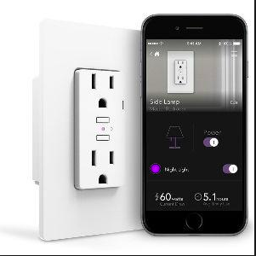
Introduction
Power Supply Detection & Measurement
Remotely Control Socket
Avoiding Electrical Accident
Energy Saving & Analysis

Slide 3
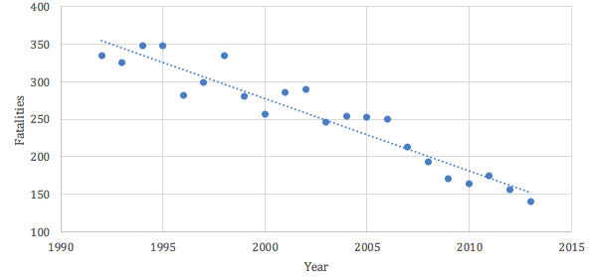
Serious Electrical Injuries in United States

Slide 4
Objective
Want to realize three functionalities:
Monitor
send the collected data of the circuit to the PC
Protection
turn off the device automatically when it works over the safety range set by user
Control
user can send command on PC to control the socket

Slide 5
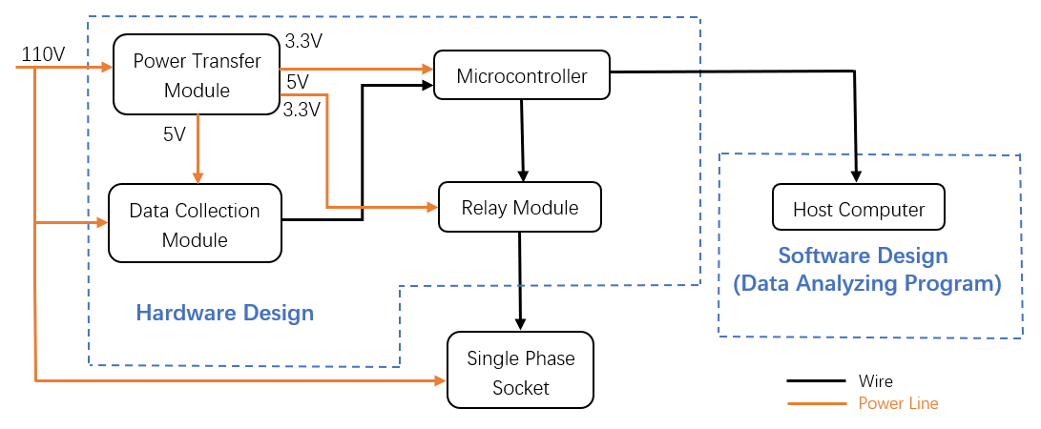
Block Diagram

Slide 6
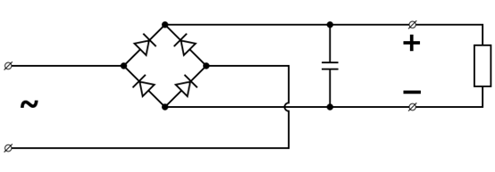
Power Transfer
Voltage Regulators: LM7805, AMS1117-3.3
Input: 110V AC
Output: 5V DC, 3.3V DC
Bridge Rectifier

Slide 7
Power Transfer
Equations:

Slide 8
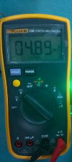
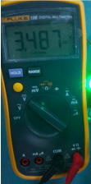
Power Transfer
What can achieve?
5.0V DC (+0.2V)
3.3V DC (+0.2V)

Slide 9
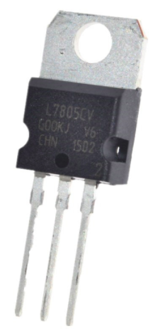
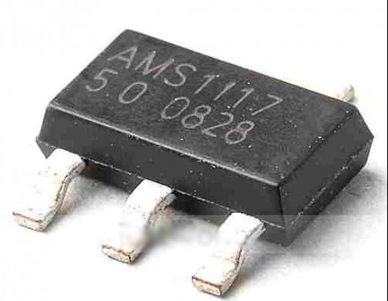
Power Transfer
Problems We Met
Problems:
Chip Problem
Voltage Range and capacitors

Slide 10
Data Collection & Measurement
Notes:
Due to the input limitation of CS5463, we can’t connect it directly to the 110V so we first use a sample circuit and then connect to the chip

Slide 11
Data Collection & Measurement
•Voltage channel of CS5463 is limited to ±250mV [1]
•Output will connect to VIN+/- and IIN+/- pins on CS5463.
Notes:
Top part is the voltage sample circuit and the bottom part is the current sample circuit. The voltage channel is limited to 250mW so we use very large resistor here to divide the voltage to make sure it within the range.

Slide 12
Data Collection & Measurement
RESET, SCLK, SDI, SDO and INT are used to communicate with microcontroller.

Slide 13
Data Collection & Measurement
SDI Write Timing
SDO Read Timing
Notes:
The microcontroller sends a write signal to SDI pin to start the writing loop. And then in the next 24 SCLK periods, it begins to write data from the high byte to the register and wait for another command.
When there is a read signal, in the next 8/16/24 SCLK periods, it begins to read data from the high byte and sends them to microcontroller.

Slide 14
Data Collection & Measurement
Problem:
Chip Pin is too small to solder wires
Solution:
Find a break board to solder the
chip for testing
Notes:
As you can see, the chip is really small and the pins are very close to each other.

Slide 15
Data Collection & Measurement
Problems:
Severe common mode interference, making the measurement very unstable
Impact the communication with microcontroller
Solution:
Add isolation circuit
Notes:
Then we use the 15V AC to test and find the data is very unstable

Slide 16
Data Collection & Measurement
HCPL2631
insert between CS5463 and
microcontroller
Notes:
HCPL2631 has very superior AC/DC rejection feature and also guarantees the circuit performance over a large temperature range.

Slide 17
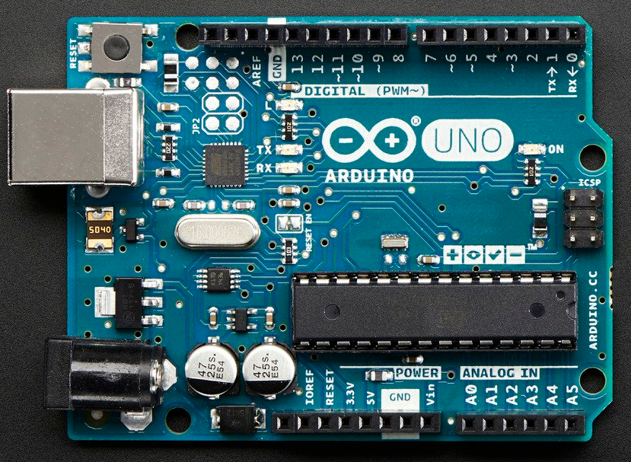
Microcontroller
ATmega 328 P
a) Low power solution
b) 28 pins, small & fast
c) Support UART
d) Easy to program on Arduino

Slide 18
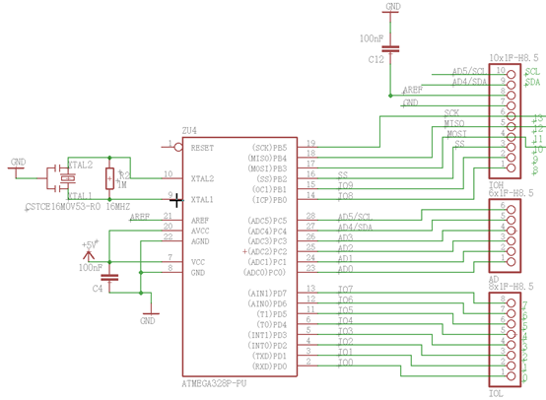
Microcontroller

Slide 19
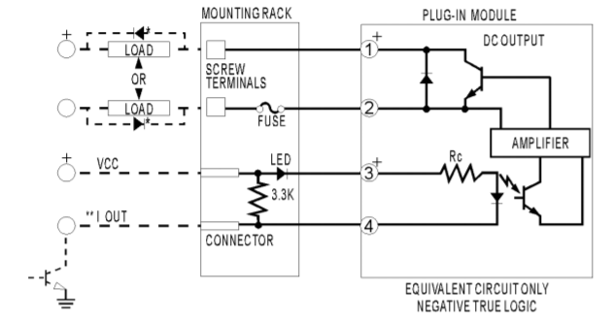
Relay Module
Model ODC5
Common Use four pin
Relay.

Slide 20
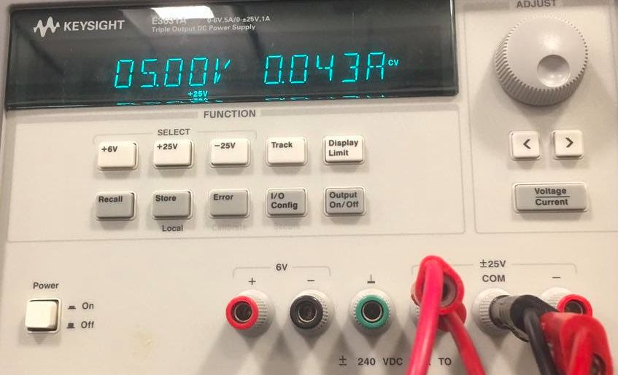
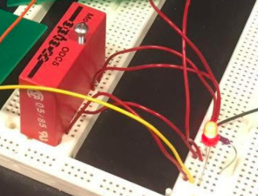
Relay Module
Working Status
The safety range is V < = 6V and below show what happen when in the range.

Slide 21
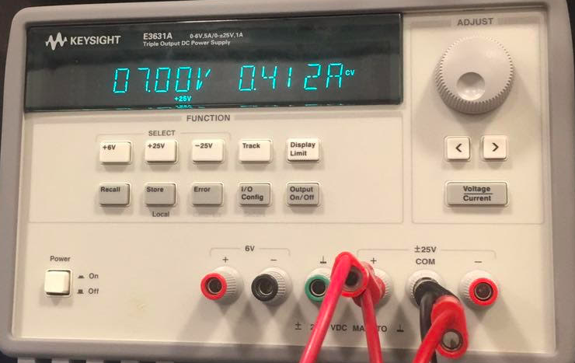
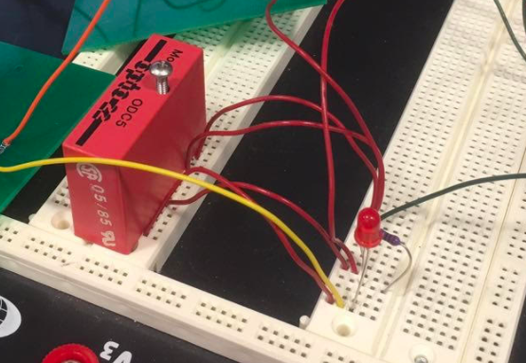
Relay Module
Working Status
The safety range is V < = 6V and below show what happen when out of the range.

Slide 22
Software
When there is client coming, it begins to receive data;
When it is done, the program starts a new monitor cycle.
Notes:
The software part is mainly to deal with the communication and data analysis task.

Slide 23
Software
When working within the safe range, the program will keep asking user whether want to turn off the socket.
Notes:
This is the image of serial monitor. Prompt

Slide 24
Demo Video
Notes:
For demo purpose, we change the 110V to function generator to show the socket status under different voltage condition

Slide 25
Future Hardware Development
Power Transformer Improvement
Larger Voltage Accommodation Relay
Temperature Sensor
WIFI connection

Slide 26
Future Software Development
User Interface
Safety Access/Permission Code [2]
Warning System: includes phone call and message
Deep learning: data analysis
Notes:
Consider the #7 and #9 of the IEEE code of Ethics, we want to avoid violation usage like shutting down the device with illegal purpose so we consider adding permission code when user want to change the socket status.
Also, for deep use of the data, we can relate it to the energy field to do analysis on the energy consumption.(make reduction plan)

Slide 27
References
[1] Circuit Logic,” CS5463 Datasheet”, 2011. [Online]. Available:
https://d3uzseaevmutz1.cloudfront.net/pubs/proDatasheet/CS5463_F3.pdf
[Accessed: 01-Oct-2017].
[2] Ieee.org, "IEEE IEEE Code of Ethics", 2016. [Online]. Available:
http://www.ieee.org/about/corporate/governance/p7-8.html.
[Accessed: 20-Sep-2017].

Slide 28
Thank you!

