Slide 1
Remote Firework Launcher
Team 5
Michael Hlinka, Daniel Middendorf, Trent Sanford
Notes:
Michael start

Slide 2
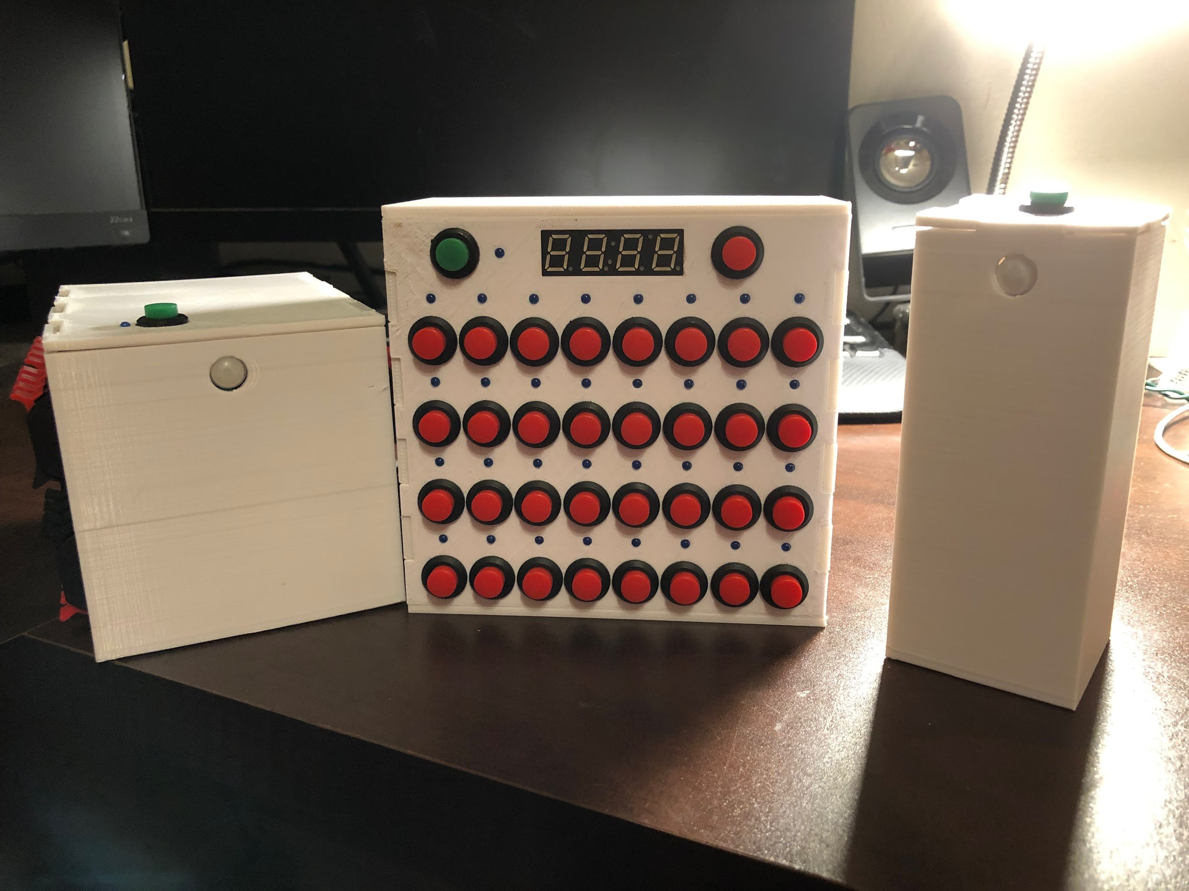
Introduction
A safe way to launch fireworks
Notes:
Trent, talk about the injuries stats. Last year 11,100 injuries and 4 deaths. Major injuries and death comes from mortars
Entire project consists of user controller, receiver (that actually launches the fireworks) and external sensor pods

Slide 3
Objectives
Reliable communication from at least 150 feet
Set off igniters at a 95% success rate
Reliably detect motion within an 8 foot radius from the launch deck
Must be as affordable as possible, ideally under $120
Notes:
Middy - safe and non-costly
Don’t mention specific # of high level reqs

Slide 4
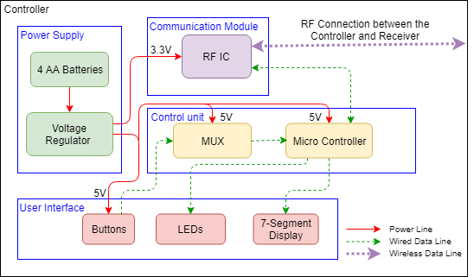
Controller - Block Diagram
Notes:
Michael talks about this. Introduce the function/purpose the controller has in our project
Talk about what the controller does in general sense, then go into module specific descriptions

Slide 5
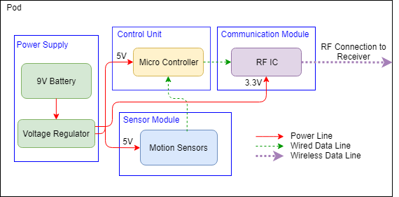
Sensor Pods - Block Diagram
Notes:
Trent - Introduce the functionality/purpose of the sensor array. And then go into blocks
AtMega328p - sends error code to receiver if motion is detected
Meant to help catch motion around launch pad
What the
3.3v and 5v regulators

Slide 6
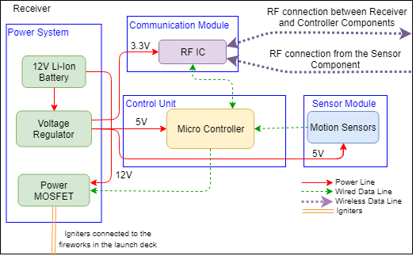
Receiver - Block Diagram
Notes:
Starting Transition: Contains a sensor array,
Blocks first then go into lighting off fuses
End Transition: end with communication hub

Slide 7
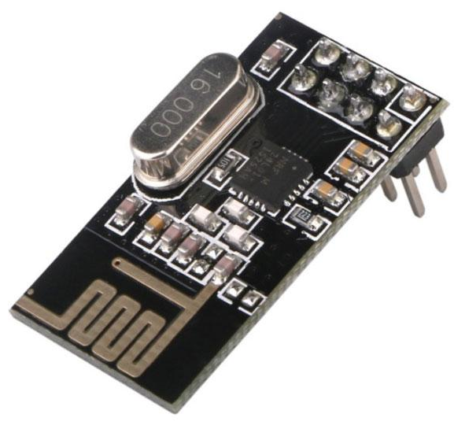
Communications
Used NRF24L01 transceiver module for communication between components
Sent information in 3 byte data packets
Tested with Arduino Uno
[1]
Notes:
Mention testing procedures for RF modules

Slide 8
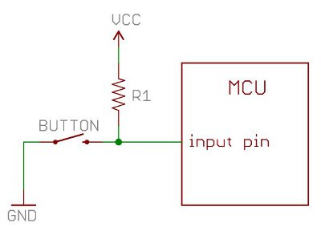
User Interface
Input
Each Button uses a pull up resistor circuit shown below
When pressed, will set data line to low which the microcontroller is waiting for
Output
Consists of button LEDs and 7-segment display
Very impractical to tie each cathode (+ side) to microcontroller for complete control
Would need 60+ General I/O pins alone
[2]
Notes:
Need to mention did not just tie each led to G I/o pin

Slide 9
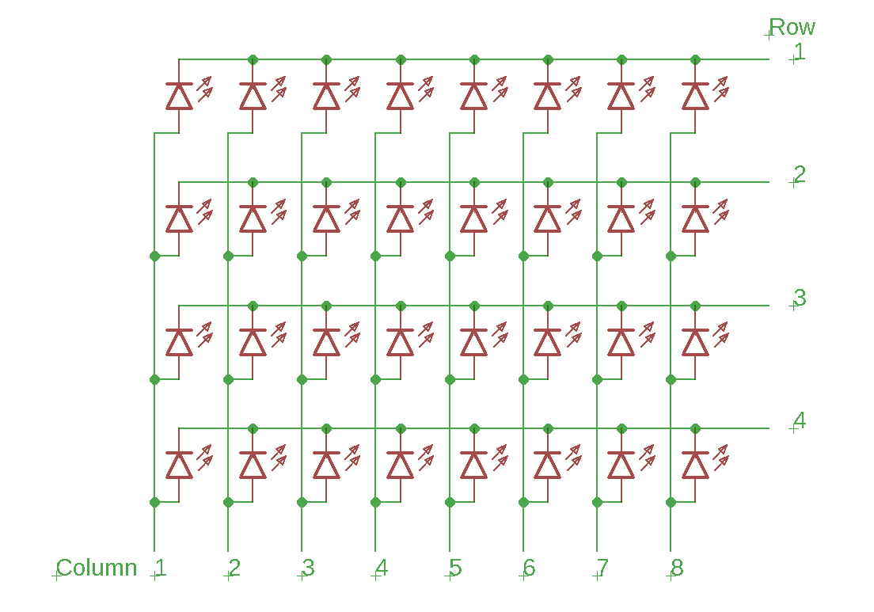
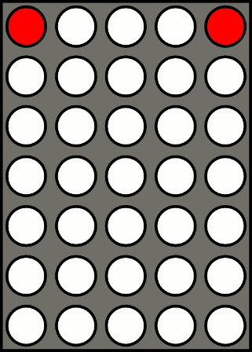
POV
“Persistence of vision refers to the optical illusion that occurs when visual perception of an object does not cease for some time after the rays of light proceeding from it have ceased to enter the eye.”[3]
Allows us to reduce the number of pins from 60+ to 28
[4]
Notes:
Mikey
Mention that 7-seg display does same operation as image on left

Slide 10
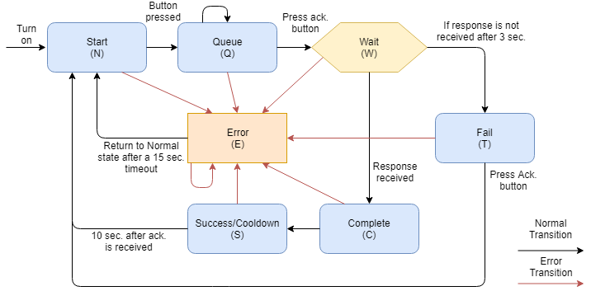
Controller States
Notes:
Arrows

Slide 11
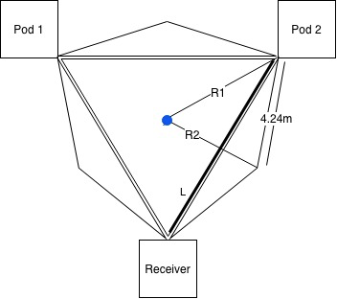
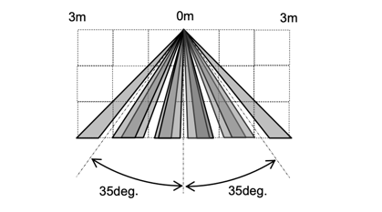
PIR Sensors
[5]
Notes:
These are maximum distance calculations. If we set R2 = 8ft, L would be approx. 18.92 ft

Slide 12
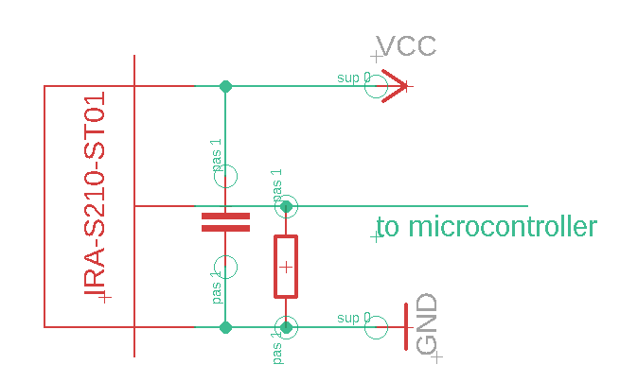
PIR Sensors
Output voltage ranged from 502mV-517mv with movement in the detection area
Converted this analog output to integer value 0-1024 with a reference to 1.1V
An integer change >=2 indicated motion within the detection area
Notes:
Capacitor allowed us to filter noise from the voltage input and more clearly detect any output changes. Mention timing interval
(5 times a second)
Change schmatic

Slide 13
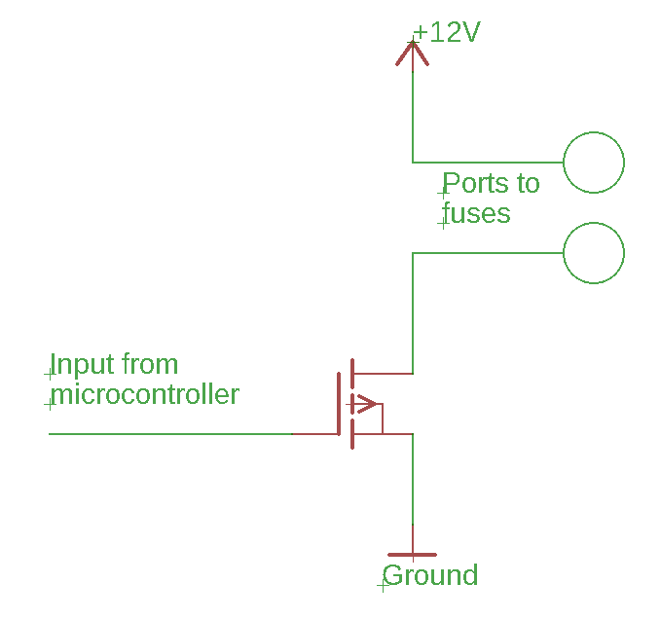
Mosfets
Required to act as a barrier between digital logic chips and more powerful sub-circuits
Acts as a switch that allows current to flow through our igniters
Notes:
Need to talk about it protecting the IC chips

Slide 14
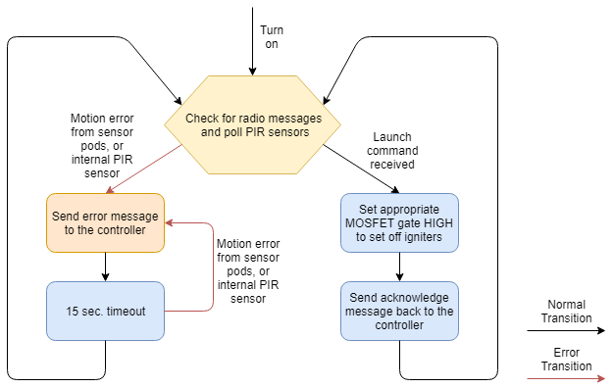
Receiver Software

Slide 15
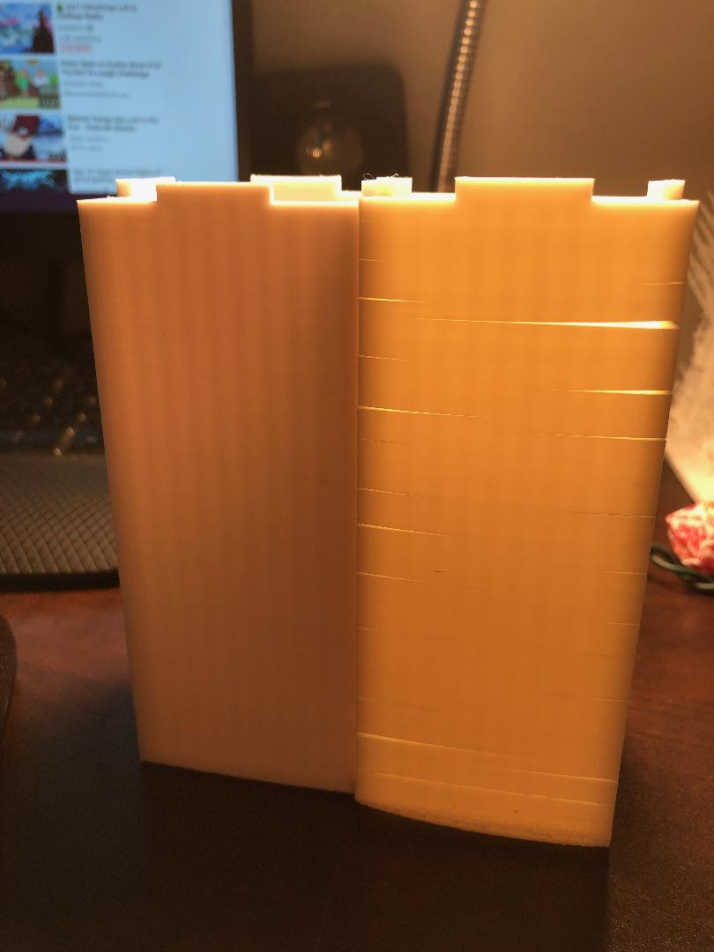
Design Challenges
Multiple circuit design iterations
Moving to breakout focused design
Stabilizing sensor noise
Switching from P-MOS to N-MOS
Programming microcontrollers
3D printer issues

Slide 16
Cost Analysis
Component | Prototype Cost | Mass Production Cost Per Unit
Controller | $46.08 | $35.74
Receiver | $74.75 | $39.56
Sensor Pod (x2) | $23.64 | $13.76
Total: | $144.47 | $89.06
Notes:
Some design decisions for aahhhhhhhhh…..
Rechargeable battery was a huge cost, we would be able to aaaaaahhhhhh……...

Slide 17
Points for Improvement (Future Work)
Controller
Switch to a 5:32 MUX
Improve refresh rate for LEDs and hex display
Explore controller substitutes (i.e. mobile app)
Receiver
Look for safer battery substitutes
Pods
Integrate low-pass filter into the pod’s PCB
Experiment with other detection methods and sensors
Notes:
Keep it simple stupid...

Slide 18
Conclusion
Overall our project worked as designed
Notes:
Discuss demo’s success and final functionality

Slide 19
Any Questions?

Slide 20
Citations
[1] Makerlab Electronics, ‘nRF24L01 Wireless Transceiver And Raspberry Pi Philippines’, 2015. [Online]. Available: https://www.makerlab-electronics.com/product/nrf24l01-wireless-transceiver-arduino-raspberry-pi/
[2] A1RONZO, ‘Pull-up Resistors’. [Online]. Available: https://learn.sparkfun.com/tutorials/pull-up-resistors/all
[3] Wikipedia, ‘Persistence of vision’, 2017. [Online]. Available: https://en.wikipedia.org/wiki/Persistence_of_vision
[4] Wikipedia, ‘File:Dot matrix.gif’, 2011. [Online]. Available: https://commons.wikimedia.org/wiki/File:Dot_matrix.gif
[5] muRata, ‘Pyro Electric Infrared Sensor Fresnel Lens’. [Online]. Available: ‘https://www.murata.com/~/media/webrenewal/products/sensor/infrared/datasheet_pir.ashx?la=en
Notes:
Make sure to update dis bitch

