Slide 1
Dynamic Ferrofluid Lamp
Team 59
Chen Huang
Chong Lu

Slide 2
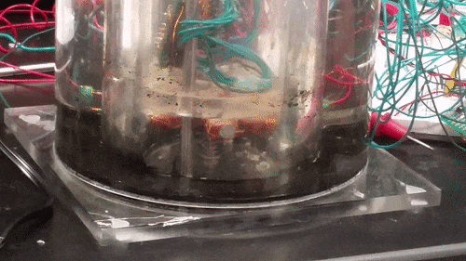
Introduction
New medium of artistic display
Limitations of current products

Slide 3
Objective
Automatic display patterns
Multiple dimensions of control over ferrofluid
Programmable interface to allow pattern design
Allow adjustable lighting effects

Slide 4
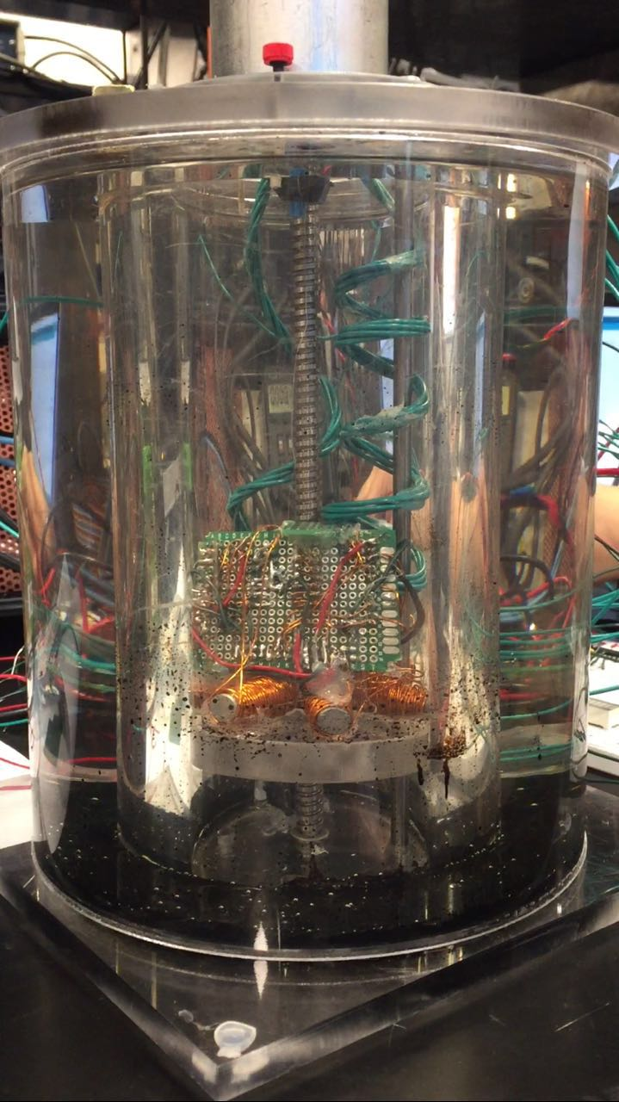
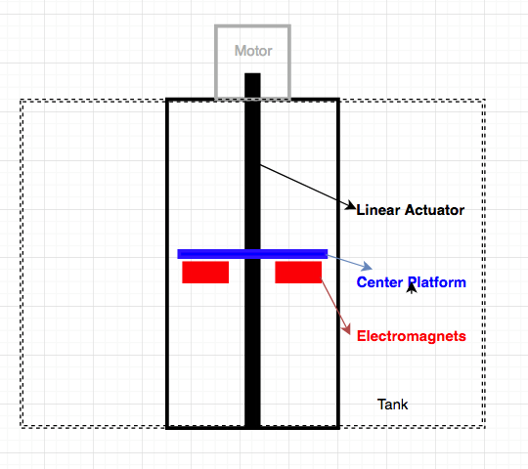
Dynamic Ferrofluid Lamp

Slide 5
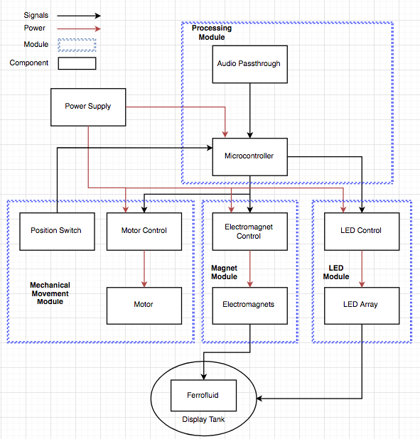
System Overview
Hardware
Processing Module
Mechanical Movement Module
LED Module
Electromagnet Module
Software
Mechanical Movement Module
Electromagnet Module
LED Module

Slide 6
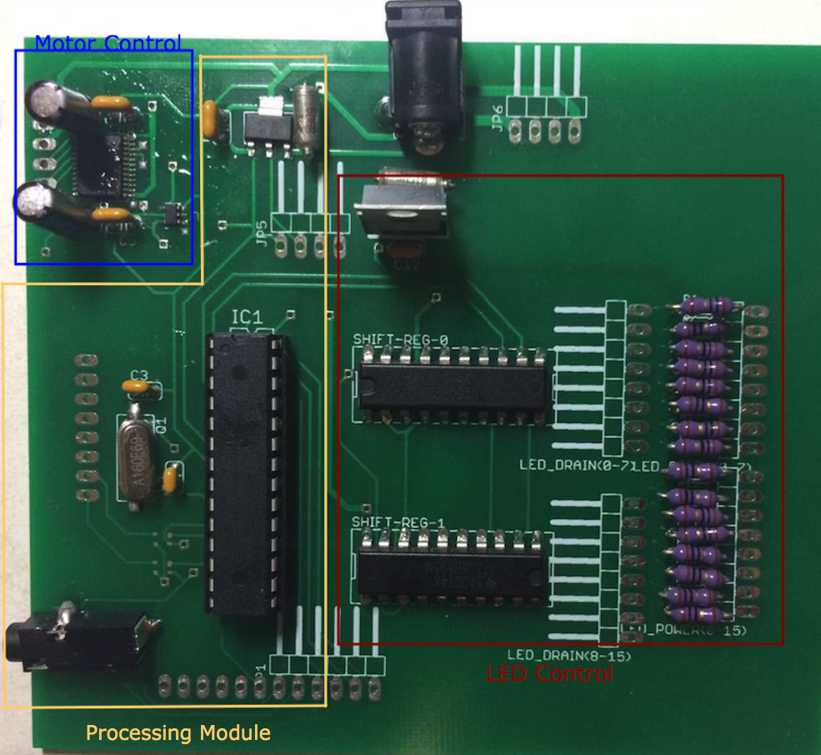
Combined Control PCB
Close Component Distance
PCB Efficiency

Slide 7
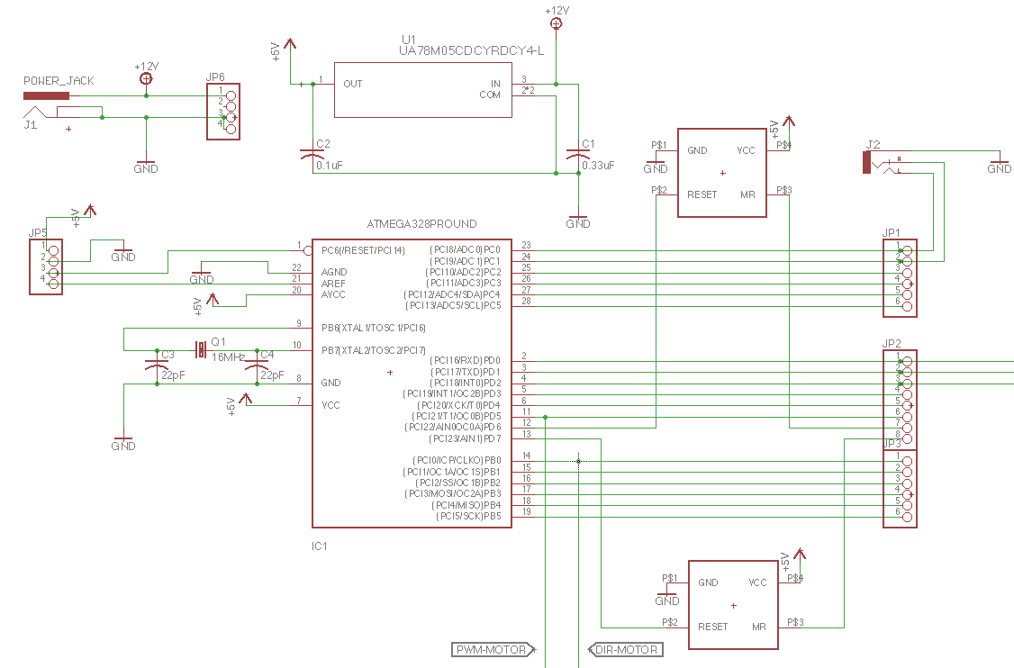
Processing Module
ATMega 328P Microprocessor
Electromagnet Control Signals
Audio Jack
MAX6384 Reset Circuit

Slide 8
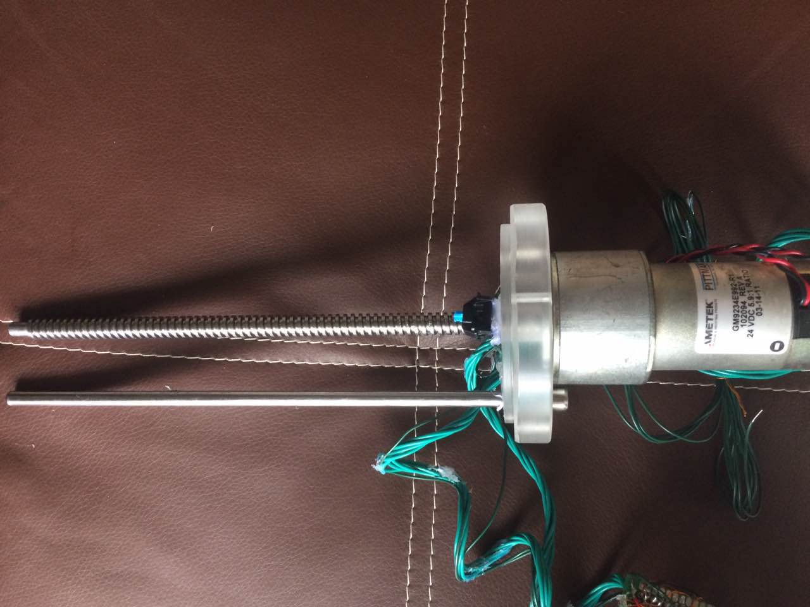
Mechanical Movement Module
Linear Actuator
Position Switches

Slide 9
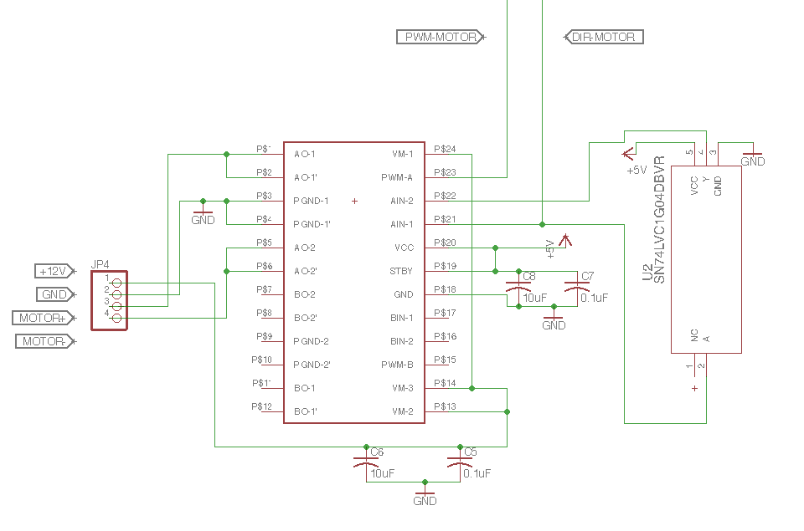
Motor Control Schematic

Slide 10
Mechanical Movement Module (Software)
Input
Speed/Direction/Time inputs from the user
Output
Speed & direction & time outputs for microcontroller
Five speed levels: 0 (slowest) to 5 (fastest)
Two directions: 1 (up) and 0 (down)

Slide 11
Pre-defined Pattern
Up s1 for 2s
Down s2 for 3s
Up s3 for 4s
Down s4 for 5s
Hit top switch, down s5 for 5s
Hit bottom switch, up s5 for 5s

Slide 12
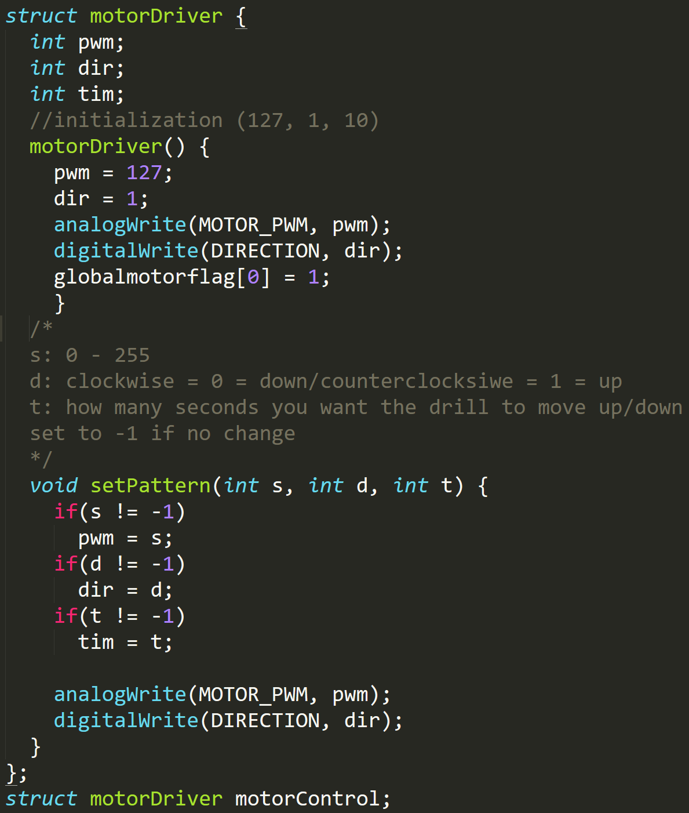
Software Interface

Slide 13
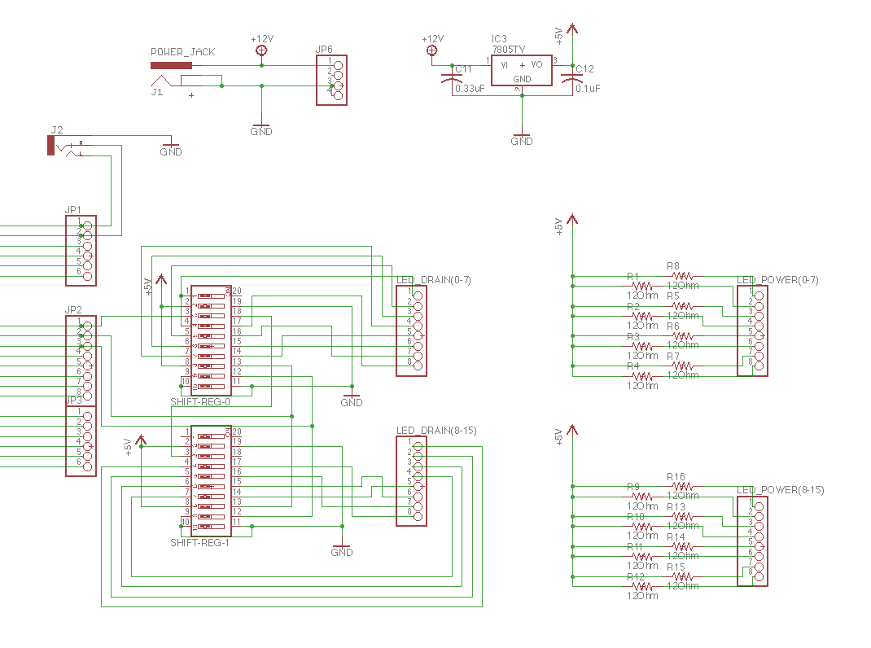
LED Module (Control Schematic)

Slide 14
LED Module (software)
Input
1-D array[9] with 1(on) or 0(off) state for each LED
Intensity for the whole LED grid
Output
On/off state & intensity outputs for microcontroller

Slide 15
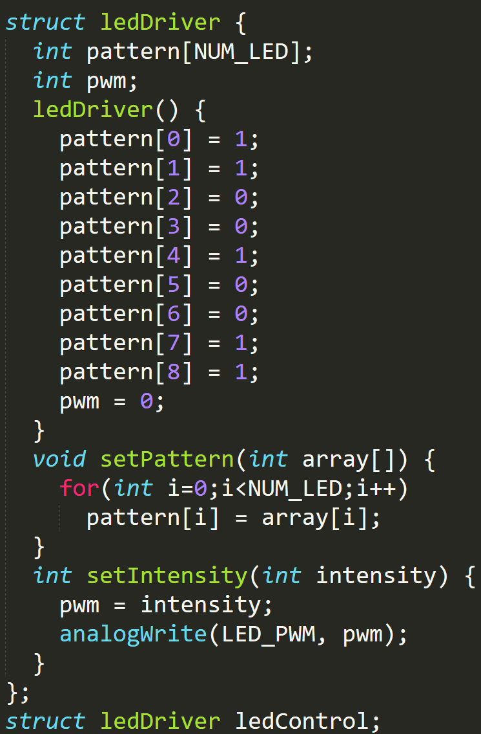
Software interface

Slide 16
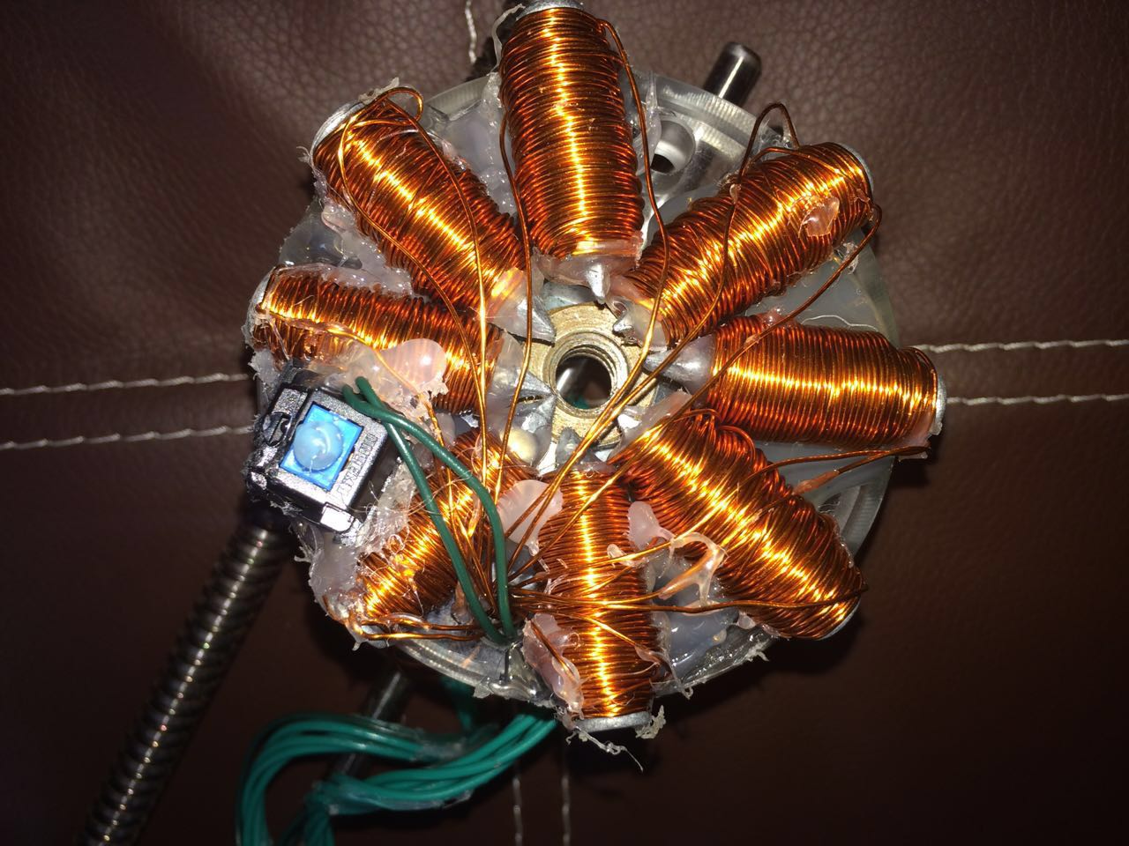
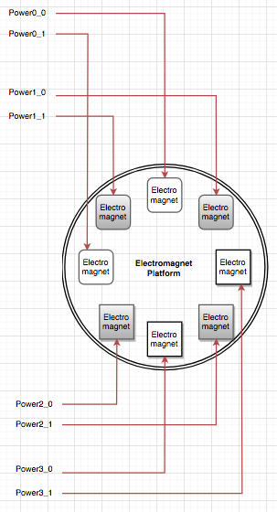
Electromagnet Module (hardware)

Slide 17
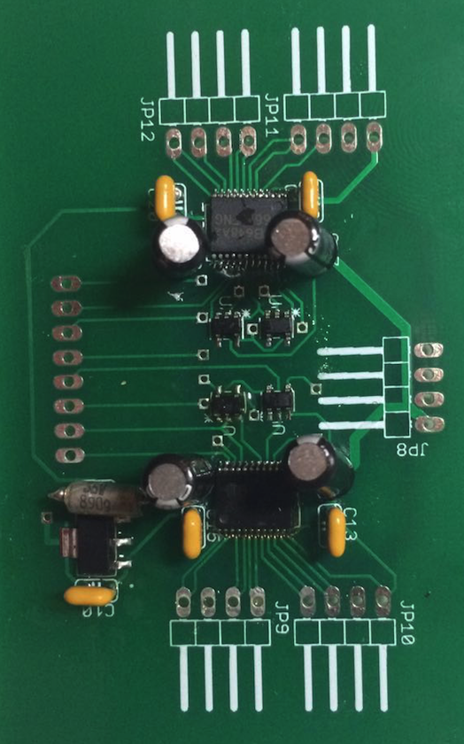
Electromagnet Module Control Unit
TB6612FNG H bridge
Integrated inverter
Voltage regulator

Slide 18
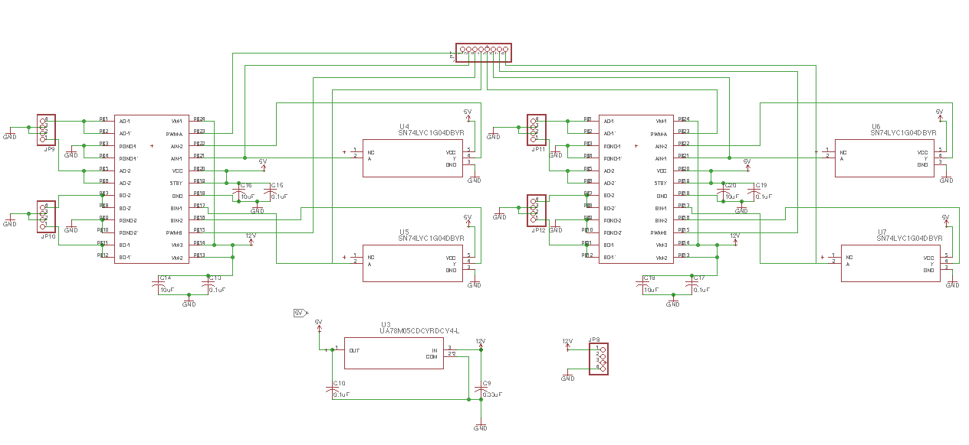
Electromagnet Module Control Unit (Schematic)

Slide 19
Electromagnet Module (software)
Input
Self-defined pattern with no user inputs
Output
Magnetic field intensity outputs for microcontroller

Slide 20
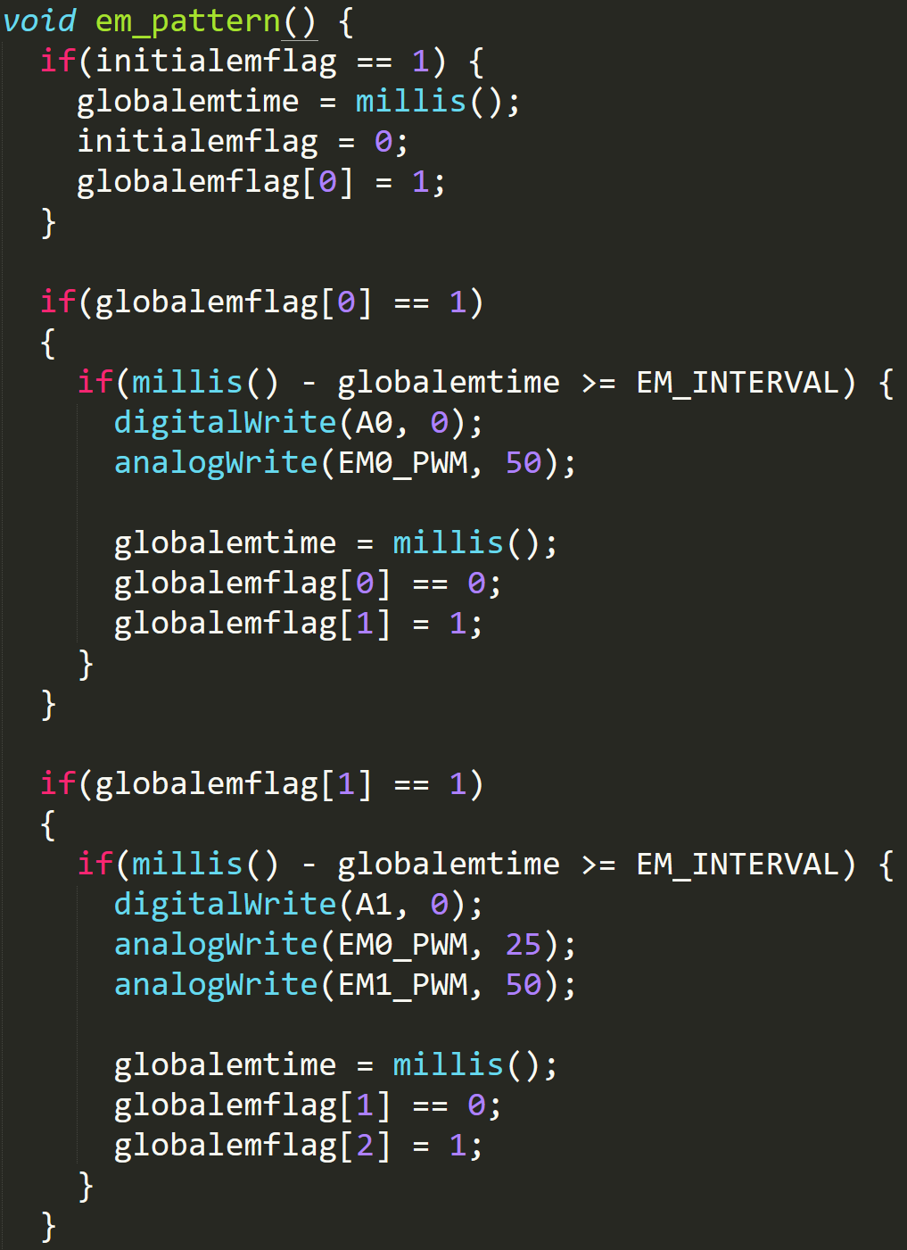
Pre-defined pattern

Slide 21
Conclusions and Future Work
Mechanical movement module verified
Electromagnet module verified
LED module verified
Combined motor and electromagnet pattern not synchronized
Improve the integration effect to achieve combined 2D motion
Allow users to modify magnetic field intensities

Slide 22
Acknowledgements
Mr. Luke Wendt
Mr. Scott A. McDonald
Mr. Zhiyuan Yao

Slide 23
Thank you!
Questions?

