Slide 1
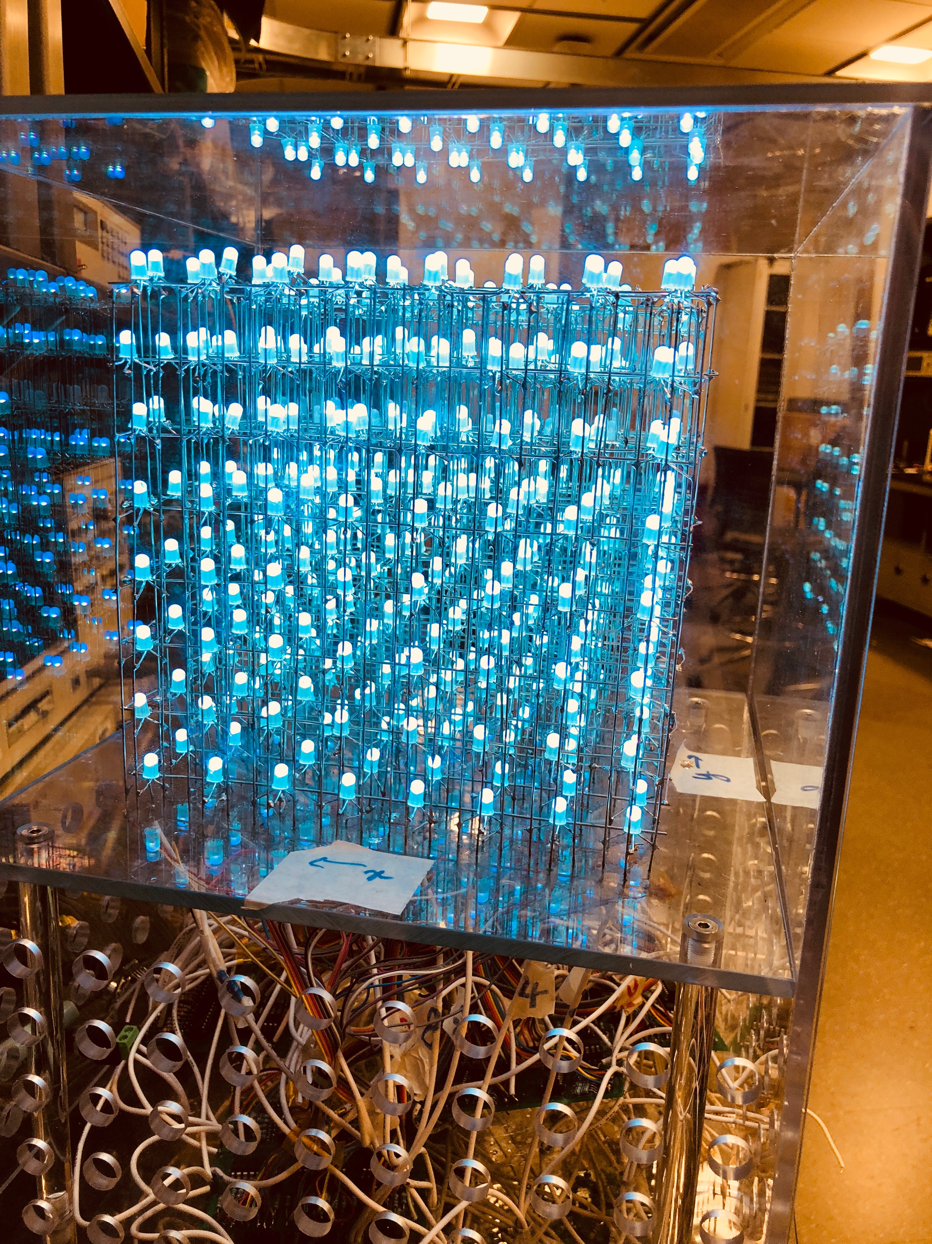
Music-Visualization and Motion-Controlled LED Cube
ECE 445 Spring 2018 Team 34
Hieu Huynh
Islam Kadri
Zihan Yan
TA: Zhen Qin

Slide 2
Problem Statement
Music visualization devices are usually expensive to build, fix, and buy.
Limited to pre-programmed displays or only use a sound’s frequency input to affect the visualization.
Additionally, these devices don’t allow for user interaction which can take away from the entertainment value of the device.

Slide 3
Proposed Solution
Build an LED grid that allows for an aesthetically pleasing way to visualize sound input.
Standardize the way the grid is built for easy fixes for potential problems.
Enable user participation with our device to further the entertainment value.

Slide 4
Objective
Create a low budget, high quality, aesthetically pleasing device for under $150.
Device can extract audible sound's frequency (50Hz - 20kHz), amplitude, and direction of arrival.
The LED cube can reflect the sound's properties in an aesthetic and representative way.
Device can correctly pick up the user’s hand motion and properly control the Snake based on that information when user’s hand is within 15cm of the sensor.

Slide 5
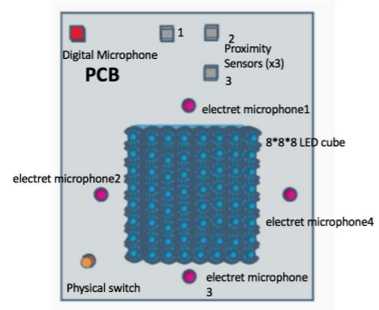
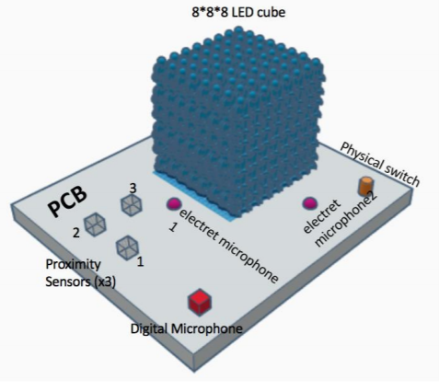
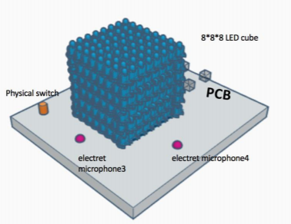
Physical Design
Top View
Side Views

Slide 6
Ultrasonic Sensors

Slide 7
Block Diagram

Slide 8
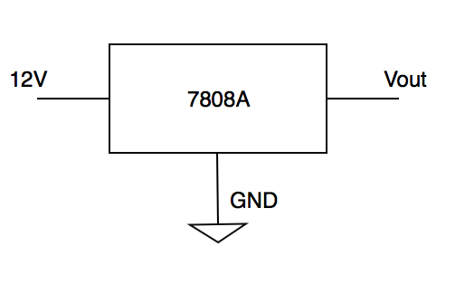
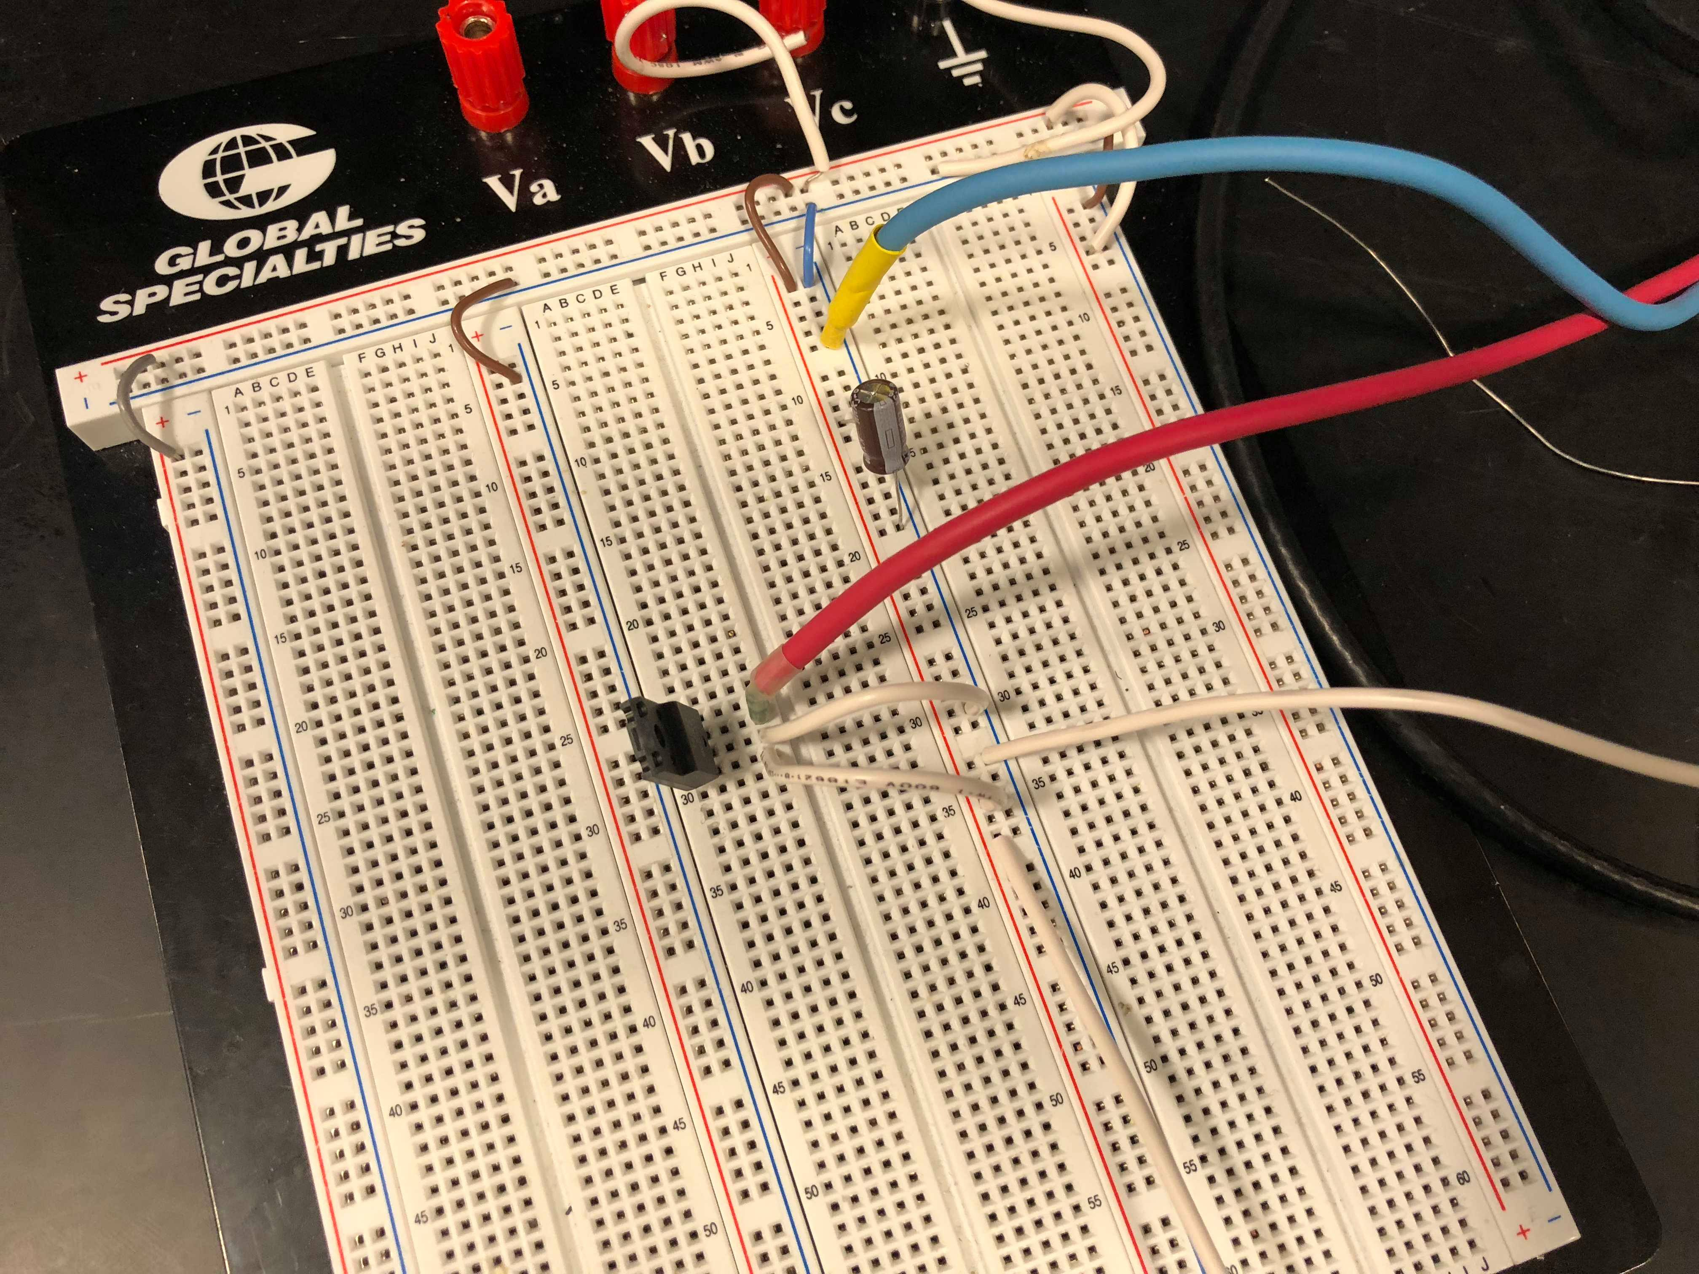
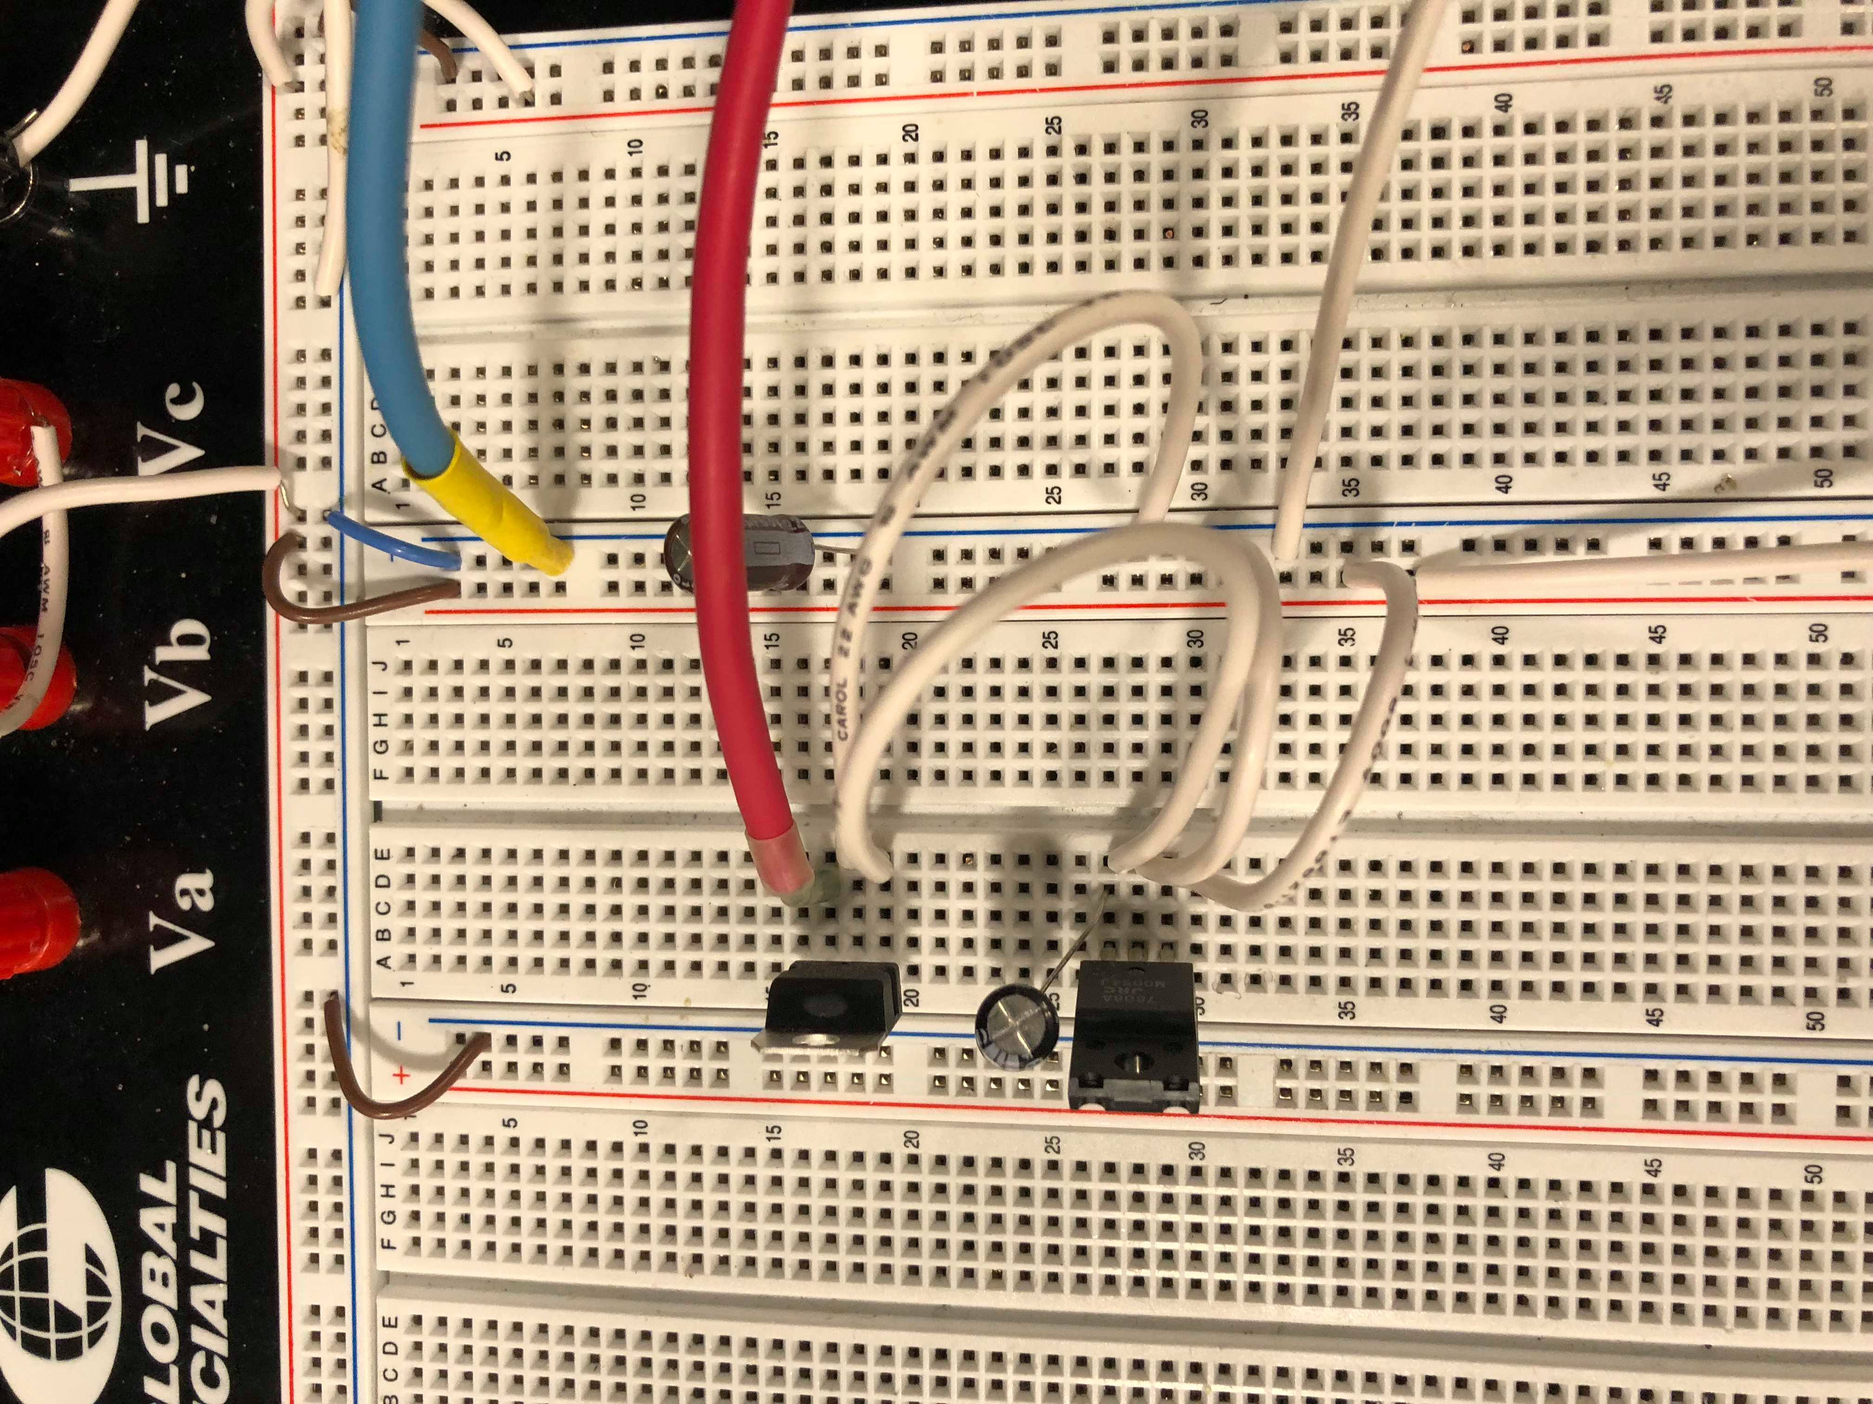
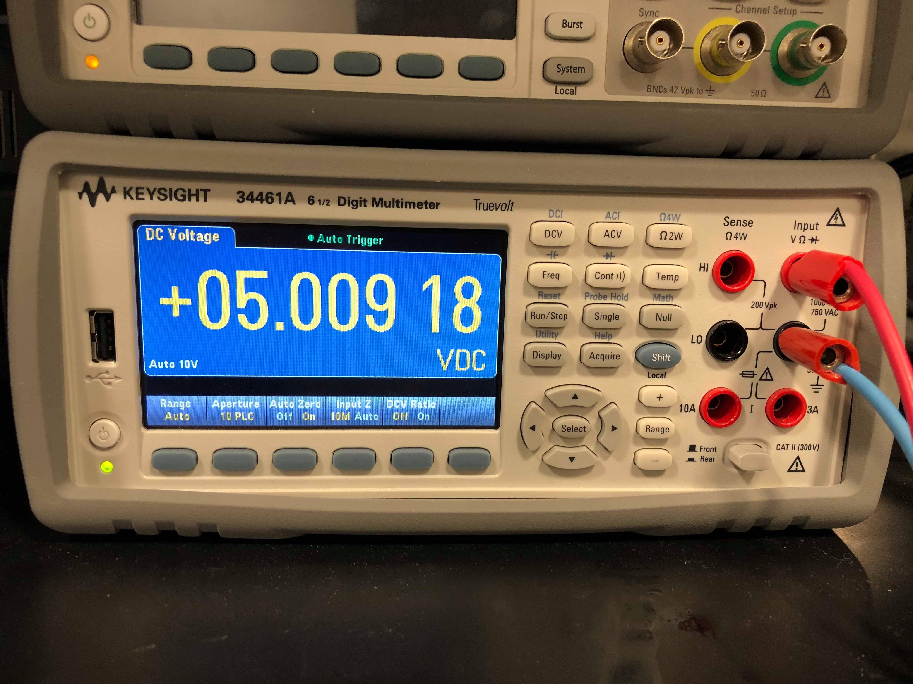
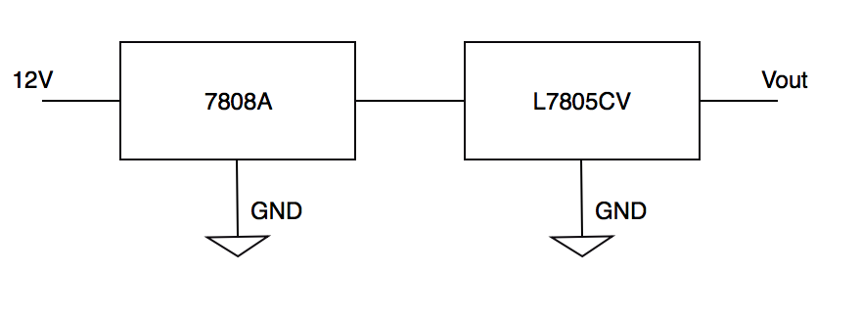
Power Module
1. Output of 8V voltage regulator is 8V +/- 0.5V​
2. Output of 5V voltage regulator is 5V +/- 0.5V

Slide 9
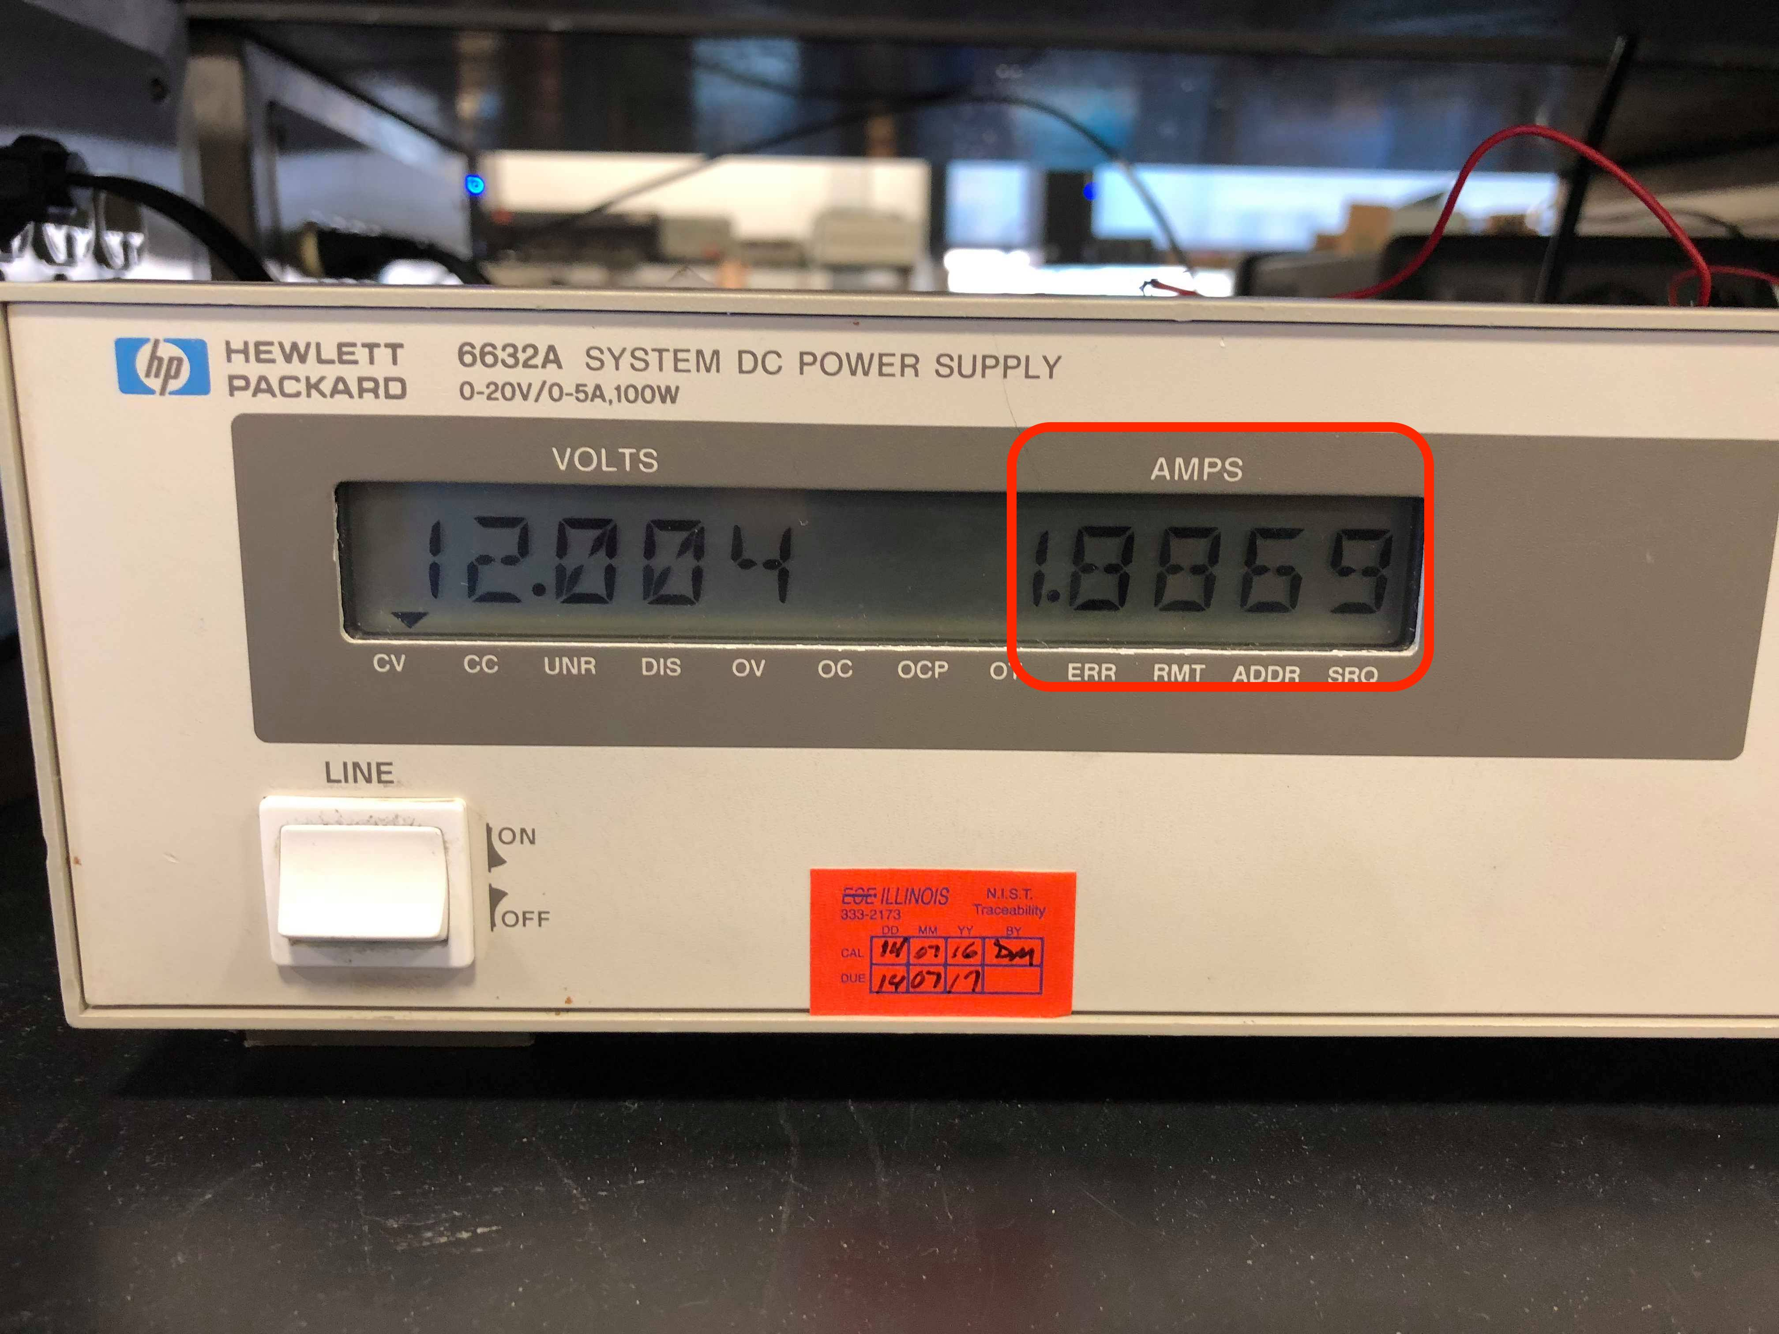
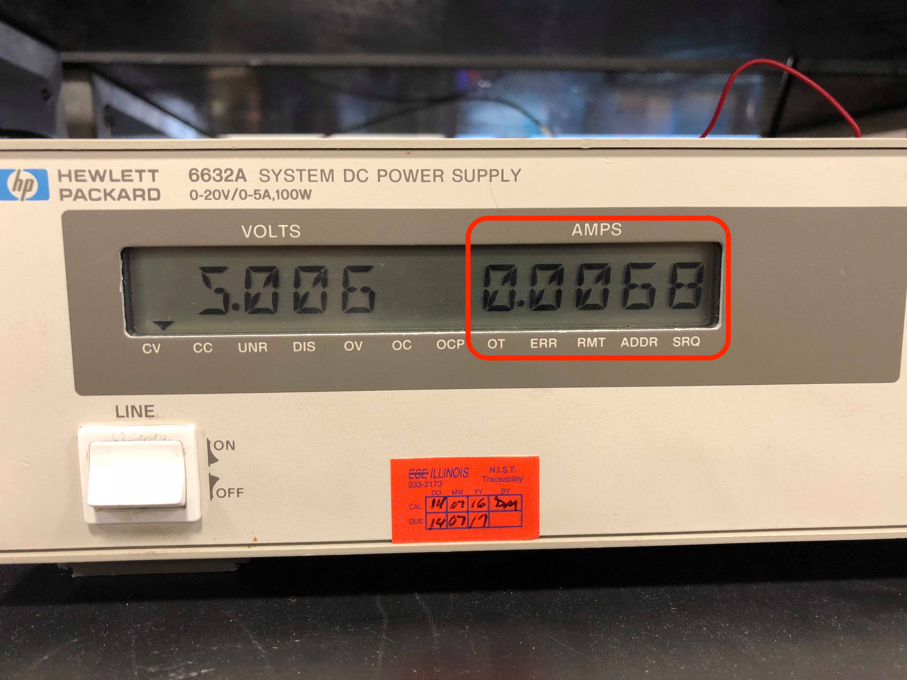
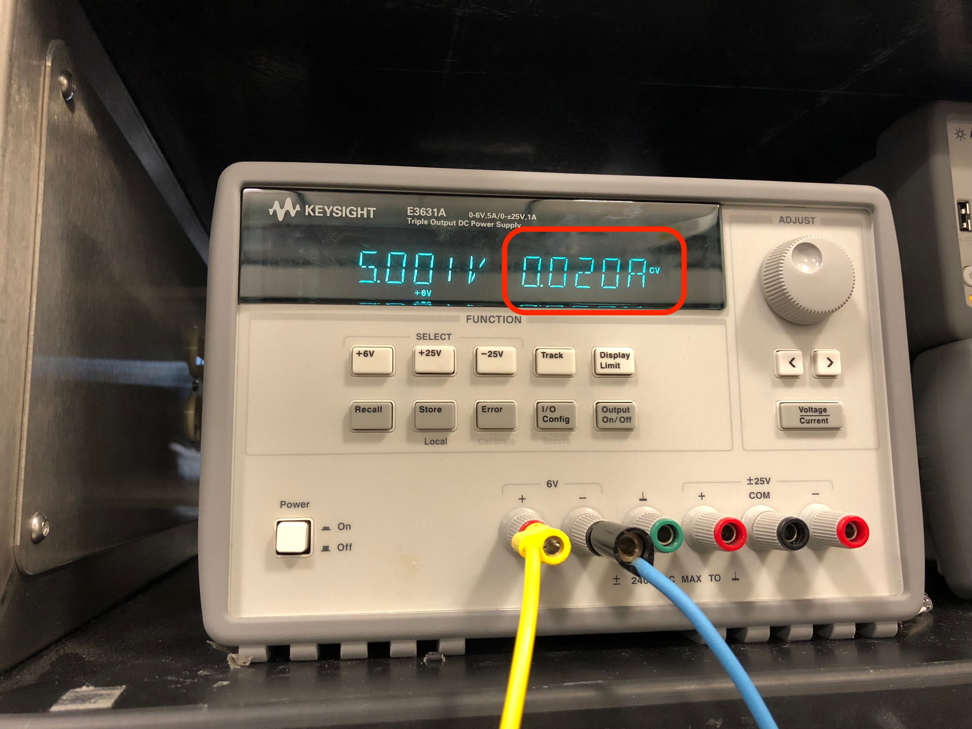
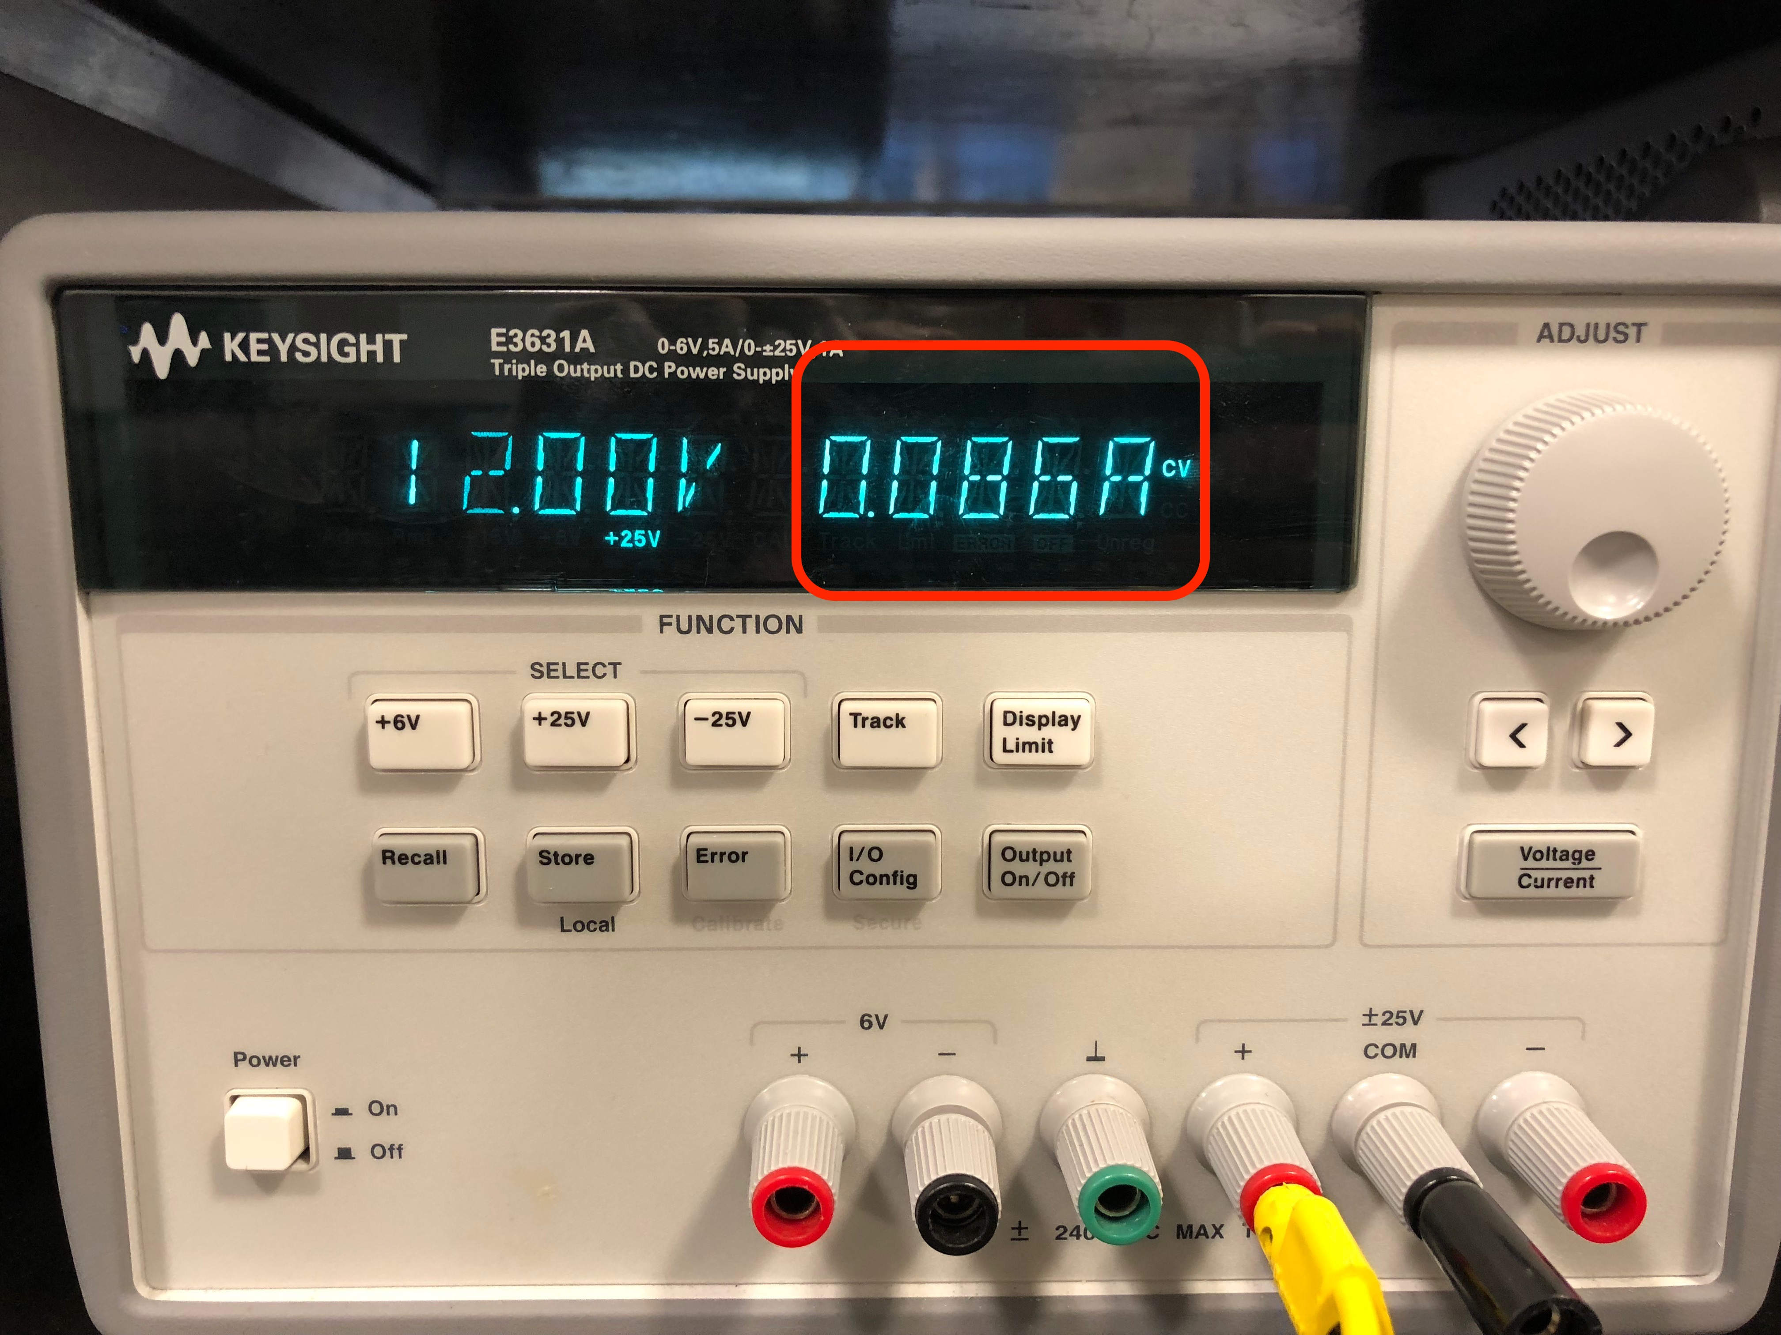
Power Module
3.Adaptor can provide enough current for the system
Current consumed by LED Module
Current consumed by Sensor Module
Current consumed by Microphone Module
The system totally consumes 1.9997A
Current consumed by Control Unit

Slide 10
LED Module
To control 64 LEDs on 1 layer: using 25 8-bit Shift Registers
Shift out 200 bits at rate 100Hz (using SPI library)
[0-63]: for Red LEDs
[64-127]: for Green LEDs
[128-191]: for Blue LEDs
[192-199]: for controlling the level of LEDs

Slide 11
LED Module
1. LED can be turned ON/OFF based on control unit's signals

Slide 12
LED Module
To control LED color: 4-bit BAM (Bit Angle Modulation)
Bit 4 (MSB): intervals 1-8
Bit 3: intervals 9-12
Bit 2: intervals 13-14
Bit 1 (LSB): intervals 15
Example: 0101

Slide 13
LED Module
2. LED's color can be set according to the control unit's signals

Slide 14
Direction of Arrival Detection
Requirement: Be able to detect direction and update within 2 seconds with at least 70% accuracy.

Slide 15
DIRECTION OF ARRIVAL

Slide 16
Direction of Arrival Response Time Test
 | Electret Microphone (Front) | Electret Microphone (Back) | Electret Microphone (Left) | Electret Microphone (Right)
 | Time (ms) | Time (ms) | Time (ms) | Time (ms)
Trial 1 | 9120 | 7450 | 9420 | 6340
Trial 2 | 8890 | 8010 | 8910 | 7820
Trial 3 | 9430 | 6380 | 9220 | 5530
Trial 4 | 9190 | 9260 | 8840 | 7470
Trial 5 | 8530 | 6850 | 9810 | 8420
Average Response Time (ms) | 9032 | 7590 | 9240 | 7116

Slide 17
Electret Microphone Accuracy Rate Test
 | Electret Microphone (Front) | Electret Microphone (Back) | Electret Microphone (Left) | Electret Microphone (Right)
100 Second Trials | Time LEDs Face Front (ms) | Time LEDs Face Back (ms) | Time LEDs Face Left (ms) | Time LEDs Face Right (ms)
Trial 1 | 87,700 | 91,600 | 81,900 | 85,800
Trial 2 | 78,100 | 78,400 | 79,200 | 67,100
Trial 3 | 59,700 | 82,500 | 83,200 | 78,200
Trial 4 | 74,600 | 80,500 | 86,100 | 84,500
Trial 5 | 86,300 | 74,600 | 62,100 | 87,800
Mean Time Facing Correct Direction (ms) | 77,280 | 81,520 | 78,500 | 80,680
Mean Time Facing Correct Direction (%) | 77.28% | 81.52% | 78.50% | 80.68%

Slide 18
Amplitude Analysis
000000 - 700000 → Green
700000 – 950000 → Blue
950001 - 1200000 → Yellow
1200001 - 1450000 → Purple
1450001 - 1700000 → Light Blue
1700001 - 1950000 →
White

Slide 19
Frequency Analysis
Requirement: Computes the frequency spectrum of sound with frequency resolution of 625Hz
To compute frequency spectrum: Use a 64-point FFT.
* 64-point FFT provides Fs/64= 40000/64 = 625Hz

Slide 20
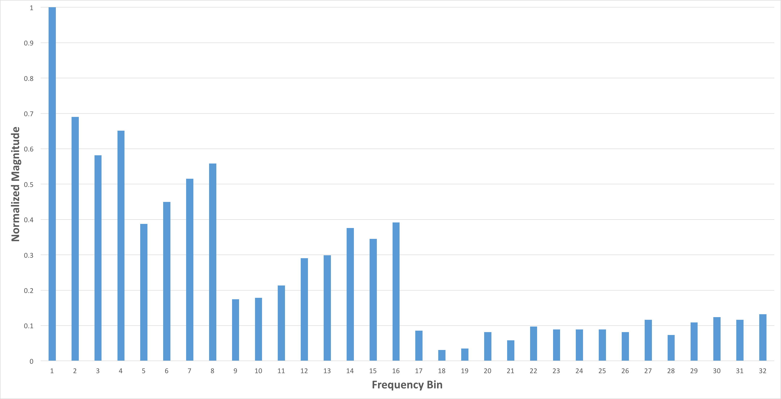
Frequency Analysis Test Result

Slide 21
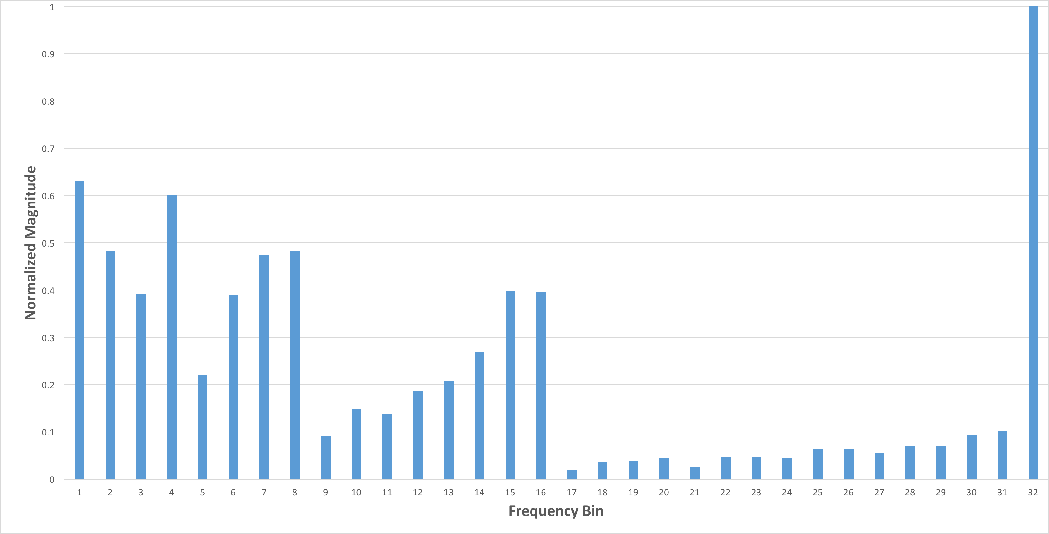
Frequency Analysis Test Result

Slide 22
FEATURE 2: 3D SNAKE GAME

Slide 23
Proximity Sensor
Requirement: Error from the actual distance versus the distance read from the sensor should be less than 10% (considering only distance under 50cm)
Verification: Place hand at the following distances from the ultrasonic sensor (cm): 5, 10, 15, 20, 25, 30, 40, 50

Slide 24
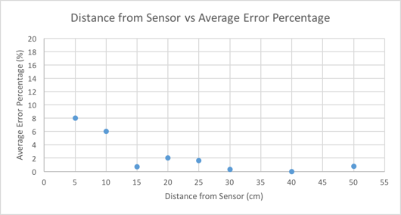
Proximity Sensor Test Result
Distance from Sensor (cm) | Average Offset over 10 Samples (cm) | Average Error Percentage (%)
5 | 0.4 | 8.00
10 | 0.6 | 6.00
15 | 0.1 | 0.67
20 | 0.4 | 2.00
25 | 0.4 | 1.60
30 | 0.1 | 0.33
40 | 0.0 | 0.00
50 | 0.4 | 0.80

Slide 25
Hand Motion Detection

Slide 26
SNAKE GAME

Slide 27
Conclusion
We successfully achieved all the goals that we set to accomplish at the beginning of the semester.
Future work:
Standardizing the build procedure so that fixing LEDs and wire connections is easier.
Increasing the size of the grid would also be an option.
Additionally, higher quality microphones can be used to capture sound in a more accurate manner.

Slide 28
Thanks to: Professor Xiaogang Chen Zhen Qin (TA) ECE Service Shop ECE Machine Shop
S

