Slide 1
ECE 445 Spring 2017 Laser Tag Droid
Group 81: Martin Litwiller, Jake Hamill, Christian Topete

Slide 2
Introduction
A droid that engages in exciting physical and computer gameplay
Fun laser tag experience which could be played in a group or solo
Create a robot competition without damage

Slide 3
Objectives
Can sense other droids and seek targets autonomously
Can be controlled physically through an iPhone app
Can be powered for a sufficient amount of time

Slide 4
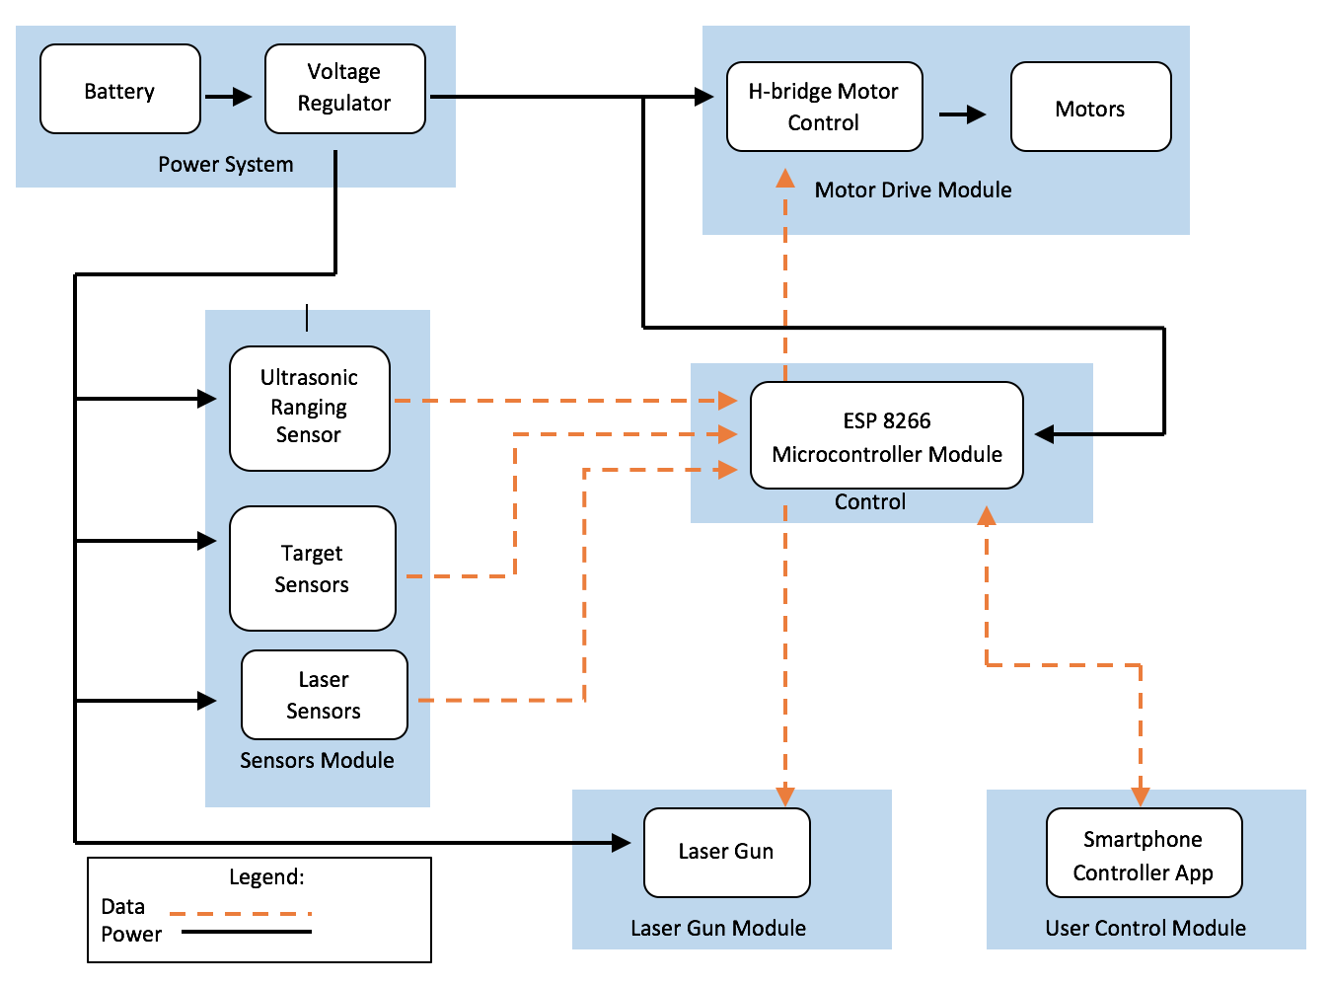

Slide 5
Power System
7.4 volt LiPo battery
LiPo Cutoff Circuit – ensure it cuts off at 6.4 volts
5 volt 3 amp Voltage Regulator
Ensure all systems receive 5 volts efficiently

Slide 7
LiPo Cutoff Circuit Data

Slide 8
Power data

Slide 9
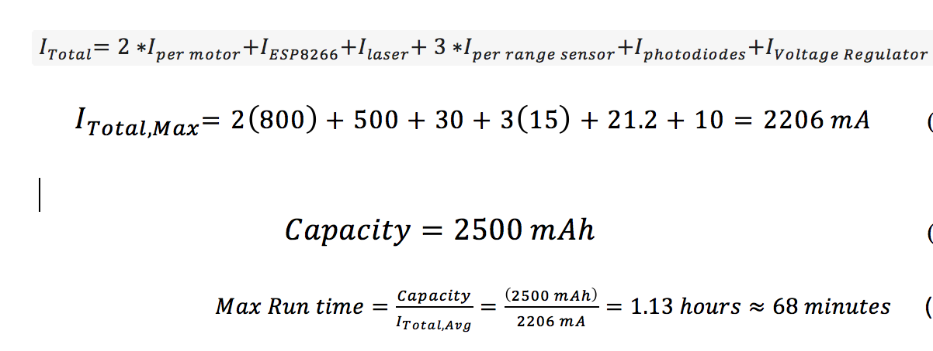
Max Run Time Calculation

Slide 10
R&V
Requirement | Verification
1. Voltage regulator must be able to output 4.9 to 5.2 volts with a maximum current rating of 2.5 amps. (3 points) | Procedure: Attach 2 ohm power resistor as load Attach oscilloscope across load Verify that voltage is steady between 4.9 to 5.2 volts
2. Battery protection circuit must cut off power (<50mV) when the battery voltage falls below 6.4V. (4 points) | Procedure: Apply 8V to the battery connections with a DC power supply Measure voltage regulator output and ensure the voltage is between 6.4-6.6V. Decrease DC power supply voltage to 6.3V Measure voltage regulator output and verify that the voltage is <50mV
3. The overall system battery life should at least be 15 minutes (3 points) | Procedure: Upload system with proper software and let the vehicle run in autonomous mode Let the droid run for at least 15 minutes Verify that the droid is still running after 15 minutes Repeat this procedure 3 times to ensure consistency of verification

Slide 11
Conclusions and Further Work
Power System tested and verified
Ensure sensor, motor-drive, microcontroller, and laser module receive 5 volts
Future work: implementation of 2 voltage regulators

