Slide 1
Automated Window Temperature Regulator (AWTR)
Group 22
Hersh Singh, Derik Lee, Louis Wright

Slide 2
Background
HVAC (Heating, Ventilating and Cooling) systems in homes use a lot of electricity to maintain the desired temperature
Heating and cooling can account for up to 42% of a household utility bill
Average monthly electricity bill in Illinois is $82 and national average is $107
Notes:
Hersh

Slide 3
Solution
Windows are a good way to take the load of HVAC unit in homes
Opening and closing a window is difficult based off outside climate
Can be used to heat up or cool down a room depending on the weather outside
Our solution is an automatic window that opens and closes depending on climate outside as well as temperature inside
User can adjust the desired temperature as well as manually open and close the window
Notes:
Hersh

Slide 4
Features
Sensors for detecting outside and inside climate
Ability to open and close with a motor
Intelligent capability to make decisions based on sensor data
Energy efficient
Detect hazards and obstructions
Notes:
Derik

Slide 5
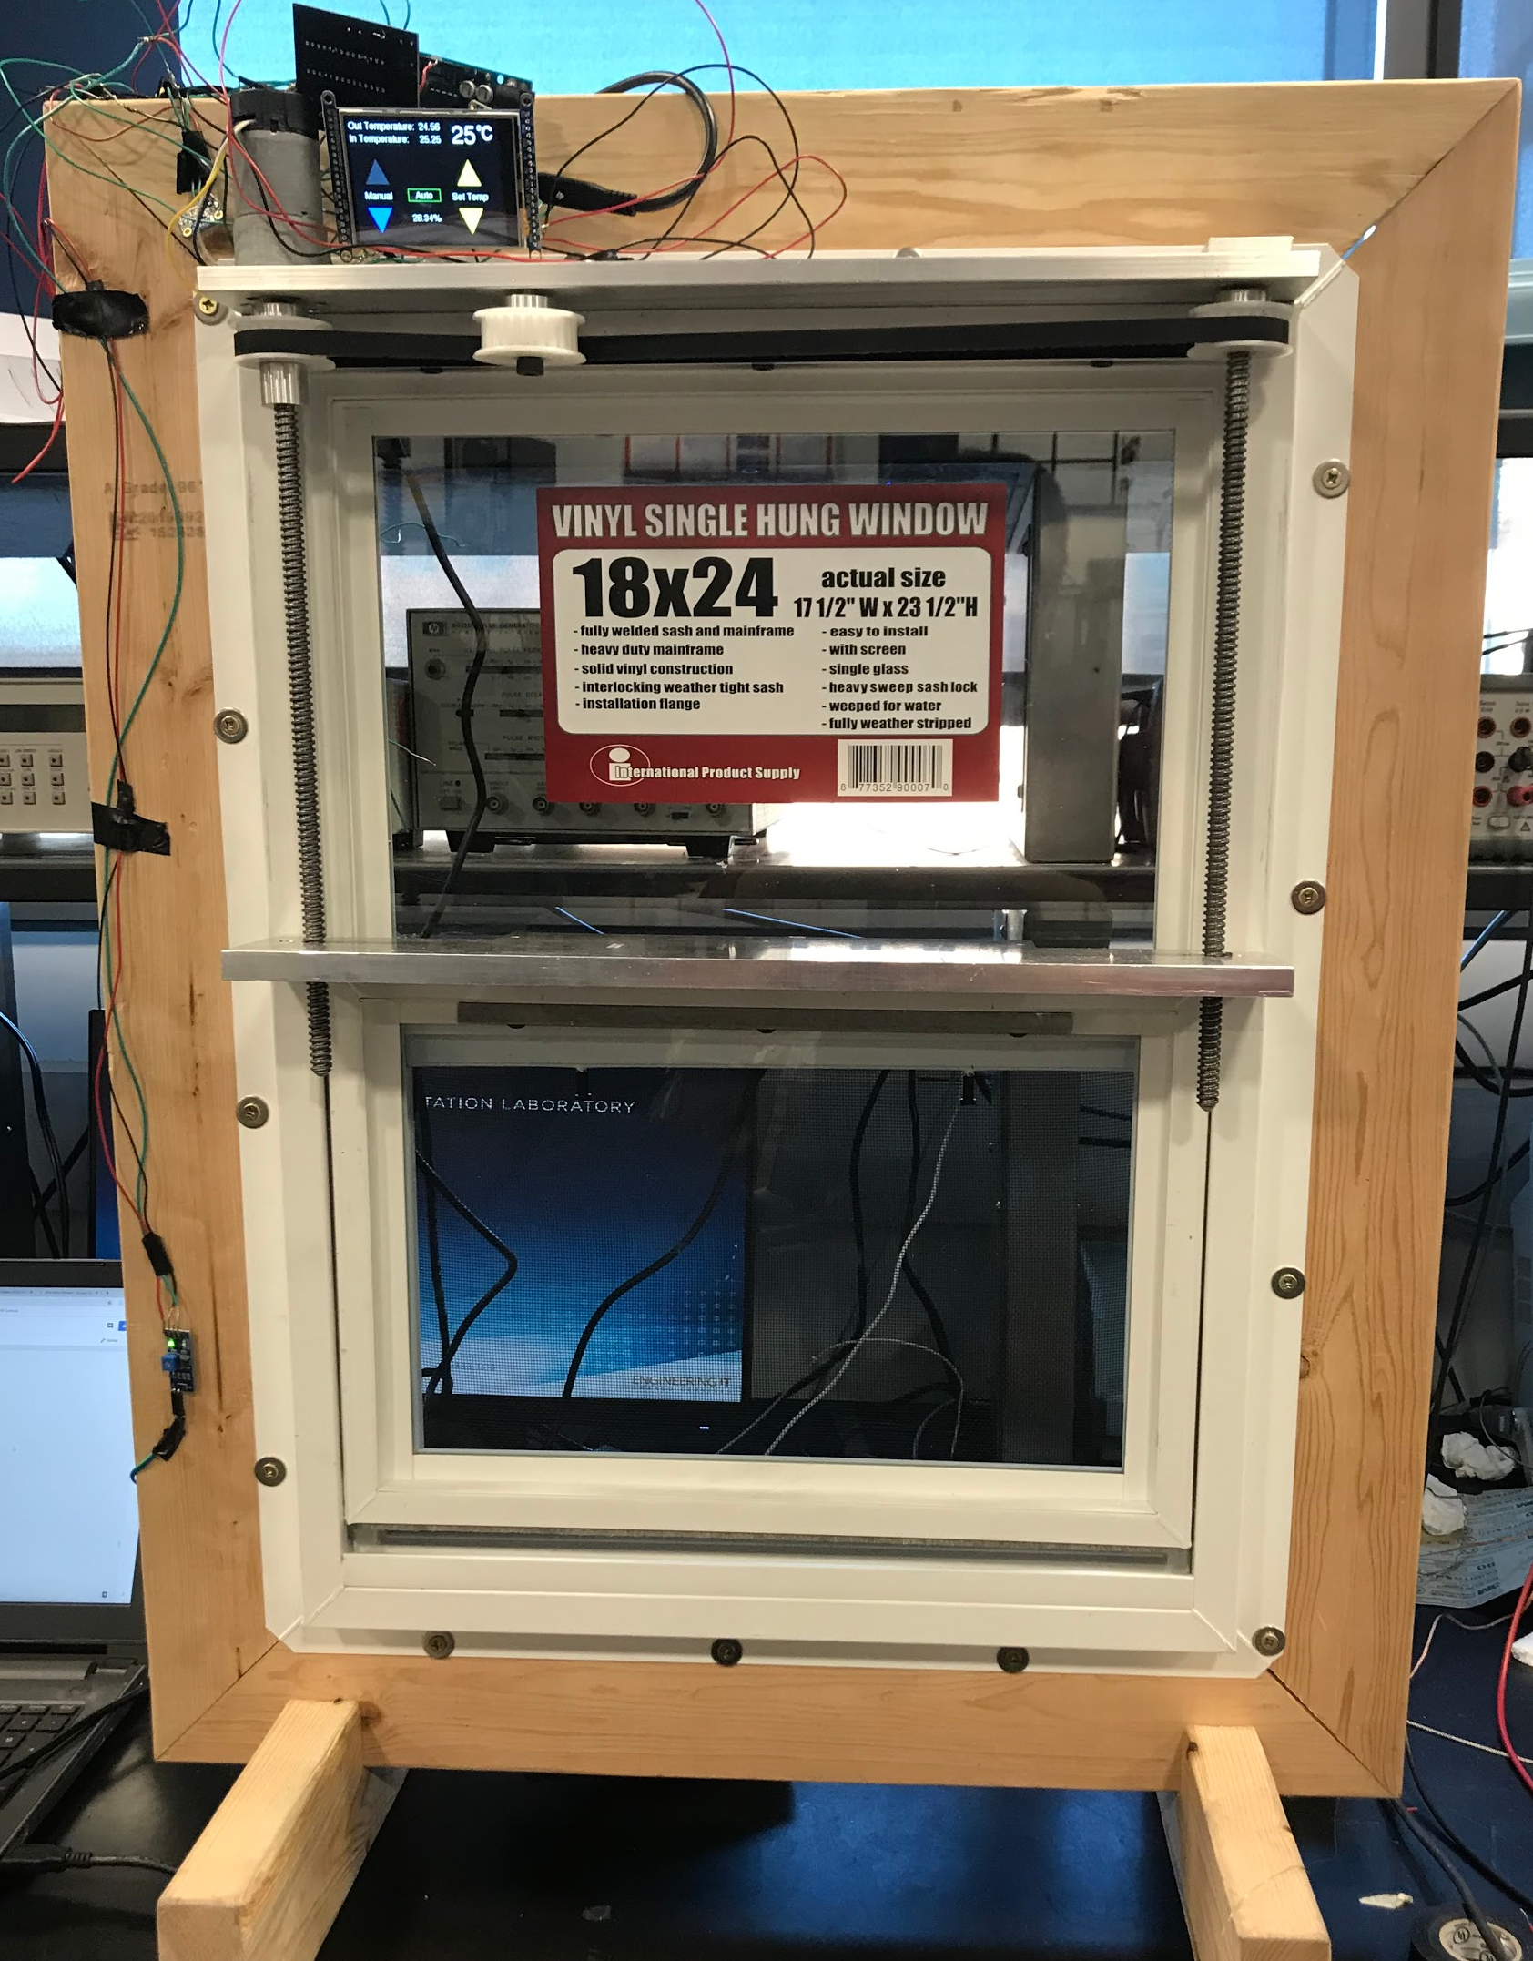
Current Iteration
Notes:
Derik

Slide 6
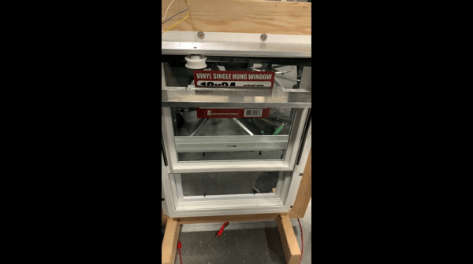
Notes:
Derik

Slide 7
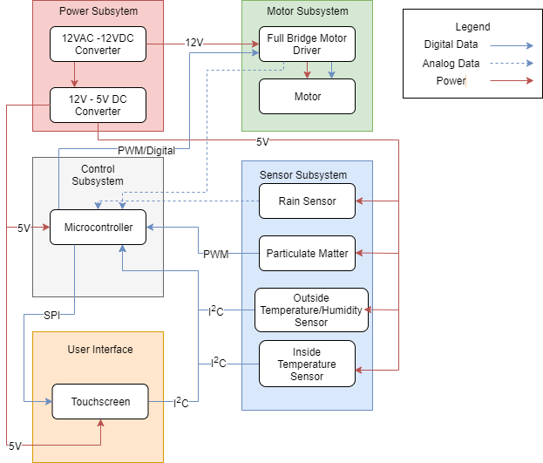
Block Design
Power: Power the device
Motor: Move the window up and down, current output
Sensors: Detect temperature, humidity, rain, pollen
UI: User should be able to see data and interact with window
Controller: Switch between automatic and manual mode as well as decide what state the window should be in
Notes:
Louis

Slide 8
Hardware Overview (Power)
120V to 12V DC converter
Wall adapter used to power entire unit and motor
12V to 5V DC converter
Step down 12V to 5V to power the microcontroller, sensors, touchscreen and motor driver
Notes:
Louis

Slide 9
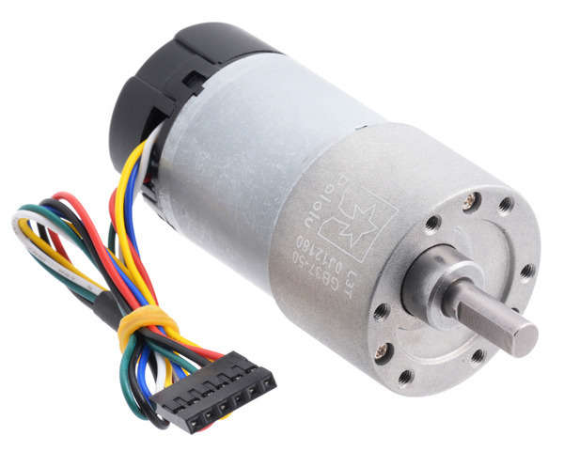
Hardware Overview (Motor)
70:1 Metal Gearmotor from Pololu
150 RPM no load speed
5.5 A stall current
Maximum output power 10 W
Typical operating current in design 0.5 A
Torque needed for 1 kg window: 1.9 Kg*mm
Motor runs at max speed at or below 32 Kg*mm
Notes:
Louis

Slide 10
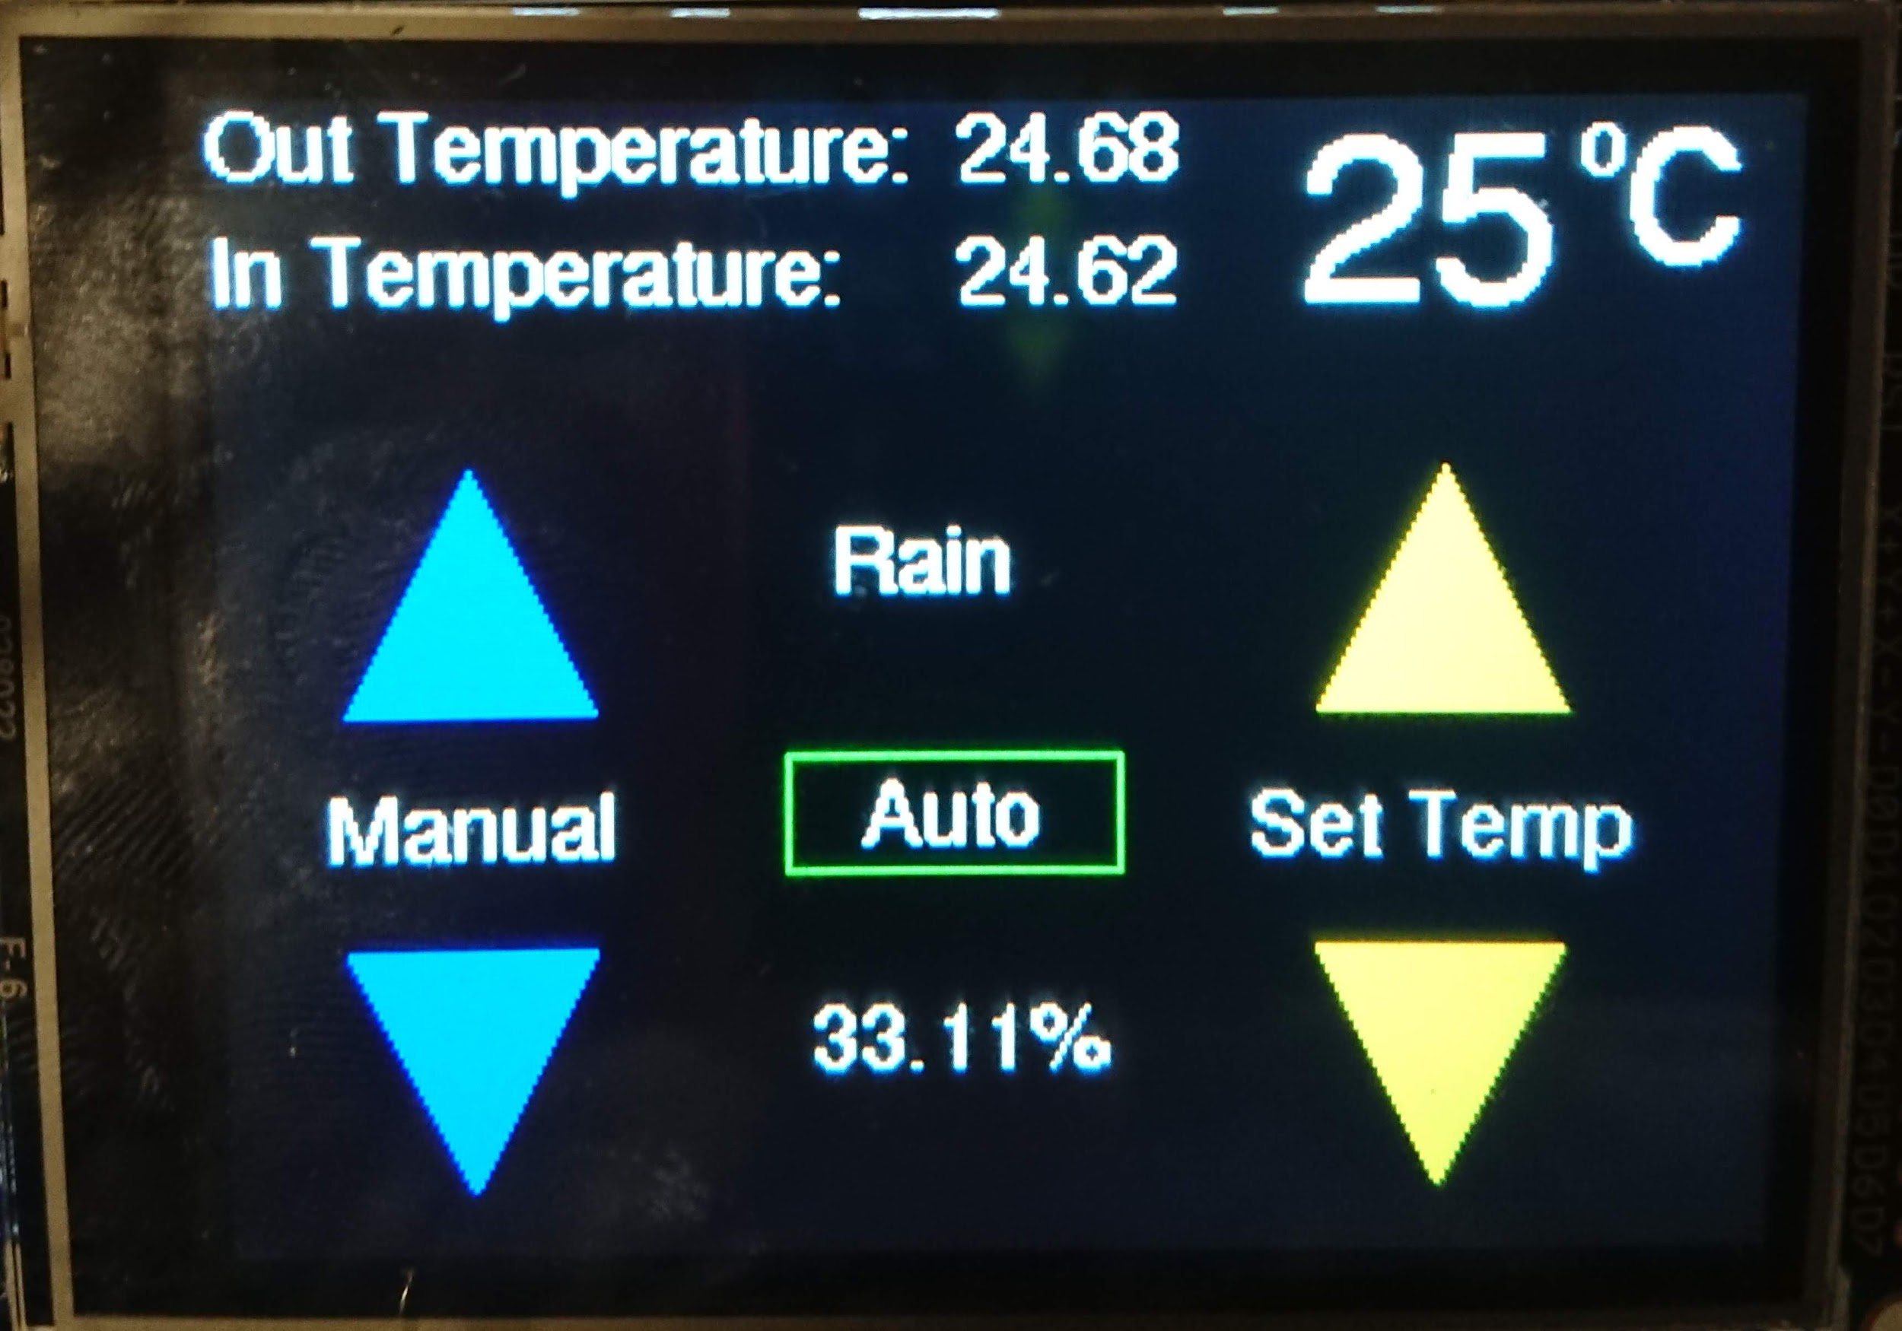
Hardware Overview (UI)
Adafruit 3.2" Color TFT Touchscreen Breakout v2
SPI commands sent to touch screen from microcontroller
I2C commands sent to microcontroller from touch screen
Show data from all sensors and switch between automatic and manual mode
Adafruit ILI9341 library necessary for low level specific to device
Adafruit GFX Library necessary for shapes and fonts
Notes:
Hersh

Slide 11
Sensors
MCP9808 Digital Temperature Sensor
I2C communication
±0.5 °C accuracy for temperature
HDC1080 Digital Humidity and Temperature Sensor
I2C communication
±2% accuracy for humidity and ±0.5 °C for temperature
Grove Dust Sensor
Pulse-width modulation (PWM) output to microcontroller
Minimum detect particle: 1um
30 seconds between readings
A13082300UX1431 from Uxcel (Rain)
Analog output to microcontroller
Sensitivity can be adjusted using a potentiometer
Voltage is high in absence of rain, low when rain is present
Notes:
Derik

Slide 12
Sensor Tolerances
 | Supply Voltage (Maximum) | Latch-up Current (Maximum) | Operating Temperature (Min/Max) | Storage Temperature (Min/Max)
Temperature Sensor | 6 V | 200 mA | -40/150 C (-40/302 F) | -65/150 C (85/302 F)
Humidity and Temperature Sensor | 6 V | 220 mA | -20/85 C (-4/185 F) | -65/150 C (-85/302 F)
Dust Sensor | 5.75 V | 90 mA | 0/45 C (32/113 F) | -30/60 C (-22/140)
Rain Sensor | 5 V | 150 mA | -15/55 C (5/131F) | -40/65 C (-40/149 F)
Notes:
Derik

Slide 13
Microcontroller
Particulate Matter Sensor
Motor Driver nSleep
Motor Driver Disable
Motor Driver PWM 1
Motor Driver PWM 2
I²C SCL
I²C SDA
Motor Encoder
Current Sense 1
Current Sense 2
Rain Sensor
SPI Clock
SPI MISO
SPI MOSI
SPI Chip Select
Touch Screen D/S
AVR ATMega328p
Interfaces with devices using I²C, SPI, PWM, digital and analog interfaces
In built logic to decide on position of window
Reads data from all sensors, outputs decisions to screen and motor driver
Notes:
Louis

Slide 14
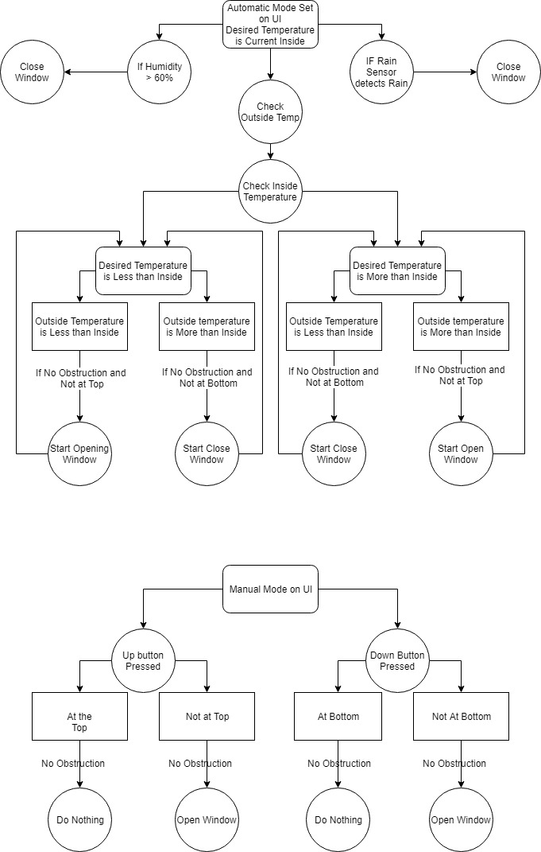
Control Description - Automatic Mode
Notes:
Hersh

Slide 15
Control Description - Automatic Mode
Notes:
Hersh

Slide 16
Control Description - Automatic Mode
Notes:
Hersh

Slide 17
Control Description - Automatic Mode
Notes:
Hersh

Slide 18
Control Description - Automatic Mode
Notes:
Hersh

Slide 19
Control Description - Manual Mode
Notes:
Hersh

Slide 20
Testing Verification
Temperature Sensors
Tested against digital thermometer
Differed by maximum +/-0.37 °C
Particulate Matter
PPM increased drastically (from <1000 ppm to 17000 ppm) when air quality was worsened (chalkboard eraser)
Rain Detector
1 mL of water needed before activation
120 VAC to 12 VDC Converter
11.983 V measured on output of converter
Motor
Opened and closed in 30 seconds
Notes:
Louis

Slide 21
Power Consumption
The fan alone in a HVAC system typically uses 500 W^{[1]} → 4.5 kWh daily minimum
1.2 W daily average → 0.0288 kWh
Saving of 4.47 kWh
Over period of a month: saving of $15, or 18% of total electricity bill***
***Based on average electricity cost of 11.38¢/kWh^{[2]}, average daily usage of 9 hours^{[3]}
Notes:
Louis - Even when considering a household with multiple windows

Slide 22
Ethical Issues
Safety
Automated system that moves on its own
Make sure owners are aware of capabilities as well as implement precautions in case obstructions or hazards are detected
Green Energy
Window is marketed as an energy saving system, analysis of power consumption should ultimately show that window helps owners save energy and money
Environmentally friendly materials
Notes:
No need for refrigerant used in HVAC systems - can be harmful for the environment
Hersh

Slide 23
Challenges
IR sensors and Motor Encoder
Realized we could use current draw from motors
Using current draw requires more hardware aspects
SMD Temperature Sensor
Analog signal gave us incorrect temperature
12 V - 5 V Converter
Gave us 1 V instead of 5 V
Notes:
Derik

Slide 24
Future Plans
Make a container for sensors, PCB, and touch screen
Find more ways to detect climate (Weather API?)
Phone app to control the window and display readings
Connect to HVAC system/smart home integration
Add a sleep function for touch screen
Notes:
Derik

Slide 25
References
USInspect. (2019. Can Running the HVAC Fan Continuously Save Energy?. [online] Available at: https://www.usinspect.com/blog/can-running-hvac-fan-continuously-save-energy-costs-part-1-3/ [Accessed 9 Dec. 2019]
Electricity Local. (2019). Champaign, IL Electricity Rates. [online] Available at: https://www.electricitylocal.com/states/illinois/champaign/ [Accessed 12 Sep. 2019].
EnergyUseCalculator.com. (2019). Electricity Usage of a Central Air Conditioner, [online] Available at: http://energyusecalculator.com/electricity_centralac.htm [Accessed 16 Sep. 2019]
Pololu Robotic & Electronics. (2019). 37D Metal Gearmotors, [online] Available at: https://www.pololu.com/file/0J1706/pololu-37d-metal-gearmotors.pdf [Accessed 10 Oct. 2019]
TI.com. (2019) TPS6213x 3-V to17-V, 3-A Step-Down Converter In 3x3 QFN Package, [online] Available at: https://www.ti.com/lit/ds/symlink/tps62133.pdf [Accessed 3 Oct. 2019]

Slide 26
Thank you!

