Slide 1
Multi-Function IoT Button
Final Presentation
University of Illinois at Urbana-Champaign
ECE 445 Senior Design
Spring 2017
Team 88: Naveed Jamali, Jin Li, Daryl Lim

Slide 2
Introduction + Objective
Problem to solve: memory, habitual tasks/ the “Doorway Effect”
Our solution: a multipurpose, IoT-enabled button with LCD display
Based off/similar to Amazon Dash button
Obvious, physical reminder present on-site of desired role
Ultimate goal - to better convenience lives of users

Slide 3
Features
3 different modes:
1. Counter - keeps count of button presses (Ex. # of cups of water drunk that day)
2. Checklist - timely reminder to perform task (Ex. go to gym, walk the dog)
3. Scripted Action - assigned task to button (Ex. turn off lights)
Voice recognition
Speaker/LED interaction

Slide 4
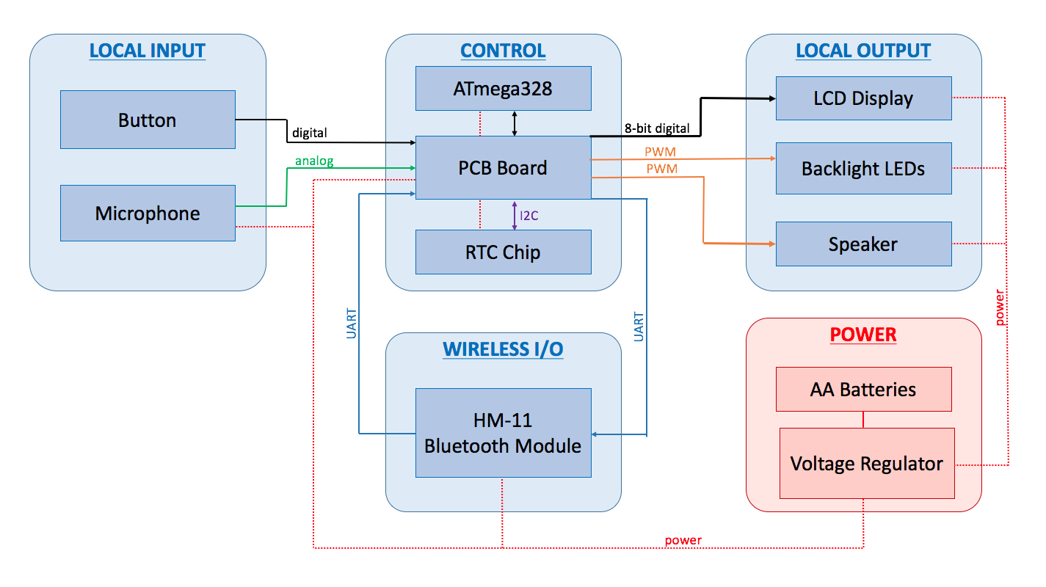
Block Diagram

Slide 5
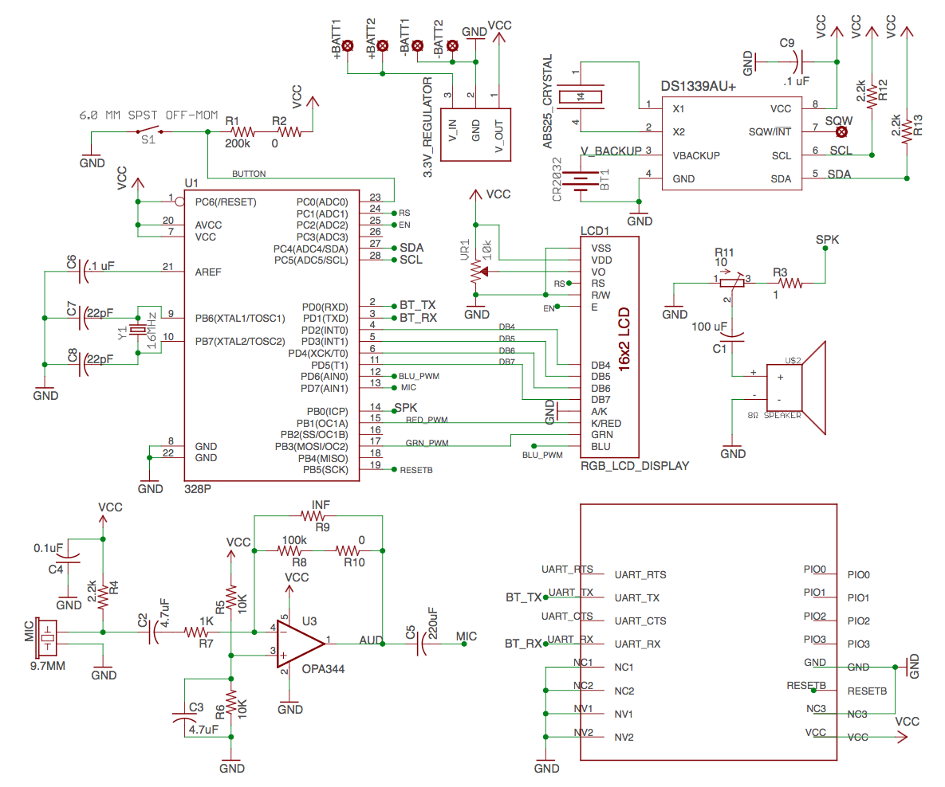
Notes:
Main purpose is to show that almost every I/O pin is used.
Ended up using two more, leaving only one empty one
Used both the I2C and serial interfaces, so we needed the external clock

Slide 6
SPEAKER
Button
HM-11
RGB LCD DISPLAY
ATmega328
Clocks / RTC
Voice Recognition Circuit

Slide 7
Power Switch
3.3V
Coin Cell
1.5 V
Coin Cell
4x AA Batteries
3.3V Voltage
Regulator

Slide 8
Notes:
Here is the what the LCD displays when first turned on
LCD contrast issue (go back slide)
Program it as a counter to limit to 3 cups of coffee a day

Slide 9
Notes:
Entered via bluetooth device (iPhone)
Have to stand in front of the button to program, makes sure you are programming the right one.

Slide 16
Notes:
Button is initialized
Explain Bluetooth Glyph
Explain Bluetooth Presence (LED vs constant update)
Backlight disabled when not present, dim right now

Slide 18
Notes:
“Good” sound played

Slide 23
Notes:
“Bad” sound

Slide 24
Notes:
Can go through the same process for the checklist mode

Slide 25
Notes:
Go through the process of setting it up

Slide 26
Notes:
Custom Glyphs once again

Slide 29
Notes:
Action Mode
Sends a signal to connected device (iPhone)
Complex action is carried out by host device
This is IoT component, simple connection to phone allows for a lot of different uses

Slide 30
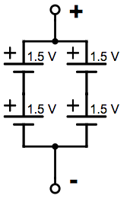
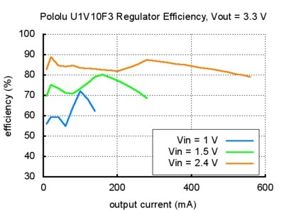
Power Supply
4 AA Batteries: 2 in series, 2 in parallel
3V regulated to 3.3V to power entire board
Notes:
Timing Delay between Speaker and LED feedback

Slide 31
Bluetooth
Transmit/receive data
Set mode
Set label
Counter: set goal/limit
Checklist: set time
Action: transmit action
User detection
Notes:
Difficulty with setting mode to act as both master and slave, had to set both mode and role properly - confusing datasheet

Slide 32
Single Word Voice Recognition
Voice Picked Up by Mic
Amplification Circuit
Analog to Digital Converter
Phoneme Estimation
Word Estimation
On PCB
On ATmega328

Slide 33
Microphone Amplification Circuit
Notes:
Main purpose is to show that almost every I/O pin is used.
Ended up using two more, leaving only one empty one
Used both the I2C and serial interfaces, so we needed the external clock

Slide 34
Phoneme Estimation
Utilized µspeech library in Arduino IDE [1]
Theory:
Premise: High frequency sounds (such as /s/, /sh/) ---> very chaotic graphs that zigzag a lot [2]
(Plotting the air pressure over time)
Evaluation Metric: [2]
Estimation: /s/ ---> very high value of c
/a/ ---> low value
/v/ --->value just in between. [2]

Slide 35
Phoneme Estimation
Utilized µspeech library in Arduino IDE [1]
Action:
Calibration: Look for threshold values.
Reason: The ranges and thresholds depend on the microphone specs and the amplification circuit (op-amp gains, circuit element precision, etc).

Slide 36
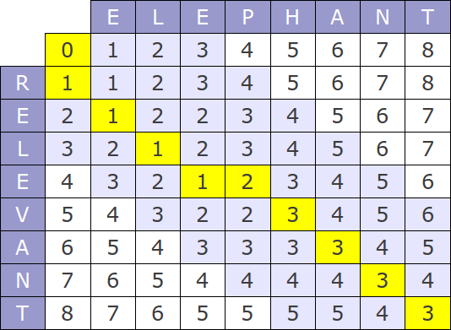
Word Estimation
Levenshtein distance: a measure of the difference between two strings
Example [3]
Algorithm [4]

Slide 37
Word Estimation
Process
Microphone captures single sound, estimate phoneme, accumulate to string
Compare input string to all four word models
Classify to word model with least Levenshtein Distance
If word model corresponds to “off”, classify as “off”

Slide 38
Conclusion
Counter, checklist, and scripted action displays on LCD as intended
Bluetooth functionality fully integrated
Further work:
Complete RTC integration (failed)
Implementation of Scripted Action functionality to achieve IoT
App development to better user interface
App development to analyze user data

Slide 39
Thank you!
Questions

