Slide 1
Table Tennis
Fault Serve Detection
Group 9: Shraddha Dangi, Katelyn Riehl, Vishesh Verma
May 3, 2017

Slide 2
Objective
Problem :
Service in competitive doubles in table tennis can lead to a lot of controversy.
Arguments often break out over whether the serve was “in” or “out”
Solution :
A table tennis fault serve detector which will determine whether the serve was valid.

Slide 4
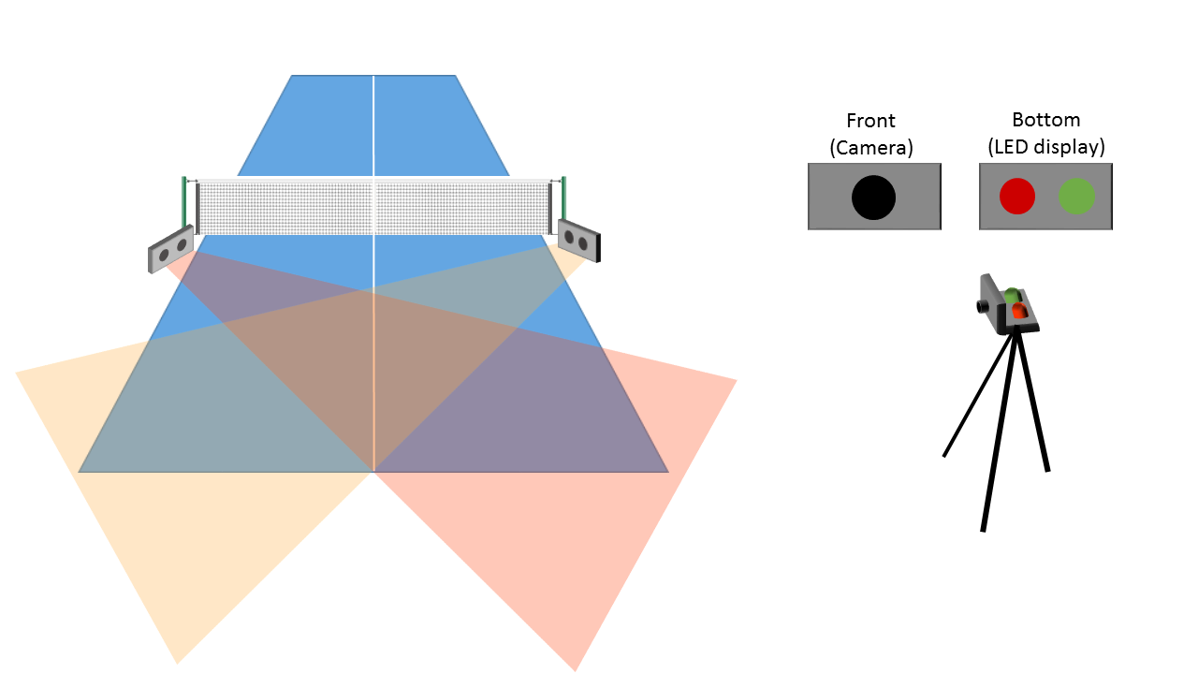
Physical Design
Figure 1: Physical design

Slide 5
Camera’s View of Table
Figure 2: Camera view

Slide 6
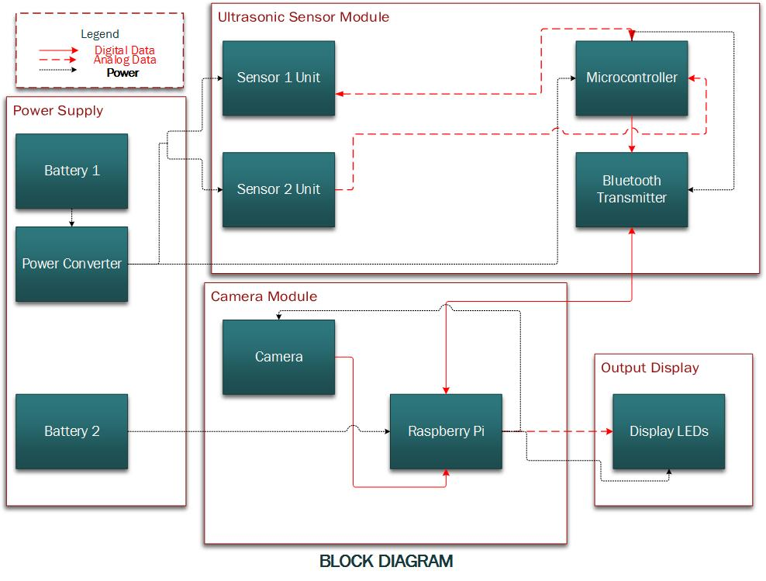
Figure 3: Block diagram

Slide 7
Power Supply

Slide 8
Battery
Sensor Module
9V battery
500mAh
~6.5 hours
Camera Module
5V rechargeable power bank
6400 mAh
~2.5 hours
Table 1: Sensor module voltage and current values
Component | Voltage | Current
Ultrasonic Sensor (x2) | 5 V | ~30 mA (x2)
ATmega | 5 V | 4.1 mA

Slide 9
Table 2: Battery test
Minutes | V_{dc,battery} | V_{DC,load} | V_{p-p, load}
0 | 8.7 V | 5.03 V | 40 mV
5 | 8.6 V | 5.03 V | 42 mV
10 | 8.5 V | 5.03 V | 59 mV
15 | 8.5 V | 5.03 V | 54 mV
20 | 8.4 V | 5.03 V | 40 mV
25 | 8.4 V | 5.03 V | 54 mV
30 | 8.3 V | 5.03 V | 31 mV
35 | 8.3 V | 5.03 V | 67 mV
40 | 8.2 V | 5.03 V | 33 mV
45 | 8.2 V | 5.03 V | 48 mV
Requirement: Battery must last at least 45 minutes

Slide 10
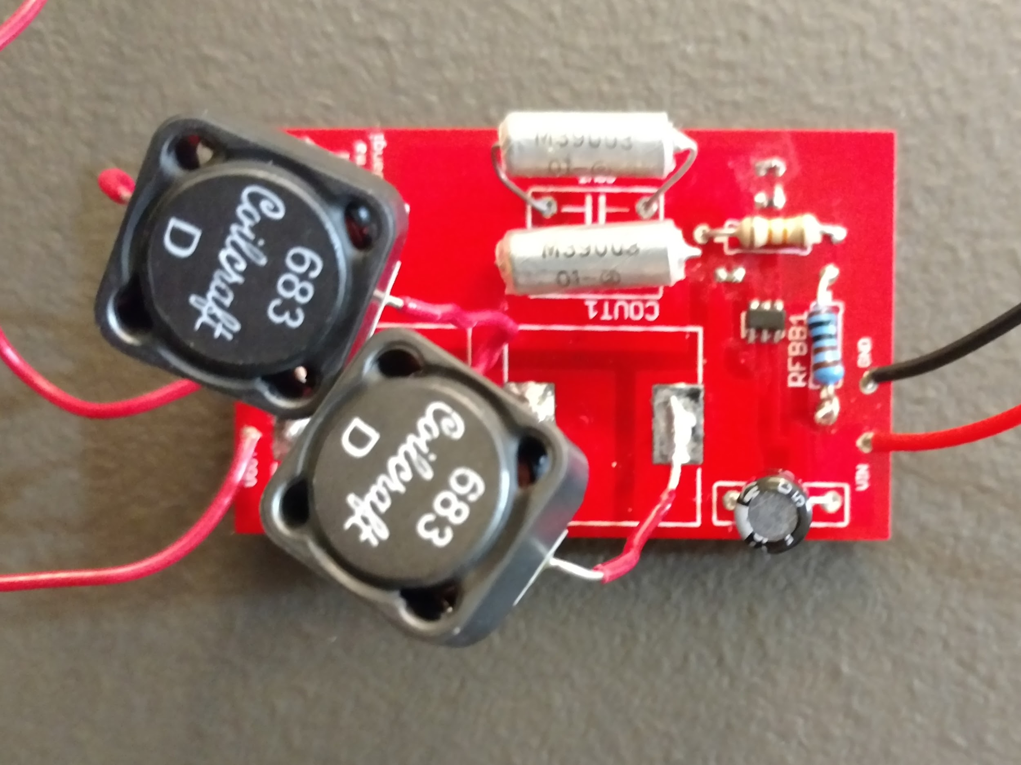
Buck Converter
9V → 5V buck converter
±5 voltage ripple%
Maximum current of 70 mA
All components in sensor module require 5V
Figure 4: Buck converter PCB

Slide 11
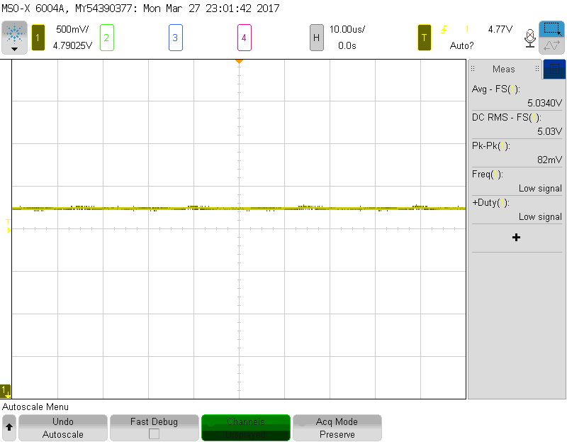
Figure 5: Buck converter output voltage
Requirement: 5V ± 5%, maximum 70 mA

Slide 12
Ultrasonic Sensor Module

Slide 13
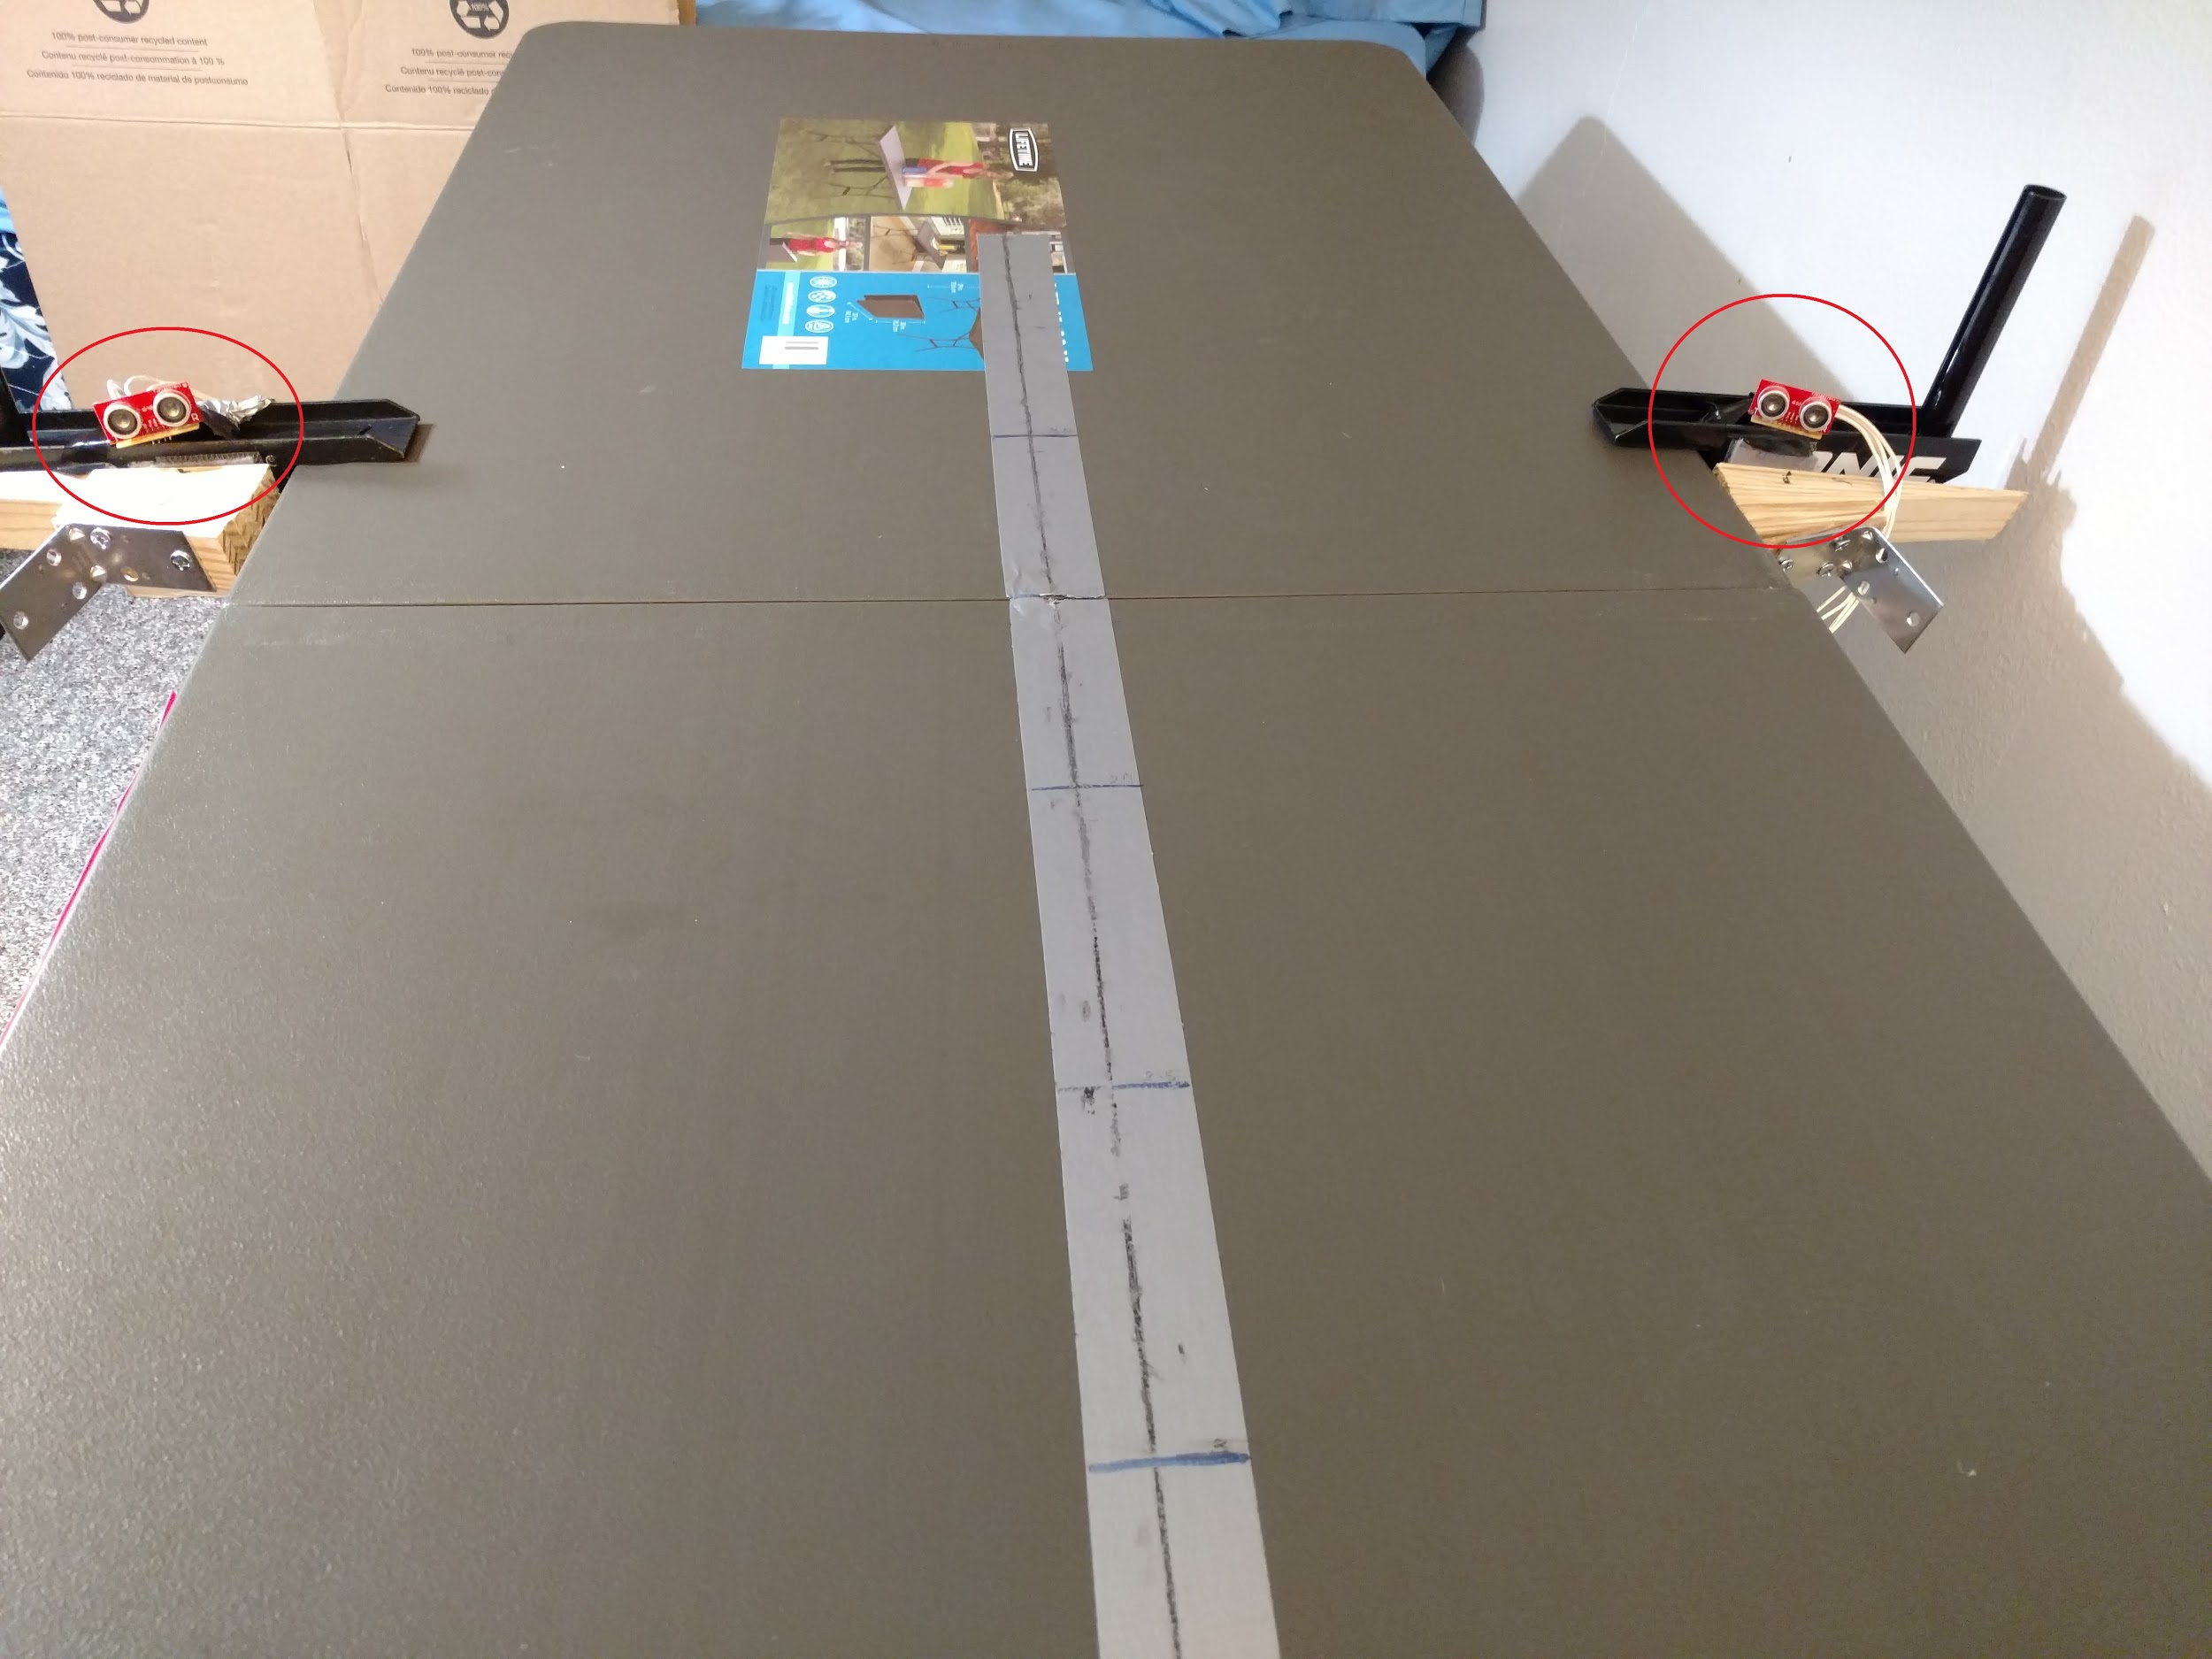
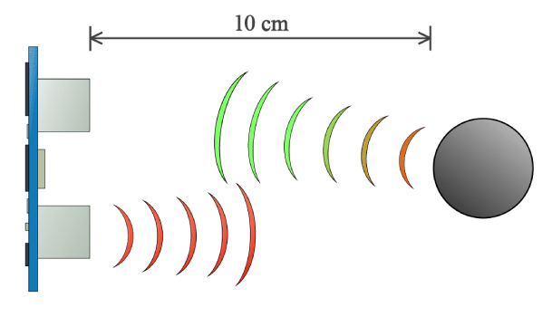
Ultrasonic Sensors
Distance equation:
distance = (time/2) * speed of sound
Figure 6: Ultrasonic sensor range
Figure 7: Ultrasonic sensor set-up
http://howtomechatronics.com/tutorials/arduino/ultrasonic-sensor-hc-sr04/

Slide 14
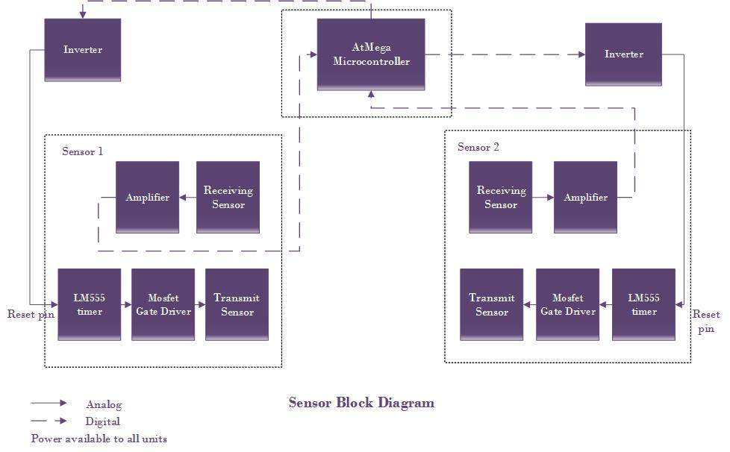
Figure 8: Sensor block diagram

Slide 15
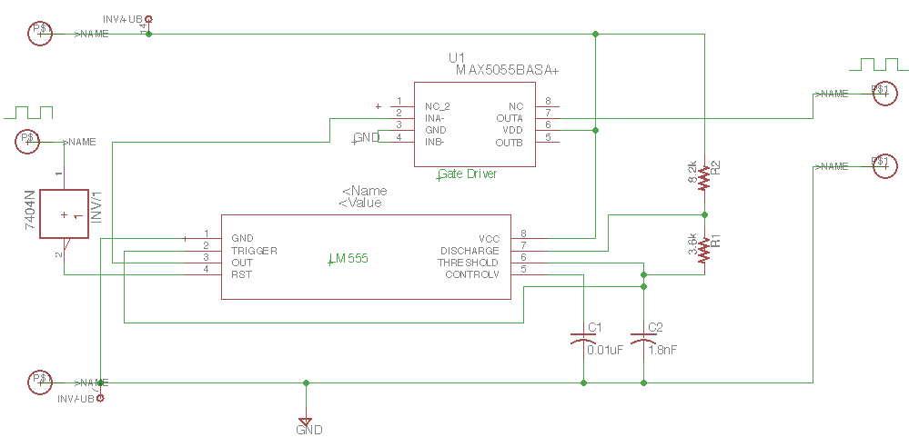
Figure 9: Ultrasonic transmitter circuit schematic

Slide 16
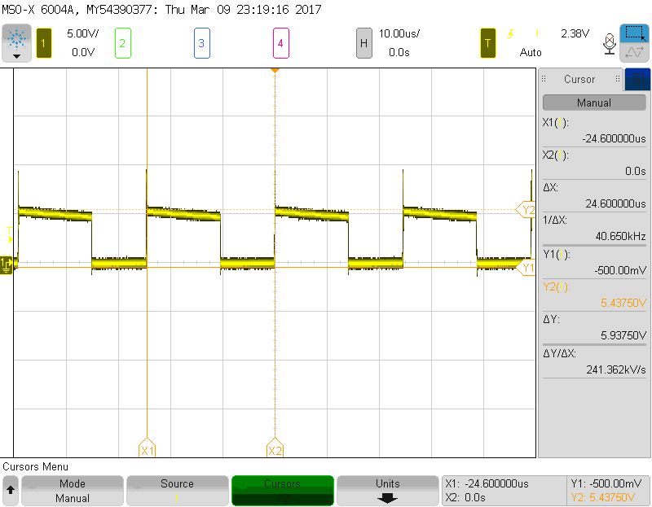
Ultrasonic Module
Astable Multivibrator
Emits a continuous square waveform at 40 KHz
Time period = 25us
fc = (1.44C)/(R2+2R1)
th = 0.693(R1+R2)C
tl = 0.693(R2)C
time period = th+tl = 0.0249 ms
Duty cycle = 60%
Figure 10: LM555 timer output waveform

Slide 17
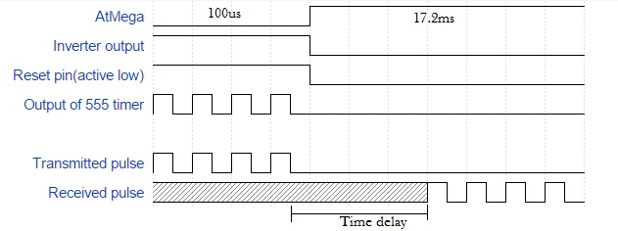
AtMega → Low for 100us, High for 17.2ms
Inverter output → Reset pin of LM555 timer
Reset pin is active low. High to reset → LM555 transmits
Figure 11: Timing diagram

Slide 18
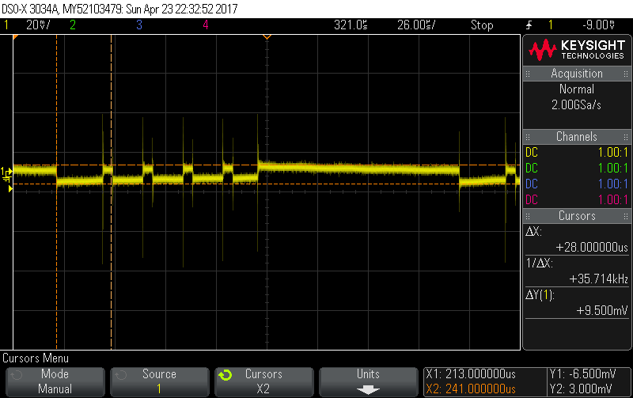
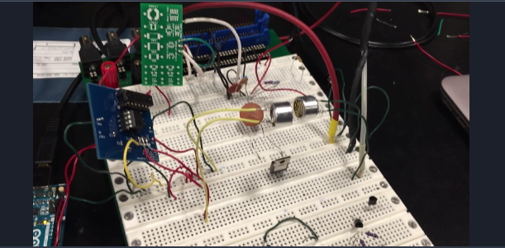
Ultrasonic module
Figure 12: Ultrasonic transmitter-receiver test
Figure 13: Ultrasonic received signal waveform

Slide 19
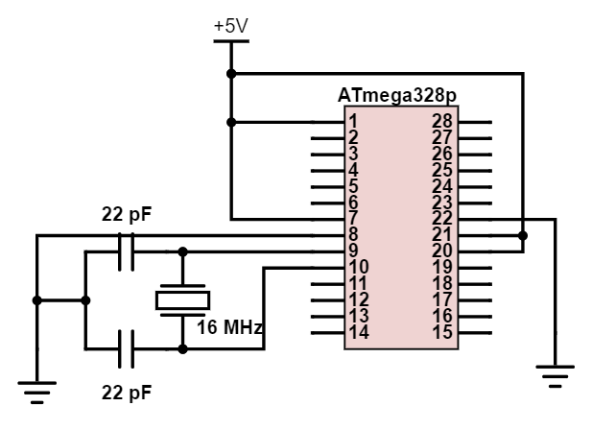
ATmega328p Microcontroller
Provides signal for reset of LM555 timer
“LOW” - 100 us
“HIGH” - 17.2 ms
Receives sensor readings
Continuously takes in sensor readings
Determines which sensor ball was closer to
Figure 14: ATmega circuit schematic

Slide 20
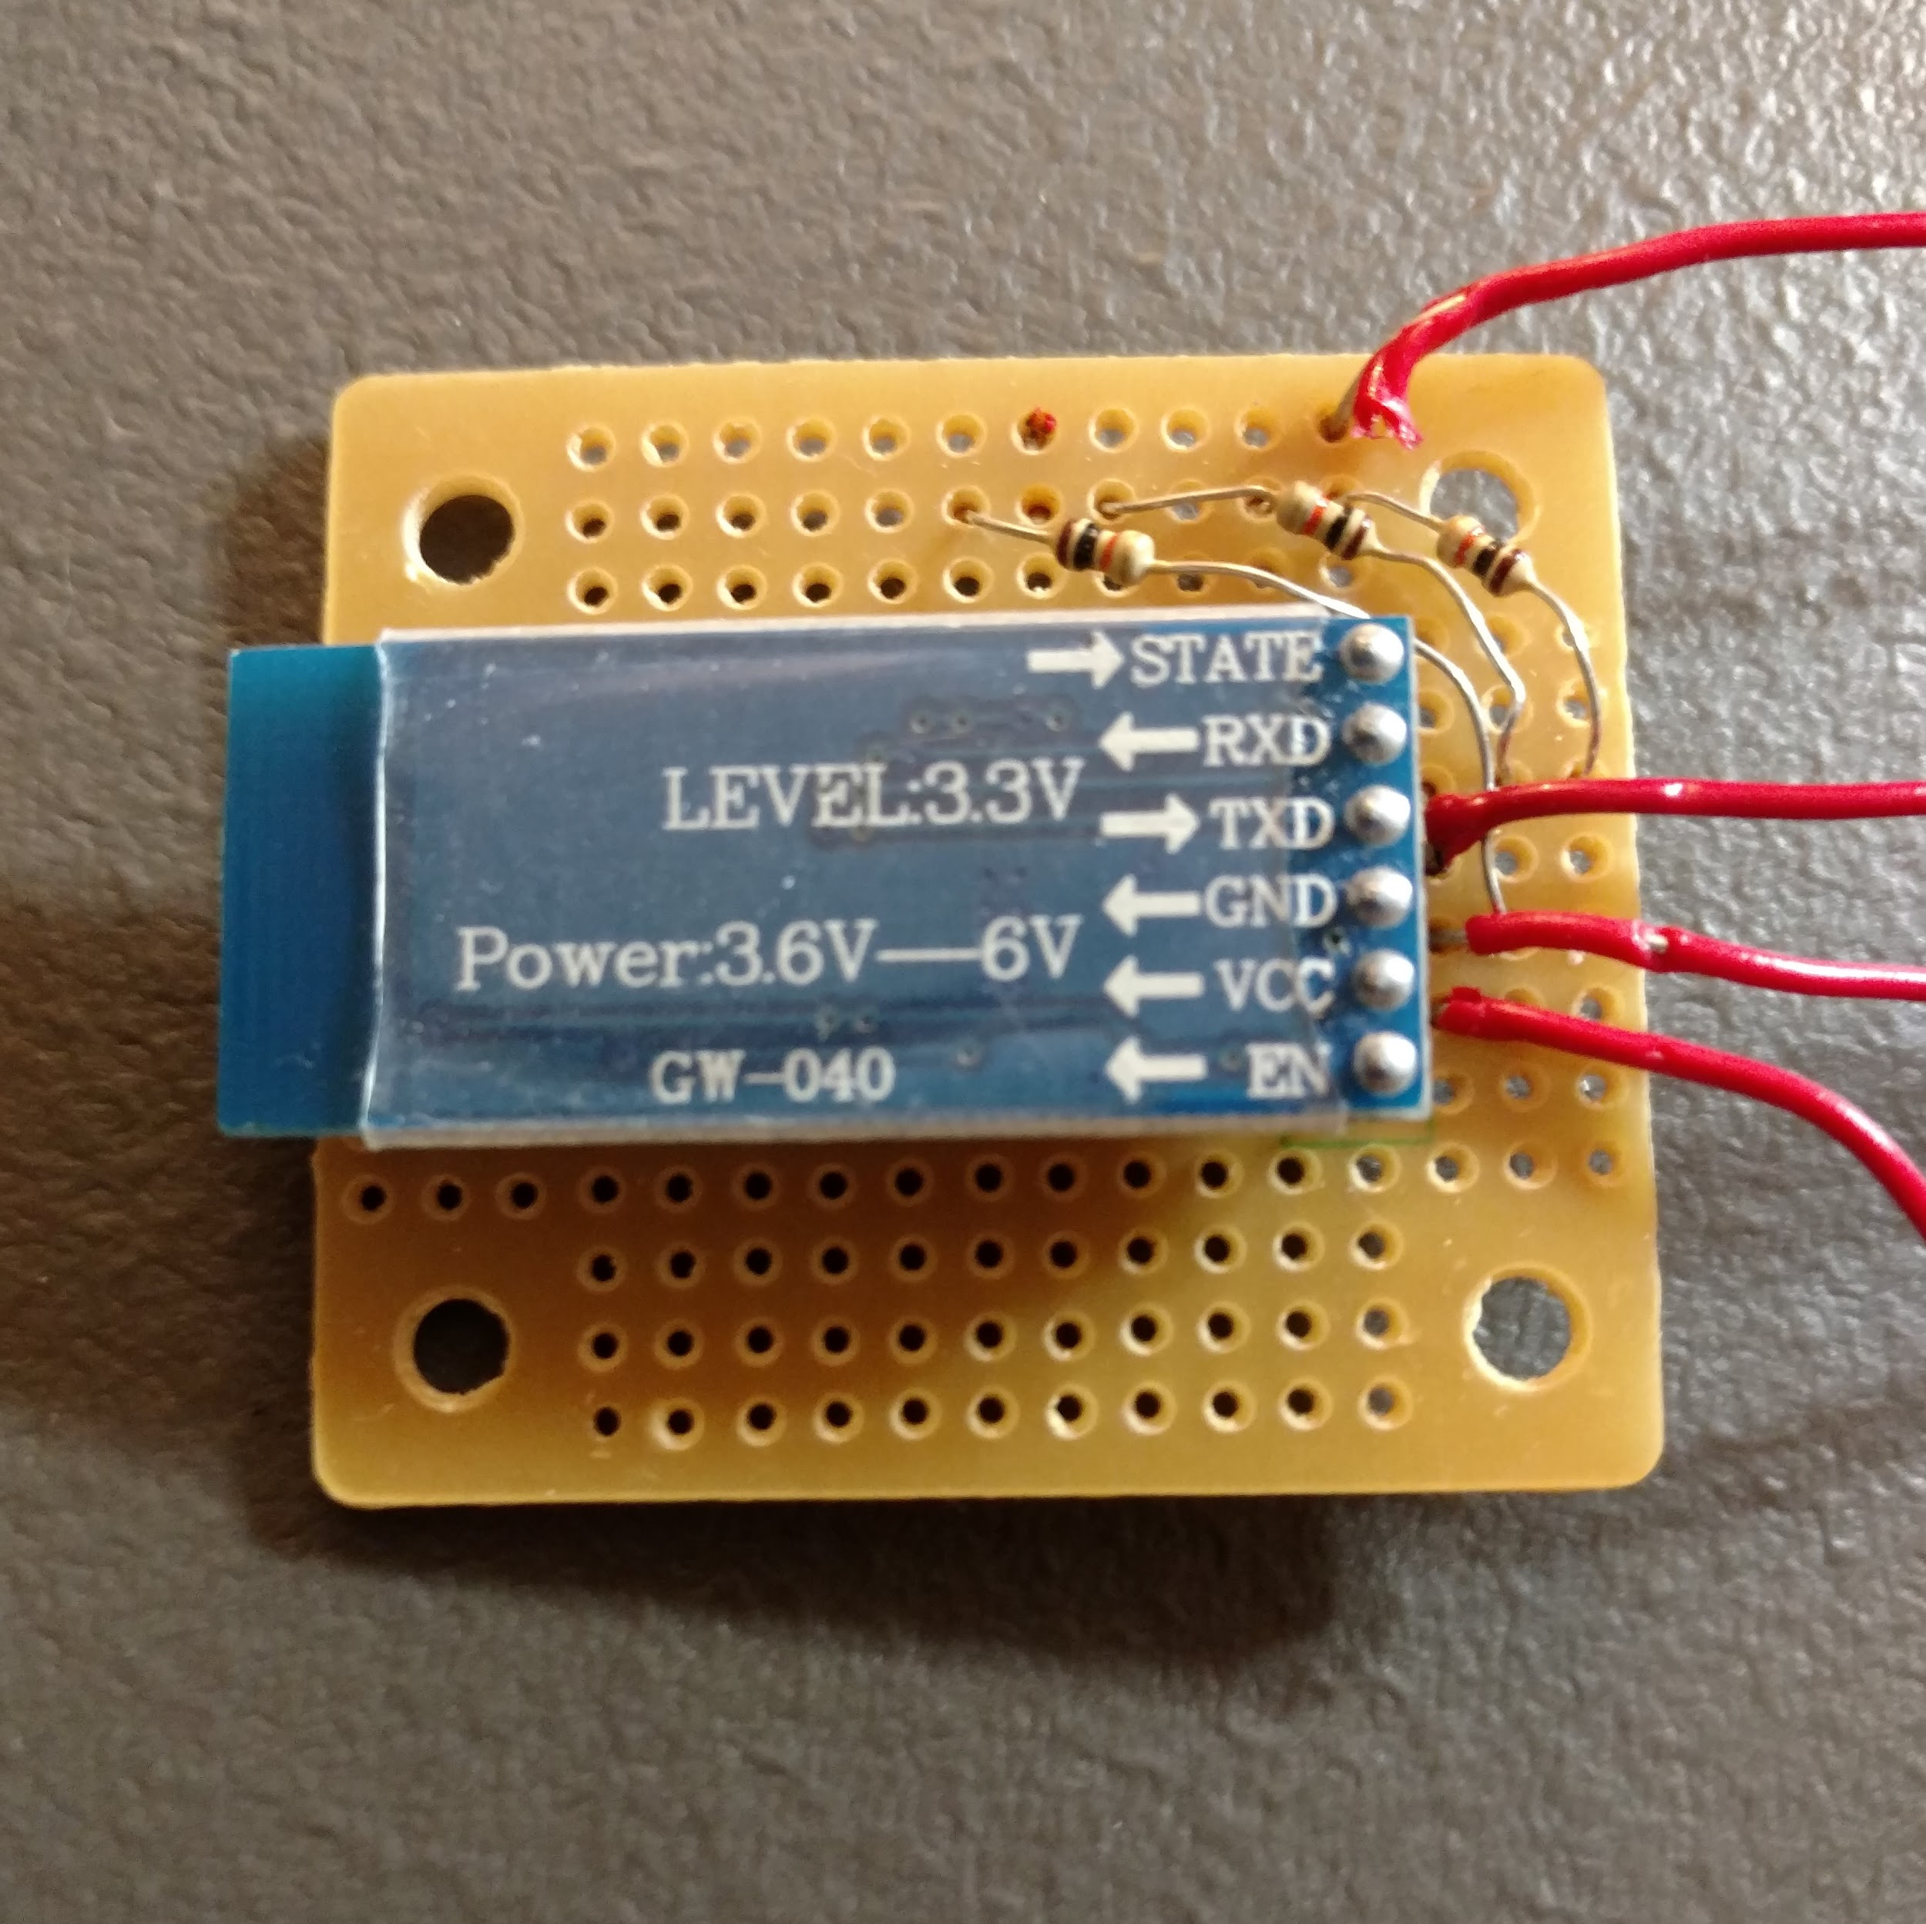
Bluetooth Transmitter (HC-05)
Sends data from the ATmega to the Raspberry Pi
Provides communication at least 12 feet away
Figure 15: BlueTooth perf board

Slide 21
Camera Module

Slide 22
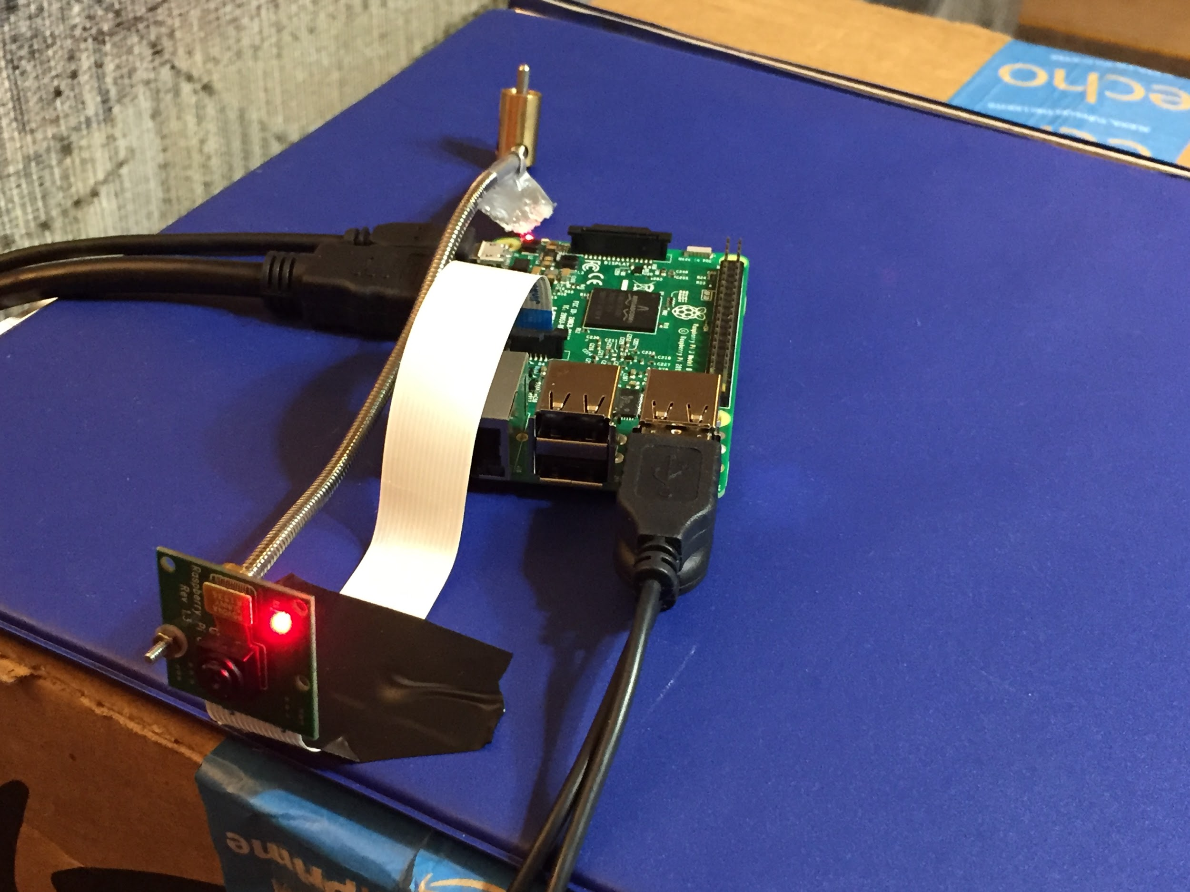
Camera
640x480 pixels, 90 frames per second
Based on experimental results from a 30 frames per second GoPro
Calculations:
𝑓 = 𝑟 ∗ 𝑐 ∗ 𝑝 ∗ 𝑥
𝑓 = 60∗3∗(640∗480)∗5 = 524.16[𝑀𝐻𝑧]
𝑓 = 90∗3∗(640∗480)∗5 = 786.24[𝑀𝐻𝑧]
f = clock frequency c = number of channels x = computation complexity p = number of pixels r = frame rate
Figure 16: Camera module

Slide 23
Raspberry Pi Microcontroller
Object tracking (ball and table)
Bluetooth communication with ATMega
Interface with Output Display

Slide 24
Raspberry Pi Microcontroller
Figure 17: Threshold determination

Slide 25
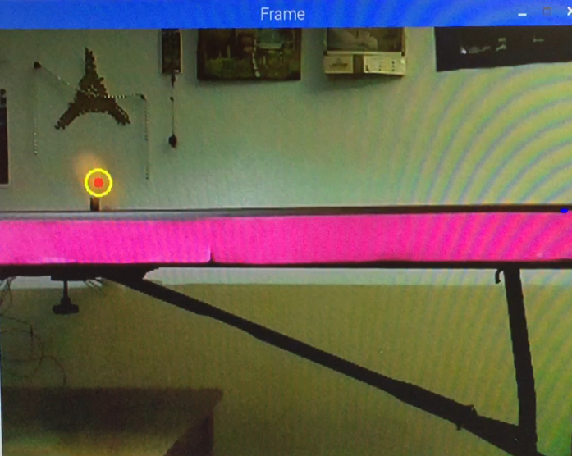
Raspberry Pi Microcontroller
Ball and table tracking
Figure 18: Ball tracking

Slide 26
Output Display

Slide 27
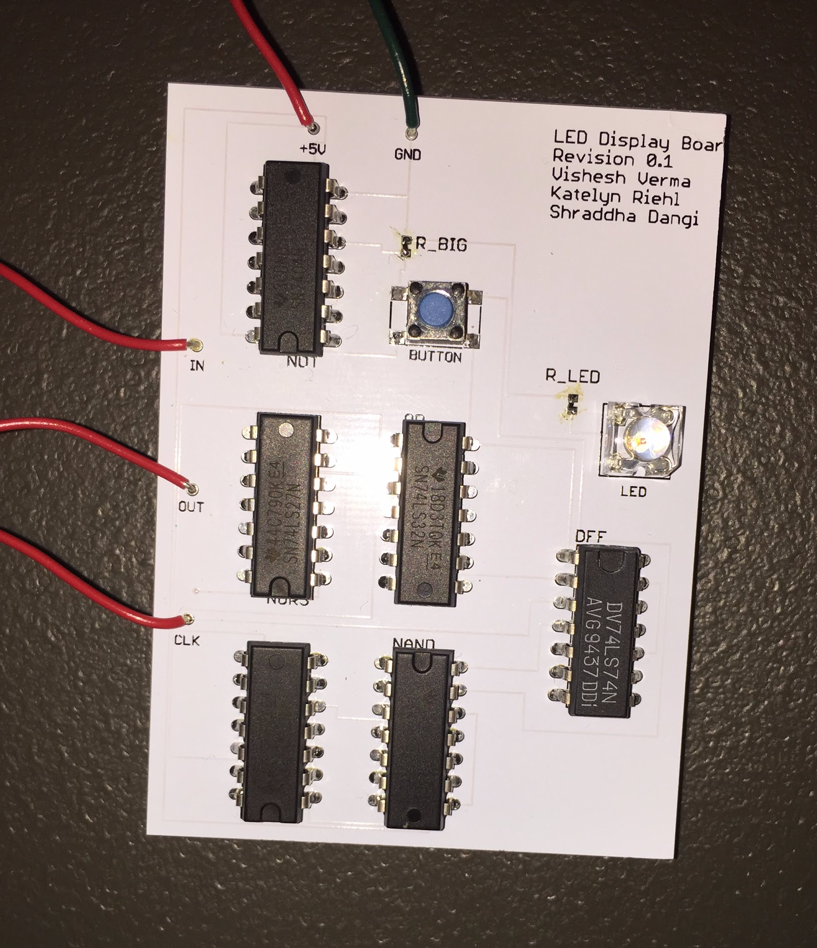
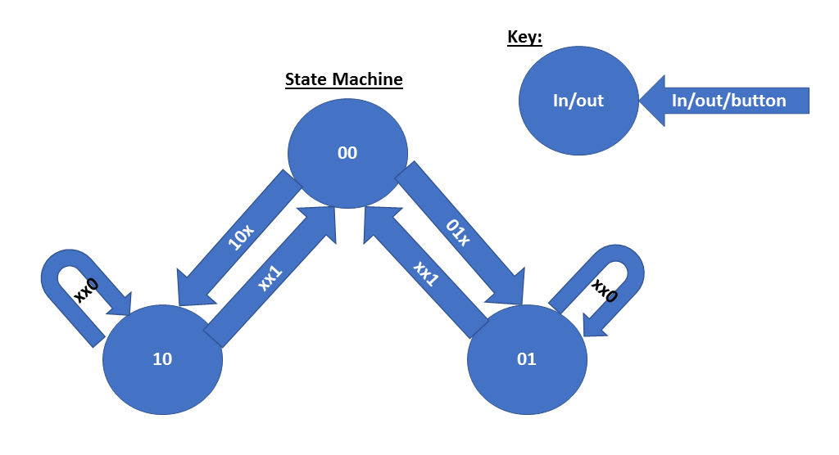
Output Display
Figure 19: Output display state diagram
Figure 20: Output display PCB

Slide 28
Future Work
Correct Output Display state machine
Improve camera frame rate
Amplify received signal to level appropriate for Arduino
Perform the final integration of the sensor module with the rest of the system
Verify modules work together as intended for the design

Slide 29
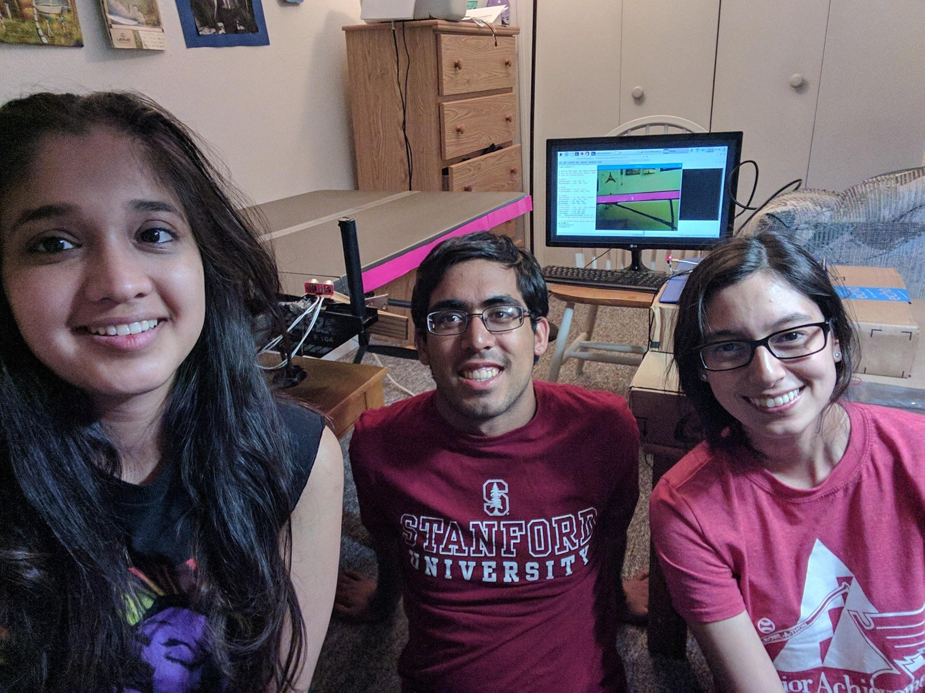
Thank you!
Questions?

Slide 30
Appendix
Why two readings?
Multipath
Interference
Explain astable multivibrator
Explain high level mosfet driver
How will we use arduino?
Current rating sensor
Why is the graph sloping downward for 555

Slide 31
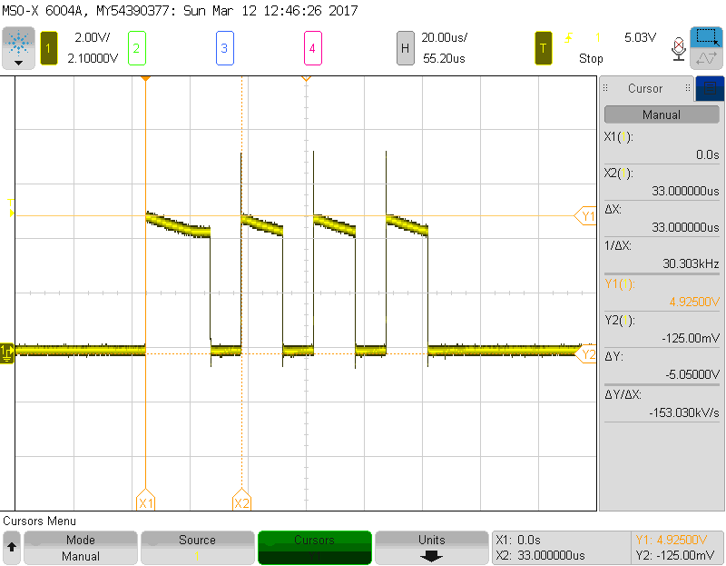
Astable Multivibrator
Output continuously cycles on and off acting as an oscillator
Capacitor charges from 0 → ⅔ Vcc
Output pin on
Capacitor discharges to ⅓ Vcc
Output pin off
Recharges to ⅔ Vcc
Output pin on

Slide 32
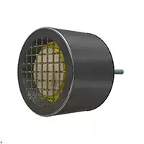
Sensor Ratings
Voltage: 30 Vrms
Capacitance: 2100 ±10% pF
Frequency: 40,000 ±1,000 Hz
Directivity: 70°
https://www.digikey.com/product-detail/en/pui-audio-inc/UR-1240K-TT-R/668-1546-ND/6071958

Slide 33
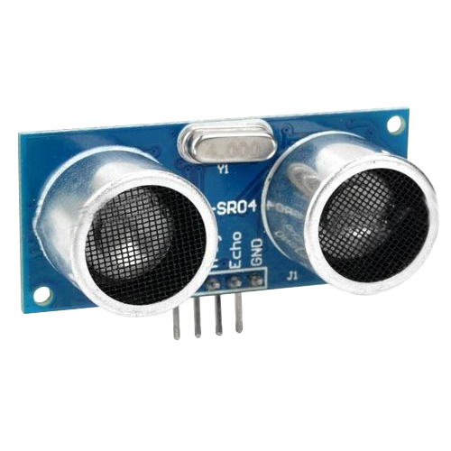
Ping Sensor Ratings
Voltage: 5V dc
Current: 15 mA
Frequency: 40 kHz
Range: 2 cm - 400 cm
Measuring angle: 15°
Accuracy:within 3 mm
https://www.robocore.net/upload/lojavirtual/620_1_H.png

Slide 34
Capacitive Coupling
Can occur when energy is coupled from one wire to another if close
Solutions
Separate wires as much as possible
True ground if possible

Slide 35
𝑀 = 𝑐 ∗ 𝑝
𝑀 = 3 ∗ (640 ∗ 480) = 921,600𝐵𝑦𝑡𝑒𝑠

Slide 36
