Slide 1
AUTOMATIC PET DOOR​
Electrical & Computer Engineering
TEAM 27: HAIJIAN WANG​, HAORAN ZHENG​, ZHIHAO XU​

Slide 2
Problem To Solve
ELECTRICAL & COMPUTER ENGINEERING
GRAINGER ENGINEERING

Slide 3
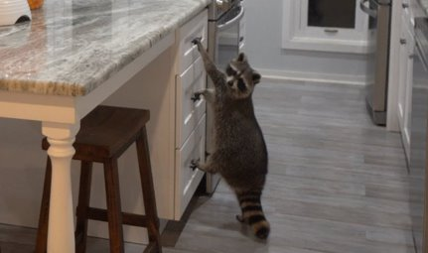
PROBLEM TO SOLVE​
For people living near the natural ecosystem, human-wildlife conflicts can frequently happen, and one type of such conflict is intruding wild animals.​
Hello there~
ELECTRICAL & COMPUTER ENGINEERING
GRAINGER ENGINEERING

Slide 4
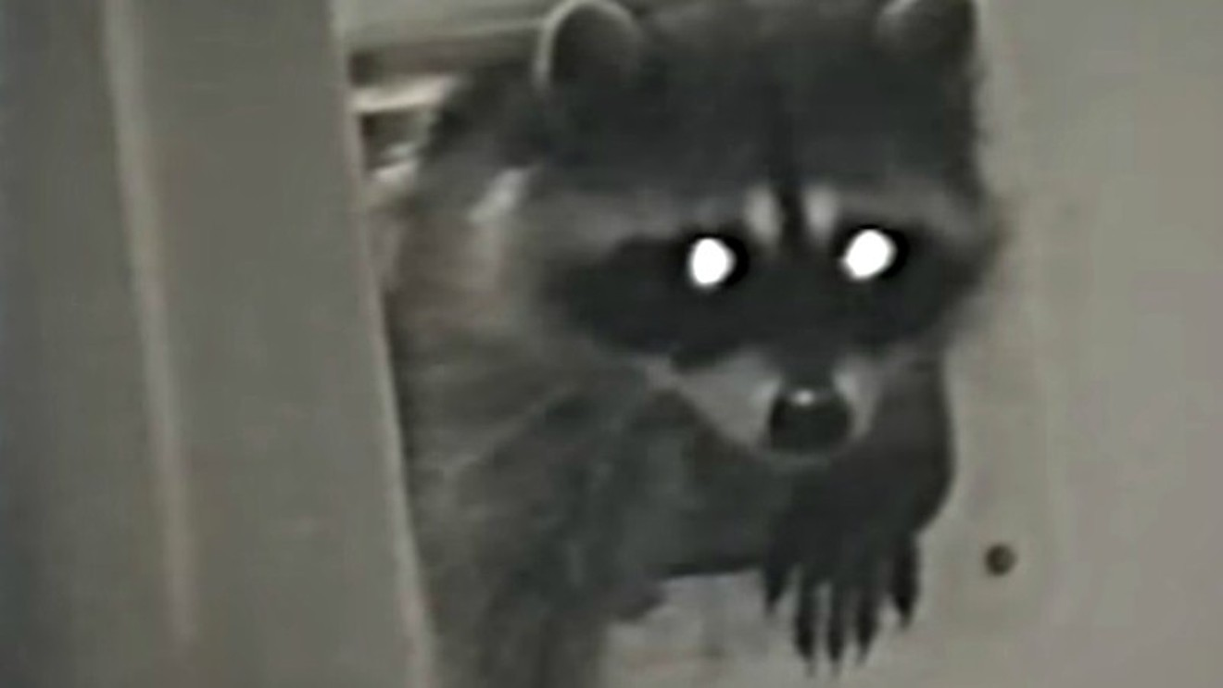
PROBLEM TO SOLVE
A “welcome-all” pet door can cause some problem…
For small to medium-sized wild animals like raccoons and coyotes, the unlocked pet door can be an entrance to people's houses.
https://www.youtube.com/watch?v=yr1OcFafctI​
I am coming…
ELECTRICAL & COMPUTER ENGINEERING
GRAINGER ENGINEERING

Slide 5
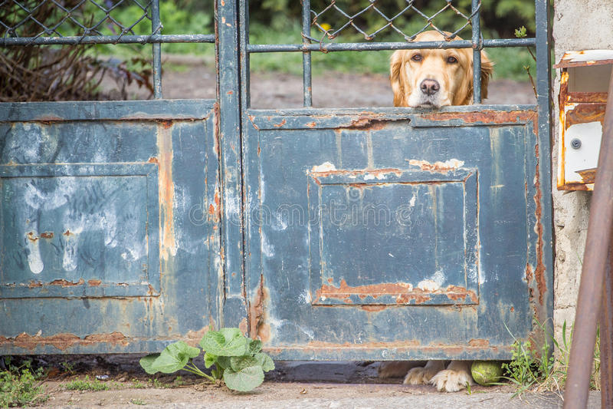
PROBLEM TO SOLVE
A “block-all” pet door also cause problems…
Locking the pet can prevent wildlife from intruding, but it will also keep the house owner's pets out of the door at the same time.
May I come in?
ELECTRICAL & COMPUTER ENGINEERING
GRAINGER ENGINEERING

Slide 6
Project Overview
ELECTRICAL & COMPUTER ENGINEERING
GRAINGER ENGINEERING

Slide 7
PROJECT OVERVIEW
We built a door to welcome pets and prevent wildlife
When an object approaches our pet door, it should be able to execute the following sequential steps without any manual operation:
Detecting the approaching object
Identifying the species of the detected object
Locking/unlocking according to the determined species
ELECTRICAL & COMPUTER ENGINEERING
GRAINGER ENGINEERING

Slide 8
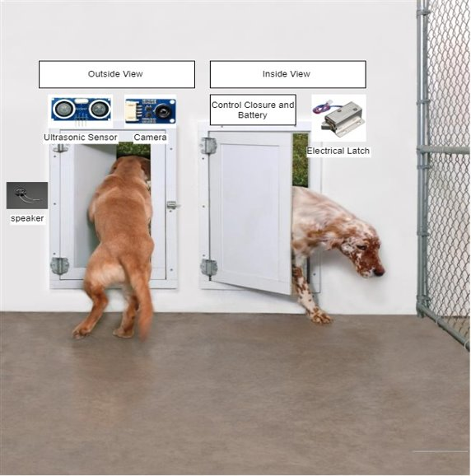
Concept Picture
ELECTRICAL & COMPUTER ENGINEERING
GRAINGER ENGINEERING

Slide 9
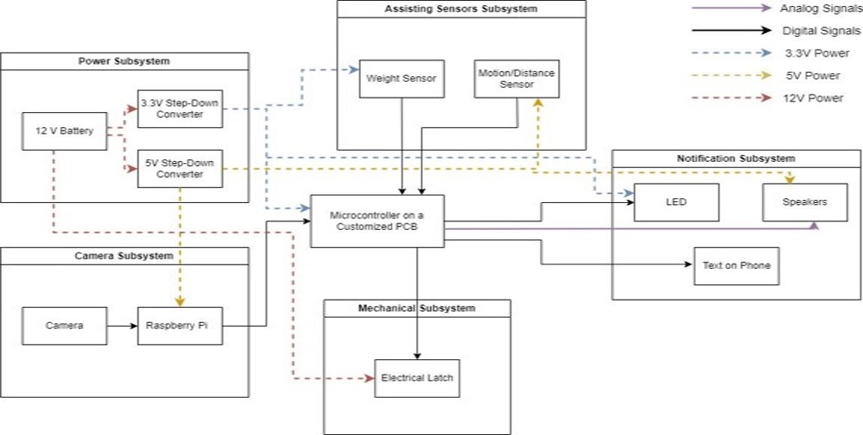
Block Diagram Overview
ELECTRICAL & COMPUTER ENGINEERING
GRAINGER ENGINEERING

Slide 10
Design Explanation
ELECTRICAL & COMPUTER ENGINEERING
GRAINGER ENGINEERING

Slide 11
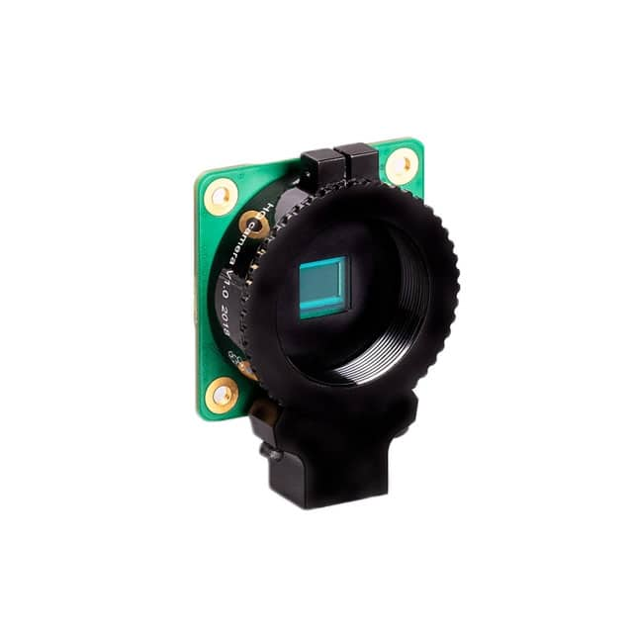
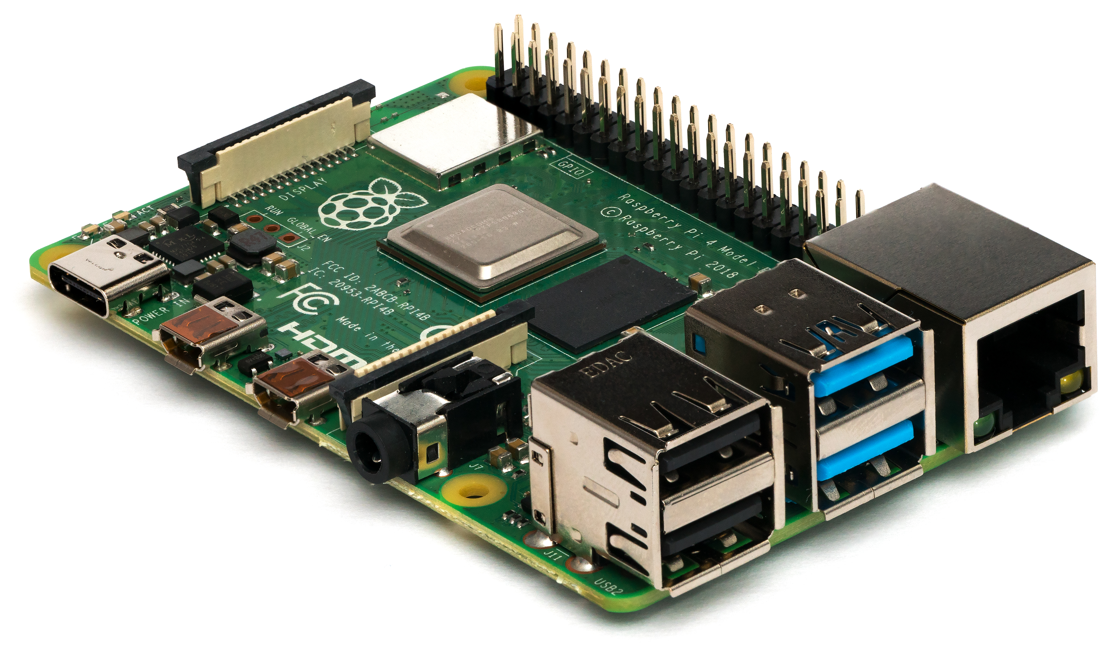
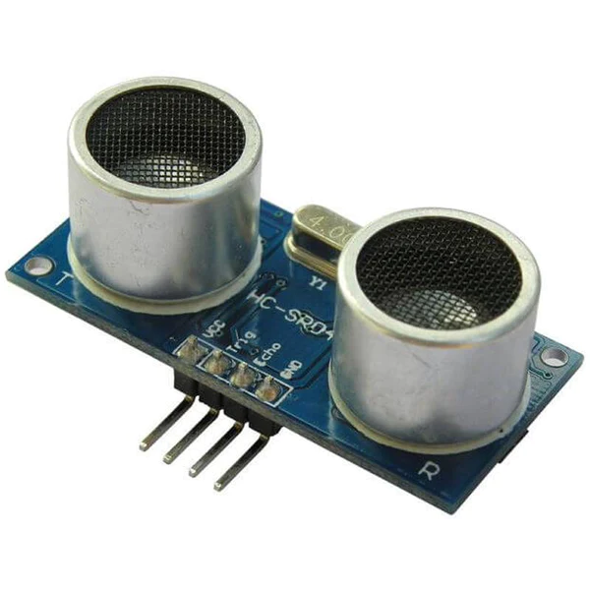
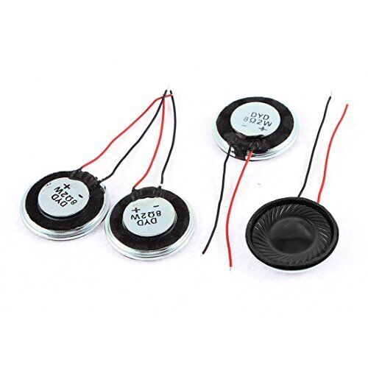
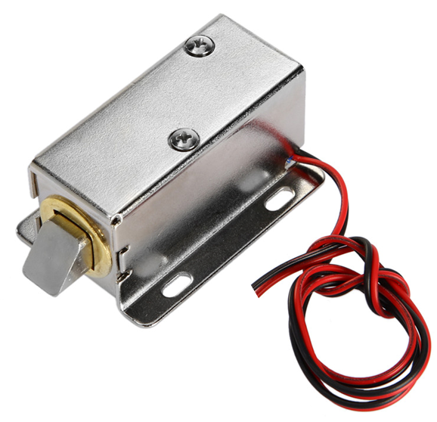
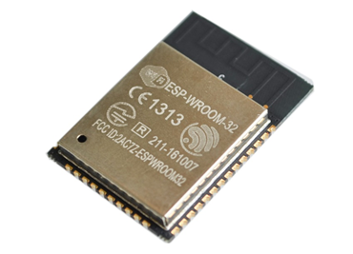
Design EXPLANATION
Our project can be divided into Five subsystems:​
Camera Subsystem
Motion Sensors Subsystem
Power Subsystem
Microcontroller
Notification Subsystem
Design EXPLANATION
ELECTRICAL & COMPUTER ENGINEERING
GRAINGER ENGINEERING

Slide 12
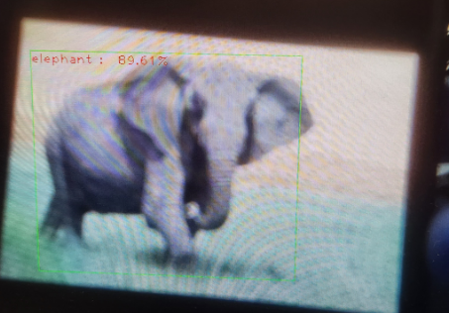
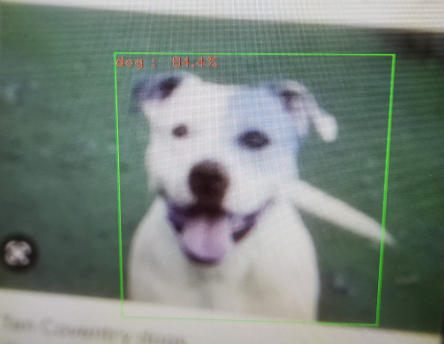
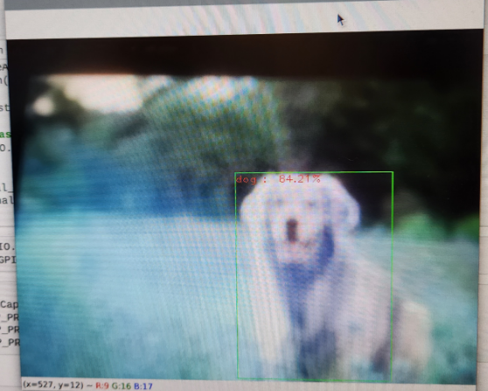
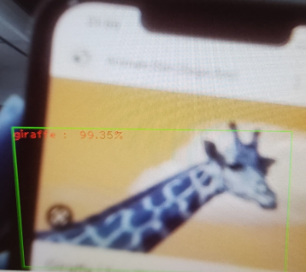
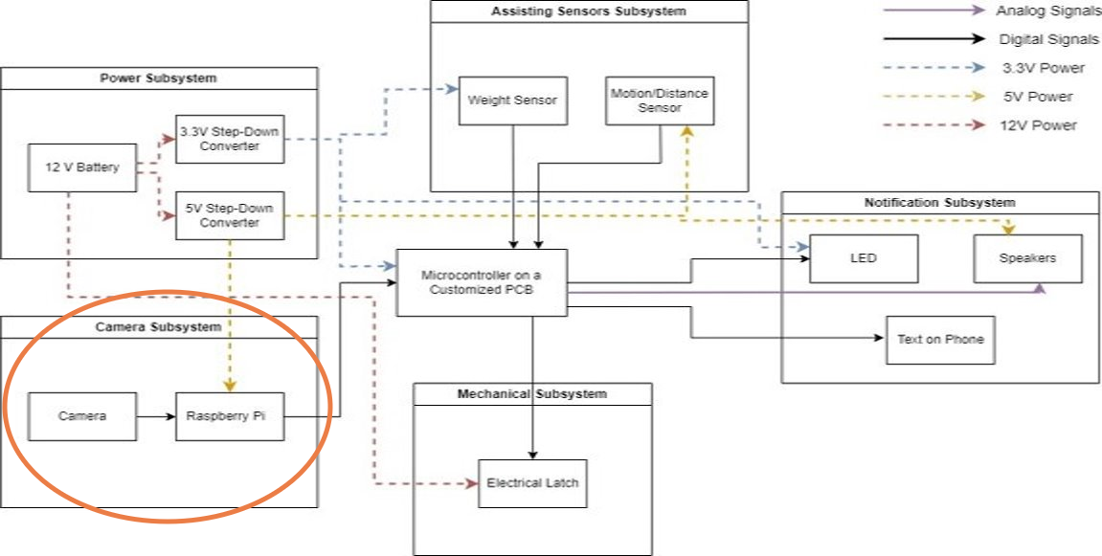
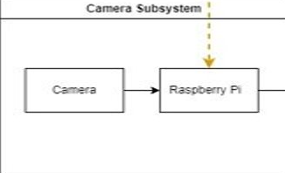
Design EXPLANATION
Camera Subsystem
Requirement: this subsystem consists of a Raspberry Pi Camera Module 3 responsible for detecting the approaching animal and a Raspberry Pi 4 Model B responsible for identifying the approaching animal.​
IMAGE / GRAPHIC
IMAGE / GRAPHIC
ELECTRICAL & COMPUTER ENGINEERING
GRAINGER ENGINEERING

Slide 13
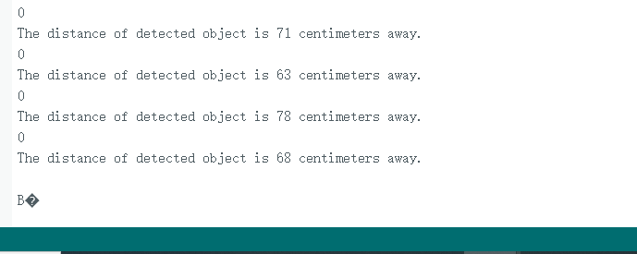
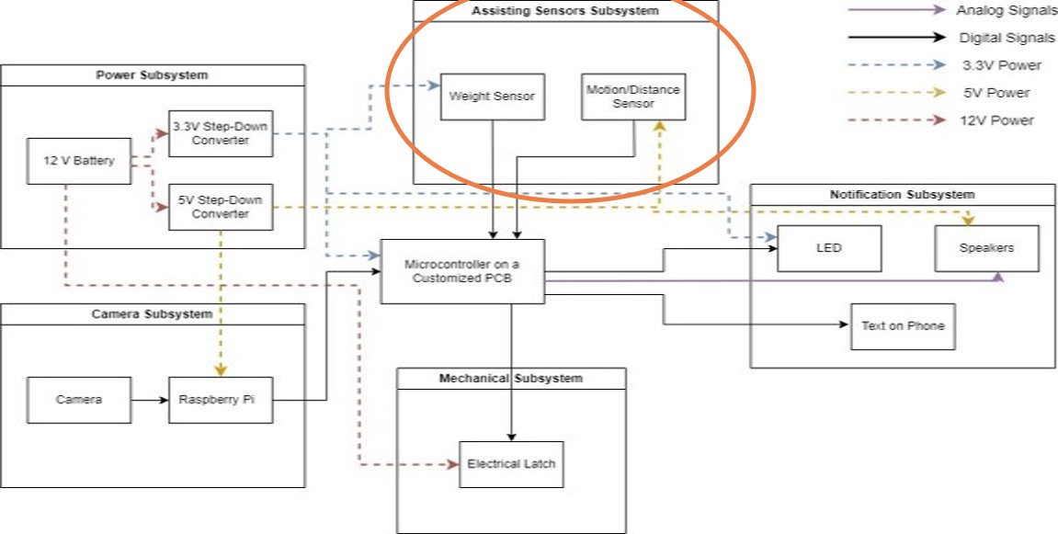
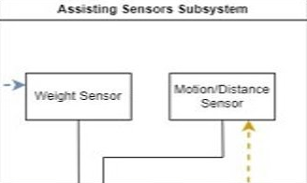
Design EXPLANATION
Motion Sensor Subsystem
This subsystem consists of an Ultrasonic Distance Sensor to measure the approaching object's distance to our pet door, so the pet door will not unlock if no object is within a certain range.​
Requirement: it should measure the distance between the pet and the door and send a signal to the microcontroller.
IMAGE / GRAPHIC
IMAGE / GRAPHIC
ELECTRICAL & COMPUTER ENGINEERING
GRAINGER ENGINEERING

Slide 14
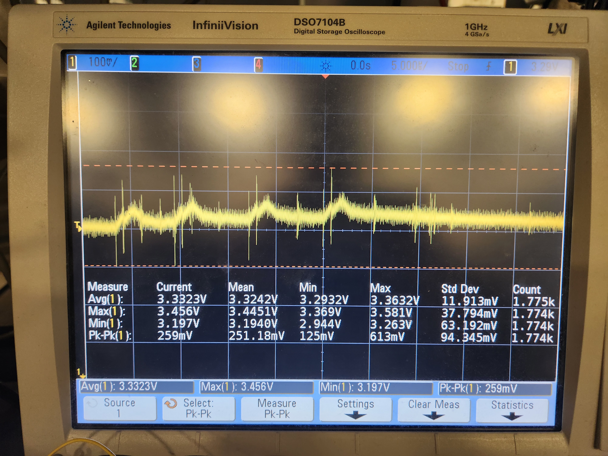
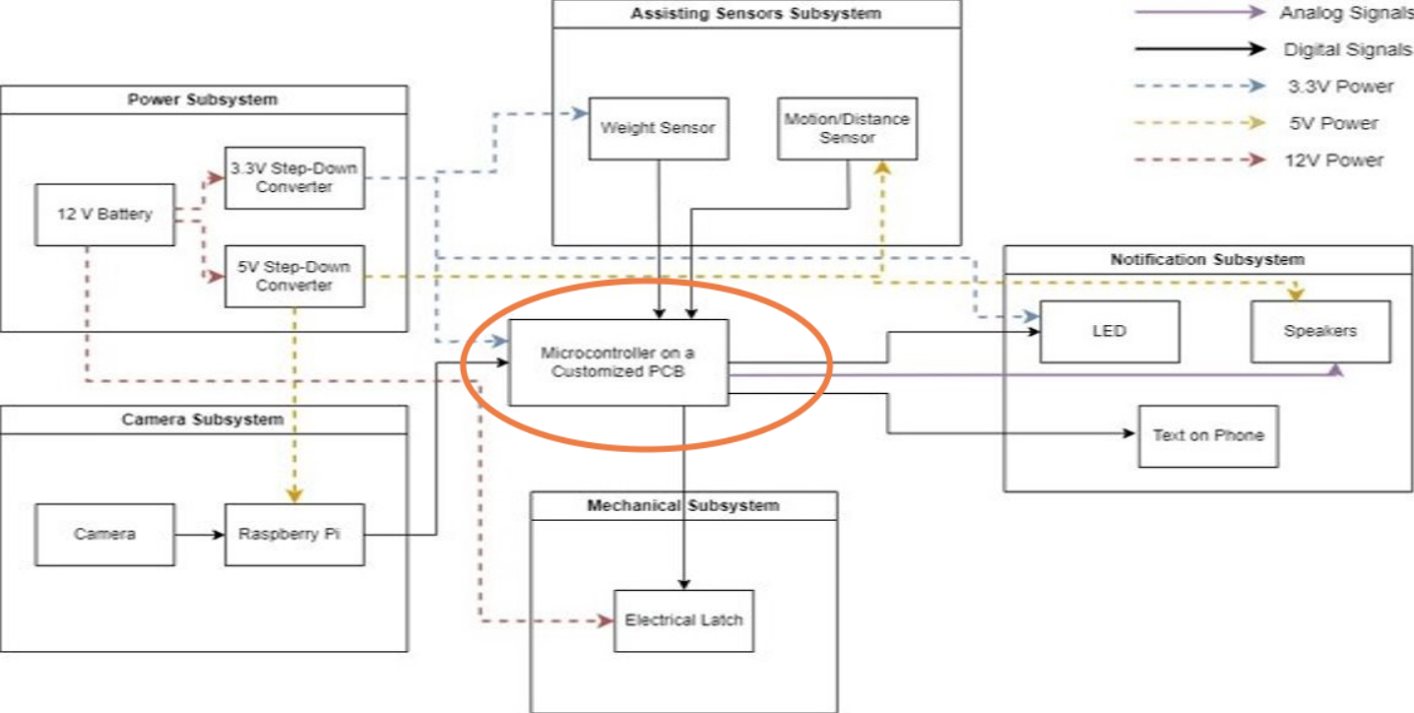
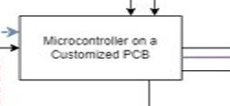
Design EXPLANATION
Microcontroller
An ESP32-S3-WROOM-2 microcontroller
Requirement: provides the main control for our latch and speaker once receiving signals from Raspberry Pi and the Ultrasonic Distance Sensor.​
IMAGE / GRAPHIC
IMAGE / GRAPHIC
ELECTRICAL & COMPUTER ENGINEERING
GRAINGER ENGINEERING

Slide 15
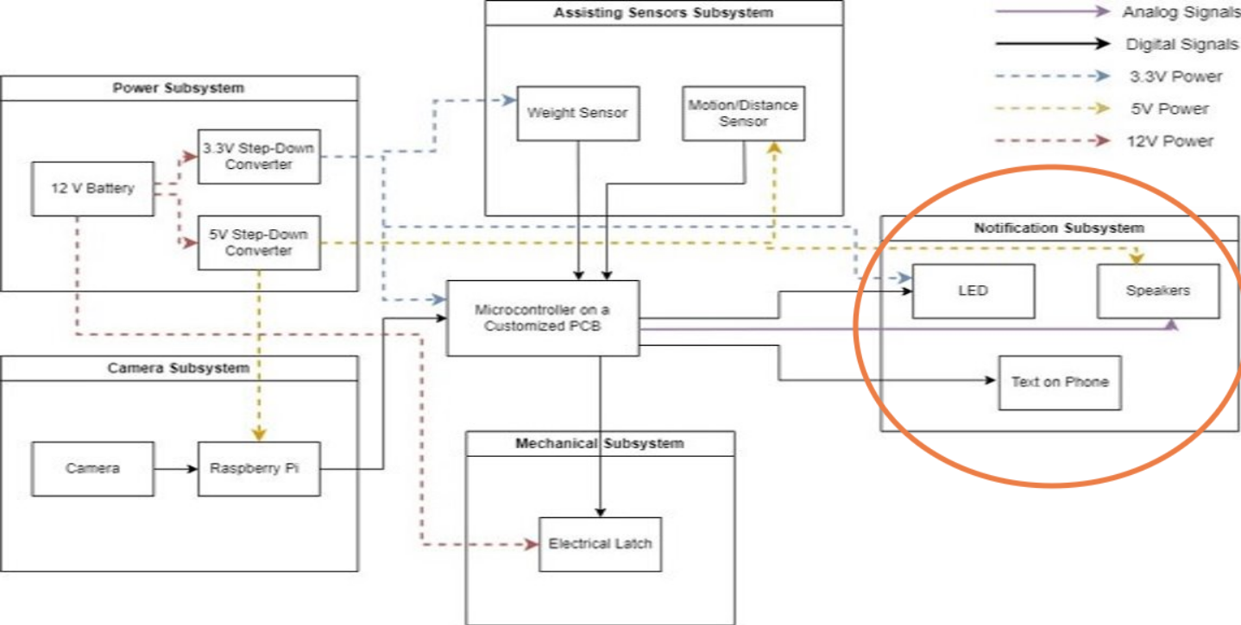
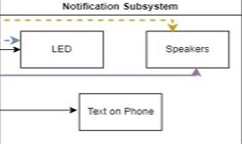
Design EXPLANATION
Notification Subsystem
This subsystem includes a Latch to Lock/unlock the door, and a Speaker to notify the house owner that the door is currently unlocked.
Requirement: After receiving the correct signal from the microcontroller, the speaker should ring, and latch should lock and unlock properly.
IMAGE / GRAPHIC
IMAGE / GRAPHIC
ELECTRICAL & COMPUTER ENGINEERING
GRAINGER ENGINEERING

Slide 16
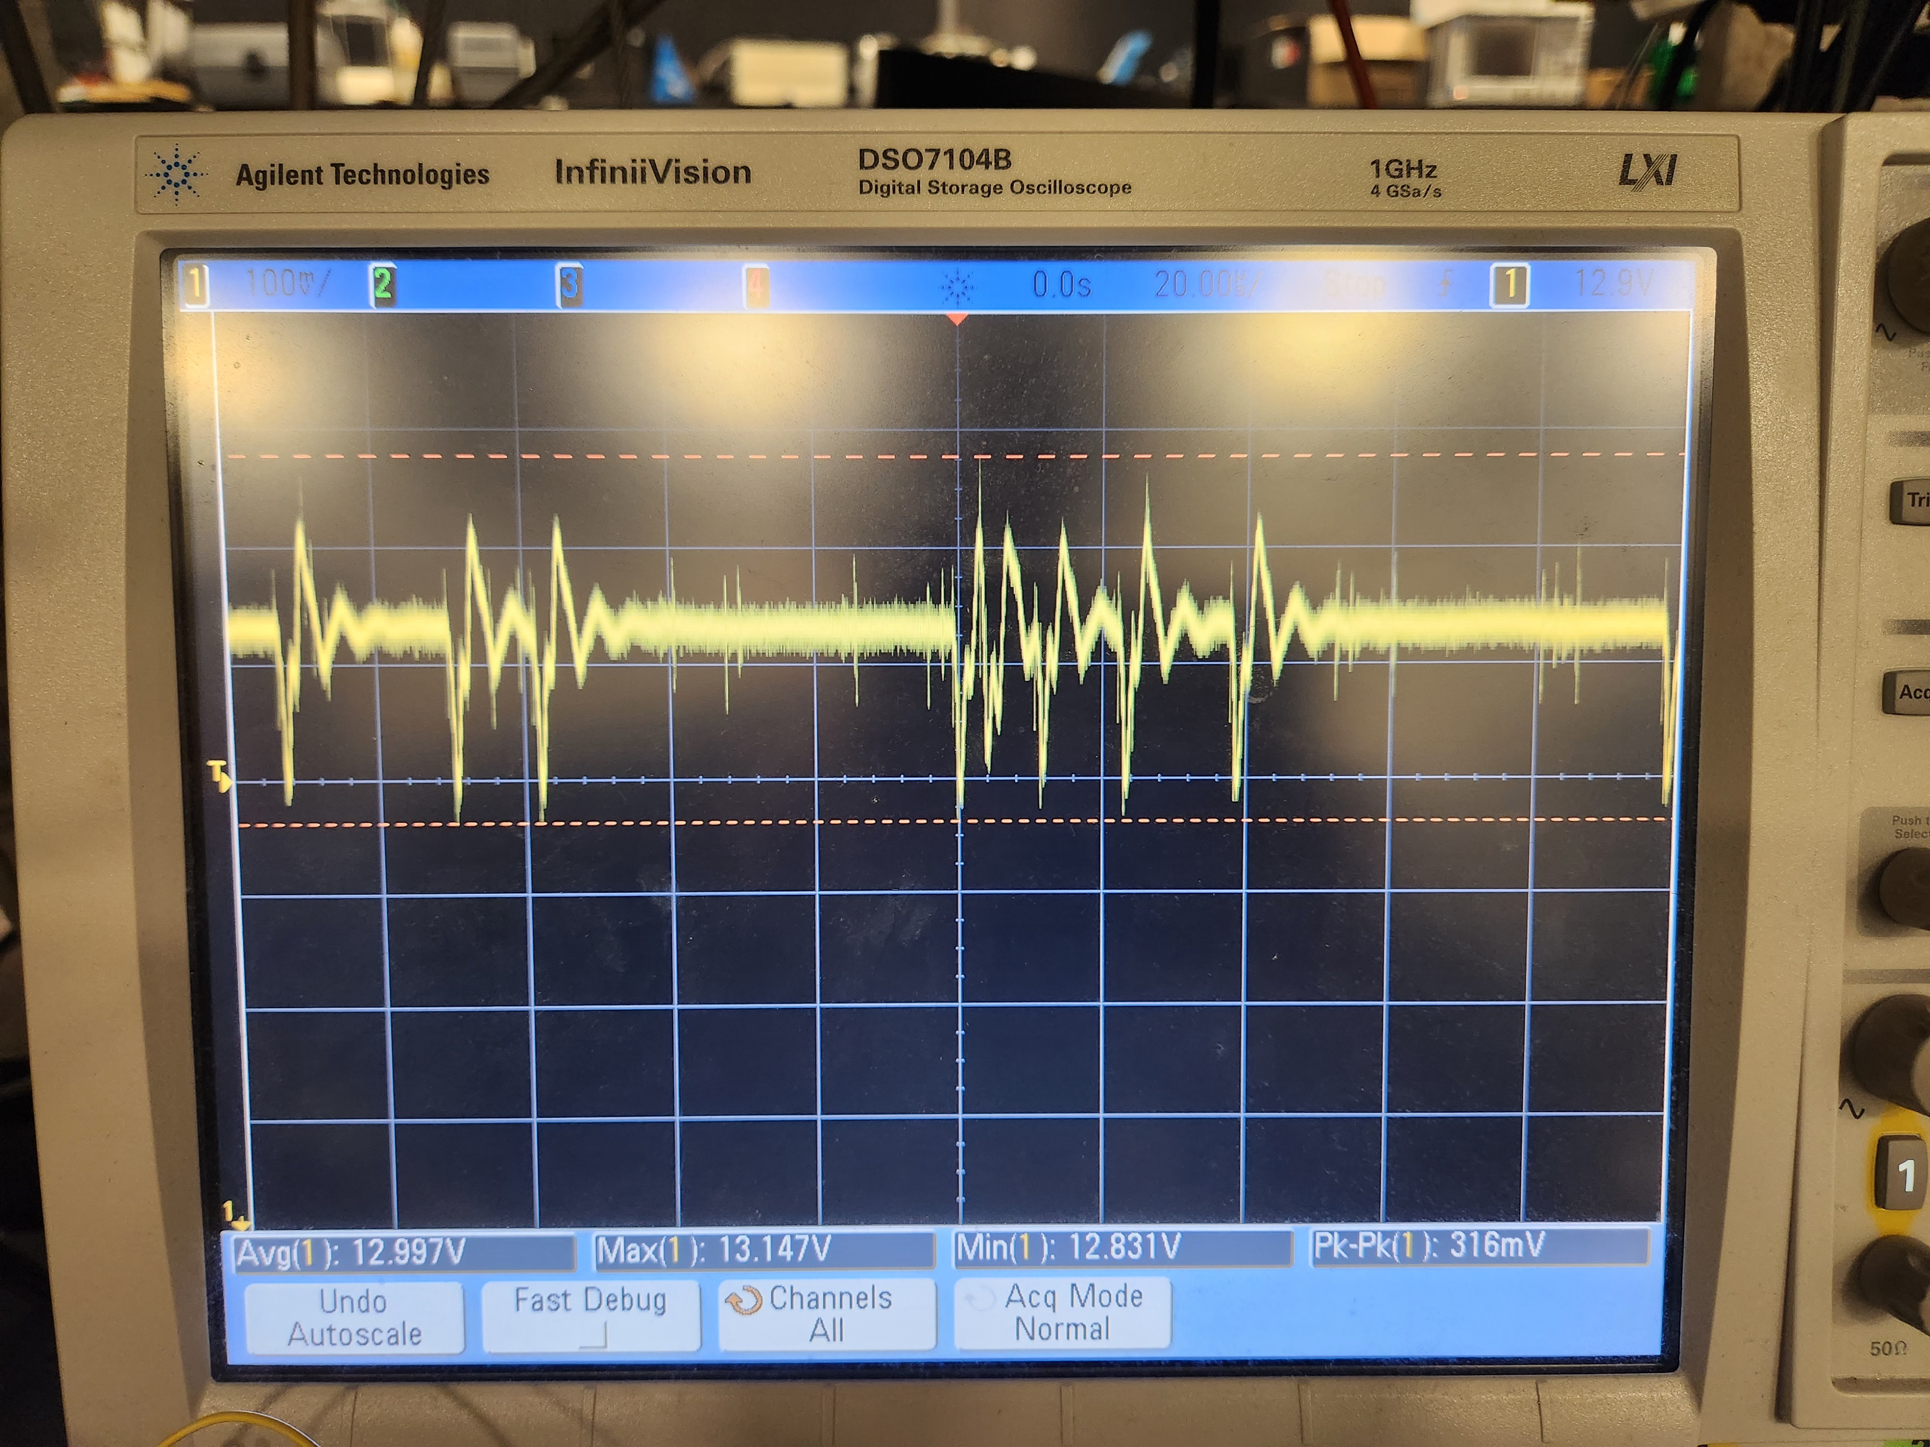
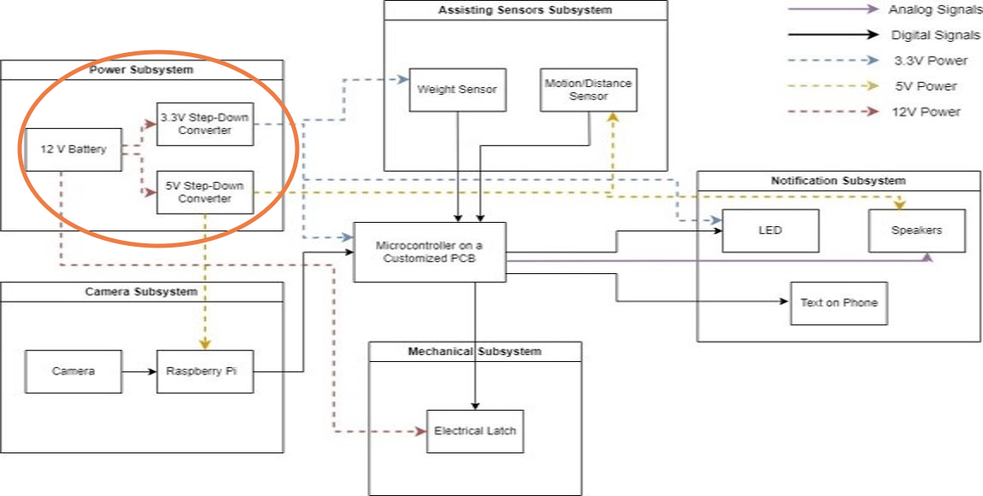
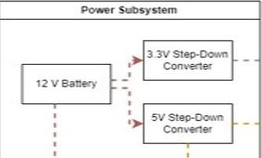
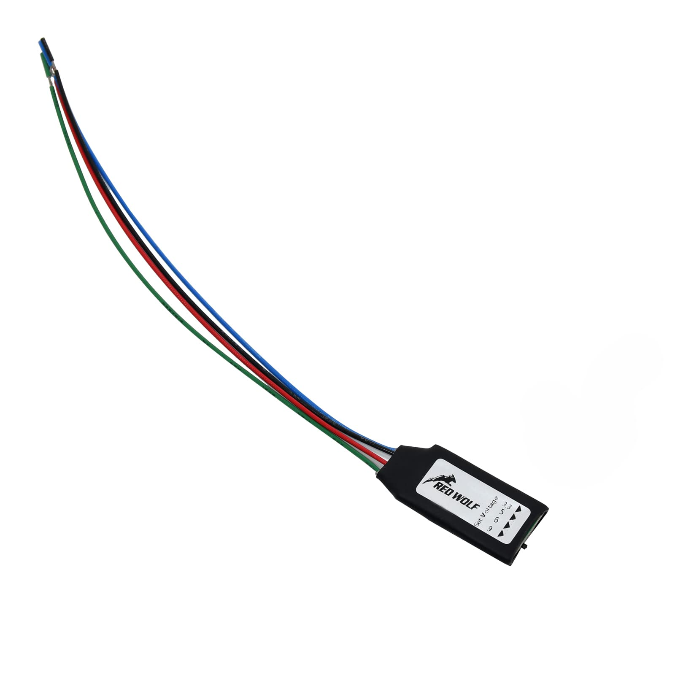
Design EXPLANATION
Power Subsystem
This subsystem consists of an HWE 12.8V 7Ah Battery and two RED WOLF Adjust DC Converters
Requirement: provide corresponding voltage and power to our whole system.
IMAGE / GRAPHIC
IMAGE / GRAPHIC
ELECTRICAL & COMPUTER ENGINEERING
GRAINGER ENGINEERING

Slide 17
Concept Picture
ELECTRICAL & COMPUTER ENGINEERING
GRAINGER ENGINEERING

Slide 18
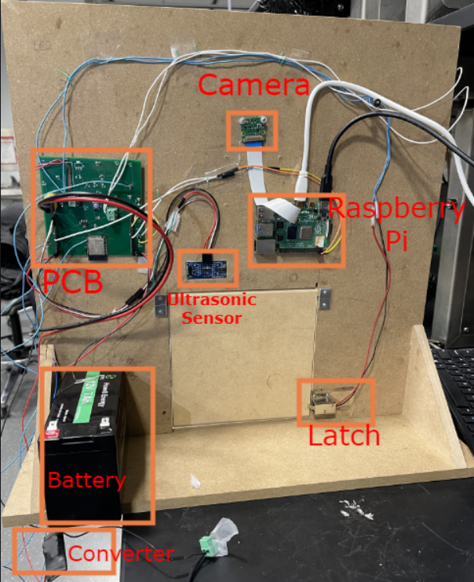
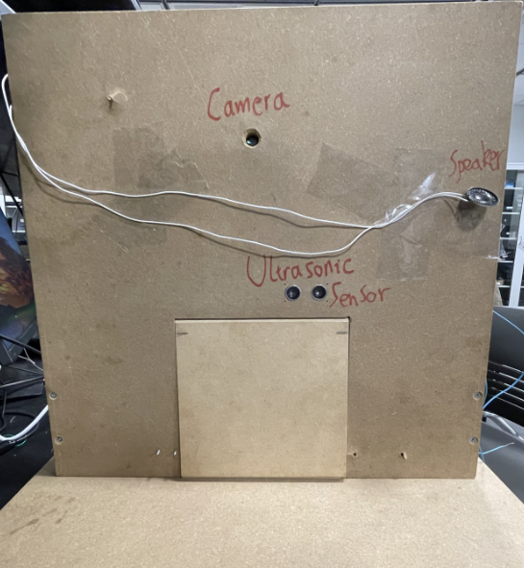
Our Final Product ...
ELECTRICAL & COMPUTER ENGINEERING
GRAINGER ENGINEERING

Slide 19
PCB Design and Results
ELECTRICAL & COMPUTER ENGINEERING
GRAINGER ENGINEERING

Slide 20
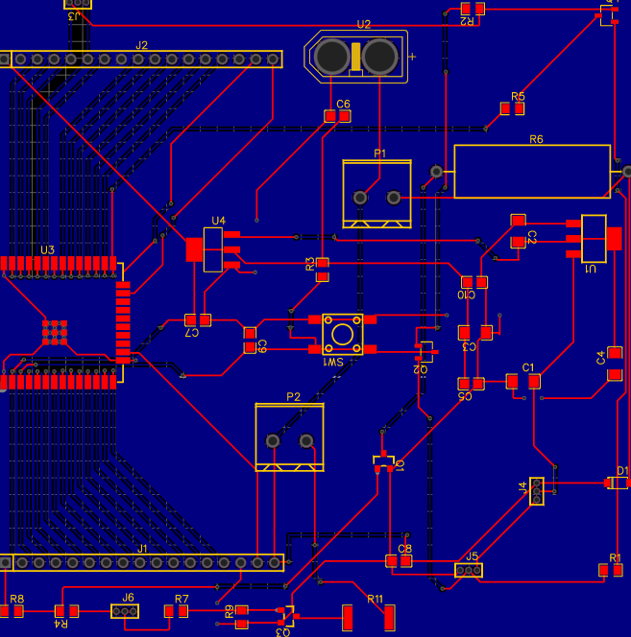
PCB Design
ELECTRICAL & COMPUTER ENGINEERING
GRAINGER ENGINEERING

Slide 22
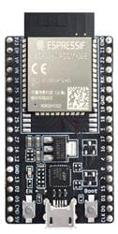
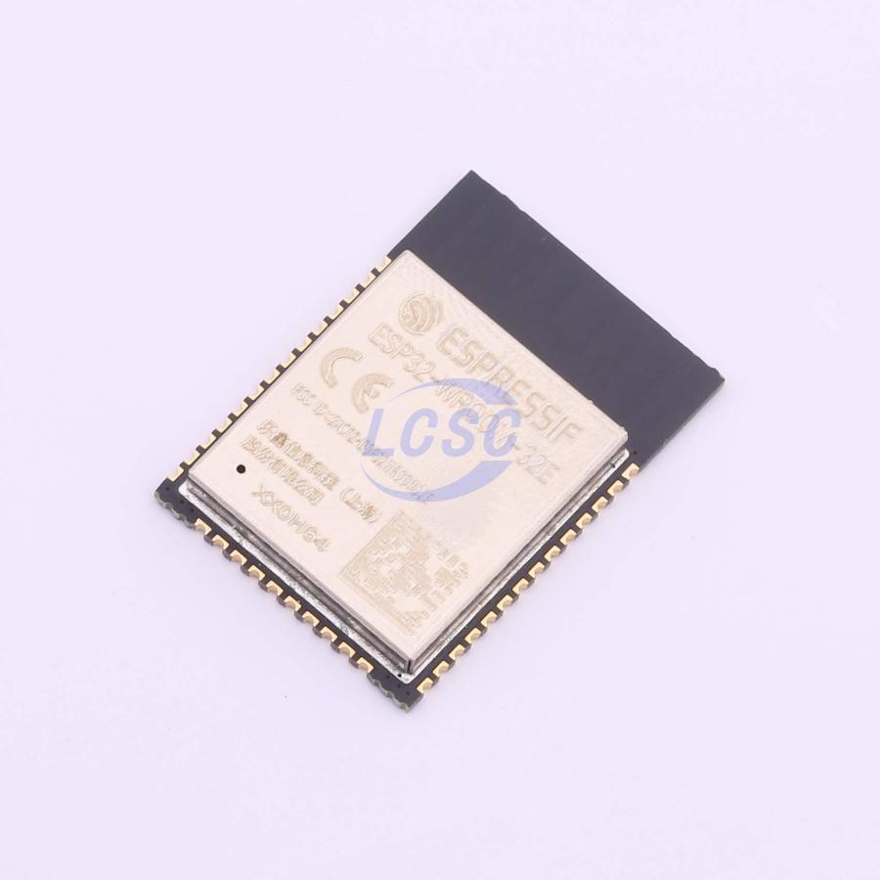
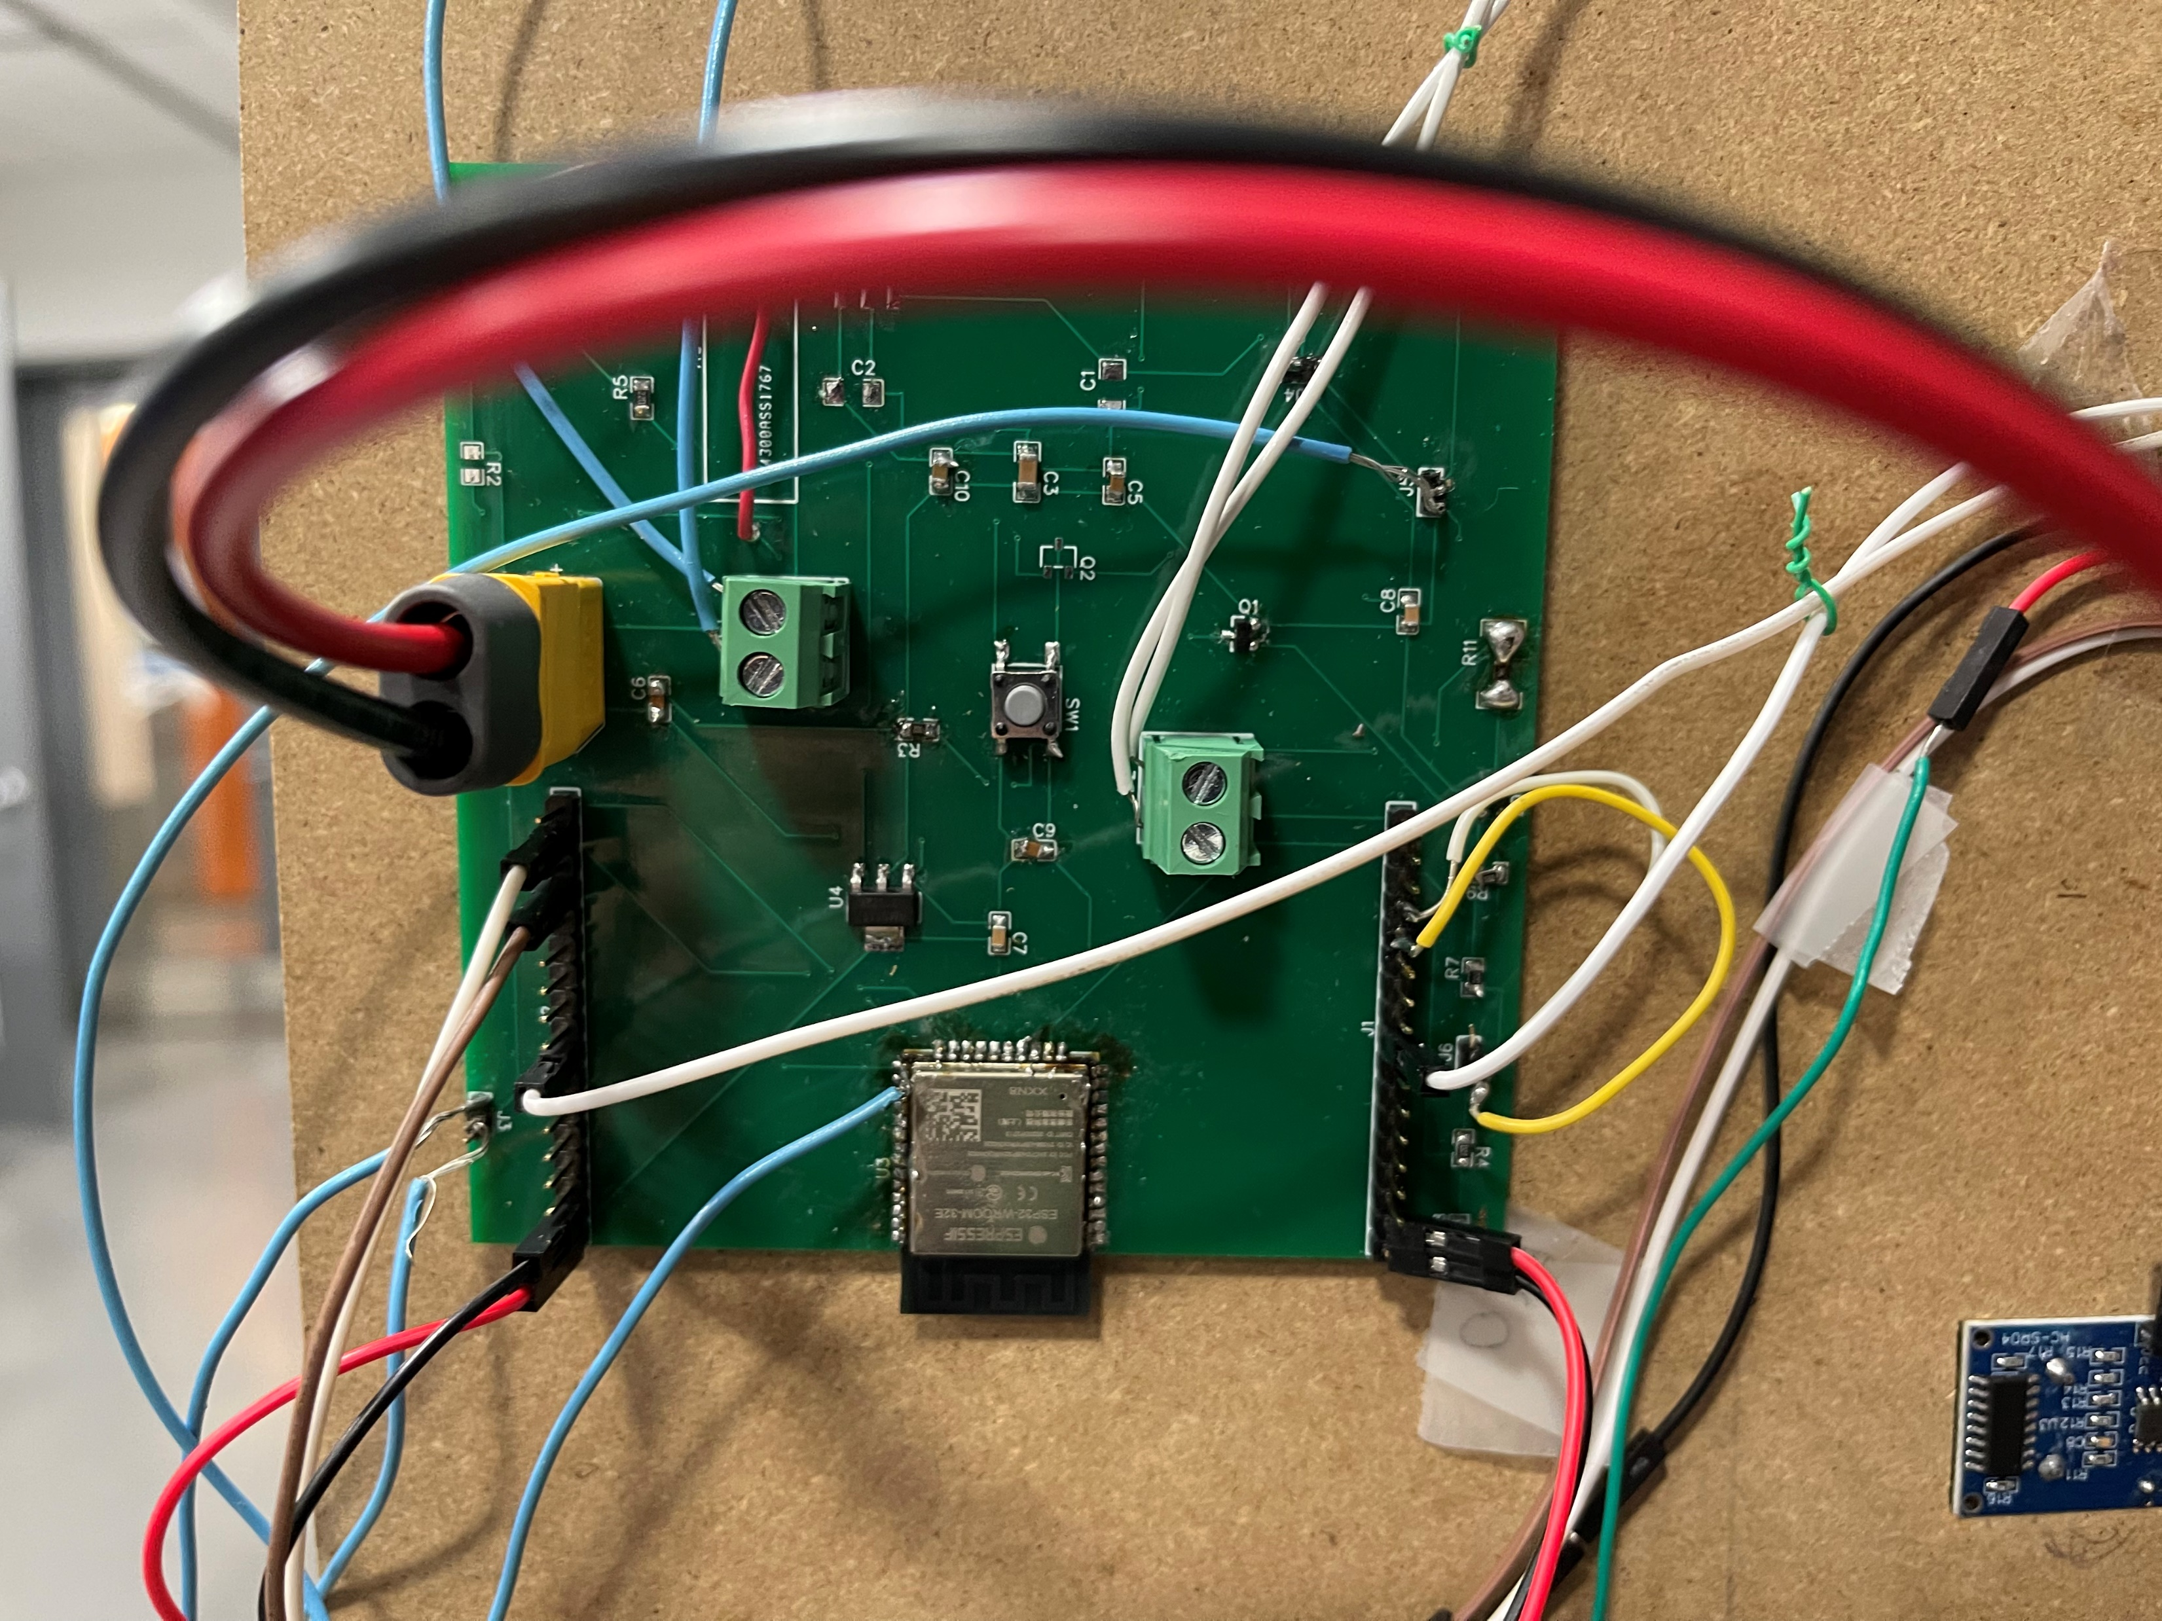
SUCCESSES...
We have a working ESP32 microcontroller on our PCB!
ELECTRICAL & COMPUTER ENGINEERING
GRAINGER ENGINEERING

Slide 23
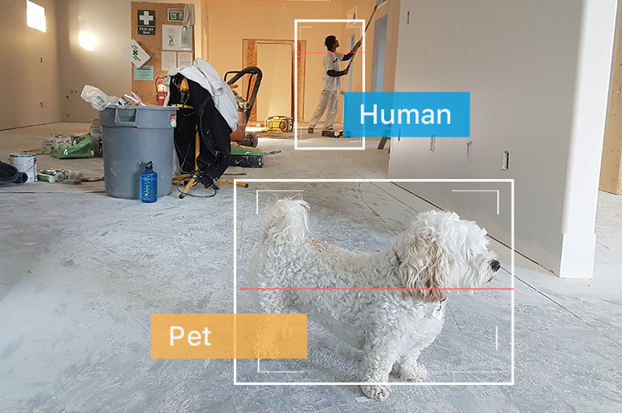
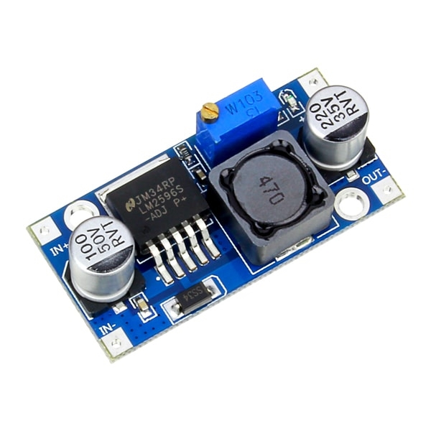
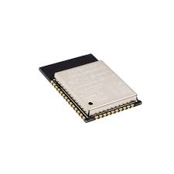
SUCCESSES...
AI and Camera:
high true positive rate, high true negative rate
Might detect a dog as a person, but it will eventually classify it as a dog
Power:
Successful 12V, 5V, and 3.3V conversion.
Using 3.3V microcontroller pin to control a 12V circuit with MOSFETs
Peripherals and Control:
Control program on ESP32: decode, display, and decide
Successfully reading from ultrasonic, outputting music from speakers, and unlocking latch.
ELECTRICAL & COMPUTER ENGINEERING
GRAINGER ENGINEERING

Slide 24
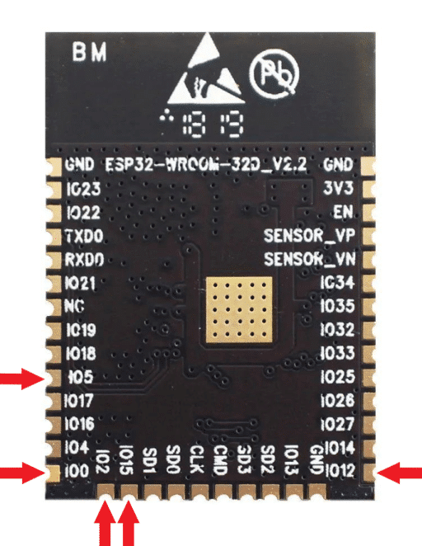
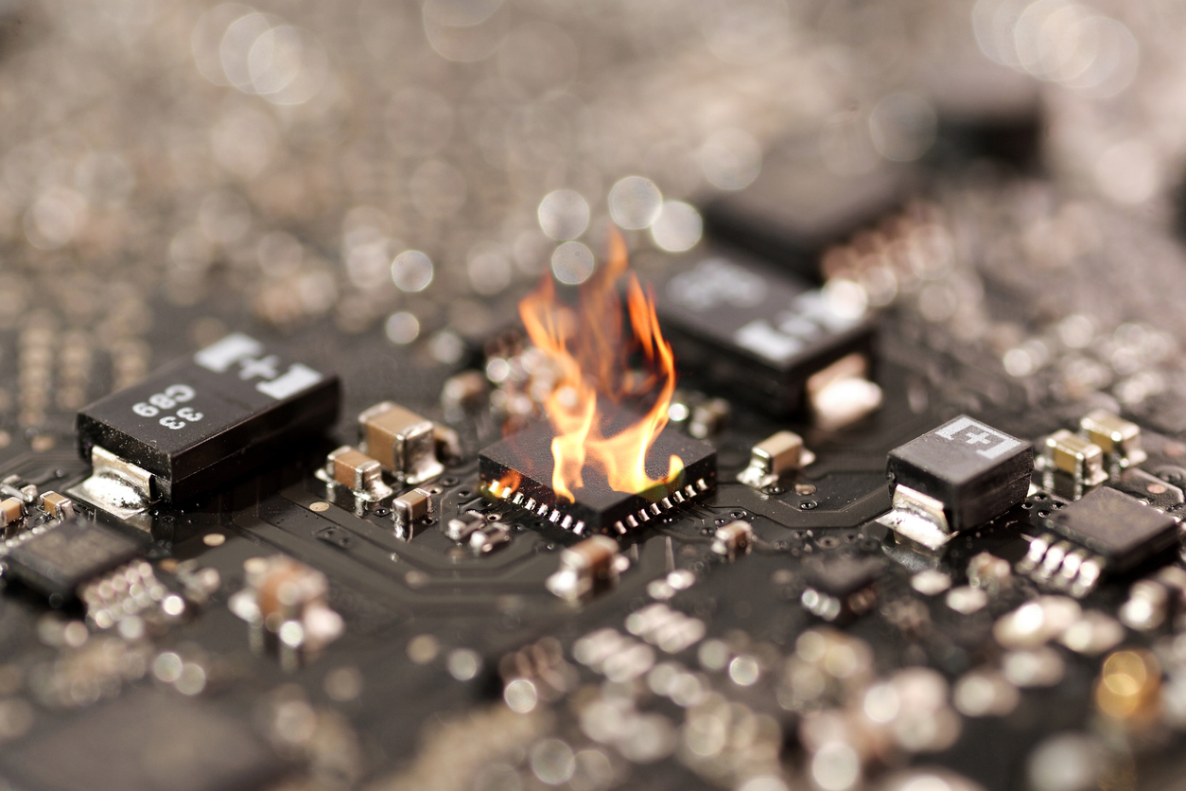
…AND CHALLENGES
“No serial data connection” in Arduino
Rx/Tx connections for UART
Boot up the ESP32 with proper strapping pins: both GPIO 0 and EN to ground
ESP32 decided to burn itself and die
Bad soldering
Maybe due to the high current from the direct connection with Raspberry Pi
ELECTRICAL & COMPUTER ENGINEERING
GRAINGER ENGINEERING

Slide 25
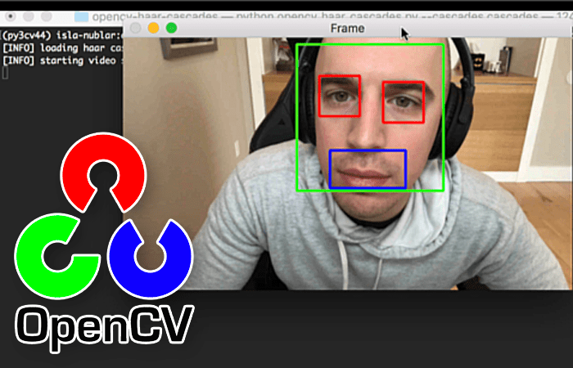
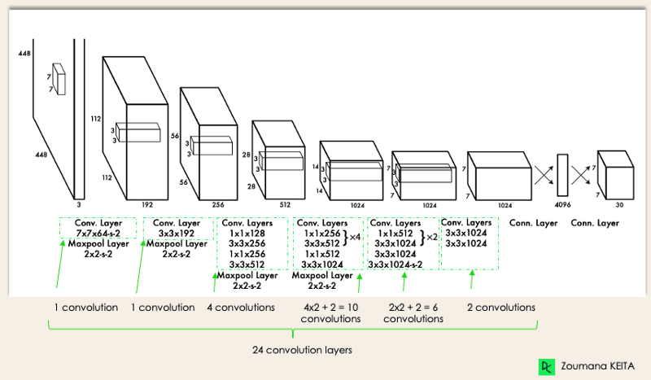
…AND CHALLENGES
Cannot get video stream from the camera in Python
OpenCV build issues
Raspberry Pi camera driver compatibility issues
Overheating voltage converter? Program not running? Floating signal voltages? ...
ALL SOLVED
ELECTRICAL & COMPUTER ENGINEERING
GRAINGER ENGINEERING

Slide 26
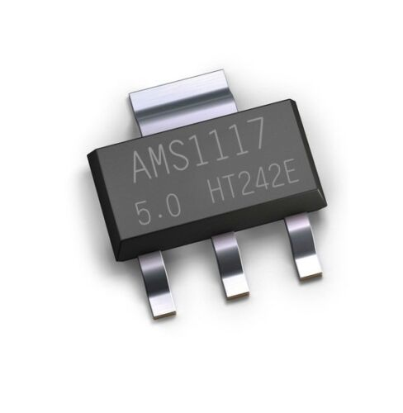
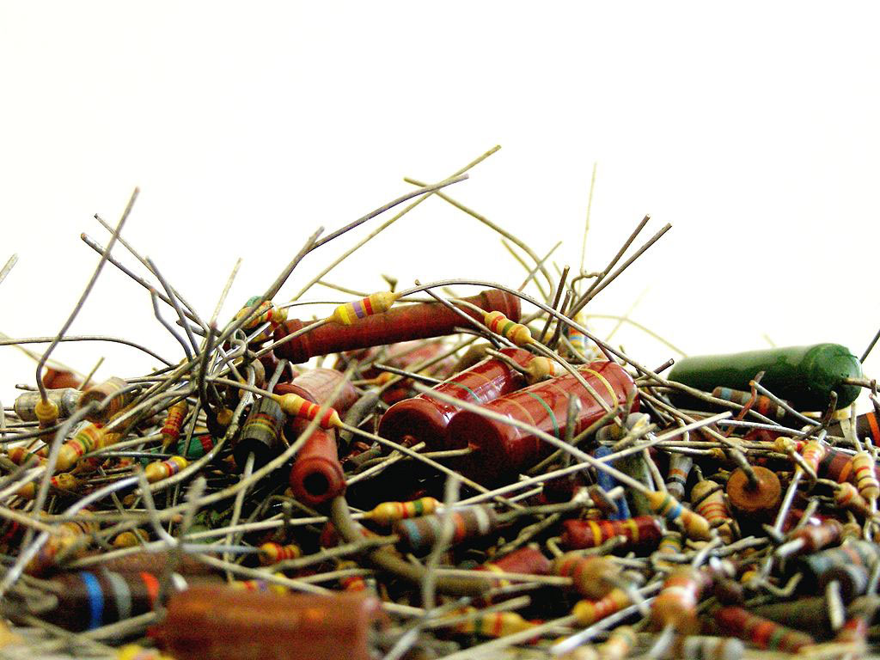
Project Conclusion
Sacrifices: 5 ESP32 chips, 6 Ultrasonic Sensors, 7 PCB boards, 10 AMS117-5V, trillions of capacitors and resistors.
ELECTRICAL & COMPUTER ENGINEERING
GRAINGER ENGINEERING

Slide 27
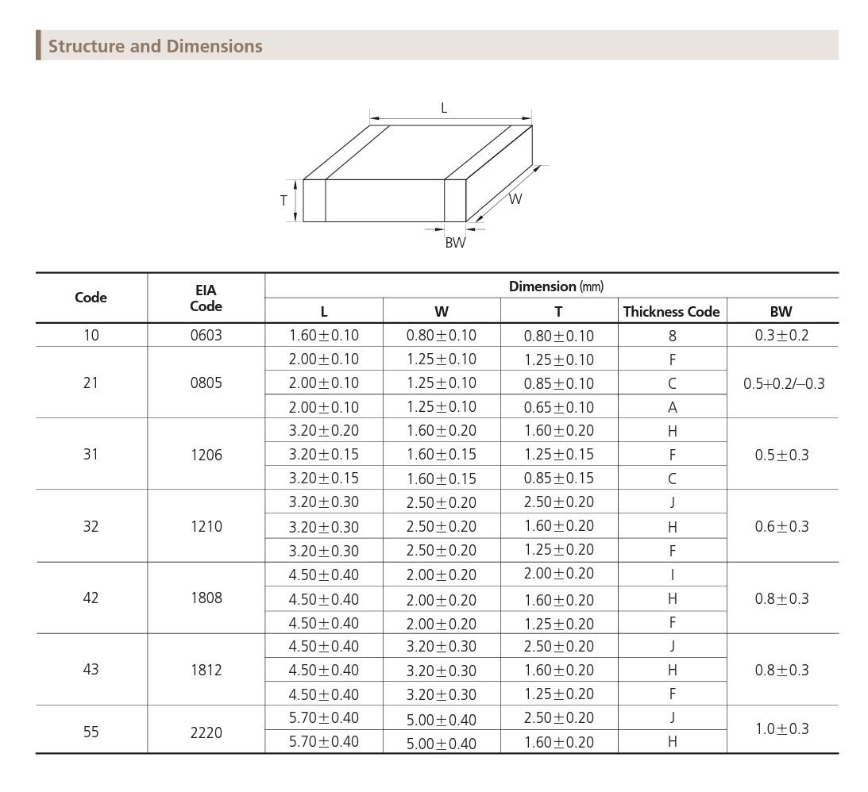
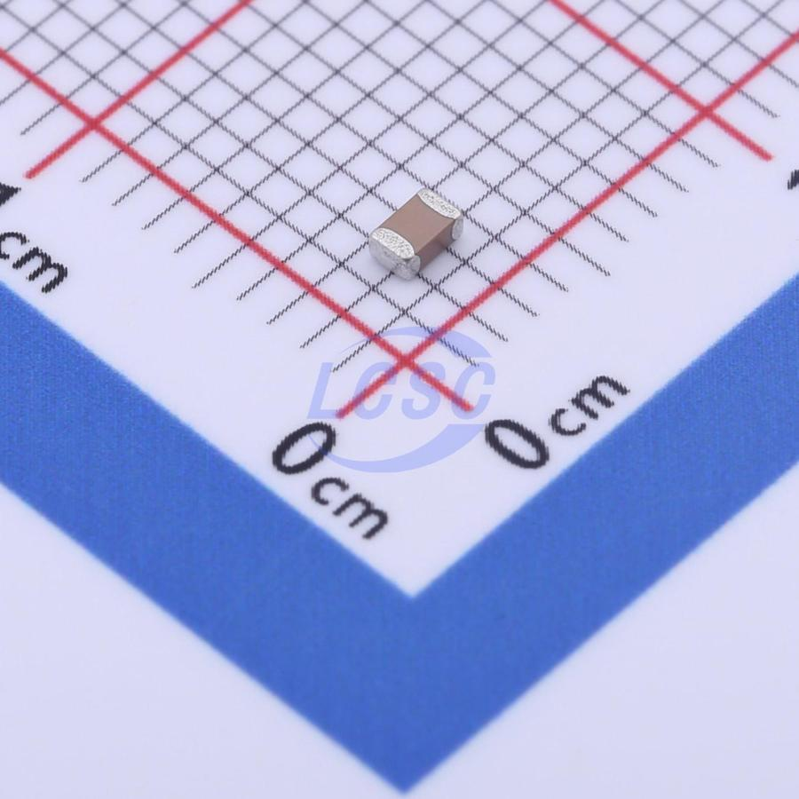
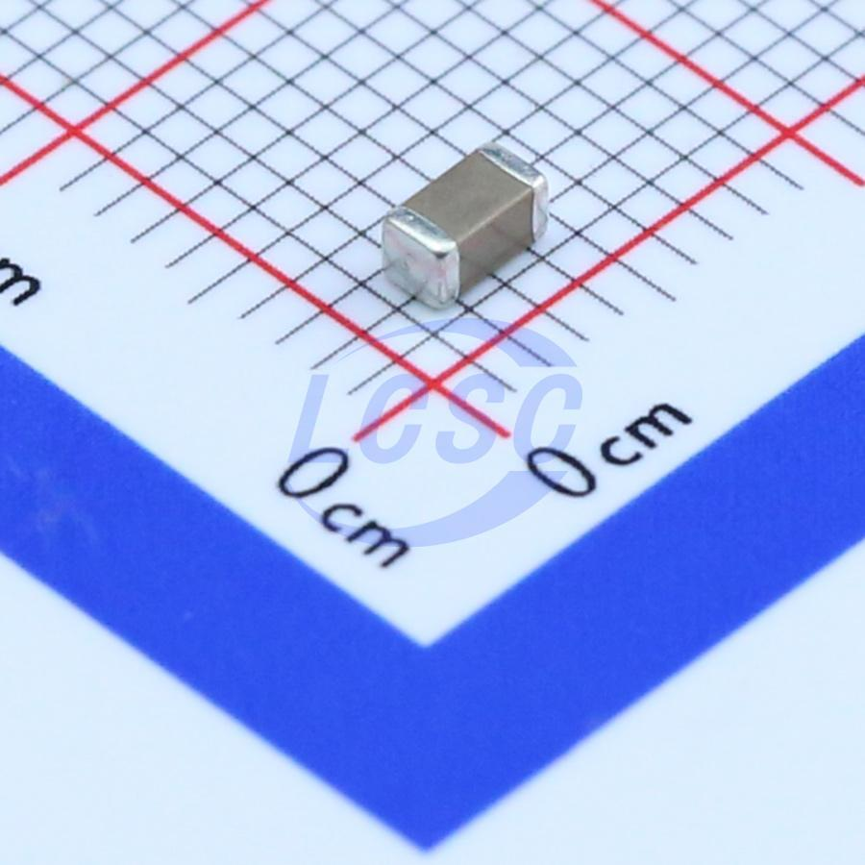
PROJECT CONCLUSION
Lessons:
PCB design process
Pay attention to packaging and dimension
Always consider the current and voltage limits in every connection
Always do more
Ordered excessive parts (Yes, we had thousands of capacitors)
Designed extra pin connections
Made multiple spare boards
ELECTRICAL & COMPUTER ENGINEERING
GRAINGER ENGINEERING

Slide 28
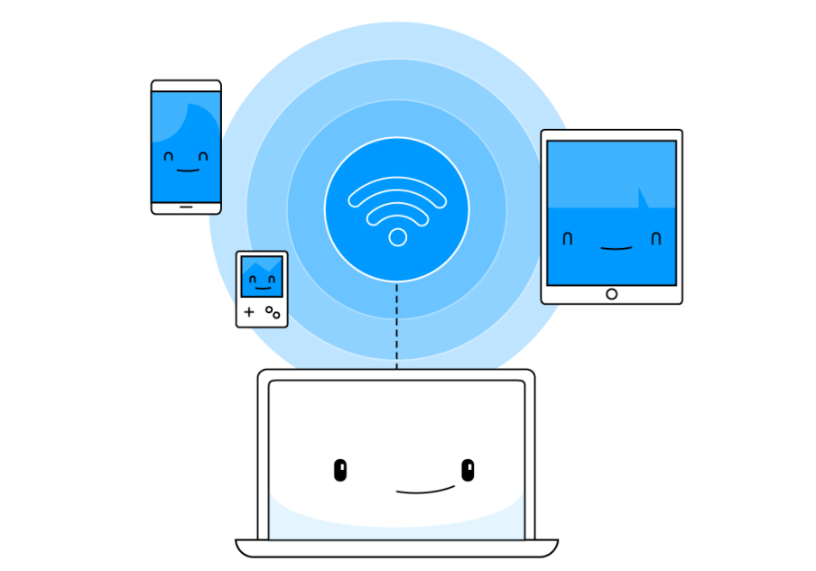
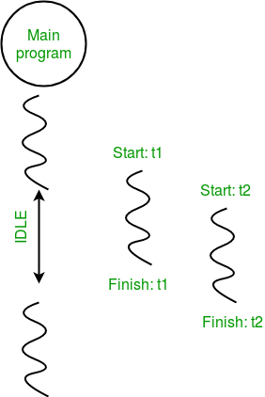
RECOMMENDED FURTHER WORK​
Multithreading in Python to speed up the AI model​
More integrated PCB: buck converter, auto reset, auto boot, USB connection​
Customized trained AI model for specific pet
Wireless Communication and Application
GRAINGER ENGINEERING

Slide 29
In conclusion, we successfully designed the hardware and software that meet our requirements
ELECTRICAL & COMPUTER ENGINEERING
GRAINGER ENGINEERING

Slide 30
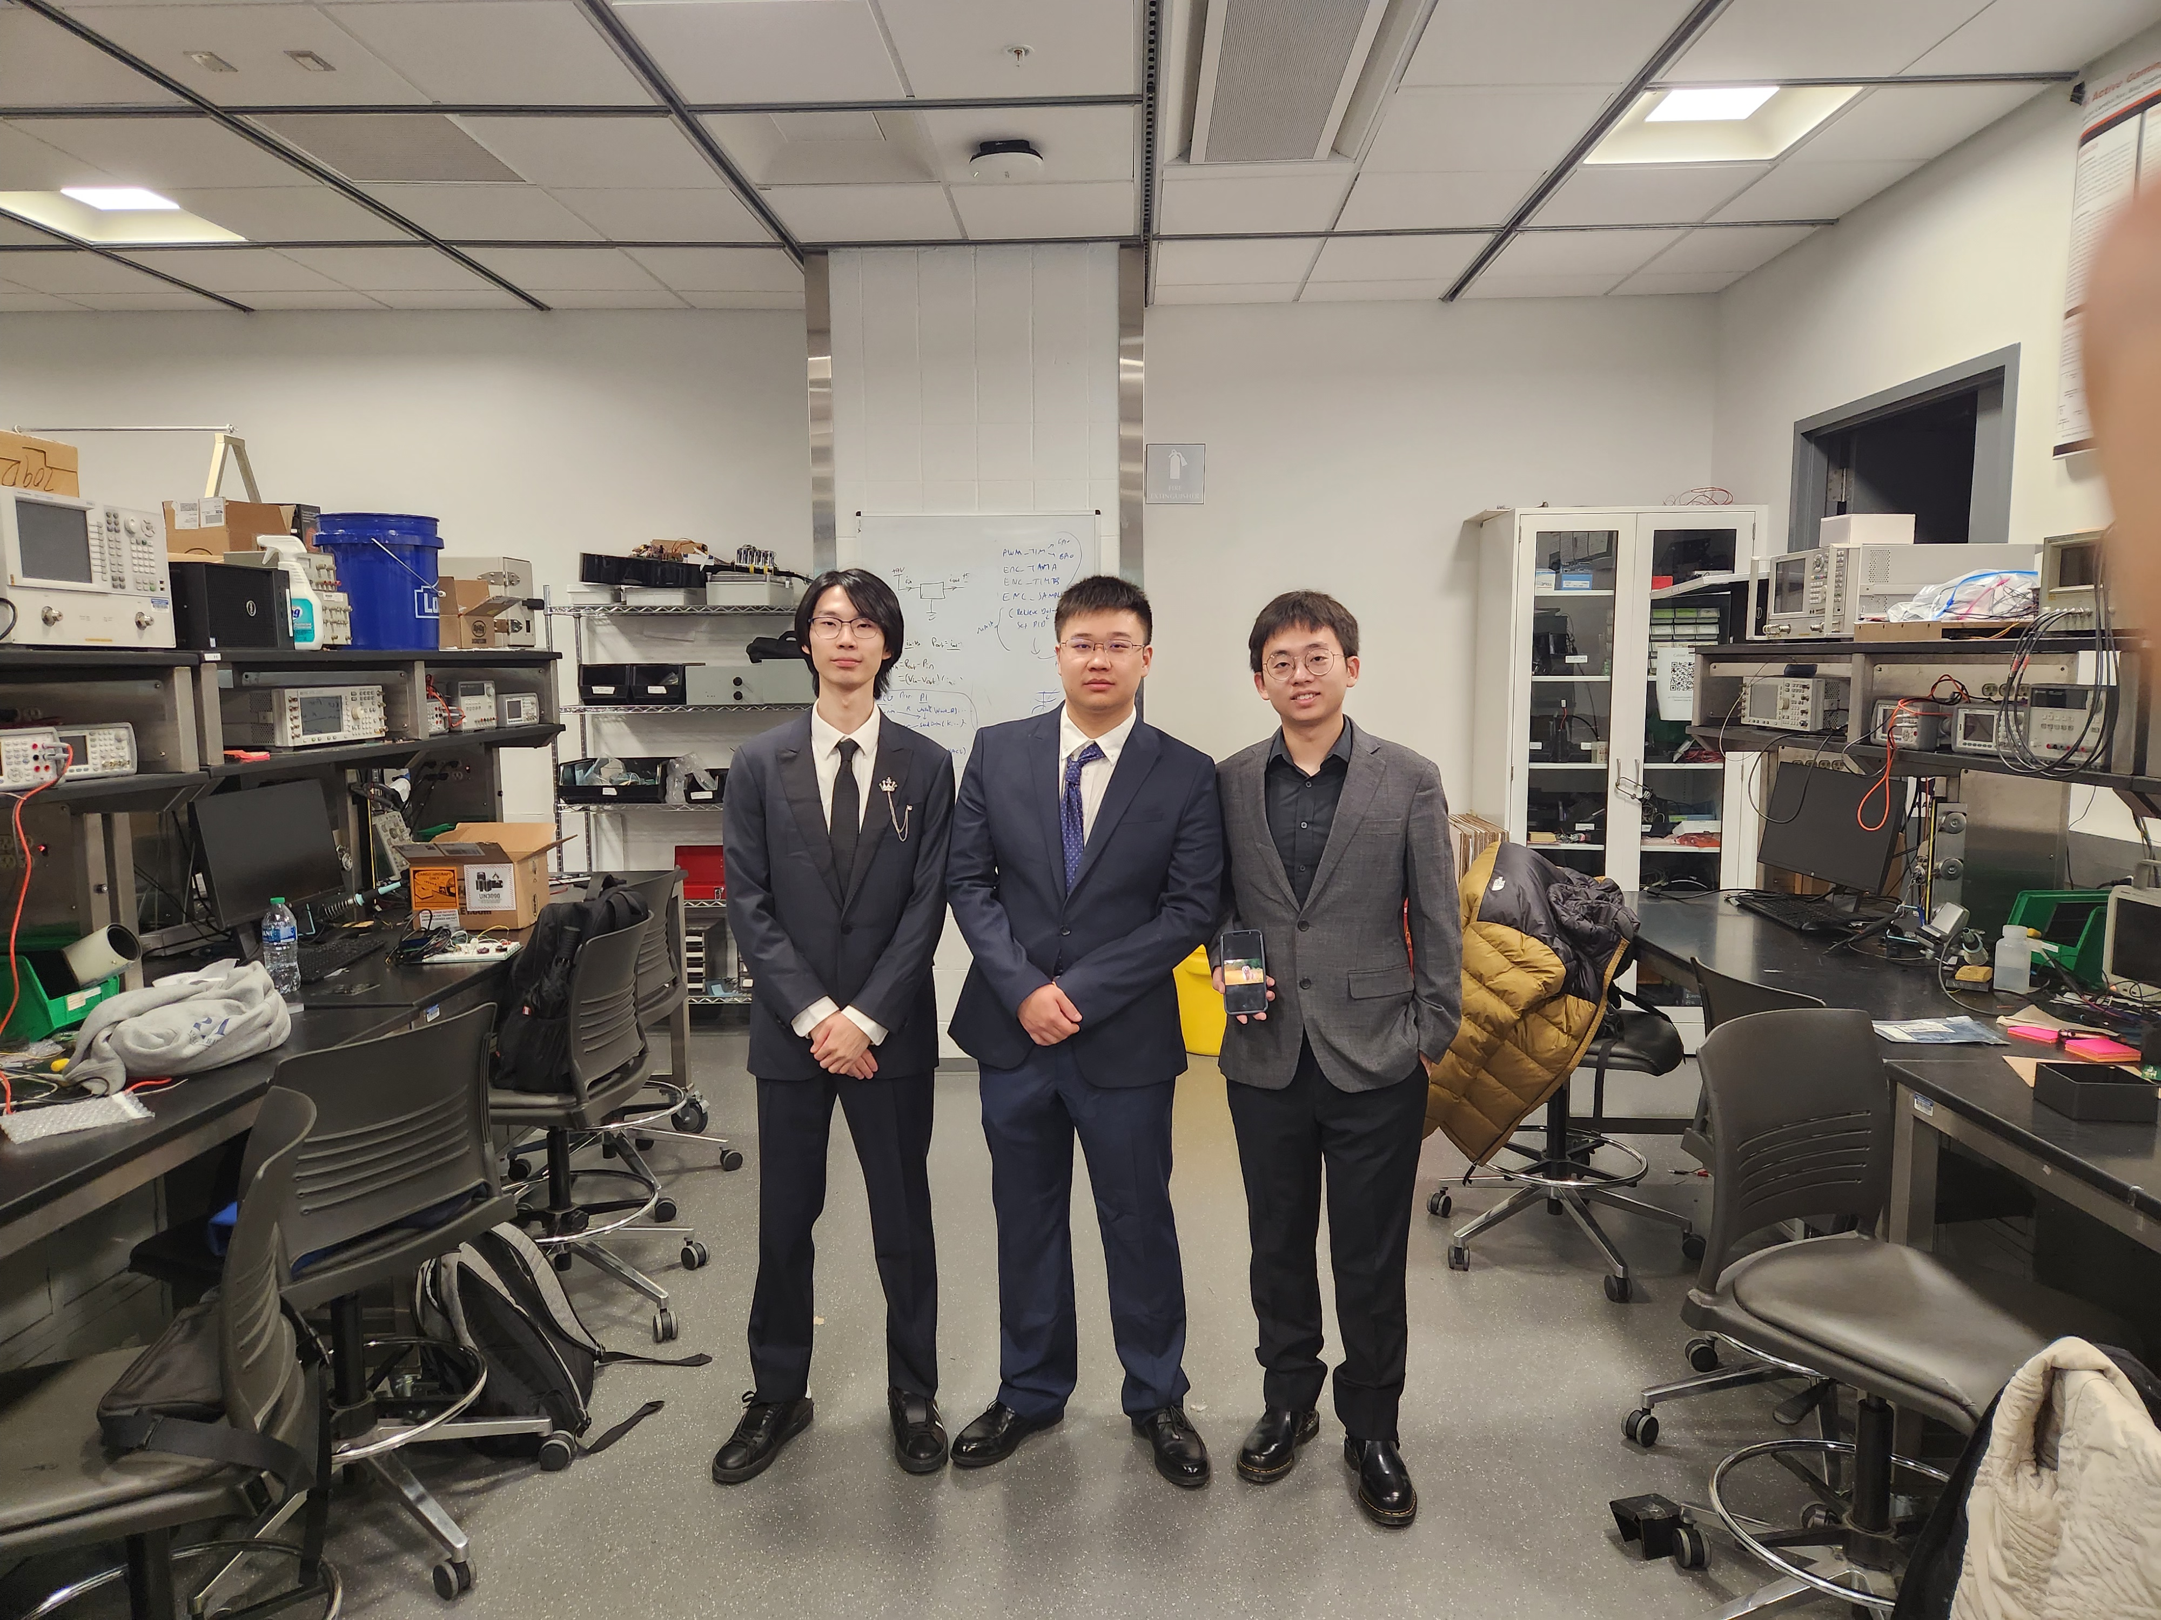
Thank You!
ELECTRICAL & COMPUTER ENGINEERING
GRAINGER ENGINEERING

