Slide 1
Desk Reservation System
Project 20
Mark Syrek, Akeem Kennedy, & Siddhant Jain

Slide 2
Introduction & Objective
Siddhant Jain

Slide 3
Objective
Problem: Finding open space in a public area such as a library is difficult.
Solution: Desk Reservation System allows users to reserve a desk for a predefined amount of time.

Slide 4
High Level Requirements
The desk module knows the status of each desk and if a reservation is made.
The desk module will verify if a user is present and alert the user on the LCD if they exceed their reservation time.
We intend to build three desk modules; however, the system is modular and can support multiple units.

Slide 5
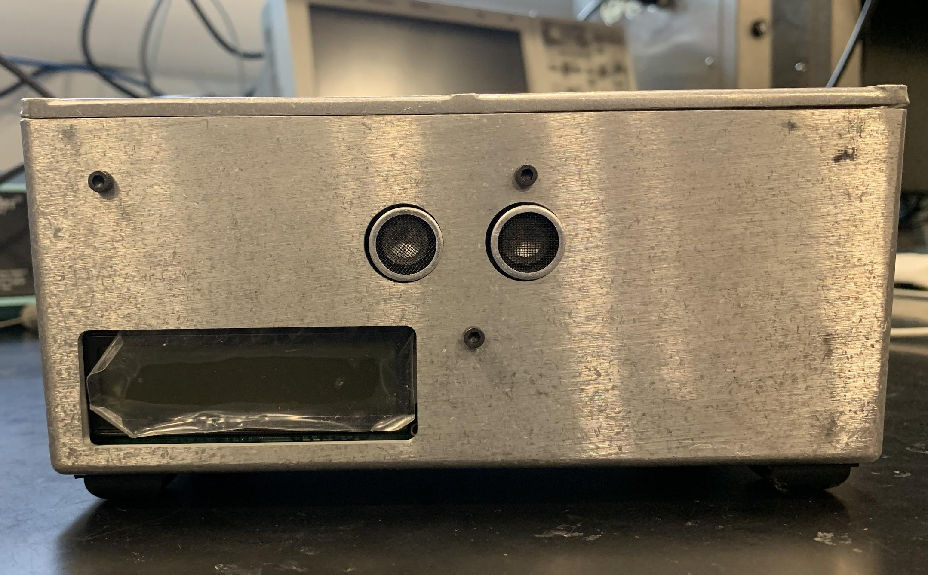
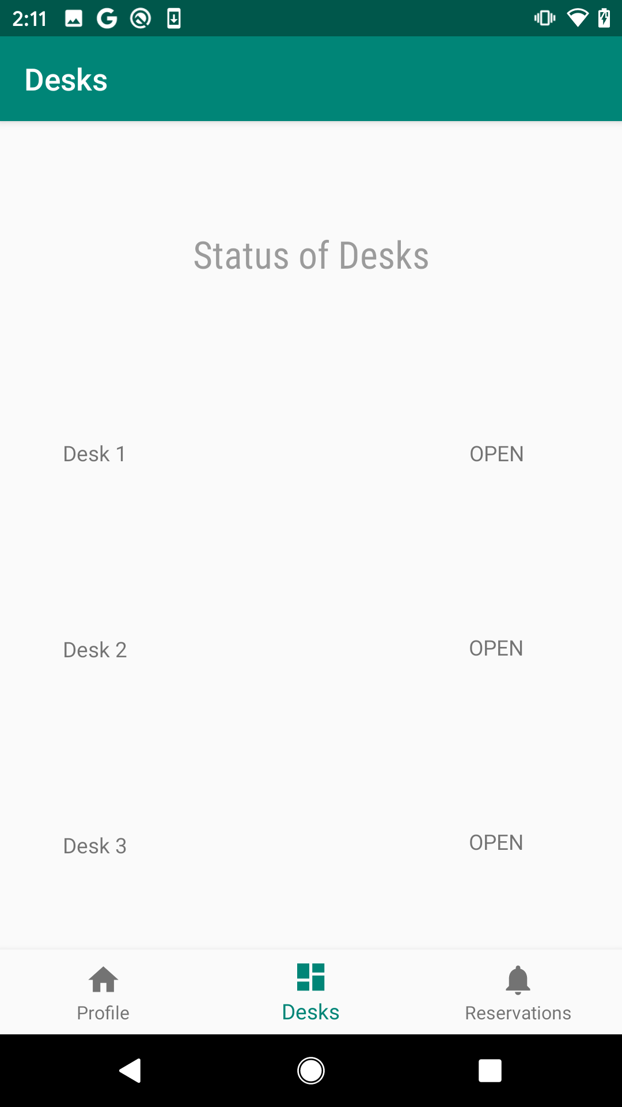
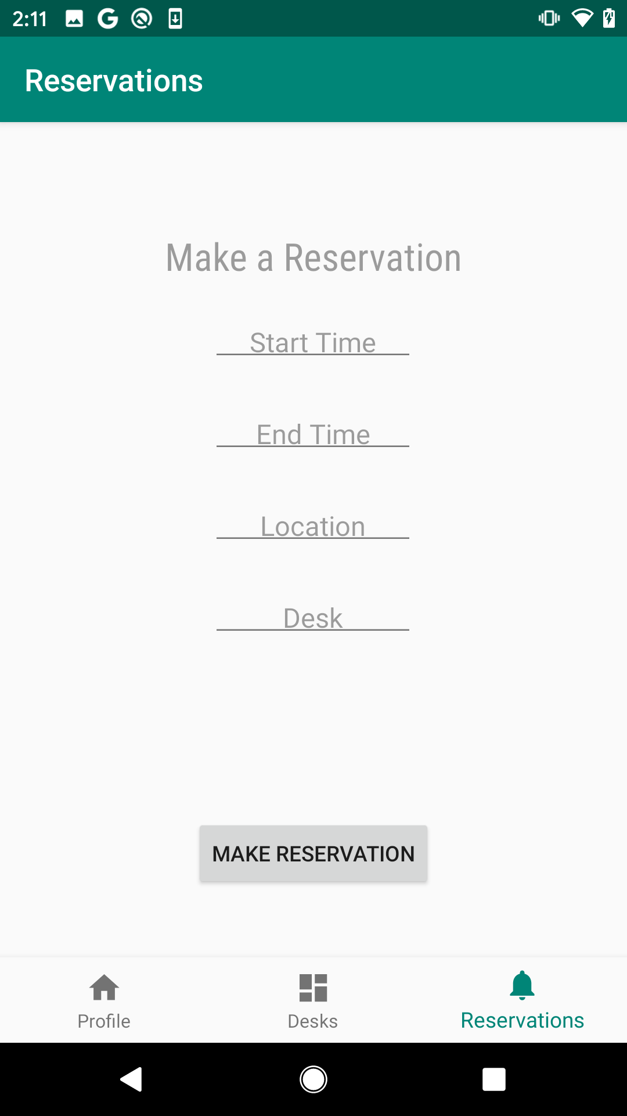
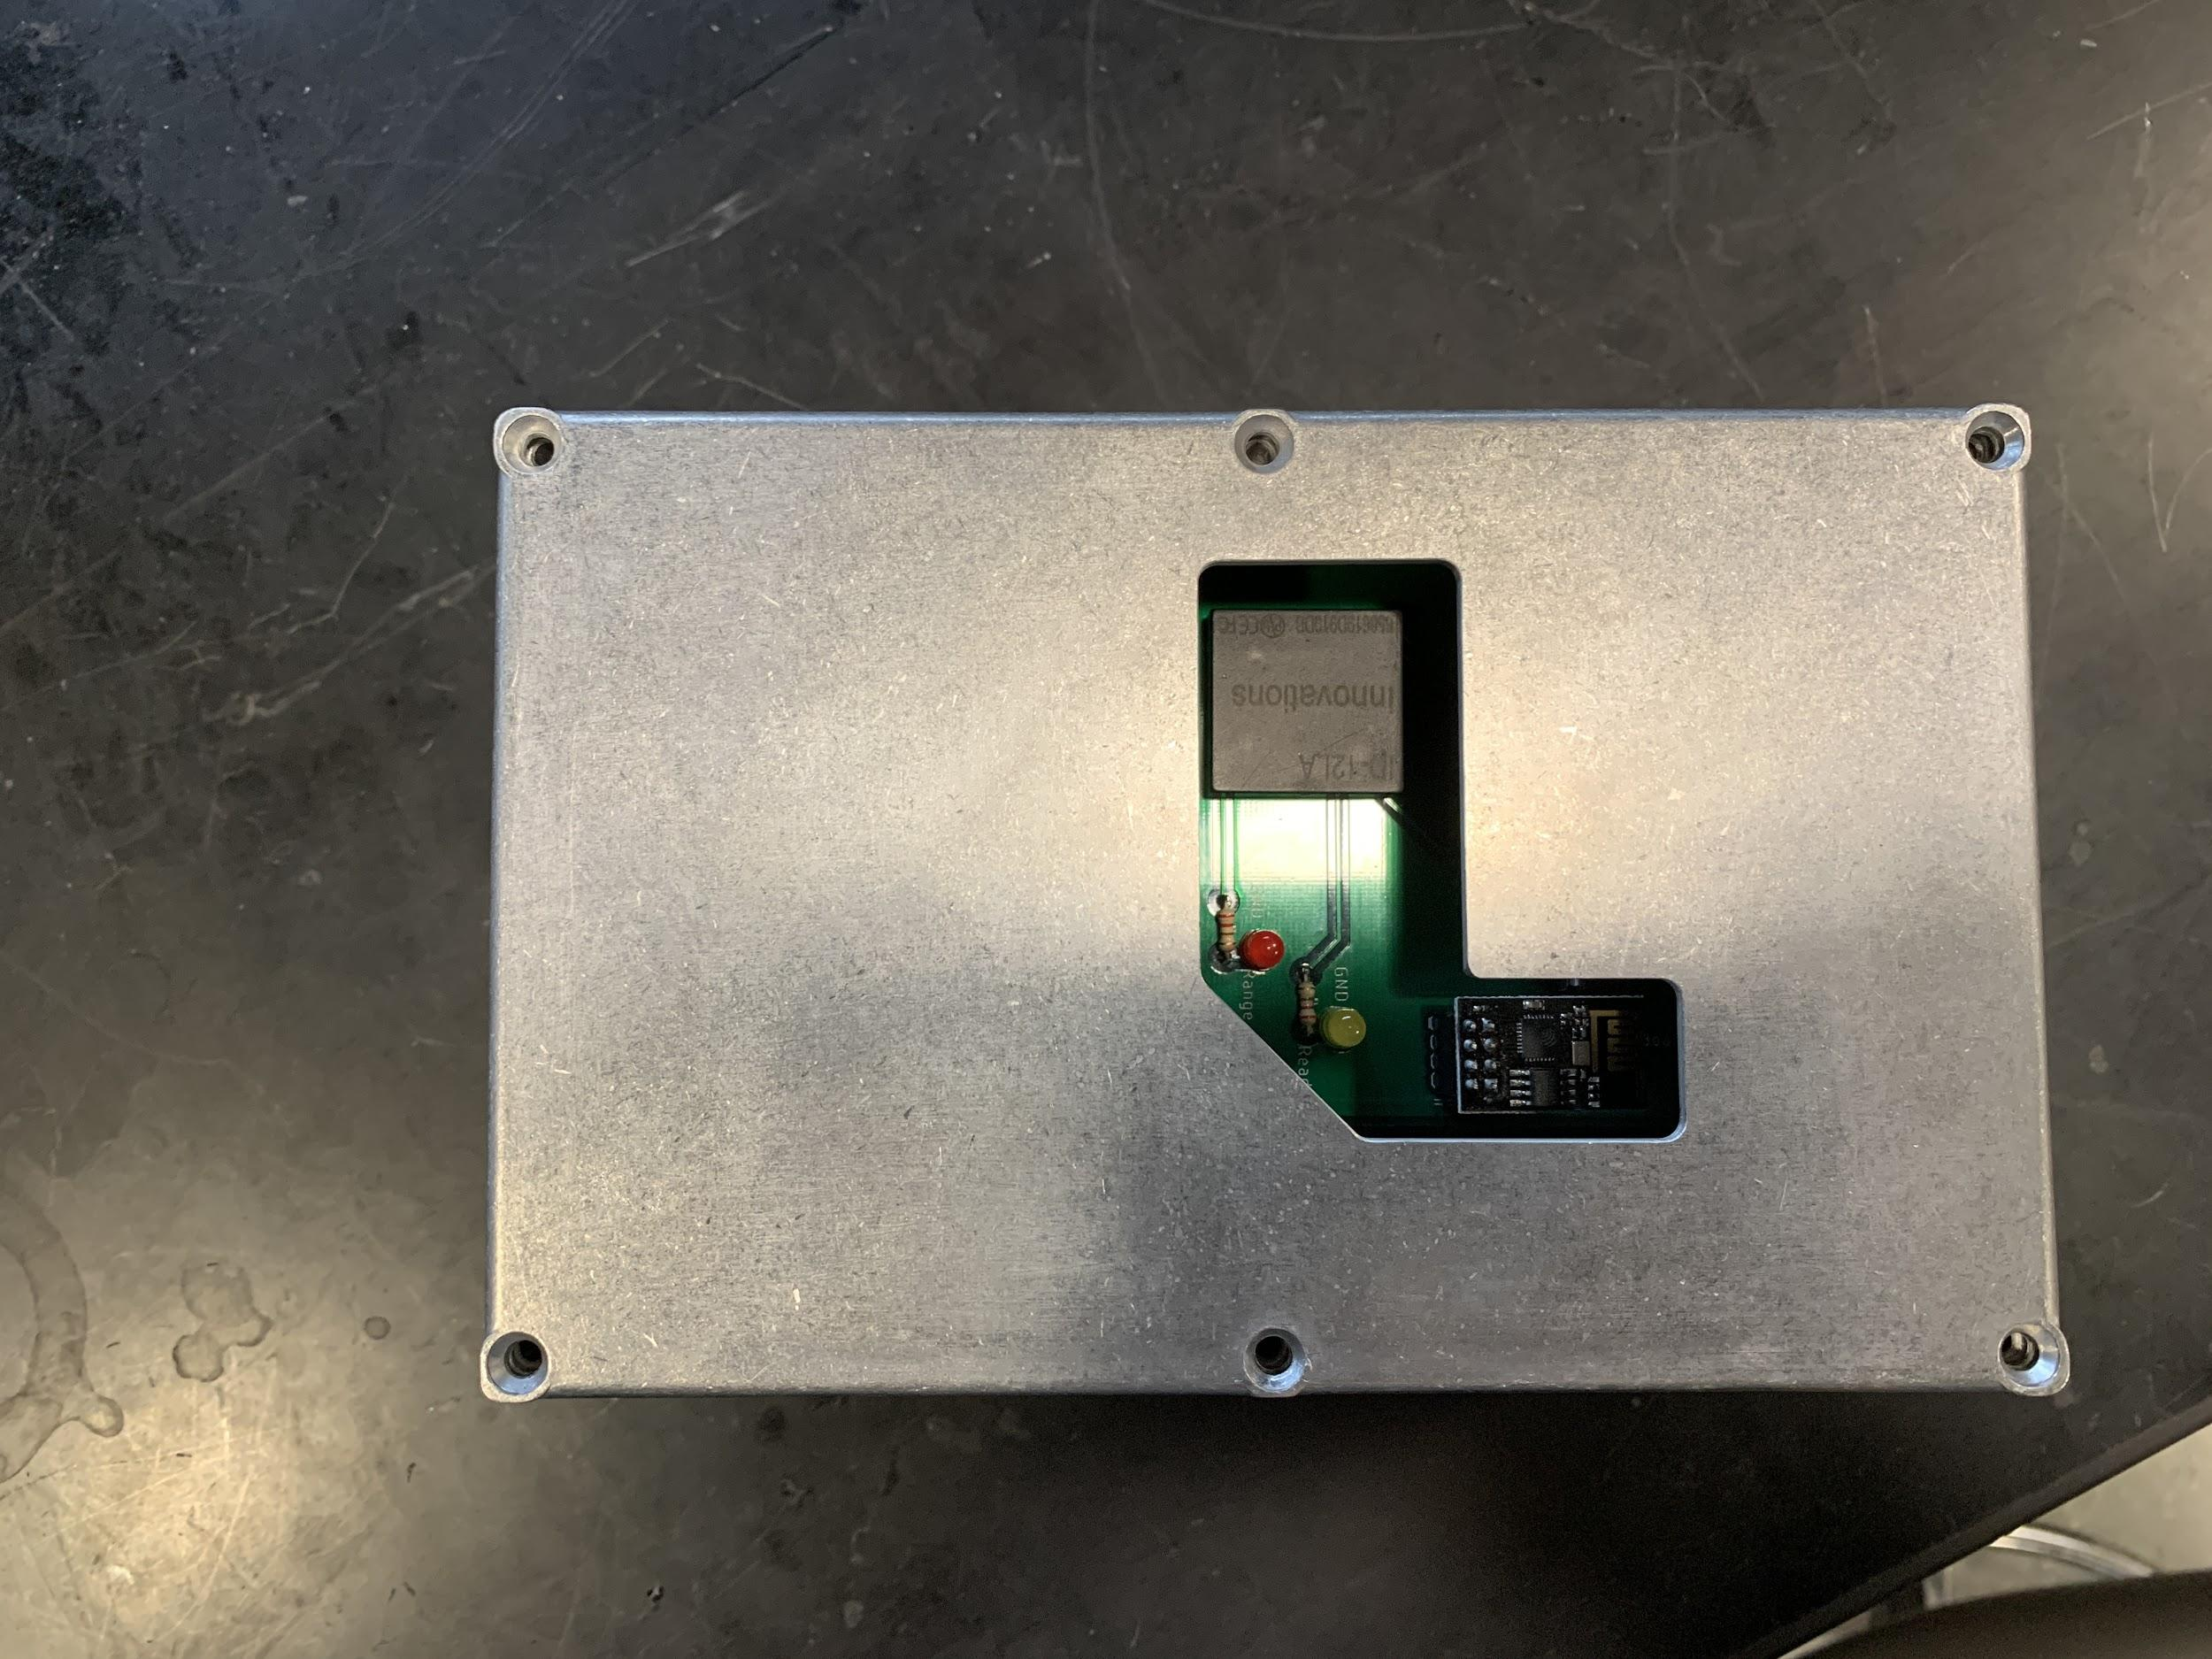
System Overview

Slide 6
Block Diagram
Mark Syrek

Slide 7
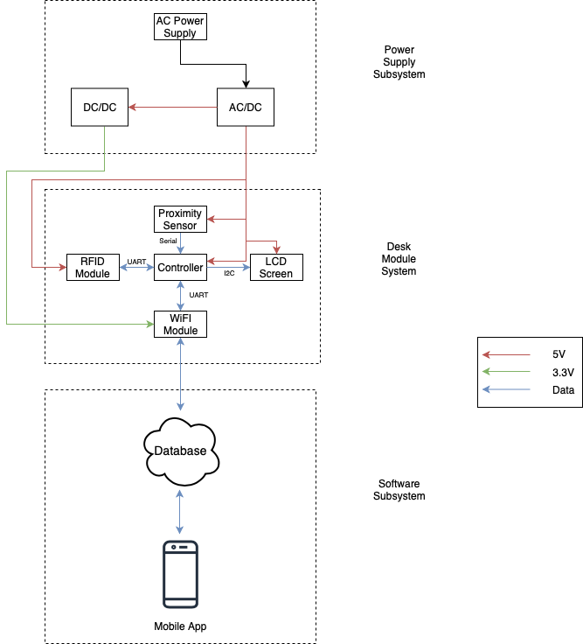
Block Diagram

Slide 8
Power Subsystem
AC/DC Converter
120 V AC/DC Converter
Outputs a 5 V DC voltage
Required for the majority of electronics on the PCB
Uses barrel jack to connect to the PCB
DC/DC Converter
3.3V Linear Regulator
Steps down voltage for Wi-Fi module
Simple to use, cheap, fast transient
Connects via through hole connection

Slide 9
Desk Modules Subsystem
Akeem Kennedy

Slide 10
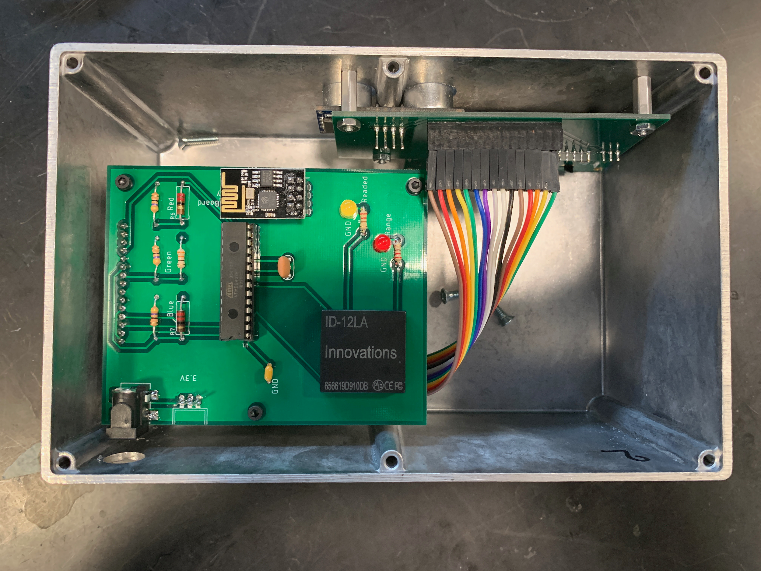
Microcontroller
ATMEGA328-PU
Compatible with Arduino IDE
UART, I2C

Slide 11
Wi-Fi Chip
ESP8266-01
Firebase library
Built-in antenna
UART Communication

Slide 12
Proximity Sensor
HC-SR04 Ultrasonic
Outputs a eight 40 kHz signals and waits for an echo
Ultrasonic sensor outputs a new read every 1.3ms

Slide 13
RFID Module
ID-12LA RFID Reader
Built-in Antenna
UART Protocol
Range: 4 cm

Slide 14
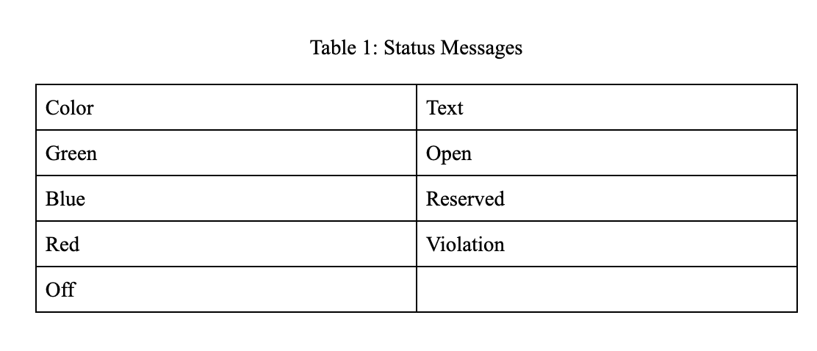
LCD
NHD-0216K3Z LCD
16x2 character LCD
I2C communication
RGB backlight

Slide 15
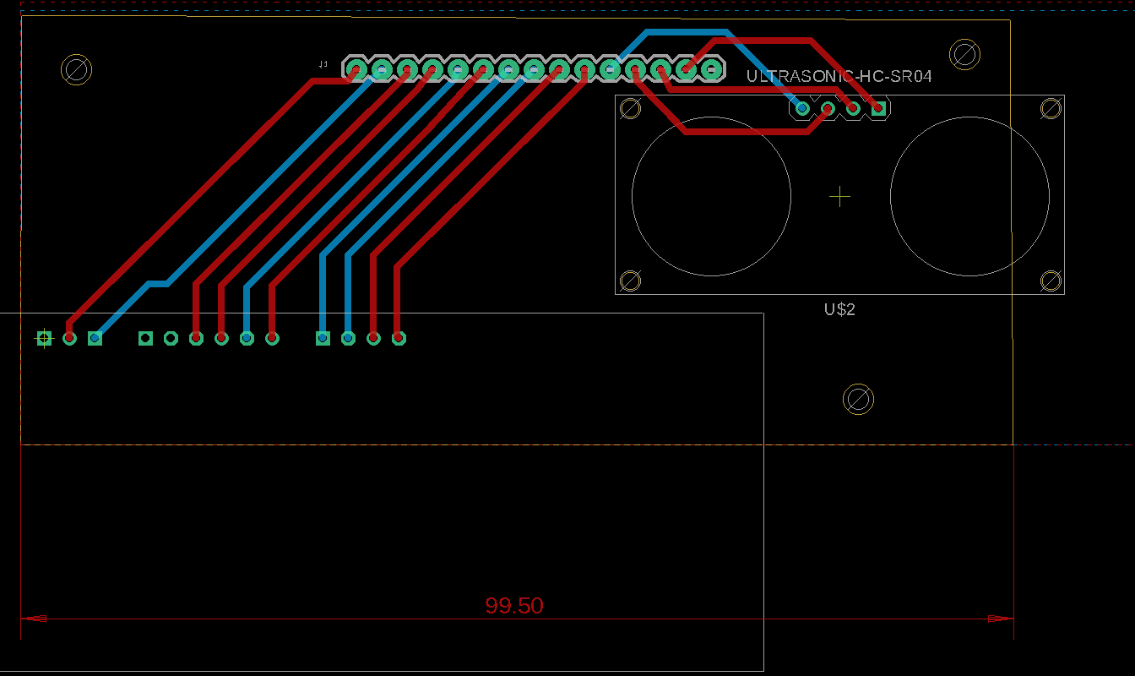
Front Printed Circuit Board (PCB)

Slide 16
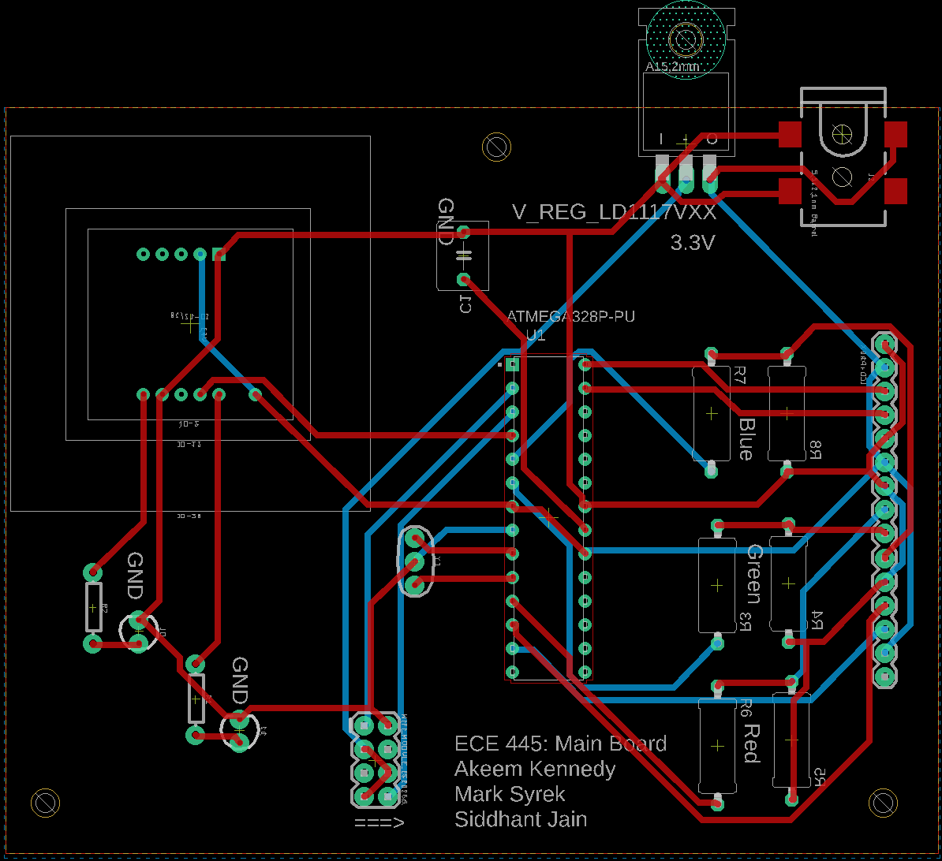
Main Board Printed Circuit Board (PCB)

Slide 17
Top View of Desk Module

Slide 18
Software
Siddhant Jain

Slide 19
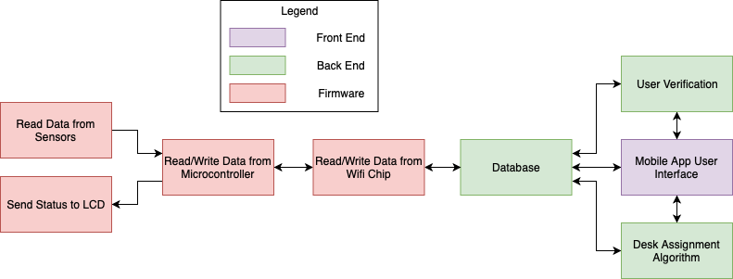
Software Architecture

Slide 20
Software Running on Desk Module
Microprocessor
Handshake between the Sensors and Wi-Fi chip
Looping two Functions
dataToESP
dataFromESP
Wi-Fi Chip
Handshake between the Database and Microprocessor
Looping two Functions
dataToFirebase
dataFromFirebase

Slide 21
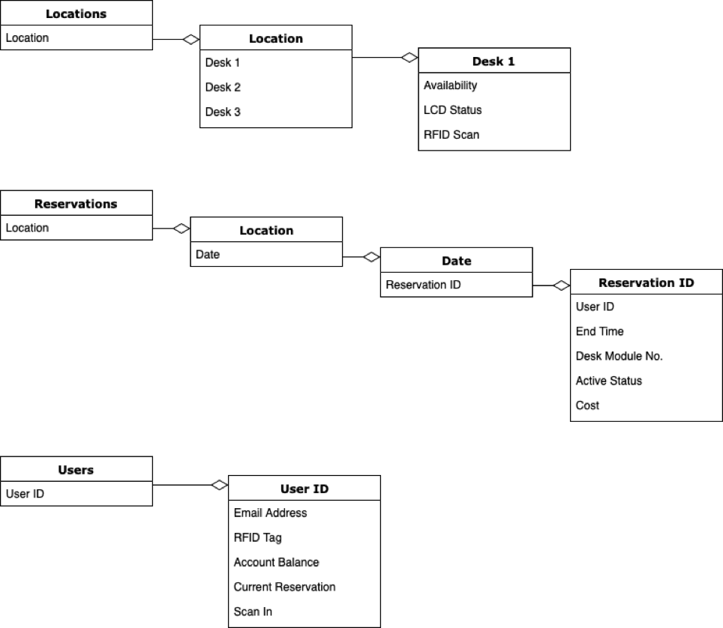
Firebase & Google Cloud Platform
Cloud Functions
Make Reservation
Desk Status Handler
Desk Status Updater

Slide 22
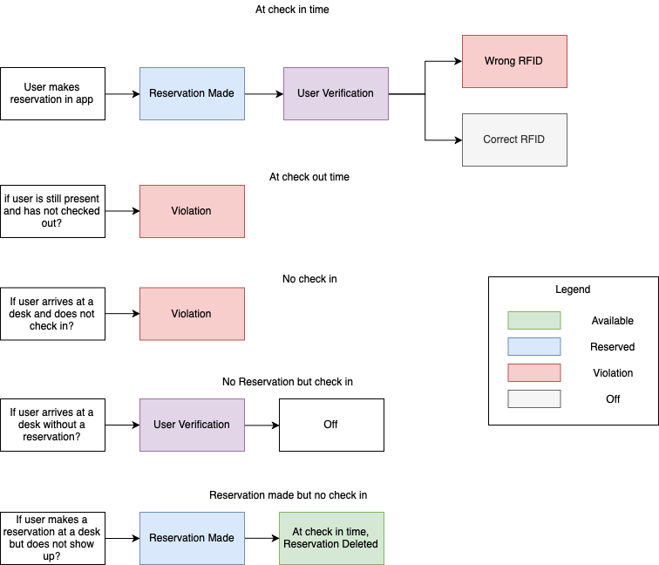
User Verification & Enforcement

Slide 23
Mobile Application
Mark Syrek

Slide 24
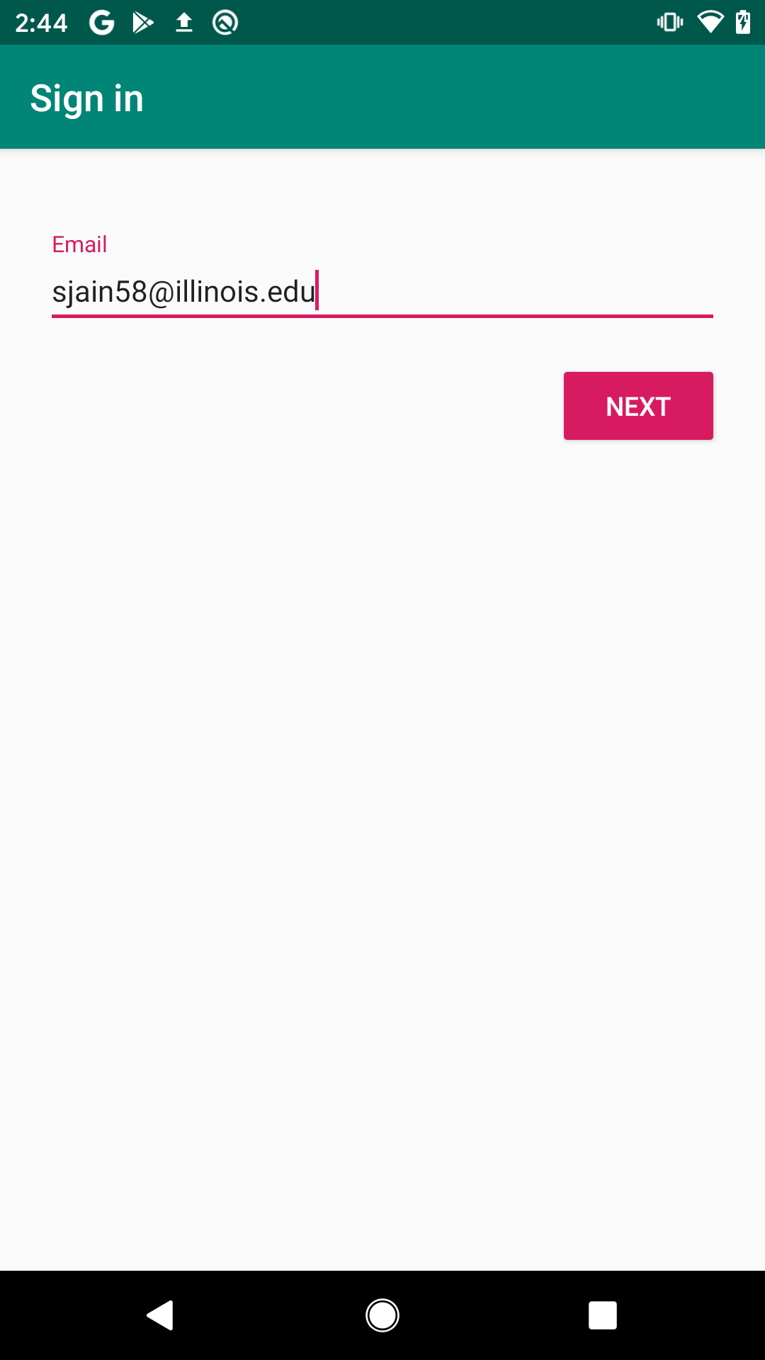
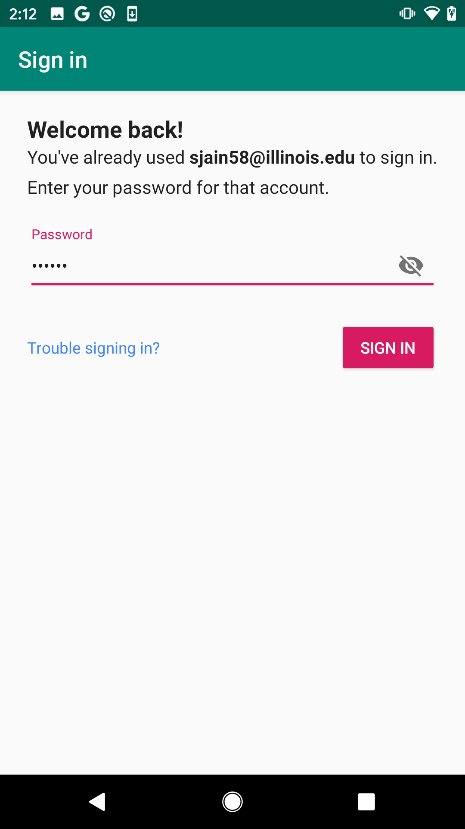
Login

Slide 25
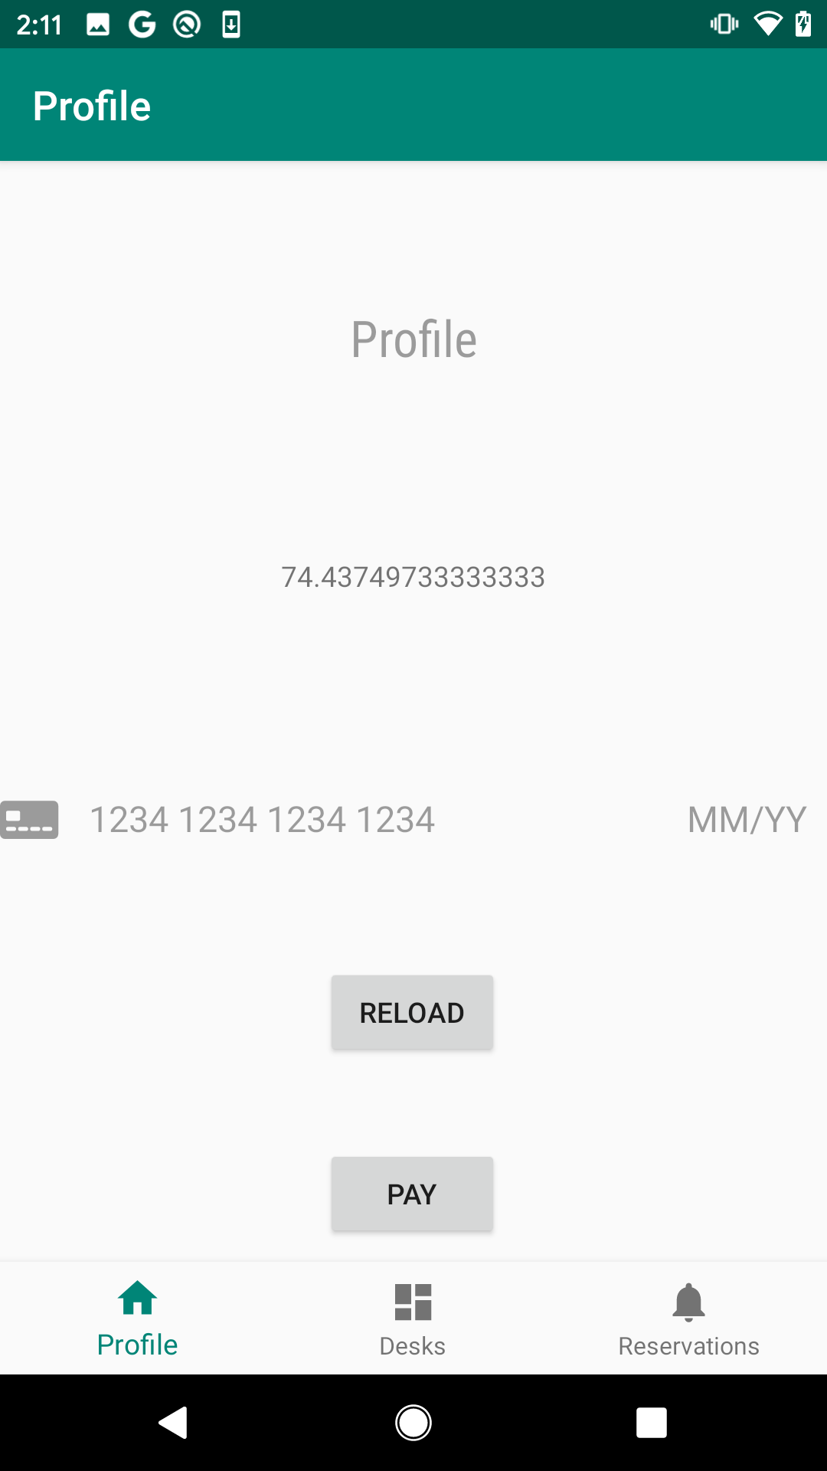
Profile
Account Balance
Stripe Integration
Online Payment Processor
Does Not Store Credit Card Data Locally

Slide 26
Available Desks
View the Available Desks based on Ultrasonic Data

Slide 27
Desk Reservations
Make Reservation
start time
end time
location
desk

Slide 28
Conclusion
Akeem Kennedy

Slide 29
Success
Desk module can enforce reservations through ultrasonic
Desk module can process reservations through RFID
Users can make reservations through the mobile app
Users can view desk module’s status through the mobile app
System is scalable since we created three desk modules

Slide 30
Challenges
Serial communication between Microprocessor and Wi-Fi Chip
Firebase-Arduino Library was not easy to setup and use
Documentation on the Wi-Fi chip was not clear
The reliability of the Ultrasonic sensor

Slide 31
Safety & Ethics
Desk Module is IP20
Reservation data is deleted after reservations are made.
User data is hashed by a unique string (key)
so no direct user lookups are possible

Slide 32
Future Work
Find a more reliable solution to the Ultrasonic Sensor
Implement NFC verification
Redesign box for better protection
Plastic Box (IP40)

Slide 33
Acknowledgement
Mengze Sha
Professor Arne Fliflet
Machine Shop
Greggory Bennett
David L. Switzer

