Slide 1
Sun Tracking Solar Panel
Leonardo Larios, Bryce Smith, Soumitri Vadali
ECE 445: Senior Design Laboratory
Project Team Number 35
Sponsor: Prof. Karl Reinhard
TA: Yuchen He

Slide 2
Introduction
Project proposed by Professor Reinhard to be integrated with other streetlight projects
The system provides a simple and effective design for tracking the sun
Notes:
Leo

Slide 3
Objectives
Move East to West and North to South
Tracking the sun
Reset functionality
Battery can support the power consumption of the system
Notes:
Bryce

Slide 4
Block Diagram
Notes:
Soumitri

Slide 5
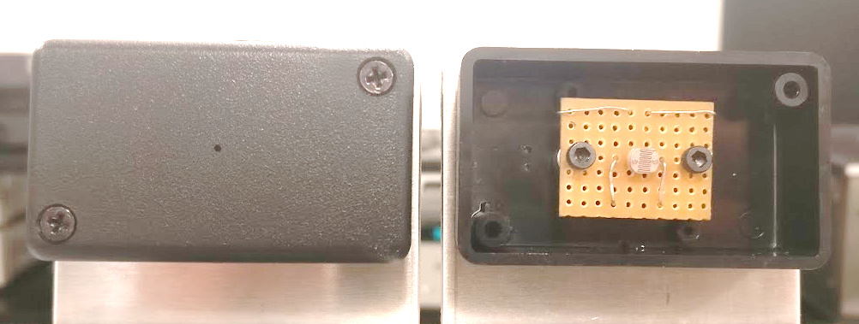
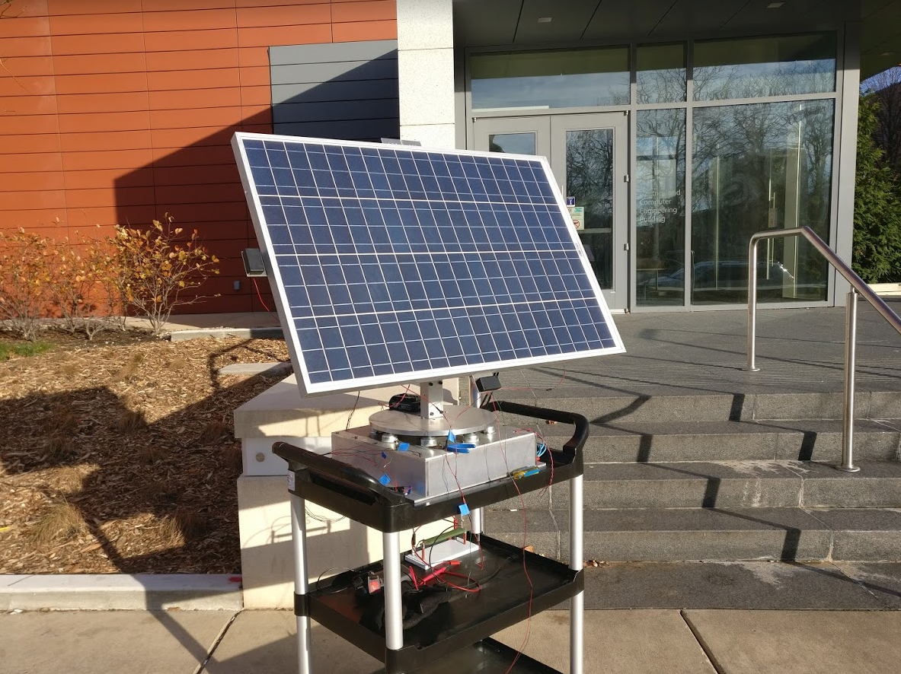
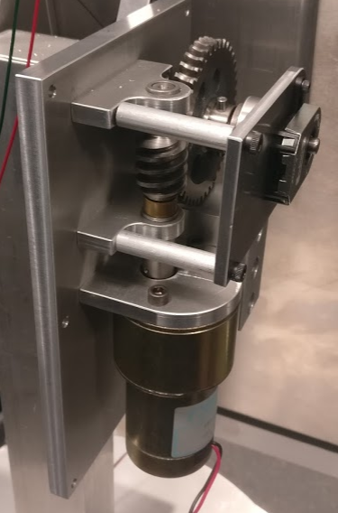
Physical Build
Notes:
Bryce – mount and motors
Soumitri – sensor placement and hole size

Slide 6
Design
Solar Panel
Power generation
Output: 14.5V – 20V
Output: 5A – 5.5A

Slide 7
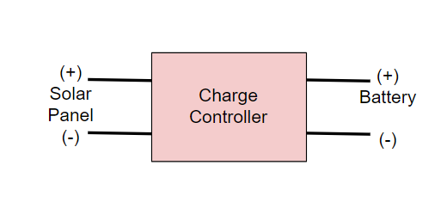
Design
Battery Charge Controller
Regulates solar input for charging
Input: 15V - 20V from solar panel
Output: PWM with amplitude 12V - 15V to the battery
Input: 12V - 12.5V from the battery
Output: 0 - 10mV to the solar panel

Slide 8
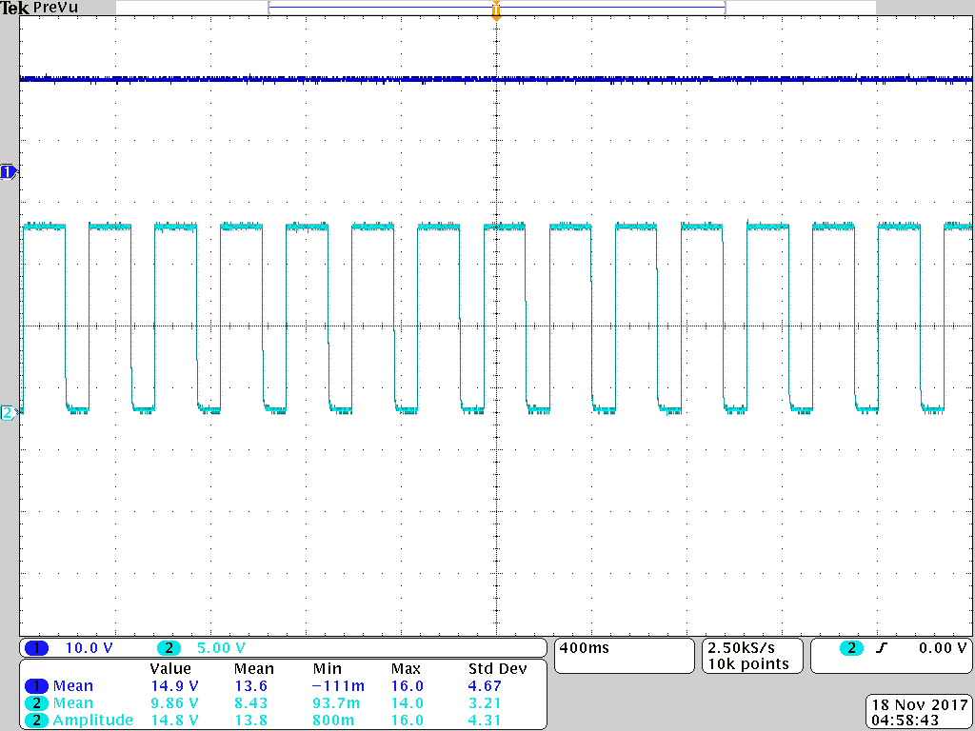
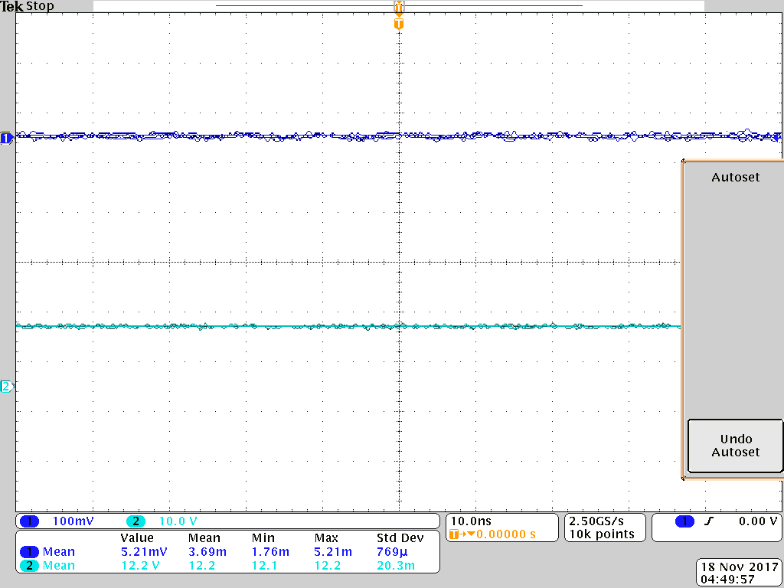
Design
Battery Charge Controller
15V
0V
0V
15V
0V
12V
0V
Blue: Solar terminals
Light blue: Battery terminals
Notes:
Change colors back the original
Add the axis label – 0V,15V and what the color represents

Slide 9
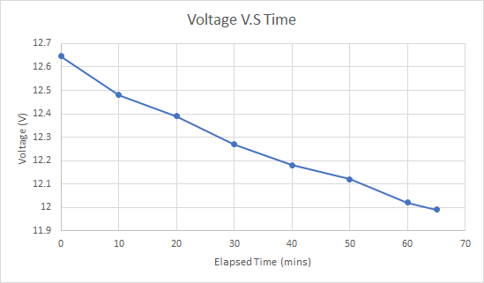
Design
Lead-acid Battery
Input: regulated input from charge controller
Output: 12V – 15V
2 hour discharge rate provides 26 Ah

Slide 10
Design
Voltage Regulator
Input: 12V -15V from battery
Output: 5V to microcontroller
Output: 12V to Over-Current Circuit (OCC)
Carry 2A of current

Slide 11
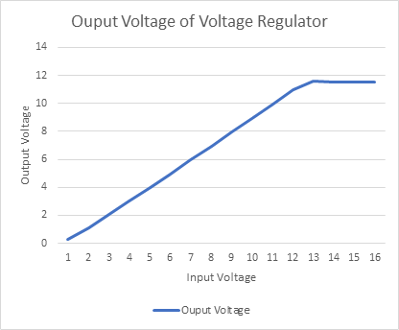
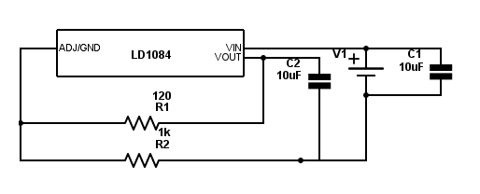
Design
Voltage Regulator
$$V_{0}=V_{ref}\left(1+\frac{R_{2}}{R_{1}}\right)$$

Slide 12
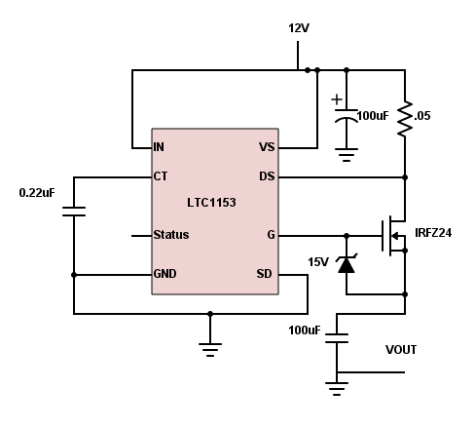
Design
Over-Current Circuit
Turns motor power off when current draw is above 2 amps
Input: 12V from the voltage regulator
Output: Input voltage to the motor drivers

Slide 13
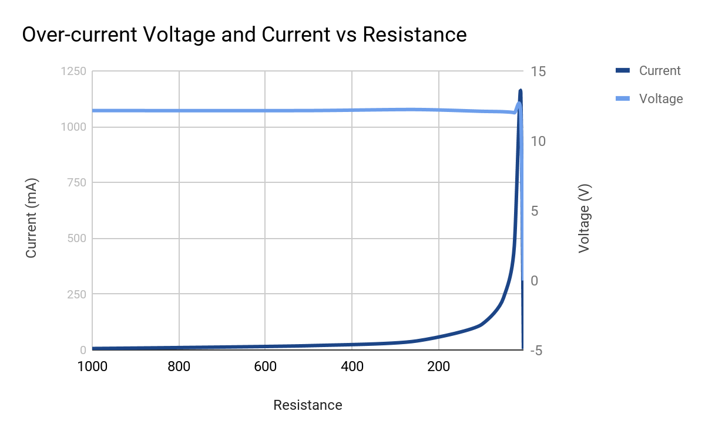
Design
Over-Current Circuit
3V
0V
t
Green: Timing capacitor voltage
Blue: Output voltage

Slide 14
Design
Microcontroller
Processes information from various inputs to drive motors
Input: 5V from the voltage regulator
Input: Analog signal from the photosensors
Input: Two digital signals from the encoders
Output: 5V to motor drivers

Slide 15
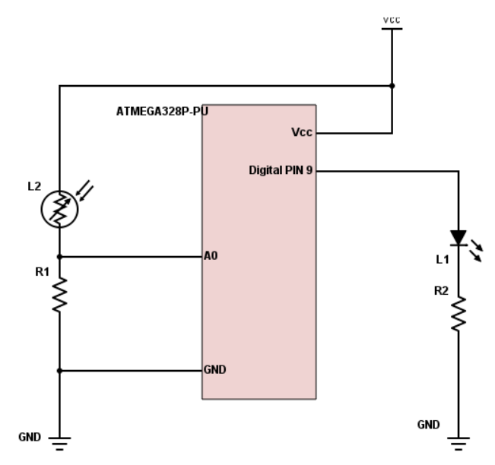
Design
Microcontroller

Slide 16
Design
Motor Driver
Controls the rotation and movement of the motors
Input: Four 5V digital signals from the microcontroller
Input: 12V from the Over-Current Circuit
Output: 12V to the motors

Slide 17
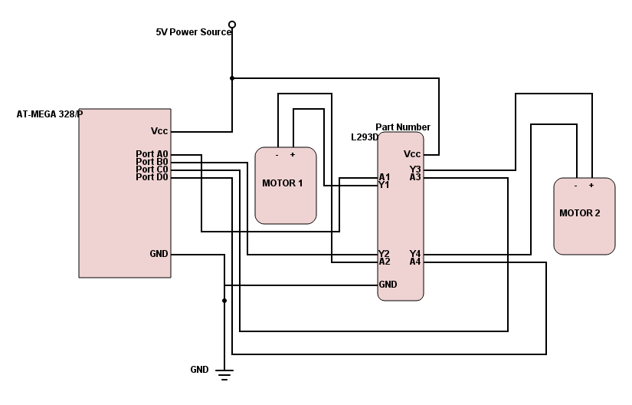
Design
Motor Driver

Slide 18
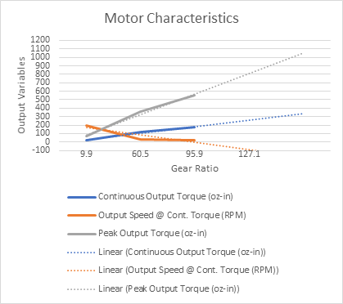
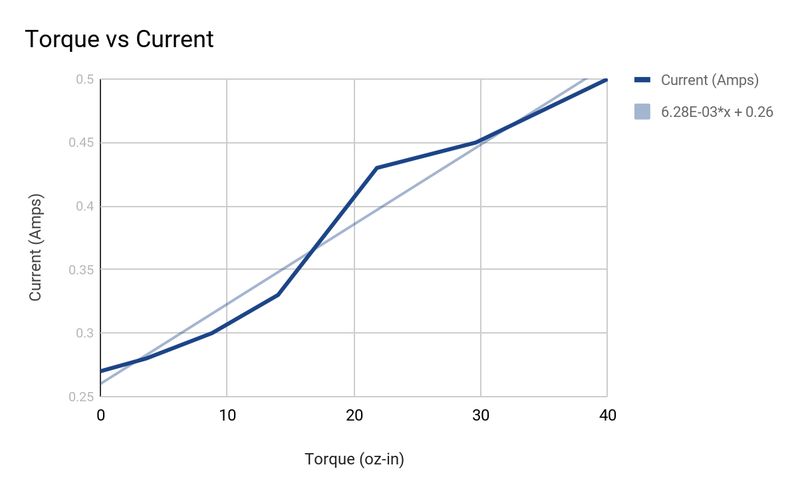
Design
DC Motors
Recycled
Characterization
Movement

Slide 19
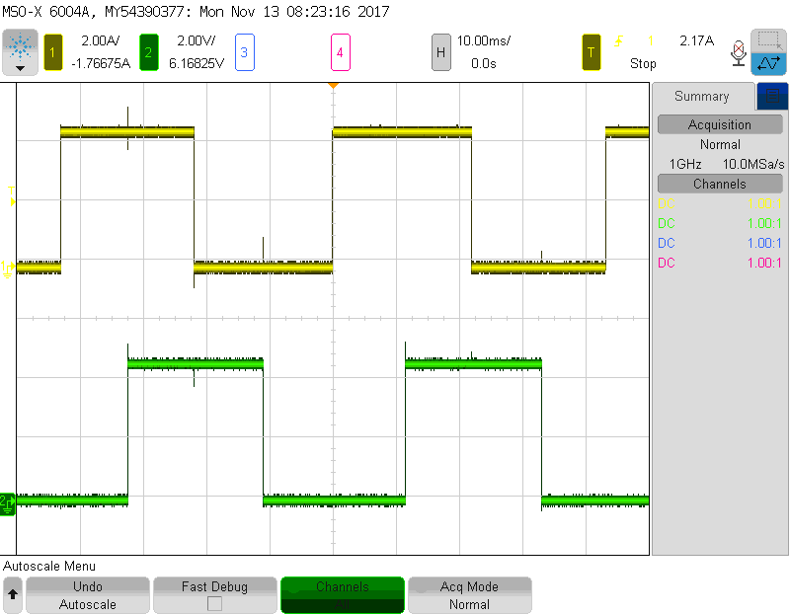
Design
Physical Angle | Code Value | Calculated Angle
6° | 26 | 4.57°
14° | 69 | 12.12°
23° | 120 | 21.09°
33° | 178 | 31.29°
47° | 254 | 44.65°
86° | 474 | 83.32°
Resolution: θ = (1/Pulses Per Revolution)*360
Encoders
Resolution: .175°
Accuracy: +/- 5°
5V
Top: Channel A
Bottom: Channel B
0V
5V
0V

Slide 20
Design
Photosensors
Differentiate between varying levels of sunlight
Input: 5V from voltage regulator
Output: Analog signal to the microcontroller
Lighting Level | Reading (V)
Covered | 0.09
Ambient | 1.57
Flashlight-Arm’s length | 2.23
Flashlight-hand’s length | 3.68
Flashlight-direct | 4.76

Slide 21
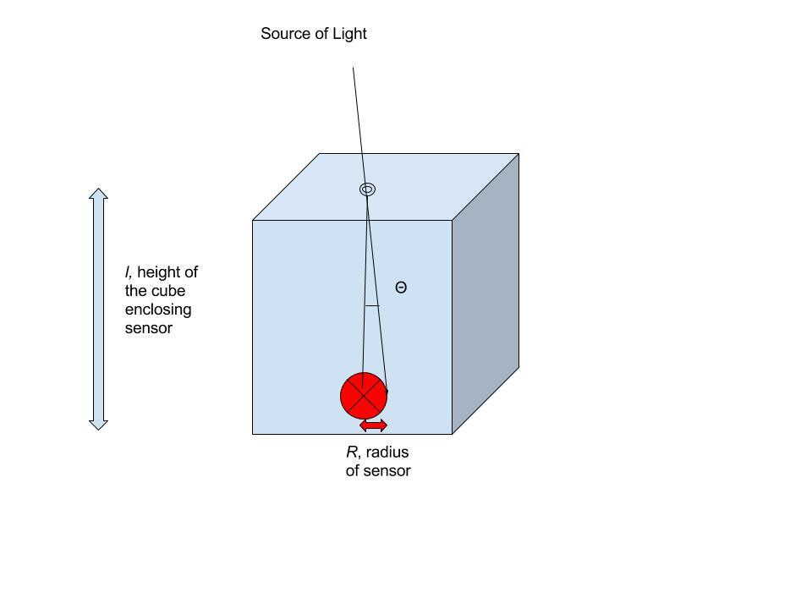
Design
Photosensors

Slide 22
Functionality Tests
Photosensing unit prototypes
Microcontroller
Inputs: Photosensors and Encoders
Outputs: Motor Driver
Light tracking capabilities
Reset Functions
Angle maximums
Low light levels
Notes:
Soumtri

Slide 23
Finding the Light…
Notes:
Leo

Slide 24
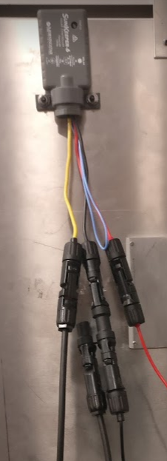
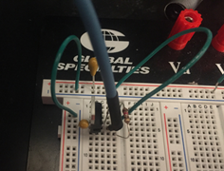
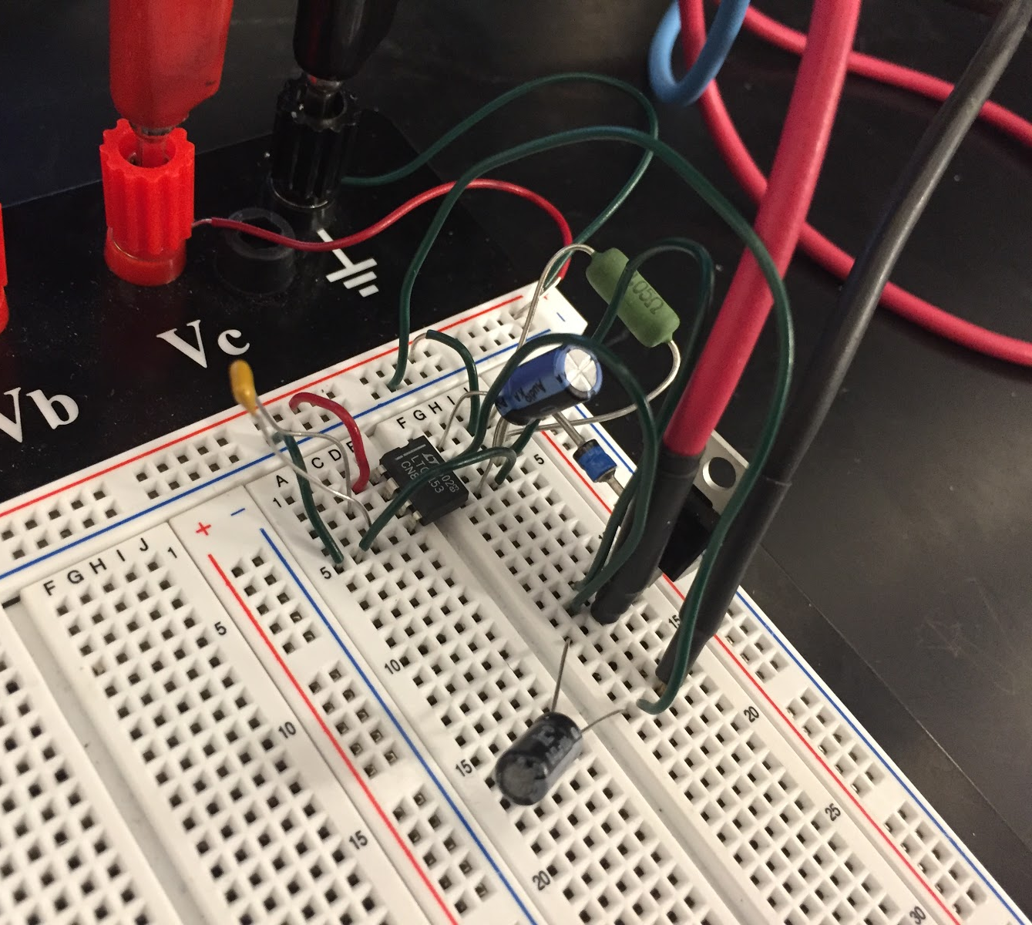
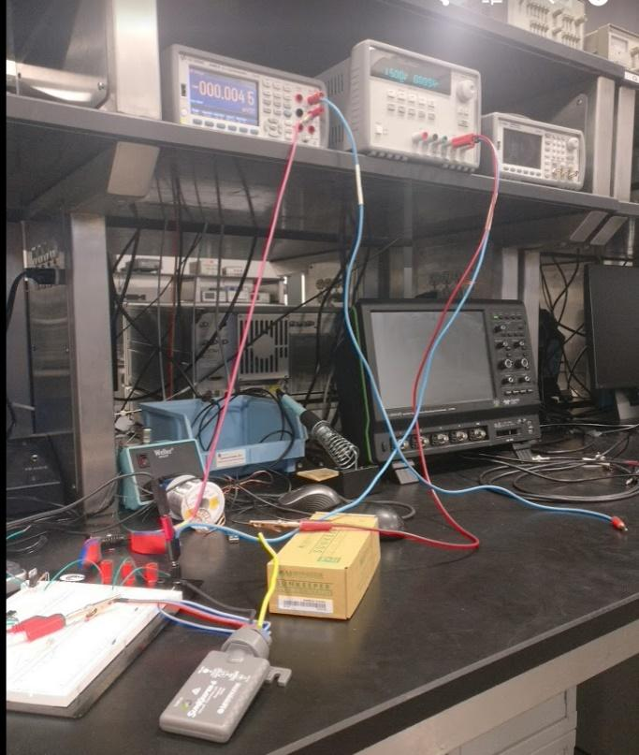
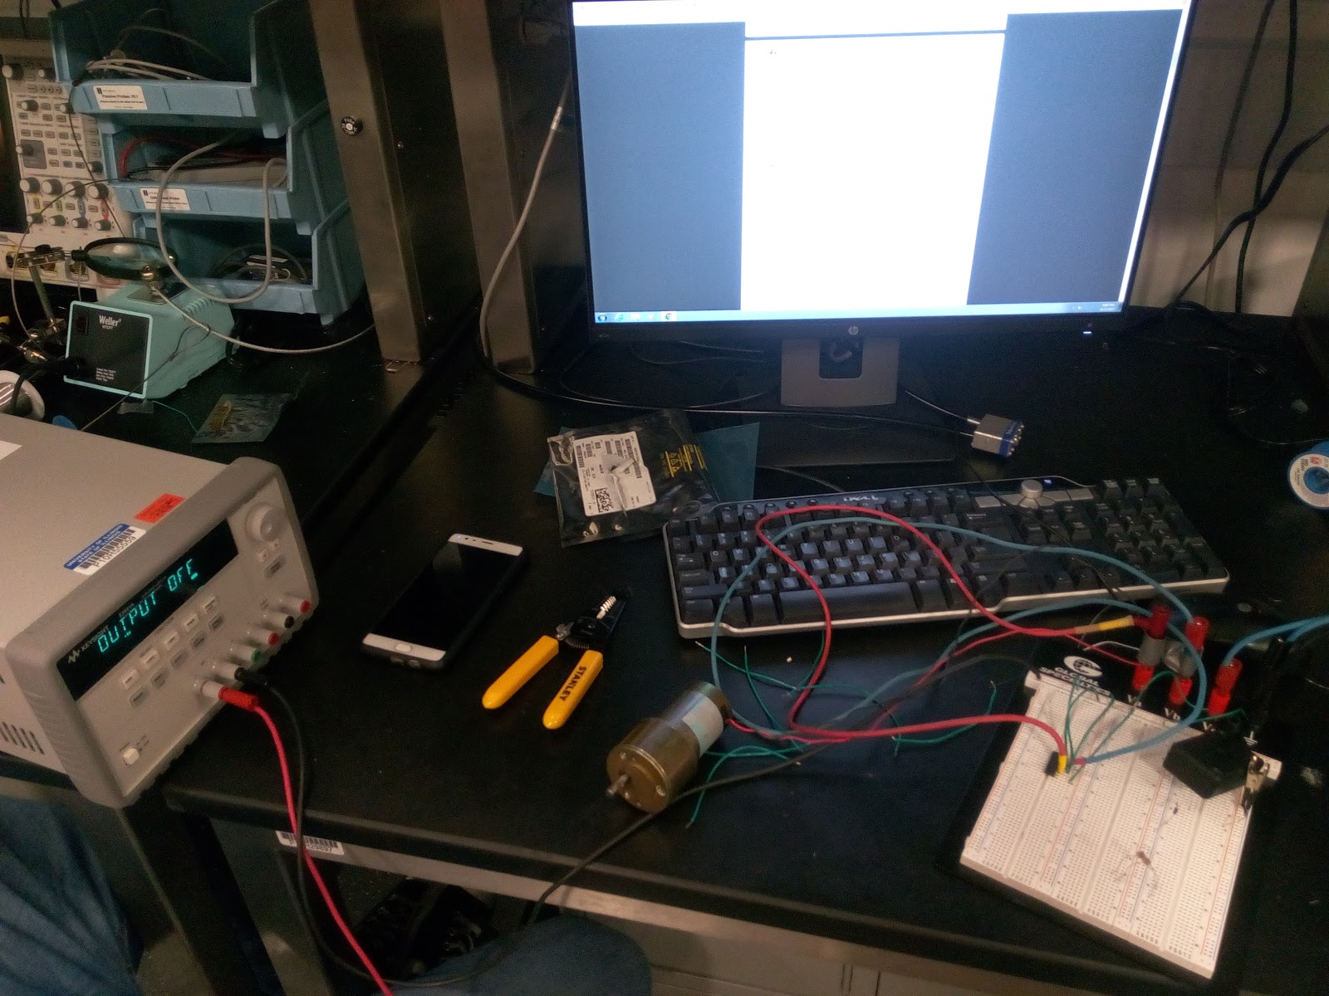
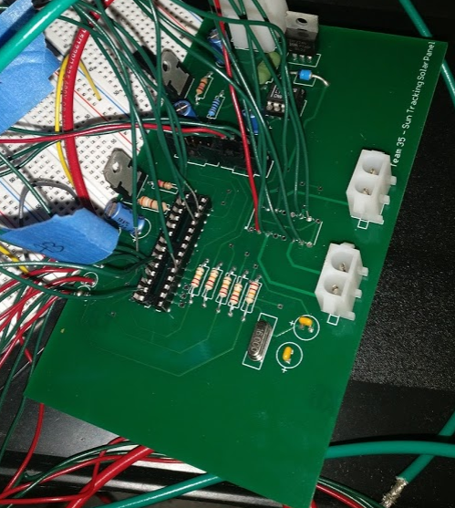
Project Build
Prototyping
Machine Shop Communication
Building the interconnections
Battery SOP
Faculty resources
PCB’s
Operational tests
Outdoor panel tests
Notes:
Bryce

Slide 25
Energy Consumption
Load | Average Power [W] | Time/day [hours/day] | Average energy per day [Wh/day] | Capacity used per day [Ah/day]
Moving panel | 13.44 | .25 | 3.36 | .28
Idle panel | .9204 | 23.75 | 21.86 | 1.82
LED Light | 33 | 5 | 165 | 13.75
Total | 190.22 | 15.85
Notes:
Leo

Slide 26
Successes
Motor is able to move about two axes
East to West: +/- 90 degrees
North to South: +/- 22.5 degrees
System is able to detect sunlight and time of day
Reset to start position on given day
Rotation limits
Optimized solar charging and power consumption for 2 days
Notes:
Leo

Slide 27
Future Work
Perfecting the software algorithm
Improve Hardware
More power efficient system
Power electronics, DC/DC Converter
Improved motor and encoder
Refined PCB Design
Increased outdoor functionality
Waterproof / Temperature / Wind
Integration and communication with other teams
Notes:
Bryce

Slide 28
Acknowledgments
Prof. Karl Reinhard
Machine Shop
Special thanks to Greg Bennett
Power Lab Resources
Special thanks to Kevin Colravy
TA: Yuchen He
Notes:
Soumtri

Slide 29
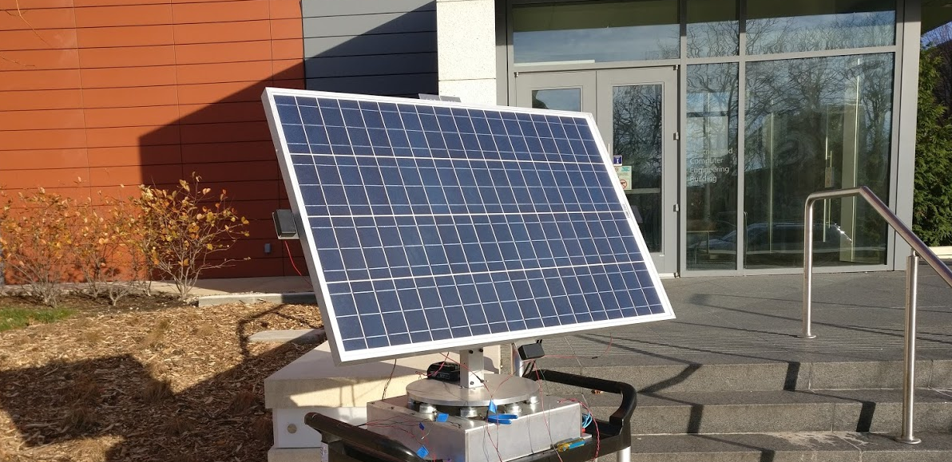
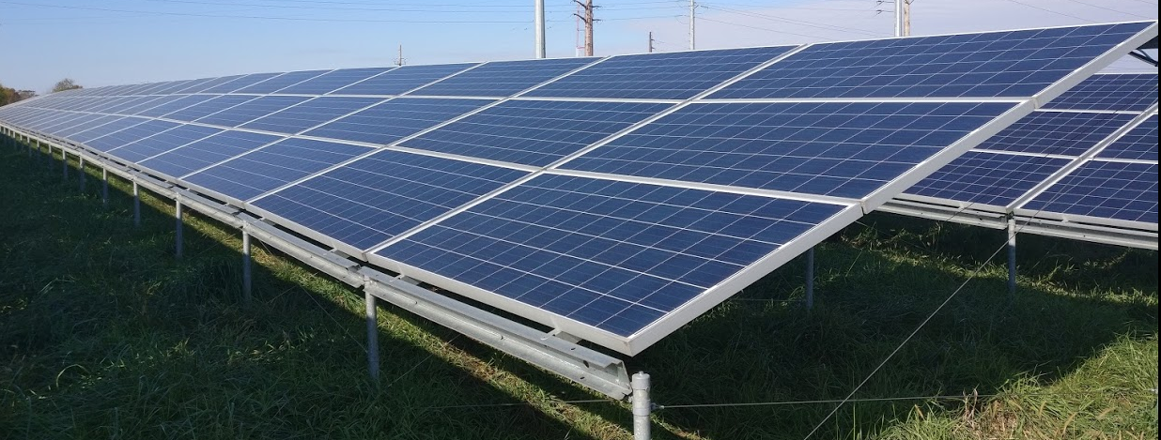
Thank you for your attention!
Any questions?

Slide 30
Where we Started…

Slide 31
Edge to Edge…

Slide 32
Reset…

