Slide 1
ECE ILLINOIS
Notes:
ECE Main Slide

Slide 2
ECE 445 Spring 2016
Smart closet
Group 24
Luchuan Zhang
Yiwei Li

Slide 3
Introduction
A direct display for all clothes in a personal closet.
Organize and record all information for users.

Slide 4
Objectives
Record each clothes’ worn times
Automatically take photos for user's clothes
Automatically drive the clothes to pick up position
A LED system to highlight the clothes
A 7" touchscreen display

Slide 6
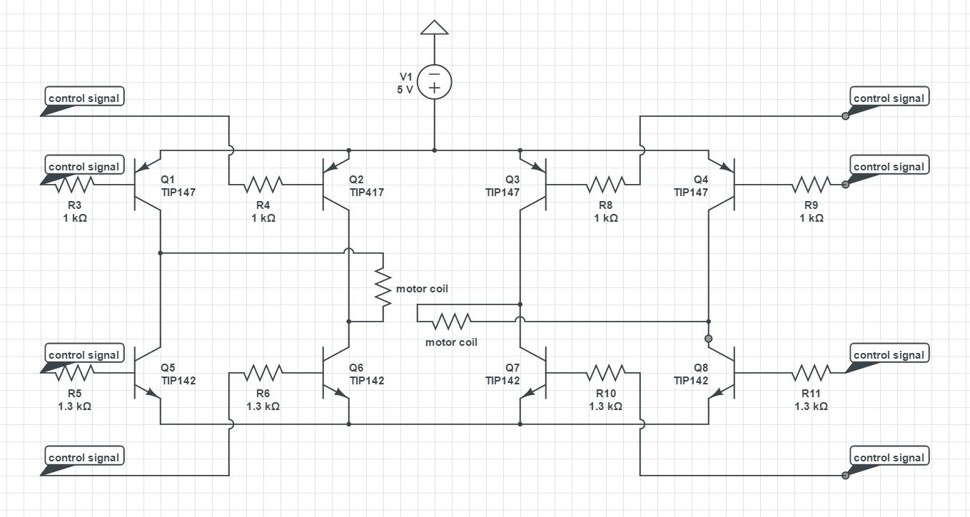
Schematic diagram for motor driver

Slide 7
Calculation for motor driver
The stepper motor have two coils, so two H-bridge should be build to drive this motor
Beta value for the transistors is around 1000. The base current $I_{b}=\frac{I_{c}}{\text{β}}=2mA$
Base resister for NPN is
$R_{b}=\frac{3.3−0.7}{0.002}=1.3 k\text{Ω}$

Slide 8
Conclusion and future work
All functions including user interface and motor work.
Should build an ios app in the future. In the app, user can remotely control closet and get information.
Add mechanical equipment to automatically pull clothes off from closet.

