Slide 1
Poppins:
The Autonomous Weather Balloon
By Team 15:
Arturo Cuevas, Marc Harvey, & Katie Stapleton
Notes:
MARC introduce & ALL say our names

Slide 2
Agenda
Introduction
Project Benefits
FAA Regulations
Subsystems
Requirements & Verification
Physical Design/Build
Software Flow
Results
Future Plans

Slide 3
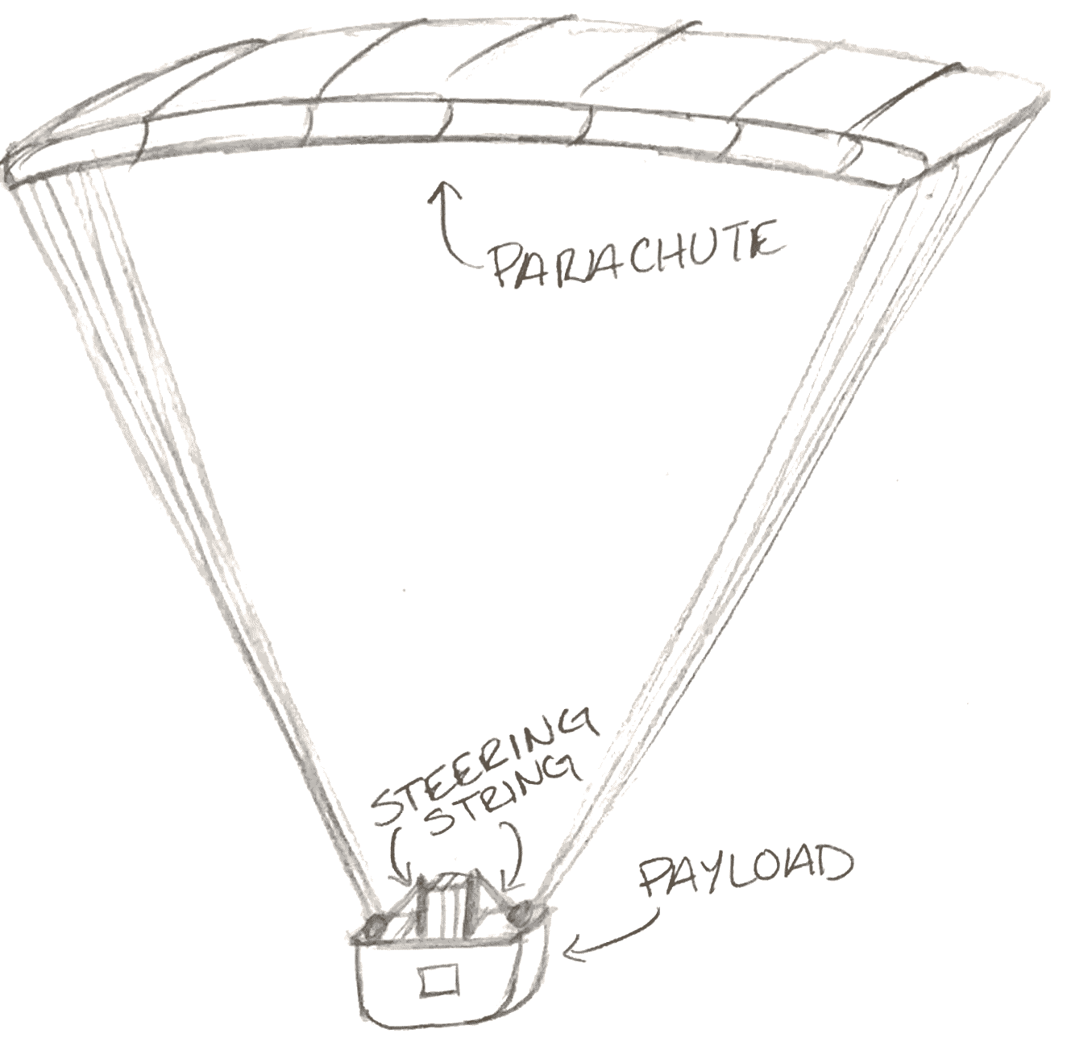
Introducing Poppins
Notes:
Our system steers a high altitude weather balloon payload to a predetermined target on descent using parachute and information from sensors
KATIE

Slide 4
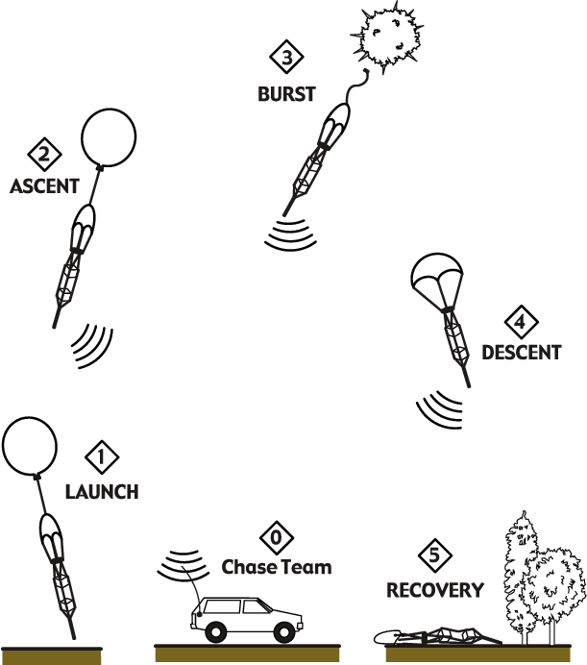
Saving Equipment, Time, & Money
No longer searching from 5 to over 200 miles for payload
More flights per payload
Trusted with higher quality equipment
https://www.researchgate.net/figure/A-typical-high-altitude-balloon-flight-profile_fig5_229042541
Notes:
KATIE

Slide 5
A parachute?
A drone?
Unmanned aircraft?
That’s for the FAA to decide
Contacted FAA Regional Office
If considered a drone, we can only fly up to 400 ft
Proof of concept until approval as “unmanned free air balloon”
https://en.wikipedia.org/wiki/Federal_Aviation_Administration
Notes:
ARTURO
Estimated 6 months until approval

Slide 6
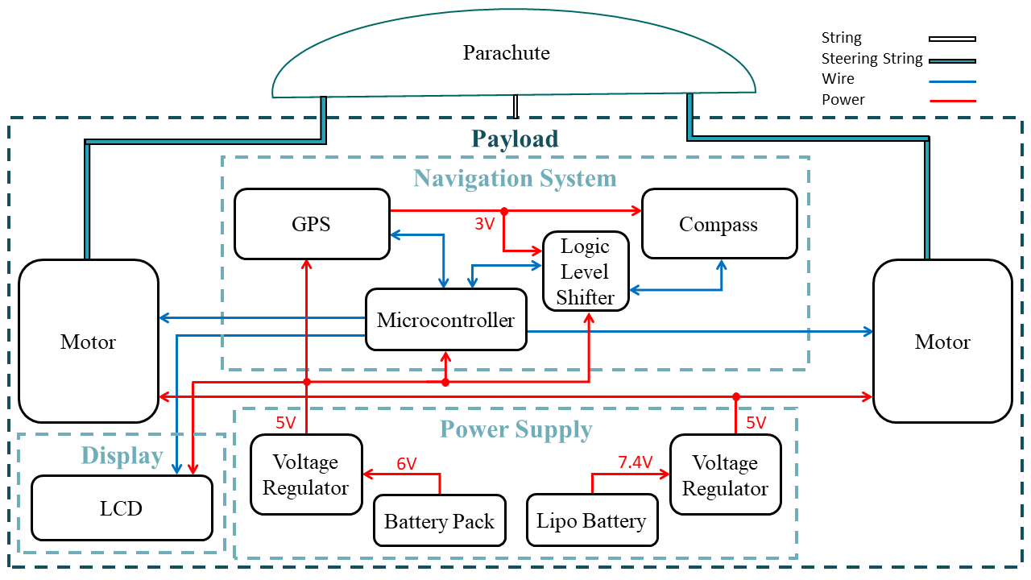
Block Diagram
Notes:
PAYLOAD

Slide 7
Block Diagram
Notes:
PAYLOAD

Slide 8
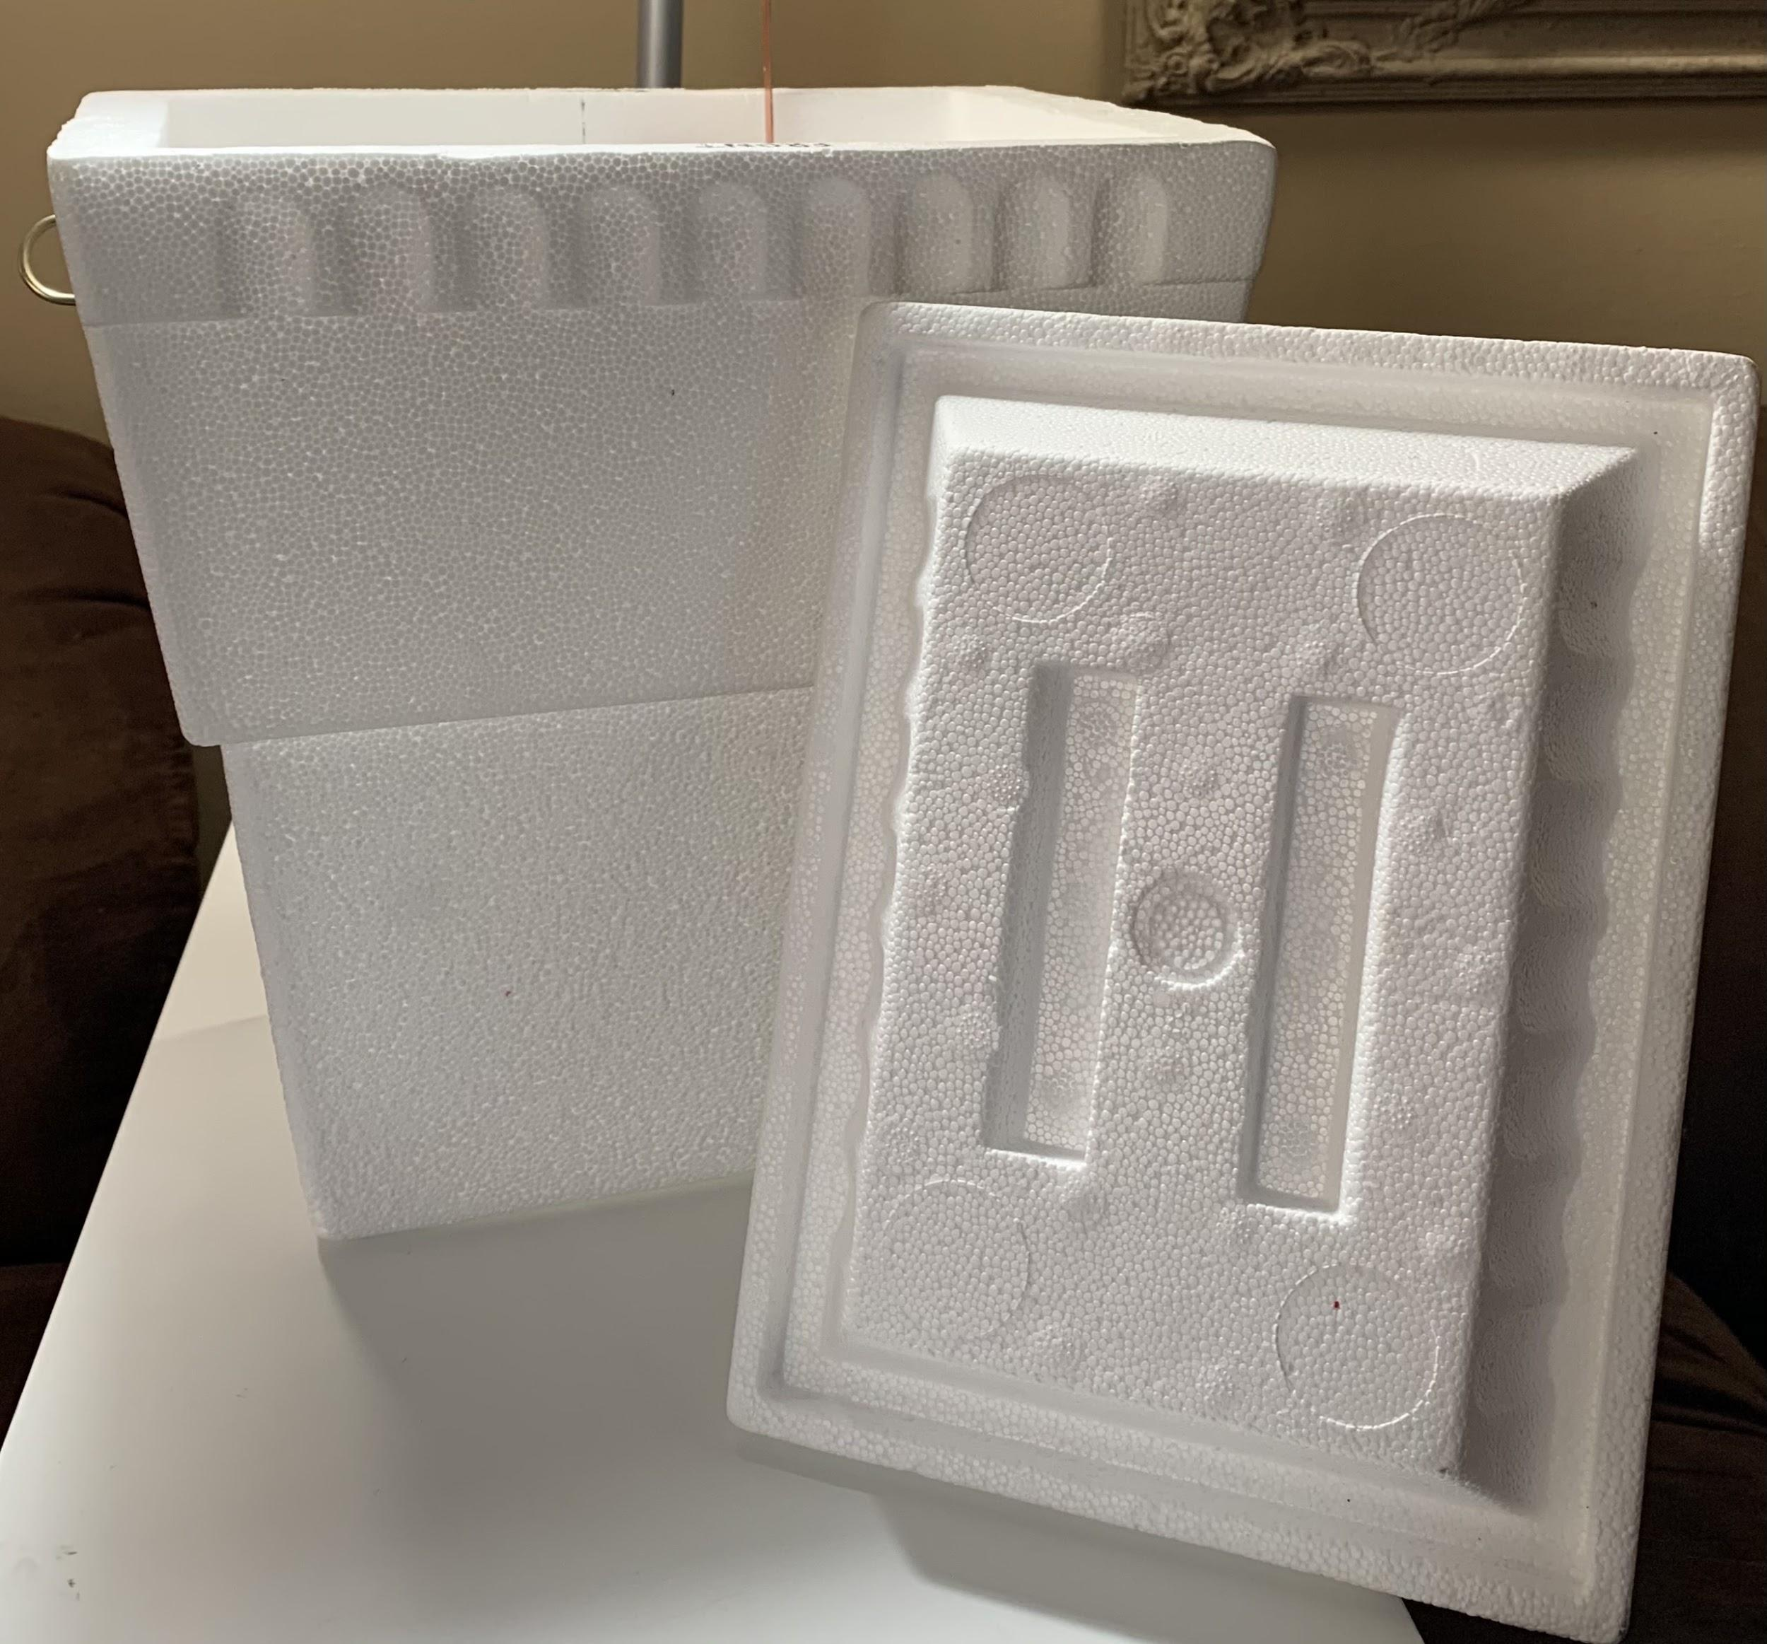
Payload
Requirement = Minimum dimensions of 6 in x 6 in x 12 in
Verification = (By ruler) Styrofoam box of 6 in x 8 in x 12 in
Notes:
ARTURO

Slide 9
Block Diagram
Notes:
ARTURO

Slide 10
Parachute
Requirement = Ram-air parachute capable of holding the full weight of the payload & left & right brakes to turn
Verification = (By observation) Holds full payload & brakes connected to the back
Notes:
ARTURO

Slide 11
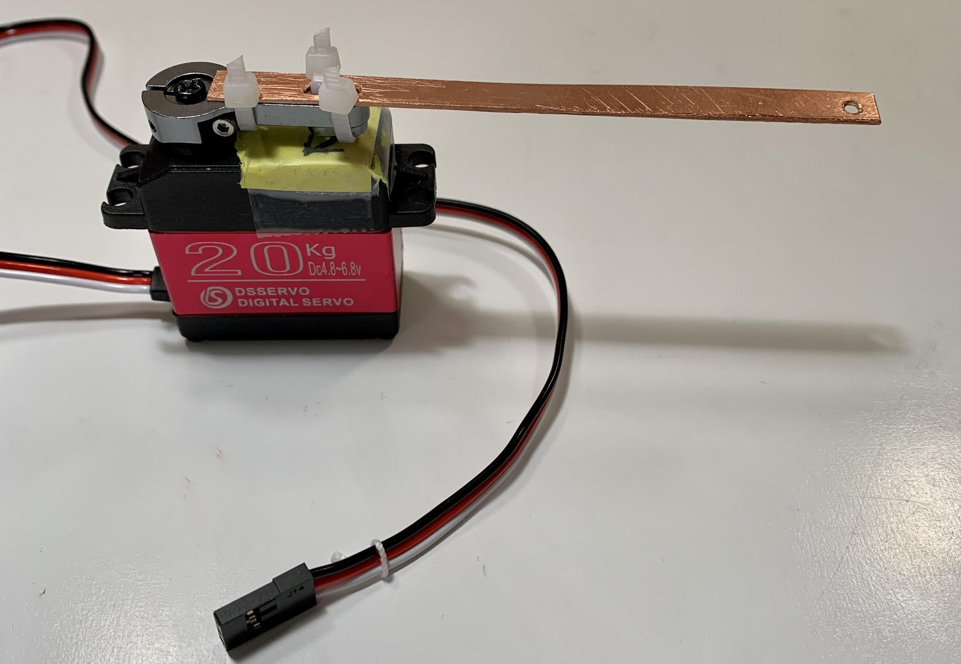
Motor
Requirement = The motors must be able to hold their rotational position against the force of the wind on the parachute. Minimum pull of 15 kg each.
Verification = Can verify 1 by attaching a 15 kg weight to a string, and seeing if a motor can pull it.
Notes:
ARTURO

Slide 12
Block Diagram
Notes:
ARTURO

Slide 13
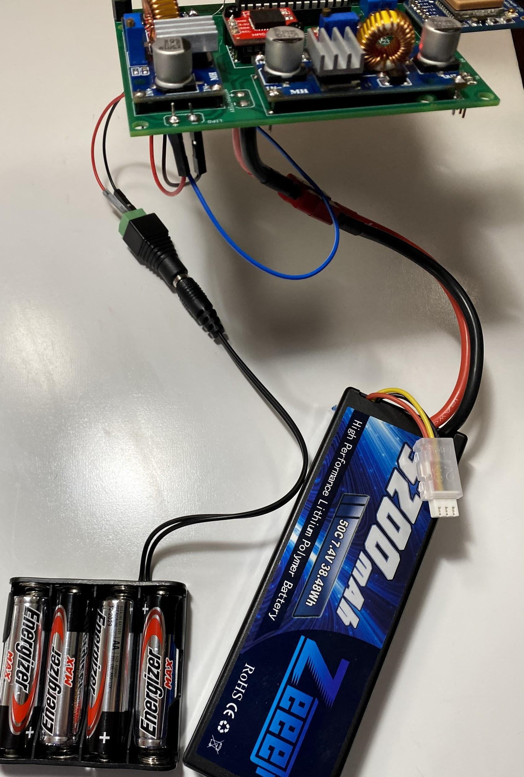
Power Supply
Requirement = Supply 6V to motors, 5V to ATMega, with ample current
Verification = Use multimeter

Slide 14
Block Diagram
Notes:
MARC

Slide 15
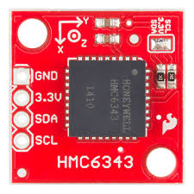
Compass
Requirement = A digital compass with L2C connections
Verification = Connect to microcontroller and verify heading direction within 2º

Slide 16
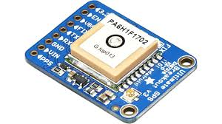
GPS
Requirement = Needs the ability to calculate coordinates with error less than 50 meters
Verification = Go to known coordinates and compare GPS results to actual coordinates

Slide 17
Block Diagram
Notes:
MARC

Slide 18
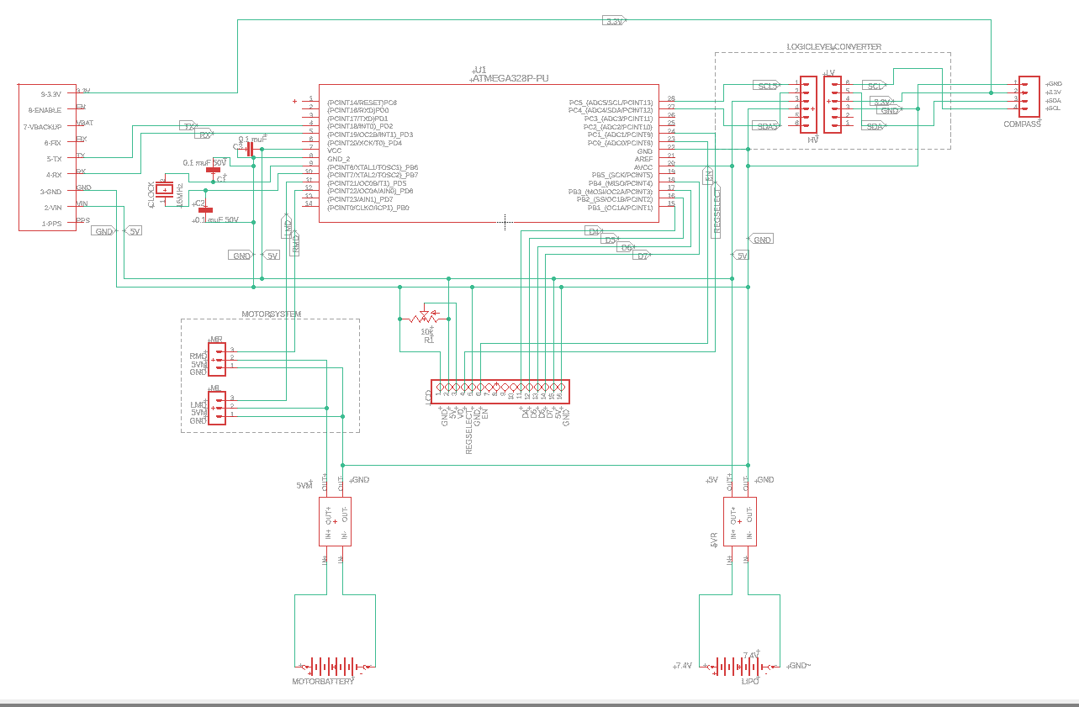
Schematic
Notes:
KATIE

Slide 19
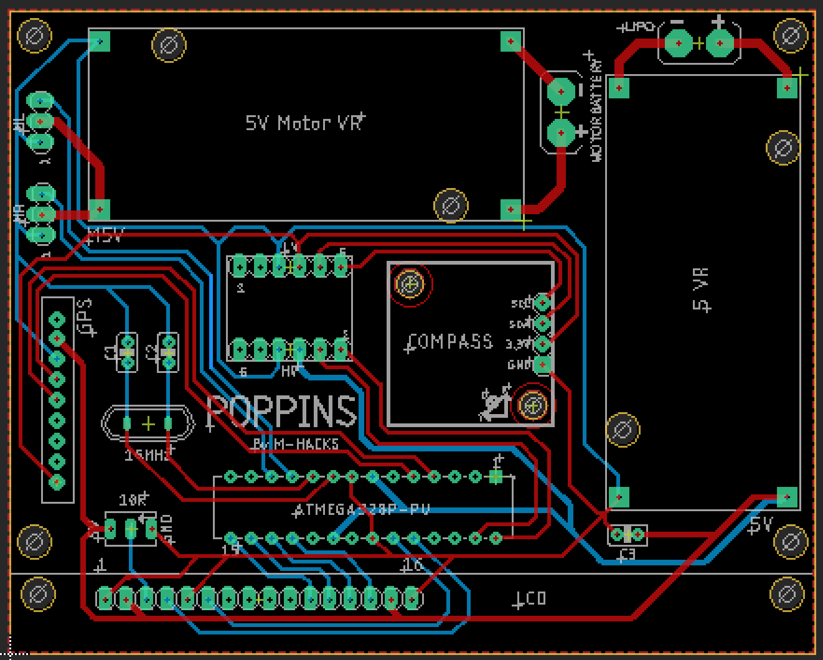
PCB
Notes:
KATIE

Slide 20
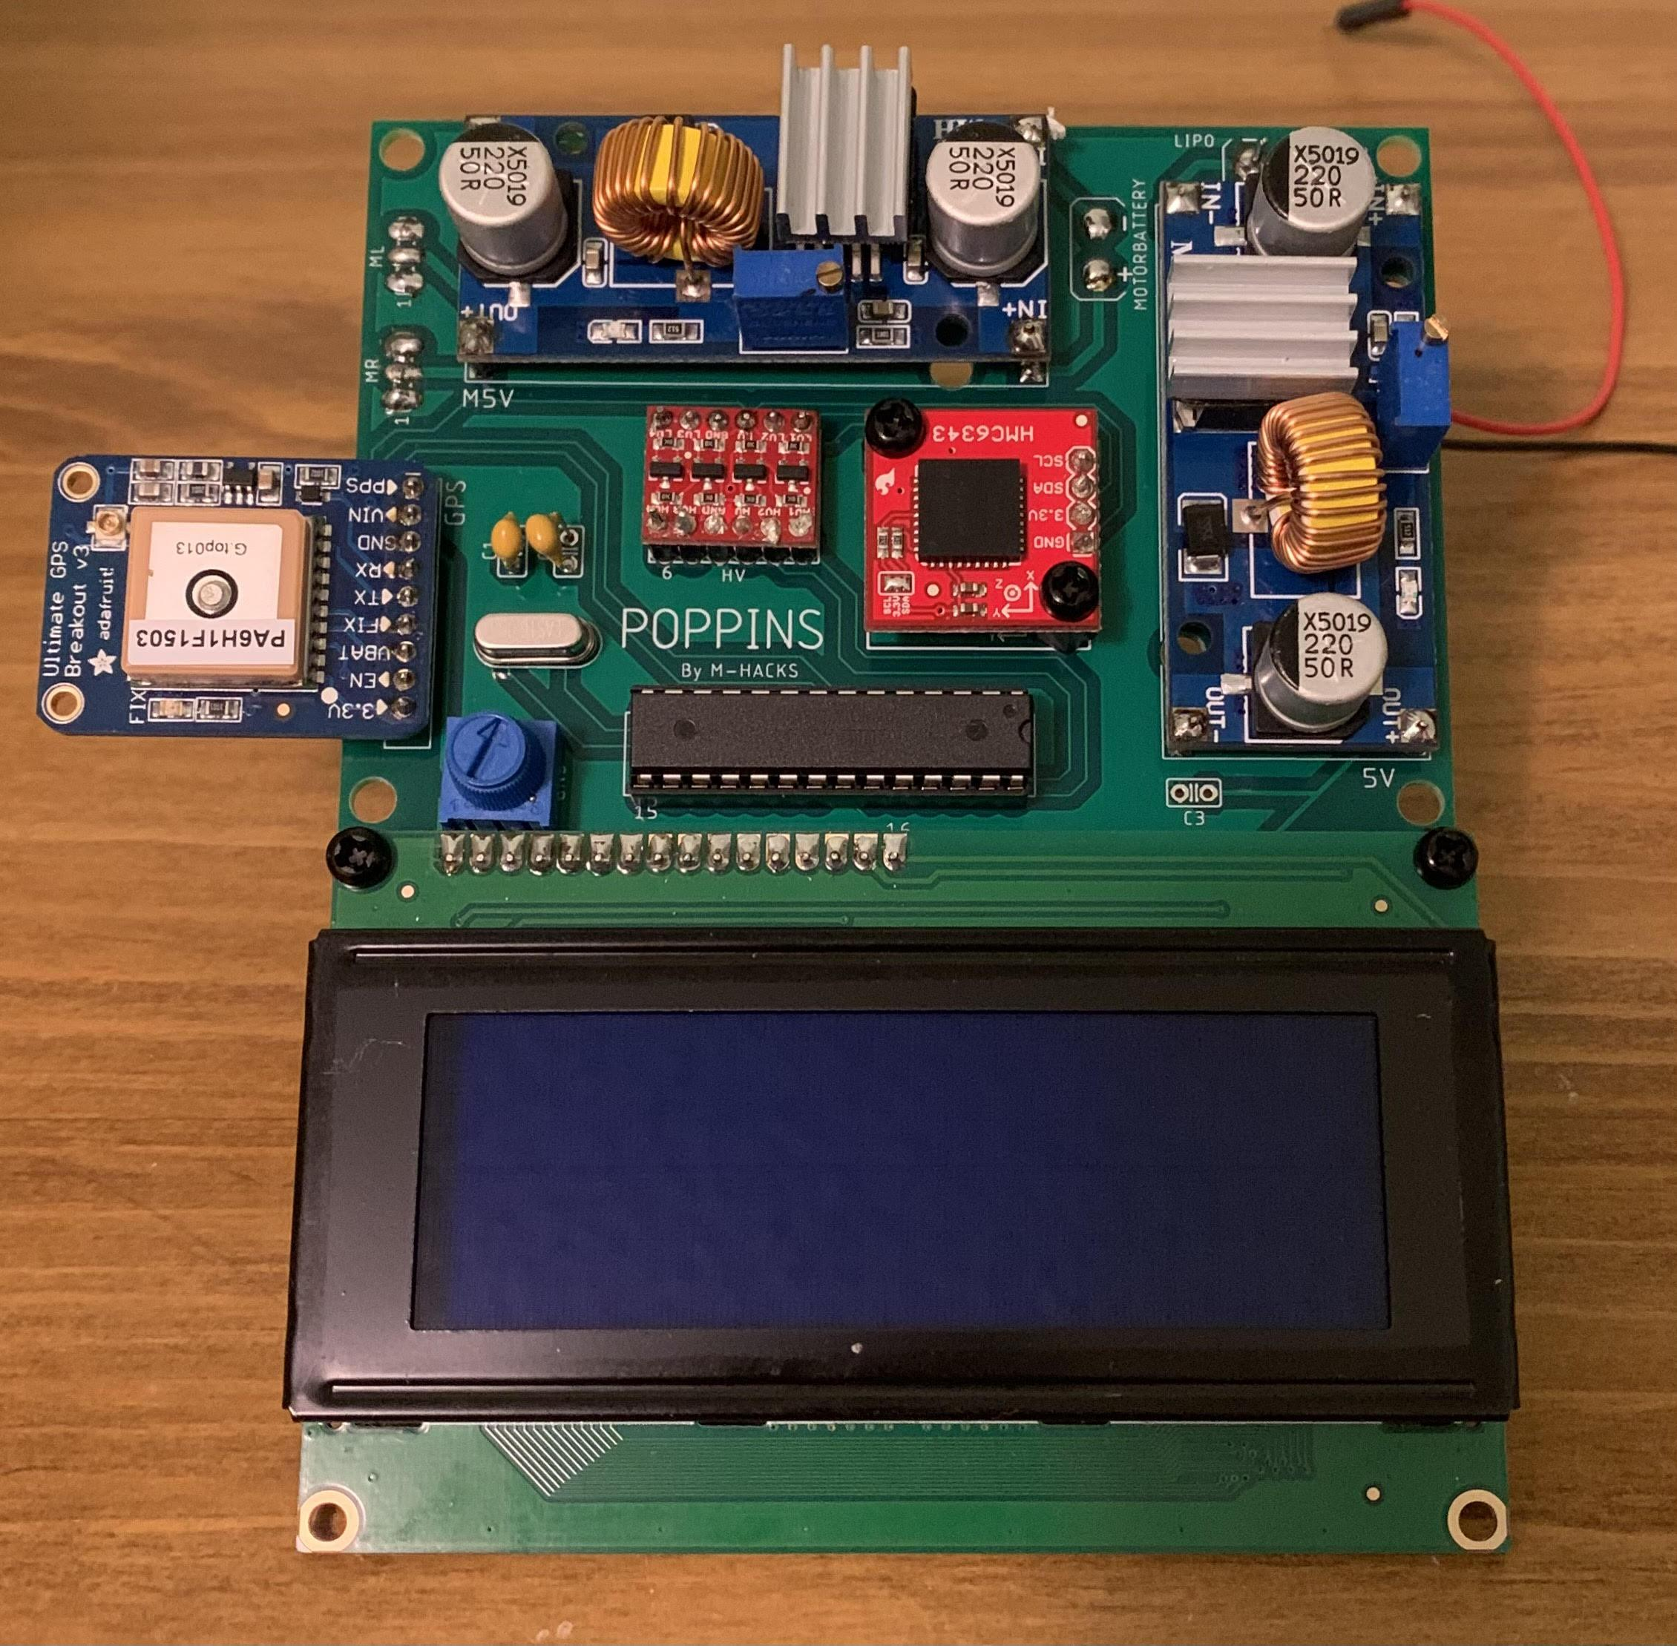
PCB
Notes:
ARTURO

Slide 21
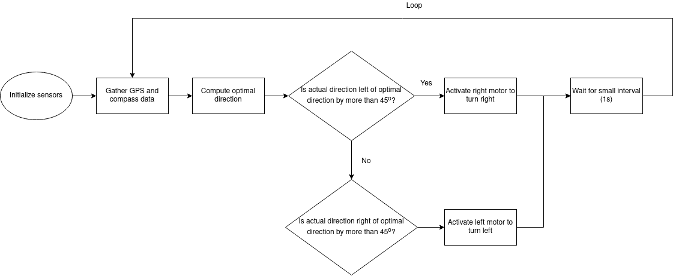
Software
Notes:
MARC

Slide 22
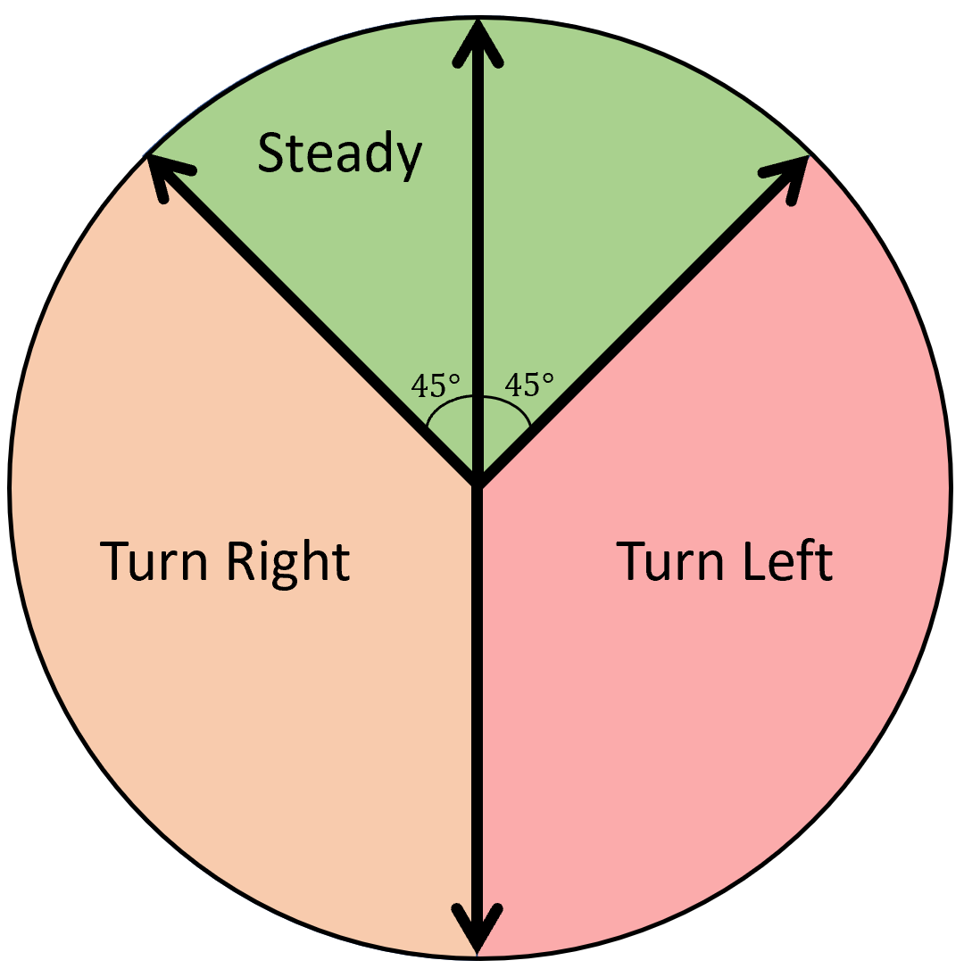
Turning Logic
Notes:
MARC explain &

Slide 23
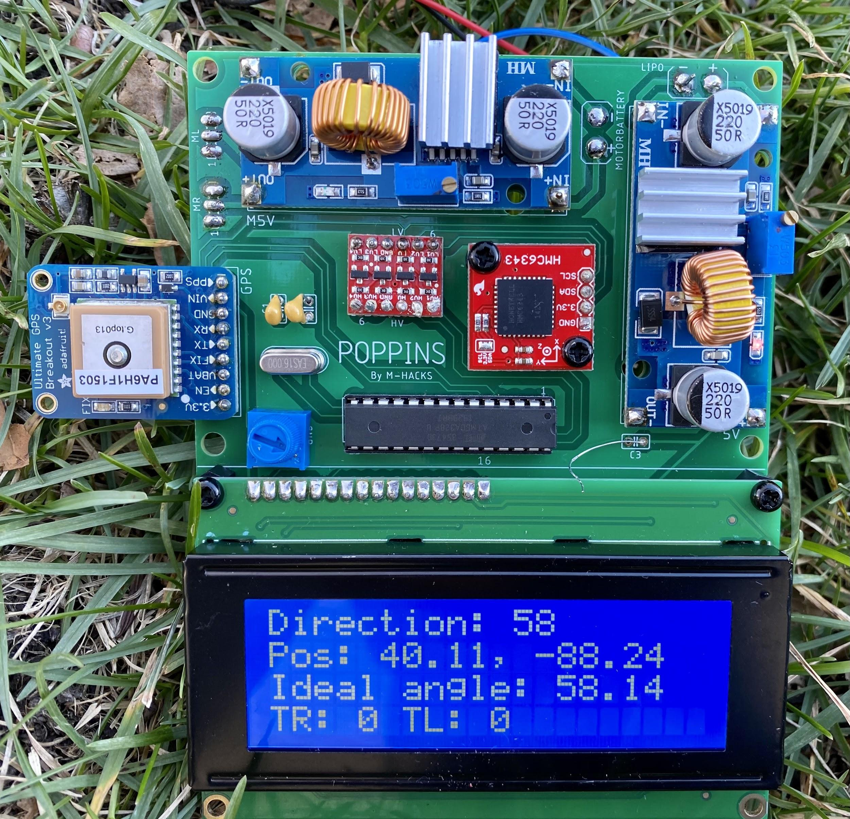
Final Result
Notes:
Maybe include LCD screenshots next to the turning logic chart
ARTURO

Slide 24
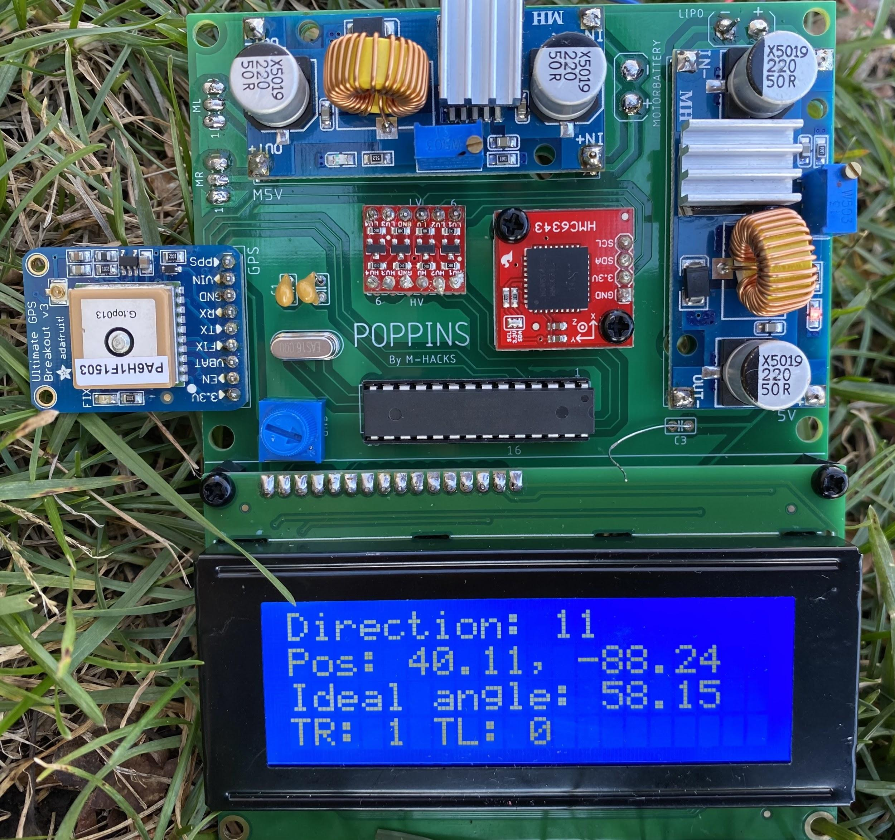
Final Result
Notes:
Maybe include LCD screenshots next to the turning logic chart
ARTURO

Slide 25
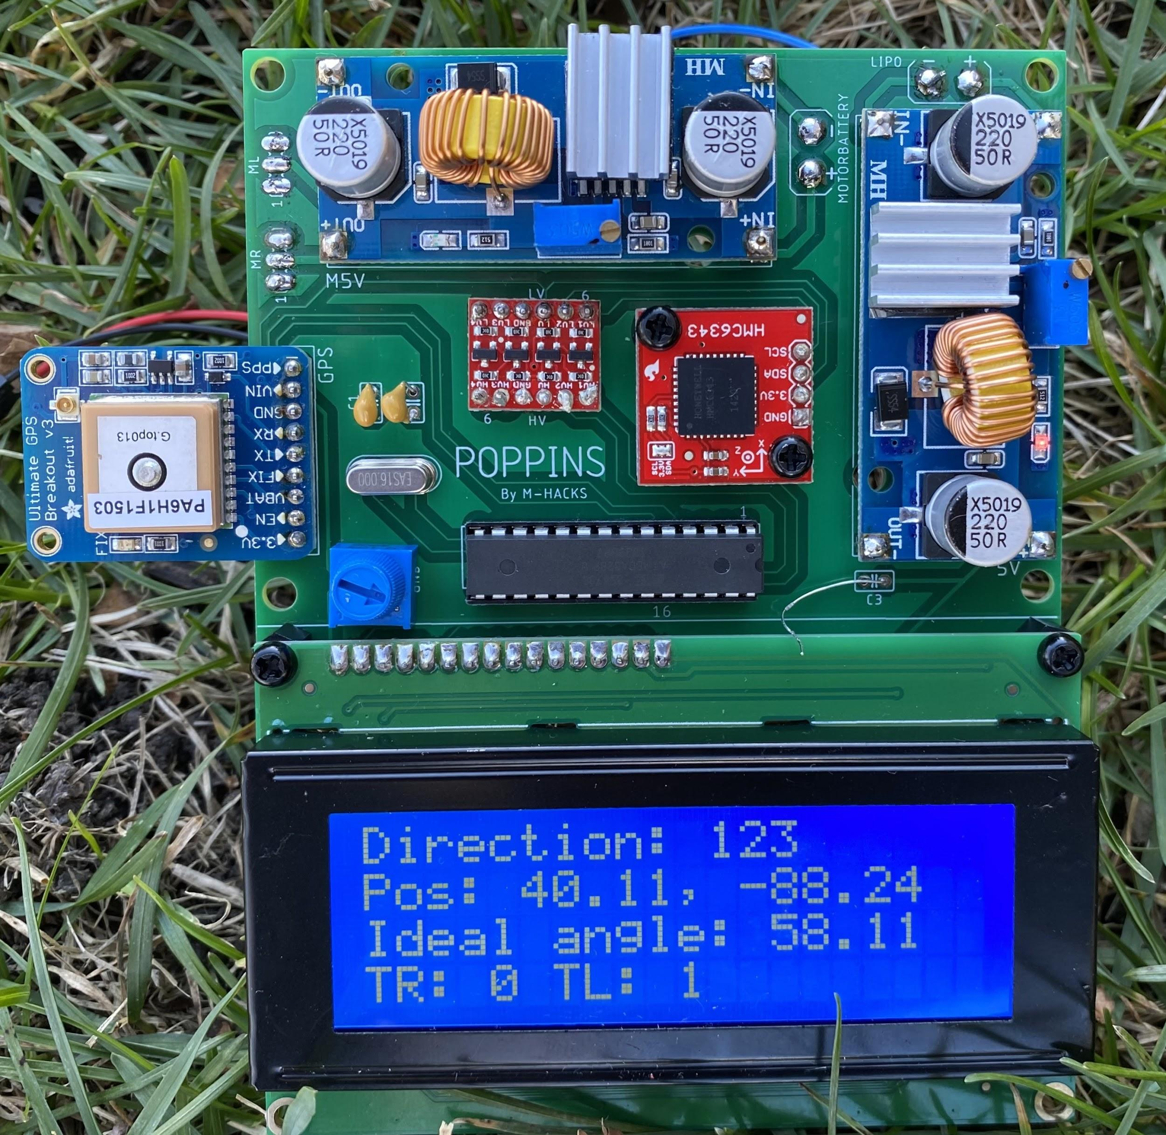
Final Result
Notes:
Maybe include LCD screenshots next to the turning logic chart
ARTURO

Slide 26
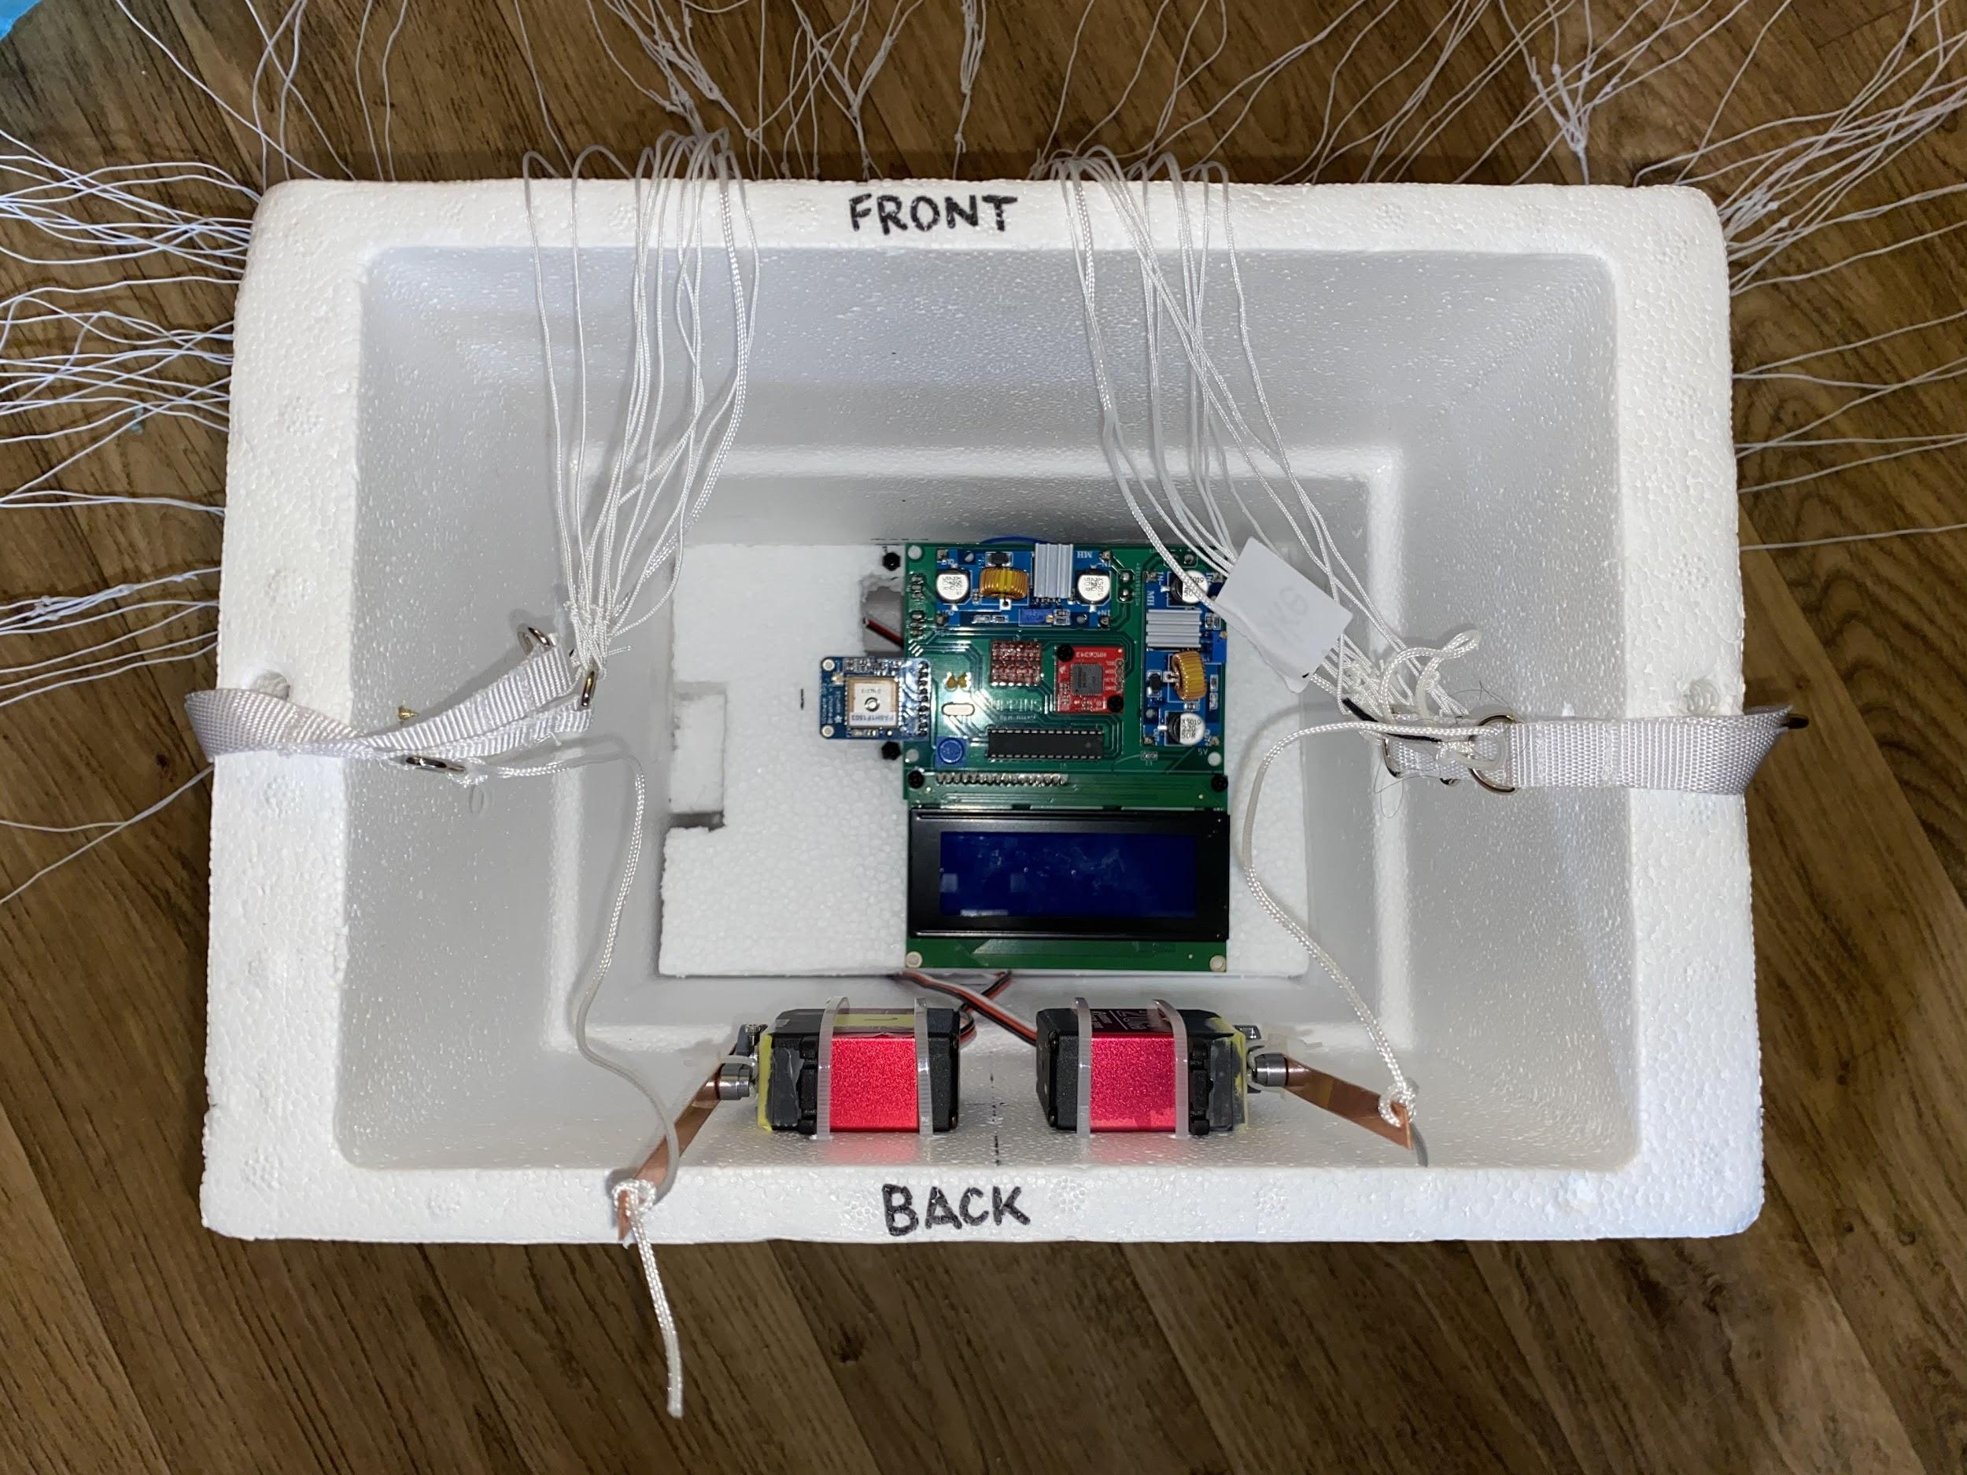
Final Result

Slide 27
Poppins:
“Practically perfect in every way”
... almost
Bugs run into on design:
Mix-up longitude and latitude coordinates
Wrong format for coordinates
Motor spasms due to interference from GPS interrupts
Incorrect ATMega setup on PCB
Notes:
ARTURO

Slide 28
Future Plans &
Ethical Considerations
Few adjustments for high altitude
Easy to assemble as those who use it will most likely have the equipment needed
Could be used with malintent or cause public harm if not used properly
Notes:
KATIE

Slide 29
Thank you
Thank you to Arne & Yifan! We learned a lot!
Any Questions?
Notes:
Thank you to Yifan

