Slide 1
MOBILE MONITORING BOX FOR SOLAR SYSTEMS
TEAM 7
TEAM: COLE FROELICH, JOE GARCIA, MATTHEW TYIRAN
TA: ENLIANG LI
Notes:
The flow of the presentation is to breeze over the original design, then talk about the real design AND why we made the changes we did, then we will go into our data, then challenges, and work for the future
I will briefly talk about the case and how it was made because it was a high level requirement, but I don’t want to talk too much about it because it isn’t electrical engineering.

Slide 2
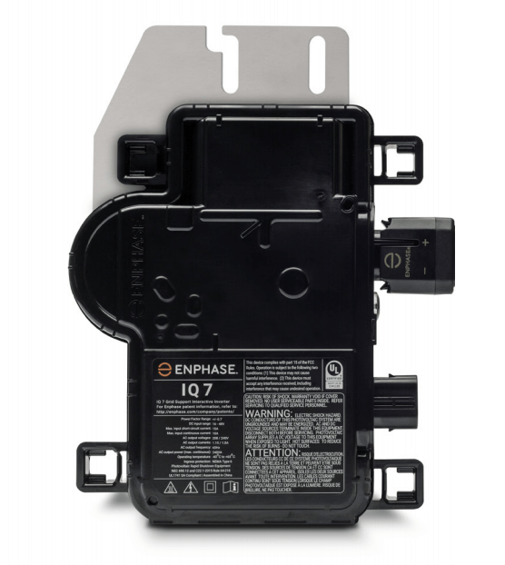
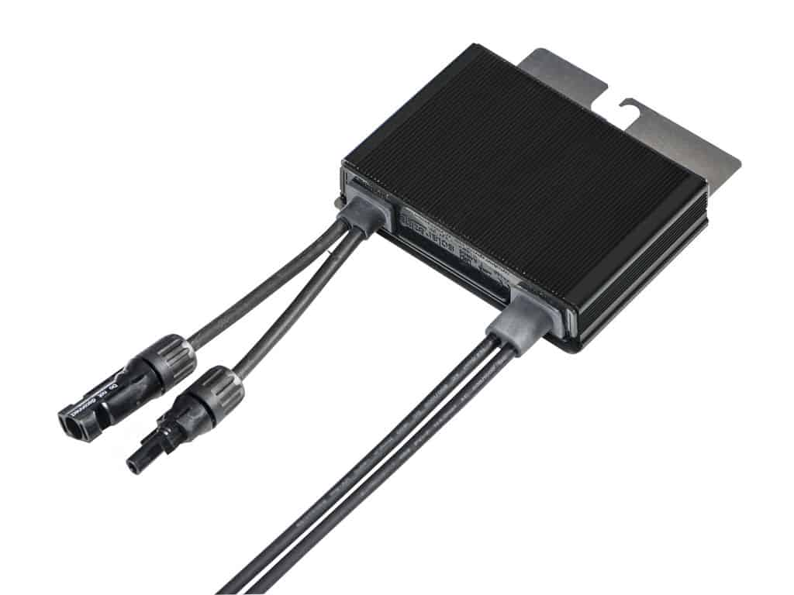
OBJECTIVE: PROBLEM
Detect problems with Photovoltaic Systems
Underproduction
Hot spots, faulty equipment, etc.
Efficiency issues
How much is the solar module producing versus how much power is being put on the grid
Enphase IQ7 Micro Inverter
~$150
SolarEdge P320 Power Optimizer
~$80

Slide 3
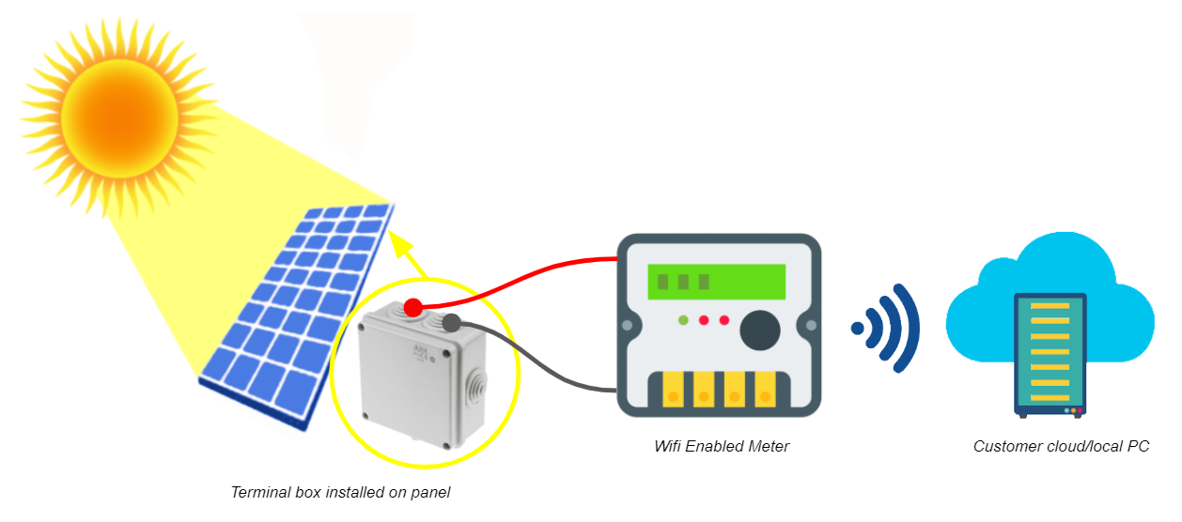
OBJECTIVE: OUR SOLUTION
Be able to measure AC and DC, Voltage and Current
Send the data to a computer via WiFi
Operate in all weather conditions
Wifi enabled meter
Customer cloud/local PC
Terminal box installed on panel

Slide 4
ORIGINAL DESIGN: BLOCK DIAGRAM

Slide 5
ORIGINAL DESIGN: MEASUREMENT MODULE
AC Measurement: Current Transformer and Power Transformer
DC Measurement: DC-DC Converter
Protection
Notes:
Protection
In the beginning we felt like that this was something that we actively needed to engineer and then we realized that this is something we can add passively throughout the whole circuit via fuses, correct ratings, etc.

Slide 6
ORIGINAL DESIGN: PROCESSOR MODULE
Processor
Antenna
GPIO
Notes:
[15 secs]
Processor - run code to communicate over Wifi, perform calculations
Antenna - transmit and receive Wifi signals
GPIO - convert analog signals to digital, communicate information to and from users

Slide 7
ORIGINAL DESIGN: POWER MODULE
12v Battery
External Charging Circuit
DC-DC Converter: Buck Converter then Linear regulator

Slide 8
FINAL DESIGN: BLOCK DIAGRAM

Slide 9
FINAL DESIGN: MEASUREMENT MODULE
AC Measurement
Hall Effect Current Sensor
ADC Voltage Sensor
SPI Communication Protocol
Rated Current: 30 A
Rated Voltage: 240 V
DC Measurement
Voltage Divider
V_{sense} = (33/4033)*V_{DC}
Rated Voltage: 400 V
Hall Effect Current Sensor
Scaled Analog Voltage
Rated Current: 10 A

Slide 10
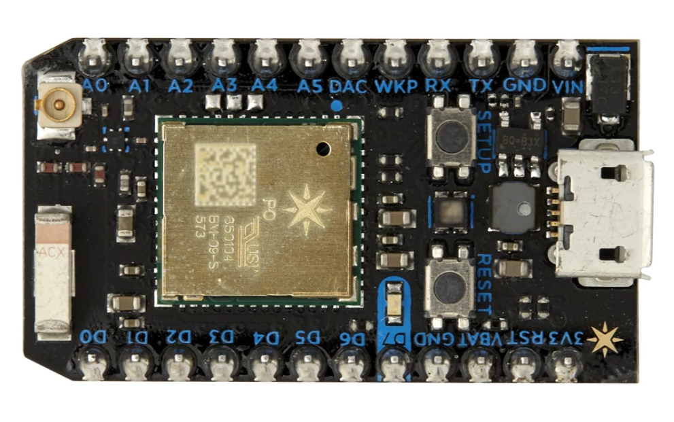
FINAL DESIGN: PROCESSOR MODULE
Particle Photon
Requires 3.7 V Input
Built-in antenna for WiFi communication
Processes digital and analog signals and converts them to measured values
Allows for connection to interface
Screen – To view commands and values
Buttons – To allow for commands to be selected on the device
Acts as charger for battery when plugged into another power source
Voltage Output: 4.2 V
Current Output: 1 A limit
Notes:
[30 secs]
Photon chosen after a lot of market research to provide best solution in terms of IO flexibility, user friendliness, Wifi capabilities, and price
Has a printed Wifi antenna with adapter for external, built-in ADCs, various communication protocol libraries, built in battery charging circuit
Selected early to provide flexibility in other design elements

Slide 11
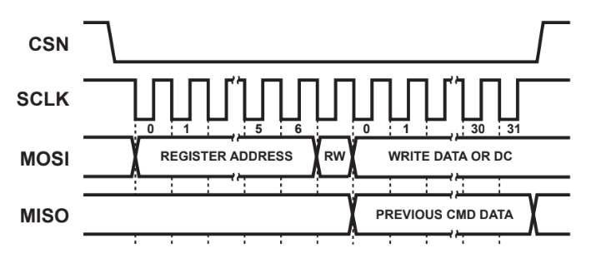
FINAL DESIGN: PHOTON CODE – AC PROCESS
Data is accessed by calling the respective two byte register address
Boot up tests check EEPROM configuration registers for errors (EEC)
Acts as a test for chip fidelity and SPI communications
Voltage and current polling procedure:
Initiate 5 byte MOSI transfer
First byte holds register address and direction bit
Other bytes ignored
Capture 5 byte response
First byte ignored
First and second byte hold 15-bit voltage
Third and forth hold 15-bit current
Concatenate and convert readings, report 50-point moving average
SPI Communication Frame
Notes:
[10 secs]
This was new to us, took a while before we could test it fully, provided us with a strong understanding of SPI communication (don’t explain in detail unless asked)

Slide 12
FINAL DESIGN: PHOTON CODE – DC PROCESS
The DC data is much easier to process; both voltage and current are delivered as signal level analog voltages
Current
Apply Hall sensor and Photon ADC conversion coefficients
Voltage
Apply voltage divider and Photon ADC conversion coefficients
Notes:
[10 secs]
This was a more simple process, worked the first time and is easier to tune, less variable coefficients

Slide 13
FINAL DESIGN: POWER MODULE
3.7 V Li-Ion Battery
Use Rating:
2.6 Ah
Can last about 24 hr on one charge
Rechargeable
Charging Current: 1.3 Ah
Charging time: 5.2 hr at 1 A (That is the limit of the photon)
Charging now integrated with the MCU (Photon)
No need for DC-DC Converter at all
Photon accepts 3.7 V as the input for power
Notes:
A 12v battery is very large for what we needed so we down sized to a 3.7v battery. Then the MCU (Photon) was found to also be able to act as the charger, removing the need for us to actually buy a charger. The Photon accepts 3.7 V as the power input so no need for a DC-DC converter.
For the time it can last on one charge, the circuit as a whole will draw about 1A (.8 A to the photon and then .2 for the ICs so that comes out to be about 26 hr)

Slide 14
FINAL DESIGN: CASE
Milled Aluminum
Waterproof – Submersible
NEMA 3R rating does not mean it can be submerged in water
Uses a rubber junction to seal the wires as they exit the case
Clear seal so that a screen can be seen when inside
O-Ring used to actually create the water-tight seal

Slide 15
DC VOLTAGE TEST SETUP
Notes:
point out the instruments being used

Slide 16
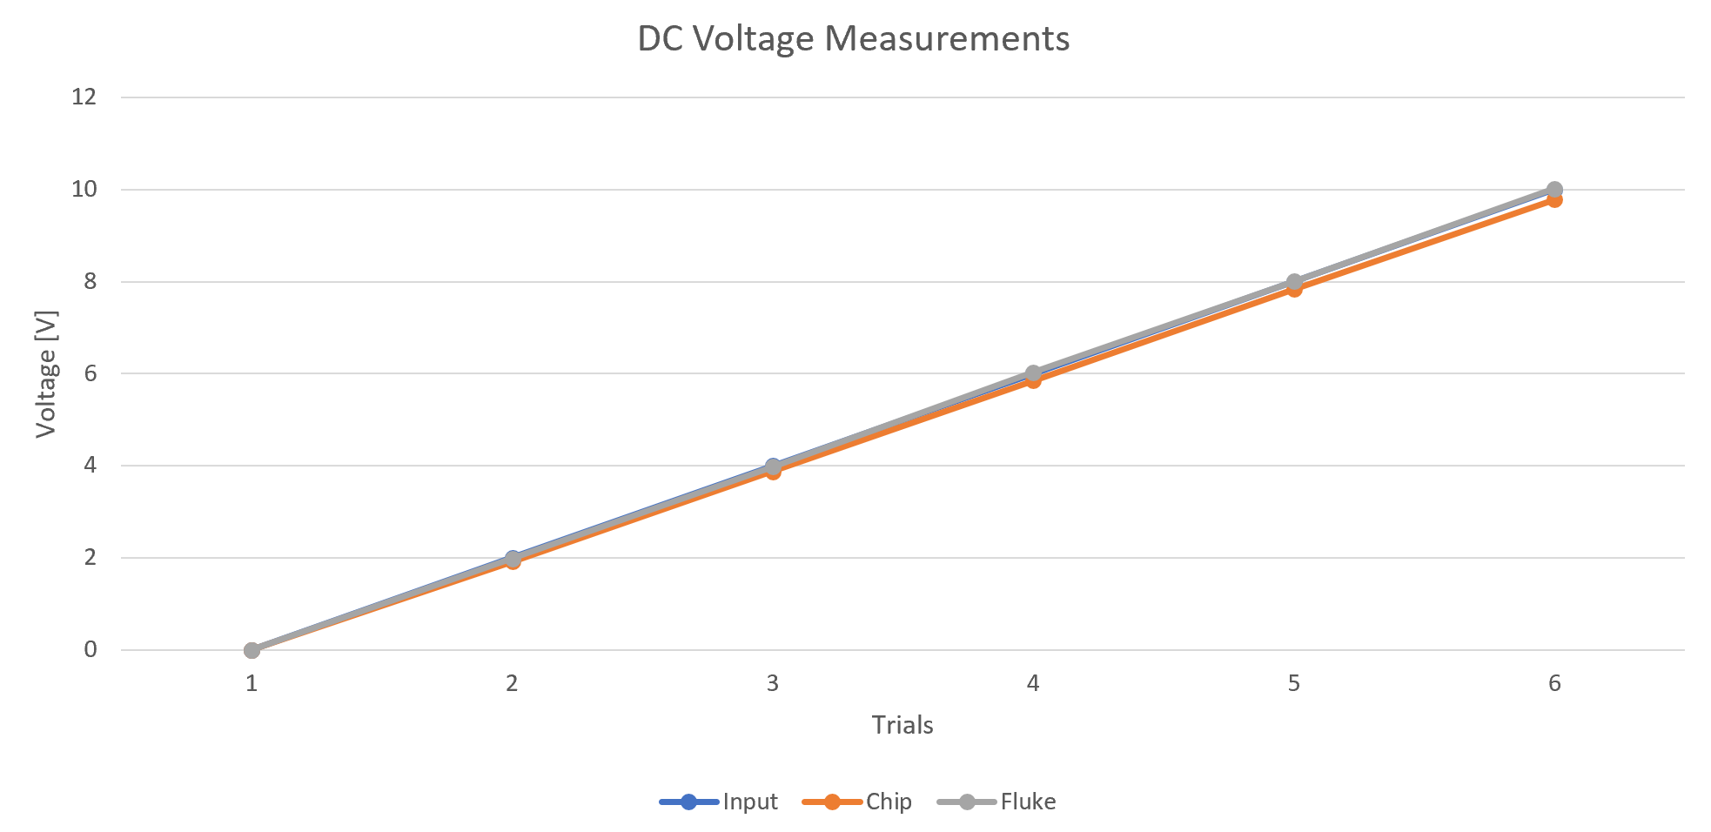
MEASUREMENT VERIFICATION: DC VOLTAGE

Slide 17
MEASUREMENT VERIFICATION: DC VOLTAGE PERCENT YIELD

Slide 18
DC CURRENT TEST SETUP

Slide 19
MEASUREMENT VERIFICATION: DC CURRENT

Slide 20
MEASUREMENT VERIFICATION: DC CURRENT PERCENT YIELD

Slide 21
AC VOLTAGE TEST SETUP

Slide 22
MEASUREMENT VERIFICATION: AC VOLTAGE

Slide 23
MEASUREMENT VERIFICATION: AC VOLTAGE PERCENT YIELD

Slide 24
AC CURRENT TEST SETUP

Slide 25
MEASUREMENT VERIFICATION: AC CURRENT

Slide 26
MEASUREMENT VERIFICATION: AC CURRENT PERCENT YIELD
Notes:
*I omitted the first point because it was a huge percent yield and it made the other data points look like zero

Slide 27
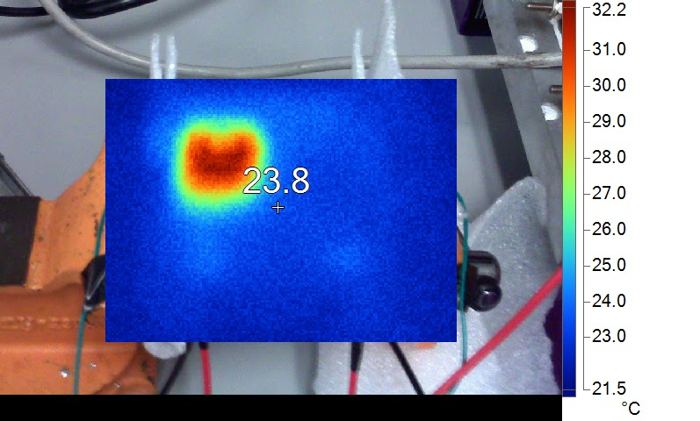
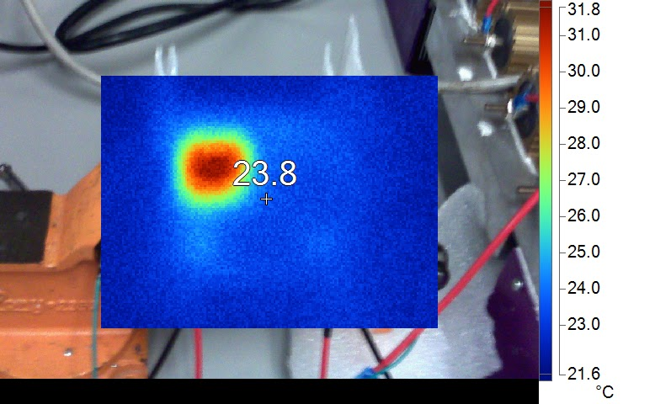
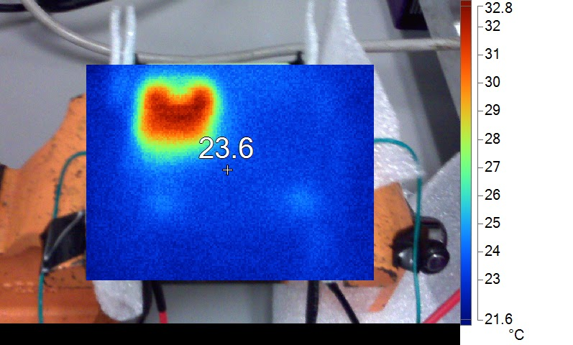
THERMAL TESTING
High AC current test (3.5 A)
High DC current test (3.2 A)
High AC voltage test (120 V)
Notes:
explain hotspot, explain chip locations, explain battery location
Thermal Pics:
#1: After low DC measurements, where the current was driven to be 1.0 A
#2: After low AC current test, the current was driven to be 1.0 Arms
#3: After AC current was 3.5 Arms
#4: DC current was 3.2 A
#5: DC voltage was 32 V

Slide 28
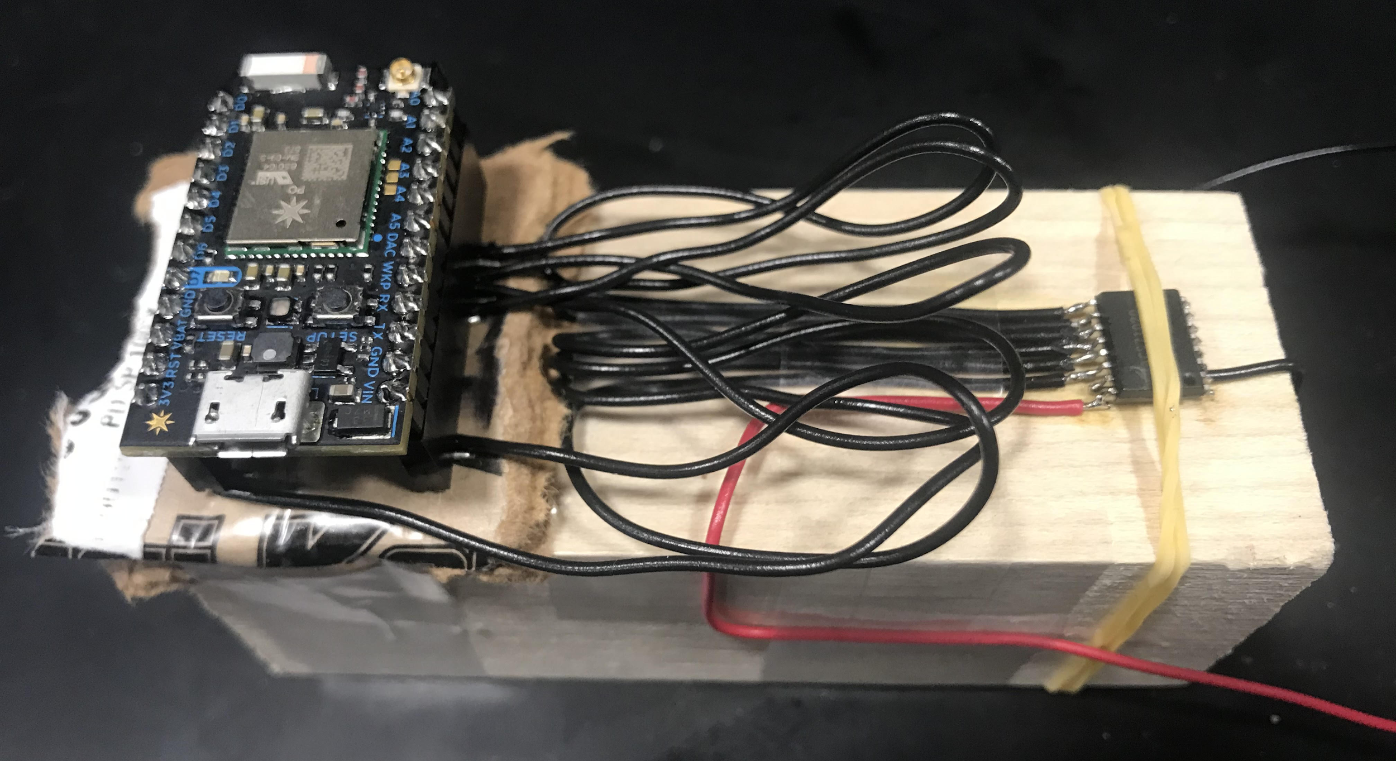
CHALLENGES
Interfacing with Screen
Uses SPI
Requires additional DIO and does not use standard SPI wiring protocol
Involved update procedure
Boot cycle
Environment definition
Image input
Update command
Power down cycle
Poorly translated documentation/lack of relevant libraries to specific application
Communicating with AC sensing IC
False positives in testing caused by delayed response characteristics
Additional false positives due to grounding errors
Some transient errors with lab equipment
Notes:
[45 secs]
Screen - many SPI frame transfers to update screen image, does not provide response to confirm nominal operating procedure, lack of power switch may have made solution impossible, however, interfacing can still be performed over Wifi so this isn’t a huge issue
SPI - as mentioned before, new to us as well as using a lot of bit manipulation and difficult to interpret results (I struggle with, Joe assisted greatly), false positives due to coincidental timing errors, problems with floating ground reference (safety feature), transient problems with lab equipment

Slide 29
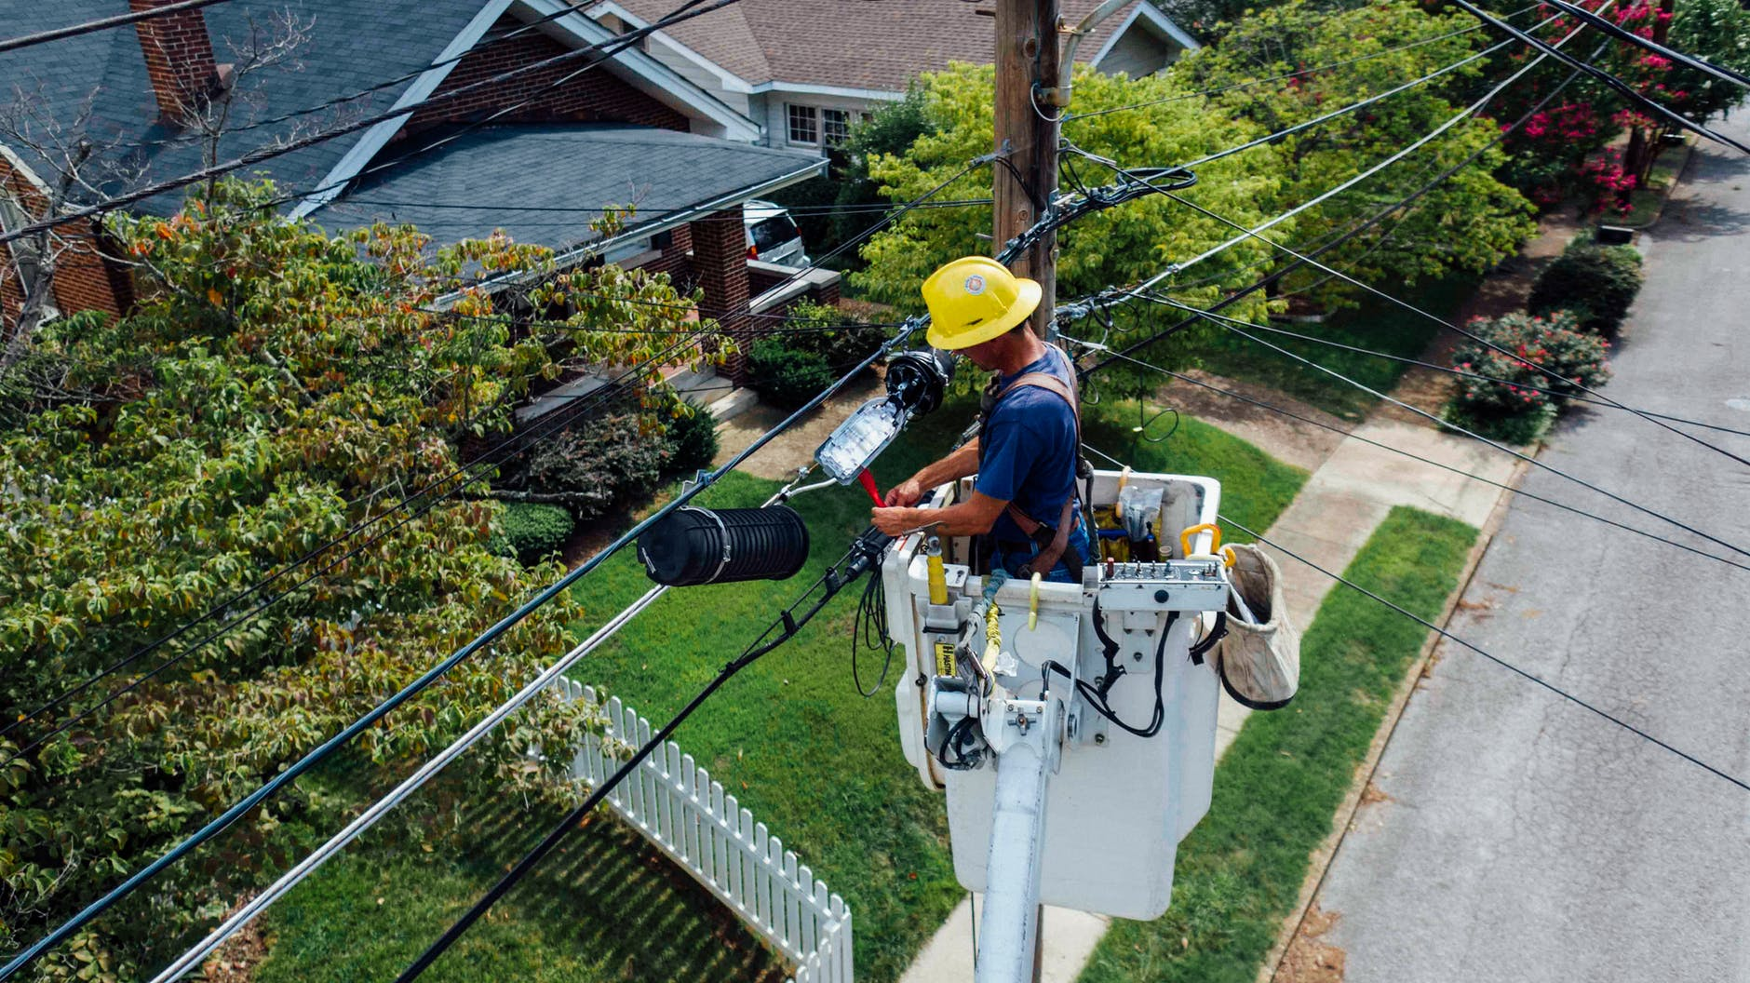
ETHICS AND SAFETY
Our solution will be handled by personnel in possibly inclement weather
Durable, waterproof cases
Separation of failure point and operator
Over-rating of design in fault conditions
Our data will inform users about their installation performance
Accurate
Reliable
Informative
Notes:
[30 secs]
Want our users to be safe in any outdoor conditions, so we move failure points away from them, used durable, resistant cases, and over-rate our design protections (in case of improper use or faults)
Do not want to provide bad data on panels as this would hurt manufacturers, need to inform customers of problems with their systems

Slide 30
WORK FOR THE FUTURE
TERMINAL BOX
BUTTONS
INTERFACE
Our device needs access to the terminals to measure the correct values
It must be cheap but also convenient
It would attach to every solar module
Allow the user the ability to interact with the interface
The case must also be modified to account for the buttons
User interface via screen
Data must be presented on the screen before sent over WiFi
Commands and options should be presented to the user
Notes:
[30 secs]
Terminal box - this would contain simple but reliable protection circuitry like fuses and varistors to prevent dangerous levels from reaching the users space, allows for easy attachment of the measurement solution, cheap but sturdy
Buttons and user interface - these elements have been fully designed, they would allow for a simplified interface to view levels and organize data sent through Wifi

Slide 31
THANK YOU!
QUESTIONS?
QUESTIONS?

