Slide 1
Rear-end Collision Prevention System
Team 32: Xiaohang Yu, Kunhao Li, Jingchao Zhou
TA: Michael Genovese

Slide 2
Introduction
A blind spot warning system to warn potential rear-end collision.
An accelerometer-based brake light
Turned on upon gentle brake
Flash upon sharp brake

Slide 3
Appearance

Slide 4
Objectives
For cyclists
Provide visual alert of objects approaching from behind the bicycle.
For drivers behind the bicycle
Provide visual cue when the bicycle reduces speed sharply.

Slide 5
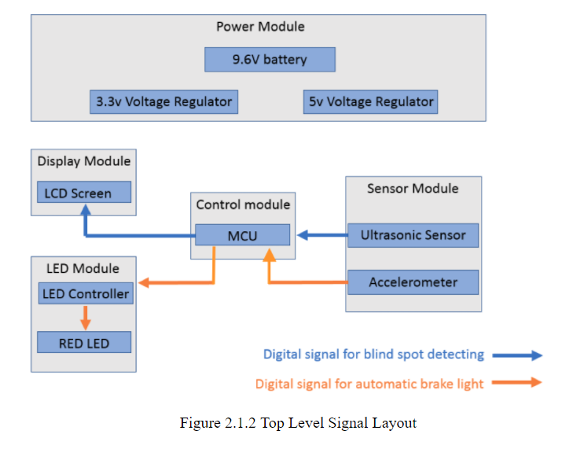
Module Layout

Slide 6
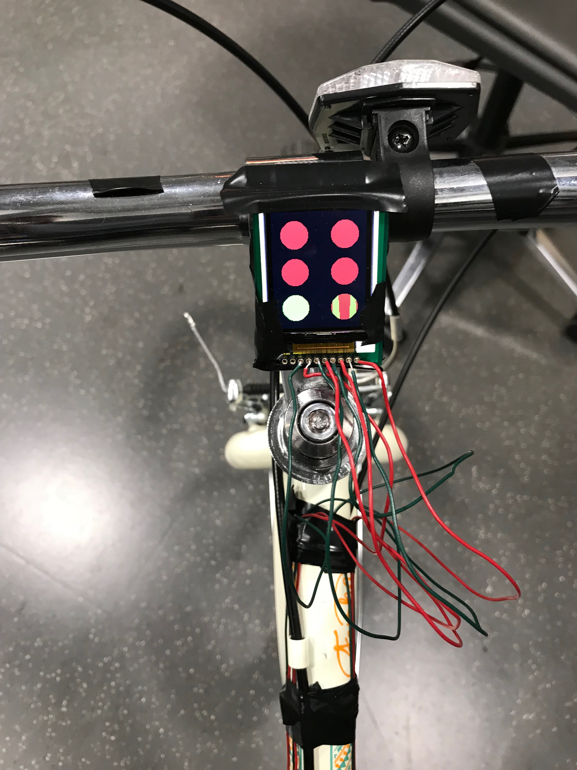
Display
Visual indicator to cyclist for objects behind
Each circle corresponds to a location
Fill color of the circle indicates proximity color
Red: less than 1 meter
Yellow: Less than 2 meters, more than 1 meter
Green: More than 2 meters, or no object present

Slide 7
Display – Implementation
Fills colors to 6 circles.
Center fixed - Same pixels but different color upon refresh.
Circle not modified if proximity level at that position did not change.

Slide 8
Display – R&V
New content should appear on display within 80ms.
Timed and printed to display.
Satisfies constraint.
Correct proximity level of approaching objects from 6 different directions.
Positioned objects at different distances.
Correct indicator colors are shown, but shifts rapidly.

Slide 9
Display - Latency

Slide 10
LEDs (Brake Light)
LED matrix with 3 modes: OFF, ON and FLASH
Turned on upon normal brake (below deceleration threshold)
Flash upon emergency stop (high deceleration above threshold)
Two subcomponents:
Control Logic – to control flashing
Accelerometer – to sense movement

Slide 11
LEDs (Brake Light)
Brake light overall was not functioning during demo
Modification:
Define maxServerity(s1, s2) – return the most severe proximity level between two sensor locations
If maxServerity(s1, s2) == YELLOW, turn on
If maxServerity(s1, s2) == RED, flash
Else, turn off

Slide 12
LEDs (Brake Light) – R&V
Should be noticeable at least 5 meters away.
Subjective observation.
Flash frequency of LEDs should be at least 5Hz.
Connect output to oscilloscope and measure frequency.
Satisfies constraint.
Correct behaviors are exhibited with inputs specified in table 2.3.5.3.
Manually supply input signal.
Satisfies requirement.

Slide 13
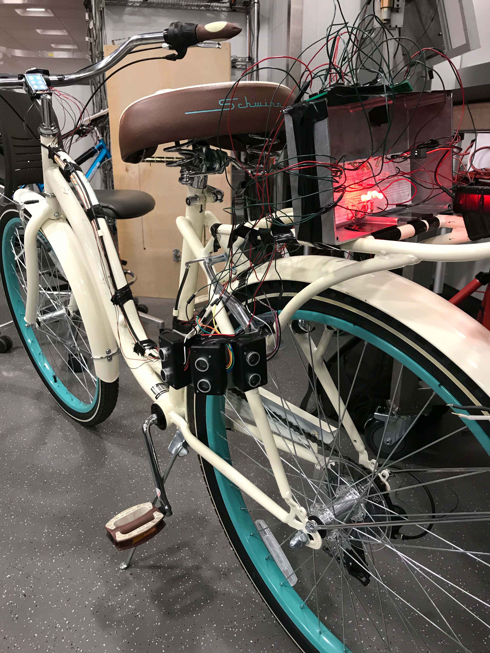
Sensors - Ultrasonic
Sense object presence behind the bicycle
Viable in terms of cost
Pins:
Vcc – 5V
TRIG
ECHO
GND

Slide 14
Sensors - Ultrasonic
TRIG – Digital trigger signal, set to HIGH to transmit ultrasonic wave
ECHO – Raised to HIGH if waves are received after sending them. Duration of HIGH is proportional to time travelled
TRIG is supplied from a single digital signal bus
All sensors emit ultrasonic wave at the same time
Requires a low pass filter
With T = Duration (sec) of ECHO HIGH, D = distance (m) to object:
$$D=\frac{T×340}{2}≈\frac{T}{0.0058}$$

Slide 15
Sensors - Ultrasonic
Should detect objects within range of 3 meters.
Positioned objects at different distances and checked calculation is within 5cm of actual distance.
Readings are unstable, calculation generally within 20cm range.
If an object is present within 3 meters, a sensor should raise ECHO signal to HIGH in no more than 20ms after TRIG is set to HIGH.
Modified code and timed worst case waiting time for ECHO.
Satisfies constraint.

Slide 16
Sensors - Ultrasonic

Slide 17
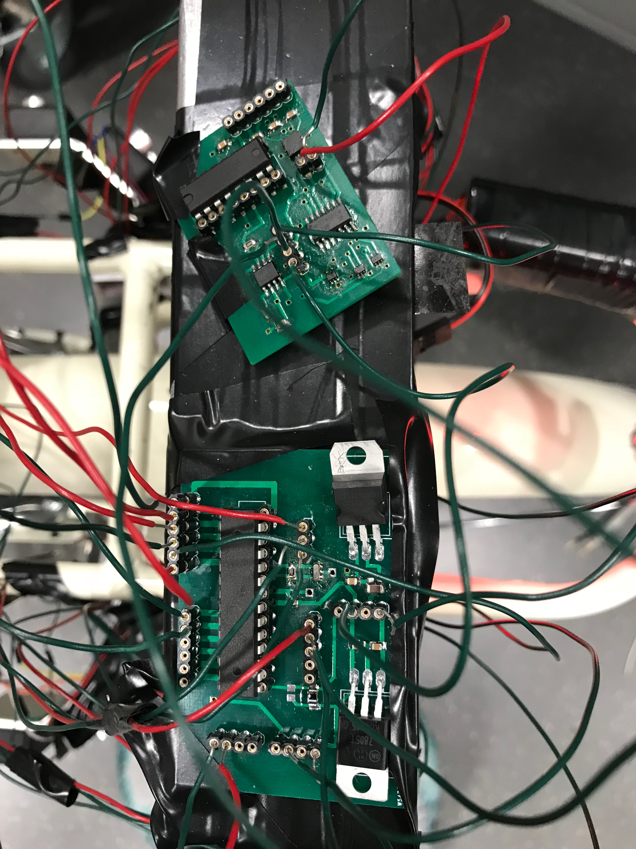
Sensors - Accelerometer
More portable than flex sensors
Detect acceleration of the sensor itself
Surface-mounted on brake light PCB
Pins:
Vcc – 3.3V
GND
X, Y and Z analog output
Self test

Slide 18
Sensors - Accelerometer
Value of z-axis used as input to MCU – chosen arbitrarily
Positive z-axis pointed to REAR of the bike
Acceleration threshold:
At VS = 3.6 V, the output sensitivity is typically 360 mV/g
g = 9.8m/s²
1 unit of AnalogRead() = 4.9mV
MCU software contains:
Calibrated base value ($Z_{BASE}$)
Threshold for flashing ($Z_{FLASH}$)
Considered normal brake if:
$$Z_{BASE}<Z≤Z_{FLASH}$$
Considered emergency brake if:
$$Z>Z_{FLASH}$$

Slide 19
Sensors - Accelerometer
Accidental break-down of accelerometer chip
Caused by incorrect wire relays on breadboard
Watch the video. It shows a working braking light.

Slide 20
Controller (MCU)
ATMega328P, used by Arduino
Detached from Arduino and installed onto customized PCB.
Receives input from ultrasonic sensor and accelerometer.
Output to display and brake light.

Slide 21
Controller (MCU)
Output correct proximity level to screen at the corresponding location when an object is within the range of 3 meters.
Rapid shifts between levels occur, due to interference from noise.
Rapid shifts between levels occur, due to interference from noise.
The two brake light arrays should flash alternatingly when the deceleration of bicycle $Z$ satisfies
$$Z>Z_{FLASH}$$
The two brake light arrays should flash alternatingly when the deceleration of bicycle 𝑍 satisfies
𝑍>𝑍_𝐹𝐿𝐴𝑆𝐻
Accelerometer was not working at demo. Switching to new accelerometer shows the constraint is satisfied, but such scenario can be trigger by sudden shocks.
The two brake light arrays should be turned on when the deceleration of bicycle $Z$ satisfies
$$Z_{BASE}<Z≤Z_{FLASH}$$
The two brake light arrays should be turned on when the deceleration of bicycle 𝑍 satisfies
𝑍_𝐵𝐴𝑆𝐸<𝑍≤𝑍_𝐹𝐿𝐴𝑆𝐻
Accelerometer was not working at demo. Switching to new accelerometer shows the constraint is satisfied.

Slide 22
Power
Supplies power to:
MCU (5V)
Ultrasonic sensor (5V)
Accelerometer (3.3V)
Display backlight & control logic (3.3V)

Slide 23
Power
The voltage supplied by the 9.6V battery should remain above 7V for more than 7 hours.
Measured total current: 126mA.
A 9.6V 2000mAh battery can endure 15 hours.
The ripple voltage at the output of 5V regulator should be smaller than 0.1V.
Connected voltage regulator output to oscilloscope.
Does not satisfy requirement due varying load of MCU
The ripple voltage at the output of 3.3V regulator should be smaller than 0.1V.
Connected voltage regulator output to oscilloscope.
Does not satisfy requirement due varying load of MCU

Slide 24
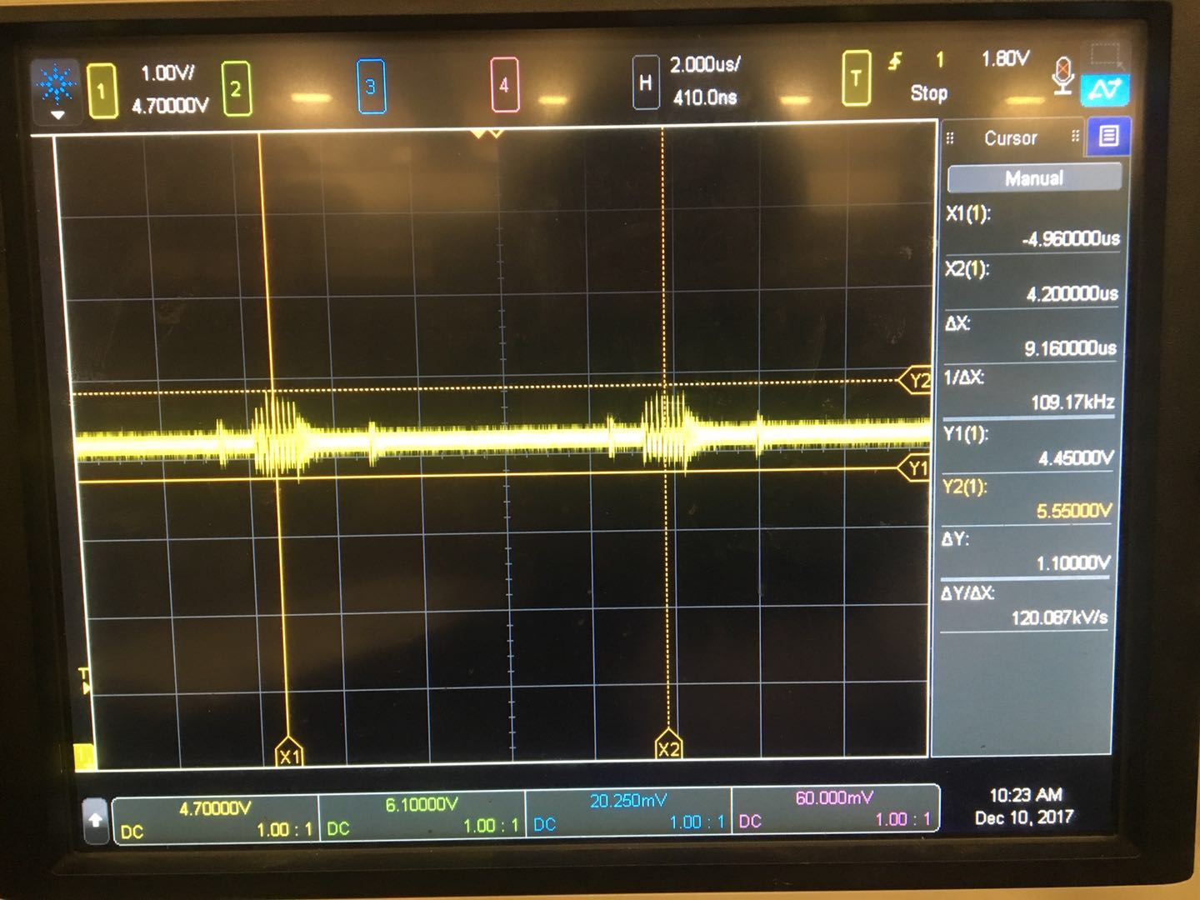
Power
Ripples in the range of 4.45~5.55V
Caused by varying load of the MCU.
Varying load is caused by sending data to the LCD screen.

Slide 25
Conclusions
Can notify cyclist of nearby objects.
Need to improve accuracy and minimize interference by noise.
Brake light logic correct.
Due to sudden accelerometer failure, brake light was not working during demo.

Slide 26
Questions

