Slide 1
Saxophone Effects Pedal - Team #28
5/3/2021
By Peter Hevrdejs, Eliseo Navarrete and Sean McGee

Slide 2
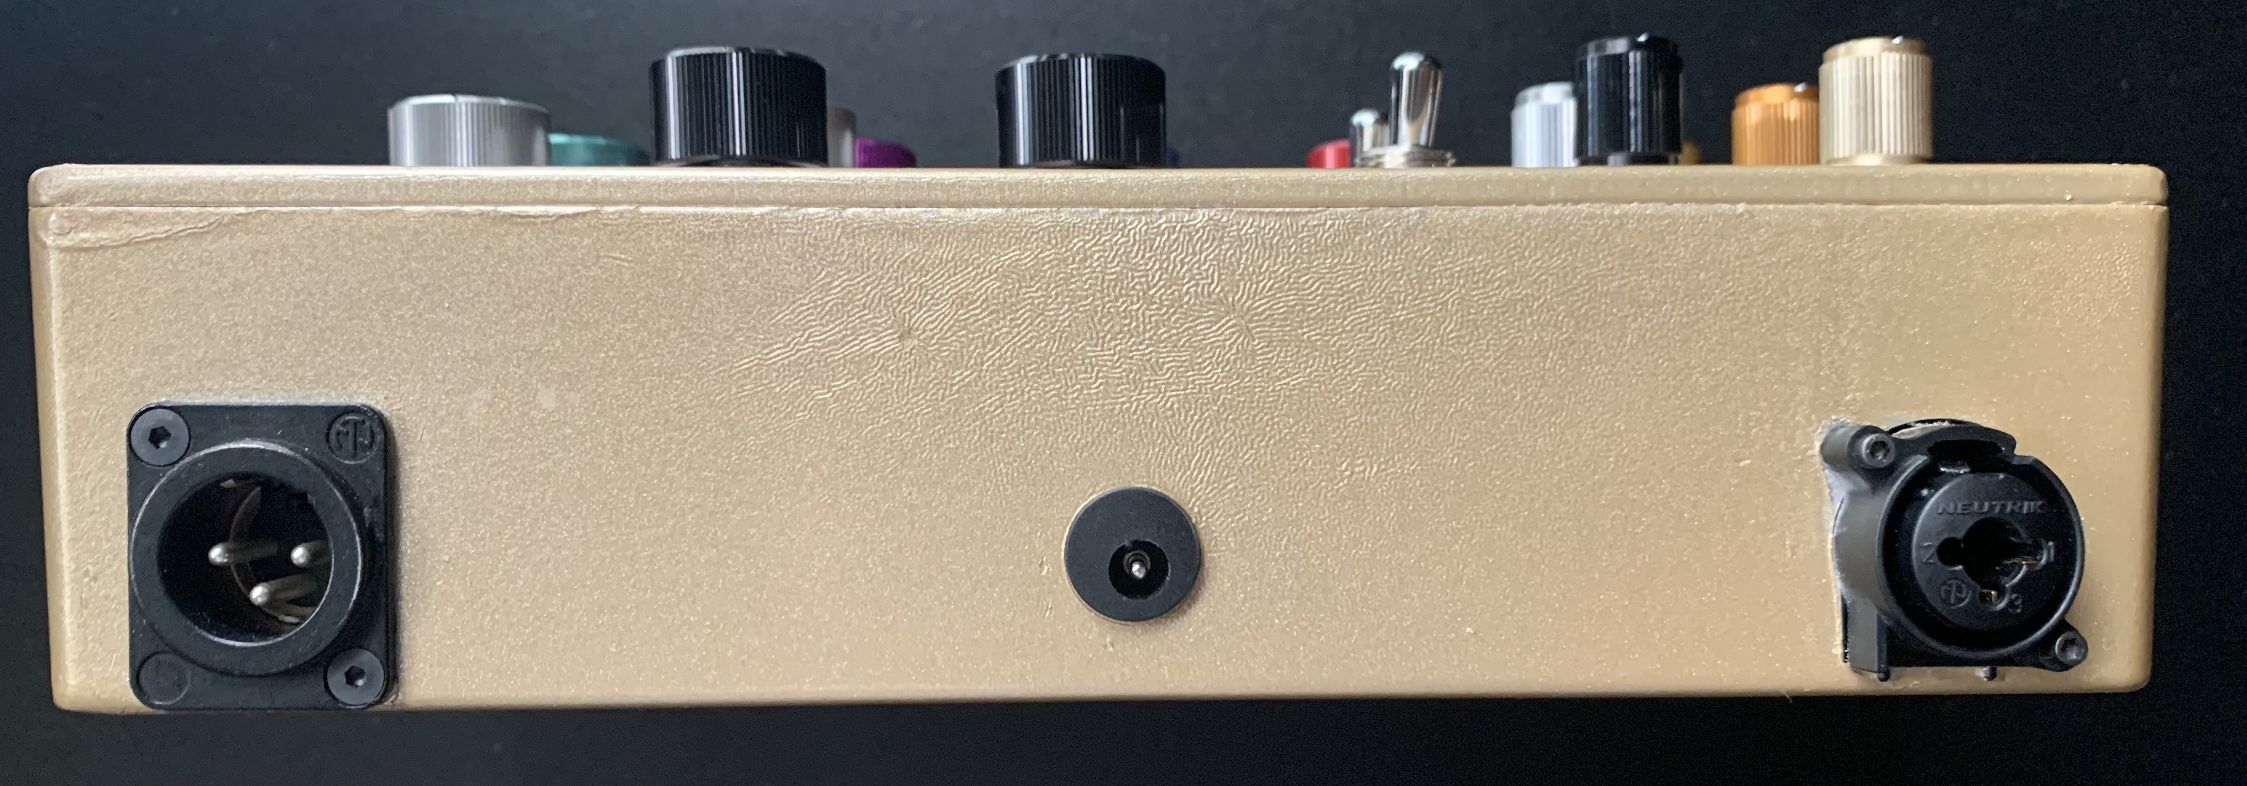
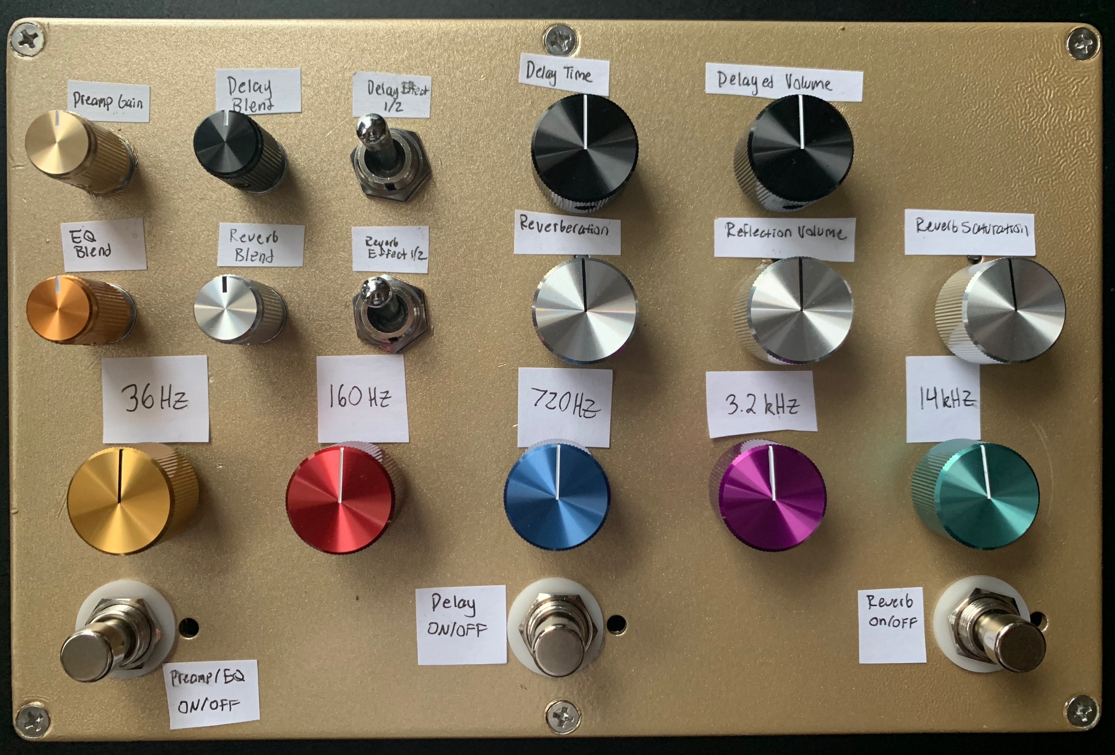
What is a Saxophone Effects Pedal?
Desired Characteristics
Performance friendly
Portable
Cost Effective
Our Effects
Pre-amplifier
Equalizer
Delay
Reverb

Slide 3
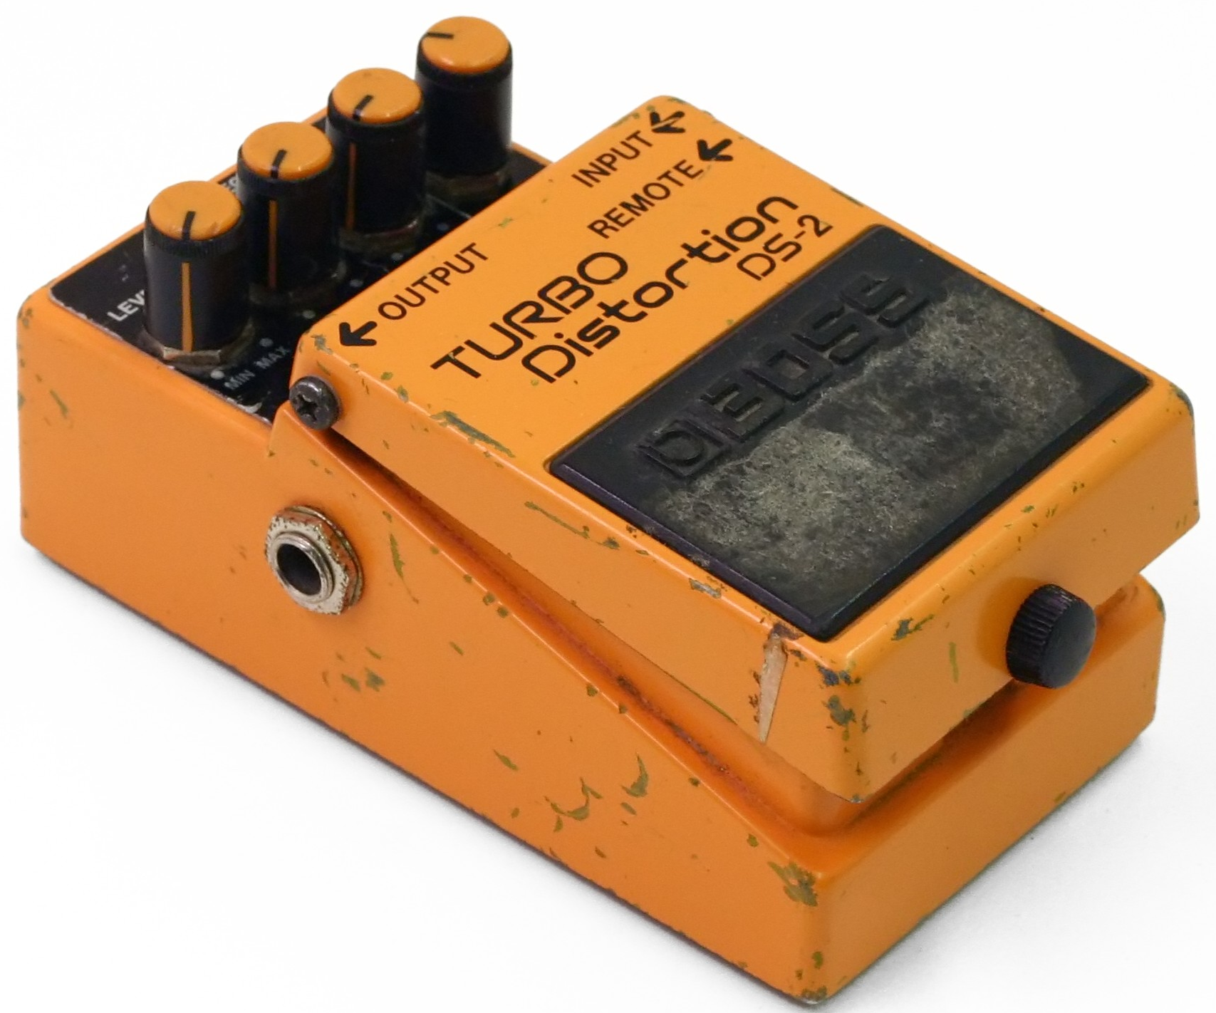
What Problem Did We Solve?
Input Type
Guitar Pedals – ¼ inch
Our Pedal – XLR
Saxophone Tailored Circuits
Emphasize Brass-wind frequencies
Using a saxophone through a guitar pedal makes it sound “tinny”

Slide 4
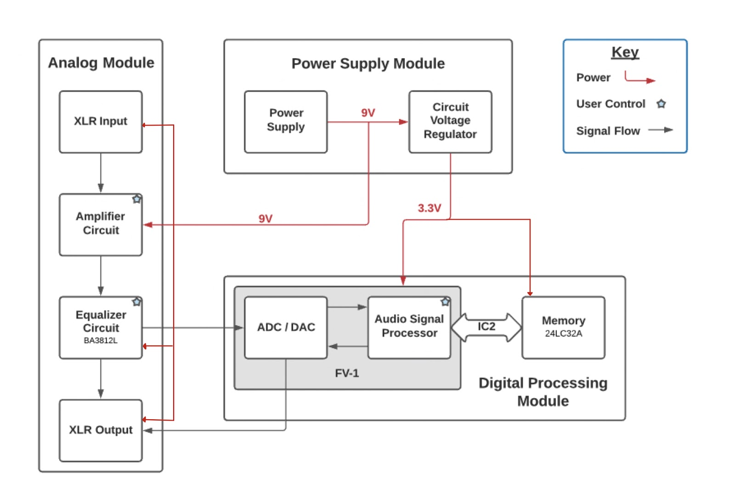
Block Diagram
Analog Module
XLR IO
Amplifier Circuit (Preamp)
Equalizer Circuit
Digital Processing Module
Delay Effect
Reverb Effect
Power Supply Module

Slide 5
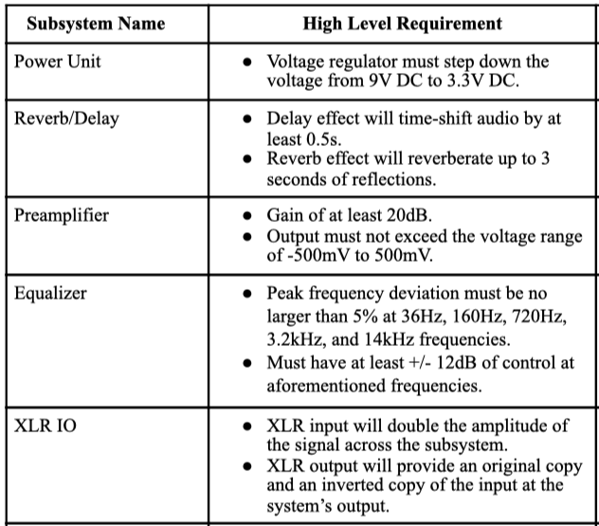
System Requirements

Slide 6
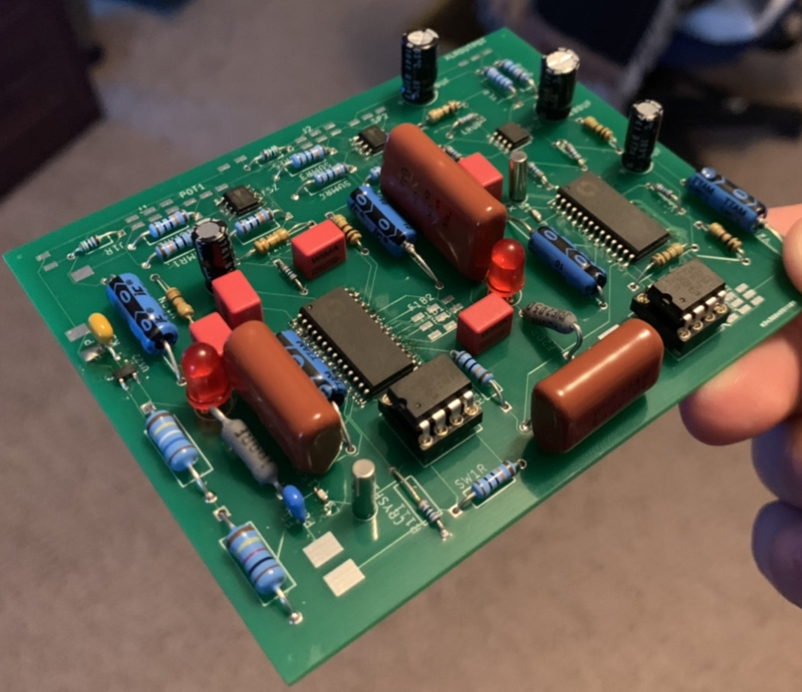
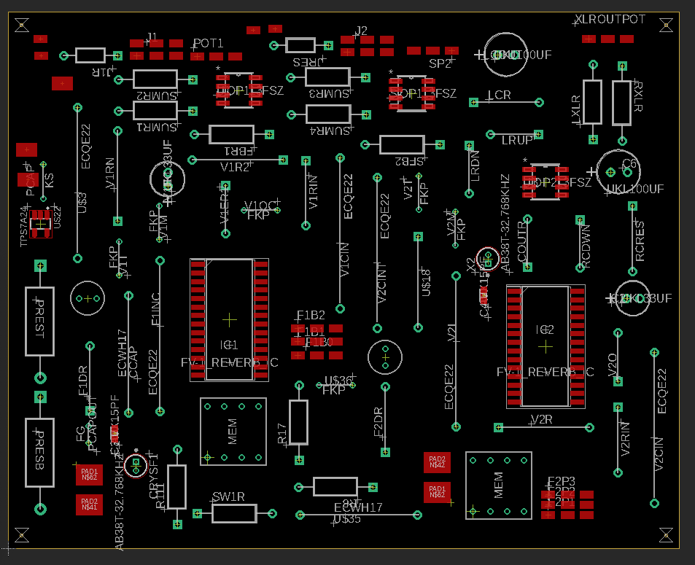
Digital Board
Delay Effect
Reverb Effect
XLR Output System
Power Scaler (9V to 3.3V)
Blend Circuits

Slide 7
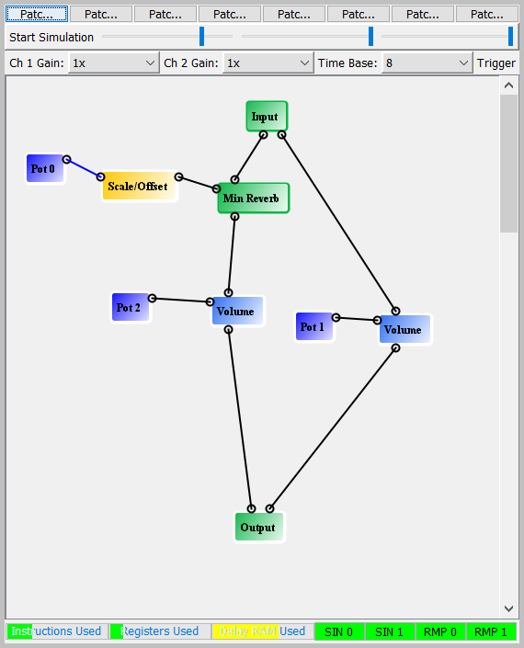
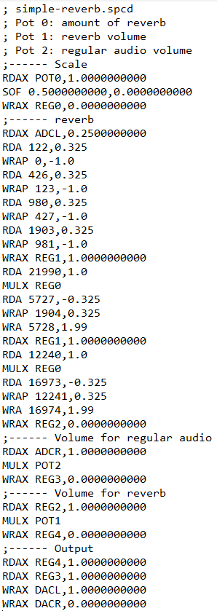
FV-1 Algorithm
Our designed reverb algorithm has a maximum of 10s of reverberations
In compliance with high level requirement of 3s
The delay algorithm we designed has up to 1s of delay
In compliance with high level requirement of 0.5s
Graphic Simulator Example
Assembly Code

Slide 8
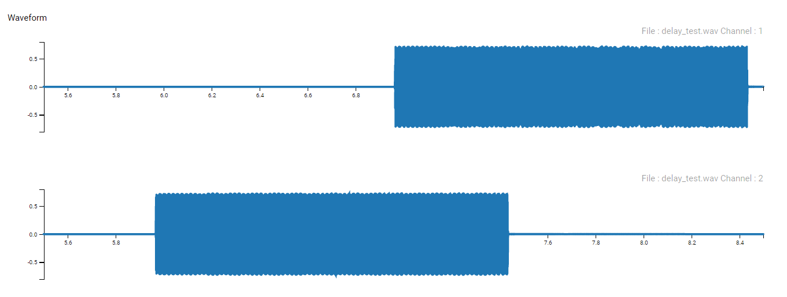
Delay Effect Verification

Slide 9
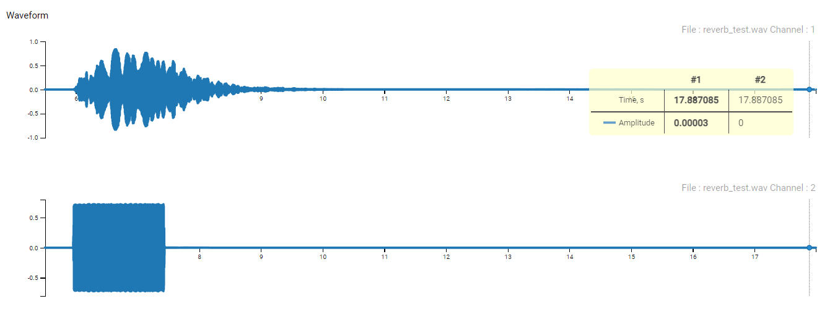
Reverb Effect Verification

Slide 10
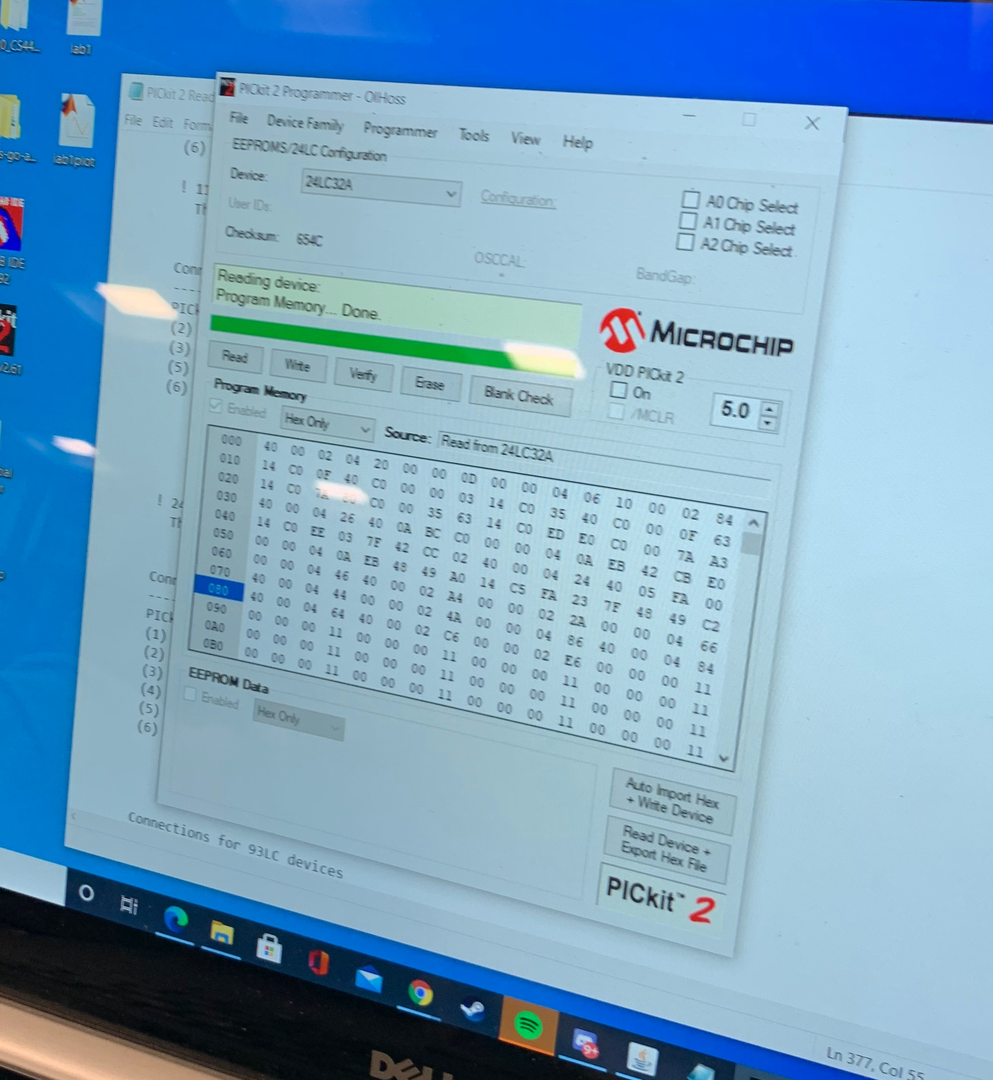
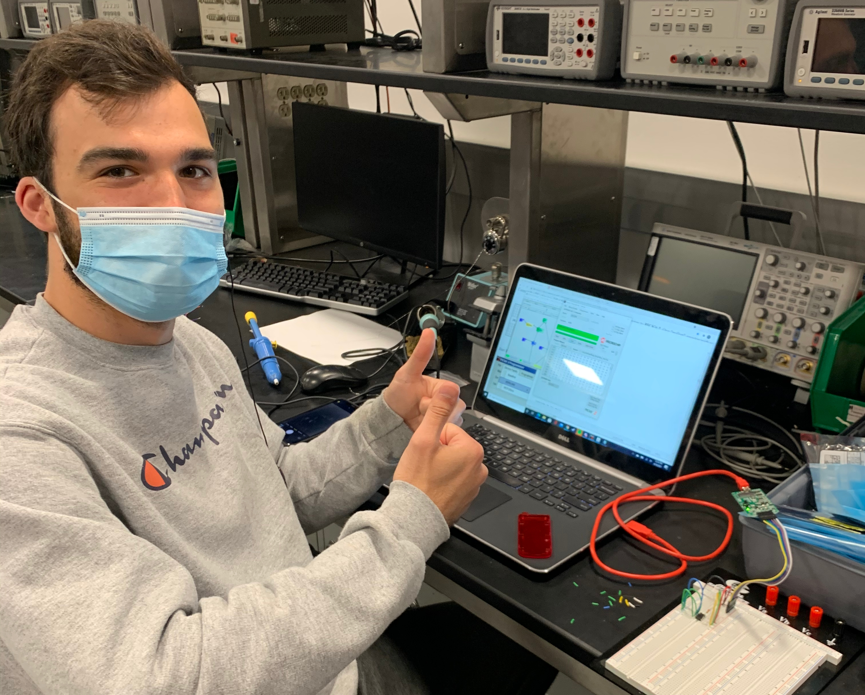
Digital Board
While our board may have failed due to power…
We could still demonstrate writing and reading to and from the EEPROM

Slide 11
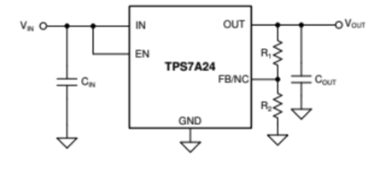
Power Unit
Worked when isolated on its own PCB
Broke down when integrated with the rest of the digital processing module
Potential causes for breakdown:
Capacitors blew, causing a short
Thermal overload fried the internal circuitry

Slide 12
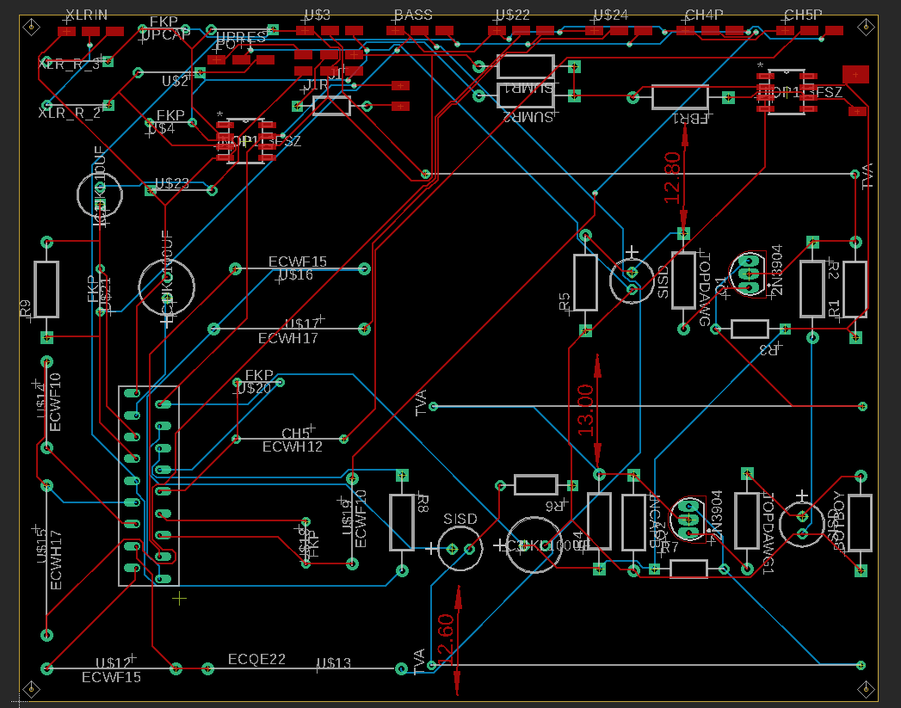
Analog Board
Preamplifier
Equalizer
Blend Circuit
XLR Input System

Slide 13
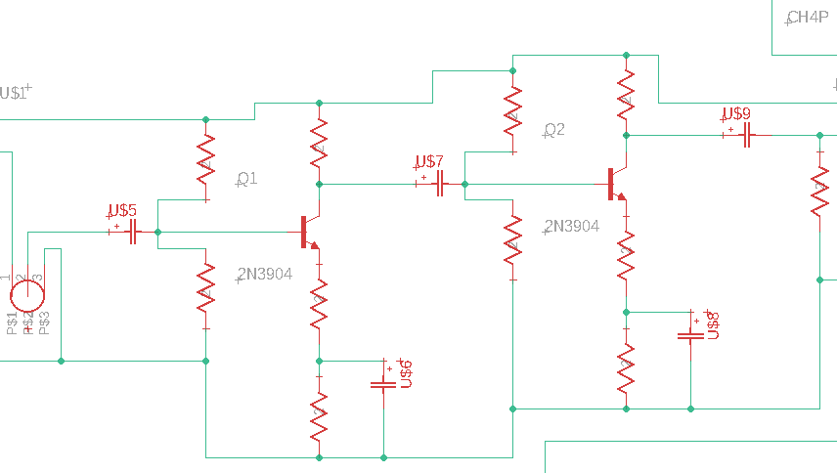
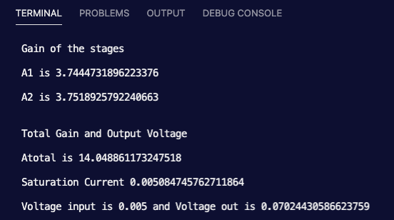
Preamplifier
Our Design:
Class-A Amplifier
Low Noise / High Fidelity
Need to bring low microphone voltage up to effects level voltage
HLR stated we needed at minimum of 20dB of gain
Our Design Process:
Modeled Class-A Amplifier in Python using knowledge from ECE 342
Model yields ~14x the original signal amplitude at maximum conditions
Equivalent to 23dB of gain

Slide 14
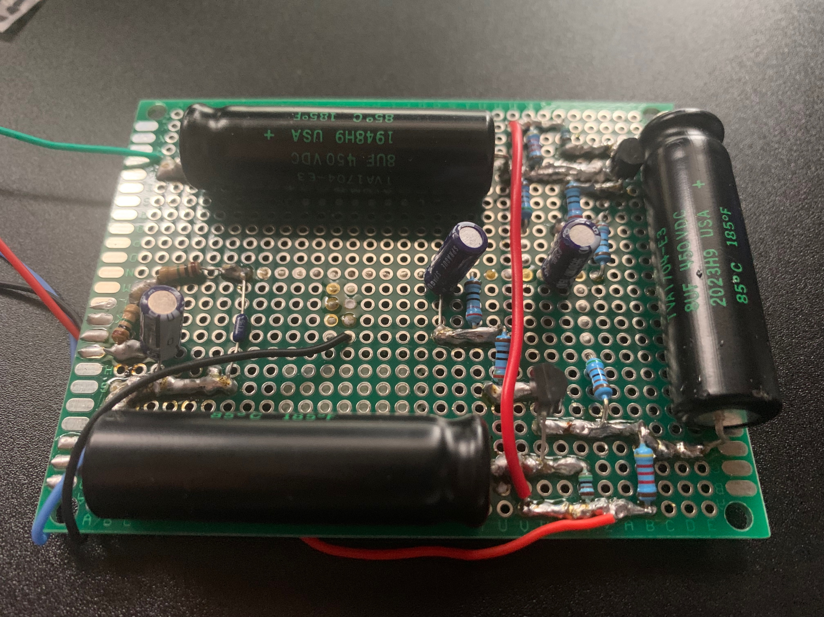
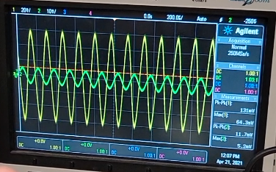
Preamplifier
Our Results:
Our design has 11.2x the original signal’s amplitude at maximum gain
Equivalent to 21.8dB
Our Error:
Simulation Results - 14x (23 dB)
22.5 % difference between amplitude magnification (5.35% dB)
Input Signal (Green) – 5.2mV
Output Signal (Yellow) – 64.3mV

Slide 15
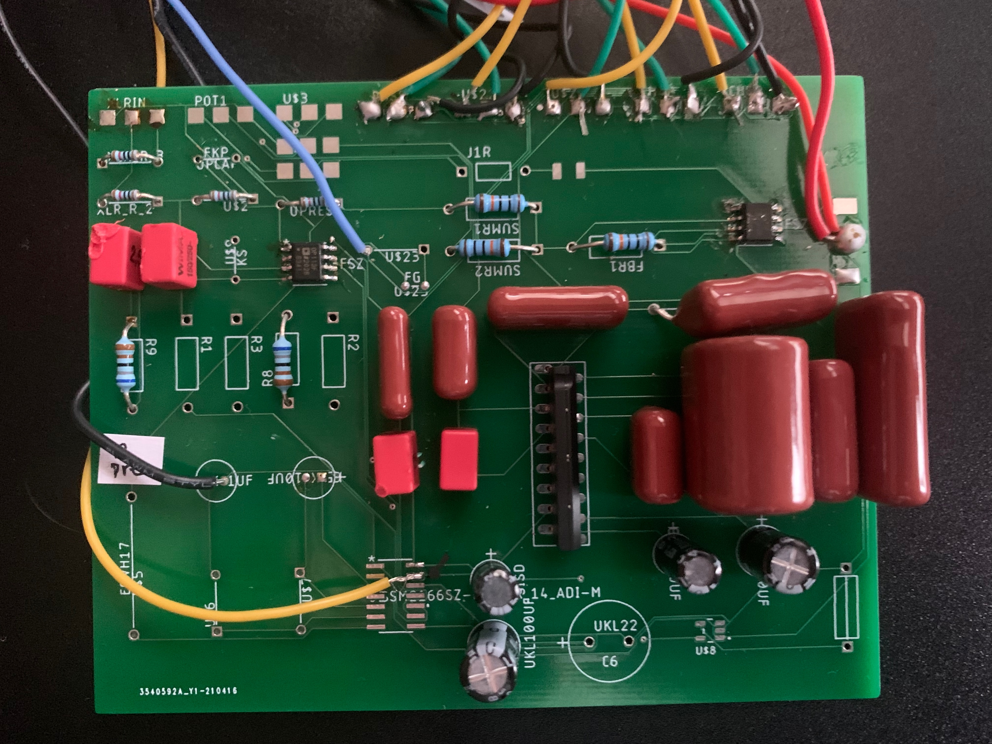
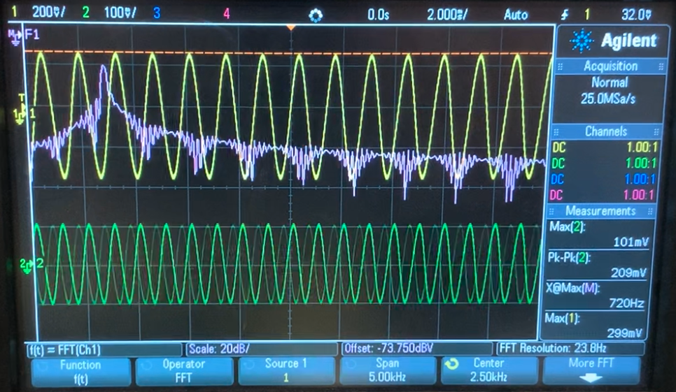
Equalizer Circuit
Variably increase or decreases frequency components
HLR requires at least +/- 12 dB of gain at the specified frequency
Our chosen frequencies are
36Hz
160Hz
720Hz
3.2kHz
14kHz

Slide 16
Equalizer Circuit
Our Design Process:
Used derived frequency equation to solve for the product of the total capacitance
Found closest film capacitors on the market to fit
Analyzed and compared actual frequency versus ideal frequency

Slide 17
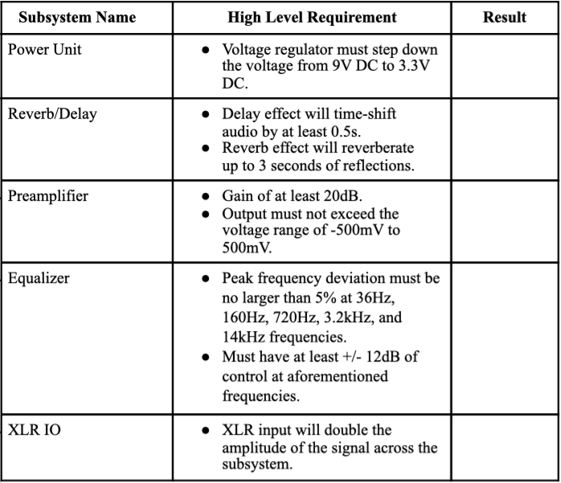
System Requirements Summary
Key
- Fully Achieved
- Partially Achieved
- Work in progress

Slide 18
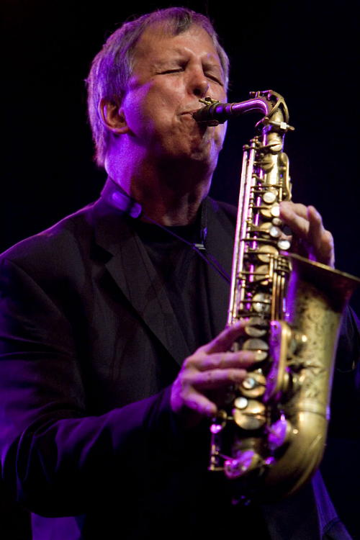
Conclusion
Still have some work to do…
Finish up XLR I/O
Find power regulator alternatives
Wire bypass controls to footswitches
Send finished product to legendary saxophonist Dick Oatts for review
What we have learned…
If soldering wires to PCB, use holes and not pads
High impedance mode is your friend
It takes a lot of time and effort to bring a design from a well researched idea to a fully working device
Saxophonist Dick Oatts

Slide 19
Thank You for Listening!
Any Questions?

