Slide 1
PillSafe - Smart Pill Box
ECE 445
Apoorva Nadella, Sumuk Rao, Yan-Jun Fang
12/06/2021

Slide 2
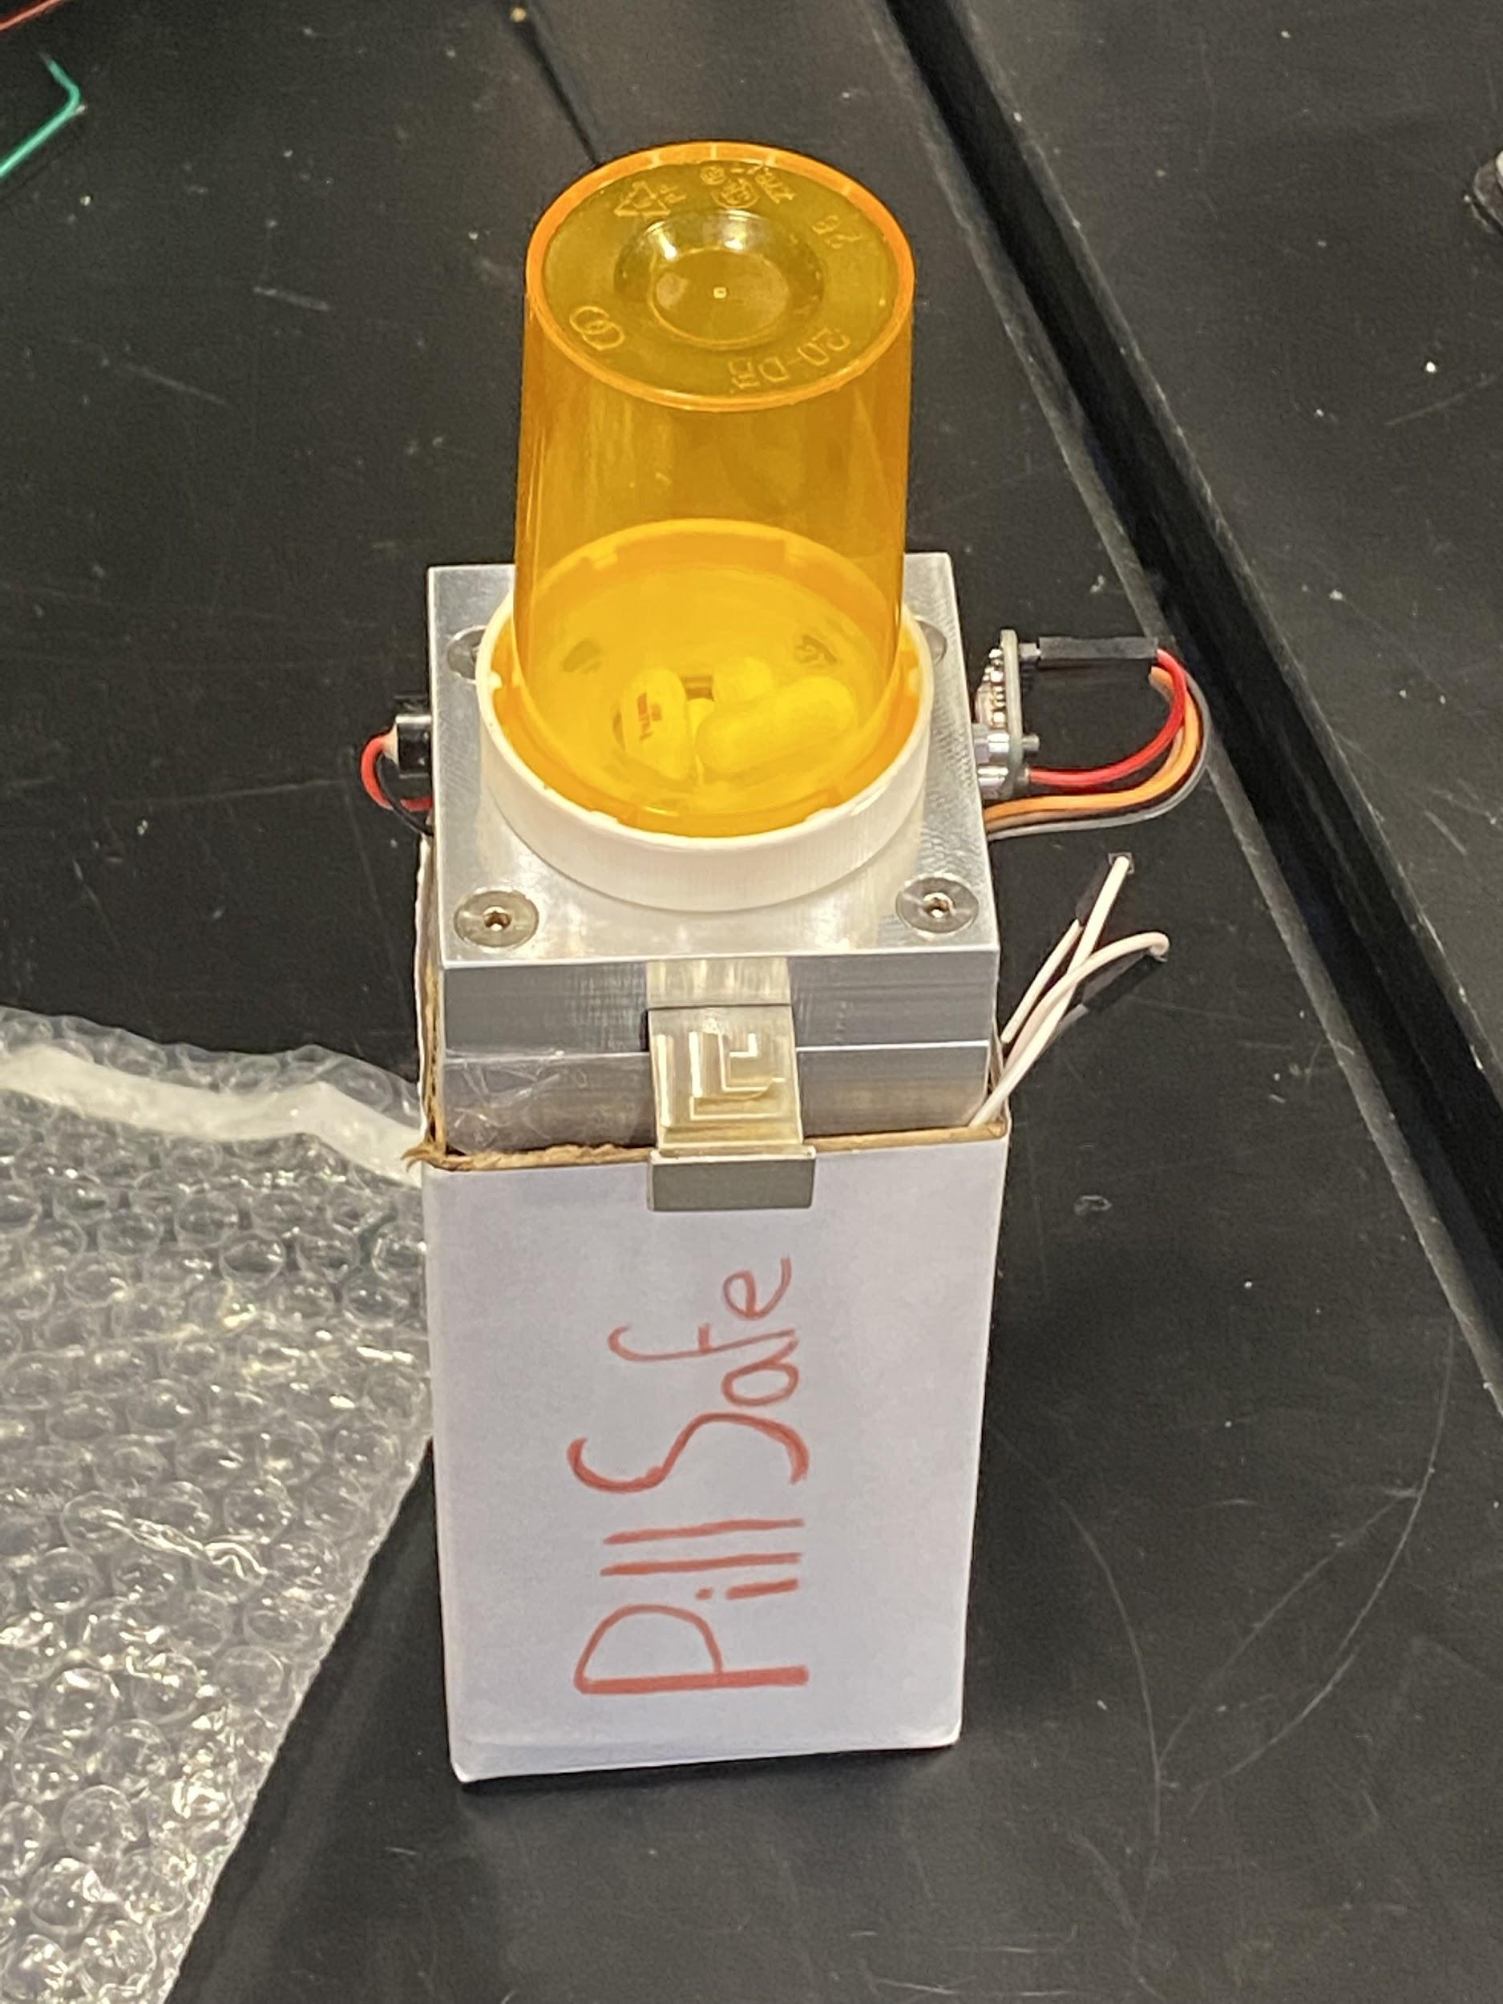
Smart Solution for Opioid Crisis
Problem
50,000+ die from Opioid Overdose per year
Pill intake unknown between checkups
Solution
Smart Pill Box to monitor pill intake
Timestamp/Frequency monitored by doctors
IMAGE / GRAPHIC
IMAGE / GRAPHIC
ELECTRICAL & COMPUTER ENG / ECE 445
GRAINGER ENGINEERING

Slide 3
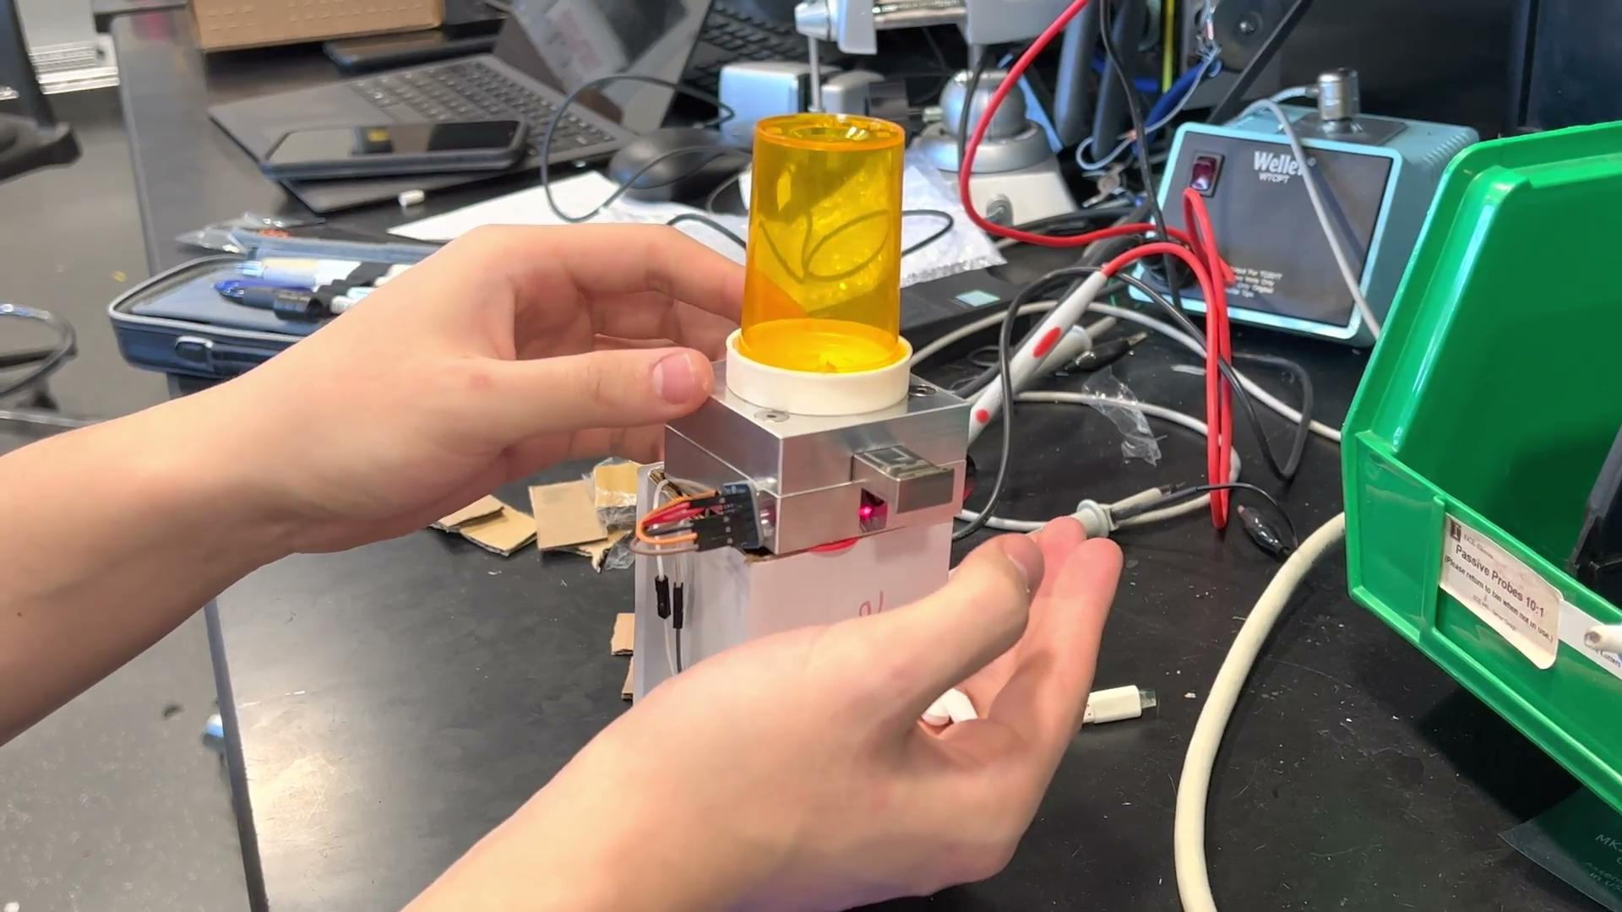
Demo Video
ELECTRICAL & COMPUTER ENG / ECE 445
GRAINGER ENGINEERING

Slide 4
Objectives
Monitor
Pill Intake
Track Intake
Over Time
Small
Size
Ease of
Use
ELECTRICAL & COMPUTER ENG / ECE 445
GRAINGER ENGINEERING

Slide 5
Overall Design
ELECTRICAL & COMPUTER ENG / ECE 445
GRAINGER ENGINEERING

Slide 6
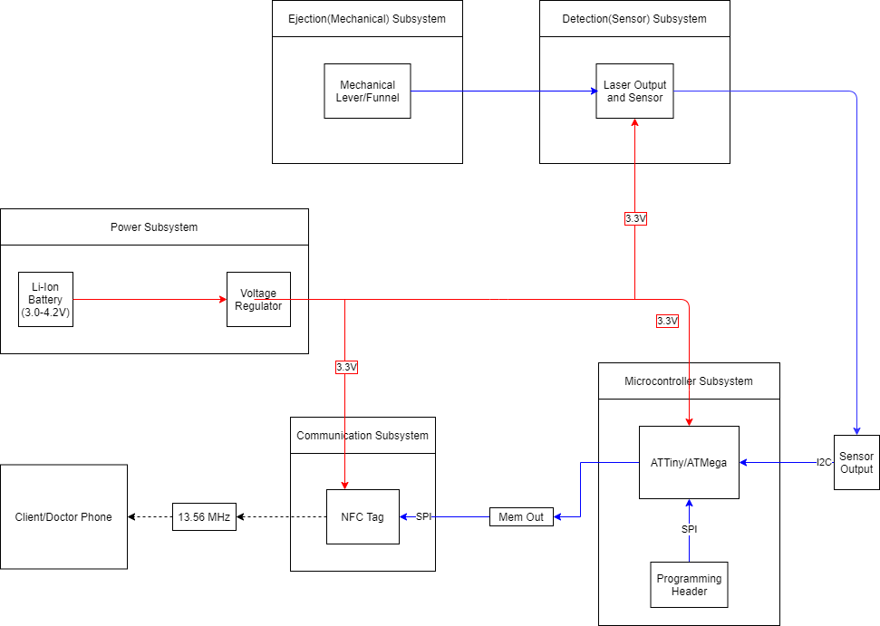
High Level Block Diagram
ELECTRICAL & COMPUTER ENG / ECE 445
GRAINGER ENGINEERING

Slide 7
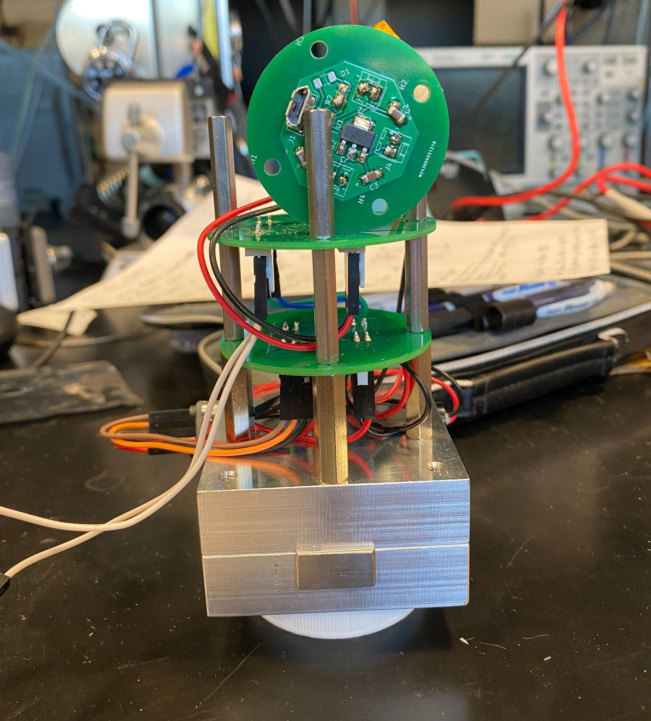
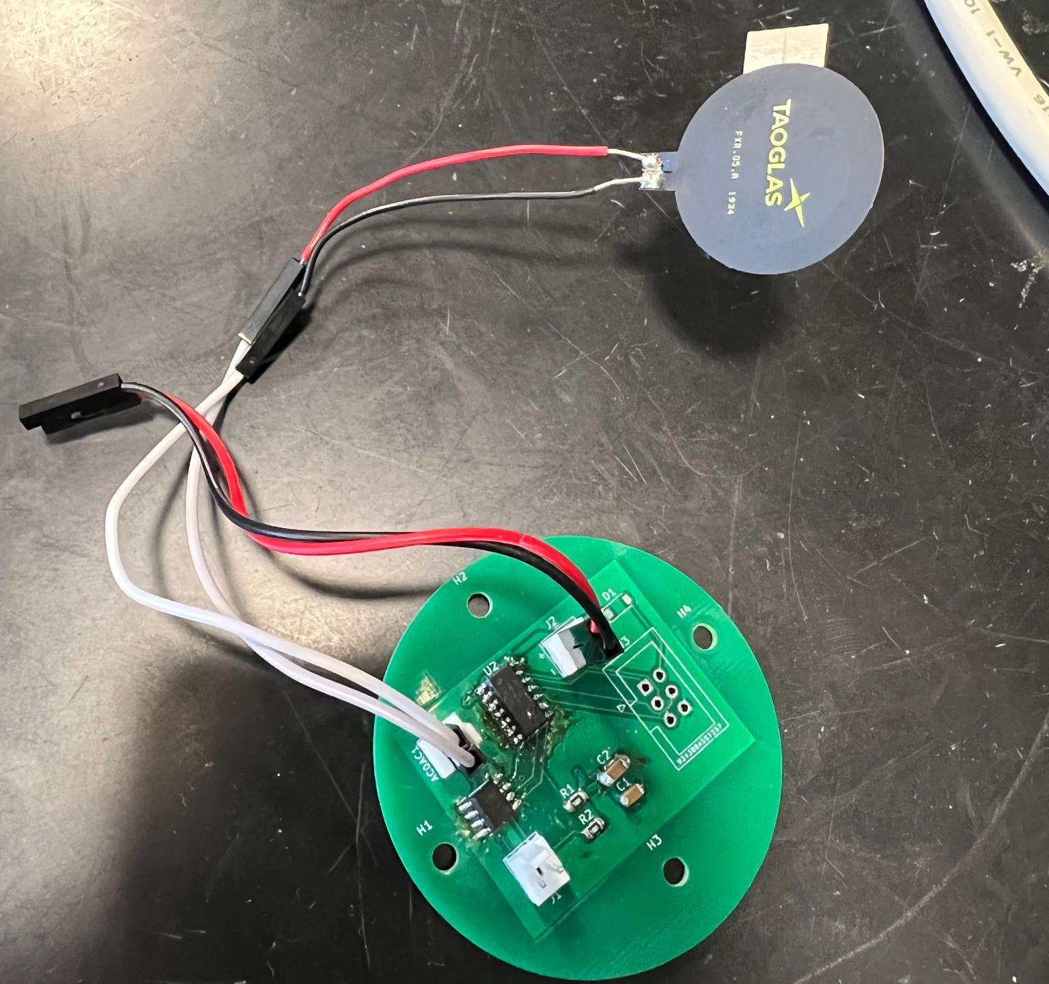
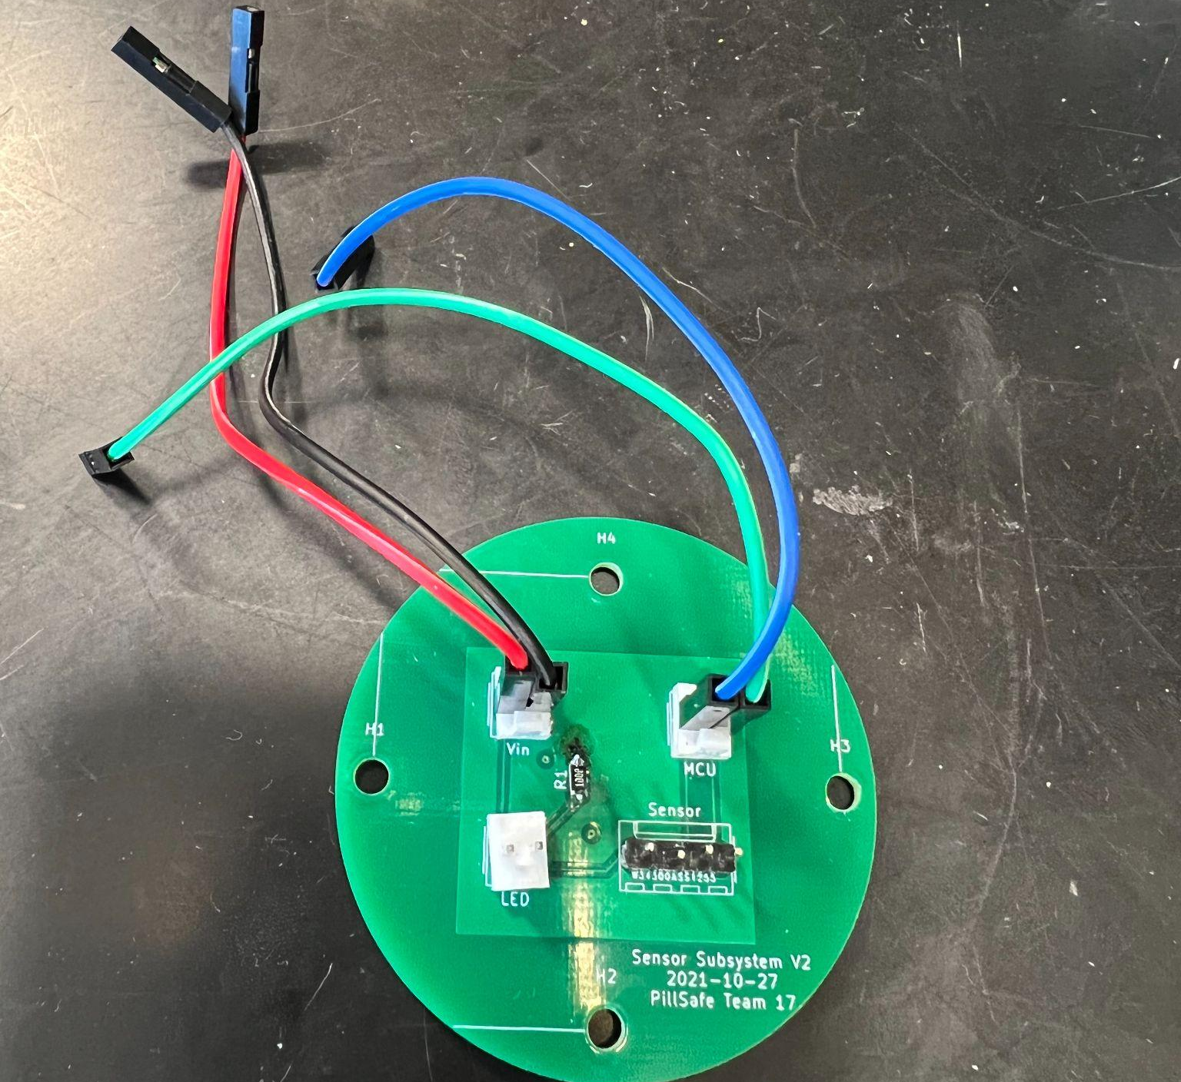
3 Part Design
1 - Battery, Voltage Regulator, Charge Controller
2 - Microcontroller, NFC EEPROM
IMAGE / GRAPHIC
3 - Photodiode Sensor, Laser
ELECTRICAL & COMPUTER ENG / ECE 445
GRAINGER ENGINEERING

Slide 8
Benefits
Easy to
Split Work
Unit Tests
& Debugging
Limit Horizontal Space
Flexibility to Alter Design
ELECTRICAL & COMPUTER ENG / ECE 445
GRAINGER ENGINEERING

Slide 9
Mechanical Component
ELECTRICAL & COMPUTER ENG / ECE 445
GRAINGER ENGINEERING

Slide 10
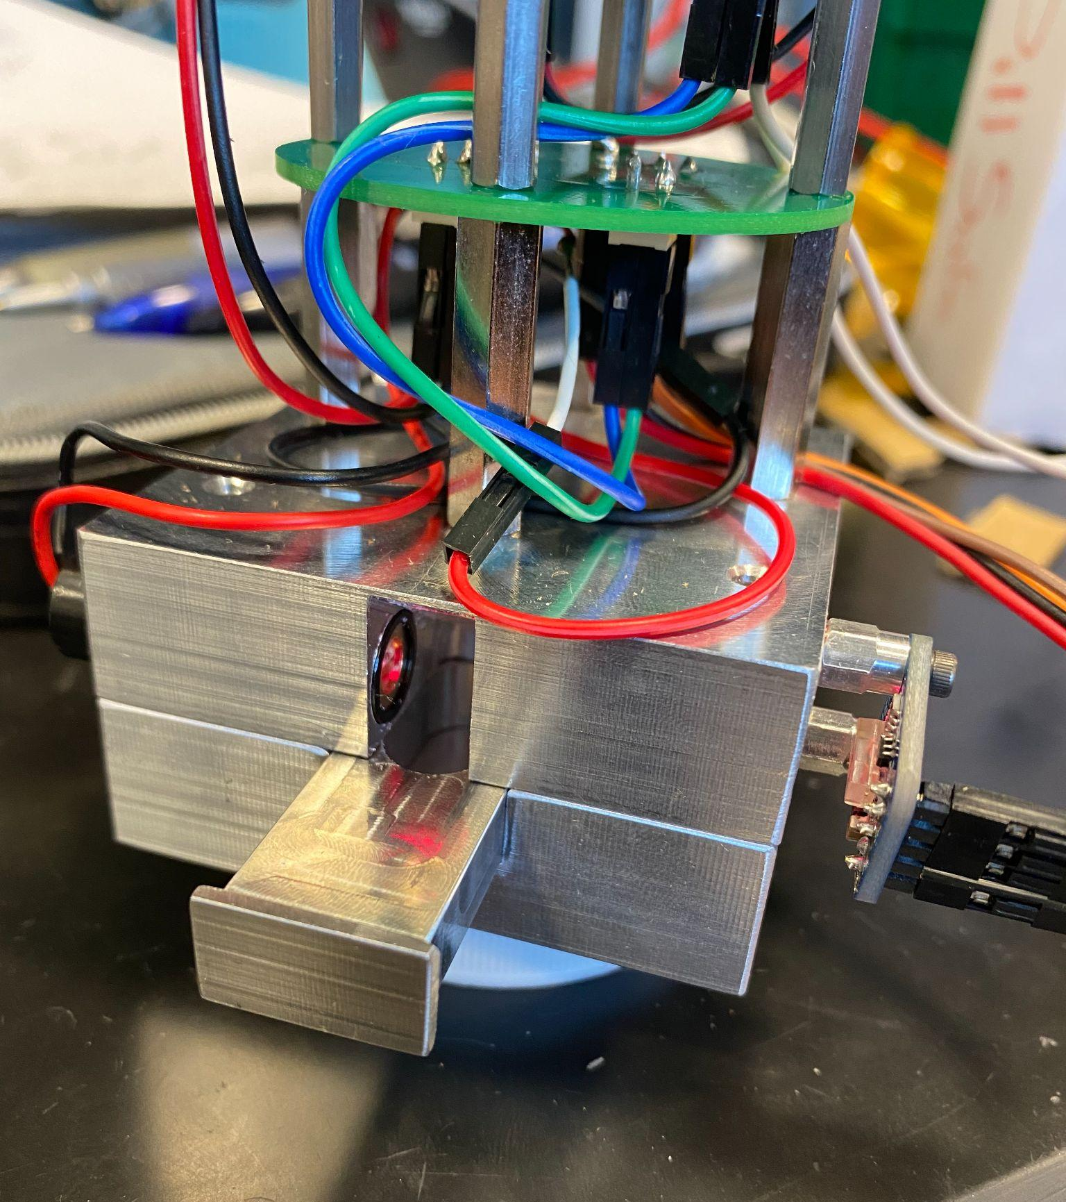
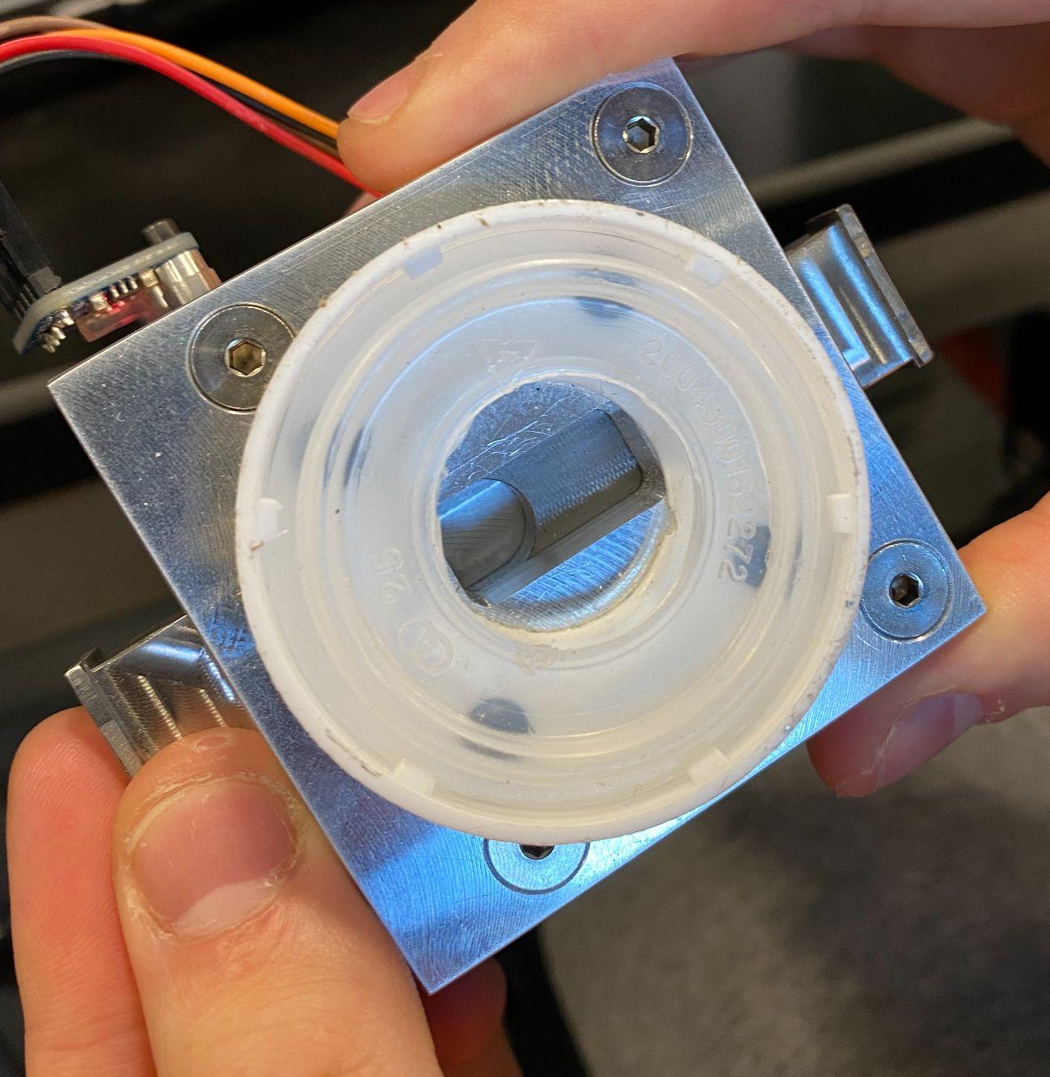
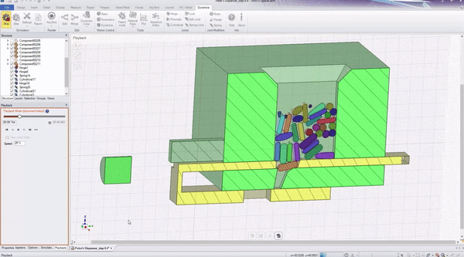
Mechanical Component: Overview
Lever Ejection System
Completed by Machine Shop
Ensures only one pill passes
IMAGE / GRAPHIC
IMAGE / GRAPHIC
ELECTRICAL & COMPUTER ENG / ECE 445
GRAINGER ENGINEERING

Slide 11
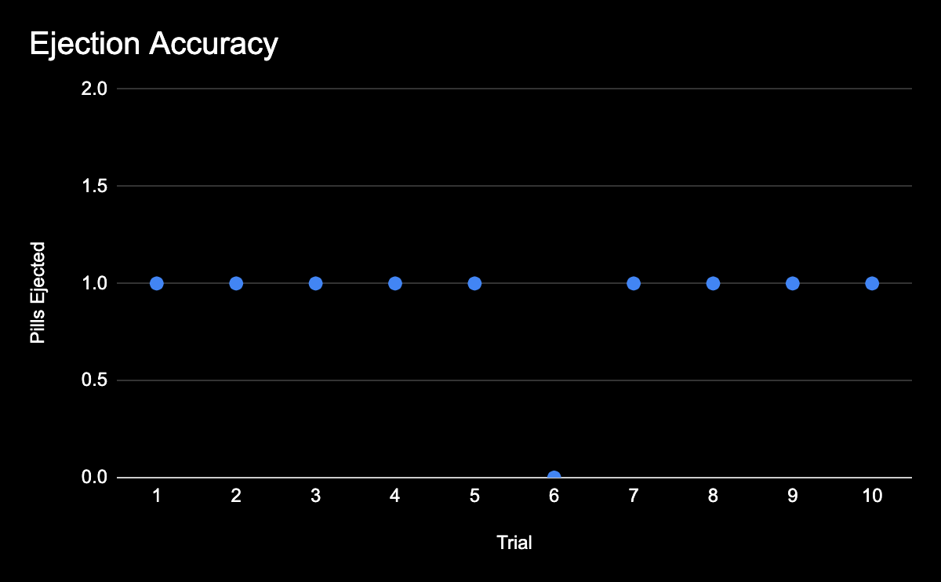
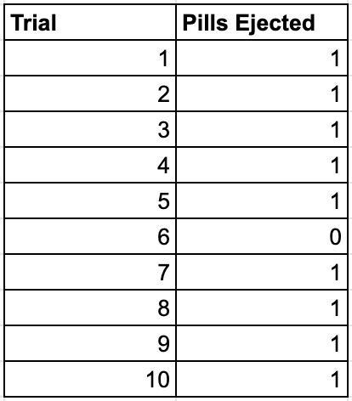
Mechanical Component: RV
Requirements
Be able to eject one and only one pill with a success rate of 90%
Verification
Pull the lever
Check to see how many pills have been ejected
Repeat 1 and 2 for a total of 10 times
ELECTRICAL & COMPUTER ENG / ECE 445
GRAINGER ENGINEERING
Notes:
Bring up challenges here:
sometimes pills can get stuck because of the slot design
Photodiode exposed to environment light

Slide 12
Power PCB
ELECTRICAL & COMPUTER ENG / ECE 445
GRAINGER ENGINEERING

Slide 13
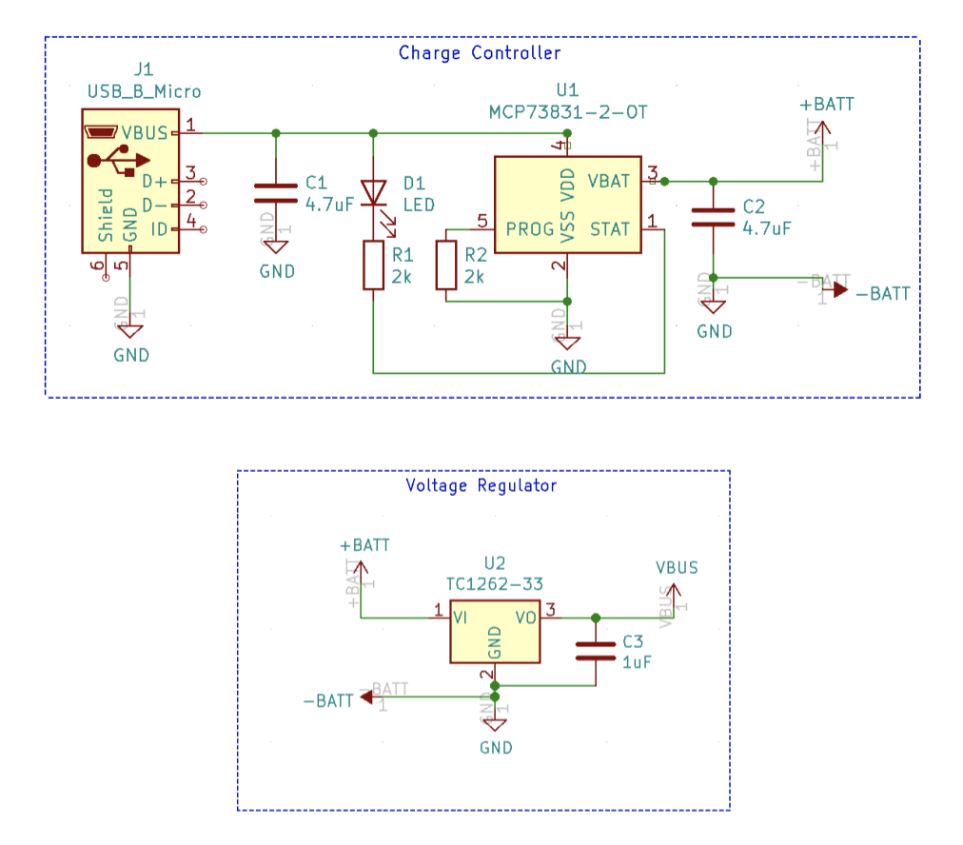
Power PCB
ELECTRICAL & COMPUTER ENG / ECE 445
GRAINGER ENGINEERING

Slide 14
Power PCB: RV Table
Requirement
Output Voltage should be 3.3V±0.5V
Verification
Measurement of Output Voltage using a Voltmeter was 3.30278V
ELECTRICAL & COMPUTER ENG / ECE 445
GRAINGER ENGINEERING

Slide 15
Power PCB: RV Table
Requirement
Battery should have reliable battery life. After 50 recharges, voltage should be no less than 90% of 3.7V (3.33V).
Verification
Drained the battery and recharged 50 times and measured final voltage.
Final measurement was 4.13503V.
ELECTRICAL & COMPUTER ENG / ECE 445
GRAINGER ENGINEERING

Slide 16
Power PCB: Battery Life
Total power consumption of all systems= 530 mAh
Used a 3.3V 100mAh battery
Battery Life: 0.1887 hours = 11.321 minutes
ELECTRICAL & COMPUTER ENG / ECE 445
GRAINGER ENGINEERING

Slide 17
MCU + NFC PCB
ELECTRICAL & COMPUTER ENG / ECE 445
GRAINGER ENGINEERING

Slide 18
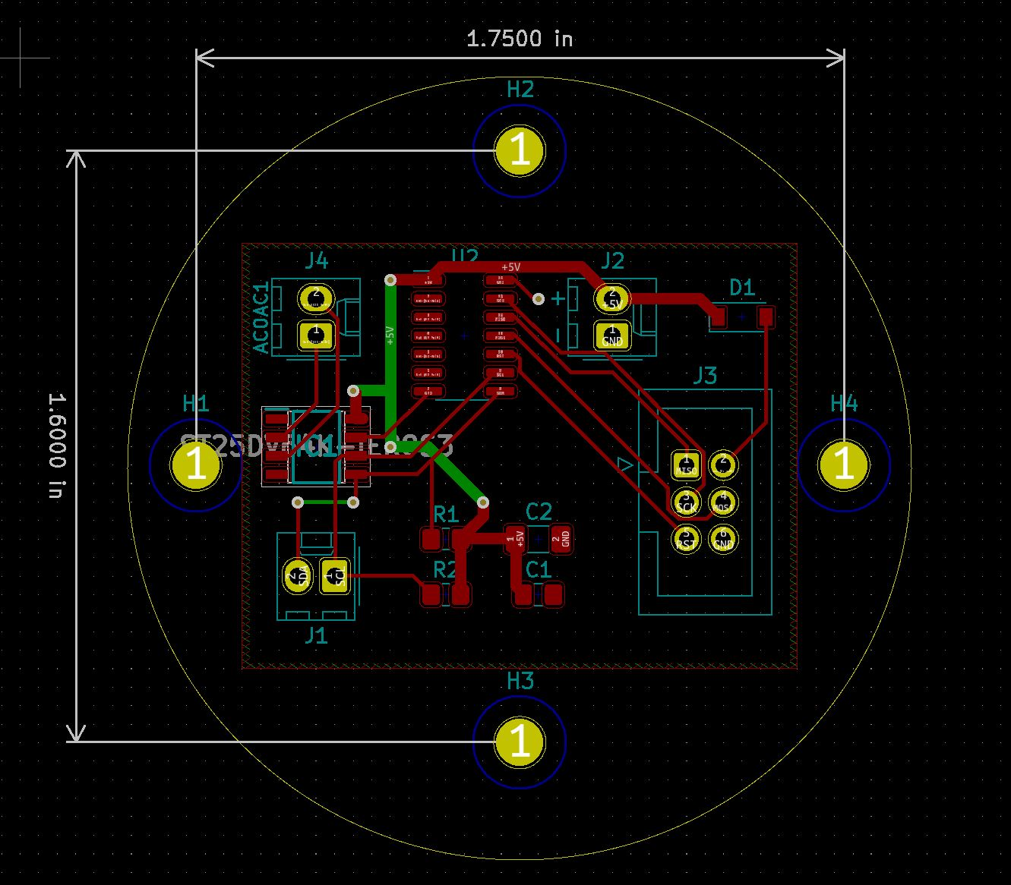
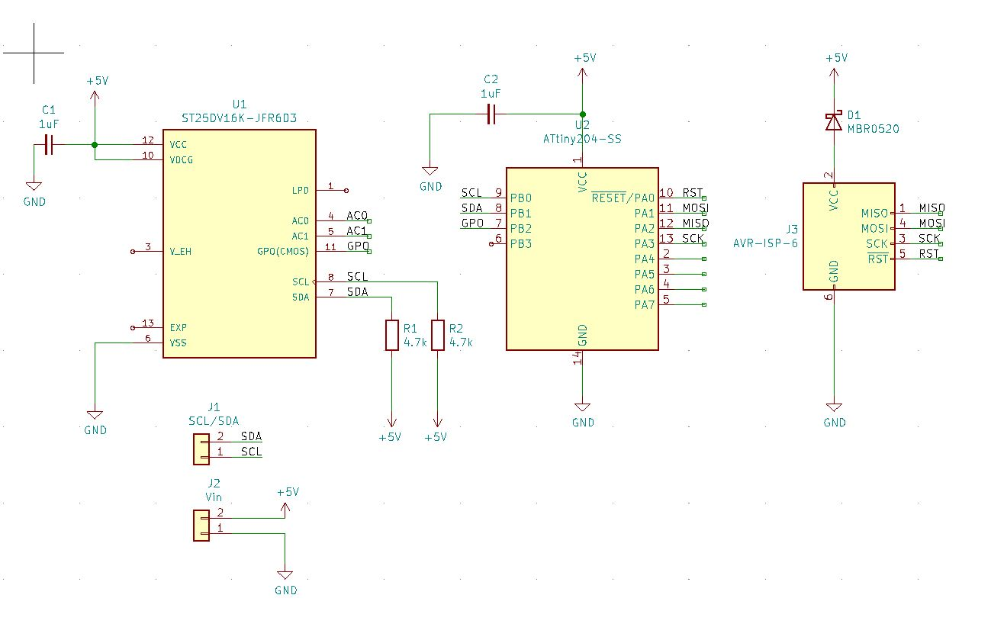
MCU + NFC PCB: Overview
3 Major Components:
PCB
Programming Header
MCU Chip
NFC EEPROM Chip
Handles Data Storage and Transfer
IMAGE / GRAPHIC
IMAGE / GRAPHIC
ELECTRICAL & COMPUTER ENG / ECE 445
GRAINGER ENGINEERING

Slide 19
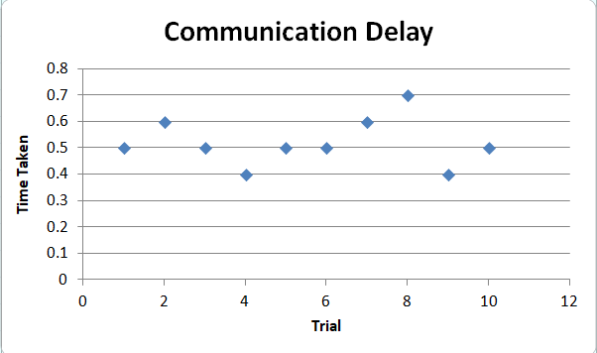
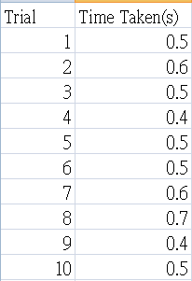
MCU + NFC PCB: RV
Requirements
Fast communication via NFC with smartphone under 1s every tap
Verification
Tap phone onto NFC antenna
Record time to receive data
Repeat 1 and 2 for a total of 10 times
ELECTRICAL & COMPUTER ENG / ECE 445
GRAINGER ENGINEERING
Notes:
Challenges:
Understanding NFC protocol and instructions
Sourcing correct components?
Programming MCU without a proper header

Slide 20
Laser + Sensor PCB
ELECTRICAL & COMPUTER ENG / ECE 445
GRAINGER ENGINEERING

Slide 21
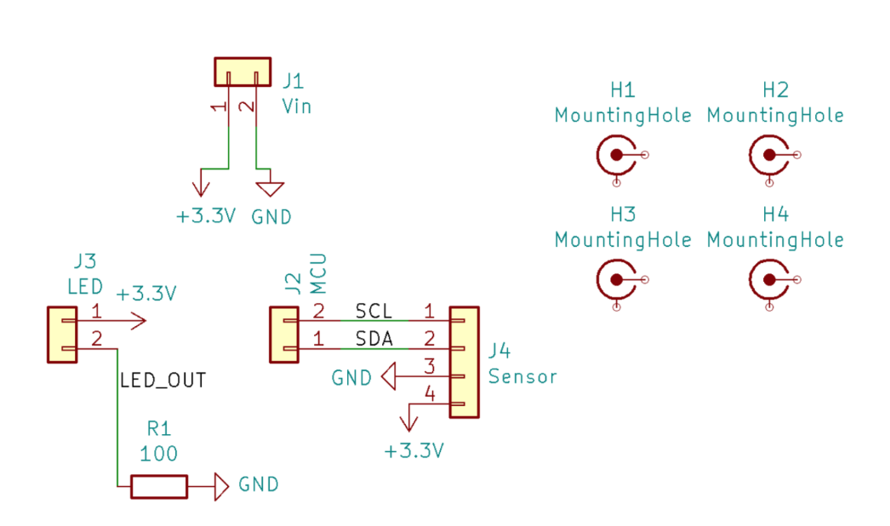
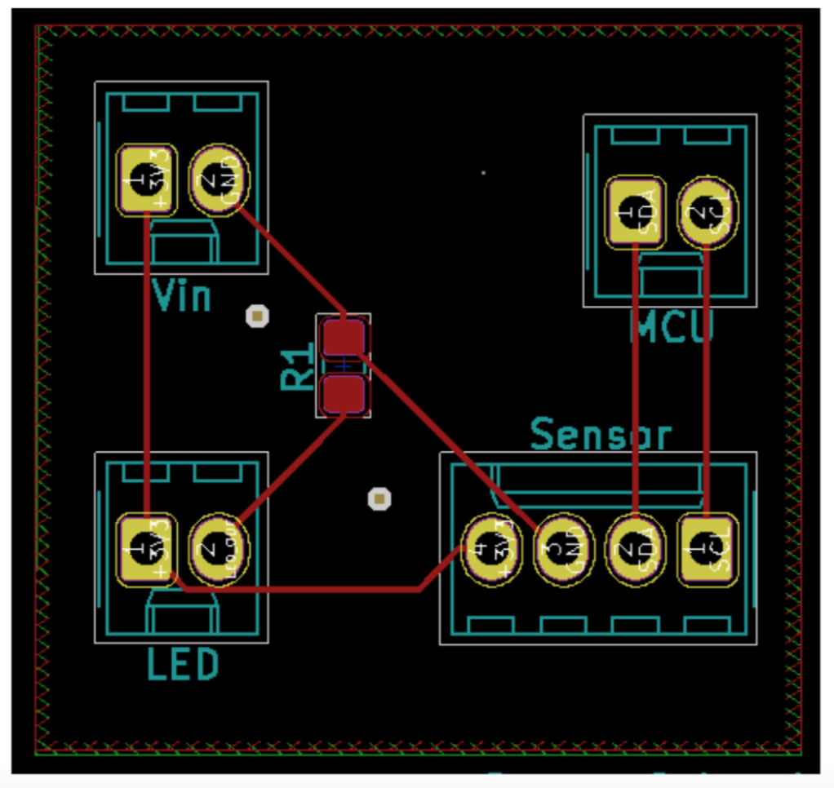
Laser + Sensor PCB: Overview
2 Major Components:
I2C Sensor
Laser
Handles Pill Ejection Detection
Connection Pins to other PCB
IMAGE / GRAPHIC
IMAGE / GRAPHIC
ELECTRICAL & COMPUTER ENG / ECE 445
GRAINGER ENGINEERING

Slide 22
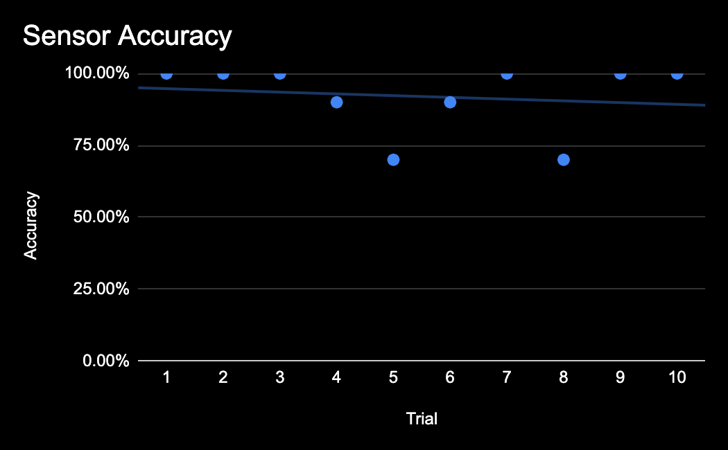
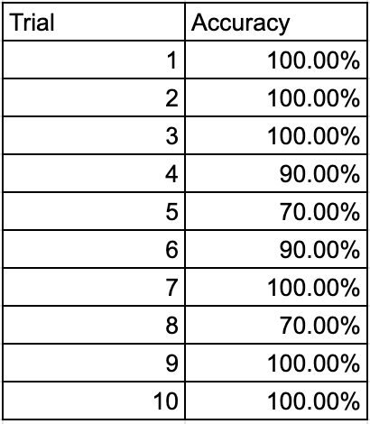
Laser + Sensor PCB: RV
Requirements
Be able to accurately detect when a pill has crossed with a success rate of 90%
Verification
Connect sensor to PC using Arduino Uno
Eject pill using lever
Repeat 2 for 10 times to check accuracy
ELECTRICAL & COMPUTER ENG / ECE 445
GRAINGER ENGINEERING
Notes:
Lux Sensitivity Issue

Slide 23
Conclusion
Preparation + Research > Implementation
ELECTRICAL & COMPUTER ENG / ECE 445
GRAINGER ENGINEERING

Slide 24
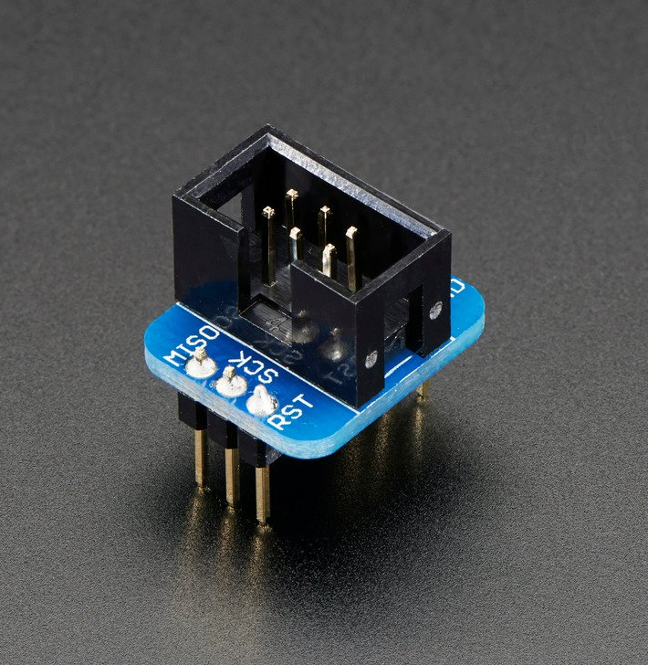
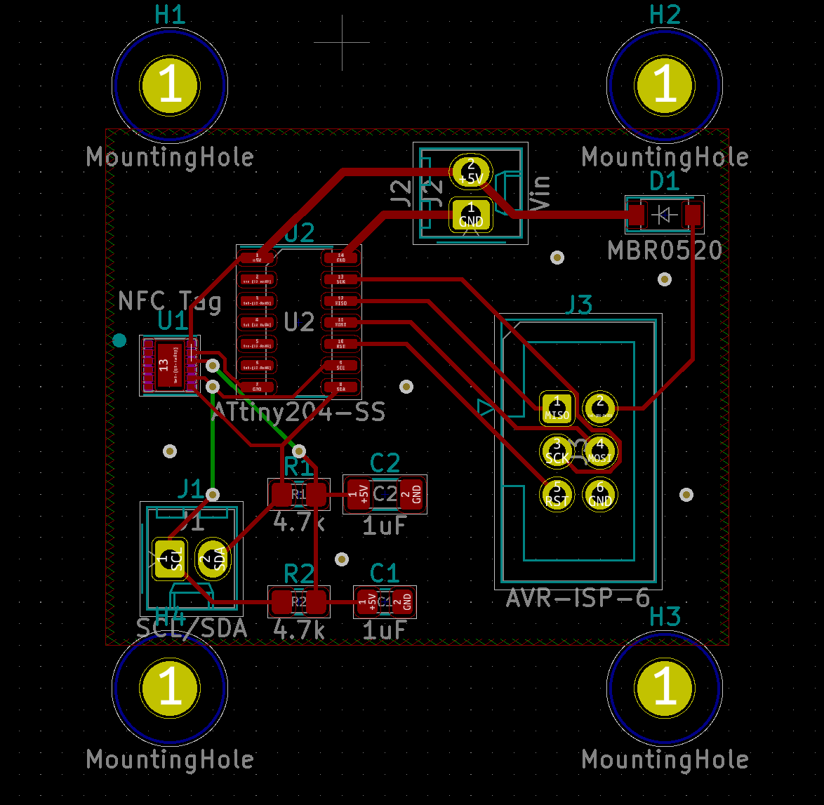
Conclusions
Wrong chip
package
Flimsy
Component
Incorrect
Protocol
ELECTRICAL & COMPUTER ENG / ECE 445
GRAINGER ENGINEERING

Slide 25
Moving Forward
ELECTRICAL & COMPUTER ENG / ECE 445
GRAINGER ENGINEERING

Slide 26
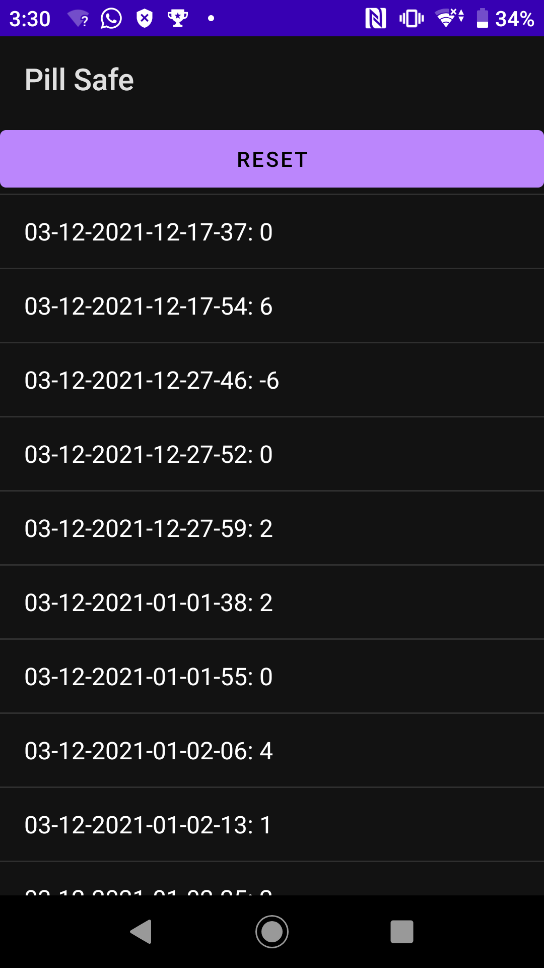
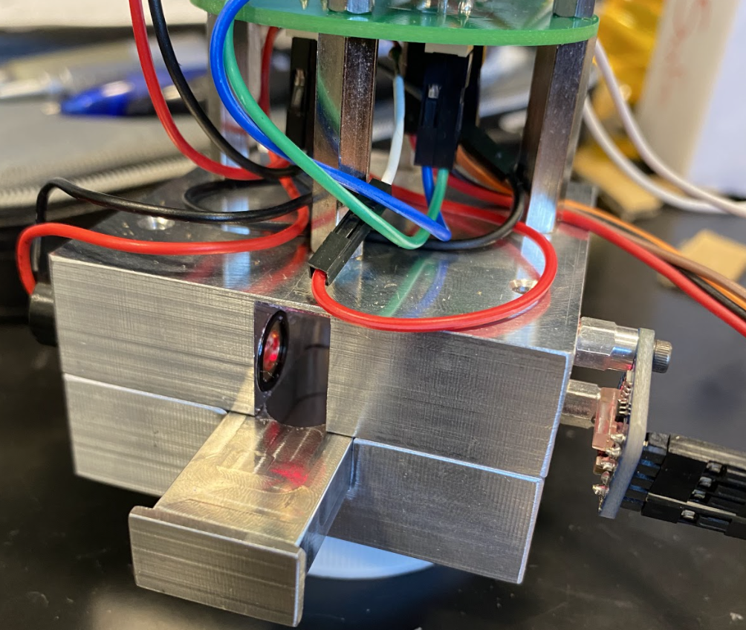
Improvements
Adding a power button
Enhancing the mechanical component
Enclosing photodiode
Improving phone app
Better charger port placement
ELECTRICAL & COMPUTER ENG / ECE 445
GRAINGER ENGINEERING

Slide 27
References
How to Invent a Pill Dispenser - Algoryx Momentum, 19 Oct. 2015, https://www.youtube.com/watch?v=iwnlcyby1cw.
Industries, Adafruit. “Adafruit VEML7700 Lux Sensor - I2C Light Sensor.” Adafruit, https://www.adafruit.com/product/4162.
Microchip Technology Inc. “MCP73831T-2ACI/OT.” PCB Electronics Supply Chain, 2014,
www.pcbelectronics.com/products/1_5466710/mcp73831t-2aci-ot?gclid=Cj0KCQjwwNWKBhDAARIsAJ8HkhcZX6Br4J8OA2ixDNeCa29FXCu2U6aX7ZfSf2O3MsaHI6r4AFEfcO8aAqU9EALw_wcB.
“PL 520 - Osram.com.” OSRAM-OS, https://www.osram.com/media/resource/hires/osram-dam-15263519/PL+520_EN.pdf.
---. “TC1262-3.3VDB.” Pcb Electronics Supply Chain, 2012,
www.pcbelectronics.com/products/1_5872754/tc1262-3-3vdb.
DEPARTMENT / UNIT NAME
GRAINGER ENGINEERING

Slide 28
THANK YOU
Apoorva Nadella (nadella3)
Sumuk Rao (sumuksr2)
Yan-Jun Fang (yjfang2)
ELECTRICAL & COMPUTER ENG / ECE 445
GRAINGER ENGINEERING

