Slide 1
Electronic Baseball Catcher
Strike Zone 2.0
ECE 445 FALL 2018
Group #42: Alex Villafuerte, Kermit Alexander, Ivan Gallardo

Slide 2
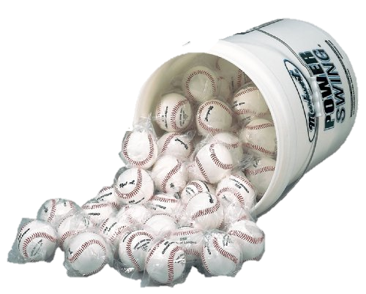
Introduction
Improve upon an existing pitching practice system
Combine existing technologies into
a convenient device
Notes:
NEED TO MAKE THEM CARE!!!!
Training is a big part of baseball (PERHAPS AN ANECDOTE ON THE INCONVENIENCE OF BASEBALL PRACTICE ALEX)- give us some authority as we hit them with ethos
Training with another person isn't always possible
People unavailable
Skill cant be handles/matched
Solo training can be inconvenient
Bucket of balls
Ball Retrieval
These are problems that pitchers at all levels experience
TRANSITION TO OBJECTIVES
And so we set out to create the strike zone 2.0 with the following objectives in mind ( GO TO THE NEXT SLIDE)

Slide 3
Objectives
Make solo practice more convenient
Provide user with feedback for skill improvement
Make solo practice enjoyable
Notes:
FIRST we wanted to make practice more convenient
Eliminating the task of ball retrieval
Decreasing the number of balls needed to practice
SECOND we wanted to provide the user with feedback
User cant improve if they dont know how they are doing
-Show them heuristics like pitching speed and strike zone accuracy
And lastly, make practice overall more enjoyable
Something capable of acting as a stand-in for another person
We produced the following device … (GO TO NEXT SLIDE)

Slide 4
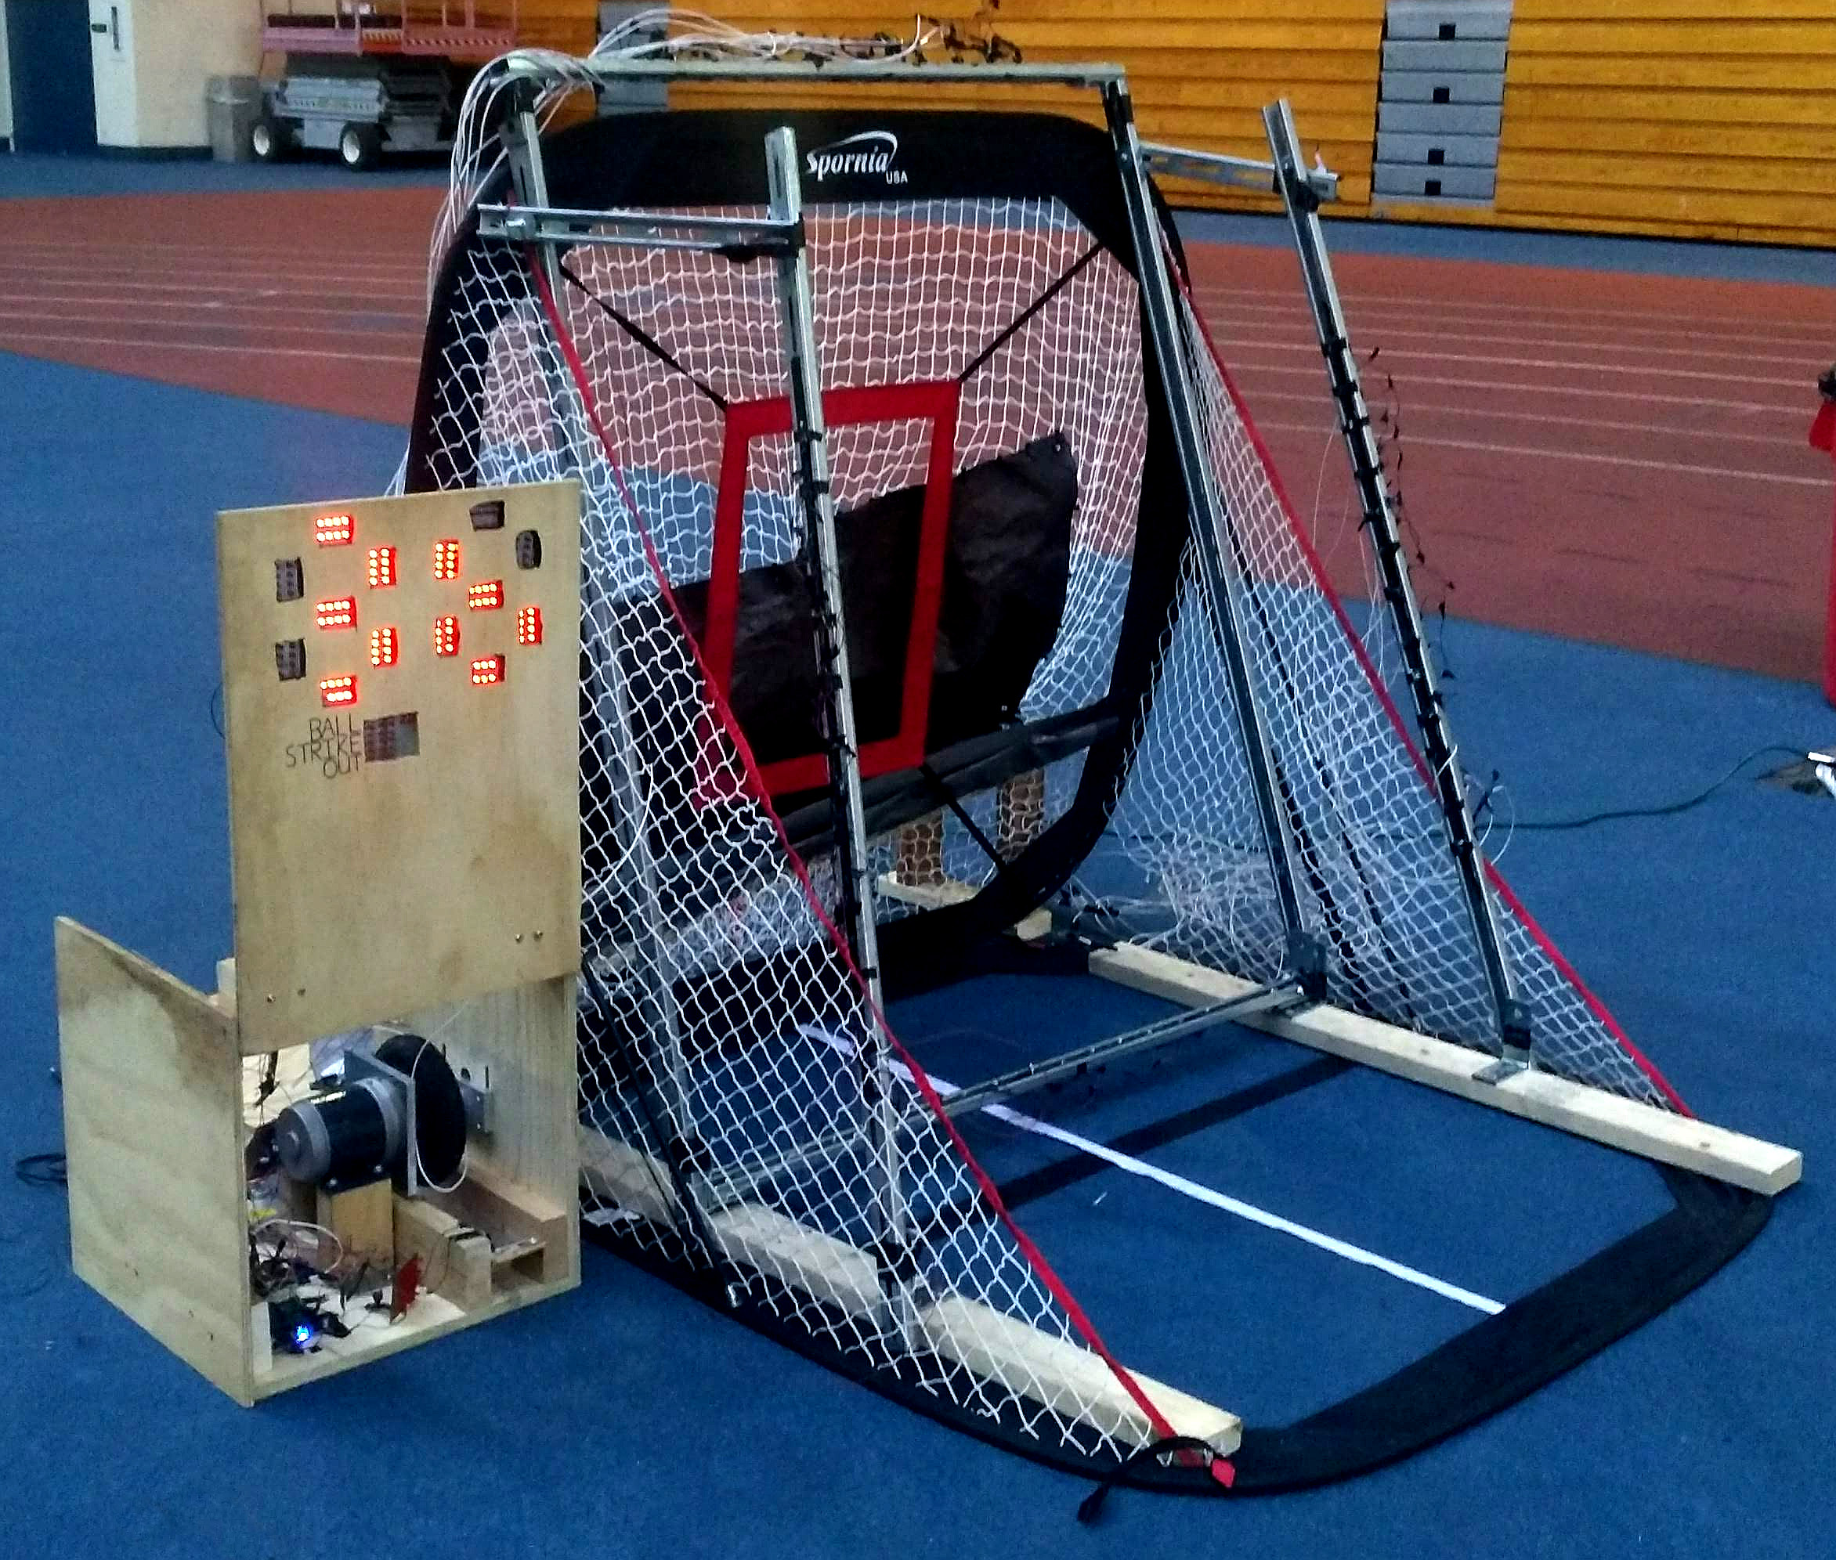

Slide 5
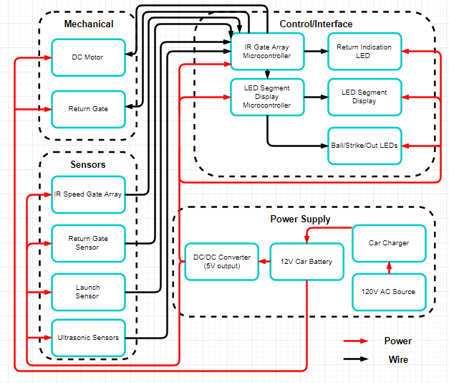
Notes:
The project was divided into the blocks you see here:
MECHANICAL: consisting of the return system used to return the ball
SENSORS: Consisting of the sensors used to calculate speed and warn the user of operation for safe use
CONTROL/INTERFACE: Control the overall system function such as motor ramping, perform calculations, and display data to the user
POWER SUPPLY: Regulate power distribution among the subsytems

Slide 6
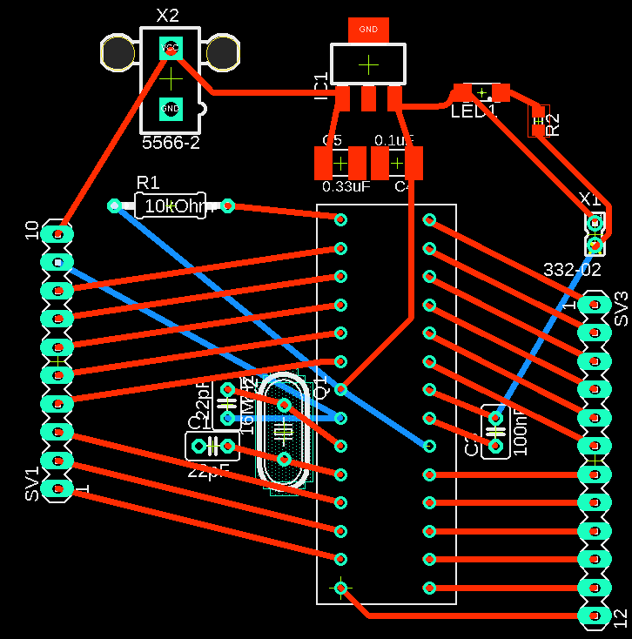
Control/Display - Microcontroller
Two Atmega328p microcontrollers used, mounted on PCB we designed
LED microcontroller controls display content using IR inputs
IR microcontroller → Motor drive control
Gradual motor ramping
Several issues with controllers
Notes:
The first subsystem we’ll be discussing is the control system specifically how we control things
Our system consist of 2 microcontrollers using Atmega328p→ chosen because it had sufficient pins, calculations not too intense
2 used for modularity and protect against complete system failure
LED Micro controls what is displayed and how
Now used to act as IR micro controller too as inputs from sensors reduced and fit on one board
- IR microcontroller now used to control the slow ramping of the motor to prevent large spikes in current

Slide 7
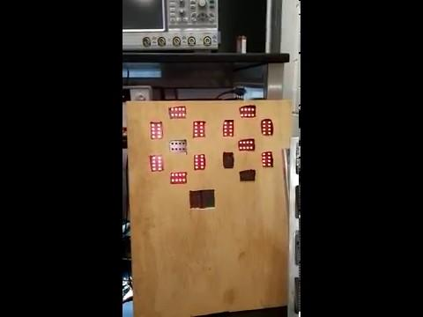
Control/Display - LED Display
Output value 0-99 using 7-segment LED display
Displays count for balls, strikes and outs
Visible up to 70 ft and displays input data
Notes:
Displays speeds up to 99 mph because professional pitching speeds > than 99 not expected but can easily be adjusted to do so
Calculated using IR gates which will be discussed later
Possible to display game scenario stuff
Indicated by position in which it crosses the IR beam
Visibility tested by standing distance of 10 ft up to 80 ft at 10 ft increments And still visible
70 ft distance made a requirement because we are simulating pitching on a mound and want the user to be able to see their feedback at that distance
Able to display numeric data as expected

Slide 8
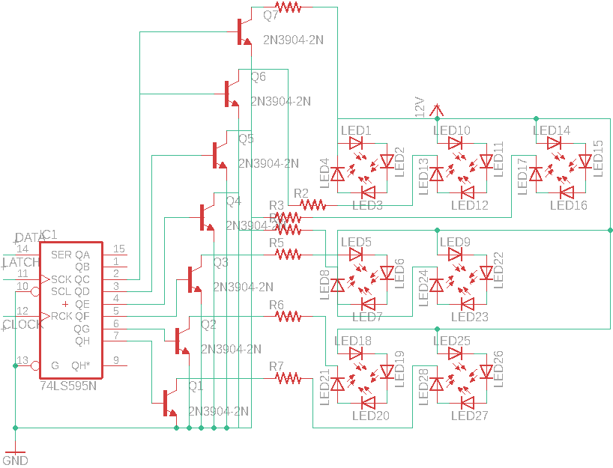
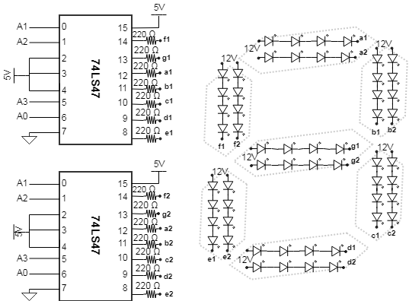
Display - Schematics
Segment Display Schematic
Game Scenario Schematic

Slide 9
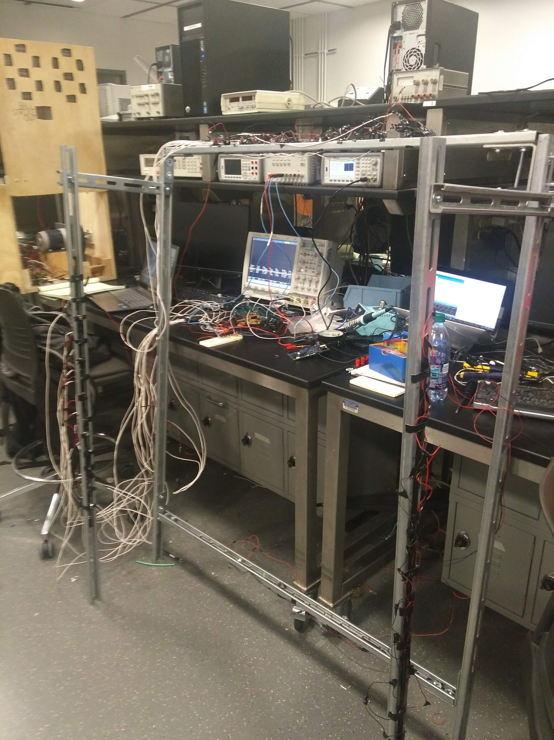
IR Sensor Array
Object detected when passing through gates
Speed calculation determined from gate outputs
PICTURE OF PHYSICAL PLACEMENT
Notes:
Maybe save discussing the issues for the end of this section????
Also maybe discuss how speed is usually measured

Slide 10
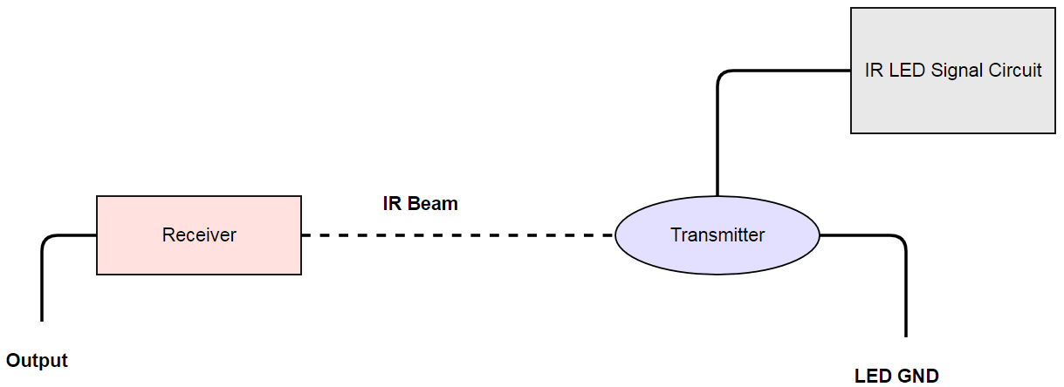
IR Receiver and Transmitter Pair

Slide 11
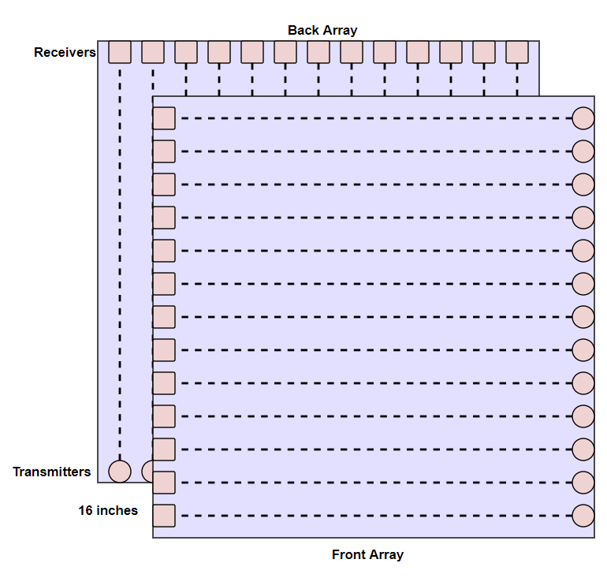
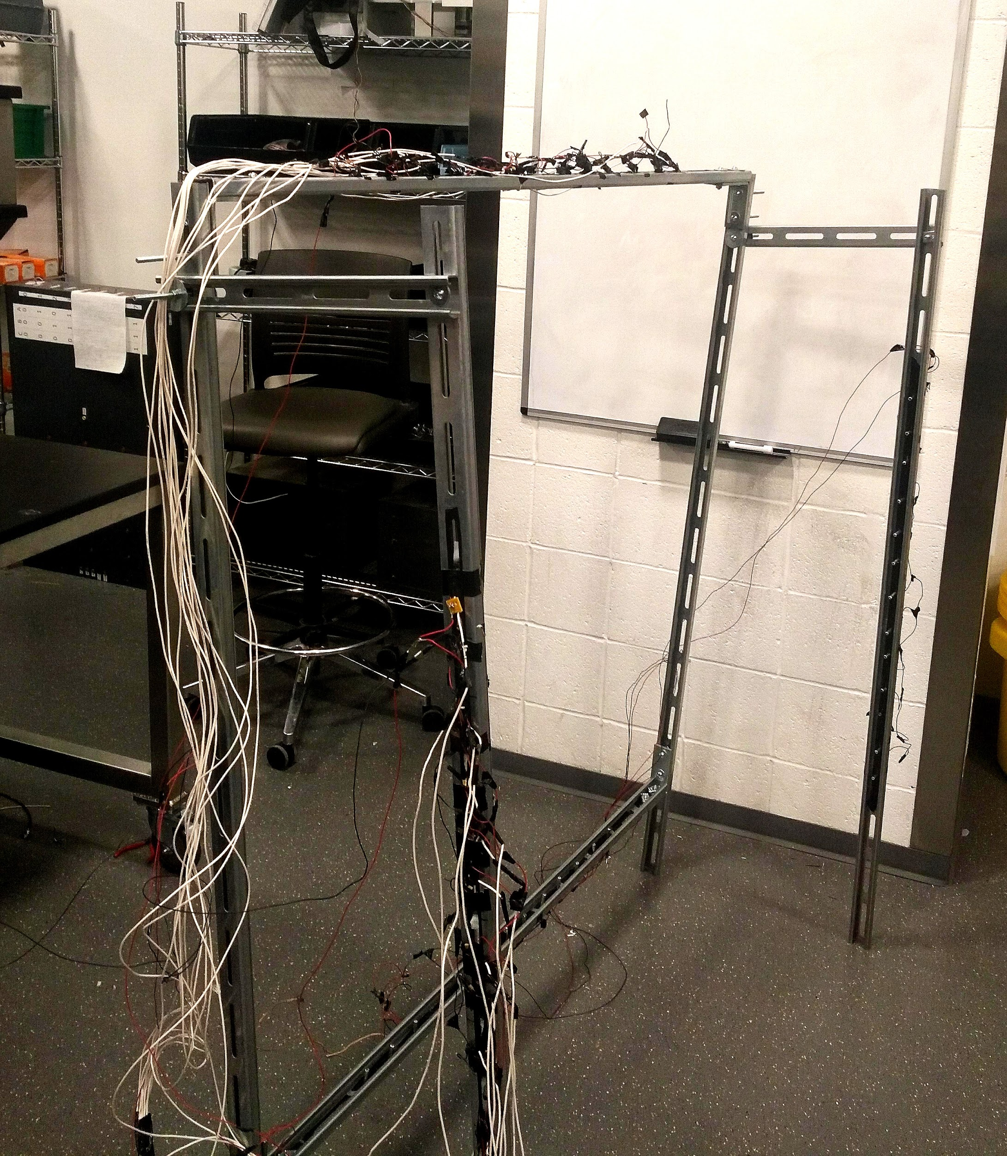
The Gate Array

Slide 12
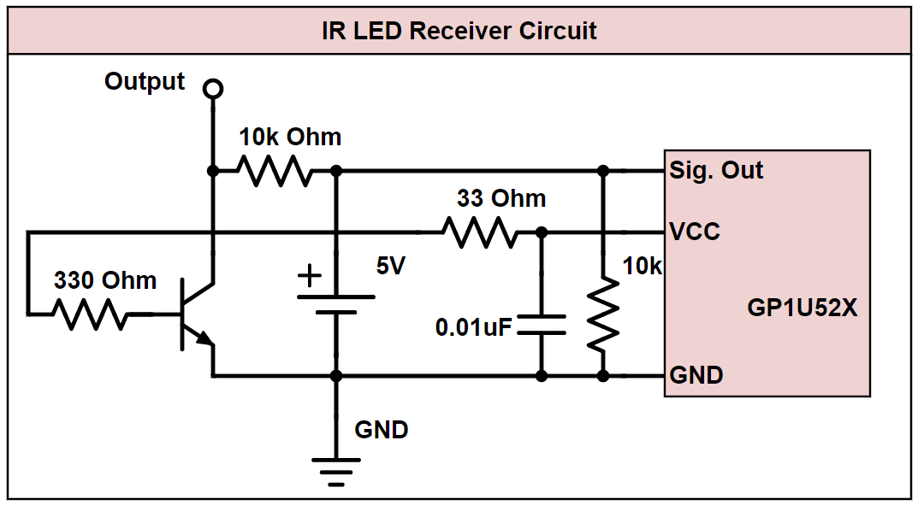

Slide 13
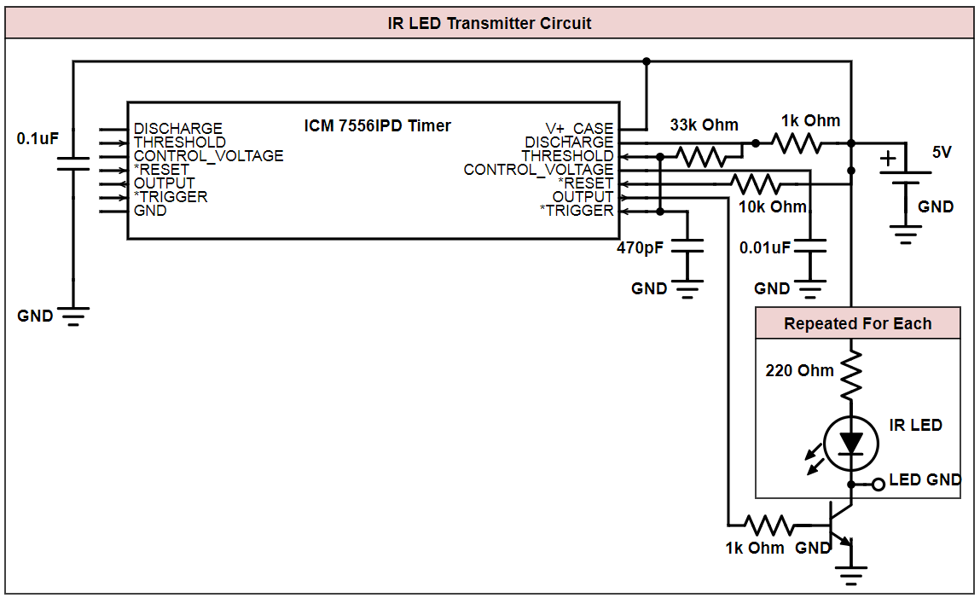

Slide 14
IR Gate Response

Slide 15
Ball Return System - Ball Ramp
Modified netting to guide ball to ball return
Wooden ramp used to support netting to return
Notes:
The ball is

Slide 16
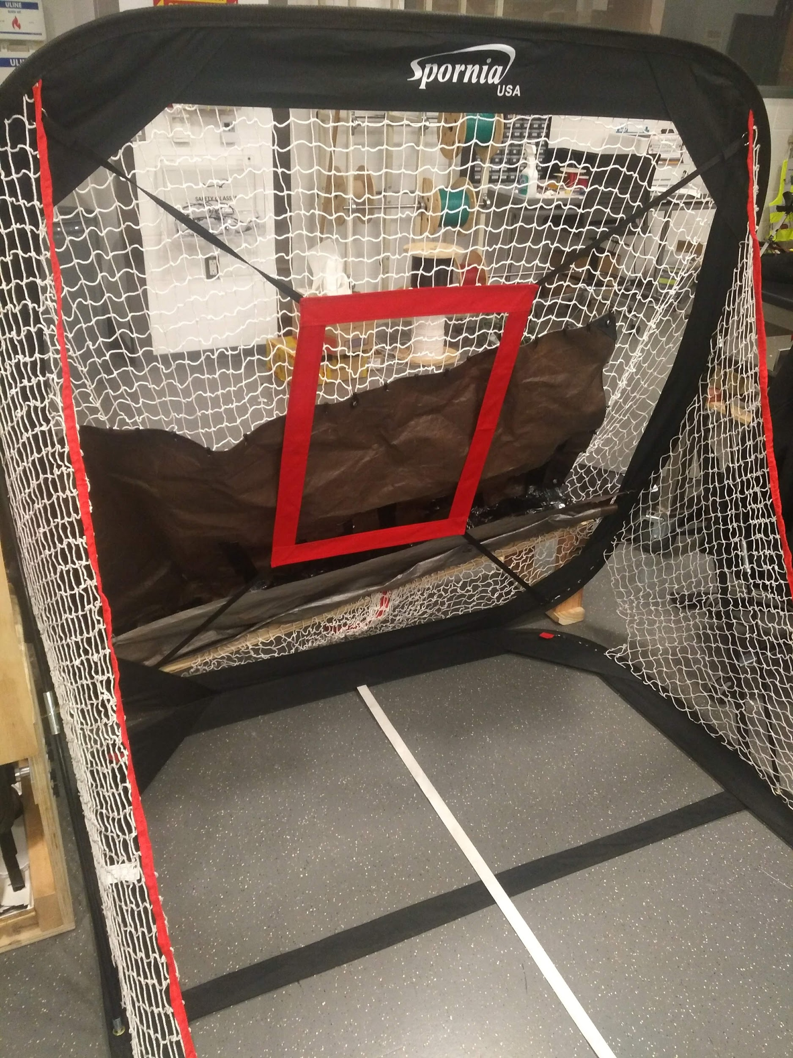
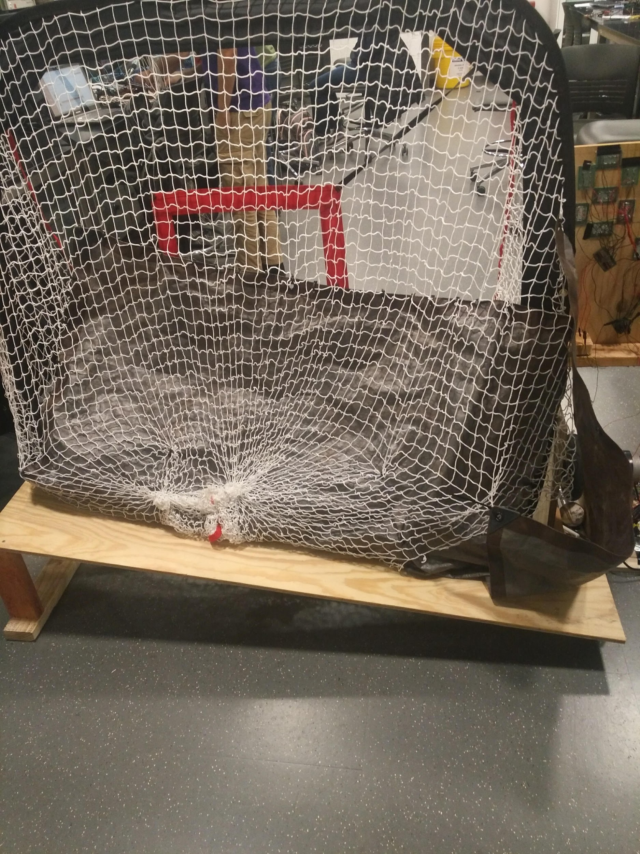

Slide 17
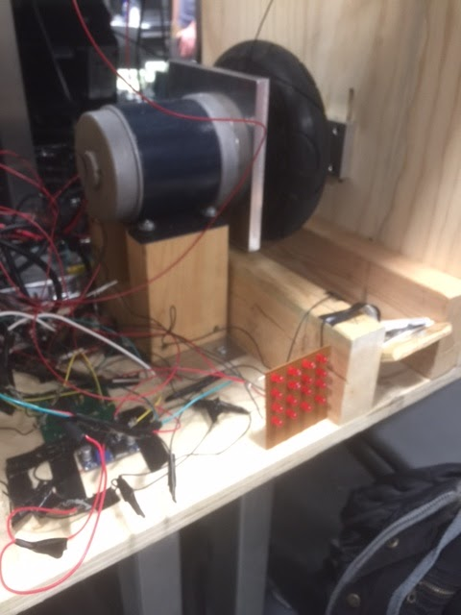
Ball Return System - Motor
Returns ball to the user
Motor automatically started

Slide 18
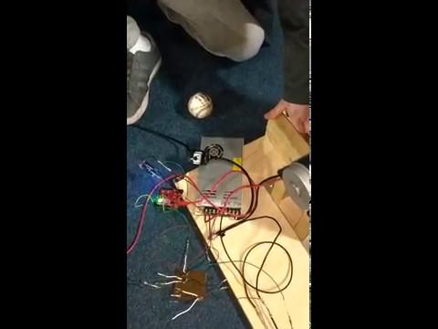
Requirements
Ball returned within a 3-foot radius of user
Return LED is seen from 60.5 feet
Motor handles sudden loading of baseball

Slide 19
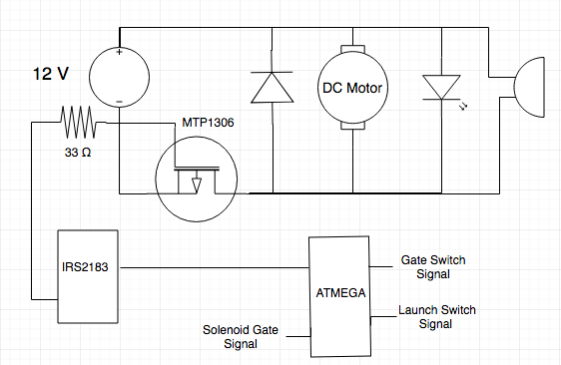
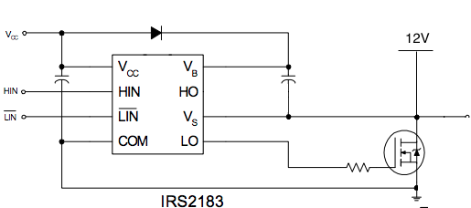
Motor Control Circuit

Slide 20
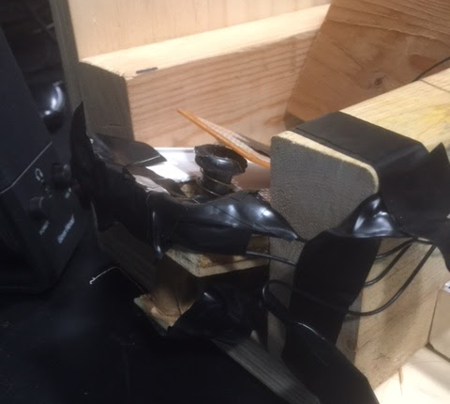
Solenoid Gate
Stops baseball from entering return system
Releases baseball after motor reaches desired speed

Slide 21
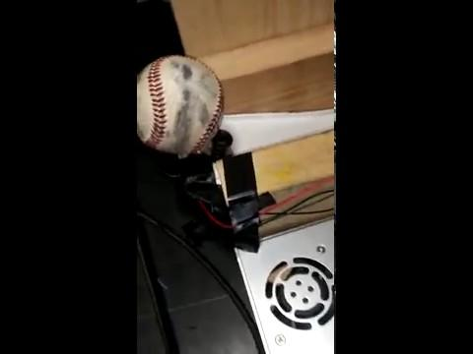
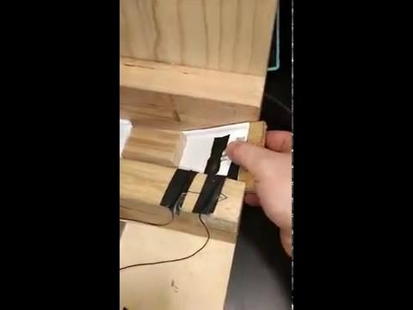
Requirements
Retains baseball until motor is up to speed

Slide 22
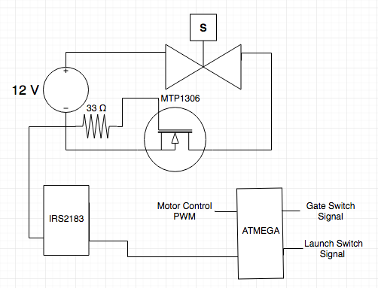
Solenoid Gate Circuit

Slide 23
Conclusions
Integrated Motor control with ramping system
Display integrated with microcontroller
Test IR Gate emitters and receivers

Slide 24
Future Works
Use IR sensors only for ball/strike detection
Safety features for object detection when launching
Replace IR speed detection with doppler speed detection
Improved portability

Slide 25
Thank you!
Questions?

