Slide 1
Weather-Adaptive Windows
Team 27
Joe Zatarski, Michael Wu, Andy Lai
TA: Michael Genovese

Slide 2
Agenda
Introduction and Objective
Finished Product
Block Diagrams
Design and Validation
Conclusion
Future Work

Slide 3
Introduction
Windows that open and close in response to adverse or undesired weather conditions
Prevent precipitation from entering through the window if mistakenly left open
Control climate by responding to indoor/outdoor temperature differentials

Slide 4
Objective
Window responds intelligently to weather conditions, taking inputs from temperature and rain sensors
Infrared sensors prevent window from closing on pets, people, or objects
System is Wi-Fi compatible allowing the user to monitor state of window and input commands

Slide 5
Agenda
Introduction and Objective
Finished Product
Block Diagrams
Design and Validation
Conclusion
Future Work

Slide 6
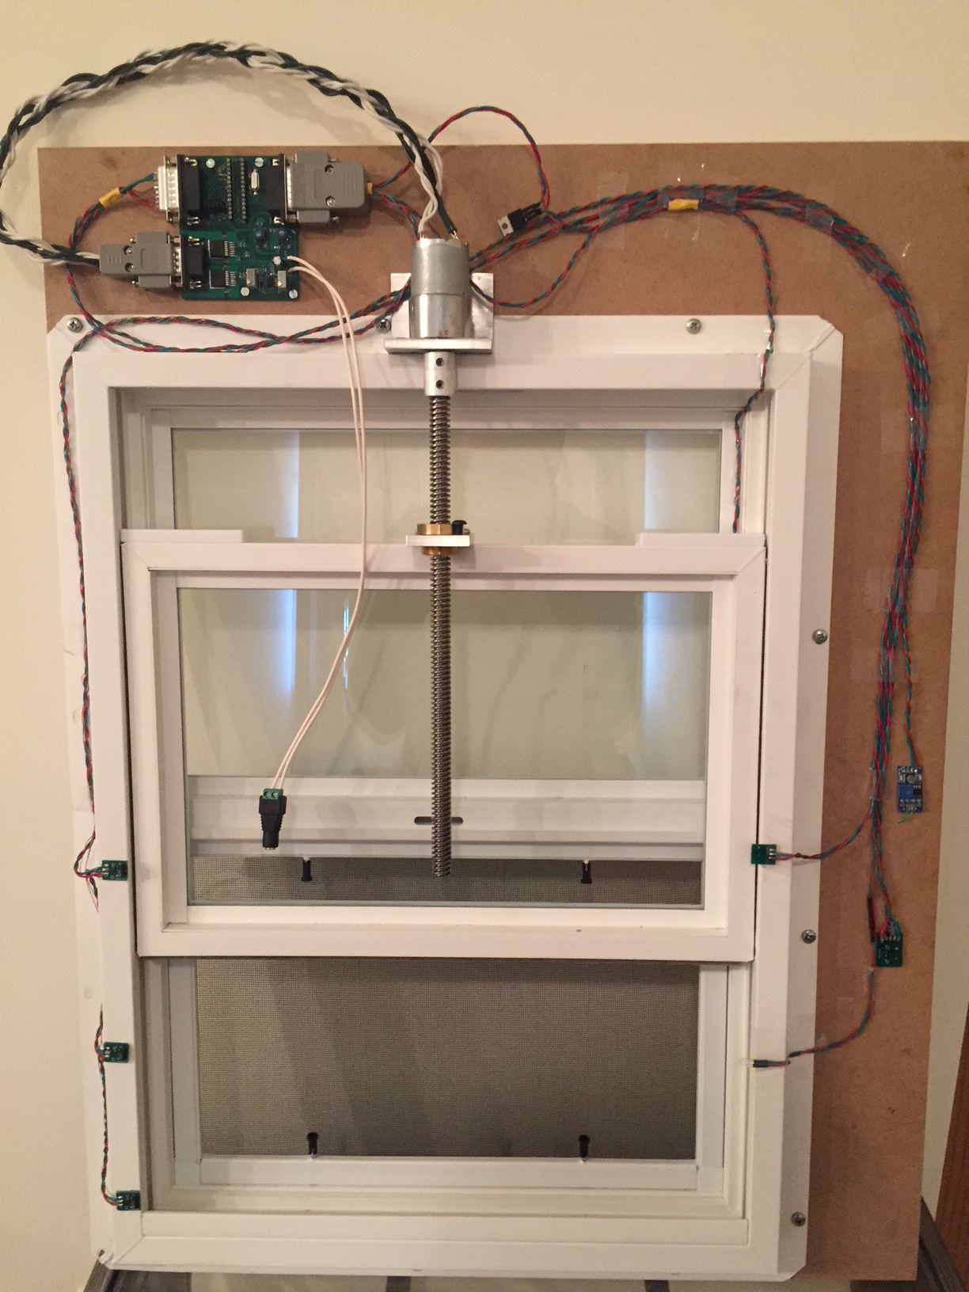
Finished Product
Inside
Houses majority of circuitry
Main board, most sensors

Slide 7
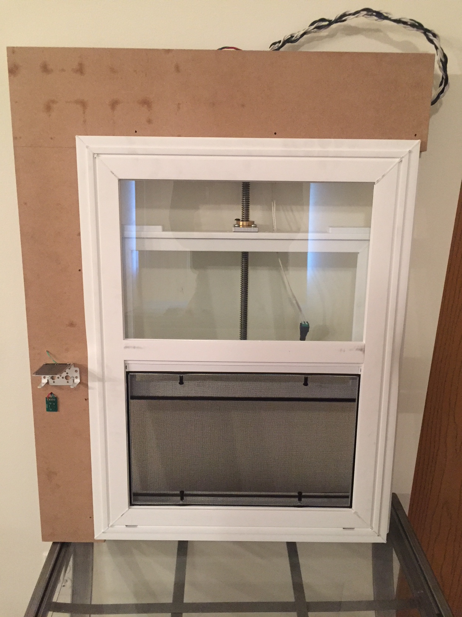
Finished Product
Outside
One temperature sensor measures outside temperature
Rain sensor mounted horizontally

Slide 8
Agenda
Introduction and Objective
Finished Product
Block Diagrams
Design and Validation
Conclusion
Future Work

Slide 9
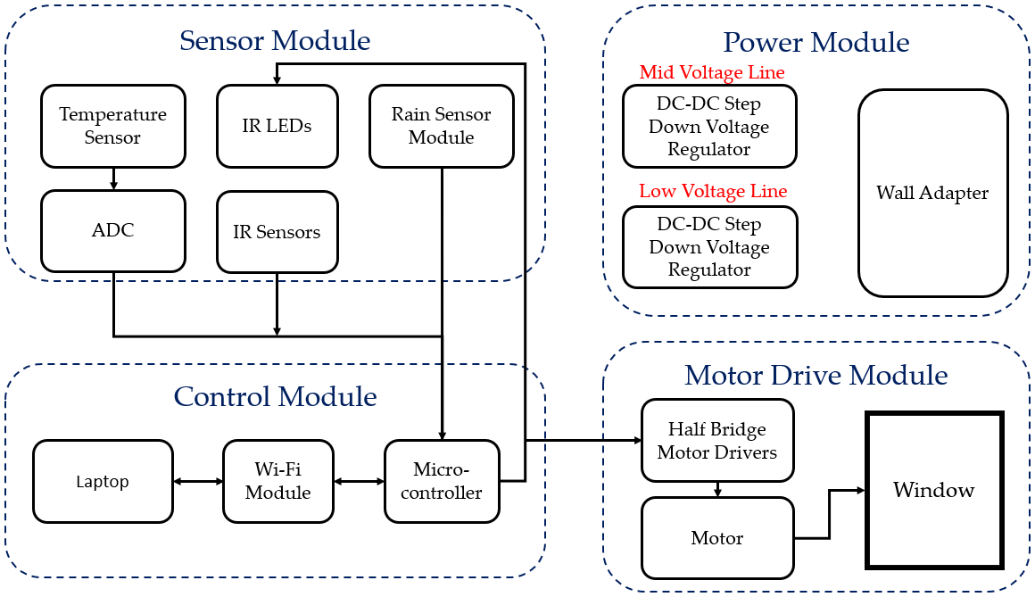
Block Diagram: Data

Slide 10
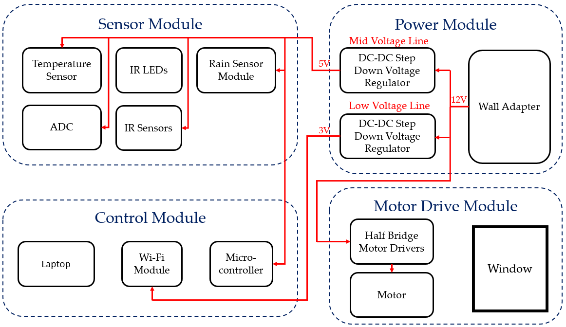
Block Diagram: Power

Slide 11
Agenda
Introduction and Objective
Finished Product
Block Diagrams
Design and Validation
Conclusion
Future Work

Slide 12
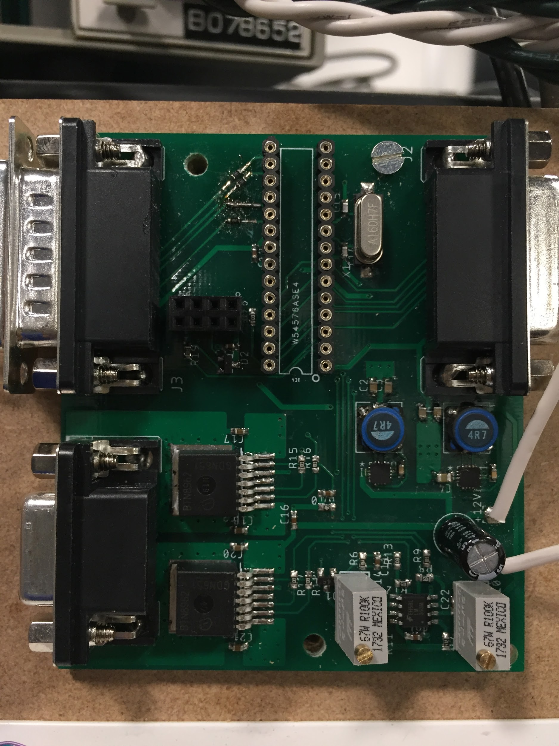
Agenda
Design and Validation
Control Module
Power Module
Motor Module
Sensor Module

Slide 13
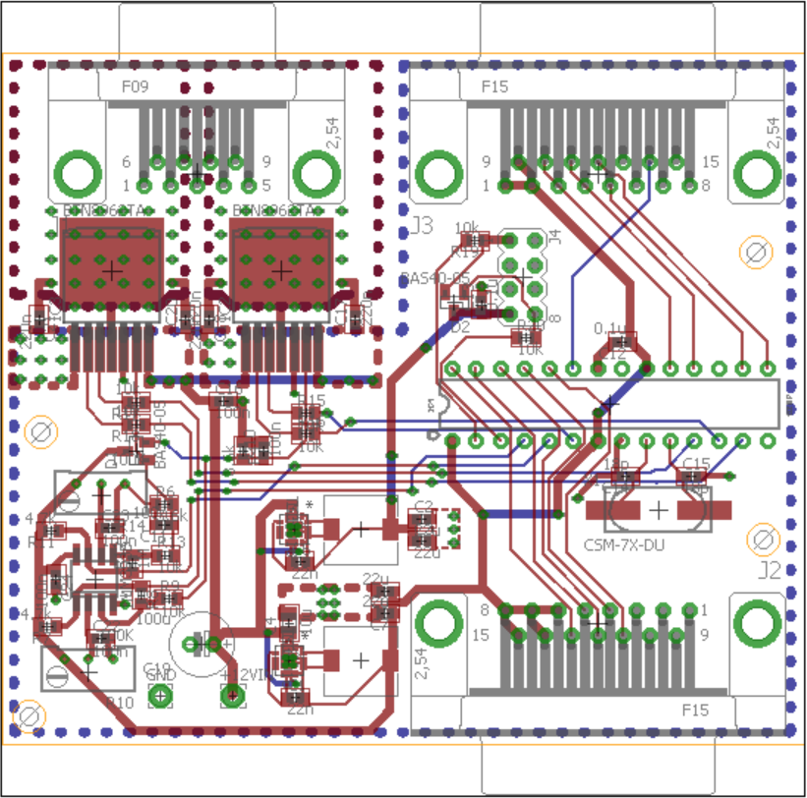
Main Board

Slide 14
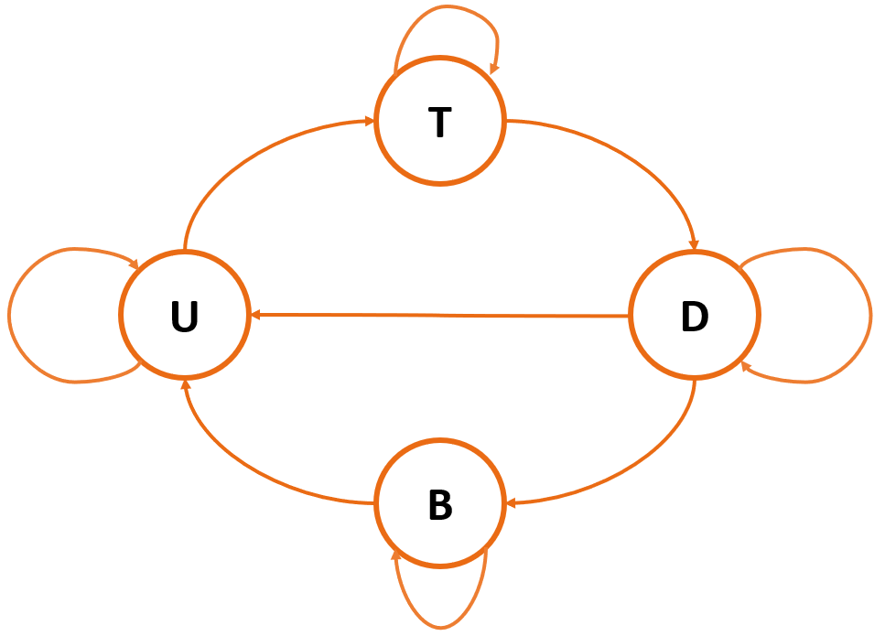
State Machine
States
T = Top
B = Bottom
U = Up
D = Down
Rain, Temp Mismatch
Reaches Top
Obstruction
No rain,
Temp Mismatch
Reaches Bottom

Slide 15
Agenda
Design and Validation
Control Module
Power Module
Motor Module
Sensor Module

Slide 16
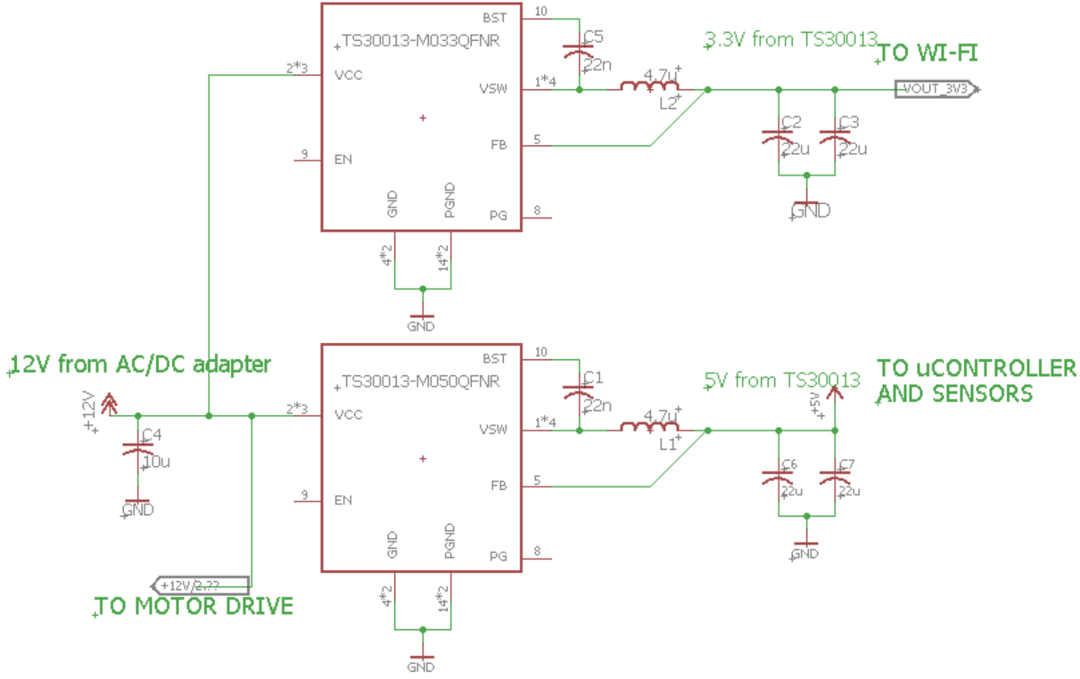
Power Schematic

Slide 17
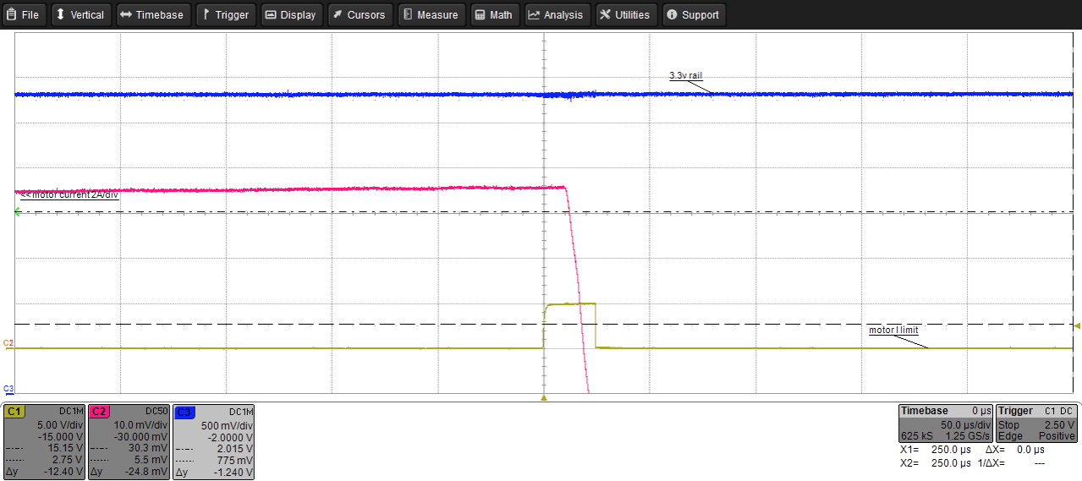
Power Converter Validation
3.3V
Ripple
Jam
Offset
3.3 V output when motor jams and switches direction
Notes:
We’re having the motor go to the top and immediately switch directions when it sense a jam
We expect this to be the extreme case
Dashed lines indicate 5%

Slide 18
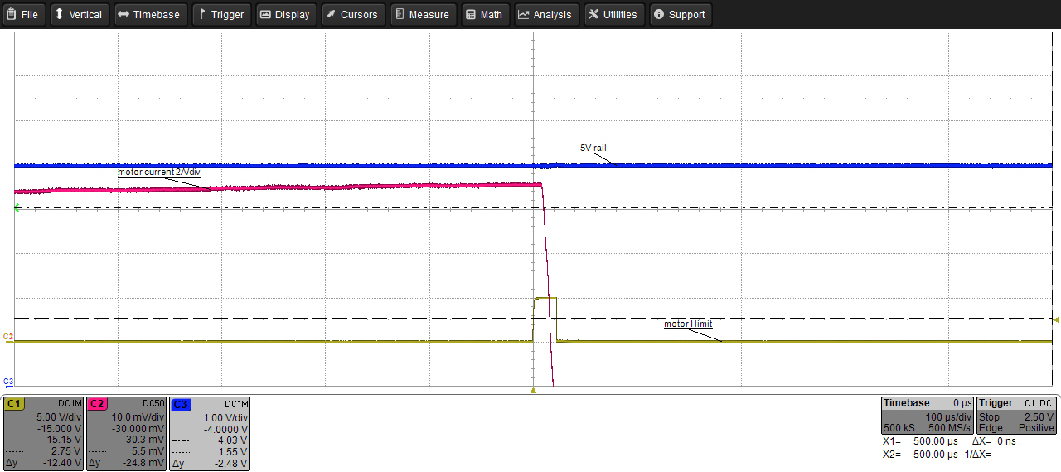
Power Converter Validation
Ripple
5V
Jam
Offset
5 V output when motor jams and switches direction

Slide 19
Agenda
Design and Validation
Control Module
Power Module
Motor Module
Sensor Module

Slide 20
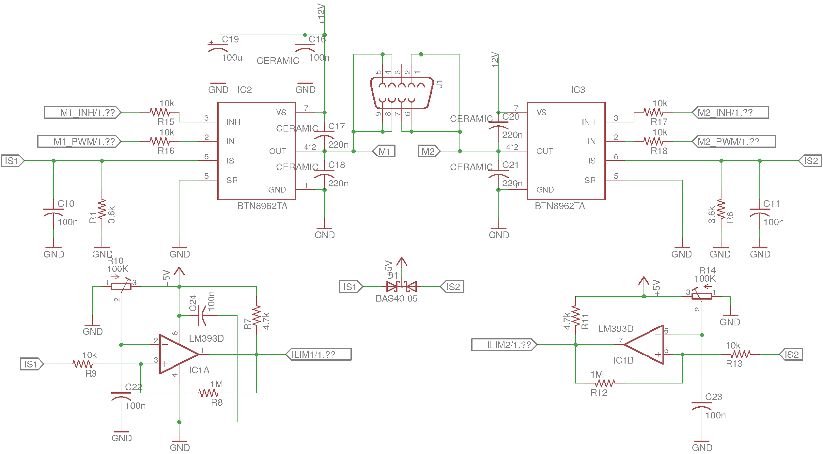
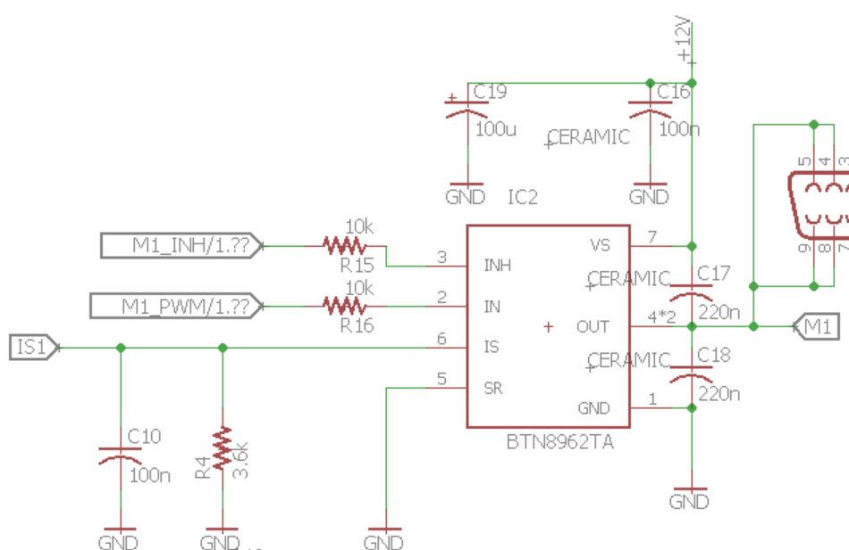
Motor Driver Schematic
Notes:
Full bridge topology allows bidirectional driving
Half bridges have built in current sense capability
Useful for jam detection
Both drivers include full protection features
Short circuit
Overtemperature

Slide 21
Current sense resistor design
Worst case BTN8962 output: 1.13mA, 1.36mA for 20% margin
Current sense should produce no more than 5V, so 5V/1.36mA=3670 ohms
Nearest 5% tolerance part is 3.6kohm (E24 value)

Slide 22
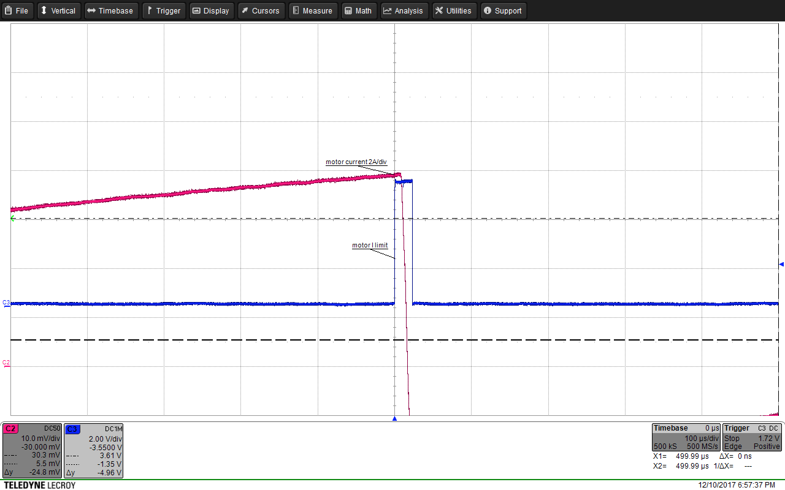
Motor Jam Detection
Current Sense
Jam Detect
Upward jam detection

Slide 23
Agenda
Design and Validation
Control Module
Power Module
Motor Module
Sensor Module

Slide 24
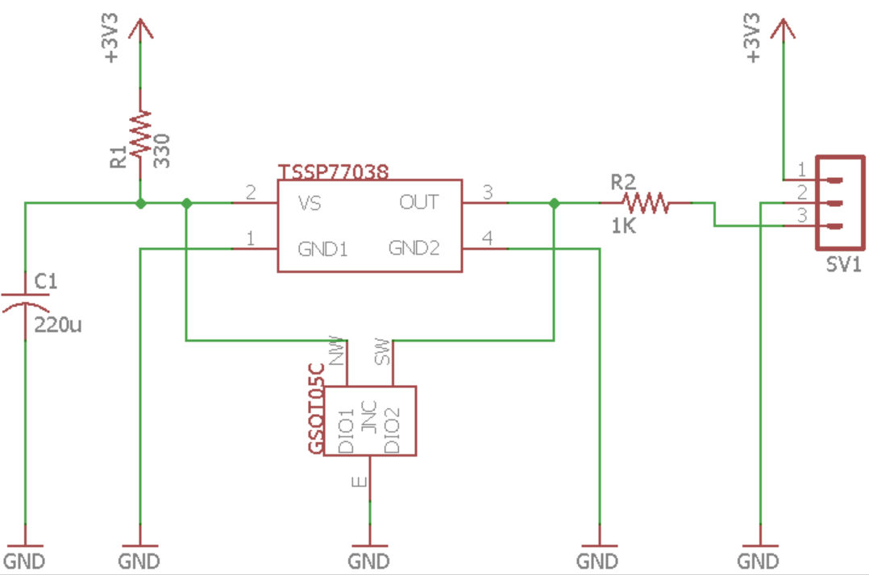
IR Sensor Schematic

Slide 25
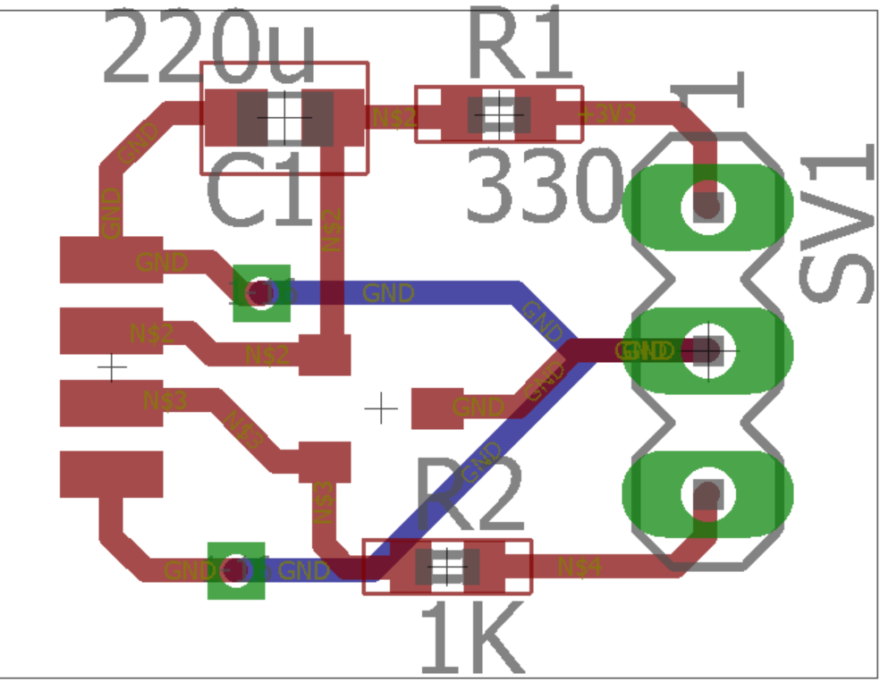
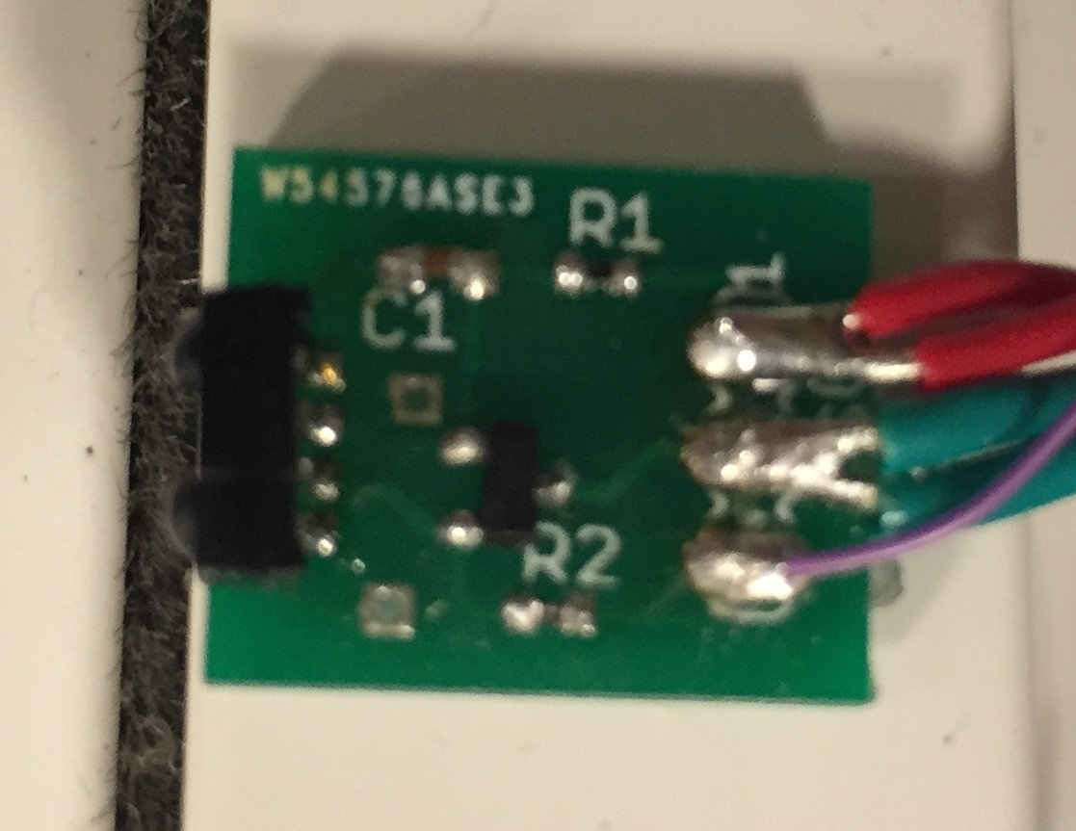
IR Sensor Board

Slide 26
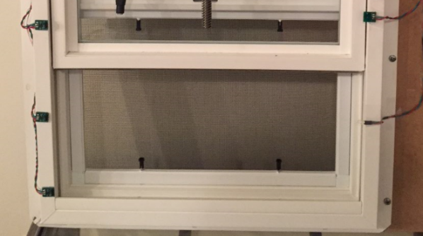
IR LED Calculations

Slide 27
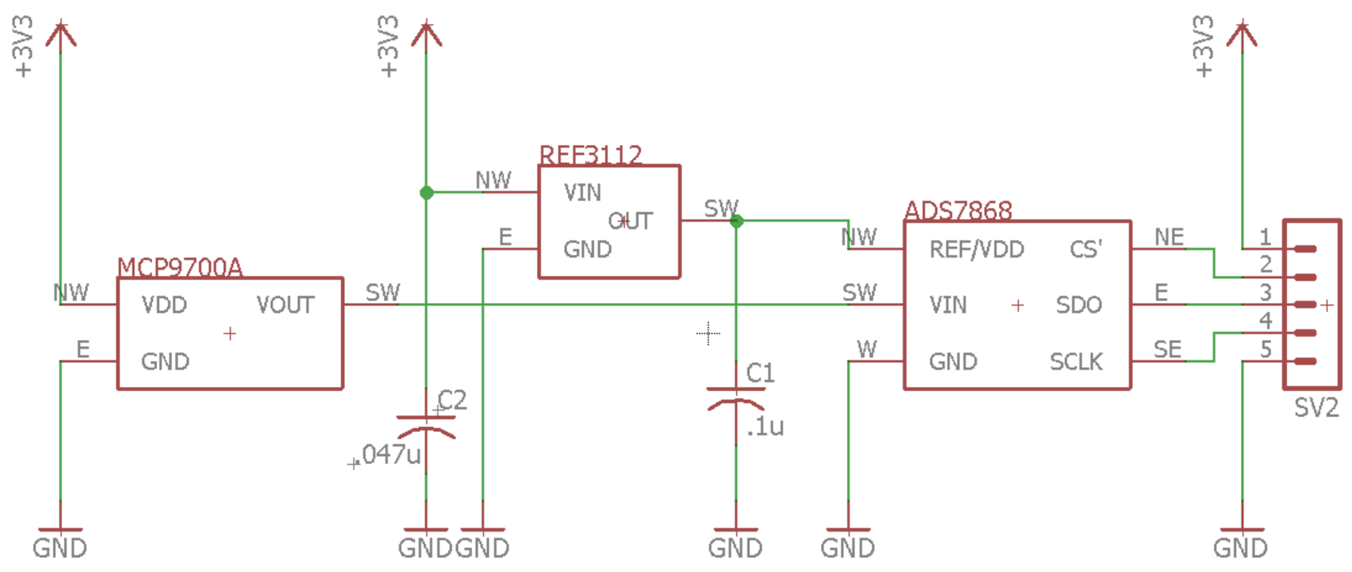
Temperature Sensor Schematic

Slide 28
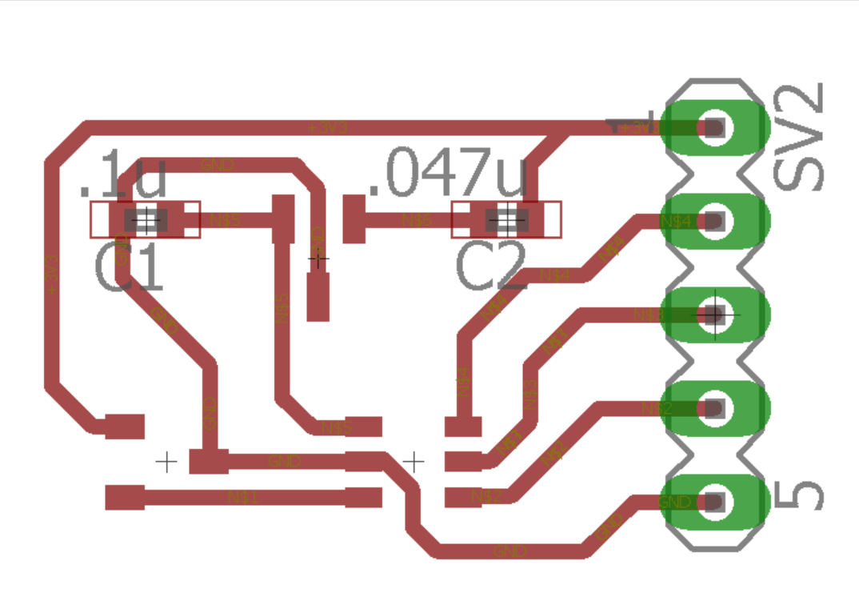
Temperature Sensor Board

Slide 29
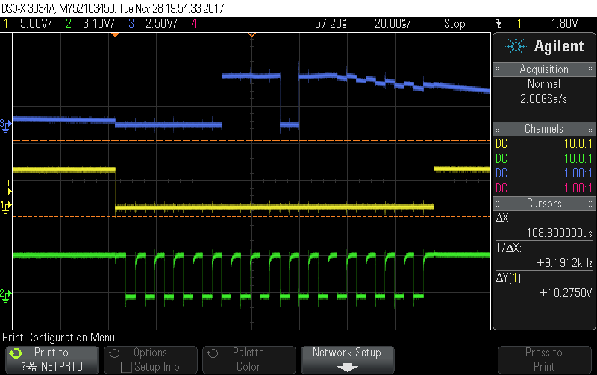
Temperature Readout
Leading 0’s
MISO
SS
00111011
High Z
CLK
SPI communication between temp sensor and uC
Notes:
SPI mode 3, data is set on falling edge and is read on rising edge
outputs 4 leading 0’s, 8 bits, then Hi Z

Slide 30
Temperature Calculation

Slide 31
Conclusion and Challenges
Responds to IR, rain sensors
Recognizes top and bottom positions
Cycles through states
Timing issues with long wires
Debugging after assembly
Hacky fixes: LED driver, logic level conversion
Power supply below specs
Notes:
Long wires: crosstalk during SPI communication, solution: increase SPI signal strength, place sensors closer to main board
Debugging: once assembled, no easy way of seeing internal variables (state, sensor vals)
Hacks: wrong IR sensor part, needed to drive an LED at appropriate frequency;
Needed 3.3V to 5V logic conversion for ADC that was unaccounted for
Power supply: rated for 8A but couldn’t handle inrush current from motor jam

Slide 32
Future Work
Finish implementation of Wi-Fi capability
Implement security features in Wi-Fi communication to prevent break-ins
Debugging of SPI communication to implement temperature sensing feedback

Slide 33
Thank you!
Special Acknowledgements
Professor Can Bayram
Michael Genovese
Glen Hedin
Notes:
Thank all the ECE 445 course staff, but especially Bayram and Mike.
Thank entire machine shop, esp Glen since he worked on the window.

Slide 34
Questions?

