Slide 1
ProxiPole: An Electronic Walking Stick for the Blind
Group 29 Landon Clipp, Fernando Hernandez, Arvind Kamal
TA Anthony Caton

Slide 2
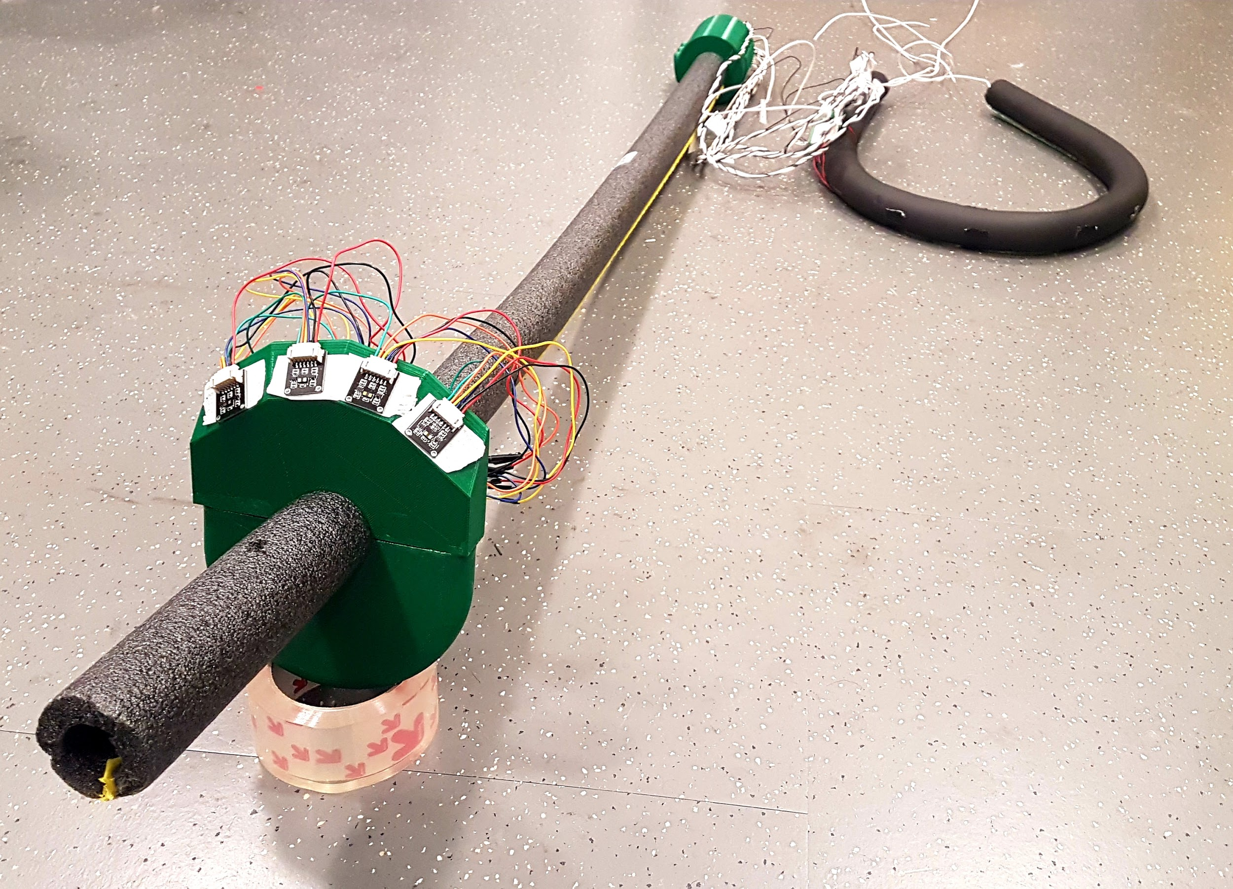
Introduction
36 million people around the world are visually impaired
ProxiPole is an enhanced electronic walking stick for them
The goal is to provide the user a heightened awareness of their environment and give them a rough spatial map of their surroundings
Landon Clipp • Fernando Hernandez • Arvind Kamal

Slide 3
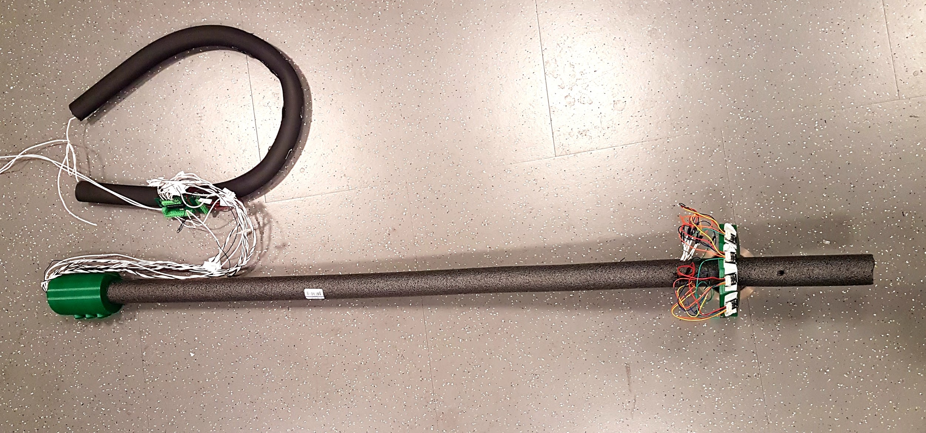
Objective
Increase range of traditional walking cane using an array of laser proximity sensors
Improve navigation using directional feedback
Provide a general idea of obstacle-distance by varying vibration intensity
Reduce anxiety in novel terrains
Landon Clipp • Fernando Hernandez • Arvind Kamal

Slide 4
High Level Requirements
The user should be alerted of the horizontal distance via increasing magnitude of the vibration motors, detecting a range of 1.5 meters and below
Should detect and alert the user of any obstacle and its direction within a sector range of 100° ahead of it
The stick should account for changes in relative yaw in case the user’s torso is turned and the stick is away from its 0° starting angle
Landon Clipp • Fernando Hernandez • Arvind Kamal

Slide 5
System Overview
Walking stick
Connected to: microcontroller, sensors (laser, orientation), user input
Belt
Connected to walking stick
Contains: battery, haptic motors, sensors (orientation), speakers
Software
Robust microcontroller code
Poll sensors
Perform calculations regarding motor intensities
Activate feedback devices
Landon Clipp • Fernando Hernandez • Arvind Kamal

Slide 6
Physical Design
Walking stick
Lightweight
Durable
Minimal amount of electronics attached to reduce weight
Belt
Attach heavy components
Battery
PCB
Haptic motors
Directional feedback
Intensity correlates to distance of object
Landon Clipp • Fernando Hernandez • Arvind Kamal

Slide 7
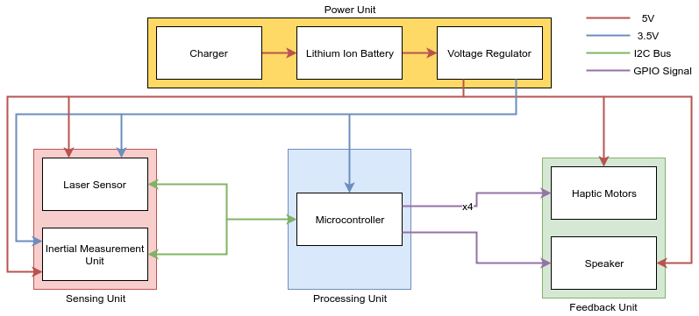
Circuit Design (1)
Integrate four key components
Sensors
Microcontroller
Feedback devices
Power system
Laser sensors on separate PCB
Design “motherboard” to integrate remaining components
Landon Clipp • Fernando Hernandez • Arvind Kamal

Slide 8
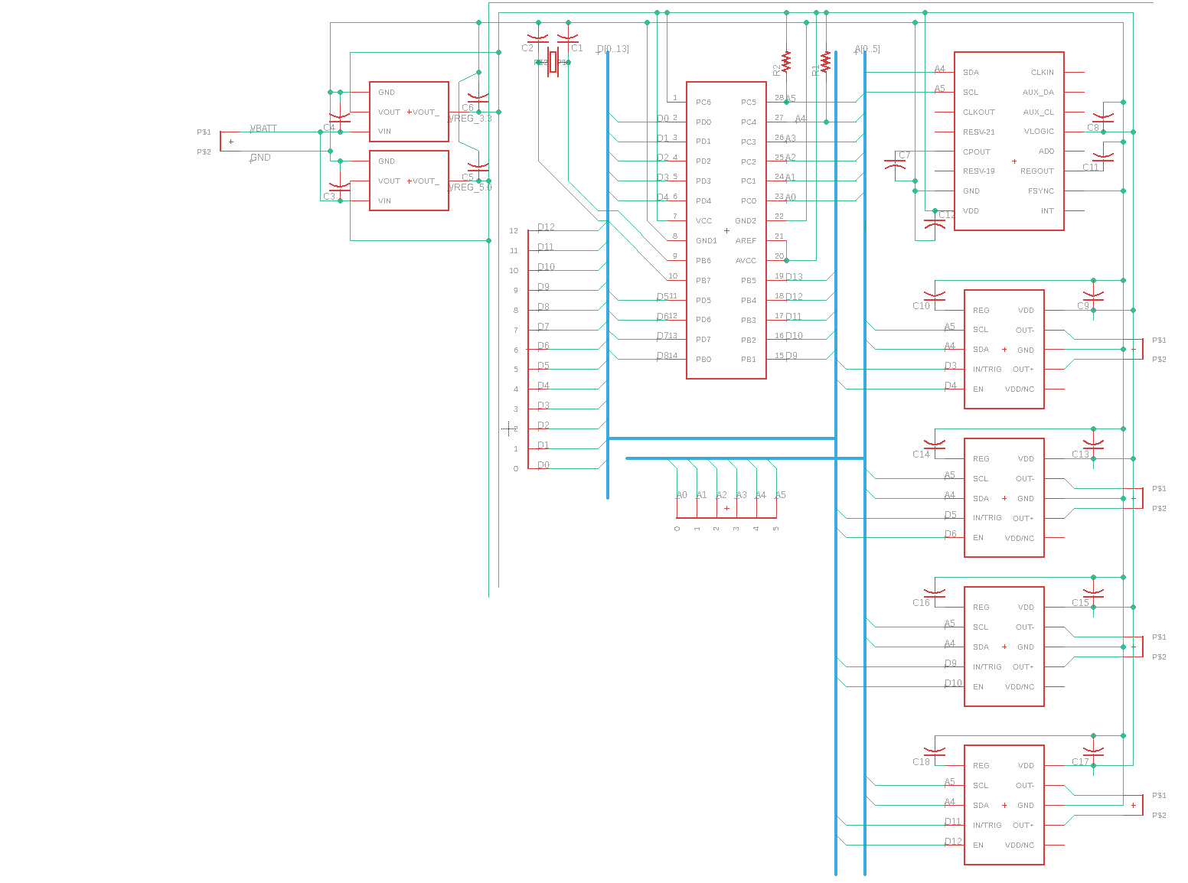
Landon Clipp • Fernando Hernandez • Arvind Kamal

Slide 9
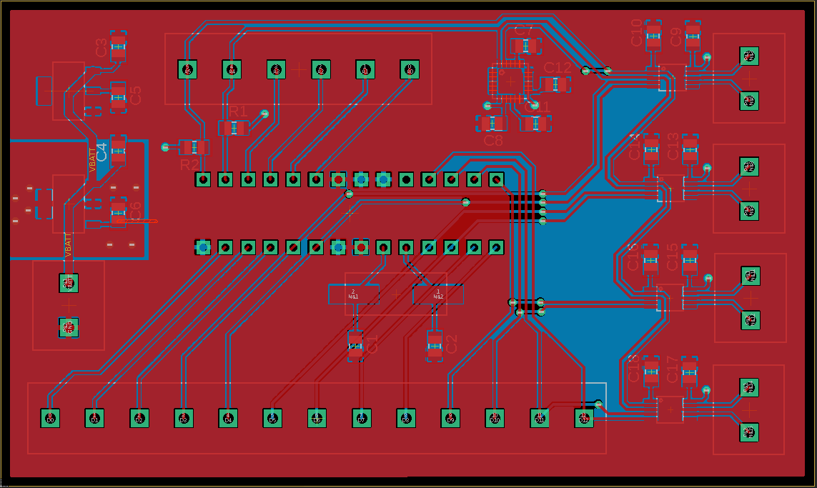
Landon Clipp • Fernando Hernandez • Arvind Kamal

Slide 10
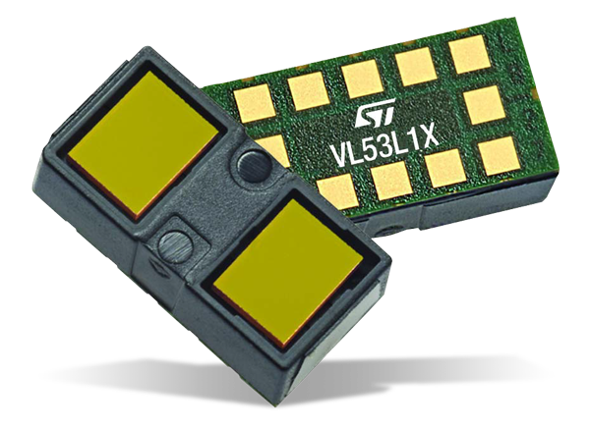
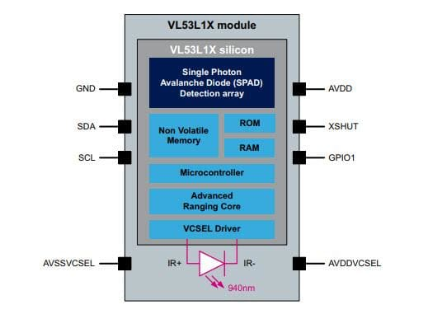
Laser System
VL53L1X Time-Of-Flight LIDAR
Infrared laser (940nm)
I2C
Variable field of view (FOV). Set at 27°.
Measure distance between emitted pulse and returning echo
R&V: 100° FOV
Array of 4 lasers. Overlap 1° each, for 100° total FOV.
Microcontroller polls for distance measurement
[1]
[2]
[1] https://www.mouser.com/images/marketingid/2018/img/185490152_STMicroelectronics_VL53L1X-Time-of-Flight-Proximity-Sensor.png
[2] https://www.mouser.com/images/marketingid/2018/microsites/185490152/BD.jpg
Landon Clipp • Fernando Hernandez • Arvind Kamal

Slide 11
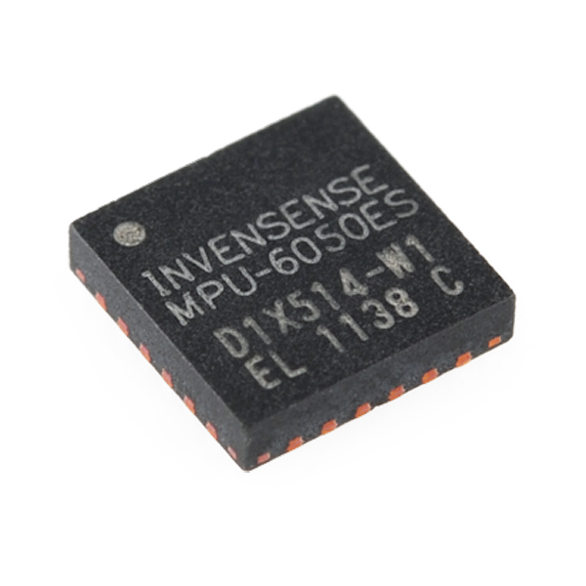
Inertial Measurement Unit (IMU)
MPU-6050
3 accelerometers
3 gyroscopes
Integrated die
MotionFusion algorithm for angular processing
I2C
Two IMUs required:
One on stick
One on belt
Use to calculate relative yaw of stick to user
Software algorithm used on microcontroller to interpret sensor data
Refer to Software Design
Landon Clipp • Fernando Hernandez • Arvind Kamal

Slide 12
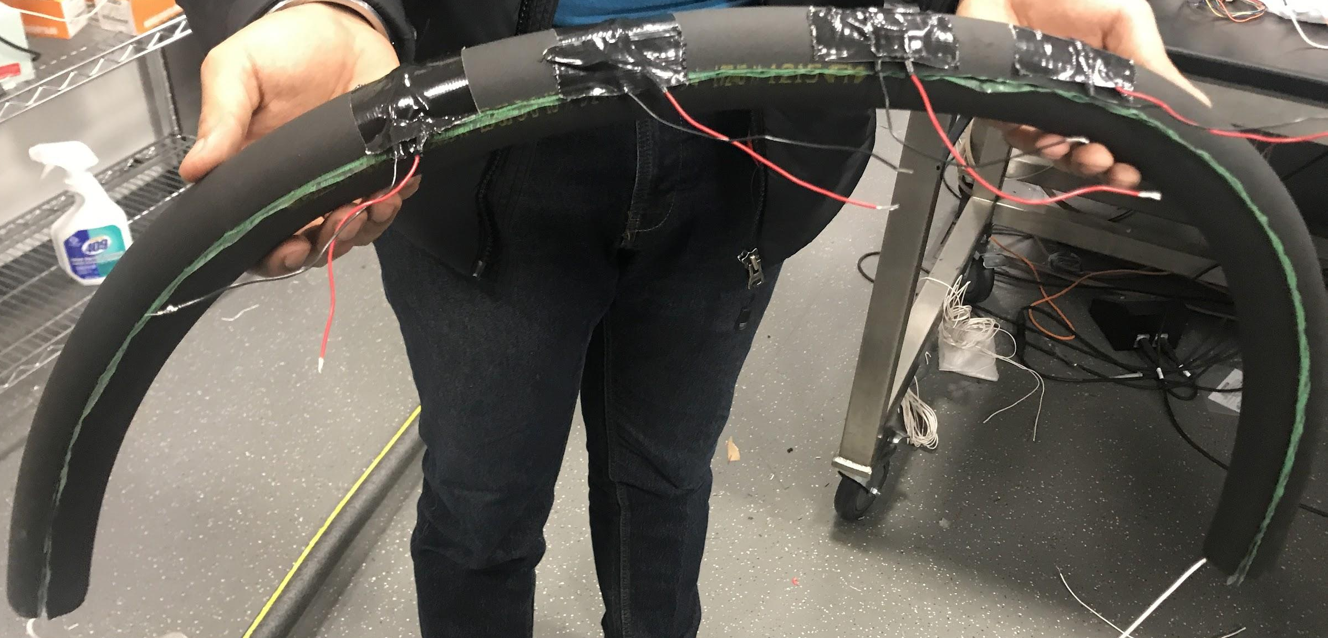
Feedback
Haptic motor belt
Directional feedback
Distance feedback
Landon Clipp • Fernando Hernandez • Arvind Kamal

Slide 13
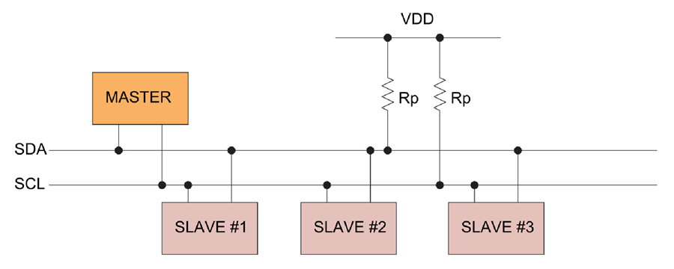
Software Design: Overview
Microcontroller has three main jobs:
Poll 4 lasers and 2 IMUs
Combine data using algorithm:
Relative distance of object
Relative location of object
Activate feedback devices accordingly
All devices communicate via I2C
Either:
Use Wire library directly or
Use convenience libraries for each device
I2C Bus Sample Layout [1]
[1] https://www.analog.com/en/technical-articles/i2c-primer-what-is-i2c-part-1.html
Landon Clipp • Fernando Hernandez • Arvind Kamal

Slide 14
Software Design: Polling Lasers
VL53L1X.h library (from Arduino)
In setup:
Check if laser visible on I2C
Initialize each laser with different address
Set distance mode
In loop:
Poll each laser with single line in for loop
Easy!!! for( int i = 0; i < NUM_LASER; i++ ){ inputs.laserDistances[i] = lasers[i].dev.read(); }
Landon Clipp • Fernando Hernandez • Arvind Kamal

Slide 15
Software Design: Polling IMU
Use Wire.h directly
In setup:
Set sample rate divider (critical for Madgwick algorithm!)
Configure gyro register
Configure accel register
Configure misc. registers
In loop:
Check if minimum polling interval passed
Grab raw accel/gyro values
Convert to physical units
Update Madgwick filter
Apply yaw correction
Landon Clipp • Fernando Hernandez • Arvind Kamal

Slide 16
Software Design: Perform Calculation
Madgwick Algorithm: Retrieve individual yaw
Input: Gyro/accel rate of change
Output: Yaw w.r.t. starting position
Requires specific update interval
25 Hz
Find relative yaw
Difference of two relative yaws
Run intensity algorithm
Refer to “Intensity Algorithm” slides
Landon Clipp • Fernando Hernandez • Arvind Kamal

Slide 17
Software Design: Madgwick Filter
Sebastian Madgwick
Sensor fusion algorithm
Ph.D research
Calculate relative angles from rate-of-change sensor data
Paper
“An efficient orientation filter for inertial and intertial/magnetic sensor arrays” Sebastian O.H. Madgwick April 30, 2010
http://x-io.co.uk/res/doc/madgwick_internal_report.pdf
Landon Clipp • Fernando Hernandez • Arvind Kamal

Slide 18
Software Design: Haptic drivers
In setup:
Enable microcontroller PWM pins
Set driver to accept PWM signal
In loop:
After intensity calculation:
Set appropriate PWM rate
If intensity below threshold:
Disable driver
Landon Clipp • Fernando Hernandez • Arvind Kamal

Slide 19
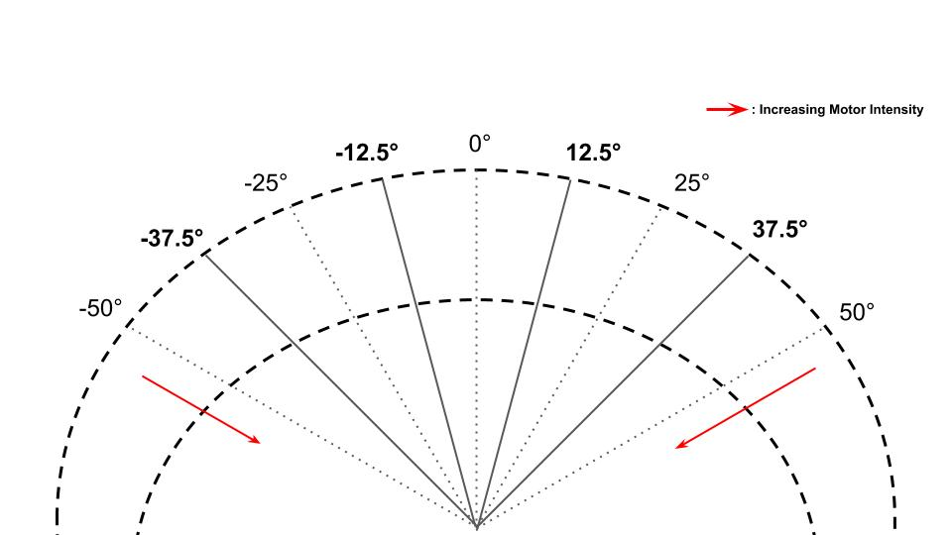
Intensity Algorithm: Prelude
Landon Clipp • Fernando Hernandez • Arvind Kamal

Slide 20
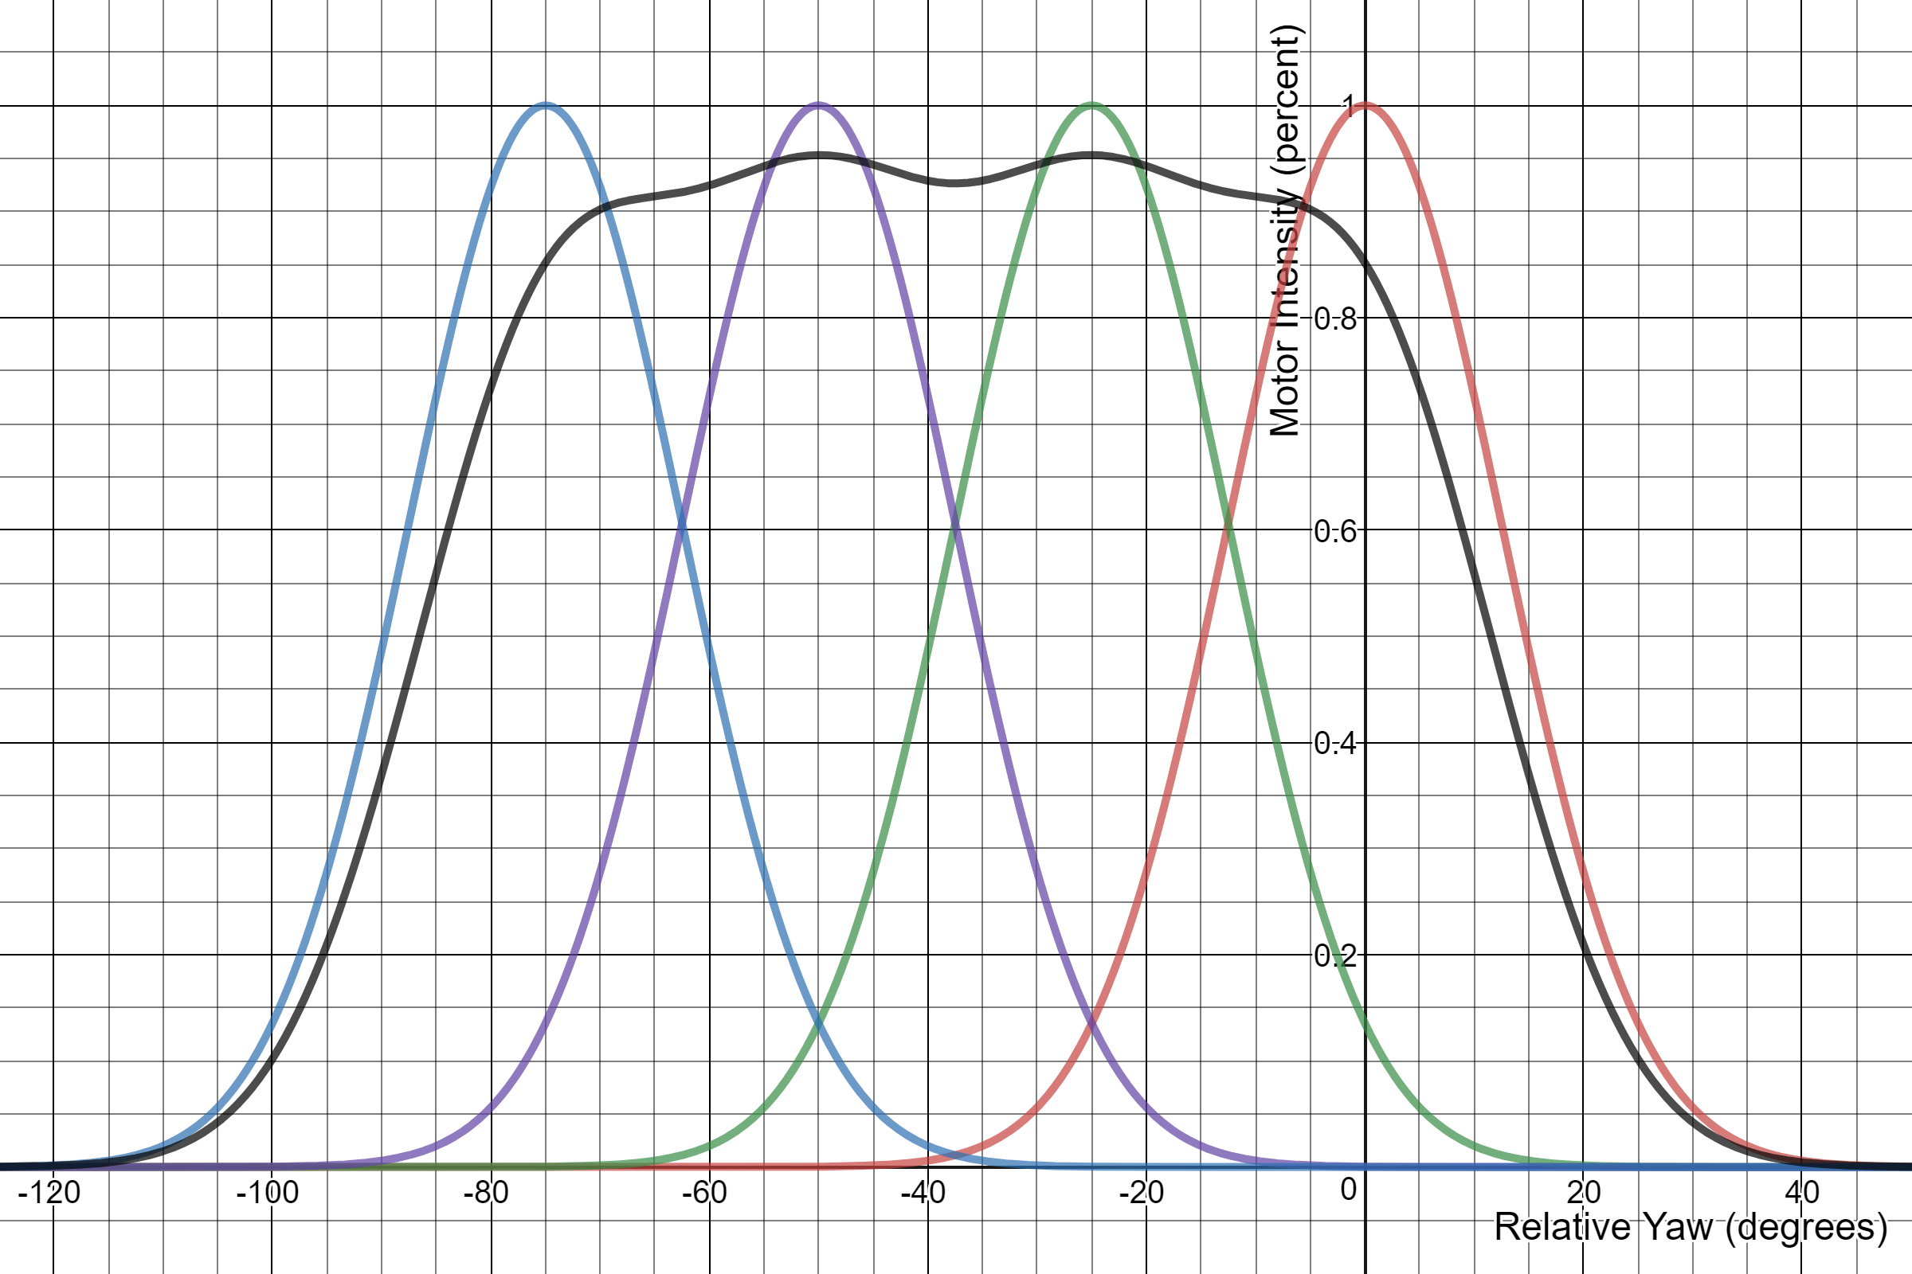
Intensity Algorithm (1)
Intensity of each motor a function of 5 variables:
4 distances reported by lasers
Relative yaw of stick to user
Each colored line represents component of individual lasers
Note: amplitude of each line a function of reported distances
Black line represents addition of all 4 lasers (plus some scaling factor).
Intensity function for Motor 0
Landon Clipp • Fernando Hernandez • Arvind Kamal

Slide 21
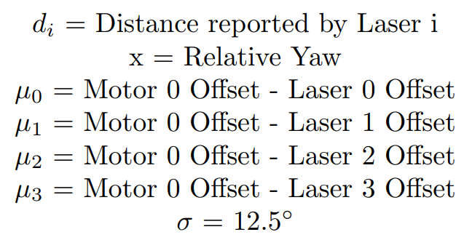
Intensity Algorithm (2)
Separate function for each motor
Only difference is offset values (μ)
μ represents degree offset from motor to laser
See motor 0 (leftmost) intensity function in figure to the right.
Each term is gaussian function that describes extent and position of each laser’s contribution to overall intensity.
Landon Clipp • Fernando Hernandez • Arvind Kamal

Slide 22
Successes
Properly integrate laser and drivers
Separately integrate laser, IMU calculation, drivers
Arduino-only
Motor properly responds to distance
Intensity calculation correct
Caveat: very expensive.
Optimizations? Discretization, dynamic programming, memoization
Landon Clipp • Fernando Hernandez • Arvind Kamal

Slide 23
Failures: IMU I2C communication
I2C communication anomaly
IMU acknowledge failure
Sends slave address with proper acknowledge
Fails when transmitting register address
Does not occur with Arduino
Result: cannot integrate IMU into PCB
Possible causes
3.3v logic causes chip instability
I2C bus interference
IC design flaw
Landon Clipp • Fernando Hernandez • Arvind Kamal

Slide 24
Failures: Incompatible driver voltage
Successfully integrate laser, IMU, driver on Arduino BUT:
Driver IC not compatible with Arduino 5V VDD/logic
Only verify correctness via serial plotting of PWM values
NOTE: Not “failure” per se
Landon Clipp • Fernando Hernandez • Arvind Kamal

Slide 25
Requirements and Verification
Power System
The power system should be able to maintain voltage sources with a tolerance of ±10% for each voltage.
Fault protect the power system’s output so that no more than 1 amp of current can be drawn at any given point in time.
Landon Clipp • Fernando Hernandez • Arvind Kamal
Notes:
Disconnect the power supply from the rest of the circuit
Draw 900mA from the {3.3V, 5V} sources and measure the amount of voltage fluctuation each time
If voltage is within 10% of the target voltage, the verification succeeded
------------
Draw 1.5A from each source individually to see if the system will fault for singular sources
Then, draw 0.5A from each source at the same time to test that drawing 1.5A in total across all sources will also engage fault protection

Slide 26
Requirements and Verification
Sensing System
The Sensing System should be able to detect obstacles with a 90% success rate at a distance of 1 meter in broad daylight.
The laser sensors should be able to detect an object within a cone around the array of 100 degrees
The combined sensing system should be able to detect an object and deterministically identify an angle of detection relative to the holder of ProxiPole.
Landon Clipp • Fernando Hernandez • Arvind Kamal
Notes:
Print out 10 pieces of paper that have varying degrees of darkness, from white to black.
Place each piece of paper directly in front of the sensors, 1 meter away.
If the system fails to detect at most 1 piece of paper, the verification succeeded.
------------
Fix 0° as directly in front of the sensor, -90° as left, and 90° as right.
Move a white piece of paper starting from -90° to 90°, half a meter away from the sensor.
Note angles at which the sensor begins to object detection and ceases it. If difference ≥ 100°, this verification succeeded.
------------
Have a blindfolded user hold the ProxiPole. Another person will randomly place a piece of paper 0.5 meters in front of the system within the 100° cone of sensing. The blindfolded user will point in the direction that the haptic motors indicate.
4 of these random angles will be selected. If the user fails to point directly at the piece of paper during any of the tests, the verification failed.

Slide 27
Requirements and Verification
Microcontroller
The microcontroller must be capable of addressing 4 separate laser sensors through its GPIO pins with the I²C protocol using a shared bus.
The microcontroller must be fast enough to allow it to poll all 5 sensors (4 proximity and 1 IMU) and activate the 5 feedback units (4 haptic motors and 1 audible alarm) at least 4 times a second.
Landon Clipp • Fernando Hernandez • Arvind Kamal
Notes:
This verification is simply inherent in the design of the circuitry. If all 4 lasers can be communicated with using a shared I²C bus, then the verification succeeded.
------------
The microcontroller will be operating in an infinite loop, continuously polling the sensors and activating the feedback system as needed.
To test this, pick a free GPIO pin and program the microcontroller to toggle the pin at the beginning of its loop.
Connect this pin to an oscilloscope and measure the frequency at which the pin oscillates.
If it oscillates ≥ 4 times/sec, the verification succeeds.

Slide 28
Requirements and Verification
Feedback System
The feedback system should be able to activate our motors given a microcontroller input.
The driver circuit must be capable of activating all haptic motors at full power.
The speaker should emit a characteristic tone that will indicate an imminent collision given microcontroller input.
Landon Clipp • Fernando Hernandez • Arvind Kamal
Notes:
Test to see that all of the motors are activated according to the direction of the detected object by individually placing a white piece of paper 10cm in front of each sensor.
------------
Place a white piece of paper 10 cm away from all sensors and test to see that all 4 haptic motors are activated. Confirm full power by measuring peak PWM voltage to each motor.

Slide 29
Ethical Issues
General ethics
Users will rely on ProxiPole to safely navigate
IEEE Code of Ethics 9th item: “to avoid injuring others, their property, or employment by false or malicious action”
Paramount importance given to reliability of design
Laser safety
VL53L1X is class 1 laser
IEC 606825-1:2007: Such class 1 lasers are completely safe under normal operating conditions
Lithium-Ion Batteries
Dangerous if charged improperly
Responsible use of certified Li-Ion charger necessary
Landon Clipp • Fernando Hernandez • Arvind Kamal

Slide 30
Conclusion & Future Pivots
Achieved original goal of obstacle detection and provision of directional feedback
ProxiPole alerts user about respective distances of obstacles
Could potentially include a GPS module to guide user to a desired location by conveying directions via belt vibrations
Fit in a GSM/GPRS module to inform contacts of any potential emergencies faced by the user
Landon Clipp • Fernando Hernandez • Arvind Kamal

Slide 31
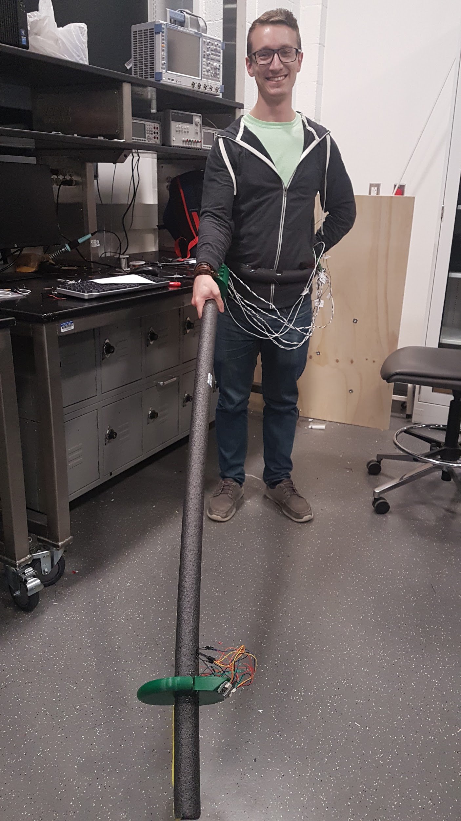
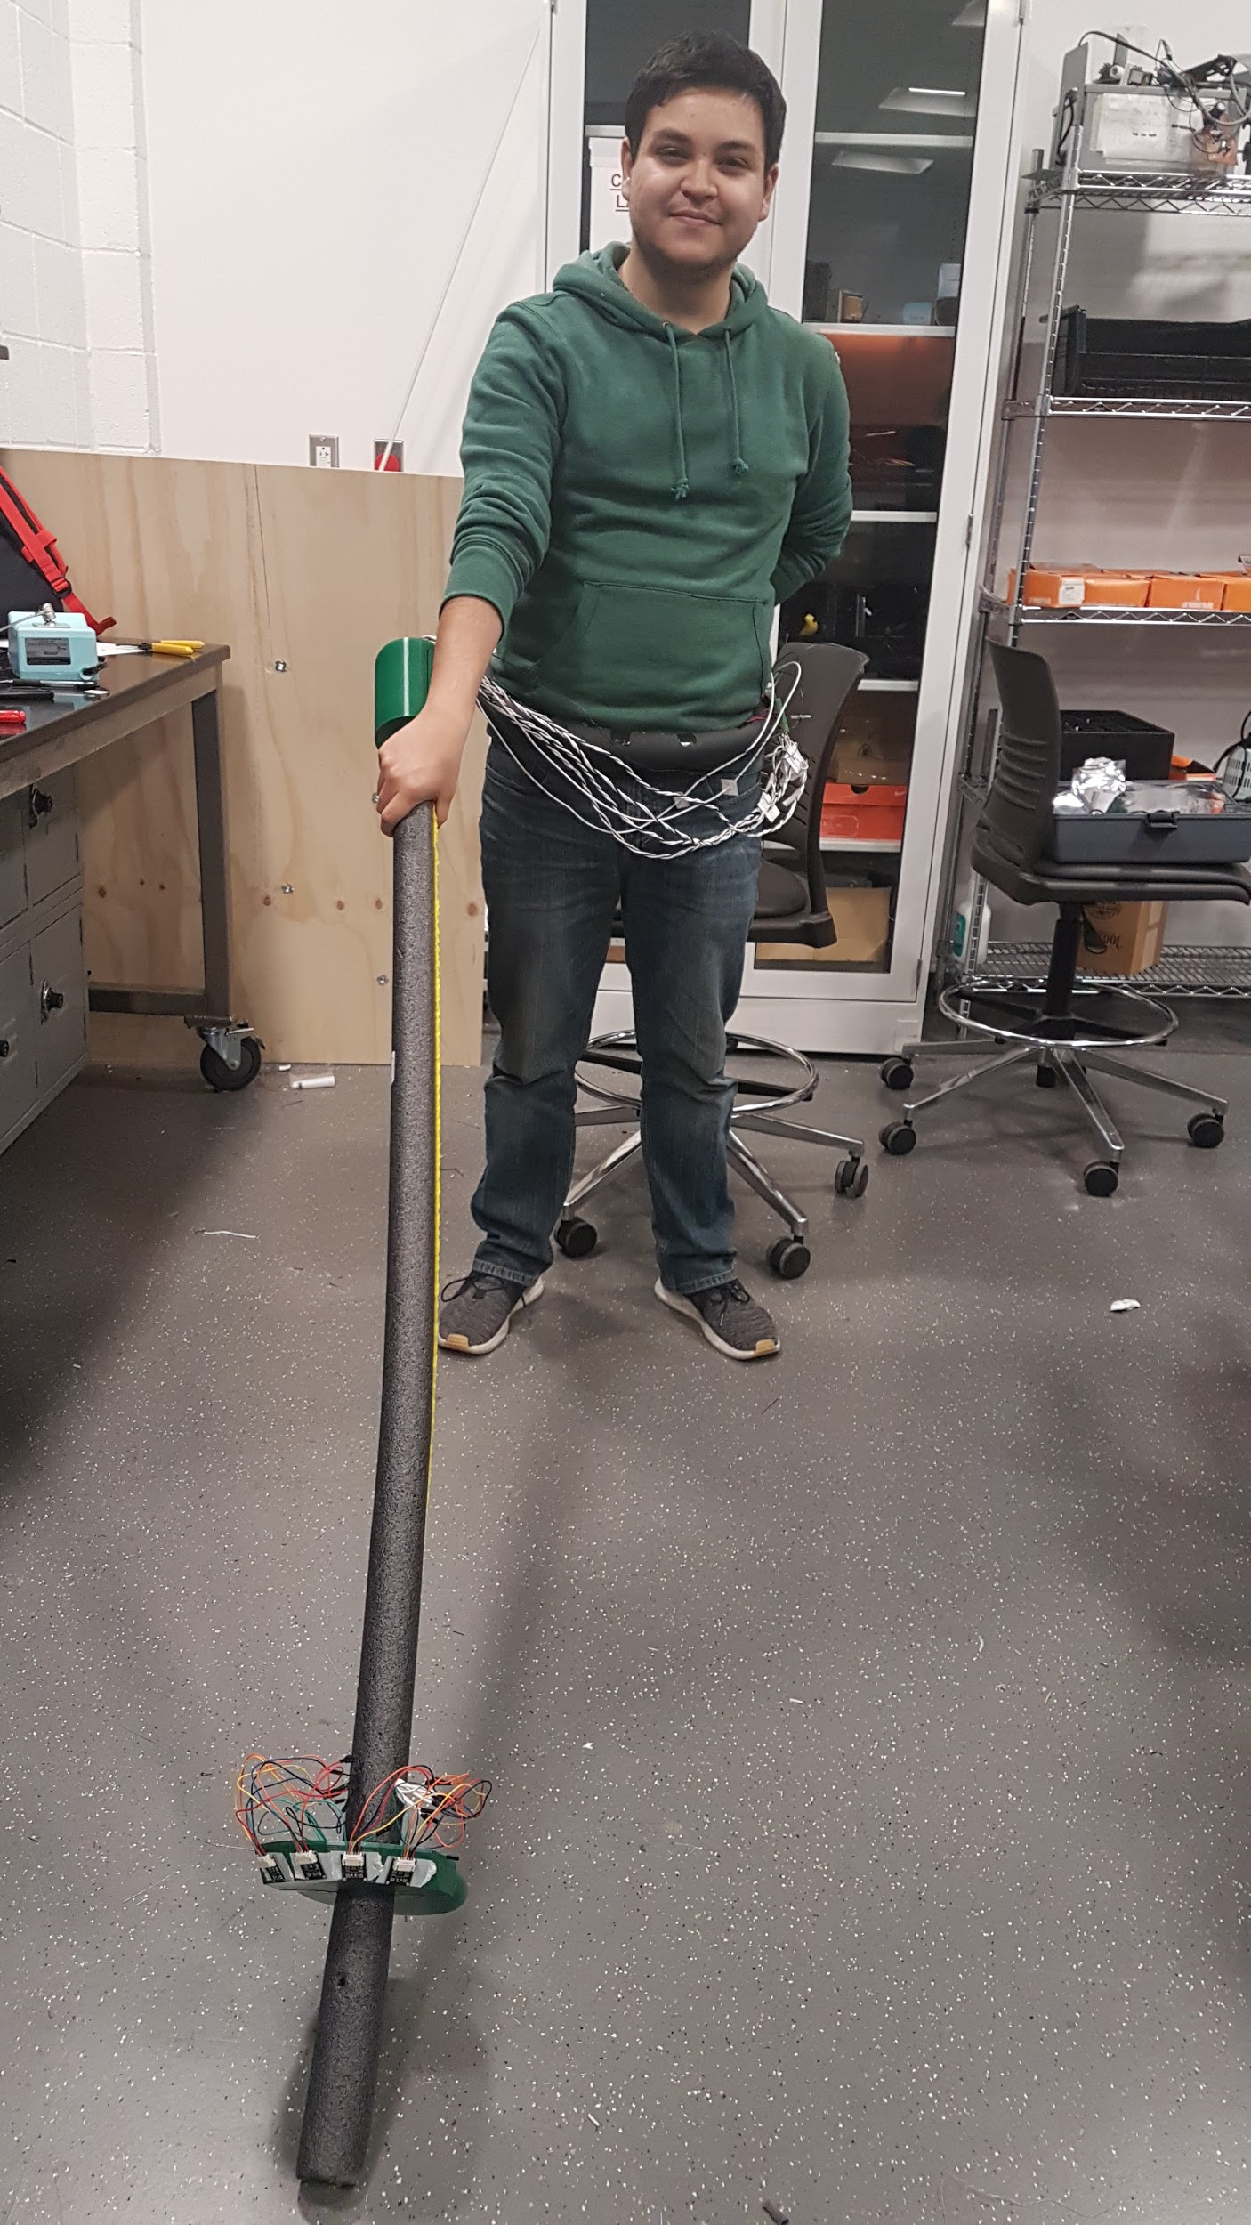
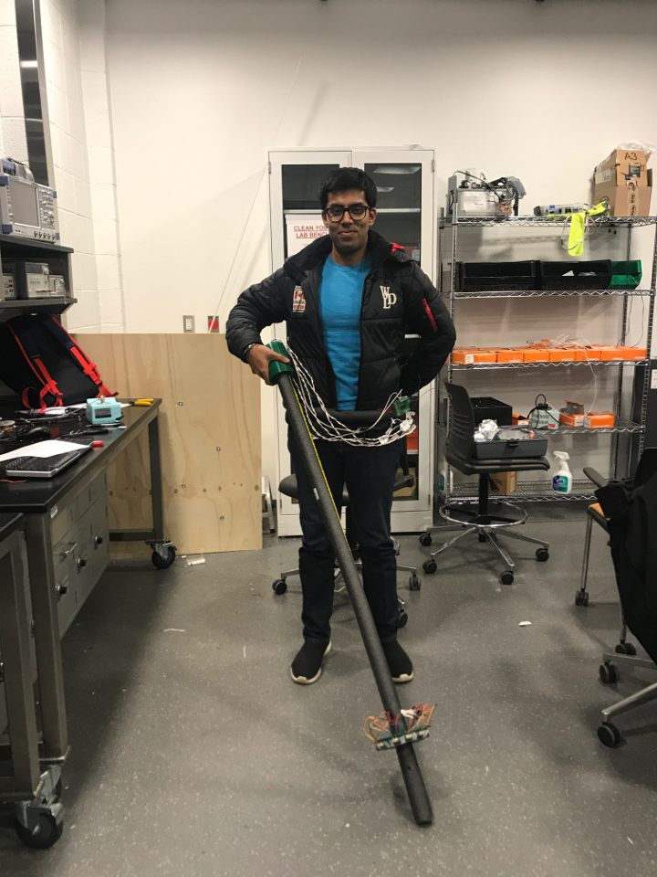
Thank You!
Landon Clipp • Fernando Hernandez • Arvind Kamal

