Slide 1
Bike Crash Detection
Brian Lin, Dhruv Mathur, Alex Tam

Slide 2
Motivation
Bike commuting is getting more popular
Lack of inexpensive bike crash detection
Market only has expensive enthusiasts solutions
Notes:
47 million riders
450 thousand accidents
2% of all traffic fatalities are due to pedal cyclists
17% of bike fatalities involve a helmet

Slide 3
Solution
Device that attaches to bike
Detects severity of crash
Notifies emergency contacts

Slide 4
High Level Requirements
Accurately detect and distinguish crashes
Send message to emergency contacts within 1 minute
Compact design for practicality

Slide 5
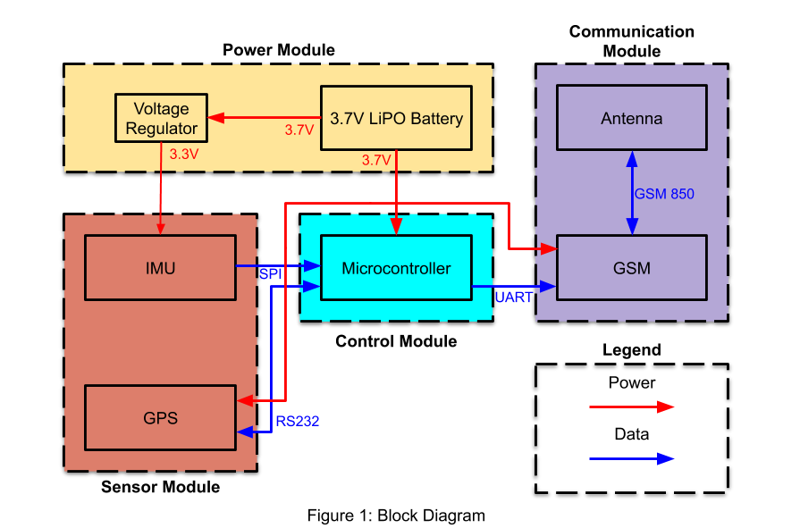
Block Diagram

Slide 6
Power Module
Requirement | Verification | Results
Must provide ≥200mA between 3.6V-3.9V for the ICs and voltage regulator | 1. Connect fully charged battery to a fixed load and make sure it provides more than 200mA 2. Discharge battery and monitor voltage with a voltmeter to ensure it stays between 3.6V-3.9V. | 3.7V 4000mAh LiPo battery Actual output: 3.6V - 4.1V Actual output: > 2A source for GSM
3.3V regulator must provide ≥150mA between 3V-3.45V | 1. Connect regulators to battery at input, and loads at each output and make sure it provides more than 150mA. 2. Discharge battery and monitor voltage at both outputs with a voltmeter to ensure it stays between 3-3.45V. | Actual output: 3.29V

Slide 7
Control Module
Requirement | Verification | Results
Must support two simultaneous software serial connections | Connect two serial ports to the two ICs and verify active communication to both | ATmega328p satisfies requirement
Must communicate at speeds over 1MHz with the IMU over SPI | Record the number of readings in a fixed time frame and check that the date rate is greater than 1MHz | SPI communication at 8MHz

Slide 8
Sensor Module
Requirement | Verification | Results
Must accurately detect accelerations over 1g and rotations over 45dps | Acceleration testing can be done by performing controlled drops of the IMU. Rotation testing can be done by mounting the IMU to a spinning wheel. | Testing Thresholds Fall: 1G in the X or Y plane Light Crash: 0.7G + 45dps Medium Crash 1.2G + 75dps Severe Crash: 1.7G + 90dps | Realistic Thresholds Fall: 1G in the X or Y plane Light Crash: 1.5G + 45dps Medium Crash 4G + 75dps Severe Crash: 7G + 90dps
Must provide GPS data in NMEA format accurate to within 10 meters | Parse the acquisition data to ensure the correct encoding and manually verify accuracy of location data when outside using a secondary GPS (Google Maps). | Actual 6 decimals of NMEA accuracy Within 1m of location
Notes:
All crashes require > 30 degree of angle

Slide 9
Communication Module
Requirement | Verification | Results
Must connect to a 2G cellular network in populated areas without major interfering structures | Confirm that the SIM card can communicate with the network in various outside locations around campus. | -80 dB 2G signal outside of buildings
Must be able to send a text message within 1 minute of detecting a crash | Simulate conditions for a crash. Then measure the time for the system to send the notification and ensure it is within 1 minute. | Text message sent in 56 seconds with GPS triangulation

Slide 10
Successes
Reliably text current GPS location
Accurately measure IMU data
Full system integration
Notes:
To review our successes and challenges

Slide 11
Challenges
Optimization of filtering
Generating crash level Gs in a laboratory environment
SIM card activation
SPI vs I²C

Slide 12
Ethics
Data privacy
Do no harm
Honest and realistic claims

Slide 13
Next Steps
Condense and optimize PCB
Work with Machine Shop on enclosure
More extensive testing
Mobile app with Bluetooth connection
Bike Lock Feature

Slide 14
Notes:
We can’t prevent crashes, but we can make sure you get the help you need when you do

Slide 15
Questions?

