Slide 1
Automated Urinalysis
Team 56:
Jovan, Patrick, & Siddarth
Notes:
Sid

Slide 2
Introduction
Urine dipsticks only provide qualitative measures, whilst 24-hr collection methods are cumbersome and prone to error
Urinalysis is the premier method, but requires separate facility to be processed
Notes:
Sid
Currently, urine dipsticks and 24hr urine collections are the most prevalent method for urinalysis
This involves monthly or even weekly visits to a medical centre for a patient of kidney or urinary disease.

Slide 3
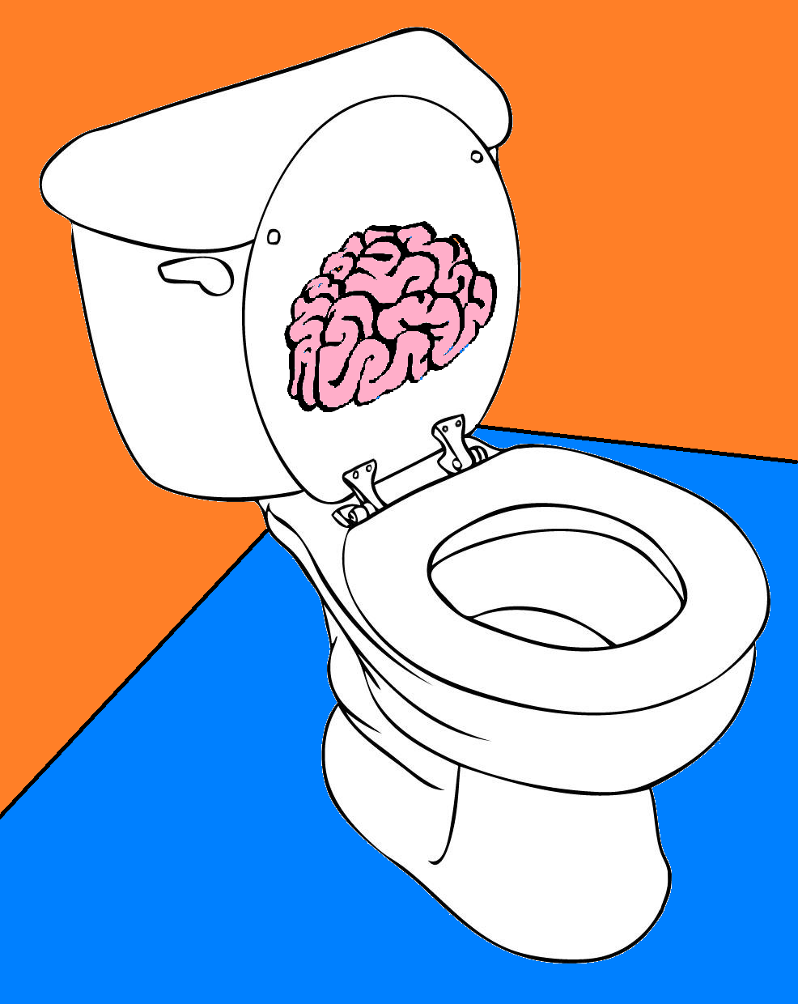
Objective
Develop autonomous method of conducting urinalysis to allowing for a time efficient in-house solution for medical professionals
Notes:
Sid
With our project we aim to eliminate the need for frequent visits to facilities

Slide 4
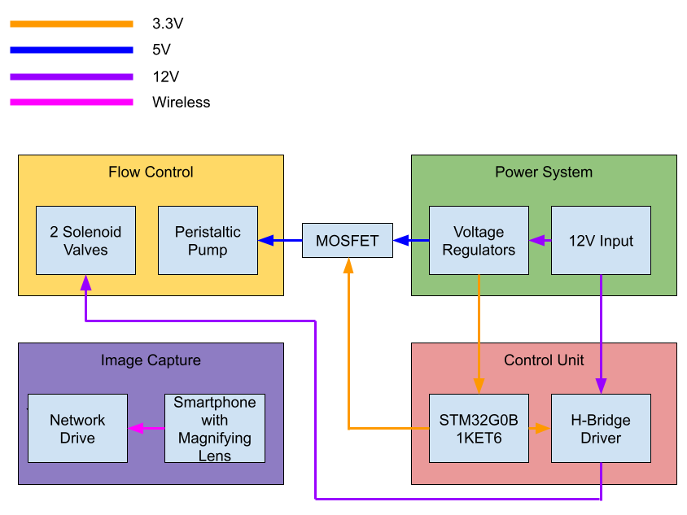
Design - Block Diagram
Notes:
Sid

Slide 5
Design - PCB
MCU: STM32G0B1KET6
Motor Driver: PMOS MOSFET
Solenoid Driver: DRV8844 with flyback diodes
Voltage Regulation: 12V, 6V (Adjustable), 3.3V
USB connection
Notes:
Patrick

Slide 6
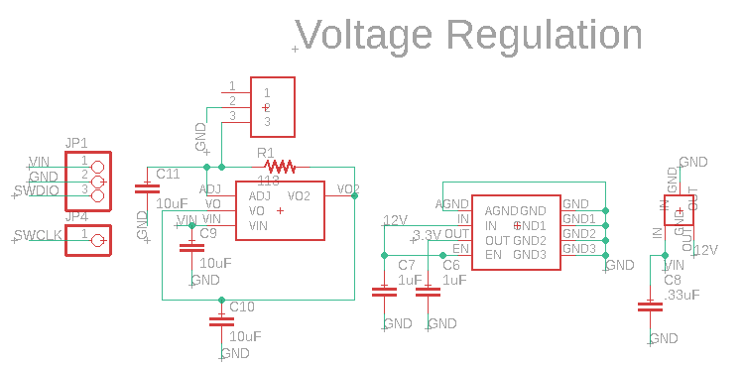
Notes:
Patrick

Slide 7
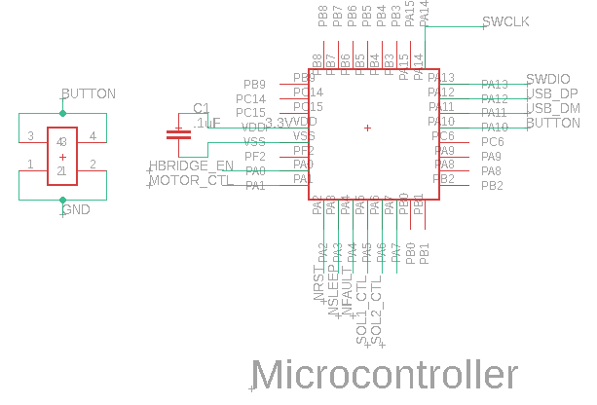
Notes:
Patrick

Slide 8
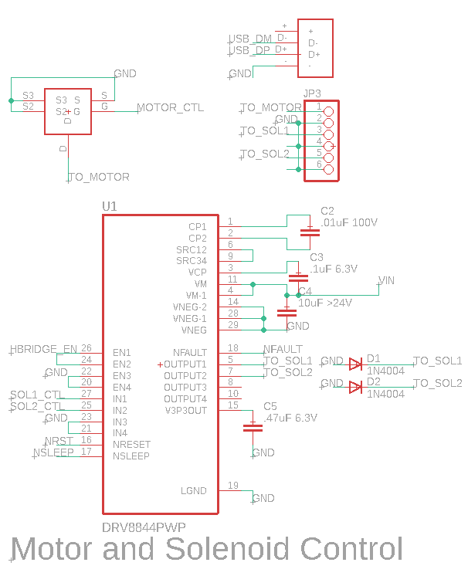
Notes:
Patrick

Slide 9
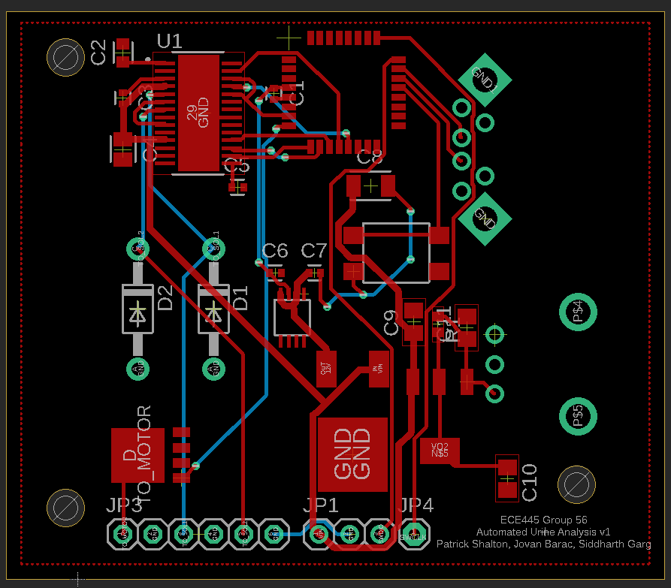
Notes:
Patrick

Slide 10
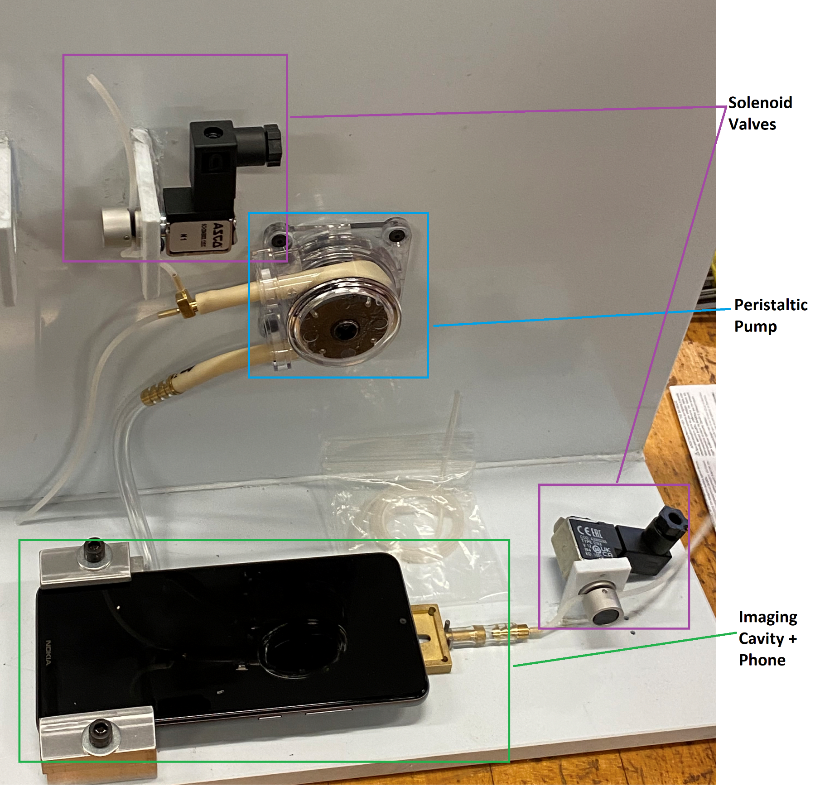
Design - Mechanical
Maintain leak-free system and keep sample turbidity low
Bernoulli Flow Calculations
Notes:
Jovan

Slide 11
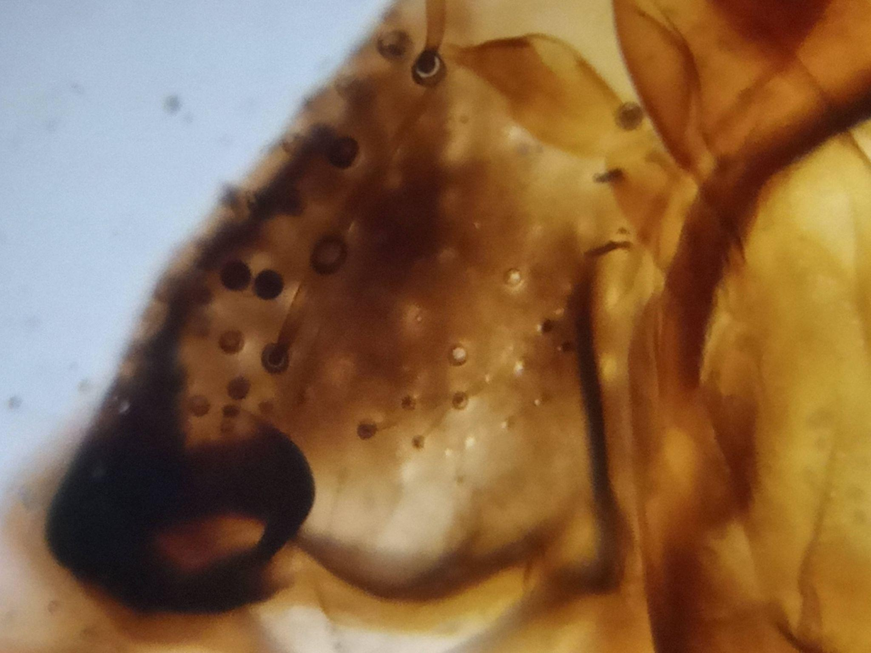
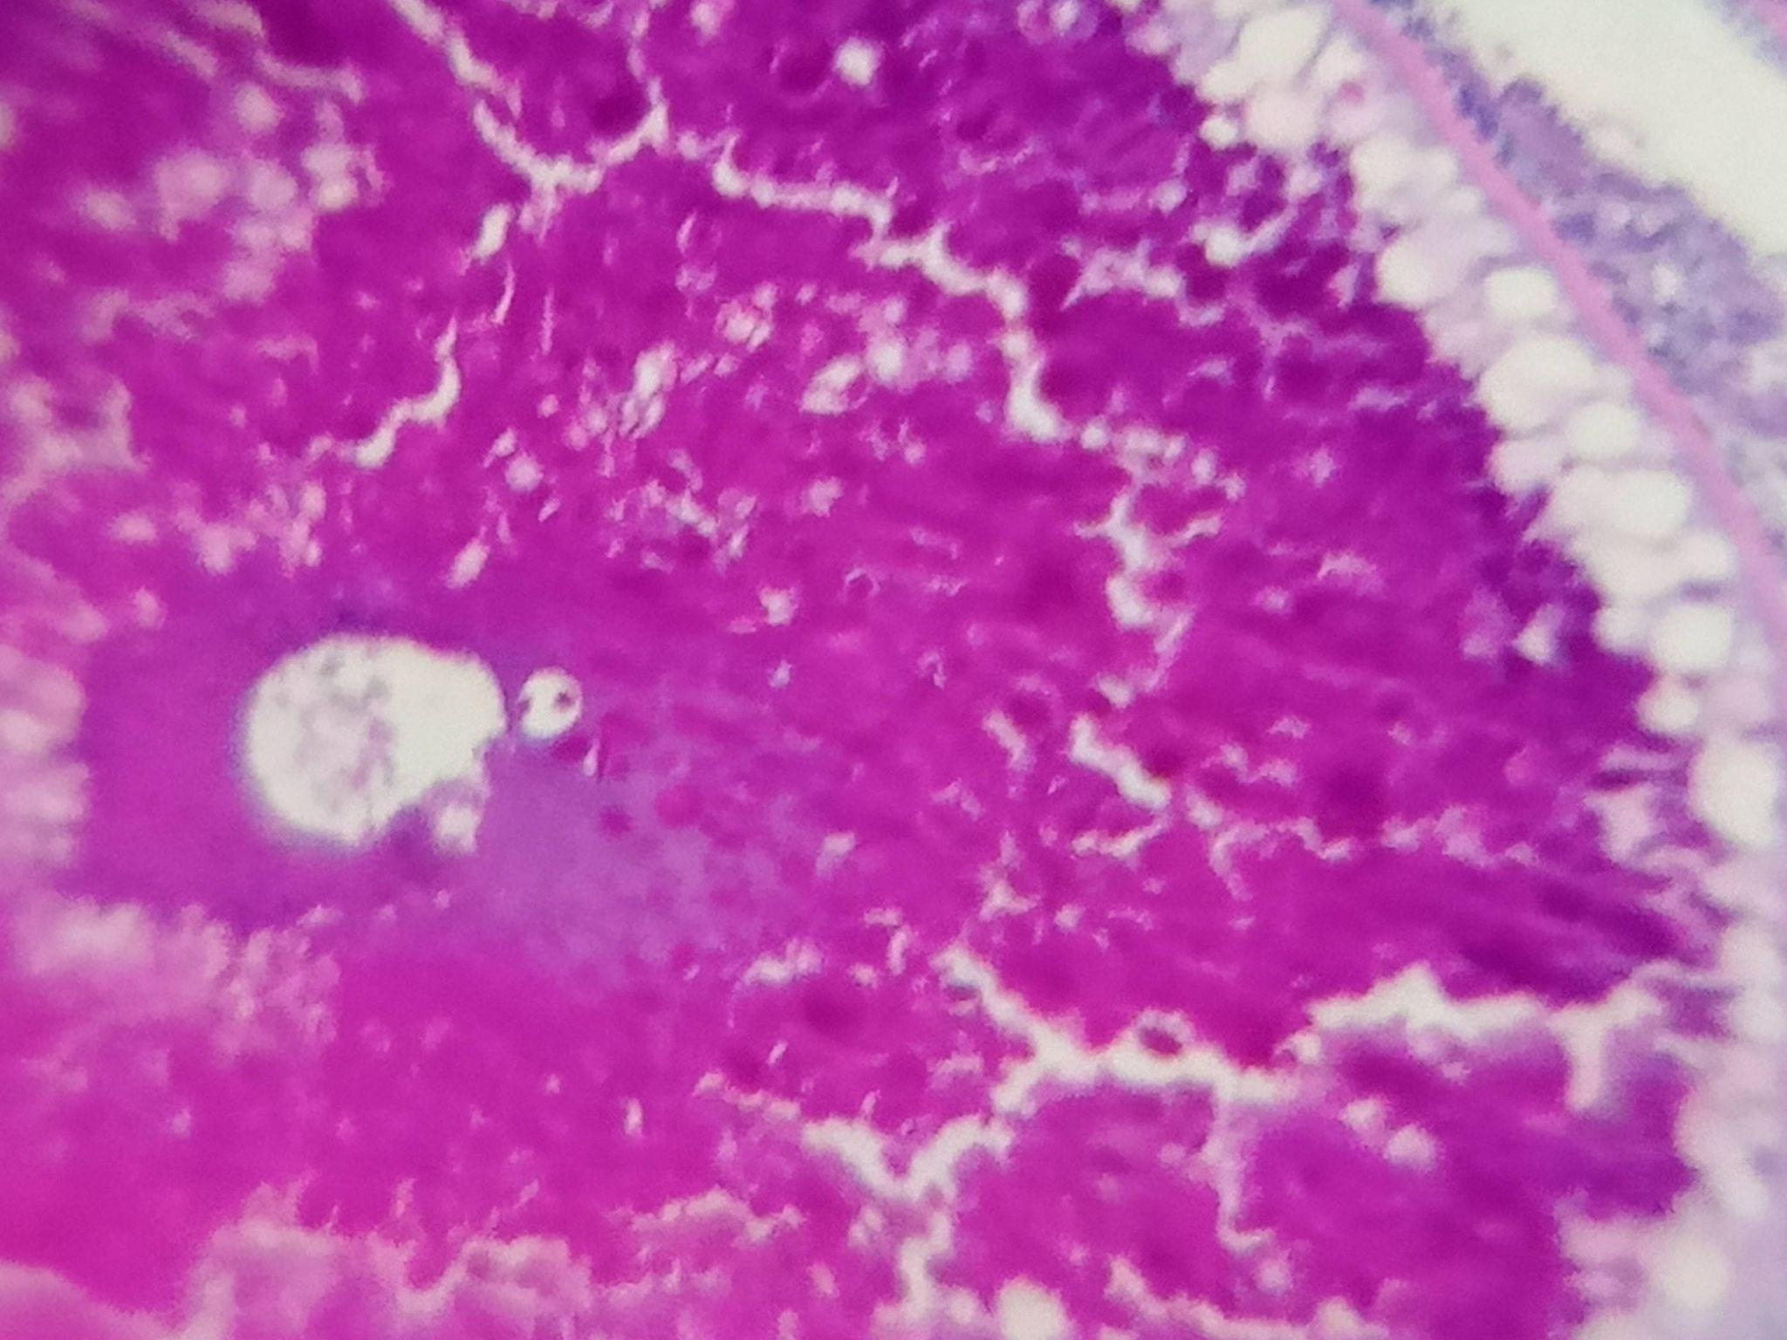
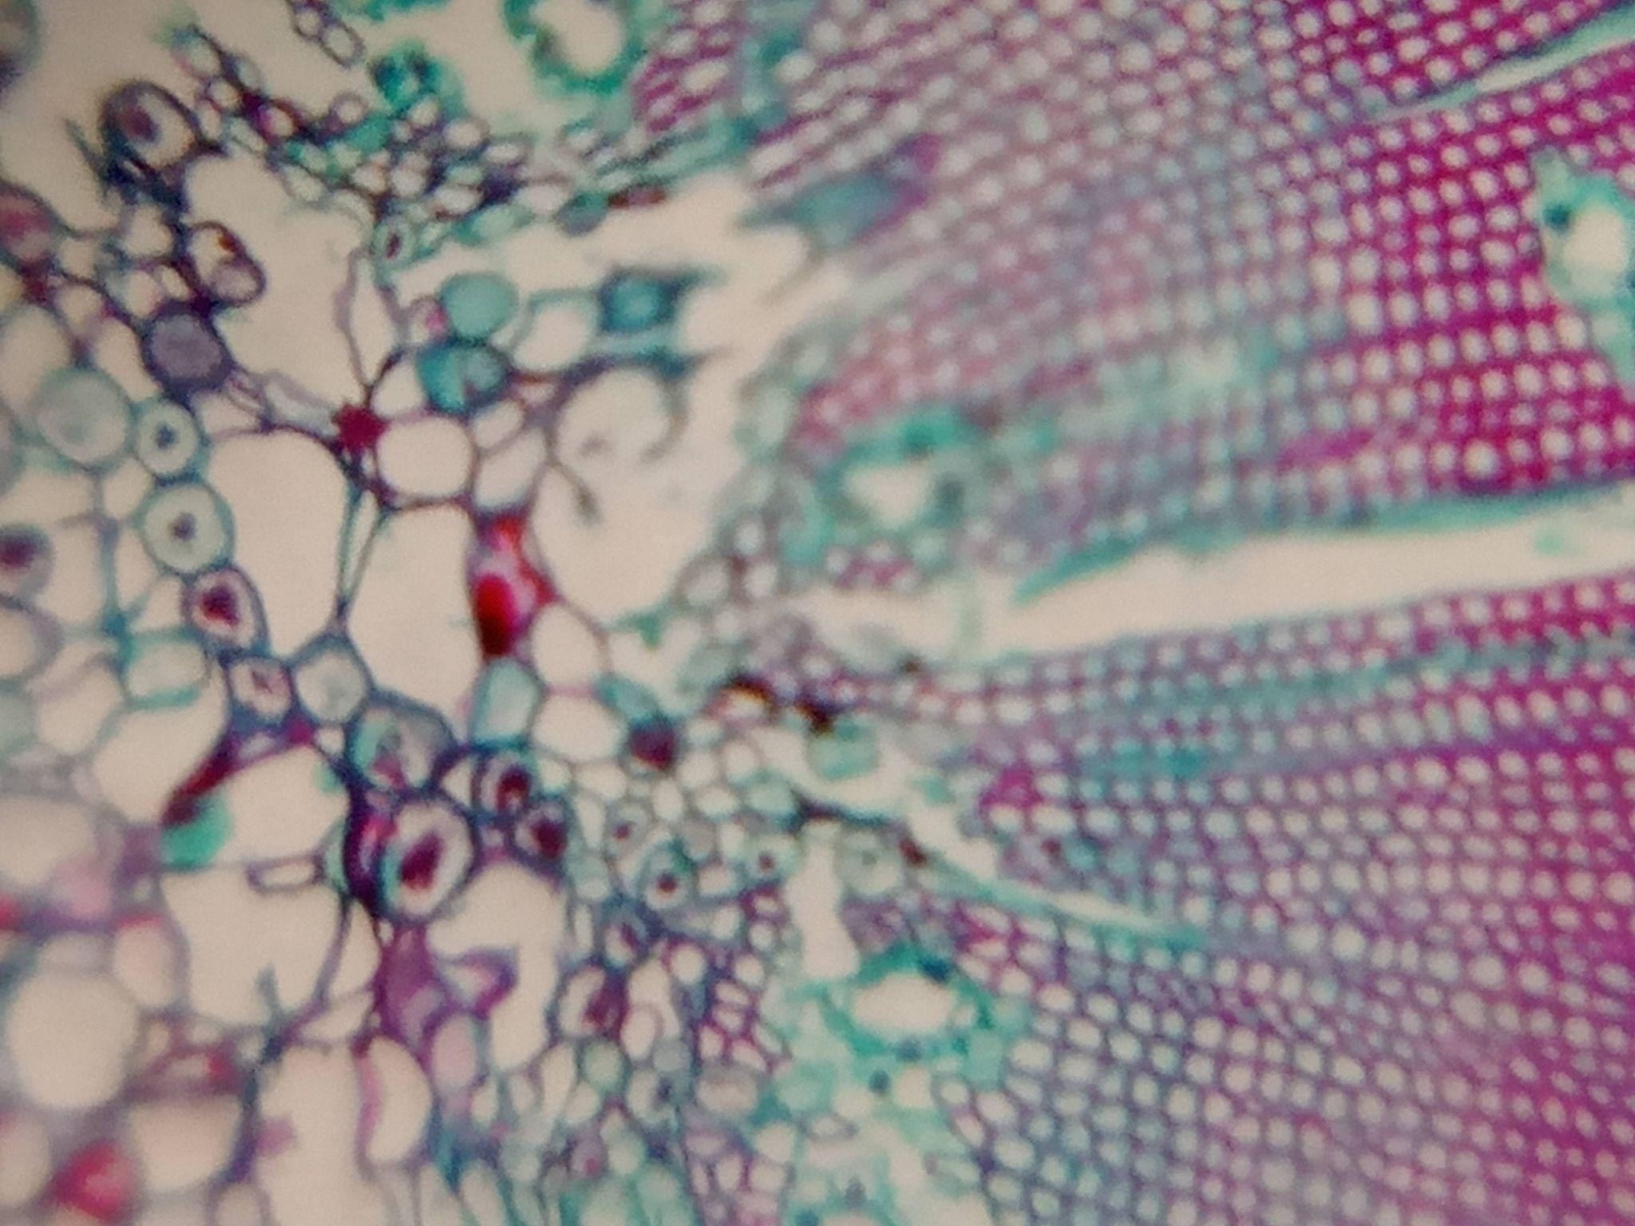
Design - Imaging Lens
Used 3mm glass bead to add optical magnification ~140x
Housefly Mouth Parts
Fish Ovary
Pine Stem
Notes:
Jovan

Slide 12
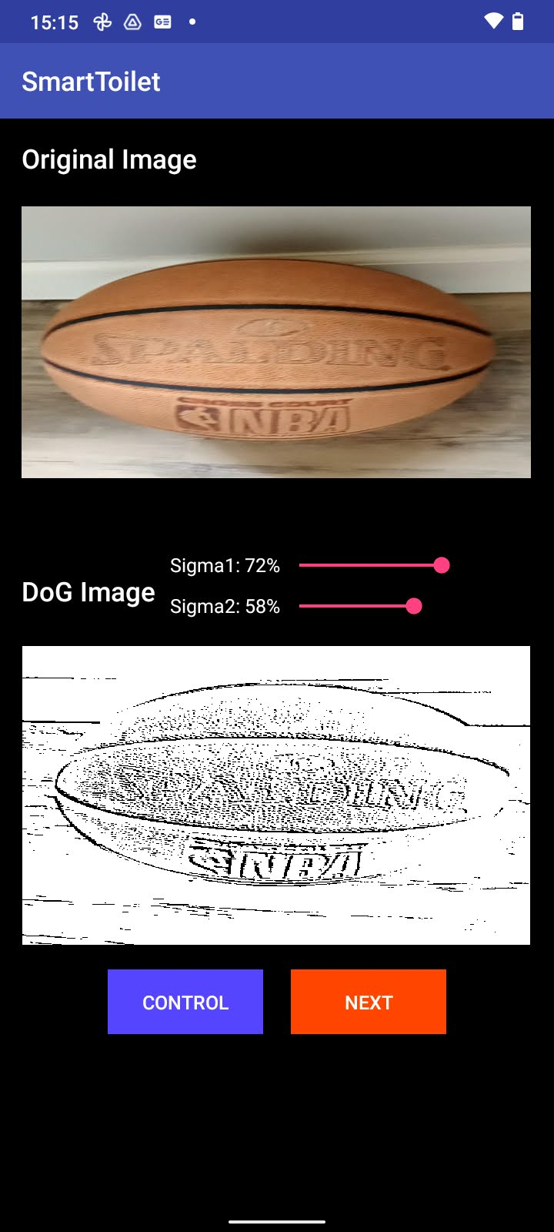
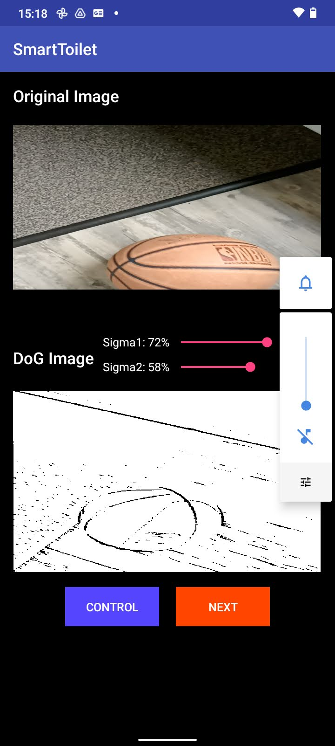
Design - Android Application
Color control → Difference of Gaussian Filtering →
Entropy Thresholding → Image Capture and Storage to Google Drive
Steady
Moving
Object
Notes:
Jovan

Slide 13
Android App - Color Control
Color specific thresholding
Notes:
Jovan

Slide 14
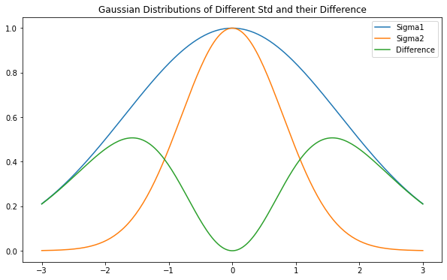
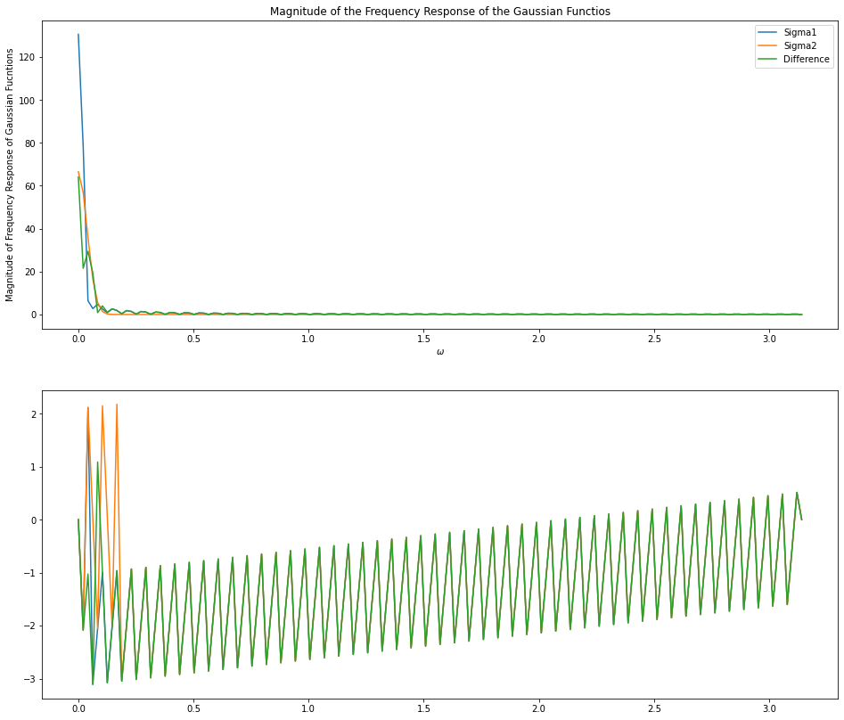
Android App - DoG Filtering
Allows for edge detection and “denoising”
Notes:
Jovan

Slide 15
Conclusion - Results
Our physical pump and valve design was reliable and did not cause any leaks or blockages with the testing samples we used and there was no cross-contamination between sample and cleaning liquid.
The microcontroller on the PCB failed to program and as a result were unable to use it to control the system.
We decided to use an Arduino as the microcontroller and built a MOSFET based circuit to control the system autonomously instead.
Notes:
Sid

Slide 16
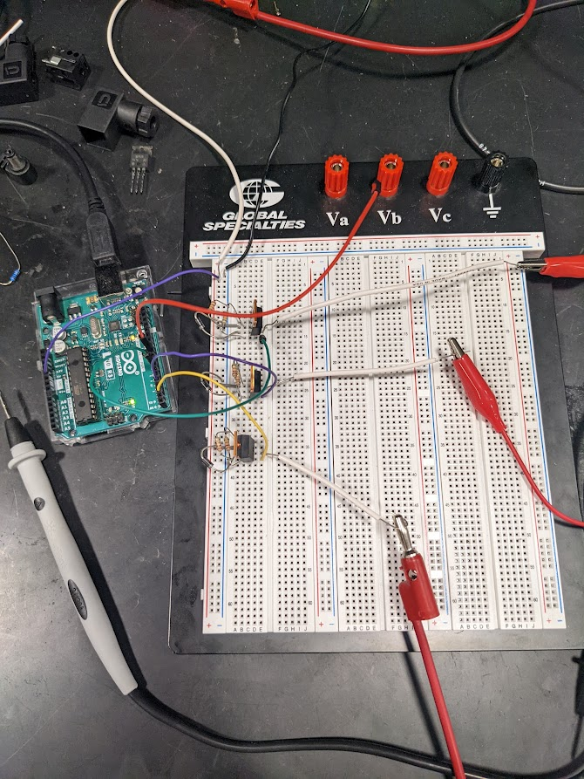
Connection to pump
Connection to solenoid 1 (sample)
Connection to solenoid 2 (cleaning)
Notes:
Sid

Slide 18
Conclusion - Future Work
Revise and debug the microcontroller and PCB to operate the entire system autonomously.
Make the design of the system more compact and retrofittable to current toilets.
Notes:
Patrick

Slide 19
Conclusion - Future Work
Add functionality for the entire system to be controlled remotely and postprocess on outside system.
Embed more refined image acquisition controls, like Monte-Carlo based focus targeting
Notes:
Jovan

