Slide 1
Roadside Sound Meter
ECE 445 Fall 2019
Group #27: Charlie Yang, Jordan Rodier, Wentao Jiang
Notes:
Charlie

Slide 2
Introduction
Planted in a residential area
Car playing loud music
Car horns / Engine revving
Automatic monitoring system that helps to reduce the level of noise produced by vehicles in the residential area
Notes:
Charlie

Slide 3
Objectives
Identify vehicle noise sources and track movement
Warn drivers if vehicles are too loud
Take pictures of offending vehicle’s license plate
Notes:
Charlie

Slide 4
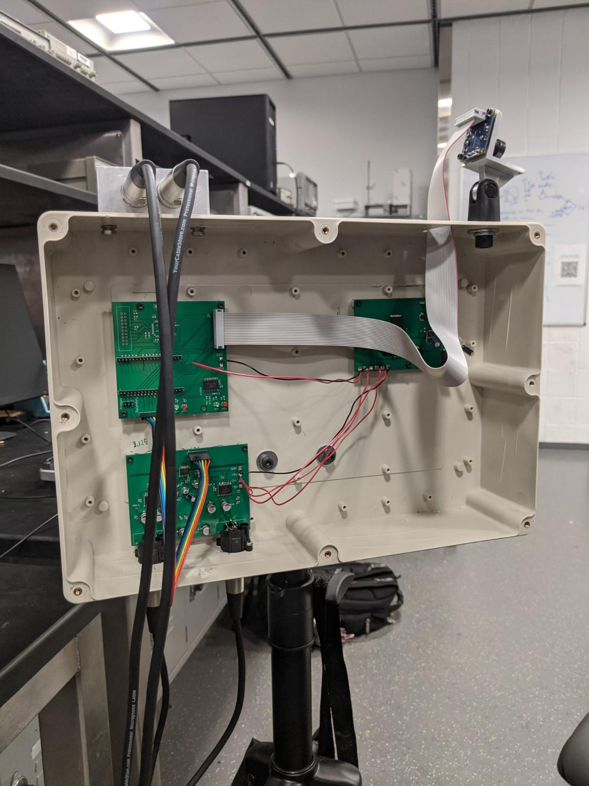
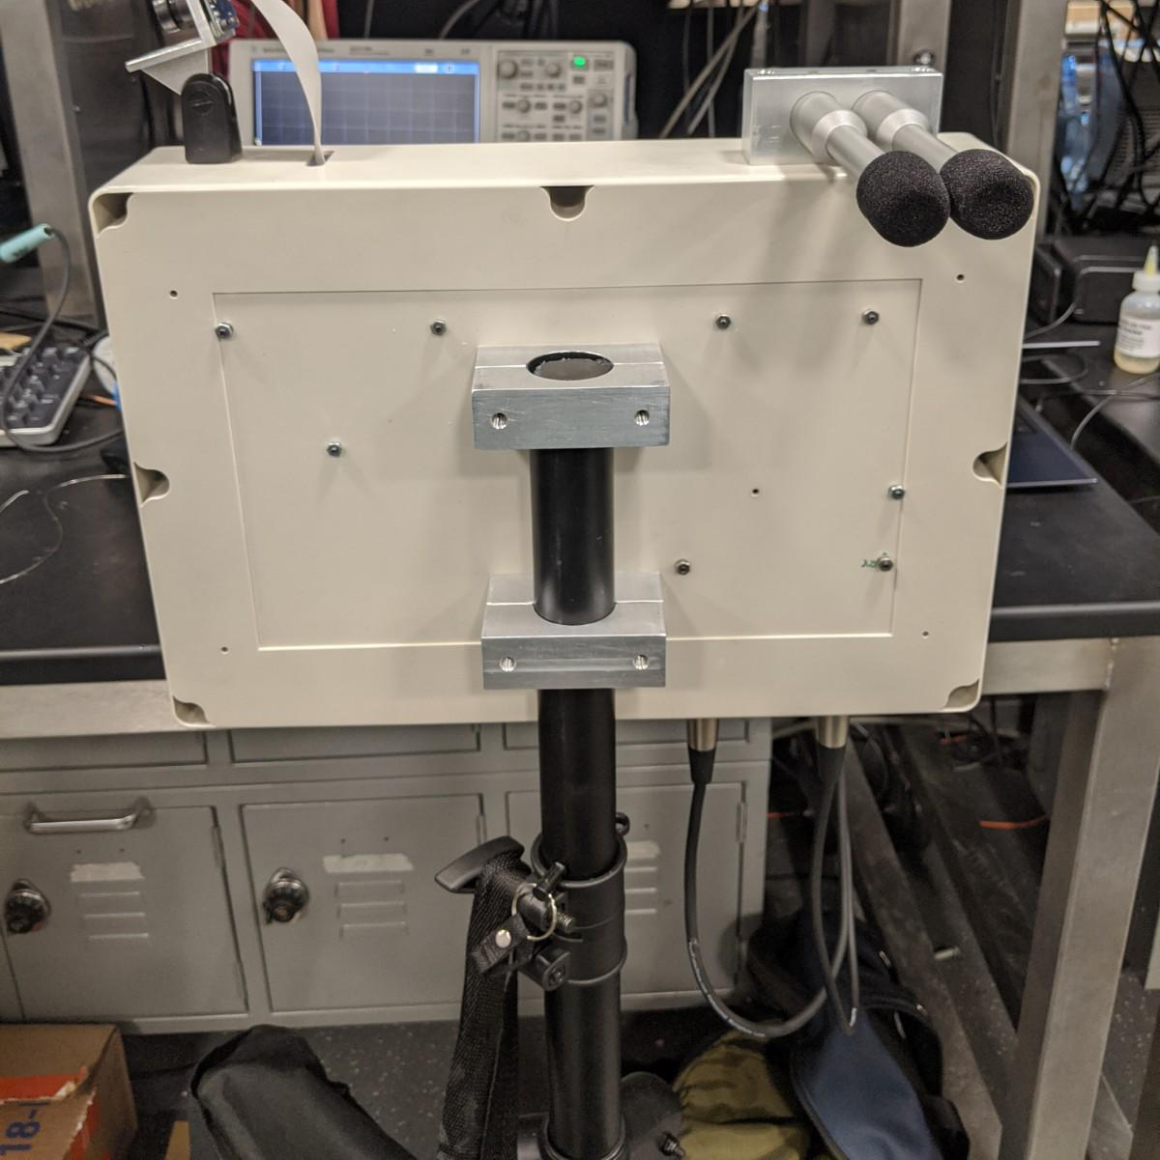
Roadside Sound Meter (One Unit)
Notes:
Charlie

Slide 5
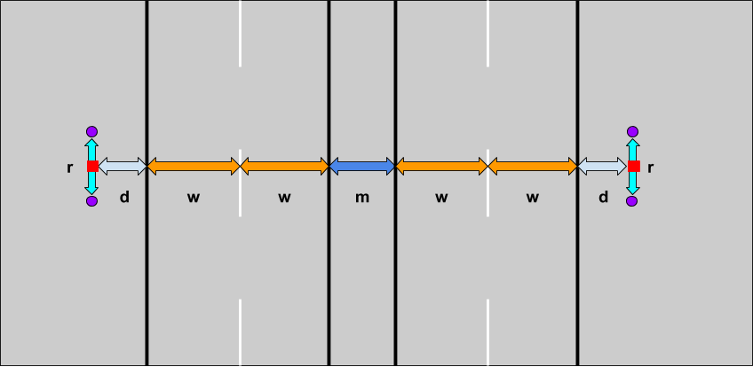
System Overview - Unit Placement
Notes:
Charlie
r - microphone spacing (1 inch)
d - distance from unit to first lane (5-10 feet)
w - lane width (typically 12 feet)
m - median width
Add legend

Slide 6
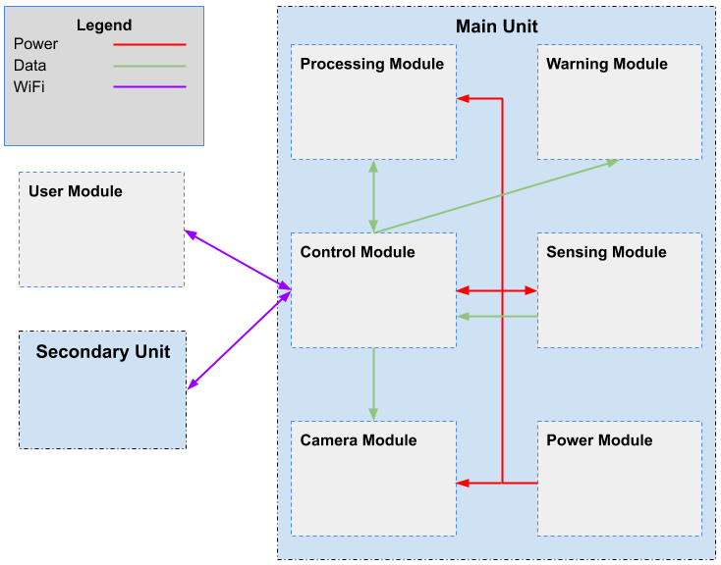
System Overview - Block Diagram
Notes:
Jordan

Slide 7
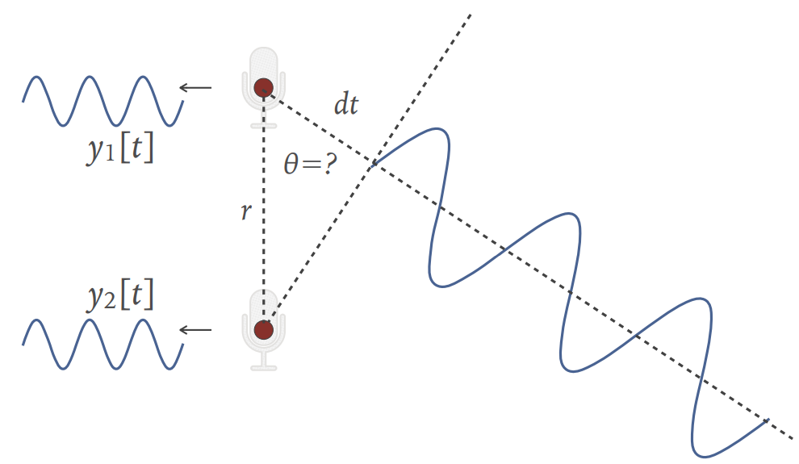
Localization Process
Corrects for phase delay between microphones in an array
Loops over a series of angles to find which gives the highest total energy
Notes:
Jordan
Image: ‘CS 498PS Lecture 6 - Microphone Arrays’ Univ. of Illinois Urbana-Champaign. 2019. [Online]. [Accessed October 28, 2019]

Slide 8
Localization Process
Can convert time delay to a set of phase delays in frequency domain
Each sound divided into multiple frequency ‘bins’ using a Fast Fourier Transform (FFT)
Multiplying each bin with a certain phase delay based on the angle being checked
Use the sum of each phase-corrected frequency bin to find peaks in total energy
Notes:
Jordan

Slide 9
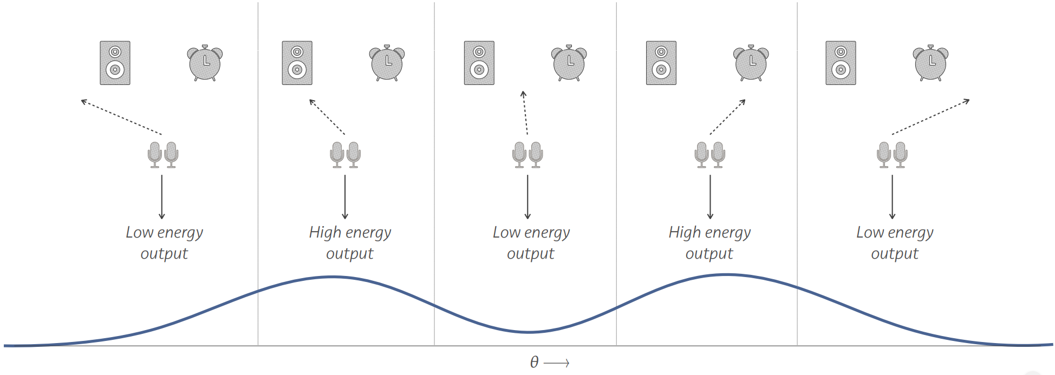
Localization Process
Notes:
Jordan
Image: ‘CS 498PS Lecture 6 - Microphone Arrays’ Univ. of Illinois Urbana-Champaign. 2019. [Online]. [Accessed October 28, 2019]

Slide 10
Localization Process - 2D
Combine localization angle from each array to pinpoint sound sources
Use inverse FFT of sum at each localization angle to get time-domain sound sample
Can use peak of sample as source sound level
Notes:
Jordan

Slide 11
Hardware Overview
Power Module
Converts 12V DC from a battery pack to supply voltage for various components in the project
Sensing Module
Converts the analog signal collected by the microphone to digital format for processing
Processing Module
Performs the localization algorithm to track the source of noise
Control Module
WiFi communication between units. Sends control signal to other modules. Transmits audio data and images
Warning Module
Warns the violating drivers with light
Camera Module
Captures the image of license plate of the violating vehicle
Notes:
Wentao - Our system has six units. The power module supplies voltage for various components in the project. The sensing module converts the analog signal collected by the microphone to digital format for processing. The control module transmits audio data and images, handles the WiFi communication between units, and sends control signals to other modules. The processing unit performs the localization algorithm to track the source of noise. The warning module warns the violating driver with light. The camera module captures the license plate of the violating vehicle.

Slide 12
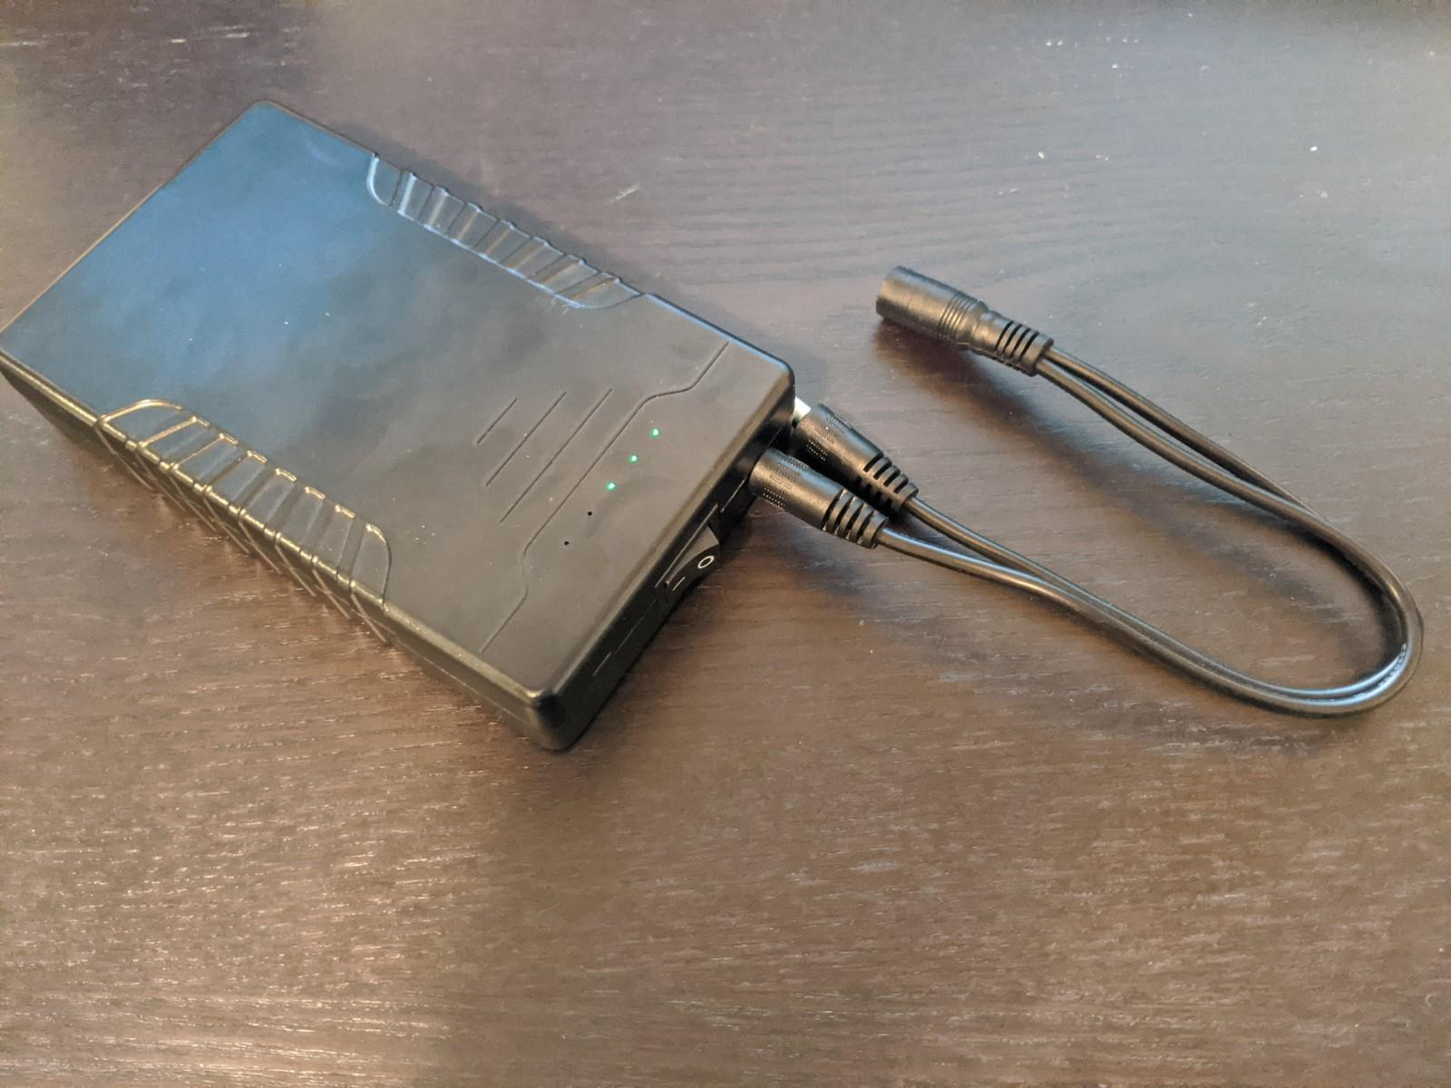
Power Module
12V Rechargeable Battery Pack
LD1117 3.3V Linear Regulator
ADC, ESP32, STM32
LD1117 5V Linear Regulator
Pre-amplifier, ADC
TPS6755 Inverting Converter (-5V)
Pre-amplifier
LM2577 Boost Converter (24V)
Microphone
Power Connector
Power Pins
5V
3.3V
-5V
24V
Notes:
Wentao - The power module consists of four types of converters. The two linear regulators converts the 12V DC from the battery pack to 3.3V and 5V respectively. The 3.3V is used by the ADC, the ESP32 control module, and the STM32 processing module. The 5V is used by the pre-amplifier and the ADC. There is an inverting converter that inverts the 5V DC to supply the negative bias of the pre-amplifier. The boost converter boosts 5V to 24V to power the microphones.

Slide 13
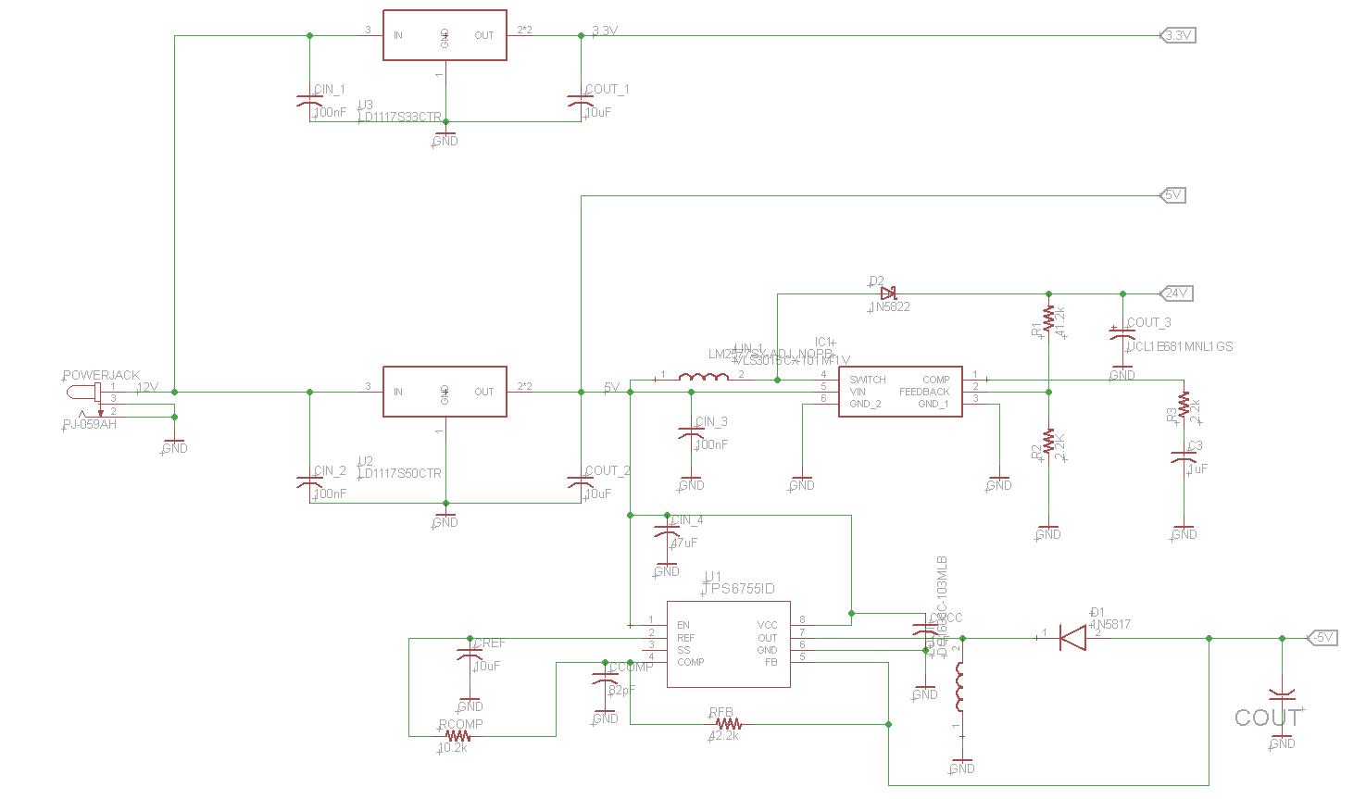
Power Module - Schematic
3.3V Linear Regulator
DC Connector
5V Linear Regulator
Boost Converter
Inverting Converter
Notes:
Wentao - From the schematic we can clearly see that the linear regulators directly take input from the 12V battery, while the inverting converter and the boost converter are supplied by the 5V linear regulator.

Slide 14
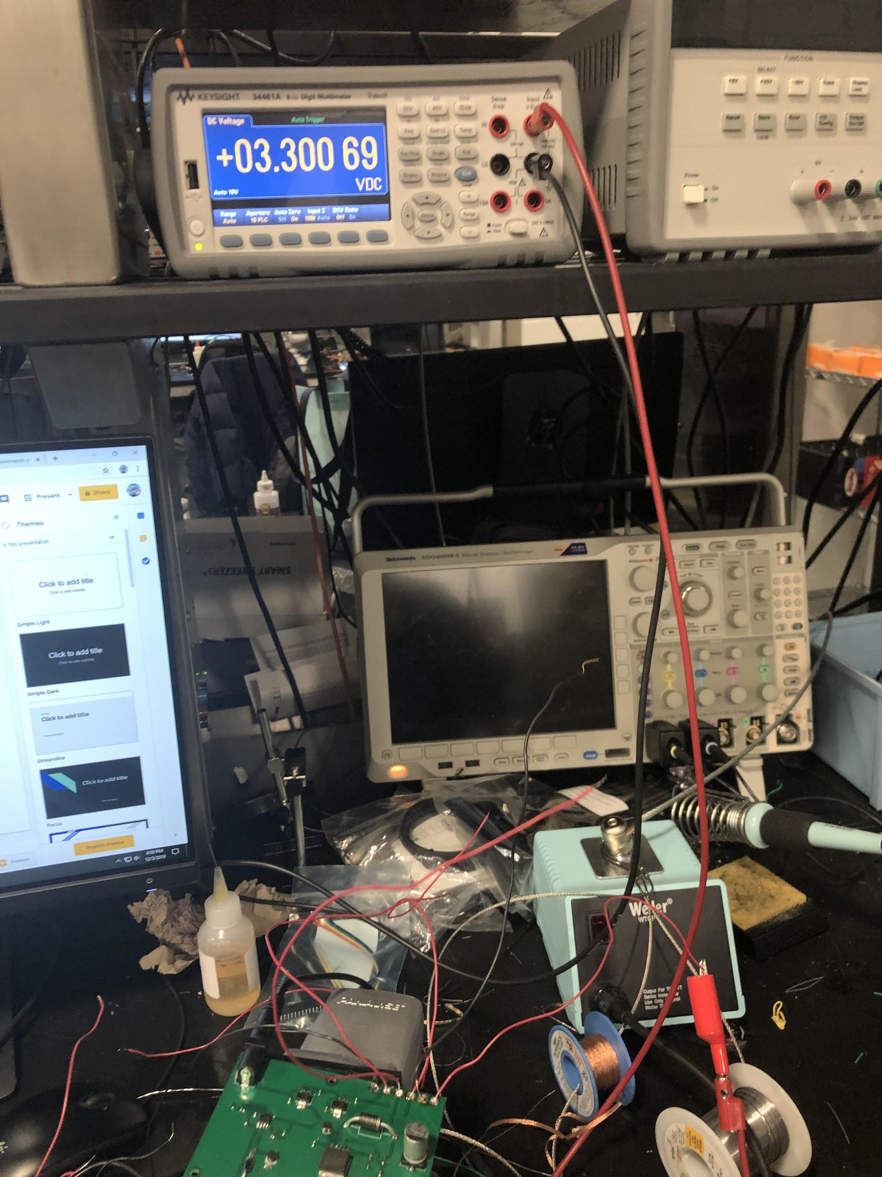
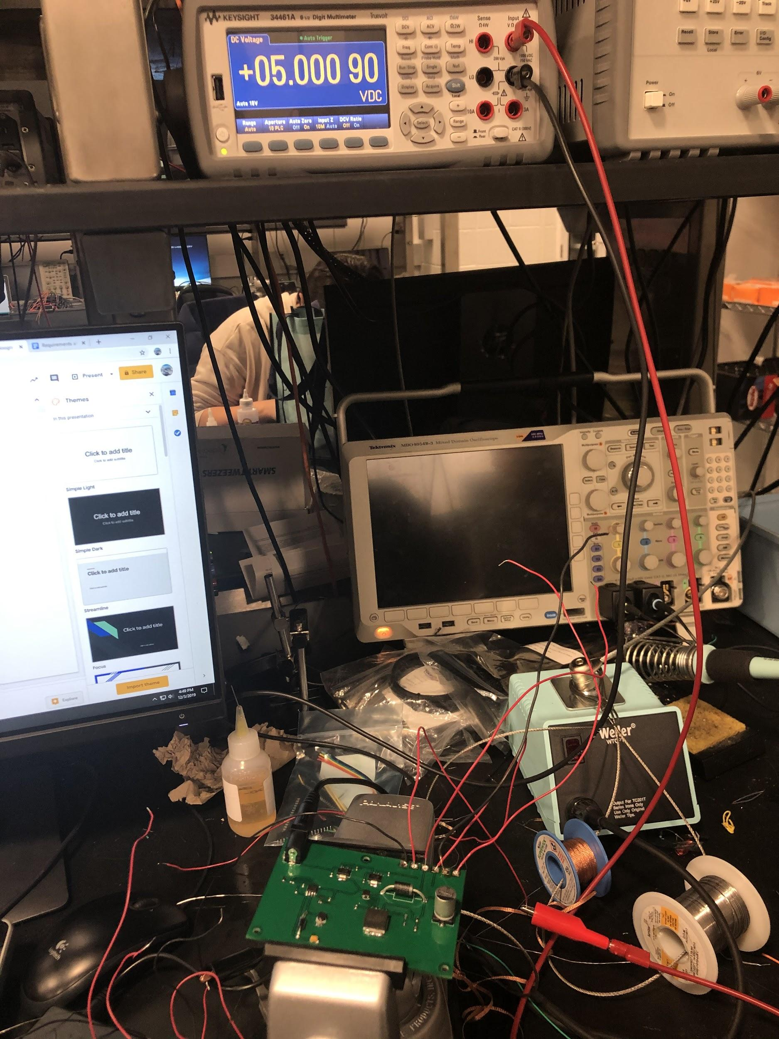
Power Module - Verification
Notes:
Wentao - We verified the power module by connecting the battery and measuring the output from each converter. We can see that the linear regulators are outputting the expected values here.

Slide 15
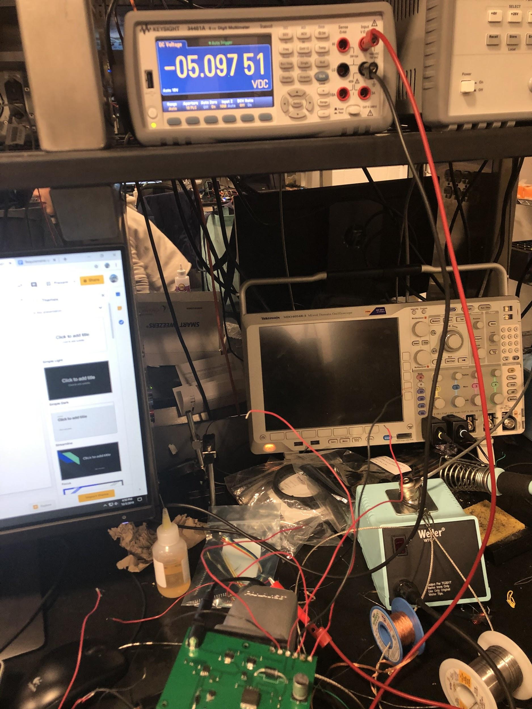
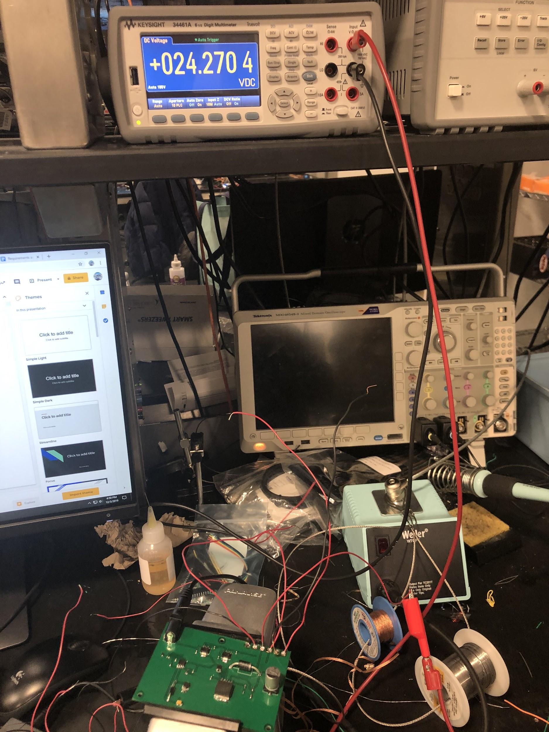
Power Module - Verification
Notes:
Wentao - From these pictures, we can show that the inverting converter and the boost converter are also working in the expected way.

Slide 16
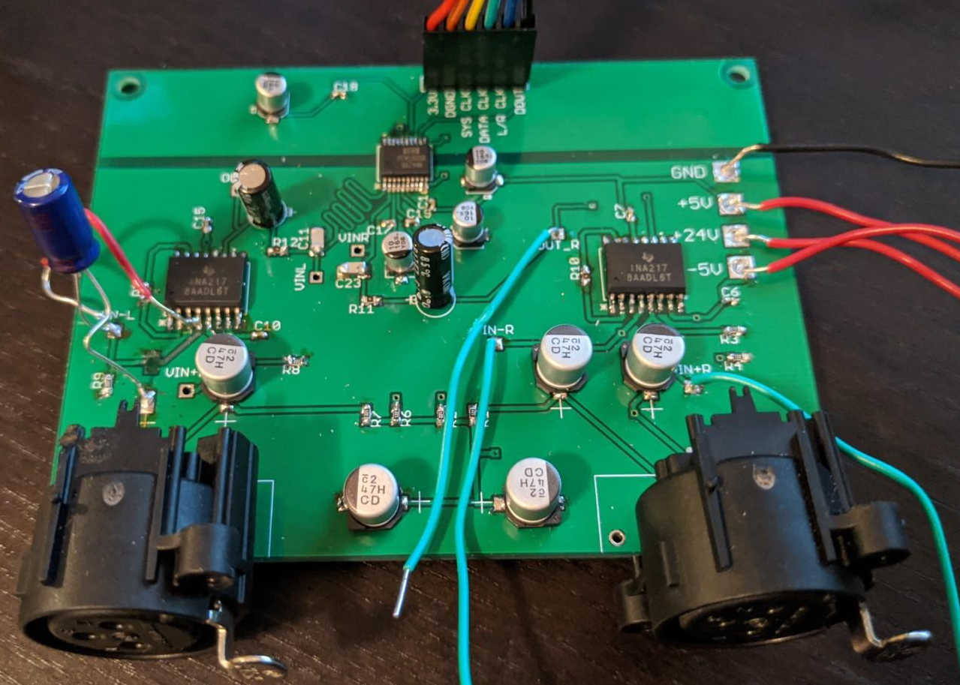
Sensing Module
Condenser Microphone
+24 V Phantom Power
INA217 Preamplifier
PCM1803A Analog-to-Digital Converter
2 channels
To control module
A/D Converter
Preamplifier
XLR Connector
Notes:
Wentao - The sensing module consists of three parts, which are the microphone, the preamplifier, and the Analog-to-digital converter. Two microphones are used in one sensing module to produce 2-channel audio signals required by the localization algorithm.

Slide 17
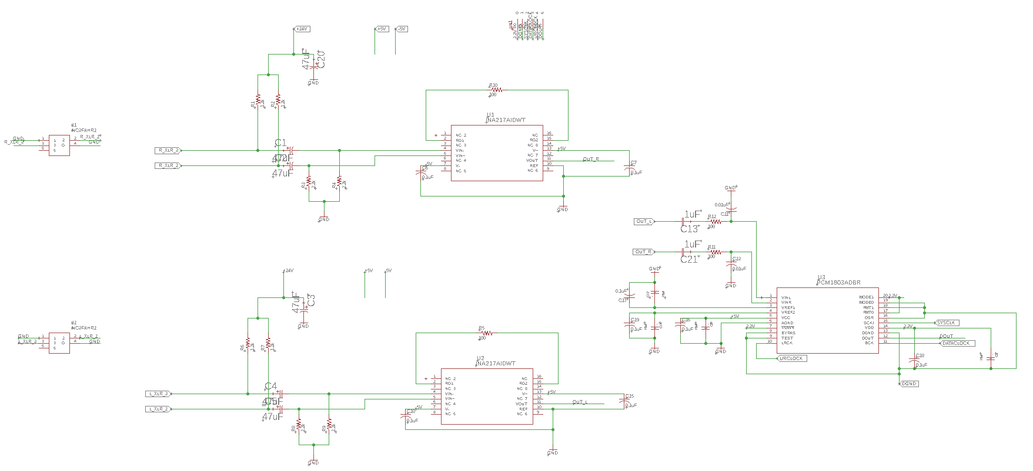
Sensing Module - Schematic
Preamplifer Right Channel
XLR Connectors
ADC
Preamplifer Left Channel
Notes:
Wentao - The schematic shows that the microphone is connected to the pre-amplifier by the XLR connectors. The output of the preamplifier is connected to the left and right channel of the ADC.

Slide 18
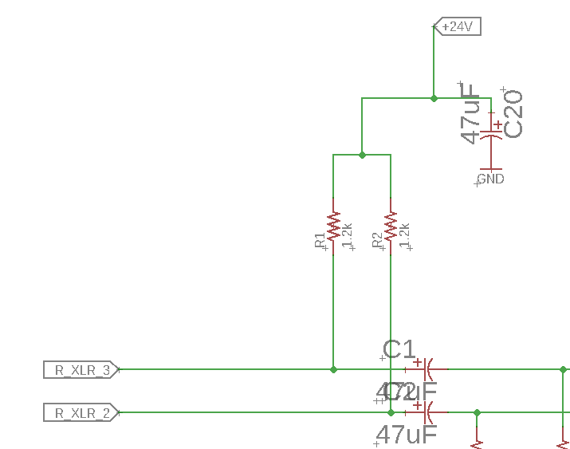
Sensing Module - Phantom Power Circuit
Provides 24V DC power supply for the microphone
Resistors provide current path
Capacitors filter out the DC component to the preamplifier
To Preamp
Notes:
Wentao - We created a simple circuit at the input of the pre-amplifier to power the microphone. As shown by the schematic, the resistors provide current path for the voltage source. The 24V DC voltage is supplied to the microphone via the XLR connector, but it is filtered out by the capacitor in front of the pre-amplifier, since only the AC part from the microphone is desired.

Slide 19
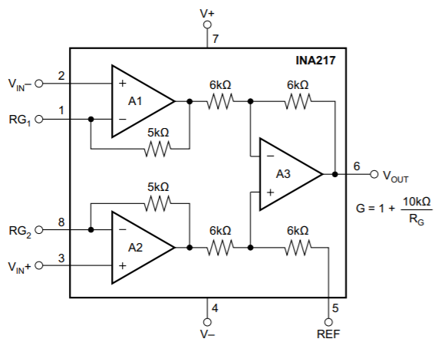
Sensing Module - Preamplifier
Amplifies the audio signal from microphones (~mv)
Gain of 100 V/V set by exterior resistor
Output to ADC
Requirement: Linear gain and phase over human hearing range (20 - 20000 Hz)
Gain resistor
Notes:
Wentao - The preamplifier amplifies the audio signal from microphones, which is in the range of millivolts. We decided to use a gain of 100, and so we are using an exterior resistance of 100 ohms from the equation. The amplified signal is sent to the ADC. We require the preamplifier to have linear gain and phase over human hearing range, and its verification is shown later.

Slide 20
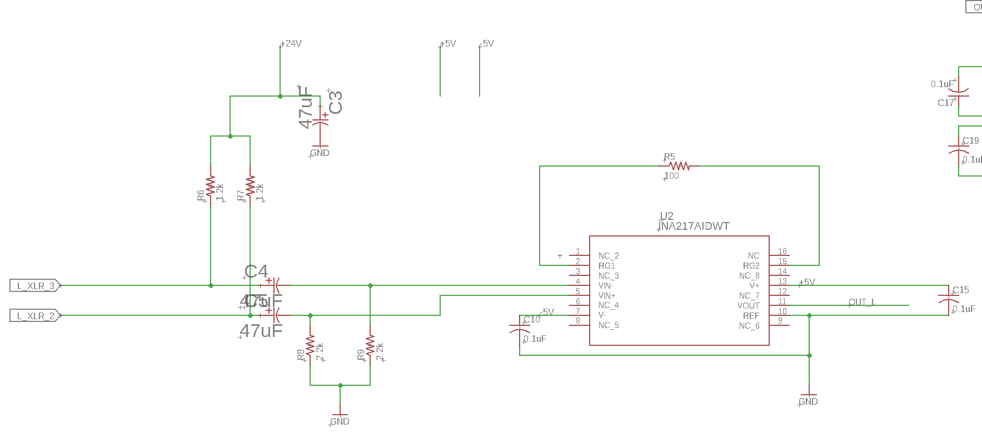
Sensing Module - Preamp Schematic
Notes:
Wentao - The schematic clearly shows the phantom circuit at the input and the placement of the gain resistor.

Slide 21
Sensing Module - Analog-to-Digital Converter
Samples the analog audio signal
Converts to 24-bit 2-channel I²S format
44100 Hz Sampling Rate
Output to ESP32 Control Module
Digital
Analog
Notes:
Wentao - The ADC converts the analog audio signal from the pre-amplifier to 24-bit 2-channel I2S format. The sampling rate is 44100 Hz, which is larger than double the maximum of human hearing range. The output is sent to the ESP32 control module. The black line in the picture shows the division of the analog and digital ground for noise suppression.

Slide 22
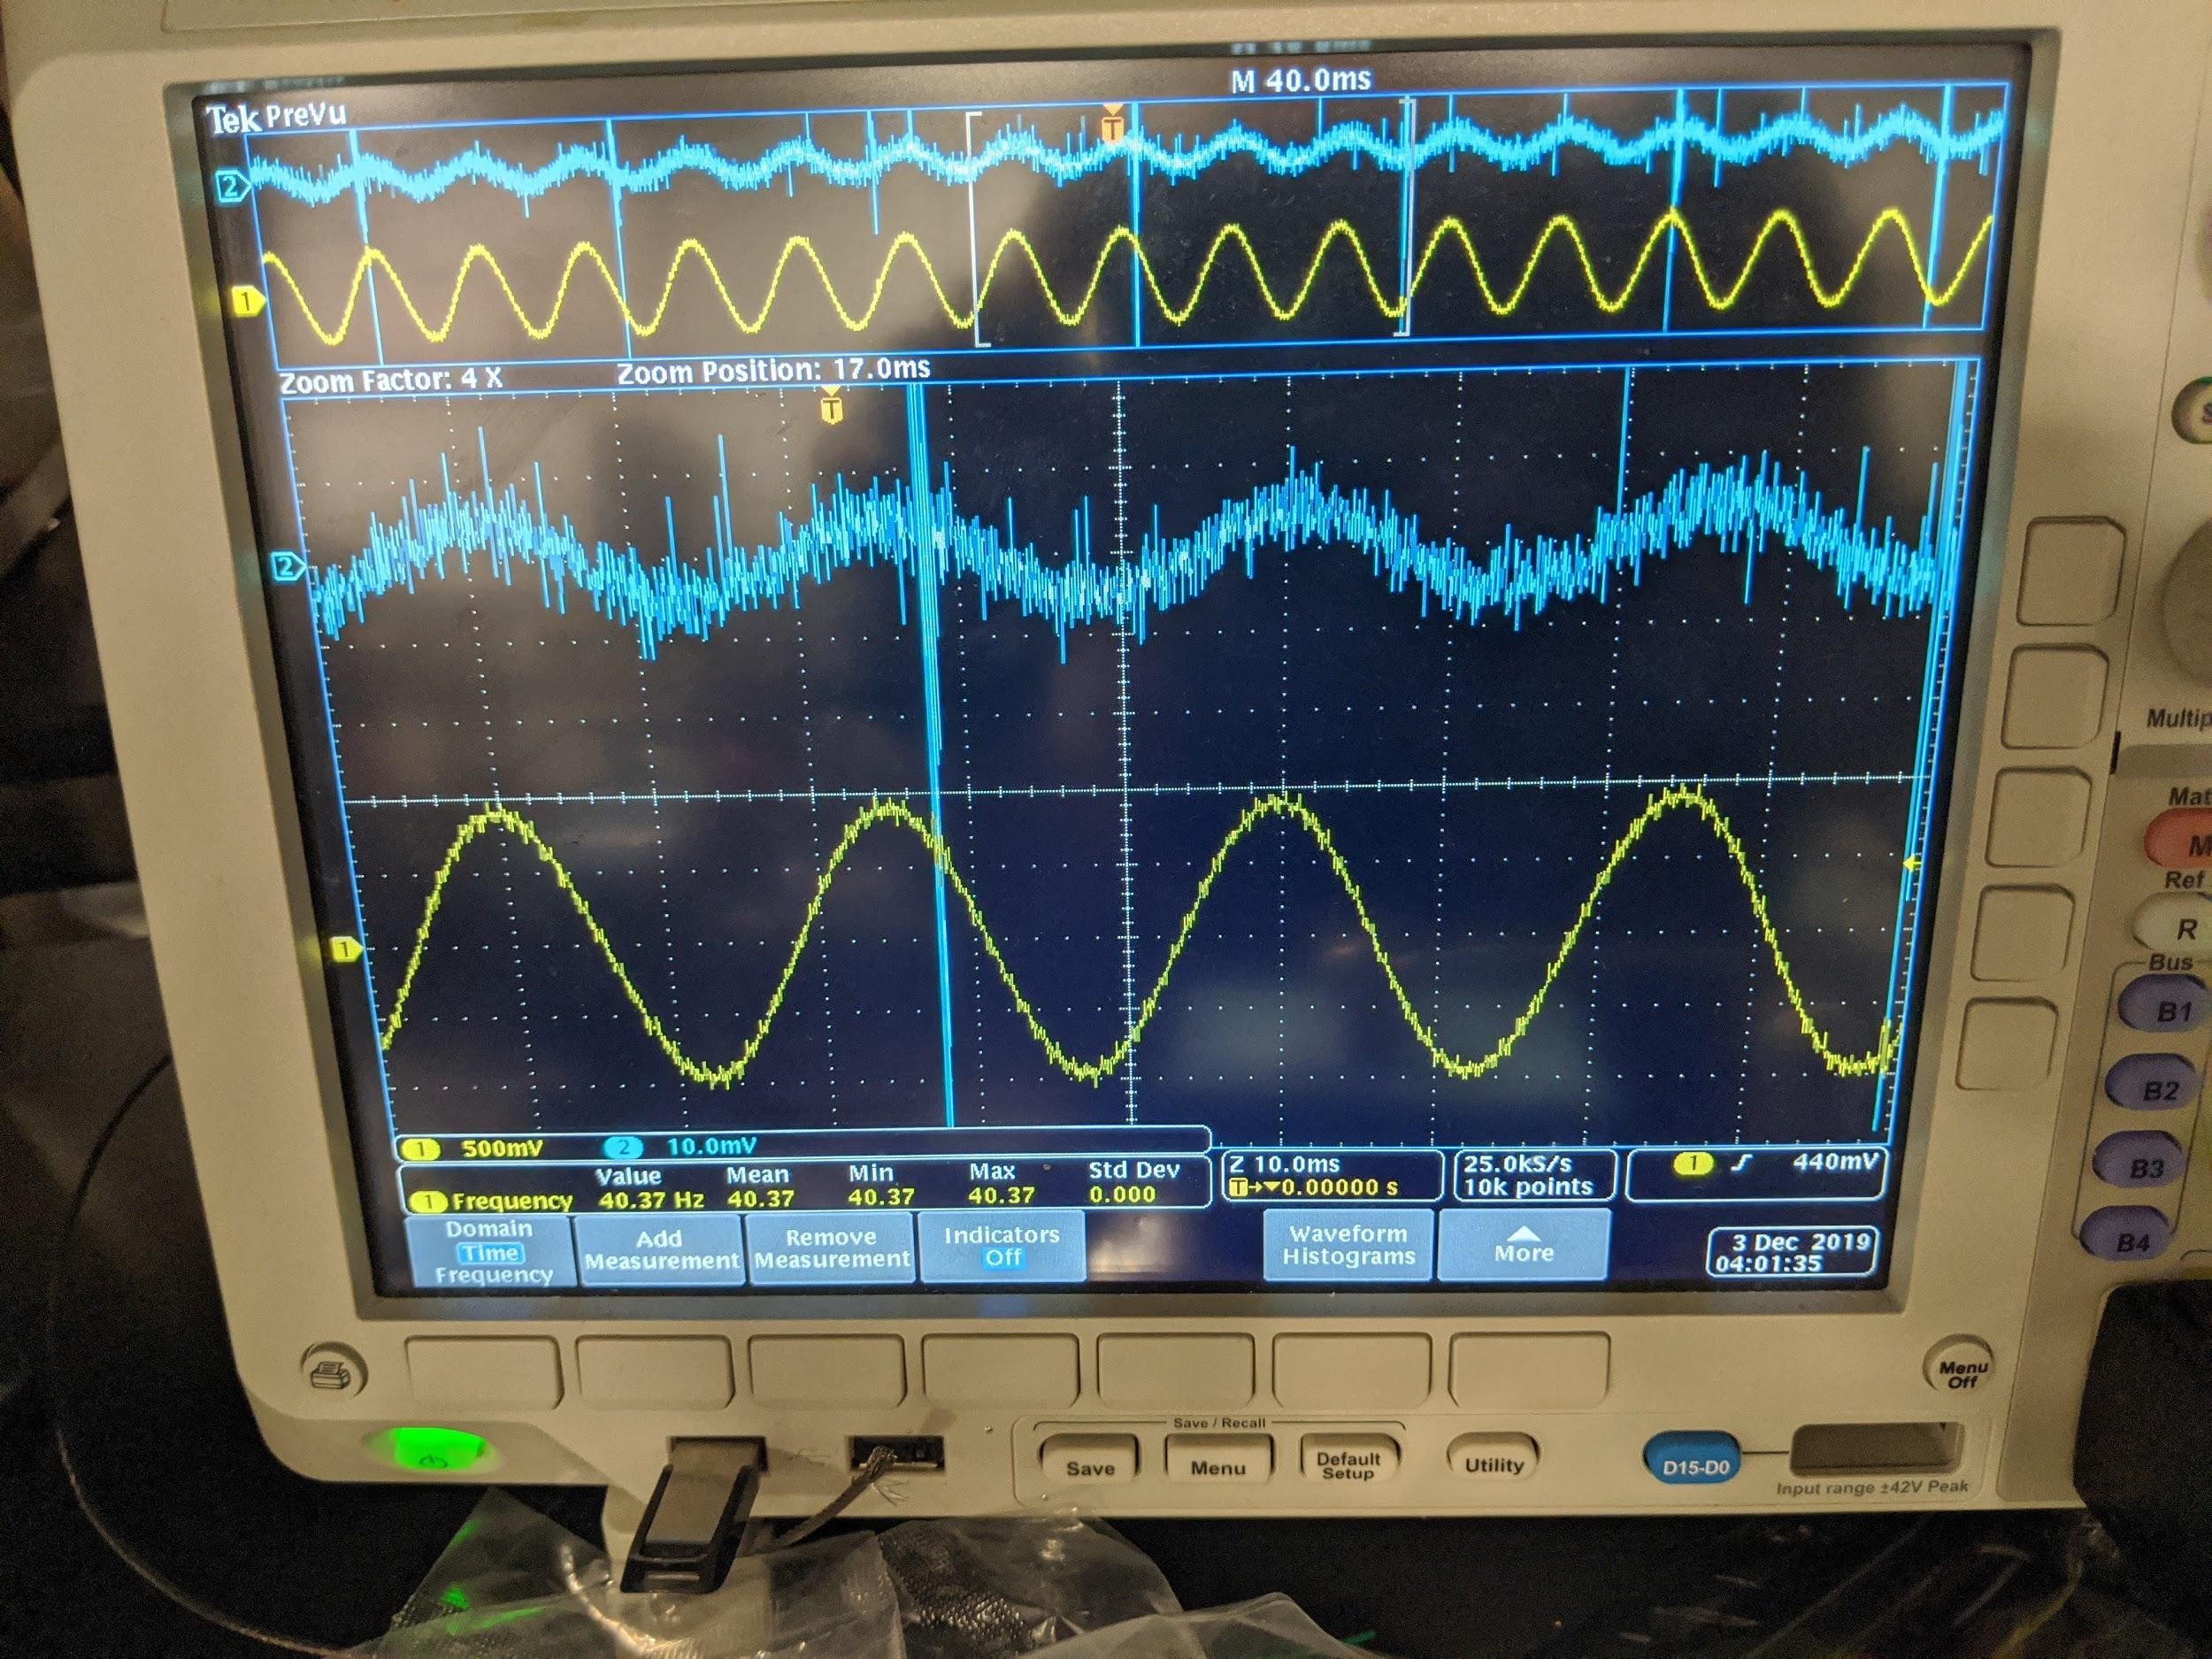
Sensing Module - Verification
10mVpp (2 channels)
Differential
2Vpp
Ground-referenced
Notes:
Wentao - We used the waveform generator to verify the pre-amplifier. The positive and negative inputs of the pre-amplifier are supplied with sine waves. They have the same frequency and amplitude, but the phase difference is 180 degrees. The picture here shows 10 mV peak to peak voltage input, and the output is 2V peak to peak. This is caused by the sum of the differential signals being converted to ground-referenced signals. We can therefore verify the gain is 100. No phase delay is displayed.

Slide 23
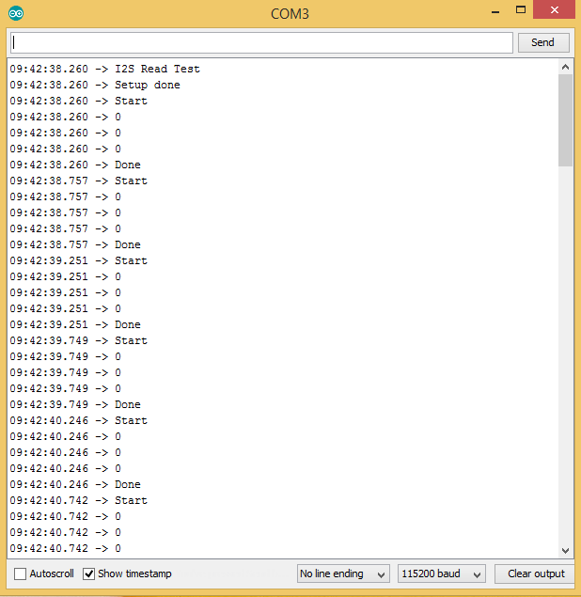
Sensing Module - Verification
Notes:
Wentao - Here we can show that the ADC is outputting correct data to the ESP32 control module. They are all zero because of silence.

Slide 24
Processing Module
Handles entire localization algorithm
Needs to process five times every second, or 200 ms per update
Processing Speed Test Results - 10 Cycles per Run
Test # | 1 | 2 | 3
Average Time/Cycle | 554 ms | 570 ms | 563 ms
Processing Time Reduction Recommendations
Remove some central angles where 2D localization precision is higher than necessary
Test if smaller FFT lengths gives same accuracy
Notes:
Jordan

Slide 25
Control Module - Physical Connections
I²S Audio - Sensing Module
I²C - Camera Module
SPI - Processing Module
Faster than I²C - no acknowledge bit
Send information bytes in first message
Send data bytes in second message
After testing, I²C would have been fast enough
6144 audio bytes (plus 1 information and 4 data header bytes)
About 6.15 ms total transmission time at 8 MHz (SPI)
About 6.92 ms total transmission time at 8 MHz (I²C)
SPI - Warning Module
Could be replaced with I²C connection to reduce pins used on ESP32
Could be replaced with direct GPIO connections to remove GPIO expander
Notes:
Jordan

Slide 26
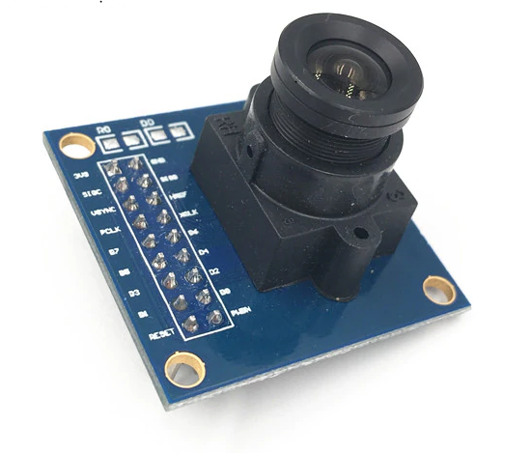
Camera Module
OV7670 without FIFO
Picture sent to ESP32 directly
VGA resolution (up to 640 * 320)
Notes:
Charlie

Slide 27
User Module - Wireless Connections
Wi-fi capability (2.4GHz)
Serving directly from ESP 32 through HTTP
MQTT is used to announce the IP address
View the image or the video with HTML
Notes:
Charlie

Slide 28
Future Work
Faster microprocessor (ARM Cortex M7 or A5 series)
Test system using audio directly from sensing module
Better camera with higher resolution and longer focal length
Solar panels for recharging battery
Server for storing captured pictures
Notes:
Charlie

Slide 29
Thank You!
Contact: haoy2@illinois.edu, jrodier2@illinois.edu wentaoj2@illinois.edu
Notes:
Charlie

