Slide 1
Anti-freeze Water Pipe System
Qinru Li, Rui Lan, and Zichen Liang
ECE 445 Group #12

Slide 2
Background
Water damage is the second-most filed claim in the US
250 gallons of water leak daily
The average residential insurance for damage from a broken pipe is over $10,000
93% of water damage is preventable had the right precautions been taken
Frozen water pipe tempts to burst.
Source: https://www.arccontracting.com/water-damage-statistics/

Slide 3
Introduction
An anti-freeze water pipe system
Real-time temperature measurement of the water pipe
110V AC power supply supported to heat up to the pipe preventing it from freezing.
Backup power source in case of blackout
Embedded Wi-Fi system sending system data wirelessly to user
Notes:
Power system: when blackout happens, an alternative battery source will keep the system functioning
WiFi: The user can therefore know the real time temperature of the water pipe and be alerted if the temperature is too lower without physically be present near the pipe.

Slide 4
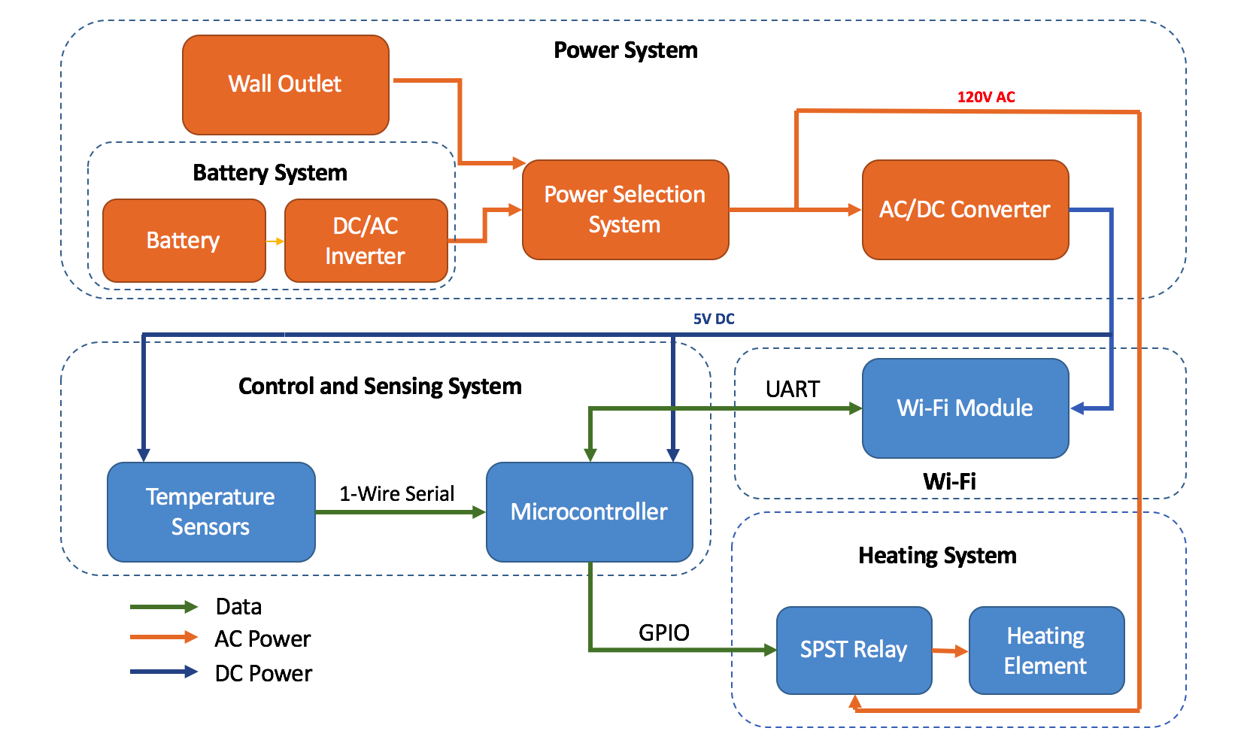
System Overview
Notes:
Power System
Two power sources: Wall outlet and battery
Power Selection System
AC/DC Converter: provide 5V DC power to the control and sensing system and WiFi module
Control and Sensing System
Temperature Sensors: acquire the temperature data
Microcontroller: decision-making center: communicate with temperature sensor and WiFi, control the heating system
Heating System
SPST Relay: low voltage control switch
Heating Element
Wi-Fi
ESP8266 Module sending data to user wirelessly

Slide 5
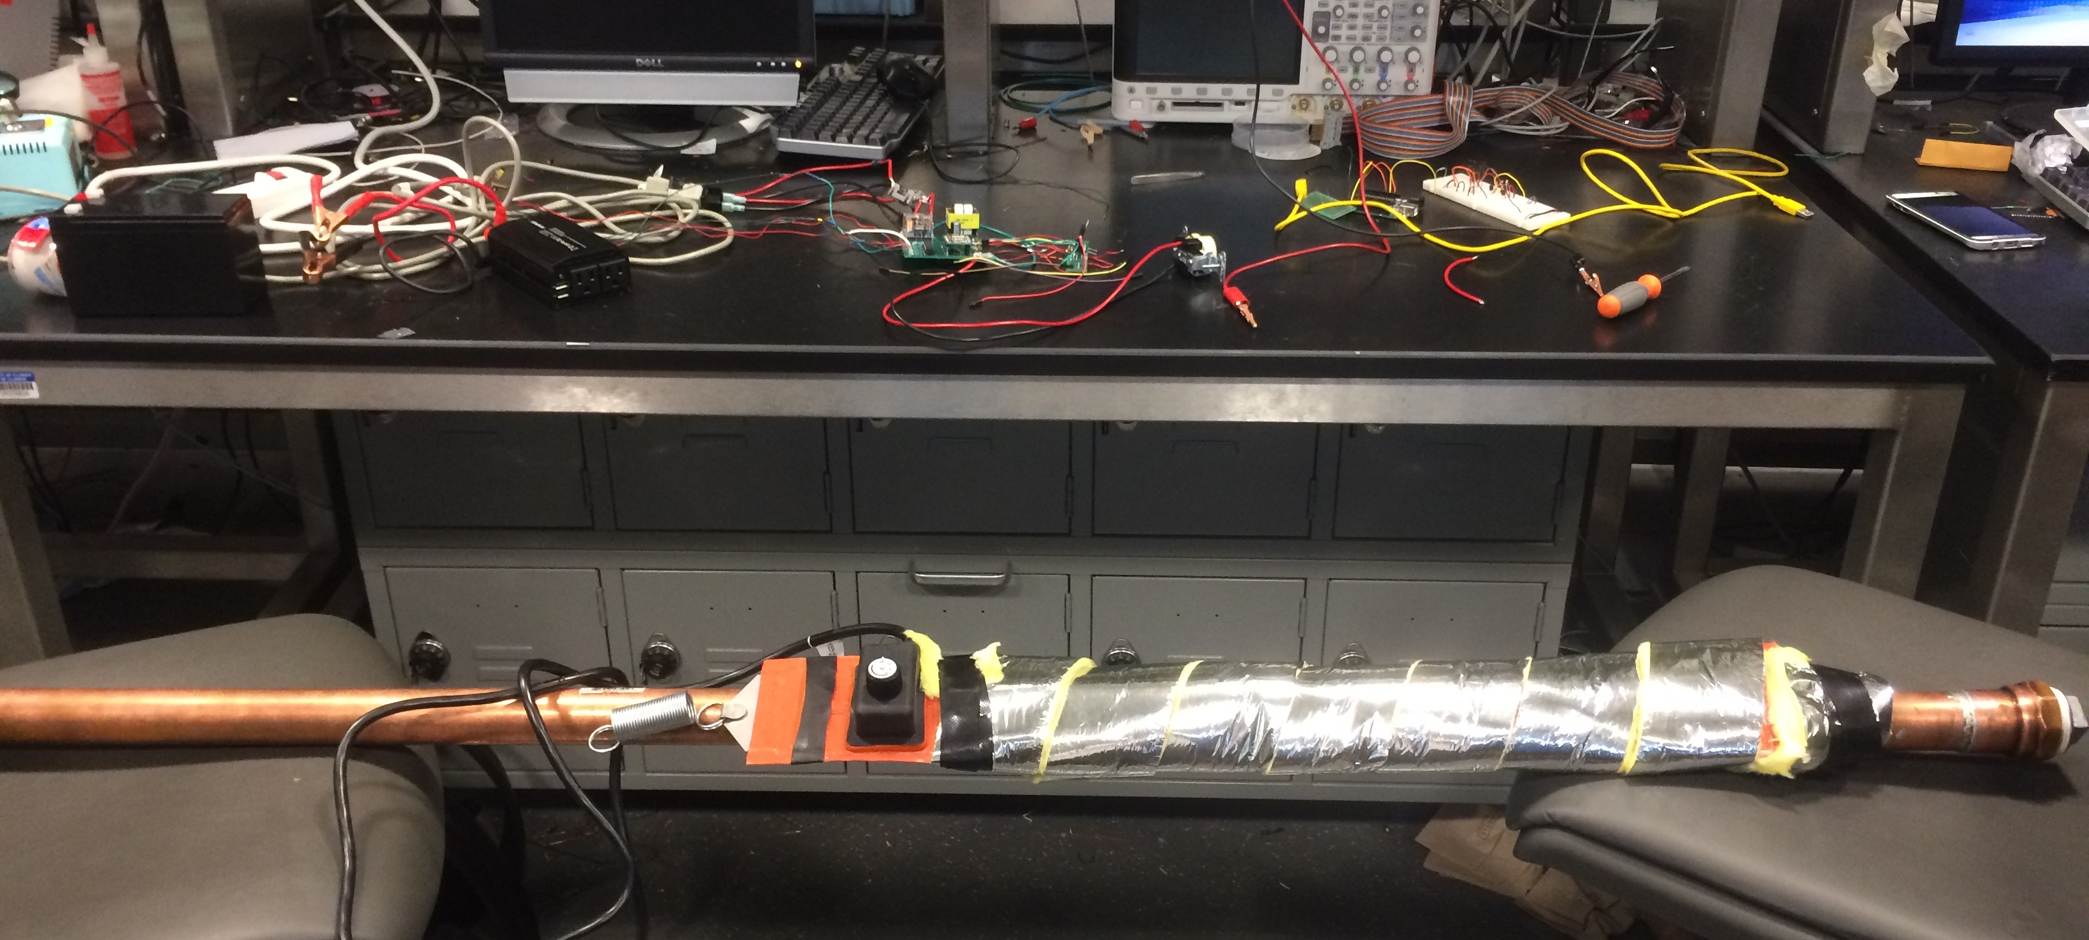
Physical Design
Overview
Notes:
5-feet long water pipe
Easy to install and disassemble

Slide 6
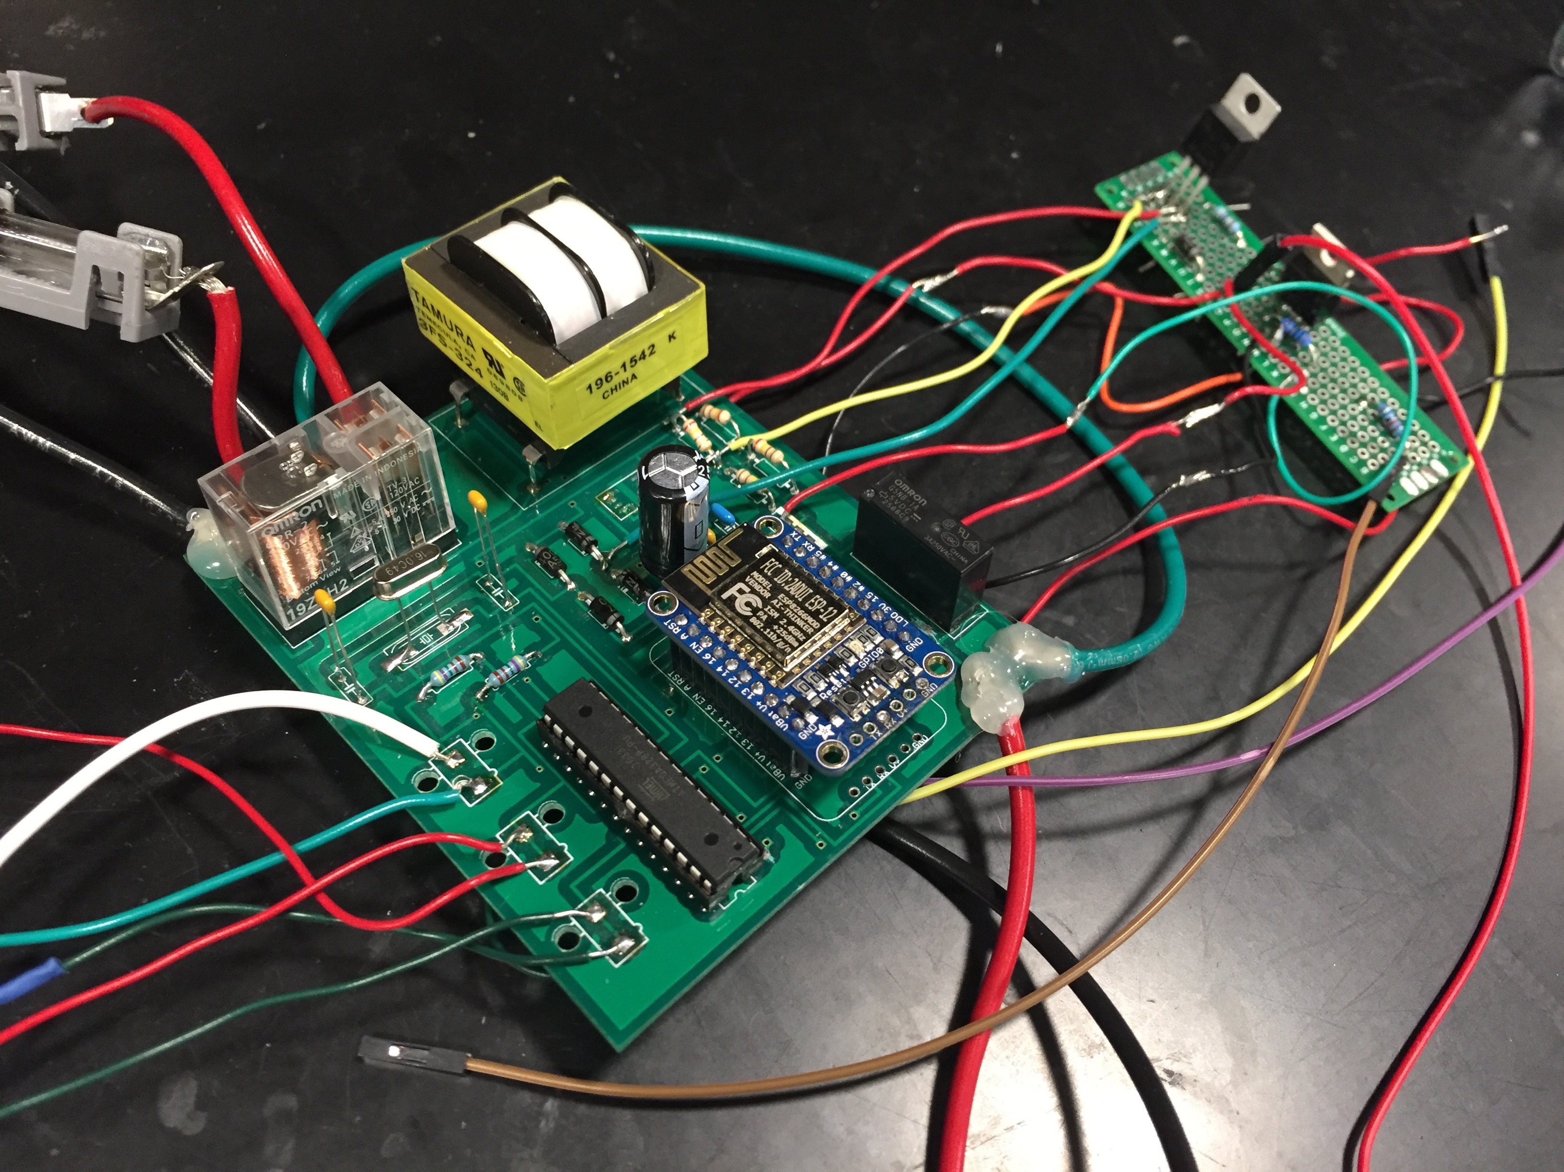
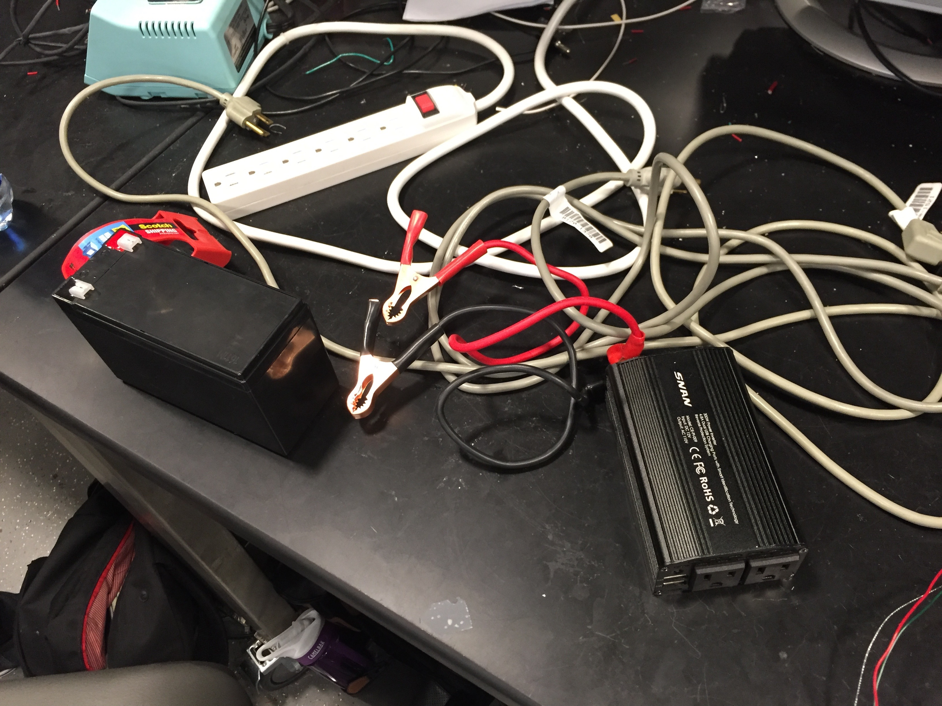
Physical Design
PCB
Battery

Slide 7
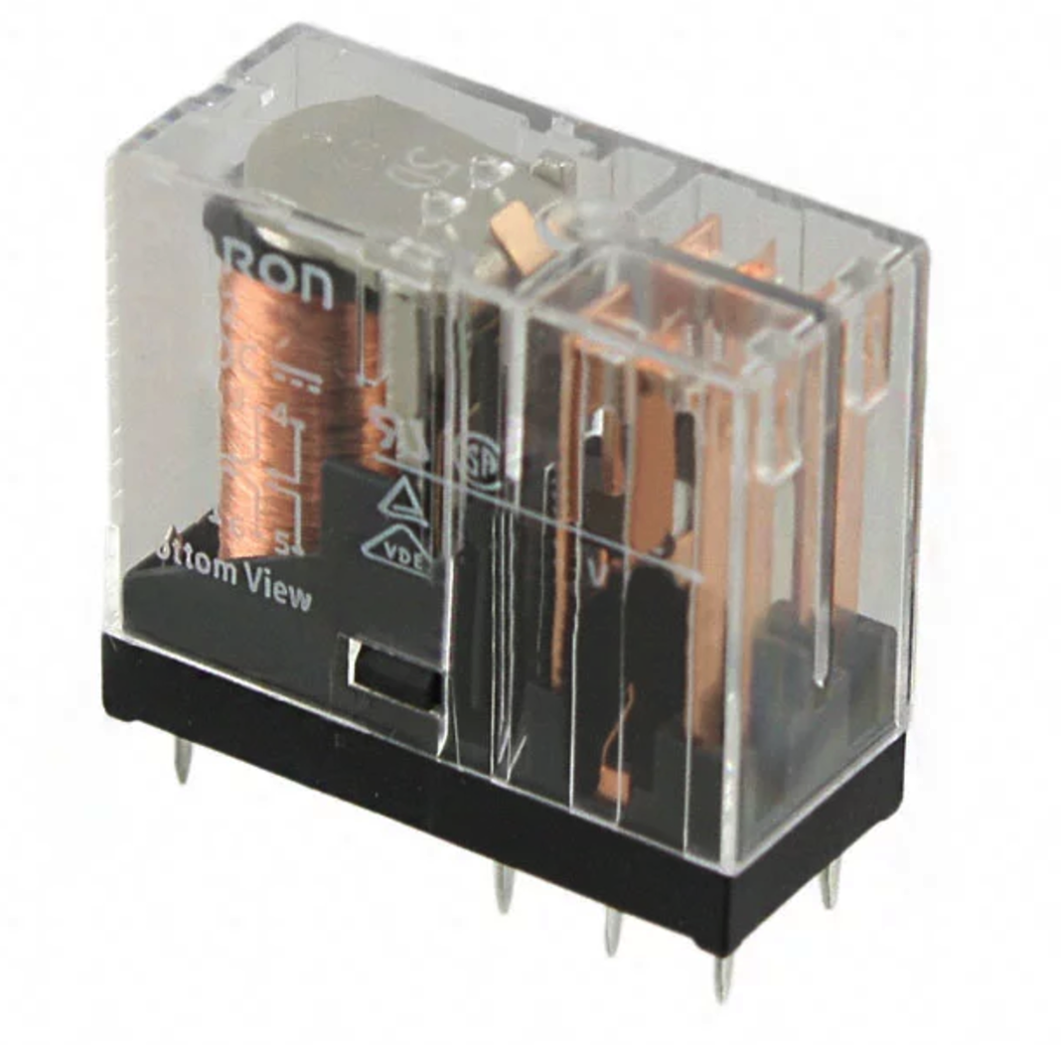
Power Selection System
Our power selection system selects from the power of wall outlet and battery system
The priority is given to the wall outlet
Backup battery system is used when wall outlet is not available
DPDT Relay
Source: https://www.digikey.com/product-detail/en/G2R-2-AC110/Z5357-ND/1789726

Slide 8
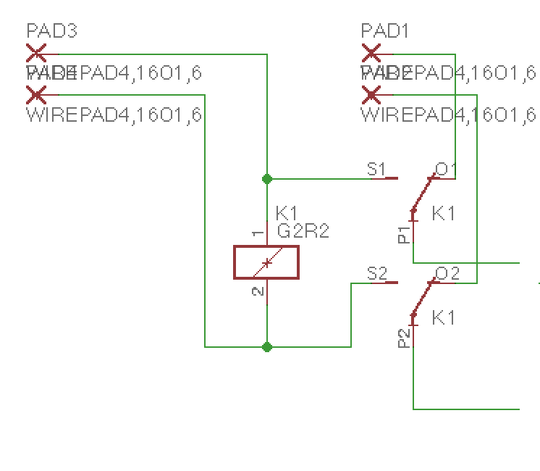
Power Selection System
Input: Wall Outlet
Input: Battery System
Coil
Output:
To AC/DC
Converter
and Heating
System

Slide 9
Power Selection System: Result
When coil is 120V AC, output chooses power from wall outlet
When coil is 0V, output chooses power from battery system

Slide 10
AC/DC Converter
Converts 110-120V AC to 5V DC
Input: Power Selection System
Output: Controller, Temperature Sensors, and Wi-Fi

Slide 11
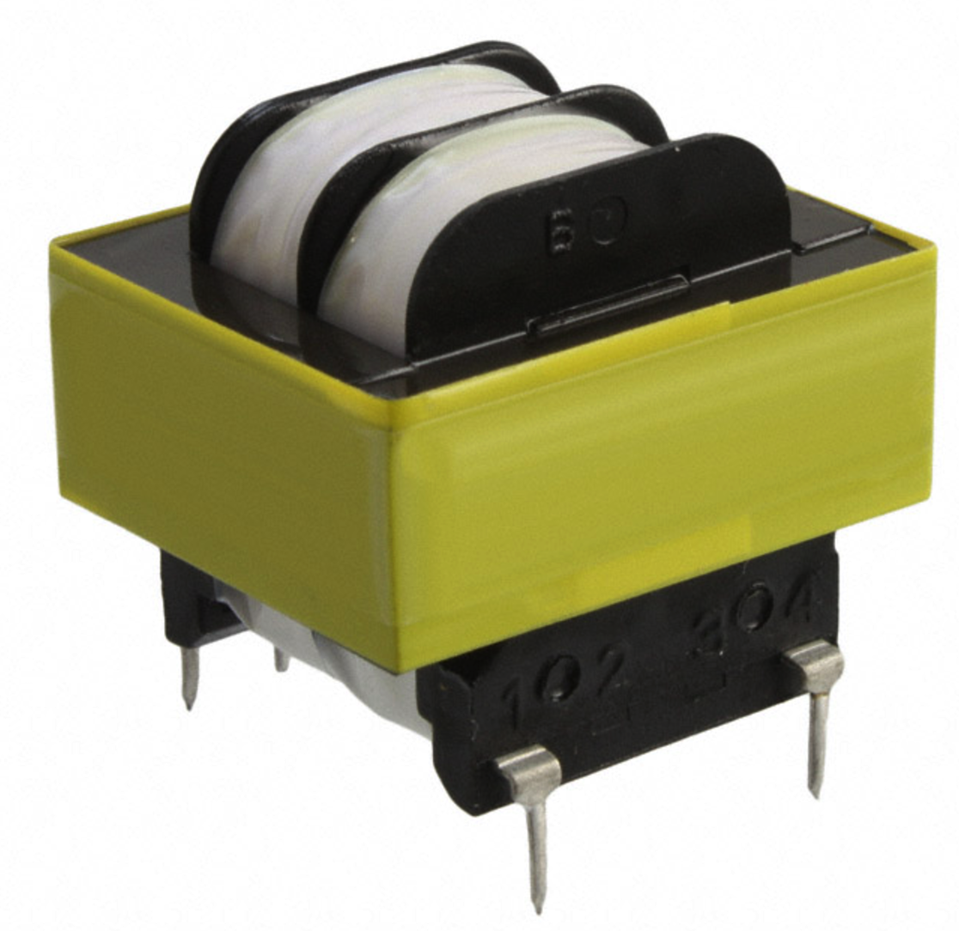
AC/DC Converter: Transformer
Primary Side: 110-120V AC from Power Selection System
Secondary Side: 12V AC voltage which will be feed into full-wave rectifier
Source: https://www.digikey.com/product-detail/en/tamura/3FS-324/MT2218-ND/285612

Slide 12
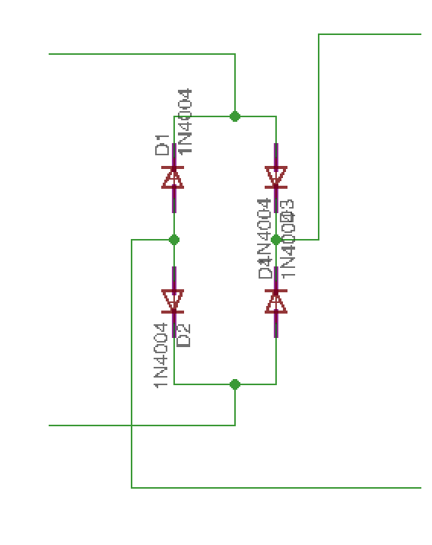
AC/DC Converter: Rectifier
Full-wave rectifier
Convert AC voltage into DC voltage
Another 470uF capacitor is used to further smooth the DC voltage
Rectifier Schematic

Slide 13
AC/DC Converter: Voltage Regulator
After the rectifier, a low-dropout (LDO) regulator provides stable 5V DC
Maximum current:1.5A
The output powers up temperature sensors, controller, and Wi-Fi module
Result: Our AC/DC Converter works well which gives us stable 5V

Slide 14
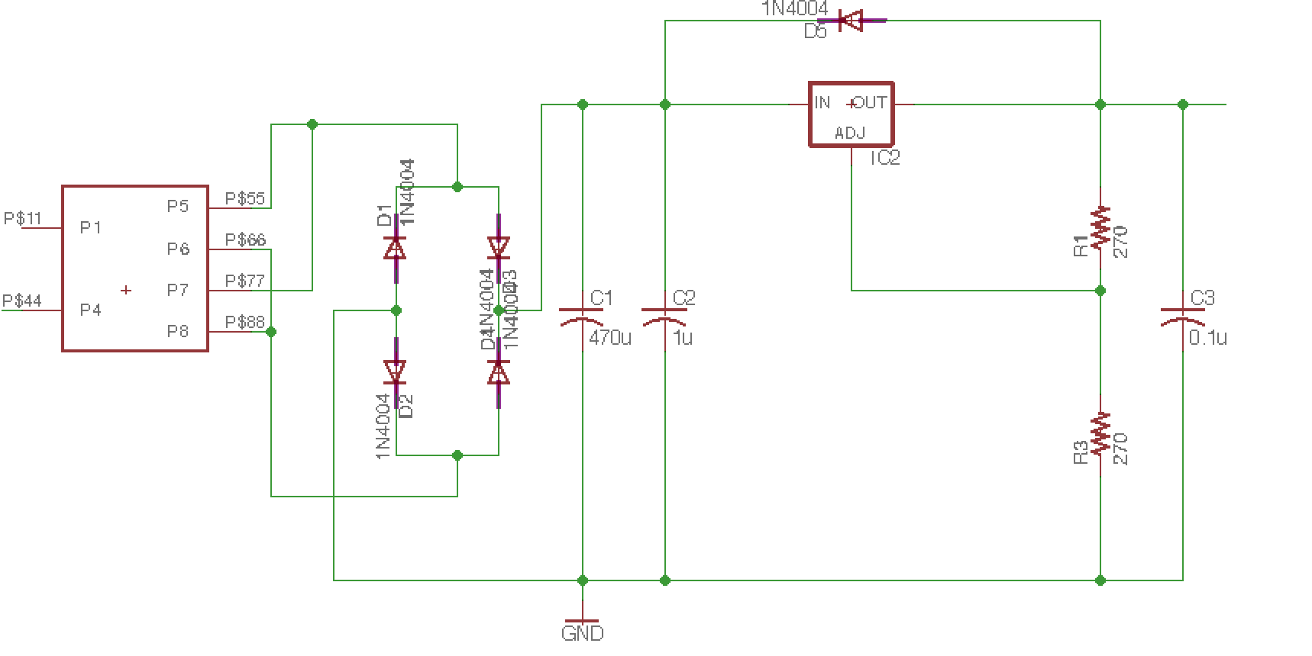
AC/DC Converter: Schematic
Transformer
Rectifier
Voltage Regulator

Slide 15
Temperature Sensor
DS18B20
A digital thermometer provides Celsius temperature measurements
User selectable resolution
1-Wire bus protocol
Requires minimal wiring
Operating temperature range from -55$°C$ to 125 $°C$
Max accuracy to $±$0.5$°C$
Notes:
Resolution: 9-bit to 12-bit
Communicates over a 1-Wire bus protocol which requires minimal wiring
Need a image here

Slide 16
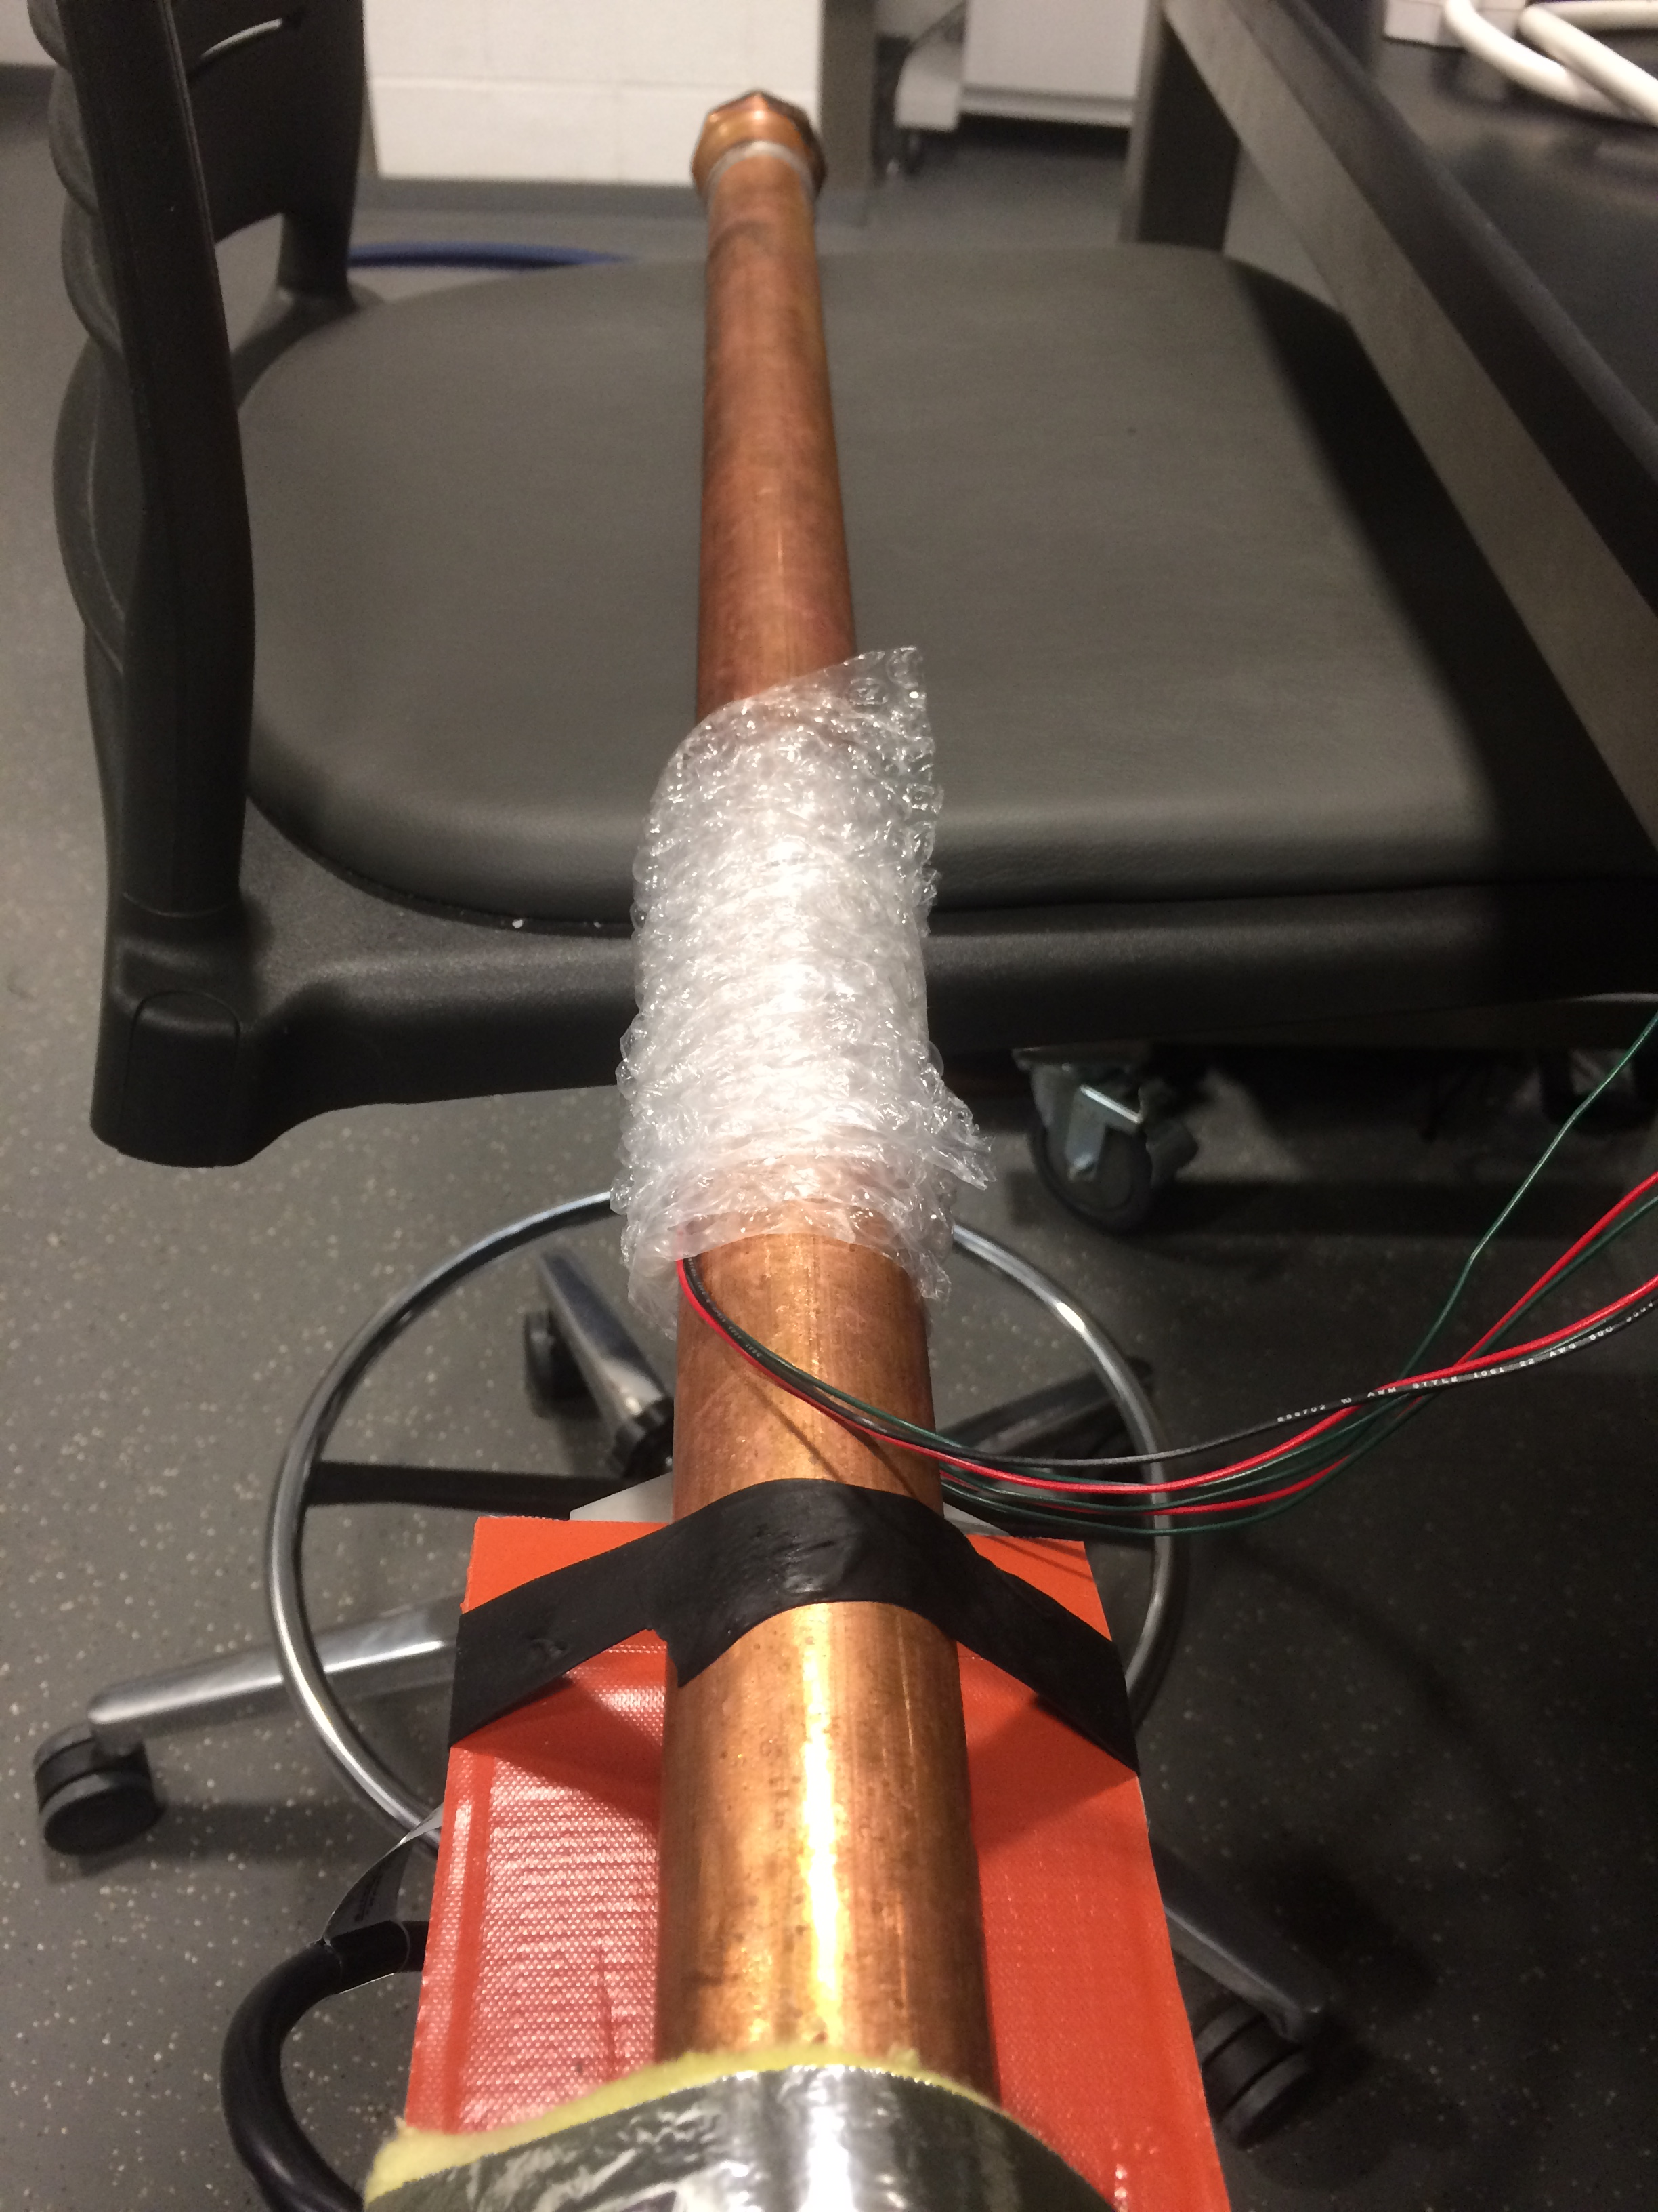
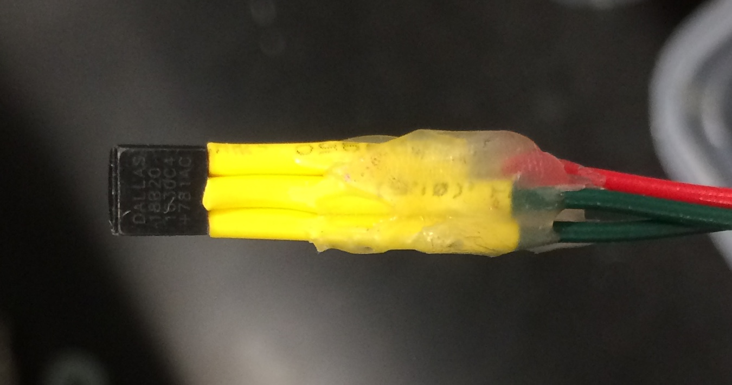
Sensor: Physical Design
Bubble Wrap for Insulation
Multiple placements for better accuracy
Waterproof design
Double layer protections: heat shrink & water-proof glue
Notes:
To prevent the external influence from environment, we use bubble wrap for insulation
Two sensors are placed in different position of the water pipe: each on each side of the water pipe. It will helps us get better measurement of the actual temperature of the water pipe when we take the average of the temperature sensor data.
All electrical connections are insulated by heat shrink and water-proof glue

Slide 17
Microcontroller
ATmega328P
Low power CMOS 8-bit microcontroller
Supporting Arduino IDE (after bootloading)
Support One Wire Protocol, UART and GPIO
Source: http://www.homeautomationhub.com/sites/default/files/imagecache/product_full/328p.jpg

Slide 18
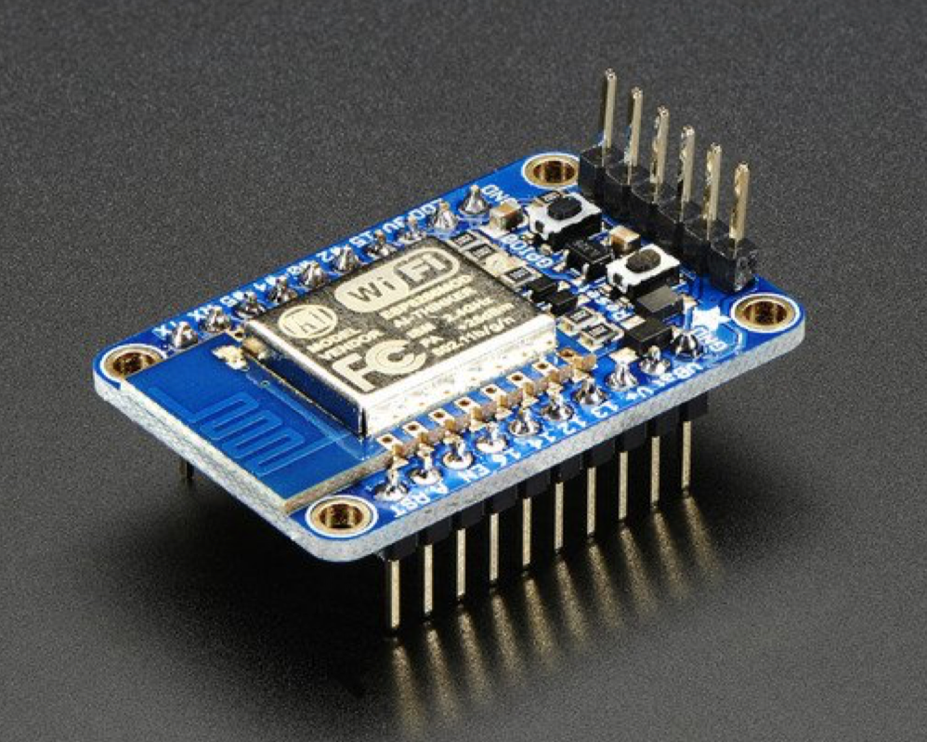
WiFi Module
HUZZAH ESP8266
Full WiFi front-end support
UART protocol supported
Arduino IDE supported
Communicate with server using MQTT protocol
High operating current
Source: Adafruit HUZZAH ESP8266 breakout
Notes:
Full WiFi front-end means can be both client and access point.
Operation current: 80mA on average
UART: which will be its primary way to communicate with microcontroller

Slide 19
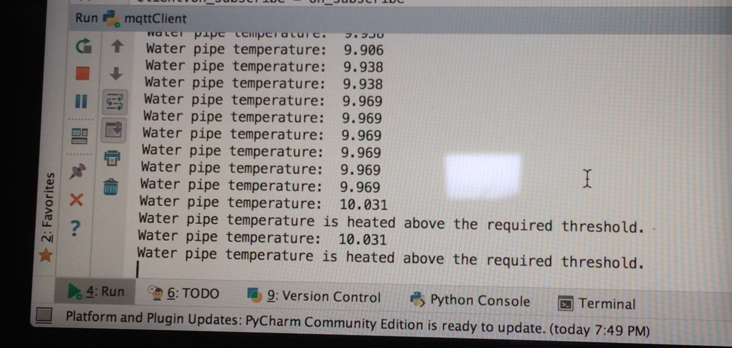
Control & Sensing: Result
Our system manages to collect data and sent it to user wirelessly

Slide 20
Battery System
ExpertPower 12V 7 Amp EXP1270 Battery
SNAN 300W Car Power Inverter 12V DC to 110V AC
Overall: the Battery System consumes 12V DC and generates 110V AC
Source:https://www.amazon.com/gp/product/B003S1RQ2S/ref=oh_aui_detailpage_o01_s00?ie=UTF8&psc=1
Source:https://www.amazon.com/gp/product/B019IFYMQU/ref=oh_aui_detailpage_o01_s01?ie=UTF8&psc=1

Slide 21
Heating System
Wrap around the frozen water pipe to provide thermal energy
Input:
110V AC from Power Selection System
5V DC from Microcontroller which uses a SPST relay to switch the heating element
Transition: a Driver (next slide) between Microcontroller and SPST Relay to protect the whole circuit
Output: thermal energy generated by the silicon rubber heating material

Slide 22
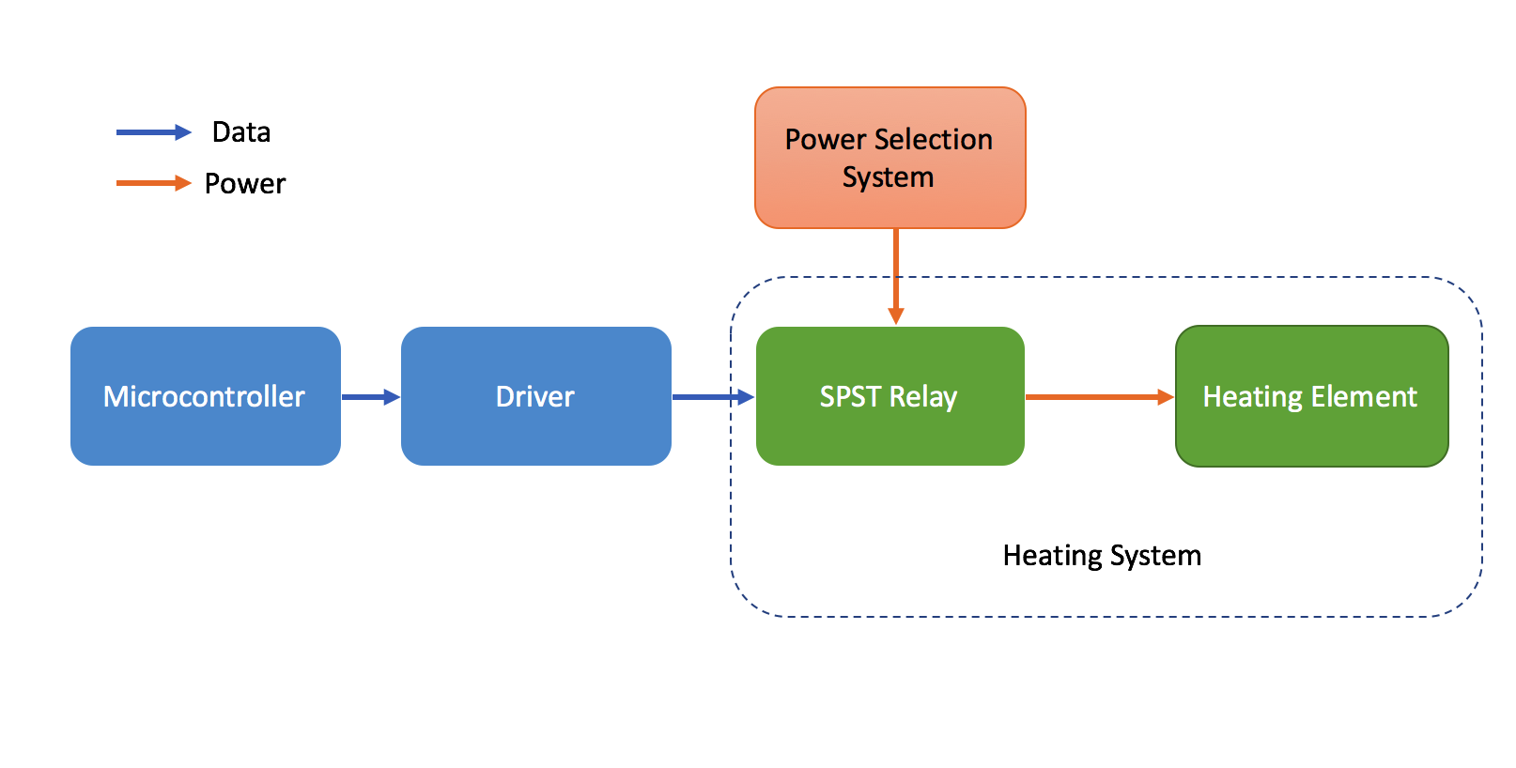
Heating System

Slide 23
Heating System: Driver
Due to the current limit of Microcontroller is 40 mA
TIP120 transistor switches larger currents as SPST Relay requires
Snubber diode protects the transistor from damage that can occur when the relay coil is de-energized
Source:https://www.wired.com/2012/09/more-arduino-fun/

Slide 24
Heating System: SPST Relay
SPST Relay switches Heating Element
Input:
5V DC control signal from Microcontroller
110V AC from Power Selection System
Output: 110V AC to Heating Element
Source:http://www.omron.com/ecb/products/pdf/en-g5nb.pdf

Slide 25
Heating System: Heating Element
Silicon Rubber Bendable Heating Element
Defects
Not fit
Slower heating time
Source:https://www.gordosales.com/store/pc/5-gallon-plastic-bucket-heater-DPCS10-p3707.htm

Slide 26
Heating System: Result
Turning on/off heating operation to water pipe based on certain temperature threshold
Heats up infused water and ice pipe by 3$℃$ in 20 minutes

Slide 27
Overall Result
Video is removed here due to the limitation of file size in ECE445 server

Slide 28
Conclusion
Our project works very well except the heating element is not very efficient
It can choose from two power sources (use battery when wall outlet power not available)
Controller & sensing system can collect data and send it to user wirelessly
Heating works but takes time

Slide 29
Future Work
Find a more efficient heating element whose size fits better to the water pipe
Measure a more accurate operating time while using battery system
Re-design PCB
Better electrical insulation

Slide 30
Thank you!

