Slide 1
Software Controlled Physical Sound Sources (SCPSS)
ECE 445 FALL 2020
Group #26
Won Woo Lyu
Micki Rentauskas
Ben Sisserman

Slide 2
Outline
I. Introduction
Introduction
Objective
Physical Overview
III. Board Design
Relay Board
Servo Board
Ring Board
II. Common Design
Holistic Block diagram
Common Parts & Software
Jitter Buffer
IV. Summary
Conclusions
Further Work

Slide 3
Introduction

Slide 4
Introduction
Our sponsored project is to fabricate software controlled physical sounds sources for the Illinois Augmented Listening Laboratory (IALL).
We have designed three devices controlled over WiFi that each create unique physical sounds:
Relay Board - Controls an array relays
Servo Board - Controls a servo motor
Ring Board - Controls ringing circuitry

Slide 5
Objective
Our objective is to create software controlled physical sound sources to be used for demoing hearing aids. They need to be consistent during testing and allow a wide range of sounds in a laboratory setting.
Our High-Level Requirements:
At least 3 different unique sounds
Latency must not vary by more than 30 milliseconds.
Devices must function with at least six feet of distance from each other.

Slide 6
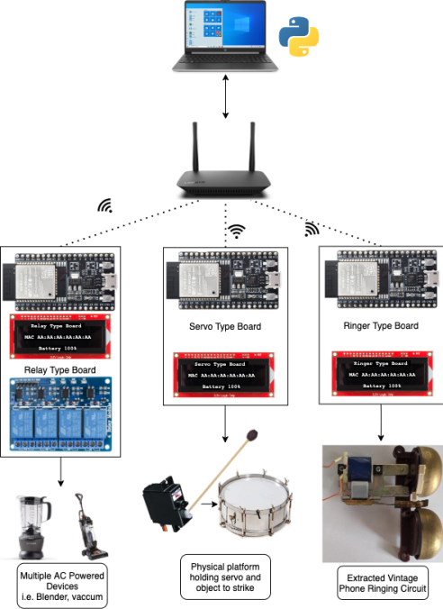
Physical Overview
(1)
Host - Researcher’s PC running SCPSS Python Module.
Router - facilitates communication between devices and the host over WiFi.
Microcontrollers - communicate over WiFi and control devices.
Physical sound sources used to generate sounds.
(2)
(3)
(4)

Slide 7
Design
Common Parts

Slide 8
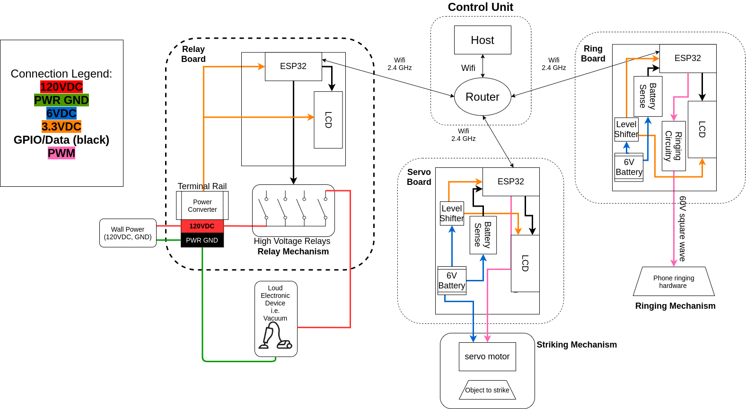
Holistic Block Diagram
Buck Chip
Buck Chip

Slide 9
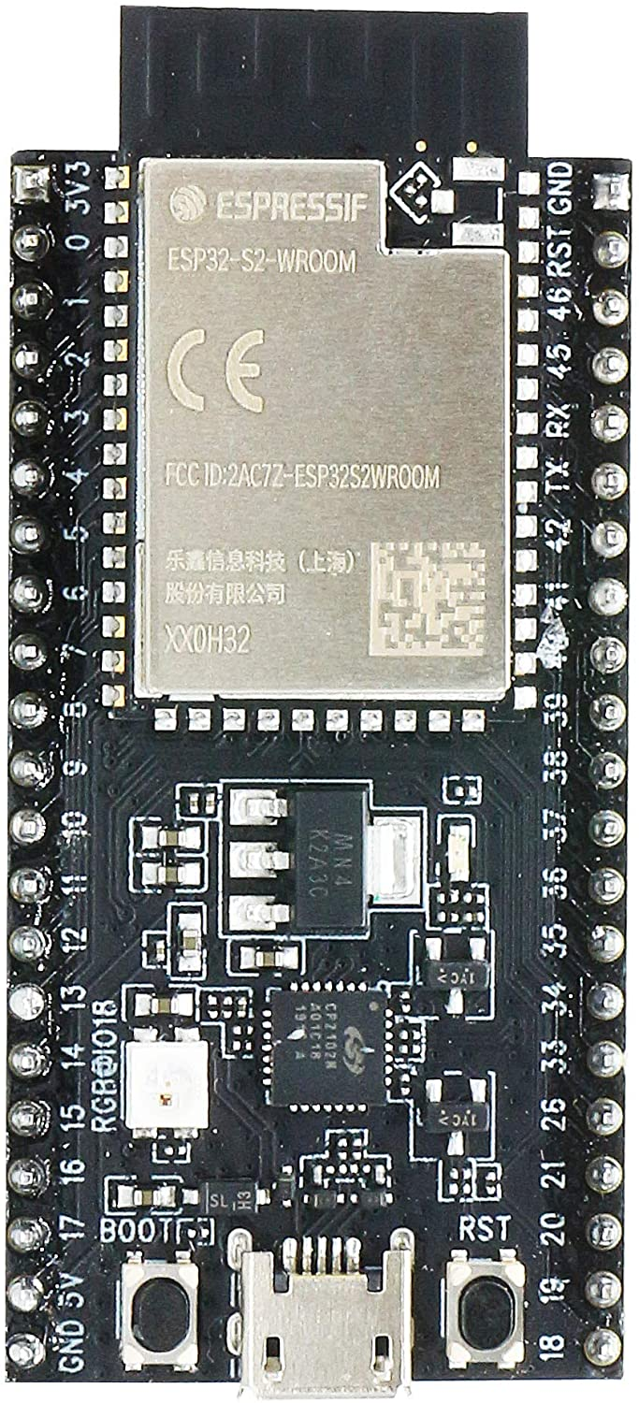
Common Parts - Microcontroller
ESP32-S2-SAOLA1
Connects to local WiFi network
Receives and decodes commands over TCP
Displays status on LCD display using SPI
Jitter Buffer prevents latency variation

Slide 10
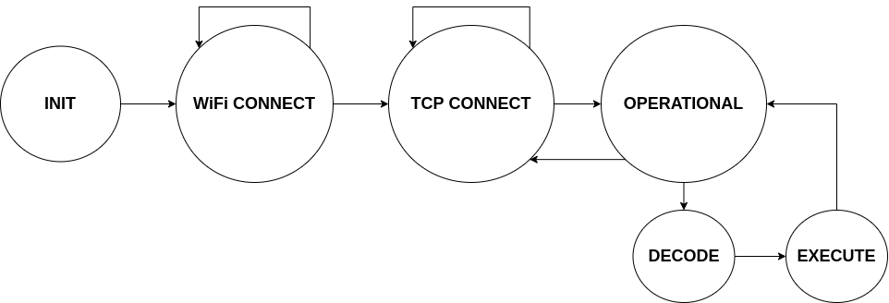
Microcontroller Software - State Machine
INIT - Initialize WiFi and SPI data structures
WiFi CONNECT - repeatedly check for WiFi connection
TCP CONNECT - Wait for a TCP connection from Host
OPERATIONAL - Wait for commands from Host
DECODE - decode command and timestamp
EXECUTE - Perform command

Slide 11
Microcontroller Software - Jitter Buffer
Problem:
TCP and WiFi do not have consistent travel time for packets. This is called network jitter.
Solution:
Buffering incoming messages by delaying their execution after arrival. The jitter buffer ensures us a minimal latency.

Slide 12
Jitter Buffer - Implementation
Initialize Timers on both Host and ESP32
Time_{esp} = Time_{Host} + Latency₀
When command received, estimate latency by
assuming Time_{esp} == Time_{Host}
Latency_{est} = Time_{esp} - Timestamp_{pc}
= Latency_{actual} + Travel Time₀
Since Latency₀ is constant, we can use Latency_{est} to measuring variation

Slide 13
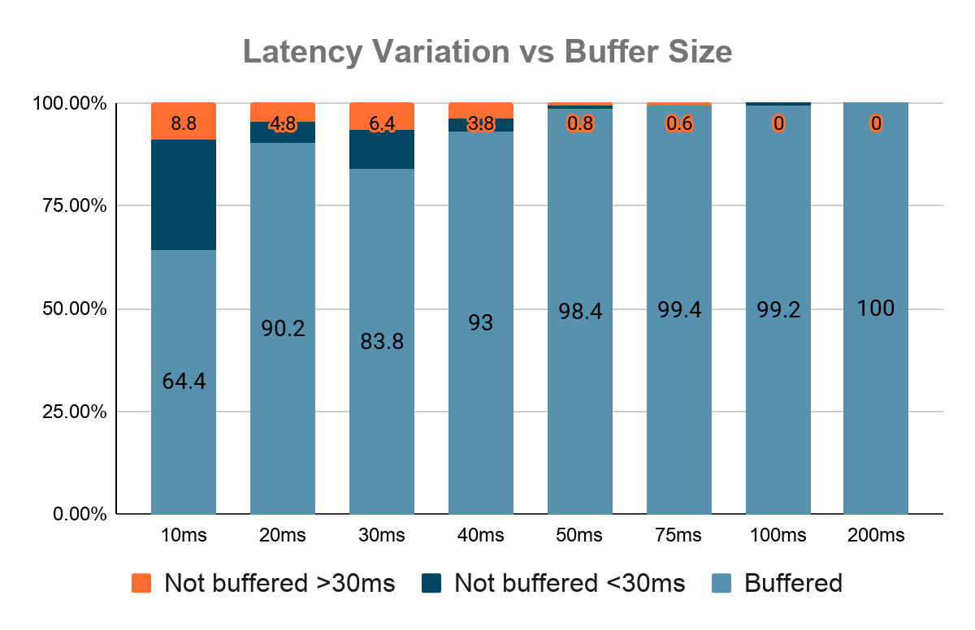
Jitter Buffer - Performance

Slide 14
Common Parts - LCD Display
Sparkfun SerLCD uses SPI interface to report…
Current state of device
IP and Port used to initialize TCP on Host
Most recent commands
Low battery warning by setting backlight to bright red

Slide 15
Common Parts - R&V
Part | Requirement | Verification
ESP32-S2 | Jitter Buffer prevents network jitter greater than 30ms | Sent 200 messages over TCP with Buffer = 200ms
LCD Display | Display Text and battery status over SPI | Displayed strings of various lengths and switched between charged and discharged batteries

Slide 16
Relay Board

Slide 17
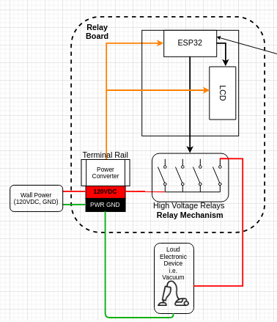
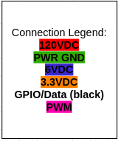
Relay Board Design
Relay Board Features:
Allows Host to control 4 separate relays
Plugs allow any wall-powered electronic devices to be used
Wall-powered
Enclosed for safety

Slide 18
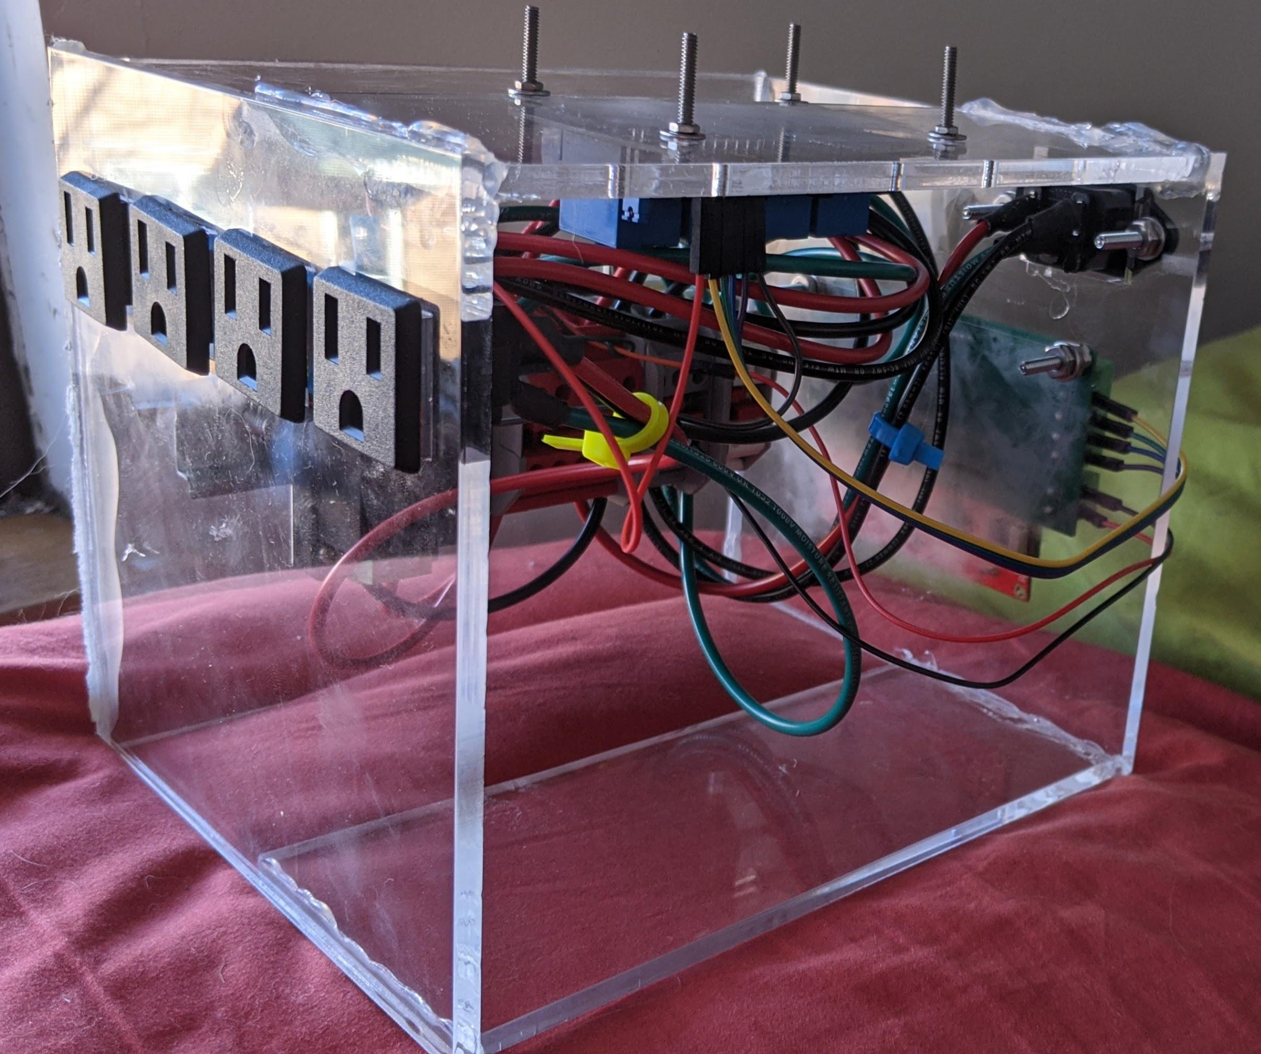
Relay Module Photos
4 AC ports for devices
Laser cut acrylic box, boards fastened with nuts and bolts
Notes:
Micki

Slide 19
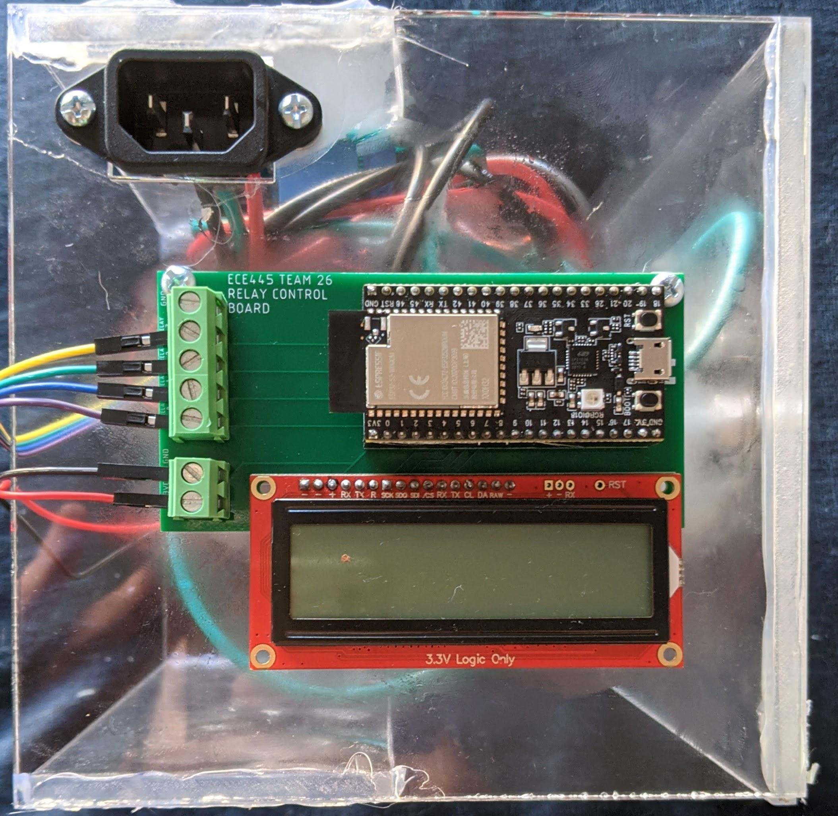
Relay Module Close Look Part 1
120VAC port
ESP32
GPIOs to relay
LCD screen
Power in from converter
Notes:
Micki

Slide 20
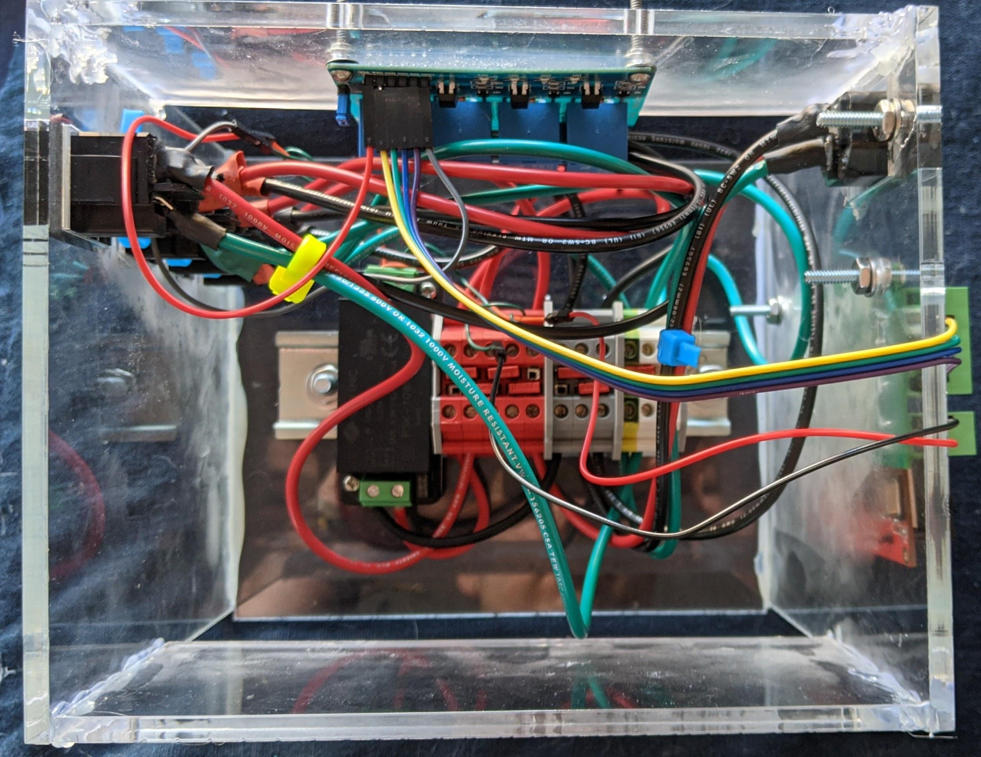
Relay Module Close Look Part 2
Off-the-shelf relay board
Terminal Rail
120VAC to 3.3VDC converter
Notes:
Micki

Slide 21
Relay Board - R&V
Part | Requirements | Verification
Relays | Relay opens and closes with GPIO Each relay can handle at least 12A | Manually applied IOs without and with sound devices to trigger relays, check with multimeter Plug in sound devices and check multimeter
Terminal Rail | High isolation between busses | Checked for overload or high impedance with a multimeter
Power Converter | Converts 120VAC to 3.3VDC | Attach power supply and check with multimeter

Slide 22
Servo Board

Slide 23
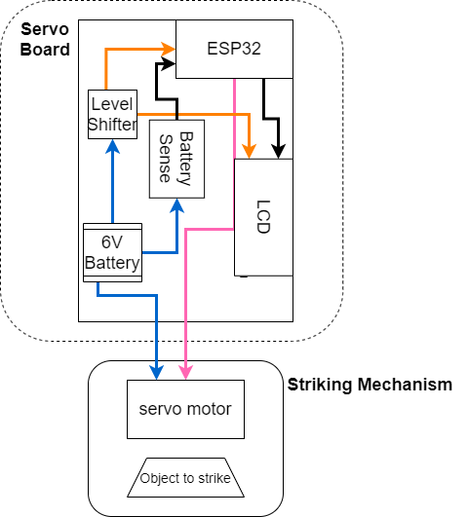
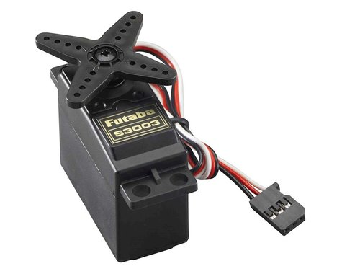
Servo Board Design
Buck Chip
Servo Board Features:
6V power source
4 rechargeable AA batteries
Controls Servo Motor attached with metal chopsticks to strike objects
LCD to display state and battery status

Slide 24
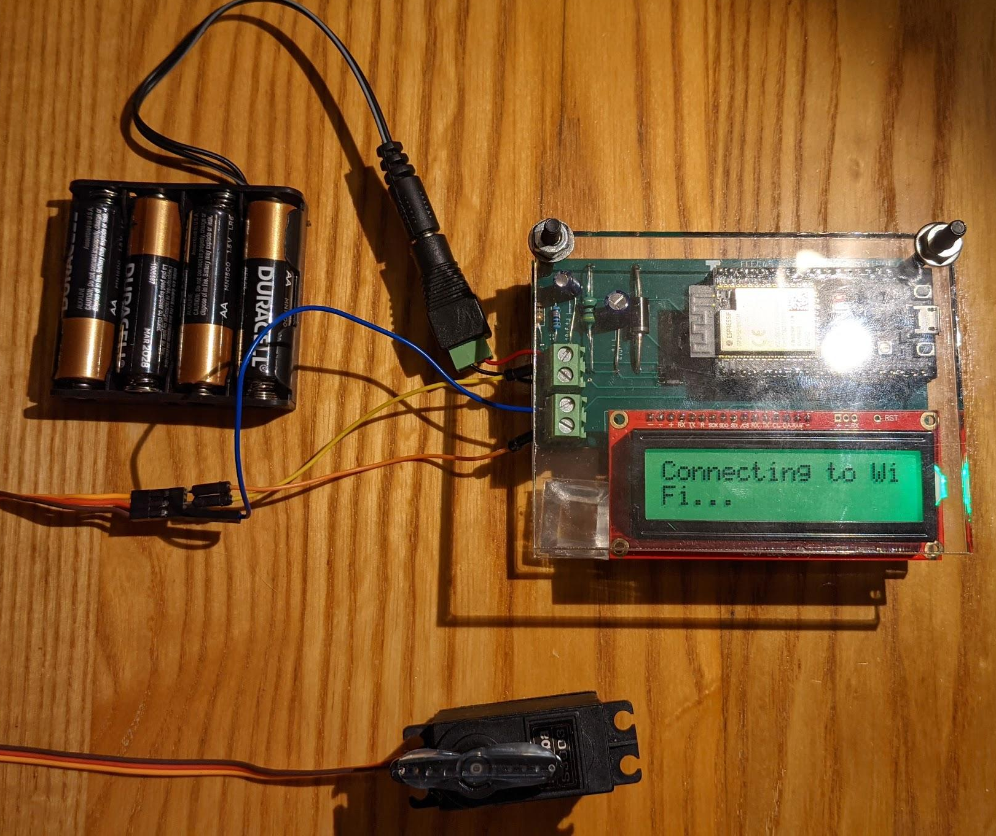
Servo Module Photos
Laser-cut acrylic enclosure
6V battery pack
Servo board (expanded on next slide)
Servo motor
(Futaba S3003)

Slide 25
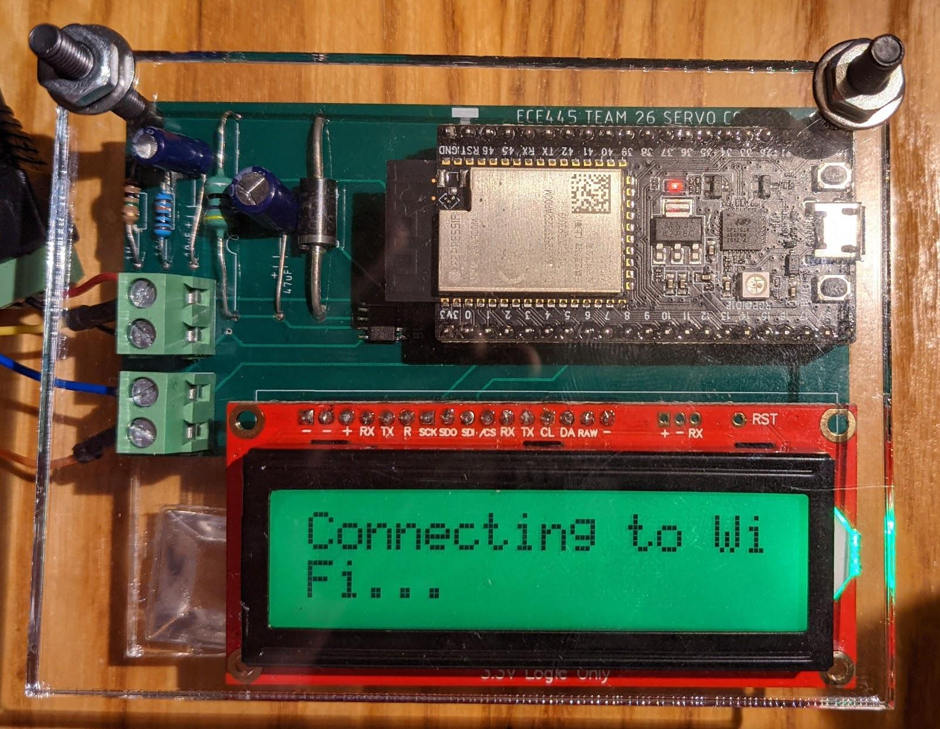
Servo Board Close Up
Buck converter (6V->3.3V)
Voltage divider for battery sensing
ESP32
6V, GND from battery
PWM, 6V, GND to servo
LCD Display
(Green showing good battery level)
Buck Chip
(AP1509-33SG-13)

Slide 26
Futaba S3003 - PWM
3.3V
0V
3.3V
0V

Slide 27
Servo - Visualize PWM

Slide 28
Servo Board - R&V
Part | Requirement | Verification
Servo Motor | Provides enough torque to make the strike audible for at least 10 ft | Tested with chime x10 in large room
Buck Converter* | Convert 6V to 3.3V | Probe with multimeter
Battery Sense Circuit* | Converts voltage to value readable by GPIO Draws at most 5 mA | Measured ~3.3V with multimeter Checked with lab multimeter
*Indicates R&V shared with ringing board

Slide 29
Ringing Board
Notes:
MICKI--This was a specific ask of ryan blah blah

Slide 30
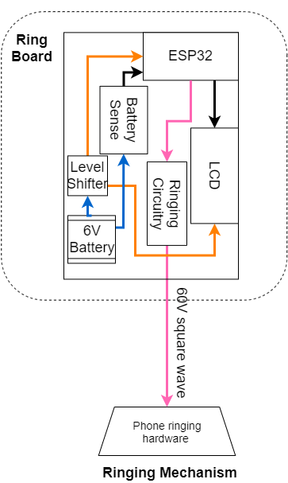
Ringing Board Design
Features:
Battery and buck chip same as servo
Boost chip that steps up 6V->60V
Ringing circuitry generates +/-60V square wave to drive
Rings bells extracted from antique phone (shown left)
Ampere’s law
Oscillating magnetic field induced by solenoid moves hammer back and forth
Buck Chip
Large solenoid (~52H)
Magnet
Notes:
Micki

Slide 31
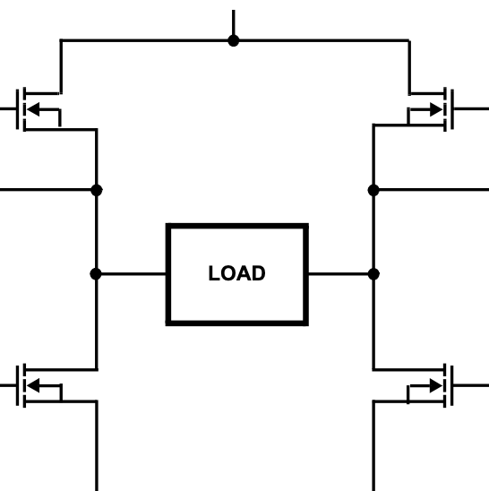
Ringing Device PWM
5V
After H-Bridge
+60V
0V
5V
-60V
Relative to solenoid terminals
0V
60V
LOW
HIGH
HIGH
LOW
From ESP32
+
-
HIGH
LOW
LOW
HIGH
+
-
Notes:
Micki

Slide 32
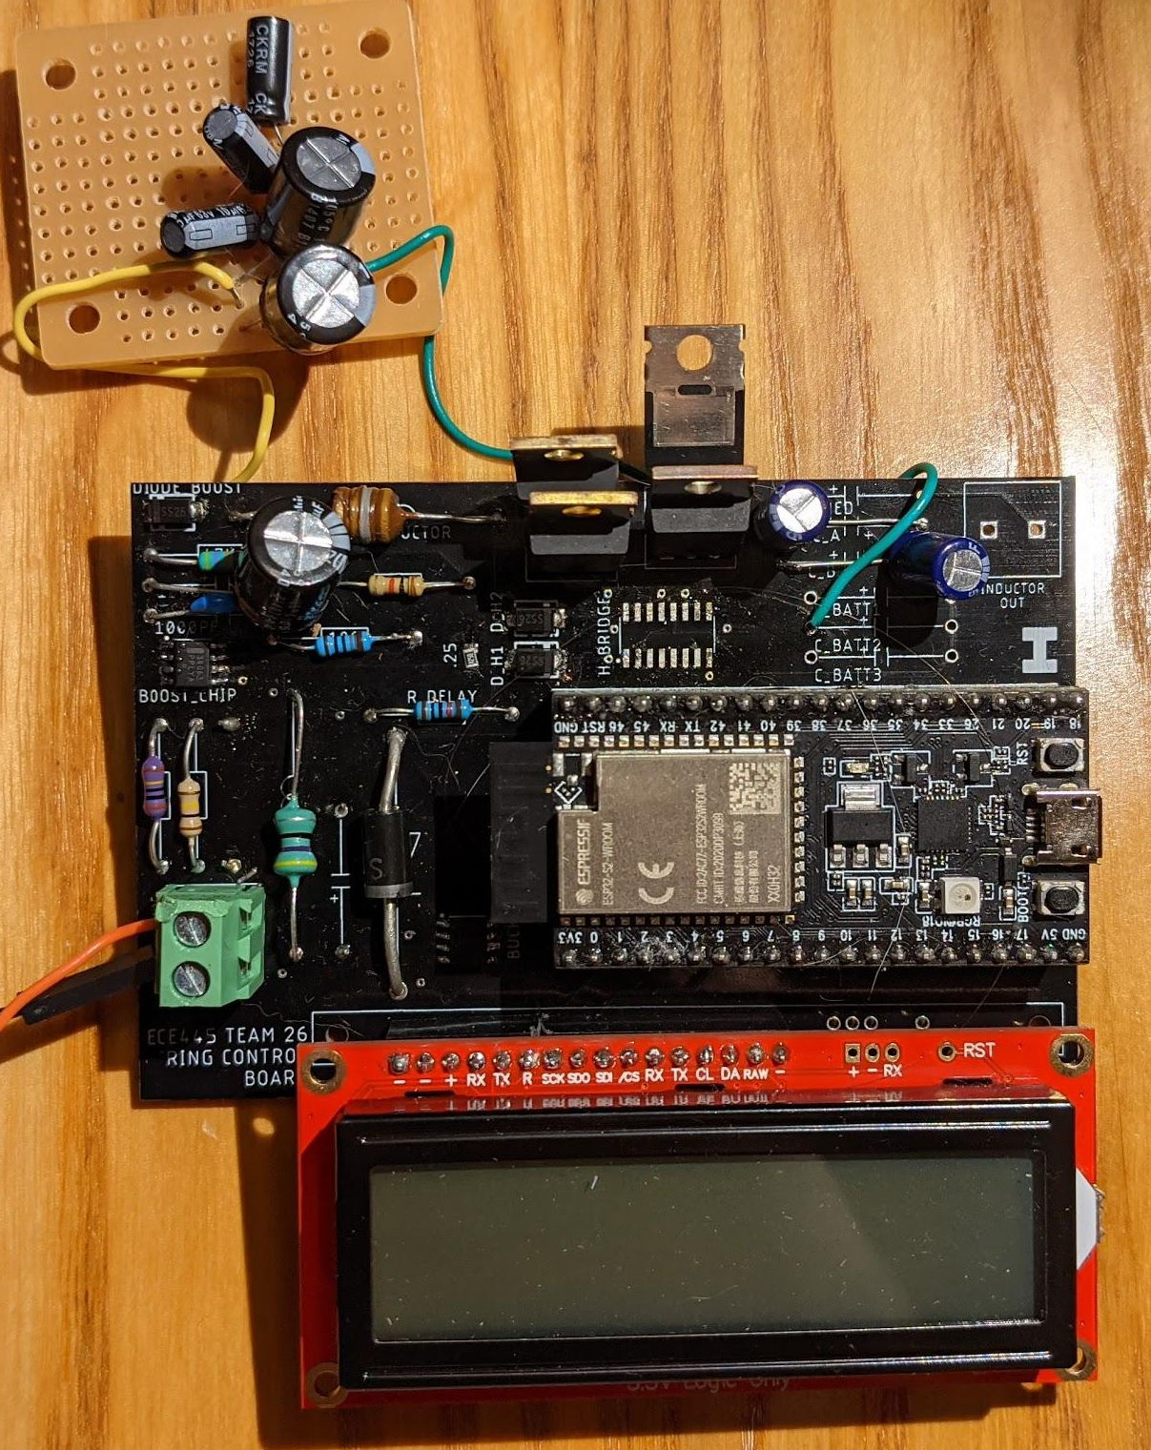
Ringing Module Photo
Extra capacitor bank
Out to solenoid
Boost chip (MC34063ADR2G)
Legend:
Buck converter (6V->3.3V)
Boost converter (6V-55V)
H-Bridge & MOSFETs
ESP32
LCD
6V, GND input from battery
Buck Chip
(AP1509-33SG-13)
Notes:
Micki

Slide 33
Ring Board - R&V
Part | Requirement | Verification
Boost Converter | Convert 6V to 60V+/-5V | Probe with multimeter
H-Bridge | Output +/-60V square wave | Probe on oscilloscope
Vintage Ringing Hardware | Ring for at least 30 seconds continuously | Trigger with ESP32 and time sound produced
Notes:
Micki
Explain why ring circuit driver failed

Slide 34
Conclusion

Slide 35
Conclusion
Successes:
Relay and Servo Boards
Control of boards with using Python
Jitter buffer
All high-level requirements achieved!

Slide 36
Further Work
Fix Ring Board PWM conversion
Git and documentation for IALL
Expand Jitter Buffer to ensure latency across instances

Slide 37
Thank You!
Any Questions?

Slide 38
Servo Board - Functionality
Microcontroller
Use GPIO to send PWM
LCD Display
Green background when battery is high or red when battery is low
Servo Motor
Continuously Rotate from 0 degree to 180 degree

Slide 39
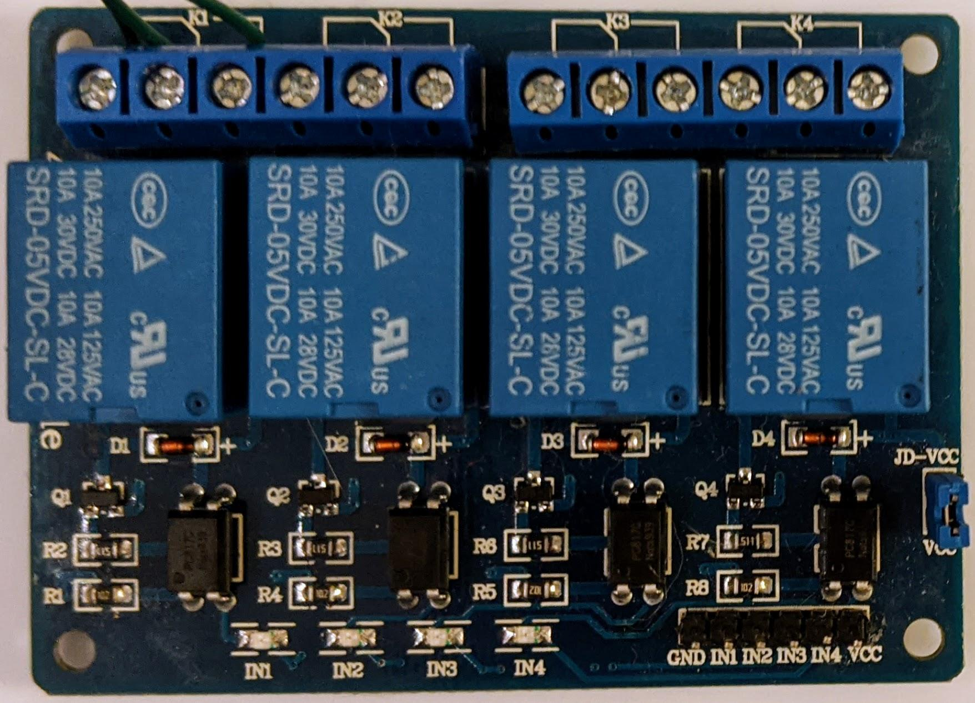
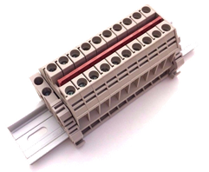
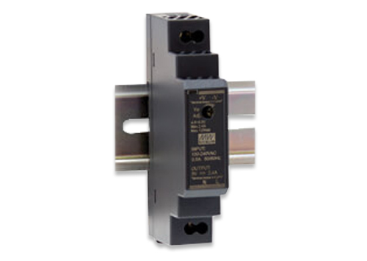
Relay Board - Functionality
Terminal rail
Route wall power and connections safely
Power converter
Input 120VAC and output 3.3VDC with at least 1A
Microcontroller
Use GPIO to control High-Voltage Relays
High Voltage Relays
Control the flow of power to and away from electronics

