Slide 1
Digital Theremin with LED
Group #71
ECE 445
Team: Phong Che, Juan Chapa, Chawakorn Wichulada
April 28, 2017

Slide 2
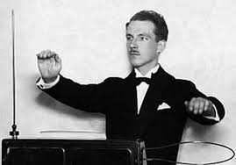
What is a Theremin?
Invented in 1928 by Leon Theremin
Electronic instrument that generates pitches without physical contact from user
Antennas act as capacitors that change volume and pitch

Slide 3
Problems with Original Theremin
Very difficult to play a precise pitch
Distance and volume readings vary depending on external factors such as humidity and temperature

Slide 4
Goals
What we do different:
LED display to help user by displaying each note played
Primary volume control using the foot
Generates different sounds using different pitches and waveforms
Kill switch to allow stutter effect

Slide 5
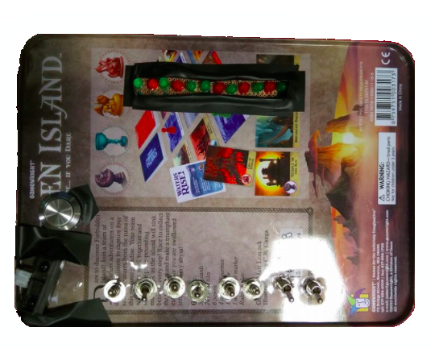
Our Digital Theremin
LEDs
Kill Switch
Sensor
Waveform Switches

Slide 6
System Overview (Block Diagram)

Slide 7
System Schematic

Slide 8
Sensor and Microcontroller

Slide 9
LED Display

Slide 10
Square to Sawtooth Converters

Slide 11
Square to Sine Converters

Slide 12
Power Module
Power is supplied by a 9V DC transformer
A Linear Regulator transistor was used to supply a steady voltage
The Linear Regulator converts the 9V to 3.3V.
Sensors required 5V
Hex Inverters required 7V
One of the challenges we faced was not getting consistent power for the sensors
Voltages are accurate within 2% of desired voltage

Slide 13
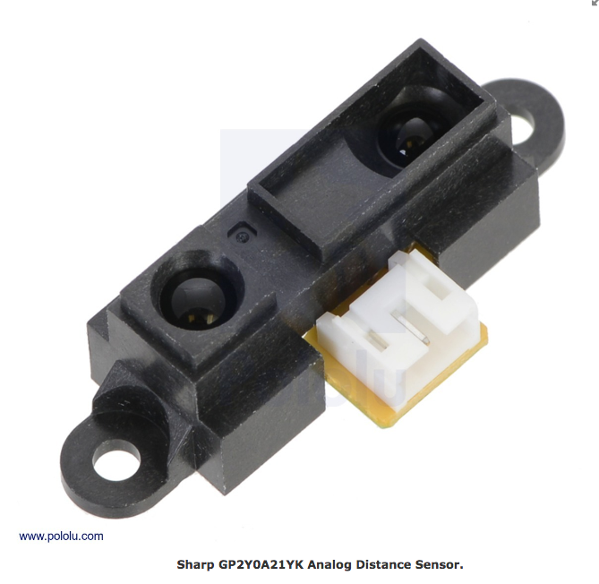
Sensor Module
Two infrared sensor to measure distance from heat source
Detect motion ranges of 10 to 80 cm +/- 8%
Update period is 38 ms +/- 10%.
Output a voltage in corresponding to distance.
Voltage is process by the ADC (analog digital converter)
Notes:
Ref: https://www.pololu.com/product/136#lightbox-picture0J149;main-pictures

Slide 14
Read the output voltage of the sensor by using multimeter
Testing Sensor Reading

Slide 15
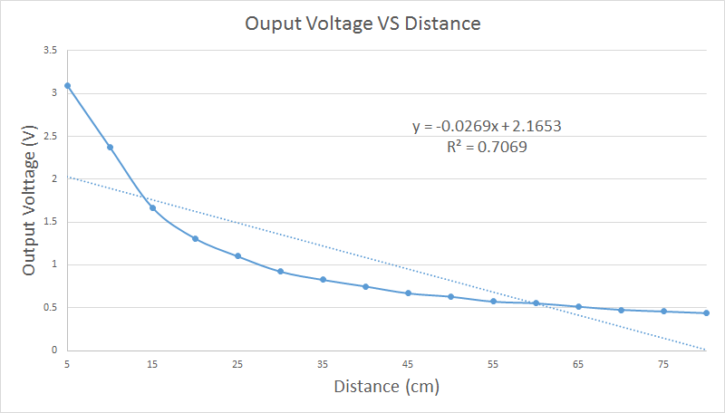

Slide 16
Original Plan: 12-bit ADC: TLC2543C
Alternate channel input to process one sensor’s data at a time.
An arduino to test ADC using SPI (Serial Peripheral Interface)
Output: A digital value representation of voltage
Problems:
Send byte packet twice per sensor data
Resolution is 16 bits when 12 bits required for MIDI
Delay of 5ms per conversion instead of 3ms +/- 5%
Solution: Implement ADC inside micro controller

Slide 17
Control Module
We use LPC1114FN28/102 as the microcontroller
An internal A/D converter converts the inputs to digital value
Around per channel 2.44 μs +/- 5%
It takes inputs from the sensors (Analog voltage 0 V to 3.3 V)
Determine the period of square waves (delay before switching its state (HIGH/LOW))

Slide 18
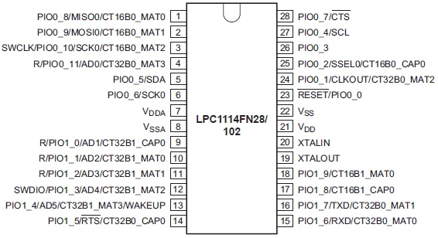
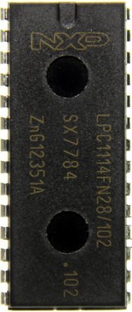
Layout of Microcontroller
Notes:
Ref: https://www.pakronics.com.au/products/lpc1114fn28-arm-cortex-m0-based-32-bit-mcu-dip-ss310010024
Ref: http://www.mouser.com/ds/2/302/LPC111X-841342.pdf

Slide 19
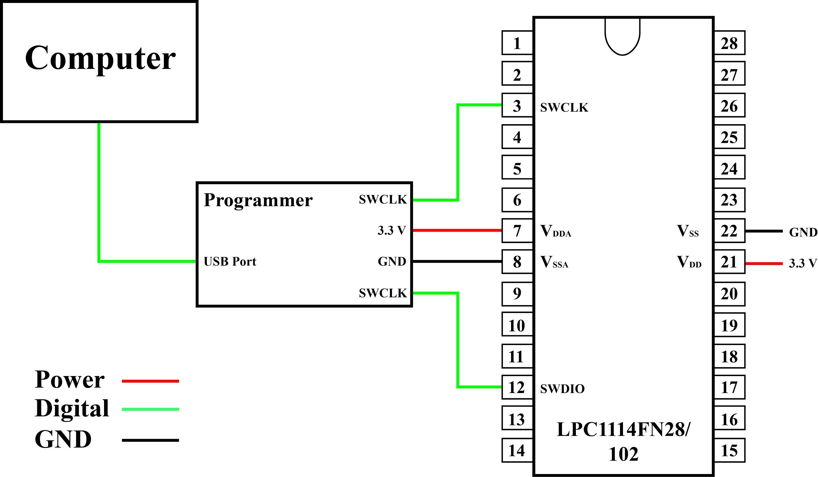
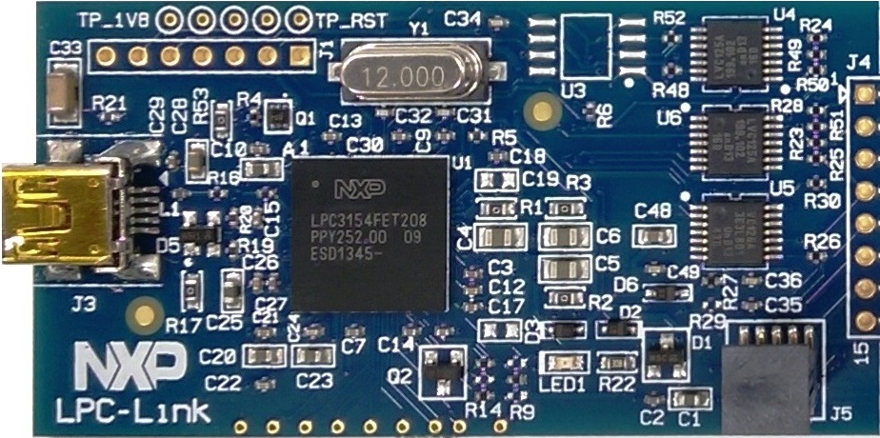
Programmer Connection
Notes:
Ref:http://www.nxp.com/products/microcontrollers-and-processors/arm-processors/lpc-cortex-m-mcus/lpc1100-cortex-m0-plus-m0/lpcxpresso-board-for-lpc11u24:OM13066

Slide 20
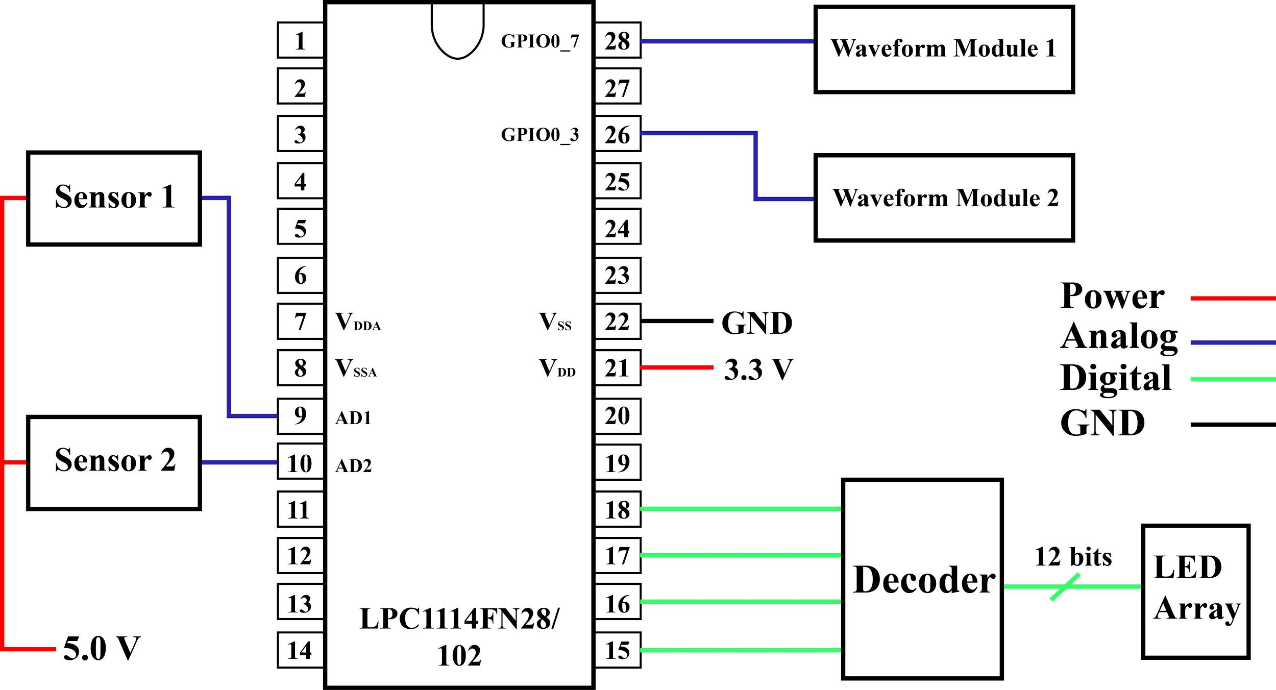

Slide 21
Setup ADC
Enable power to ADC hardware
Enable clock to ADC hardware
Setup pins that will be used for ADC inputs
Enable Burst mode
Allow the hardware to convert in background

Slide 22
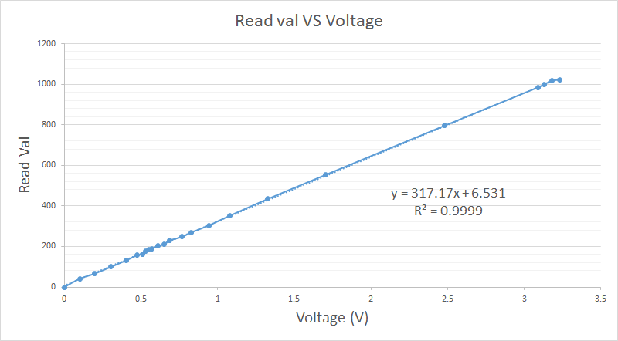

Slide 23
What about reading the sensor value from ADC?

Slide 24
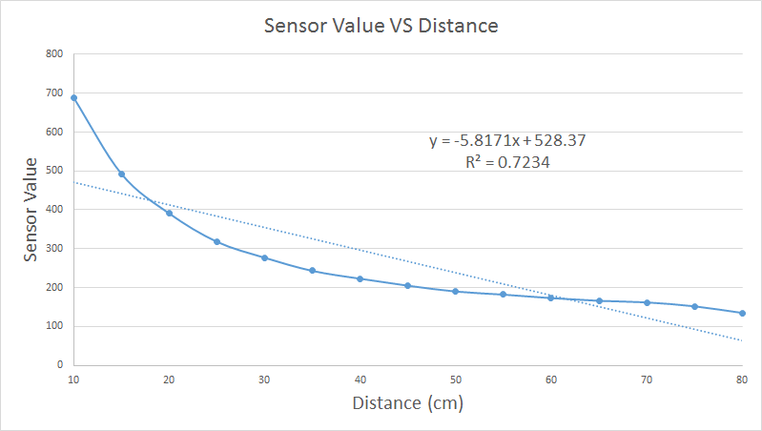

Slide 25
The Read value is not linear function
logarithmic scale can help make it more linear

Slide 26
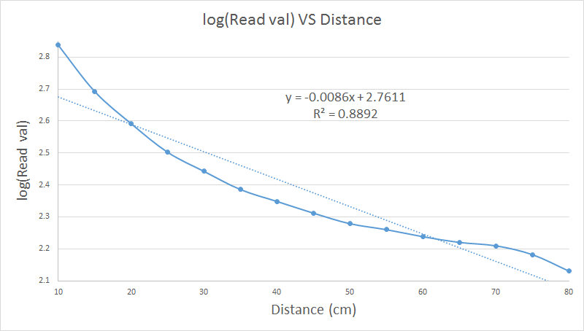

Slide 27
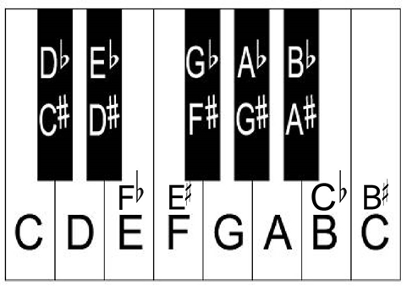
LED Module
12 Notes representation of an octave
5 Red LEDs for Sharp note
7 Green LEDs for Normal note
Prioritize notes played by high pitch sensor
Visible 3+/- 5% meters away
Notes:
Ref: http://takelessons.com/blog/piano-theory-for-all-musicians

Slide 28
Selecting LEDs
A 1-16 Decoder and inverters to select a LED
4 bit select used and output by microcontroller
A lookup table was used to determine which note played
Note 1 - 12 from left to right

Slide 29
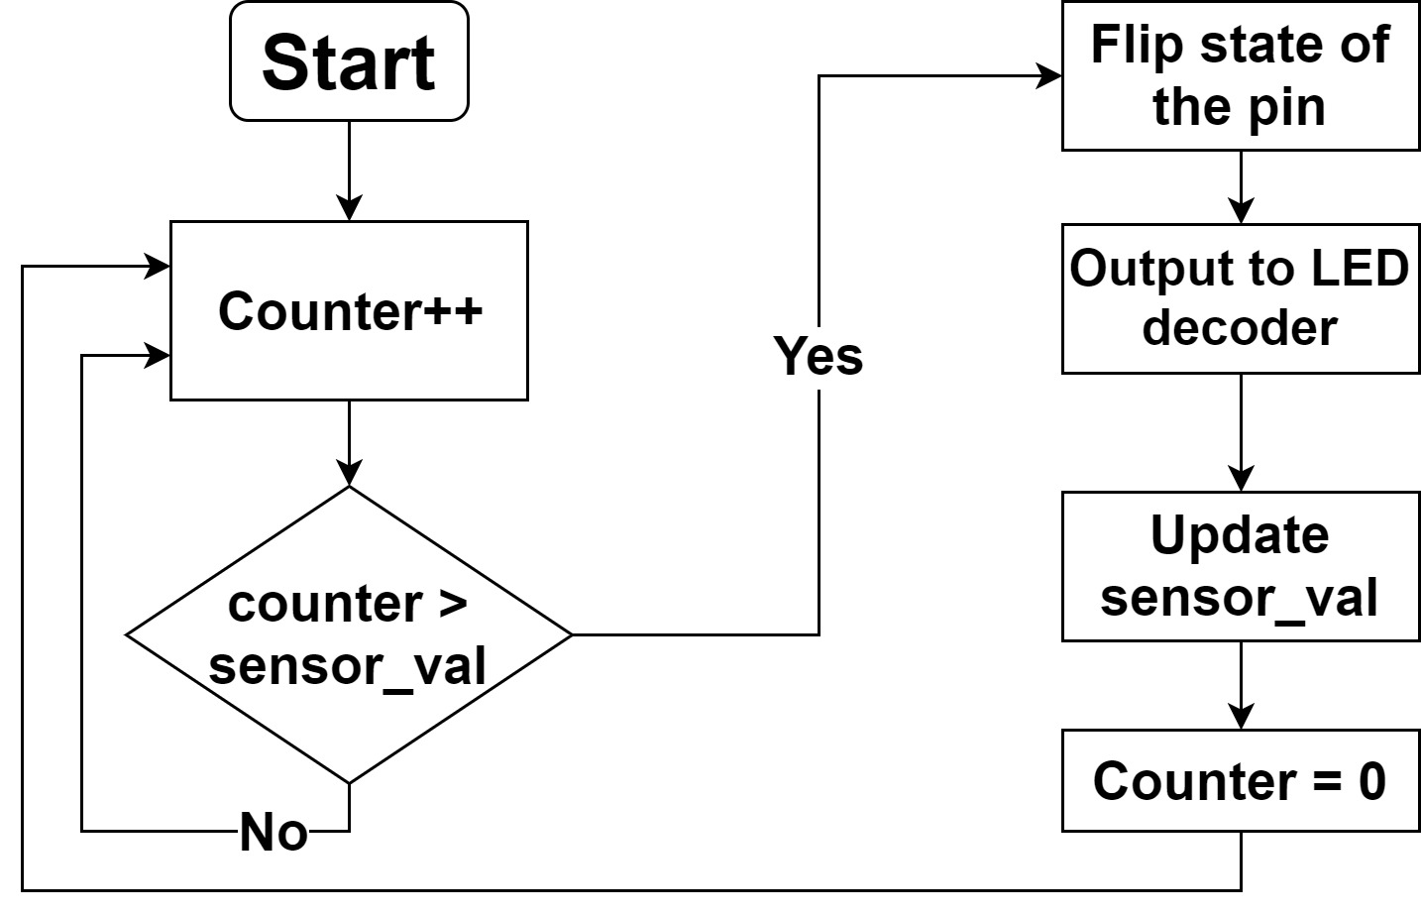
Algorithm for Generating Square Waves
while true do
counter = counter + 1
if counter > Read_value then
Flip state of the pin (HIGH / LOW)
Output to LED decoder based on Read_value
counter = 0
end if
end while

Slide 30
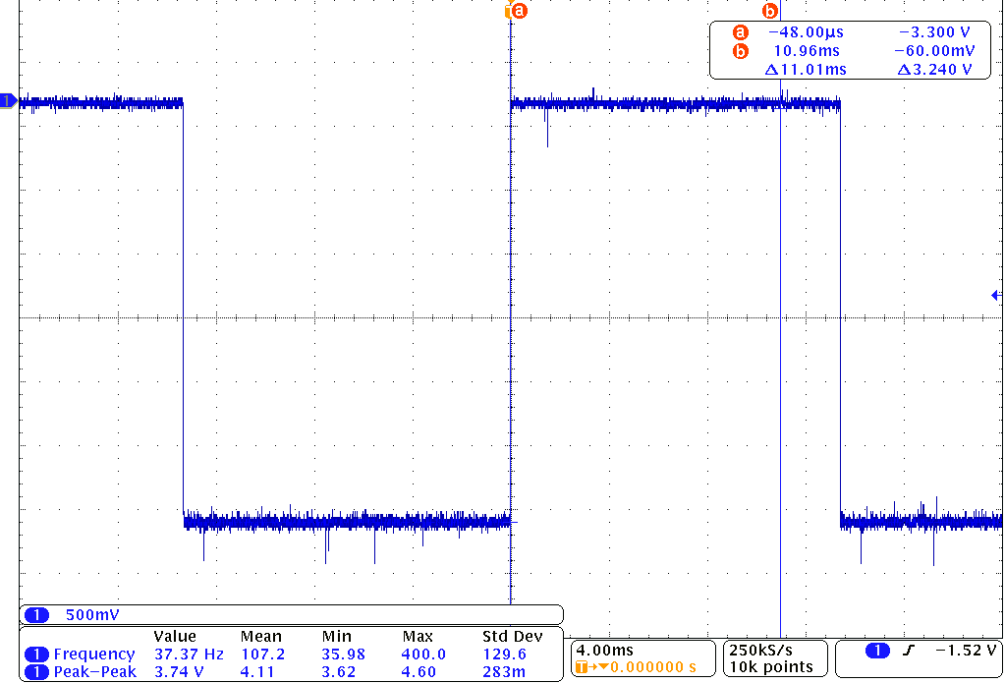
This is what the output looks like

Slide 31
Waveform Module
Consists of two square to sine converters (one for each note being played)
Consists of two square to sawtooth converters (one for each note being played)
Square Wave comes from microcontroller output
Outputs are clean and audible

Slide 32
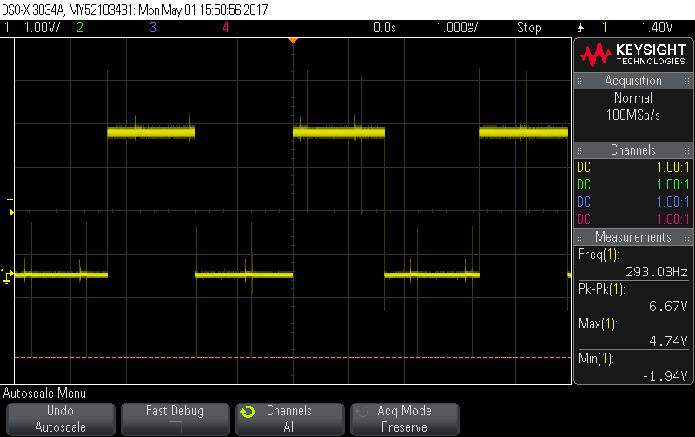
Square

Slide 33
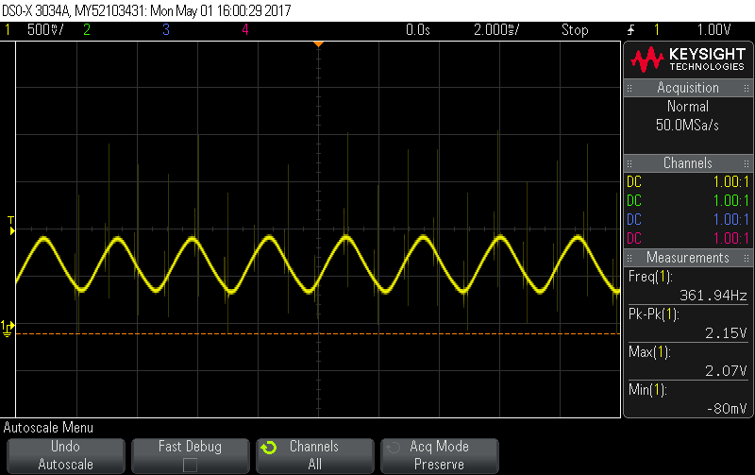
Sine

Slide 34
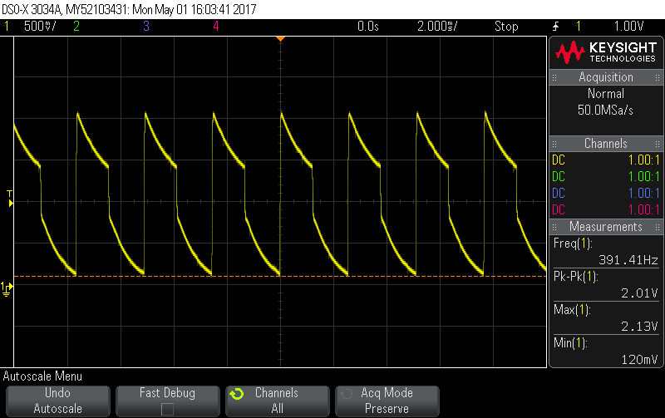
Sawtooth

Slide 35
Volume Control
The foot pedal applies varying resistance
Resistance is adjusted with the use of a potentiometer
The more resistance the lower the audio output
Resistance measure using multimeter

Slide 36
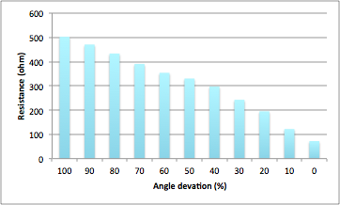
Potentiometer Data

Slide 37
Possible Improvement
Incorporate and test low pitch sensor
Adding 5V linear voltage regulator for sensor
Further tune and test algorithm like tuning an instrument
Examine waveform circuit to improve wave modifier

Slide 38
Thank You
We would like to say Thank You to all the staffs: Professors and TA (especially Jose) for feedback and advice.

Slide 39
Questions

