Slide 1
Wireless programmable keyboard with LCD screen
Nguyen Phan | Yihan Liu | Wei-Tang Wang
ECE 445 | Fall 2017 | Group 19
Dec. 11, 2017
Notes:
Wireless programmable keyboard with LCD screen

Slide 2
Introduction
Goal: Design and build a keyboard that can connect to computer via Bluetooth
Features:
Provide a number keypad for 13’ inch laptop
Provide a gaming keypad.
Allowing user to set up additional functionality for the keypad using add-on software
Notes:
Wei-Tang
And so, the main goal of our project
Our main objectives include…
+Provide a number keypad for 13’ inch laptop
+Provide a media controller. The keystrokes allow users to play or pause the current music or video on the host computer, change the brightness of the screen.
+And finally allowing user to set up additional functionality for the keypad using add-on software

Slide 3
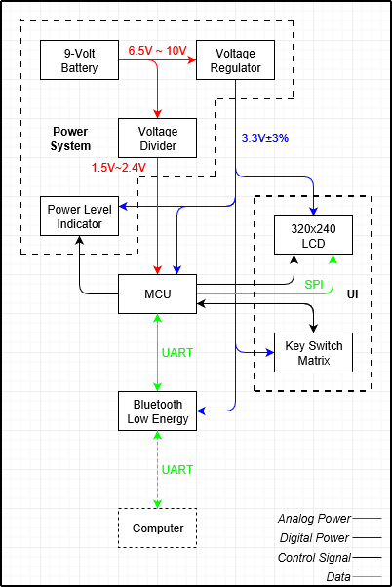
Block Diagram
Notes:
Nguyen
5 main modules

Slide 4
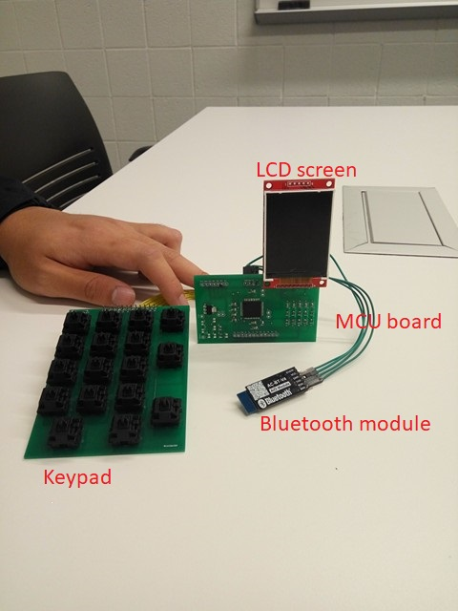
Complete implemented System

Slide 5
System Overview
Voltage Regulator
LCD Screen
Bluetooth Module
Keypad Matrix
Microcontroller Board

Slide 6
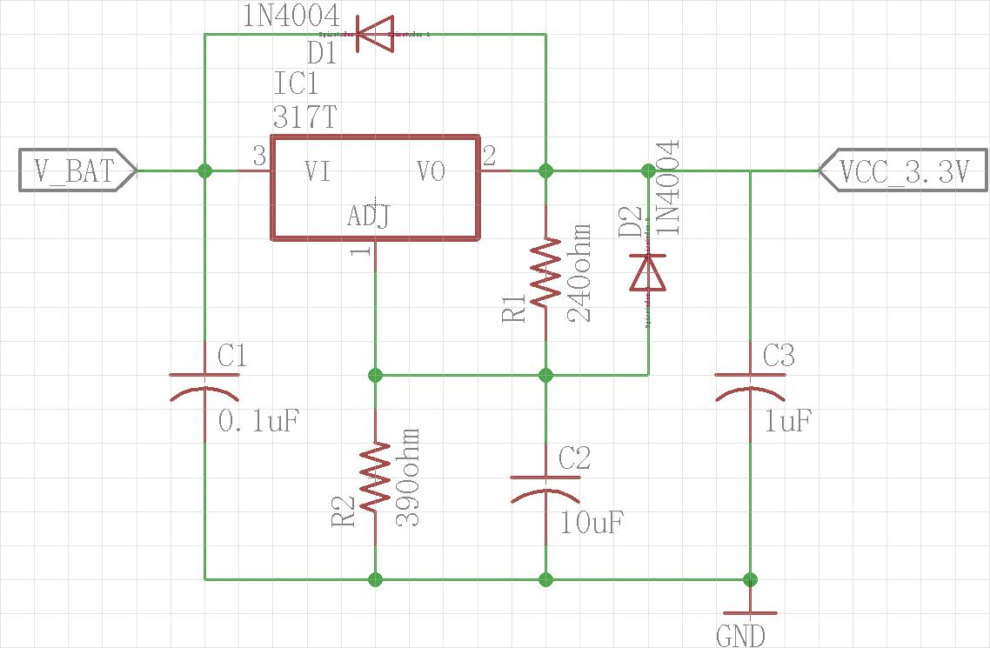
Voltage Regulator (1/2)
Based on the desired output voltage, the value of R2:
Notes:
Yihan

Slide 7
Voltage Regulator (2/2)
Verification of 3.3V regulator
Notes:
Yihan
Here from the graph we can see that the output voltage remain stable at 3.3V when the input voltage is greater than 5V

Slide 8
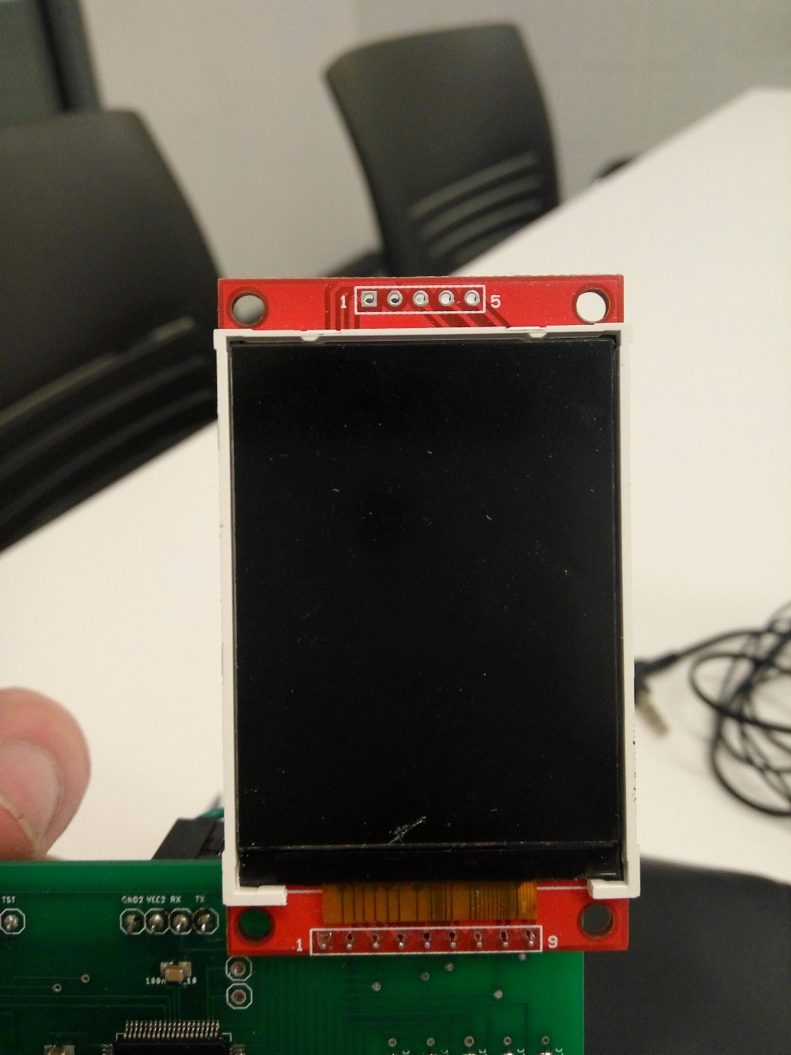
LCD Screen (1/4)
Notes:
Nguyen

Slide 9
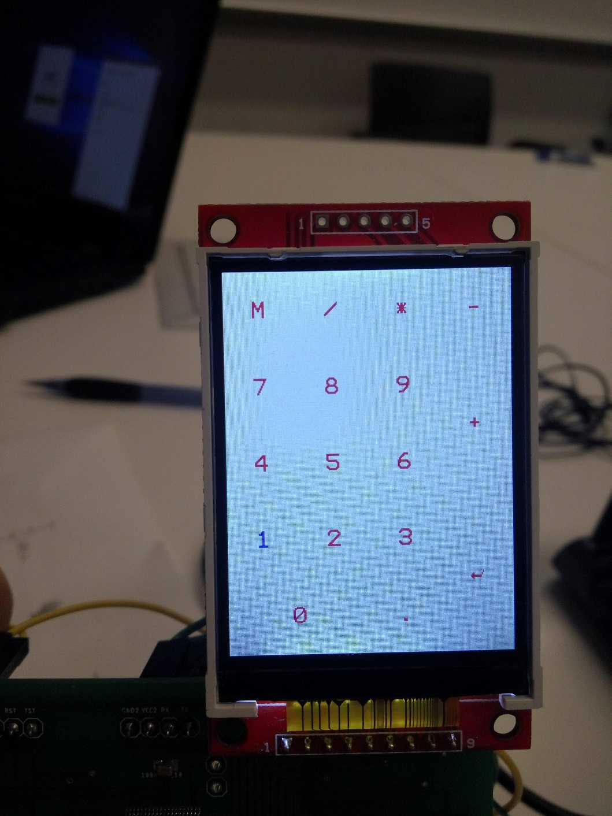
LCD Screen (2/4)
Numpad mode
Notes:
Nguyen

Slide 10
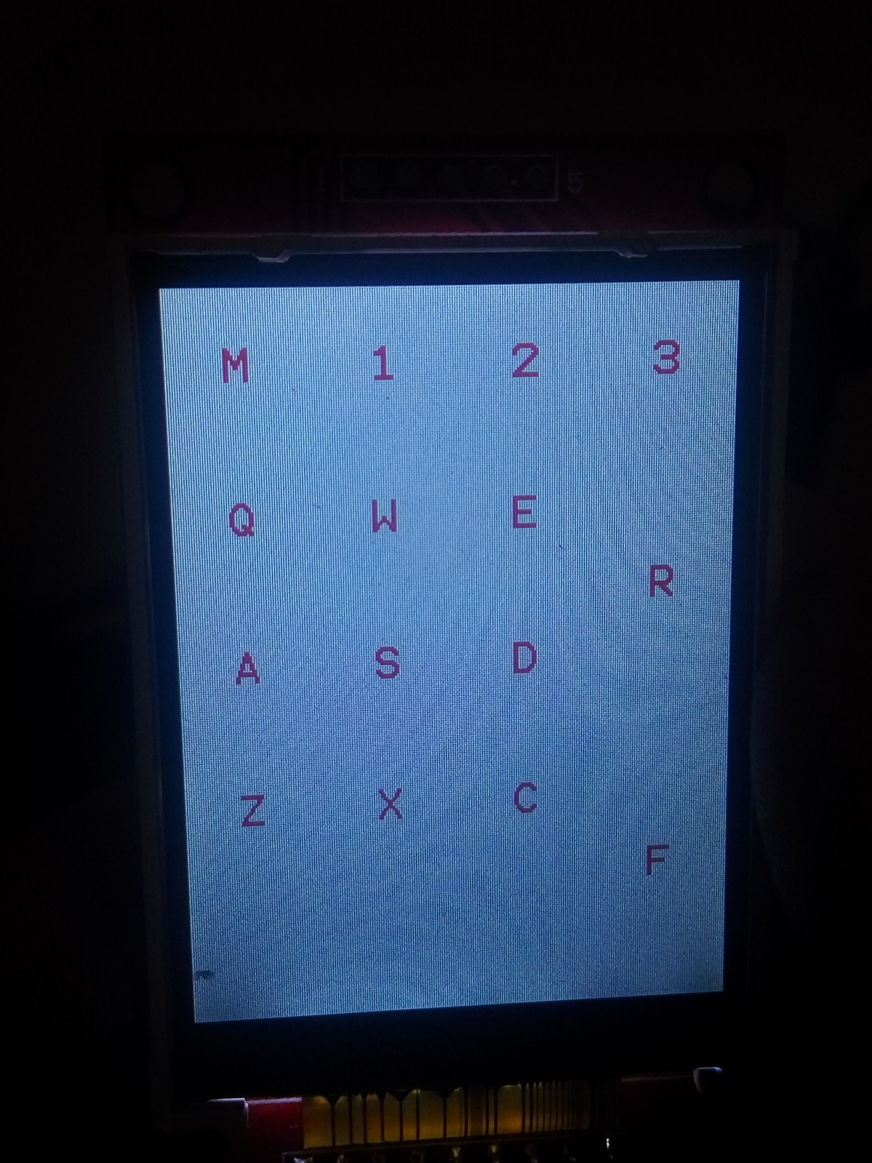
LCD Screen (3/4)
Gaming mode

Slide 11
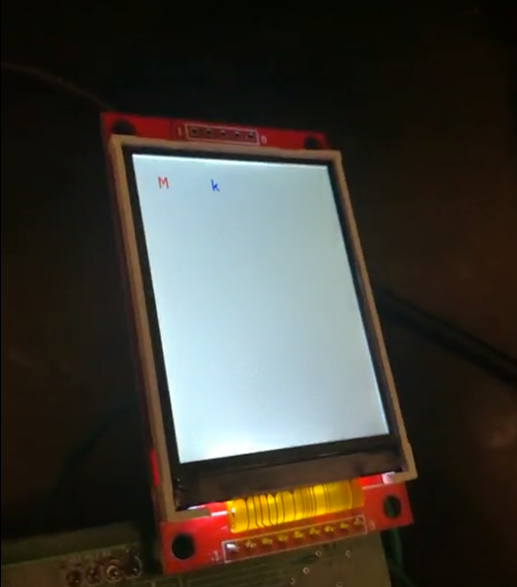
LCD Screen (4/4)
Remapping mode

Slide 12
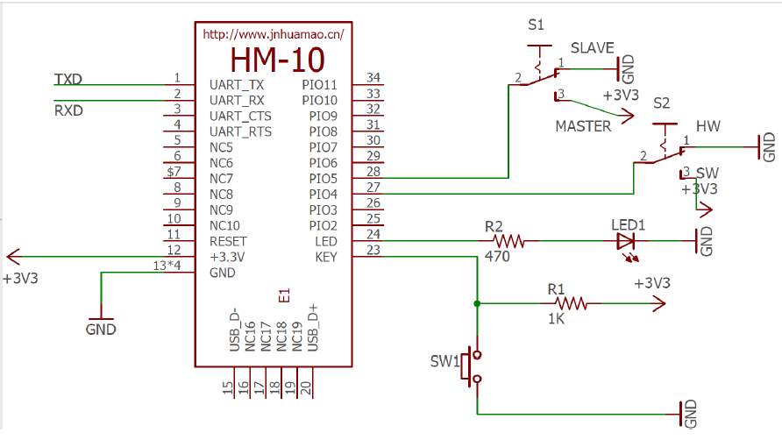
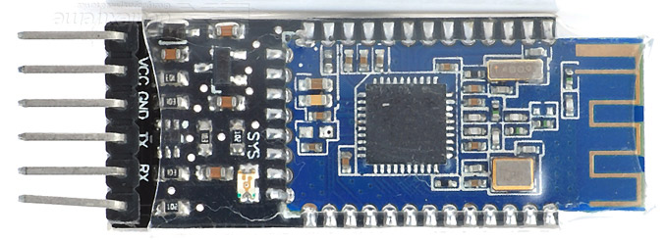
Bluetooth module (1/3)
Notes:
Wei-Tang
We are using the HM-10 model for the Bluetooth module

Slide 13
Bluetooth module (2/3)
Transmission demo (clip)

Slide 14
Bluetooth module (3/3)
Receive demo (clip)
Notes:
Wei-Tang

Slide 15
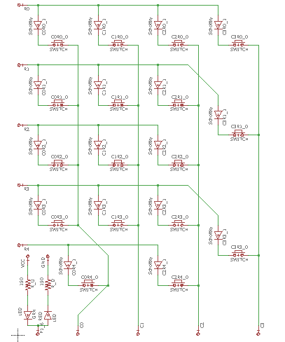
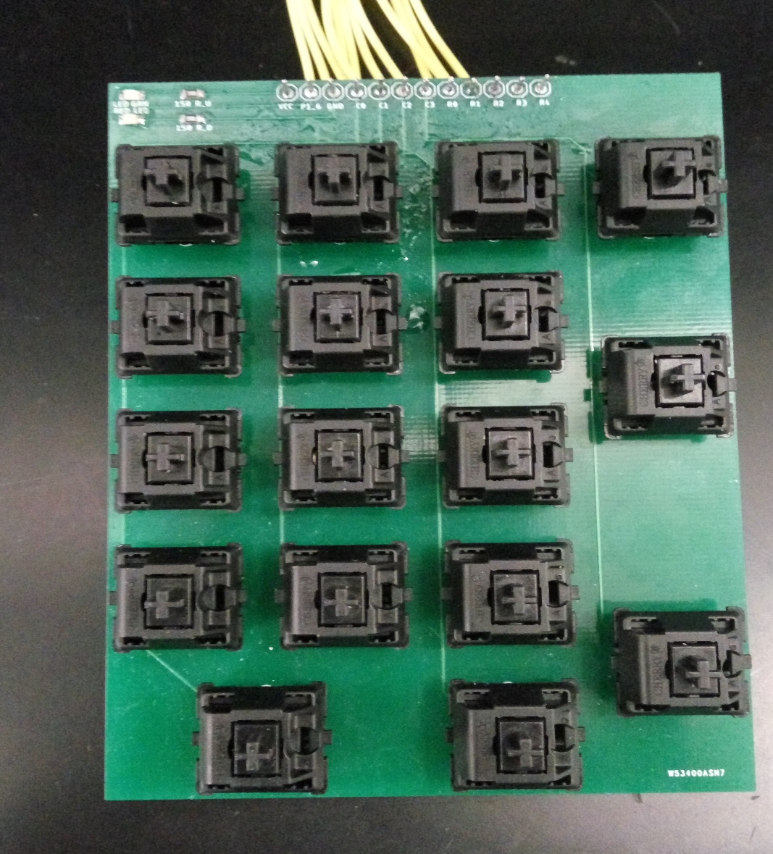
Keypad matrix (1/6)
Notes:
Nguyen
As you can see on the right is the physically implementation of the keypad, and on the left is its schematic

Slide 16
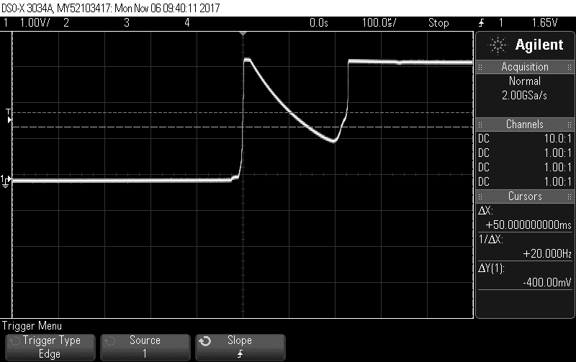
Keypad matrix (2/6)
Bounce time graph (without filter)
Notes:
Yihan

Slide 17
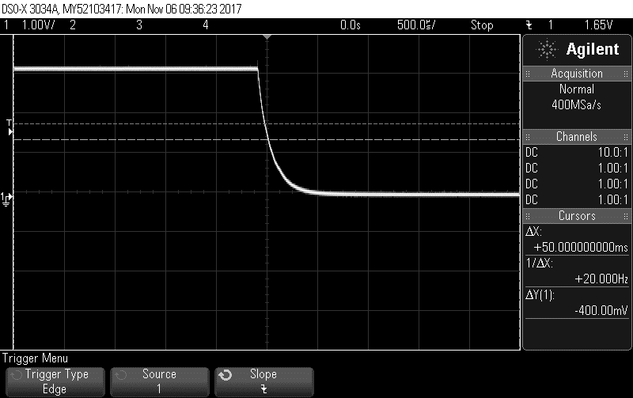
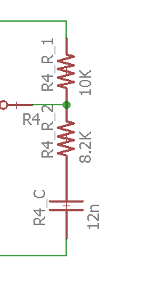
Keypad matrix (3/6)
Bounce time graph (filter)

Slide 18
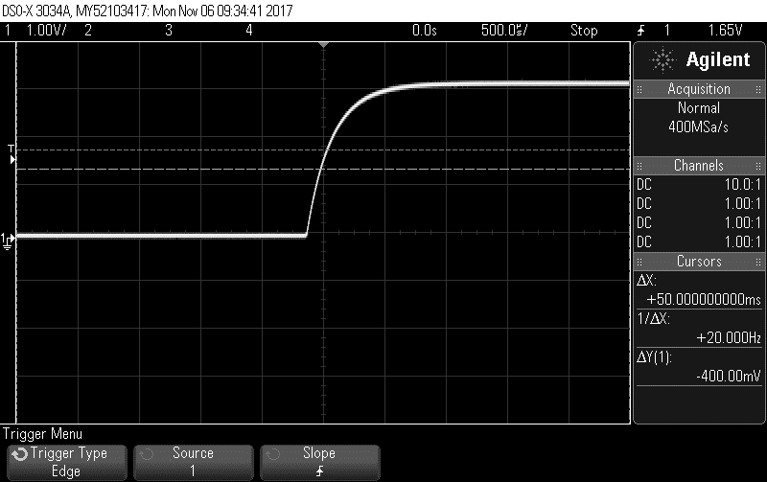
Keypad matrix (4/6)

Slide 19
Keypad matrix (5/6)
Ghosting and Masking Test (clip)

Slide 20
Keypad matrix (6/6)
Holding key vs pressing key

Slide 21
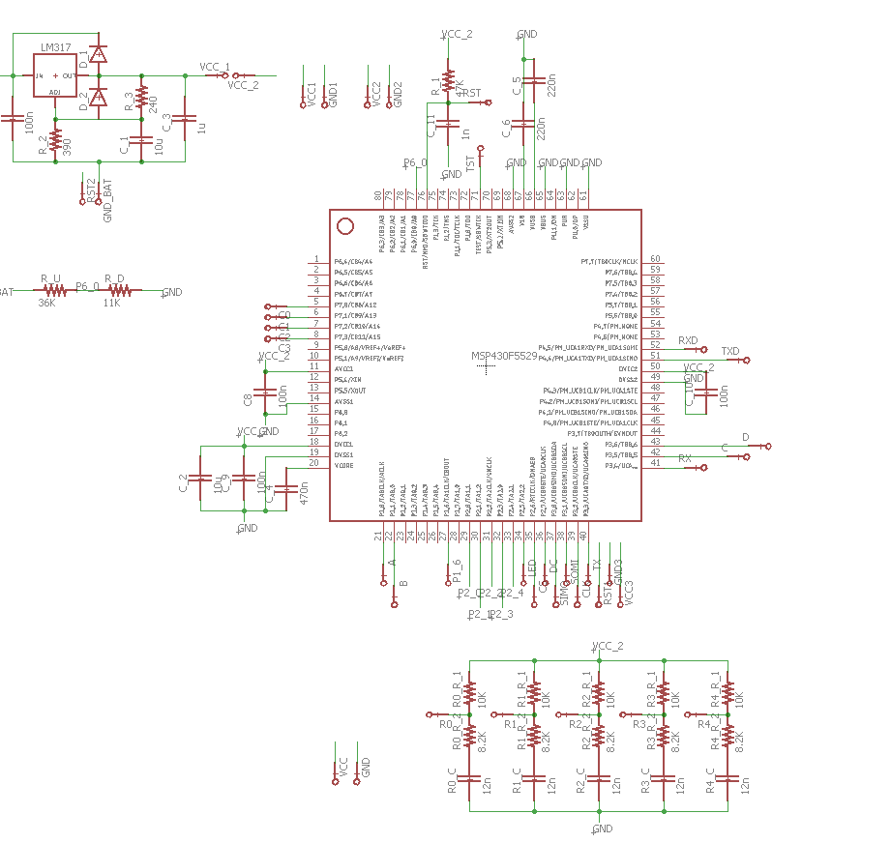
Microcontroller board (1/3)
Notes:
Yihan

Slide 22
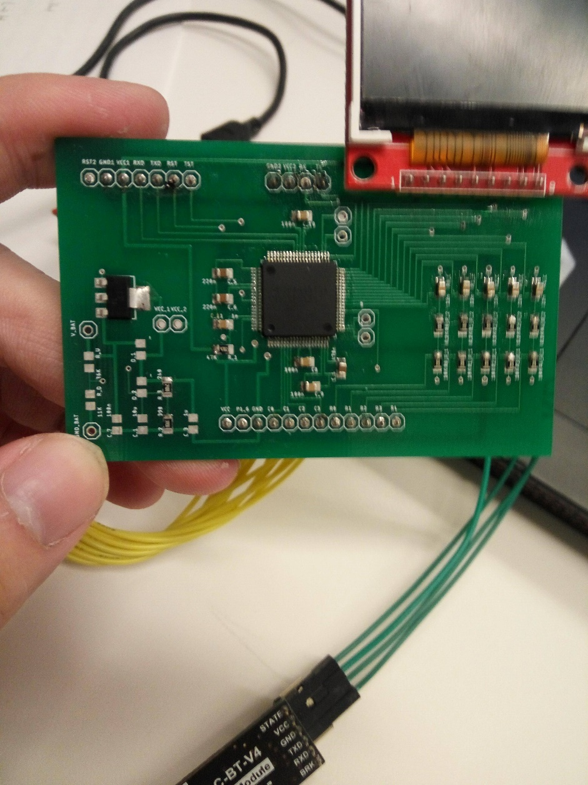
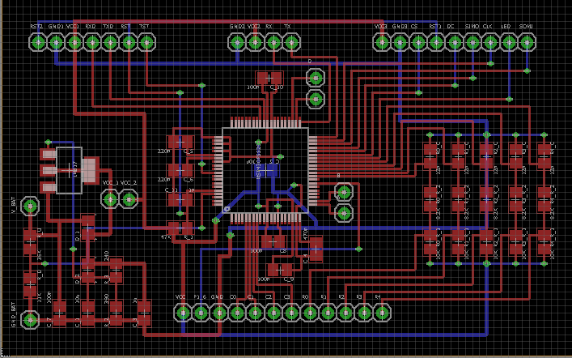
Microcontroller board (2/3)
PCB design
Notes:
Nguyen

Slide 23
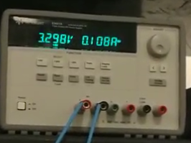
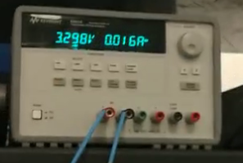
Microcontroller board (3/3)
When the screen is on
When the screen is off

Slide 24
Conclusion
Successful in achieving most of the design goals
The keyboard can transmit correct data to the computer
User is able to remap the keypad using computer
Some setbacks
Unable to integrate the voltage regulator into the over circuit
The keypad is only compatible to Mac
Notes:
Nguyen
Successful in achieving most of the design goals
The keyboard can transmit correct data to the computer
User is able to remap the keypad using computer
Some setbacks
Unable to integrate the voltage regulator into the over circuit
The keypad is only compatible to Mac

Slide 25
Challenges
Bluetooth communication (RN-42 v.s. HM-10)
Component selection & Board layout
Integration of voltage regulator
Notes:
Wei-Tang
Component selection - size and current
Board layout – breakouts ,
Layout was challenging because everything needs to be integrated

Slide 26
Future Work
Bluetooth module with HID support
Better hardware design
User-friendly software for remapping the key
Notes:
Yihan
Bluetooth module with HID support
Better mechanical design
User-friendly software for remapping the key

Slide 27
Question

