Slide 1
Advanced Interface Box
for Solar Panels
ECE445: Senior Design Lab
Team 10:
Maram Safi
Nikhil Mathew Sebastian
Sydney Li

Slide 2
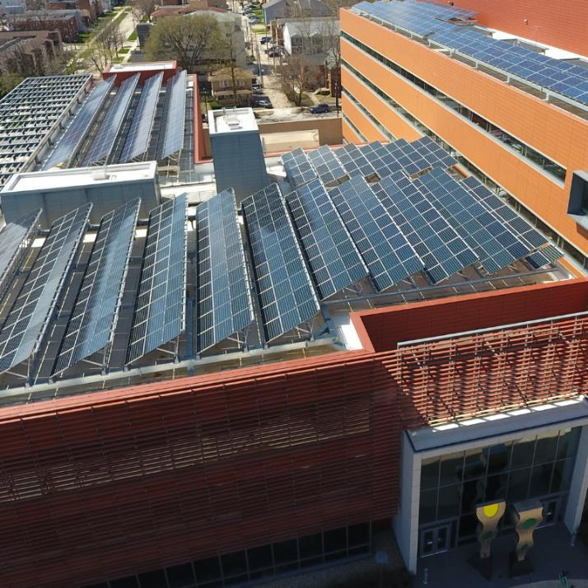
Introduction
Project Sponsor: Arijit Banerjee
60 Research Solar Panels on ECEB roof
Not distributing power into the grid
Not adequately monitored
Previously attempted in Fall 2019
Ethernet Connection
Not Scalable
ECE 445, Fall 2021
GRAINGER ENGINEERING

Slide 3
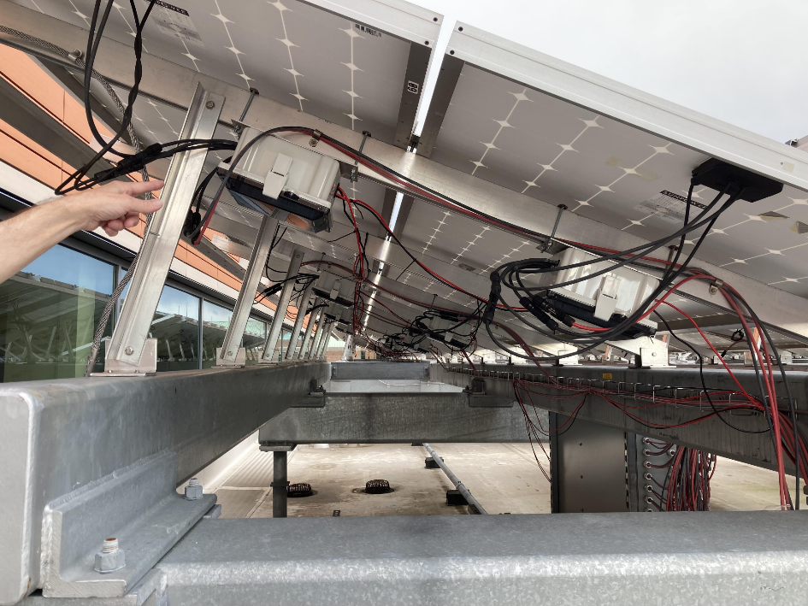
Solution: Advanced Interface Box
Collectively display live data of solar panels on a single portal
Webpage allowing ECEB personnel to both access and configure data
Allow for future full-scale implementation to all 60 solar panels
ECE 445, Fall 2021
GRAINGER ENGINEERING

Slide 4
High-Level Requirements
Record 3 key solar panel parameters at the interface level:
Voltage (accurate to within 300 mV)
Current (accurate to within 1.5%)
Temperature (accurate within ± 0.5°C)
Wireless communication capability with interface box through remote external portal (“Research Hub”) for observation and configuration
Interface boxes should allow for Scalability - ability to communicate with and retrieve data from multiple panels
ECE 445, Fall 2021
GRAINGER ENGINEERING
Notes:
Nikhil

Slide 5
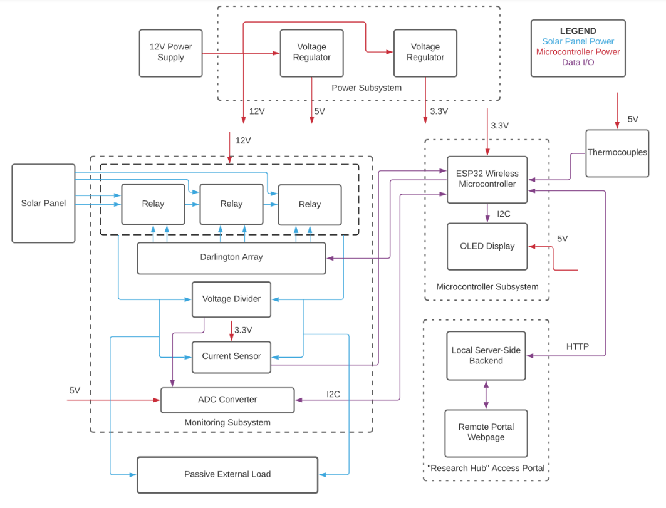
Block Diagram
ECE 445, Fall 2021
GRAINGER ENGINEERING
Notes:
Nikhil

Slide 6
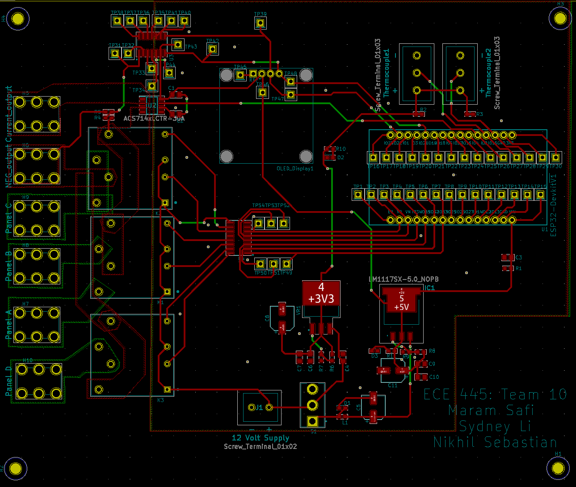
Initial PCB Design
ECE 445, Fall 2021
GRAINGER ENGINEERING

Slide 7
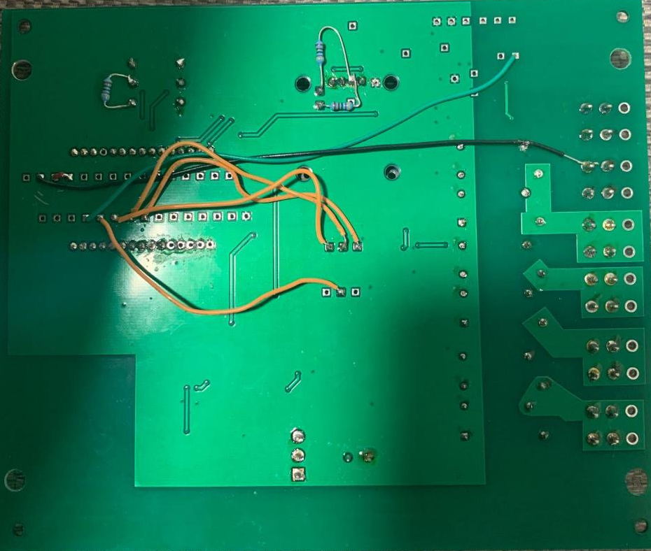
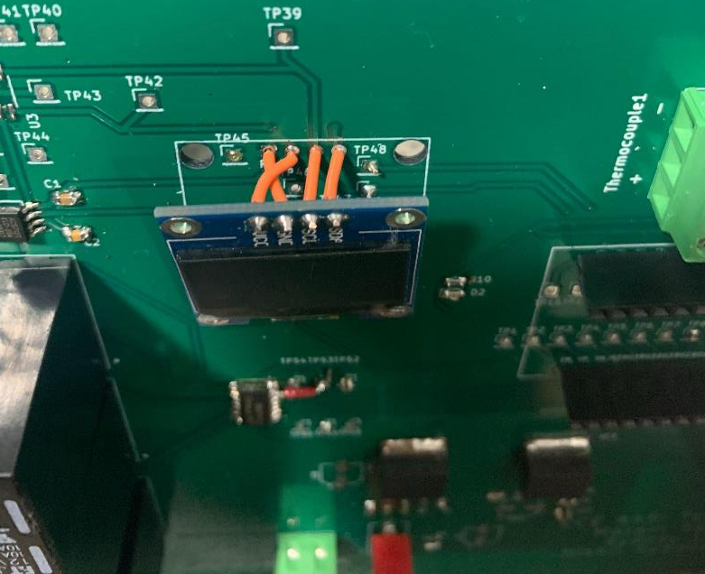
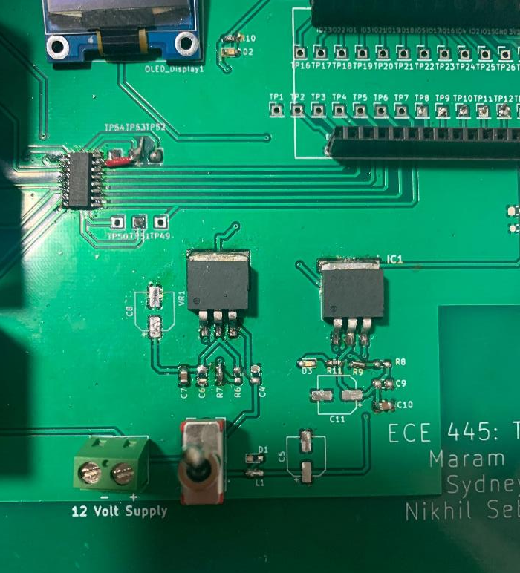
Final PCB Design
ECE 445, Fall 2021
GRAINGER ENGINEERING

Slide 8
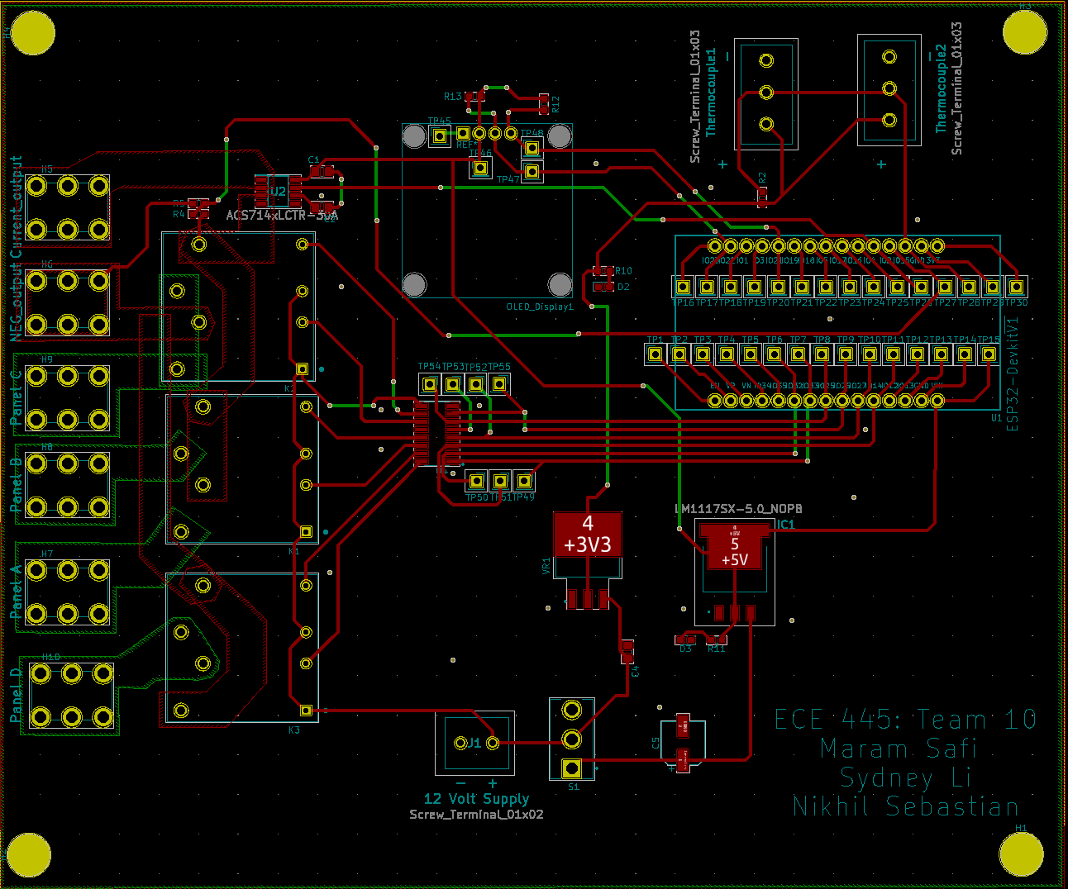
Final PCB Design
ECE 445, Fall 2021
GRAINGER ENGINEERING

Slide 9
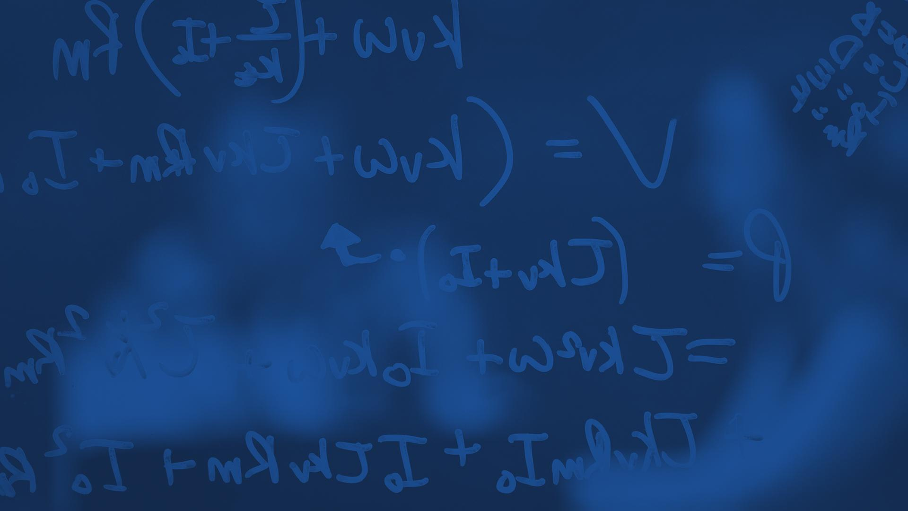
Power
Subsystem
ECE 445, Fall 2021
GRAINGER ENGINEERING

Slide 10
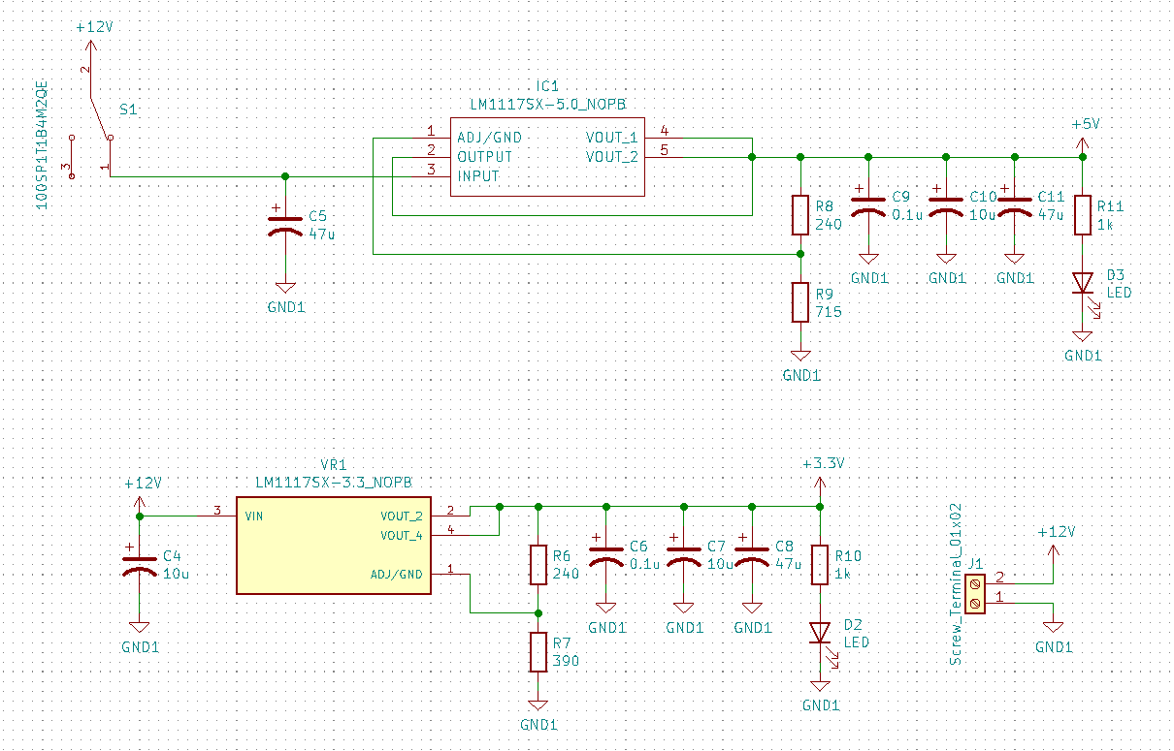
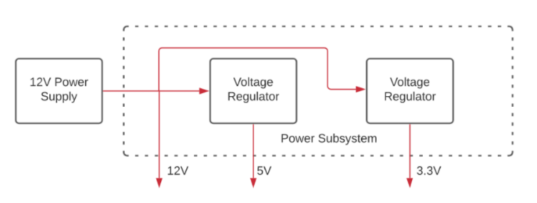
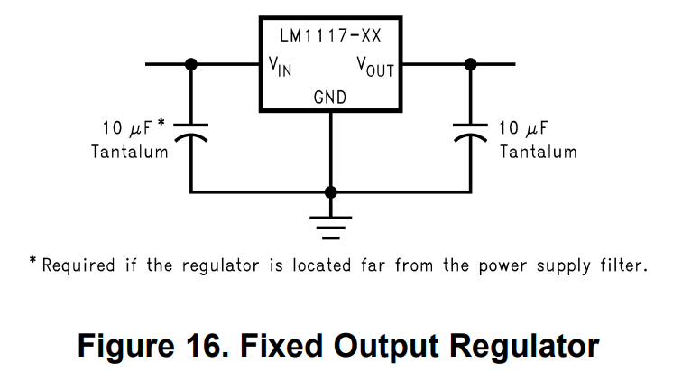
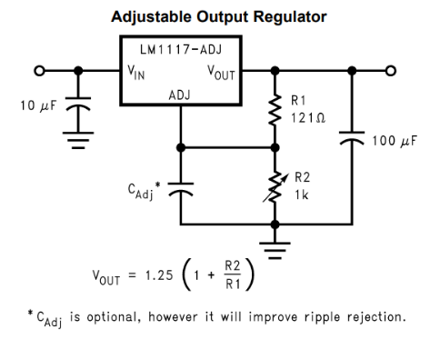
Design Details
ECE 445, Fall 2021
GRAINGER ENGINEERING

Slide 11
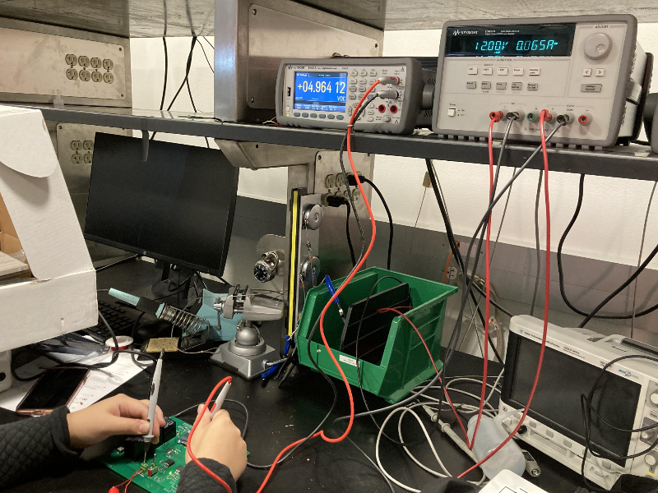
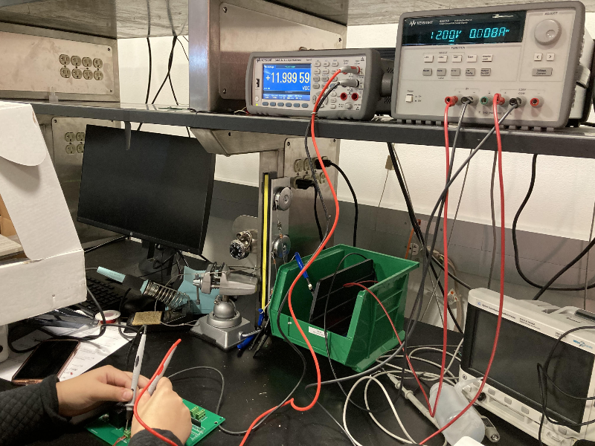
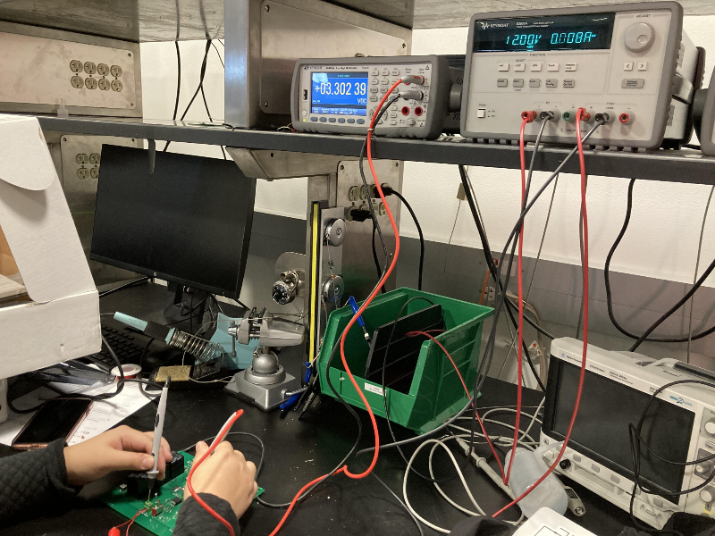
Requirements and Functional Tests
The 12-volt power rail provides a 12-volt DC output within the range of ± 1%
Converts a 12-volt input into a 5-volt DC output within the range of 4.90V ≤ Vout ≤ 5.10V
Converts a 12-volt input into a 3.3-volt DC output within the range of 3.235V ≤ Vout ≤ 3.365V
ECE 445, Fall 2021
GRAINGER ENGINEERING

Slide 12
Microcontroller
Subsystem
ECE 445, Fall 2021
GRAINGER ENGINEERING

Slide 13
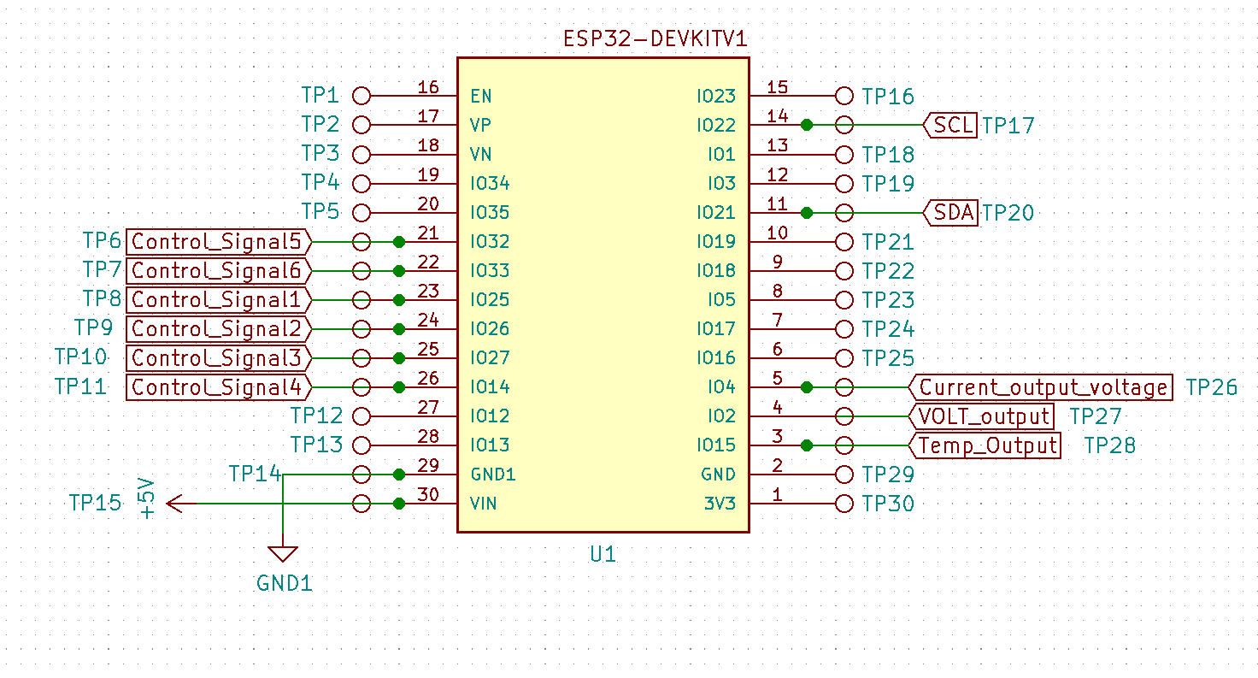
Hardware Design Details: ESP32
ECE 445, Fall 2021
GRAINGER ENGINEERING

Slide 14
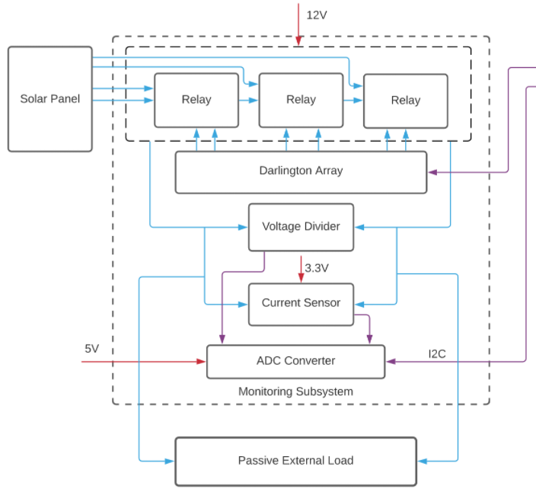
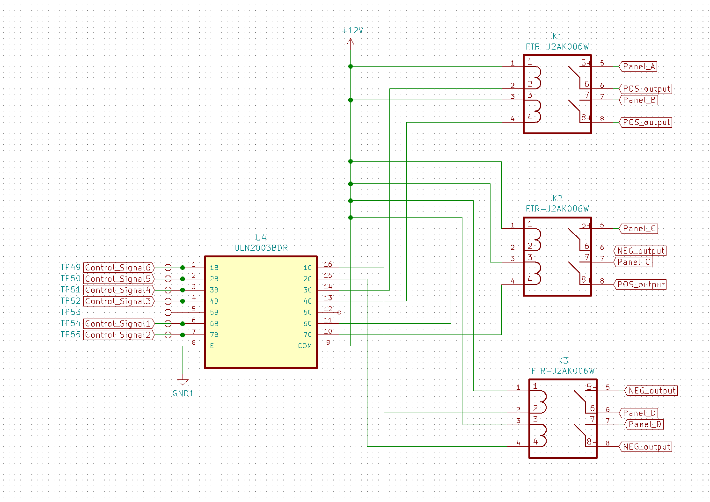
Hardware Design Details: Relay Configuration
ECE 445, Fall 2021
GRAINGER ENGINEERING

Slide 15
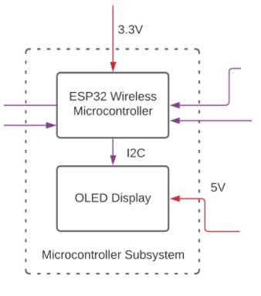
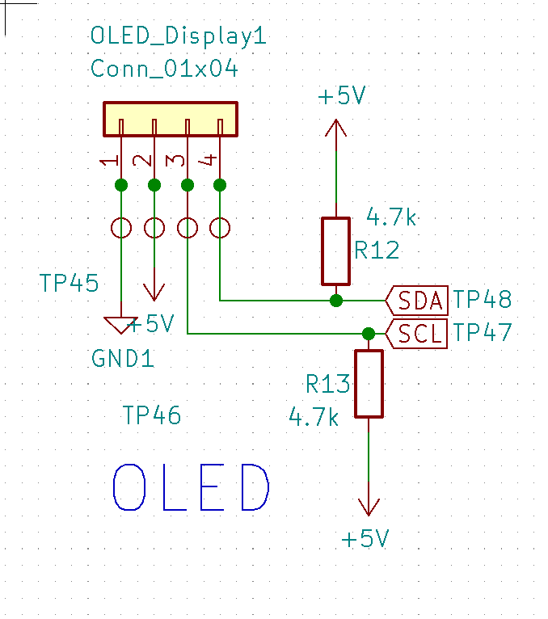
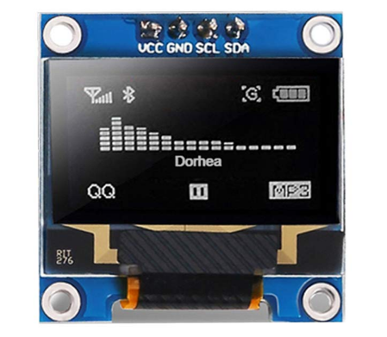
Hardware Design Details: OLED
ECE 445, Fall 2021
GRAINGER ENGINEERING

Slide 16
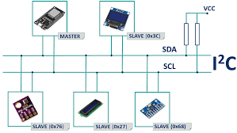
Software Design Details
Modular design for testing and development
OLED (SSD1306)
Adafruit library
ESP32 I2C Bus
Darlington Array programmed to receive brute inputs and translate
Relays fed by converted signal from Darlington Array
ECE 445, Fall 2021
GRAINGER ENGINEERING

Slide 17
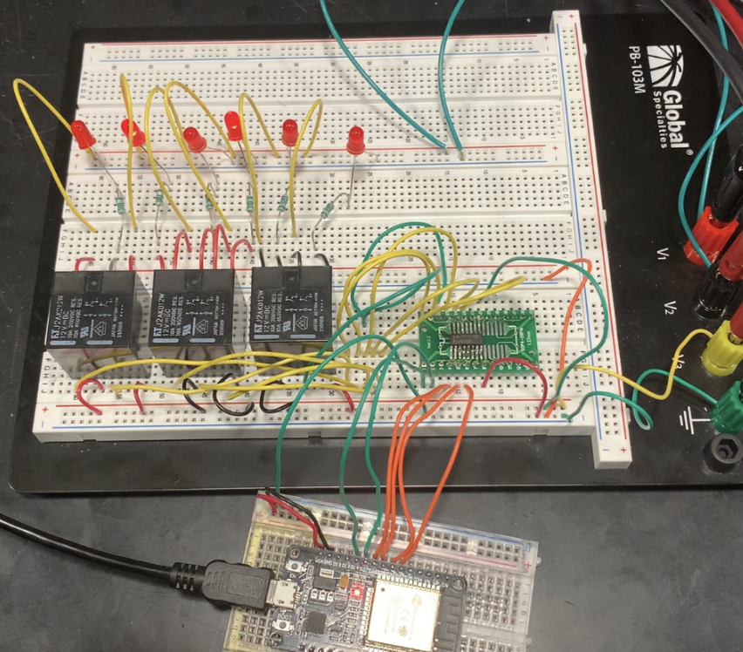
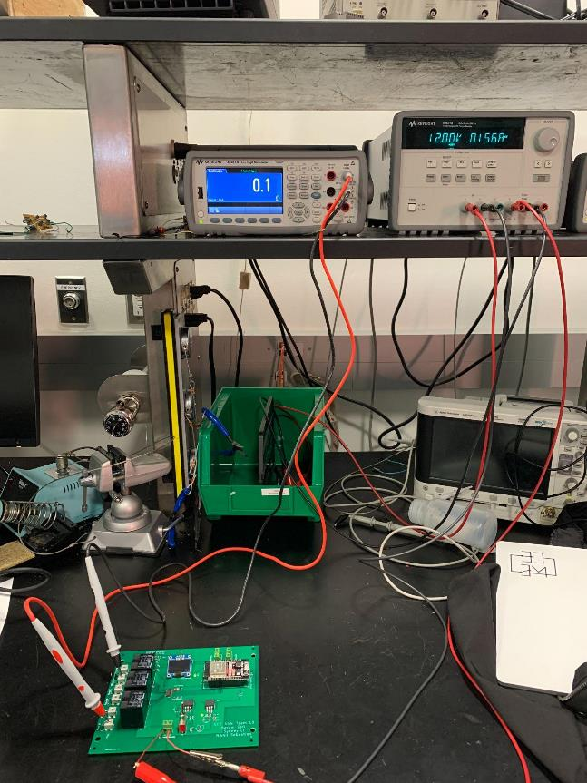
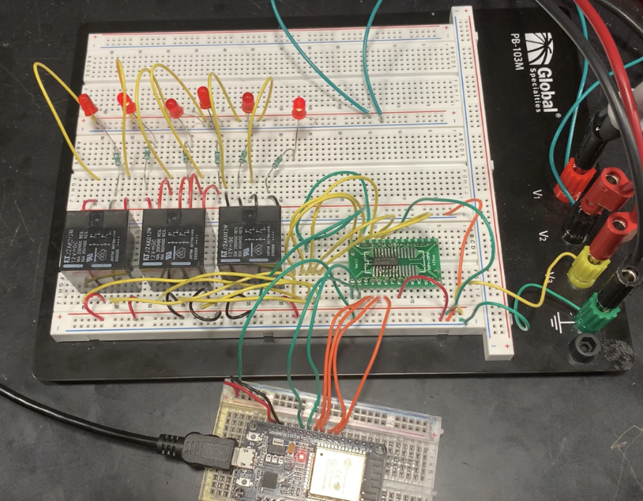
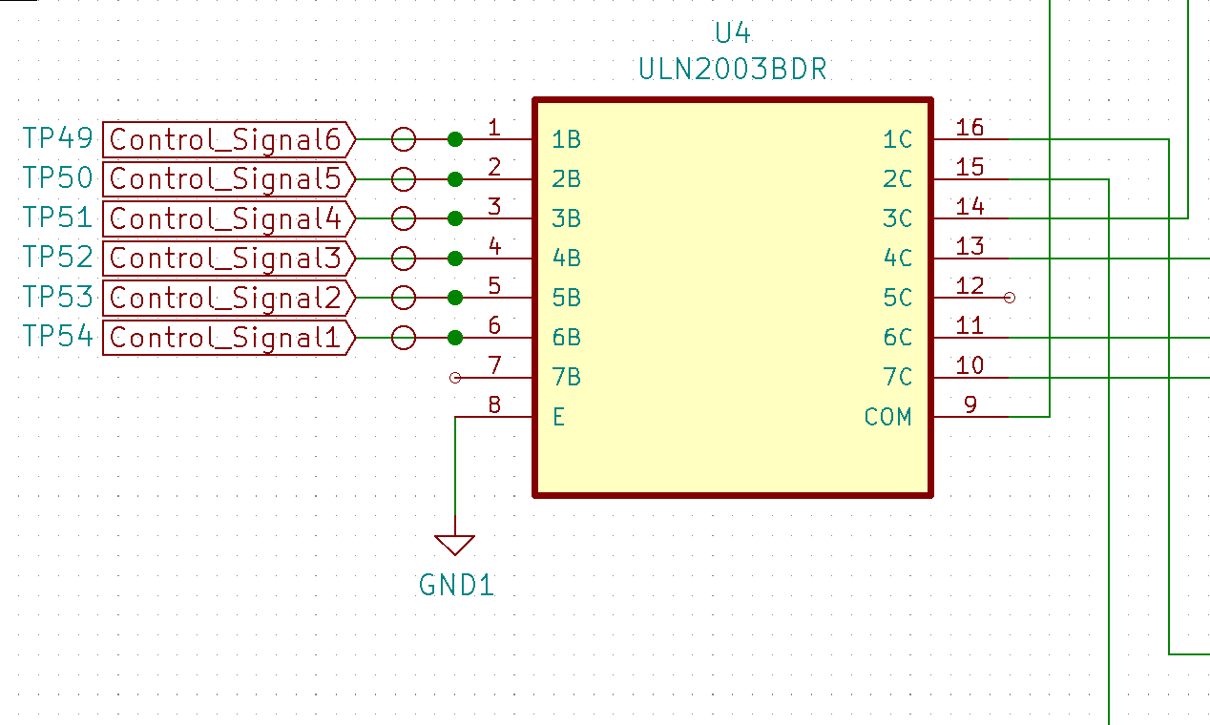
Requirements and Functional Tests
1. The relay subsystem must be able to switch between the different solar cell configurations:
128-cells (AD)
32-cells (CD)
64-cells (BC)
Breadboard | PCB
128 Cells | 128 Cells
32 Cells | 32 Cells
64 Cells | 64 Cells
ECE 445, Fall 2021
GRAINGER ENGINEERING

Slide 18
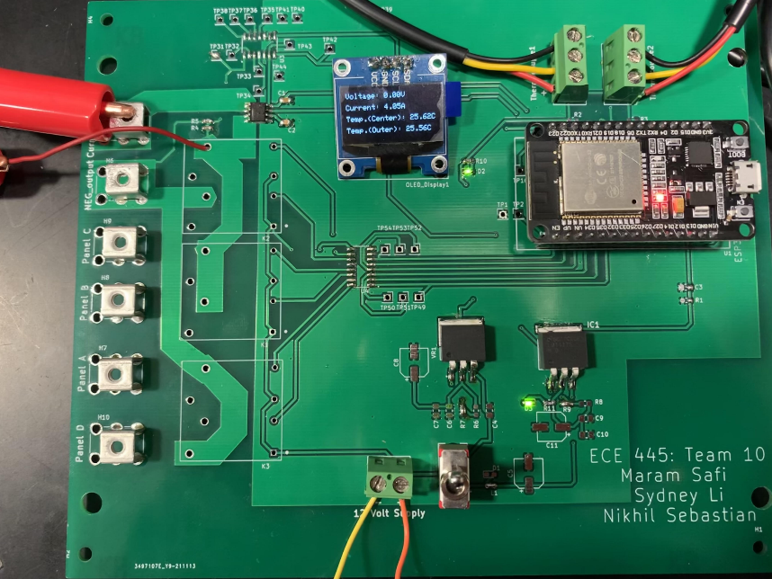
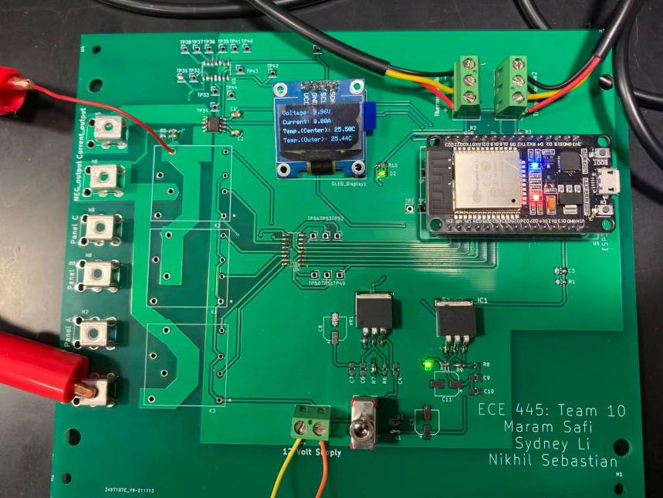
Requirements and Functional Tests
2. The ESP32 can communicate the immediate solar panel parameters to the OLED display
ECE 445, Fall 2021
GRAINGER ENGINEERING

Slide 19
Monitoring
Subsystem
ECE 445, Fall 2021
GRAINGER ENGINEERING

Slide 20
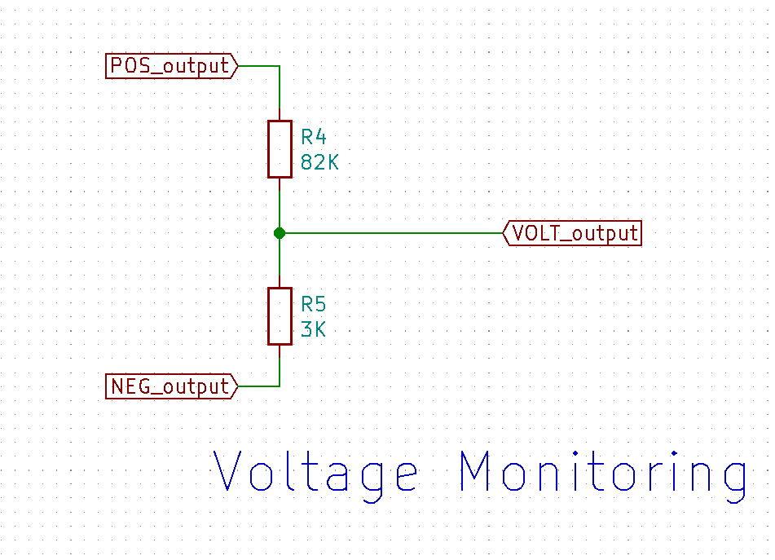
Hardware Design Details: Voltage Monitoring
Inputs from relay configuration
POS_output
NEG_output
Outputs to ADC
VOLT_output
Outputs to ESP32
VOLT_Output (GPIO 15)
ECE 445, Fall 2021
GRAINGER ENGINEERING

Slide 21
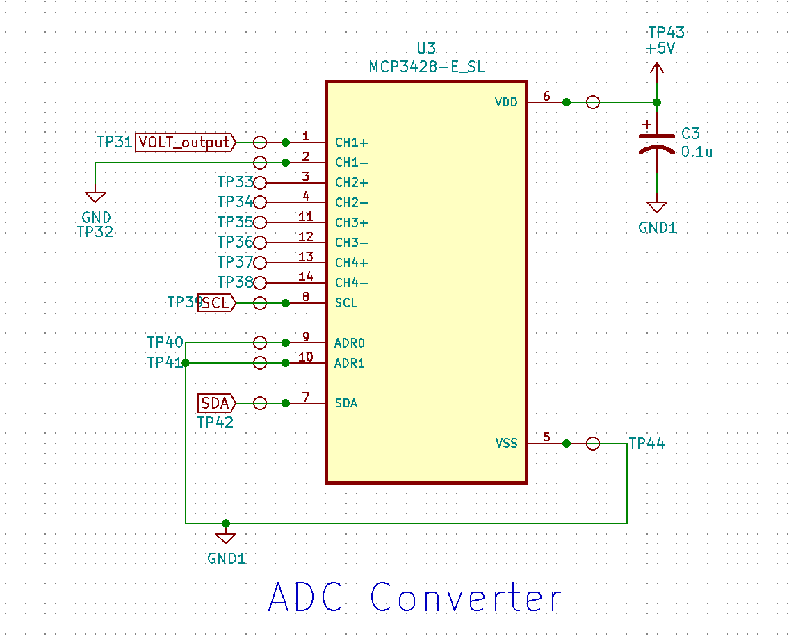
Hardware Design Details: ADC
Inputs from Voltage Divider
VOLT_output
Outputs to ESP32
I2C Bus (SCL, SDA)
Isolation
ECE 445, Fall 2021
GRAINGER ENGINEERING

Slide 22
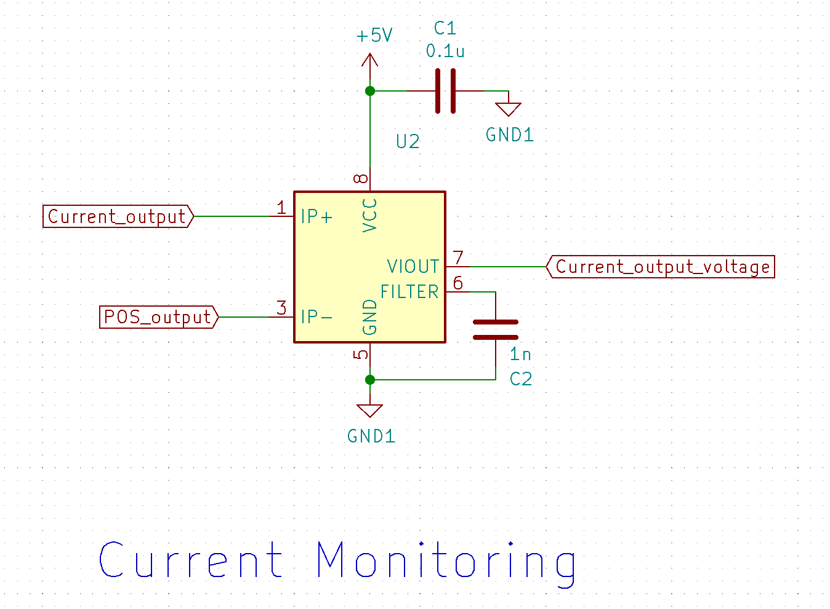
Hardware Design Details: Current Monitoring
Inputs from relay configuration
Current_output
POS_output
Outputs to ESP32
Current_output_voltage (GPIO 2)
Galvanically Isolated
ECE 445, Fall 2021
GRAINGER ENGINEERING

Slide 23
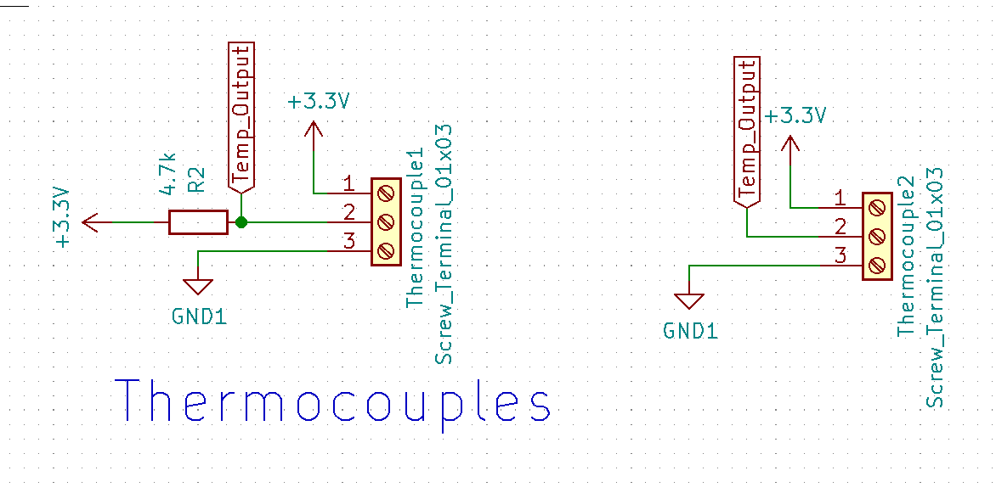
Hardware Design Details: Thermocouple Monitoring
Inputs from external thermocouples
Outputs to ESP32
Temp_Output
ECE 445, Fall 2021
GRAINGER ENGINEERING

Slide 24
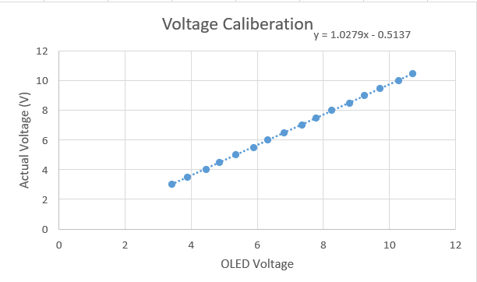
Software Design Details
Modular design for testing and development
Thermocouples:
DallasTemperatures library
Single datapath for ESP32 measurement
Current Sensor:
ESP32 ADC input
Calibration: 1.0279x - 0.5137
Voltage Measurement:
ESP32 ADC input
Calibration: 0.9304x - 0.0337x^2 - 0.0124
ECE 445, Fall 2021
GRAINGER ENGINEERING

Slide 25
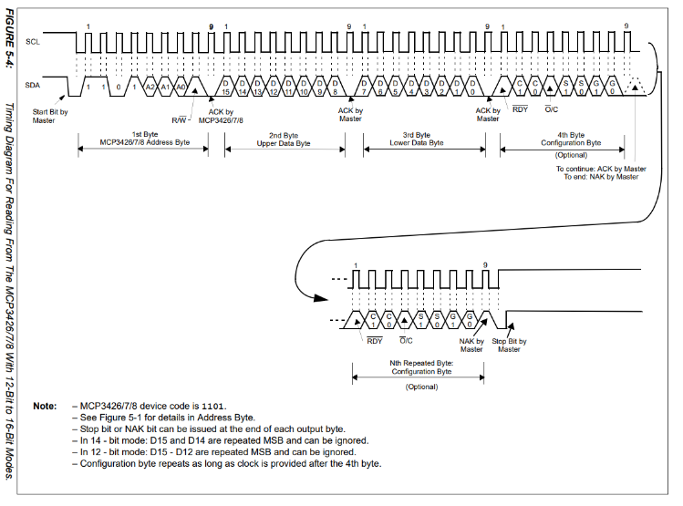
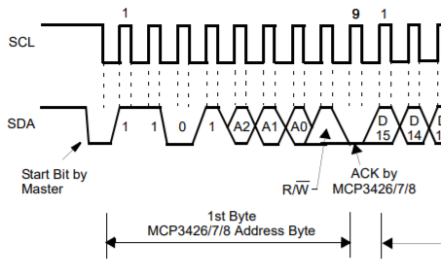
Requirements and Functional Tests
1. The ADC Converter should output a 16 bit digital code to our ESP32 that corresponds to the analog input into the IC once decoded.
MCP3428 Device Code: 1101
ECE 445, Fall 2021
GRAINGER ENGINEERING

Slide 26
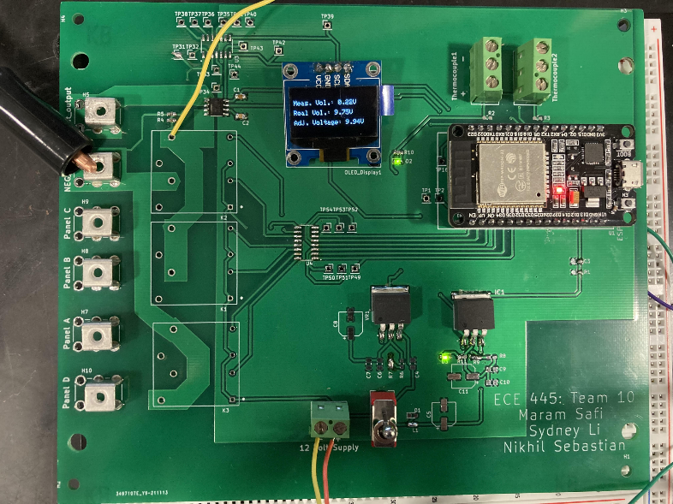
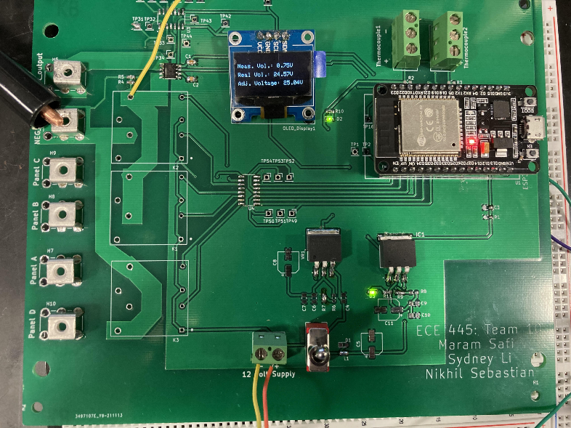
Requirements and Functional Tests
2. The voltage divider must be able to step down input voltages within the ranges of 0V - 85.6V and corresponding output voltages within the range of 0V - 3.3V
ECE 445, Fall 2021
GRAINGER ENGINEERING

Slide 27
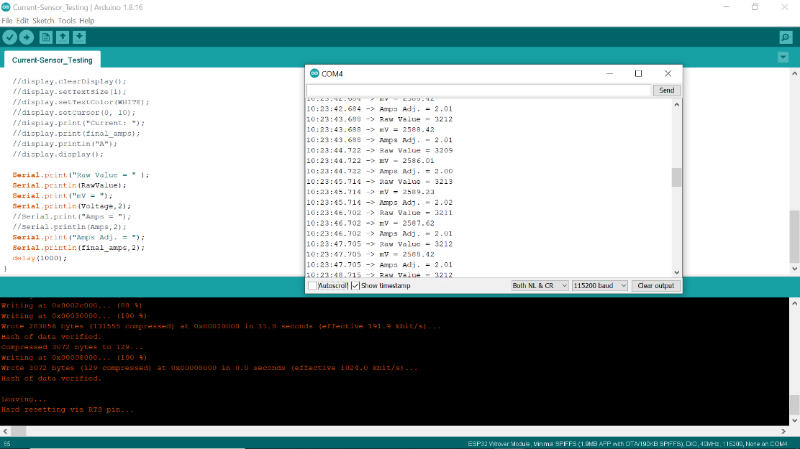
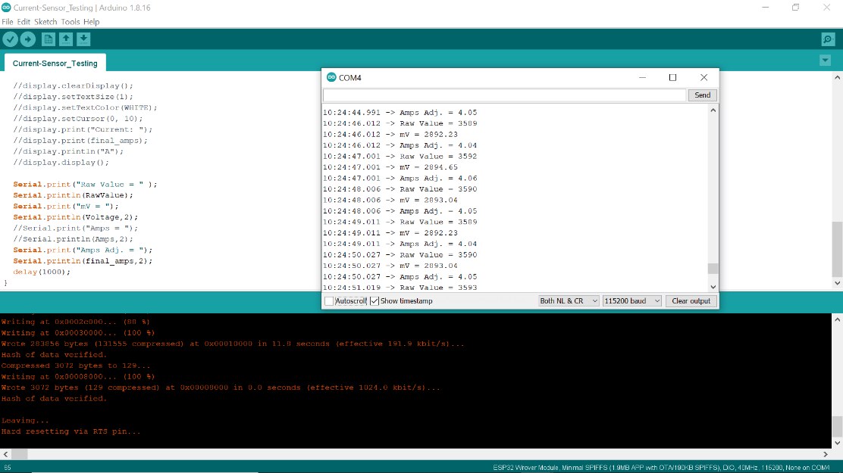
Requirements and Functional Tests
3. The current sensor must accurately read the current of the relay output within an error range of 1.5%
ECE 445, Fall 2021
GRAINGER ENGINEERING

Slide 28
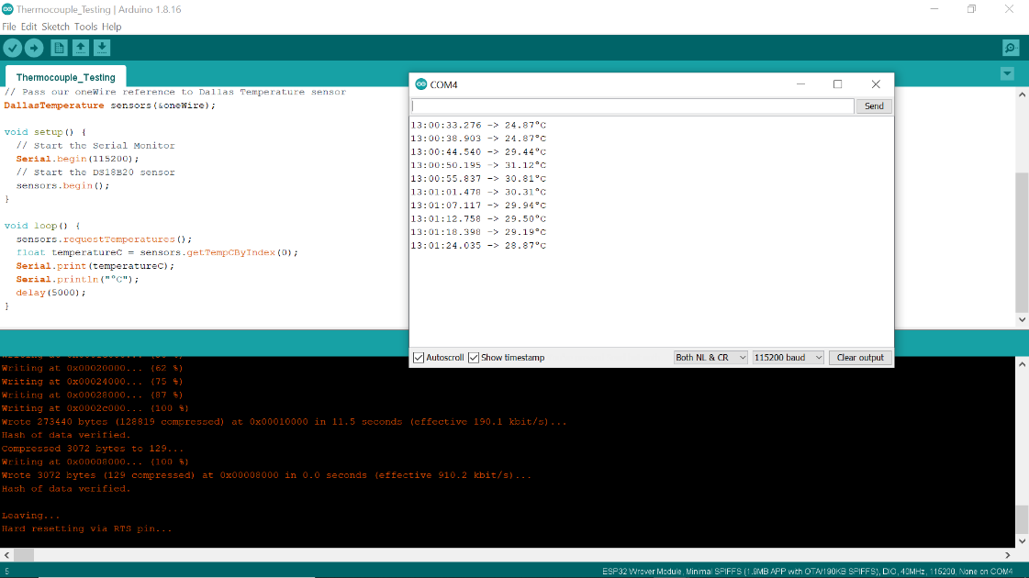
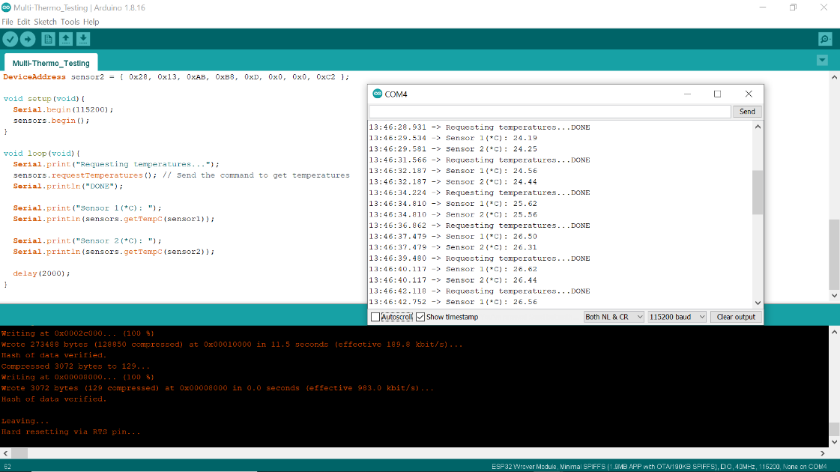
Requirements and Functional Tests
4. Thermocouples should measure values between the range -10°C and 85°C within an accuracy of ± 0.5°C
ECE 445, Fall 2021
GRAINGER ENGINEERING

Slide 29
“Research Hub”
Subsystem
ECE 445, Fall 2021
GRAINGER ENGINEERING

Slide 30
Design Details
Webpage Front-end implementation: Django Framework
User Authentication - django.contrib.auth.urls
Observation data - ManyToOne model relationships
Data Visualization - plotly Python Library
Server Back-end implementation: Django ORM and Django-REST Framework
ESP32 HTTP Communication:
Observation data - WiFi.h and HTTPClient.h
Configuration inputs - WiFi.h and ESPAsyncWebServer.h
ECE 445, Fall 2021
GRAINGER ENGINEERING

Slide 31
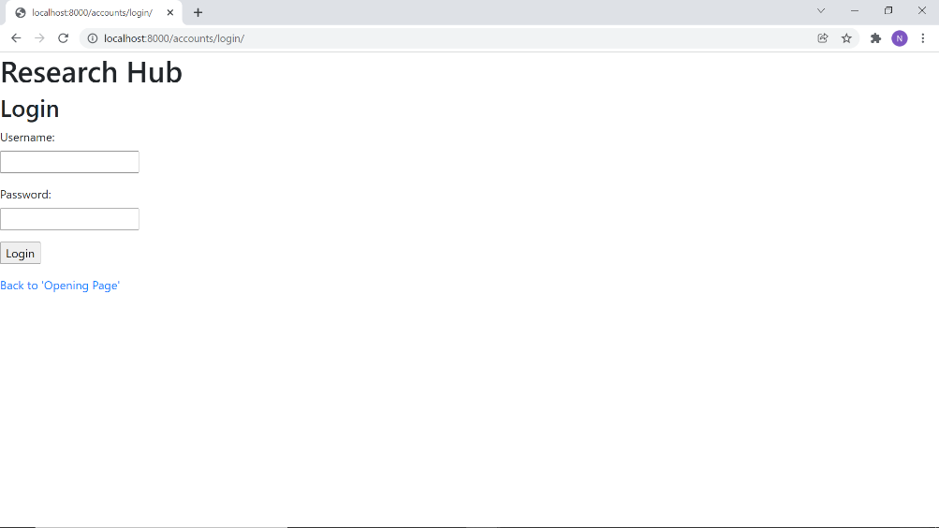
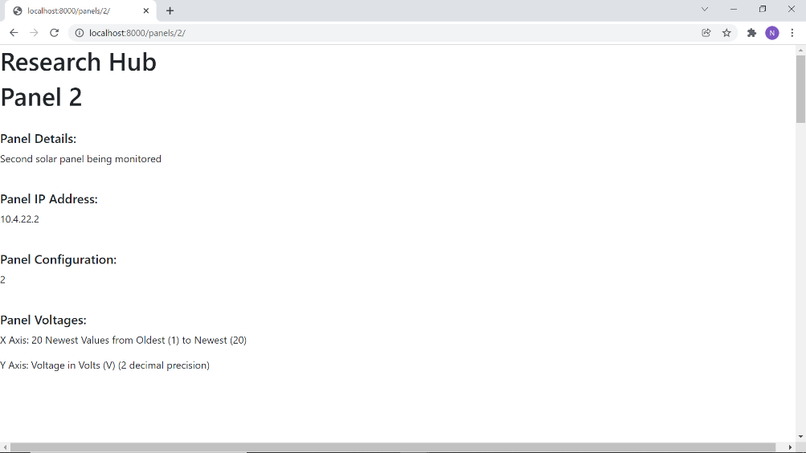
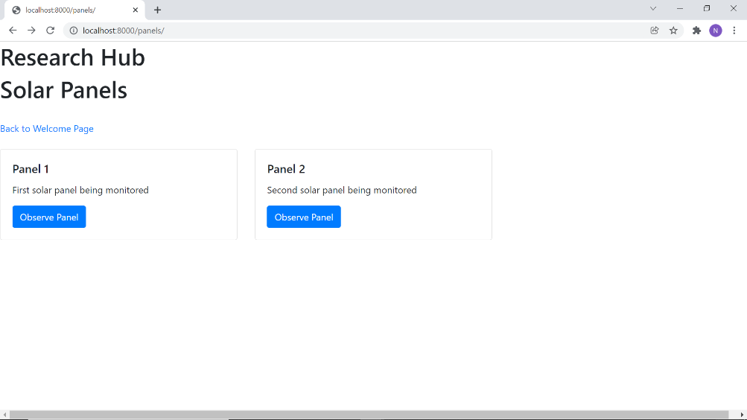
Requirements and Functional Tests
Front-end website should successfully route between pages and display solar panel data based on security and observation use cases
Working user authentication on the remote portal that restricts Research Hub access to allowed members (ECEB personnel) only
ECE 445, Fall 2021
GRAINGER ENGINEERING

Slide 32
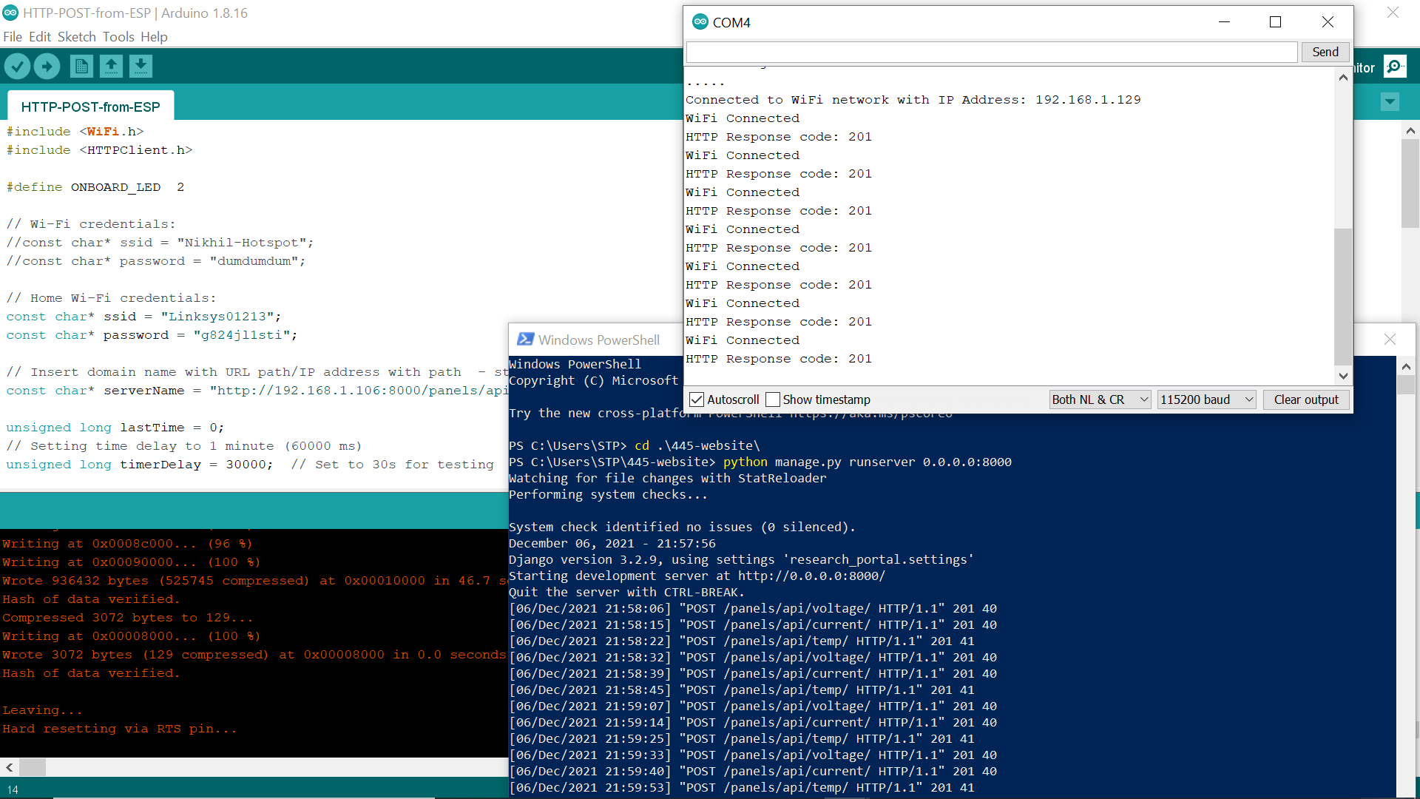
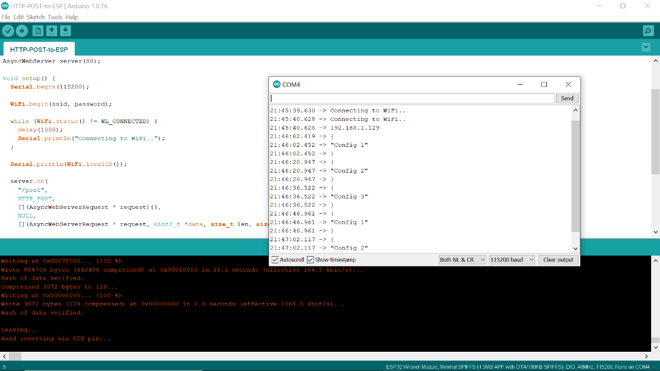
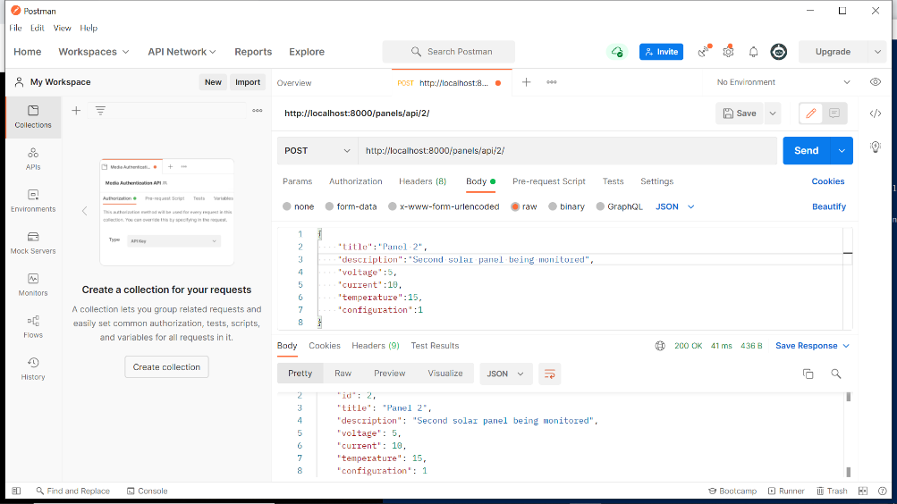
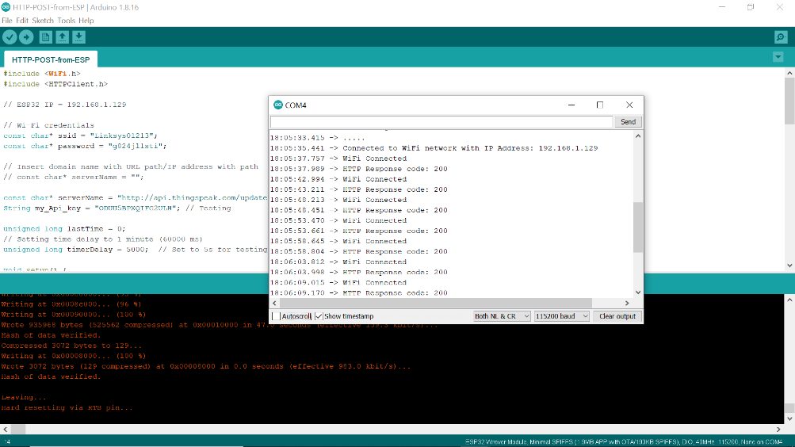
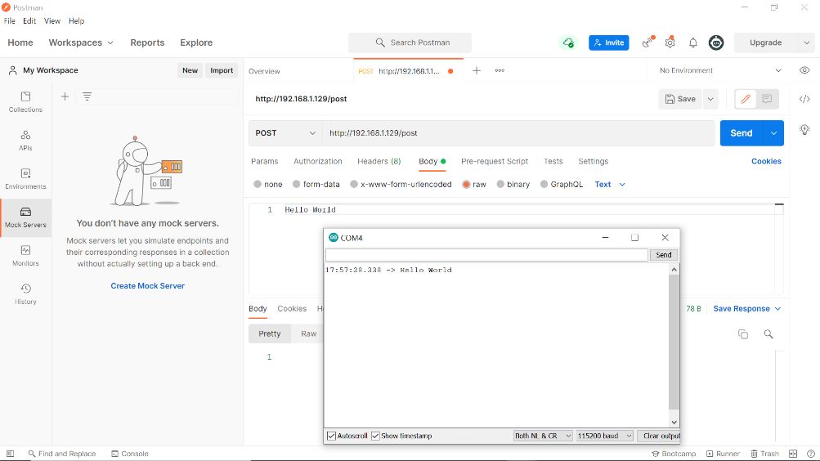
Requirements and Functional Tests
3. The back-end of the Django framework should have HTTP communication ability (2-way POST requests)
4. The ESP32 microcontroller should have HTTP communication ability (2-way POST requests)
ECE 445, Fall 2021
GRAINGER ENGINEERING

Slide 33
Requirements and Functional Tests
5. Real-time observed data that is received should be processed correctly for plot/visualization updates for the specific panel
6. User-input configuration settings should be panel-specific and submission should trigger back-end communication
ECE 445, Fall 2021
GRAINGER ENGINEERING

Slide 34
Successes and Challenges
Challenges:
PCB Connections:
Pull up resistors
OLED shorting
ADC Bypass
Enable Pin
Linear Regulators
Darlington Array
Software Interface:
WiFi connection on independent power supply
Successes:
All 4 subsystems working independently
Successful hardware integration (3 subsystems)
ECE 445, Fall 2021
GRAINGER ENGINEERING

Slide 35
Conclusions and Future Work
Updating our PCB with correct internal connections
Testing further with different ADC components to achieve isolation
Establish reliable independent ESP32 WiFi connection
Visually advancing our Research Hub interface
ECE 445, Fall 2021
GRAINGER ENGINEERING

Slide 36
Special Thank You!
Our TA, Evan Widloski
Our sponsor and guide, Professor Banerjee
Kevin Colravy
Bonhyun Ku
Our mentor, Professor Schuh
And, the entire ECE 445 team!
ECE 445, Fall 2021
GRAINGER ENGINEERING

Slide 37
Thank you!
Any Questions?
ECE 445, Fall 2021
GRAINGER ENGINEERING

