Slide 1
Reconnaissance robot (SCD pitch)
Team 55
Xuqing Sun/ Shenyi Wang/ Sophie Jin

Slide 2
Introduction
A robot to recon unknown area
Movements are controlled remotely
Users can see live video through their phone

Slide 3
Objective
Transfer back live video stream to user end
Movement controlled by remote controller
Wireless two-way communication

Slide 4
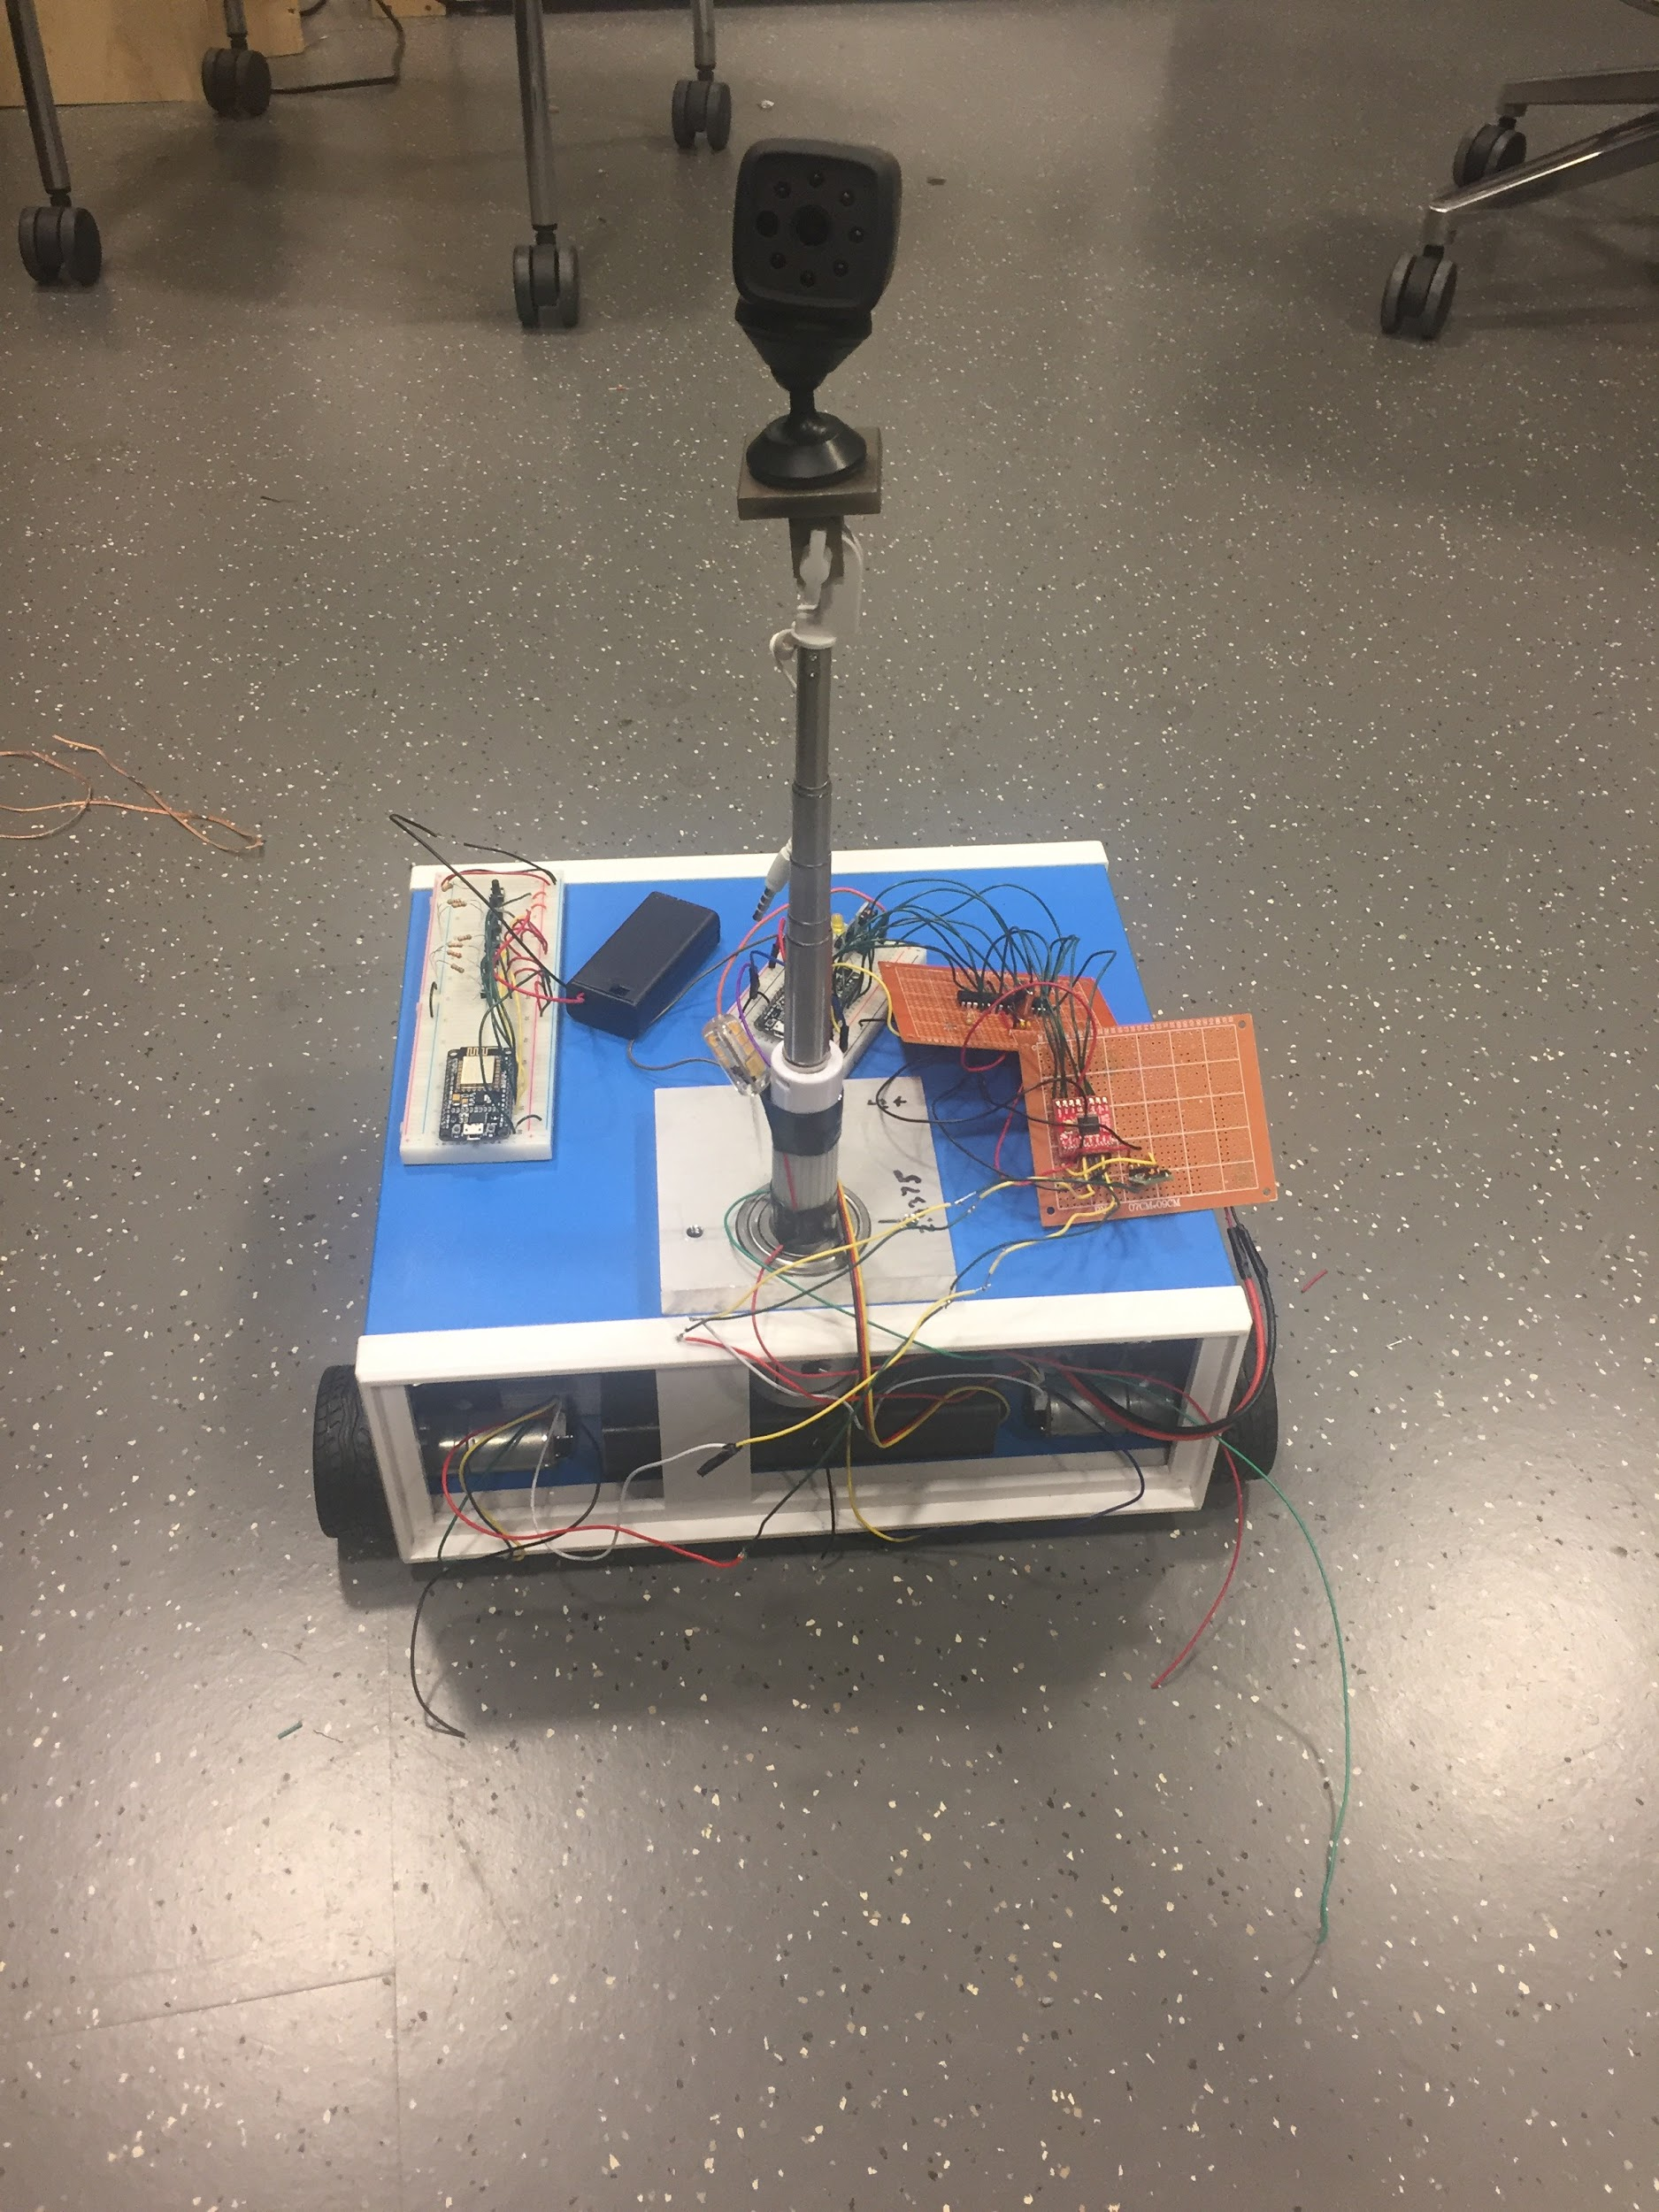
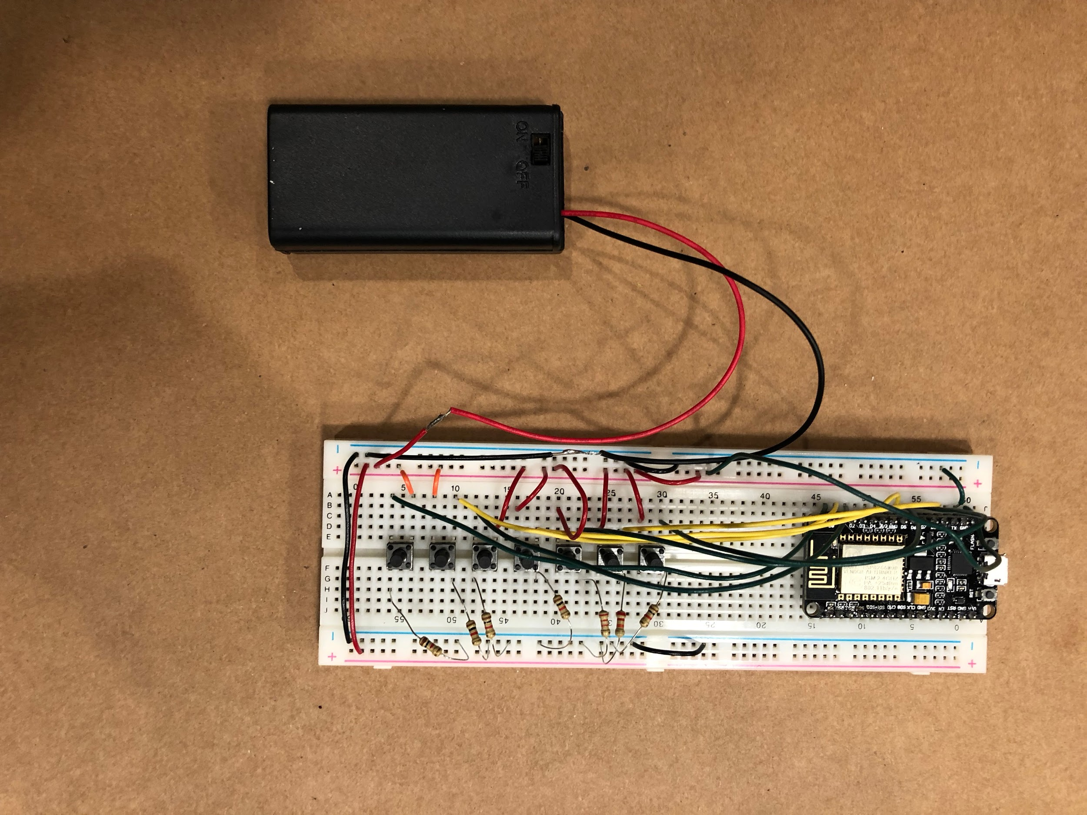

Slide 5
High level requirements
The user is able to control movements, allow the camera lift to rotate, turn on and off the light
The robot can transfer back images and sound data.
The power system can sustain the robot for at least half an hour of full operation.

Slide 6
Block Diagram

Slide 7
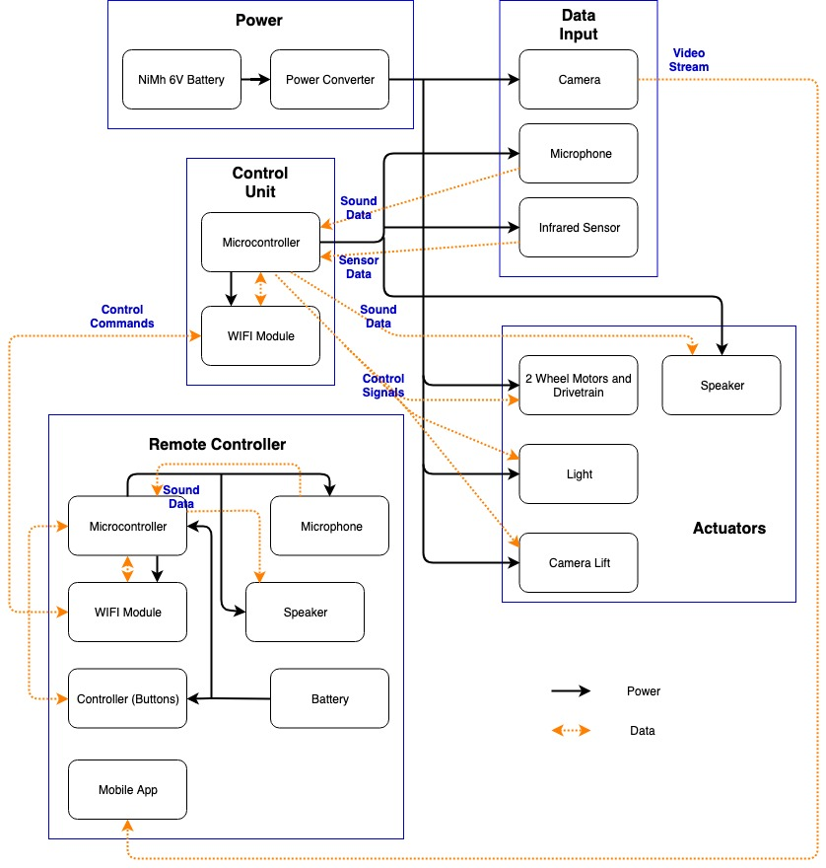

Slide 8
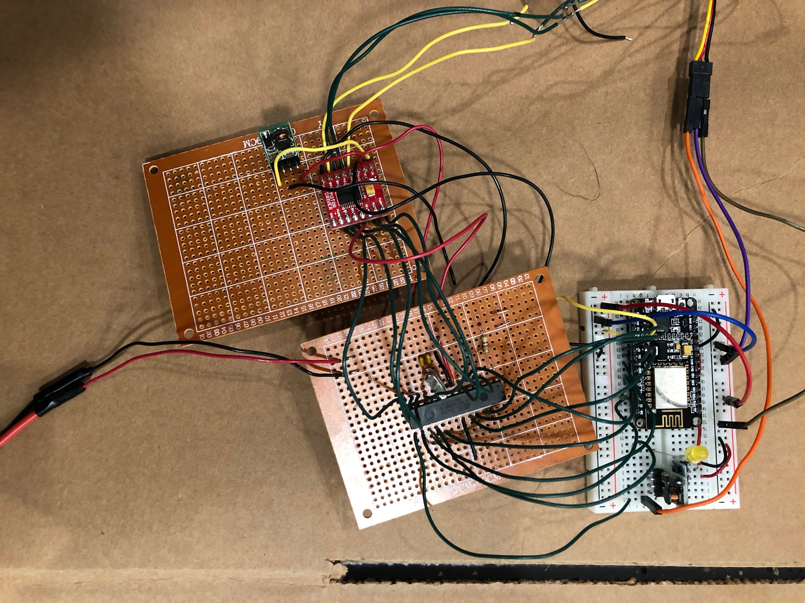
Control unit-design
Microcontroller-Atmega328P
Wifi module-ESP8266
Process data and communicate
with remote controller

Slide 9
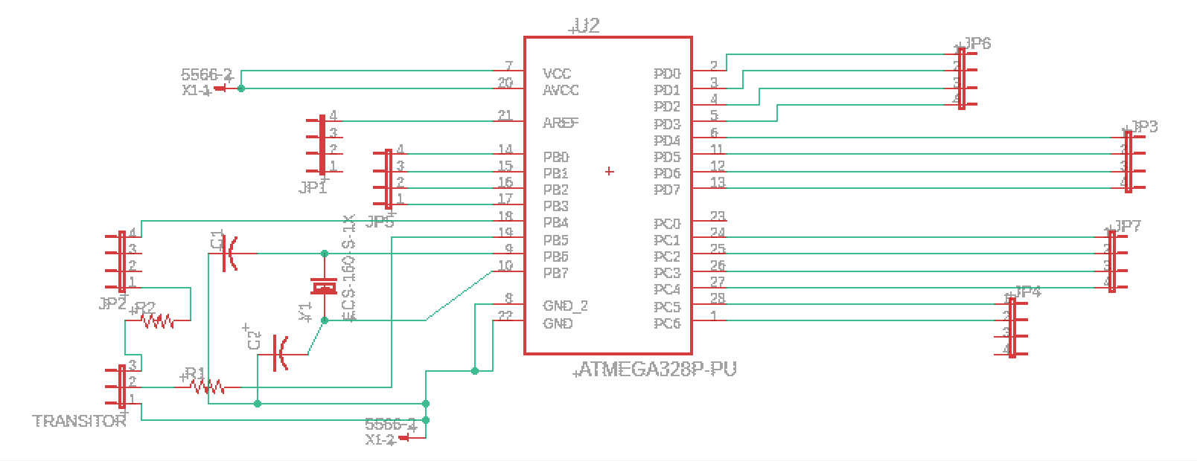
Control unit schematics

Slide 10
WIFI module
Server-client structure to communicate between two ESP8266s
Failure of serial communication between WIFI module and microcontroller
Result: Failure of audio data, short of pins
Possible remedy: new chip, different software implementation

Slide 11
Control unit verification
With buttons pressed on remote controller, microcontroller on robot receives the output
When direction buttons and rotation buttons are specified, the wheels and camera lift can turn correspondingly

Slide 12
Power Unit
Battery (6V, 10000mAh)
Power supply for all components on the robot
Battery (two 1.5V AA battery pack)
Power supply for remote controller
Voltage converter
6V - 3.3V: for microcontroller, PIR sensor, etc.
6V - 12V: for LED, motor
6V: for motor driver

Slide 13
The main power consumption comes from motors.
We have 2 motors, total power is 175.2W
The efficiency of power converter on data sheet is 90%.
Our battery’s capacity is 10000mAh (under 12V: 120Wh)
120Wh * 0.9 / 175.2 = 0.61h
Battery could sustain for at least 30 minutes.
Voltage | 12V
Current | 7.3A

Slide 14
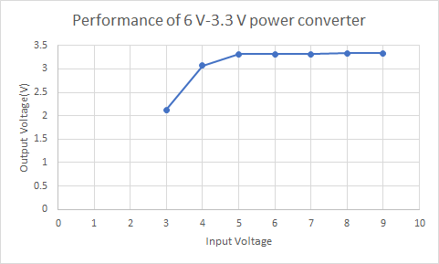
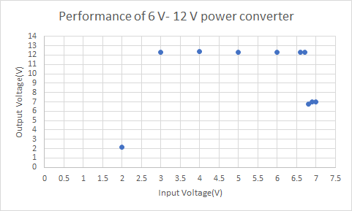
Power converters

Slide 15
Data Input
Camera
Live stream video
Microphone
Two-way sound communication
Infrared sensors
Approximate direction that people locate at

Slide 16
Camera
Resolution | 1080P
Number of frames | 30 fps
Power consumption | 1.036W
Field of view | 140 degrees

Slide 17
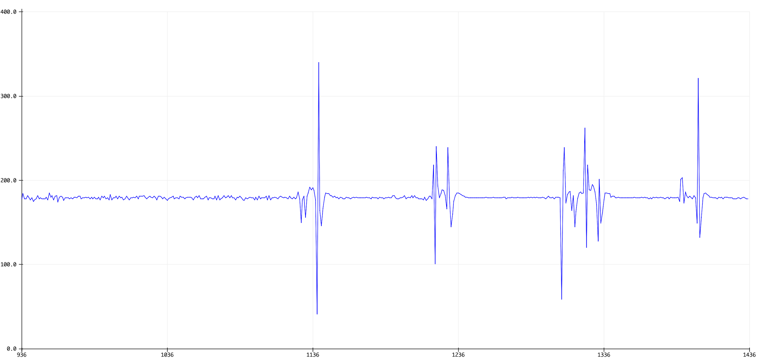
Microphone
Figure 5. Serial Plot of Sound Data from Microphone

Slide 18
PIR sensors
Situation | Voltage
Obstruct IR sensor | 3.18V/3.25V
Stand away from IR sensor (1 meter away) | 170mV/100mV

Slide 19
Actuators
Motors
2 geared motors of 12V, 220RPM
Camera lift
About 50 cm high, can be rotated by a servo motor
LED

Slide 20
Motor & Motor Driver
In1 | In2 | PWM | Out1 | Out2 | Mode
L | H | H | L | H | CCW
H | L | H | H | L | CW
TB6612FNG

Slide 21
Camera Lift
The camera’s height can be adjusted manually
The camera’s rotation is controlled by servo motor 180 degrees unidirectionally

Slide 22
LED
Designed: 12V, 3W, 310 Lumens
Resistor | Threshold Voltage
10K Ohm | 9V
1K Ohm | 8V
100 Ohm | 7V

Slide 23
Remote controller
Buttons
ESP8266 Wifi module
Battery

Slide 24
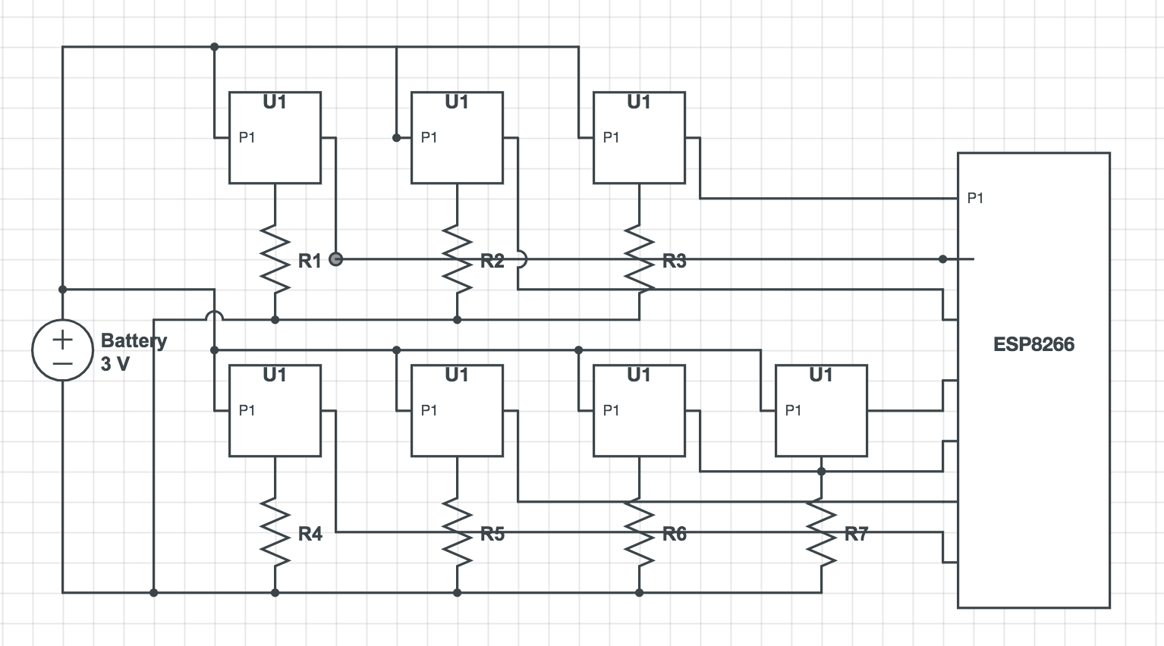
Controller Circuit Schematic
Notes:
output of the buttons are connected to the wifi module

Slide 25
Botton encoding
Since the ESP8266 chip could only send out one message at a time, we have to integrate all buttons into one message. We use a 3-digit integer to represent the command pressed by the users.
 | Code[2] | Code[1] | Code[0]
0 | LED_OFF | Lift_still | Stand still
1 | LED_ON | Lift_turn_CW | Move forward
2 |  | Lift_turn_CCW | Move backward
3 |  |  | Turn left
4 |  |  | Turn right
Notes:
inefficient to send one by one

Slide 26
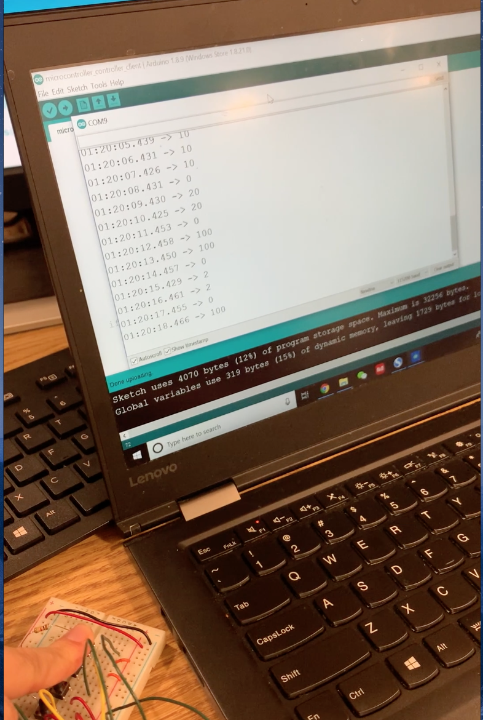
Verification:
Mostly meet the requirement
When button is pressed, the command is received by WIFI module (ESP8266) and sent to the robot side
No obvious delay
Failed to output sound received by microphone and data captured by IR sensor. (Due to failure in data input module)
Notes:
The remote controller’s basic functionality works well because…..

Slide 27
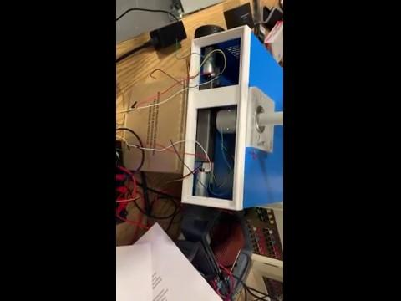

Slide 28
Conclusion and Future Work
Successfully built the prototype
There are many places we could work on in the future:
Two-way audio communication
Better physical design for remote controller
Refine actuators to make the robot move more accurately when commands are given
Add basket on robot to exchange stuff
Notes:
still far away from what could be used by police officers in real work

