Slide 1
Team 43: EpiCap
ECE 445
Yuanrui Chen, Yichen Wu, Yiyang Xu
4/29/2022

Slide 2
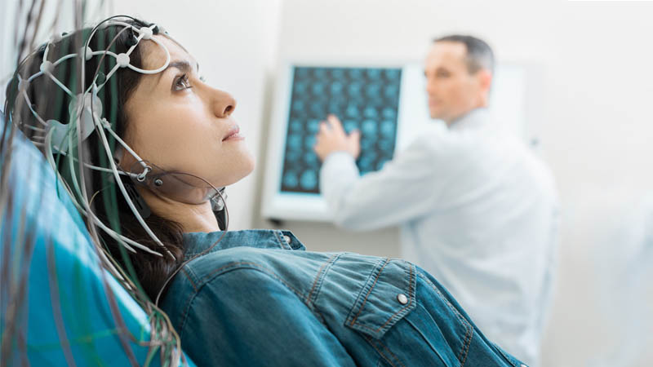
Introduction
Problem
Inpatient setting brings inconvenience and expensive hospital spendings.
ranged from $1,000 to $20,000 annually per person
Ambulatory devices have limited functionality.
no video recording of physical symptoms
data retrieval is difficult
bulky and ugly – less likely to carry around
Epilepsy patients have unpredictable schedules.
lower employment rate
lower income
ECE 445
GRAINGER ENGINEERING

Slide 3
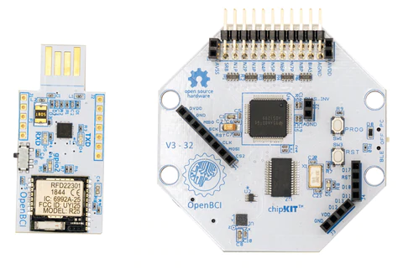
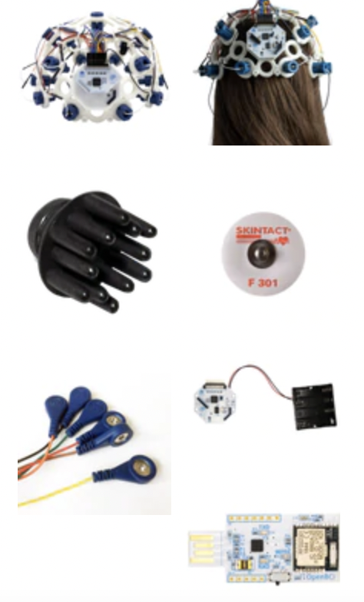
Introduction
OpenBCI
This is one of the available openBCI products for sale online.
ECE 445
GRAINGER ENGINEERING

Slide 4
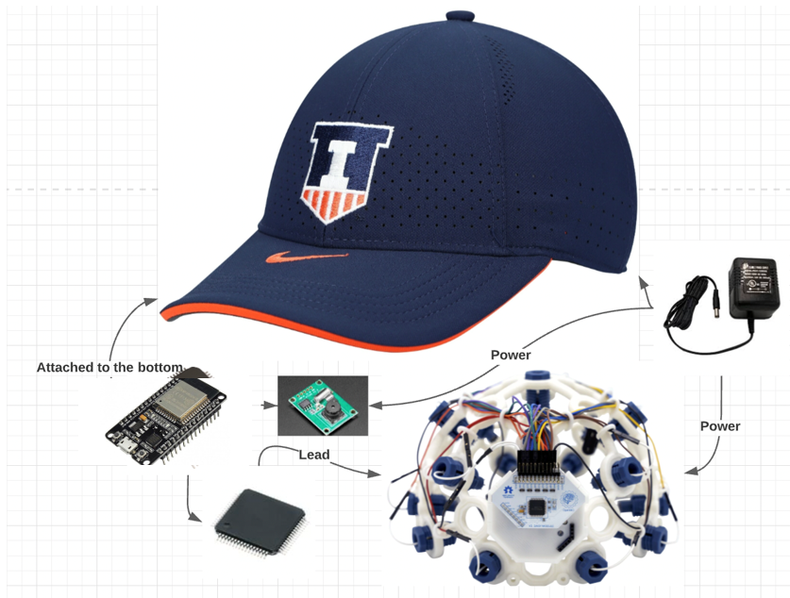
Introduction
Solution
A small device with all of the necessary functionality integrated.
EEG data storage
built-in camera
lightweight
not preventing patients from normal activities
Cheaper than the OpenBCI product
Component overview of the product
ECE 445
GRAINGER ENGINEERING

Slide 5
Objective
High Level Requirements
EEG data should be collected at 250 +/- 5% Hz and uploaded continuously to the SD card and web server in real time with timestamps.
The EEG cap should be able to record the patient’s eye and arm movement. Large number of pictures should be taken with timestamps for future analyse by doctors.
Every component should be mounted under the cap visor and not affect patient’s line of sight.
ECE 445
GRAINGER ENGINEERING

Slide 6
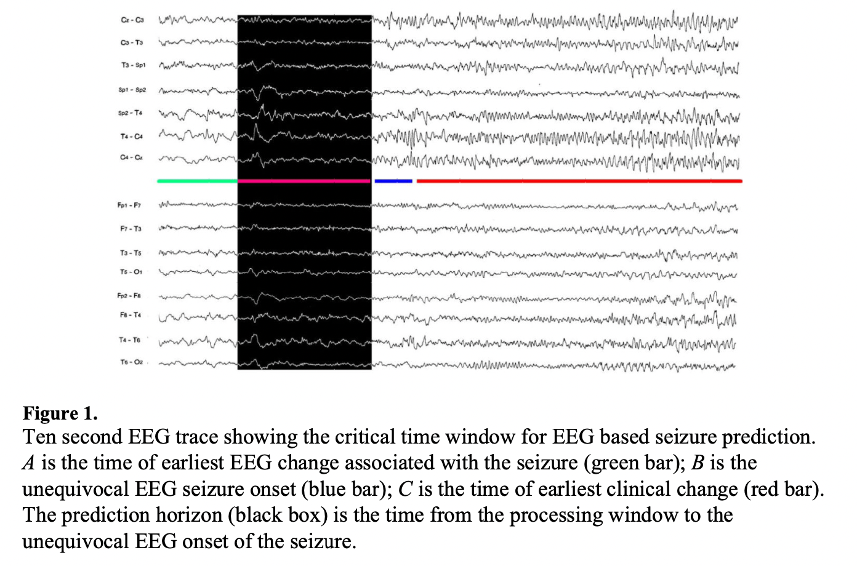
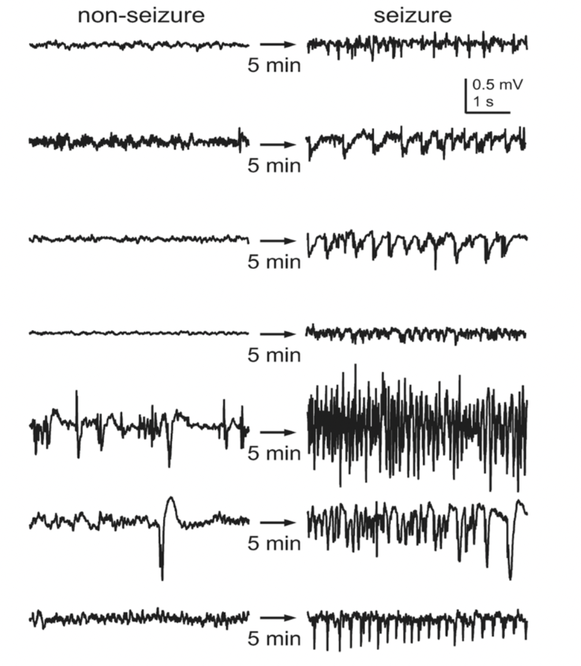
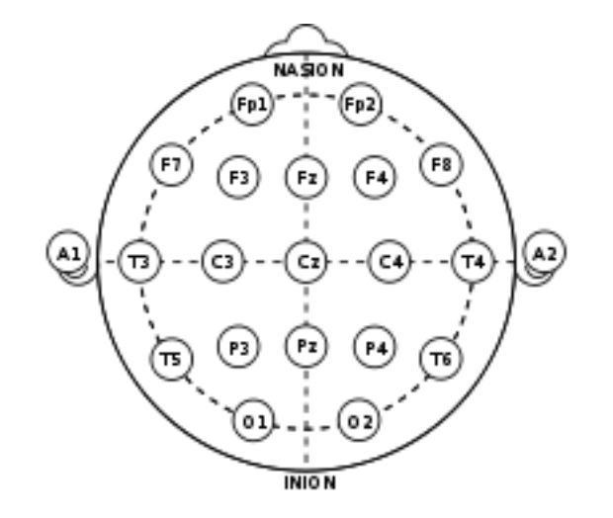
Objective
Overview of EEG
Electroencephalography (EEG) is a method to record an electrogram of the electrical activity on the scalp that has been shown to represent the macroscopic activity of the surface layer of the brain underneath. It is typically non-invasive, with the electrodes placed along the scalp.
Positions of electrodes on scalp
Seizure/non-seizure brain activities
ECE 445
GRAINGER ENGINEERING

Slide 7
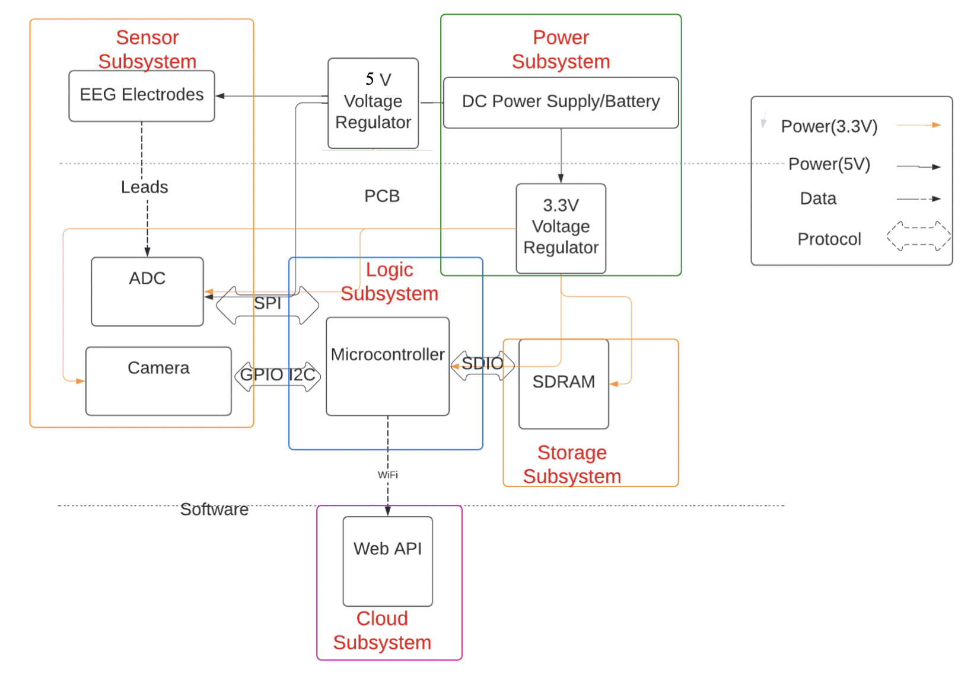
Design
Block Diagram
SPI
GPIO
SPI
Camera Subsystem
ECE 445
GRAINGER ENGINEERING

Slide 8
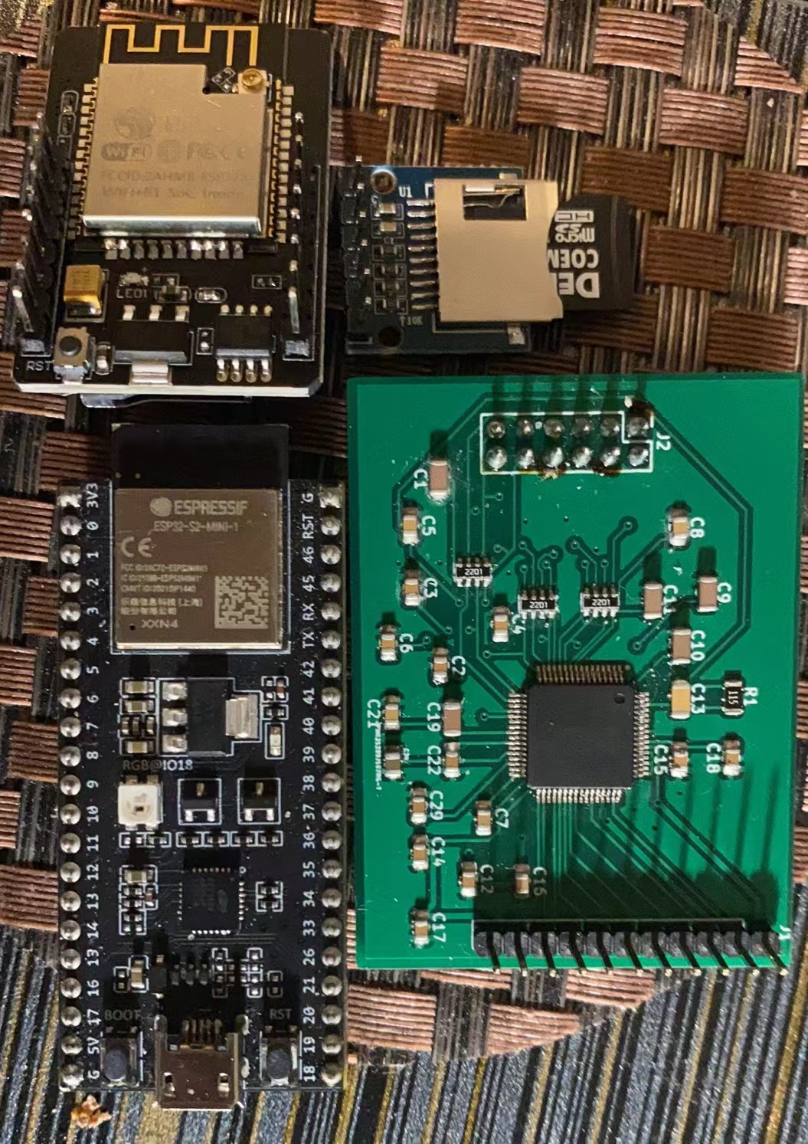
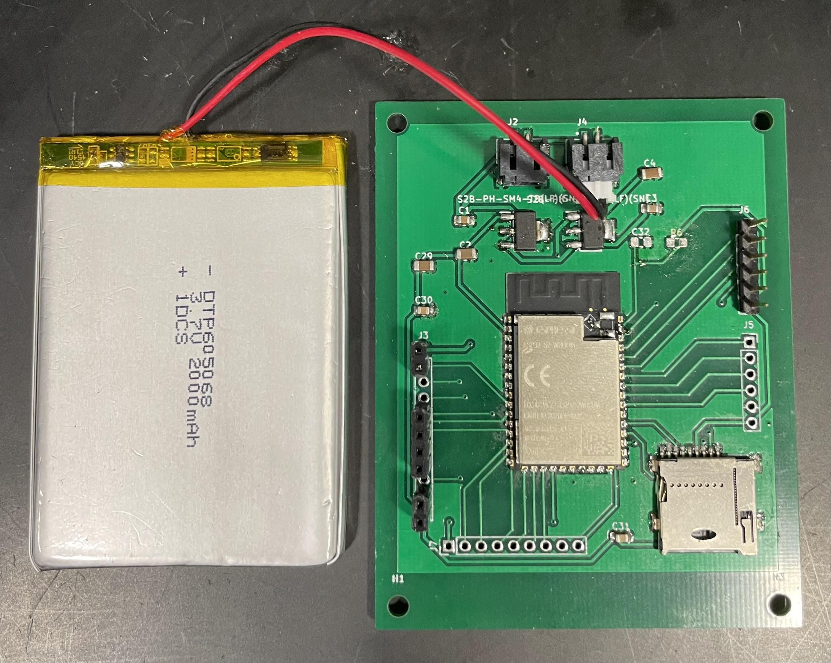
Design
Product
ECE 445
GRAINGER ENGINEERING

Slide 9
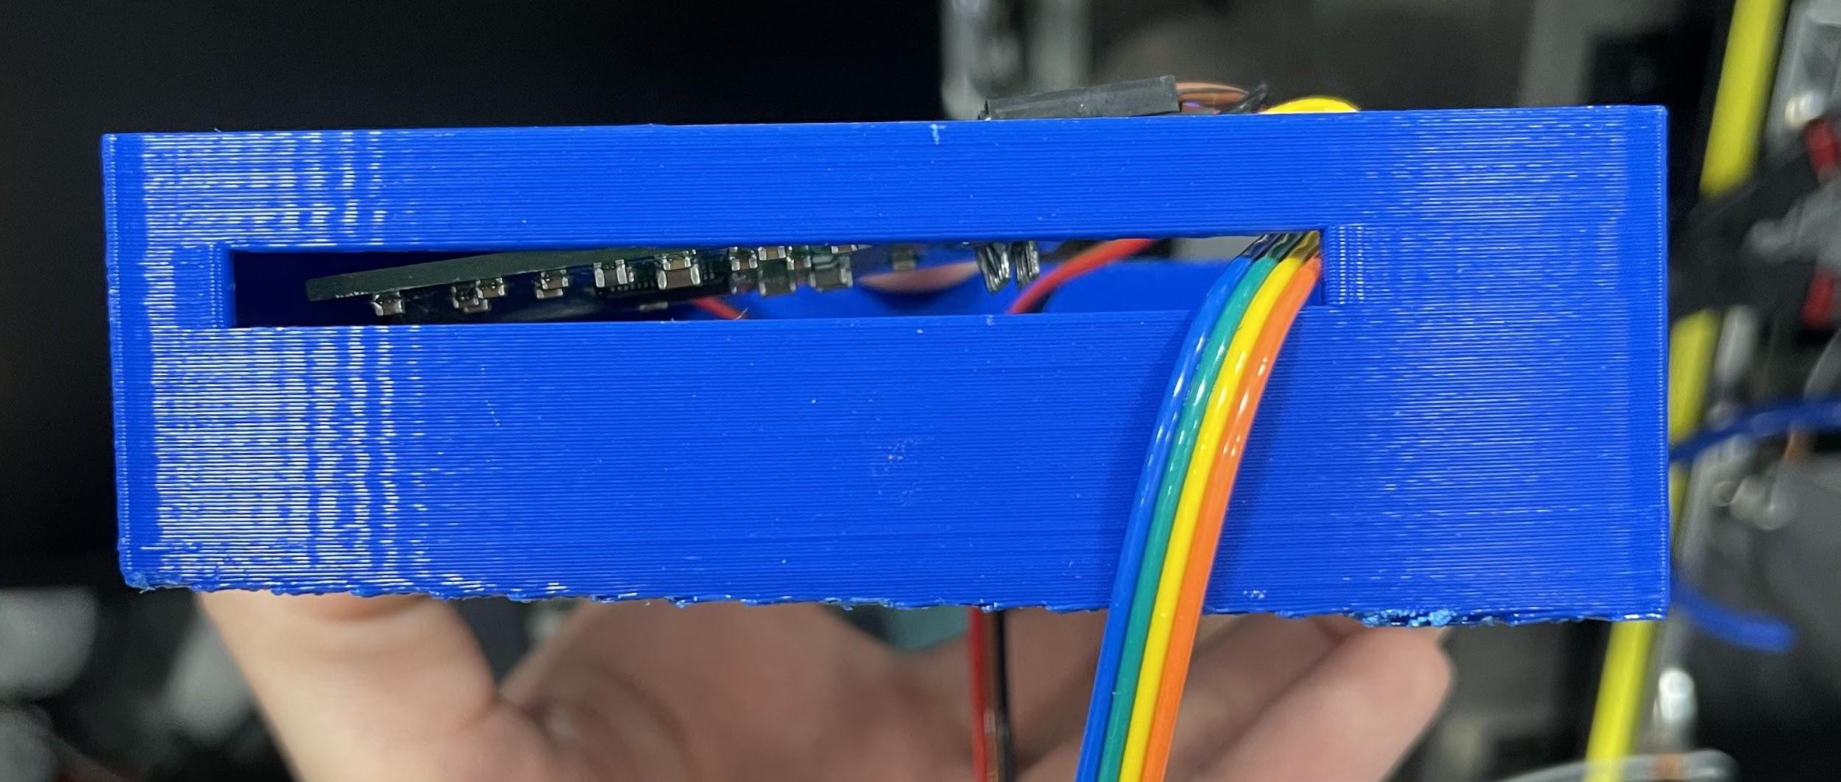
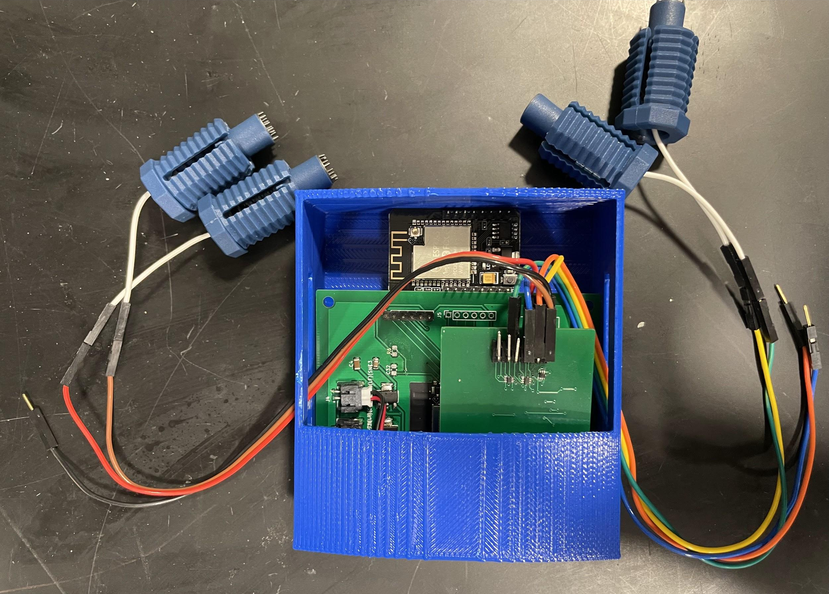
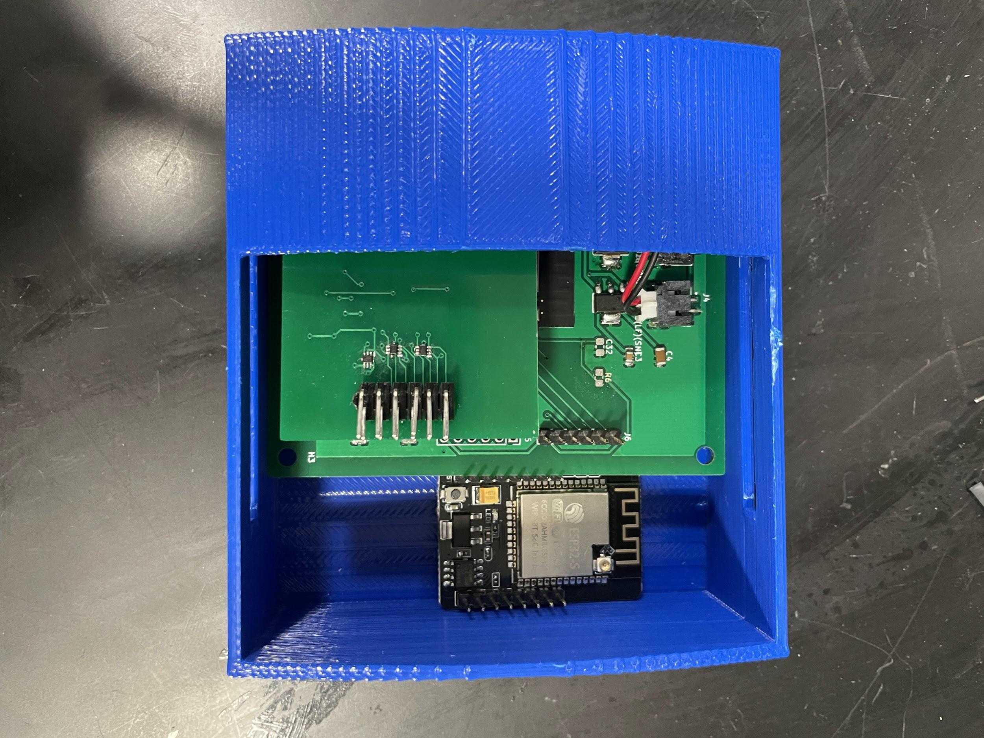
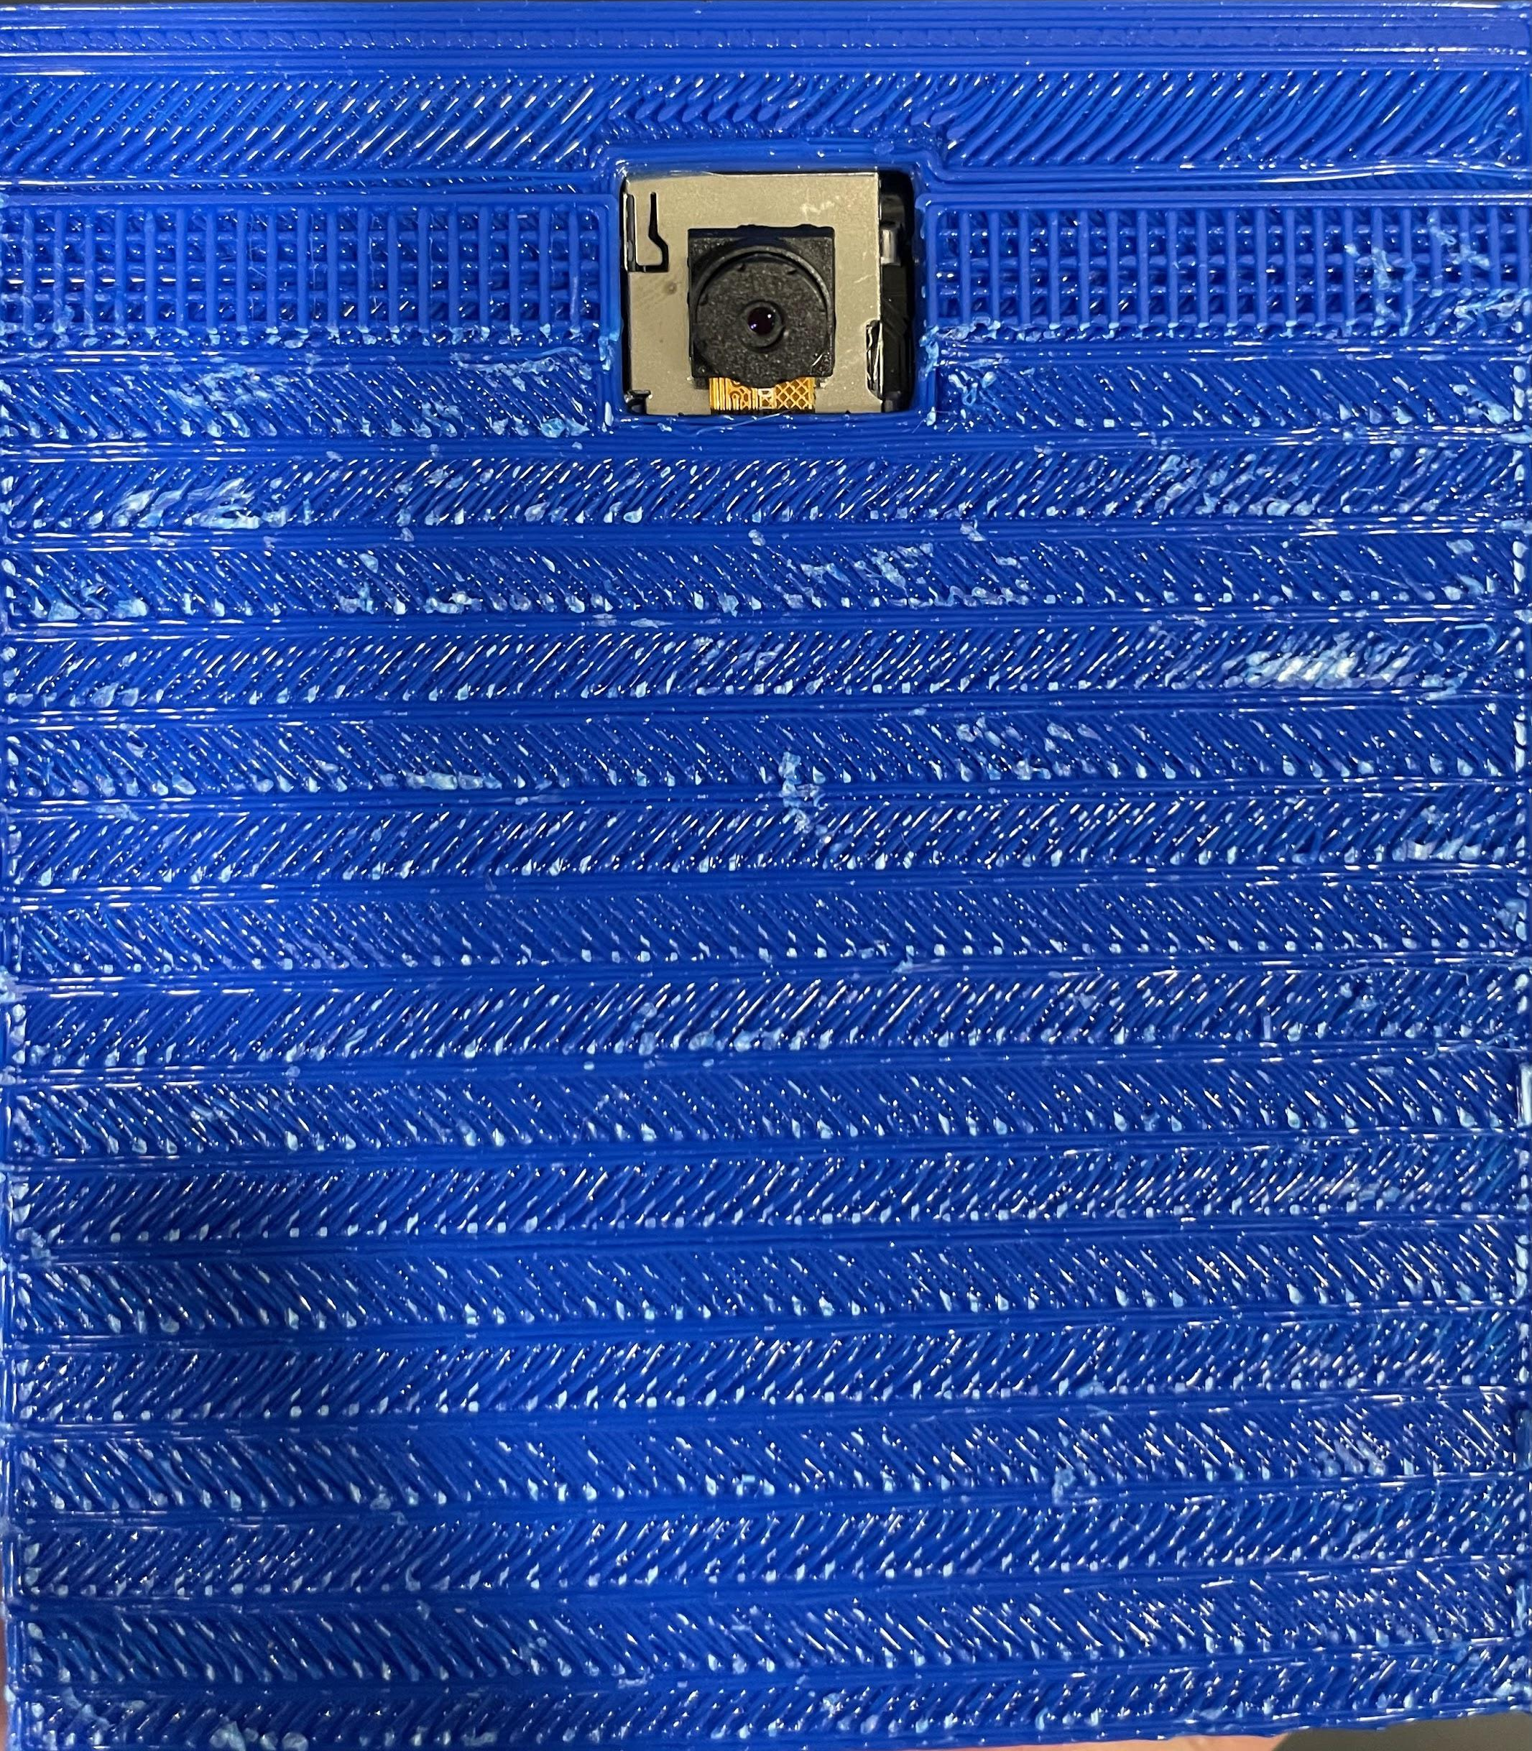
Design
Product
ECE 445
GRAINGER ENGINEERING

Slide 10
Design
Sensor Subsystem
TI-ADS1299-4, 24-Bit, Analog-to-Digital Converter for EEG and Biopotential Measurements
Why choose this chip? Ans: Accurate, flexible, small, multifunctional, SPI(mode1)
Texas Instruments. ADS1299-x datasheet. 2017, Texas Instruments. Dallas, TX
ECE 445
GRAINGER ENGINEERING

Slide 11
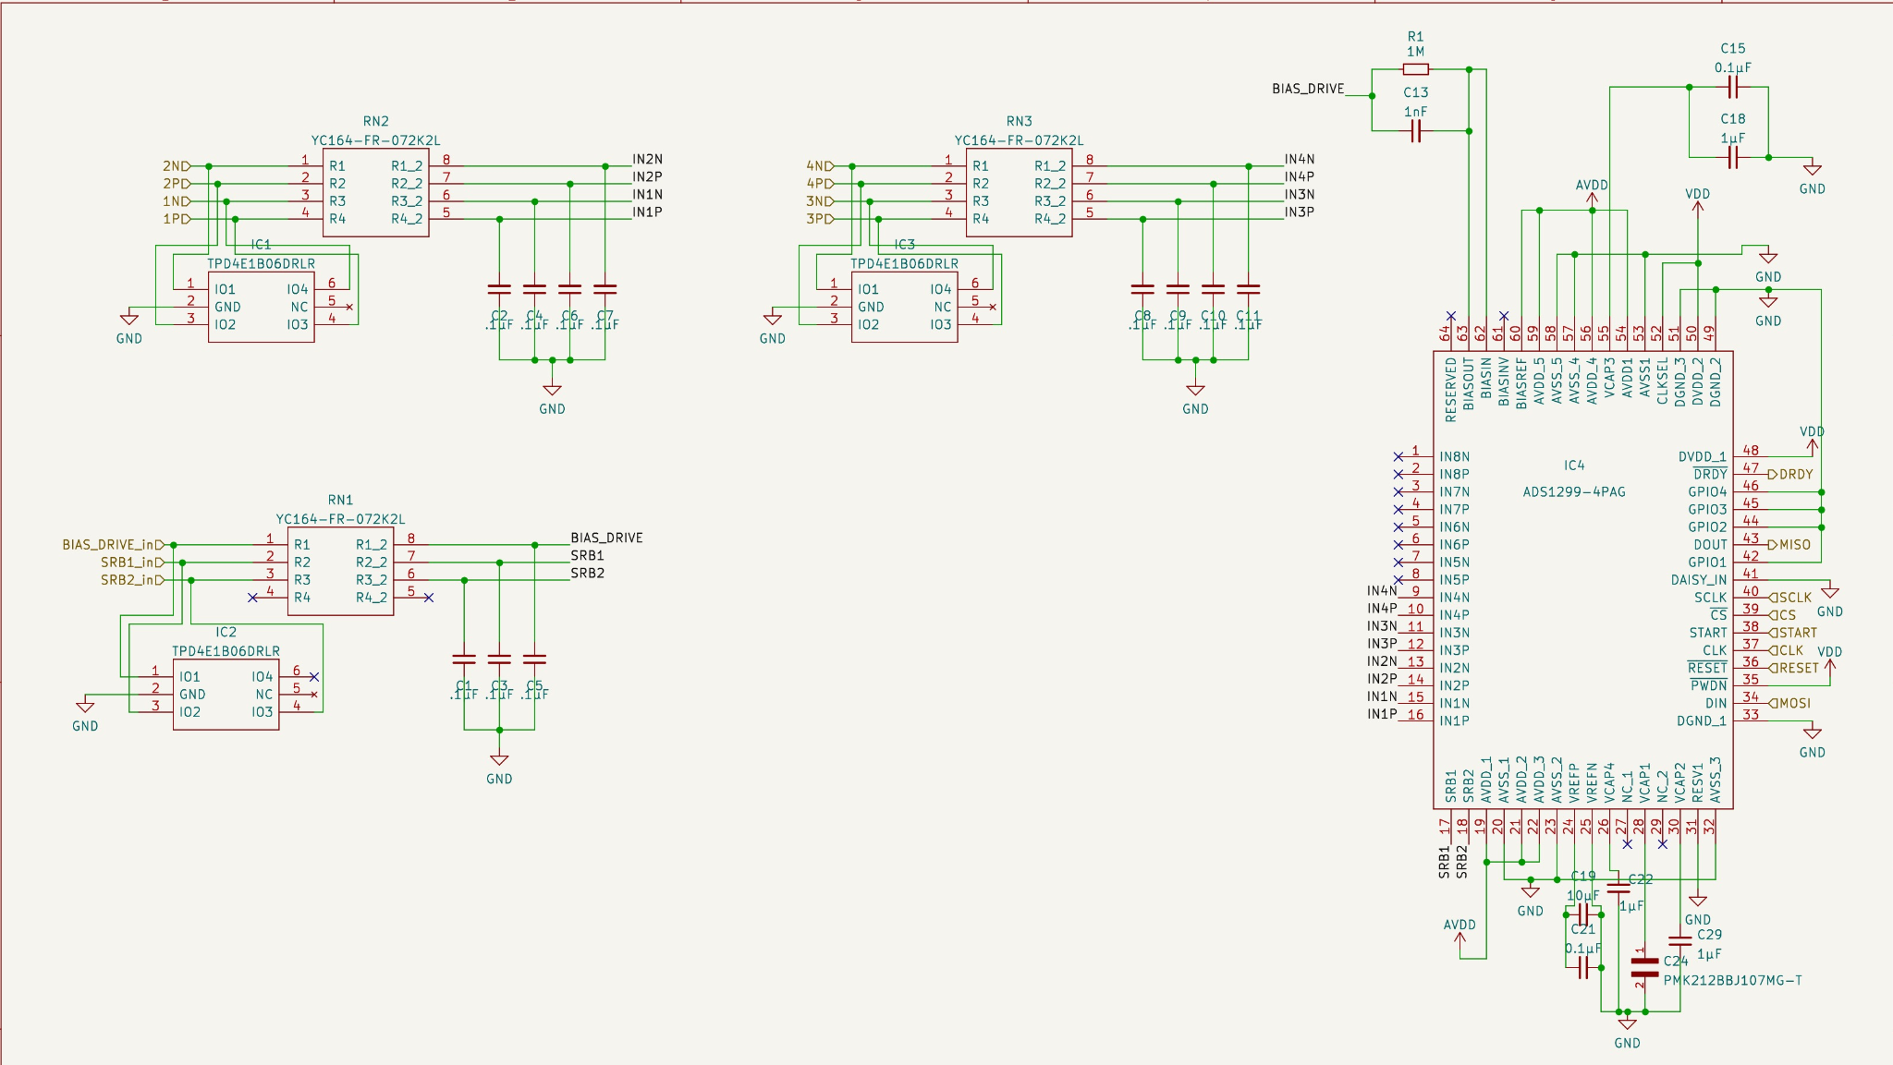
Sensor Subsystem
Schematics
ECE 445
GRAINGER ENGINEERING

Slide 12
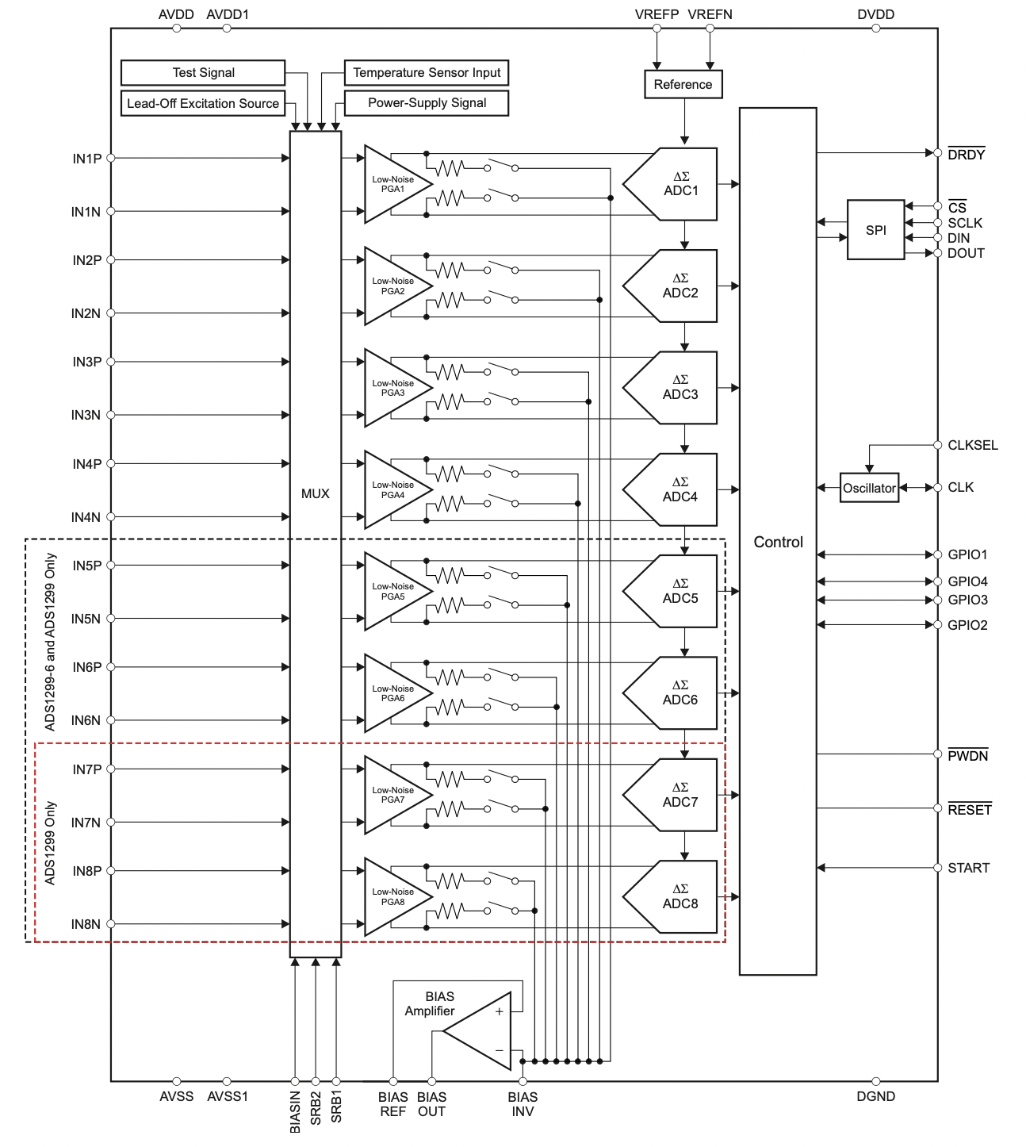
Sensor Subsystem
ADC Peripheral Design Considerations
Analog RC filter at the input stage
TVS diode protection
Reference, VCAP, and power supply decoupling
capacitors
Use of resistor pack and diode pack to minimize the area
Texas Instruments. ADS1299-x datasheet. 2017, Texas Instruments. Dallas, TX
ECE 445
GRAINGER ENGINEERING

Slide 13
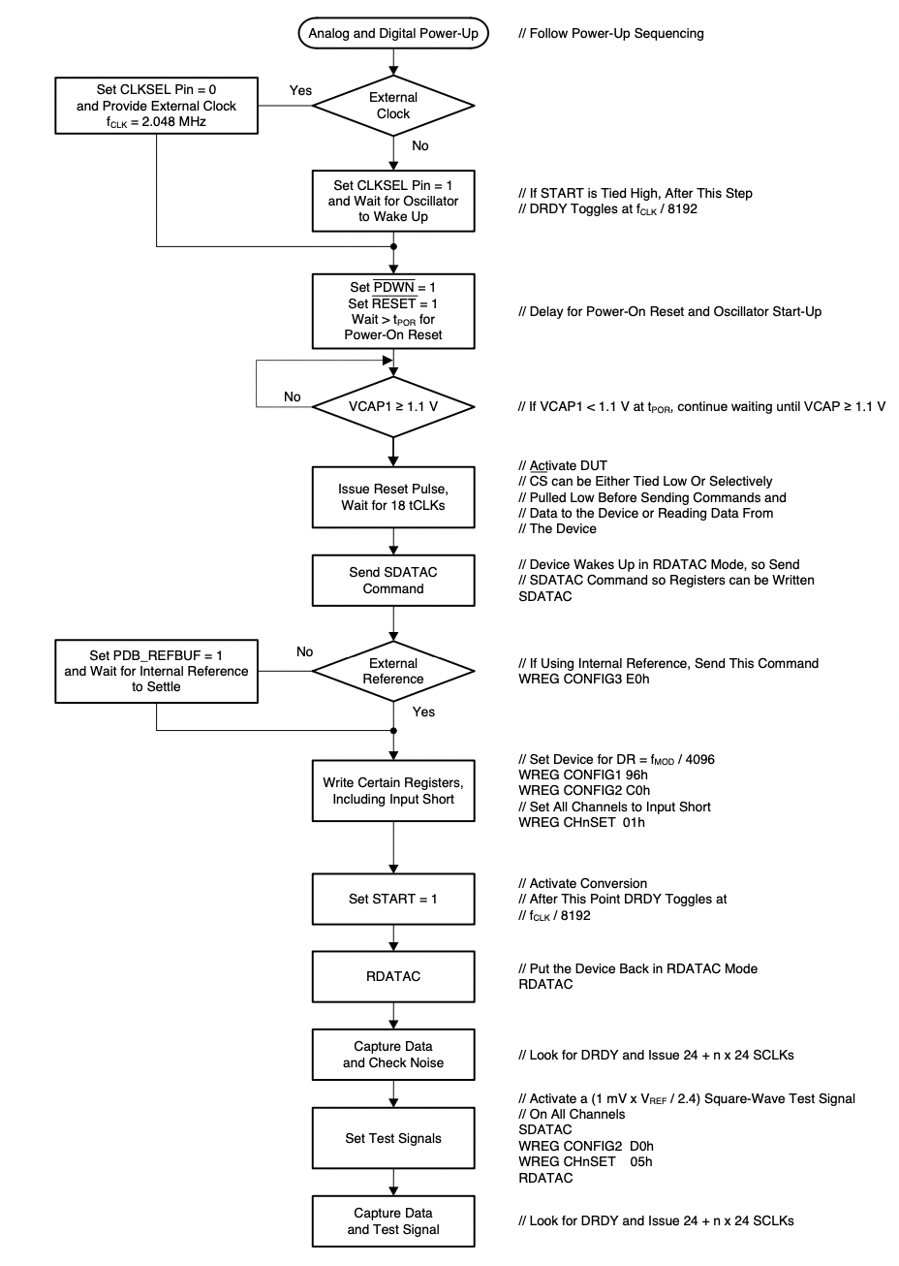
Sensor Subsystem
ADC Programming
Follow the procedure given to the right
Read and write the registers
Poll DRDY
Critical: PWDN, START and RESET should be pulled
to the right levels
Our code depends on this Git Repository:
https://github.com/conorrussomanno/ADS1299’
Texas Instruments. ADS1299-x datasheet. 2017, Texas Instruments. Dallas, TX
ECE 445
GRAINGER ENGINEERING

Slide 14
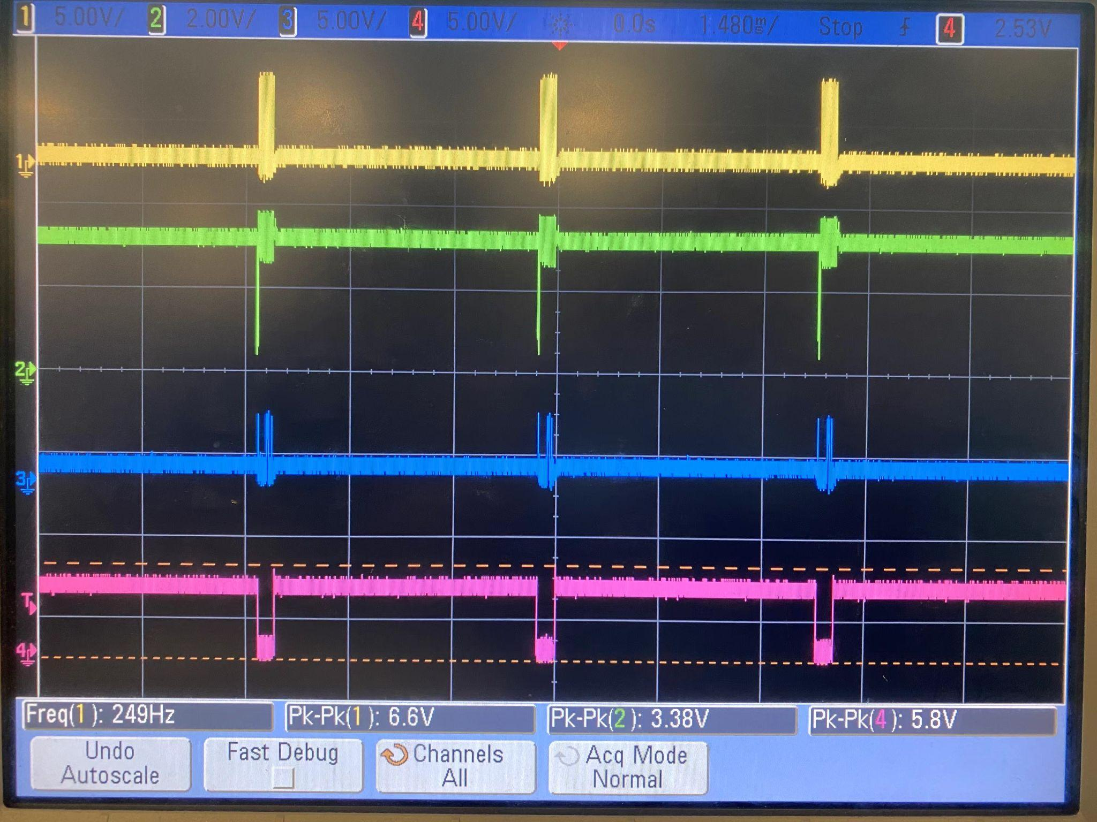
Sensor Subsystem
ADC Verification
Texas Instruments. ADS1299-x datasheet. 2017, Texas Instruments. Dallas, TX
ECE 445
GRAINGER ENGINEERING

Slide 15
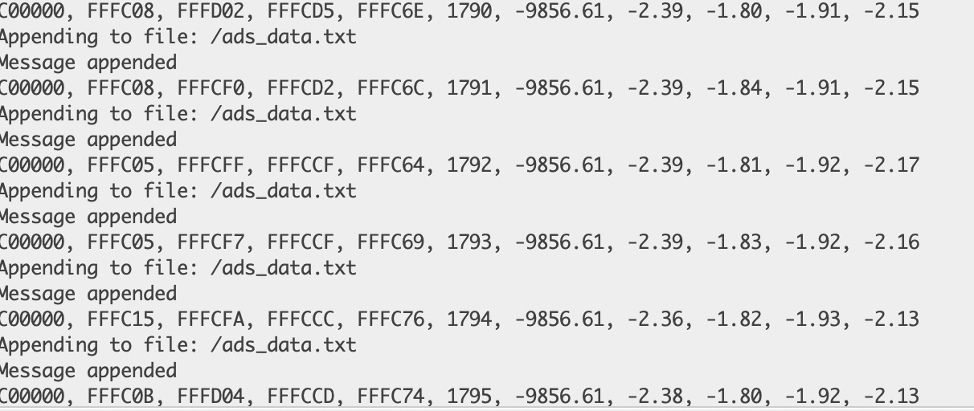
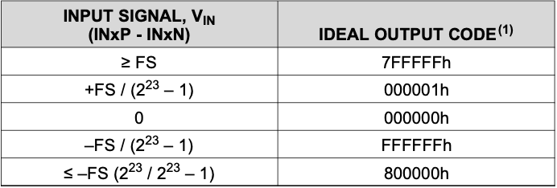
Sensor Subsystem
ADC Verification
Data retrieved from ADS1299
Texas Instruments. ADS1299-x datasheet. 2017, Texas Instruments. Dallas, TX
ECE 445
GRAINGER ENGINEERING

Slide 16
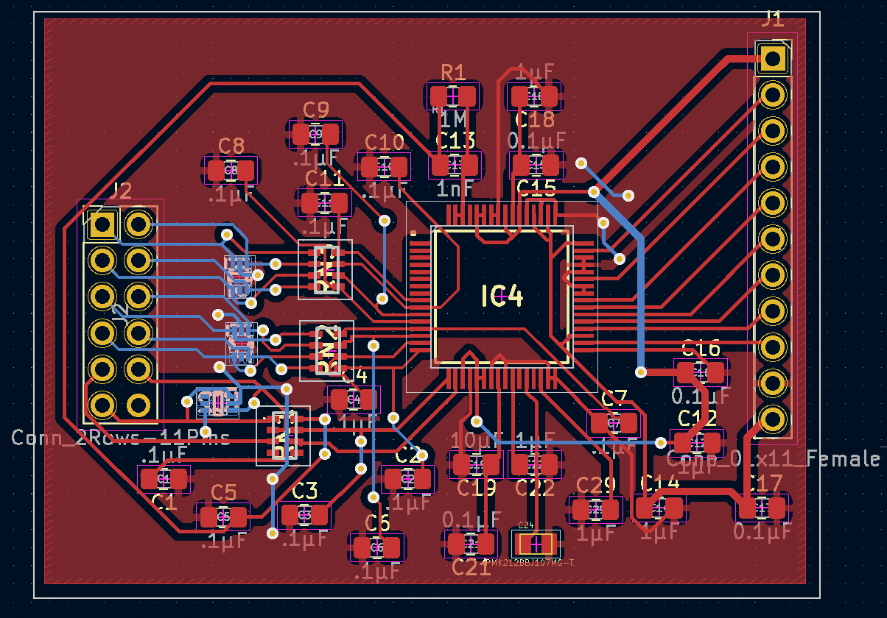
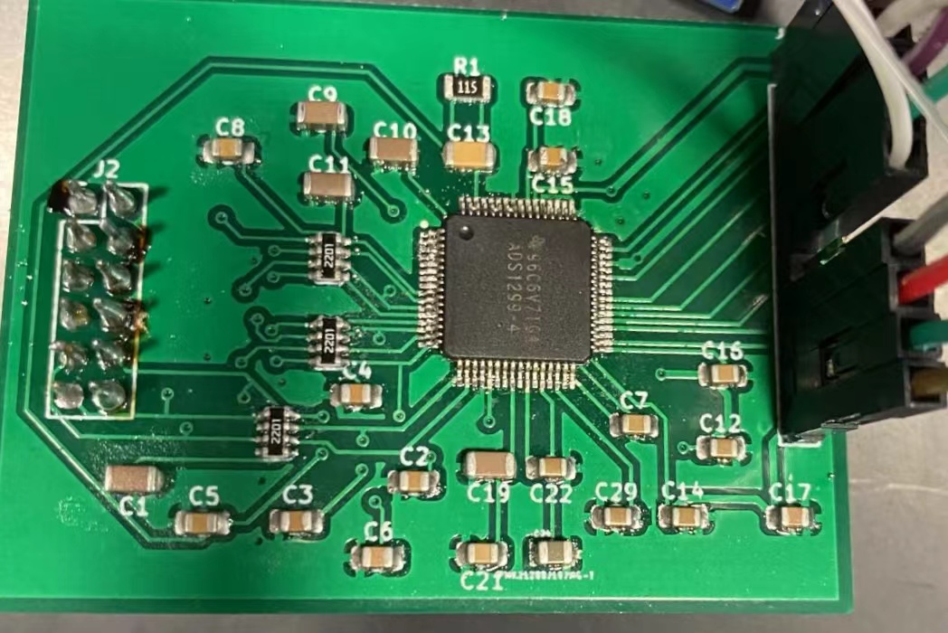
Sensor Subsystem
PCB and Soldered Board
ECE 445
GRAINGER ENGINEERING

Slide 17
Sensor Subsystem
Test Results
The output signal from the internal test signal provided by ADS1299
ECE 445
GRAINGER ENGINEERING

Slide 18
Sensor Subsystem
ECE 445
GRAINGER ENGINEERING

Slide 19
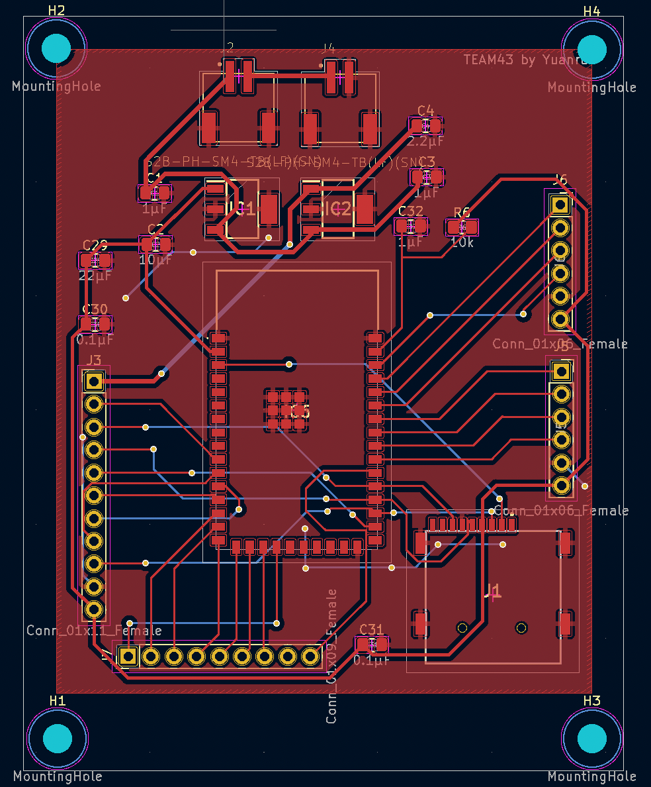
Design
MCU+Power+SD
Remove JTAG header pins
Add breakout points for BOOT and EN to allow programming
Add a switch for the power supply
Decrease the size
ECE 445
GRAINGER ENGINEERING

Slide 20
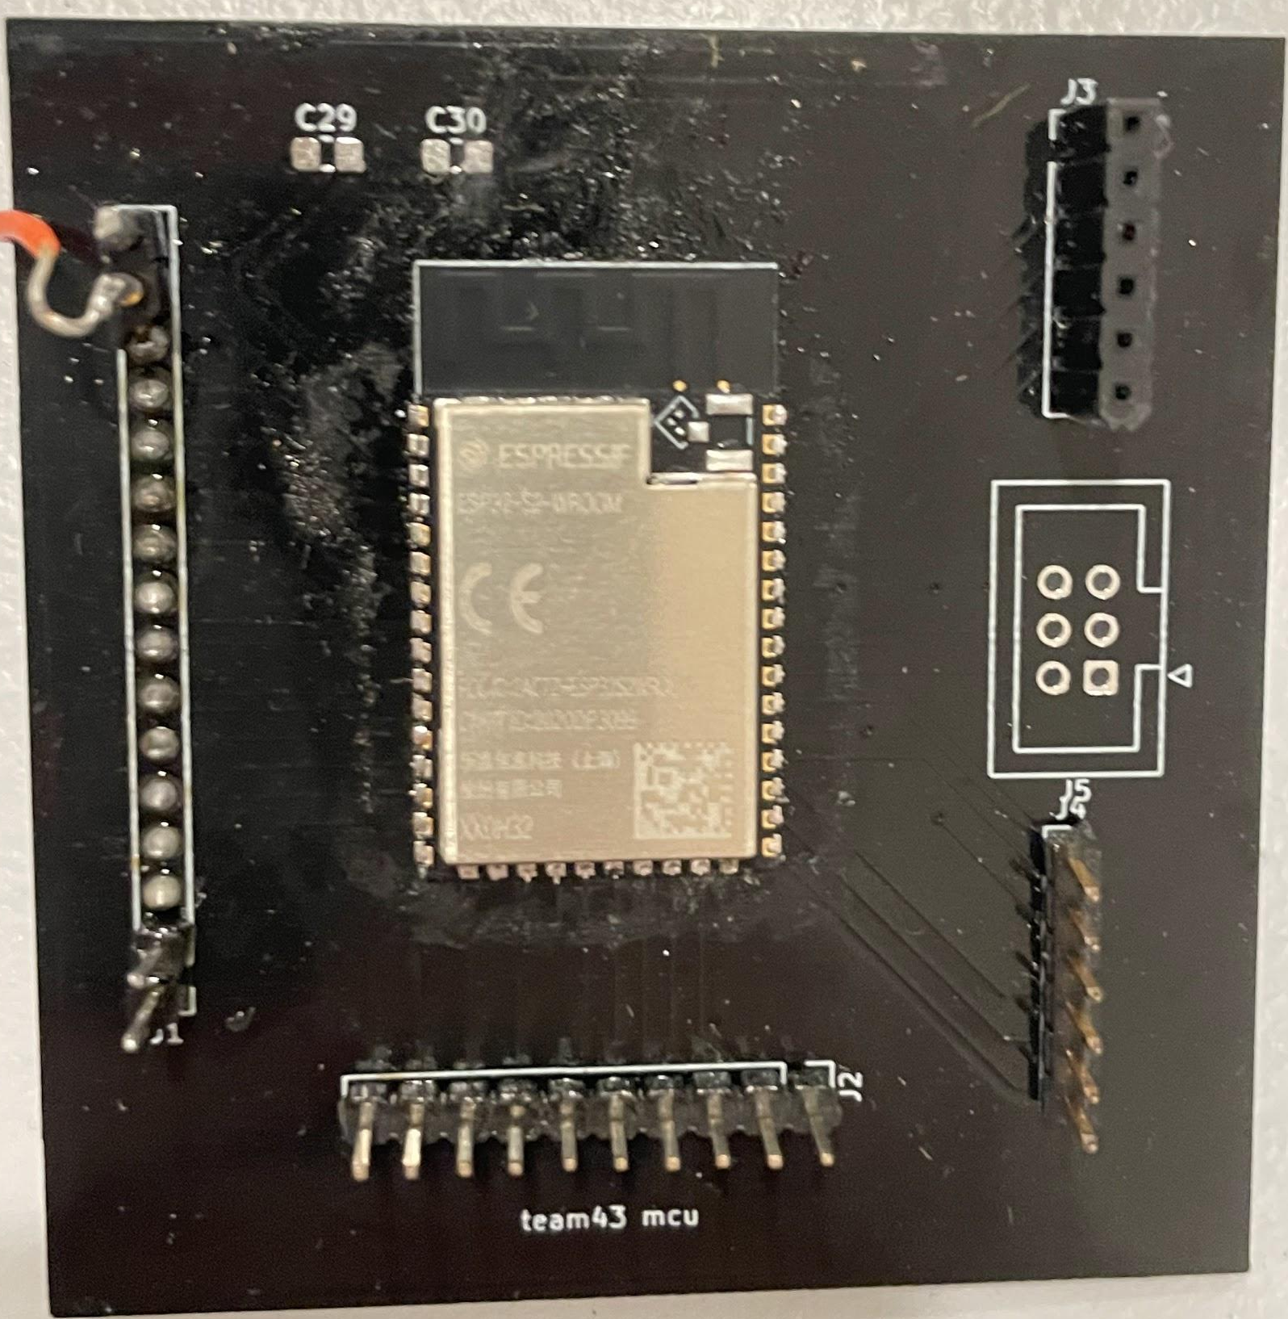
Logic Subsystem
Logic Subsystem
MCU: ESP32-S2 WROOM Module
WiFi, 32-bit, On-board PCB Antenna, 2 sets of SPI(hspi and vspi), Arduino IDE
Passes the entire RV table
Flashed via UART
SD card: VSPI; ADC: HSPI
Serial Monitor and Serial Plotter
Breakout board for ESP32-S2 module
ECE 445
GRAINGER ENGINEERING

Slide 21
Logic Subsystem
ECE 445
GRAINGER ENGINEERING

Slide 22
Logic Subsystem
Logic Subsystem Results
The microcontroller must be able to establish duplex communication with the ADC. √
The microcontroller must be able to upload data given WiFi connection. √
The microcontroller should have enough RAM/cache to process EEG data and camera video data. √
The microcontroller module must be able to determine the WiFi connectivity. √
The microcontroller is able to send signals to the camera peripheral. √
The microcontroller must write to the SD FAT32 filesystem. √
ECE 445
GRAINGER ENGINEERING

Slide 23
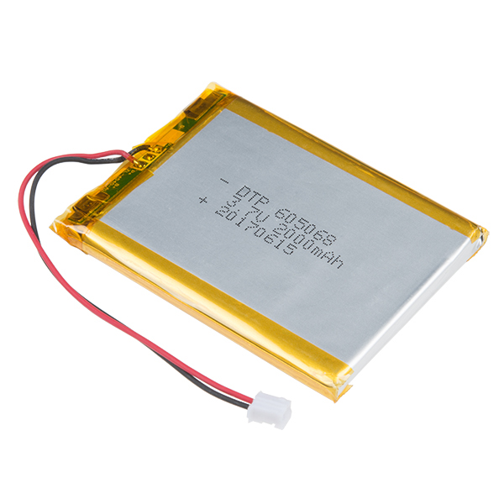
Design
Power Subsystem
Two 3.7V 2000mAh LiPo Batteries
3.3V and 5V regulators, provide digital and analog voltage
ADC: 50mA; MCU: 150mA
Results: Steady 3.3V&5V output with
ripple less than 0.1V
Schematic for power source
ECE 445
GRAINGER ENGINEERING

Slide 24
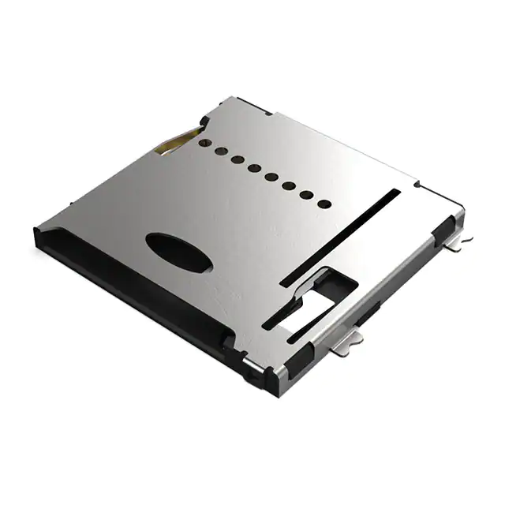
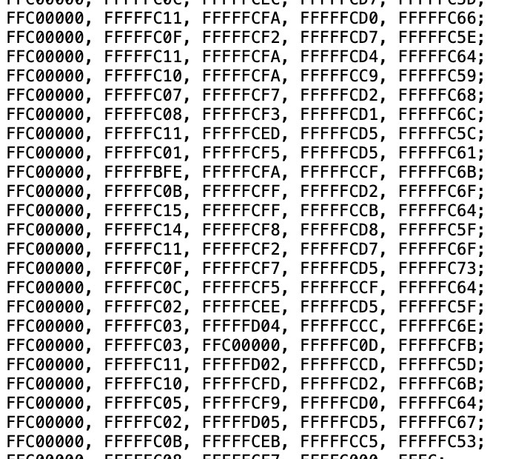
Design
Storage Subsystem
Micro SD
Libraries: SPI, FS, SD
FSPI, GPIO 35-37
Format: FAT32, <=32GB
Problem: when CS is high, MISO is not High-Z
Camera module has its own SD storage
Memory usage for 24 hours is less than 1GB
Data stored in the microSD card
ECE 445
GRAINGER ENGINEERING

Slide 25
Design
Cloud Subsystem
Use ESP32-S2 devkitM-1 to perform the test.
Library used: WiFi.h, EspAsyncWebServer.h and AsyncTCP.h
Create an HTML file to store data in SD-card called ads_data.html
Synchronize the data stored in SD-card and on the web server using the unique ip-address provided by the ESP32-S2
Obtain time information from NTP (Network Time Protocol) server to generate timestamps for EEG data and photos.
Code reference: https://randomnerdtutorials.com/esp32-web-server-arduino-ide/
ECE 445
GRAINGER ENGINEERING

Slide 26
Cloud Subsystem
The video shows the data uploaded onto the web server each with a specific timestamp.
ECE 445
GRAINGER ENGINEERING

Slide 27
Cloud Subsystem
Storage and Cloud Subsystem Results
The data must be correctly shown in the sd card and on the web server.√
The doctor must have access to the web server.√
Each data must have a specific time stamp that is synchronized with the photo.√
ECE 445
GRAINGER ENGINEERING

Slide 28
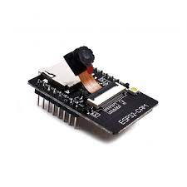
Design
Camera Subsystem
Stream the patient’s condition once is connected to a power source.
Take photos in user-defined amount of time and rate with maximum resolution 1600x1200, the rate at most 0.2sec per photo.
Save the photos into SD-card with specific timestamps synchronized with EEG data.
The size of the camera module is small enough to fit onto the cap.
ECE 445
GRAINGER ENGINEERING

Slide 29
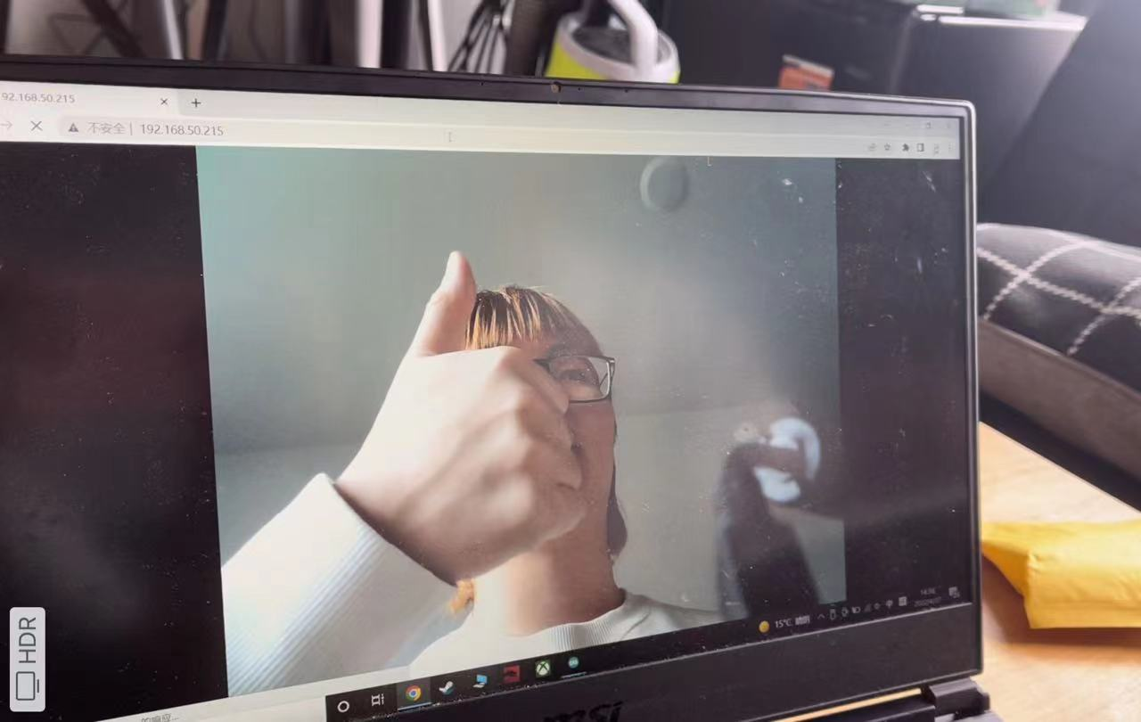
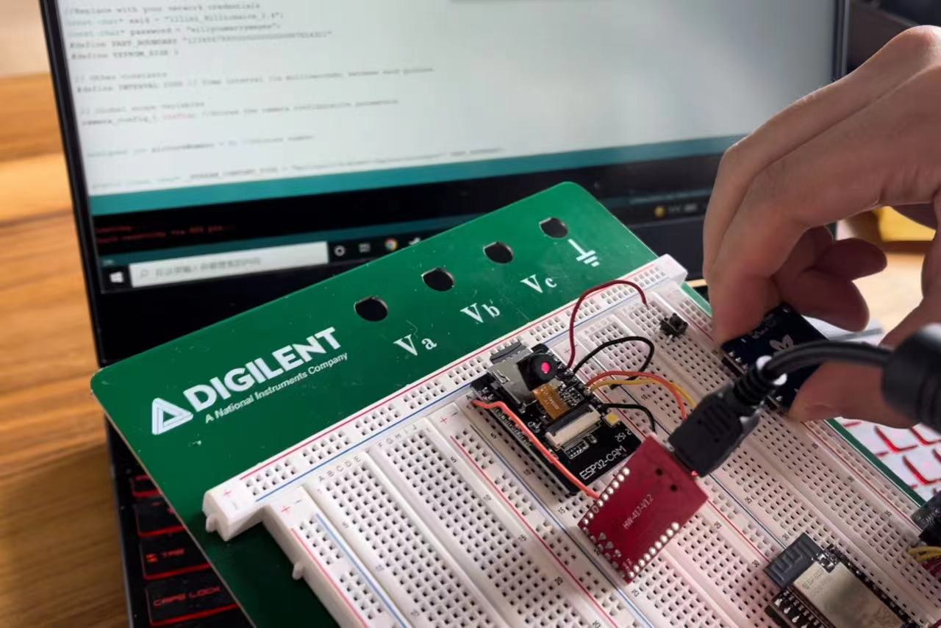
Camera Subsystem
Streaming on the web server
Programming using the FTDI programmer
ECE 445
GRAINGER ENGINEERING

Slide 30
Camera Subsystem
Photos taken and saved to the SD-card.
ECE 445
GRAINGER ENGINEERING

Slide 31
Camera Subsystem
Sensor Subsystem Results
We can write to the registers of the ADC.
The ADC samples at 250Hz±5Hz.
The ADC is able to measure internal noise, test signal and down to 1mV signal generated from signal generator.
ECE 445
GRAINGER ENGINEERING

Slide 32
Conclusion
Setbacks and Learning
For the first 1-2 weeks, we were not testing the ADC correctly (we didn’t send the commands). Read the datasheet, even if it seems daunting!
Our first two rounds of ADC boards failed because of some errors in schematics. Lesson: ensure that your PCB is correct before ordering another round!
Our camera module burned one night before the demo. Lesson: always buy extra parts!
ECE 445
GRAINGER ENGINEERING

Slide 33
Conclusion
Achievements
Every subsystem other than ADC is fully verified.
The ADC’s digital part is fully verified.
The whole system is able to run with ESP32-S2 dev board.
The unsoldered PCB is verified. The program can be successfully uploaded the ESP32-S2 module with a breakout board.
ECE 445
GRAINGER ENGINEERING

Slide 34
Conclusion
Further Development
Calibrate the ADC with real EEG inputs. Before this, verify that the electrodes and cables are functional.
Solve the timing and overshoot issue of ADC reading.
Put every subsystems on one PCB and reduce the size.
Implement the Seizure Detection Algorithm on chip or on cloud.
Enable daisy chain that supports more channels.
Develop a backend server and a GUI that visualizes the EEG data, or try to integrate with the OpenBCI Software.
ECE 445
GRAINGER ENGINEERING

Slide 35
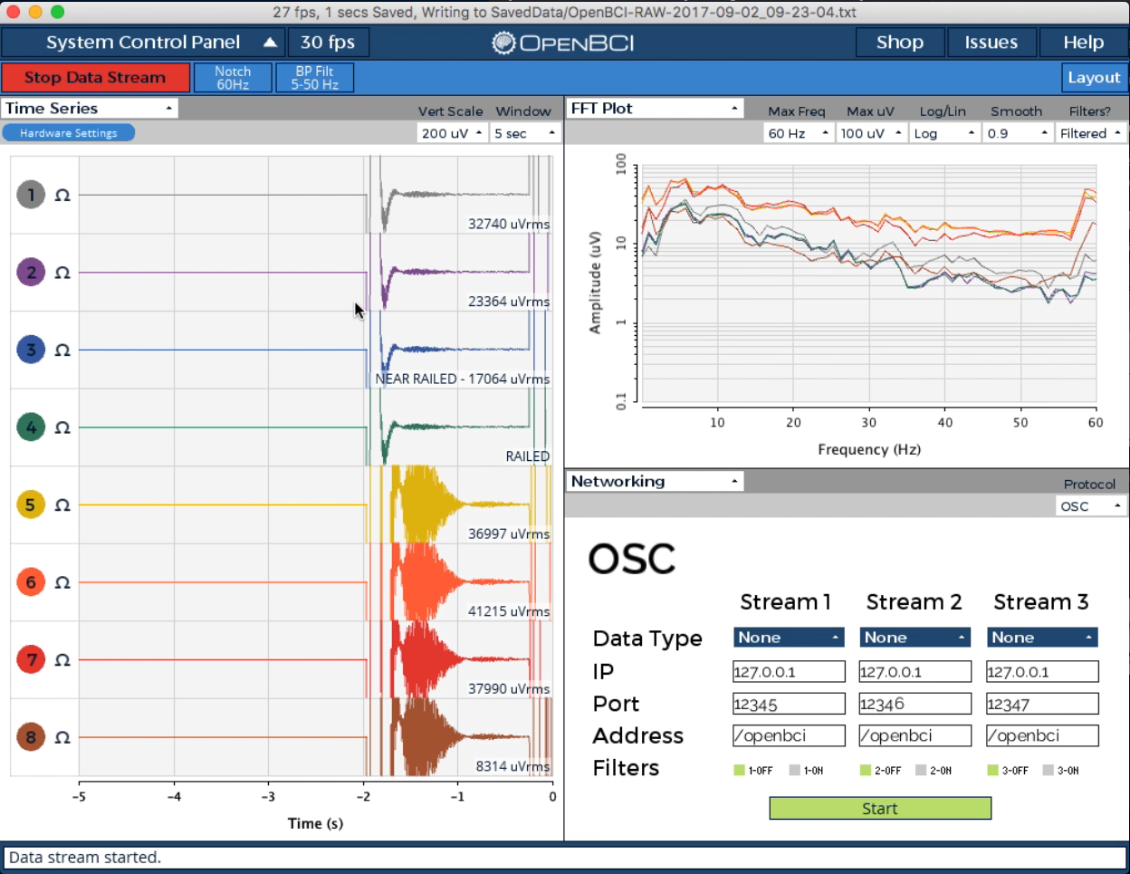
Conclusion
Further Development
OpenBCI GUI
ECE 445
GRAINGER ENGINEERING

Slide 36
Thank you for watching!
Thank Prof. Schuh, Kenny and Jaime for all the support
ECE 445
GRAINGER ENGINEERING

Slide 37
Conclusion
Reference
OpenBCI Documentation
An EEG Experimental Study Evaluating the Performance of Texas Instruments ADS1299
Seizure Prediction: Methods
TI-ADS1299 Datasheet
ECE 445
GRAINGER ENGINEERING

