Slide 1
ECE 333
Green Energy Systems
Lecture 5: Transformers, Harmonics, Power Industry History
Dr. Karl Reinhard
Dept. of Electrical and Computer Engineering
University of Illinois at Urbana-Champaign
reinhrd2@illinois.edu

Slide 2

Announcements
Be reading Chapter 3 from the book
Homework 2 is 2.9, 2.15, 3.6, 3.8, 3.9, 3.10
In-class quiz Thursday 1 Feb drawn from Hmwk 2

Slide 3
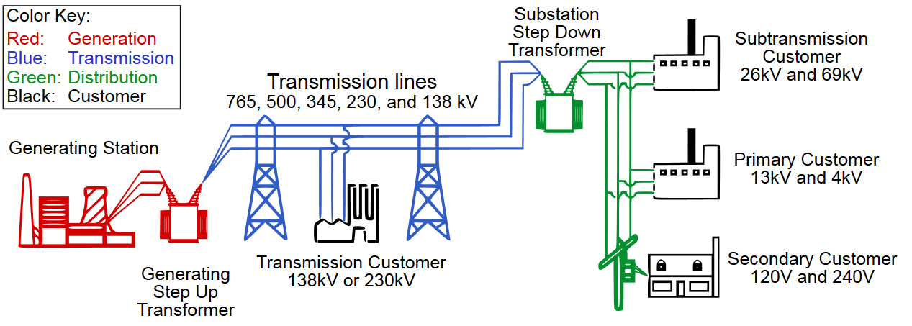
Transformers
Key ac advantage over dc systems is the transformer -- that easily & cheaply steps voltage levels up or down
Power transmission capacity ∝ V ² → Encouraging Hi T.L.Voltage
U.S. Power systems voltages range from 120/240 V to 765 kV
~20kV
Source: U.S. Federal Energy Regulatory Commission and U.S. Department of Energy, Office of Electricity Delivery and Energy Reliability

Slide 4
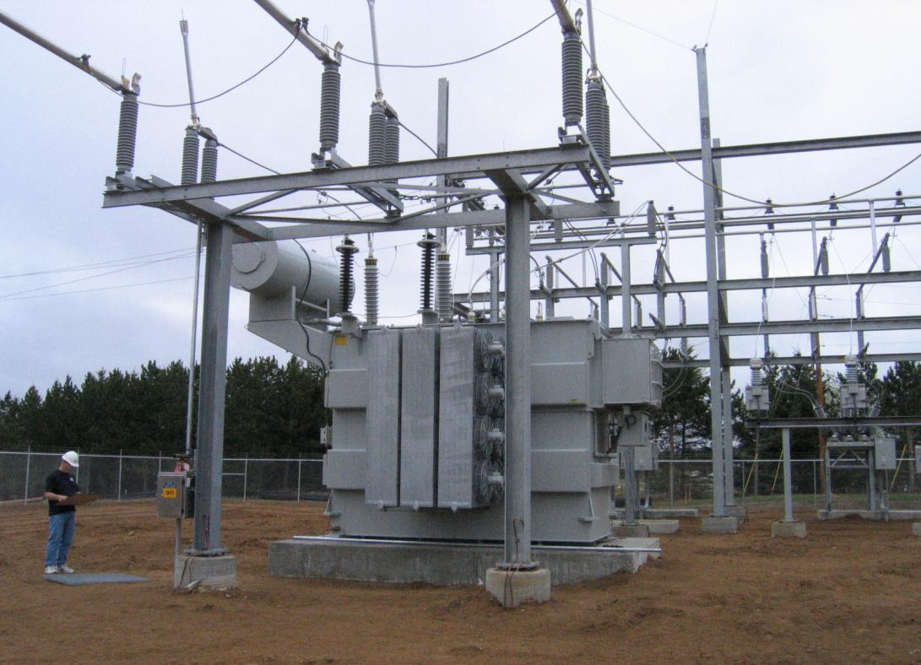
Distribution Transformer Picture
LTC
Radiators W/Fans
115 – 35 kV distribution transformer

Slide 5
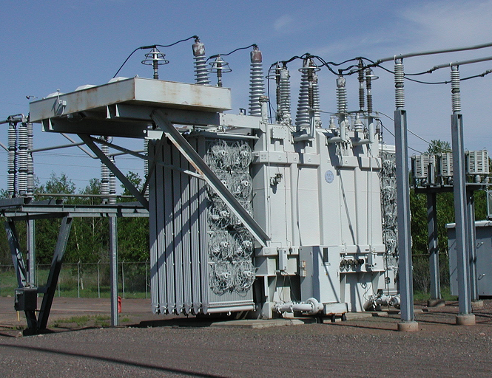
Transmission Level Transformer
230 kV surge arrestors
115 kV surge arrestors
Oil Cooler
Oil pump
Radiators W/Fans

Slide 6
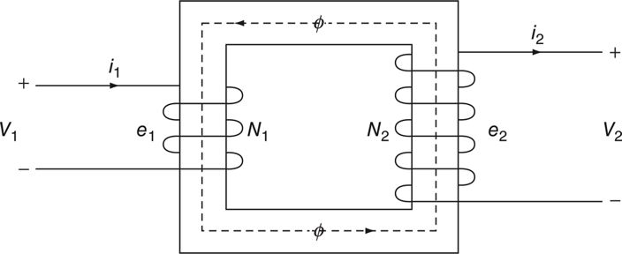
Ideal Transformer
Ideal Transformer
  no real power losses
  magnetic core has infinite permeability
  no leakage flux
Transformer’s “primary” is the power input side
  Primary is usually high V side; exception generator step-up transformer
Transformer’s “secondary” is the power delivery side.
Fig. 2.27 An idealized two-winding transformer
Masters, Gilbert M. Renewable and Efficient Electric Power Systems, 2nd Edition. Wiley-Blackwell

Slide 7
Ideal Transformer
φ
φ
Fig. 2.27 An idealized two-winding transformer
Masters, Gilbert M. Renewable and Efficient Electric Power Systems, 2nd Edition. Wiley-Blackwell
Power must be conserved crossing the transformer.
What is the necessary relationship between primary and secondary currents ?
✓

Slide 8
Ideal Transformer (xformer)
i₂
i₁
+
+
v₁
v₂
_
_
Fig. 2.27 An idealized two-winding transformer
Masters, Gilbert M. Renewable and Efficient Electric Power Systems, 2nd Edition. Wiley-Blackwell
Xformer “dot” notation – indicates the primary to secondary “+” terminal voltage relationship
Describe how the the “Load” Power convention applies…
Power into primary consistent with “Load” Power convention; current sense reverses on secondary → power out

Slide 9
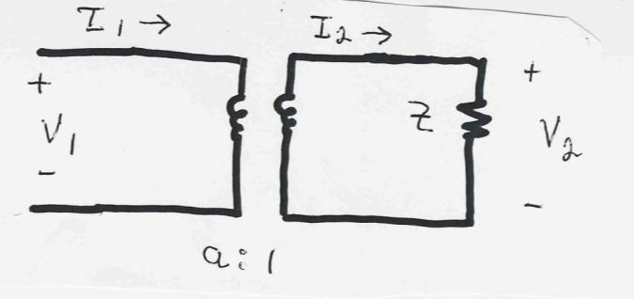
Impedance Transformation Example
Example: Calculate the primary voltage and current for an impedance load on the secondary

Slide 10
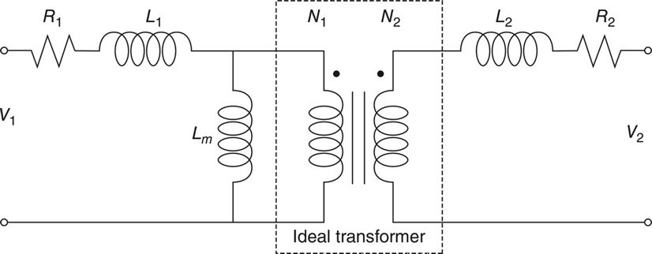
Real Transformers
Real transformers
  have losses – R₁ and R₂
  have leakage flux – L₁ and L₂
  have finite magnetic core permeability – L_{m} , magnetization inductance
Also issues about how three phase transformers are connected
Details are covered in ECE 330 and 476

Slide 11
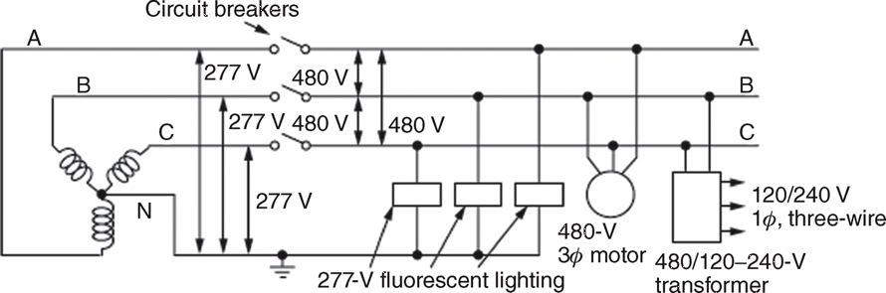
Residential Distribution Transformers
FIGURE 3.20 Example of a three-phase, 480-V, large-building wiring system
Provides 480-V, 277-V, 240-V and 120-V service
The source voltage (ABC on right) is 480V_{l-l}
3 windings on the secondary side of the three-phase transformer

Slide 12
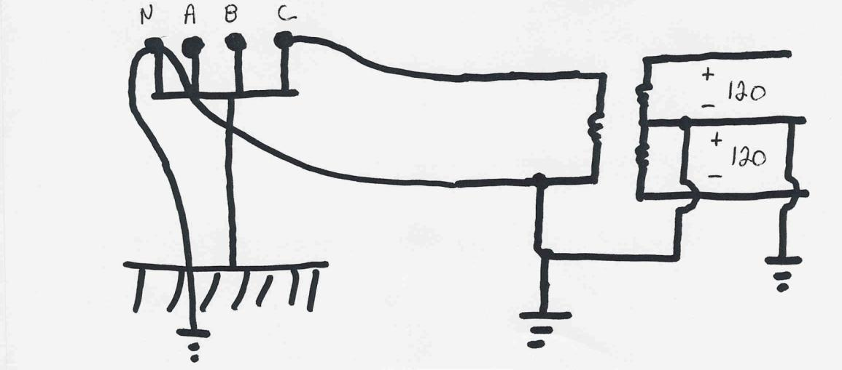
Residential Distribution Transformers
1φ transformers commonly used in residential distribution systems.
Most are 4 wire, with a multi-grounded, common neutral.

Slide 13
Power System Harmonics
To date have focused on fundamental frequency analysis – i.e. 60 Hz sinusoid
Many traditional loads (thermal, motor, etc.) only consume power at the fundamental frequency.
However electronically-switched loads have been increasing….
Tend to draw current in non-linear pulses, which gives rise to harmonics – non- 60 Hz components
If current has half-wave-symmetry (values are equal and opposite when separated by T/2) then there are no even harmonics

Slide 14
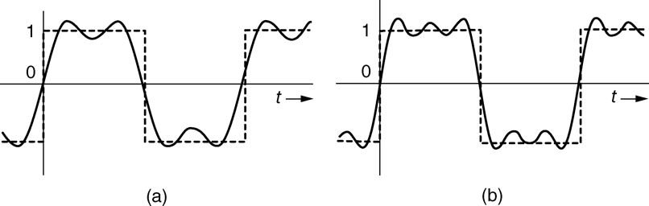
Quick Fourier Analysis Reminder
  .
Masters, Gilbert M. Renewable and Efficient Electric Power Systems, 2nd Edition. Wiley-Blackwell
FIGURE 3.36 Showing the sum of the first two terms (a) and first three terms (b) of the Fourier series for a square wave, along with the square wave that it is approximating.

Slide 15
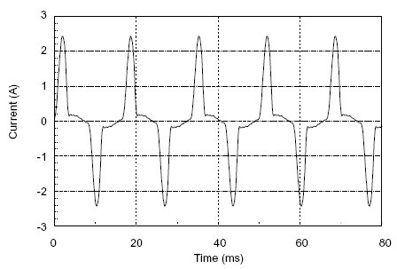
Switched-Mode Power Supply Current
Source: www.utterpower.com/commercial_grid.htm

Slide 16
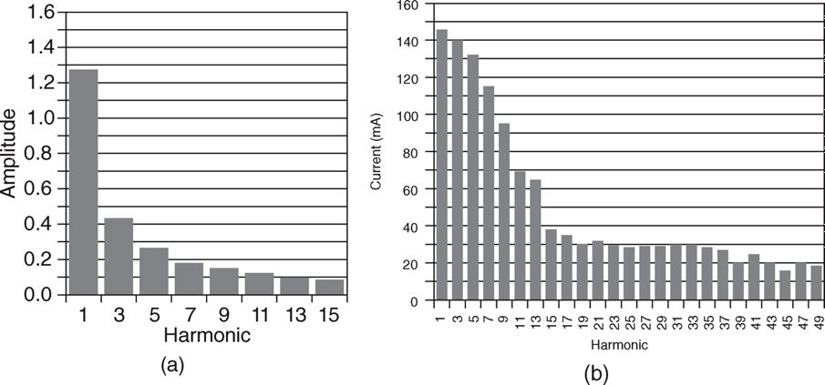
Harmonic Current Spectrum
The figure shows the harmonic current components for
square wave
18-W electronic-ballast compact fluorescent lamp.
Source: Fig 3.37 of “Renewable and Efficient Electric Power Systems” by Masters, 2d edition

Slide 17
Current Waveform for CFL
Figure 2.35 The sum of the first through seventh harmonics for an 18 W electronic-ballast compact fluorescent light (Fig 3.37 previous slide).
Masters, Gilbert M. Renewable and Efficient Electric Power Systems, 1st Edition. Wiley

Slide 18
Total Harmonic Distortion (THD)

Slide 19
Key Harmonics Consequences
3d harmonics are problematic for non-zero neutral currents –
  3d harmonic of fundamental’s 120 degree phase shift is 360º
  Therefore 3d harmonic currents do not cancel → neutral line now has non-zero currents
  Also appears for higher triple n harmonics
  Soln: delta-grounded wye transformers prevent triple n harmonic currents from flowing into the power grid
Harmonics cause transformer overheating since core losses are proportional to frequency
Harmonic resonance, particularly with shunt capacitors, frequently occurs around the 5th or 7th harmonic values

Slide 20
Power Supplies for AC to DC
Two main types of power supplies: linear (simpler) and switched-mode (more efficient)
Linear
Switched-mode

