Slide 1
ECE 333
Green Energy Systems
Lecture 4: Three-Phase
Dr. Karl Reinhard
Dept. of Electrical and Computer Engineering
University of Illinois at Urbana-Champaign
reinhrd2@illinois.edu

Slide 2
Announcements
Be reading Chapter 3 from the book
Quiz today on Homework 1
Homework 2 will be posted this afternoon.
Quiz on Thursday, 1 Feb

Slide 3
Complex Power
POWER TRIANGLE
S
Q
Asterisk denotes complex conjugate
P
S
Apparent
(complex) power
P – Real Power
Heat, motion, etc.
Q – Reactive Power
Energy stored in Electric or Magnetic Field
S = P + jQ

Slide 4
Apparent, Real, Reactive Power
P = Real power (W, kW, MW)
Q = Reactive power (VAR, kVAR, MVAR)
S = Apparent power (VA, kVA, MVA)
Power factor angle
Power factor

Slide 5
Apparent, Real, Reactive Power
Inductive loads: + Q
Capacitive loads: – Q
P
Q and φ are positive
Q and φ are negative
S
Q
Q
S
P
ELI
ICE
I lags V (or E)
I leads V (or E)
Remember ELI the ICE man

Slide 6
Apparent, Real, Reactive Power
Relationships between P, Q, and S can be derived from the power triangle just introduced
Ex: A 100 kW load with leading pf of 0.85. What are the φ (power factor angle), Q (reactive power), and S (apparent power)?
leading pf → Capacitive Load
P
Q and φ are negative
Q
S

Slide 7
Conservation of Power
Kirchhoff’s voltage and current laws (KVL and KCL)
  Sum of voltage drops around a loop must be zero
  Sum of currents into a node must be zero
Conservation of power follows
  Sum of real power into every node must equal zero
  Sum of reactive power into every node must equal zero

Slide 8
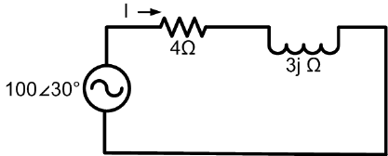
Conservation of Power Example
Inductive load: + Q
S
Q
P
Resistor: consumed power
Inductor: consumed power

Slide 9
Power Consumption in Devices
Resistors only consume real power
Inductors only consume reactive power
Capacitors only produce reactive power

Slide 10
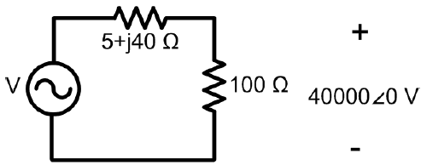
Example
Solve for the apparent power delivered by the source

Slide 11
Reactive Power Compensation
Reactive compensation is used extensively by utilities
Capacitors are used to correct the power factor (pf)
This allows reactive power to be supplied locally
Supplying reactive power locally decreases line current, which results in
  Decreased line losses
  Ability to use smaller wires
  Less voltage drop across the line

Slide 12
Power Factor Correction Example
Assume we have a 100 kVA load with pf = 0.8 lagging, and would like to correct the pf to 0.95 lagging. How many kVAR?
We know:
We want:
S
Q_{des.}=?
P = 80
Thus requiring a capacitor producing kVar:
P = 80
Q_{cap} = -33.7
Q = 60
Q_{des}= 26.3
P = 80
Notes:
11

Slide 13
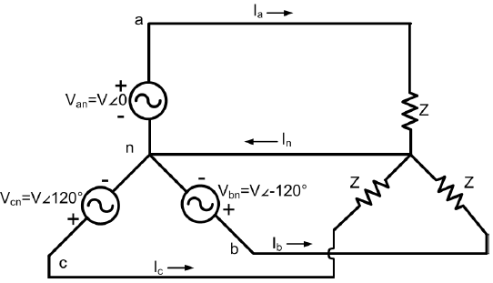
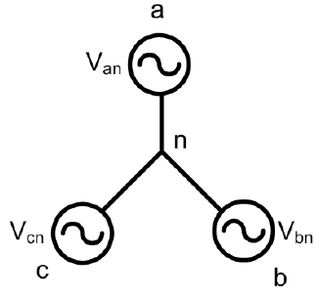
Balanced 3 Phase (φ) Systems
A balanced 3 phase (φ) system has
  3 voltage sources w/ equal magnitude, but w/ 120° phase shift
  Equal loads on each phase
  Equal impedance on the lines connecting generators to loads
Bulk power systems are almost exclusively 3φ
Single phase is used primarily only in low voltage, low power settings, such as residential and some commercial
V_{cn}
V_{ab}
V_{ca}
V_{bn}
V_{an}
V_{bc}
Notes:
12

Slide 14
Balanced 3φ -- No Neutral Current
Notes:
13

Slide 15
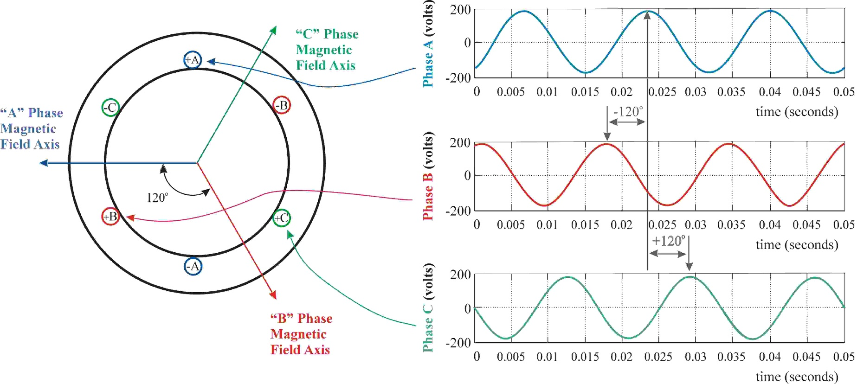
3φ Power Advantages
Can transmit more power for same amount of wire (2x 1φ)
3φ machines produce constant torque (balanced conditions)
3φ machines use less material for same power rating
3φ machines start more easily than 1φ machines
Notes:
14

Slide 16
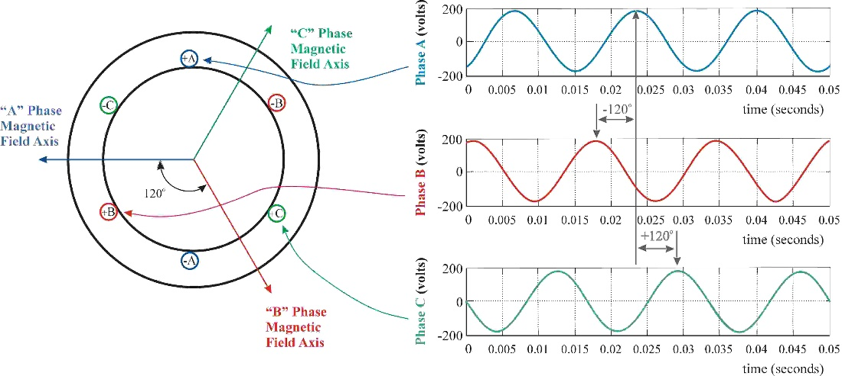
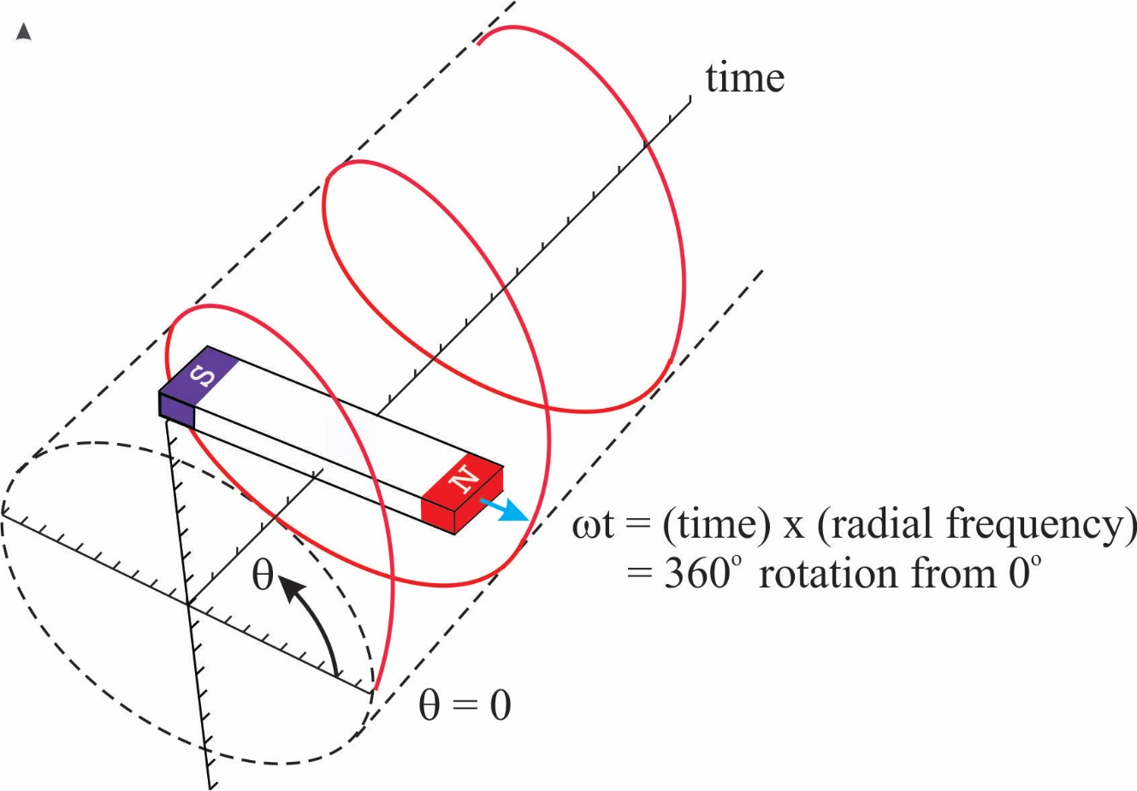
3φ Power Advantages – Rotating Field
Notes:
15

Slide 17
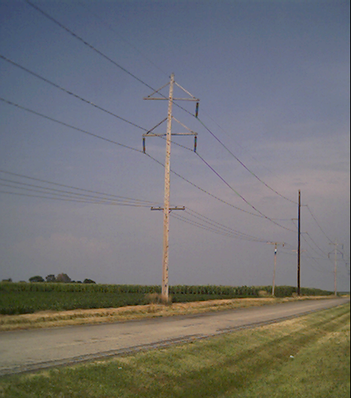
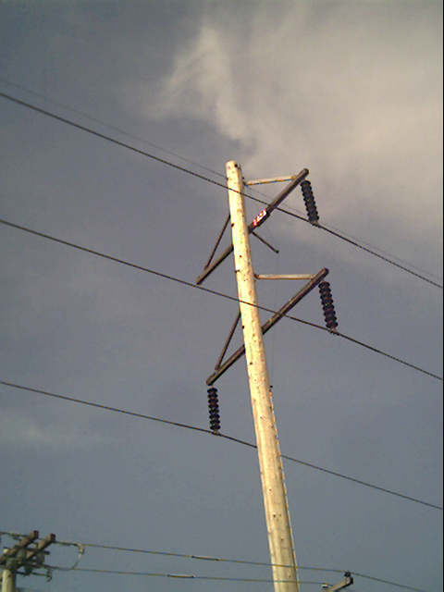
Three Phase Transmission Line
Notes:
16

Slide 18
Three Phase - Wye Connection
There are two ways to connect 3φ systems
  Wye (Y)
  Delta (Δ)
Notes:
17

Slide 19
Wye Connection Line Voltages
V_{cn}
V_{ab}
V_{ca}
-V_{bn}
V_{bn}
V_{an}
V_{bc}
(V_{l-l} )
(α = 0 in this case)
Line to line voltages are balanced
Notes:
18

Slide 20
Wye Connection, cont’d
voltage across device to be phase voltage
current through device to be phase current
voltage across lines to be the line voltage
current through lines to be line current
Notes:
19

Slide 21
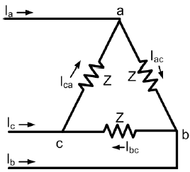
Delta Connection
KCL using
Load Convention !!
I_{ab}
I_{c}
I_{ca}
I_{ab}
-I_{ca}
I_{b}
I_{a}
I_{bc}
Phase voltages = Line voltages
Notes:
20

Slide 22
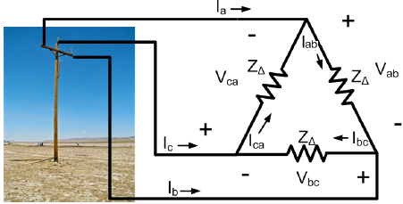
Three Phase Example
Assume a Δ-connected load is supplied from a 3φ, 13.8 kV_{(l-l)} source w/ Z = 100∠20°Ω
V_{cn}
V_{ab}
V_{ca}
a
a
V_{an}
V_{bn}
c
b
V_{bc}
c
b
Notes:
21

Slide 23
Three Phase Example, cont’d
I_{c}
I_{ca}
I_{ab}
-I_{ca}
I_{b}
I_{a}
I_{bc}
Notes:
22

Slide 24
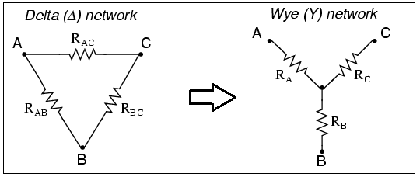
Delta-Wye Transformation
To simplify balanced 3φ systems analysis:
V_{cn}
V_{ab}
V_{ca}
V_{bn}
V_{an}
V_{bc}
Notes:
23

Slide 25
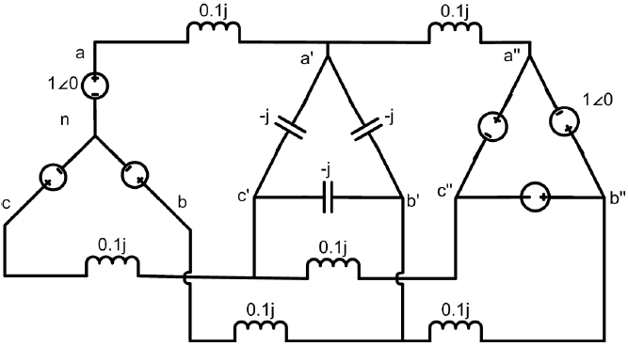
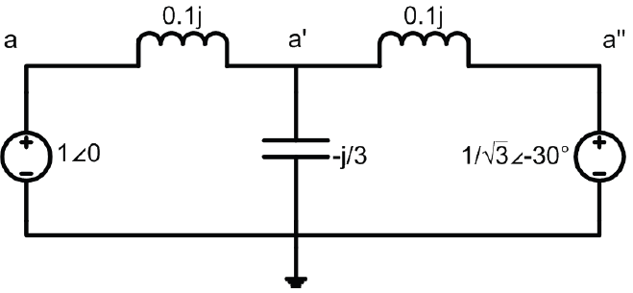
Per Phase Analysis
Per phase analysis enables balanced 3φ system analysis w/ the same effort as a single phase system
Balanced 3φ Theorem: For a balanced 3φ system w/
  All loads and sources Y– connected
  Mutual Inductance between phases is neglected
Notes:
24

Slide 26
Per Phase Analysis
Per phase analysis enables balanced 3φ system analysis w/ the same effort as a single phase system
Balanced 3φ Theorem: For a balanced 3φ system w/
  All loads and sources Y– connected
  Mutual Inductance between phases is neglected
→ Then
  All neutrals are at the same potential
  All phases are COMPLETELY decoupled
  All system values are the same sequence as sources.
  Sequence order we’ve been using (phase b lags phase a and phase c lags phase a) is known as “positive” sequence
  Later we’ll discuss negative and zero sequence systems.
Notes:
25

Slide 27
Per Phase Analysis Procedure
Per phase analysis procedure
Convert all Δ load/sources to equivalent Y’s
Solve phase “a” independent of the other phases
Total system power S = 3 V_{a} I_{a}*
If desired, phase “b” and “c” values can be determined by inspection (i.e., ±120° degree phase shifts)
If necessary, go back to original circuit to determine line-line values or internal Δ values.
Notes:
26

Slide 28
Per Phase Example
Assume a 3φ, Y-connected generator with V_{an} = 1∠0° volts supplies a Δ-connected load with Z_{Δ} = -jΩ through a transmission line with impedance of j0.1Ω per phase. The load is also connected to a
Δ-connected generator with V_{a”b”} = 1∠0° through a second transmission line which also has an impedance of j0.1Ω per phase.
Find
1. The load voltage V_{a’b’}
2. The total power supplied by each generator, S_{Y} and
S_{Δ}
Notes:
27

Slide 29
Per Phase Example, cont’d
Notes:
28

Slide 30
Per Phase Example, cont’d
Notes:
29

Slide 31
Per Phase Example, cont’d
Notes:
30

Slide 32
Per Phase Example, cont’d
Notes:
31

Slide 33
Transformers Overview
Power systems are characterized by many different voltage levels, ranging from 765 kV down to 240/120 volts.
Transformers are used to transfer power between different voltage levels.
The ability to inexpensively change voltage levels is a key advantage of ac systems over dc systems.
In 333 we just introduce the ideal transformer, with more details covered in 330 and 476.

