Slide 1
Lecture 5: Equilibrium Computation
in Two-player Games
Ruta Mehta

Slide 2
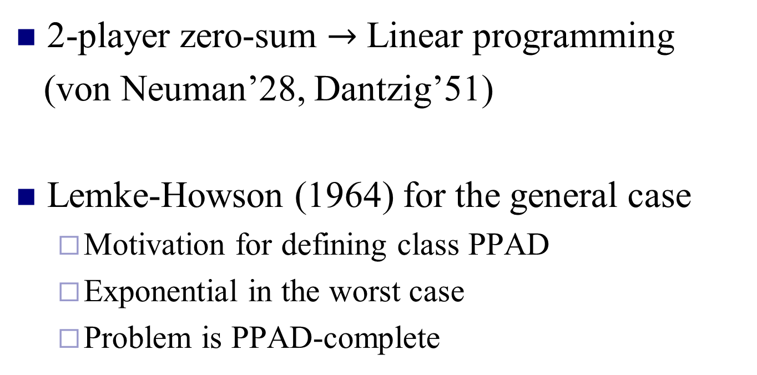
Algorithms So far
2-player zero-sum $→$ Linear programming
(von Neuman’28, Dantzig’51)
Lemke-Howson (1964) for the general case
  Motivation for defining class PPAD
  Exponential in the worst case
  Problem is PPAD-complete

Slide 3
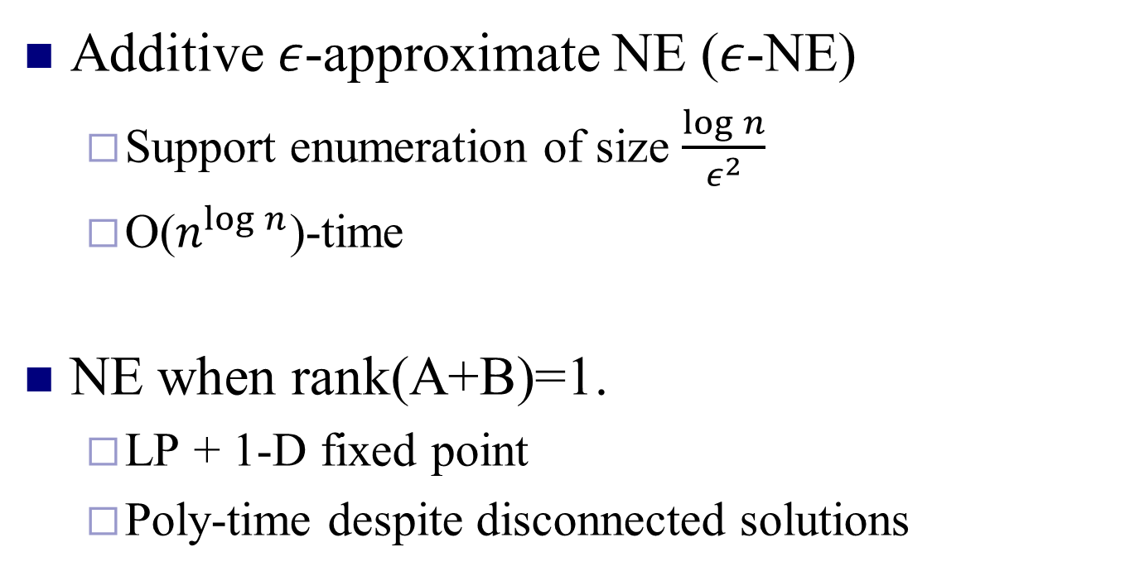
Today: Algorithm for
Additive $ε$-approximate NE ($ε$-NE)
  Support enumeration of size $\frac{\log{n}}{ε^{2}}$
  O($n^{\log{n}}$)-time
NE when rank(A+B)=1.
  LP + 1-D fixed point
  Poly-time despite disconnected solutions

Slide 4


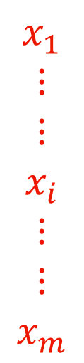
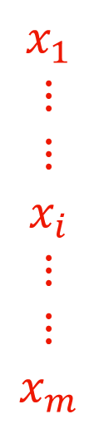
Alice
Bob
m choices
Randomize
n choices
$$y_{1} …… y_{j} …… y_{n}$$
$$y_{1} …… y_{j} …… y_{n}$$
$$x_{1}$$
$$⋮$$
$$⋮$$
$$x_{i}$$
$$⋮$$
$$⋮$$
$$x_{m}$$
$$x_{1}$$
$$⋮$$
$$⋮$$
$$x_{i}$$
$$⋮$$
$$⋮$$
$$x_{m}$$
A
B

Slide 5






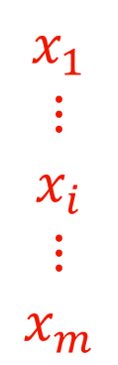

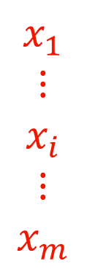

$$y_{1} … y_{j} … y_{n}$$
$$y_{1} … y_{j} … y_{n}$$
$$x_{1}$$
$$⋮$$
$$x_{i}$$
$$⋮$$
$$x_{m}$$
$$x_{1}$$
$$⋮$$
$$x_{i}$$
$$⋮$$
$$x_{m}$$
A
B
NE:
$x^{T}Ay≥{x^{′}}^{T}Ay,$ $∀x′$
$x^{T}By≥x^{T}By′,$ $∀y′$
$$A,B∈[0, 1]$$
$ε$-NE:
$x^{T}Ay+ε≥{x^{′}}^{T}Ay,$ $∀x′$
$x^{T}By+ε≥x^{T}By′,$ $∀y′$

Slide 6
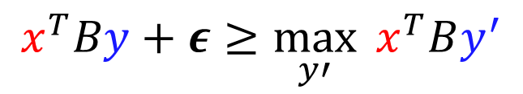
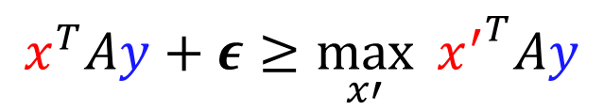

$$y_{1} … y_{j} … y_{n}$$
$$y_{1} … y_{j} … y_{n}$$
$$x_{1}$$
$$⋮$$
$$x_{i}$$
$$⋮$$
$$x_{m}$$
$$x_{1}$$
$$⋮$$
$$x_{i}$$
$$⋮$$
$$x_{m}$$
A
B
$ε$-NE:
$$x^{T}Ay+ε≥\max_{x′}{ {x^{′}}^{T}Ay}$$
$$x^{T}By+ε≥\max_{y′}{ x^{T}By^{′}}$$

Slide 7


$$y_{1} … y_{j} … y_{n}$$
$$y_{1} … y_{j} … y_{n}$$
$$x_{1}$$
$$⋮$$
$$x_{i}$$
$$⋮$$
$$x_{m}$$
$$x_{1}$$
$$⋮$$
$$x_{i}$$
$$⋮$$
$$x_{m}$$
A
B
Alice playing move i
$ε$-NE:
$$x^{T}Ay+ε≥e_{i}Ay, ∀i∈S_{1}$$
$$x^{T}By+ε≥x^{T}Be_{j},∀j∈S_{2}$$
Bob playing move j

Slide 8
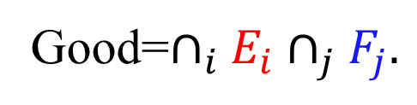




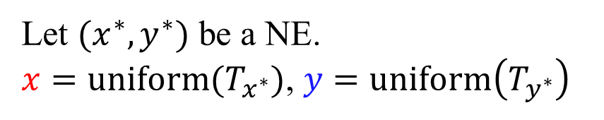


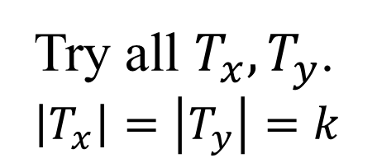
$ε$-NE:
$$x^{T}Ay+ε≥e_{i}Ay, ∀i∈S_{1}$$
$$→event E_{i}$$
$$x^{T}By+ε≥x^{T}Be_{j},∀j∈S_{2}$$
$$→event F_{j}$$
$k=\frac{9\ln{n}}{ε^{2}}, T_{z}≝$ k independent samples as per $z$ (w/ repetition)
Theorem:
Let $(x^{∗},y^{∗})$ be a NE.
$x=uniform(T_{x^{∗}})$, $y=uniform\left(T_{y^{∗}}\right)$
Then,
Good=$∩_{i}E_{i}∩_{j}F_{j}.$
Pr(Good) > 0
Algorithm:
Takes $n^{O\left(\frac{\ln{n}}{ε^{2}}\right)}$ time.
Try all $T_{x},T_{y}$.
$\left|T_{x}\right|=\left|T_{y}\right|=k$

Slide 9
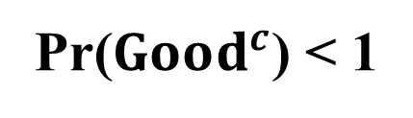
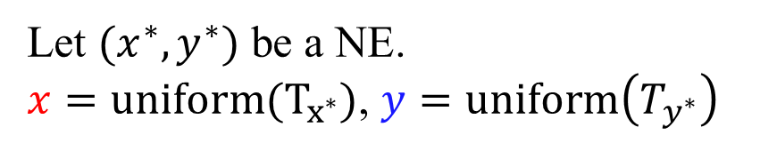
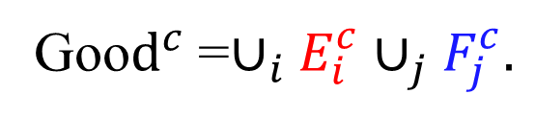
$ε$-NE:
$$x^{T}Ay+ε≥e_{i}Ay, ∀i∈S_{1}$$
$$→event E_{i}$$
$$x^{T}By+ε≥x^{T}Be_{j},∀j∈S_{2}$$
$$→event F_{j}$$
$k=\frac{9\ln{n}}{ε^{2}}, T_{z}≝$ k independent samples as per $z$ (w/ repetition)
Theorem:
Let $(x^{∗},y^{∗})$ be a NE.
$x=uniform(T_{x^{∗}})$, $y=uniform\left(T_{y^{∗}}\right)$
Then,
Good=$∩_{i}E_{i}∩_{j}F_{j}.$
Pr(Good) > 0
Goo$d^{c}$=$∪_{i}E_{i}^{c}∪_{j}F_{j}^{c}.$
Pr($Good^{c}$) < 1

Slide 10

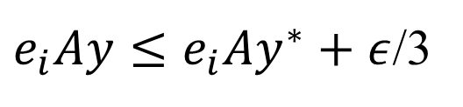





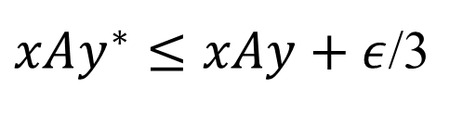

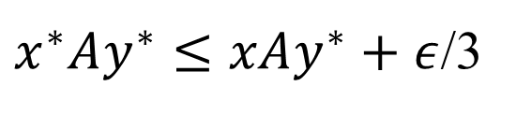

$$E_{i}: e_{i}Ay≤xAy+ε$$
$$E_{i}^{c}$$
$$E_{i1}:$$
$e_{i}Ay≤e_{i}Ay^{∗}+ε$/3
$$E_{i1}^{c}$$
&
OR
$$E_{i2}:$$
$x^{∗}Ay^{∗}≤xAy^{∗}+ε$/3
$$E_{i2}^{c}$$
&
OR
$$E_{i3}^{c}$$
$$E_{i3}:$$
$xAy^{∗}≤xAy+ε$/3

Slide 11


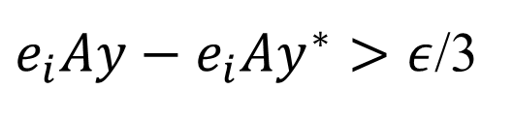

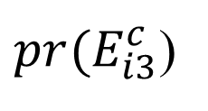



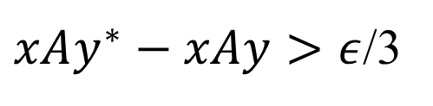

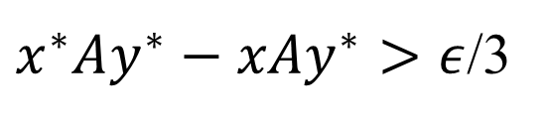

$$E_{i}: e_{i}Ay≤xAy+ε$$
$$pr(E_{i}^{c})$$
$$≤$$
$$E_{i1}^{c}:$$
$e_{i}Ay−e_{i}Ay^{∗}>ε$/3
$$pr(E_{i1}^{c})$$
+
$$E_{i2}^{c}:$$
$x^{∗}Ay^{∗}−xAy^{∗}>ε$/3
$${pr(E}_{i2}^{c})$$
+
${pr(E}_{i3}^{c}$)
$$E_{i3}^{c}:$$
$xAy^{∗}−xAy>ε$/3

Slide 12
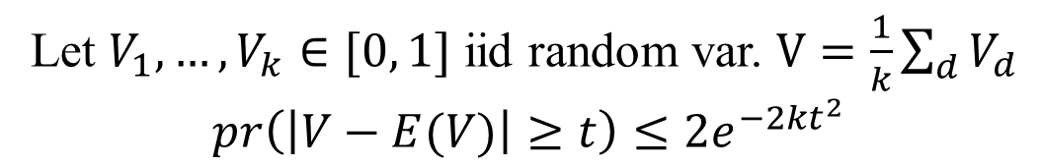
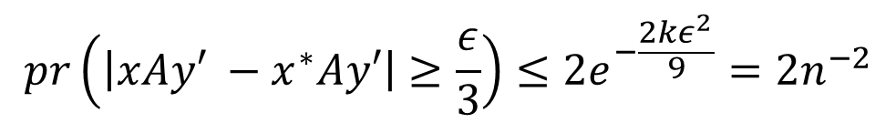

Hoeffding’s
inequality:
Let $V_{1},…, V_{k}∈[0, 1]$ iid random var. $V=\frac{1}{k}\sum_{d}{V_{d}}$
$$pr\left(\left|V−E(V)\right|≥t\right)≤2e^{−2kt^{2}}$$
Fix $y′. V_{d}=e_{i}Ay′, where e_{i}\sim x^{∗}. x=$ uniform($T_{x^{∗}})$.
$$V=xAy′. E\left(V\right)=x^{∗}Ay′$$
$$pr\left(\left|xAy′ −x^{∗}Ay′\right|≥\frac{ε}{3}\right)≤2e^{−\frac{2kε^{2}}{9}}=2n^{−2}$$
$k=\frac{9\ln{n}}{ε^{2}}, T_{z}≝$ k independent samples as per $z$ (w/ repetition)

Slide 13

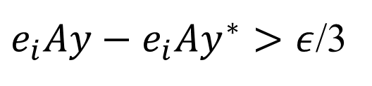









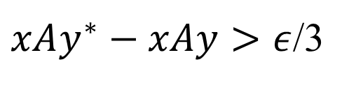

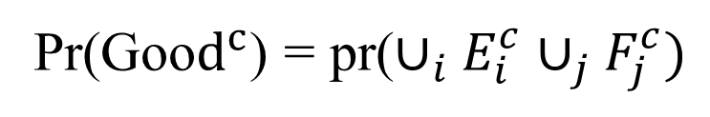
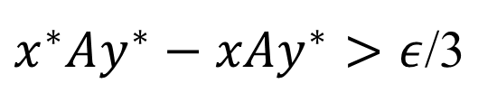
Hoeffding’s
inequality
Fix $y′. x=$ uniform($S_{x^{∗}})$.$pr\left(\left|xAy′ −x^{∗}Ay′\right|≥\frac{ε}{3}\right)≤2n^{−2}$
Fix $x′. y=$ uniform($S_{y^{∗}})$.$pr\left(\left|x′Ay −x′Ay^{∗}\right|≥\frac{ε}{3}\right)≤2n^{−2}$
$$E_{i}: e_{i}Ay≤xAy+ε$$
$$pr(E_{i}^{c})$$
$$<6n^{−2}$$
$$<$$
$$E_{i1}^{c}:$$
$e_{i}Ay−e_{i}Ay^{∗}>ε$/3
$$pr\left(E_{i1}^{c}\right)≤2n^{−2}$$
+
$$E_{i2}^{c}:$$
$x^{∗}Ay^{∗}−xAy^{∗}>ε$/3
$${pr(E}_{i2}^{c})≤2n^{−2}$$
+
$$E_{i3}^{c}:$$
$xAy^{∗}−xAy>ε$/3
$${pr(E}_{i3}^{c})≤2n^{−2}$$
Pr(Goo$d^{c}$) = pr($∪_{i}E_{i}^{c}∪_{j}F_{j}^{c})$
$$<12n ∗n^{−2}<1$$

Slide 14








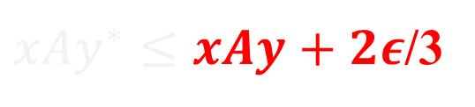


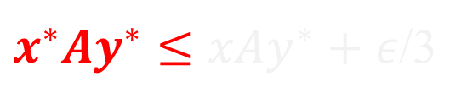


Hoeffding’s
inequality
Fix $y′. x=$ uniform($S_{x^{∗}})$.$pr\left(\left|xAy′ −x^{∗}Ay′\right|≥\frac{ε}{3}\right)≤2n^{−2}$
Fix $x′. y=$ uniform($S_{y^{∗}})$.$pr\left(\left|x′Ay −x′Ay^{∗}\right|≥\frac{ε}{3}\right)≤2n^{−2}$
$$E_{i}: e_{i}Ay≤xAy+ε$$
$$pr(E_{i}^{c})$$
$$<6n^{−2}$$
$$<$$
$$E_{i1}:$$
$e_{i}Ay≤e_{i}Ay^{∗}+ε$/3
$$pr\left(E_{i1}^{c}\right)≤2n^{−2}$$
Almost NE payoff!
&
+
$$E_{i2}:$$
$x^{∗}Ay^{∗}≤xAy^{∗}+ε$/3
$${pr(E}_{i2}^{c})≤2n^{−2}$$
&
+
$${pr(E}_{i3}^{c})≤2n^{−2}$$
$$E_{i3}:$$
$xAy^{∗}≤xAy+2ε$/3
Pr(Goo$d^{c}$) = pr($∪_{i}E_{i}∪_{j}F_{j})<12n ∗n^{−2}<1$

Slide 15
Constant rank games

Slide 16
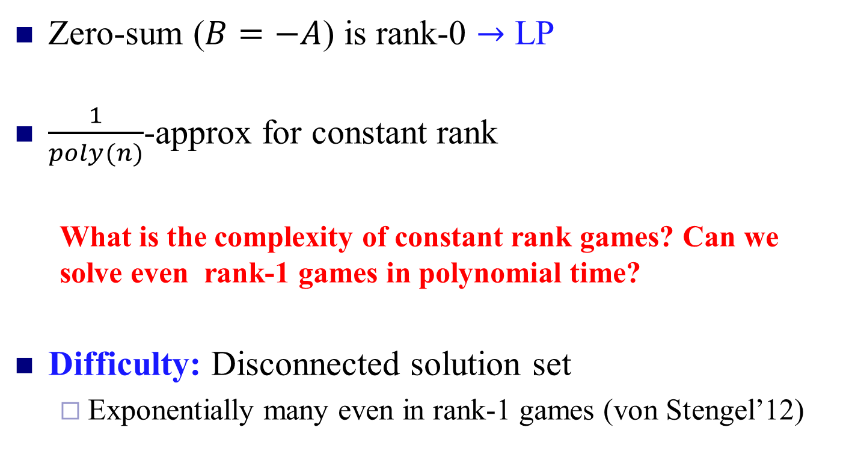
Rank of a Game: rank(A+B)
(Kannan and Theobald’05)
Zero-sum ($B=−A$) is rank-0 $→$ LP
$\frac{1}{poly(n)}$-approx for constant rank
  What is the complexity of constant rank games? Can we solve even rank-1 games in polynomial time?
Difficulty: Disconnected solution set
  Exponentially many even in rank-1 games (von Stengel’12)

Slide 17
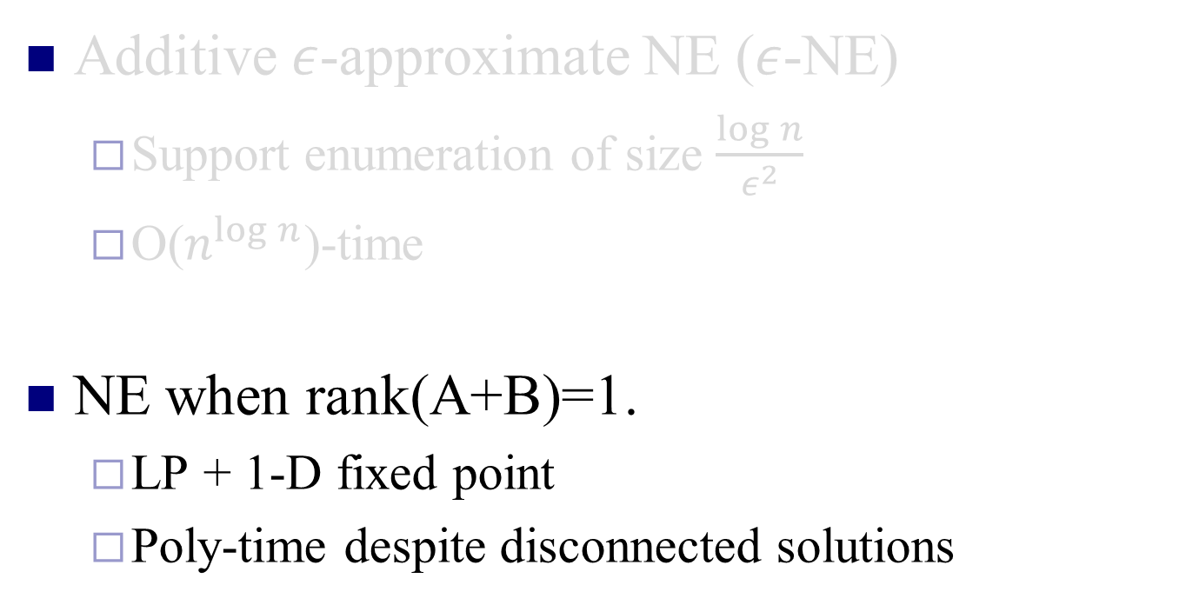
Today: Algorithm for
Additive $ε$-approximate NE ($ε$-NE)
  Support enumeration of size $\frac{\log{n}}{ε^{2}}$
  O($n^{\log{n}}$)-time
NE when rank(A+B)=1.
  LP + 1-D fixed point
  Poly-time despite disconnected solutions

Slide 18


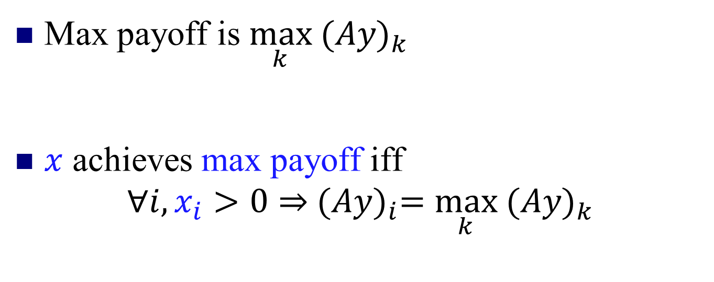


$i^{th}$ strategy gives Alice
$$y_{1}$$
$$y_{2}$$
$$⋮$$
$$⋮$$
$$⋮$$
$$y_{n}$$
$$i$$
$${\left(Ay\right)}_{i}$$
A
Max payoff is $\max_{k}{ (Ay)}_{k}$
$x$ achieves max payoff iff
$$∀i, x_{i}>0⇒{ (Ay)}_{i}=\max_{k}{ (Ay)}_{k}$$
Complementarity

Slide 19

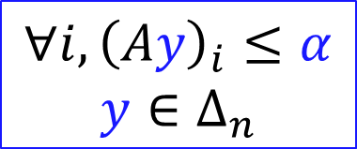

Polyhedra
Alice
Scalar variable$α$
$$∀i, {\left(Ay\right)}_{i}≤α$$
$$y∈Δ_{n}$$
$$P$$

Slide 20


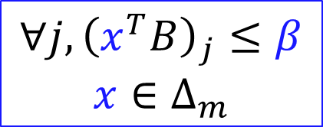
Polyhedra
Alice
Bob
Scalar variable$α$
Scalar variable$β$
$$∀i, {\left(Ay\right)}_{i}≤α$$
$$y∈Δ_{n}$$
$$Q$$
$$∀j, {\left(x^{T}B\right)}_{j}≤β$$
$$x∈Δ_{m}$$
$$P$$

Slide 21




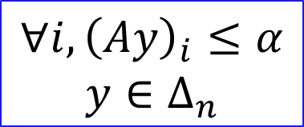

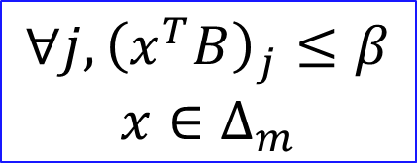
$$∀i, {\left(Ay\right)}_{i}≤α$$
$$y∈Δ_{n}$$
$$Q$$
$$∀j, {\left(x^{T}B\right)}_{j}≤β$$
$$x∈Δ_{m}$$
$$P$$
$$\left(y,α,x,β \right)∈P×Q$$
At least the sum of
max payoffs
Sum of payoffs
$$x^{T}\left(A+B\right)y−\left(α+β\right)$$
$$≤0$$

Slide 22



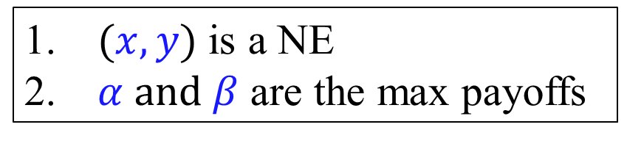
$$∀i, {\left(Ay\right)}_{i}≤α$$
$$y∈Δ_{n}$$
$$Q$$
$$∀j, {\left(x^{T}B\right)}_{j}≤β$$
$$x∈Δ_{m}$$
$$P$$
$$\left(y,α,x,β\right)∈P×Q$$
At least the sum of
max payoffs
Sum of payoffs
$$x^{T}\left(A+B\right)y−\left(α+β\right)$$
$$=0$$
$$⇔$$
Complementarity
$(x,y)$ is a NE
$α and β$ are the max payoffs

Slide 23


$$∀i, {\left(Ay\right)}_{i}≤α$$
$$y∈Δ_{n}$$
$$Q$$
$$∀j, {\left(x^{T}B\right)}_{j}≤β$$
$$x∈Δ_{m}$$
$$P$$
$$\left(y,α,x,β\right)∈P×Q$$
At least the sum of
max payoffs
Sum of payoffs
2-Nash
max:
$$x^{T}\left(A+B\right)y−\left(α+β\right)$$
$$=0$$
s.t.
$$⇔$$
Complementarity
$$\left(y,α,x,β\right)∈P×Q$$
$(x,y)$ is a NE
$α and β$ are the max payoffs

Slide 24
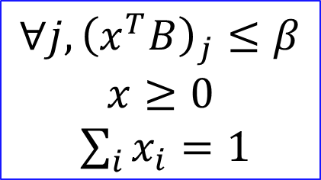


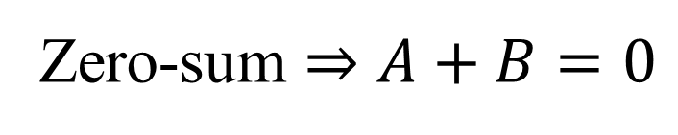

$$∀i, {\left(Ay\right)}_{i}≤α$$
$$y≥0$$
$\sum_{j}{y_{j}}=1$
$$Q$$
$$∀j, {\left(x^{T}B\right)}_{j}≤β$$
$$x≥0$$
$\sum_{i}{x_{i}}=1$
$$P$$
2-Nash
max:
$$x^{T}\left(A+B\right)y−\left(α+β\right)$$
s.t.
$$\left(y,α,x,β\right)∈P×Q$$
Zero-sum $⇒A+B=0$

Slide 25

$$∀i, {\left(Ay\right)}_{i}≤α$$
$$y≥0$$
$\sum_{j}{y_{j}}=1$
$$Q$$
$$∀j, {\left(x^{T}B\right)}_{j}≤β$$
$$x≥0$$
$\sum_{i}{x_{i}}=1$
$$P$$
2-Nash
max:
$$x^{T}\left(0\right)y−\left(α+β\right)$$
s.t.
$$\left(y,α,x,β\right)∈P×Q$$
Zero-sum $⇒A+B=0$

Slide 26
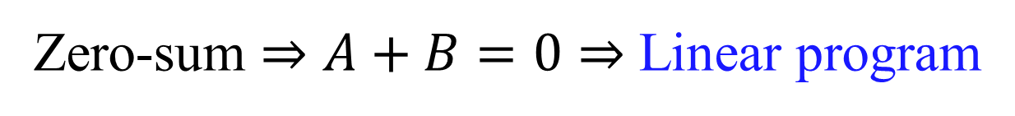

$$∀i, {\left(Ay\right)}_{i}≤α$$
$$y≥0$$
$\sum_{j}{y_{j}}=1$
$$Q$$
$$∀j, {\left(x^{T}B\right)}_{j}≤β$$
$$x≥0$$
$\sum_{i}{x_{i}}=1$
$$P$$
2-Nash
min:
$$α+β$$
s.t.
$$\left(y,α,x,β\right)∈P×Q$$
Zero-sum $⇒A+B=0⇒$ Linear program

Slide 27






Rank 1 Game
$$A+B=$$
$$u{⋅v}^{T}$$
$$∈R^{n}$$
$$∈R^{m}$$
Bilinear
2-Nash
max:
$$x^{T}\left(A+B\right)y−\left(α+β\right)$$
s.t.
$$\left(y,α,x,β\right)∈P×Q$$

Slide 28

Rank 1 Game
$$A+B=$$
$$u{⋅v}^{T}$$
Product of two linear terms
2-Nash
max:
$$\left(x^{T}u\right)(v^{T}y)−\left(α+β\right)$$
s.t.
$$\left(y,α,x,β\right)∈P×Q$$
Rank 1 QP is NP-hard in general

Slide 29


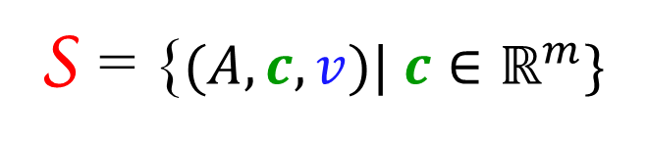
Think Big!
$$A+B=$$
$$u{⋅v}^{T}$$
$$(A,u,v)$$
Consider a space of rank-1 games
S = {$(A,c,v)| c∈ℝ^{m}\}$

Slide 30

Think Big!
$$A+B=$$
$$u{⋅v}^{T}$$
$$(A,u,v)$$
Consider a space of rank 1 games
$$\text{S} \text{=} \left(A, ∗,v\right)$$

Slide 31




Think Big!
$$(A,u,v)$$
2-Nash
max:
$$\left(x^{T}u\right)(v^{T}y)−\left(α+β\right)$$
s.t.
$$P×Q$$
$$\left(x^{T}u\right)v^{T}−x^{T}A$$

Slide 32




Think Big!
Consider game space
$$\text{S} \text{=} \left(A,∗,v\right)$$
2-Nash
max:
$$\left(x^{T}∗\right)(v^{T}y)−\left(α+β\right)$$
s.t.
$$P×Q$$
$$\left(x^{T}∗\right)v^{T}−x^{T}A$$

Slide 33
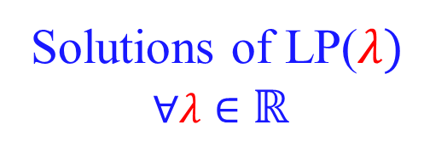

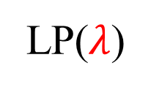


Think Big!
Consider game space
$$\text{S} \text{=} \left(A,∗,v\right)$$
All NE of S
Complementarity
Captures
max:
$$λ(v^{T}y)−\left(α+β\right)$$
s.t.
$$P×Q$$
Solutions of LP($λ)$
$$∀λ∈ℝ$$
LP($λ$)
$$λv^{T}−x^{T}A$$

Slide 34

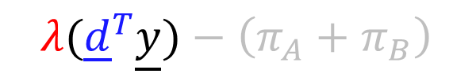
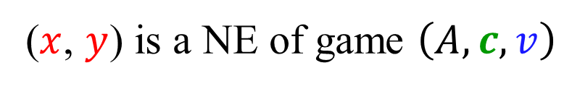
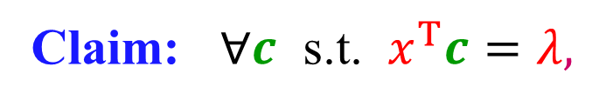

$$λ$$
LP($λ$)
$$(y,α,x,β)$$
Claim: $∀c$ s.t. $x^{T}c=λ,$
($x$, $y$) is a NE of game $\left(A,c,v\right)$

Slide 35




$$λ$$
LP($λ$)
$$(y,α,x,β)$$
Goal: NE of $\left(A,u,v\right)$
(m-1)-dimensional
space in S
If $u$ one of them
then done!
Claim: $∀c$ s.t. $x^{T}c=λ,$
($x$, $y$) is a NE of game $\left(A,c,v\right)$

Slide 36







Goal: NE of game $\left(A,u,v\right)$
$$λ$$
LP($λ$)
$$f:$$
$$(y,α,x,β)$$
$$x^{T}u$$
If $x^{T}u$ =$λ$ then done!

Slide 37




Goal: NE of game $\left(A,u,v\right)$
$$λ$$
LP($λ$)
$$f:$$
$$(y,α,x,β)$$
$$x^{T}u$$
NE of game $\left(A,u,v\right) ↔$ Fixed points of $f$
If $x^{T}u$ =$λ$ then done!

Slide 38






NE of game $\left(A,\underline{u},\underline{v}\right) ↔$ Fixed points of $f$
$$:D→D$$
$$D=[u_{min, }u_{max}]$$
$$λ$$
LP($λ$)
$$f:$$
Continuous
$$(\underline{y},π_{A},\underline{x},π_{B})$$
$$u_{min}≤$$
$${\underline{x}}^{T}\underline{u}$$
$${≤u}_{max}$$

Slide 39





1-D Fixed Point
$$f$$
Lower
Upper
$$u_{max}$$
Upper
Lower
$$u_{min}$$
$$u_{max}$$
$$λ$$

Slide 40

1-D Fixed Point
$$f$$
Lower
Upper
$$u_{max}$$
Upper
Lower
$$u_{min}$$
$$u_{max}$$
$$λ$$
And so on until the difference becomes small enough

Slide 41









$$λ$$
$${\left(Ay\right)}_{i}≤α, ∀i$$
$$λv_{j}−{\left(x^{T}A\right)}_{j}≤β, ∀j$$
$$x_{i}\left({\left(Ay\right)}_{i}−α\right)≤0 ∀i$$
$$y_{j}(λv_{j}−{\left(x^{T}A\right)}_{j}−β≤0, ∀j$$
LP($λ$)
Add all
$$(y,α,x,β)$$
$$λ\left(v^{T}y\right)−α−β≤0$$
$∀c$ s.t. $x^{T}c=λ,$
Proof:
At any feasible point Cost of LP($λ$) $≤$ zero.
($x$, $y$) is a NE of
game $\left(A,c,v\right)$.

Slide 42



$$λ$$
$${\left(Ay\right)}_{i}≤α, ∀i$$
$$λv_{j}−{\left(x^{T}A\right)}_{j}≤β, ∀j$$
$$x_{i}\left({\left(Ay\right)}_{i}−α\right)≤0 ∀i$$
$$y_{j}(λv_{j}−{\left(x^{T}A\right)}_{j}−β≤0, ∀j$$
LP($λ$)
Complementarity
$$x_{i}\left({\left(Ay\right)}_{i}−α\right)=0, ∀i$$
$$y_{j}\left(λv_{j}−{\left(x^{T}A\right)}_{j}−β\right)=0, ∀j$$
$$(y,α,x,β)$$
$$λ\left(v^{T}y\right)−α−β=0$$
$∀c$ s.t. $x^{T}c=λ,$
Proof:
At any feasible point Cost of LP($λ$) $≤$ zero.
It is zero iff complemetarity.
($x$, $y$) is a NE of
game $\left(A,c,v\right)$.

Slide 43



$$λ$$
$${\left(Ay\right)}_{i}≤α, ∀i$$
$$λv_{j}−{\left(x^{T}A\right)}_{j}≤β, ∀j$$
$${\left(Ay\right)}_{i}≤α, ∀i$$
$${\left(x^{T}B\right)}_{j}≤β, ∀j$$
LP($λ$)
$$x^{T}B=λv−x^{T}A$$
$$(y,α,x,β)$$
$∀c$ s.t. $x^{T}c=λ,$
Proof:
At any feasible point Cost of LP($λ$) $≤$ zero.
It is zero iff complemetarity.
NE ($x$, $y$) of $\left(A,B=λv−A\right)$ is feasible.
($x$, $y$) is a NE of
game $\left(A,c,v\right)$.

Slide 44

$$λ$$
$${\left(Ay\right)}_{i}≤α, ∀i$$
$$λv_{j}−{\left(x^{T}A\right)}_{j}≤β, ∀j$$
$${\left(Ay\right)}_{i}≤α, ∀i$$
$${\left(x^{T}B\right)}_{j}≤β, ∀j$$
LP($λ$)
$$x^{T}B=λv−x^{T}A$$
$$(y,α,x,β)$$
$∀c$ s.t. $x^{T}c=λ,$
Proof:
At any feasible point Cost of LP($λ$) $≤$ zero.
It is zero iff complemetarity.
NE ($x$, $y$) of $\left(A,B=λv−A\right)$ is feasible.
($x$, $y$) is a NE of
game $\left(A,c,v\right)$.

Slide 45





$$λ$$
$${\left(Ay\right)}_{i}≤α$$
$$λv_{j}−{\left(x^{T}A\right)}_{j}≤β$$
$${\left(Ay\right)}_{i}≤α$$
$${\left(x^{T}B\right)}_{j}≤β$$
LP($λ$)
Complementarity
$$x_{i}\left({\left(Ay\right)}_{i}−α\right)=0, ∀i$$
$$y_{j}\left(λv_{j}−{\left(x^{T}A\right)}_{j}−β\right)=0, ∀j$$
Complementarity
$$x_{i}\left({\left(Ay\right)}_{i}−α\right)=0, ∀i$$
$$y_{j}\left({\left(x^{T}B\right)}_{j}−β\right)=0, ∀j$$
$$(y,α,x,β)$$
$$x^{T}B=λv−x^{T}A$$
$∀c$ s.t. $x^{T}c=λ,$
Proof:
At any feasible point Cost of LP($λ$) $≤$ zero.
It is zero iff complemetarity.
NE ($x$, $y$) of $\left(A,B=λv−A\right)$ is feasible.
  (NE iff complementarity) $⇒$cost is zero.
($x$, $y$) is a NE of
game $\left(A,c,v\right)$.

Slide 46


$$λ$$
$${\left(Ay\right)}_{i}≤α$$
$$λv_{j}−{\left(x^{T}A\right)}_{j}≤β$$
$${\left(Ay\right)}_{i}≤α$$
$${\left(x^{T}B\right)}_{j}≤β$$
LP($λ$)
Complementarity
$$x_{i}\left({\left(Ay\right)}_{i}−α\right)=0, ∀i$$
$$y_{j}\left(λv_{j}−{\left(x^{T}A\right)}_{j}−β\right)=0, ∀j$$
Complementarity
$$x_{i}\left({\left(Ay\right)}_{i}−α\right)=0, ∀i$$
$$y_{j}\left({\left(x^{T}B\right)}_{j}−β\right)=0, ∀j$$
$$(y,α,x,β)$$
$$λv−x^{T}A=\left(x^{T}c\right)v−x^{T}A=x^{T}B$$
$∀c$ s.t. $x^{T}c=λ,$
Proof:
At any feasible point Cost of LP($λ$) $≤$ zero.
It is zero iff complemetarity.
NE ($x$, $y$) of $\left(A,B=λv−A\right)$ is feasible.
  (NE iff complementarity) $⇒$cost is zero.
Since $x^{T}c=λ$, for $B=cv^{T}−A$ too ($x$, $y$) is feasible and satisfies complementarity.
QED
($x$, $y$) is a NE of
game $\left(A,c,v\right)$.

Slide 47
What about rank-2 or more?

Slide 48









Rank-0 (zero-sum) games
LP
Von Neumann
(1928)
$$λ$$
Rank-1 games
$x$= LP($λ$)
$$u^{T}x$$
$$λ_{1}$$
$$λ_{2}$$
Rank-2 games
$x$= LP($λ_{1}, λ_{2}$)
$$…$$
$$u^{T}x w^{T}x$$
$$…$$

Slide 49
Rank-0 (zero-sum) games
LP
Von Neumann
(1928)
1-D Fixed
Point
Rank-1 games
In P
Rank-2 games
2-D Fixed
Point
$$…$$

Slide 50

Rank-0 (zero-sum) games
LP
Von Neumann
(1928)
1-D Fixed
Point
Rank-1 games
PPAD-hard
in general
Rank-2 games
2-D Fixed
Point
$$…$$
$$…$$

Slide 51
Rank-0 (zero-sum) games
LP
Von Neumann
(1928)
1-D Fixed
Point
Rank-1 games
PPAD-hard
in general
?
Rank-2 games
2-D Fixed
Point
$$…$$
$$…$$

Slide 52



Almost! [M (STOC’14)]
2-D Brouwer
(Discrete)
PPAD-hard
(CD’06)
$$λ_{1}$$
$$λ_{2}$$
Rank-3
game
LP($λ_{1}, λ_{2}$)
Gives a simpler proof of PPAD-hardness for 2-Nash

