Slide 1
Role of Language in Vision
04/27/17
Computer Vision
CS 543 / ECE 549
University of Illinois
Tanmay Gupta

Slide 2
Today’s class: Role of Language in Vision
Part I:
Moving from Classification to Embedding Models for recognition
Part II:
Language representation
Part III: Hot topics in Vision-Language Research
Phrase Localization
Visual Question Answering
Image Captioning

Slide 3
MOVING FROM CLASSIFICATION TO EMBEDDING MODELS
PART I

Slide 4
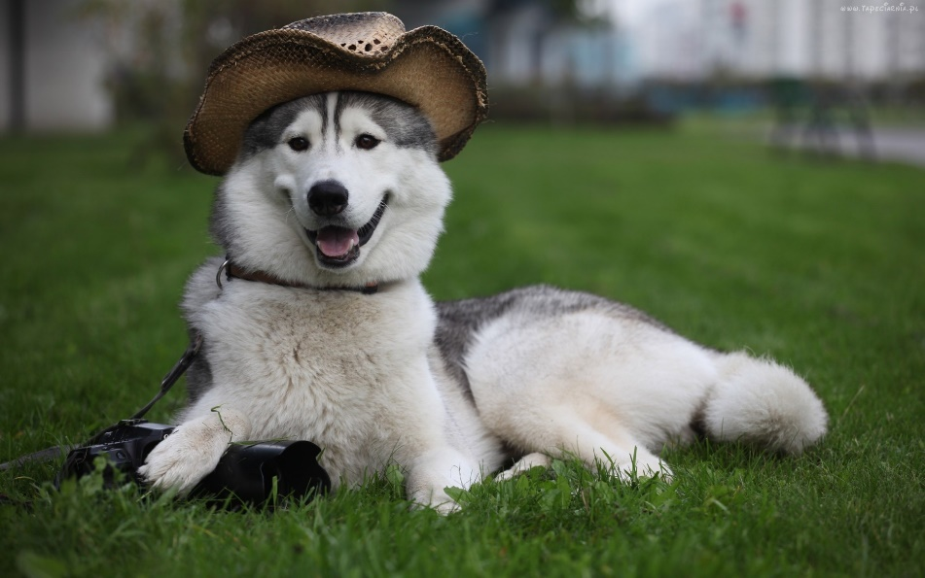
Recognition as Image Classification
Many visual recognition tasks posed as k-way classification with exclusive categorical labels
Dog Breed Classification
0.1
0.2
0.6
0.05
0.05
Pug
Bulldog
Husky
Poodle
Dalmatian
Classifier

Slide 5
Recognition as Image Classification
Many visual recognition tasks posed as k-way classification with exclusive categorical labels
Modified Dog Breed Classification
0.1
0.2
0.6
0.05
0.05
Pug
Dog
Husky
Human
Animal
Classifier

Slide 6
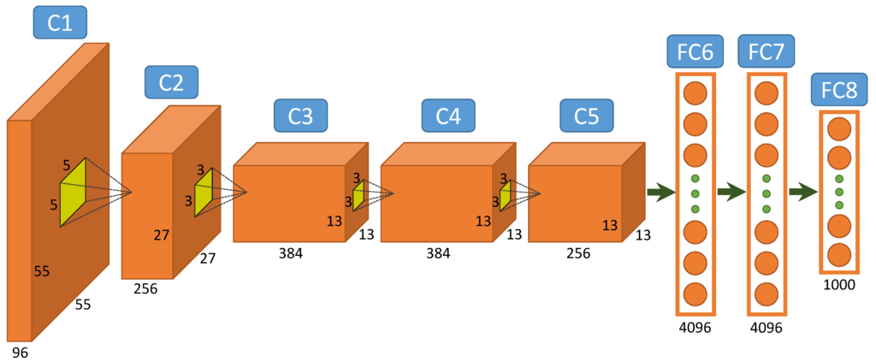
Recognition as Image Classification
Many visual recognition tasks posed as k-way classification with exclusive categorical labels
Modified Dog Breed Classification
Pug
Dog
…
Husky
Human
$$x$$
Output of FC7 Layer = Image Representation, $φ(x)$
FC8 Weights, $W$ act as linear classifiers $s\left(x,y\right)=w_{y}⋅φ(x)$

Slide 7
Recognition as Image Classification
Many visual recognition tasks posed as k-way classification with exclusive categorical labels
Modified Dog Breed Classification
Pug
Dog
…
Husky
Human
$$x$$
$$P\left(y_{i} | x\right)=\frac{e^{s(x,y_{i})}}{\sum_{y}{e^{s(x,y)}}}$$
$s\left(x,y\right)=w_{y}φ(x)$

Slide 8
Limitations of the classification approach
Hard to scale to large number of classes
Ignores structure in label space
Hypernyms (Dog-Husky)
Co-Hyponyms (Pug-Husky)
Ignores additional information about classes available in the form of text
$$P\left(y_{i} | x\right)=\frac{e^{s(x,y_{i})}}{\sum_{y}{e^{s(x,y)}}}$$
O(#classes)
Animal
Dog
Human
Pug
Husky
Poodle
Notes:
This is where the fact that our labels are words in natural language that has a lot of structure helps

Slide 9
Scalability
Structure in label space
External Knowledge
$$P\left(y_{i} | x\right)=\frac{e^{s(x,y_{i})}}{\sum_{y}{e^{s(x,y)}}}$$
$s\left(x,y\right)=w_{y}φ(x)$
Compatibility / Scoring Function
Score is enough to make a prediction
Eliminate probability computation during training
Consider only relative ranking of subset of classes
Design compatibility functions that encode structure in the label space
Notes:
Score order preserved

Slide 10
Compatibility Functions
$s\left(x,y\right)=φ\left(x\right)⋅Θ(y)$
Pros:
The representations are learned
Structure in label space can be discovered
Inference can use fast (approx.) nearest neighbor lookup
Cons:
The representations of images and labels need to lie in the same inner product space
Features need to correspond or align
Solution:
Learn to align representations
Notes:
Other metrics like L2, cosine

Slide 11
Compatibility Functions
$s\left(x,y\right)=φ^{T}\left(x\right) W Θ\left(y\right)$

Slide 12
Compatibility Functions
$⨂$ Outer product
$\text{vec}\text{(.)}$ Converts $\text{mx}\text{n}$
matrices to
$\text{mn}$ dim. vector
$s\left(x,y\right)=φ^{T}\left(x\right) W Θ\left(y\right)$
$=\text{vec}\left(W\right)⋅\text{vec}(φ\left(x\right)⨂Θ(y))$
Pros:
Can learn to align representations
Cons:
Relatively expensive to compute if m and n are large
More parameters to learn ($m×n$ parameters)
Solution:
Assume a low rank decomposition of $W$
$W=U^{T}V$ where $U∈k×m$ and $V∈k×n$
$s\left(x,y\right)=φ^{T}\left(x\right) U^{T}V Θ\left(y\right)$
$$=\left(Uφ\left(x\right)\right)⋅\left(VΘ\left(y\right)\right)=φ^{′}\left(x\right)⋅Θ′(y)$$
$$k×\left(m+n\right)$$
parameters

Slide 13
Embeddings
Space of Images
Space of Labels
$$y$$
$$x$$
$$Θ(y)$$
$$φ(x)$$
Embedding Space

Slide 14
Embedding Network
$$φ(x)$$
$$Θ(y)$$
Wang, Liwei, Yin Li, and Svetlana Lazebnik. "Learning Two-Branch Neural Networks for Image-Text Matching Tasks." arXiv preprint arXiv:1704.03470 (2017).

Slide 15
Embedding/Metric Learning
Minimize distance between GT pairs
Ignores relative ranking
Max-Margin Loss
Preserves ranking but O(#classes)
Triplet Loss
Preserves ranking but O(constant)
Bi-directional Ranking Loss
Good for bi-directional retrieval

Slide 16
Minimize distance between GT pairs
Ground truth image-label pairs ${\left\{\left(x_{i},y_{i}\right)\right\}}_{i=1}^{N}$
$$L\left(φ,Θ\right)=−\sum_{i}{s(x,y;φ,Θ)}$$
$$Φ($$
$$)$$
$$Θ(husky)$$

Slide 17
Minimize distance between GT pairs
Ground truth image-label pairs ${\left\{\left(x_{i},y_{i}\right)\right\}}_{i=1}^{N}$
$$L\left(φ,Θ\right)=−\sum_{i}{s(x,y;φ,Θ)}$$
$$Φ($$
$$)$$
$$Θ(husky)$$

Slide 18
Minimize distance between GT pairs
Ground truth image-label pairs ${\left\{\left(x_{i},y_{i}\right)\right\}}_{i=1}^{N}$
$$L\left(φ,Θ\right)=−\sum_{i}{s(x,y;φ,Θ)}$$
$$Φ($$
$$)$$
$$Θ(husky)$$

Slide 19
Minimize distance between GT pairs
Ground truth image-label pairs ${\left\{\left(x_{i},y_{i}\right)\right\}}_{i=1}^{N}$
$$L\left(φ,Θ\right)=−\sum_{i}{s(x,y;φ,Θ)}$$
$$Φ($$
$$)$$
$$Θ(husky)$$

Slide 20
Minimize distance between GT pairs
Ground truth image-label pairs ${\left\{\left(x_{i},y_{i}\right)\right\}}_{i=1}^{N}$
$$L\left(φ,Θ\right)=−\sum_{i}{s(x,y;φ,Θ)}$$
Trivial Solution
Map all $x$ and $y$ to the same point at infinity for $φ\left(x\right)⋅Θ(y)$
Ignores the relative score of labels for the same image!
What we really want is for the correct label to have a high score while producing a lower score for incorrect labels

Slide 21
Max-Margin Loss
Ground truth image-label pairs ${\left\{\left(x_{i},y_{i}\right)\right\}}_{i=1}^{N}$
$$L\left(φ,Θ\right)=\sum_{i}{\sum_{l≠y_{i}}{\max\left\{0, 1+s\left(x_{i},l\right)−s\left(x_{i},y_{i}\right)\right\}}}$$
$$Φ($$
$$)^{T}$$
$$Θ(husky)$$
$$>$$
$$Φ($$
$$)^{T}$$
$Θ(pug)$ + 1
$$Φ($$
$$)^{T}$$
$$Θ(husky)$$
$$>$$
$$Φ($$
$$)^{T}$$
$Θ(poodle)$ + 1
$$⋮$$
Notes:
s depends on phi and theta

Slide 22
Max-Margin Loss
Ground truth image-label pairs ${\left\{\left(x_{i},y_{i}\right)\right\}}_{i=1}^{N}$
$$L\left(φ,Θ\right)=\sum_{i}{\sum_{l≠y_{i}}{\max\left\{0, 1+s\left(x_{i},l\right)−s\left(x_{i},y_{i}\right)\right\}}}$$
Need to compute scores for all labels
Not scalable to large number of classes
Not suitable when multiple labels apply.
Eg. Dog and Husky
Notes:
s depends on phi and theta

Slide 23
Triplet Loss
Ground truth image-label triplets ${\left\{\left(x_{i},y_{i}^{+},y_{i}^{−}\right)\right\}}_{i=1}^{N}$
$$L\left(φ,Θ\right)=\sum_{i}{max⁡\{0, 1+s\left(x_{i},y_{i}^{−}\right)−s\left(x_{i},y_{i}^{+}\right)\}}$$
$$x_{i}=$$
$$y_{i}^{+}=husky$$
$$y_{i}^{−}=human$$

Slide 24
Triplet Loss
Ground truth image-label triplets ${\left\{\left(x_{i},y_{i}^{+},y_{i}^{−}\right)\right\}}_{i=1}^{N}$
$$L\left(φ,Θ\right)=\sum_{i}{max⁡\{0, 1+s\left(x_{i},y_{i}^{−}\right)−s\left(x_{i},y_{i}^{+}\right)\}}$$
Scalable and preserves label order ☺
Common to provide more than one but small $\left(≪\text{\#}\text{labels}\right)$ number of negative example

Slide 25
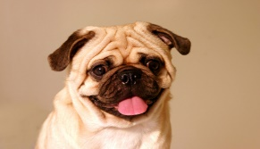
Bi-direction Ranking Loss
Ground truth image-label pairs ${\left\{\left(x_{i}^{+},x_{i}^{−},y_{i}^{+},y_{i}^{−}\right)\right\}}_{i=1}^{N}$
$L\left(φ,Θ\right)=\sum_{i}{max⁡\{0, 1+s\left(x_{i}^{+},y_{i}^{−}\right)−s\left(x_{i}^{+},y_{i}^{+}\right)\}}$
$+\sum_{i}{max⁡\{0, 1+s\left(x_{i}^{−},y_{i}^{+}\right)−s\left(x_{i}^{+},y_{i}^{+}\right)\}}$
$$x_{i}^{+}=$$
$$y_{i}^{+}=husky$$
$$y_{i}^{−}=human$$
$$x_{i}^{−}=$$

Slide 26
Bi-direction Ranking Loss
Ground truth image-label pairs ${\left\{\left(x_{i}^{+},x_{i}^{−},y_{i}^{+},y_{i}^{−}\right)\right\}}_{i=1}^{N}$
$L\left(φ,Θ\right)=\sum_{i}{max⁡\{0, 1+s\left(x_{i}^{+},y_{i}^{−}\right)−s\left(x_{i}^{+},y_{i}^{+}\right)\}}$
$+\sum_{i}{max⁡\{0, 1+s\left(x_{i}^{−},y_{i}^{+}\right)−s\left(x_{i}^{+},y_{i}^{+}\right)\}}$
Useful when the goal is bi-direction retrieval
Image-Caption Retrieval

Slide 27
Canonical Correlation Analysis (CCA)
A non deep-learning alternative
Often provides a strong baseline for embedding approaches for image-caption retrieval
For random vectors $X$ and $Y$, finds projection matrices $W$ and $V$ which maximize the correlation between $WX$ and $VY$.
Gong, Yunchao, et al. "Improving image-sentence embeddings using large weakly annotated photo collections." European Conference on Computer Vision. Springer International Publishing, 2014.

Slide 28
Language representation
PART II

Slide 29
Representations
Image
Outputs of CNNs, Spatial Pyramid, HOG …
Language Labels
Word:
Object/Attribute recognition, scene classification
Phrase:
Human-Object-Interaction, Visual Relationship Detection
Sentence:
Image Captioning, Visual Question Answering
Notes:
Directly labels, Structure in label space using external knowledge

Slide 30
Word Representations
One-Hot Encoding $e_{w}$
Identity vector of the size of word vocabulary
Index of $w$ in vocabulary
$$e_{w}=$$
0 | 0 | 0 | 0 | 1 | 0 | 0 | 0
Size of vocabulary
Notes:
One hot vector, motorcycle example, remove external knowledge

Slide 31
Word Representations
One-Hot Encoding $e_{w}$
Identity vector of the size of word vocabulary
Linear/Non-Linear Transformation of $e_{w}$
More compact representation than one-hot (300 vs 3M dim.)
Trained using large text corpuses (300B words, 3M vocab)
Capture semantics from training data
Eg. Word2vec, GloVe …
0 | 0 | 0 | 0 | 1 | 0 | 0 | 0
$$Θ(w)$$
Textual data can be thought of as external knowledge in many vision tasks. Hence, common to learn $Θ$ as a transformation of word2vec representation.
0 | 0 | 0 | 0 | 1 | 0 | 0 | 0
Notes:
One hot vector, motorcycle example, remove external knowledge

Slide 32
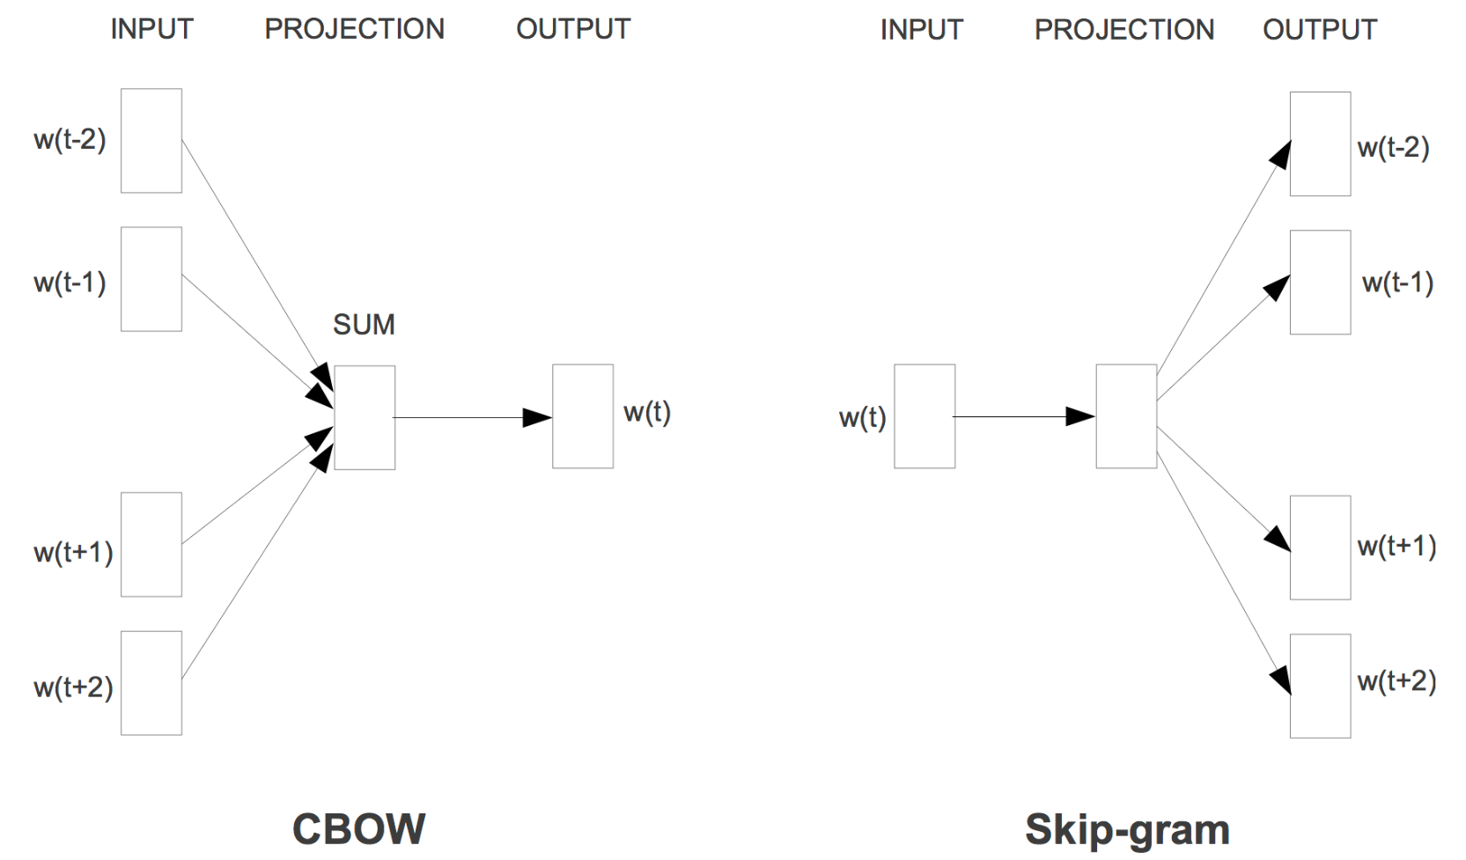
Word2Vec
Words that occur in similar contexts are semantically similar
Predict word from context
Mikolov, Tomas, et al. "Efficient estimation of word representations in vector space." arXiv preprint arXiv:1301.3781 (2013).

Slide 33
Word2Vec
Words that occur in similar contexts are semantically similar
Predict word from context
Predict context from word
Mikolov, Tomas, et al. "Efficient estimation of word representations in vector space." arXiv preprint arXiv:1301.3781 (2013).

Slide 34
Word2Vec Arithmetics
Japan – Sushi + Germany = ?

Slide 35
Word2Vec Arithmetics
Japan – Sushi + Germany = Bratwurst
bigger – big + small = ?

Slide 36
Word2Vec Arithmetics
Japan – Sushi + Germany = Bratwurst
bigger – big + small = smaller
Paris – France + Italy = ?

Slide 37
Word2Vec Arithmetics
Japan – Sushi + Germany = Bratwurst
bigger – big + small = smaller
Paris – France + Italy = Rome
similarity(tremendous, enormous) = 0.74
similarity(tremendous, negligible) = 0.37
most_similar(psyched) = geeked
excited
jazzed
bummed
https://quomodocumque.wordpress.com/2016/01/15/messing-around-with-word2vec/

Slide 38
Representing Phrases/Sentences
Average or concatenate word representations
Simple
Works well for short and simple phrases “the brown cat”
For complex sentences combine word representations guided by a parse tree
Recurrent Neural Language Models
Dependency Parse Tree
Iyyer, Mohit, et al. "A Neural Network for Factoid Question Answering over Paragraphs." EMNLP. 2014.

Slide 39
Hot topics in vision-language research
PART III

Slide 40
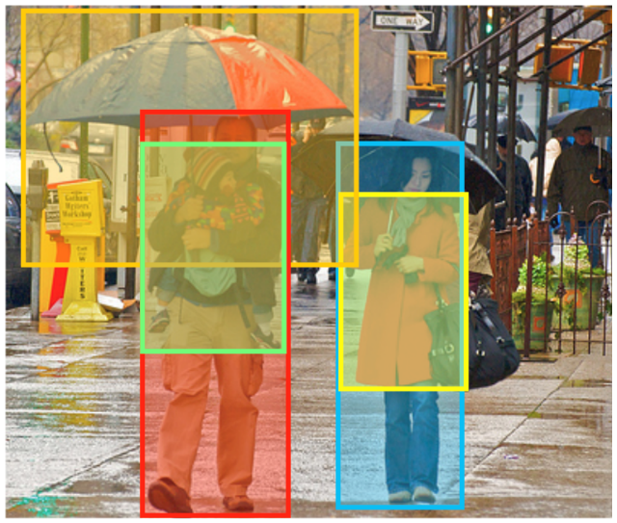
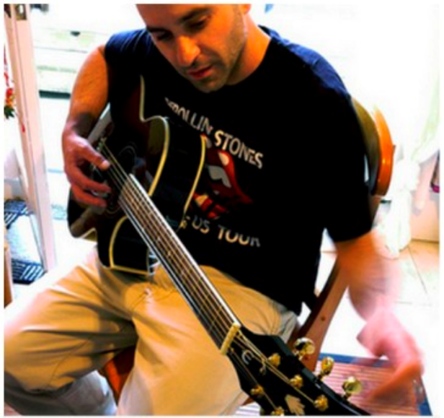
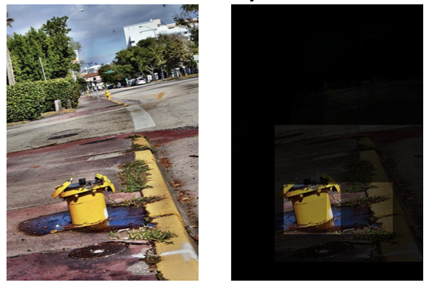
#TrendingInVisionLanguage
Phrase Localization
Image Captioning
Caption: Man in black shirt playing a guitar.
Visual Question Answering (VQA)
Question: What is the yellow object in the street?
Answer: Hydrant

Slide 41
#TrendingInVisionLanguage
Phrase Localization
Image Captioning
Caption: Man in black shirt playing a guitar.
Visual Question Answering (VQA)
Question: What is the yellow object in the street?
Answer: Hydrant

Slide 42
Phrase Localization
Plummer, Bryan A., et al. "Phrase Localization and Visual Relationship Detection with Comprehensive Linguistic Cues." arXiv preprint arXiv:1611.06641 (2016).

Slide 43
Appearance
Position & Shape
Adjective
Verb
Preposition
Region Proposal Boxes $\{b_{1},⋯, b_{n}\}$
Find the most likely assignment of boxes to $(B_{umbr}, B_{man}, B_{baby}, B_{woman}, B_{jacket})$
$$B_{umbr}$$
$$B_{jacket}$$
carries
$$B_{man}$$
next to
under
red
red & blue
$$B_{baby}$$
$$B_{woman}$$
in
Notes:
300 rp but 5 np

Slide 44
Phrase Loc. As Energy Minimization
Even 10 region proposals and 5 noun phrases lead to large search space $({10}^{5})$
Fast inference methods
Graph Cuts with $α$-expansion
Belief Propagation (max-product)
Integer Quadratic Program Solvers
Plummer, Bryan A., et al. "Phrase Localization and Visual Relationship Detection with Comprehensive Linguistic Cues." arXiv preprint arXiv:1611.06641 (2016).
Notes:
First inference

Slide 45
Learning factors for Phrase Loc.
Factors
Given the ground truth bounding boxes
Each factor is trained separately
A mix of CCA based (appearance), SVM based (position) and hand coded factors (size)
Weights
The relative weighting of the factors needs to be learned
Directly search for weights that maximize recall at IOU 0.5 (fminsearch in MATLAB)
Plummer, Bryan A., et al. "Phrase Localization and Visual Relationship Detection with Comprehensive Linguistic Cues." arXiv preprint arXiv:1611.06641 (2016).
Notes:
Now lest learn factors

Slide 46
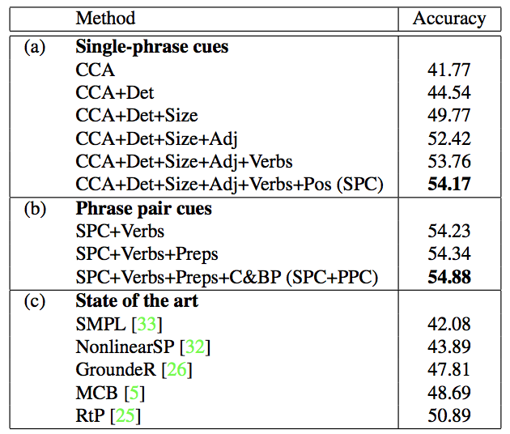
Effect of different cues on performance
Results on Flickr 30k Entities

Slide 47
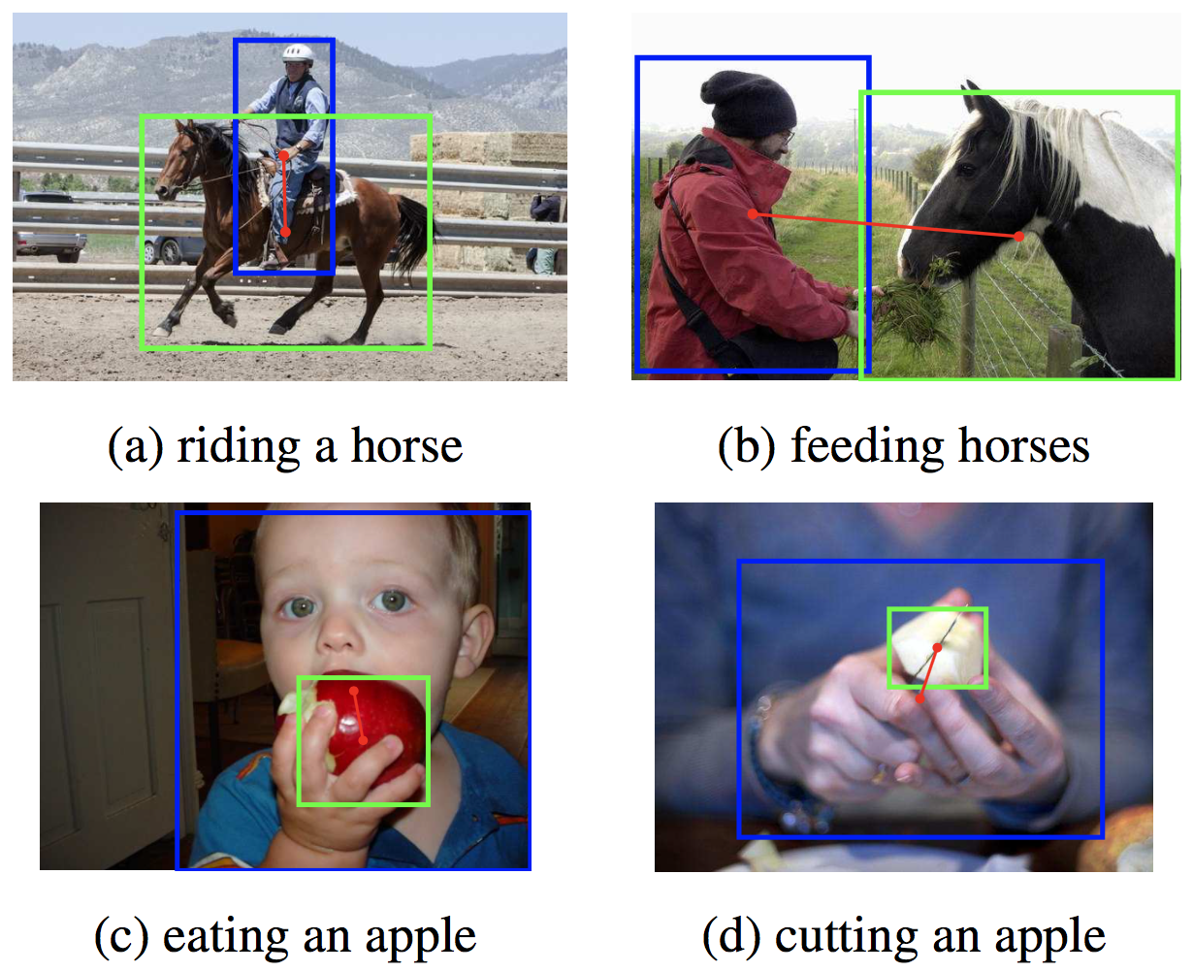
Similar problems
Human-Object Interaction
Chao, Yu-Wei, et al. "Learning to Detect Human-Object Interactions." arXiv preprint arXiv:1702.05448 (2017).

Slide 48
Similar problems
Visual relationship detection
Object-Object Interaction as well
Lu, Cewu, et al. "Visual relationship detection with language priors." European Conference on Computer Vision. Springer International Publishing, 2016.

Slide 49
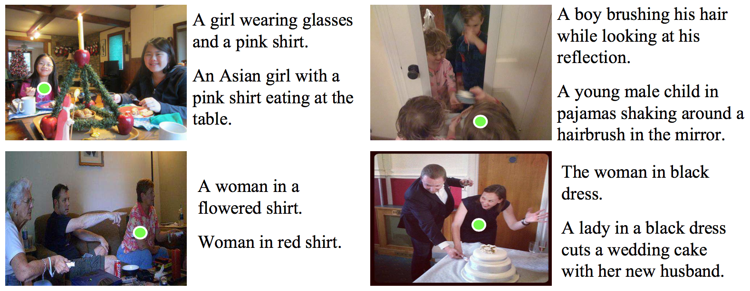
Similar problems
Referring Expression Comprehension
Multiple confusable objects
Mao, Junhua, et al. "Generation and comprehension of unambiguous object descriptions." Proceedings of the IEEE Conference on Computer Vision and Pattern Recognition. 2016.

Slide 50
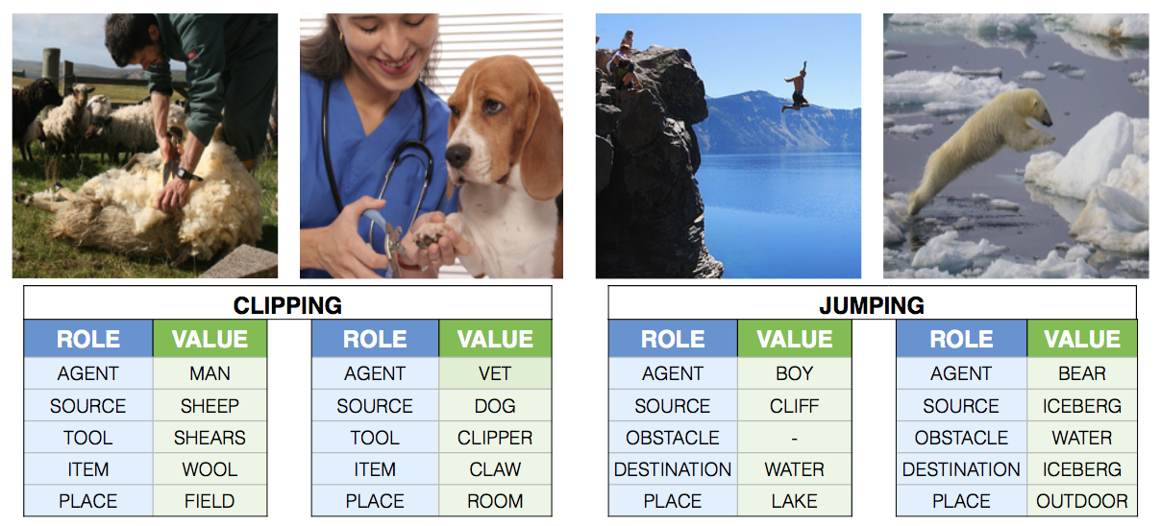
Similar problems
Visual Semantic Role Labelling / Situation Recognition
Appearance changes with actions (clipping vs jumping)
Different situation with same action can look different
Yatskar, Mark, Luke Zettlemoyer, and Ali Farhadi. "Situation recognition: Visual semantic role labeling for image understanding." Proceedings of the IEEE Conference on Computer Vision and Pattern Recognition. 2016

Slide 51
Open questions
How are these tasks related?
What is common among them?
What is different?
Is there a single computational model for them?
Good and extensible representations?
Connections to weakly supervised learning?

Slide 52
#TrendingInVisionLanguage
Phrase Localization
Image Captioning
Caption: Man in black shirt playing a guitar.
Visual Question Answering (VQA)
Question: What is the yellow object in the street?
Answer: Hydrant

Slide 53
Visual Question Answering
Question:
Are these people family?
Answer:
Yes
What do “people” look like?
What makes a group of people “family”?
Understand the question
Verify answer
Is the answer valid for the given question (language prior)
Does the answer apply to the image (visual verification)
Notes:
Understand question – the question is not if the family is enjoying themselves, or if the people are having dinner, or what are the people doing

Slide 54
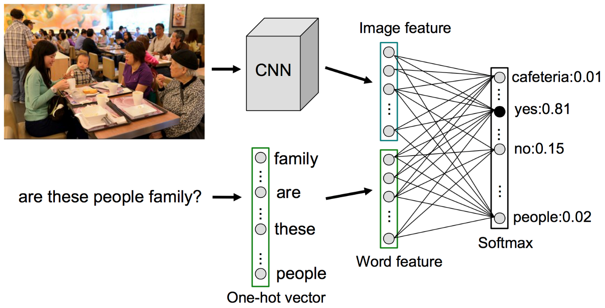
Simple Baseline for VQA
Construct a vocabulary of 5000 most frequent answers
Extract all the information from the image, $I$
Construct an image representation using a CNN
Represent the question, $Q$ with BoW
Compute distribution of answers, $P(A|Q,I)$
Zhou, Bolei, et al. "Simple baseline for visual question answering." arXiv preprint arXiv:1512.02167 (2015).

Slide 55
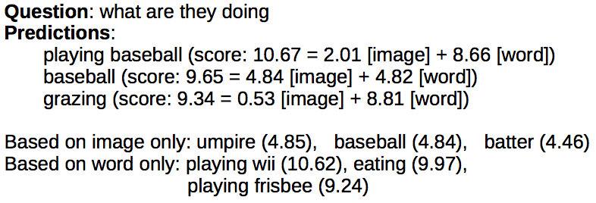
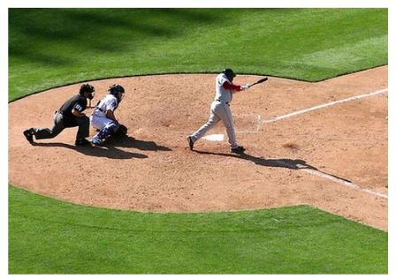
Qualitative Results

Slide 56
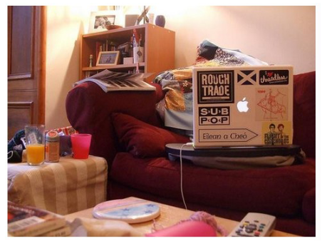
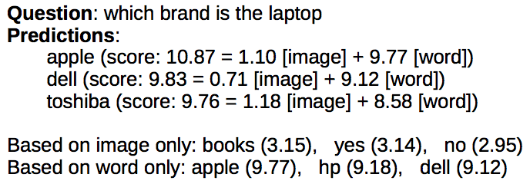
Qualitative Results
Language prior prunes the answer space significantly

Slide 57
Quantitative Evaluation
Evaluated on the VQA dataset

Slide 58
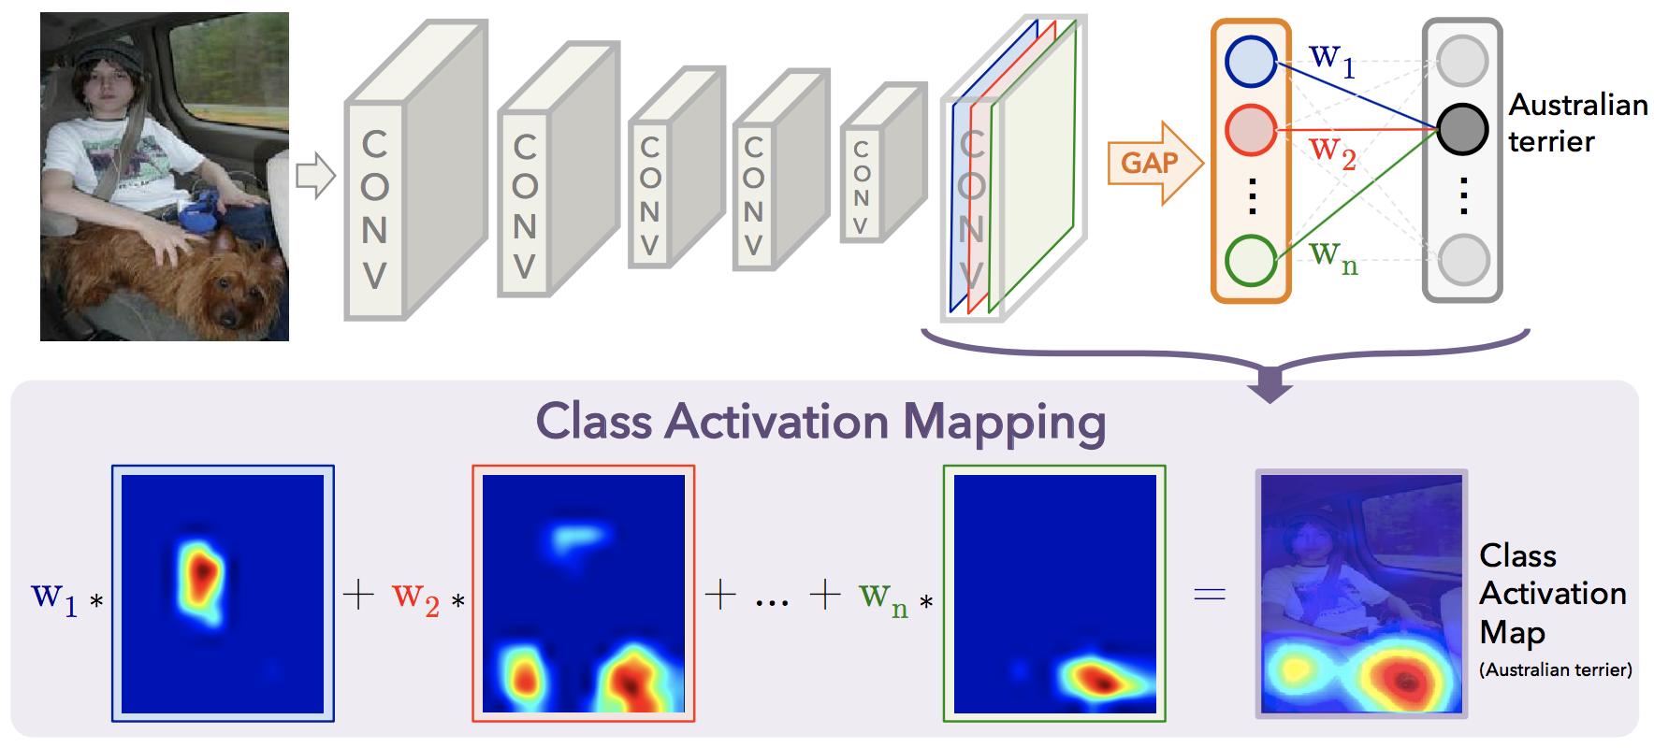
Does the model learn to localize?
Class Activation Mapping
Technique to generate localization heat maps from classification networks
Zhou, Bolei, et al. "Learning deep features for discriminative localization." Proceedings of the IEEE Conference on Computer Vision and Pattern Recognition. 2016.

Slide 59
Does the model learn to localize?
Class Activation Mapping applied to VQA Baseline

Slide 60
VQA models with explicit localization
Neural models with attention
Treat the relevance of each location (pixels/region proposals) as latent variables
Encodes our intuition
Need to look at the right region to answer the question
Need to look at the hat to answer "What color is the person’s hat?”
Possibly reduces model complexity
Bias-Variance Tradeoff
Improves interpretability

Slide 61
VQA Model that knows “Where To Look”
Shih, Kevin J., Saurabh Singh, and Derek Hoiem. "Where to look: Focus regions for visual question answering." Proceedings of the IEEE Conference on Computer Vision and Pattern Recognition. 2016.

Slide 62
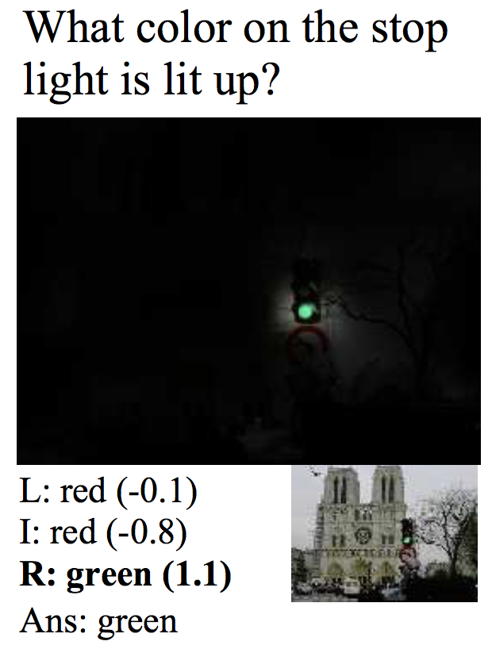
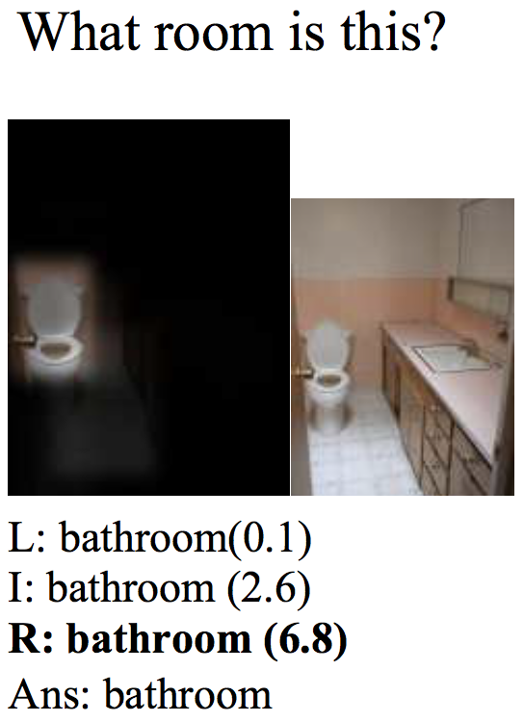
VQA Model that knows “Where To Look”
Shih, Kevin J., Saurabh Singh, and Derek Hoiem. "Where to look: Focus regions for visual question answering." Proceedings of the IEEE Conference on Computer Vision and Pattern Recognition. 2016.

Slide 63
A shift towards compositional models
Answering a question can be divided into subtasks
Design components/modules for each subtask
Given a question
Decide which modules to use and the arrangement of modules on the fly based on the question parse tree
Execute the constructed compositional model on the image

Slide 64
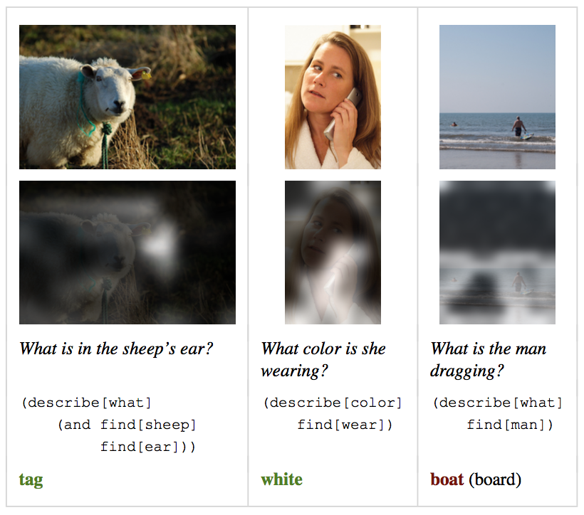
Neural Module Networks
Q: What color is the bird?
Andreas, Jacob, et al. "Learning to compose neural networks for question answering." arXiv preprint arXiv:1601.01705 (2016).

Slide 65
#TrendingInVisionLanguage
Phrase Localization
Image Captioning
Caption: Man in black shirt playing a guitar.
Visual Question Answering (VQA)
Question: What is the yellow object in the street?
Answer: Hydrant

Slide 66
Representing Phrases/Sentences
Using recurrent neural language models
Word-level Language Model
Given the sequence of words $w_{1},⋯, w_{n}$ that form a sentence, produces likelihood of the sentence
$$P\left(w_{1},⋯, w_{n}\right)=\prod_{i}{P(w_{i}|w_{1:i−1})}$$
$$w_{1}$$
$$w_{2}$$
$$w_{3}$$
$$w_{4}$$

Slide 67
Representing Phrases/Sentences
Using recurrent neural language models
Recurrent Models
$$P\left(w_{1},⋯, w_{n}\right)=\prod_{i}{P(w_{i}|w_{1:i−1})}$$
Recurrent Unit
RNN/LSTM/GRU
$$o_{t}=P(w_{t}|w_{1:t−1})$$
$$w_{t−1}$$
$$h_{t−1}$$
$$h_{t}$$
$h_{n}$ could serves as full sentence representation
-1
Delay
Notes:
dotted

Slide 68
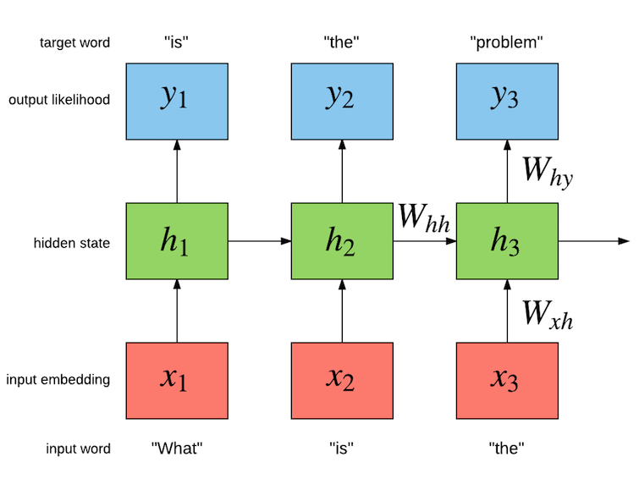
Representing Phrases/Sentences
Recurrent neural language model unfolded in time
Representation of phrase
“What is the”

Slide 69
Training Recurrent Language Models
Trained on domain specific text data
News articles, image captions, Linux code base …
Parameters learned through maximization of likelihood of ground truth text using Back-Propagation Through Time (BPTT)
Gating mechanism used to overcome vanishing/exploding gradients due to chain rule
Notes:
Recap slide

Slide 70
Image Captioning
Generate caption given image
Training involves learning
$$P\left(S | I;θ\right)=P(s_{1},⋯,s_{n}|I;θ)$$
Generation involves sampling from $P\left(S | I\right)$ or performing MAP inference
$$S^{∗}=\text{argmax} P(S|I)$$

Slide 71
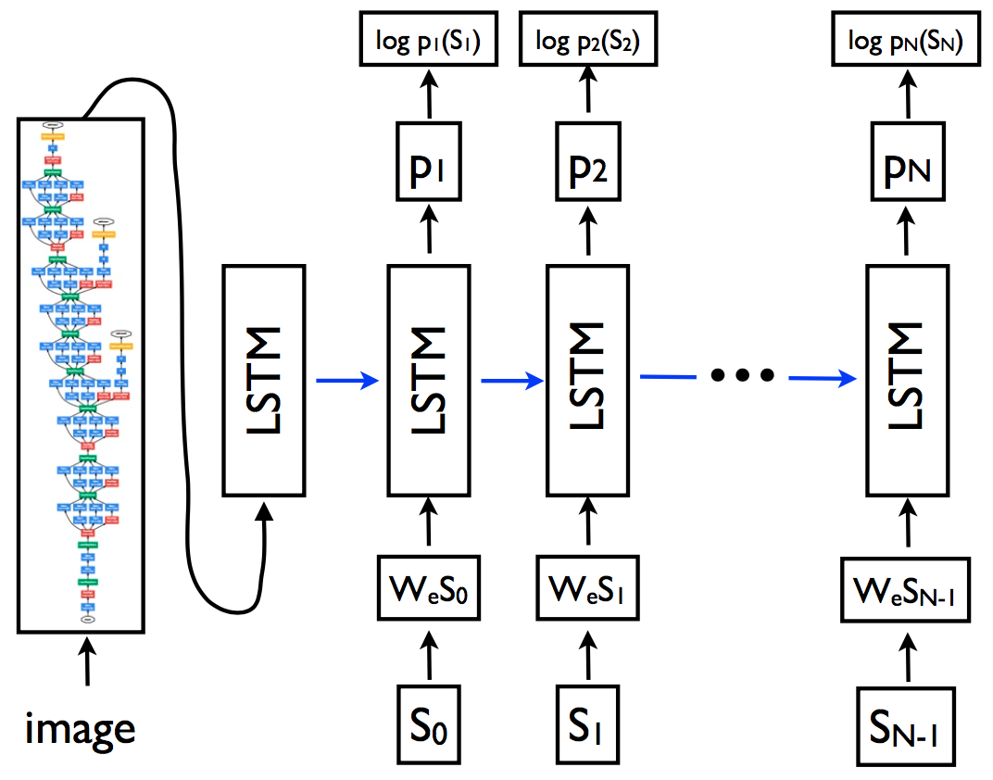
Image Captioning Model
$$P\left(S | I;θ\right)=P(s_{1},⋯,s_{n}|I;θ)$$
Recall we modelled $P(s_{1},⋯, s_{n})$ for language models

Slide 72
Image Captioning Model
$$P\left(S | I;θ\right)=P(s_{1},⋯,s_{n}|I;θ)$$
Recall we modelled $P(s_{1},⋯, s_{n})$ for language models
Vinyals, Oriol, et al. "Show and tell: A neural image caption generator." Proceedings of the IEEE Conference on Computer Vision and Pattern Recognition. 2015.

Slide 73
Image Caption Generation
How to sample from $P(S|I)$
$$s_{1}$$
$$s_{2}$$
$$s_{3}$$
$$s_{4}$$
$$s_{1}\sim P(s_{1}|s_{o},I)$$
$$s_{2}\sim P(s_{2}|s_{o:1},I)$$
$$s_{3}\sim P(s_{3}|s_{o:2},I)$$
$$s_{4}\sim P(s_{4}|s_{o:3},I)$$

Slide 74
Image Caption Generation
MAP inference on $P(S|I)$
Beam Search for approximate inference
$$s_{1}$$
$$s_{2}$$
$$s_{3}$$
$$s_{4}$$
$$5×s_{1}\sim P(s_{1}|s_{o},I)$$
$25×(s_{1},s_{2})\sim P(s_{2}|s_{o:1},I)$ (keep top 5)
$25×(s_{1},s_{2},s_{3})\sim P(s_{3}|s_{o:2},I)$ (keep top 5)
$25×(s_{1},s_{2},s_{3},s_{4})\sim P\left(s_{4} | s_{o:3},I\right)$ (keep top 1)

Slide 75
Qualitative Results

Slide 76
Evaluation
Bleu Score
Given a candidate (machine generated) caption
Compare to reference (human annotated) captions
Modified n-grams word precision
Prefers shorter captions
Eg. “the cat” has BLEU-2 = 2/2
Uni-gram Precision = 7/7
BLEU-1 = 2/7
BLEU-2 = 0/6

Slide 77
Key Takeaways
Advantages of embedding based recognition
Scalability
Structure in label space
Use external knowledge
Ways of representing words/phrases/sentences
Use context : Word2vec
Use language model : RNN/LSTM
Vision-Language Applications:
Using multiple cues improves localization
Attention mechanisms make models more interpretable
Image Captioning models combine classification networks with language models but tricky to evaluate

