Slide 1
Action Recognition
04/20/17
Computer Vision
CS 543 / ECE 549
University of Illinois
Derek Hoiem

Slide 2
Last classes
Parts-based/articulated object models
Tracking objects

Slide 3
Tracking people
Person model = appearance + structure (+ dynamics)
Structure and dynamics are general, appearance is person-specific
Trying to acquire an appearance model “on the fly” can lead to drift
Instead, can use the whole sequence to initialize the appearance model and then keep it fixed while tracking
Given strong structure and appearance models, tracking can essentially be done by repeated detection (with some smoothing)
D. Ramanan, D. Forsyth, and A. Zisserman. Tracking People by Learning their Appearance. PAMI 2007.

Slide 4
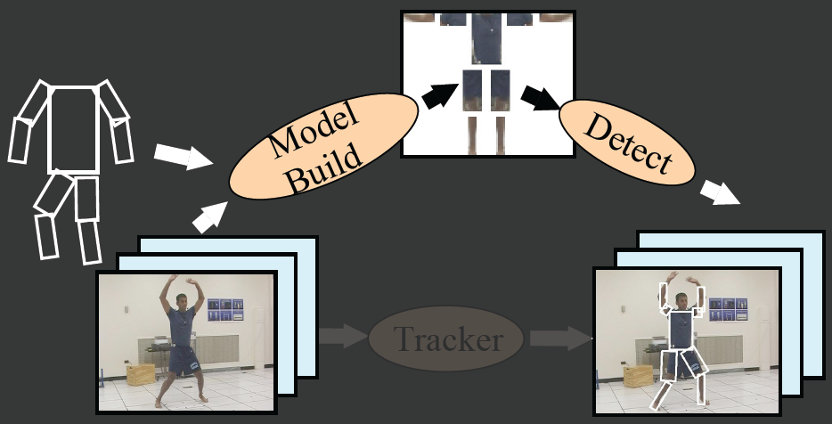
Tracking people by learning their appearance
Tracker
D. Ramanan, D. Forsyth, and A. Zisserman. Tracking People by Learning their Appearance. PAMI 2007.

Slide 5
Top-down method to build model:
Exploit “easy” poses
D. Ramanan, D. Forsyth, and A. Zisserman. Tracking People by Learning their Appearance. PAMI 2007.

Slide 6
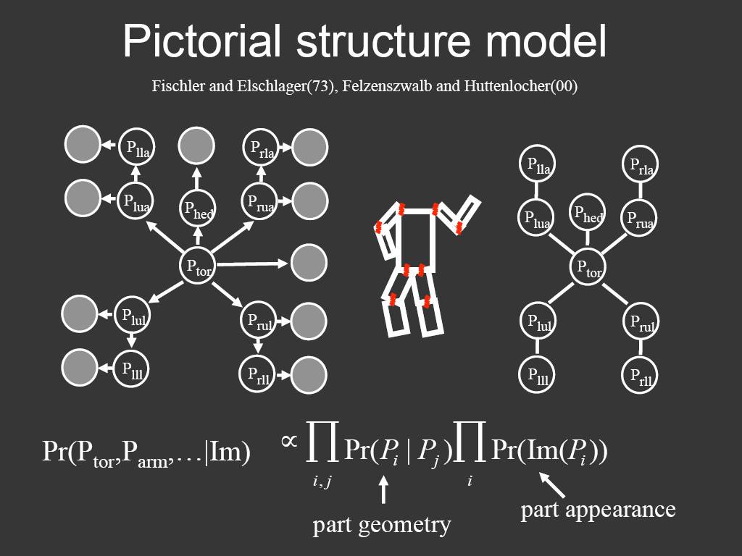
Representing people

Slide 7
Temporal model
Parts cannot move too far

Slide 8
Example results
http://www.ics.uci.edu/~dramanan/papers/pose/index.html

Slide 9
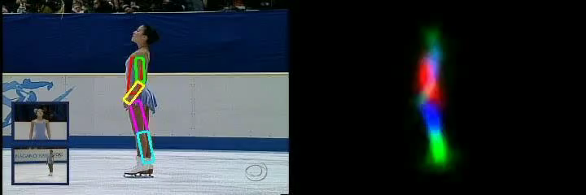
Video
http://www.ics.uci.edu/~dramanan/papers/pose/index.html

Slide 10
This section: advanced topics
Action recognition
3D Scenes and Context
Visual Question Answering (Tanmay)

Slide 11
Today: action recognition
Action recognition
  What is an “action”?
  How can we represent movement?
  How do we incorporate motion, pose, and nearby objects?

Slide 12

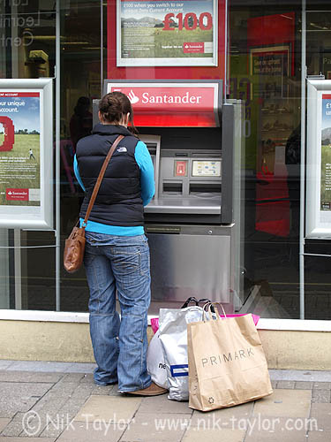
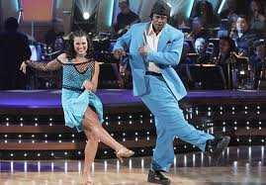
What is an action?
Action: a transition from one state to another
Who is the actor?
How is the state of the actor changing?
What (if anything) is being acted on?
How is that thing changing?
What is the purpose of the action (if any)?

Slide 13
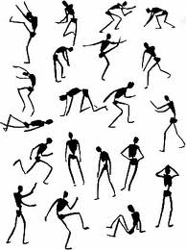
How do we represent actions?
Categories
  Walking, hammering, dancing, skiing, sitting down, standing up, jumping
Poses
Nouns and Predicates
<man, swings, hammer>
<man, hits, nail, w/ hammer>

Slide 14
What is the purpose of action recognition?
To describe
  https://www.youtube.com/watch?v=bcgXAQcvxdc
To predict
http://www.youtube.com/watch?v=LQm25nW6aZw

Slide 15
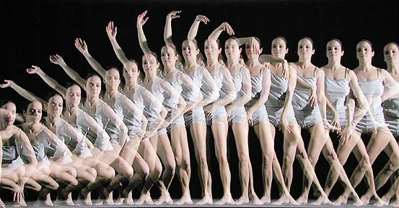
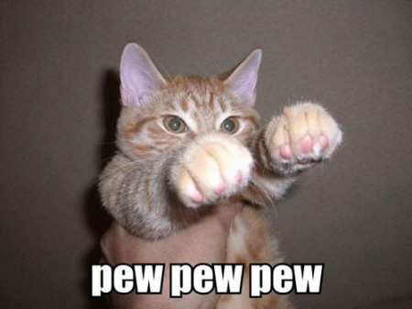

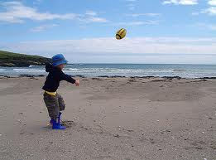
How can we identify actions?
Motion
Pose
Held Objects
Nearby Objects

Slide 16
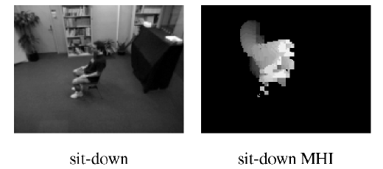
Representing Motion
Optical Flow with Motion History
Bobick Davis 2001
Notes:
Values reflect magnitude and recentness of movements

Slide 17
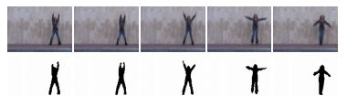
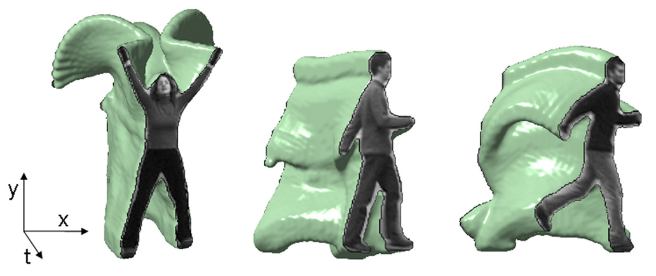
Representing Motion
Space-Time Volumes
Blank et al. 2005

Slide 18
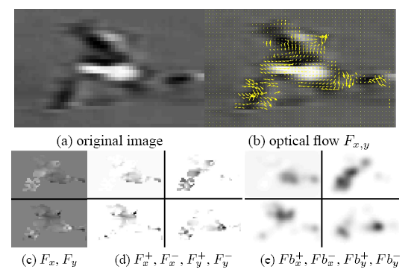
Representing Motion
Optical Flow with Split Channels
optical flow
split into pos/neg channels
blurred pos/neg flow
Efros et al. 2003

Slide 19
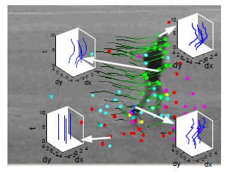
Representing Motion
Tracked Points
Matikainen et al. 2009
Notes:
Point tracks reflect long-term motions

Slide 20
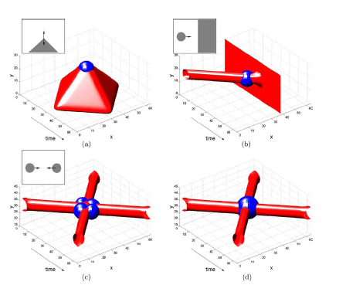
Representing Motion
Space-Time Interest Points
Moving corner
Ball hits wall
Corner detectors in space-time
Balls collide
Balls collide (different scale)
Laptev 2005
Notes:
Detect interest points in time and position

Slide 21
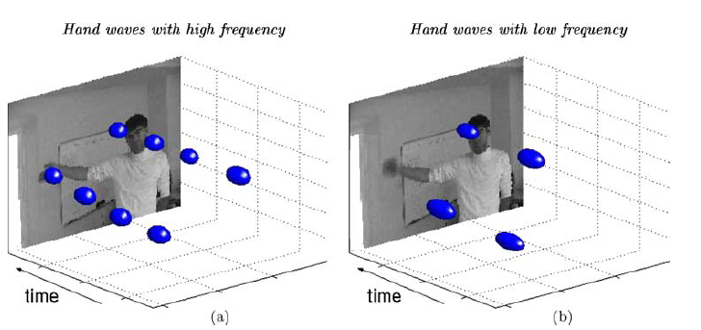
Representing Motion
Space-Time Interest Points
Laptev 2005
Notes:
Detect interest points in time and position

Slide 22
Examples of Action Recognition Systems
Feature-based classification
Recognition using pose and objects

Slide 23
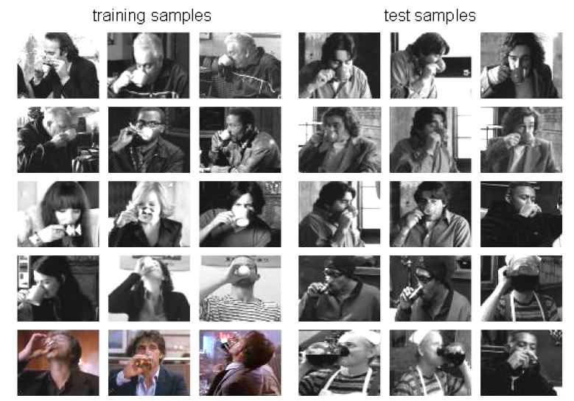
Action recognition as classification
Retrieving actions in movies, Laptev and Perez, 2007

Slide 24
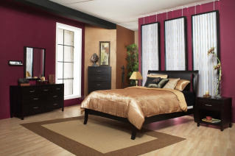




Remember image categorization…
Training
Training Labels
Training Images
Image Features
Classifier Training
Trained Classifier
Testing
Image Features
Trained Classifier
Prediction
Outdoor
Test Image

Slide 25
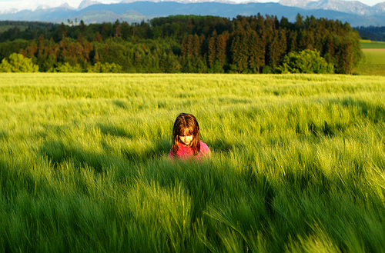
Remember spatial pyramids….
Compute histogram in each spatial bin

Slide 26
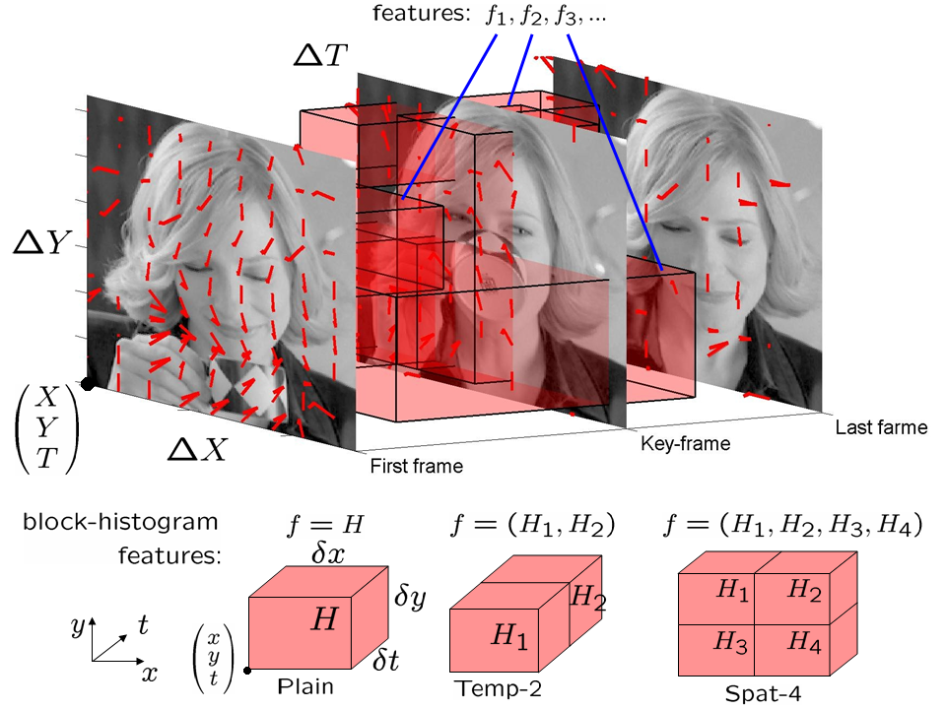
Features for Classifying Actions
Spatio-temporal pyramids
  Image Gradients
  Optical Flow

Slide 27
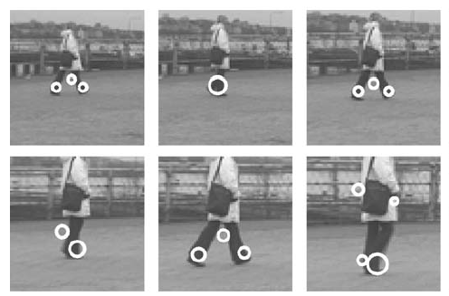
Features for Classifying Actions
Spatio-temporal interest points
Corner detectors in space-time
Descriptors based on Gaussian derivative filters over x, y, time

Slide 28
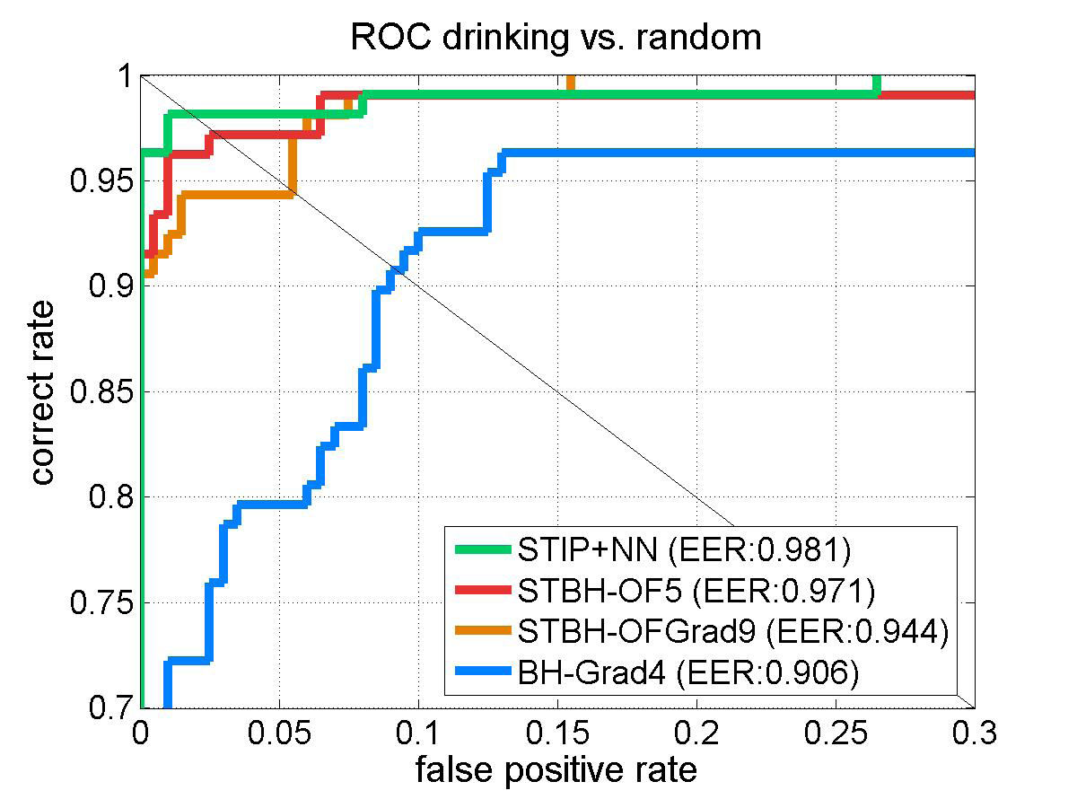
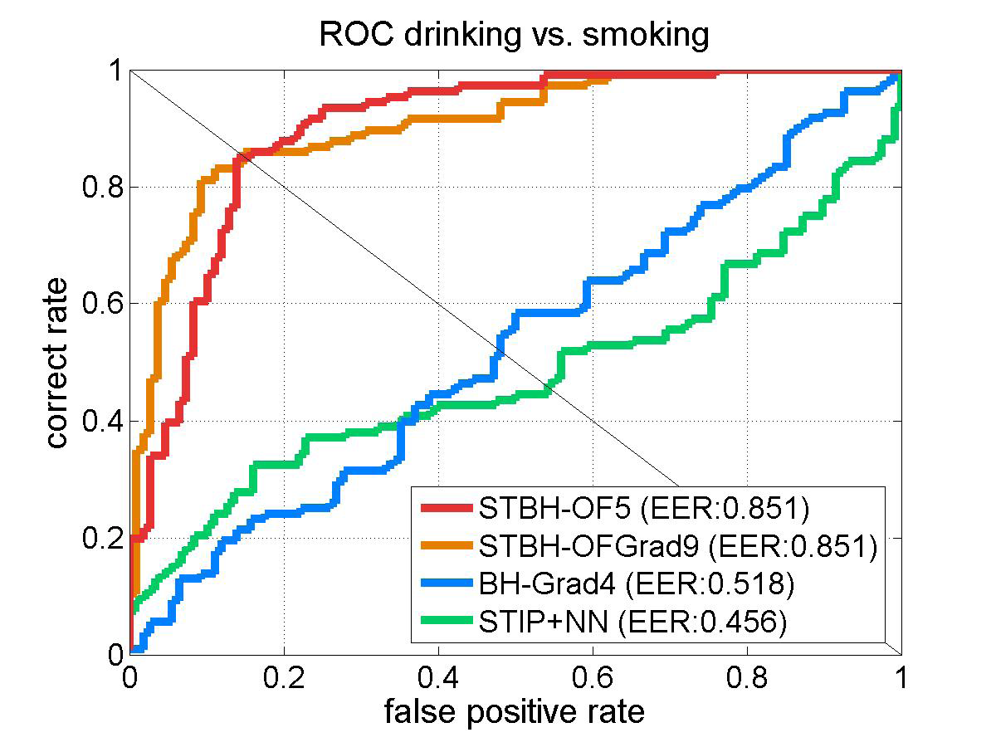
Classification
Boosted stubs for pyramids of optical flow, gradient
Nearest neighbor for STIP

Slide 29
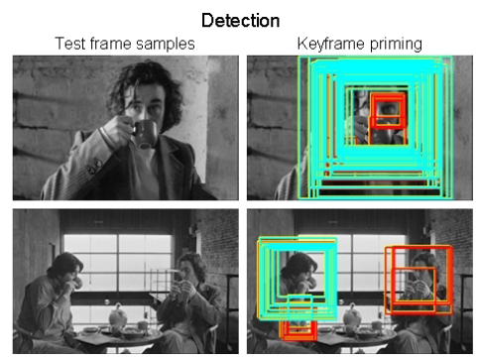
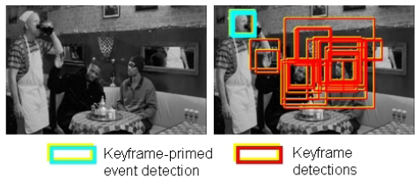
Searching the video for an action
Detect keyframes using a trained HOG detector in each frame
Classify detected keyframes as positive (e.g., “drinking”) or negative (“other”)

Slide 30
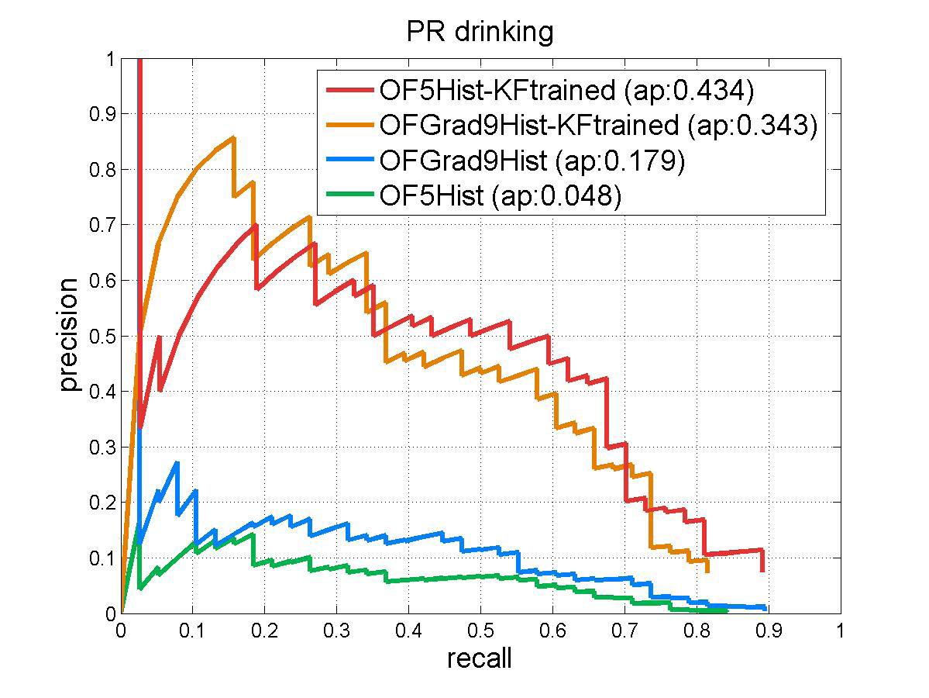
Accuracy in searching video
With keyframe detection
Without keyframe detection

Slide 31

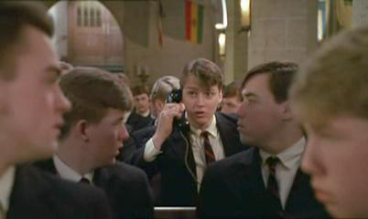
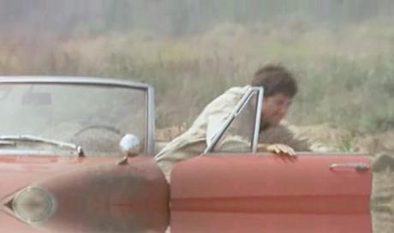
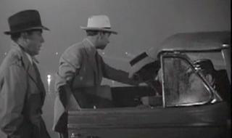
“Talk on phone”
“Get out of car”
Learning realistic human actions from movies, Laptev et al. 2008

Slide 32
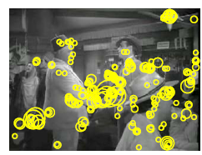
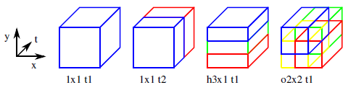
Approach
Space-time interest point detectors
Descriptors
  HOG, HOF
Pyramid histograms (3x3x2)
SVMs with Chi-Squared Kernel
Spatio-Temporal Binning
Interest Points

Slide 33
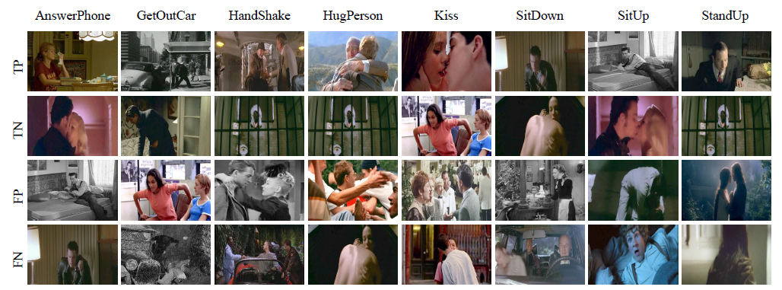
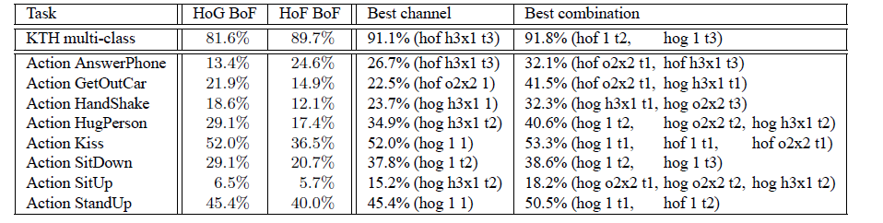
Results

Slide 34
Bring on the conv-nets
IDT: improved dense trajectories + HOG/motion descriptor
Note: No big win over hand-crafted features, perhaps due to more limited training data. Latest (Wang et al. ECCV 2016) does better (94%, 69%)

Slide 35
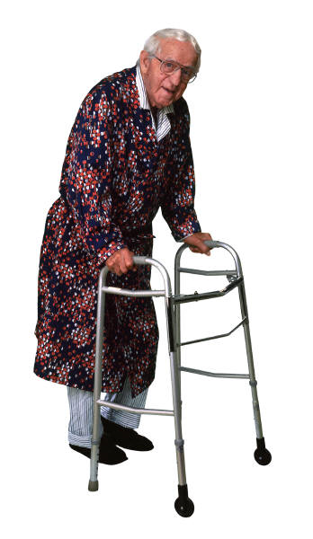
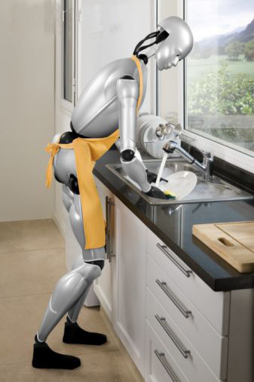
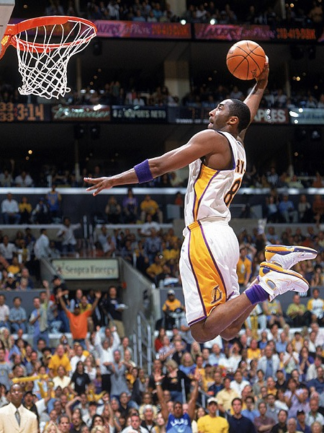
Action Recognition using Pose and Objects
Modeling Mutual Context of Object and Human Pose in Human-Object Interaction Activities, B. Yao and Li Fei-Fei, 2010
Slide Credit: Yao/Fei-Fei

Slide 36
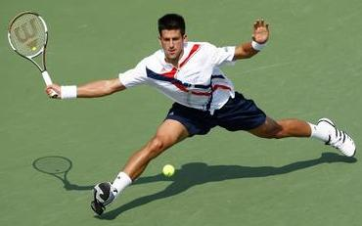
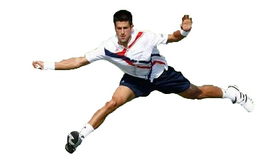
Human-Object Interaction
Holistic image based classification
Integrated reasoning
Human pose estimation
Head
Right-arm
Left-arm
Torso
Right-leg
Left-leg
Slide Credit: Yao/Fei-Fei

Slide 37

Human-Object Interaction
Holistic image based classification
Integrated reasoning
Human pose estimation
Object detection
Tennis racket
Slide Credit: Yao/Fei-Fei

Slide 38
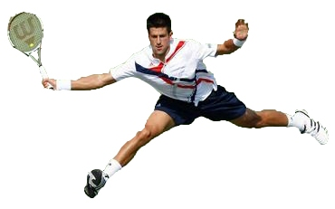
Human-Object Interaction
Holistic image based classification
Integrated reasoning
Human pose estimation
Object detection
Action categorization
Head
Right-arm
Left-arm
Tennis racket
Torso
Right-leg
Left-leg
Activity: Tennis Forehand
Slide Credit: Yao/Fei-Fei

Slide 39
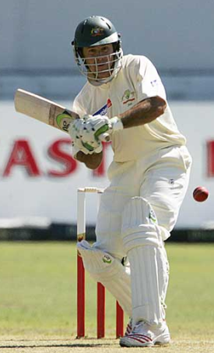
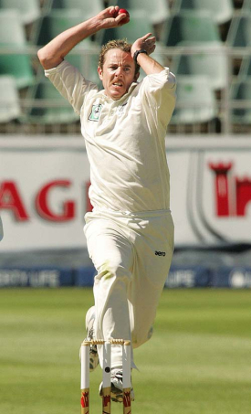
Human pose estimation & Object detection
Human pose estimation is challenging.
Difficult part appearance
Self-occlusion
Image region looks like a body part
Felzenszwalb & Huttenlocher, 2005
Ren et al, 2005
Ramanan, 2006
Ferrari et al, 2008
Yang & Mori, 2008
Andriluka et al, 2009
Eichner & Ferrari, 2009
Slide Credit: Yao/Fei-Fei

Slide 40
Human pose estimation & Object detection
Human pose estimation is challenging.
Felzenszwalb & Huttenlocher, 2005
Ren et al, 2005
Ramanan, 2006
Ferrari et al, 2008
Yang & Mori, 2008
Andriluka et al, 2009
Eichner & Ferrari, 2009
Slide Credit: Yao/Fei-Fei

Slide 41
Human pose estimation & Object detection
Facilitate
Given the object is detected.
Slide Credit: Yao/Fei-Fei

Slide 42
Human pose estimation & Object detection
Object detection is challenging
Small, low-resolution, partially occluded
Image region similar to detection target
Viola & Jones, 2001
Lampert et al, 2008
Divvala et al, 2009
Vedaldi et al, 2009
Slide Credit: Yao/Fei-Fei

Slide 43
Human pose estimation & Object detection
Object detection is challenging
Viola & Jones, 2001
Lampert et al, 2008
Divvala et al, 2009
Vedaldi et al, 2009
Slide Credit: Yao/Fei-Fei

Slide 44
Human pose estimation & Object detection
Facilitate
Given the pose is estimated.
Slide Credit: Yao/Fei-Fei

Slide 45

Human pose estimation & Object detection
Mutual Context
Slide Credit: Yao/Fei-Fei

Slide 46
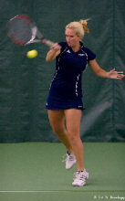
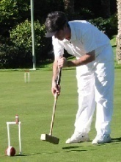
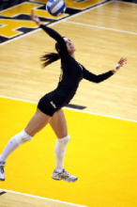
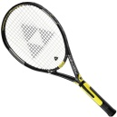
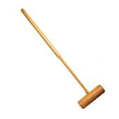
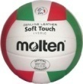

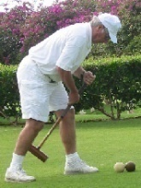
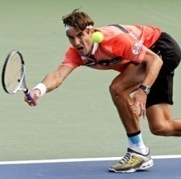
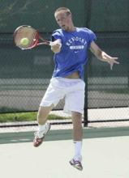


Mutual Context Model Representation
A:
Activity
A
Tennis forehand
Croquet shot
Volleyball smash
Human pose
H
O:
Object
O
Tennis racket
Croquet mallet
Volleyball
Body parts
P₁
P₂
P_{N}
H:
f_{O}
f₁
f₂
f_{N}
Intra-class variations
More than one H for each A;
Unobserved during training.
Image evidence
P:
l_{P}: location; θ_{P}: orientation; s_{P}: scale.
f:
Shape context.
[Belongie et al, 2002]
Slide Credit: Yao/Fei-Fei

Slide 47
Mutual Context Model Representation
Markov Random Field
, , : Frequency of co-occurrence between A, O, and H.
A
Clique weight
Clique potential
H
O
P₁
P₂
P_{N}
f_{O}
f₁
f₂
f_{N}
Slide Credit: Yao/Fei-Fei

Slide 48
Mutual Context Model Representation
Markov Random Field
, , : Frequency of co-occurrence between A, O, and H.
A
, , : Spatial relationship among object and body parts.
Clique weight
Clique potential
H
O
location
orientation
size
P₁
P₂
P_{N}
f_{O}
f₁
f₂
f_{N}
Slide Credit: Yao/Fei-Fei

Slide 49
Mutual Context Model Representation
Markov Random Field
, , : Frequency of co-occurrence between A, O, and H.
A
, , : Spatial relationship among object and body parts.
Clique weight
Clique potential
H
O
Obtained by structure learning
location
orientation
size
Learn structural connectivity among the body parts and the object.
P₁
P₂
P_{N}
f_{O}
f₁
f₂
f_{N}
Slide Credit: Yao/Fei-Fei

Slide 50
Mutual Context Model Representation
Markov Random Field
, , : Frequency of co-occurrence between A, O, and H.
A
, , : Spatial relationship among object and body parts.
Clique weight
Clique potential
H
O
location
orientation
size
Learn structural connectivity among the body parts and the object.
P₁
P₂
P_{N}
f_{O}
and : Discriminative part detection scores.
f₁
f₂
f_{N}
Shape context + AdaBoost
[Andriluka et al, 2009]
[Belongie et al, 2002]
[Viola & Jones, 2001]
Slide Credit: Yao/Fei-Fei

Slide 51






Model Learning
A
Input:
H
O
cricket shot
cricket bowling
P₁
P₂
P_{N}
f_{O}
f₁
f₂
f_{N}
Goals:
Hidden human poses
Slide Credit: Yao/Fei-Fei

Slide 52
Model Learning
A
Input:
H
O
cricket shot
cricket bowling
P₁
P₂
P_{N}
f_{O}
f₁
f₂
f_{N}
Goals:
Hidden human poses
Structural connectivity
Slide Credit: Yao/Fei-Fei

Slide 53
Model Learning
A
Input:
H
O
cricket shot
cricket bowling
P₁
P₂
P_{N}
f_{O}
f₁
f₂
f_{N}
Goals:
Hidden human poses
Structural connectivity
Potential parameters
Potential weights
Slide Credit: Yao/Fei-Fei

Slide 54
Model Learning
A
Input:
H
O
cricket shot
cricket bowling
P₁
P₂
P_{N}
f_{O}
f₁
f₂
f_{N}
Goals:
Hidden human poses
Hidden variables
Structural connectivity
Structure learning
Potential parameters
Parameter estimation
Potential weights
Slide Credit: Yao/Fei-Fei
Notes:
Structure learning for each pose subclass

Slide 55



Model Learning
A
Approach:
H
croquet shot
O
P₁
P₂
P_{N}
f_{O}
f₁
f₂
f_{N}
Goals:
Hidden human poses
Structural connectivity
Potential parameters
Potential weights
Slide Credit: Yao/Fei-Fei
Notes:
Iteratively identify the pose that results in the most activity classification errors. Then, split the images assigned to that pose into two clusters

Slide 56
Model Learning
A
Approach:
H
Hill-climbing
O
Joint density of the model
Gaussian priori of the edge number
P₁
P₂
P_{N}
f_{O}
f₁
f₂
f_{N}
Add an edge
Remove an edge
Goals:
Hidden human poses
Structural connectivity
Potential parameters
Add an edge
Remove an edge
Potential weights
Slide Credit: Yao/Fei-Fei

Slide 57
Model Learning
A
Approach:
H
Maximum likelihood
O
P₁
P₂
P_{N}
f_{O}
Standard AdaBoost
f₁
f₂
f_{N}
Goals:
Hidden human poses
Structural connectivity
Potential parameters
Potential weights
Slide Credit: Yao/Fei-Fei

Slide 58
Model Learning
A
Approach:
H
Max-margin learning
O
P₁
P₂
P_{N}
f_{O}
f₁
f₂
f_{N}
Goals:
Hidden human poses
Notations
Structural connectivity
x_{i}: Potential values of the i-th image.
w_{r}: Potential weights of the r-th pose.
y(r): Activity of the r-th pose.
ξ_{i}: A slack variable for the i-th image.
Potential parameters
Potential weights
Slide Credit: Yao/Fei-Fei

Slide 59


















Learning Results
Cricket defensive shot
Cricket bowling
Croquet shot
Slide Credit: Yao/Fei-Fei

Slide 60


















Learning Results
Tennis forehand
Tennis serve
Volleyball smash
Slide Credit: Yao/Fei-Fei

Slide 61




Model Inference
The learned models
Slide Credit: Yao/Fei-Fei

Slide 62



Model Inference
The learned models
Head detection
Torso detection
Compositional Inference
[Chen et al, 2007]
Tennis racket detection
Layout of the object and body parts.
Slide Credit: Yao/Fei-Fei

Slide 63
Model Inference
The learned models
Output
Slide Credit: Yao/Fei-Fei

Slide 64






Dataset and Experiment Setup
Sport data set: 6 classes
180 training (supervised with object and part locations) & 120 testing images
Tasks:
Object detection;
Pose estimation;
Activity classification.
Cricket defensive shot
Cricket bowling
Croquet shot
Tennis forehand
Tennis serve
Volleyball smash
[Gupta et al, 2009]
Slide Credit: Yao/Fei-Fei

Slide 65
Dataset and Experiment Setup
Sport data set: 6 classes
180 training (supervised with object and part locations) & 120 testing images
Tasks:
Object detection;
Pose estimation;
Activity classification.
Cricket defensive shot
Cricket bowling
Croquet shot
Tennis forehand
Tennis serve
Volleyball smash
[Gupta et al, 2009]
Slide Credit: Yao/Fei-Fei

Slide 66









Object Detection Results
Cricket bat
Cricket ball
Valid region
Sliding window
Pedestrian context
Our Method
[Andriluka et al, 2009]
[Dalal & Triggs, 2006]
Croquet mallet
Tennis racket
Volleyball
Slide Credit: Yao/Fei-Fei

Slide 67






Object Detection Results
Sliding window
Pedestrian context
Our method
Cricket ball
Small object
Volleyball
Background clutter
Slide Credit: Yao/Fei-Fei

Slide 68
Dataset and Experiment Setup
Sport data set: 6 classes
180 training & 120 testing images
Tasks:
Object detection;
Pose estimation;
Activity classification.
Cricket defensive shot
Cricket bowling
Croquet shot
Tennis forehand
Tennis serve
Volleyball smash
[Gupta et al, 2009]
Slide Credit: Yao/Fei-Fei

Slide 69
Human Pose Estimation Results
Method | Torso | Upper Leg |  | Lower Leg |  | Upper Arm |  | Lower Arm |  | Head
Ramanan, 2006 | .52 | .22 | .22 | .21 | .28 | .24 | .28 | .17 | .14 | .42
Andriluka et al, 2009 | .50 | .31 | .30 | .31 | .27 | .18 | .19 | .11 | .11 | .45
Our full model | .66 | .43 | .39 | .44 | .34 | .44 | .40 | .27 | .29 | .58
Slide Credit: Yao/Fei-Fei

Slide 70




Human Pose Estimation Results
Method | Torso | Upper Leg |  | Lower Leg |  | Upper Arm |  | Lower Arm |  | Head
Ramanan, 2006 | .52 | .22 | .22 | .21 | .28 | .24 | .28 | .17 | .14 | .42
Andriluka et al, 2009 | .50 | .31 | .30 | .31 | .27 | .18 | .19 | .11 | .11 | .45
Our full model | .66 | .43 | .39 | .44 | .34 | .44 | .40 | .27 | .29 | .58
Tennis serve model
Our estimation result
Andriluka et al, 2009
Volleyball smash model
Our estimation result
Andriluka et al, 2009
Slide Credit: Yao/Fei-Fei

Slide 71






Human Pose Estimation Results
Method | Torso | Upper Leg |  | Lower Leg |  | Upper Arm |  | Lower Arm |  | Head
Ramanan, 2006 | .52 | .22 | .22 | .21 | .28 | .24 | .28 | .17 | .14 | .42
Andriluka et al, 2009 | .50 | .31 | .30 | .31 | .27 | .18 | .19 | .11 | .11 | .45
Our full model | .66 | .43 | .39 | .44 | .34 | .44 | .40 | .27 | .29 | .58
One pose per class | .63 | .40 | .36 | .41 | .31 | .38 | .35 | .21 | .23 | .52
Estimation result
Estimation result
Estimation result
Estimation result
Slide Credit: Yao/Fei-Fei

Slide 72
Dataset and Experiment Setup
Sport data set: 6 classes
180 training & 120 testing images
Tasks:
Object detection;
Pose estimation;
Activity classification.
Cricket defensive shot
Cricket bowling
Croquet shot
Tennis forehand
Tennis serve
Volleyball smash
[Gupta et al, 2009]
Slide Credit: Yao/Fei-Fei

Slide 73










Activity Classification Results
Cricket shot
Tennis forehand
Our model
Gupta et al, 2009
Bag-of-words
SIFT+SVM
Slide Credit: Yao/Fei-Fei

Slide 74

More results
Joint
Independent
Joint
Independent

Slide 75
Take-home messages
Action recognition is an open problem.
  How to define actions?
  How to infer them?
  What are good visual cues?
  How do we incorporate higher level reasoning?

Slide 76
Take-home messages
Some work done, but it is just the beginning of exploring the problem. So far…
  Actions are mainly categorical (could be framed in terms of effect or intent)
  Just a couple works on how to incorporate pose and objects (though recently more datasets getting into this)
  Not much idea of how to reason about long-term activities or to describe video sequences

Slide 77

Next class: 3D Scenes and Context

