Slide 1
Tracking Objects with Dynamics
04/18/17
Computer Vision
CS 543 / ECE 549
University of Illinois
Derek Hoiem
some slides from Amin Sadeghi, Lana Lazebnik, Kristen Grauman, Deva Ramanan

Slide 2
Today: Tracking Objects
Goal: Locating a moving object/part across video frames
This Class:
Examples and Applications
Overview of probabilistic tracking
Kalman Filter
Particle Filter

Slide 3
Tracking Examples
Traffic: https://www.youtube.com/watch?v=DiZHQ4peqjg
Soccer: http://www.youtube.com/watch?v=ZqQIItFAnxg
Face: http://www.youtube.com/watch?v=i_bZNVmhJ2o
Body: https://www.youtube.com/watch?v=_Ahy0Gh69-M
Eye: http://www.youtube.com/watch?v=NCtYdUEMotg

Slide 4
Further applications
Motion capture
Augmented Reality
Action Recognition
Security, traffic monitoring
Video Compression
Video Summarization
Medical Screening

Slide 5
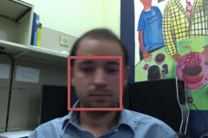
Things that make visual tracking difficult
Small, few visual features
Erratic movements, moving very quickly
Occlusions, leaving and coming back
Surrounding similar-looking objects

Slide 6
Strategies for tracking
Tracking by repeated detection
  Works well if object is easily detectable (e.g., face or colored glove) and there is only one
  Need some way to link up detections
  Best you can do, if you can’t predict motion

Slide 7
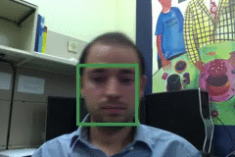
Tracking with dynamics
Key idea: Based on a model of expected motion, predict where objects will occur in next frame, before even seeing the image
  Restrict search for the object
  Measurement noise is reduced by trajectory smoothness
  Robustness to missing or weak observations

Slide 8
Strategies for tracking
Tracking with motion prediction
  Predict the object’s state in the next frame
  Kalman filtering: next state can be linearly predicted from current state (Gaussian)
  Particle filtering: sample multiple possible states of the object (non-parametric, good for clutter)

Slide 9
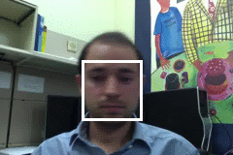
General model for tracking
state X: The actual state of the moving object that we want to estimate
  State could be any combination of position, pose, viewpoint, velocity, acceleration, etc.
observations Y: Our actual measurement or observation of state X. Observation can be very noisy
At each time t, the state changes to X_{t} and we get a new observation Y_{t}

Slide 10
Steps of tracking
Prediction: What is the next state of the object given past measurements?

Slide 11
Steps of tracking
Prediction: What is the next state of the object given past measurements?
Correction: Compute an updated estimate of the state from prediction and measurements

Slide 12
Simplifying assumptions
Only the immediate past matters
dynamics model

Slide 13
Simplifying assumptions
Only the immediate past matters
Measurements depend only on the current state
dynamics model
observation model

Slide 14
Simplifying assumptions
Only the immediate past matters
Measurements depend only on the current state
dynamics model
observation model
…
X₀
X₁
X₂
X_{t-1}
X_{t}
Y₀
Y₁
Y₂
Y_{t-1}
Y_{t}

Slide 15
Problem statement
We have models for
  Likelihood of next state given current state:
  Likelihood of observation given the state:
We want to recover, for each t:

Slide 16
Probabilistic tracking
Base case:
  Start with initial prior that predicts state in absence of any evidence: P(X₀)
  For the first frame, correct this given the first measurement: Y₀=y₀

Slide 17
Probabilistic tracking
Base case:
  Start with initial prior that predicts state in absence of any evidence: P(X₀)
  For the first frame, correct this given the first measurement: Y₀=y₀

Slide 18
Probabilistic tracking
Base case:
  Start with initial prior that predicts state in absence of any evidence: P(X₀)
  For the first frame, correct this given the first measurement: Y₀=y₀
Given corrected estimate for frame t-1:
  Predict for frame t ➔
  Observe y_{t}; Correct for frame t ➔
predict
correct

Slide 19
Prediction
Prediction involves representing
given
Law of total probability

Slide 20
Prediction
Prediction involves representing
given
Conditioning on X_{t–1}

Slide 21
Prediction
Prediction involves representing
given
Independence assumption

Slide 22
Prediction
Prediction involves representing
given
dynamics
model
corrected estimate
from previous step

Slide 23
Correction
Correction involves computing
given predicted value

Slide 24
Correction
Correction involves computing
given predicted value
Bayes’ Rule

Slide 25
Correction
Correction involves computing
given predicted value
Independence assumption
(observation y_{t} directly depends only on state X_{t})

Slide 26
Correction
Correction involves computing
given predicted value
Conditioning on X_{t}

Slide 27
Correction
Correction involves computing
given predicted value
observation
model
predicted
estimate
normalization factor

Slide 28
Summary: Prediction and correction
Prediction:
Correction:
dynamics
model
corrected estimate
from previous step
observation
model
predicted
estimate

Slide 29
The Kalman filter
Linear dynamics model: state undergoes linear transformation plus Gaussian noise
Observation model: measurement is linearly transformed state plus Gaussian noise
The predicted/corrected state distributions are Gaussian
  You only need to maintain the mean and covariance
  The calculations are easy (all the integrals can be done in closed form)

Slide 30
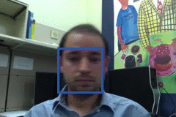
Example: Kalman Filter
Ground Truth
Observation
Correction
Next Frame
Update Location, Velocity, etc.
Prediction

Slide 31
Comparison
Ground Truth
Observation
Correction

Slide 32
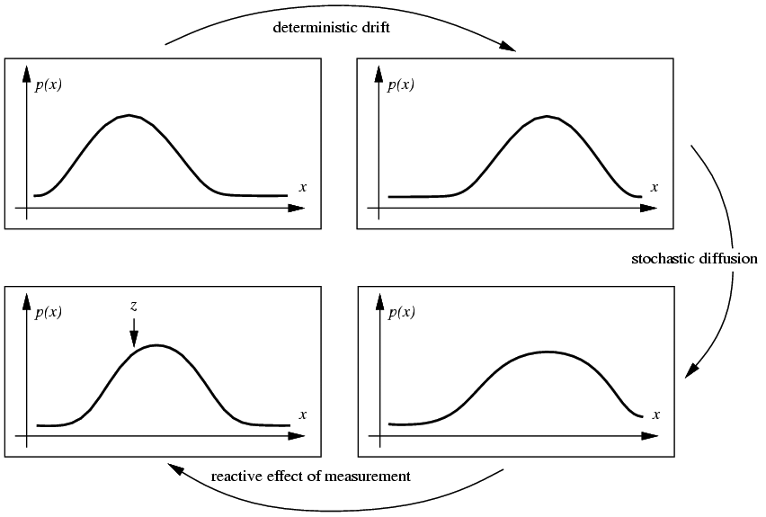
Propagation of Gaussian densities
Current state
Expected change
Decent model if there is just one object, but localization is imprecise
Uncertainty
Observation and Correction

Slide 33
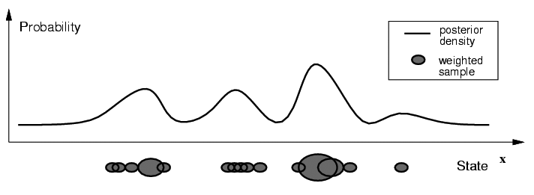
Particle filtering
Represent the state distribution non-parametrically
Prediction: Sample possible values X_{t-1} for the previous state
Correction: Compute likelihood of X_{t} based on weighted samples and P(y_{t}|X_{t})
M. Isard and A. Blake, CONDENSATION -- conditional density propagation for visual tracking, IJCV 29(1):5-28, 1998

Slide 34
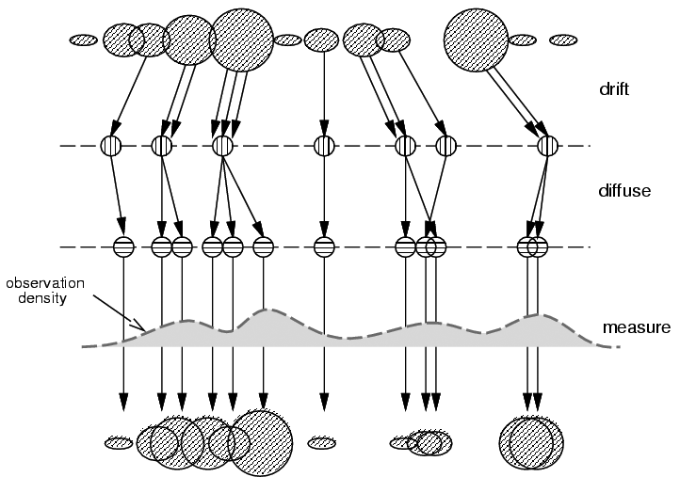
Particle filtering
Start with weighted samples from previous time step
Sample and shift according to dynamics model
Spread due to randomness; this is predicted density P(X_{t}|Y_{t-1})
Weight the samples
according to observation density
Arrive at corrected density estimate P(X_{t}|Y_{t})
M. Isard and A. Blake, CONDENSATION -- conditional density propagation for visual tracking, IJCV 29(1):5-28, 1998

Slide 35
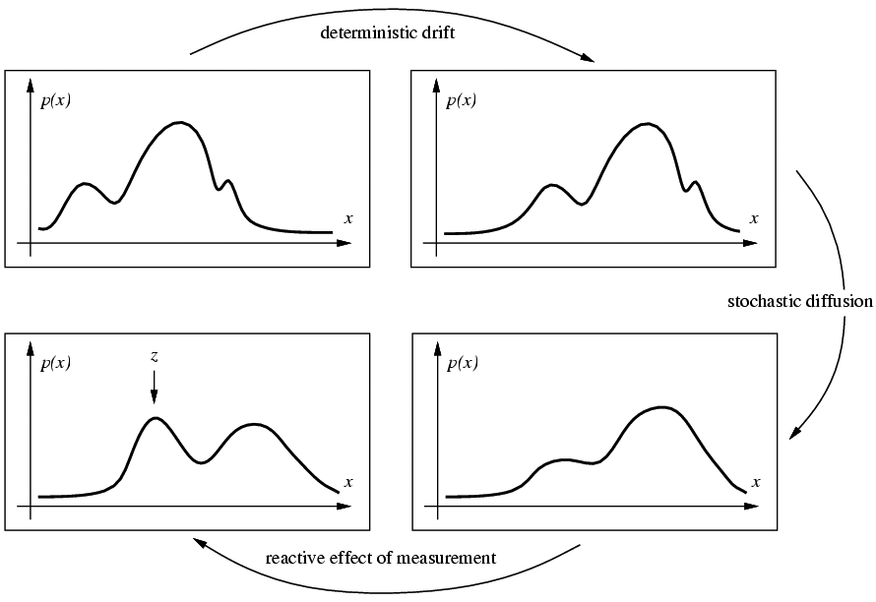
Propagation of non-parametric densities
Current state
Expected change
Good if there are multiple, confusable objects (or clutter) in the scene
Uncertainty
Observation and Correction

Slide 36

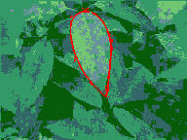
Particle filtering results
People: http://www.youtube.com/watch?v=wCMk-pHzScE
Hand: http://www.youtube.com/watch?v=tIjufInUqZM
Localization (similar model): https://www.youtube.com/watch?v=rAuTgsiM2-8
http://www.cvlibs.net/publications/Brubaker2013CVPR.pdf
Good informal explanation: https://www.youtube.com/watch?v=aUkBa1zMKv4

Slide 37
MD-Net
(tracking by detection)
Learning Multi-Domain Convolutional Neural Networks for Visual Tracking – Nam and Han CVPR 2016
Offline, train to differentiate between target object and background for K targets
Online, fine-tune for target in new sequence
https://www.youtube.com/watch?v=zYM7G5qd090

Slide 38
Tracking issues
Initialization
  Manual
  Background subtraction
  Detection

Slide 39
Tracking issues
Initialization
Getting observation and dynamics models
  Observation model: match a template or use a trained detector
  Dynamics model: usually specify using domain knowledge

Slide 40
Tracking issues
Initialization
Obtaining observation and dynamics model
Uncertainty of prediction vs. correction
  If the dynamics model is too strong, will end up ignoring the data
  If the observation model is too strong, tracking is reduced to repeated detection
Too strong dynamics model
Too strong observation model

Slide 41
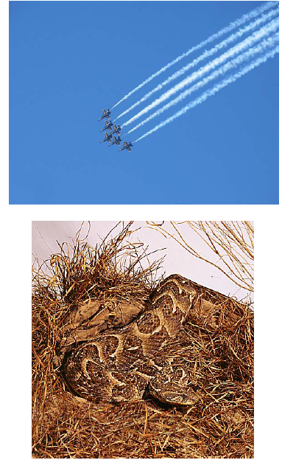
Tracking issues
Initialization
Getting observation and dynamics models
Prediction vs. correction
Data association
  When tracking multiple objects, need to assign right objects to right tracks (particle filters good for this)

Slide 42
Tracking issues
Initialization
Getting observation and dynamics models
Prediction vs. correction
Data association
Drift
  Errors can accumulate over time

Slide 43
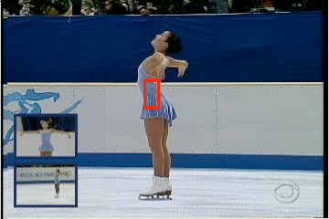
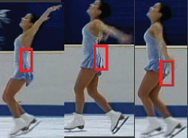
Drift
D. Ramanan, D. Forsyth, and A. Zisserman. Tracking People by Learning their Appearance. PAMI 2007.

Slide 44
Things to remember
Tracking objects = detection + prediction
Probabilistic framework
  Predict next state
  Update current state based on observation
Two simple but effective methods
  Kalman filters: Gaussian distribution
  Particle filters: multimodal distribution

Slide 45
Next class: action recognition
Action recognition
  What is an “action”?
  How can we represent movement?
  How do we incorporate motion, pose, and nearby objects?

