Slide 1
Convolutional Neural Networks
05/05/15
Computer Vision
CS 543 / ECE 549
University of Illinois
Jia-Bin Huang

Slide 2
Reminder: final project
Posters on Friday, May 8 at 7pm in SC 2405
  two rounds, 1.25 hr each
Papers due May 11 by email
Cannot accept late papers/posters due to grading deadlines
Send Derek an email if you can’t present your poster
Notes:
This is friendly reminder that we will have the poster session this Friday night in Siebel Center 2405.

Slide 3
Today’s class
Overview
Convolutional Neural Network (CNN)
Understanding and Visualizing CNN
Training CNN
Probabilistic Interpretation
Notes:
Today I am going to talk about convolutional neural network for computer vision. I will start with an overview. Talk about what is a CNN. Various ways to visualize and understand CNN. Then, introduce various tricks to train a CNN. In the end, I will talk about a probabilistic interpretation of CNN.

Slide 4

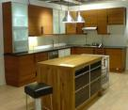
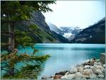

Image Categorization: Training phase
Training Images
Training
Training Labels
Image Features
Classifier Training
Trained Classifier
Notes:
Recall this image classification diagram in the previous lecture. Here we want to classify an image. We collect a dataset of examples with labels, extract some image features, train a classifier so that the prediction errors on the training images are minimized.

Slide 5

Image Categorization: Testing phase
Training Images
Training
Training Labels
Image Features
Classifier Training
Trained Classifier
Testing
Image Features
Trained Classifier
Prediction
Outdoor
Test Image
Notes:
At testing time, when given a new test image, we extract the same image features and use the trained classified for prediction.

Slide 6
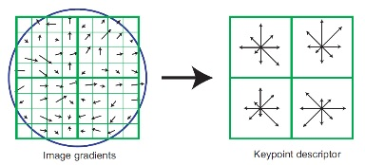
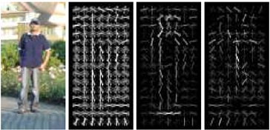
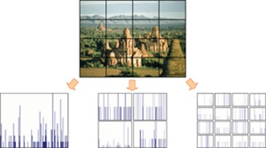
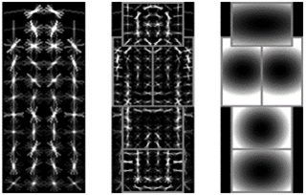
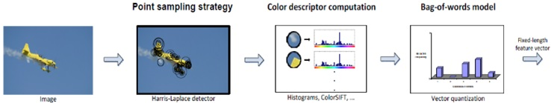
Features are the Keys
SIFT [Loewe IJCV 04]
HOG [Dalal and Triggs CVPR 05]
SPM [Lazebnik et al. CVPR 06]
DPM [Felzenszwalb et al. PAMI 10]
Color Descriptor [Van De Sande et al. PAMI 10]

Slide 7
Learning a Hierarchy of Feature Extractors
  Each layer of hierarchy extracts features from output of previous layer
  All the way from pixels → classifier
  Layers have the (nearly) same structure
  Image/video
  Labels
Image/Video
Pixels
Layer 1
Layer 2
Layer 3
Simple
Classifier
Notes:
Make clear that classic methods, e.g. convnets are purely supervised.

Slide 8
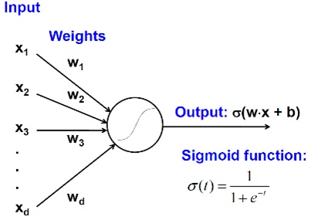
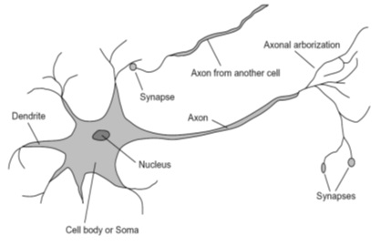
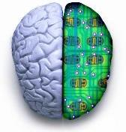
Biological neuron and Perceptrons
A biological neuron
An artificial neuron (Perceptron)
- a linear classifier

Slide 9
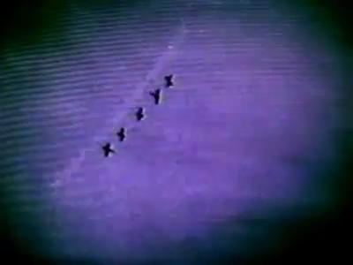
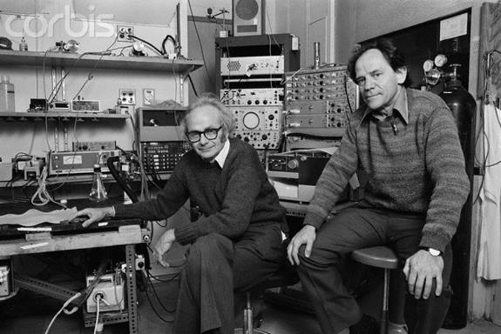
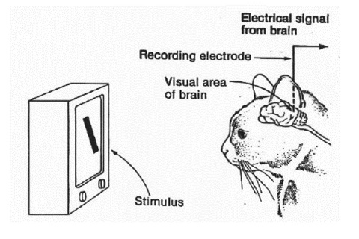
Simple, Complex and Hypercomplex cells
David H. Hubel and Torsten Wiesel
Suggested a hierarchy of feature detectors in the visual cortex, with higher level features responding to patterns of activation in lower level cells, and propagating activation upwards to still higher level cells.
David Hubel's Eye, Brain, and Vision

Slide 10
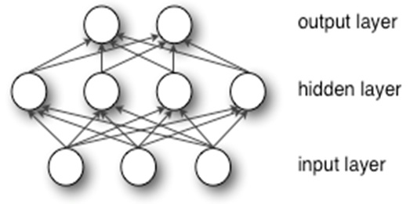
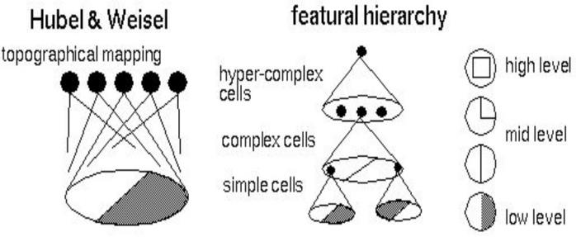
Hubel/Wiesel Architecture and Multi-layer Neural Network
Hubel and Weisel’s architecture
Multi-layer Neural Network
- A non-linear classifier

Slide 11
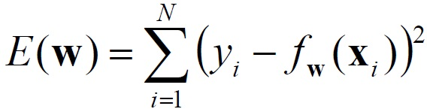
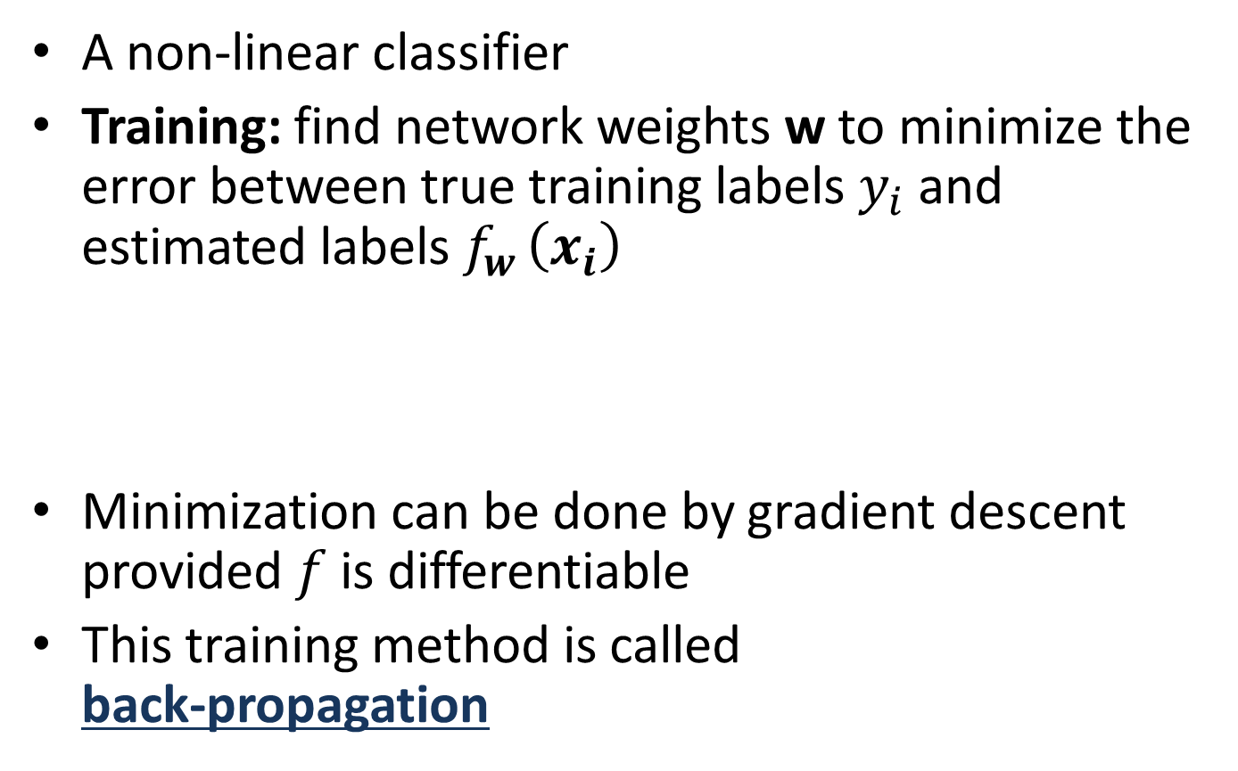
Multi-layer Neural Network
A non-linear classifier
Training: find network weights w to minimize the error between true training labels $y_{i}$and estimated labels $f_{w }\left(x_{i}\right)$
Minimization can be done by gradient descent provided $f$ is differentiable
This training method is called
back-propagation

Slide 12
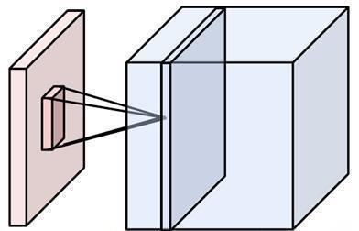
Convolutional Neural Networks
(CNN, ConvNet, DCN)
CNN = a multi-layer neural network with
  Local connectivity
  Share weight parameters across spatial positions
One activation map (a depth slice), computed with one set of weights
Image credit: A. Karpathy

Slide 13
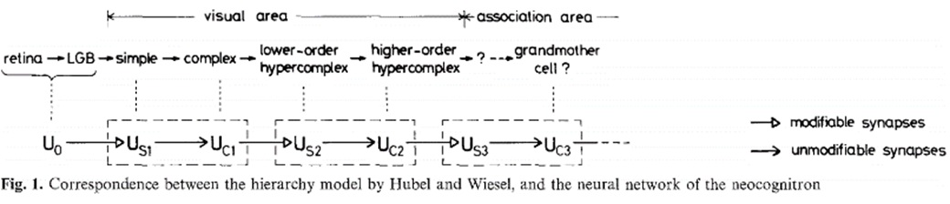
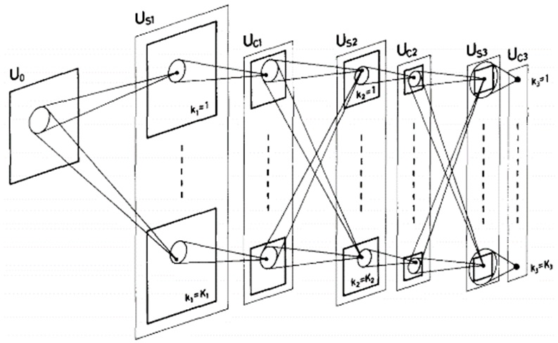
Neocognitron [Fukushima, Biological Cybernetics 1980]
Deformation-Resistant Recognition
S-cells: (simple)
- extract local features
C-cells: (complex)
- allow for positional errors

Slide 14
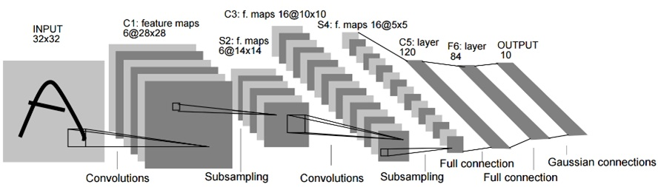
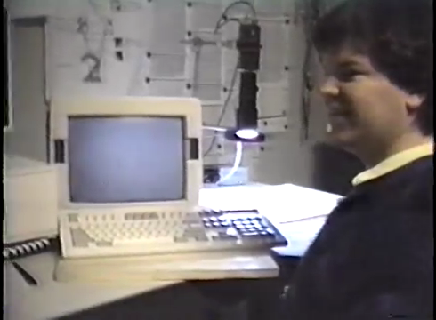
LeNet [LeCun et al. 1998]
Gradient-based learning applied to document recognition [LeCun, Bottou, Bengio, Haffner 1998]
LeNet-1 from 1993

Slide 15
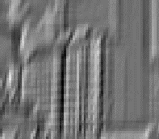


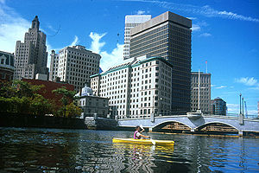
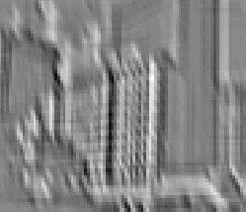
What is a Convolution?
Weighted moving sum
...
Input
Feature Activation Map
slide credit: S. Lazebnik

Slide 16
Convolutional Neural Networks
Feature maps
Normalization
Spatial pooling
Non-linearity
Convolution (Learned)
Input Image
slide credit: S. Lazebnik

Slide 17
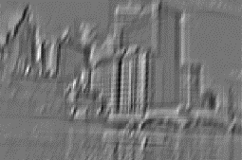

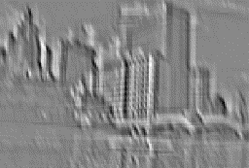
Convolutional Neural Networks
Feature maps
Normalization
Spatial pooling
Non-linearity
...
Convolution (Learned)
Input
Feature Map
Input Image
slide credit: S. Lazebnik

Slide 18
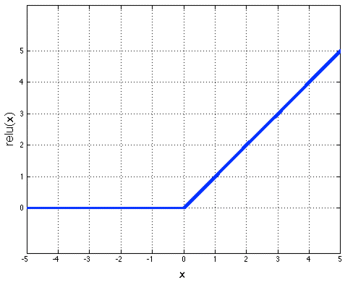
Convolutional Neural Networks
Feature maps
Normalization
Rectified Linear Unit (ReLU)
Spatial pooling
Non-linearity
Convolution (Learned)
Input Image
slide credit: S. Lazebnik

Slide 19
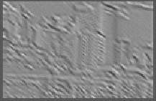

Convolutional Neural Networks
Feature maps
Normalization
  Max pooling
Spatial pooling
Non-linearity
Convolution (Learned)
Max-pooling: a non-linear down-sampling
Provide translation invariance
Input Image
slide credit: S. Lazebnik

Slide 20
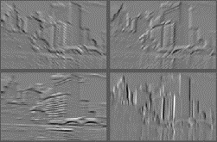
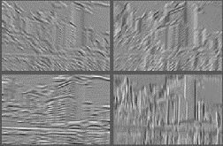
Convolutional Neural Networks
Feature maps
Normalization
Spatial pooling
Feature Maps
Feature Maps
After Contrast Normalization
Non-linearity
Convolution (Learned)
Input Image
slide credit: S. Lazebnik

Slide 21
Convolutional Neural Networks
Feature maps
Normalization
Spatial pooling
Non-linearity
Convolution (Learned)
Input Image
slide credit: S. Lazebnik

Slide 22
Engineered vs. learned features
Label
Convolutional filters are trained in a supervised manner by back-propagating
classification error
Dense
Dense
Dense
Convolution/pool
Label
Convolution/pool
Classifier
Convolution/pool
Pooling
Convolution/pool
Feature extraction
Convolution/pool
Image
Image

Slide 23
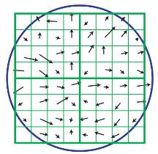

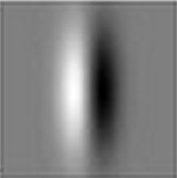
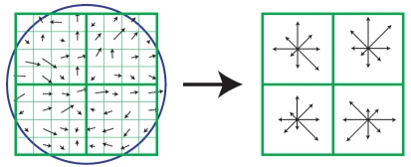
SIFT Descriptor
Lowe [IJCV 2004]
Image
Pixels
Apply gradient filters
Spatial pool
(Sum)
Feature
Vector
Normalize to unit length

Slide 24
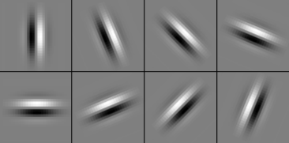
SIFT Descriptor
Lowe [IJCV 2004]
Image
Pixels
Apply
oriented filters
Spatial pool
(Sum)
Feature
Vector
Normalize to unit length
slide credit: R. Fergus

Slide 25




Spatial Pyramid Matching
Lazebnik,
Schmid,
Ponce
[CVPR 2006]
SIFT
Features
Filter with
Visual Words
Max
Multi-scale
spatial pool
(Sum)
Classifier
slide credit: R. Fergus

Slide 26
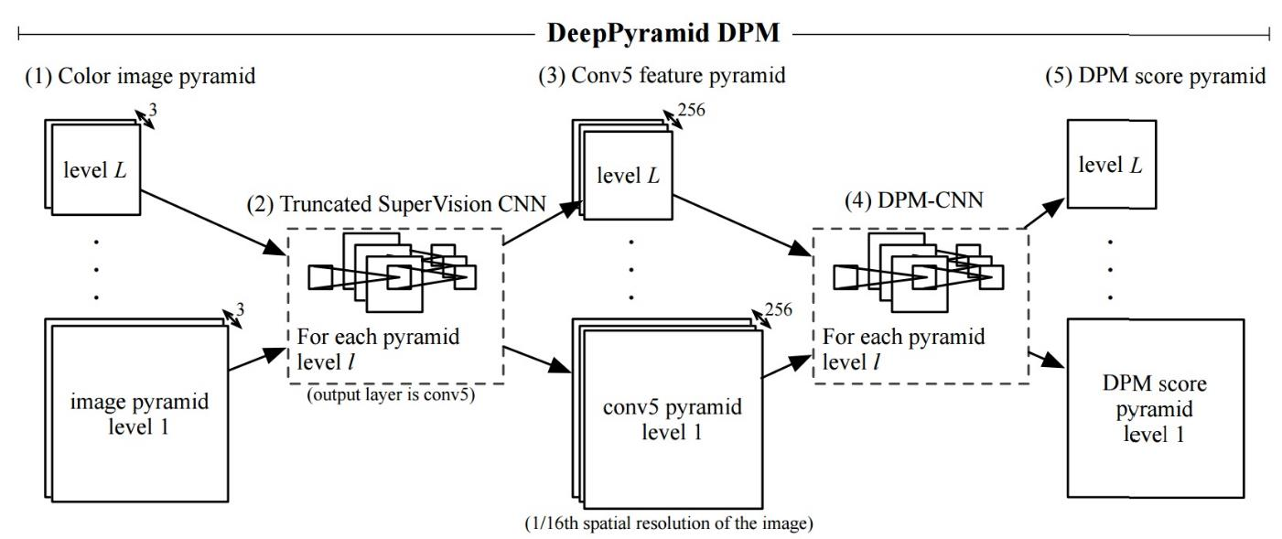
Deformable Part Model
Deformable Part Models are Convolutional Neural Networks [Girshick et al. CVPR 15]

Slide 27
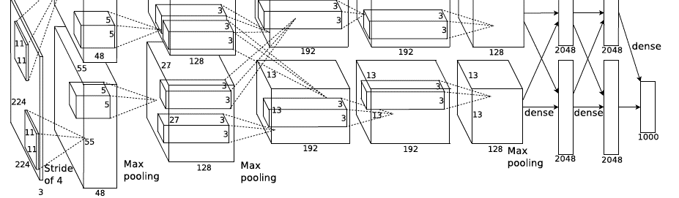
AlexNet
Similar framework to LeCun’98 but:
  Bigger model (7 hidden layers, 650,000 units, 60,000,000 params)
  More data (10⁶ vs. 10³ images)
  GPU implementation (50x speedup over CPU)
    Trained on two GPUs for a week
A. Krizhevsky, I. Sutskever, and G. Hinton,
ImageNet Classification with Deep Convolutional Neural Networks, NIPS 2012
Notes:
Two-GPU architecture

Slide 28

Using CNN for Image Classification
Fully connected layer Fc7
d = 4096
AlexNet
Averaging
Fixed input size: 224x224x3
Softmax Layer
“Jia-Bin”
d = 4096

Slide 29
ImageNet Challenge 2012-2014
Best non-convnet in 2012: 26.2%
Team | Year | Place | Error (top-5) | External data
SuperVision – Toronto (7 layers) | 2012 | - | 16.4% | no
SuperVision | 2012 | 1st | 15.3% | ImageNet 22k
Clarifai – NYU (7 layers) | 2013 | - | 11.7% | no
Clarifai | 2013 | 1st | 11.2% | ImageNet 22k
VGG – Oxford (16 layers) | 2014 | 2nd | 7.32% | no
GoogLeNet (19 layers) | 2014 | 1st | 6.67% | no
Human expert* |  |  | 5.1%
Team | Method | Error (top-5)
DeepImage - Baidu | Data augmentation + multi GPU | 5.33%
PReLU-nets - MSRA | Parametric ReLU + smart initialization | 4.94%
BN-Inception ensemble - Google | Reducing internal covariate shift | 4.82%
Notes:
Best non-convnet in 2012: 26.2%

Slide 30
Beyond classification
Detection
Segmentation
Regression
Pose estimation
Matching patches
Synthesis
and many more…

Slide 31
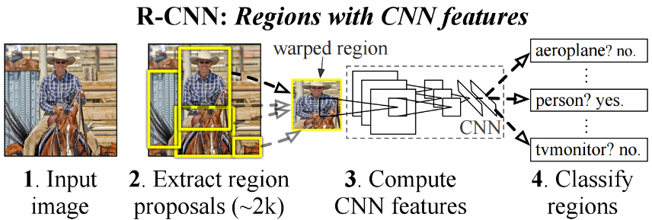
R-CNN: Regions with CNN features
Trained on ImageNet classification
Finetune CNN on PASCAL
RCNN [Girshick et al. CVPR 2014]

Slide 32
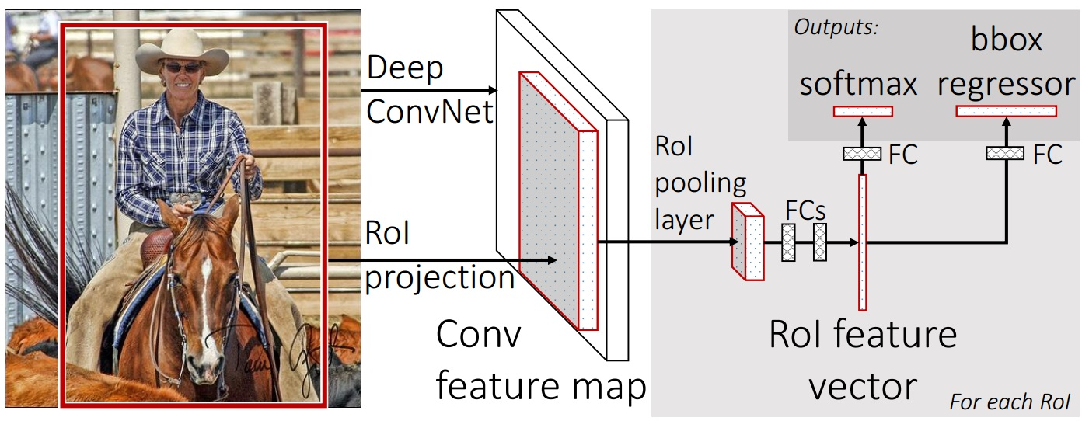
Fast R-CNN
Fast RCNN [Girshick, R 2015]
https://github.com/rbgirshick/fast-rcnn

Slide 33
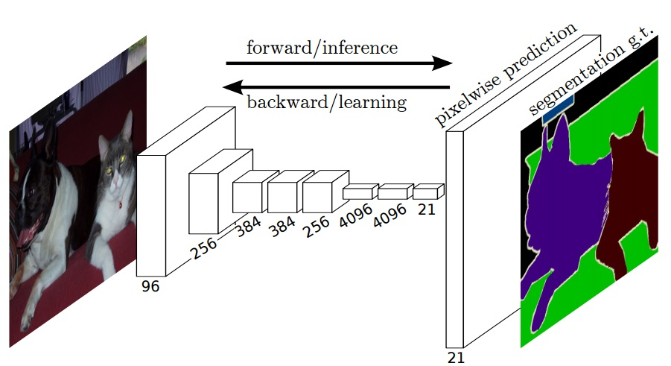
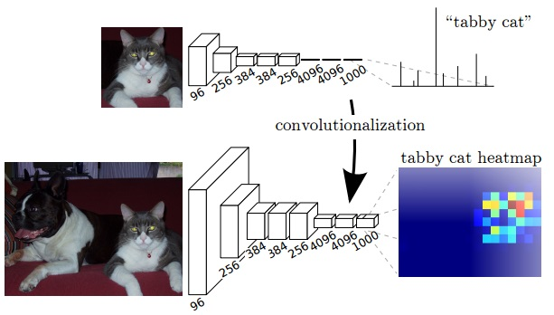
Labeling Pixels: Semantic Labels
Fully Convolutional Networks for Semantic Segmentation [Long et al. CVPR 2015]

Slide 34
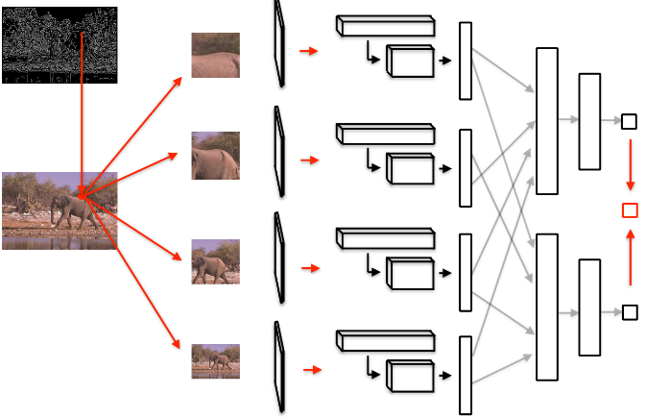
Labeling Pixels: Edge Detection
DeepEdge: A Multi-Scale Bifurcated Deep Network for Top-Down Contour Detection
[Bertasius et al. CVPR 2015]

Slide 35
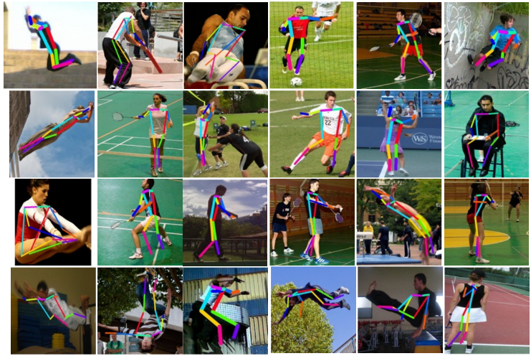
CNN for Regression
DeepPose [Toshev and Szegedy CVPR 2014]

Slide 36
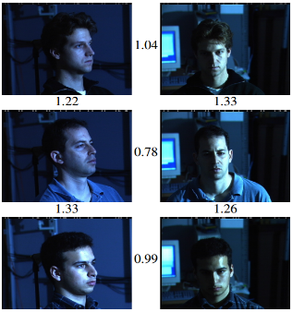
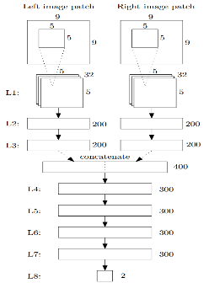
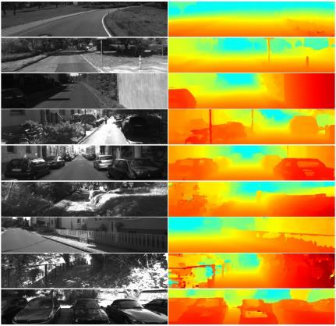
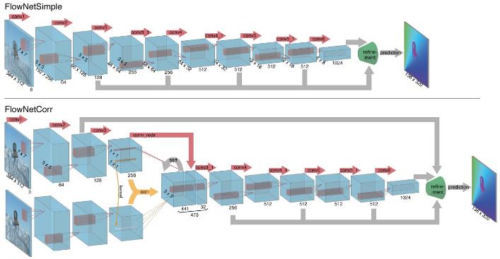
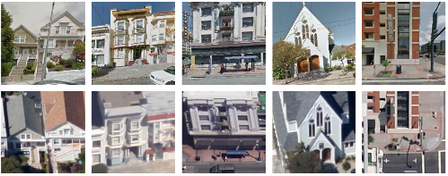
CNN as a Similarity Measure for Matching
Stereo matching [Zbontar and LeCun CVPR 2015]
Compare patch [Zagoruyko and Komodakis 2015]
FaceNet [Schroff et al. 2015]
Match ground and aerial images
[Lin et al. CVPR 2015]
FlowNet [Fischer et al 2015]

Slide 37
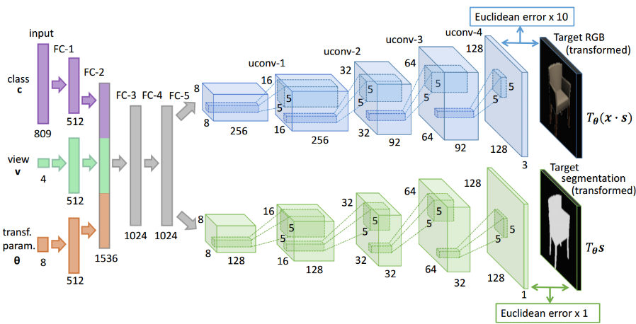
CNN for Image Generation
Learning to Generate Chairs with Convolutional Neural Networks [Dosovitskiy et al. CVPR 2015]

Slide 38
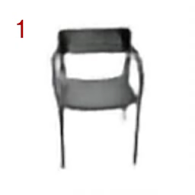
Chair Morphing
Learning to Generate Chairs with Convolutional Neural Networks [Dosovitskiy et al. CVPR 2015]

Slide 39



CNN for Image Restoration/Enhancement
Super-resolution
[Dong et al. ECCV 2014]
Non-blind deconvolution
[Xu et al. NIPS 2014]
Non-uniform blur estimation
[Sun et al. CVPR 2015]

Slide 40

Take a break…
Image source: http://mehimandthecats.com/feline-care-guide/

Slide 41
Understanding and Visualizing CNN
Find images that maximize some class scores
Individual neuron activation
Visualize input pattern using deconvnet
Invert CNN features
Breaking CNNs

Slide 42

Find images that maximize some class scores
person: HOG template
Deep Inside Convolutional Networks: Visualising Image Classification Models and Saliency Maps
[Simonyan et al. ICLR Workshop 2014]

Slide 43

Individual Neuron Activation
RCNN [Girshick et al. CVPR 2014]

Slide 44

Individual Neuron Activation
RCNN [Girshick et al. CVPR 2014]

Slide 45

Individual Neuron Activation
RCNN [Girshick et al. CVPR 2014]

Slide 46

Map activation back to the input pixel space
What input pattern originally caused a given activation in the feature maps?
Visualizing and Understanding Convolutional Networks [Zeiler and Fergus, ECCV 2014]

Slide 47

Layer 1
Visualizing and Understanding Convolutional Networks [Zeiler and Fergus, ECCV 2014]

Slide 48

Layer 2
Visualizing and Understanding Convolutional Networks [Zeiler and Fergus, ECCV 2014]

Slide 49

Layer 3
Visualizing and Understanding Convolutional Networks [Zeiler and Fergus, ECCV 2014]

Slide 50

Layer 4 and 5
Visualizing and Understanding Convolutional Networks [Zeiler and Fergus, ECCV 2014]

Slide 51

Invert CNN features
Reconstruct an image from CNN features
Understanding deep image representations by inverting them
[Mahendran and Vedaldi CVPR 2015]

Slide 52


CNN Reconstruction
Reconstruction from different layers
Multiple reconstructions
Understanding deep image representations by inverting them
[Mahendran and Vedaldi CVPR 2015]

Slide 53

Breaking CNNs
Intriguing properties of neural networks [Szegedy ICLR 2014]

Slide 54

What is going on?
x
Explaining and Harnessing Adversarial Examples [Goodfellow ICLR 2015]
http://karpathy.github.io/2015/03/30/breaking-convnets/

Slide 55
What is going on?
Recall gradient descent training: modify the weights to reduce classifier error
Adversarial examples: modify the image to increase classifier error
Explaining and Harnessing Adversarial Examples [Goodfellow ICLR 2015]
http://karpathy.github.io/2015/03/30/breaking-convnets/

Slide 56
Fooling a linear classifier
Perceptron weight update: add a small multiple of the example to the weight vector:
w ← w + α x
To fool a linear classifier, add a small multiple of the weight vector to the training example:
x ← x + α w
Explaining and Harnessing Adversarial Examples [Goodfellow ICLR 2015]
http://karpathy.github.io/2015/03/30/breaking-convnets/

Slide 57

Fooling a linear classifier
http://karpathy.github.io/2015/03/30/breaking-convnets/

Slide 58

Breaking CNNs
Deep Neural Networks are Easily Fooled: High Confidence Predictions for Unrecognizable Images [Nguyen et al. CVPR 2015]

Slide 59

Images that both CNN and Human can recognize
Deep Neural Networks are Easily Fooled: High Confidence Predictions for Unrecognizable Images [Nguyen et al. CVPR 2015]

Slide 60

Direct Encoding
Deep Neural Networks are Easily Fooled: High Confidence Predictions for Unrecognizable Images [Nguyen et al. CVPR 2015]

Slide 61

Indirect Encoding
Deep Neural Networks are Easily Fooled: High Confidence Predictions for Unrecognizable Images [Nguyen et al. CVPR 2015]

Slide 62
Training Convolutional Neural Networks
Backpropagation + stochastic gradient descent with momentum
  Neural Networks: Tricks of the Trade
Dropout
Data augmentation
Batch normalization
Initialization
  Transfer learning

Slide 63



Dropout
Main Idea: approximately combining exponentially many different neural network architectures efficiently
Dropout: A simple way to prevent neural networks from overfitting [Srivastava JMLR 2014]

Slide 64

Data Augmentation (Jittering)
Create virtual training samples
  Horizontal flip
  Random crop
  Color casting
  Geometric distortion
Deep Image [Wu et al. 2015]

Slide 65


Parametric Rectified Linear Unit
Delving Deep into Rectifiers: Surpassing Human-Level Performance on
ImageNet Classification [He et al. 2015]

Slide 66


Batch Normalization
Batch Normalization: Accelerating Deep Network Training by
Reducing Internal Covariate Shift [Ioffe and Szegedy 2015]

Slide 67

Transfer Learning
Improvement of learning in a new task through the transfer of knowledge from a related task that has already been learned.
Weight initialization for CNN
Learning and Transferring Mid-Level Image Representations using
Convolutional Neural Networks [Oquab et al. CVPR 2014]

Slide 68


Convolutional activation features
[Donahue et al. ICML 2013]
CNN Features off-the-shelf:
an Astounding Baseline for Recognition
[Razavian et al. 2014]

Slide 69


How transferable are features in CNN?
How transferable are features in deep
neural networks [Yosinski NIPS 2014]

Slide 70

Deep Neural Networks Rival the Representation of Primate Inferior Temporal Cortex
Deep Neural Networks Rival the Representation of Primate IT Cortex for Core Visual Object Recognition [Cadieu et al. PLOS 2014]

Slide 71


Deep Neural Networks Rival the Representation of Primate Inferior Temporal Cortex
Deep Neural Networks Rival the Representation of Primate IT Cortex for Core Visual Object Recognition [Cadieu et al. PLOS 2014]

Slide 72


Deep Rendering Model (DRM)
A Probabilistic Theory of Deep Learning [Patel, Nguyen, and Baraniuk 2015]

Slide 73

CNN as a Max-Sum Inference
A Probabilistic Theory of Deep Learning [Patel, Nguyen, and Baraniuk 2015]

Slide 74

Model
Inference
Learning

Slide 75
Tools
Caffe
cuda-convnet2
Torch
MatConvNet
Pylearn2

Slide 76
Resources
http://deeplearning.net/
https://github.com/ChristosChristofidis/awesome-deep-learning

Slide 77
Things to remember
Overview
  Neuroscience, Perceptron, multi-layer neural networks
Convolutional neural network (CNN)
  Convolution, nonlinearity, max pooling
  CNN for classification and beyond
Understanding and visualizing CNN
  Find images that maximize some class scores;
  visualize individual neuron activation, input pattern and images; breaking CNNs
Training CNN
  Dropout; data augmentation; batch normalization; transfer learning
Probabilistic interpretation
  Deep rendering model; CNN forward-propagation as max-sum inference; training as an EM algorithm

