Slide 1
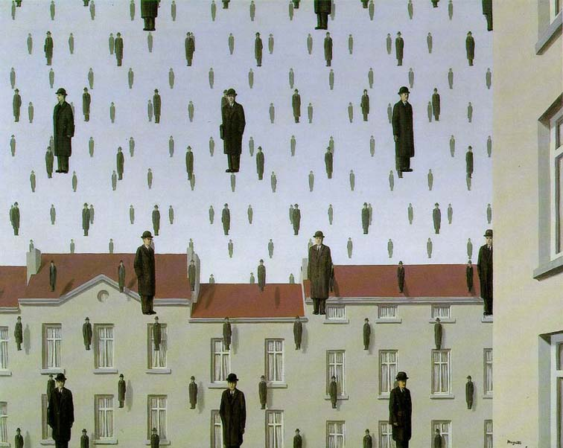
Templates, Image Pyramids, and Filter Banks
01/31/12
Computer Vision
Derek Hoiem, University of Illinois

Slide 2
Administrative stuff
Update on registration
Extra office hour: Amin Sadeghi – Friday at 5pm before HW is due

Slide 3
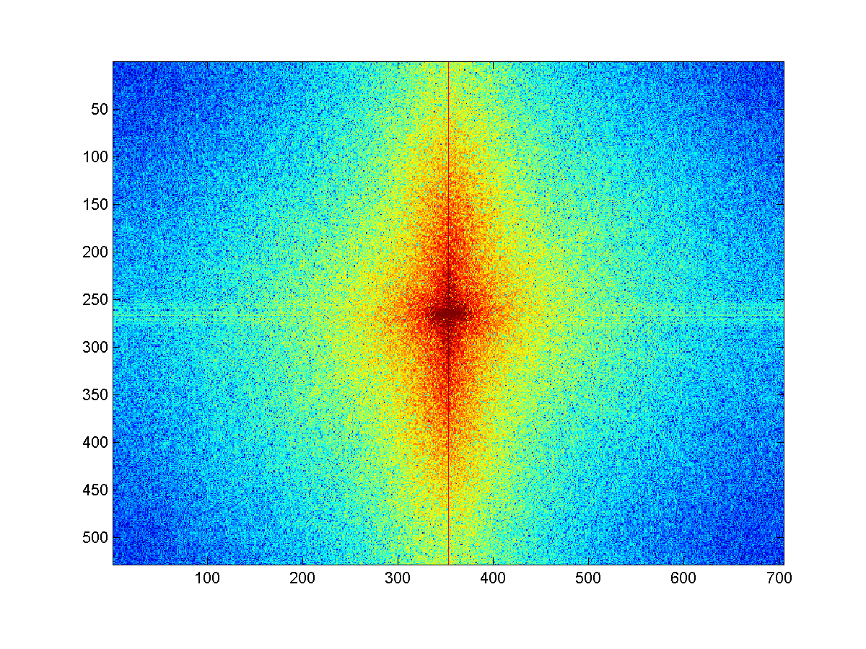
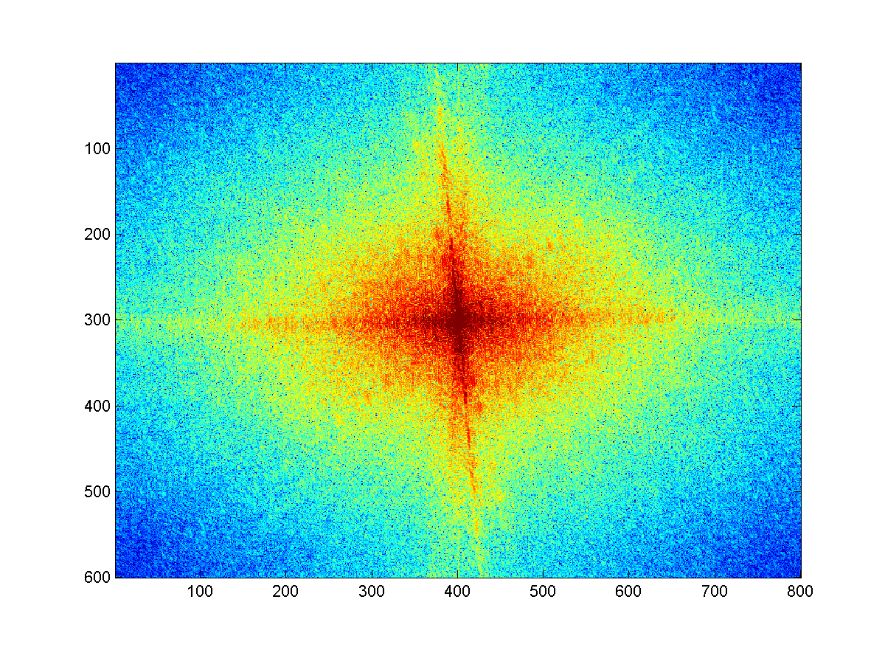
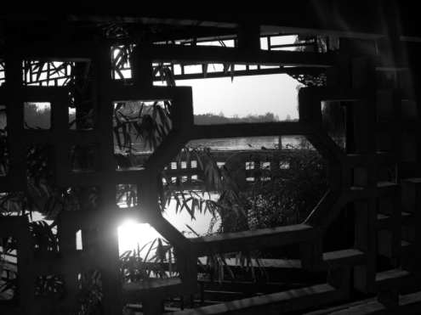
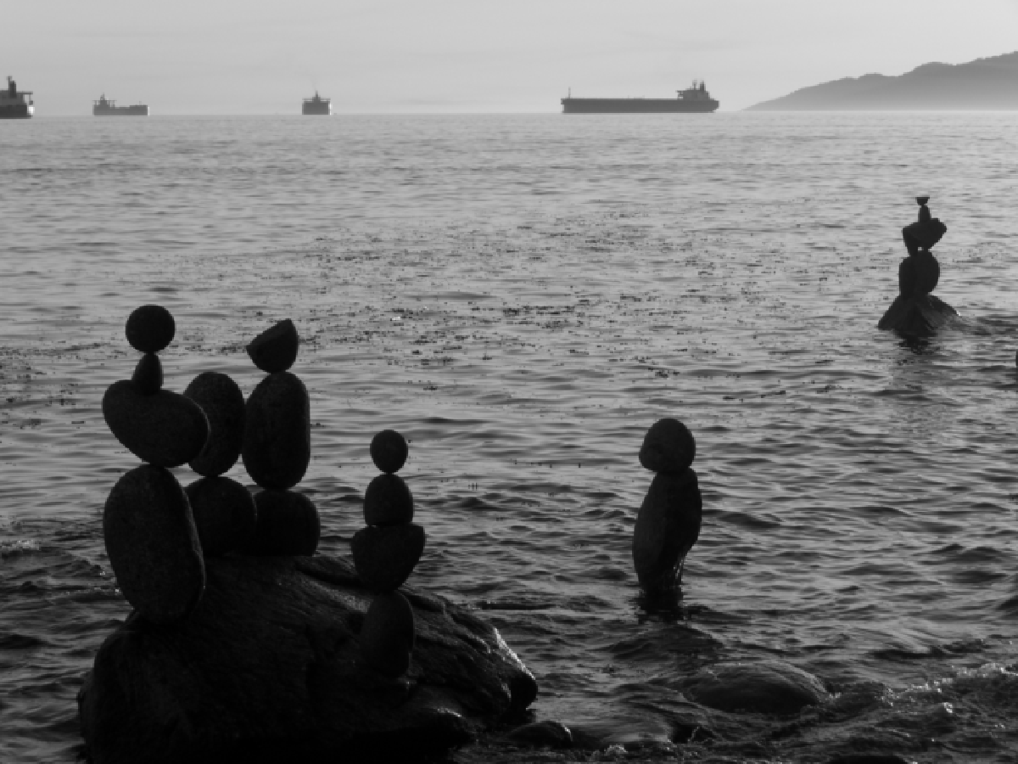
Review
Match the spatial domain image to the Fourier magnitude image
1
2
3
4
5
B
A
C
E
D

Slide 4
Today’s class
Template matching
Image Pyramids
Filter banks and texture
Denoising, Compression

Slide 5
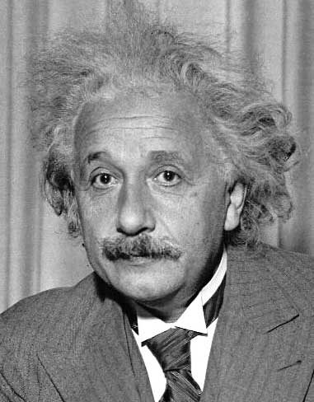
Template matching
Goal: find in image
Main challenge: What is a good similarity or distance measure between two patches?
Correlation
Zero-mean correlation
Sum Square Difference
Normalized Cross Correlation

Slide 6
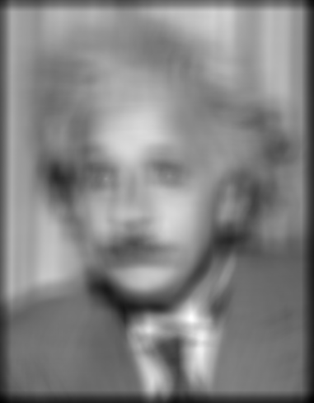
Matching with filters
Goal: find in image
Method 0: filter the image with eye patch
f = image
g = filter
What went wrong?
Input
Filtered Image
Notes:
Problem: response is stronger for higher intensity

Slide 7
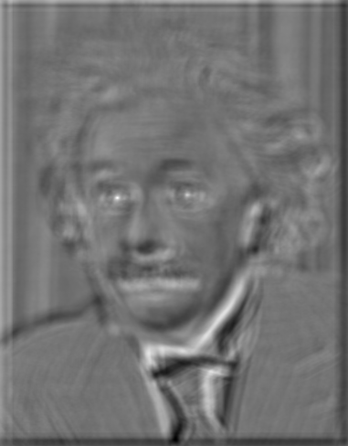
Matching with filters
Goal: find in image
Method 1: filter the image with zero-mean eye
mean of template g
True detections
False detections
Input
Filtered Image (scaled)
Thresholded Image
Notes:
Likes bright pixels where filters are above average, dark pixels where filters are below average. Problems: response is sensitive to gain/contrast, pixels in filter that are near the mean have little effect, does not require pixel values in image to be near or proportional to values in filter.

Slide 8
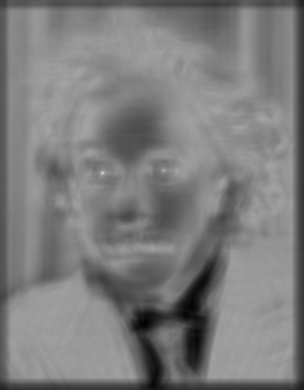
Matching with filters
Goal: find in image
Method 2: SSD
True detections
Input
1- sqrt(SSD)
Thresholded Image
Notes:
Problem: SSD sensitive to average intensity

Slide 9
Matching with filters
Can SSD be implemented with linear filters?

Slide 10
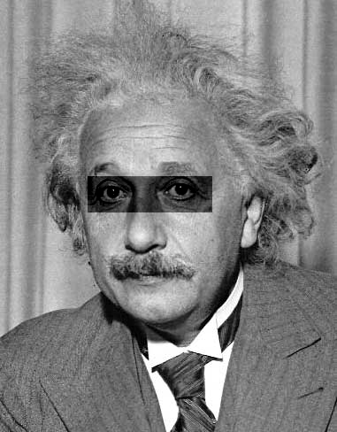
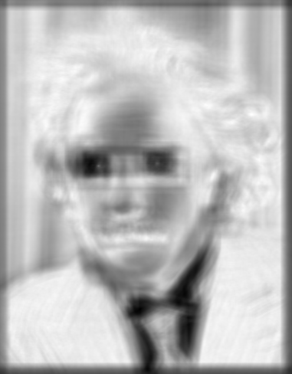
Matching with filters
Goal: find in image
Method 2: SSD
What’s the potential downside of SSD?
Input
1- sqrt(SSD)
Notes:
Problem: SSD sensitive to average intensity

Slide 11
Matching with filters
Goal: find in image
Method 3: Normalized cross-correlation
mean template
mean image patch
Matlab: normxcorr2(template, im)
Notes:
Invariant to mean and scale of intensity

Slide 12
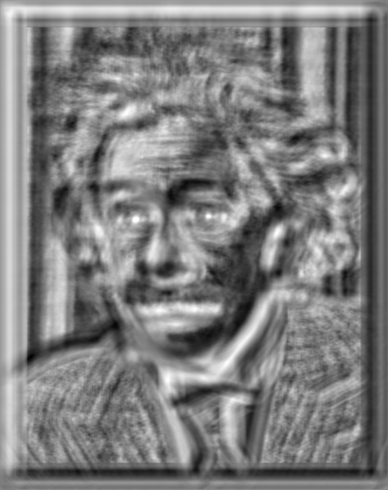
Matching with filters
Goal: find in image
Method 3: Normalized cross-correlation
True detections
Input
Normalized X-Correlation
Thresholded Image

Slide 13
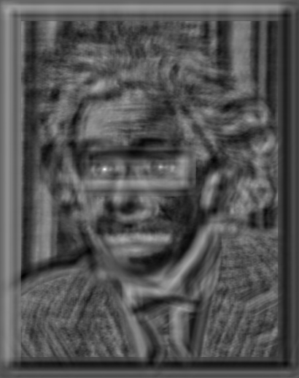
Matching with filters
Goal: find in image
Method 3: Normalized cross-correlation
True detections
Input
Normalized X-Correlation
Thresholded Image

Slide 14
Q: What is the best method to use?
A: Depends
Zero-mean filter: fastest but not a great matcher
SSD: next fastest, sensitive to overall intensity
Normalized cross-correlation: slowest, invariant to local average intensity and contrast

Slide 15
Q: What if we want to find larger or smaller eyes?
A: Image Pyramid

Slide 16
Review of Sampling
Gaussian
Filter
Image
Low-Pass Filtered Image
Sample
Low-Res Image

Slide 17
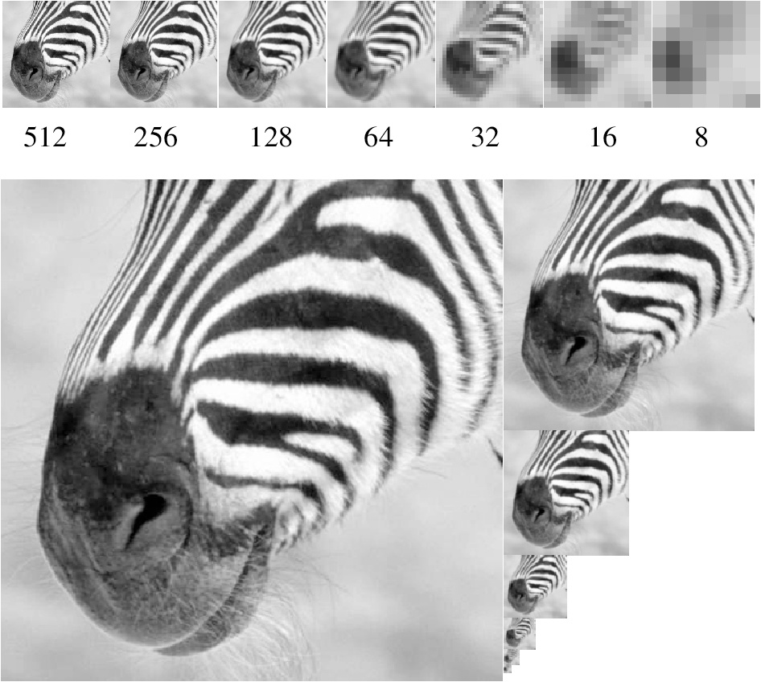
Gaussian pyramid
Source: Forsyth

Slide 18
Template Matching with Image Pyramids
Input: Image, Template
Match template at current scale
Downsample image
In practice, scale step of 1.1 to 1.2
Repeat 1-2 until image is very small
Take responses above some threshold, perhaps with non-maxima suppression

Slide 19
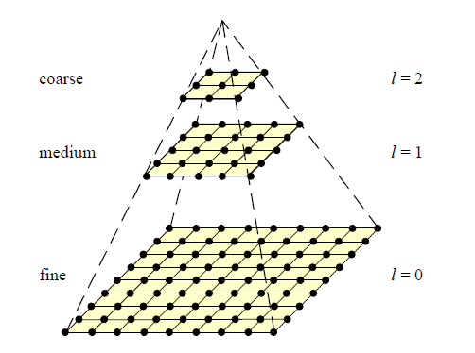
Coarse-to-fine Image Registration
Compute Gaussian pyramid
Align with coarse pyramid
Successively align with finer pyramids
Search smaller range
Why is this faster?
Are we guaranteed to get the same result?

Slide 20
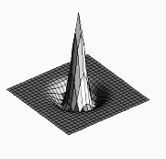
Laplacian filter
unit impulse
Gaussian
Laplacian of Gaussian
Source: Lazebnik

Slide 21
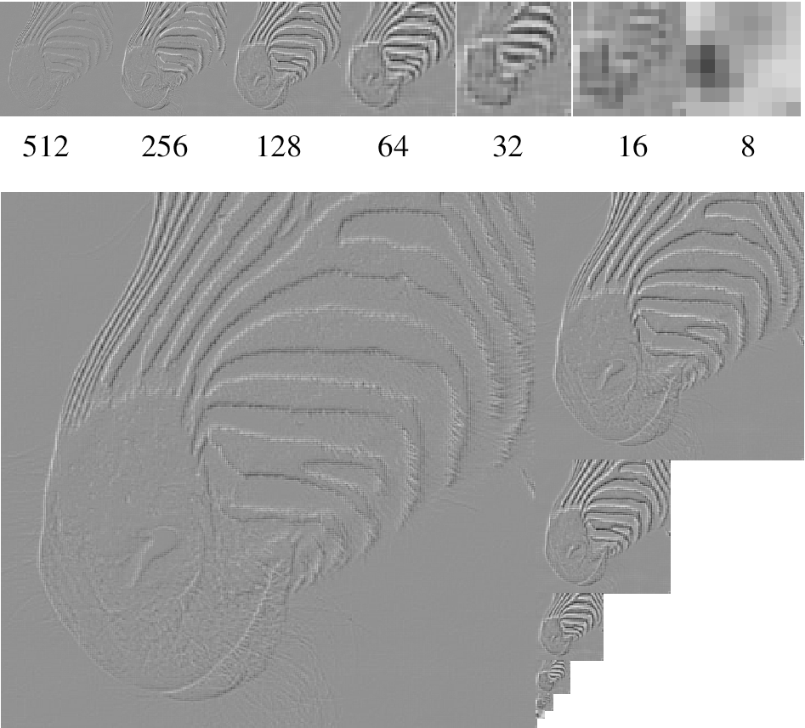
Laplacian pyramid
Source: Forsyth

Slide 22
Computing Gaussian/Laplacian Pyramid
Can we reconstruct the original from the laplacian pyramid?
http://sepwww.stanford.edu/~morgan/texturematch/paper_html/node3.html

Slide 23
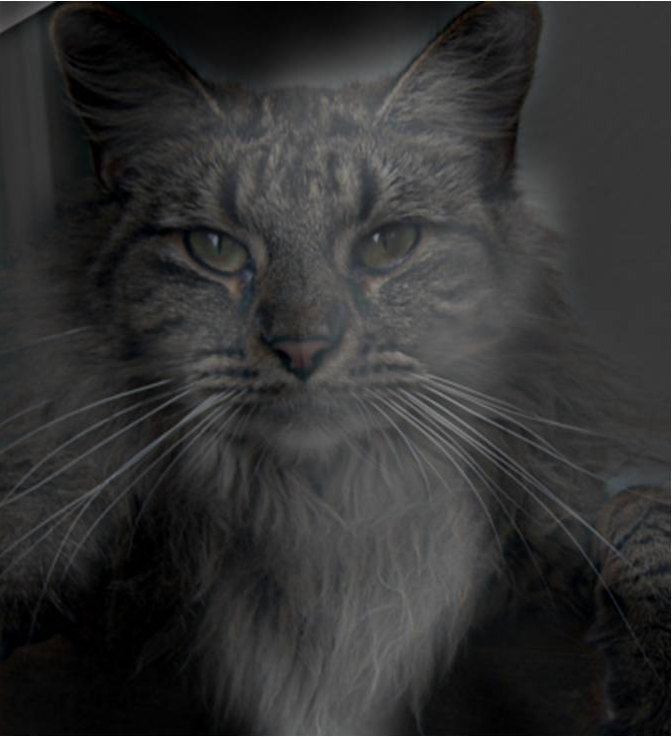
Hybrid Image

Slide 24
Hybrid Image in Laplacian Pyramid
High frequency → Low frequency

Slide 25
Image representation
Pixels: great for spatial resolution, poor access to frequency
Fourier transform: great for frequency, not for spatial info
Pyramids/filter banks: balance between spatial and frequency information

Slide 26
Major uses of image pyramids
Compression
Object detection
Scale search
Features
Detecting stable interest points
Registration
Course-to-fine

Slide 27
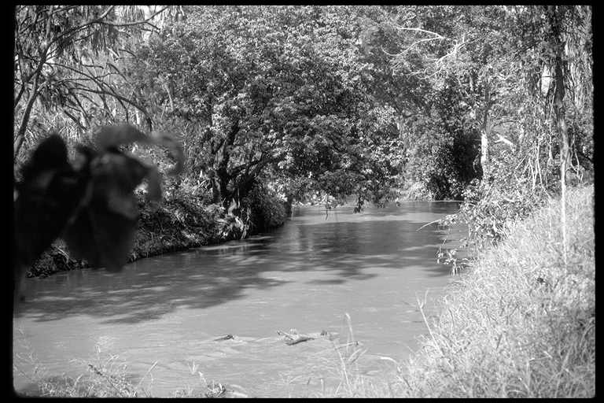
Application: Representing Texture
Source: Forsyth

Slide 28
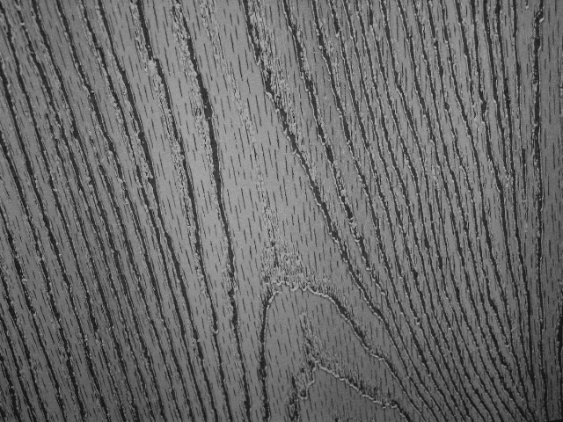
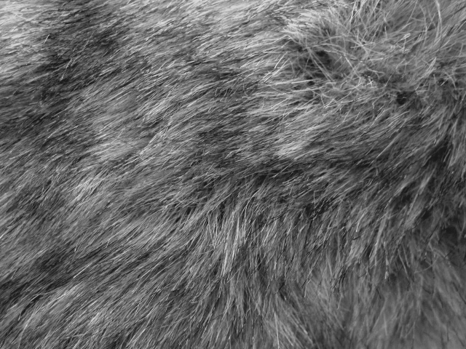
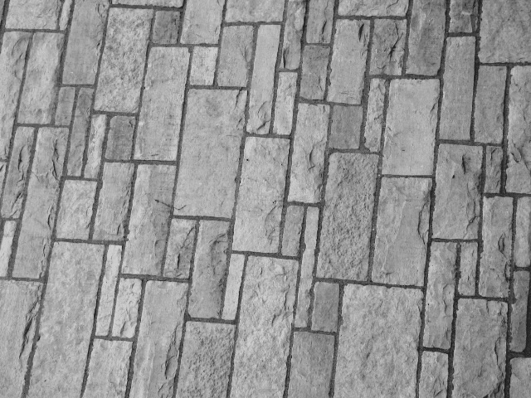
Texture and Material
http://www-cvr.ai.uiuc.edu/ponce_grp/data/texture_database/samples/

Slide 29
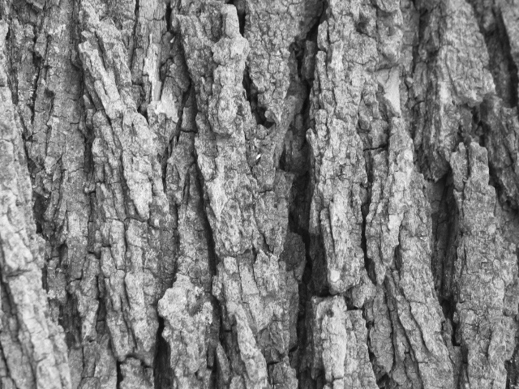
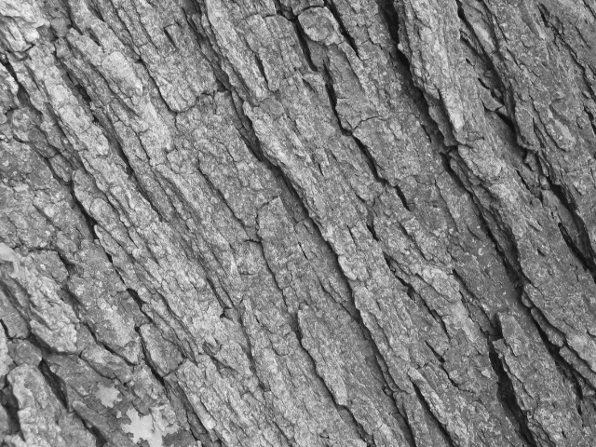
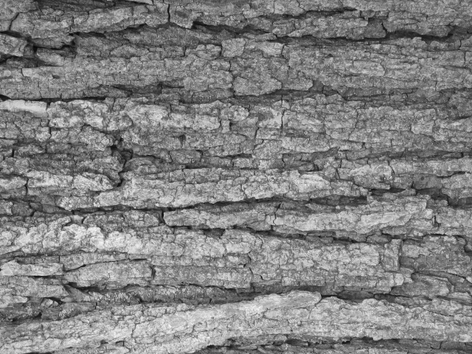
Texture and Orientation
http://www-cvr.ai.uiuc.edu/ponce_grp/data/texture_database/samples/

Slide 30
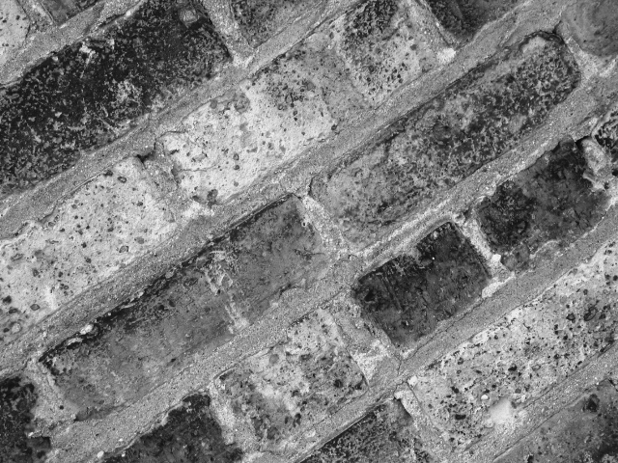
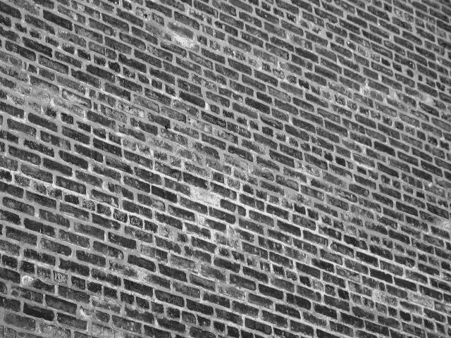
Texture and Scale
http://www-cvr.ai.uiuc.edu/ponce_grp/data/texture_database/samples/

Slide 31
What is texture?
Regular or stochastic patterns caused by bumps, grooves, and/or markings

Slide 32
How can we represent texture?
Compute responses of blobs and edges at various orientations and scales

Slide 33
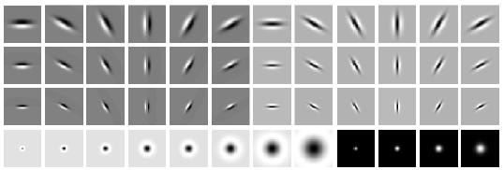
Overcomplete representation: filter banks
LM Filter Bank
Code for filter banks: www.robots.ox.ac.uk/~vgg/research/texclass/filters.html

Slide 34
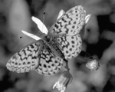
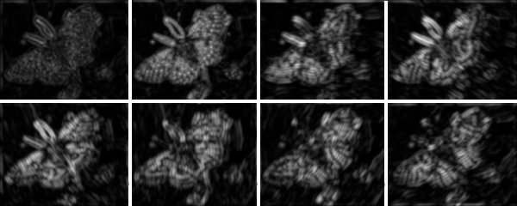
Filter banks
Process image with each filter and keep responses (or squared/abs responses)

Slide 35
How can we represent texture?
Measure responses of blobs and edges at various orientations and scales
Idea 1: Record simple statistics (e.g., mean, std.) of absolute filter responses

Slide 36
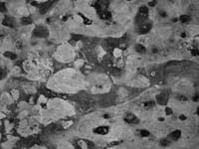
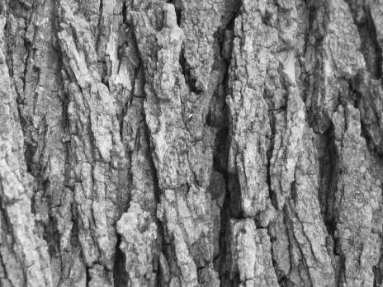
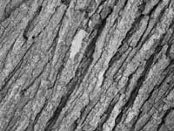
Can you match the texture to the response?
Filters
A
B
1
2
C
3
Mean abs responses

Slide 37
Representing texture by mean abs response
Filters
Mean abs responses

Slide 38
Representing texture
Idea 2: take vectors of filter responses at each pixel and cluster them, then take histograms (more on this in coming weeks)

Slide 39
Compression
How is it that a 4MP image can be compressed to a few hundred KB without a noticeable change?

Slide 40
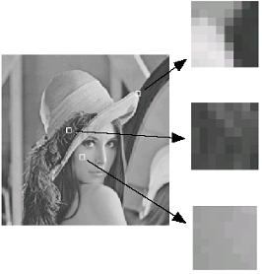
Lossy Image Compression (JPEG)
Block-based Discrete Cosine Transform (DCT)
Slides: Efros

Slide 41
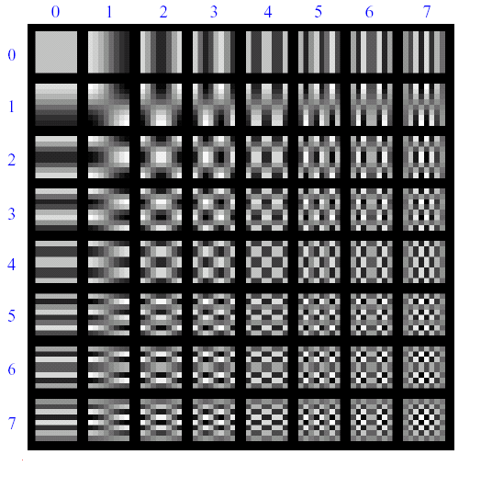
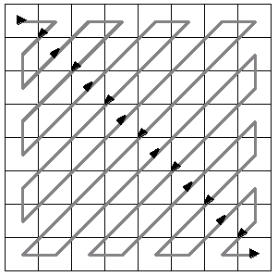
Using DCT in JPEG
The first coefficient B(0,0) is the DC component, the average intensity
The top-left coeffs represent low frequencies, the bottom right – high frequencies

Slide 42
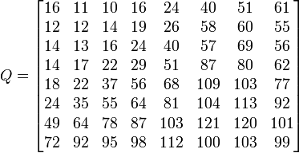
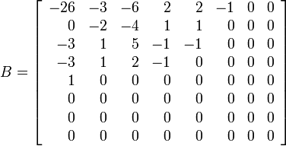
Image compression using DCT
Quantize
More coarsely for high frequencies (which also tend to have smaller values)
Many quantized high frequency values will be zero
Encode
Can decode with inverse dct
Filter responses
Quantization table
Quantized values

Slide 43
JPEG Compression Summary
Convert image to YCrCb
Subsample color by factor of 2
People have bad resolution for color
Split into blocks (8x8, typically), subtract 128
For each block
Compute DCT coefficients
Coarsely quantize
Many high frequency components will become zero
Encode (e.g., with Huffman coding)
http://en.wikipedia.org/wiki/YCbCr
http://en.wikipedia.org/wiki/JPEG

Slide 44
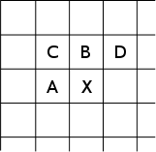
Lossless compression (PNG)
Predict that a pixel’s value based on its upper-left neighborhood
Store difference of predicted and actual value
Pkzip it (DEFLATE algorithm)

Slide 45
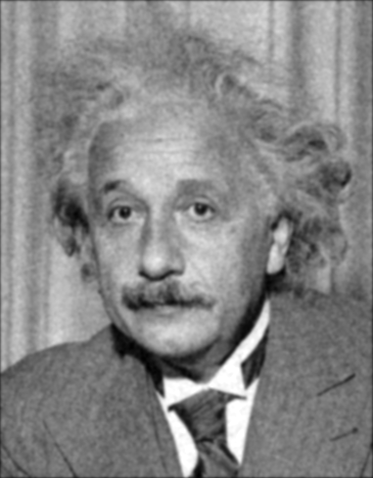
Denoising
Gaussian Filter
Additive Gaussian Noise

Slide 46
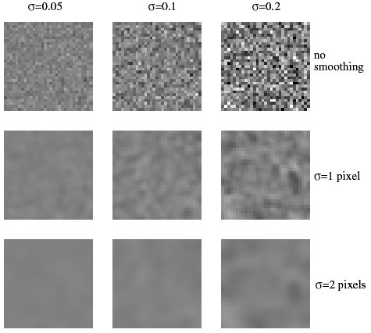
Reducing Gaussian noise
Smoothing with larger standard deviations suppresses noise, but also blurs the image
Source: S. Lazebnik

Slide 47
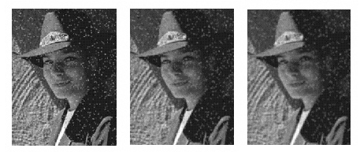
Reducing salt-and-pepper noise by Gaussian smoothing
3x3
5x5
7x7
Notes:
What’s wrong with these results?

Slide 48
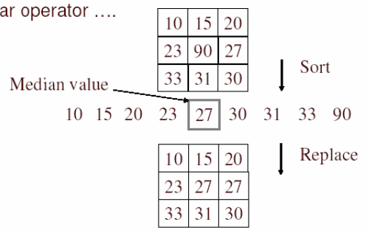
Alternative idea: Median filtering
A median filter operates over a window by selecting the median intensity in the window
Is median filtering linear?
Source: K. Grauman
Notes:
Better at salt’n’pepper noise
Not convolution: try a region with 1’s and a 2, and then 1’s and a 3

Slide 49
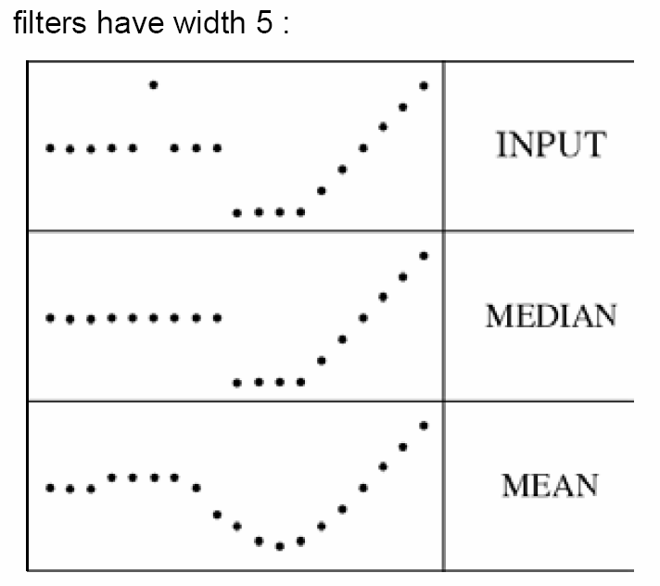
Median filter
What advantage does median filtering have over Gaussian filtering?
Robustness to outliers
Source: K. Grauman

Slide 50
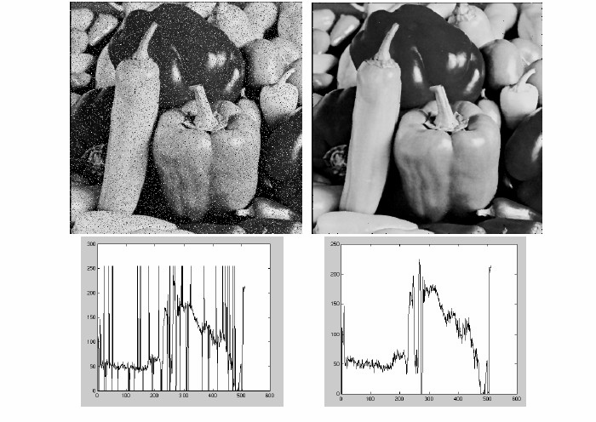
Median filter
Salt-and-pepper noise
Median filtered
MATLAB: medfilt2(image, [h w])
Source: M. Hebert

Slide 51
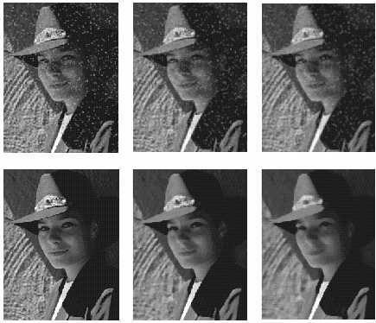
Median vs. Gaussian filtering
3x3
5x5
7x7
Gaussian
Median

Slide 52
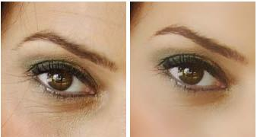
Other non-linear filters
Weighted median (pixels further from center count less)
Clipped mean (average, ignoring few brightest and darkest pixels)
Bilateral filtering (weight by spatial distance and intensity difference)
Bilateral filtering
Image:
http://vision.ai.uiuc.edu/?p=1455

Slide 53
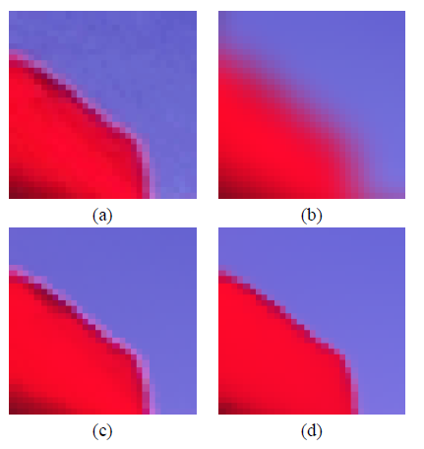
Bilateral filters
Edge preserving: weights similar pixels more
Original
Gaussian
Bilateral
spatial
similarity (e.g., intensity)
Carlo Tomasi, Roberto Manduchi, Bilateral Filtering for Gray and Color Images, ICCV, 1998.

Slide 54
Review of last three days

Slide 55
Review: Image filtering
1
1
1
1
1
1
1
1
1
0 | 0 | 0 | 0 | 0 | 0 | 0 | 0 | 0 | 0
0 | 0 | 0 | 0 | 0 | 0 | 0 | 0 | 0 | 0
0 | 0 | 0 | 90 | 90 | 90 | 90 | 90 | 0 | 0
0 | 0 | 0 | 90 | 90 | 90 | 90 | 90 | 0 | 0
0 | 0 | 0 | 90 | 90 | 90 | 90 | 90 | 0 | 0
0 | 0 | 0 | 90 | 0 | 90 | 90 | 90 | 0 | 0
0 | 0 | 0 | 90 | 90 | 90 | 90 | 90 | 0 | 0
0 | 0 | 0 | 0 | 0 | 0 | 0 | 0 | 0 | 0
0 | 0 | 90 | 0 | 0 | 0 | 0 | 0 | 0 | 0
0 | 0 | 0 | 0 | 0 | 0 | 0 | 0 | 0 | 0
 | 0
0 | 0 | 0 | 0 | 0 | 0 | 0 | 0 | 0 | 0
0 | 0 | 0 | 0 | 0 | 0 | 0 | 0 | 0 | 0
0 | 0 | 0 | 90 | 90 | 90 | 90 | 90 | 0 | 0
0 | 0 | 0 | 90 | 90 | 90 | 90 | 90 | 0 | 0
0 | 0 | 0 | 90 | 90 | 90 | 90 | 90 | 0 | 0
0 | 0 | 0 | 90 | 0 | 90 | 90 | 90 | 0 | 0
0 | 0 | 0 | 90 | 90 | 90 | 90 | 90 | 0 | 0
0 | 0 | 0 | 0 | 0 | 0 | 0 | 0 | 0 | 0
0 | 0 | 90 | 0 | 0 | 0 | 0 | 0 | 0 | 0
0 | 0 | 0 | 0 | 0 | 0 | 0 | 0 | 0 | 0
Credit: S. Seitz
Notes:
ones, divide by 9

Slide 56
Image filtering
1
1
1
1
1
1
1
1
1
0 | 0 | 0 | 0 | 0 | 0 | 0 | 0 | 0 | 0
0 | 0 | 0 | 0 | 0 | 0 | 0 | 0 | 0 | 0
0 | 0 | 0 | 90 | 90 | 90 | 90 | 90 | 0 | 0
0 | 0 | 0 | 90 | 90 | 90 | 90 | 90 | 0 | 0
0 | 0 | 0 | 90 | 90 | 90 | 90 | 90 | 0 | 0
0 | 0 | 0 | 90 | 0 | 90 | 90 | 90 | 0 | 0
0 | 0 | 0 | 90 | 90 | 90 | 90 | 90 | 0 | 0
0 | 0 | 0 | 0 | 0 | 0 | 0 | 0 | 0 | 0
0 | 0 | 90 | 0 | 0 | 0 | 0 | 0 | 0 | 0
0 | 0 | 0 | 0 | 0 | 0 | 0 | 0 | 0 | 0
 | 0 | 10
0 | 0 | 0 | 0 | 0 | 0 | 0 | 0 | 0 | 0
0 | 0 | 0 | 0 | 0 | 0 | 0 | 0 | 0 | 0
0 | 0 | 0 | 90 | 90 | 90 | 90 | 90 | 0 | 0
0 | 0 | 0 | 90 | 90 | 90 | 90 | 90 | 0 | 0
0 | 0 | 0 | 90 | 90 | 90 | 90 | 90 | 0 | 0
0 | 0 | 0 | 90 | 0 | 90 | 90 | 90 | 0 | 0
0 | 0 | 0 | 90 | 90 | 90 | 90 | 90 | 0 | 0
0 | 0 | 0 | 0 | 0 | 0 | 0 | 0 | 0 | 0
0 | 0 | 90 | 0 | 0 | 0 | 0 | 0 | 0 | 0
0 | 0 | 0 | 0 | 0 | 0 | 0 | 0 | 0 | 0
Credit: S. Seitz
Notes:
ones, divide by 9

Slide 57
Image filtering
1
1
1
1
1
1
1
1
1
0 | 0 | 0 | 0 | 0 | 0 | 0 | 0 | 0 | 0
0 | 0 | 0 | 0 | 0 | 0 | 0 | 0 | 0 | 0
0 | 0 | 0 | 90 | 90 | 90 | 90 | 90 | 0 | 0
0 | 0 | 0 | 90 | 90 | 90 | 90 | 90 | 0 | 0
0 | 0 | 0 | 90 | 90 | 90 | 90 | 90 | 0 | 0
0 | 0 | 0 | 90 | 0 | 90 | 90 | 90 | 0 | 0
0 | 0 | 0 | 90 | 90 | 90 | 90 | 90 | 0 | 0
0 | 0 | 0 | 0 | 0 | 0 | 0 | 0 | 0 | 0
0 | 0 | 90 | 0 | 0 | 0 | 0 | 0 | 0 | 0
0 | 0 | 0 | 0 | 0 | 0 | 0 | 0 | 0 | 0
 | 0 | 10 | 20
0 | 0 | 0 | 0 | 0 | 0 | 0 | 0 | 0 | 0
0 | 0 | 0 | 0 | 0 | 0 | 0 | 0 | 0 | 0
0 | 0 | 0 | 90 | 90 | 90 | 90 | 90 | 0 | 0
0 | 0 | 0 | 90 | 90 | 90 | 90 | 90 | 0 | 0
0 | 0 | 0 | 90 | 90 | 90 | 90 | 90 | 0 | 0
0 | 0 | 0 | 90 | 0 | 90 | 90 | 90 | 0 | 0
0 | 0 | 0 | 90 | 90 | 90 | 90 | 90 | 0 | 0
0 | 0 | 0 | 0 | 0 | 0 | 0 | 0 | 0 | 0
0 | 0 | 90 | 0 | 0 | 0 | 0 | 0 | 0 | 0
0 | 0 | 0 | 0 | 0 | 0 | 0 | 0 | 0 | 0
Credit: S. Seitz
Notes:
ones, divide by 9

Slide 58
Filtering in spatial domain
1
0
-1
2
0
-2
1
0
-1
*
=

Slide 59
Filtering in frequency domain
FFT
FFT
=
Inverse FFT

Slide 60
Review of Last 3 Days
Linear filters for basic processing
Edge filter (high-pass)
Gaussian filter (low-pass)
[-1 1]
Gaussian
FFT of Gradient Filter
FFT of Gaussian

Slide 61
Review of Last 3 Days
Derivative of Gaussian

Slide 62
Review of Last 3 Days
Applications of filters
Template matching (SSD or Normxcorr2)
SSD can be done with linear filters, is sensitive to overall intensity
Gaussian pyramid
Coarse-to-fine search, multi-scale detection
Laplacian pyramid
More compact image representation
Can be used for compositing in graphics

Slide 63
Review of Last 3 Days
Applications of filters
Downsampling
Need to sufficiently low-pass before downsampling
Compression
In JPEG, coarsely quantize high frequencies

Slide 64
Next class: edge detection

