Slide 1
Clustering
02/17/11
Computer Vision
CS 543 / ECE 549
University of Illinois
Derek Hoiem

Slide 2
Today’s class
Fitting and alignment
One more algorithm: ICP
Review of all the algorithms
Clustering algorithms
K-means
Hierarchical clustering
Spectral clustering

Slide 3
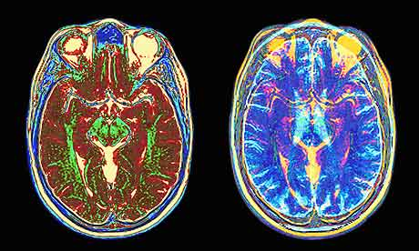
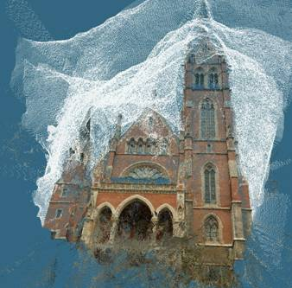
What if you want to align but have no prior matched pairs?
Hough transform and RANSAC not applicable
Important applications
Medical imaging: match brain scans or contours
Robotics: match point clouds

Slide 4
Iterative Closest Points (ICP) Algorithm
Goal: estimate transform between two dense sets of points
Assign each point in {Set 1} to its nearest neighbor in {Set 2}
Estimate transformation parameters
e.g., least squares or robust least squares
Transform the points in {Set 1} using estimated parameters
Repeat steps 2-4 until change is very small

Slide 5
Example: solving for translation
A₁
A₂
A₃
B₁
B₂
B₃
Given matched points in {A} and {B}, estimate the translation of the object

Slide 6
Example: solving for translation
A₁
A₂
A₃
(t_{x}, t_{y})
B₁
B₂
B₃
Least squares solution
Write down objective function
Derived solution
Compute derivative
Compute solution
Computational solution
Write in form Ax=b
Solve using pseudo-inverse or eigenvalue decomposition

Slide 7
Example: solving for translation
A₁
A₅
B₄
A₂
A₃
(t_{x}, t_{y})
B₁
A₄
B₂
B₃
B₅
Problem: outliers
RANSAC solution
Sample a set of matching points (1 pair)
Solve for transformation parameters
Score parameters with number of inliers
Repeat steps 1-3 N times

Slide 8
Example: solving for translation
B₄
A₁
B₅
B₆
A₂
A₃
(t_{x}, t_{y})
B₁
A₄
B₂
B₃
A₅
A₆
Problem: outliers, multiple objects, and/or many-to-one matches
Hough transform solution
Initialize a grid of parameter values
Each matched pair casts a vote for consistent values
Find the parameters with the most votes
Solve using least squares with inliers

Slide 9
Example: solving for translation
(t_{x}, t_{y})
Problem: no initial guesses for correspondence
ICP solution
Find nearest neighbors for each point
Compute transform using matches
Move points using transform
Repeat steps 1-3 until convergence

Slide 10
Clustering: group together similar points and represent them with a single token
Key Challenges:
1) What makes two points/images/patches similar?
2) How do we compute an overall grouping from pairwise similarities?

Slide 11
Why do we cluster?
Summarizing data
Look at large amounts of data
Patch-based compression or denoising
Represent a large continuous vector with the cluster number
Counting
Histograms of texture, color, SIFT vectors
Segmentation
Separate the image into different regions
Prediction
Images in the same cluster may have the same labels

Slide 12
How do we cluster?
K-means
Iteratively re-assign points to the nearest cluster center
Agglomerative clustering
Start with each point as its own cluster and iteratively merge the closest clusters
Spectral clustering
Split the nodes in a graph based on assigned links with similarity weights

Slide 13
Clustering for Summarization
Goal: cluster to minimize variance in data given clusters
Preserve information
Cluster center
Data
Whether x_{j} is assigned to c_{i}

Slide 14
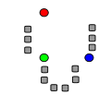
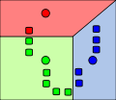
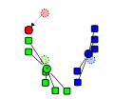
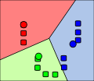
K-means
0. Initialize Cluster Centers
1. Assign Points to Clusters
2. Re-compute Means
Repeat (1) and (2)
Illustration Source: wikipedia

Slide 15
K-means
Initialize cluster centers: c⁰ ; t=0
Assign each point to the closest center
Update cluster centers as the mean of the points
Repeat 2-3 until no points are re-assigned (t=t+1)

Slide 16
K-means: design choices
Initialization
Randomly select K points as initial cluster center
Or greedily choose K points to minimize residual
Distance measures
Traditionally Euclidean, could be others
Optimization
Will converge to a local minimum
May want to perform multiple restarts
Illustration Source: wikipedia

Slide 17
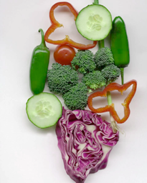
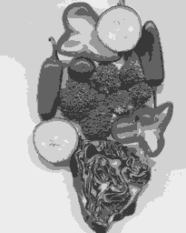
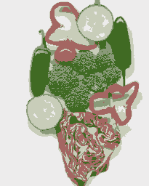
K-means clustering using intensity or color
Image
Clusters on intensity
Clusters on color
Notes:
I gave each pixel the mean intensity or mean color of its cluster --- this is basically just vector quantizing the image intensities/colors. Notice that there is no requirement that clusters be spatially localized and they’re not.

Slide 18
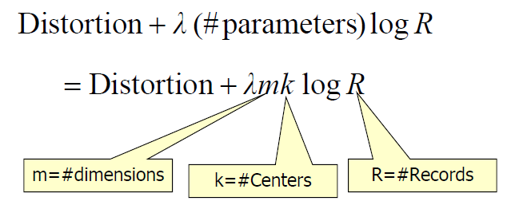
How to choose the number of clusters?
Minimum Description Length (MDL) principal for model comparison
Minimize Schwarz Criterion
also called Bayes Information Criteria (BIC)

Slide 19
How to evaluate clusters?
Generative
How well are points reconstructed from the clusters?
Discriminative
How well do the clusters correspond to labels?
Purity
Note: unsupervised clustering does not aim to be discriminative

Slide 20
How to choose the number of clusters?
Validation set
Try different numbers of clusters and look at performance
When building dictionaries (discussed later), more clusters typically work better

Slide 21
K-means demos
General
http://home.dei.polimi.it/matteucc/Clustering/tutorial_html/AppletKM.html
http://www.cs.washington.edu/research/imagedatabase/demo/kmcluster/
Color clustering

Slide 22
Conclusions: K-means
Good
Finds cluster centers that minimize conditional variance (good representation of data)
Simple to implement, widespread application
Bad
Prone to local minima
Need to choose K
All clusters have the same parameters (e.g., distance measure is non-adaptive)
Can be slow: each iteration is O(KNd) for N d-dimensional points

Slide 23
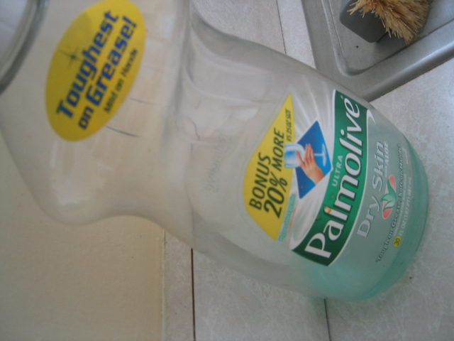
Building Visual Dictionaries
Sample patches from a database
E.g., 128 dimensional SIFT vectors
Cluster the patches
Cluster centers are the dictionary
Assign a codeword (number) to each new patch, according to the nearest cluster

Slide 24
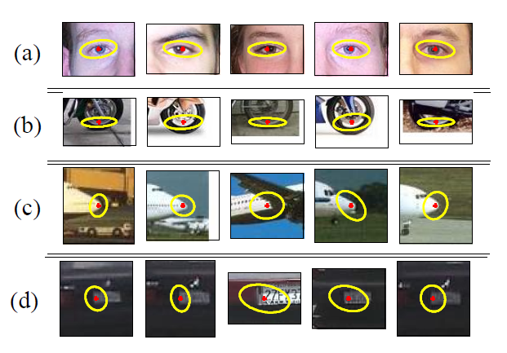
Examples of learned codewords
Most likely codewords for 4 learned “topics”
EM with multinomial (problem 3) to get topics
http://www.robots.ox.ac.uk/~vgg/publications/papers/sivic05b.pdf
Sivic et al. ICCV 2005

Slide 25
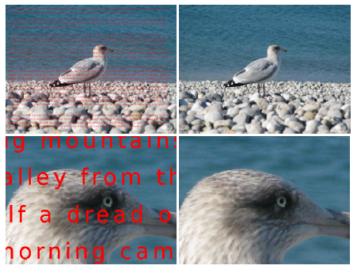
Learning Visual Dictionaries
Inpainting Application

Slide 26
Common similarity/distance measures
P-norms
City Block (L1)
Euclidean (L2)
L-infinity
Mahalanobis
Scaled Euclidean
Cosine distance
Here x_{i} is the distance between two points

Slide 27
K-medoids
Just like K-means except
Represent the cluster with one of its members, rather than the mean of its members
Choose the member (data point) that minimizes cluster dissimilarity
Applicable when a mean is not meaningful
E.g., clustering values of hue or using L-infinity similarity

Slide 28
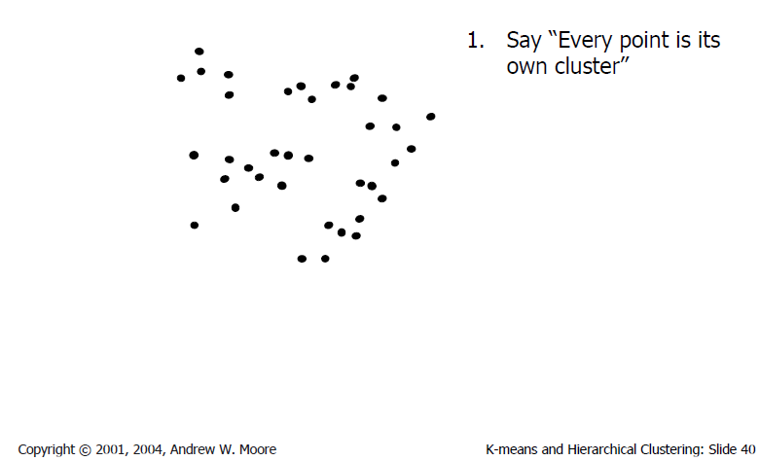
Agglomerative clustering

Slide 29
Agglomerative clustering

Slide 30
Agglomerative clustering

Slide 31
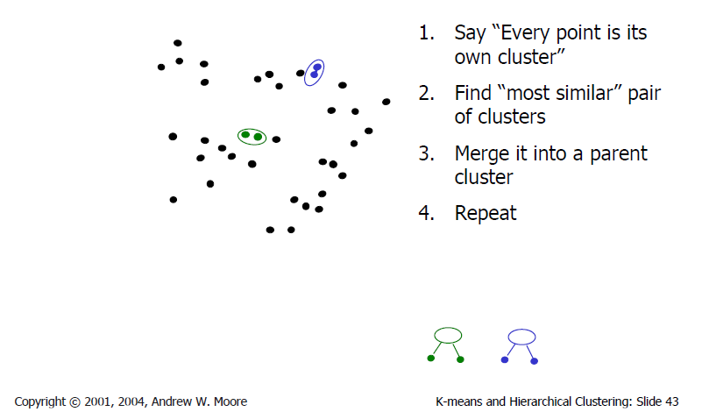
Agglomerative clustering

Slide 32
Agglomerative clustering

Slide 33
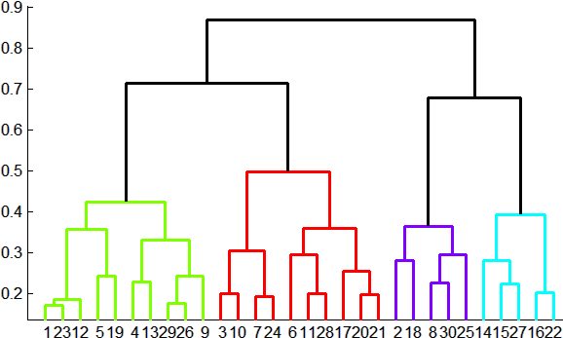
Agglomerative clustering
How to define cluster similarity?
Average distance between points, maximum distance, minimum distance
Distance between means or medoids
How many clusters?
Clustering creates a dendrogram (a tree)
Threshold based on max number of clusters or based on distance between merges
distance

Slide 34
Agglomerative clustering demo
http://home.dei.polimi.it/matteucc/Clustering/tutorial_html/AppletH.html

Slide 35
Conclusions: Agglomerative Clustering
Good
Simple to implement, widespread application
Clusters have adaptive shapes
Provides a hierarchy of clusters
Bad
May have imbalanced clusters
Still have to choose number of clusters or threshold
Need to use an “ultrametric” to get a meaningful hierarchy

Slide 36
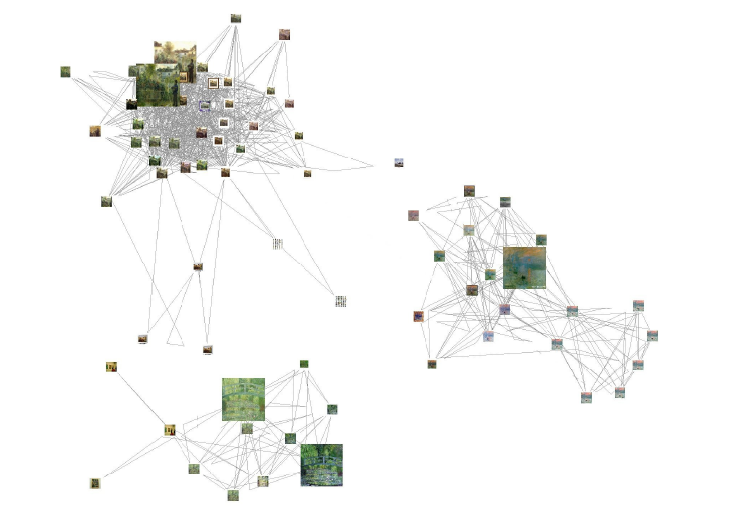
Spectral clustering
Group points based on links in a graph
B
A

Slide 37
Cuts in a graph
B
A
Normalized Cut
a cut penalizes large segments
fix by normalizing for size of segments
volume(A) = sum of costs of all edges that touch A
Source: Seitz

Slide 38
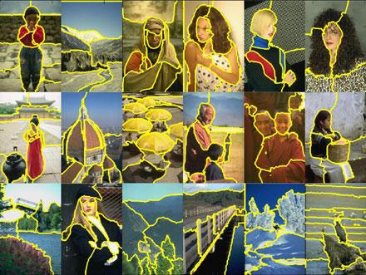
Normalized cuts for segmentation

Slide 39
Visual PageRank
Determining importance by random walk
What’s the probability that you will randomly walk to a given node?
Create adjacency matrix based on visual similarity
Edge weights determine probability of transition
Jing Baluja 2008

Slide 40
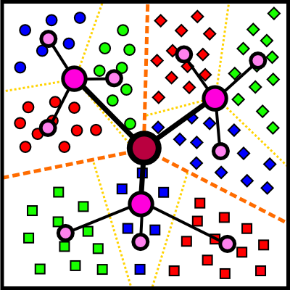
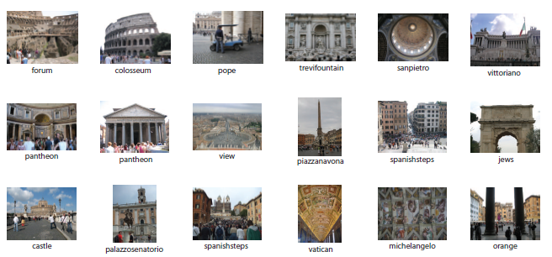
Which algorithm to use?
Quantization/Summarization: K-means
Aims to preserve variance of original data
Can easily assign new point to a cluster
Summary of 20,000 photos of Rome using “greedy k-means”
http://grail.cs.washington.edu/projects/canonview/
Quantization for computing histograms

Slide 41
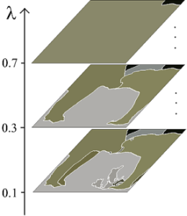
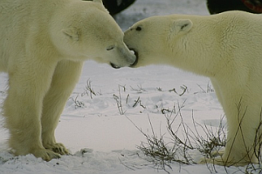
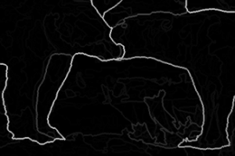
Which algorithm to use?
Image segmentation: agglomerative clustering
More flexible with distance measures (e.g., can be based on boundary prediction)
Adapts better to specific data
Hierarchy can be useful
http://www.cs.berkeley.edu/~arbelaez/UCM.html

Slide 42
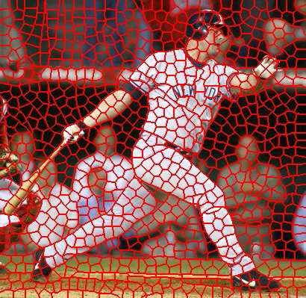
Which algorithm to use?
Image segmentation: spectral clustering
Can provide more regular regions
Spectral methods also used to propagate global cues (e.g., Global pB)

Slide 43
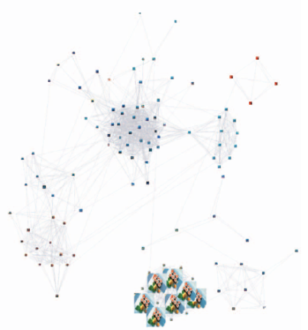
Things to remember
K-means useful for summarization, building dictionaries of patches, general clustering
Agglomerative clustering useful for segmentation, general clustering
Spectral clustering useful for determining relevance, summarization, segmentation

Slide 44
Next class
EM algorithm
Soft clustering
Mixture models
Hidden labels

