Slide 1
Advanced Computer Networks cs538, Spring 2016
Conclusion
Klara Nahrstedt
Department of Computer Science
University of Illinois at Urbana-Champaign
May 3, 2016

Slide 2
Outline
Summary of Course
  What we learned?
  What are the main concepts to take away?
Final Project
  Poster Format
  Paper Format
  Grading
Next Steps

Slide 3
Course Topics
IP History
IP Architecture
  General Architectural Principles
  Forwarding IP Architecture
Routing
  Inter-domain routing – BGP routing
  QoS routing
  Routing reliability
  Secure routing
Congestion Control
Software-defined Networks
  Architecture
  Applications
Data Centers
  Network architecture
  Congestion control
  Cloud services
Internet Measurements
Multimedia Networks
  Content Distribution
Security
Health Networks

Slide 4
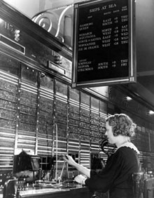
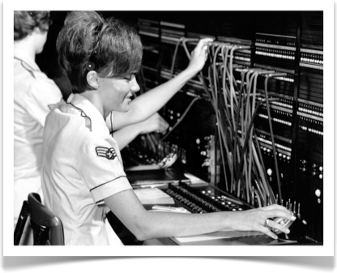
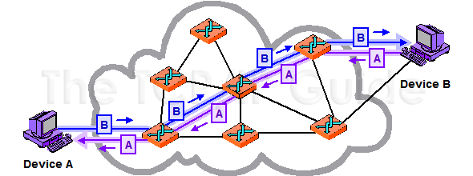
IP History
Vision
  Memex (thinking machine): Vannevar Bush (1945)
  Galactic Network: J.C. R. Licklider (1962) - First Head of DARPA computer research
Circuit Switching
  1935
International operator, New York AT&T
Source: http://www.corp.att.com/history/nethistory/switching.html
1967

Slide 5
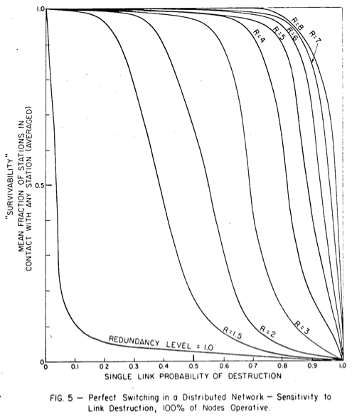
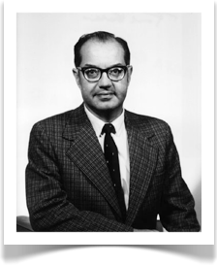

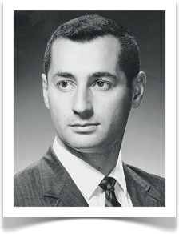
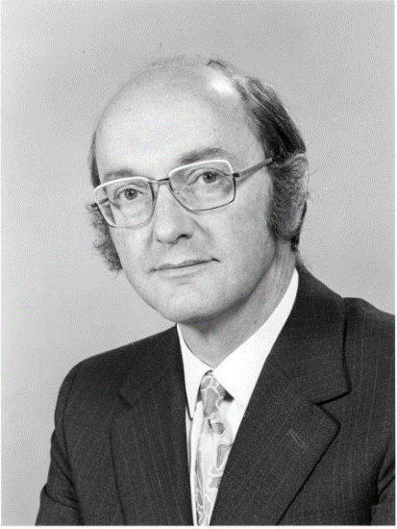
1961-64: Packet switching – Store and Forward
Concurrent development at three groups
  Leonard Kleinrock (MIT): queueing-theoretic analysis of packet switching in Ph.D. thesis (1961-63) demonstrated value of statistical multiplexing
  Paul Baran (RAND) – Reliability of Packet-Switched Links
  Donald Davies (National Physical Laboratories, UK)
Kleinrock
Baran
Davies
Notes:
Paul Baran – pioneer in development of computer networks, one of the independent intentors of packet switched computer networking,
Worked for RAND corporation
Had task to design “survivable” communication system that could maintain communication between end points in face of damage from nucler weapons.
Donald Davies – British computer scientist, worked at National Physical Labs where Alan Turing was designing the Automatic Computing Engine computer.
Worked on Pilot ACE computer which first worked in May 1950
- at NPL Davies helped build a packet switched network Mark I
- developed packet switching theory which impacted ARPANET

Slide 6
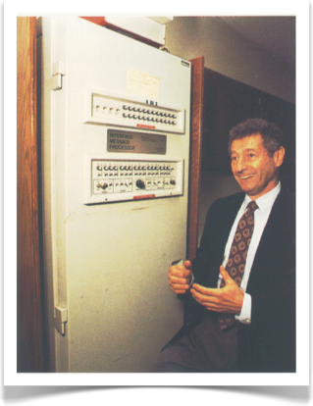
ARPANET begins
Roberts joins DARPA (1966), publishes plan for the ARPANET computer network (1967)
December 1968: Bolt, Beranek, and Newman (BBN) win bid to build packet switch, the Interface Message Processor (IMP)
  First generation of gateways
September 1969: BBN delivers first IMP to Kleinrock’s lab at UCLA
An older Kleinrock
with the first IMP
B. M. Leiner et al, “Brief History of the Internet”, Internet Society 2014

Slide 7
IP Architecture
Stateless network with datagram packet switching (for survivability)
Multiple types of services
  Unreliable UDP service
  Reliable TCP service
What Internet does not do well:
  Reporting failure
  Resource management
  Multipath forwarding
  Full illusion of reliability during failures
  Security
    Host misbehavior and accountability discussed briefly
    Other aspects missing
P2P
Web
Email
...
HTTP
FTP
VoIP
TCP
UDP
...
IP
Ethernet
NTP
...
Copper
Fiber
Radio
...
Vinton G. Cerf and Robert E. Kahn, “A Protocol for Packet Network Intercommunication”, IEEE Trans. On Communication, 1974

Slide 8
Gateways and IP
Gateways sit at interface between networks
...and speak an Internetworking protocol
Internetwork Packet Format
Notes:
Flag field is used to convey specific control information, e.g., to assist in retransmission or duplicate detection.
Retransmission – timeout and positive acknowledgement mechanism

Slide 9
Addressing & Routing
Original Routing is unspecified, but constrained!
  Hierarchical (network, host) address
  Route computed within network, hop-by-hop
    Early: 8 bits for network
      “This size seems sufficient for the foreseeable future.”
    Later: 32 bits in three size classes (A,B,C), and then CIDR (Classless Inter-Domain Routing)
Many new routing/forwarding designs need to change this address format
TCP Address
Segments and Packets
from Messages

Slide 10
Ports
Associate with a process on a host
Identify endpoints of a connection (“association”)
Goals of IP Architecture
  Interconnect existing networks
  Survivability
  Multiple communication services
  Variety of networks
  Distributed management
  Cost effective
  Easy host attachment
  Resource usage accountability
Notes:
Why was that design rejected? One reason is host would need to do reassembly before passing to app. Lower performance.
Isn’t the port just an address of a process? Can’t we think of a process as a virtual host? Why did they separate them artificially? [My answer: there’s not a lot of difference; and in fact we use ports as addresses now (NAT), and addresses as effectively ports (VMs in a cloud)! Ask them for these examples.]

Slide 11
IP Routing
Partridge et al. “50Gbps Ip Router”, ToN 1998

Slide 12
Traffic Engineering to Move Data across Internet
Minimize maximum utilization of network
  Objective: reliability and performance
Plan for best routes
  Methods: offline and online
Calculate offline paths
  Examples: OSPF, MPLS Multi-commodity Flow Optimizer
  Problems: not adaptive to current conditions
Calculate online paths
  Examples: central authority, distributed TeXCP
    TeXCP: Feedback Controller and Load Balancer
Consider IXP (Internet Exchange Points)
TeXCP (Kandula, SIGCOMM 2005)

Slide 13
BGP Routing
BGP does one time complete exchange of routing table
BGP does incremental exchanges of new route advertisements, changes to route attributes, and prefix level route advertisement
BGP hides how ASes are physically connected
BGP only shows how ASes prefer to route
BGP has issues such as configurations, policy specification, ….
BGP routing policies in ISP networks (Caesar and Rexford, IEEE Network Magazine, Nov/Dec 2005)

Slide 14
Congestion
Jacobson
Congestion Window
  Add congestion window cwnd to per-connection state
  Starting or restarting after loss, set cwnd to 1 packet
  On each ack for new data, increase cwnd by one packet
  When sending, send minimum of receiver’s advertised window and cwnd
Timeout Interval
  Estimate mean round-trip time
    R ← αR+ (1−α)M
  Once R estimate is updated, retransmit timeout interval rto, for next packet sent
Congestion Avoidance
  On any timeout, set cwnd to half of current window size
  On each ack for new data, increase cwnd by 1/cwnd
Congestion Avoidance and Control(Jacobson, SIGCOMM 1988

Slide 15
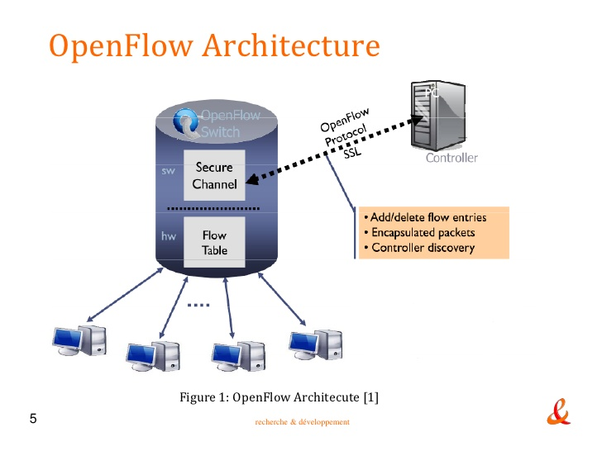
Software-Defined Networks
OpenFlow switch is implementation of SDN and consists of at least three parts:
  1. A Flow Table, used to instruct the switch how to process the flow.
  2. A Secure Channel, used to connect the switch to a remote control process(called Controller) using
  3. The OpenFlow Protocol, which provides an open and standard way for a controller to communicate with a switch.
OpenFlow (McKeown, 2008)

Slide 16
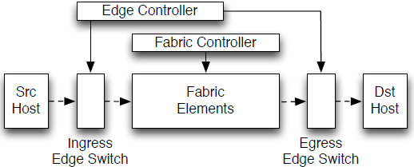
Software-Defined Networks
Fabric is extended SDN
  Network components:
    Host, Edge, Fabric (switch for basic packet transport only)
    Two logical controllers (edge and fabric controllers)
  Network Interfaces:
    Host – Network : Ingress edge switch
    Operator– Network : Edge controller
    Packet– Switch: Fabric elements and controller
  Edge/Fabric Addresses
    Address translation and encapsulation
Fabric: A Retrospective on Evolving SDN(Casado, Koponen, Shenker, Tootoonchian, HotSDN 2012)

Slide 17
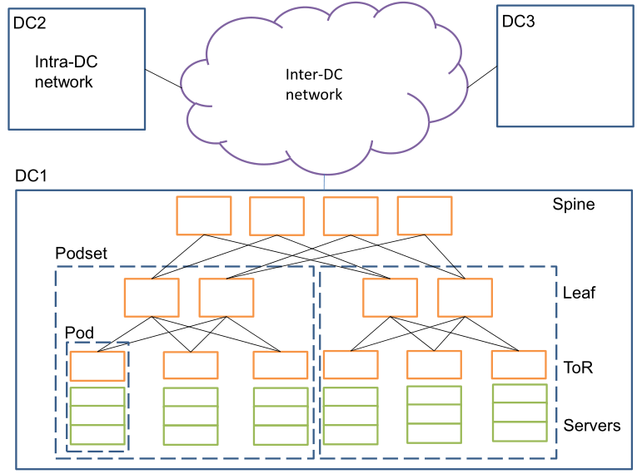
Data Center Networks
[1] Guo et al, “Pingmesh: A Large System for Data Center Network Latency Measurement and Analysis”, SIGCOMM 2015
Notes:
Using existing Ethernet switches, an intra-DC network can connect tens of thousands or more servers with high network capacity.

Slide 18
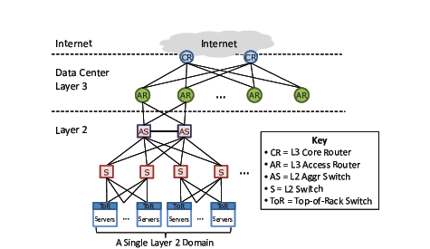
Data Centers
CR
CR
1:240
AR
AR
AR
AR
S
S
S
S
1:80
S
S
S
S
. . .
S
S
S
S
1:5
A
A
…
A
A
A
…
A
A
A
…
A
A
A
…
A
Limited Server-to-Server Capacity
Fragmentation of Resources
Poor reliability and utilization

Slide 19
Virtual Layer 2 Switch (VL2)
The Illusion of a Huge L2 Switch
CR
1. L2 semantics
CR
. . .
AR
AR
AR
AR
2. Uniform high capacity
3. Performance isolation
S
S
S
S
S
S
S
S
. . .
S
S
S
S
A
A
A
…
A
A
…
A
A
A
A
A
A
A
A
A
A
A
A
A
A
A
A
A
…
A
A
…
A
A
A
A
A
A
A
A
A
A
A
A
A
VL2: A Scalable and Flexible Data Center Network (Greenberg et al, SIGCOMM 2009)
Notes:
Creating the illusion that hosts are connected to a big, non-interfering data-center-wide layer-2 switch.

Slide 20
VL2 Overview: Goals and Solutions
Objective
Approach
Solution
1. Uniform
high capacity between servers
Guarantee bandwidth for
hose-model traffic
VLB & Scale-out Clos topology
2. Performance Isolation
Enforce hose model using existing mechanisms only
TCP
3. Layer-2 semantics
Employ flat addressing
Name-location separation & resolution service

Slide 21
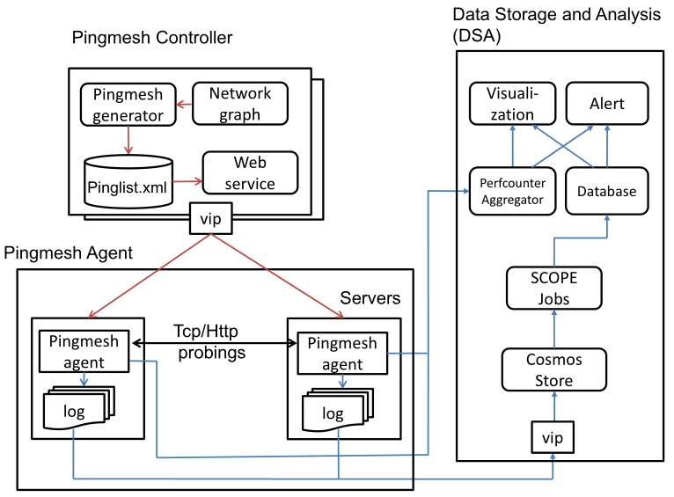
Internet Measurements
In large systems such as data centers, software and hardware failures are the norm rather than the exception.
Challenge 1: Determine if an application perceived latency issue is caused by the network or not.
Challenge 2: Define and track network service level agreements (SLAs) – network latency
Challenge 3: Perform network troubleshooting.
Guo et al, “Pingmesh: A Large System for Data Center Network Latency Measurement and Analysis”, SIGCOMM 2015

Slide 22
Multimedia Networks
Video Client
Video Control Plan
Yin et al. “A Control-Theoretic Approach for Dynamic Adaptive Video Streaming over HTTP”, SIGCOMM 2015
A Case for a Coordinated Internet Video Control Plane (Liu, Dobrian, Milner, Jiang, Sekar, Stoica, Zhang, SIGCOMM 2012)

Slide 23
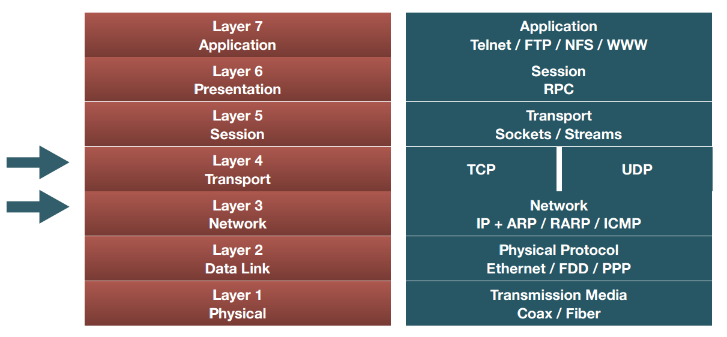
Internet Security – Example: DDoS Attacks
Past DDoS attacks were mainly Layer 3/ Layer 4 Attacks.
DDoS Defense by Offense (Walfish, SIGCOMM 2006)

Slide 24
Layer 3 DDoS Attack
Layer 3 DDoS attack floods TCP/UDP/ICMP/IGMP packets, overloads infrastructure due to high rate processing/discarding of packets and fills up the packet queues, or saturate pipes
Example
  UDP flood to non-listening port
Notes:
Introducing a packet workload most gear isn't designed for
This type of attack floods random ports on a remote host with numerous UDP packets, causing the host to repeatedly check for the application listening at that port, and (when no application is found) reply with an ICMP Destination Unreachable packet. This process saps host resources, and can ultimately lead to inaccessibility.

Slide 25
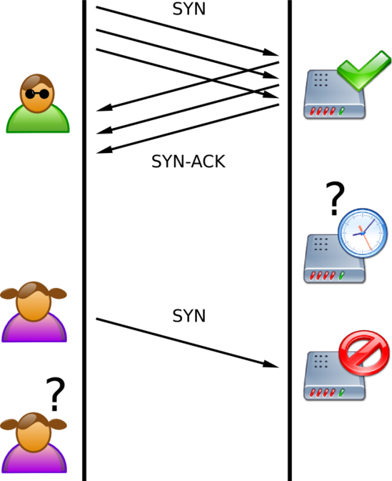
Layer 4 DDoS Attack
Layer 4 DDoS attack is more sophisticated. It consumes extra memory, available connections
Examples
  TCP SYN flood
  TCP new connections flood
  TCP concurrent connections exhaustion
Notes:
A SYN flood DDoS attack exploits a known weakness in the TCP connection sequence (the “three-way handshake”), wherein a SYN request to initiate a TCP connection with a host must be answered by a SYN-ACK response from that host, and then confirmed by an ACK response from the requester. In a SYN flood scenario, the requester sends multiple SYN requests, but either does not respond to the host’s SYN-ACK response, or sends the SYN requests from a spoofed IP address. Either way, the host system continues to wait for acknowledgement for each of the requests, binding resources until no new connections can be made, and ultimately resulting in denial of service.

Slide 26
Layer 7 DDoS Attack
Layer 7 DDoS attack abuses the server memory and performance limitations – masquerading as legitimate transactions
Examples
  HTTP POST/GET flood
  DNS query flood
  Low rate, high impact attacks – e.g. Slowloris, HTTP POST DoS
Notes:
On application-layer attack, the amplification is CPU, memory or resource-based, not network-based

Slide 27

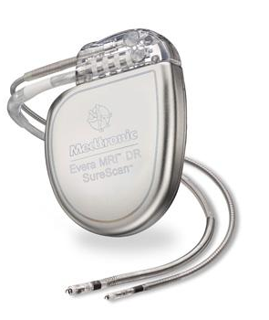
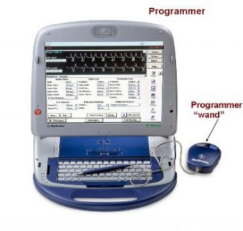

Security and Privacy Goals in Health Networks
Authorization.
IMD selection. When an external entity communicates with one or more IMDs, it must ensure it communicates with only the intended devices.
Halperin et al. “Security and Privacy for Implantable Medical Devices”, IEEE Pervasive Computing, Mobile and Ubiquitous Systems, 2008
Notes:
IMD selection means that When an external entity communicates with one or more IMDs, it must ensure it communicates with only the intended devices.

Slide 28


Security and Privacy Goals
Availability. An adversary should not be able to mount a successful denial-of-service (DoS) attack against an IMD.
Notes:
Note that IMDs are also vulnerable to DoS attack. The designer of IMDs should prevent attackers from mounting DoS attack.

Slide 29

Security and Privacy Goals
Device software and settings. Only authorized parties should be allowed to modify an IMD or to otherwise trigger specific device behavior.
Notes:
It is also easy to understand that Only authorized parties should be allowed to modify an IMD.

Slide 30



Security and Privacy Goals
Device-existence privacy. An unauthorized party should not be able to remotely determine that a patient has one or more IMDs.
Notes:
Patients will not like any bad guys to know that they are using a IMD, so we need to prevent the unauthorized party from determining who is using a IMD.

Slide 31
Security and Privacy Goals
Even if a device is revealed,
Device-type privacy. IMDs’ type should still only be disclosed to authorized entities.
Specific-device ID privacy. An adversary should not be able to wirelessly track individual IMDs.
Bearer privacy. An adversary should not be able to exploit an IMD’s properties to identify the bearer or extract private information about the patient.
Notes:
Even if a IMD is revealed, the adversary still should not recognize the type of IMD, and should not be able to wirelessly track individual IMDs.
Also, the personal information of the patient should not be exposed to the adversary.

Slide 32
Security and Privacy Goals
Measurement and log privacy. An unauthorized party should not be able to learn private information about the measurements or audit log data stored on the device.
Data integrity. An adversary should not be able to tamper with past device measurements or log files or induce specious modifications into future data.
Notes:
The measurement results and the audit log cannot be exposed to An unauthorized party, and An adversary cannot modify the measured data.

Slide 33
Networking and System Conferences
Publication Venues
  Core networking conferences and journals
    SIGCOMM, NSDI, HotNets, IMC, CoNEXT, CCR, INFOCOM, ACM/IEEE ToN, ICC, …
  Wireless
    MobiCom, MobiSys, HotMobile, SenSys, IPSN, Percom, Globecom,…
  Systems and Networking
    SOSP, OSDI, USENIX ATC, HotOS, ICDCS, Cloud-based Conferences (HPDC, Cloudcom, Big Data, Cloud,..…)
  Security and Networking
    CCS, USENIX Security, NDSS, IEEE Symposium on Security and Privacy
  Theory and Networking
    SIGMETRICS, PODC, SPAA, MobiHoc
  Multimedia Systems and Networking
    MMSys, NOSSDAV, ACM Multimedia, ACM TOMCCAP, Springer Multimedia Systems Journal, IEEE TMM, IEEE ICME, BigMM…

Slide 34
Network Resources
Experimental Resources
Testbeds
  Planetlab
  GENI
  Emulab
  Others
Emulators and Simulators
  Ns-2
  Ns-3
  Mininet
  ModelNet
  C-BGP
Measurement Data
  CAIDA (Center for Applied Internet Data Analysis)
  Route Views (from Oregon) – real-time BGP data collection
  SNAP (Stanford Network Analysis Project) – mining of network graphs – social networks, web graphs, road networks, ….
  FCC data
  FCC maps
  Others

Slide 35
Final Project (1)
Final Project (Group Effort)
  Project Proposal
  Project Midterm Presentation
  Final Paper
  Poster Presentation
Groups of
  1 member
  2 members
  3 members

Slide 36
Final Project (2)
Final report (see piazza postings) – (refined)
  Use ACM Format
    6 pages for single person project (6-8pages)
    8 pages for two people project (8-10 pages)
    12 pages for three people project (12-14 pages)
  References and appendix are parts of the specified pages
  Deadline for final report: 11:59pm, May 12, Thursday
  Report Submission via email to instructor
Poster (refined)
  6 slides with
    problem motivation,
    problem description,
    problem solution (2-3 slides)
    experimental results
    conclusion and lessons learned
Present poster
  Deadline: Poster presentation 1pm, May 12, Thursday 2nd floor atrium (in front of 2405 Siebel Center
    Online students submit their poster to instructor and TA

Slide 37
Final Project (3)
Final Project – 40% of your grade
  Project Proposal - 2%
  Project Midterm Presentation – 6%
  Final Paper – 24%
  Poster Presentation - 8%

Slide 38
Course Evaluation
Project – 40% (Group Effort)
Two Paper Reviews – 10% (Individual Effort)
Paper presentation (or scribe) – 10% (Individual Effort)
Midterm Exam – 20% (Individual Effort)
Assignment 1 – 10% (Individual Effort)
Assignment 2 – 10% (Individual Effort)

Slide 39
Grading
93: A (100-93: A/A+)
90: A- (90-92.99: A-)
87: B+ (87-89.99: B+)
83: B (83-86.99: B)
80: B- (80-82.99: B-)
77: C+ (77-79.99: C+)
73: C (73-76.99: C)
70: C- (70-72.99: C-)
67: D+ (67-69.99: D+)
63: D (63-66.99: D)
60: D- (60-62.99: D-)
This is the “worst-case” cutoff
It might be lowered based on class performance, but it won’t be raised

Slide 40





